Slide 1
Automotive Technology: Principles, Diagnosis, and Service
Seventh Edition
Chapter 4
Working as a Professional Service Technician
Copyright © 2023 Pearson Education, Inc. All Rights Reserved
Notes:
INSTRUCTOR NOTE: This presentation includes text explanation notes, you can use to teach the course. When in SLIDE SHOW mode, you RIGHT CLICK and select SHOW PRESENTER VIEW, to use the notes.

Slide 2
Learning Objectives (1 of 2)
4.1 Discuss aspects of professionalism and ethics.
4.2 Discuss how to start a new job and be a good employee
4.3 Describe a service technician’s duties.
4.4 Describe the use of work orders.
4.5 Describe the types and pricing of parts.
4.6 Describe the advantages of having a mentor
4.7 Describe the role of teamwork for service technicians.

Slide 3
Learning Objectives (2 of 2)
4.8 Describe the role of goal setting and business meetings for service technicians.
4.9 List useful business skills for service technicians to develop.
4.10 List housekeeping duties service technicians typically perform
4.11 Explain formal and informal evaluations.
4.12 Discuss ASE technician certification.

Slide 4
Professionalism
Practice consistency
Keep your word
Develop technical expertise
Become a teammate with your coworkers
Be accountable

Slide 5
Ethics
Set of principles that govern
Conduct of an individual or group
Ask 3 questions:
Is it legal?
Is it against local, state, or federal laws?
Is it fair?
Notes:
Ethics are a set of principles that govern the conduct of an individual or group. Sometimes ethical decisions are easy to recognize and are perceived as popular choices of behavior by the people
around us. At other times, the spectrum of potential choices falls into gray areas in which the “right” or “wrong” course of action is difficult or nearly impossible to identify. When faced with
an ethically challenging situation, ask yourself the following questions:
Is it legal?
Is it against local, state, or federal laws?)
Is it fair?
TECH TIP: Clean Clothes Are a Must
Anyone who meets the public in any business must not only be dressed appropriately, but the clothing should be clean. Service advisors and others that greet the public should also be sure
that their shoes are shined. Dull, dirty, or scuffed shoes or a messy appearance reflects an unprofessional look.
TECH TIP: Never Use Profanity Regardless of the situation, a true professional never resorts to the use of profanity. If tensions are high and the discussion becomes heated, try to defuse the situation by turning the situation over to someone else.

Slide 6
What Happens the First Day
Introduction of the technician to key people
Show the technician the facility and explain the regulations of the organization
Establish the technician’s work area
Determine the technician’s skills and abilities
Notes:
TECH TIP: Don’t Touch Other Technician’s Tools
A beginning technician seldom has all of the tools needed to perform all of the service and repair tasks. A technician’s tools are very important. If a tool needs to be borrowed, the beginning
technician should ask for permission to borrow a tool. Then when the tool is returned, it should be clean and replaced back exactly where the technician asks for it to be returned.
TECH TIP: Regulated Terms to Use: In some states or areas where automotive service is regulated, such as in California or Michigan, it is important that the term used to describe a labor
operation is the term defined by the state agency. This means that some terms used in parts and time guides may not be the same terms used by the state. Always check that the terms used are in
compliance with all regulations. Some terms that could be affected include rebuild, repair, overhaul, inspection and R & R (remove and replace), and safety inspection.

Slide 7
Concern, Cause, Correction
Technician Completes Work Order
Adds:
Cause of the Concern
Correction of the Cause
Notes:
A work order, also called a repair order or RO, is assigned to a technician who is best qualified to perform the work. The technician gets the keys and drives the vehicle to an assigned service bay (also called a stall), performs the proper diagnosis, gets the necessary parts from the parts department, and completes the repair.
After the service work has been performed, the service technician should then fill out the work order and describe what work was performed. These are called the “three Cs.”
Concern—Write on the work order what was done to confirm the customer’s concern. For example, “Drove the vehicle at highway speed and verified a vibration.”
Cause—The service technician should write the cause of the problem. For example, “Used a scan tool and discovered that cylinder #3 was misfiring.”
Correction—The service technician should write what was done to correct the problem. For example, “Removed the spark plug wire from cylinder number three and by visual inspection found that the boot had been arcing to the cylinder head. Replaced the spark plug wire and verified that the misfire was corrected.”

Slide 8
Duties of a Service Technician
Reading the repair order
Talking to the customer
Estimating a repair
Documenting the work order
Following recommended procedures
Notes:
TECH TIP: If Late—Call
When running late, you may know that you will be just a few minutes late, but your boss does not
know how late you will be. If you are going to be late, even by a few minutes, call the shop and
let them know. This does not eliminate your being late from your record but does demonstrate your
concern to your service manager and other technicians who are counting on
you to be on time to work every day.
TECH TIP: Car, Truck, or Vehicle?
When discussing a vehicle with a customer, it is best to avoid creating problems. For example, if a
technician asked about a customer’s “car,” the customer could become concerned because they drive a
truck and many owners of trucks do not want their vehicle called a car. Use of the term “vehicle,”
a generic term, is often recommended when talking to customers to avoid
possible concerns.

Slide 9
Frequently Asked Question: What Can a Service Technician Do to Earn More Money?
? Frequently Asked Question
What Can a Service Technician Do to Earn More Money? Because service technicians are paid on a commission basis (flat-rate), the more work that is completed, the more hours the technician can “turn.” Therefore, to earn the most money, the service technician could do the following to increase the amount of work performed: Keep up-to-date and learn the latest technical information. Practice good habits that help avoid errors or incomplete repairs. Learn from experienced and successful fellow technicians and try to approach the repair the same way the successful technician does. Purchase the proper tools to do the work efficiently. NOTE: This does not mean that every technician needs to purchase all possible tools. Purchase only those tools that you know you will need and use.
e
Notes:
CASE STUDY: The Case of the Flat-Rate Technician
A technician was new to flat-rate after working at a shop by the hour for six weeks. The technician
seemed overwhelmed and was not able to make as much money as when working by the hour. The shop
supervisor noticed that the technician was not working efficiently. The supervisor saw that the
Technician was working on the rear tail lights of a pickup truck and asked “Did you know that you were going
to be working on the rear of the truck when you drove it into your stall?” The technician said yes.
The supervisor suggested that the truck should have been backed into the stall making the rear of
the truck closer to the tool box, saving a lot of walking and unnecessary time. The technician
learned that planning ahead for a job by
placing the tools needed on a tool cart and taking them to the vehicle saved a lot of time.
Summary:
Complaint—A technician new to flat-rate was overwhelmed and not making much money.
Cause—The
technician was not working efficiently.
Correction—The technician learned to become more organized, which greatly improved the amount of work that could be achieved in a day.

Slide 10
Animation: Work Order: Technician Copy (Animation will automatically start)

Slide 11
Flagging a Work Order
Technician number
Work order number
Actual clock time
Amount of time allocated for repair

Slide 12
Figure 4.1 Skill Levels
Note the skill levels of the technician and the extra time that should be added if work is being performed on a vehicle that has excessive rust or other factors as stated in the time guide

Slide 13
Sublet Repairs
Repair or part of repair completed outside of the repair facility.
Examples:
Radiator repair
Engine rebuild
Expenses add to work order as a sublet repair.

Slide 14
Parts Replacement
R&R: Remove and Replace
R&I: Remove and Inspect
Original equipment parts
Aftermarket parts
New versus remanufactured parts
Used parts

Slide 15
Table 1
Retail Parts Store | New Vehicle Dealership
Manufacturer’s selling price = $17.00 | Manufacturer’s selling price = $25.00
Warehouse distributor’s selling price = $26.15 ($17.00 ÷ 0.65 = $26.15) | Parts department selling price = $38.46 ($25.00 ÷ 0.65 = $38.46)
Retail store selling price = $40.23 ($26.15 ÷ 0.65 = $40.23) | Blank

Slide 16
Working With a Mentor
Role of Mentor
Teacher
Coach
Counsellor
Advisor
Qualifications of a good mentor
Trade proficiency
Good coaching/mentoring skills and techniques
Leadership/role model
Notes:
TECH TIP: Work Habit Hints
The following statements reflect the expectations of service managers or shop owners for their
technicians:
1. Report to work every day on time. Being several minutes early every day is an easy way to show
your service manager and fellow technicians that you are serious about your job and career.
2. If you must be late or absent, call your service manager as soon as possible.
3. Keep busy. If not assigned to a specific job, ask what activities the service manager or supervisor wants you to do.
4. Report any mistakes or accidents immediately to your supervisor or team leader. Never allow a customer to be the first to discover a mistake.
5. Never lie to your employer or to a customer.
6. Always return any borrowed tools as soon as you are done with them and in clean condition. Show the person you borrowed the tools from that you are returning them to the toolbox or workbench.
7. Keep your work area neat and orderly.
8. Always use fender covers when working under the hood.
9. Double-check your work to be sure that everything is correct.
a. Remember: “If you are forcing something, you are probably doing something wrong.”
b. Ask for help if unclear as to what to do or how to do it.
10. Do not smoke in a customer’s vehicle.
11. Avoid profanity.
12. DO NOT TOUCH THE RADIO! If the radio is turned on and prevents you from hearing noises, turn the volume down. Try to return the vehicle to the owner with the radio at the same volume as originally set.
NOTE: Some shops have a policy that requires employees to turn the radio off.
13. Keep yourself neatly groomed, including:
a. Shirttail tucked into pants (unless shirt is designed to be worn outside)
b. Daily bathing and use of deodorant
c. Clean hair, regular haircuts, and hair tied back if long
d. Men: daily shave or keep beard and/or mustache
e. Women: makeup and jewelry kept to a minimum

Slide 17
Animation: Soft Skills Mentoring (Animation will automatically start)

Slide 18
Question 2
What is a mentor?
Notes:
TECH TIP: Adhere to the Times
When starting a new job at a shop or dealership, be sure to ask about the following:
What time should I arrive at work? This may be different than the scheduled work starting time. For example, the work day could start at 8 a.m. but the shop owner or service manager may want all technicians to arrive and start to get ready to work at 7:50 a.m.
When is break time? Breaks may or may not be regularly scheduled and it is important for the beginning technician to know and adhere to break times.
When is lunch time? In some busy shops, the lunch period is staggered to be sure that some technicians are always available for work. Always be willing to adhere to the requested lunch period.

Slide 19
Answer 2
A mentor is a coach, teacher, counsellor, and advisor.

Slide 20
Teamwork
Team Building
A group of individuals working together to achieve a common goal
Leadership Roles
More experienced technician
Provides help with paperwork, parts, and shop-related issues

Slide 21
Goal Setting and Business Meetings
Goal Setting
To focus efforts on improving your personal and professional life
Business Meetings
All technicians attend
Typically has an agenda
Attendees from inside and outside the shop

Slide 22
Advancement Skills
Always verify the concern.
Perform a thorough visual inspection.
Use a scan tool to check for D T C s.
Check service information for T S B s.
Follow trouble charts.
Locate and correct the problem.
Verify the repair and document the R O.

Slide 23
Housekeeping Duties
Tool box
Clean floor
Items kept off the floor
Keep areas around exits and fire extinguishers clear
Avoid spraying chemicals in the air
Notes:
TECH TIP: Keeping “Things” Off the Floor
To make cleaning easier and for a more professional shop appearance, keep only those items on the
floor that have to be on the floor and find a place off the floor for all other items.
TECH TIP: Look at the Shop from a Customer’s Point of View
To determine if the shop and other technicians look professional, step outside and enter the shop
through the same door as a customer. Now look around. Look at the shop and the other technicians.
Does the shop give the appearance of a professional service facility? If not, try to improve the
look by asking the shop owner or service manager to do the same thing in an attempt to create a
more professional-looking shop.

Slide 24
Job Evaluation
Formal Evaluation
May or may not be written
Occurs on a regular basis
Covers many points
Informal Evaluation
Generally a beginning technician
Simple observations
Notes:
TECH TIP Write It Down
If a technician needs to have another technician finish a repair due to illness or some other reason, be sure to write down exactly what was done and what needs to be done. Verbal communication, while very
effective, is often not a good way to explain multiple steps or processes. For example, the other technician could easily forget that the oil had not yet been added to the engine, which could cause a serious problem
if the engine were to be started. If in doubt, write it down.
TECH TIP: Don’t Cover Up Mistakes Everyone makes mistakes. While a damaged component or vehicle is never a good thing to have happen, the wise technician should notify the service manager or other person in charge as soon as a problem or accident occurs. Only then can work begin to correct the problem. If a mistake is hidden, eventually someone will learn about the error and then people will not think it was wise to ignore or to cover up the situation.

Slide 25
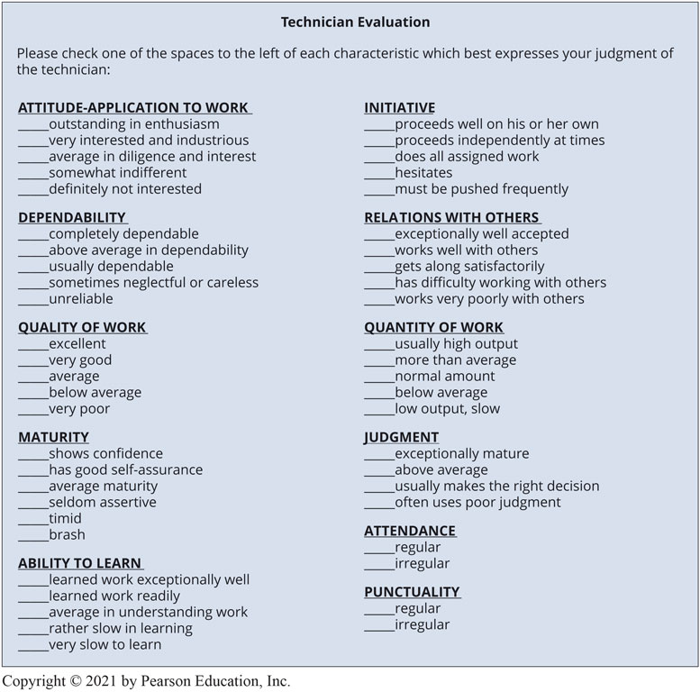
Unnumbered Figure 1

Slide 26
Question 3: ?
What makes an evaluation formal?

Slide 27
Answer 3
The evaluation occurs on a regular basis and covers many points.

Slide 28
Animation: Technician Certification (Animation will automatically start)

Slide 29
Animation: ASE Tests (Animation will automatically start)

Slide 30
Question 4
What are the eight A S E test areas?

Slide 31
Answer 4
National Institute of Automotive Service Excellence (A S E)
A1 Engine Repair
A2 Automatic Transmission
A3 Manual Drive Train & Axles
A4 Suspension & Steering
A5 Brakes
A6 Electrical/Electronics
A7 Air Conditioning
A8 Engine Performance

Slide 32
Qualifying and Registering for A S E Tests
Contact
A S E: 1-877-A S E-T E C H
Test times and locations
Throughout the year at multiple online test sites
Registration
Create an account
Work experience
Two or more years of work experience. Some credit for school.
Types of questions
Objective multiple choice questions

Slide 33
Automotive Fundamentals Videos and Animations
Videos Link: (A0) Automotive Fundamentals Videos
Animations Link: (A0) Automotive Fundamentals Animations

Slide 34
Copyright
This work is protected by United States copyright laws and is provided solely for the use of instructors in teaching their courses and assessing student learning. Dissemination or sale of any part of this work (including on the World Wide Web) will destroy the integrity of the work and is not permitted. The work and materials from it should never be made available to students except by instructors using the accompanying text in their classes. All recipients of this work are expected to abide by these restrictions and to honor the intended pedagogical purposes and the needs of other instructors who rely on these materials.

