Slide 1
Automotive Technology: Principles, Diagnosis, and Service
Seventh Edition
Chapter 3
Starting a Career in the Automotive Industry
Copyright © 2023 Pearson Education, Inc. All Rights Reserved
Notes:
INSTRUCTOR NOTE: This presentation includes text explanation notes, you can use to teach the course. When in SLIDE SHOW mode, you RIGHT CLICK and select SHOW PRESENTER VIEW, to use the notes.

Slide 2
Learning Objectives
3.1 Explain the options and preparations for applying for a job.
3.2 Describe what the resume and cover letter should include.
3.3 Discuss the process of applying for employment, interviewing, and accepting employment.
3.4 Explain how the flat-rate pay plan works.
3.5 Discuss the payroll deductions and the expenses of an employee working in the automotive industry.

Slide 3
Preparing for an Automotive Service Career (1 of 3)
Desire and Interest
Strong computer skills
Interest in vehicles
Enjoy working on own vehicles and projects
Technical Knowledge and Skills
Owning and experience using hand tools
A basic knowledge for understanding parts and procedures.

Slide 4
Preparing for an Automotive Service Career (2 of 3)
Job Shadowing
Follow a professional for a day or more.
Arranged through an automotive program.
Does not allow the person to work on vehicles.
Cooperative Education Programs
Formal plans of study
Attend class and work in local shop or dealership

Slide 5
Preparing for an Automotive Service Career (3 of 3)
Apprentice Programs
Beginning technician
Works in the shop during the day
Attends class at night
Part-Time Employment
Working part-time to gain hands-on experience
Allows flexibility with class schedules and provides needed income.

Slide 6
Question 1
What is job shadowing?
Notes:
Tech Tip: If in Doubt, Ask
No one expects a beginning service technician to know everything, but other technicians do not know what you do or do not know. It is usually assumed that the beginning technician will ask for help if they think they need the help. However, asking for help is very rare and requires the beginning technician to admit that they do
not know something. Not asking for help can cause harm to the vehicle or the service technician. If in doubt— always ask. No one will be upset, and learning the answer
to your question will help in the learning experience.

Slide 7
Answer 1
Following a professional for a day or more.

Slide 8
Developing an Employment Plan
Soft Skills
Working cooperatively
Communicating effectively
Working as a team member
Locating Employment Possibilities
Job description
Tools needed
Hours needed
Drug testing

Slide 9
Animation: Soft Skills (Animation will automatically start)

Slide 10
Preparing a Resume
Personal Information
Educational Information
Experience and Skills
References

Slide 11
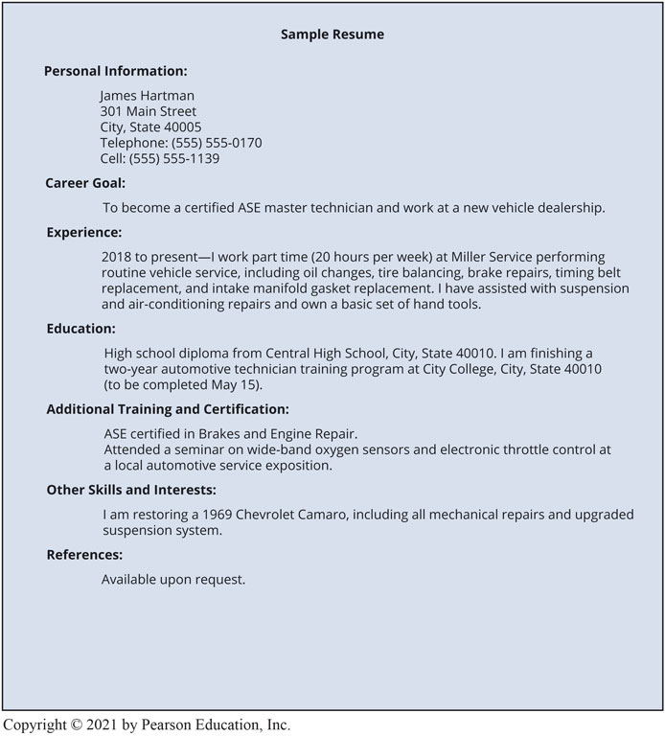
Unnumbered Figure 1

Slide 12
Preparing a Cover Letter
Include:
Details of the where ad was seen
Specified skills and training needed
Contact the correct person

Slide 13
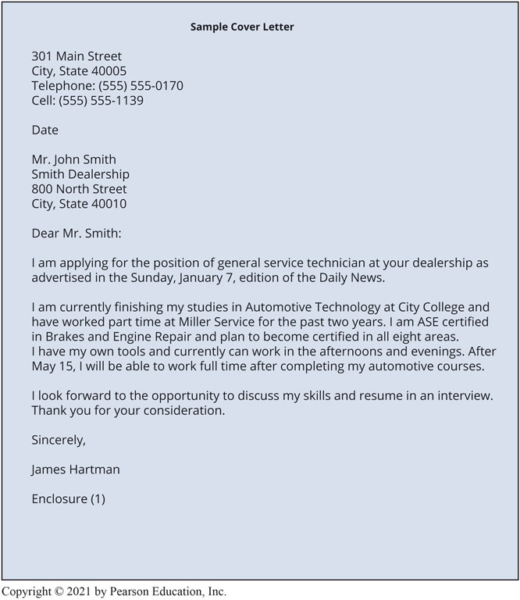
Unnumbered Figure 2
Notes:
Tech Tip: Always Be Truthful No one is smart enough to be a liar. If you say something that is not true, then you have to remember what was said forever or your lie will often be discovered. If asked about your experience or knowledge, try to be as truthful as possible. Facts and skills can be learned, and not knowing how to do everything that a shop may be involved with is not an indication that you will be rejected from the job opening.

Slide 14
Contacting Potential Employers
Completing the employment application
Provide the needed information
The interview
Dress appropriately and show enthusiasm
After the interview
Follow up with a thank you letter
Accepting employment
Complete the required paperwork and processes

Slide 15
Technician Pay Methods
Straight-Time Pay Methods
The technician is payed on clock time.
Used on difficult or repairs not covered in the guide.
Flat Rate Pay Methods
Technician is payed a specific amount for a repair.
The amount of time actually taken to make the repair does not effect the amount payed.
Experienced technicians

Slide 16
Payroll Deductions and Expenses
Gross versus net compensation
Taxes may be deducted from pay
Retirement information and payments
Employer sponsored 401(k) accounts
Additional service technician benefits
Vacation
Training
Healthcare

Slide 17
Housing and Living Expenses
Housing: 30% of gross income
Vehicle: 25% of gross income

Slide 18
Question 2
What is the difference between gross pay and net pay?

Slide 19
Answer 2
Gross pay is what you earn, net pay is the amount you receive after taxes and other deductions.
Notes:
Tech Tip: Hourly Rate to Annual Income
To calculate the amount of income that will be earned
using an hourly rate, do the following:
Multiply the hourly rate times 2 and then times 1,000.
For example:
$10 per hour × 2 × 1,000 = $20,000 per year.
Th is easy-to-use formula assumes working eight hours a
day, five days a week for 50 weeks (instead of 52 weeks
in the year).
The reverse can also be easily calculated:
Di vide the yearly income by 2 and then by
1,000 = hourly rate
For example: $36,000 per year ÷ 2 = $18,000 ÷ 1,000 =
$18 per hour

Slide 20
Animation: Starting Your Career (Animation will automatically start)

Slide 21
Frequently Asked Question: Where Does All the Money Go?
? Frequently Asked Question
Where Does All the Money Go? Money earned does seem to quickly disappear. For example, if a soft drink and a bag of chips were purchased every day at work for $2.50, this amounts to $12.50 per week or $50 per month, which is $600 per year. Use following to see where the money goes. Income, Labor rate per hour × number of hours worked = Overtime pay, if applicable, Part-time work on weekends = TOTAL WEEKLY INCOME Multiply by 4.3 to get the MONTHLY INCOME = Monthly Expenses Car/truck payment, Rent/mortgage, Gasoline, Food (groceries), Fast food or restaurants, Heat and electric, Water and sewer, Telephone (cell), Cable TV/Internet access, Clothing (including cleaning), Credit card.

Slide 22
Frequently Asked Question: Employee or Contract Labor?
? Frequently Asked Question
Employee or Contract Labor? Most shops and dealerships hire service technicians as employees. However, some shops or businesses will pay a technician for services performed on a contract basis. This means that they are not hiring you as an employee, but simply paying for a service similar to having a plumber repair a toilet. The plumber is performing a service and is paid for the job rather than as an employee of the shop. An employer/employee relationship exists if the shop meets two factors: 1. Direction—This means that the employer can direct the technician to report to work to perform service work. 2. Control—This means that the employer can direct the hours and days when the work is to be performed and at the employer’s location. A contract labor association exists if the repairs are performed without both direction and control of the shop. If a contract labor basis is established, then no taxes are withheld. It is then the responsibility of the technician to make the necessary and required general tax payments and pay all taxes on time.

Slide 23
Becoming a Shop Owner
Non-automotive repair duties:
Handling customers
Ordering and paying for shop equipment
Bookkeeping and payroll
Budgeting
Rent
Advertising
Hiring and firing employees
Notes:
Tech Tip: Find Three Key People: An entrepreneur is a person who organizes and manages their own business assuming the risk for the
sake of a profit. Many service technicians have the desire to own their own repair facility. The wise business owner (entrepreneur) seeks the advice of the following people when starting and operating their own business.
Attorney (lawyer)—This professional will help guide you to make sure that your employees and your customers are protected by the laws of your community, state, and federal regulations.
Accountant—This professional will help you with the journals and records that must be kept by all businesses and to help with elements, such as payroll taxes, unemployment taxes, and worker’s compensation that all businesses have to pay.
Insurance Agent—This professional will help you select the coverage needed to protect you and your business from major losses.

Slide 24
Automotive Fundamentals Videos and Animations
Videos Link: (A0) Automotive Fundamentals Videos
Animations Link: (A0) Automotive Fundamentals Animations

Slide 25
Copyright
This work is protected by United States copyright laws and is provided solely for the use of instructors in teaching their courses and assessing student learning. Dissemination or sale of any part of this work (including on the World Wide Web) will destroy the integrity of the work and is not permitted. The work and materials from it should never be made available to students except by instructors using the accompanying text in their classes. All recipients of this work are expected to abide by these restrictions and to honor the intended pedagogical purposes and the needs of other instructors who rely on these materials.

