Slide 1
Automotive Technology: Principles, Diagnosis, and Service
Seventh Edition
Chapter 1
Automotive Background and Overview
Copyright © 2023 Pearson Education, Inc. All Rights Reserved
Notes:
INSTRUCTOR NOTE: This presentation includes text explanation notes, you can use to teach the course. When in SLIDE SHOW mode, you RIGHT CLICK and select SHOW PRESENTER VIEW, to use the notes.

Slide 2
Learning Objectives
1.1 Explain the evolution of the automobile.
1.2 Discuss the components of the vehicle body, frame, and chassis.
1.3 Describe the evolution of engines.
1.4 Describe the purpose of the powertrain.
1.5 List the major systems common to most vehicles.
1.6 Provide an overview of the electrical/electronic systems.
1.7 Provide an overview of the heating, ventilation, and air-conditioning systems.

Slide 3
Historical Background
Self-propelled vehicles—vehicles that move under their own power
Developed after the invention of electric, steam,
and gasoline propulsion systems
Replace walking and animal use

Slide 4
Figure 1.1
A model of the Quadricycle, a car built by Henry Ford in 1896

Slide 5
Bodies, Chassis Systems, & Frames
Early motor vehicles evolved from horse-drawn carriages.
Most vehicle bodies were constructed with a
Wood framework until the 1920s.

Slide 6
Chassis Systems Overview
Chassis system of the vehicle includes:
Frame or body
Suspension system
Braking system
Wheels and tires
Notes:
Instructor Notes
The chassis system of the vehicle includes the following components:
Frame or body of the vehicle, which is used to provide the support for the suspension and steering components as well as the powertrain.
The suspension system of the vehicle provides a smooth ride to the driver and passengers and helps the tires remain on the road even when the vehicle is traveling over rough roads. The suspension system includes springs and control arms that allow the wheel to move up and down and
keep the tires on the road.
The braking system of the vehicle is used to slow and stop the rotation of the wheels, which in turn stops the vehicle. The braking system includes the brake pedal, master cylinder, plus wheel brakes at each wheel. Two types of wheel brakes are used. Disc brakes include a caliper, which applies force to brake pads on both sides of a rotating disc or rotor. Drum brakes use brake shoes,
which are applied by hydraulic pressure outward against a rotating brake drum. The brake drum is attached to and stops the rotation of the wheels. Drum brakes are used on the rear of many vehicles.
Wheels and tires—The wheels are attached to the bearing hubs on the axles. The tires must provide traction for accelerating, braking, and cornering, as well as provide a comfortable ride. Wheels are constructed of steel or aluminum alloy and mount to the hubs of the vehicle using
lug nuts, which must be tightened correctly to the proper torque.

Slide 7
Figure 1.2 Wood Body
Most vehicle bodies were constructed with a wood framework until the 1920s

Slide 8
Question 1
Early vehicles were constructed mostly of what material?

Slide 9
Answer 1
Wood.

Slide 10
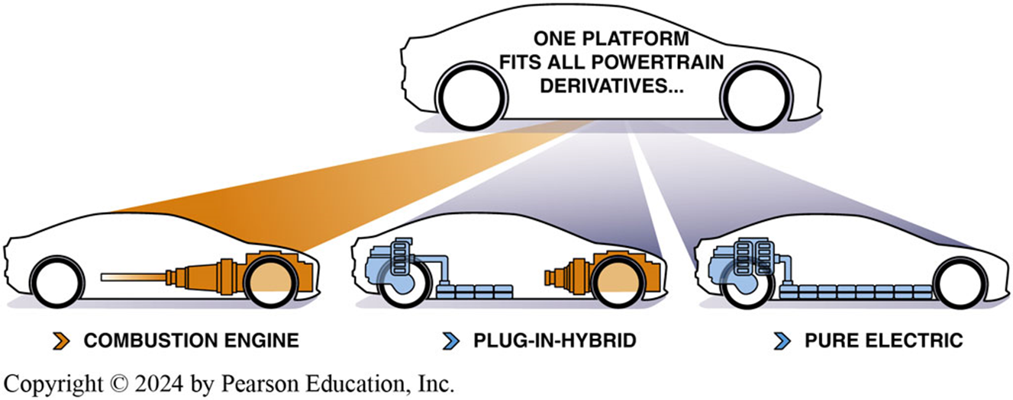
Figure 1.3 Vehicle Platforms
Some vehicle manufacturers are able to manufacture one platform that can be used with an internal combustion engine, a plug-in hybrid powertrain, or a full electric powertrain.

Slide 11
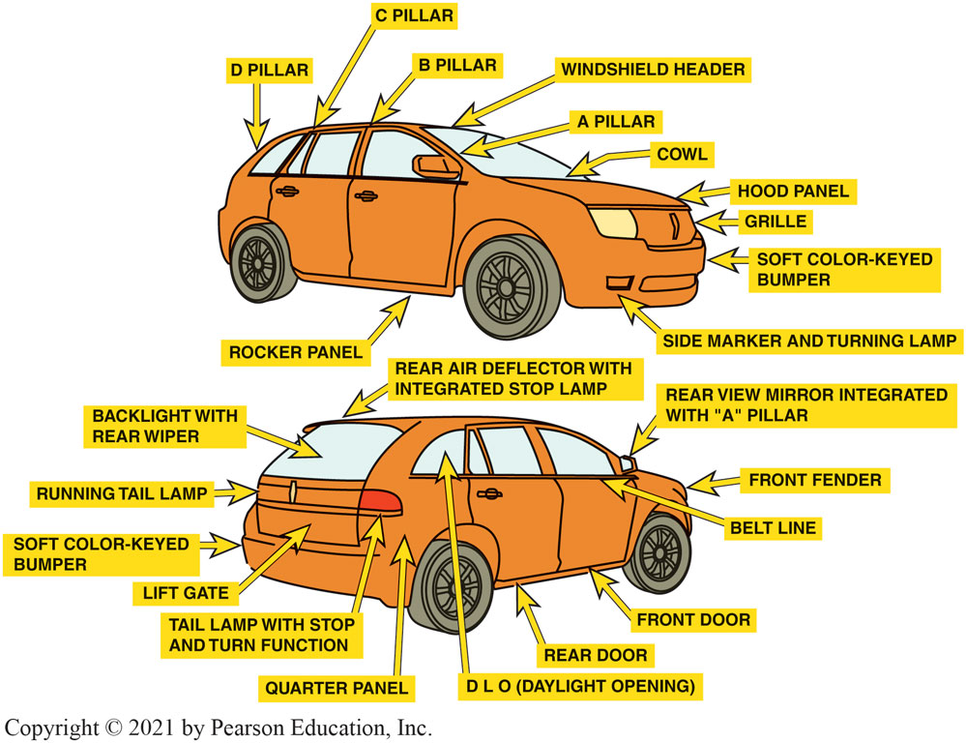
Figure 1.4 Body and Terms
Notes:
BODY TERMS The roof of a vehicle is supported by pillars and they are labeled A, B, C, and D from
the front to the rear of the vehicle. All vehicles have an A pillar at the windshield but many,
such as a hardtop, do not have a B pillar. Station wagons and sport utility vehicles (SUVs) often
have a D pillar at the rear of the vehicle. SEE FIGURE 1–4.

Slide 12
Animation: Body Terms (Animation will automatically start)

Slide 13
Frames (1 of 3)
Frame Construction
Vehicles with a separate frame and body
Called body-on-frame (B O F) vehicles.
Notes:
Frame construction usually consists of channel- shaped steel beams welded and/or fastened together. Vehicles with a separate frame and body are usually called body-on- frame (BOF) vehicles. Many terms are used to label or describe of a vehicle including: unit-body construction (sometimes called unibody) is a design that combines the body with the structure of the frame.

Slide 14
Frames (2 of 3)
Unit–Body Construction
Combines the body with structure of the frame
Composed of many individual stamped-steel panels
Welded together

Slide 15
Figure 1.5 Vehicle Body
Note the ribbing and the many different pieces of sheet metal used in the construction of this body
Notes:
Tech Tip: Treat a Vehicle Body with Respect
Do not sit on a vehicle. The metal can easily be distorted, which could cost hundreds of dollars to repair. This includes sitting on the hood, roof, and deck (trunk) lid, as well as fenders. Also, do
not hang on any opened door as this can distort the hinge area causing the door not to
close properly.

Slide 16
Frames (3 of 3)
Space-Frame Construction
Consists of formed sheet steel used to
Construct a framework of the entire vehicle.
The vehicle is drivable without the body.
Plastic or steel panels cover the framework.

Slide 17
Figure 1.6 Corvette Body
A corvette without the body. Notice that the vehicle is complete enough to be driven. This photo was taken at the Corvette Museum in Bowling Green, Kentucky

Slide 18
Engine Design Evolution (1 of 2)
Internal Combustion Engine
All gasoline and diesel engines
Designed to compress an ignitable mixture
Inline Versus V-Type Design
Inline: 4 or 6 cylinders arranged inline
V-Type: 4, 6, 8,10,12, or 16 cylinders arranged
Half cylinders on each side of “V”
Connected to common crankshaft

Slide 19
Engine Design Evolution (2 of 2)
Valve Location Design
Flathead: Valves located in the engine block
Overhead valve (O H V): Valves located in head
Single Overhead Cam (S O H C): Camshaft and valves located in head
Double Overhead Cam (D O H C): Two camshafts and valves located in head

Slide 20
Figure 1.7 Flathead V8
A Ford flathead V-8 engine. This engine design was used by Ford from 1932 through 1953. In a flathead design, the valves are located next to (beside) the cylinders

Slide 21
Question 2:
Why were early engines referred to as flat head design?

Slide 22
Answer 2
The cylinder head did not contain the valves.

Slide 23
Frequently Asked Question: What Is the Monroney Label?
? Frequently Asked Question
What Is the Monroney Label? The Monroney label is the sticker on the vehicle that lists the Manufacturer’s Suggested Retail Price, usually abbreviated MSRP. The law that requires this label on all vehicles is called the Monroney Law, named for the congressman who sponsored the bill, Almer S. Monroney (1902–1980), a U.S. farm representative from Oklahoma from 1939 to 1951 and a U.S. Senator from 1951 to 1969. Before the Monroney label law was passed in 1958, the price of a vehicle was unknown to new vehicle buyers who had to rely on the dealer for pricing. Besides all of the standard and optional equipment on the vehicle, the Monroney label also includes fuel economy and exhaust emission information. Figure 1-8

Slide 24
Figure 1.8 Monroney Label
A Monroney label as shown on the side window of a new vehicle
Notes:
What Is the Monroney Label? The Monroney label is the sticker on the vehicle that lists the Manufacturer’s Suggested Retail Price, usually abbreviated MSRP. The law that requires this label on all vehicles is called the Monroney Law, named for the congressman who sponsored the bill, Almer S. Monroney (1902–1980), a U.S. farm representative from Oklahoma from 1939 to 1951 and a U.S. Senator from 1951 to 1969. Before the Monroney label law was passed in 1958, the price of a vehicle was unknown to new vehicle buyers who had to rely on the dealer for pricing. Besides all of the standard and optional equipment on the vehicle, the Monroney label also includes fuel economy and exhaust emission information. Figure 1-8

Slide 25
Engine Systems Overview (1 of 7)
Cooling System
Coolant circulated by a water pump through passages in the block called water jackets.
Coolant is mixture of antifreeze and water to provide corrosion and freeze protection.
Engine heat removed from coolant when it flows through a radiator.
Temperature of coolant maintained using a thermostat.

Slide 26
Engine Systems Overview (2 of 7)
Lubrication System (Continued)
Forces oil under pressure through engine
To reduce friction and heat
Oil pan or oil sump holds the oil
Oil pump forces the oil under pressure
Through oil filter and oil galleries
In block and cylinder head

Slide 27
Engine Systems Overview (3 of 7)
Air Intake System
All engines draw air from the atmosphere.
Approximately 9000 gallons of air is
Needed for every gallon of fuel.
The air must be drawn into the engine
From a place water cannot enter.
Air is filtered by a replaceable air filter.
Filtered air passes through the throttle valve
Into the intake manifold.

Slide 28
Engine Systems Overview (4 of 7)
Fuel System
Fuel system includes following components & systems:
Fuel tank
Fuel lines and filter(s)
Fuel injectors
Electronic control of the fuel pump and fuel injection

Slide 29
Engine Systems Overview (5 of 7)
Starting and Charging System
Includes the following components:
Battery
Starter
Alternator
Associated circuits

Slide 30
Engine Systems Overview (6 of 7)
Ignition System
Ignition Coils
Create a high voltage spark
Ignition Control Module
Controls the timing of the spark

Slide 31
Engine Systems Overview (7 of 7)
Emission Control System
Control of tailpipe and evaporative emissions
Using the following systems:
Positive Crankcase Ventilation (P C V)
Exhaust Gas Recirculation (E G R)
Catalytic converter
On-board diagnostics

Slide 32
Powertrain Overview (1 of 3)
Rear-Wheel-Drive Powertrain
Transmission: an automatic/manual method of providing the correct torque for the desired speed.
Driveshaft (also called a propeller shaft):
Used to connect the transmission to the differential.
Differential: allows for different axle speeds
For cornering and increase torque to the drive wheels.

Slide 33
Powertrain Overview (2 of 3)
Front-Wheel-Drive Powertrain
Uses transaxle
Combination of transmission & differential in one assembly.
Drive axle shafts transfer power to front drive wheels.

Slide 34
Powertrain Overview (3 of 3)
Four-Wheel-Drive System
Powers all four wheels
Many systems
A transfer case splits engine torque to both front and rear wheels.

Slide 35
Figure 1.9
A dash control panel used by the driver to control the four-wheel-drive system

Slide 36
Electrical/Electronic Systems Overview
Systems include:
Tire pressure monitoring
Heated and cooled seats
Automatic climate control
Power windows
Security systems
Electric power steering
Electronic suspension
Notes:
NOTE on Air Conditioning: Today, air-conditioning systems are on most vehicles and
incorporate defrosters and passenger compartment heating, often in two zones for maximum comfort of
the driver and passenger. Additional related comfort options today include heated
and cooled seats, and heated steering wheels.

Slide 37
Figure 1.10
The alternator is responsible for supplying the electrical needs of the vehicle and to keep the battery charged

Slide 38
Animation: World Car Production (Animation will automatically start)

Slide 39
Question 3: ?
What component regulates the temperature of the coolant in an engine?
a. Cooling (water) jackets
b. Thermostat
c. Cooling fan(s)
d. Radiator

Slide 40
Answer 3
What component regulates the temperature of the coolant in an engine?
b. Thermostat

Slide 41
Automotive Fundamentals Videos and Animations
Videos Link: (A0) Automotive Fundamentals Videos
Animations Link: (A0) Automotive Fundamentals Animations

Slide 42
Copyright
This work is protected by United States copyright laws and is provided solely for the use of instructors in teaching their courses and assessing student learning. Dissemination or sale of any part of this work (including on the World Wide Web) will destroy the integrity of the work and is not permitted. The work and materials from it should never be made available to students except by instructors using the accompanying text in their classes. All recipients of this work are expected to abide by these restrictions and to honor the intended pedagogical purposes and the needs of other instructors who rely on these materials.

