Slide 1

Automotive Chassis Systems
Eighth Edition
Chapter 08
Brake Fluid and Lines
Notes:
If this PowerPoint presentation contains mathematical equations, you may need to check that your computer has the following installed:
1) MathType Plugin
2) Math Player (free versions available)
3) NVDA Reader (free versions available)

Slide 2
Objectives
Discuss the need for brake bleeding.
Discuss the various methods of loosening the brake bleeder valve.
Describe the bleeding sequence for most vehicles.
Describe the manual bleeding procedure.
Discuss how to vacuum bleed and gravity bleed the hydraulic brake system.
Discuss how to pressure bleed the hydraulic brake system.
Describe how to service the hydraulic ABS and flush brake fluid.

Slide 3
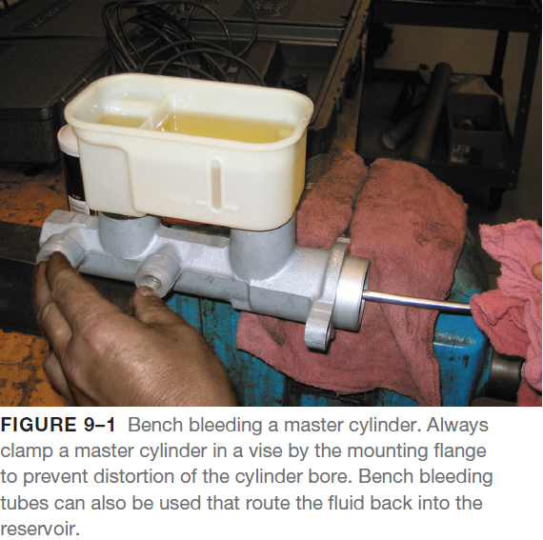
Brake Bleeding
The Need for Brake Bleeding
  Brake bleeding is removing any trapped air from the hydraulic system.
  If air is in the brake hydraulic system, the brake pedal will often feel “spongy.”
  The brake pedal will also travel farther (lower-than normal brake pedal) before the brakes start to apply
Bleeding the Master Cylinder
  Whenever the master cylinder is replaced or the hydraulic system has been left opened for several hours, the air may have to be bled from the master cylinder.
  The master cylinder is located in the highest section of the hydraulic braking system.

Slide 4
Brake Bleeding
The Need for Brake Bleeding
  If bleeding the master cylinder after working on the hydraulic system, follow these steps:
    STEP 1 Fill the master cylinder with clean brake fluid from a sealed container up to the recommended “full” level.
    STEP 2 Have an assistant slowly depress the brake pedal as you “crack open” the master cylinder bleed screw starting with the section closest to the brake pedal.
      It is very important that the primary section of the master cylinder be bled before attempting to bleed the air out of the secondary section of the master cylinder.
    STEP 3 Repeat the procedure several times until a solid flow of brake fluid is observed leaving the bleeder valve.

Slide 5
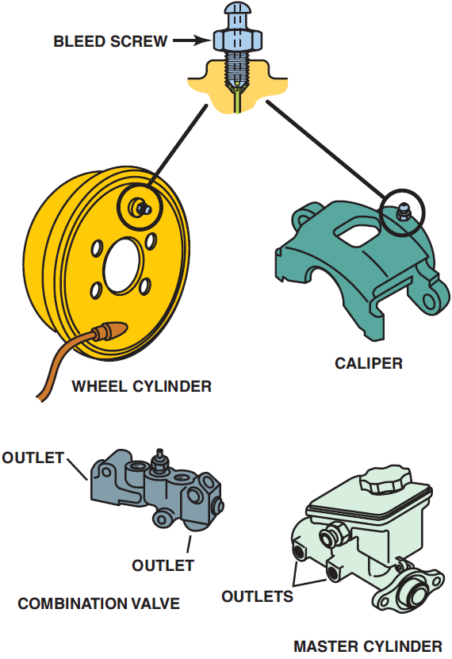
Brake Bleeder Valve Loosening Methods
Attempting to loosen a bleeder valve often results in breaking (shearing off) the bleeder valve.
  Several of these service procedures can be tried that help prevent the possibility of breaking a bleeder valve.
  Bleeder valves are tapered and become wedged in the caliper on the wheel cylinder housing.
  All of these methods use shock to “break the taper” and to loosen the stuck valve.
FIGURE 9–3 Typical bleeder locations. Note that the combination valve and master cylinder shown do not have bleeder valves; therefore, bleeding is accomplished by loosening the brake line at the outlet ports.

Slide 6
Brake Bleeder Valve Loosening Methods
Hit and Tap Method
  STEP 1 Tap on the end of the bleeder valve with a steel hammer.
    This shock often “breaks the taper” at the base of the bleeder valve. The shock also breaks loose any rust or corrosion on the threads.
  STEP 2 U sing a 6-point wrench or socket, tap the bleeder valve in the clockwise direction (tighten).
  STEP 3 Using the same 6-point socket or wrench, tap the bleeder valve counterclockwise to loosen and remove the bleeder valve.
  STEP 4 If the valve is still stuck (frozen), repeat steps 1 through 3.
Air Punch Method
  Use an air punch near the bleeder valve while attempting to loosen the bleeder valve at the same time.
  The air punch creates a shock motion that often loosens the taper and threads of the bleeder valve from the caliper or wheel cylinder.

Slide 7
Brake Bleeder Valve Loosening Methods
Heat and Tap Method
  Heat the area around the bleeder valve with a torch.
  The heat expands the size of the hole and usually allows the bleeder to be loosened and removed.
Wax Method
  STEP 1 Heat the bleeder valve itself with a torch. The heat causes the valve itself to expand.
  STEP 2 Remove the heat from the bleeder valve. As the valve is cooling, touch paraffin wax or candle wax to the hot valve.
    The wax will melt and run down around the threads of the bleeder valve.
  STEP 3 Allow the bleeder valve to cool until it can be safely touched with your hand.
    This assures that the temperature is low enough for the wax to return to a solid and provide the lubricating properties necessary for the easy removal of the bleeder valve.

Slide 8
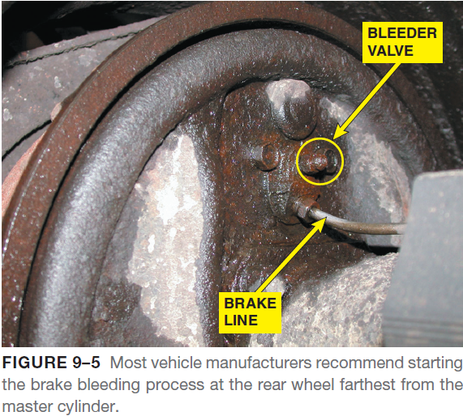
Bleeding Sequence
After bleeding the master cylinder, the combination valve should be bled if equipped.
  Check the level in the master cylinder frequently being careful not to allow the master cylinder to run dry and keep it filled with clean brake fluid throughout the brake bleeding procedure.
  For most rear-wheel-drive vehicles equipped with a front/ rear split system, start the bleeding with the wheel farthest from the master cylinder and work toward the closest.
  For most vehicles, this sequence is as follows:
    Right rear
    Left rear
    Right front
    Left front
  For vehicles equipped with a diagonal split section or equipped with ABS, follow the brake bleeding procedure recommended in the service information for the vehicle.

Slide 9
Manual Bleeding
Manual bleeding is the most commonly used method and uses hydraulic pressure created by the master cylinder to pump fresh fluid through the brake system.
  This method is also called the single stroke bleeding method.
Advantages of Manual Bleeding
  The manual method of brake bleeding is the most common. Manual bleeding requires the following:
    An assistant to apply and release the brake pedal
    A bleeder screw wrench
    Approximately 2 feet of clear, plastic hose with an inside diameter small enough to fit snugly over the bleeder screws
    A clear jar partially filled with clean brake fluid

Slide 10
Manual Bleeding
Manual Bleeding Procedure
  To manually bleed the brake system, follow these steps:
    STEP 1 Discharge the vacuum or hydraulic power booster (if equipped) by pumping the brake pedal with the ignition OFF until the pedal feels hard.
    STEP 2 Fill the master cylinder reservoir with new brake fluid and make sure it remains at least half full throughout the bleeding procedure.
    STEP 3 Attach the plastic hose over the bleeder screw of the first wheel cylinder or caliper in the bleeding sequence, and submerge the end of the tube in the jar of brake fluid.
    STEP 4 Loosen the bleeder screw approximately one-half turn, and have an assistant slowly depress the brake pedal. It is extremely important when manually bleeding a brake system that the pedal be applied and released slowly and gently.
    STEP 5 Tighten the bleeder screw, then have your assistant slowly release the brake pedal.
    STEP 6 Wait at least 15 seconds to allow time for any small bubbles to form into larger bubbles.
    STEP 7 Repeat steps 4 and 5 until no more air bubbles emerge from the bleeder.
    STEP 8 Transfer the plastic hose to the bleeder screw of the next wheel cylinder or caliper in the bleeding sequence, and repeat steps 4 through 7.

Slide 11
Vacuum Bleeding
Vacuum bleeding uses a special suction pump that attaches to the bleeder screw.
  The pump creates a low-pressure area at the bleeder screw, which allows atmospheric pressure to force brake fluid through the system when the bleeder screw is opened.
Advantages of Vacuum Bleeding
  Vacuum bleeding requires only one technician.
  It is easy and the equipment needed can be low cost.
Disadvantages of Vacuum Bleeding
  The disadvantage of using a vacuum bleeding method is that a vacuum tool must be used and often air can be drawn into the line between the bleeder valve and the hose creating some bubbles that can be interpreted by the technician as air in the system.

Slide 12
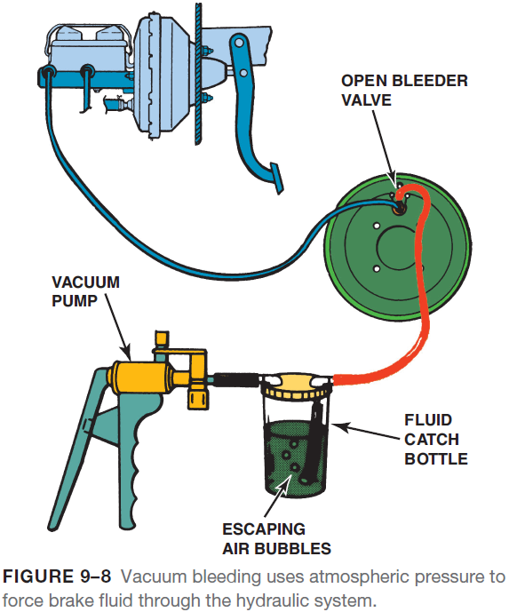
Vacuum Bleeding
Vacuum Bleeding Procedure
  To vacuum bleed a brake system, use the following steps:
  STEP 1 Fill the master cylinder reservoir with new brake fluid and make sure it remains at least half full throughout the bleeding procedure.
  STEP 2 Attach the plastic tube from the vacuum bleeder to the bleeder screw of the first wheel cylinder or caliper in the bleeding sequence.
  STEP 3 Operate the pump handle to create a partial vacuum in the catch bottle.

Slide 13
Vacuum Bleeding
Vacuum Bleeding Procedure
  STEP 4 Loosen the bleeder screw approximately one-half turn.
    Brake fluid and air bubbles will flow into the bottle.
    When the fluid flow stops, tighten the bleeder screw.
  STEP 5 Repeat steps 3 and 4 until no more air bubbles emerge from the bleeder.
  STEP 6 Transfer the vacuum bleeder to the bleeder screw of the next wheel cylinder or caliper in the bleeding sequence, and repeat steps 3 and 4.

Slide 14
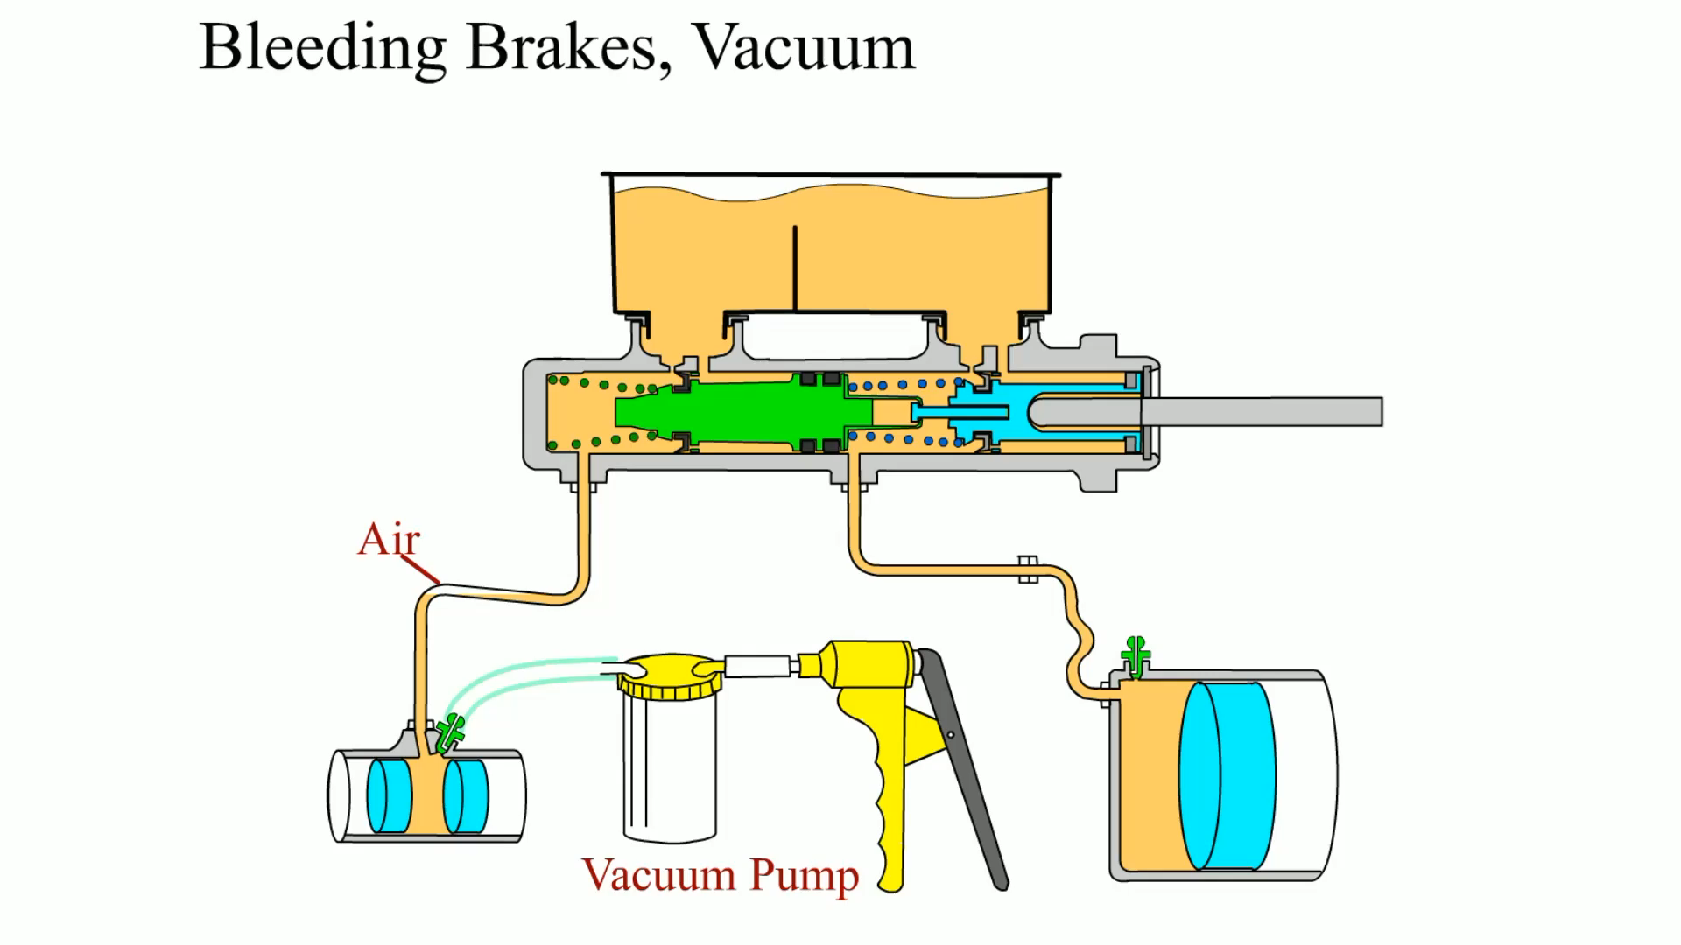
Animation: Bleeding Brakes, Vacuum
(The animation will automatically start in a few seconds)

Slide 15
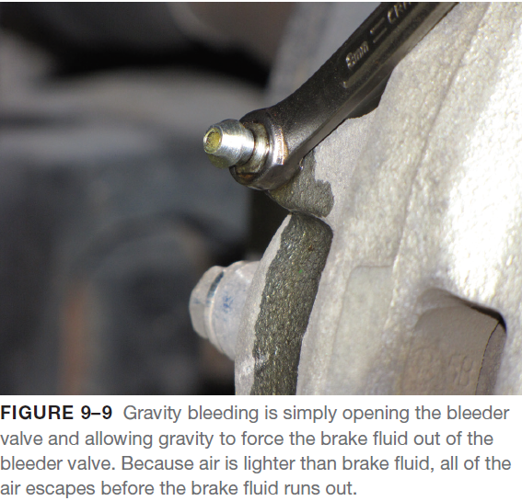
Gravity Bleeding
Gravity bleeding is a slow, but effective, method that will work on many vehicles to rid the hydraulic system of air.
  The procedure involves simply opening the bleeder valve and waiting until brake fluid flows from the open valve.
  Any air trapped in the part being bled will rise and escape from the vent port when the valve is opened.
  This flow of brake fluid can even get past the metering valve and proportioning valve.
  The proportioning valve is normally open to the rear brakes until the pressure reaches a predetermined level when it starts to limit increasing pressure to the rear brakes.
  Since no pressure is exerted on the brake fluid, the large air bubbles remain large air bubbles and are not separated into smaller, harder-to-bleed air bubbles that can occur with manual bleeding.

Slide 16
Gravity Bleeding
Advantages of Gravity Bleeding
  All four-wheel brakes can be bled at one time using the gravity method.
  In this process, the bleeder screws at all four wheels are opened at the same time, and the system is allowed to drain naturally until the fluid coming out of the bleeders is free of air.
  Gravity bleeding can be done by a single technician, who is freed to attend to other jobs while the brakes bleed.
Disadvantages of Gravity Bleeding
  Gravity bleeding is a slow process that can take an hour or more.
  When other bleeding procedures fail, gravity bleeding can sometimes be effective on brake systems that trap small pockets of air.

Slide 17
Gravity Bleeding
Gravity Bleeding Procedure
  Gravity bleeding requires the following:
    A bleeder wrench
    Four lengths of plastic hose that fit snugly over the bleeder screws
    Four jars to catch the dripping fluid—one for each wheel brake
  Unless a plastic hose is used to “start a siphon” at each bleeder screw, it is possible that air may enter the system rather than be bled from it.
  To gravity bleed the brake system, follow these steps:
    STEP 1 Fill the master cylinder reservoir with new brake fluid and leave the cap off.
    STEP 2 Attach a length of plastic tubing to each bleeder screw, and place the ends of the tubes in jars to catch the drainage.
      Do not press on the brake pedal with the bleeder valve out while gravity bleeding.
    STEP 3 Close the bleeder screws and top up the fluid level in the master cylinder reservoir and replace the master cylinder reservoir cap.

Slide 18
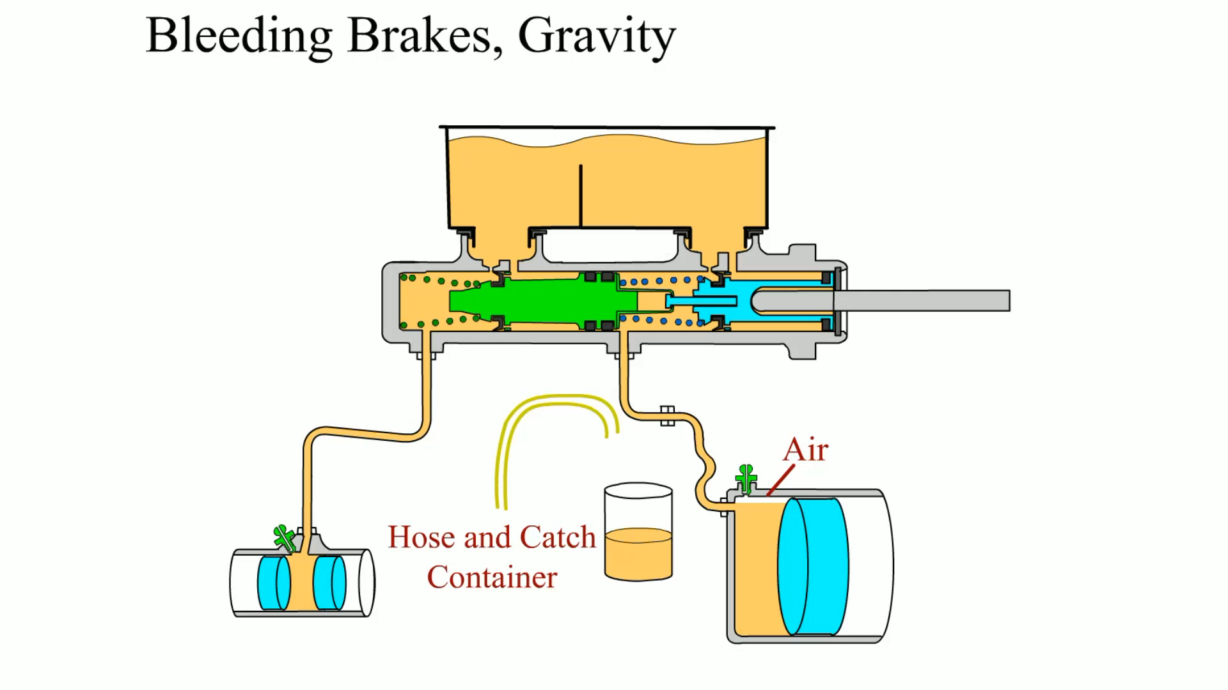
Animation: Bleeding Brakes, Gravity
(The animation will automatically start in a few seconds)

Slide 19
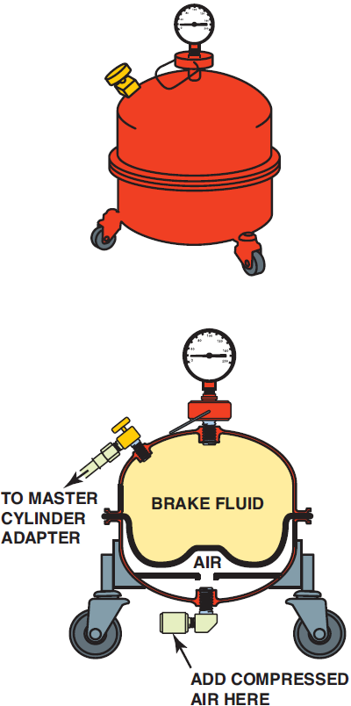
Pressure Bleeding
Pressure bleeding, sometimes called power bleeding, is a common method used to bleed the brake hydraulic system.
  In this process, a pressure bleeder attached to the master cylinder forces brake fluid through the system under pressure to purge any trapped air.
  Once the hydraulic system is pressurized, the technician simply opens the bleeder screws in the prescribed order and allows fluid to flow until it is free of air bubbles.
  The tools required for pressure bleeding include a plastic hose and fluid catch jar as used in manual bleeding, as well as a pressure bleeder, a source of air pressure to charge the bleeder, and an adapter to attach the pressure bleeder to the master cylinder fluid reservoir.
FIGURE 9–10 A typical pressure bleeder. The brake fluid inside is pressurized with air pressure in the air chamber. This air pressure is applied to the brake fluid in the upper section. A rubber diaphragm separates the air from the brake fluid.

Slide 20
Pressure Bleeding
Metering Valve Override Tools
  In addition to the tools previously described, a metering valve override tool is required when pressure bleeding the front brakes of certain vehicles.
  The override tool is used to deactivate the metering valve because the operating pressure of power bleeders is within the range where the metering valve blocks fluid flow to the front brakes.
  To install the override tool used on General Motors vehicles, loosen the combination valve mounting bolt and slip the slot in the tool under the bolt head.
  Push the end of the tool toward the valve body until it depresses the valve plunger, then tighten the mounting bolt to hold the tool in place.
  Some full-size Ford vehicles have a metering valve with a stem that must be pushed in to bleed the front brakes, but Ford does not offer a special tool for this purpose.
  To install the override tool used on older Chrysler and Ford vehicles, slip one fork of the tool under the rubber boot and the other fork under the valve stem head.
  The spring tension of the tool holds the valve open, but allows the valve stem to move slightly when the system is pressurized.

Slide 21
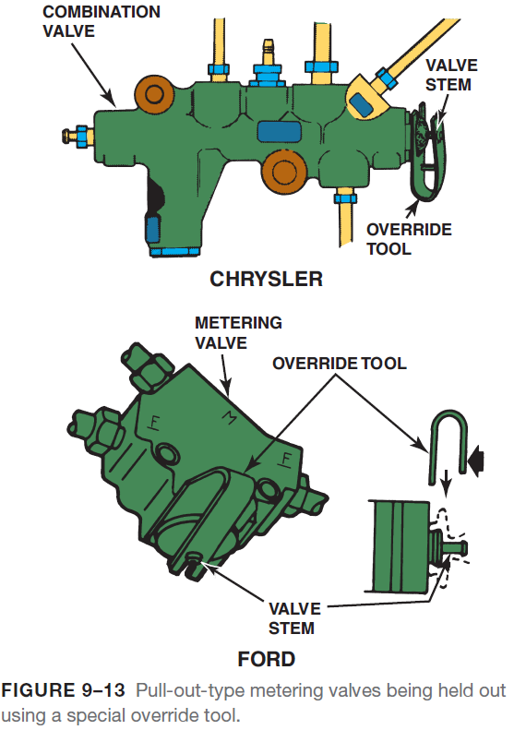
Pressure Bleeding
Pressure Bleeding Procedure
  Just as in manual bleeding, it is important to follow the proper sequence when pressure bleeding a brake system.
  To pressure bleed a brake system, follow these steps:
    STEP 1 If it has not already been done, consult the equipment manufacturer’s instructions and fill the pressure bleeder with the proper type of brake fluid.
    STEP 2 Make sure the bleeder is properly sealed and the fluid supply valve is closed, then use compressed air to pressurize the bleeder until approximately 30 PSI (207 kPa) is indicated on the bleeder gauge.
    STEP 3 If the vehicle is equipped with a metering valve, override it with the appropriate tool.

Slide 22
Pressure Bleeding
Pressure Bleeding Procedure
    STEP 4 Clean the top of the master cylinder, then remove the master cylinder cover and clean around the gasket surface.
    STEP 5 Fill the reservoir about half full with new brake fluid, then install the proper pressure bleeder adapter on the master cylinder.
    STEP 6 Connect the pressure bleeder fluid supply hose to the adapter, making sure the hose fitting is securely engaged.
    STEP 7 Open the fluid supply valve on the pressure bleeder to allow pressurized brake fluid to enter the system.
    STEP 8 Slip the plastic hose over the bleeder screw of the first wheel cylinder or caliper to be bled, and submerge the end of the tube in the jar of brake fluid.
    STEP 9 Open the bleeder screw approximately one-half turn, and let the fluid run until air bubbles no longer emerge from the tube. Close the bleeder screw.

Slide 23
Pressure Bleeding
Pressure Bleeding Procedure
    STEP 10 Transfer the plastic hose to the bleeder screw of the next wheel cylinder or caliper in the bleeding sequence, and repeat steps 8 and 9.
    STEP 11 Remove the metering valve override tool.
    STEP 12 Close the fluid supply valve on the pressure bleeder.
    STEP 13 Wrap the end of the fluid supply hose in a shop towel, and disconnect it from the master cylinder adapter.
    STEP 14 Remove the master cylinder adapter, adjust the fluid level to the full point, and install the fluid reservoir cover.

Slide 24
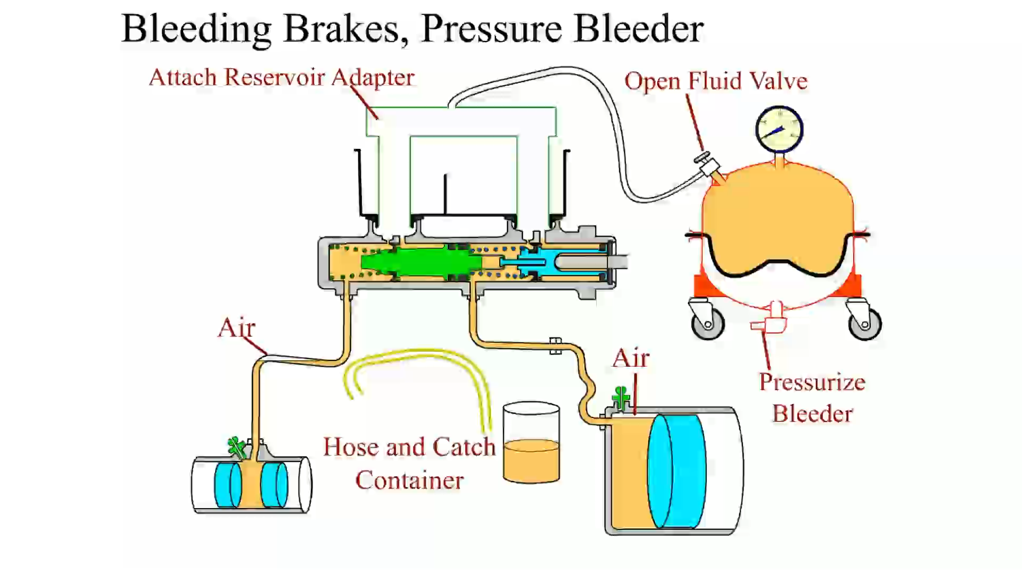
Animation: Bleeding Brakes, Pressure Bleeder
(The animation will automatically start in a few seconds)

Slide 25
Hydraulic ABS Service
Check Service Information
  Before doing any brake work on a vehicle equipped with antilock brakes, always consult the appropriate service information for the exact vehicle being serviced.
Bleeding the Electronic-Hydraulic Assembly
  Air can easily get trapped in the ABS electronic-hydraulic (E-H) assembly whenever the hydraulic system is opened.
  Even though the master cylinder and all four wheel cylinders/calipers have been bled, sometimes the brake pedal will still feel spongy.
  Bleeding the E-H unit also purges out the older brake fluid, which can cause rust and corrosion damage.

Slide 26
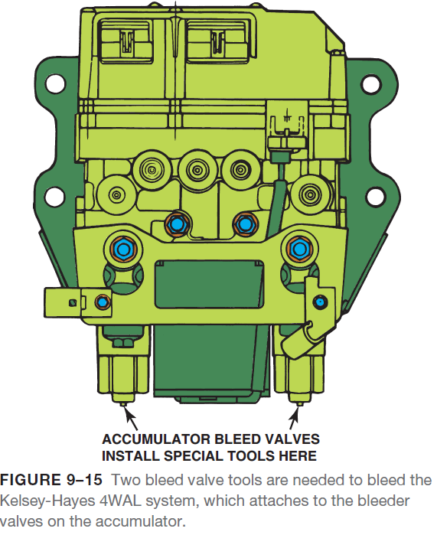
Hydraulic ABS Service
Manually Bleeding ABS Wheel Brakes
  During routine brake service, attempt to keep the air from entering the hydraulic system by doing the following:
    Do not allow the brake system to run dry. Use a brake pedal depressor or plug any open brake line to keep brake fluid from flowing out of the brake master cylinder reservoir.
    Do not allow the master cylinder to run dry during the bleeding operation.
    Always bench bleed a replacement master cylinder to help prevent against introducing air into the hydraulic system.
  After depressing the unit as per manufacturer’s recommended procedures, the brakes can be bled using the same procedure as for a vehicle without ABS.
  The bleeding procedure for vehicles equipped with antilock brakes is often different than vehicles without ABS.

Slide 27
Hydraulic ABS Service
Scan Tool Bleeding
  To bleed the system using a scan tool, use the following steps:
    STEP 1 Check service information and determine the specified procedure to follow. This usually involves manually bleeding the wheel brakes before using a scan tool.
    STEP 2 Use a factory scan tool or one that is capable of performing an automated bleed procedure.
    STEP 3 Connect the scan tool to the data link connector (DLC). This connector can be located under the dash or in the center console or even covered by a panel.
    STEP 4 Enter vehicle information as shown on the display of the scan tool and locate the antilock brake system (ABS) function area.
    STEP 5 Select ABS automated bleed from the ABS menu.
      The instructions on the scan tool could include several steps including manually bleeding the system, then allowing the scan tool to cycle the hydraulic ABS solenoid valves and then bleeding again.

Slide 28
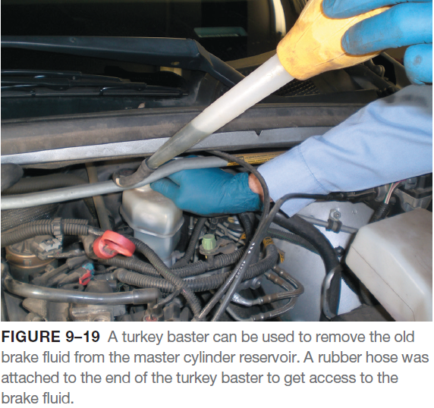
Brake Fluid Replacement/Flushing
Brake fluid flushing is a procedure where the old brake fluid is removed and new brake fluid is added to the hydraulic system.
Flushing Procedure
  The brake fluid flushing procedure usually requires the following:
    An assistant to pump the brake pedal
    A bleeder screw wrench
    Approximately 2 feet of clear, plastic hose with an inside diameter small enough to fit snugly over the bleeder screw
    A jar partially filled with clean brake fluid

Slide 29
Brake Fluid Replacement/Flushing
To flush a brake system, use the following steps:
  STEP 1 Using a turkey baster or similar tool, remove the old brake fluid from the master cylinder reserve
  STEP 2 Fill the master cylinder reservoir with new brake fluid from a sealed container.
  STEP 3 Slip the plastic hose over the bleeder screw of the wheel cylinder or caliper to be bled and submerge the end of the tube in the jar of brake fluid.
  STEP 4 Open the bleeder screw approximately one-half turn.
  STEP 5 With the bleeder screw open, have your assistant slowly depress the brake pedal.
  STEP 6 While your assistant holds the brake pedal to the floor, close the bleeder screw.
  STEP 7 Continue to bleed at each wheel until the fluid that emerges from the bleeder screw is free of any discoloration and contamination.
  STEP 8 Repeat steps 4 through 7 at each bleeder screw in the recommended order.
  STEP 9 Check the brakes for proper operation and rebleed the system if needed.

Slide 30
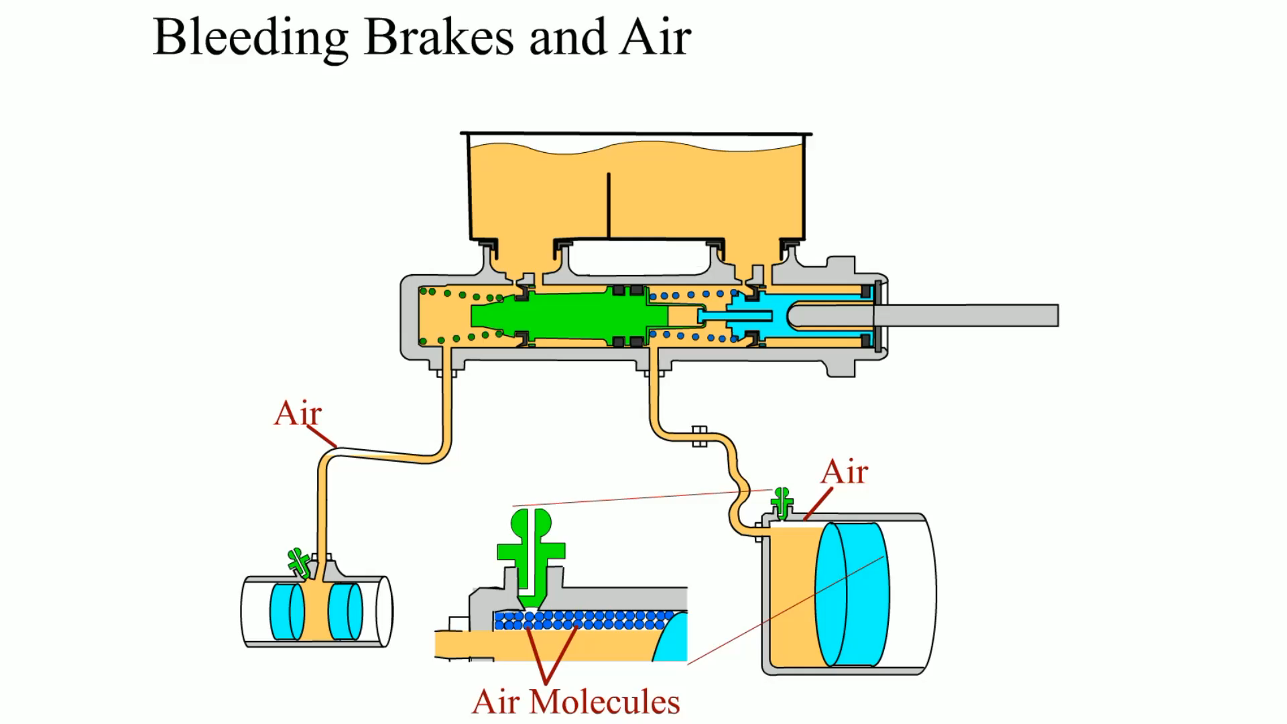
Animation: Bleeding Brakes and Air
(The animation will automatically start in a few seconds)

Slide 31
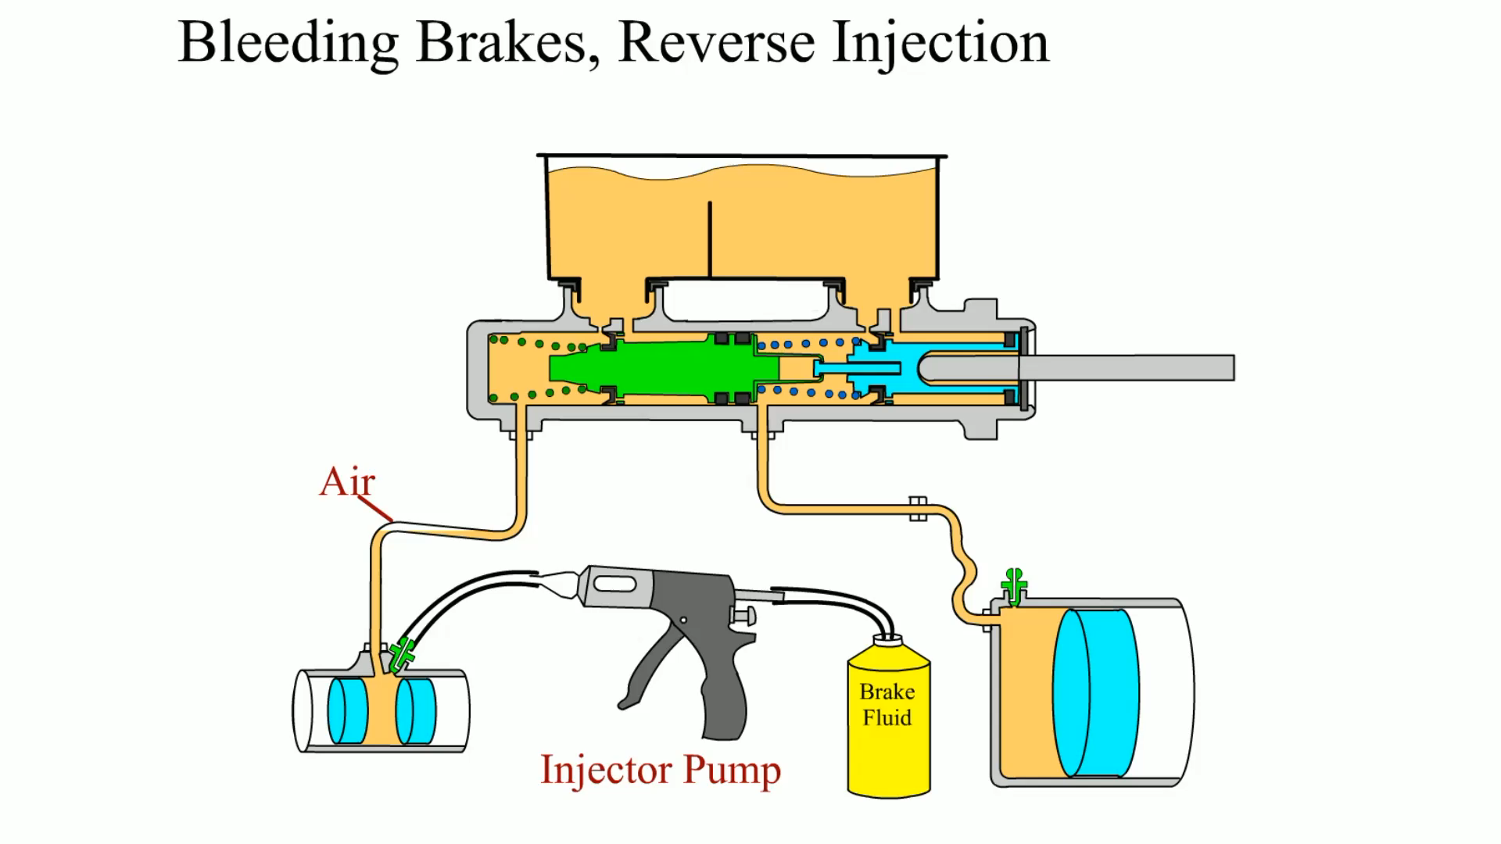
Animation: Bleeding Brakes, Reverse Injection
(The animation will automatically start in a few seconds)

Slide 32
Summary
Brake bleeding is removing any trapped air from the hydraulic system. If air is in the brake hydraulic system, the brake pedal will often feel “spongy.”
Attempting to loosen a bleeder valve often results in breaking (shearing off) the bleeder valve. Several of these service procedures can be tried that help prevent the possibility of breaking a bleeder valve. Bleeder valves are tapered and become wedged in the caliper on the wheel cylinder housing. All of these methods use shock to “break the taper” and to loosen the stuck valve.
After bleeding the master cylinder, the combination valve should be bled if equipped. For most rear-wheel-drive vehicles equipped with a front/rear split system, start the bleeding with the wheel farthest from the master cylinder and work toward the closest.
Manual bleeding is the most commonly used method and uses hydraulic pressure created by the master cylinder to pump fresh fluid through the brake system.
Vacuum bleeding uses a special suction pump that attaches to the bleeder screw. The pump creates a low pressure area at the bleeder screw, which allows atmospheric pressure to force brake fluid through the system when the bleeder screw is opened.

Slide 33
Summary Cont….
Gravity bleeding is a slow, but effective, method that will work on many vehicles to rid the hydraulic system of air. The procedure involves simply opening the bleeder valve and waiting until brake fluid to flow through the opened bleeder valves.
Pressure bleeding, sometimes called power bleeding, is a common method used to bleed the brake hydraulic system. In this process, a pressure bleeder attached to the master cylinder forces brake fluid through the system under pressure to purge any trapped air.
To bleed many ABS systems requires the use of a scan tool.

Slide 34
Video Links (Internet Access Required)
How to bleed your brakes by yourself (time 8:44)
Bleeding the brake system (time 6:00)
Brake bleeder screw (time 4:47)

