Slide 1

Automotive Chassis Systems Eighth Edition
Chapter 08
Brake Fluid and Lines
Notes:
If this PowerPoint presentation contains mathematical equations, you may need to check that your computer has the following installed:
1) MathType Plugin
2) Math Player (free versions available)
3) NVDA Reader (free versions available)

Slide 2
Objectives
Discuss the purpose, function, and specifications of brake fluids.
Describe brake service procedures and precautions.
Discuss the types of rubber that are used in brake system components.
Discuss the use of brake lines.

Slide 3
Brake Fluid
Purpose and Function
Brake fluid is designed to function in the hydraulic brake system under all operating conditions.
Brake fluid boiling point is one of the most critical aspects and ratings for brake fluid.
As brake fluid ages, it absorbs moisture, which lowers its boiling point and causes increased corrosion of the brake system components.
All brake fluids must be able to pass tests for the following:
Fluidity at low temperatures
Controlled percentage loss due to evaporation at high temperatures (tested at 212°F [100°C])
Compatibility with other brake fluids
Resistance to oxidation
Specific effects on rubber, including the following:
No disintegration
No increase in hardness of the rubber tested
Limited amount of decrease in hardness of the rubber

Slide 4
Brake Fluid
Physical Properties
Brake fluid is made from a combination of various types of glycol, a non-petroleum-based fluid.
Brake fluid is a polyalkylene-glycol-ether mixture called polyglycol for short. All polyglycol brake fluid is clear to amber in color. Brake fluid has to have the following characteristics:
A high boiling point
A low freezing point
No ability to damage rubber parts in the brake system

Slide 5
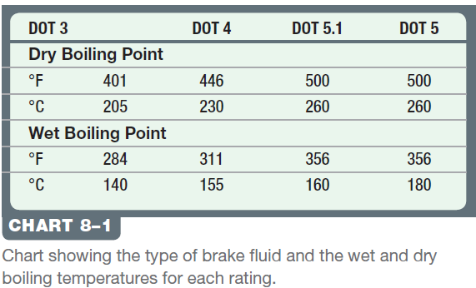
Brake Fluid Specifications
FMVSS 116
All automotive brake fluid must meet Federal Motor Vehicle Safety Standard (FMVSS) 116.
The Society of Automotive Engineers (SAE) and the Department of Transportation (DOT) have established brake fluid specification standards.
The wet boiling point is often referred to as “equilibrium reflux boiling point” (ERBP). ERBP refers to the method in the specification (SAE J1703) by which the fluid is exposed to moisture and tested.

Slide 6
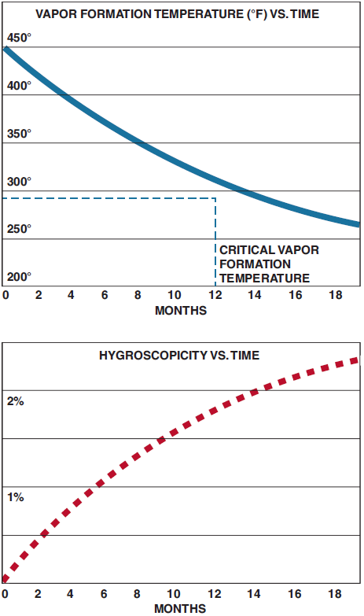
Brake Fluid Specifications
FMVSS 116
DOT 3 DOT 3 brake fluid is the type most often used.
DOT 3 absorbs moisture. According to the SAE, DOT 3 can absorb 2% of its volume in water per year.
Moisture is absorbed by the brake fluid through microscopic seams in the brake system and around seals.
DOT 3 must be used from a sealed (capped) container. If allowed to remain open for any length of time, DOT 3 will absorb moisture from the surrounding air, which is called hygroscopic.
Always check the brake fluid recommendations on the top of the master cylinders of imported vehicles before adding DOT 3.
FIGURE 8–2 Brake fluid absorbs moisture from the air at the rate of about 2% per year. As the brake fluid absorbs water, its boiling temperature decreases.

Slide 7
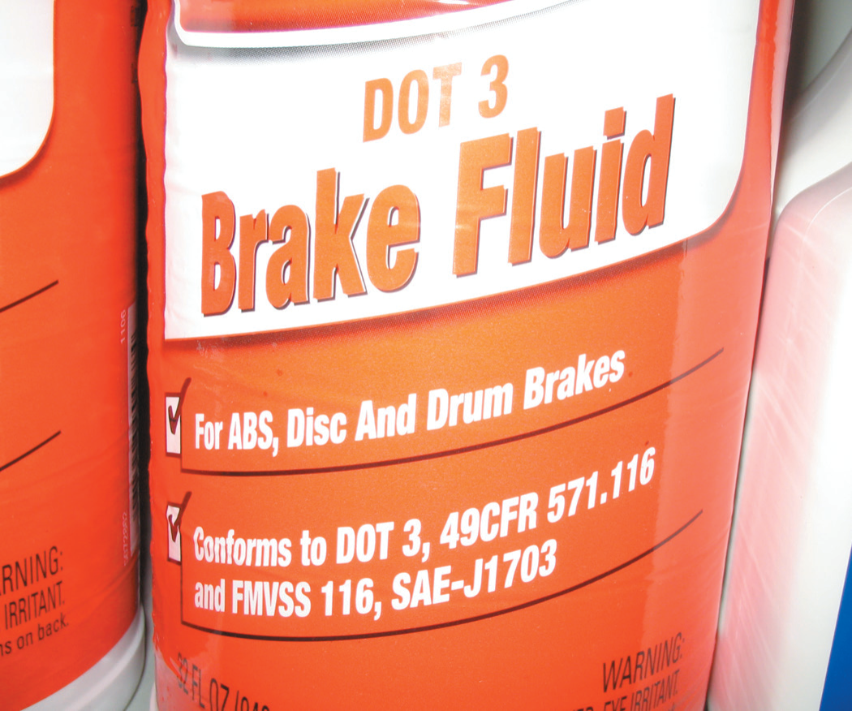
Brake Fluid Specifications
FIGURE 8–1 Brake fluid can absorb moisture from the air even through plastic, so many experts recommend that brake fluid be purchased in metal containers, if possible.

Slide 8
Brake Fluid Specifications
FMVSS 116
DOT 4. DOT 4 brake fluid is the specified brake fluid for use in many European vehicles.
DOT 4 is polyglycol based but has borate esters added to provide an extra buffer for the fluid against acids that can form in the moisture that has been absorbed in the fluid when it is heated.
DOT 5.1. DOT 5.1 brake fluid is a non-silicone-based polyglycol fluid and is clear to amber in color.
This severe duty fluid has a boiling point of over 500°F equal to the boiling point of silicone-based DOT 5 fluid.
Unlike DOT 5, DOT 5.1 can be mixed with either DOT 3 or DOT 4 according to brake fluid manufacturer’s recommendations.
DOT 5. DOT 5 brake fluid is commonly called silicone brake fluid and is made from polydimethylsiloxanes.
DOT 5 brake fluid is purple (violet) in color to distinguish it from DOT 3 or DOT 4 brake fluid.
It does not absorb any water and is therefore called nonhygroscopic.

Slide 9
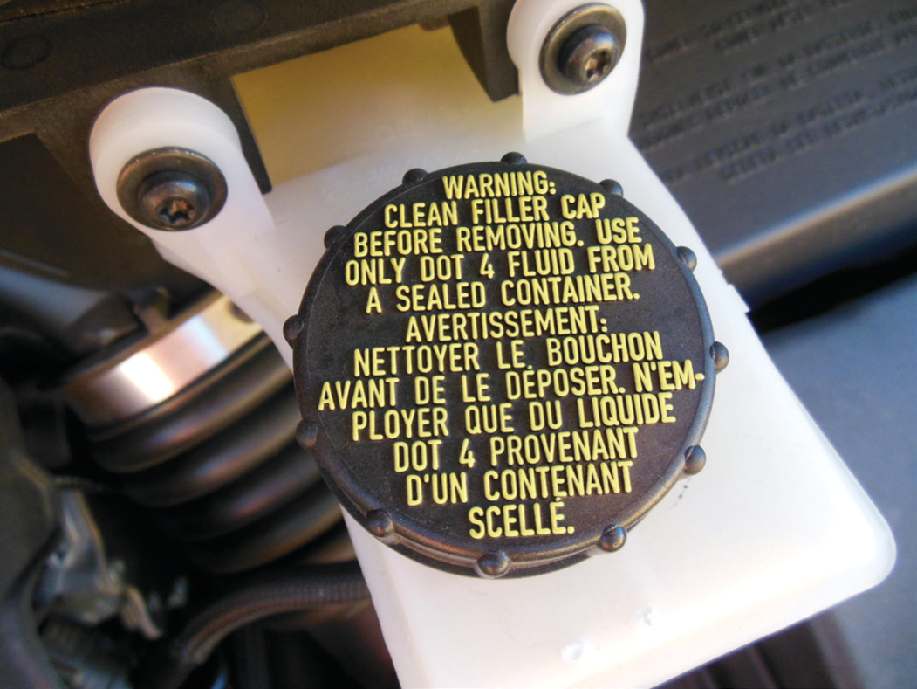
Brake Fluid Specifications
FIGURE 8–3 This Ford Escape requires DOT 4 as stated on
the cap of the master cylinder.

Slide 10
Brake Fluid Specifications
FMVSS 116
Silicones have about three times the amount of dissolved air as glycol fluids (about 15% of dissolved air versus only about 5% for standard glycol brake fluid).
It is this characteristic of silicone brake fluid that causes the most concern about its use.
Silicone brake fluid has an affinity for air; therefore, it is more difficult to bleed the hydraulic system of trapped air.
The trapped air expands with increasing temperature.
This causes the brake pedal to feel “mushy” because the pressure exerted on the hydraulic system simply compresses the air in the system and does not transfer the force to the wheel cylinders and calipers as it should.
The air trapped in the silicone brake fluid can also “off-gas” at high altitudes, causing a mushy brake pedal and reduced braking performance.
DOT 5 brake fluid should not be mixed with any other type of brake fluid. Therefore, the entire braking system must be completely flushed and refilled with DOT 5.

Slide 11
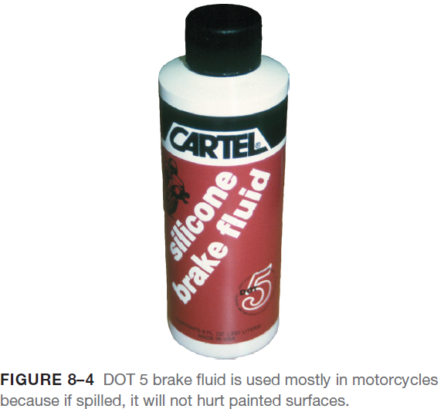
Brake Fluid Specifications
FMVSS 116
DOT 5 brake fluid should not be mixed with any other type of brake fluid. Therefore, the entire braking system must be completely flushed and refilled with DOT 5.
DOT 5 does not affect rubber parts and will not cause corrosion.
DOT 5 is expensive. It is approximately four times the cost of DOT 3 brake fluid.

Slide 12
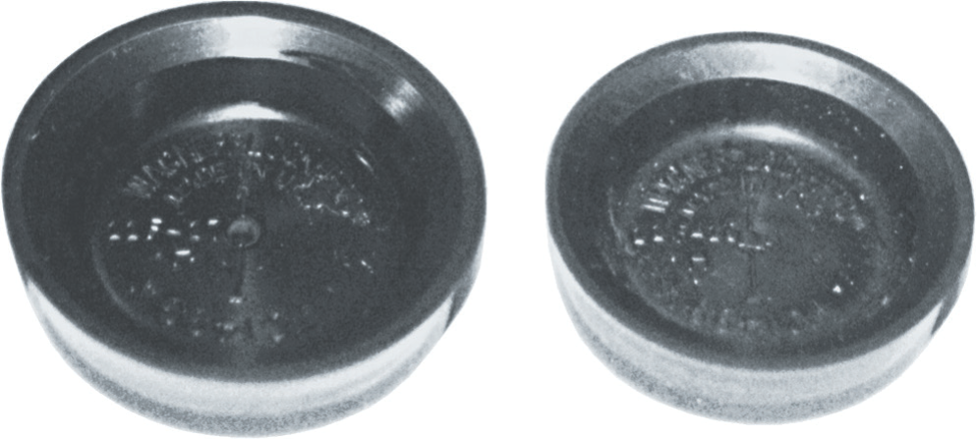
Brake Fluid Specifications
FIGURE 8–5 Both rubber sealing cups were exactly the same size. The cup on the left was exposed to mineral oil. Notice how the seal greatly expanded.

Slide 13
Brake Fluid Specifications
Brake Fluid Inspection and Testing
The brake fluid should be inspected regularly by performing the following tests:
Proper level. The brake fluid level should be above the minimum level (labeled MIN) and below the maximum (labeled MAX) on the side of the master cylinder reservoir.
Color/condition. New brake fluid is clear or amber in color.
If the brake fluid is black or discolored like black coffee or coffee with cream, the fluid should be changed.
Tested using a tester or test strips. Often, brake fluid does not look as if it is bad but has absorbed moisture enough to reduce its effectiveness.
Test strips can be used to measure copper ions that increase as the brake fluid becomes deteriorated.
Boiling point tester. An electronic tester can be used to measure the actual boiling temperature of the brake fluid.
The tester probe is inserted into the brake fluid and then a button is pushed and the boiling temperature is displayed.

Slide 14
Brake Fluid Specifications
Brake Fluid Inspection and Testing
Brake fluid contamination test. If brake fluid is mixed with any mineral oil, such as engine oil, power steering fluid, or automatic transmission fluid, rubber components will swell and cause brake system failure.
To check the brake fluid, use a Styrofoam cup filled with water.
Place a teaspoon (1 ml) of brake fluid from the master cylinder into the water.
Pure brake fluid will completely dissolve in the water.
Petroleum or mineral oil fluids will float on the surface of the water and retain their color.
Petroleum fluids will also dissolve the Styrofoam cup at the waterline.
If the brake fluid is contaminated, the entire braking system must be drained and flushed and all rubber components replaced.

Slide 15
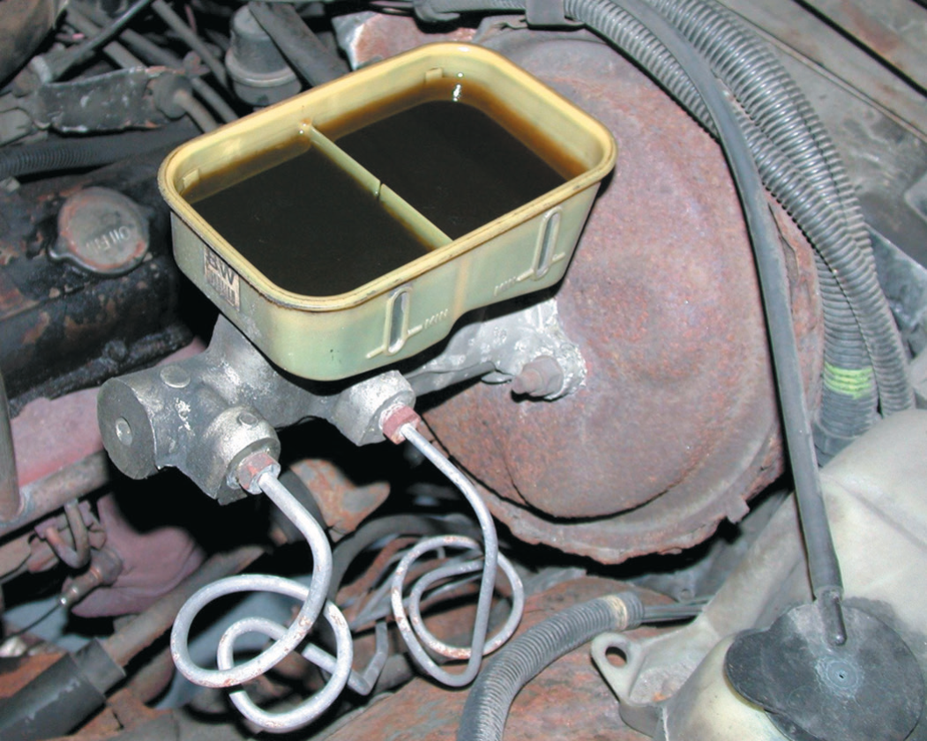
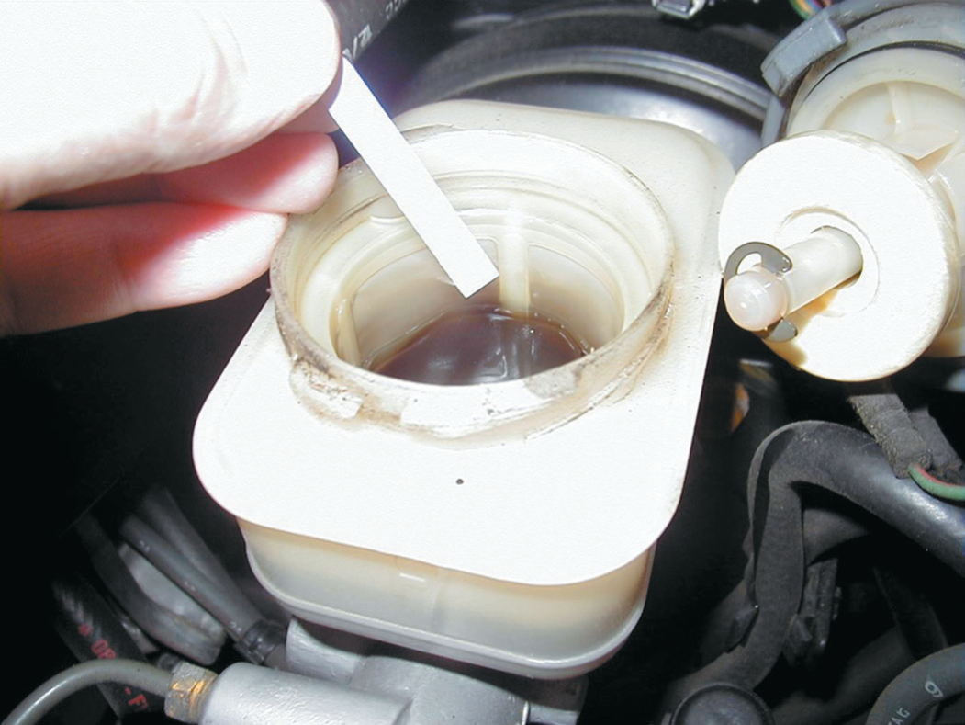
Brake Fluid Specifications
FIGURE 8–6 If the brake fluid is black in color, it should be replaced.
FIGURE 8–7 (a) A brake fluid test strip is being used to test the condition of the brake fluid.

Slide 16
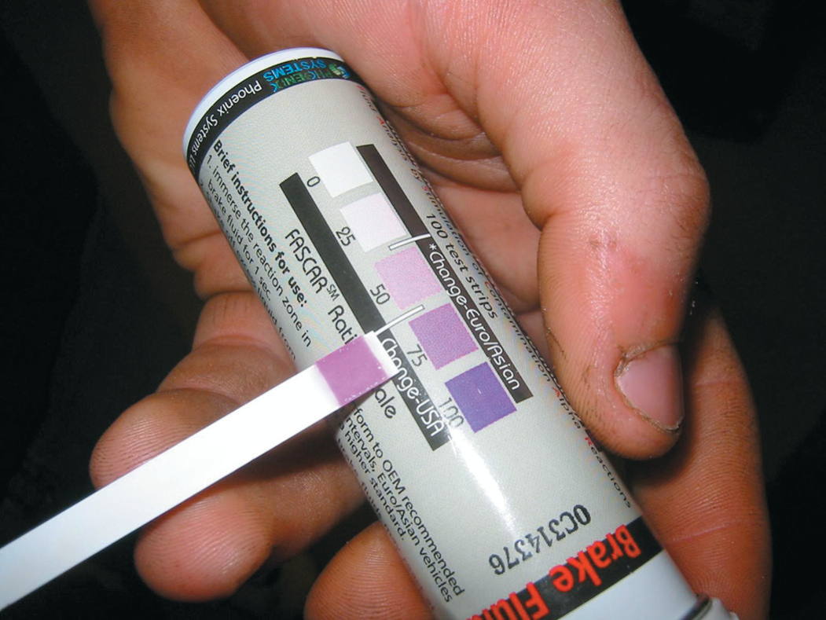
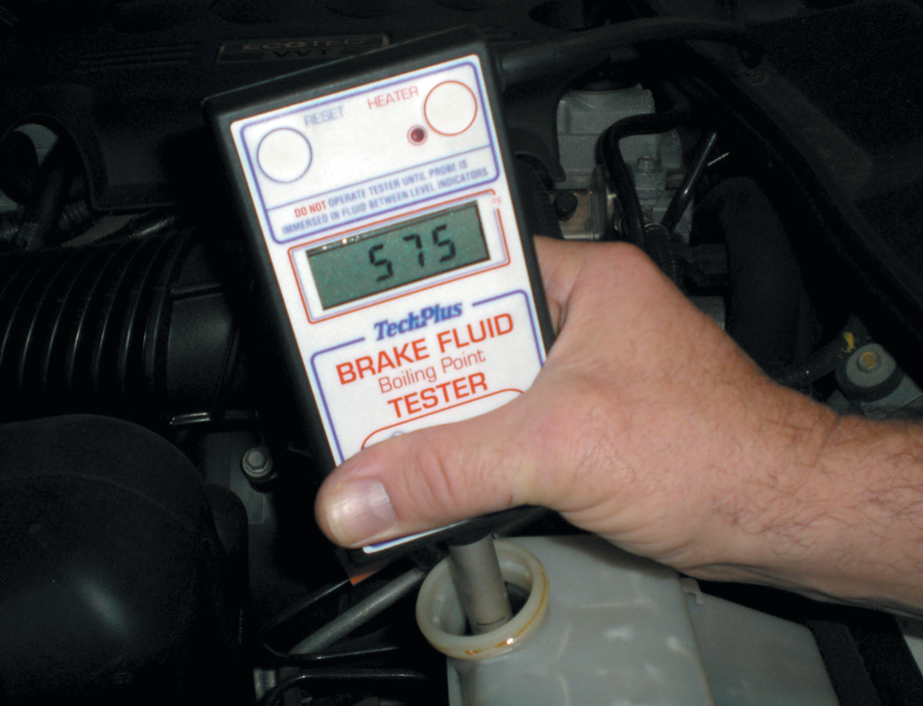
Brake Fluid Specifications
FIGURE 8–7 (b) The color of the test strip is then compared with a chart on the package, which indicates the condition and if the fluid should be replaced.
FIGURE 8–8 An electronic tester that measures the boiling temperature of the brake fluid is useful to help determine if the brake fluid needs to be replaced. The boiling temperature of brake fluid decreases as the fluid ages.

Slide 17
Brake Fluid Service Procedures
Storage of Brake Fluid
Store brake fluid only in its original container.
To help prevent possible contamination with moisture, air, or other products, purchase brake fluid in small containers.
Keep all brake fluid containers tightly closed to prevent air (containing moisture) from being absorbed.
Before opening a brake fluid container, remove any dirt, moisture, or other contamination from the top and outside of the container.
When a brake fluid container is empty, it should be discarded—the container should never be used for anything except brake fluid.
Do not transfer brake fluid to any other container that may have contained oil, kerosene, gasoline, antifreeze, water, cleaners, or any other liquids or chemicals.
Do not reuse brake fluid that has been siphoned from another vehicle or drawn out during a brake bleeding operation.
Use only fresh, new brake fluid for flushing the hydraulic brake system.

Slide 18
Brake Fluid Service Procedures
Brake Fluid Handling and Disposal
Polyglycol brake fluid presents little toxicity hazard, but for some individuals, brake fluid may produce moderate eye and skin irritation.
For good safety practice, protective clothing and safety glasses or goggles should be worn.
The disposal requirements for brake fluid spilled onto open ground vary with the exact amount spilled and other factors.

Slide 19
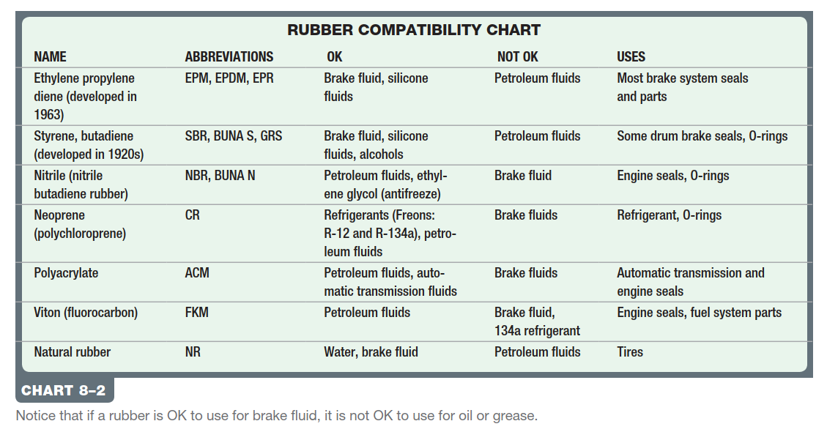
Brake Fluid Service Procedures

Slide 20
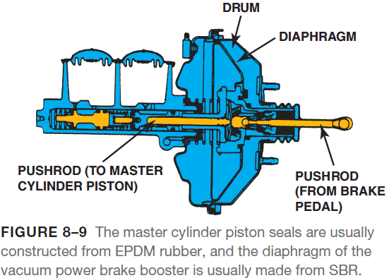
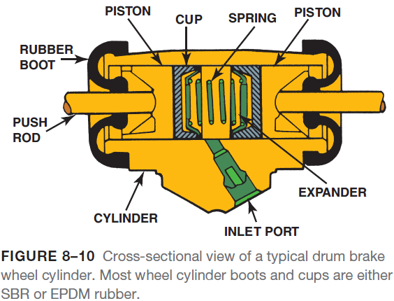
Rubber Types
Terminology
Vehicles use a wide variety of rubber in the braking system, suspension system, steering system, and engine.
Rubber products are called elastomers.
Some are oil- and grease-resistant elastomers and can be harmed by brake fluid, while others are brake fluid resistant and can swell or expand if they come in contact with oil or grease.

Slide 21
Brake Lines
Construction
High-pressure double-walled steel brake lines or high-strength flexible lines are used to connect the master cylinder to each wheel.
The steel brake lines are also called brake pipes or brake tubing.
Brake lines carry brake fluid from the master cylinder to the wheel cylinder and brake calipers.
The brake lines contain and direct the pressure of the brake hydraulic system.
There are two types of double-walled tubing:
Seamless
Multiple ply
All double-walled brake tubing is plated with tin, zinc, or other similar substances for protection against rust and corrosion.

Slide 22
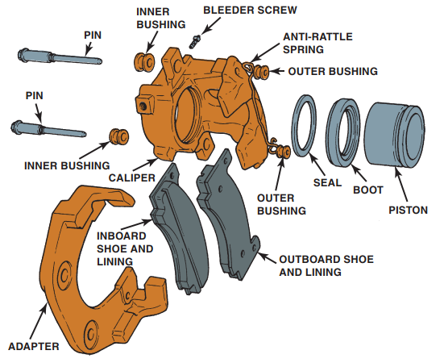
Brake Lines
FIGURE 8–11 Exploded view of a typical disc brake caliper. Both the caliper seal and dust boot are constructed of EPDM rubber.

Slide 23
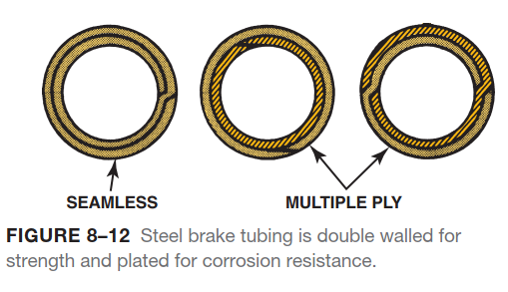
Brake Lines

Slide 24
Brake Lines
Steel Brake Line Coatings
Because steel tube alone does not have adequate corrosion resistance, it requires a coating.
The coatings in wide use include:
Aluminum-rich paint (called AlGal)
Nylon-coated (called NyGal)
Zinc
Terne plate (lead and tin alloy)
Epoxy
PVF (Polyvinylfluoride)—olive green color
While these coatings have been effective, the liquid sodium chloride and rock salt used to de-ice winter roads break down and will eventually destroy steel tubing lines.

Slide 25
Brake Lines
Cooper-Nickel Brake Lines
Copper-nickel brake line is commonly referred to as “90-10 copper” because it contains about 90% copper and 10% nickel.
Copper-nickel brake lines have been used on several European vehicle brake systems since the 1970s, including:
Volvo
Audi
Porsche
Aston Martin
Copper-nickel alloy brake tubing meets SAE Standard J1047 and ISO 4038, meeting all international and U.S. requirements for brake tubing and has the strength of steel lines, but is much more corrosion-resistant.
This type is also pliable, making flaring and bending easier than when using steel brake line.

Slide 26
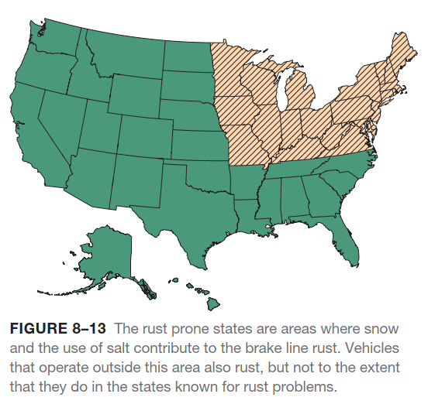
Brake Lines

Slide 27
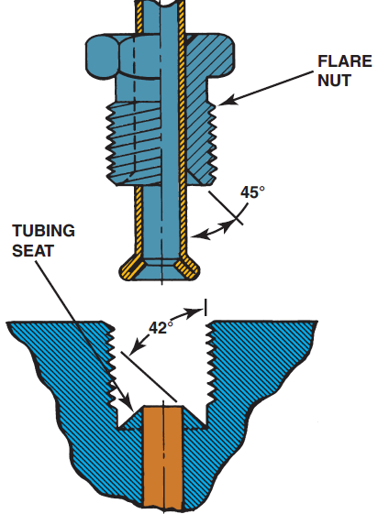
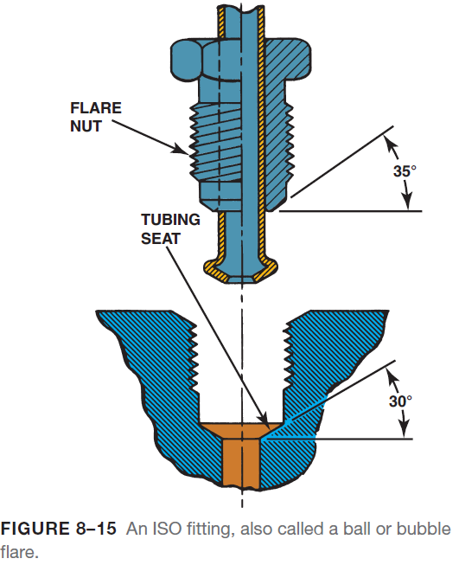
Brake Lines
Types of Flares
All steel brake lines have one of two basic types of ends:
Double flare.
ISO, which means International Standards Organization (also called a ball flare or bubble flare).
FIGURE 8–14 Because of the slight difference in flare angle, double-flare fitting seals cause a wedging action.

Slide 28
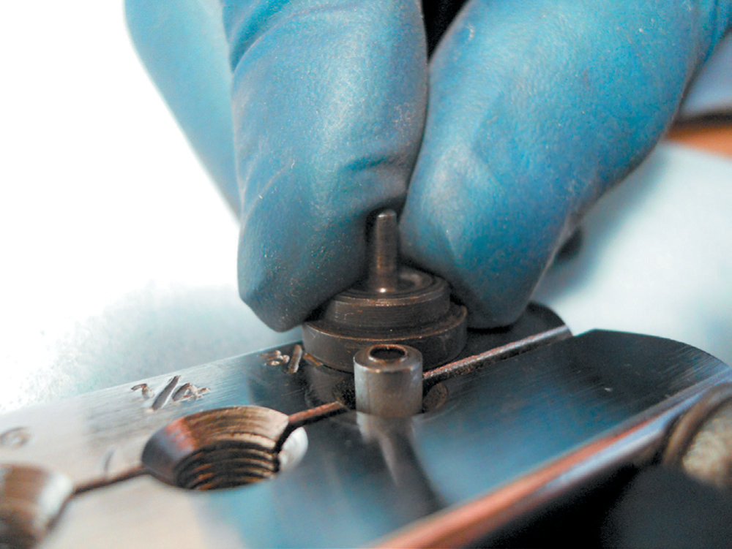
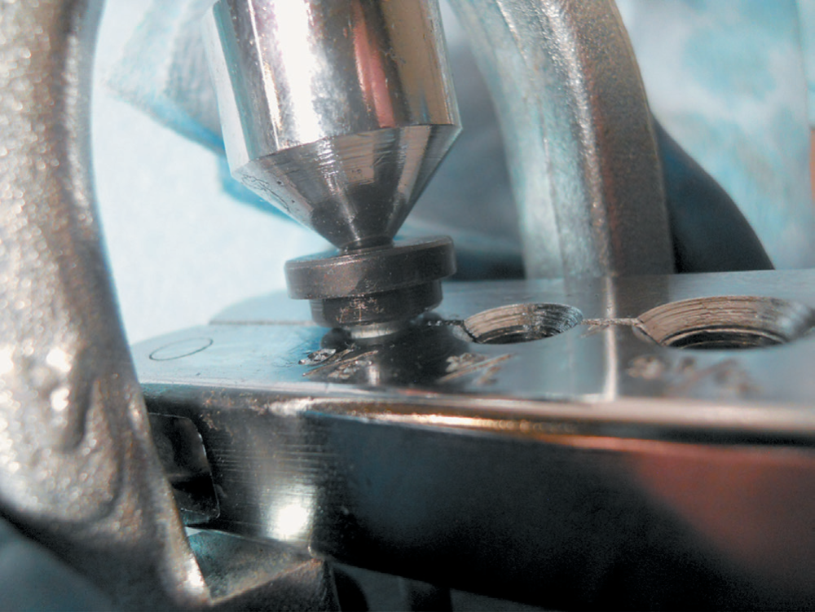
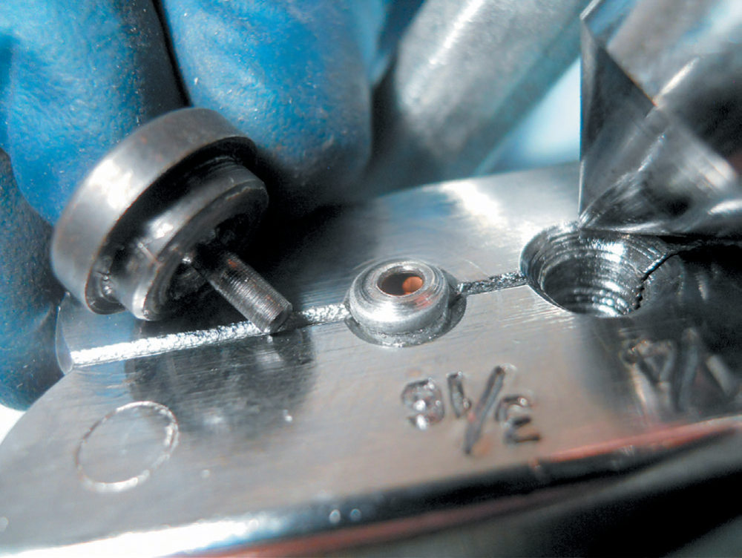
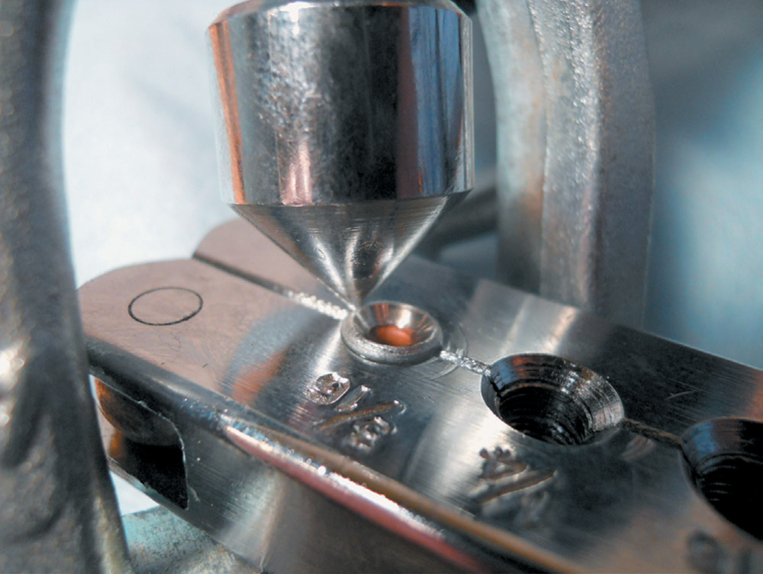
Brake Lines
B
A
FIGURE 8–16 Double flaring the end of a brake line. (a) Clamp the line at the correct height above the surface of the clamping tool using the shoulder of the insert as a gauge. (b) The insert is pressed into the end of the tubing. This creates the first bend. (c) Remove the insert and use the pointed tool to complete the overlap double flare. (d) The completed operation as it appears while still in the clamp.
C
D

Slide 29
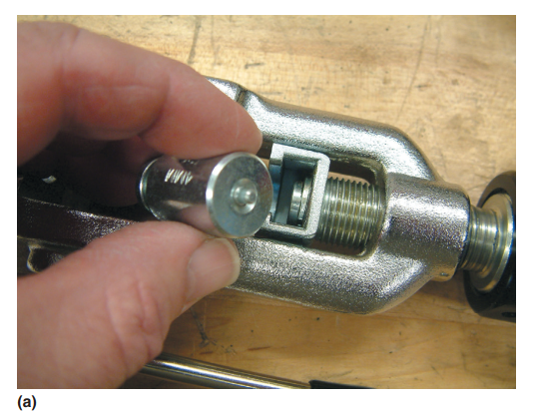
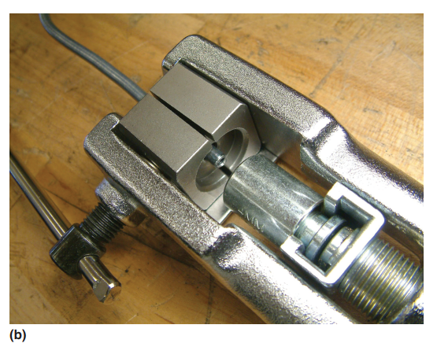
Brake Lines (Figure 8-17 1 of 2)
FIGURE 8–17 Making an ISO flare requires a special tool. (a) Select the proper size forming mandrel. (b) Clamp the tubing flush with the split die and place the mandrel into the tool.

Slide 30
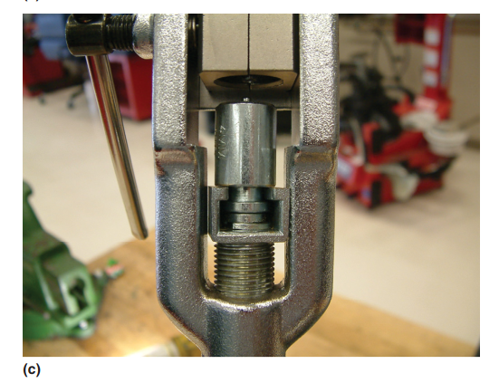
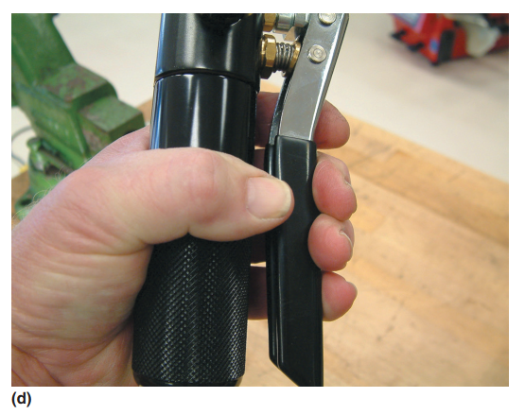
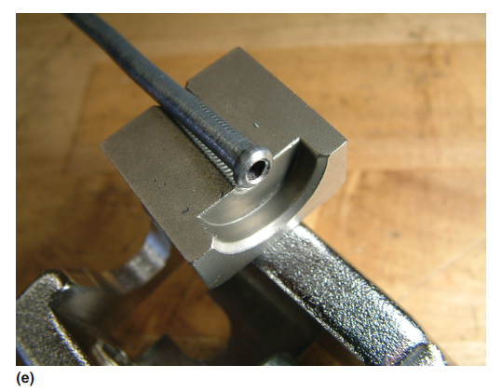
Brake Lines (Figure 8-17 2 of 2)
FIGURE 8–17 (c)Thread the tool handle in until the mandrel pilot seats into the tubing. (d) Close the tool valve and pump the handle until the mandrel seats in the die. (e) The strong hydraulic pressure
forms the ISO flare.

Slide 31
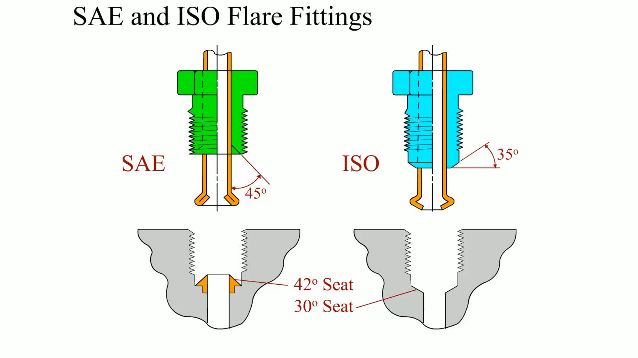
Animation: SAE and ISO Flare Fittings (The animation will automatically start in a few seconds)

Slide 32
Brake Lines
Brake Line Replacement
If replacing a brake line, there are two options:
OPTION 1 Purchase pre-made lines in the diameter and length needed. Brake line can also be purchased in selected lengths already correctly flared. They are available in different diameters, the most commonly used with an outside diameter (OD) of:
3/16 inch (4.8 mm)
1/4 inch (6.4 mm)
5/16 inch (7.9 mm)
OPTION 2 Cut and flare lines to match what is needed. When replacing steel brake lines, new steel tubing should be used and a double lap flare or an ISO flare needs to be completed at each end using a special flaring tool.

Slide 33
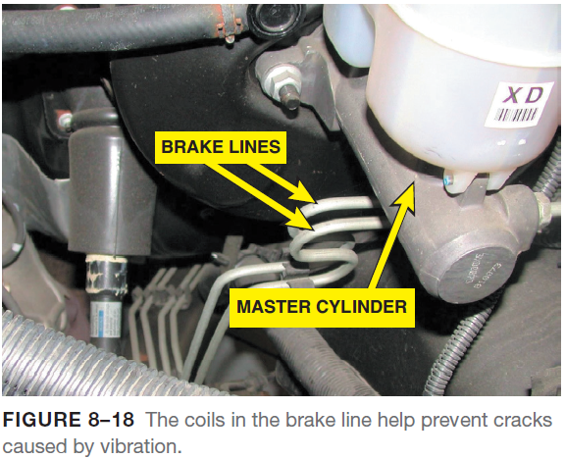
Brake Lines
Coiled Brake Line
Steel brake line is often coiled to allow movement between the brake components without stress that could lead to metal fatigue and brake line breakage.
The typical master cylinder attaches to the bulkhead of the vehicle and the combination valve is often attached to the frame.
Because the body and frame are usually insulated from each other using rubber isolators, some movement occurs while driving.

Slide 34
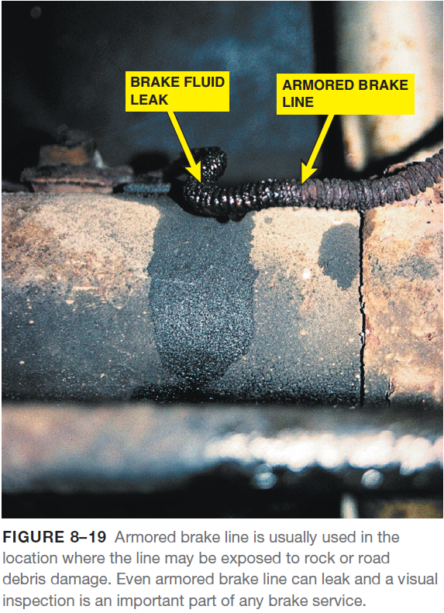
Brake Lines
Armored Brake Line
In many areas of the brake system, the steel brake line is covered with a wire coil wrap.
This type of brake line is called armored brake line.
This armor is designed to prevent damage from stones and other debris that could dent or damage the brake line.
If a section of armored brake line is to be replaced, armored replacement line should be installed.

Slide 35
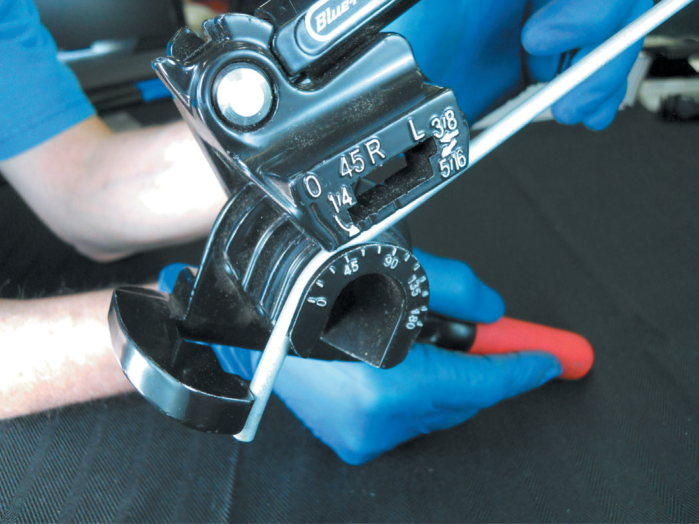
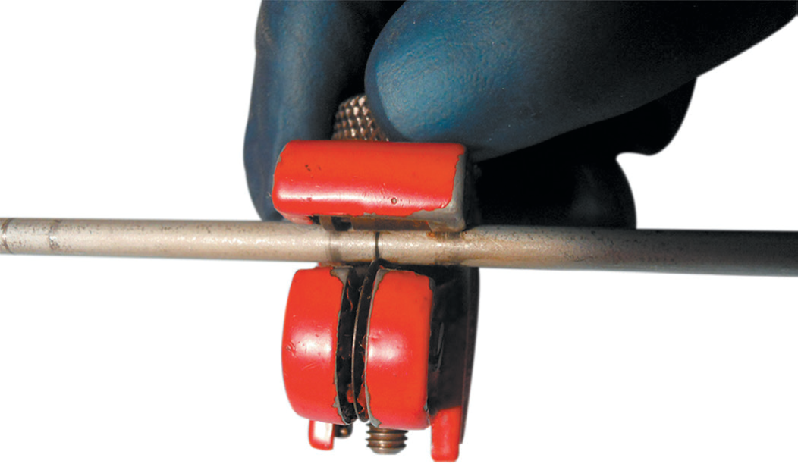
Brake Lines
FIGURE 8–21 A tubing cutter is the preferred tool to use to cut brake line because it leaves a clean edge.
FIGURE 8–20 A tube bender being used to bend a brake line.

Slide 36
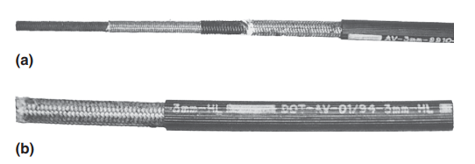
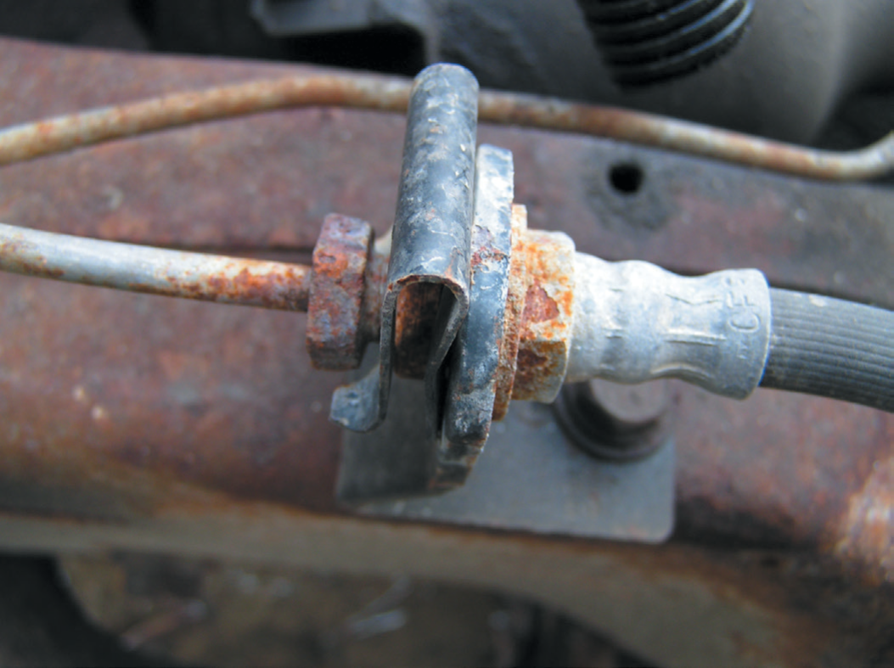
Brake Lines
FIGURE 8–22 Flexible brake hoses are used between the frame or body of the vehicle and the wheel brakes. Because
of suspension and/or steering movement, these flexible brake lines must be strong enough to handle high brake fluid pressures, yet remain flexible.
FIGURE 8–23 (a) Typical flexible brake hose showing the multiple layers of rubber and fabric. (b) The inside diameter (ID) is printed on the hose (3 mm).

Slide 37
Brake Lines
Flexible Brake Hose
Flexible brake hoses are used on each front wheel to allow for steering and suspension movement and at the rear to allow for rear suspension travel.
Flexible brake hose is made from synthetic yarn (poly vinyl alcohol, abbreviated PVA) that is braided into position from multi-end yarn spindles.
By braiding the yarn, all of the strands operate in tension and, therefore, have great strength to withstand braking system pressure over 1,000 PSI (6,900 kPa).
A typical brake hose has an inner tube for moving the brake fluid and a cushion liner that is between the braided layers to prevent the braids from chafing.
An outside jacket is made from rubber and protects the reinforcement fabric from moisture and abrasion.
The outside covering is also ribbed as part of the manufacturing process to hide surface blemishes.
These ribs also make it easy for the technician to see if the hose is twisted.

Slide 38
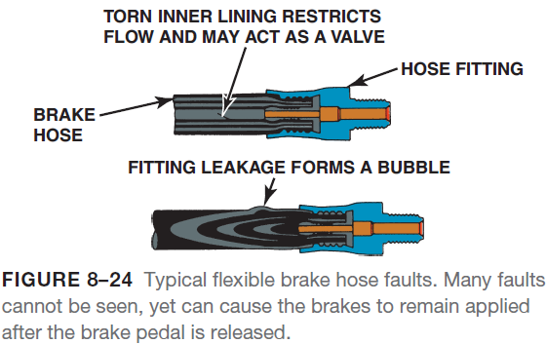
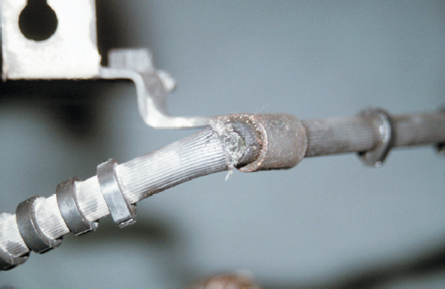
Brake Lines
Flexible Brake Hose
These rubber high-strength hoses can crack, blister, or leak and should be inspected at least every six months.
A constricted brake hose can cause the brakes to remain applied, thereby causing excessive brake pad wear and unequal braking.
A constricted flexible brake line can also cause the vehicle to pull to one side.
FIGURE 8–25 Flexible brake hose should be carefully inspected for cuts or other damage, especially near sections where the brake hose is attached to the vehicle. Notice the crack and cut hose next to the mounting bracket.

Slide 39
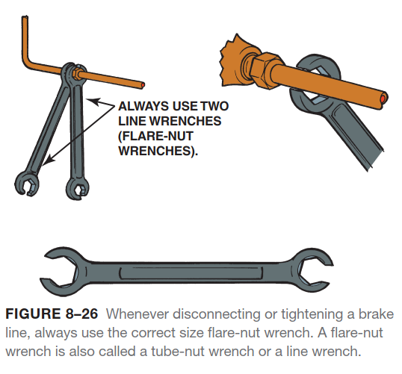
Brake Lines

Slide 40
Summary
Brake fluid is designed to function in the hydraulic brake system under all operating conditions. Brake fluid boiling point is one of the most critical aspects and ratings for brake fluid. As brake fluid ages, it absorbs moisture, which lowers its boiling point and causes increased corrosion of the brake system components.
All automotive brake fluid must meet Federal Motor Vehicle Safety Standard (FMVSS) 116. The Society of Automotive Engineers (SAE) and the Department of Transportation (DOT) have established brake fluid specification standards. Most vehicles use DOT 3 or DOT 4 brake fluid.
Store brake fluid only in its original container.
Rubber products are called elastomers. Some are oil- and grease-resistant elastomers and can be harmed by brake fluid, while others are brake-fluid resistant and can swell or expand if they come in contact with oil or grease.
The steel brake lines are also called brake pipes or brake tubing. Brake lines carry brake fluid from the master cylinder to the wheel cylinder and brake calipers.
All steel brake lines have one of two basic types of ends:
Double flare.
ISO, which means International Standards Organization (also called a ball flare or bubble flare).

Slide 41
Video Links (Internet Access Required)
Brake line flaring (time 8:05)
Tubing flare (time 3:43)
Double flare (time 1:48)
Brake hose (time 3:39)
Brake fluid fill (time 2:19)
Brake fluid contamination check (time 0:41)
How to replace a brake hose (time 7:01)
How to replace a brake line (time 9:17)

