Slide 1
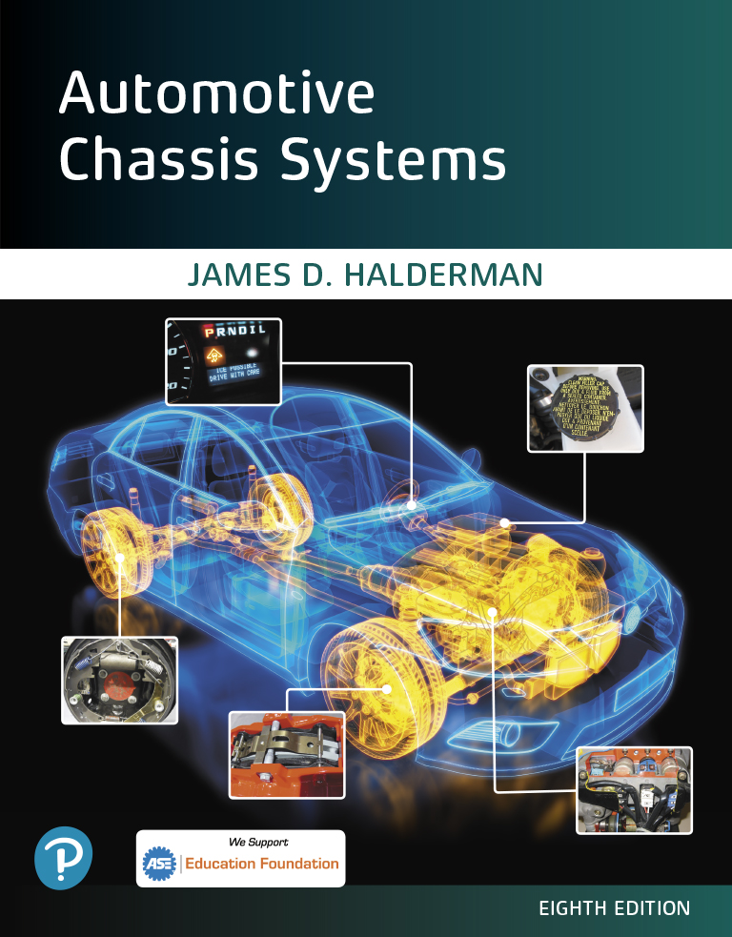
Automotive Chassis Systems Eighth Edition
Chapter 06
Brake Hydraulic Systems
Notes:
If this PowerPoint presentation contains mathematical equations, you may need to check that your computer has the following installed:
1) MathType Plugin
2) Math Player (free versions available)
3) NVDA Reader (free versions available)

Slide 2
Objectives
Explain how the noncompressibility of liquids is used in brake systems.
State Pascal’s law.
Describe the function, purpose, operation, and types of master cylinders.
Describe the process of diagnosing and troubleshooting master cylinders.

Slide 3
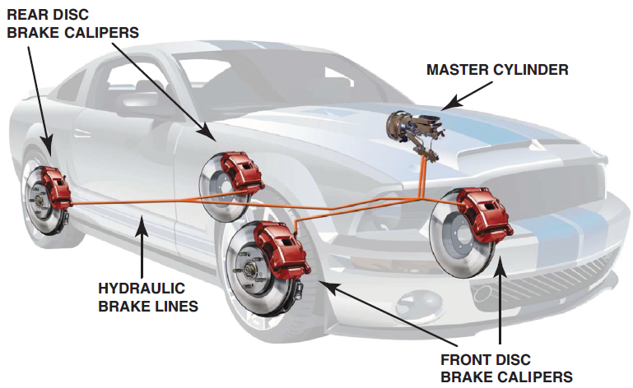
Hydraulic Principles
Need for Hydraulics
In addition to the mechanical advantage provided by leverage at the brake pedal assembly, all vehicles use hydraulic pressure to help increase brake application force.
All braking systems require that a driver’s force is transmitted to the drum or rotor attached to each wheel.
The force that can be exerted on the brake pedal varies due to the strength and size of the driver.
FIGURE 6–1 Hydraulic brake lines transfer the brake effort to each brake assembly attached to all four wheels.

Slide 4
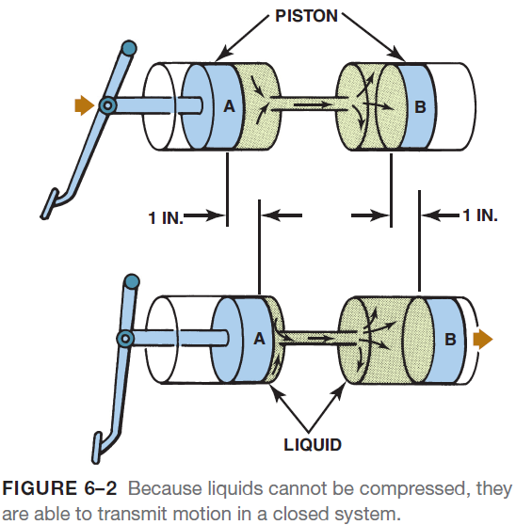
Hydraulic Principles
Noncompressibility of Liquids
Hydraulic systems use liquids to transmit motion.
For all practical purposes, a liquid cannot be compressed.
No matter how much pressure or force is placed on a quantity of liquid, its volume remains the same.
This fact enables liquids in a closed system to transmit motion.
If piston A is moved a distance of 1 inch, the liquid is displaced ahead of it and piston B moves 1 inch as well.
Even though piston A is moved a distance of 1 inch , piston B does not move if the load on it is greater than the pressure of the air in the system.
Even though piston A is moved a distance of 1 inch, piston B does not move if the load on it is greater than the pressure of the air in the system.

Slide 5
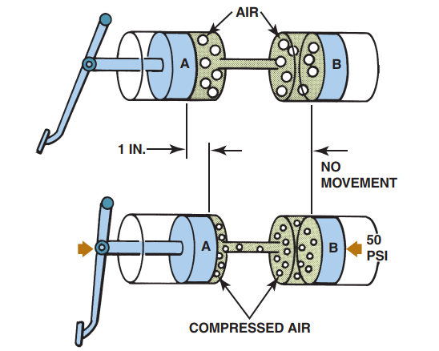
Hydraulic Principles
FIGURE 6–3 Hydraulic system must be free of air to operate properly. If air is in the system, the air is compressed when the brake pedal is depressed and the brake fluid does not transmit the force to the wheel brakes.

Slide 6
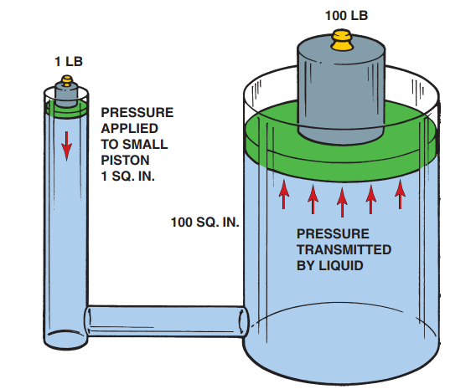
Hydraulic Principles
FIGURE 6–4 A 1-pound force exerted on a small piston in a sealed system transfers the pressure to each square inch throughout the system. In this example, the 1-pound force is able to lift a 100-lb weight because it is supported by a piston
that is 100 times larger in area than the small piston.

Slide 7
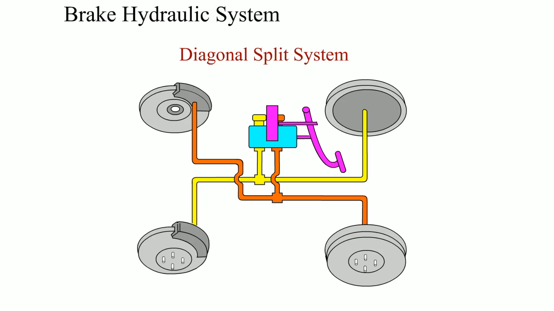
Animation: Brake Hydraulic System (The animation will automatically start in a few seconds)

Slide 8
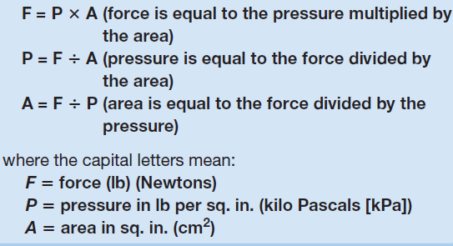
Pascal’s Law
Definition
The hydraulic principles that permit a brake system to function were discovered by a French physicist, Blaise Pascal (1632–1662). Pascal’s law states:
When force is applied to a liquid confined in a container or an enclosure, the pressure is transmitted equally and undiminished in every direction.
Since this force measured in lb or Newtons (N) is applied to a piston with an area measured in square inches (sq. in.), the pressure is the force divided by the area or “10 PSI.”
It is this “pressure” that is transmitted, without loss, throughout the entire hydraulic system

Slide 9
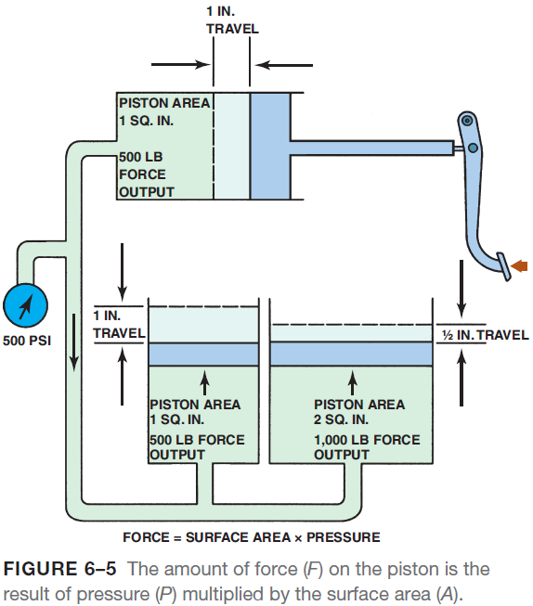
Pascal’s Law
Example of Pascal’s Law
If two out of the three factors are known, then the other one can be calculated by using this formula.
A practical example involves a master cylinder with a piston area of 1 sq. in., one wheel cylinder with an area of 1 sq. in., and one wheel cylinder with a piston area of 2 sq. in.
Brake Hydraulic Forces
The real “magic” of a hydraulic brake system is the fact that different forces can be created at different wheel cylinders.
More force is necessary for front brakes than for rear brakes because, as the brakes are applied, the weight of the vehicle moves forward.

Slide 10
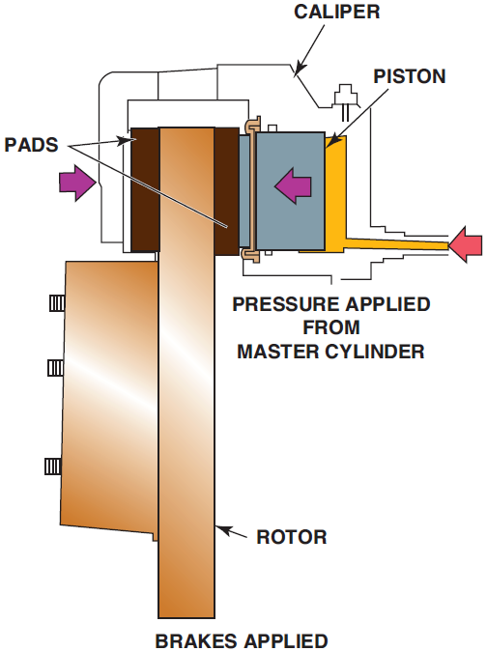
Pascal’s Law
Brake Hydraulic Forces
Larger (area) pistons are used in brake calipers on the front wheels to increase the force used to apply the front brakes.
Not only can hydraulics act as a “force machine” (by varying piston size), but the hydraulic system also can be varied to change piston stroke distances.
With a drum brake, the wheel cylinder expands and pushes the brake shoes against a brake drum.
With a disc brake, brake fluid pressure pushes on the piston in the caliper a small amount and causes a clamping of the disc brake pads against both sides of a rotor (disc).
FIGURE 6–6 The brake pad (friction material) is pressed on both sides of the rotating rotor by the hydraulic pressure of the caliper.

Slide 11
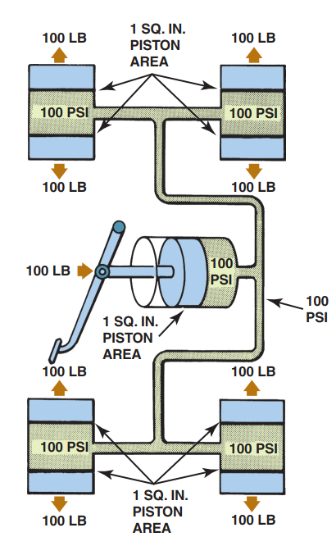
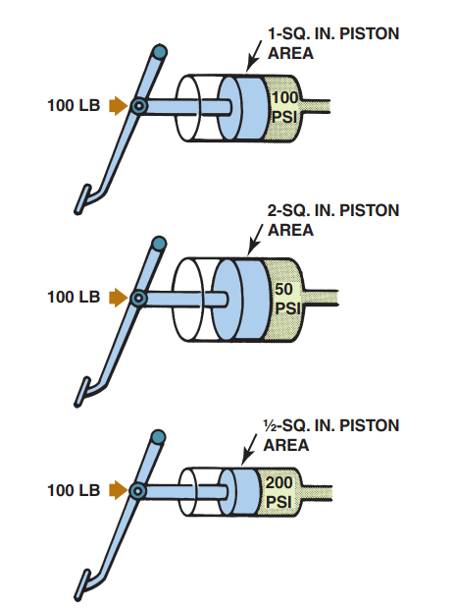
Pascal’s Law
FIGURE 6–7 Mechanical force and the master cylinder piston area determine the hydraulic pressure in the brake system.
FIGURE 6–8 Hydraulic pressure is the same throughout a closed system and acts with equal force on equal areas.

Slide 12
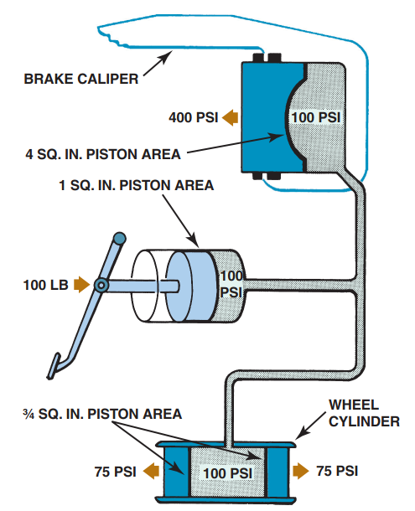
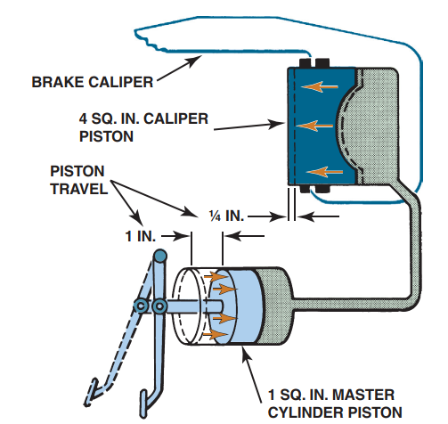
Pascal’s Law
FIGURE 6–9 Differences in brake caliper and wheel cylinder piston area have a major effect on brake application force.
FIGURE 6–10 The increase in application force created by the large brake caliper piston is offset by a decrease in piston travel.

Slide 13
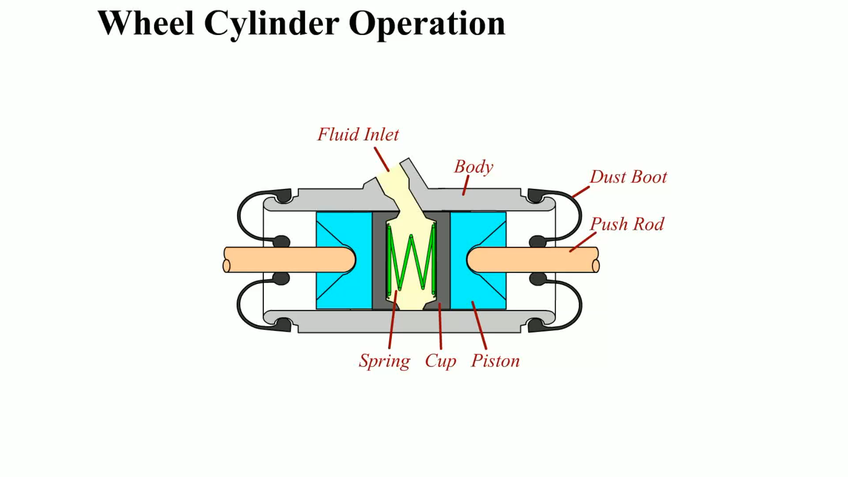
Animation: Wheel Cylinder Operation (The animation will automatically start in a few seconds)

Slide 14



Pascal’s Law
Hydraulic Pressure and Piston Size
If a mechanical force of 100 lb is exerted by the brake pedal pushrod onto a master cylinder piston with 1 sq. in. of surface area, the equation reads as follows:
Z
The result in this case is 100 PSI of brake system hydraulic pressure.
However, if the same 100 lb force is applied to a master cylinder piston with twice the area (2 sq. in.), the equation reads as follows:
Doubling the area of the master cylinder piston cuts the hydraulic system pressure in half.
Conversely, if the same 100 lb force is applied to a master cylinder piston with only half the area (0.5 or ½ sq. in.), the equation shows that the system pressure is doubled:

Slide 15
Pascal’s Law
Application Force and Piston Size
While the size of the master cylinder piston affects the hydraulic pressure of the entire brake system, weight shift and bias require that the heavily loaded front brakes receive much higher application force than the lightly loaded rear brakes.
However, when equal pressure acts on unequal areas, as with different-sized pistons, the brake application force differs as well.
The mechanical force ( F) at the brake pedal pushrod is applied to the master cylinder piston area (A) and converted into brake system hydraulic pressure (P).
Brake calipers and wheel cylinders perform exactly the opposite.
Because the variables are identical, the same equation can be rewritten to explain how changes in piston size affect brake application force.
P x A = F
It is piston surface area, not diameter, that affects force.
In the simple brake system, the pedal and linkage apply a 100 lb force on a master cylinder piston with an area of 1 sq. in.

Slide 16
Pascal’s Law
Application Force a
If the hydraulic system pressure remains 100 PSI, the equation for this example is as follows:
100 PSI ∙ 0.75 sq. in. = 75 lb
Just as larger pistons increase application force, this example shows that smaller pistons decrease it.
The system hydraulic pressure remains 100 PSI at all points, but the smaller piston is unable to transmit all of the available pressure.
As a result, the mechanical application force is reduced to only 75 lb.
Piston Size Versus Piston Travel
In disc brakes, the mechanical force available to apply the brakes is four times greater because of the size difference between the master cylinder and caliper pistons.
Some of the hydraulic energy is converted into increased mechanical force.
The trade-off is that the larger caliper piston with the greater force does not move as far as the smaller master cylinder piston.
The amount of hydraulic energy converted into mechanical motion is decreased.

Slide 17
Pascal’s Law
Hydraulic Principles and Brake Design
When a brake system is designed, the hydraulic relationships play a major part in determining the sizes of the many pistons within the system.
The piston sizes selected must move enough fluid to operate the wheel cylinder and brake caliper pistons through a wide range of travel, while, at the same time, they must create enough application force to lock the wheel brakes.
The piston sizes chosen should also provide the driver with good brake pedal “feel” so the brakes are easy to apply in a controlled manner.
Master cylinders are designed with pistons that are large enough to move the required volume of fluid and a power booster to reduce the required brake pedal force.

Slide 18
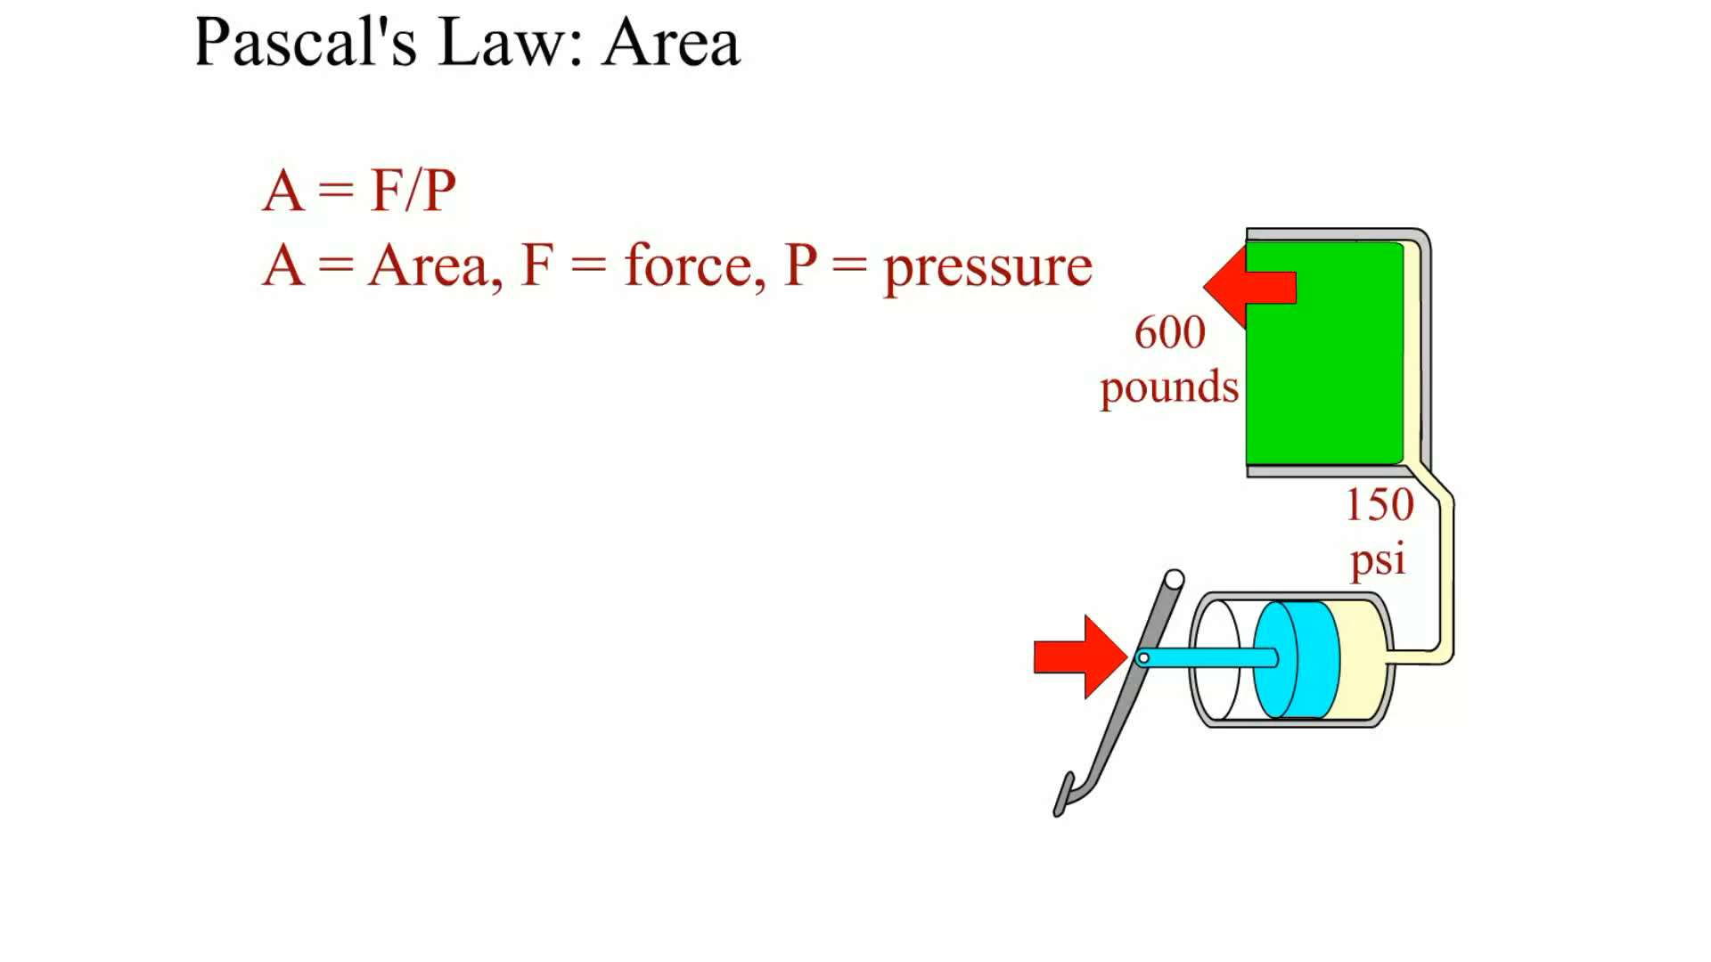
Animation: Pascal’s Law: Area (The animation will automatically start in a few seconds)

Slide 19
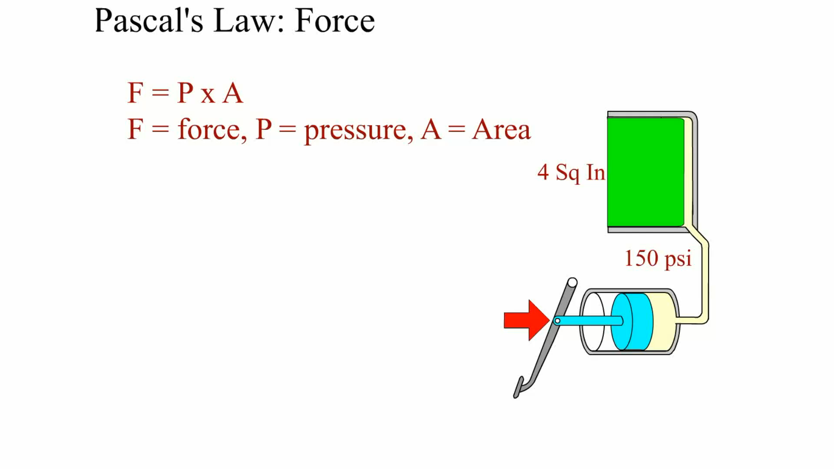
Animation: Pascal’s Law: Force (The animation will automatically start in a few seconds)

Slide 20
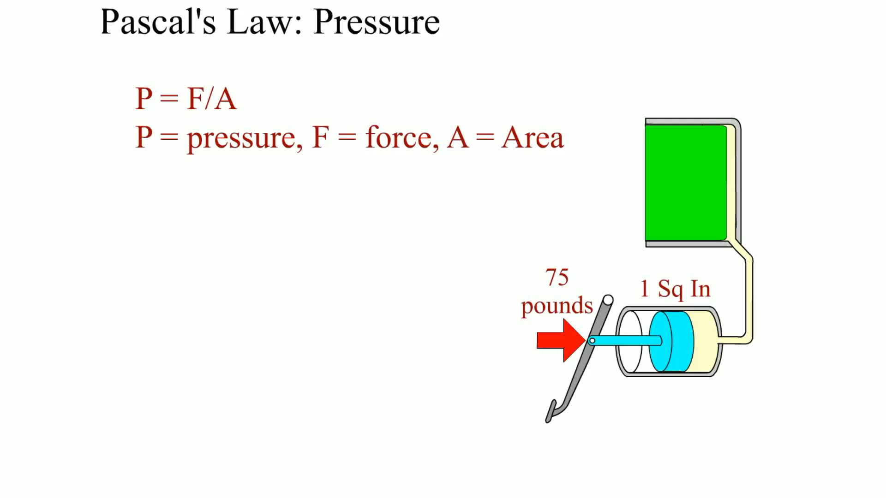
Animation: Pascal’s Law: Pressure (The animation will automatically start in a few seconds)

Slide 21
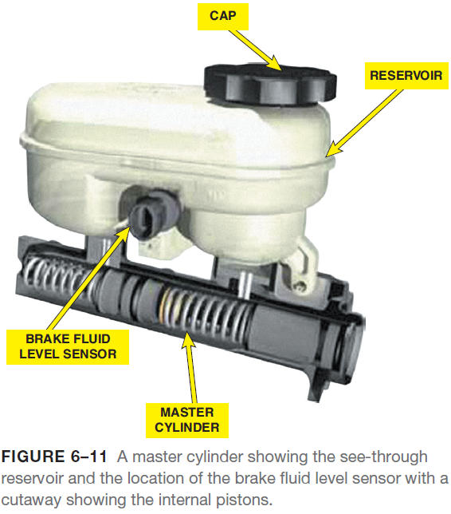
Master Cylinders
Purpose and Function
The master cylinder is the heart of the entire braking system.
No braking occurs until the driver depresses the brake pedal.
The brake pedal linkage is used to apply the force of the driver’s foot into a closed hydraulic system.
Master Cylinder Reservoirs
Most vehicles built since the early 1980s are equipped with see-through master cylinder reservoirs, which permit owners and service technicians to check the brake fluid level without having to remove the top of the reservoir.

Slide 22
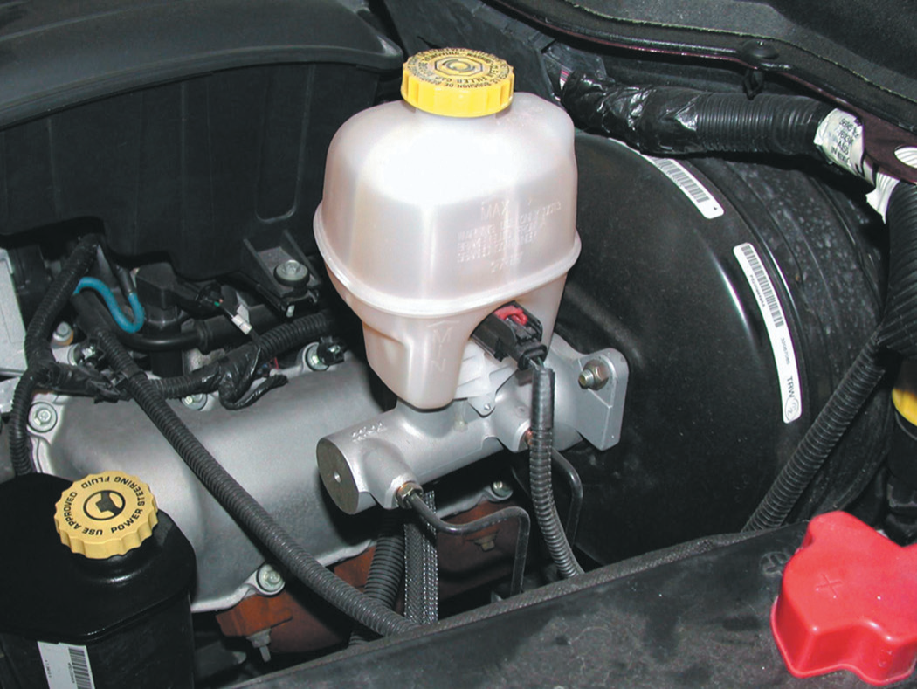
Master Cylinders
FIGURE 6–12 Master cylinder with brake fluid level at the
“max” (maximum) line.

Slide 23
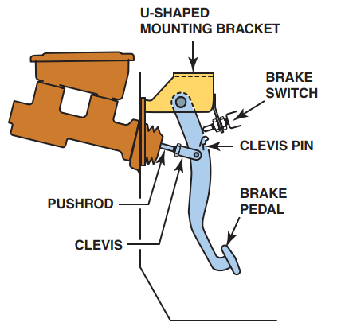
Master Cylinders
FIGURE 6–13 The typical brake pedal is supported by a
mount and attached to the pushrod by a u-shaped bracket. The pin used to retain the clevis to the brake pedal is usually called a clevis pin.

Slide 24
Master Cylinders
Master Cylinders Reservoirs
The reservoir capacity is great enough to allow for the brakes to become completely worn out and still have enough reserve for safe operation.
The typical capacity of the entire braking system is usually 2 to 3 pints (1 to 1.5 L).
Master Cylinder Reservoir Diaphragm
The entire brake system is filled with brake fluid up to the “full” level of the master cylinder reservoir.
The reservoir is vented to the atmosphere so the fluid can expand and contract without difficulty, as would be the case if the reservoir were sealed.
To help reduce the moisture from getting in contact with the brake fluid, master cylinders use a rubber diaphragm or floating disc to help seal outside air from direct contact with brake fluid.

Slide 25
Master Cylinders
Master Cylinder Operation
The master cylinder is the heart of any hydraulic braking system.
Brake pedal movement and force are transferred to the brake fluid and directed to wheel cylinders or calipers.
The master cylinder is also separated into two pressure building chambers (or circuits) to provide braking force to one-half of the brake in the event of a leak or damage to one circuit.
Both pressure-building sections of the master cylinder contain two holes from the reservoir. According to the Society of Automotive Engineers (SAE), the terms used include:
The forward (tapered) high pressure hole is the vent port, also called the compensating port.
The rearward straight drilled low pressure hole is called the replenishing port, also called the inlet port, bypass port, filler port, or the breather port.

Slide 26
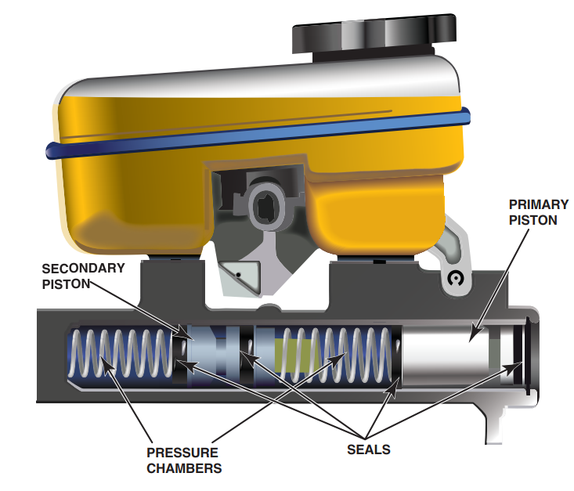
Master Cylinders
FIGURE 6–14 A cutaway of a master
cylinder. The reservoir feeds both chambers and uses a fluid level switch that activates the
red brake warning lamp if the brake fluid level drops too low.

Slide 27
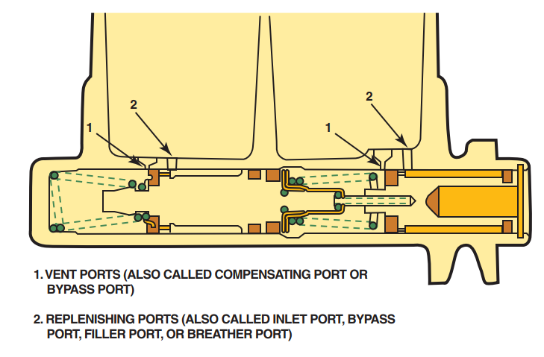
Master Cylinders
FIGURE 6–15 Note the various names for the vent port (front port) and the replenishing port (rear port). Names vary by vehicle and brake component manufacturer. Vent port and replenishing port are the terms
recommended by the Society of Automotive Engineers (SAE).

Slide 28
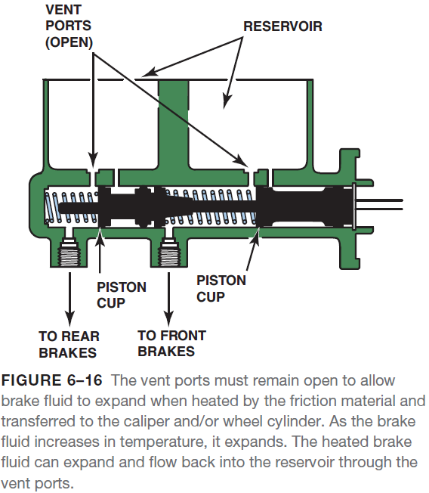
Master Cylinders
Master Cylinder Operation
AT-REST POSITION. The primary sealing cups are between the compensating port hole and the inlet port hole.
In this position, the brake fluid is free to expand and move from the calipers, wheel cylinders, and brake lines up into the reservoir through the vent port (compensation port) if the temperature rises and the fluid expands.

Slide 29
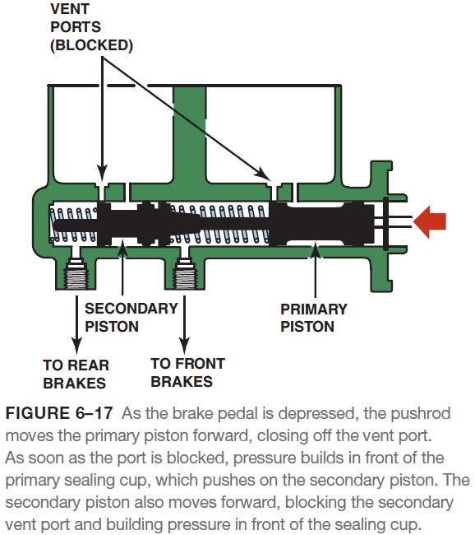
Master Cylinders
Master Cylinder Operation
Applied Piston. When the brake pedal is depressed, the pedal linkage forces the pushrod and primary piston down the bore of the master cylinder.
As the piston moves forward, the primary sealing cup covers and blocks off the vent port (compensating port).
Hydraulic pressure builds in front of the primary seal as the pushrod moves forward.
The back of the piston is kept filled through the replenishing port.
This stops any suction (vacuum) from forming behind the piston.
The secondary piston is moved forward as pressure is exerted by the primary piston.

Slide 30
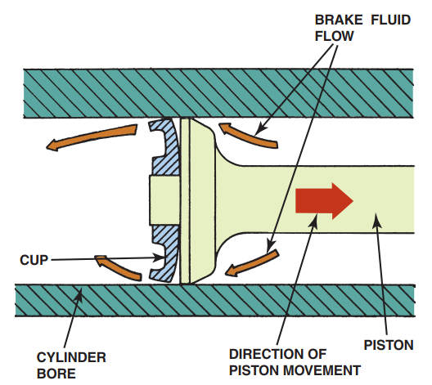
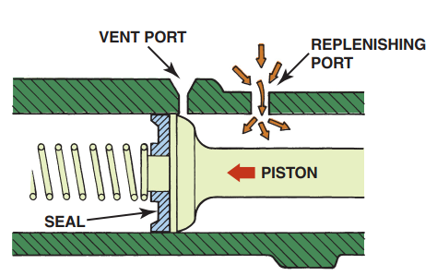
Master Cylinders
FIGURE 6–18 The purpose of the replenishing port is to keep the volume behind the primary piston filled with brake fluid from the reservoir as the piston moves forward during a brake application.
FIGURE 6–19 When the brake pedal is released, the master cylinder piston moves rearward. Some of the brake fluid is pushed back up through the replenishing port, but most of the fluid flows past the sealing cup. Therefore, when the driver pumps the brake pedal, the additional fluid in front of the pressure-building sealing cup is available quickly.

Slide 31
Master Cylinders
Master Cylinder Operation
RELEASED POSITION. Releasing the brake pedal removes the pressure on the pushrod and master cylinder pistons.
A spring on the brake pedal linkage returns the brake pedal to its normal at-rest (up) position. The spring in front of the master cylinder piston expands, pushing the pistons rearward.
At the same time, pressure is released from the entire braking system and the released brake fluid pressure is exerted on the master cylinder pistons, forcing them rearward.
As the piston is pushed back, the lips of the seal fold forward, allowing fluid to quickly move past the piston.
Front/rear Split Master Cylinders
Front/rear split master cylinders use two separate pressure-building sections.
One section operates the front brakes and the other section operates the rear brakes on vehicles equipped with a front/rear-split system.

Slide 32
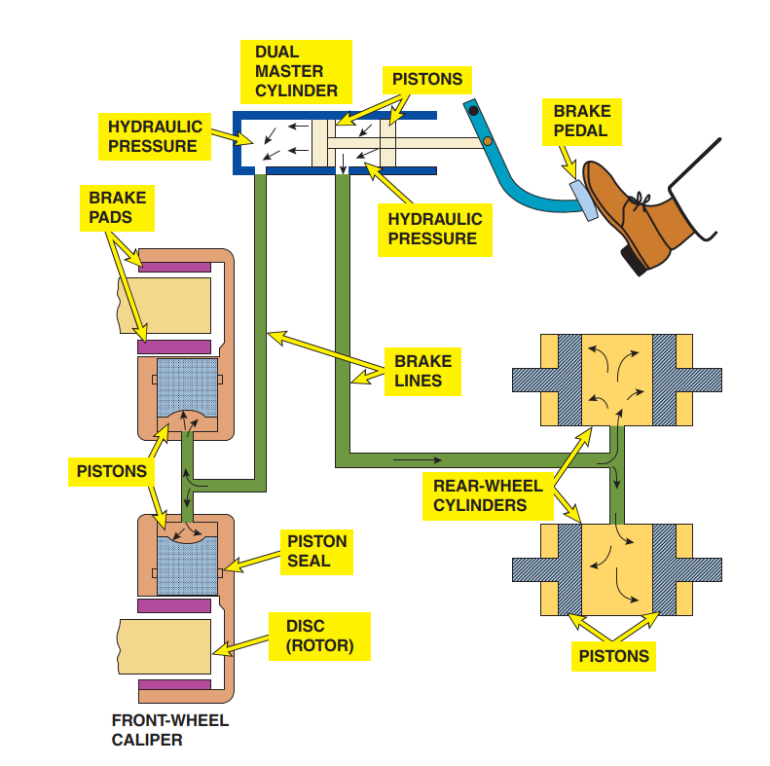
Master Cylinders
FIGURE 6–20 Rear-wheel-drive
vehicles use a dual split master cylinder.

Slide 33
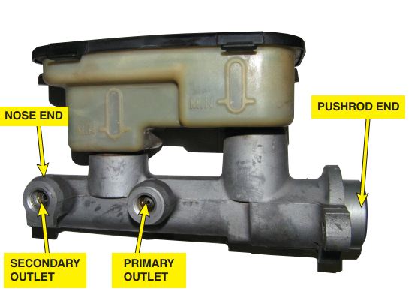
Master Cylinders
FIGURE 6–21 The primary outlet is closest to the pushrod
end of the master cylinder and the secondary outlet is closest to the nose end of the master cylinder.

Slide 34
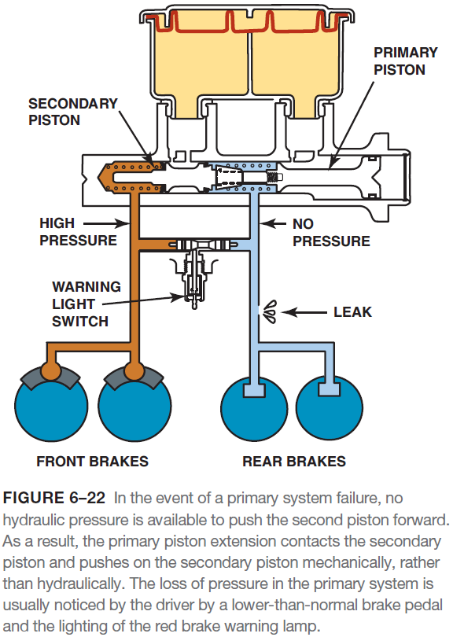
Master Cylinders
Hydraulic Failure
If the rear section of the hydraulic system fails, the primary piston does not build pressure to operate the secondary piston.
To permit the operation of the secondary piston (nose end piston) in the event of a hydraulic failure of the rear section, the primary piston extension mechanically contacts and pushes on the secondary piston.
If there is a failure of the front-section hydraulic system, the primary piston (pushrod end) operates normally and exerts pressure on the secondary piston.

Slide 35
Master Cylinders
Diagonal Split Master Cylinders
With front wheel- drive vehicles, the weight of the entire power train is on the front wheels and 80% to 90% of the braking force is achieved by the front brakes.
This means that only 10% to 20% of the braking force is being handled by the rear brakes.
The solution is the use of a diagonal split master cylinder.
In a diagonal split braking system, the left front brake and the right rear brake are on one circuit, and the right front with the left rear is another circuit of the master cylinder.
If one circuit fails, the remaining circuit can still stop the vehicle in a reasonable fashion because each circuit has one front brake.
To prevent this one front brake from causing the vehicle to pull toward one side during braking, the front suspension is designed with negative scrub radius geometry.

Slide 36
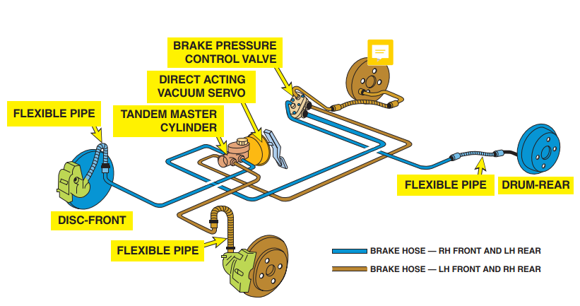
Master Cylinders
FIGURE 6–23 Front-wheel-drive vehicles use a diagonal split master cylinder. In this design, one section of the master cylinder operates the right front and the left rear brake and the other section operates the left front and right rear. In the event of a failure in one section, at least one front brake still functions.

Slide 37
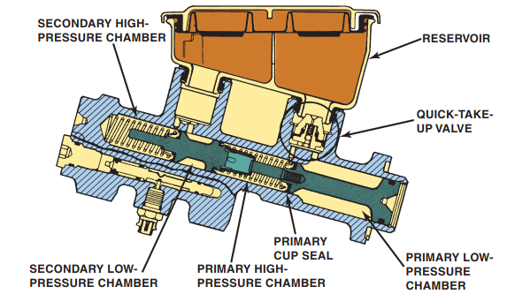
Master Cylinders
FIGURE 6–24 Quick take-up master cylinder can be
identified by the oversize primary low-pressure chamber.

Slide 38
Master Cylinders
Quick Take-Up Master Cylinders
Some vehicles use low-drag disc brake calipers to increase fuel economy.
However, due to the larger distance between the rotor and the friction pads, excessive brake pedal travel is required before the pads touched the rotor.
The solution to this problem is a master cylinder design that can take up this extra clearance.
The design of a quick take-up master cylinder includes a larger diameter primary piston (low-pressure chamber) and a quick take-up valve.
A spring-loaded check ball valve holds pressure on the brake fluid in the large diameter rear chamber of the primary piston.
When the brakes are first applied, the movement of the rear larger piston forces this larger volume of brake fluid forward past the primary piston seal and into the primary high-pressure chamber.
At 70 to 100 PSI, the check ball valve in the quick take-up valve allows fluid to return to the brake fluid reservoir.
Because the quick take-up “works” until 100 PSI is reached, a metering valve is not required to hold back the fluid pressure to the front brakes.

Slide 39
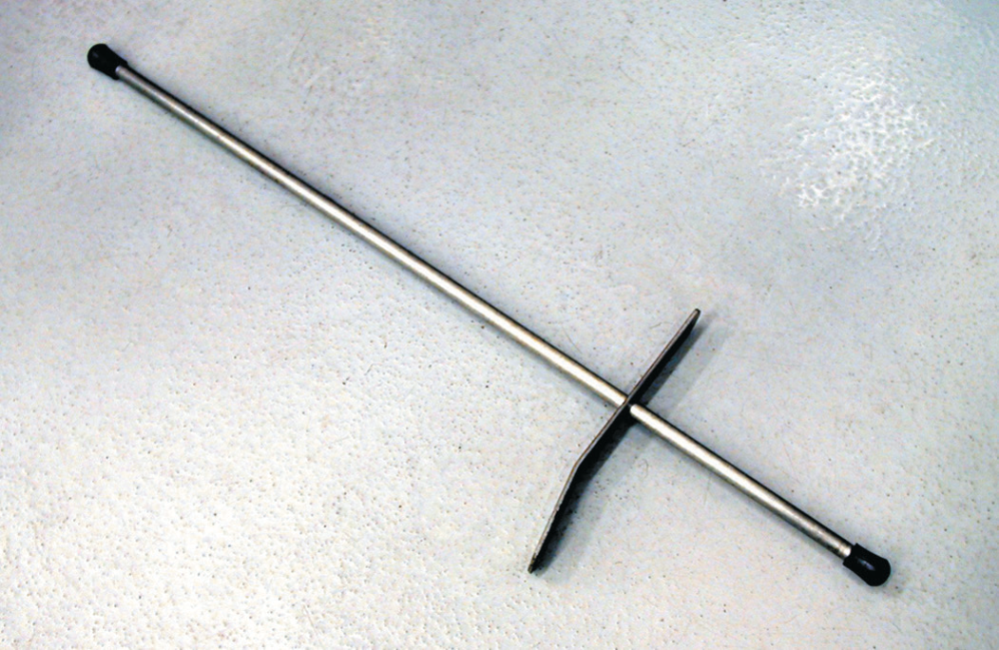
Master Cylinders
FIGURE 6–25 A brake pedal depressor like this can be
used during brake service to block the flow of brake
fluid from the master cylinder during service work on the
hydraulic system.

Slide 40
Diagnosing Master Cylinders
Visual Inspection
A thorough visual inspection is important when inspecting any master cylinder. The visual inspection should include checking the following items:
Check the brake fluid for proper level and condition. Brake fluid should not be rusty, thick, or contaminated.\
Check that the vent holes in the reservoir cover are open and clean.
Check that the reservoir cover diaphragm is not torn or enlarged.
Check for any external leaks at the lines or at the pushrod area.
Brake Pedal Height
Proper brake pedal height is important for the proper operation of the stop (brake) light switch.
If the pedal is not correct, the pushrod may be in too far forward, preventing the master cylinder cups from uncovering the compensation port.
If the pedal is too high, the free play is excessive.

Slide 41
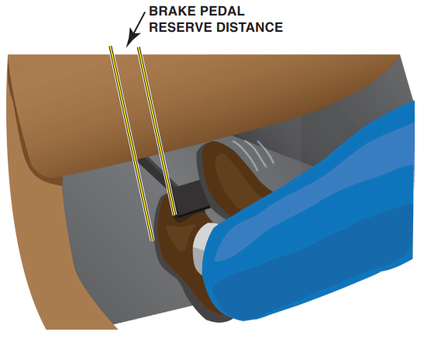
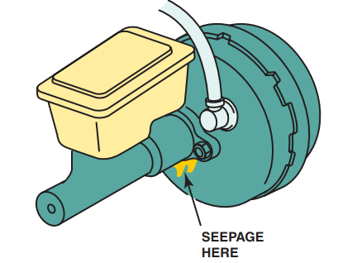
Diagnosing Master Cylinders
FIGURE 6–27 Pedal height is usually measured from
the floor to the top of the brake pedal. Always follow
the manufacturer’s recommended procedures and
measurements.
FIGURE 6–26 Seepage at the booster indicates a leaking secondary (end) seal.

Slide 42
Diagnosing Master Cylinders
Brake Pedal Free Play
Pedal free play is the distance the brake pedal travels before the primary piston in the master cylinder moves.
Brake Pedal Travel
A more accurate measurement is obtained using a pedal pressure gauge and ruler, following these steps:
STEP 1 With the ignition off, pump the brake pedal until it becomes firm (depletes power booster reserve).
STEP 2 Measure and record the distance from the brake pedal to the lower rim of the steering wheel
STEP 3 Apply the brakes with 100 pounds of pressure. Use a brake pedal pressure gauge, if available, to help ensure accurate test results.
STEP 4 While holding the pedal with 100 pounds of force, measure and record the distance from the pedal to the lower rim of the steering wheel.
STEP 5 Subtract the applied measurement from the unapplied measurement to get the total travel.
Compare the pedal travel with the specification found in service information.

Slide 43
Diagnosing Master Cylinders
Master Cylinder Symptoms
Some common master cylinder fault symptoms include:
Spongy brake pedal. A spongy pedal with a larger-than-normal travel indicates air in the lines.
Lower-than-normal brake pedal. A brake pedal that travels downward more than normal and then gets firm is an indication that one circuit of the dual-circuit hydraulic system is probably not working.
Sinking brake pedal. If the brake pedal sinks all the way to the floor especially when the vehicle is not moving, suspect a defective master cylinder that is leaking internally.

Slide 44
Master Cylinder Service
Purpose for Service
Many master cylinders can be disassembled, cleaned, and restored to service.
Disassembly is most commonly done for diagnostic purposes.
Disassembly Procedure
The disassembly of a master cylinder usually includes the following steps:
STEP 1 Remove the master cylinder from the vehicle, being careful to avoid dripping or spilling brake fluid onto painted surfaces of the vehicle.
STEP 2 Remove the reservoir, if possible, as shown in
STEP 3 If used, remove the retaining bolt that holds the secondary piston assembly in the bore.
STEP 4 Depress the primary piston with a blunt tool, such as a Phillips screwdriver, a rounded wooden dowel, or an engine pushrod.
STEP 5 Remove the snap ring and slowly release the pressure on the depressing tool.
STEP 6 Remove the master cylinder from the vise and tap the open end of the bore against the top of a workbench to force the secondary piston out of the bore.

Slide 45
Master Cylinder Service
Inspection of the Master Cylinder
Most cast-iron master cylinders cannot be honed because of the special surface finish that is applied to the bore during manufacturing.
Slight corrosion or surface flaws can usually be removed with a hone or crocus cloth.
Aluminum master cylinders cannot be honed.
Aluminum master cylinders have an anodized surface coating applied that is hard and wear-resistant.
Honing removes this protective coating.

Slide 46
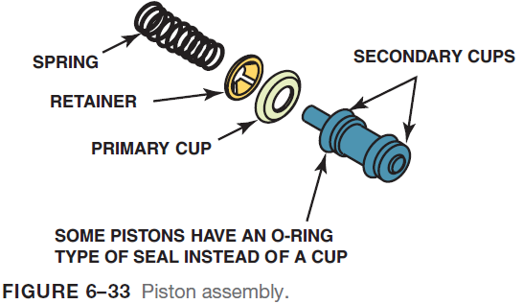
Master Cylinder Service
Reassembly of the Master Cylinder
To reassemble a master cylinder, perform the following steps:
STEP 1 Install the secondary (smaller) piston assembly into the bore, spring end first.
STEP 2 Install the primary piston assembly, spring end first.
STEP 3 Depress the primary piston and install the snap ring.
STEP 4 Install the secondary piston retaining bolt, if used.
STEP 5 Reinstall the plastic reservoir.

Slide 47
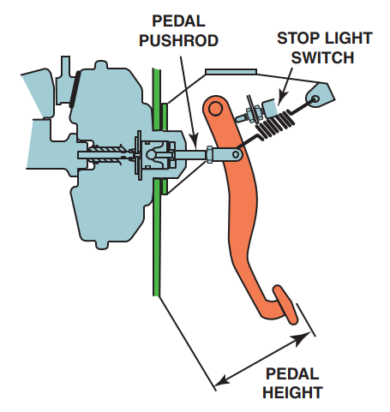
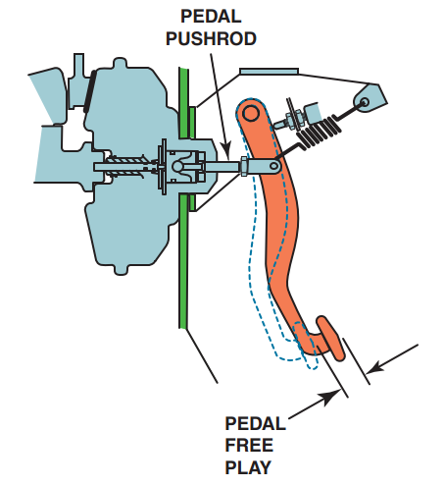
Master Cylinder Service
FIGURE 6–28 Pedal height is usually measured from the floor to the top of the brake pedal. Always follow the manufacturer’s recommended procedures and measurements.
FIGURE 6–29 Brake pedal free play is the distance between the brake pedal fully released and the position of the brake pedal when braking resistance is felt.

Slide 48
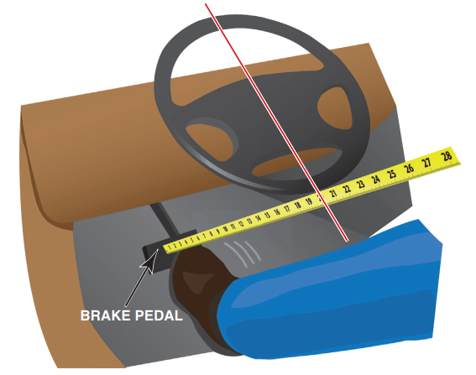
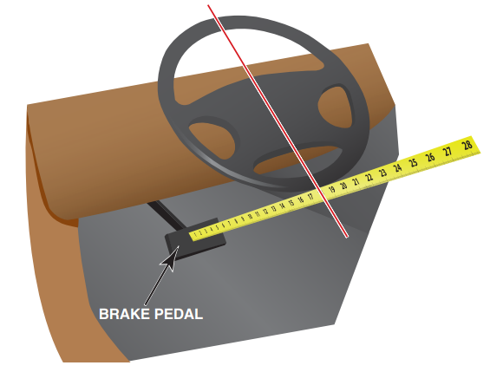
Master Cylinder Service
FIGURE 6–30 Measure the unapplied distance between the brake pedal and the steering wheel.
FIGURE 6–31 Apply the brakes and measure the distance again.

Slide 49
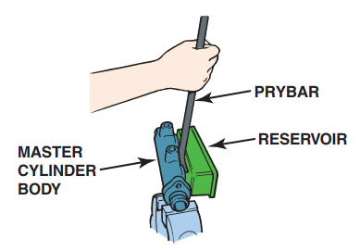
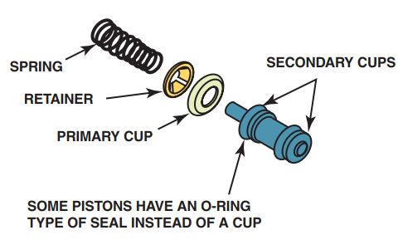
Master Cylinder Service
FIGURE 6–32 use a pry bar to carefully remove the reservoir from the master cylinder.
FIGURE 6–33 Piston assembly.

Slide 50
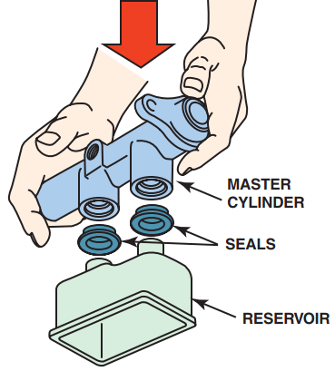
Master Cylinder Service
FIGURE 6–34 To reinstall the reservoir onto a master
cylinder, place the reservoir on a clean flat surface and
push the housing down onto the reservoir, after coating the rubber seals with brake fluid.

Slide 51
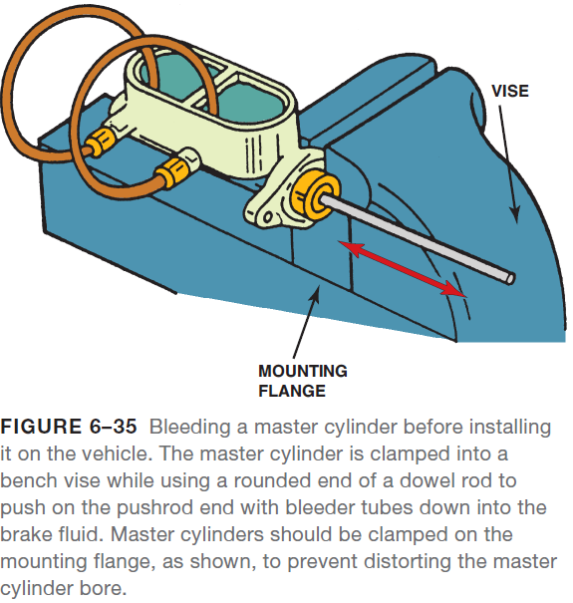
Master Cylinder Service
Reassembly of the Master Cylinder
STEP 6 Bench bleed the master cylinder.
Installing the Master Cylinder
After the master cylinder has been bench bled, it can be installed in the vehicle.
Tighten the fasteners to factory specifications.
Bleed the system as needed.

Slide 52
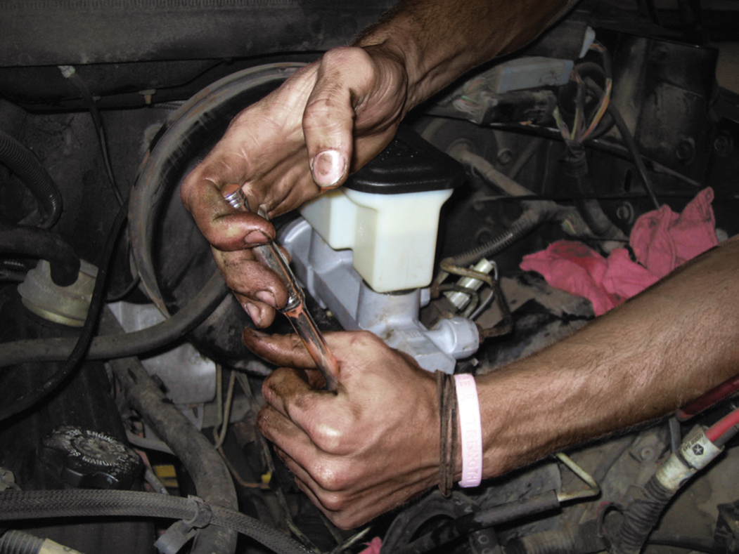
Master Cylinder Service
NOTE: Brake fluid can drip from the outlet of the master cylinder and could drip onto the vehicle. Brake fluid is very corrosive and can remove paint. Use fender covers and avoid letting brake fluid touch any component of the vehicle. ● SEE FIGURE 6–36.
FIGURE 6–36 Installing a master cylinder. Always tighten the retaining fasteners and brake lines to factory specifications.

Slide 53
Summary
Hydraulic systems use liquids to transmit motion. For all practical purposes, a liquid cannot be compressed. No matter how much pressure or force is placed on a quantity of liquid, its volume remains the same. This fact enables liquids in a closed system to transmit motion.
Blaise Pascal (1632–1662). Pascal’s law states: When force is applied to a liquid confined in a container or an enclosure, the pressure is transmitted equally and undiminished in every direction.
The master cylinder is the heart of the entire braking system. No braking occurs until the driver depresses the brake pedal. The brake pedal linkage is used to apply the force of the driver’s foot into a closed hydraulic system.
Thorough visual inspection is important when inspecting any master cylinder.
After the master cylinder has been bench bled, it can be installed in the vehicle. Tighten the fasteners to factory specifications. Bleed the system as needed.

Slide 54
Video Links (Internet Access Required)
Master cylinder bleeding (time 8:02)
Master cylinder installation (time 4:50)
Hydraulic brakes part 1 (time 24:44)
Master cylinder replacement (time 9:57)
Wheel cylinder (time 1:12)
Master cylinder (time 3:15)
Bench bleed a master cylinder (time 2:17)
Pascal’s Law (time 4:46)
Brake Pressure Concerns (time 4:02)

Slide 55
Video Links (Internet Access Required)
Brake pedal play (time 1:47)
Master cylinder leak test (time 4:05)
Brake warning light components (time 3:12)
Master cylinder pushrod length (time 9:36)

