Slide 1
Automotive Chassis Systems Eighth Edition
Chapter 03
Environmental and Hazardous Materials
Notes:
If this PowerPoint presentation contains mathematical equations, you may need to check that your computer has the following installed:
1) MathType Plugin
2) Math Player (free versions available)
3) NVDA Reader (free versions available)

Slide 2
Objectives
Identify hazardous waste materials in accordance with state and federal regulations, and follow proper safety precautions while handling hazardous materials.
Define the Occupational Safety and Health Act (OSHA).
Explain the term “safety data sheets (SDS).”
Define the steps required to safely handle and store automotive chemicals and waste.

Slide 3
Hazardous Waste
Definition of Hazardous Waste
Hazardous waste materials are chemicals, or components, that the shop no longer needs and that pose a danger to the environment and people if they are disposed of in ordinary garbage cans or sewers.
Personal Protective Equipment (PPE)
When handling hazardous waste material, always wear the proper protective clothing and equipment detailed in the right-to-know laws.
This includes respirator equipment.

Slide 4
Federal and State Laws
Occupational Safety and Health Act
The U.S. Congress passed the Occupational Safety and Health Act (OSHA) in 1970.
This legislation was designed to assist and encourage the citizens of the United States in their efforts to assure the following:
Safe and healthful working conditions by providing research, information, education, and training in the field of occupational safety and health.
Safe and healthful working conditions by authorizing enforcement of the standards developed under the act.
Because about 25% of workers are exposed to health and safety hazards on the job, OSHA standards are necessary to monitor, control, and educate workers regarding health and safety in the workplace.

Slide 5
Federal and State Laws
EPA
The Environmental Protection Agency (EPA) publishes a list of hazardous materials that is included in the Code of Federal Regulations (CFR).
The EPA considers waste hazardous if it is included on the EPA list of hazardous materials, or it has one or more of the following characteristics:
Reactive—Any material that reacts violently with water or other chemicals is considered hazardous.
Corrosive—If a material burns the skin, or dissolves metals and other materials, a technician should consider it hazardous.
A pH scale is used, with number 7 indicating neutral.
Toxic—Materials are hazardous if they leak one or more of eight different heavy metals in concentrations greater than 100 times the primary drinking water standard.
Ignitable—A liquid is hazardous if it has a flash point below 140°F (60°C), and a solid is hazardous if it ignites spontaneously.
Radioactive—Any substance that emits measurable levels of radiation is radioactive.

Slide 6
Federal and State Laws
Right-To-Know Laws
The right-to-know laws state that employees have a right to know when the materials they use at work are hazardous.
The right-to-know laws started with the Hazard Communication Standard published by the Occupational Safety and Health Administration (OSHA) in 1983.
SAFETY DATA SHEETS (SDS). All hazardous materials must be properly labeled, and information about each hazardous material must be posted on safety data sheets (SDS), formally called material safety data sheets (MSDS), available from the manufacturer.
The employer has a responsibility to place MSDS information where it is easily accessible by all employees.
The data sheets provide the following information about the hazardous material: chemical name, physical characteristics, protective handling equipment, explosion/fire hazards, incompatible materials, health hazards, medical conditions aggravated by exposure, emergency and first aid procedures, safe handling, and spill/leak procedures.

Slide 7
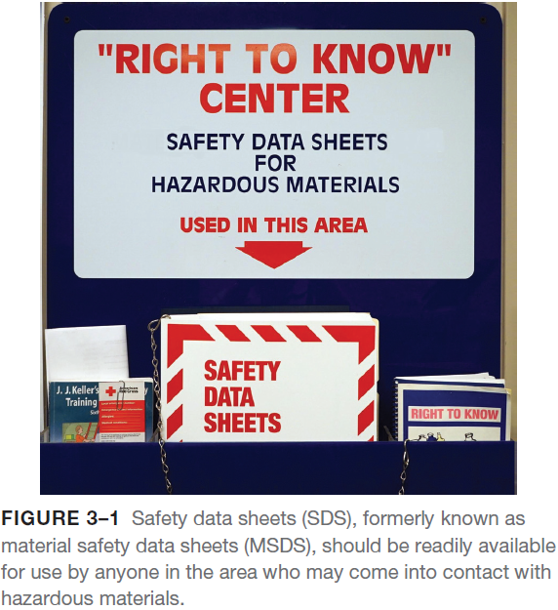
Federal and State Laws
Right-To-Know Laws
The employer also has a responsibility to make sure that all hazardous materials are properly labeled.
The label information must include health, fire, and reactivity hazards posed by the material, as well as the protective equipment necessary to handle the material.
The manufacturer must supply all warning and precautionary information about hazardous materials.
This information must be read and understood by the employee before handling the material.

Slide 8
Federal and State Laws
Research Conservation and Recovery Act
Federal and state laws control the disposal of hazardous waste materials and every shop employee must be familiar with these laws.
Hazardous waste disposal laws include the Resource Conservation and Recovery Act (RCRA).
This law states that hazardous material users are responsible for hazardous materials from the time they become a waste until the proper disposal is completed.
The RCRA controls the following types of automotive waste:
Paint and body repair products waste
Solvents for parts and equipment cleaning
Batteries and battery acid
Mild acids used for metal cleaning and preparation
Waste oil and engine coolants or antifreeze
Air-conditioning refrigerants and oils
Engine oil filters

Slide 9
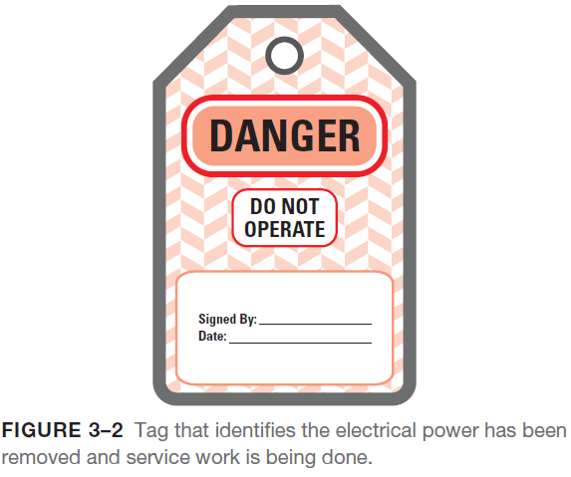
Federal and State Laws
Lockout/Tagout
According to OSHA Title 29, Code of Federal Regulations (CPR), part 1910.147, machinery must be locked out to prevent injury to employees when maintenance or repair work is being performed.
Any piece of equipment that should not be used must be tagged and the electrical power disconnected to prevent it from being used.
Always read, understand, and follow all safety warning tags.
Clean Air Act
Air-conditioning (A/C) systems and refrigerant are regulated by the Clean Air Act (CAA), Title VI, Section 609.
Technician certification and service equipment is also regulated.
Any technician working on automotive A/C systems must be certified.

Slide 10
Federal and State Laws
Asbestos Hazards
Friction materials, such as brake and clutch linings, often contain asbestos.
Asbestos exposure can cause scar tissue to form in the lungs.
This condition is called asbestosis.
It gradually causes increasing shortness of breath, and scarring to the lungs is permanent.
Even low exposures to asbestos can cause mesothelioma, a type of fatal cancer of the lining of the chest or abdominal cavity
Government agencies recommend that asbestos exposure should be eliminated or controlled to the lowest level possible.
These agencies have developed recommendations and standards that the automotive service technician and equipment manufacturer should follow.

Slide 11
Federal and State Laws
Asbestos OSHA Standards
The Occupational Safety and Health Administration has established three levels of asbestos exposure.
Any vehicle service establishment that does either brake or clutch work must limit employee exposure to asbestos to less than 0.2 fibers per cubic centimeter (cc) as determined by an air sample.
If the level of exposure to employees is greater than specified, corrective measures must be performed and a large fine may be imposed.
Asbestos EPA Regulations
The federal Environmental Protection Agency has established procedures for the removal and disposal of asbestos.
The EPA procedures require that products containing asbestos be “wetted” to prevent the asbestos fibers from becoming airborne.
Asbestos Handling Guidelines
The air in the shop area can be tested by a testing laboratory, but this can be expensive.
Tests have determined that asbestos levels can easily be kept below the recommended levels by using a liquid, like water, or a special vacuum.

Slide 12
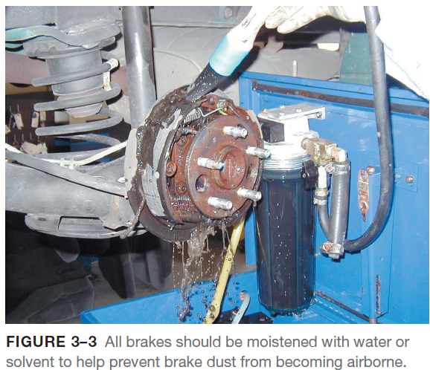
Federal and State Laws
Asbestos Handling Guidelines
HEPA VACUUM. A special high-efficiency particulate air (HEPA) vacuum system has been proven to be effective in keeping asbestos exposure levels below 0.1 fibers per cubic centimeter.
SOLVENT SPRAY. Many technicians use an aerosol can of brake cleaning solvent to wet the brake dust and prevent it from becoming airborne.
DISPOSAL OF BRAKE DUST AND BRAKE SHOES. The hazard of asbestos occurs when asbestos fibers are airborne.
Old brake shoes and pads should be enclosed, preferably in a plastic bag, to help prevent any of the brake material from becoming airborne.

Slide 13
Used Brake Fluid
Storage and Disposal of Brake Fluid
Most brake fluid is made from polyglycol, is water soluble, and can be considered hazardous if it has absorbed metals from the brake system.
Collect brake fluid in a container clearly marked to indicate that it is designated for that purpose.
If the waste brake fluid is hazardous, be sure to manage it appropriately and use only an authorized waste receiver for its disposal.
If the waste brake fluid is nonhazardous (such as old, but unused), determine from your local solid waste collection provider what should be done for its proper disposal.
Do not mix brake fluid with used engine oil.
Do not pour brake fluid down drains or onto the ground.
Recycle brake fluid through a registered recycler.

Slide 14
Used Oil
Used oil is any petroleum-based or synthetic oil that has been used.
To meet the EPA’s definition of used oil, a substance must meet each of the following three criteria:
Origin. The first criterion for identifying used oil is based on the oil’s origin. Used oil must have been refined from crude oil or made from synthetic materials.
Use. The second criterion is based on whether and how the oil is used. Oils used as lubricants, hydraulic fluids, heat transfer fluids, and for other similar purposes are considered used oil.
Contaminants. The third criterion is based on whether or not the oil is contaminated with either physical or chemical impurities.
If used oil is dumped down the drain and enters a sewage treatment plant, concentrations as small as 50 to 100 PPM (parts per million) in the waste water can foul sewage treatment processes.

Slide 15
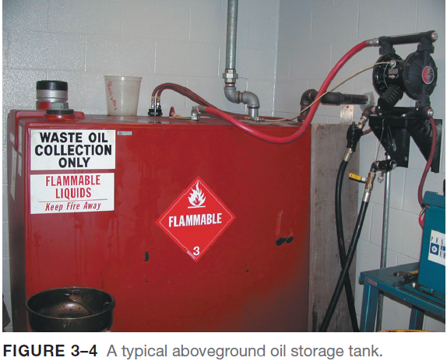
Used Oil
Storage and Disposal of Used Oil
Once oil has been used, it can be collected, recycled, and used over and over again.
An estimated 380 million gallons of used oil are recycled each year.
After collecting used oil in an appropriate container such as a 55 gallon steel drum, the material must be disposed of in one of two ways:
Shipped offsite for recycling
Burned in an onsite or offsite EPA-approved heater for energy recovery
Used (waste) oil must be stored in compliance with an existing underground storage tank (UST) or an aboveground storage tank (AGST) standard, or kept in separate containers.

Slide 16
Used Oil
Storage and Disposal of Used Oil
KEEP USED OIL STORAGE DRUMS IN GOOD CONDITION. This means that they should be covered, secured from vandals, properly labeled, and maintained in compliance with local fire codes.
Frequent inspections for leaks, corrosion, and spillage are an essential part of container maintenance.
NEVER STORE USED OIL IN ANYTHING OTHER THAN TANKS AND STORAGE CONTAINERS. Used oil may also be stored in units that are permitted to store regulated hazardous waste.
USED OIL FILTER DISPOSAL REGULATIONS. Used oil filters contain used engine oil that may be hazardous.
Before an oil filter is placed into the trash or sent to be recycled, it must be drained using one of the following hot-draining methods approved by the EPA :
Puncture the filter antidrainback valve or filter dome end and hot-drain for at least 12 hours
Hot-drain and crushing
Dismantling and hot-draining
Any other hot-draining method, which will remove all the used oil from the filter
After the oil has been drained from the oil filter, the filter housing can be disposed of in any of the following ways:
Sent for recycling
Picked up by a service contract company
Disposed of in regular trash

Slide 17
Solvents
The major sources of chemical danger are liquid and aerosol brake cleaning fluids that contain chlorinated hydrocarbon solvents.
There is no specific standard for physical contact with chlorinated hydrocarbon solvents or the chemicals replacing them.
Effect of Chemical Poisoning
The effects of exposure to chlorinated hydrocarbon and other types of solvents can take many forms. Short-term exposure at low levels can cause symptoms, such as the following:
Headache
Nausea
Drowsiness
Dizziness
Lack of coordination
Unconsciousness
It may also cause irritation of the eyes, nose, and throat, and flushing of the face and neck.
Short-term exposure to higher concentrations can cause liver damage with symptoms such as yellow jaundice or dark urine.

Slide 18
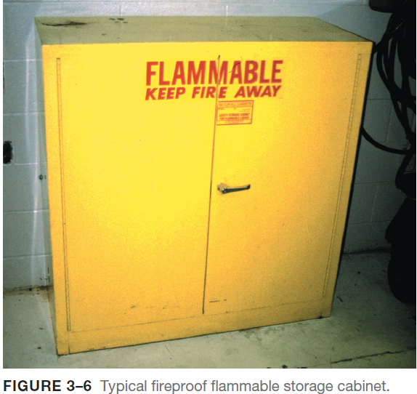
Solvents
Hazardous Solvents and Regulatory Status
Most solvents are classified as hazardous wastes.
Other characteristics of solvents include the following:
Solvents with flash points above 140°F (60°C) are considered flammable and, like gasoline, are federally regulated by the Department of Transportation (DOT).
Solvents and oils with flash points above 140°F (60°C) are considered combustible and, like engine oil, are also regulated by the DOT.
All flammable items must be stored in a fireproof container.
It is the responsibility of the repair shop to determine if spent solvent is hazardous waste

Slide 19
Solvents
Used Solvents
Used or spent solvents are liquid materials that have been generated as waste and may contain xylene, methanol, ethyl ether, and methyl isobutyl ketone (MIBK).
These materials must be stored in OSHA-approved safety containers with the lids or caps closed tightly. Additional requirements include the following:
Containers should be clearly labeled “Hazardous Waste” and the date the material was first placed into the storage receptacle should be noted.
Labeling is not required for solvents being used in a parts washer.
Used solvents will not be counted toward a facility’s monthly output of hazardous waste if the vendor under contract removes the material.
Used solvents may be disposed of by recycling with a local vendor, like SafetyKleen®, to have the used solvent removed according to specific terms in the vendor agreement.
Use aqueous-based (nonsolvent) cleaning systems to help avoid the problems associated with chemical solvents.

Slide 20
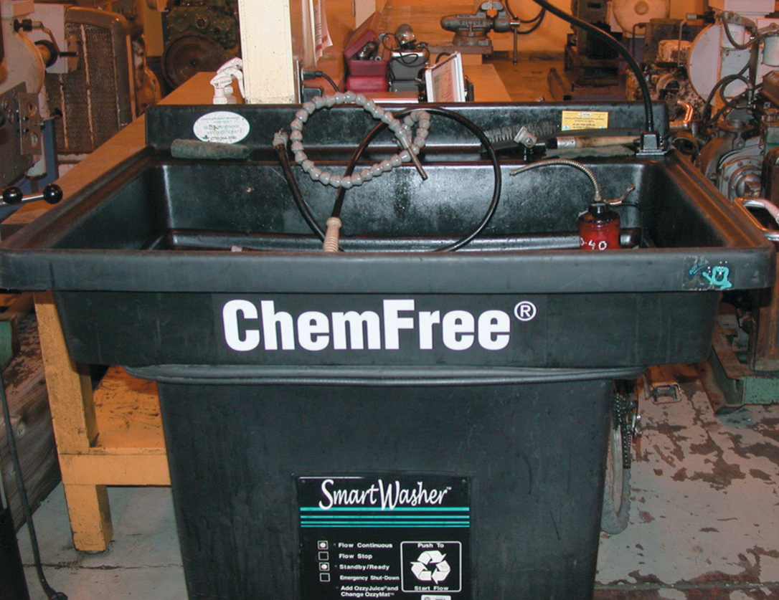
Solvents
FIGURE 3–7 Using a water-based cleaning system helps reduce the hazards from using strong chemicals.

Slide 21
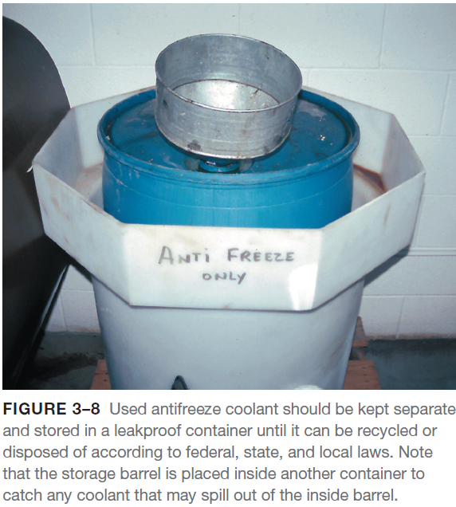
Coolant Disposal
Coolant is a mixture of antifreeze and water.
New antifreeze is not considered to be hazardous even though it can cause death if ingested.
Coolant should be disposed of in one of the following ways:
Coolant should be recycled either onsite or offsite.
Used coolant should be stored in a sealed and labeled container.
Used coolant can often be disposed of into municipal sewers with a permit.
Check with local authorities and obtain a permit before discharging used coolant into sanitary sewers.

Slide 22
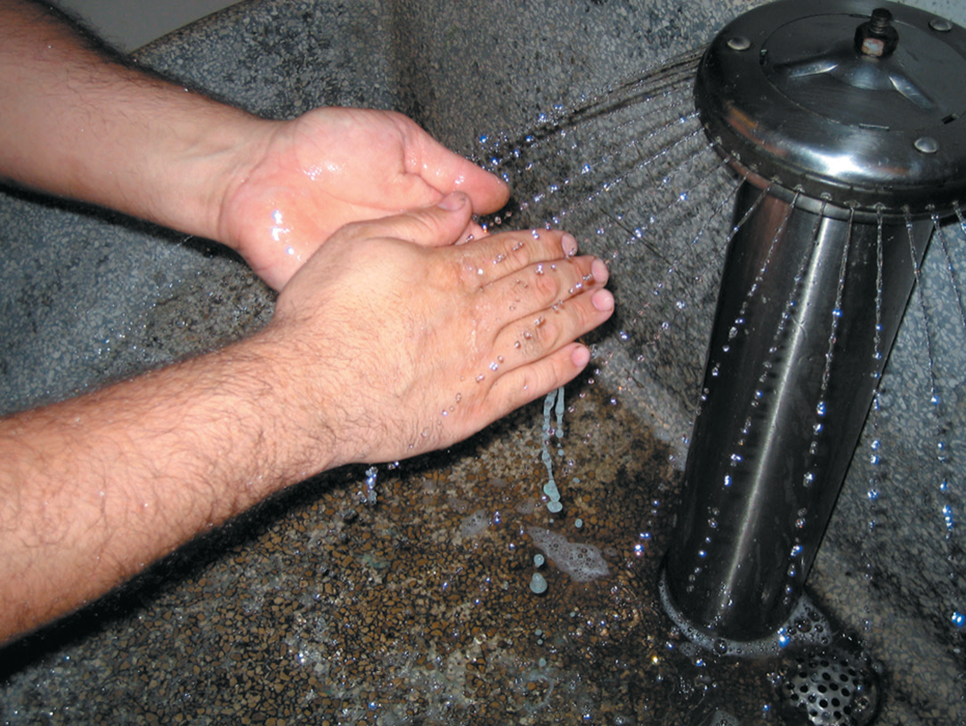
Hand Washing
FIGURE 3–5 Washing hands and removing jewelry are two
important safety habits all service technicians should practice.

Slide 23
Lead-Acid Battery Waste
Battery Disposal
Used lead–acid batteries must be reclaimed or recycled in order to be exempt from hazardous waste regulations.
According to the Battery Council International (BCI), battery laws usually include the following rules:
Lead–acid battery disposal is prohibited in landfills or incinerators. Batteries are required to be delivered to a battery retailer, wholesaler, recycling center, or lead smelter.
All retailers of automotive batteries are required to post a sign that displays the universal recycling symbol and indicates the retailer’s specific requirements for accepting used batteries.
Battery electrolyte contains sulfuric acid, which is a very corrosive substance capable of causing serious personal injury, such as skin burns and eye damage.
Battery Handling and Storage
Batteries, whether new or used, should be kept indoors if possible. The storage location should be an area specifically designated for battery storage and must be well ventilated (to the outside).

Slide 24
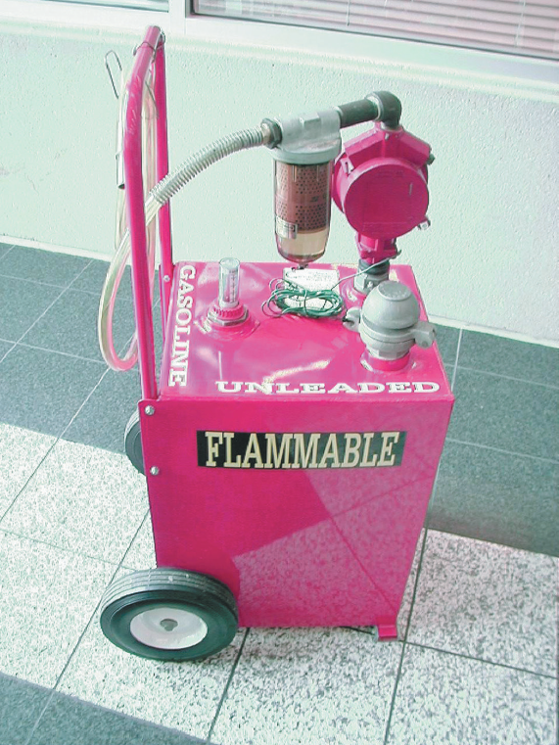
Fuel Safety and Storage
Gasoline is a very explosive liquid.
The expanding vapors that come from gasoline are extremely dangerous
Although diesel fuel is not as volatile as gasoline, the same basic rules apply to diesel fuel and gasoline storage.
These rules include the following:
Use storage cans that have a flash-arresting screen at the outlet.
Use only a red approved gasoline container to allow for proper hazardous substance identification.
Do not fill gasoline containers completely full. Always leave the level of gasoline at least 1 inch from the top of the container.
Never leave gasoline containers open, except while filling or pouring gasoline from the container.
Never use gasoline as a cleaning agent.
Always connect a ground strap to containers when filling or transferring fuel or other flammable products from one container to another to prevent static electricity that could result in explosion and fire.
FIGURE 3–9 This red gasoline container holds about 30 gallons of gasoline and is used to fill vehicles used for training.

Slide 25
Airbag Handling
Airbag modules are pyrotechnic devices that can be ignited if exposed to an electrical charge or if the body of the vehicle is subjected to a shock.
Airbag safety should include the following precautions:
Disarm the airbag(s) if you will be working in the area where a discharged bag could make contact with any part of your body.
Do not expose an airbag to extreme heat or fire.
Always carry an airbag pointing away from your body.
Place an airbag module facing upward.
Always follow the manufacturer’s recommended procedure for airbag disposal or recycling, including the proper packaging to use during shipment.
Wear protective gloves if handling a deployed airbag.
Always wash your hands or body well if exposed to a deployed airbag.
The chemicals involved can cause skin irritation and possible rash development.

Slide 26
Used Tire Disposal
Used tires are an environmental concern because of several reasons, including the following:
In a landfill, they tend to “float” up through the other trash and rise to the surface.
The inside of tires traps and holds rainwater, which is a breeding ground for mosquitoes. Mosquito-borne diseases include encephalitis and dengue fever.
Used tires present a fire hazard and, when burned, create a large amount of black smoke that contaminates the air.
Used tires should be disposed of in one of the following ways:
Used tires can be reused until the end of their useful life.
Tires can be retreaded.
Tires can be recycled or shredded for use in asphalt.
Tires removed from the rims can be sent to a landfill (most landfill operators will shred the tires because it is illegal in many states to landfill whole tires).
Tires can be burned in cement kilns or other power plants where the smoke can be controlled.
A registered scrap tire handler should be used to transport tires for disposal or recycling.

Slide 27
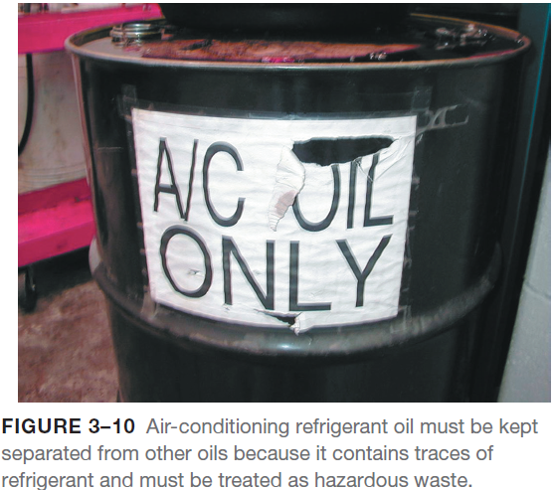
Air-Conditioning Refrigerant Oil Disposal
Air-conditioning refrigerant oil contains dissolved refrigerant and is therefore considered to be hazardous waste.
This oil must be kept separated from other waste oil or the entire amount of oil must be treated as hazardous.
Used refrigerant oil must be sent to a licensed hazardous waste disposal company for recycling or disposal.
Waste Chart
All automotive service facilities create some waste and while most of it is handled properly, it is important that all hazardous and nonhazardous waste be accounted for and properly disposed

Slide 28
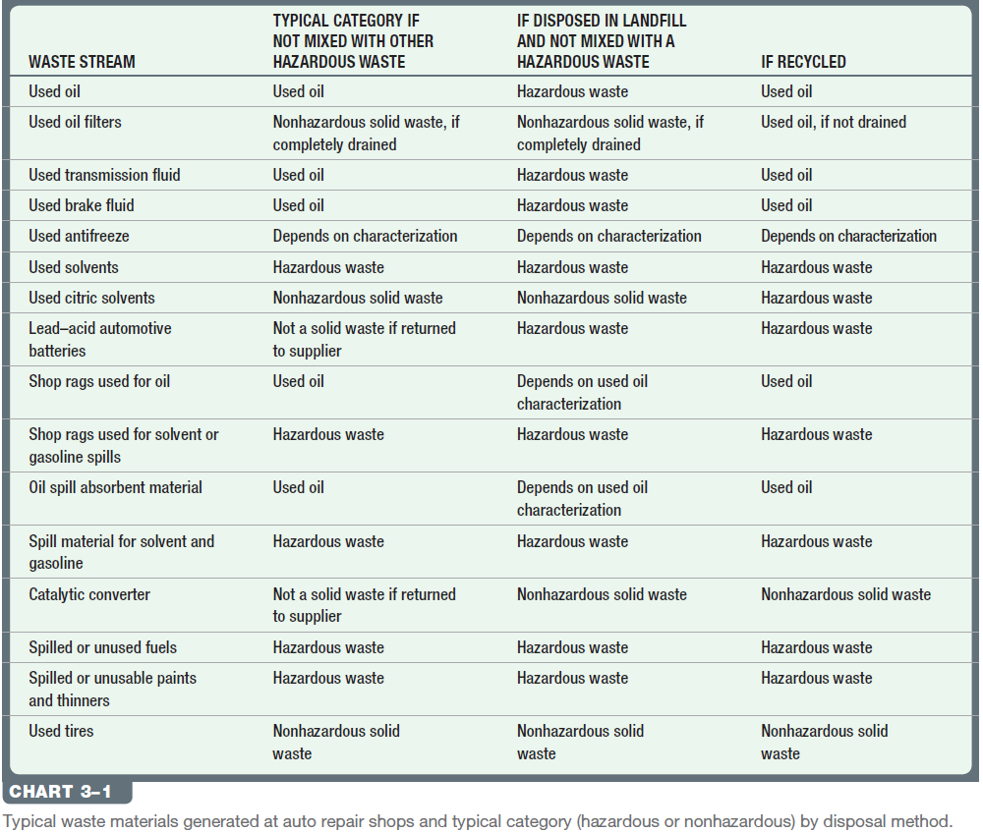
Air-Conditioning Refrigerant Oil Disposal

Slide 29
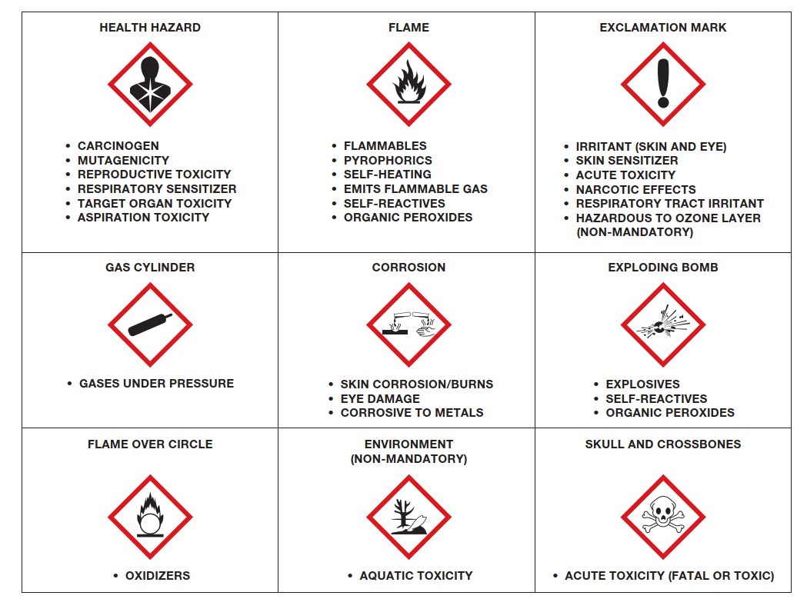
Air-Conditioning Refrigerant Oil Disposal
FIGURE 3–12 The OSHA global hazardous materials labels.

Slide 30
Animation: Ozone Depletion (The animation will automatically start in a few seconds)

Slide 31
Summary
Hazardous materials include common automotive chemicals, liquids, and lubricants, especially those whose ingredients contain chlor or fluor in their name.
Right-to-know laws require that all workers have access to safety data sheets (SDS).
Asbestos fibers should be avoided and removed according to current laws and regulations.
Used engine oil contains metals worn from parts and should be handled and disposed of properly.
Solvents represent a serious health risk and should be avoided as much as possible.
Coolant should be disposed of properly or recycled.
Batteries are considered to be hazardous waste and should be discarded to a recycling facility.

Slide 32
Video Links (Internet Access Required)
Fluid disposal (time 15:37)

