Slide 1
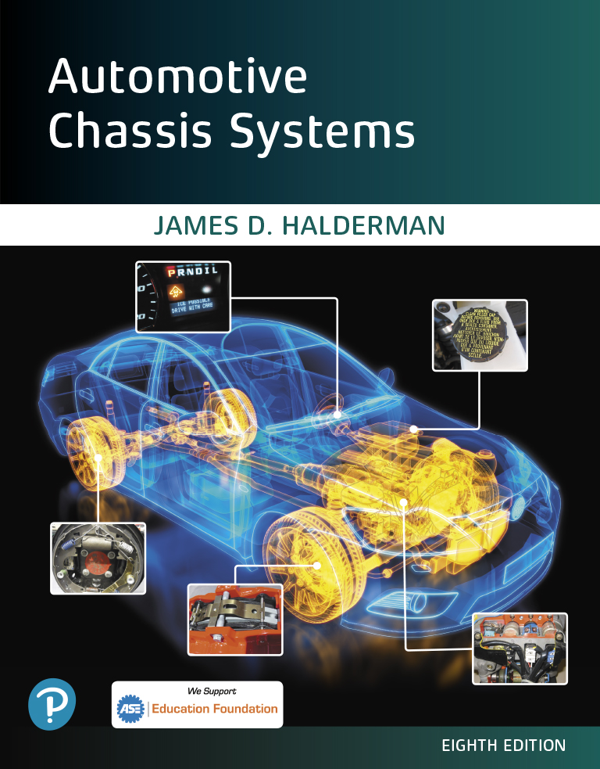
Automotive Chassis Systems Eighth Edition
Chapter 37
Vibration and Noise Diagnosis and Correction
Notes:
If this PowerPoint presentation contains mathematical equations, you may need to check that your computer has the following installed:
1) MathType Plugin
2) Math Player (free versions available)
3) NVDA Reader (free versions available)

Slide 2
Objectives
List the possible vehicle components that can cause a vibration or noise.
List the procedures for a test-drive and neutral run-up test for vibration/noise problems.
Explain the vibration speed ranges and how to determine the frequency of the vibration.
Explain how to check driveline angles and driveshaft runout.
Discuss the methods for measuring driveshaft U-joint phasing and balancing the driveshaft.
Diagnose and correct noise problems.

Slide 3
Causes of Vibration and Noise
Vehicles are designed and built to prevent most vibrations and to dampen out any vibrations that cannot be eliminated.
Dampening weights are also fastened to engines or transmissions in an effort to minimize noise, vibration, and harshness (called NVH).
If a new vehicle has a vibration or noise problem, then the most likely cause is an assembly or parts problem.
Vibration at higher vehicle speeds
Incorrect driveshaft angles could be the result of a change in the U-joints, springs, transmission mounts, or anything else that can cause a change in driveshaft angles.
Noise over rough roads
Exhaust system or parking brake cables are often causes of noise while driving over rough road surfaces.
Defective shock absorbers or shock absorber mountings are also a common cause of noise.

Slide 4
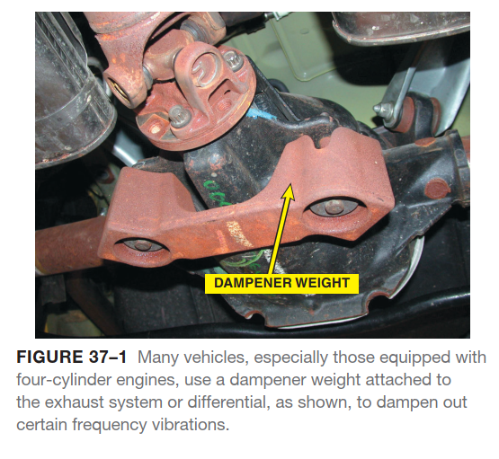
Causes of Vibration and Noise

Slide 5
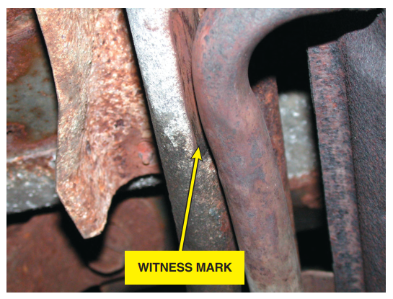
Causes of Vibration and Noise
FIGURE 37–2 The exhaust was found to be rubbing on the frame rail during a visual inspection. Rubber exhaust
system hangers are used to isolate noise and vibration from the exhaust system from entering the interior. These rubber supports can fail causing the exhaust system to be out of proper location. It was found by looking for evidence of witness marks.

Slide 6
Animation: Noise, Vibration and Harshness, NVH (The animation will automatically start in a few seconds)

Slide 7
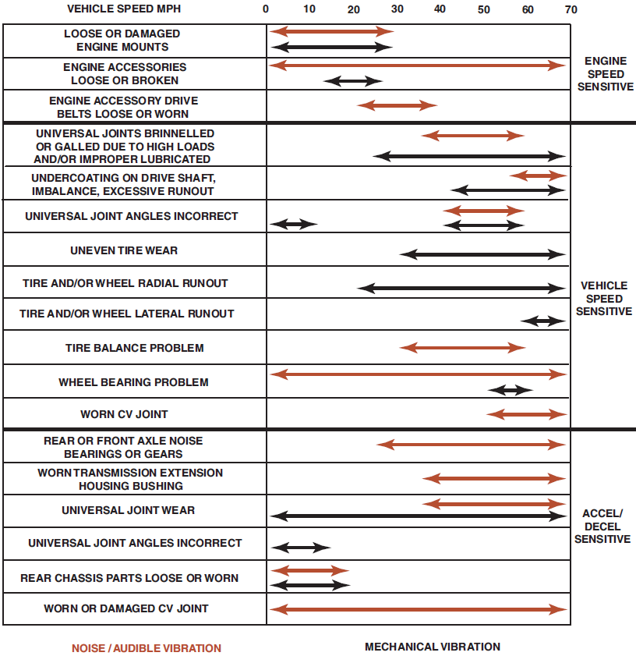
Test-Drive
The first thing a technician should do when given a vibration or noise problem to solve is to duplicate the condition.
This means the technician should drive the vehicle and observe when and where the vibration is felt or heard.
FIGURE 37–3 A chart showing the typical vehicle and engine speeds at which various components will create a noise or vibration and under what conditions.

Slide 8
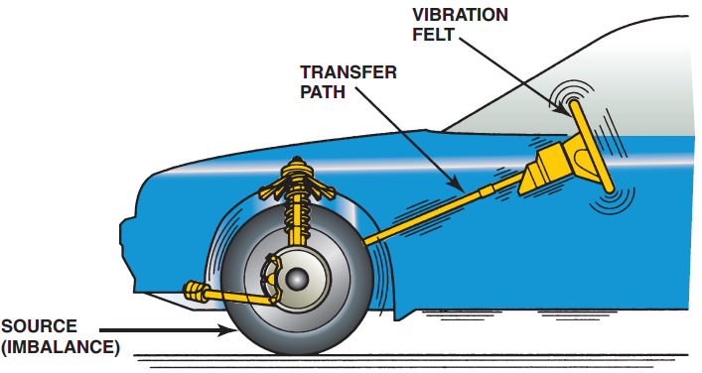
Test-Drive
Though there are many possible sources of a vibration, some simple observations may help to locate the problem quickly:
If the vibration is felt or seen in the steering wheel, dash, or hood of the vehicle, the problem is most likely to be caused by defective or out-of-balance front wheels or tires.
If the vibration is felt in the seat of the pants or seems to be all over the vehicle, the problem is most likely to be caused by defective or out-of-balance rear wheels or tires.
FIGURE 37–4 Vibration created at one point is easily transferred to the passenger compartment. MacPherson strut suspensions are more sensitive to tire imbalance than SLA type suspensions.

Slide 9
Test Drive
While on the test-drive, try to gather as much information about the vibration or noise complaint as possible.
STEP 1 Determine the vehicle speed (mph or km/h) or engine speed (RPM) where the vibration occurs.
Drive on a smooth, level road and accelerate up to highway speed, noting the vehicle speed or speeds at which the vibration or noise occurs.
STEP 2 To help pin down the exact cause of the vibration, accelerate to a speed slightly above the point of maximum vibration.
Shift the vehicle into neutral and allow it to coast down through the speed of maximum vibration.
If the vibration is eliminated when shifted out of gear, the problem is related to the engine or transmission.

Slide 10
Neutral Run-Up Test
The neutral run-up test is used to determine if the source of the vibration is engine-related.
With the transmission in Neutral or Park, slowly increase the engine RPM and with a tachometer, observe the RPM at which the vibration occurs. Do Not Exceed the Manufacturer’s Recommended Maximum Engine RPM.
If the fault is found in the engine itself, further engine testing is needed to find the root cause.
Vibration During Braking
A vibration during braking usually indicates out-of-round brake drums, warped disc brake rotors, or other braking system problems.
The front rotors are the cause of the vibration if the steering wheel is also vibrating (moving) during braking.
The rear drums or rotors are the cause of the vibration if the vibration is felt throughout the vehicle and brake pedal, but not the steering wheel.
Another way to check if the vibration is due to rear brakes is to use the parking brake to stop the vehicle.
If a vibration occurs while using the parking brake, the rear brakes are the cause.

Slide 11
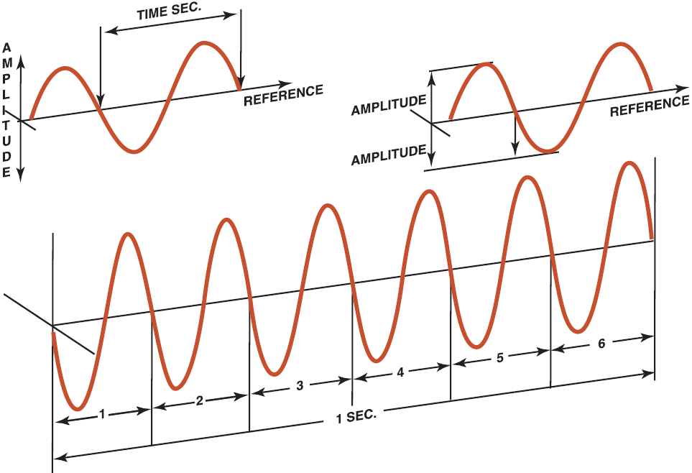
Vibration Speed Ranges
Vibration describes an oscillating motion around a reference position.
The number of times a complete motion cycle takes place during a period of one second is called frequency and is measured in hertz (Hz) (named for Heinrich R. Hertz, a nineteenth-century German physicist).
FIGURE 37–5 Hertz means cycles per second. If six cycles occur in one second, then the frequency is 6 Hz. The amplitude refers to the total movement of the vibrating component.

Slide 12
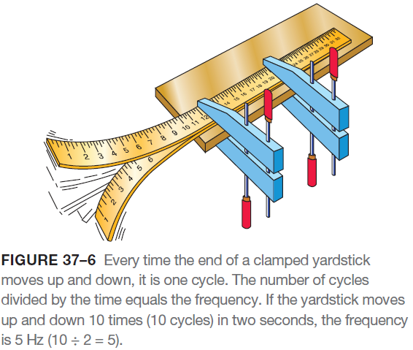
Vibration Speed Ranges
The unit of measure for frequency was originally cycles per second (CPS). This was changed to hertz in the 1960s.
To help understand frequency, think of the buzzing sound made by some fluorescent light fixtures.
That 60 Hz hum is the same frequency as the alternating current.
A 400 Hz sound is high pitched. In fact, most people can only hear sounds between 20 and 15,000 Hz.
Generally, low-frequency oscillations between 1 and 80 Hz are the most disturbing to vehicle occupants.

Slide 13
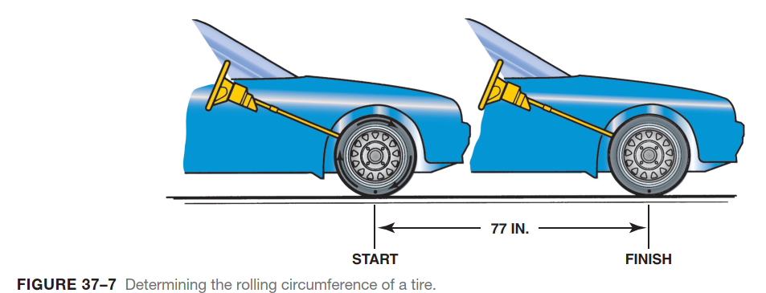
Vibration Speed Ranges

Slide 14
Vibration Order
Vibration order is the number of vibrations created in one revolution of a component.
A single high spot on a tire, for example, will cause one bump per revolution, which is a first-order vibration.
Tire and Wheel Vibrations
Typical vehicle components that can cause vibration in specific frequency ranges at 50 mph (80 km/h) include the following:
LOW FREQUENCY (5–20 HZ). This frequency range of vibration is very disturbing to many drivers because this type of vibration can be seen and felt in the steering wheel, seats, mirrors, and other components.
Tires and wheels are the most common source of vibration in the low-frequency range.
To determine the exact frequency for the vehicle being checked, the following formula and procedure can be used.
Tire rolling frequency is calculated as follows:

Slide 15
Vibration Order
This formula works for all vehicles regardless of tire size.
The circumference (distance around the tread) can be measured by using a tape measure around the tire. The rolling circumference of the tire is usually shorter due to the contact patch. To determine the rolling circumference, follow these easy steps:
STEP 1 Inflate the tire(s) to the recommended pressure.
STEP 2 Slowly roll the vehicle forward (or rearward) until the valve stem is again straight down.
STEP 3 Measure the distance between the marks in feet.

Slide 16
Vibration Order
Driveline Vibrations
MEDIUM FREQUENCY (20–50 HZ). This frequency range of vibrations may also be described as a shake, oscillation, or shimmy.
These higher frequencies may also be called roughness or buzz.
Components become blurred and impossible to focus on above a vibration of 30 Hz.
Engine-Related Vibrations
HIGH FREQUENCY (50–100 HZ). Vibrations in this range may also be heard as a moan or hum.
The vibration is high enough that it may be felt as a numbing sensation that can put the driver’s hands or feet to sleep.
Engine-related vibrations vary with engine speed, regardless of road speed.
Frequency of the vibration from an engine is determined from the engine speed in revolutions per minute (RPM).

Slide 17
Vibration Frequency
Measuring Frequency
Knowing the frequency of the vibration greatly improves the speed of tracking down the source of the vibration.
Vibration can be measured using a reed tachometer or an electronic vibration analyzer (EVA).
A reed tachometer is placed on the dash, console, or other suitable location inside the vehicle.
The vehicle is then driven on a smooth, level road at the speed where the vibration is felt the most.
The reeds of the reed tachometer vibrate at the frequency of the vibration.
Correcting Low-Frequency Vibrations
A low-frequency vibration (5–20 Hz) is usually due to tire/wheel problems, including the following:
Tire and/or wheel imbalance.
Tire and/or wheel radial or lateral runout.
Radial force variation within the tire itself.
If front-wheel drive, a bent or damaged drive axle joint or shaft.
Warped rotors.

Slide 18
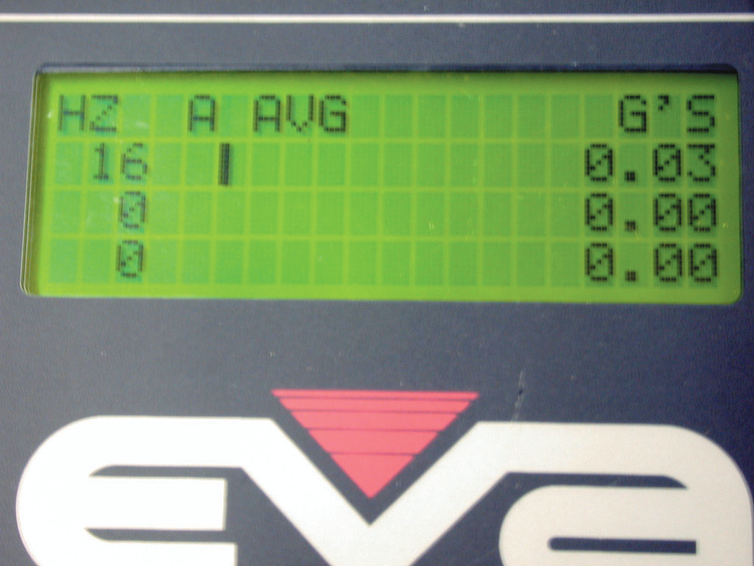
Vibration Frequency
FIGURE 37–8 An electronic vibration analyzer.

Slide 19
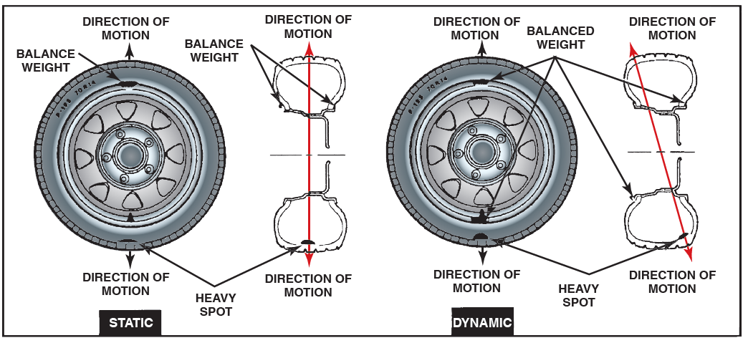
Vibration Frequency
Correcting Low-Frequency Vibrations
Tires that are out of round or defective will be most noticeable at low speeds, will get better as speed increases, and then will vibrate again at highway speeds.
Tires that are out of balance will tend not to be noticeable at low speeds, and will be most noticeable at highway speeds.
FIGURE 37–9 Properly balancing all wheels and tires solves most low-frequency vibrations.

Slide 20
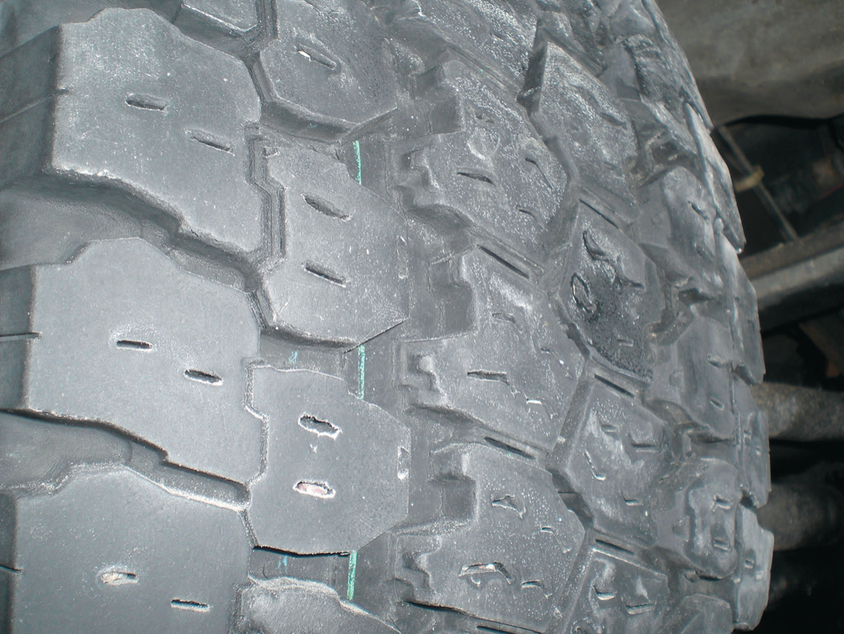
Vibration Frequency
FIGURE 37–10 An out-of-balance tire showing scallops or bald spots around the tire. Even if correctly balanced, this
cupped tire would create a vibration.

Slide 21
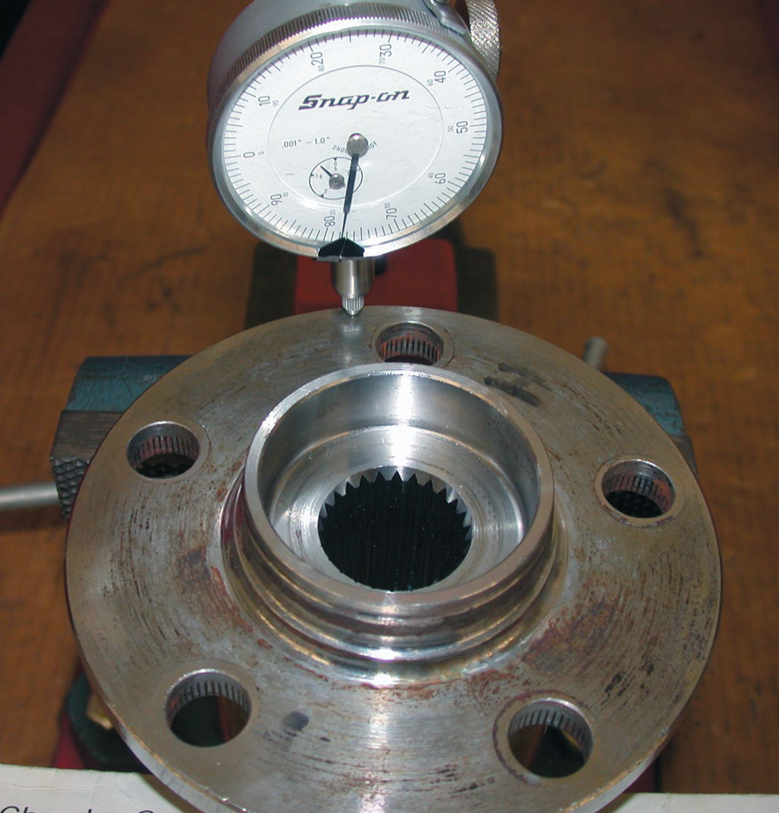
Vibration Frequency
FIGURE 37–11 Another cause of a vibration that is often
blamed on wheels or tires is a bent bearing hub. Use a dial
indicator to check the flange for runout.

Slide 22
Animation: Tire Vibration (The animation will automatically start in a few seconds)

Slide 23
Vibration Frequency
Correcting Medium-Frequency Vibrations
Medium-frequency vibrations (20–50 Hz) can be caused by imbalances of the driveline as well as such things as the following:
Defective U-joints. Sometimes an old or a newly installed U-joint can be binding.
This binding of the U-joint can cause a vibration.
Often a blow to the joint with a brass hammer can free a binding U-joint.
Driveshaft imbalance (such as undercoating on the driveshaft) or excessive runout.
Incorrect or unequal driveshaft angles.
Driveline vibrations are usually the result of an imbalance in the rotating driveshaft (propeller shaft) assembly.
The driveshaft of a typical rear-wheel-drive (RWD) vehicle rotates at about three times the speed of the drive wheels.
The differential gears in the rear end change the direction of the power flow from the engine and driveshaft, as well as provide for a gear reduction.
All driveshafts are balanced at the factory, and weights are attached to the driveshaft, if necessary, to achieve proper balance.

Slide 24
Vibration Frequency
Correcting High-Frequency Vibrations
High-frequency vibrations (50–100 Hz) are commonly caused by a fault of the clutch, torque converter, or transmission main shaft that rotates at engine speed; in the engine itself, they can be caused by items such as the following:
A defective spark plug wire
A burned valve
Any other mechanical fault that will prevent any one or more cylinders from firing correctly
A defective harmonic balancer
If the engine is the cause, run in Neutral at the same engine speed.
Exhaust system pulses occur at the following conditions:
4-cylinder engine 2 × engine RPM
6-cylinder engine 3 × engine RPM
8-cylinder engine 4 × engine RPM
If the exhaust system is touching the body, it will transfer these pulses as a vibration.
Exhaust system vibrations vary with engine speed and usually increase as the load on the engine increases.

Slide 25
Correcting Driveline Angles
Incorrect driveline angles are usually caused by one or more of the following:
Worn, damaged, or improperly installed U-joints.
Worn, collapsed, or defective engine or transmission mount(s).
Incorrect vehicle ride height. (As weight is added to the rear of a rear-wheel-drive vehicle, the front of the differential rises and changes the working angle of the rear U-joint.)
Bent or distorted driveshaft.

Slide 26
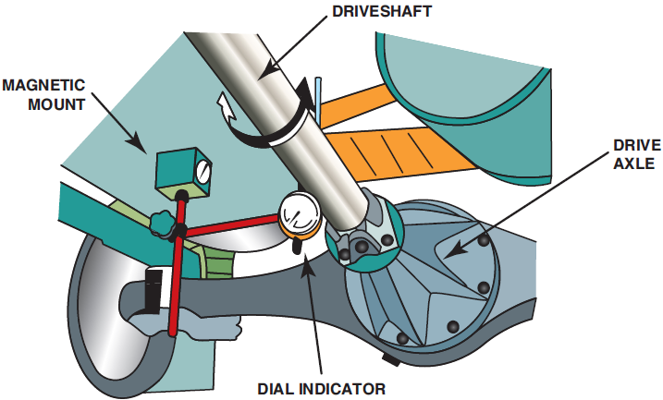
Checking Driveshaft Runout
Check to see that the driveshaft is not bent by performing a driveshaft runout test using a dial indicator.
Runout should be measured at three places along the length of the driveshaft.
The maximum allowable runout is 0.030 inch (0.8 mm).
If runout exceeds 0.030 inch, remove the driveshaft from the rear end and reindex the driveshaft onto the companion flange at 180 degrees from its original location.
Remeasure the driveshaft runout.
If the runout is still greater than 0.030 inch, the driveshaft is bent and needs replacement or the companion flange needs replacement.
FIGURE 37–12 Checking a driveshaft for runout using a magnetic mounted dial indicator

Slide 27
Measuring Driveshaft U-Joint Phasing
Measuring driveshaft U-joint phasing involves checking to see if the front and rear U-joints are directly in line or parallel with each other.
With the vehicle on a drive-on lift, or if using a frame contact hoist, support the weight of the vehicle on stands placed under the rear axle.
Place an inclinometer on the front U-joint bearing cup and rotate the driveshaft until horizontal; note the inclinometer reading.
Move the inclinometer to the rear U-joint. The angles should match.
If the angles are not equal, the driveshaft is out of phase and should be replaced.
Incorrect phasing is usually due to a twisted driveshaft or an incorrectly welded end yoke.

Slide 28
Checking Companion Flange Runout
The companion flange is splined to the rear axle pinion shaft and provides the mounting for the rear U-joint of the driveshaft.
Two items should be checked on the companion flange while diagnosing a vibration:
The companion flange should have a maximum runout of 0.006 inch (0.15 mm) while being rotated.
If the flange was pounded off with a hammer during a previous repair, the deformed flange could cause a vibration.
Check the companion flange for a missing balance weight.

Slide 29
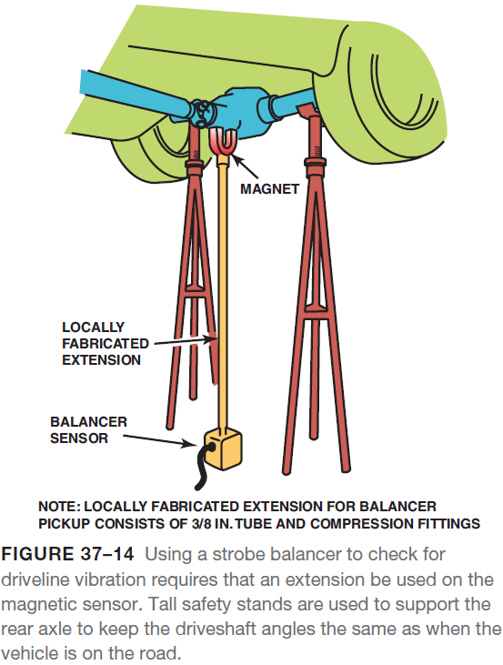
Balancing the Driveshaft
If the driveshaft (propeller shaft) is within runout specification and a vibration still exists, the balance of the shaft should be checked and corrected as necessary.
The procedure for testing driveshaft balance using a strobe balancer includes the following:
STEP 1 Raise the vehicle and mark the driveshaft with four equally spaced marks around its circumference.
STEP 2 Attach the strobe balancer sensor to the bottom of the differential housing as close to the companion flange as possible.
STEP 3 With the vehicle securely hoisted and the drive wheels off the ground, start the engine and put the transmission into gear to allow the drive wheels to rotate.

Slide 30
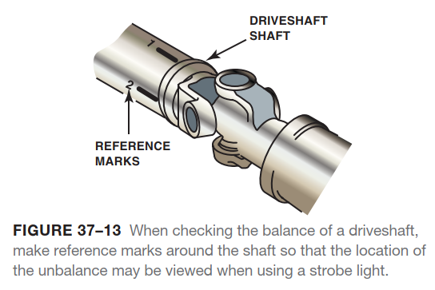
Balancing the Driveshaft

Slide 31
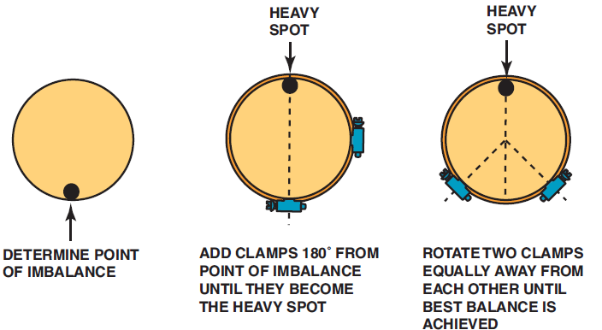
Balancing the Driveshaft
STEP 4 Hold the strobe light close to the marks on the driveshaft.
If the light does not flash, the driveshaft is balanced and no corrective action is necessary.
If the light does flash, observe what number mark is shown by the flashing light.
STEP 5 Apply hose clamps so that the screw portion of the clamp(s) is opposite the number seen with the strobe light.
The screw portion of the hose clamp is the corrective weight.

Slide 32
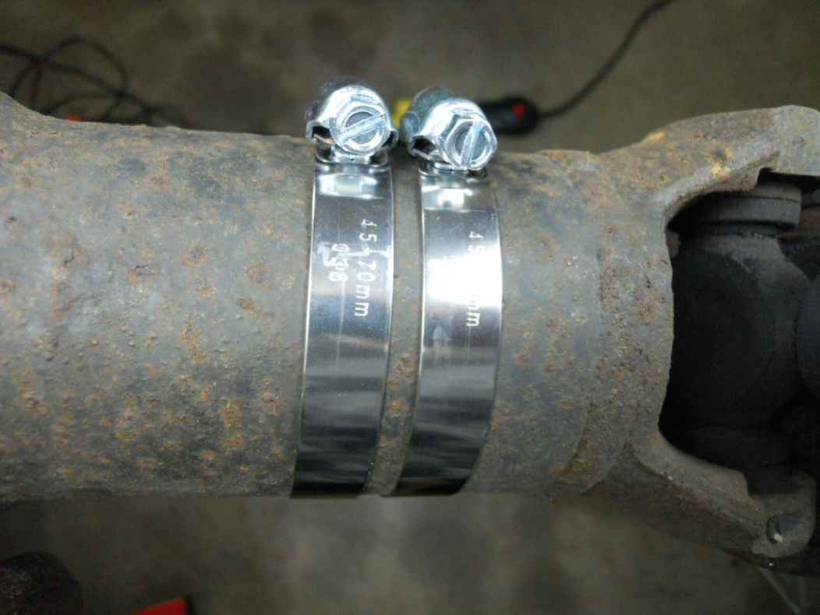
Balancing the Driveshaft
FIGURE 37–16 Two clamps were required to balance this front driveshaft of a four-wheel-drive vehicle. be careful when
using hose clamps so that the ends of the clamps do not interfere with the body or other parts of the vehicle.

Slide 33
Noise Diagnosis
Noise diagnosis is difficult because a noise is easily transmitted from its source to other places in the vehicle.
For example, if a rear shock absorber mount is loose, the noise may be heard as coming from the middle or even the front of the vehicle.
As the axle moves up and down, the noise is created where metal touches metal between the shock absorber bolt and the axle shock mount.
The noise is then transmitted throughout the frame of the vehicle, and therefore causes the sound to appear to come from “everywhere.”
To help pin down the exact location of the sound, perform a thorough test-drive, including driving beside parked vehicles or walls with the vehicle windows open.
Some noises may be normal; a similar vehicle should be driven and compared before replacing parts that may not be defective.
Noises usually become louder and easier to find as time and mileage increase.
An occasional noise usually becomes a constant noise.

Slide 34
Noise Correction
The proper way to repair a noise is to repair the cause. Other methods that have been used by technicians include the following:
Insulating the passenger compartment to keep the noise from the passengers.
Turning up the radio!
While these methods are usually inexpensive, the noise is still being generated, and if a noisy bearing or other vehicle component is not corrected, more expensive damage is likely to occur.
Always remember: Almost all vehicle faults cause noise first—do not ignore the noise because it is the early warning signal of more serious and possibly dangerous problems.
Some of the things that can be done to correct certain vibrations and noise include the following:
Check all power steering high-pressure lines, being certain that they do not touch any part of the body, frame, or engine except where they are mounted.
Carefully check, tighten, and lubricate the flexible couplings in the exhaust system.
Lubricate all rubber bushings with rubber lube and replace any engine or transmission mounts that are collapsed.
Replace and/or tighten all engine drive belts and check that all accessory mounting brackets are tight.

Slide 35
Noise Correction
Noise
Tire noise
Change tire pressure; if no change, then the problem is not tires but bearings, or other components.
Drive on various road surfaces—smooth asphalt reduces tire noise.
Rotate the tires front to rear, if possible.
Various tread designs can cause added noise.

Slide 36
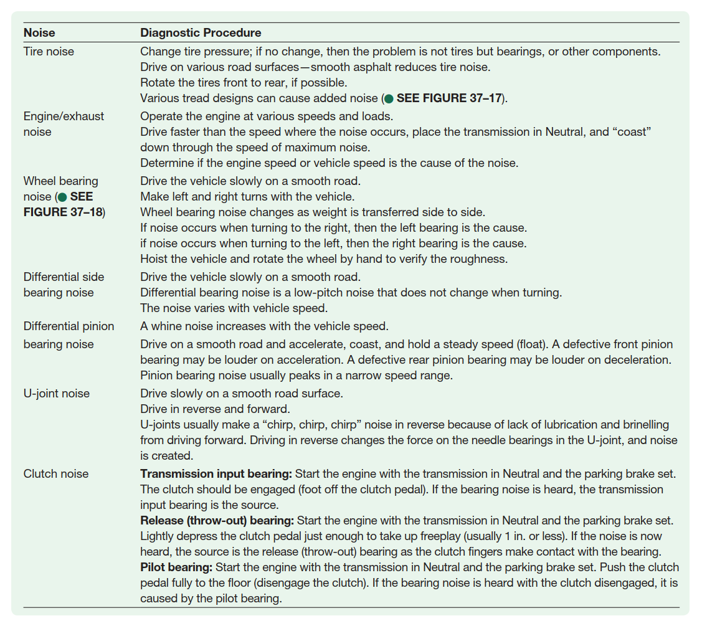
Noise Correction

Slide 37
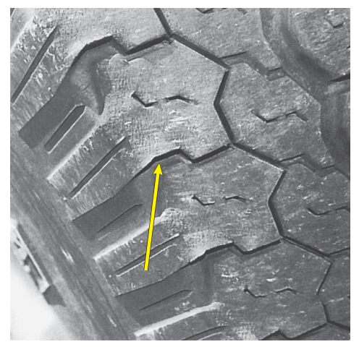
Noise Correction
FIGURE 37–17 Tire wear caused by improper alignment or driving habits, such as high-speed cornering, can create tire noise. Notice the feather-edged outer tread blocks.

Slide 38
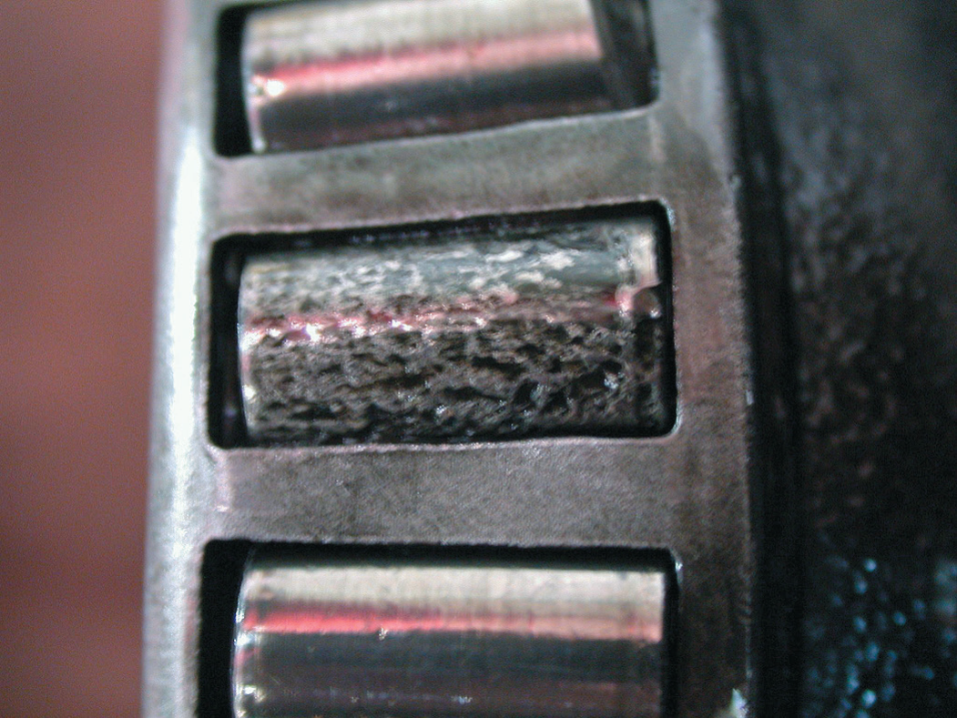
Noise Correction
FIGURE 37–18 This bearing was found on a vehicle that had been stored over the winter. This corroded bearing produced a lot of noise and had to be replaced.

Slide 39
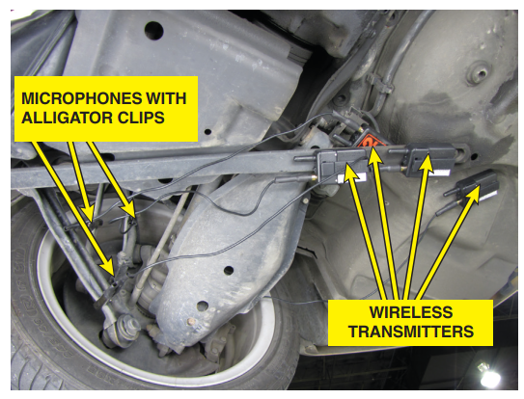
Noise Correction
FIGURE 37–19 Chassis ear microphones attached to various
suspension components using the integral clamps. The sound
is transmitted wirelessly to the receiver inside the vehicle
where an assistant technician can listen for noises while the
vehicle is being driven.

Slide 40
Summary
Vibration and noise are two of the most frequently heard complaints from vehicle owners. Noise is actually a vibration (vibrations cause the air to move, creating noise).
A vibration felt in the steering wheel, dash, or hood is usually due to out-of-balance or defective front tires. A vibration felt in the seat of the pants or throughout the entire vehicle is usually due to out-of-balance or defective rear tires.
Defective engine or transmission mounts, warped rotors, and out-of-round brake drums can all cause a vibration.
Vibration is measured by an electronic vibration analyzer (EVA) or a reed tachometer and measured in units called Hertz.
Low-frequency vibrations (5–20 Hz) are usually due to tires or wheels.
Medium-frequency vibrations (20–50 Hz) are usually caused by driveline problems on rear-wheel-drive vehicles.
High-frequency vibrations (50–100 Hz) are usually caused by an engine problem.
Driveshafts should be inspected for proper U-joint working angles and balance.

