Slide 1
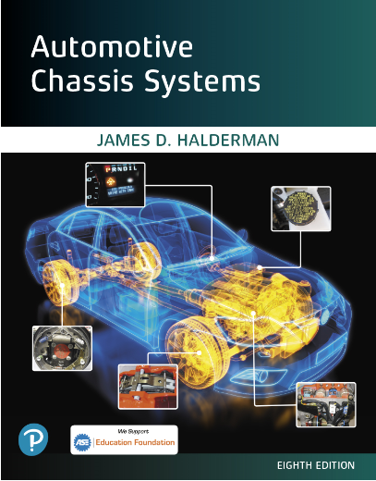
Automotive Chassis Systems Eighth Edition
Chapter 33
Driveshafts and CV Joints
Notes:
If this PowerPoint presentation contains mathematical equations, you may need to check that your computer has the following installed:
1) MathType Plugin
2) Math Player (free versions available)
3) NVDA Reader (free versions available)

Slide 2
Objectives
Describe driveshaft design and balance.
Describe the function and operation of U-joints.
Discuss the two types of CV joints and how they work.
This chapter will help prepare for Suspension and Steering (A4) ASE certification test content area “C” (Related Suspension and Steering Service).

Slide 3
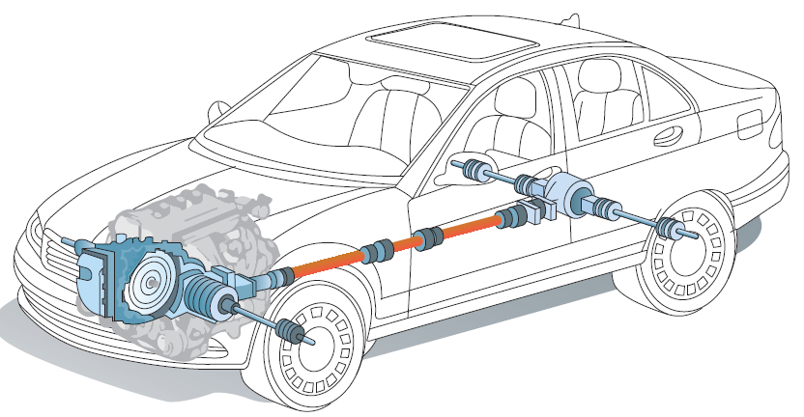
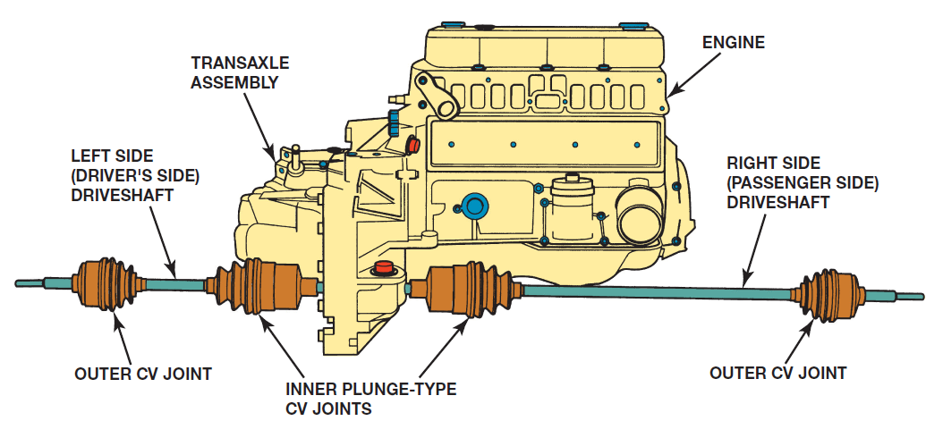
Driveshafts
PURPOSE AND FUNCTION A driveshaft transmits engine torque from the transmission or transaxle (if front-wheel drive) to the rear axle assembly or drive wheels.
FIGURE 33–1 A vehicle equipped with all wheel drive using a transaxle uses many different driveshafts. From the transaxle to the front wheels, two “half shafts” are used. In this example, the multi-piece driveshaft is used to transmit engine torque to the drive axle at the rear of the vehicle. From the drive axle, two more half-shafts (drive axle shafts) are used to transmit torque to the rear wheels.
FIGURE 33–2 On a rear wheel drive vehicle, the driveshaft transmits engine torque from the transmission to the rear axle assembly and drive wheels. On a front-wheel-drive vehicle driveshafts (also called axle shafts) transmit torque from the transaxle to each of the front drive wheels.

Slide 4
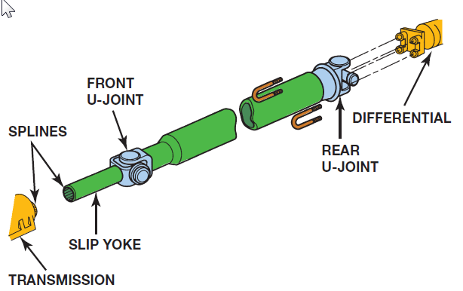
Driveshafts
Driveshaft is the term used by the Society of Automotive Engineers (SAE) to describe the shaft between the transmission and the rear axle assembly on a rear-wheel-drive vehicle.
General Motors and some other manufacturers use the term propeller shaft or prop shaft to describe this same part.
The SAE term will be used throughout this textbook. A typical driveshaft is a hollow steel tube.
A splined end yoke is welded onto one end that slips over the splines of the output shaft of the transmission.
An end yoke is welded onto the other end of the driveshaft.
Some driveshafts use a center support bearing.
FIGURE 33–3 Typical driveshaft (also called a propeller shaft). The driveshaft transfers engine power from the transmission to the differential.

Slide 5
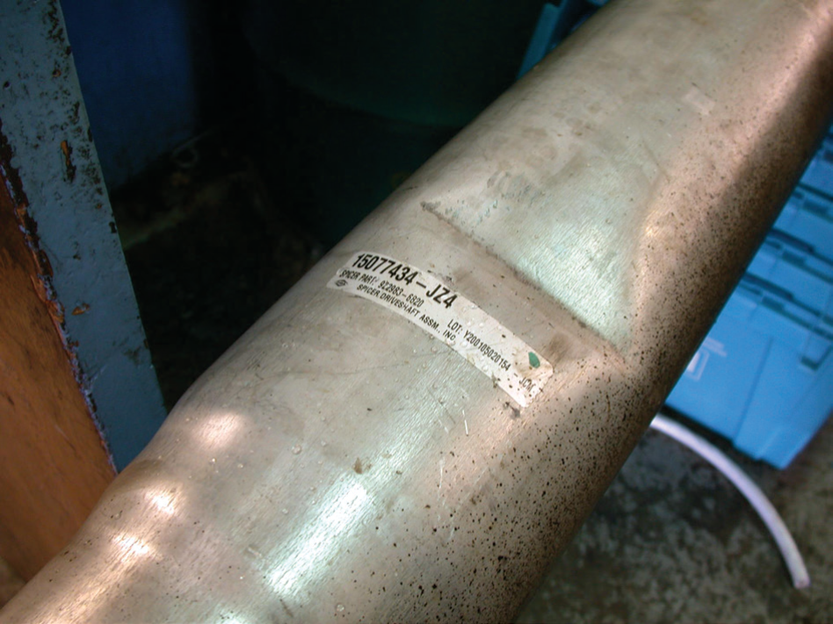
Driveshafts
FIGURE 33–4 This driveshaft was found to be dented during a visual inspection and has to be replaced.

Slide 6
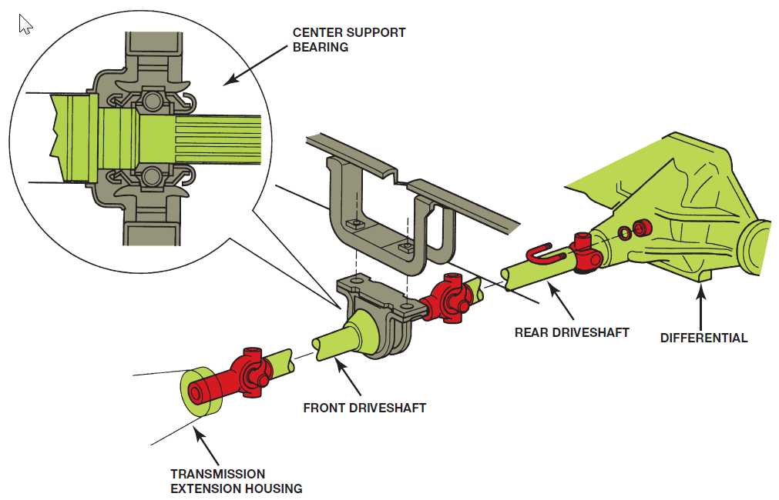
Driveshafts
A center support bearing is also called a steady bearing or hanger bearing.
Many extended- cab pickup trucks and certain vans use aluminum driveshafts to eliminate the need (and expense) of a center support bearing.
Composite-material driveshafts are also used in some vehicles.
To dampen driveshaft noise, it is common to line the inside of the hollow driveshaft with cardboard or rubber.
This helps eliminate the tinny sound whenever shifting between drive and reverse in a vehicle equipped with an automatic transmission.
FIGURE 33–5 A center support bearing is used on many vehicles with long two-part driveshafts.

Slide 7
Driveshaft Balance
All driveshafts are balanced. Generally, any driveshaft whose rotational speed is greater than 1000 RPM must be balanced.
Driveshaft balance should be within 0.5% of the driveshaft weight.
(This is one of the biggest reasons why aluminum or composite driveshafts can be longer because of their light weight.)
Driveshafts are often not available by make, model, and year of the vehicle.
There are too many variations at the factory, such as transmission type, differential, or U-joint type.
To get a replacement driveshaft, it is usually necessary to know the series of U-joints (type or style of U-joint) and the center-to-center distance between the U-joints.

Slide 8
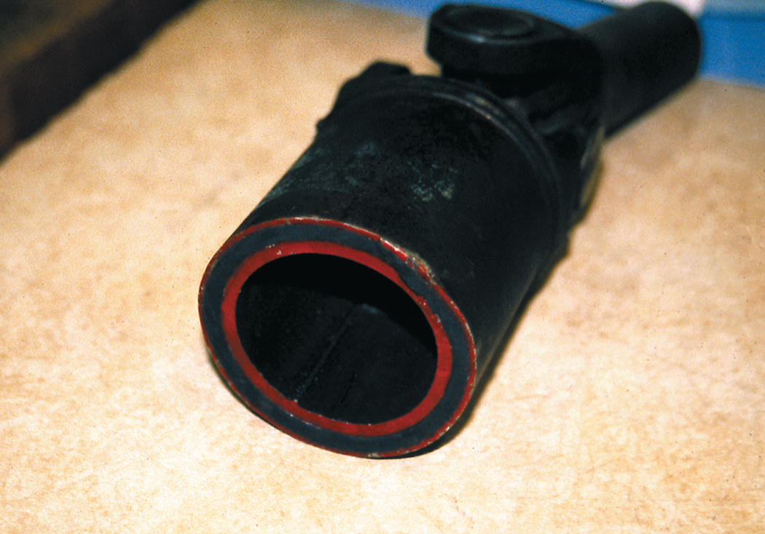
Driveshaft Balance
FIGURE 33–6 Some driveshafts use rubber between an inner and outer housing to absorb vibrations and shocks to
the driveline.

Slide 9
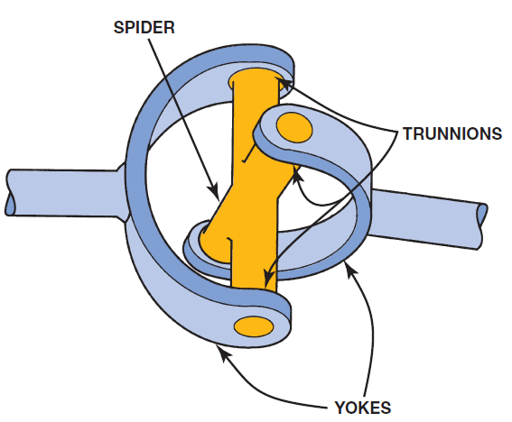
U-Joint Design and Operation
Universal joints (U-joints) are used at both ends of a driveshaft.
U-joints allow the wheels and the rear axle to move up and down, remain flexible, and still transfer torque to the drive wheels.
A similar design is the common U-joint used with a socket wrench set. Most U-joints are called cross-yoke joints or Cardan joints.
Cardan is named for a sixteenth-century Italian mathematician who worked with objects that moved freely in any direction.
Torque from the engine is transferred through the U-joint.
The speed changes twice per revolution. The greater the angle, the greater the change in speed (velocity)..
FIGURE 33–7 A simple universal joint (U-joint).

Slide 10
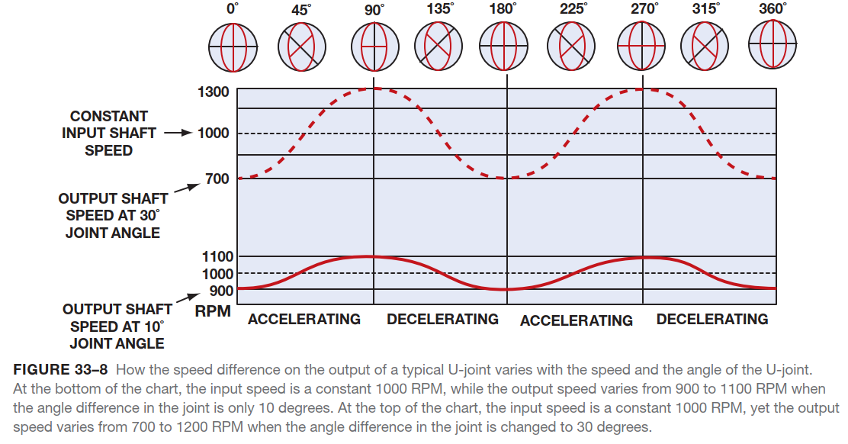
U-Joint Design and Operation

Slide 11
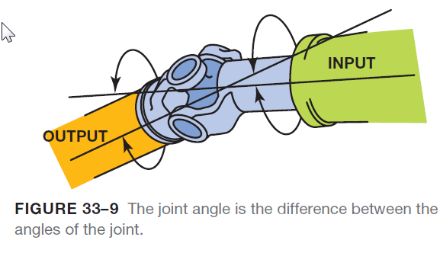
U-Joint Design and Operation
If only one U-joint were used in a driveline, this change in speed of the driven side (output end) would generate vibrations in the driveline.
To help reduce vibration, another U-joint is used at the other end of the driveshaft.
If the angles of both joints are nearly equal, the acceleration and deceleration of one joint is offset by the alternate deceleration and acceleration of the second joint.
It is very important that both U-joints operate at about the same angle to prevent excessive driveline vibration.

Slide 12
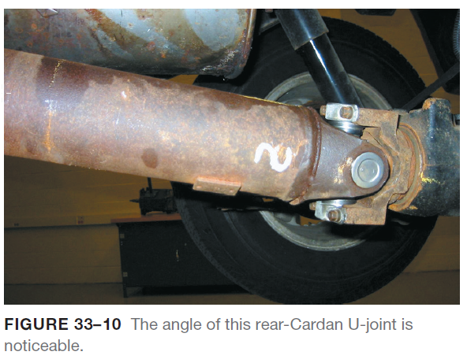
U-Joint Design and Operation
ACCEPTABLE WORKING ANGLES- Universal joints used in a typical driveshaft should have a working angle of 1/2 to 3 degrees.
If the driveshaft is perfectly straight (0 degree working angle), then the needle bearings inside the bearing cap are not revolving because there is no force (no difference in angles) to cause the rotation of the needle bearings.
If the needle bearings do not rotate, they can exert a constant pressure in one place and damage the bearing journal.
If a two-piece driveshaft is used, one U-joint (usually the front) runs at a small working angle of about 1/2 degree, just enough to keep the needle bearings rotating.
The other two U-joints (from the center support bearing and rear U-joint at the differential) operate at typical working angles of a single-piece driveshaft.

Slide 13
U-Joint Design and Operation
If the U-joint working angles differ by more than a 1/2 degree between the front and the rear joint, a vibration is usually produced that is torque sensitive.
As the vehicle is first accelerated from a stop, engine torque can create unequal driveshaft angles by causing the differential to rotate on its suspension support arms.
If the driveshaft angles are excessive (over 3 degrees), a vibration is usually produced that increases as the speed of the vehicle (and driveshaft) increases.

Slide 14
Animation: Universal Joint Operation (The animation will automatically start in a few seconds)

Slide 15
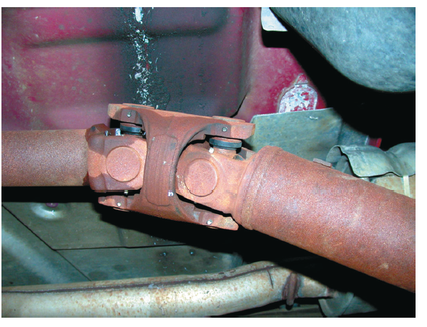
Double-Cardan Joints
Regular U-joints are usually designed to work up to 12 degrees of angularity.
If two Cardan-style U-joints are joined together, the angle at which this double-Cardan joint can function is about 18 to 20 degrees.
Double-Cardan U-joints were first used on large rear wheel- drive vehicles to help reduce drive line-induced vibrations, especially when the rear of the vehicle was fully loaded and driveshaft angles were at their greatest.
As long as a U-joint (either single or double Cardan) operates in a straight line, the driven shaft will rotate at the same constant speed (velocity) as the driving shaft.
As the angle increases, the driven shaft speed or velocity varies during each revolution.
FIGURE 33–11 A double-Cardan U-joint.

Slide 16
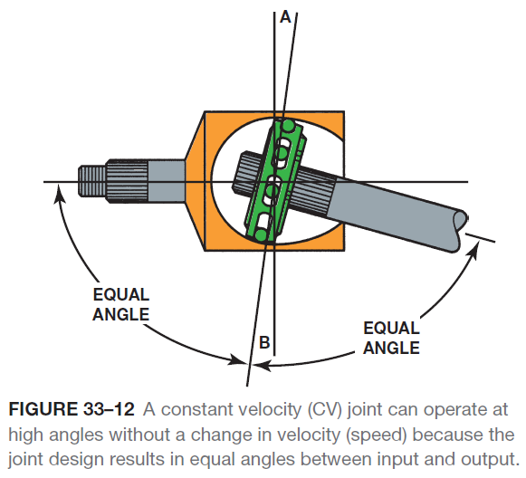
Constant Velocity Joints
PURPOSE AND FUNCTION- Constant velocity joints, commonly called CV joints, are designed to rotate without changing speed.
RZEPPA JOINTS- The Rzeppa joint transfers torque through six round balls that are held in position midway between the two shafts.
This design causes the angle between the shafts to be equally split regardless of the angle.
While commonly used today in all front-wheel-drive vehicles and many four-wheel-drive vehicles, its first use was on the front-wheel-drive 1929 Cord.
Built in Auburn, Indiana, the Cord was the first front-wheel-drive car to use a CV-type drive axle joint.

Slide 17
Animation: CV Joint (The animation will automatically start in a few seconds)

Slide 18
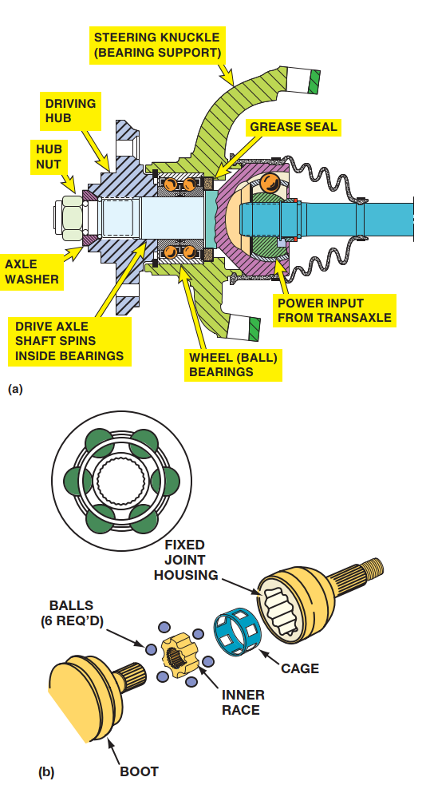
Constant Velocity Joints
FIGURE 33–13 (a) A cutaway view of the outer CV joint with a double-row ball bearing assembly that shows the relations of the parts involved. (b) A Rzeppa fixed joint. This type of CV joint is commonly used at the wheel side of the drive axle shaft. This joint can operate at high angles to compensate for suspension travel and steering angle changes.

Slide 19
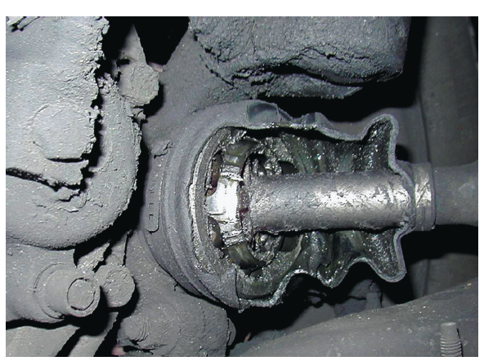
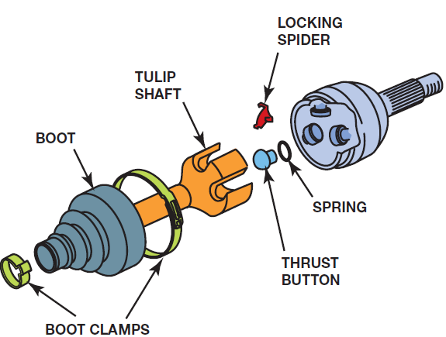
Constant Velocity Joints
OUTER CV JOINTS The Rzeppa-type CV joint is most commonly used as an outer joint on most front-wheel-drive vehicles. The outer joint must do the following:
Allow up to 40 degrees or more of movement to allow the front wheels to turn.
Allow the front wheels to move up and down through normal suspension travel in order to provide a smooth ride over rough surfaces.
Be able to transmit engine torque to drive the front wheels.
Outer CV joints are called fixed joints.
The outer joints are also attached to the front wheels.
FIGURE 33–15 A tripod fixed joint. This type of joint is found on some Japanese vehicles. If the joint wears out, it is to be replaced with an entire drive axle shaft assembly.
FIGURE 33–14 T he protective CV joint boot has been torn away on this vehicle and all of the grease has been thrown outward onto the brake and suspension parts. The driver of this vehicle noticed a “clicking” noise, especially when turning.

Slide 20
Constant Velocity Joints
INNER CV JOINTS- Inner CV joints attach the output of the transaxle to the drive axle shaft. Inner CV joints are therefore inboard, or toward the center of the vehicle.
CV joints have to be able to perform two very important movements:
Allow the drive axle shaft to move up and down as the wheels travel over bumps.
Allow the drive axle shaft to change length as required during vehicle suspension travel movements (lengthening and shortening as the vehicle moves up and down; same as the slip yoke on a conventional RWD driveshaft).
CV joints are also called plunge joints.
FIGURE 33–16 The fixed outer joint is required to move in all directions because the wheels must turn for steering as well as move up and down during suspension movement. The inner joint has to be able to not only move up and down but also plunge in and out as the suspension moves up and down.

Slide 21
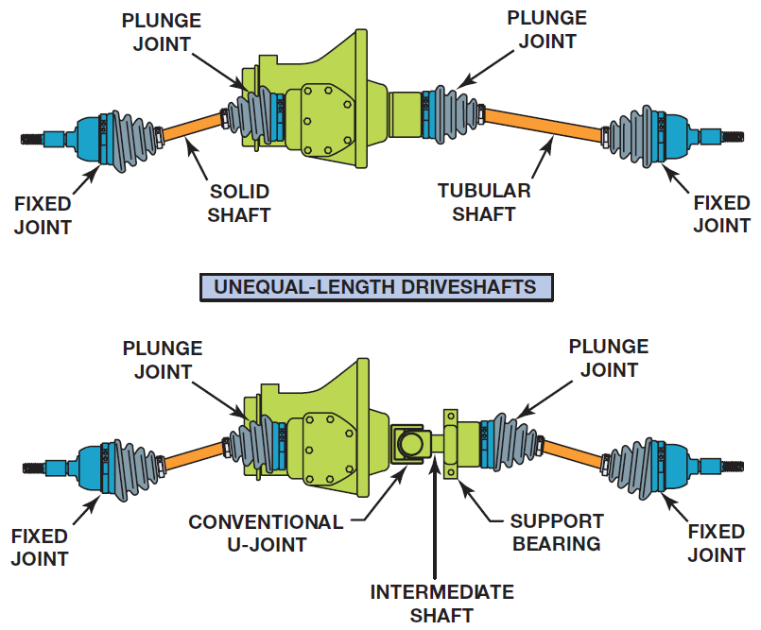
Constant Velocity Joints
DRIVE AXLE SHAFTS Unequal-length drive axle shafts (also called half shafts) result in unequal drive axle shaft angles to the front drive wheels.
This unequal angle often results in a pull on the steering wheel during acceleration.
This pulling to one side during acceleration due to unequal engine torque being applied to the front drive wheels is called torque steer.
To help reduce the effect of torque steer, some vehicles are manufactured with an intermediate shaft that results in equal drive axle shaft angles.
FIGURE 33–17 Unequal-length driveshafts result in unequal drive axle shaft angles to the front drive wheels. This unequal angle side to side often results in a steering of the vehicle during acceleration called torque steer. By using an intermediate shaft, both drive axles are the same angle and the torque steer effect is reduced.

Slide 22
Constant Velocity Joints

Slide 23
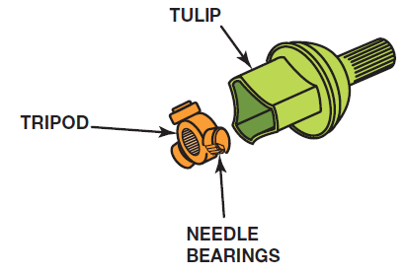
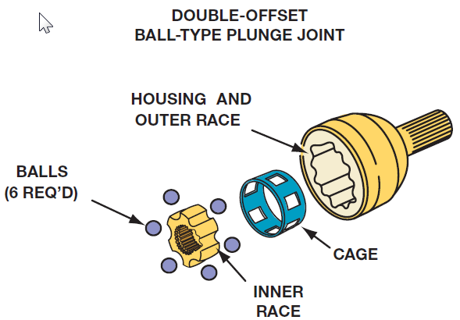
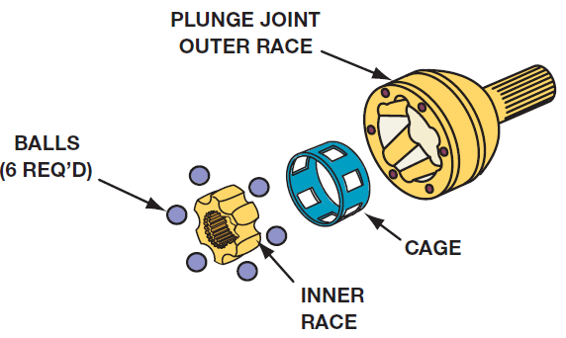
Constant Velocity Joints
Typical types of inner CV joints that are designed to move axially, or plunge, include the following:
1. Tripod.
2. Cross-groove.
3. Double offset.
FIGURE 33–19 A tripod joint is also called a tripot, tripode, or tulip design.
FIGURE 33–20 A cross-groove plunge joint is used on many German front-wheel-drive vehicles and as both inner and outer joints on the rear of vehicles that use an independent-type rear suspension.
FIGURE 33–21 Double-offset ball-type plunge joint

Slide 24
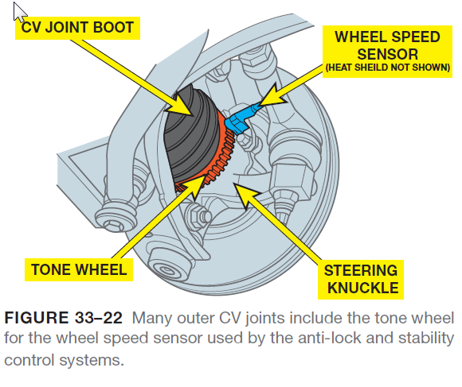
Constant Velocity Joints
CV JOINT BOOT MATERIALS- The pliable boot surrounding the CV joint, or CV joint boot, must be able to remain flexible under all weather conditions and still be strong enough avoid being punctured by road debris. There are four basic types of boot materials used over CV joints:
Natural rubber (black) uses a bridge-type stainless steel clamp to retain.
Silicone rubber (gray) is a high-temperature-resistant material that is usually used only in places that need heat protection, such as the inner CV joint of a front-wheel- drive vehicle.
Hard thermoplastic (black) is a hard plastic material requiring heavy-duty clamps and a lot of torque to tighten (about 100lb-ft!).
Urethane (usually blue) is a type of boot material usually found in an aftermarket part.

Slide 25
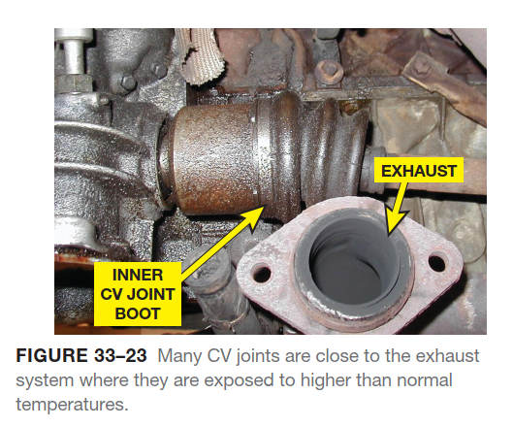
Constant Velocity Joints

Slide 26
Constant Velocity Joints
CV JOINT GREASE CV joints require special greases. Grease is an oil with thickening agents.
Greases are named for the thickening agents used.
Most CV joint grease is molybdenum-disulfide-type grease, commonly referred to as moly grease.
The grease supplied with a replacement CV joint or boot kit should be the only grease used.
The exact mix of chemicals, viscosity (thickness), wear, and corrosion-resistant properties varies from one CV joint application to another.
Some technicians mistakenly think that the color of the grease determines in which CV joint it is used.

Slide 27
Constant Velocity Joints
The exact grease to use depends on many factors, including the following:
The type (style) of CV joint. For example, outer (fixed) and inner (plunging) joints have different lubricating needs.
The location of the joint on the vehicle. For example, inner CV joints are usually exposed to the greatest amount of heat.
The type of boot. The grease has to be compatible with the boot material.

Slide 28
Summary
The driveshaft of a rear-wheel-drive vehicle transmits engine torque from the transmission to the differential.
Driveshaft length is usually limited to about 65 inches due to balancing considerations unless a two-piece or a composite-material shaft is used.
Universal joints (U-joints) allow the driveshaft to transmit engine torque while the suspension and the rear axle assembly are moving up and down during normal driving conditions.
Acceptable working angles for a Cardan-type U-joint fall within 1/2 to 3 degrees. Some angle is necessary to cause the roller bearings to rotate; a working angle of greater than 3 degrees can lead to driveline vibrations.
Constant velocity (CV) joints are used on all front-wheel drive vehicles and many four-wheel-drive vehicles to provide a smooth transmission of torque to the drive wheels regardless of angularity of the wheel or joint.
Outer or fixed CV joints commonly use a Rzeppa design, while inner CV joints are the plunging or tripod type.

Slide 29
Video Links (Internet Access Required)
Drive axle repair (time 5:14)
How to replace a FWD axle shaft (time 14:26)
How to replace CV boots (time 19:32)
How to replace a CV joint (time 1:21)
How to rebuild a CV joint part 1 (time 9:17)
How to rebuild a CV joint part 2 (time 9:46)

