Slide 1
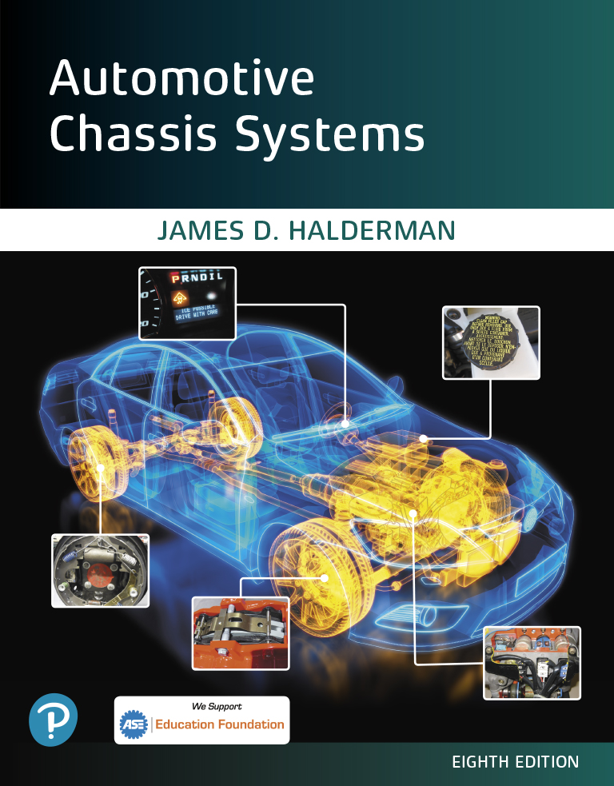
Automotive Chassis Systems Eighth Edition
Chapter 30
Steering Linkage and Service
Notes:
If this PowerPoint presentation contains mathematical equations, you may need to check that your computer has the following installed:
1) MathType Plugin
2) Math Player (free versions available)
3) NVDA Reader (free versions available)

Slide 2
Objectives
Identify steering linkage components.
Describe rack-and-pinion inner tie rod ends.
Describe four-wheel steering systems.
Discuss steering linkage lubrication.
Describe the purpose and procedure for performing a dry park test.
List common wear items in steering systems.
Describe the steps for under-vehicle inspection of steering systems.
Explain how to replace steering linkage parts.
This chapter will help prepare for Suspension and Steering (A4) ASE certification test content area “A” (Steering System Diagnosis and Repair).

Slide 3
Steering Linkage
PURPOSE AND FUNCTION- The steering linkage relays steering forces from the steering gear to the front wheels.
Most conventional steering linkages use the parallelogram type design.
A parallelogram is a geometric box shape where opposite sides are parallel and equal distance. A parallelogram type linkage uses four tie rods, two inner and two outer (left and right), a center link (between the tie rods), and an idler arm on the passenger side and a pitman arm attached to the steering gear output shaft (pitman shaft).
As the steering wheel is rotated, the pitman arm is moved.
The pitman arm attaches to a center link. At either end of the center link are inboard (inner) tie rods, adjusting sleeves, and outboard (outer) tie rods connected to the steering arm, which moves the front wheels.
The passenger side of all these parts is supported and held horizontal by an idler arm that is bolted to the frame.

Slide 4
Steering Linkage
FIGURE 30–1 Steering movement is transferred from the pitman arm that is splined to the sector shaft (pitman shaft), through the center link and tie rods, to the steering knuckle at each front wheel. The idler arm supports the passenger side of the center link and keeps the steering linkage level with the road. This type of linkage is called a parallelogram-type design

Slide 5
Steering Linkage
Connections between all steering component parts are constructed of small ball-and-socket joints.
These joints allow side-to-side movement to provide steering of both front wheels, and allow the joints to move up and down, which is required for normal suspension travel.
It is important that all of these joints be lubricated with chassis grease through a grease fitting, also called a zerk fitting, at least every six months or per the vehicle manufacturer’s specifications.
Some vehicles come equipped with sealed joints and do not require periodic servicing.
Some vehicles come from the factory with plugs that need to be removed and replaced with grease fittings and then lubricated.

Slide 6
Animation: Steering Linkage, Parallelogram (The animation will automatically start in a few seconds)

Slide 7
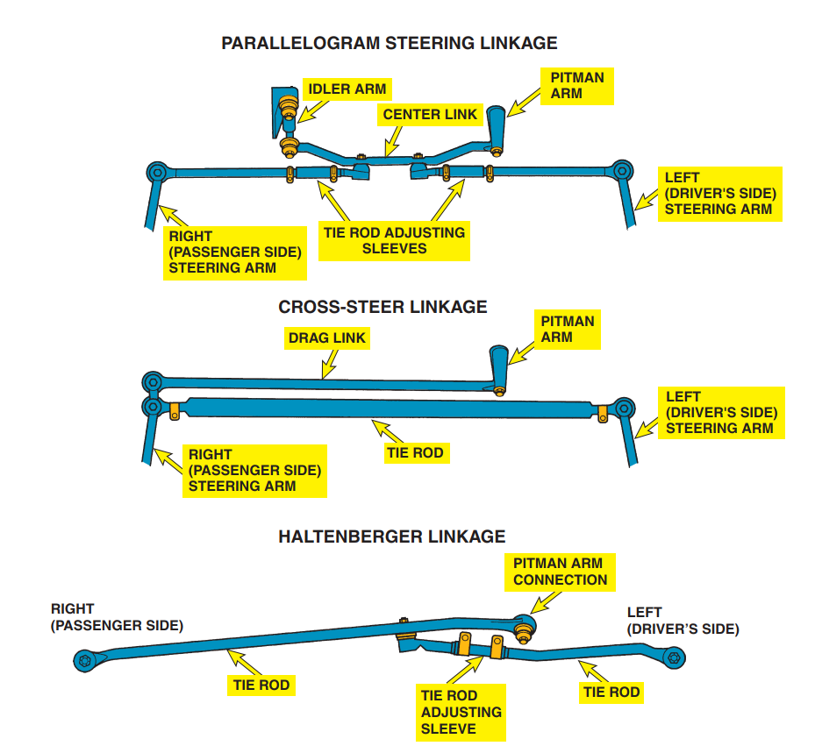
Rack-and-Pinion Inner Tie Rod Ends
FIGURE 30–2 The most common type of steering is the parallelogram. The cross-steer and Haltenberger linkage designs are
used on some trucks and vans.

Slide 8
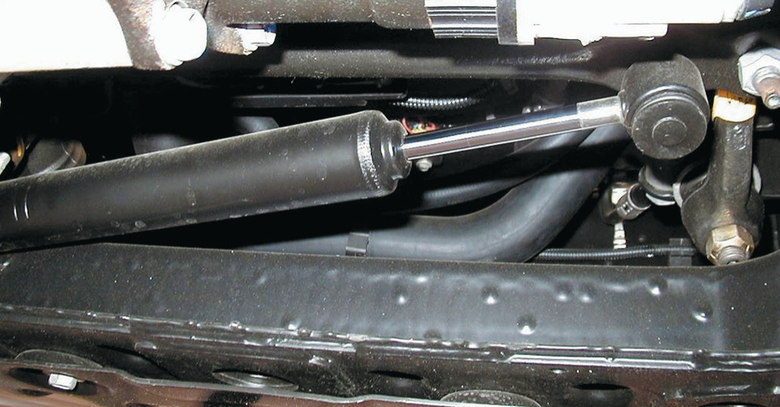
Rack-and-Pinion Inner Tie Rod Ends
FIGURE 30–3 Typical steering dampener used on a Hummer H2.

Slide 9
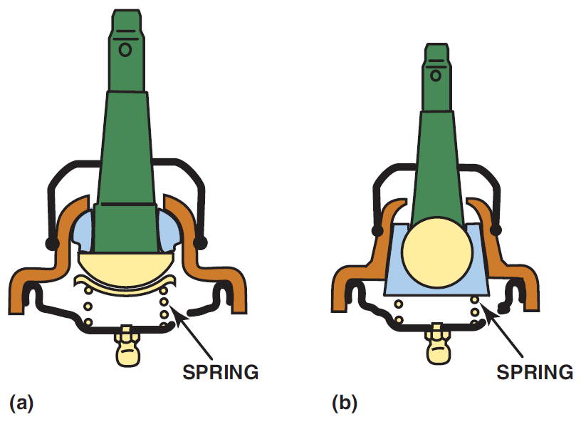
Steering Linkage
TIE ROD ENDS- Tie rod ends connect the steering linkage to the steering knuckles and to other steering linkage components.
Conventional tie rod ends use a hardened steel ball stud assembled into a hardened steel and thermoplastic bearing.
An internal preload spring limits the ball stud endplay and helps compensate for ball-and-socket wear.
For many years, Ford Motor Company used tie rod ends that included a rubber-bonded steel ball stud.
Because there is no sliding friction inside the tie rod end, no lubrication was needed. This type of tie rod end is called RBS (rubber-bonded socket).
FIGURE 30–4 (a) A dual bearing design with a preload spring. The use of two bearing surfaces allows one surface for rotation (for steering) and another surface for pivoting (to allow for suspension up-and-down movement). (b) The nylon wedge bearing type allows for extended lube intervals. Wear is automatically compensated for by the tapered design and spring-loaded bearing.

Slide 10
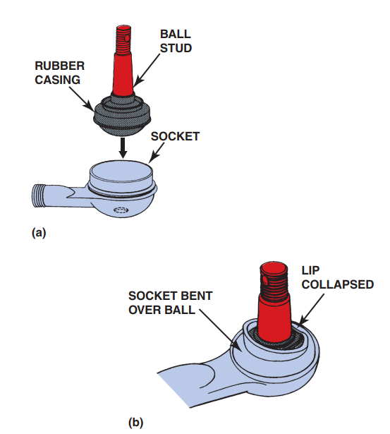
Rack-and-Pinion Inner Tie Rod Ends
FIGURE 30–5 (a) A rubber-bonded socket is constructed of a rubber casing surrounding the ball stud, which is then
inserted into the socket of the tie rod end. The hole in the socket allows air to escape as the ball stud is installed and there is not a place for a grease fitting. (b) The socket is
crimped over the ball so that part of the socket lip retains the stud.

Slide 11
Rack-and-Pinion Inner Tie Rod Ends
TERMINOLOGY- Inner tie rod end assemblies used on rack-and- pinion steering units require special consideration and often special tools.
The inner tie rod end is also called a ball socket assembly.
STAKED- This method is common on Saginaw-style rack and- pinion steering units found on General Motors vehicles.
The flange around the outer tie rod must be restaked to the flat on the end of the rack.
FIGURE 30–6 Rack-and-pinion steering systems use a balland-socket-type inner tie rod end.

Slide 12
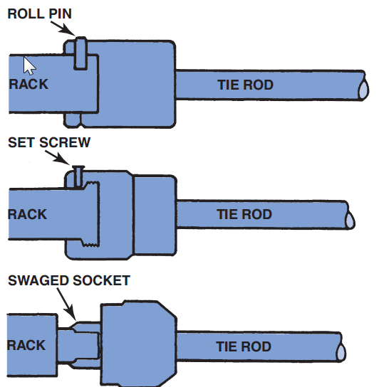
Rack-and-Pinion Inner Tie Rod Ends
RIVETED OR PINNED- This method is commonly found on Ford vehicles.
Some roll pins require a special puller, or the pin can be drilled out.
Many styles use an aluminum rivet.
A special, very deep socket or a large open-end wrench can usually be used to shear the aluminum rivet by unscrewing the socket assembly from the end of the rack while the rack-and-pinion unit is still in the vehicle.
FIGURE 30–7 A variety of methods are used to secure the inner tie rod end socket assembly to the end of the rack.

Slide 13
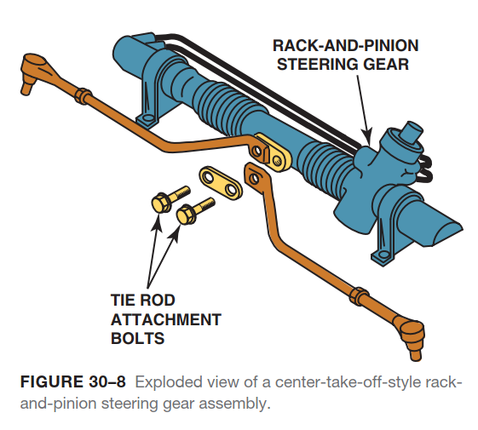
Rack-and-Pinion Inner Tie Rod Ends

Slide 14
Animation: Replace Tie Rod End (The animation will automatically start in a few seconds)

Slide 15
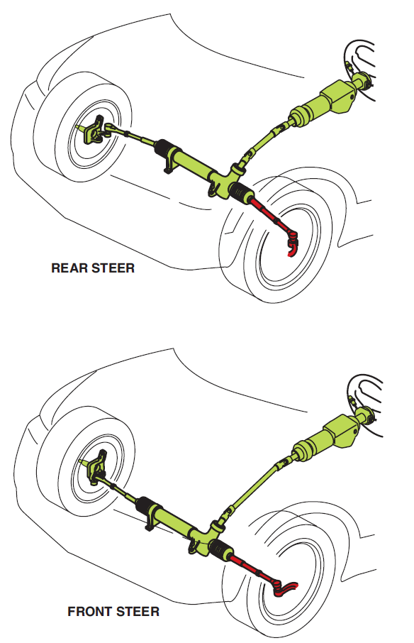
Front Steer Versus Rear Steer
TERMINOLOGY- Front steer, also called forward steer, is the term used to describe a vehicle that has the steering gear in front of the front wheel centerline.
Having the steering gear located in this position improves handling and directional stability, especially when the vehicle is heavily loaded.
Front-steer vehicles usually produce an understeer effect that makes the vehicle feel very stable while cornering.
If the steering gear linkage is located behind the wheels, it is called rear steer and the cornering forces are imposed on the steering in the direction of the turn.
Most front-wheel-drive vehicles are rear steering, with the rack-and-pinion steering unit attached to the bulkhead or subframe behind the engine.
FIGURE 30–9 In a rear-steer vehicle, the steering linkage is behind the centerline of the front wheels, whereas the linkage is in front on a front-steer vehicle.

Slide 16
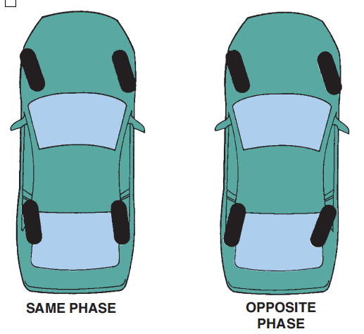
Front Steer Versus Rear Steer
TERMINOLOGY- Some vehicles were equipped with a system that steers all four wheels. Two terms are commonly used when discussing four-wheel steering:
Same-phase steering. Same-phase steering means that the front and rear wheels are steered in the same direction.
Opposite-phase steering. Also called negative-phase mode, opposite-phase steering is when the front wheels and rear wheels are steered in the opposite direction.
● Opposite-phase steering will quickly change the vehicle’s direction, but may cause a feeling of oversteering.
Opposite-phase steering is best at low speeds; same-phase steering is best for higher-speed handling and lane-change maneuvers.
FIGURE 30–10 Opposite-phase four-wheel steer is usually used only at low vehicle speed to help in parking maneuvers. Same-phase steering helps at higher speeds and may not be noticeable by the average driver.

Slide 17
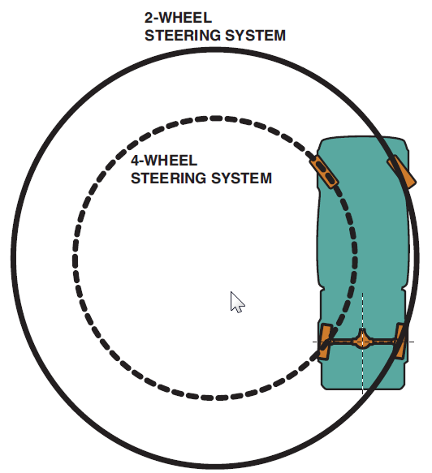
Four-Wheel Steering Systems
QUADRASTEER- Quadrasteer™ is a four-wheel steering system that dramatically enhances low-speed maneuverability, high-speed stability, and towing capability.
Four-wheel steer mode. The four-wheel steering mode provides three principal phases of steering: negative phase, neutral phase, and positive phase.
Negative phase occurs at low speeds and the rear wheels turn opposite of the front wheels. In the neutral phase, the rear wheels are centered and do not turn.
Positive phase occurs at higher speeds and the rear wheels turn in the same direction as the front wheels.
Four-wheel steer tow mode. The four-wheel steer tow mode provides more positive-phase steering than the normal four-wheel steering at high speed.
During low speed driving, the four-wheel steer tow mode provides similar negative- phase steering as it does in the normal four-wheel steering mode.
FIGURE 30–11 Being equipped with four-wheel steer allows a truck to make shorter turns than would otherwise be possible.

Slide 18
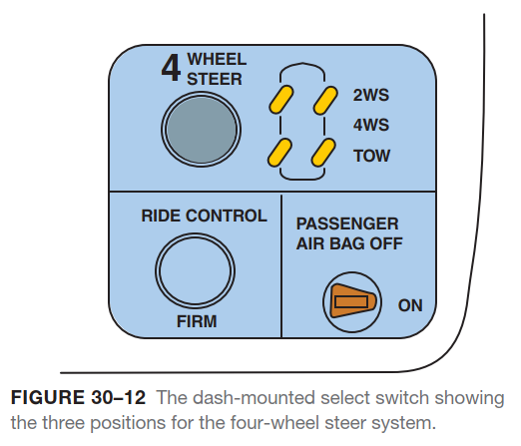
Four-Wheel Steering Systems

Slide 19
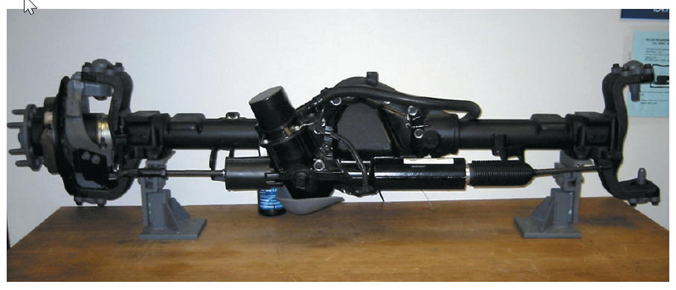
Four-Wheel Steering Systems
STEERABLE REAR AXLE. The steerable rear axle has a rack-and-pinion-style actuator mounted to the differential cover, specially designed axle shafts, and movable hub and bearing assemblies mounted by upper and lower ball joints.
The actuator housing is part of the differential cover.
The actuator has specially designed inner and outer tie rod ends.
The actuator has the rear wheel steering motor assembly attached to the upper housing.
FIGURE 30–13 A Quadrasteer system showing all of the components. The motor used to power the rear steering rack can draw close to 60 amperes during a hard turn and can be monitored using a Tech 2.

Slide 20
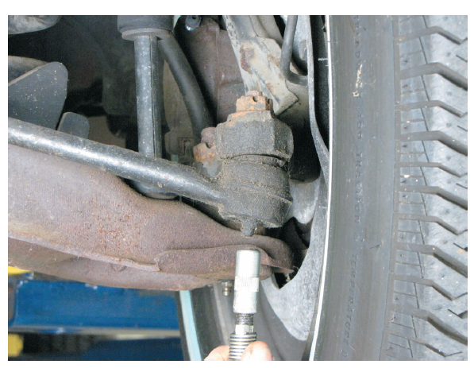
Steering Linkage Lubrication
Keeping all joints equipped with a grease fitting properly greased is necessary for long life and ease of steering.
During a chassis lubrication, do not forget to put grease on the steering stop, if so equipped.
Steering stops are the projections or built-up areas on the control arms of the front suspension designed to limit the steering movement at full lock.
When the steering wheel is turned as far as it can go, the steering should not stop inside the steering gear.
Forces exerted by the power steering system can do serious damage to the steering gear if absorbed by the steering gear rather than the steering stop.
FIGURE 30–14 Greasing a tie rod end. Some joints do not have a hole for excessive grease to escape, and excessive grease can destroy the seal.

Slide 21
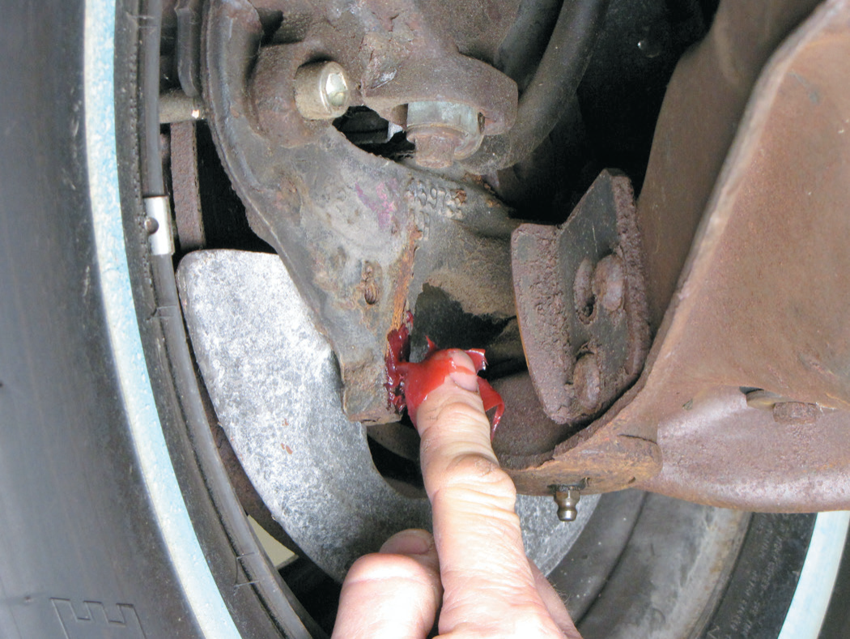
Steering Linkage Lubrication
FIGURE 30–15 Part of steering linkage lubrication is
applying grease to the steering stops. If these stops are not lubricated, a grinding sound may be heard when the vehicle hits a bump when the wheels are turned all the way one direction or the other. This often occurs when driving into or out of a driveway that has a curb.

Slide 22
Dry Park Test
PURPOSE- Since many steering (and suspension) components do not have exact specifications for replacement purposes, it is extremely important that the beginning service technician work closely with an experienced veteran technician.
While most technicians can determine when a steering component such as a tie rod end is definitely in need of replacement, marginally worn parts are often hard to spot and can lead to handling problems.
One of the most effective, yet easy to perform, steering component inspection methods is called the dry park test.
Excessive play in the steering wheel can be caused by worn or damaged steering components.
Looseness in the steering components usually causes freeplay in the steering wheel.
Freeplay refers to the amount of movement of the steering wheel required to cause movement of the front wheels.

Slide 23
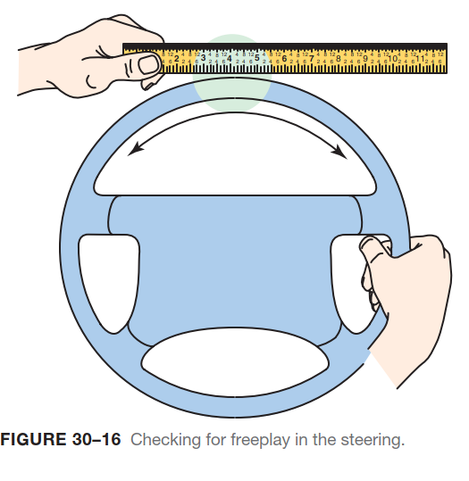
Dry Park Test

Slide 24
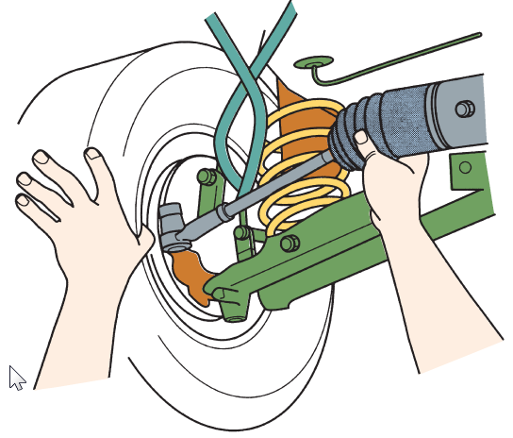
Dry Park Test
This simple test is performed with the vehicle on the ground or on a drive-on ramp-type hoist, moving the steering wheel back and forth slightly while an assistant feels for movement at each section of the steering system.
The technician can start checking for any looseness in the steering linkage starting either at the outer tie rod ends and working toward the steering column, or from the steering column toward the outer tie rod ends.
It is important to check each and every joint and component of the steering system, including the following:
The intermediate shaft and flexible coupling.
All steering linkage joints, including the inner tie rod end ball socket.
Steering gear mounting and rack-and-pinion mounting bushings
FIGURE 30–17 All joints should be felt during a dry park test. Even inner tie rod ends (ball socket assemblies) can be felt through the rubber bellows on many rack-and-pinion steering units.

Slide 25
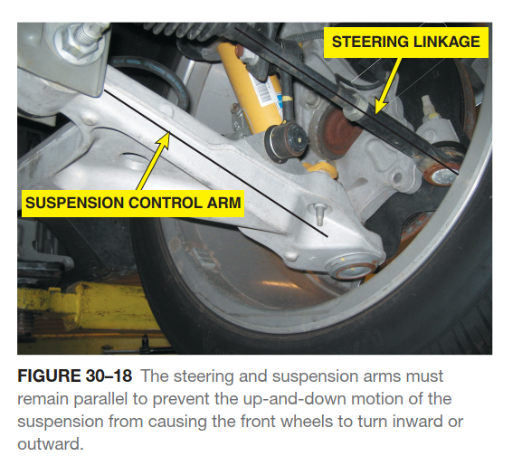
Dry Park Test

Slide 26
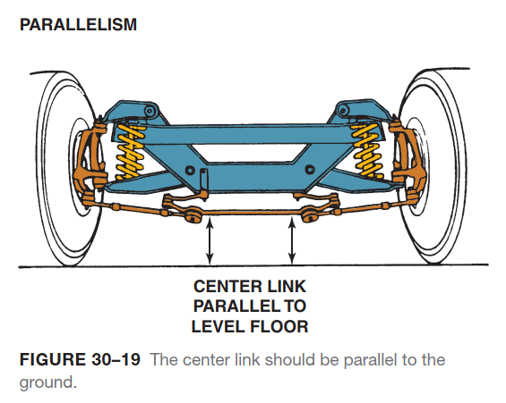
Dry Park Test

Slide 27
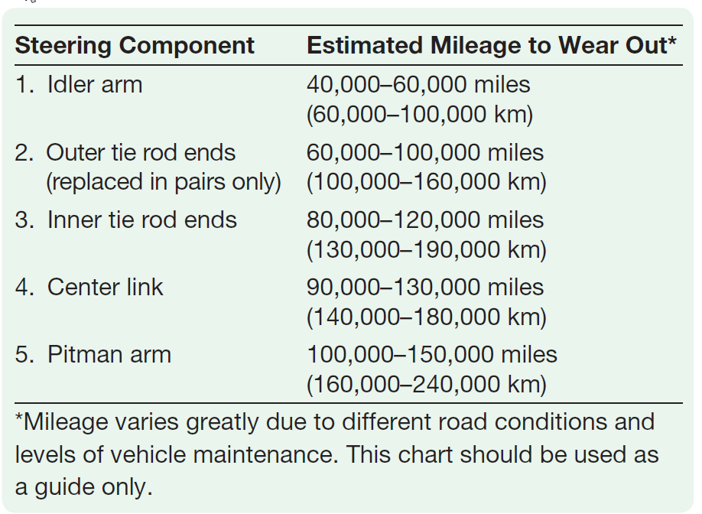
Common Wear Items
On a vehicle equipped with a conventional steering gear and parallelogram linkage, typical items that wear first, second, and so on include the following:

Slide 28
Common Wear Items
FIGURE 30–20 Typical parallelogram steering linkage. The center link can also be named the relay rod, drag link, or connecting link.

Slide 29
Common Wear Items
Note that there are overlapping mileage intervals for several components.
Also note that the mileage interval for an idler arm is such that by the time other components are worn, the idler arm may need to be replaced a second time.
For vehicles that use rack-and-pinion-type steering systems, the list is shorter because there are fewer steering components and the forces exerted on a rack-and-pinion system are in a straight line.
The first to wear is usually the outer tie rod ends (one or both) followed by the inner tie rod ball-and-socket joints, usually after 60,000 miles (100,000 km) or more.
Intermediate shaft U-joints usually become worn and can cause steering looseness after 80,000 miles (130,000 km) or more.

Slide 30
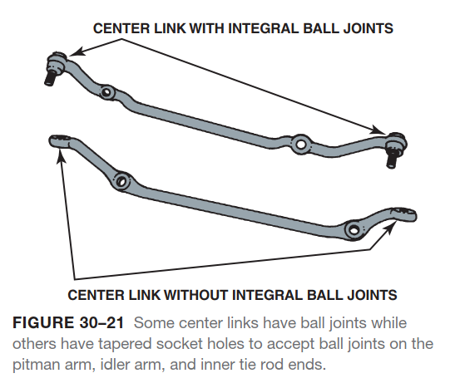
Under Vehicle Inspection

Slide 31
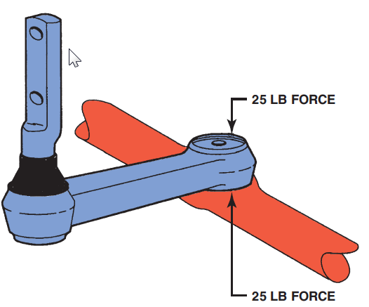
Under Vehicle Inspection
After checking the steering system components as part of a dry park test, hoist the vehicle and perform a thorough part-by-part inspection:
1. Inspect each part for damage due to an accident or bent parts due to the vehicle hitting an object in the roadway.
2. Idler arm inspection is performed by using hand force of 25 pounds (110 N-m) up and down on the arm. If the total movement exceeds 1/4 inch (6 mm), the idler arm should be replaced.
FIGURE 30–22 To check an idler arm, most vehicle
manufacturers specify that 25 pounds of force be applied by hand up and down to the idler arm. The idler arm should be replaced if the total movement (up and down) exceeds ¼ inch (6 mm).

Slide 32
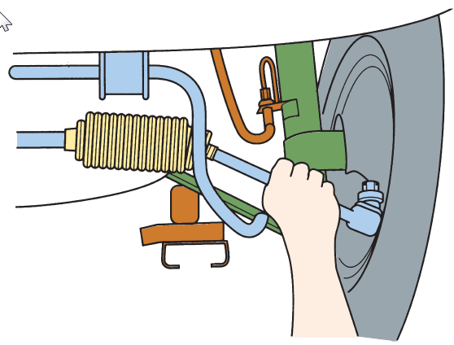
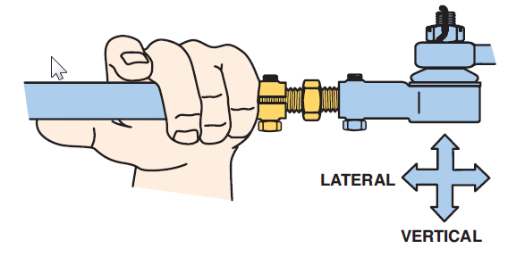
Under Vehicle Inspection
3. All other steering linkage should be tested by hand for any vertical or side-to-side looseness.
Tie rod ends use ball-and- socket joints to allow for freedom of movement for suspension travel and to transmit steering forces to the front wheels.
It is therefore normal for tie rods to rotate in their sockets when the tie rod sleeve is rocked.
Endplay in any tie rod should be zero. Many tie rods are spring loaded to help keep the ball-and-socket joint free of play as the joint wears.
Eventually, the preloaded spring cannot compensate for the wear, and endplay occurs in the joint.
4. All steering components should be tested with the wheels in the straight-ahead position..
FIGURE 30–23 Steering system component(s) should be replaced if any noticeable looseness is detected when moved by hand.
FIGURE 30–24 All joints should be checked by hand for any lateral or vertical play.

Slide 33
Steering Linkage Replacement
PARALLELOGRAM TYPE- When replacing any steering system component, it is best to replace all defective and marginally good components at the same time. Use the following guidelines.
Parts that can be replaced individually include the following:
Idler arm
Center link
Pitman arm
Intermediate shaft
Intermediate shaft U
Parts that should be replaced in pairs only include the following:
Outer tie rod ends
Inner tie rod ends
Idler arm (if there are two on the same vehicle, such as GM’s Astro van)

Slide 34
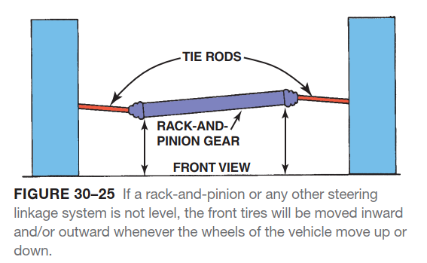
Steering Linkage Replacement

Slide 35
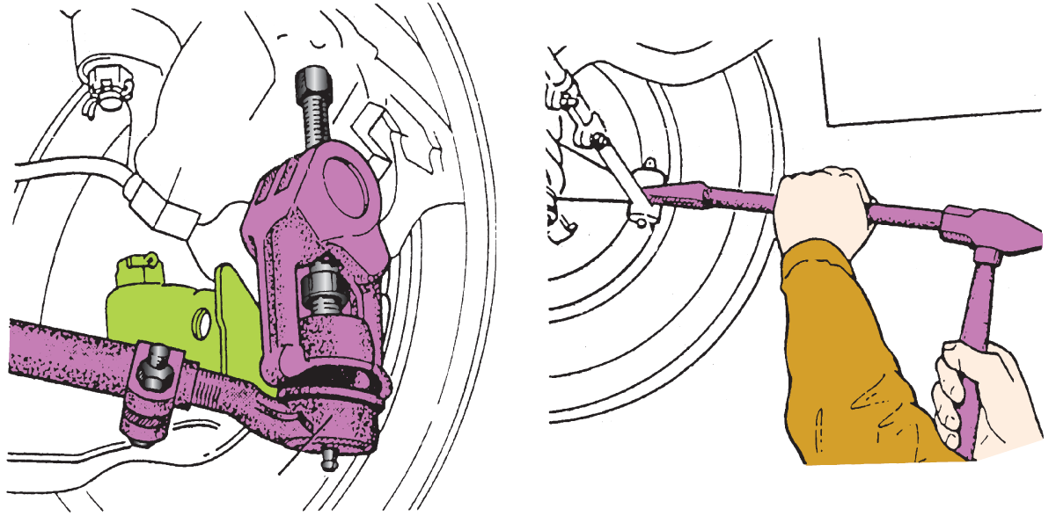
Steering Linkage Replacement
Replacing steering system components involves these steps:
STEP 1 Hoist the vehicle safely with the wheels in the straight ahead position. Remove the front wheels, if necessary, to gain access to the components.
STEP 2 Loosen the retainer nut on tapered components, such as tie rod ends. Use a tie rod removal puller (also called a taper breaker), or use hammers to slightly deform the taper.
FIGURE 30–26 The preferred method for separating the tie rod end from the steering knuckle is to use a puller such as the one shown. A pickle-fork-type tool should only be used if the tie rod end is going to be replaced. A pickle-fork-type tool can damage or tear the rubber grease boot.

Slide 36
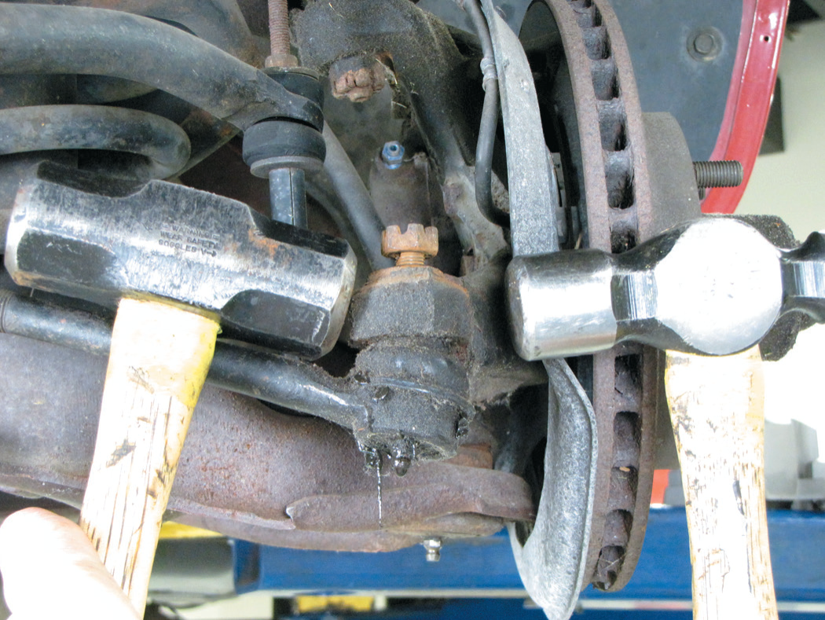
Steering Linkage Replacement
FIGURE 30–27 Two hammers being used to disconnect a tie rod end from the steering knuckle. One hammer is used as a backing for the second hammer. notice that the attaching nut has been loosened, but not removed. This prevents the tie rod end from falling when the tapered connection is knocked loose.

Slide 37
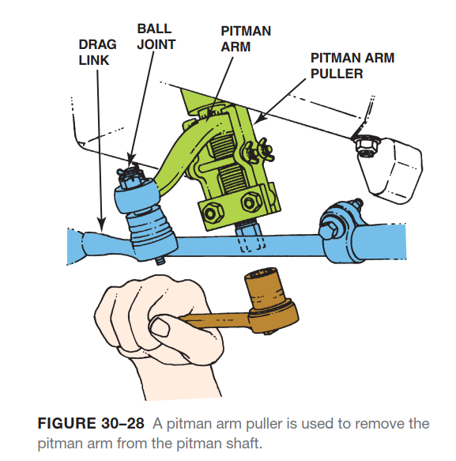
Steering Linkage Replacement

Slide 38
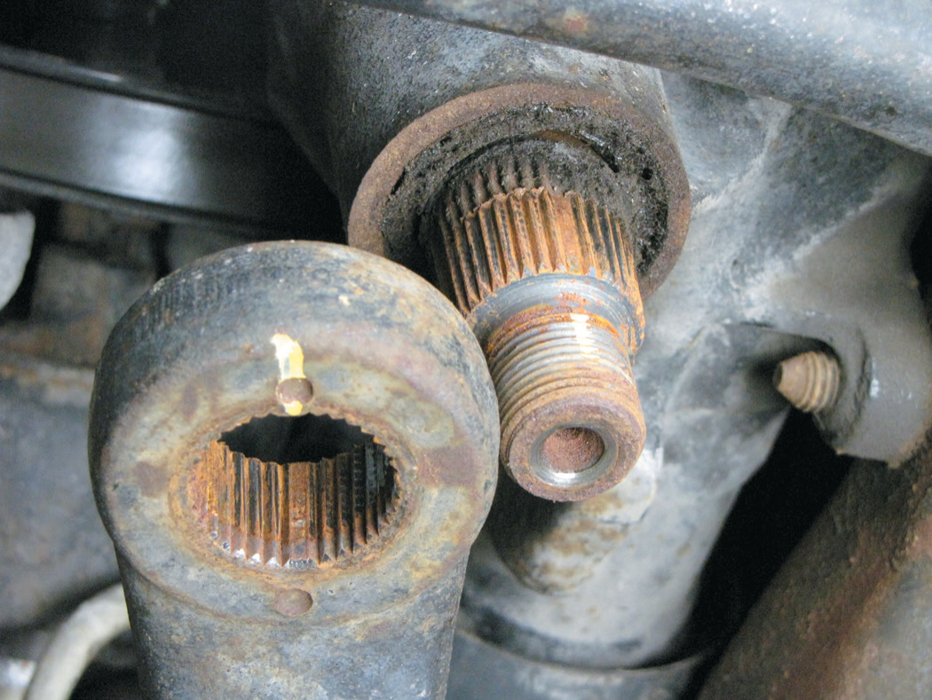
Steering Linkage Replacement
FIGURE 30–29 Pitman arm and pitman shaft indexing splines.

Slide 39
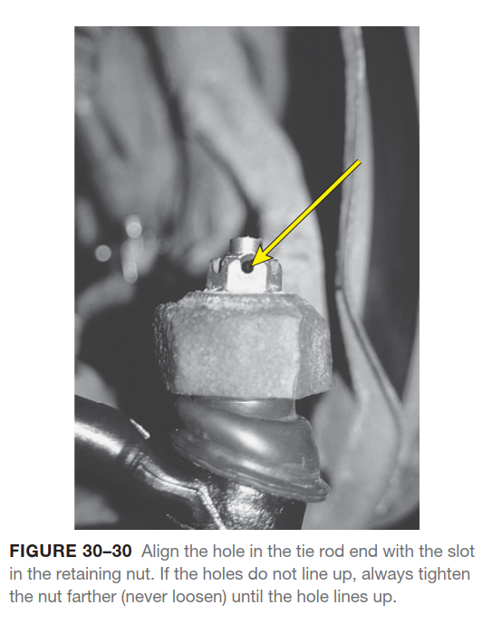
Steering Linkage Replacement

Slide 40
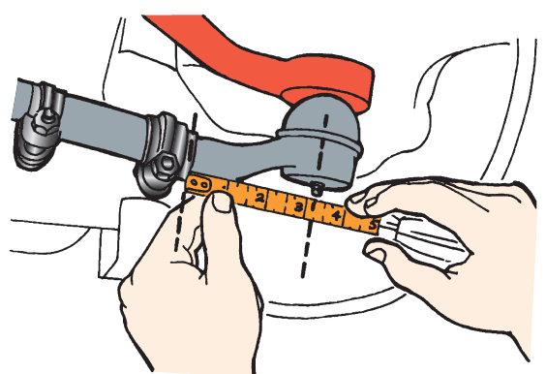
Steering Linkage Replacement
STEP 3 Replace the part using the hardware and fasteners supplied with the replacement part. Do not reuse the prerecrimped torque prevailing nuts used at the factory as original equipment on many tie rod ends.
When replacing tie rod ends, use the adjusting sleeve to adjust the total length of the tie rod to the same position and length as the original. Measure the original length of the tie rods and assemble the replacement tie rod(s) to the same overall length.
When positioning the tie rod end(s), check that the stud is centered in the socket. This permits maximum steering linkage movement without getting into a bind if the steering linkage is pivoted beyond the angle the tie rod end can move in the socket.
FIGURE 30–31 Replacement tie rods should be of the same overall length as the originals. Measure from the edge of the tie rod sleeve to the center of the grease fitting. When the new tie rod is threaded to this dimension, the toe setting will be close to the original.

Slide 41
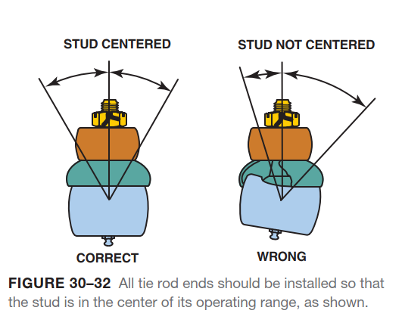
Steering Linkage Replacement

Slide 42
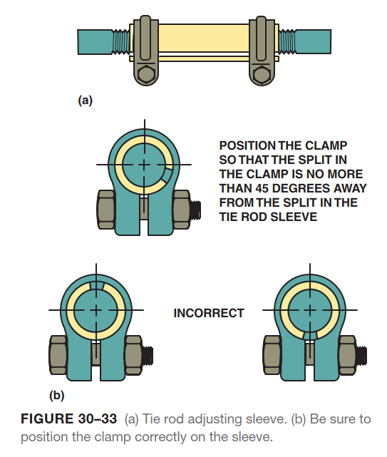
Steering Linkage Replacement

Slide 43
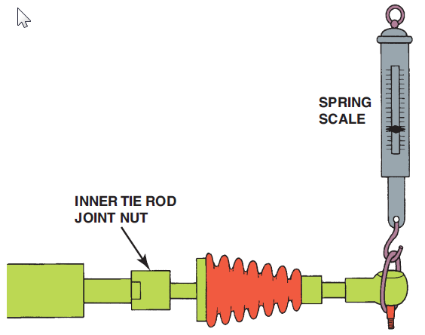
Steering Linkage Replacement
SERVICE OF BALL SOCKET ASSEMBLIES- Inner tie rod end assemblies used on rack-and-pinion steering units require special consideration and often special tools.
The inner tie rod end, also called a ball socket assembly, should be replaced whenever there is any noticeable freeplay in the ball-and-socket joint.
Another test of this joint is performed by disconnecting the outer tie rod end and measuring the effort required to move the tie rod in the socket.
This is called the articulation test.
FIGURE 30–34 An articulation test uses a spring scale to measure the amount of force needed to move the tie rod in the ball socket assembly. Most manufacturers specify a minimum of 1 pound (4.4 N) of force and a maximum of 6 pounds (26 N).

Slide 44
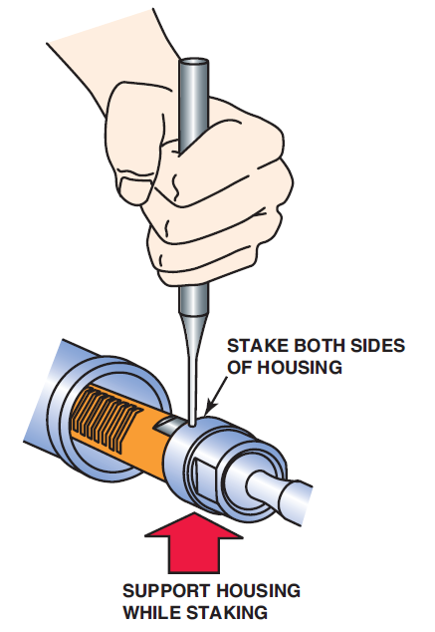
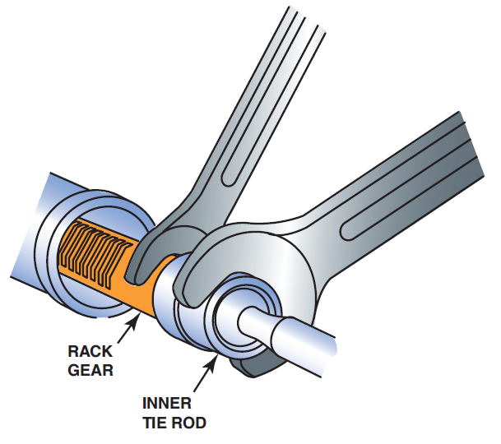
Steering Linkage Replacement
The inner tie rod assemblies are attached to the end of the steering rack by one of several methods.
Removing a ball socket assembly usually requires the use of two wrenches or a special tool.
The flange around the outer tie rod must be restaked to the flat shoulder on the end of the rack.
FIGURE 30–35 Removing a staked inner tie rod assembly requires two wrenches—one to hold the rack and the other to unscrew the joint from the end of the steering rack.
FIGURE 30–36 When the inner tie rod end is reassembled, both sides of the housing must be staked down onto the flat shoulder of the rack.

Slide 45
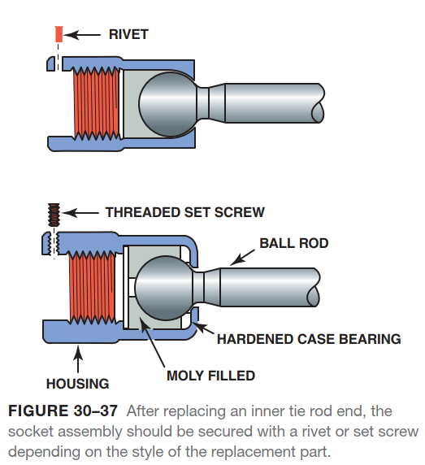
Steering Linkage Replacement

Slide 46
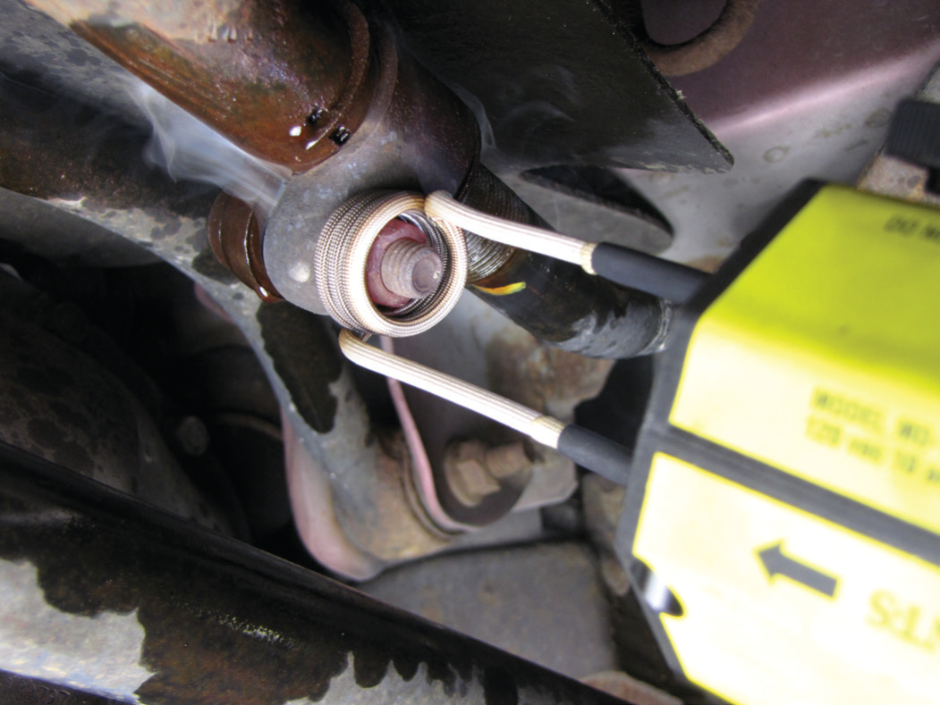
Steering Linkage Replacement
FIGURE 30–38 Using an inductive heater caused this retaining nut to be cherry red in a just a few seconds.

Slide 47
Animation: Rack & Pinion Gear, Remove & Replace (The animation will automatically start in a few seconds)

Slide 48
Summary
The dry park test is a very important test to detect worn or damaged steering parts. With the vehicle on the ground, have an assistant move the steering wheel back and forth while the technician feels for any looseness in each steering system part.
The steering system must be level side to side to prevent unwanted bump steer. Bump steer is when the vehicle’s direction is changed when traveling over bumps or dips in the road.
The idler arm usually is the first steering system component to wear out in a conventional parallelogram-type steering system. Following the idler arm in wear are the tie rods, center link, and then the pitman arm.
Steering components should be checked for wear using hand force only.
All steering components should be installed and tightened with the front wheels in the straight-ahead position.
Always use a tie rod remover/puller or a taper breaker when separating tapered components, such as tie rods.

Slide 49
Video Links (Internet Access Required)
GM Steering Wheel Removal
Rack and Pinion Gear Remove and Replace
Steering Linkage Operation
Tie Rod End Replace
Tie Rod End Remove and Replace

