Slide 1
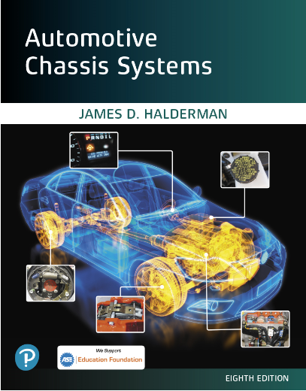
Automotive Chassis Systems Eighth Edition
Chapter 28
Electronic Suspension
Systems
Notes:
If this PowerPoint presentation contains mathematical equations, you may need to check that your computer has the following installed:
1) MathType Plugin
2) Math Player (free versions available)
3) NVDA Reader (free versions available)

Slide 2
Objectives
Discuss the need for electronic suspension systems.
Explain the characteristics of the various sensors used for electronic suspension control.
Describe electronic suspension system actuators.
List the types of electronic suspension systems.
Describe the parts and operation of the automatic level control system.
Explain the procedure to troubleshoot rear electric leveling systems.
Explain how magneto-rheological shocks work.
This chapter will help prepare for ASE Suspension and Steering (A4) certification content area “C” (Related Suspension and Steering Service).

Slide 3
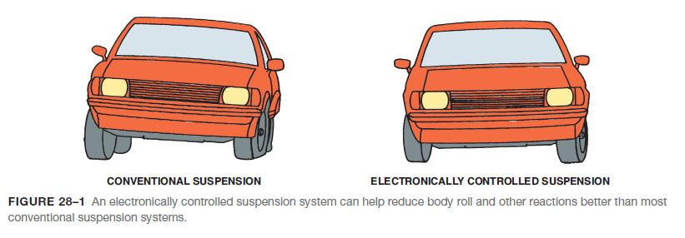
The Need For Electronic Suspensions
Since the mid-1980s, many vehicle manufacturers have been introducing models with electronic suspension controls that provide a variable shock stiffness or spring rate.
The main advantage of electronic controls is that the suspension can react to different conditions.

Slide 4
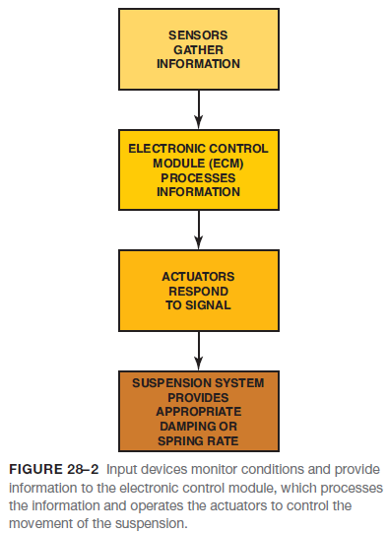
Electronic Suspension Controls And Sensors
INPUTS AND OUTPUTS- Sensors and switches provide input to the electronic control module (ECM), or system computer.
HEIGHT SENSORS- Sensors, which are the input devices that transmit signals to the ECM, monitor operating conditions and component functions.

Slide 5
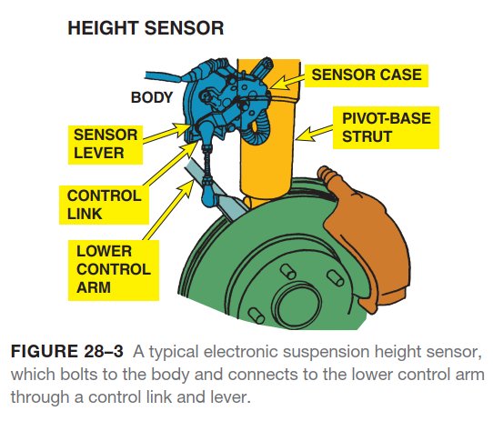
Electronic Suspension Controls And Sensors

Slide 6
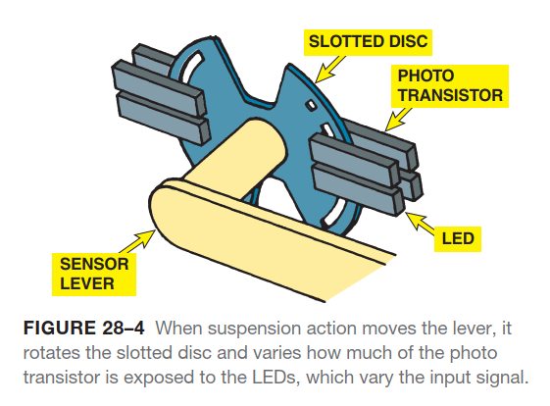
Electronic Suspension Controls And Sensors

Slide 7
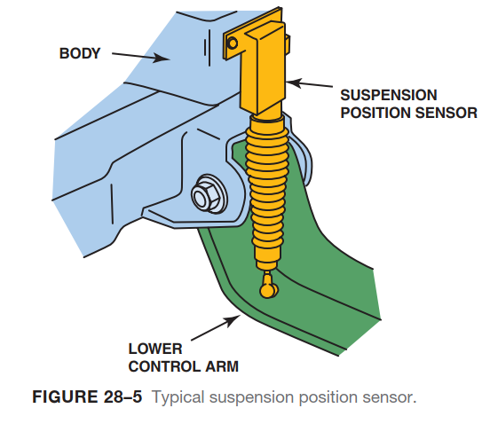
Electronic Suspension Controls And Sensors

Slide 8
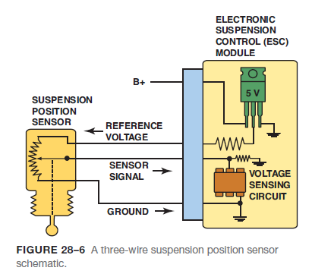
Electronic Suspension Controls And Sensors
GENERAL MOTORS ELECTRONIC SUSPENSION SENSORS- There are five different sensors found on electronic suspension systems, and GM vehicles can have between one and four of these sensors, depending on the system.
Depending on the vehicle, the suspension position sensor may be called by a different name.
It can be called:
An automatic level control sensor
An electronic suspension position sensor
A position sensor
An air suspension sensor

Slide 9
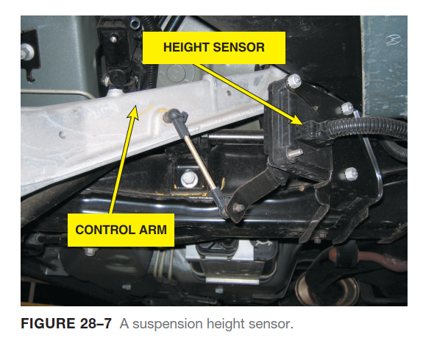
Electronic Suspension Controls And Sensors

Slide 10
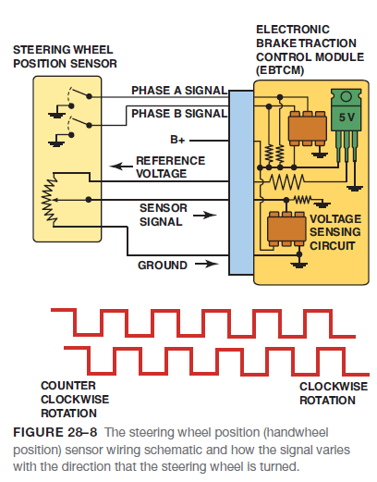
Electronic Suspension Controls And Sensors
STEERING WHEEL POSITION SENSOR- Depending on the vehicle, the steering wheel position sensor may also be called a handwheel position sensor.
The function of this sensor is to provide the control module with signals relating to steering wheel position, the speed, and direction of handwheel position.

Slide 11
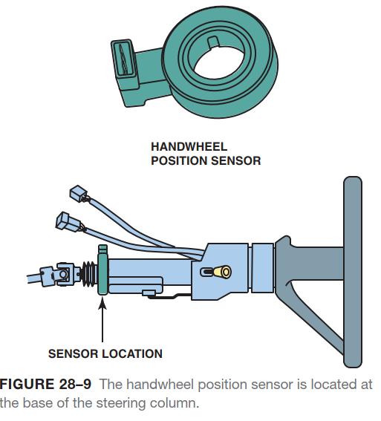
Electronic Suspension Controls And Sensors

Slide 12
Animation: Electronic Suspension System (The animation will automatically start in a few seconds)

Slide 13
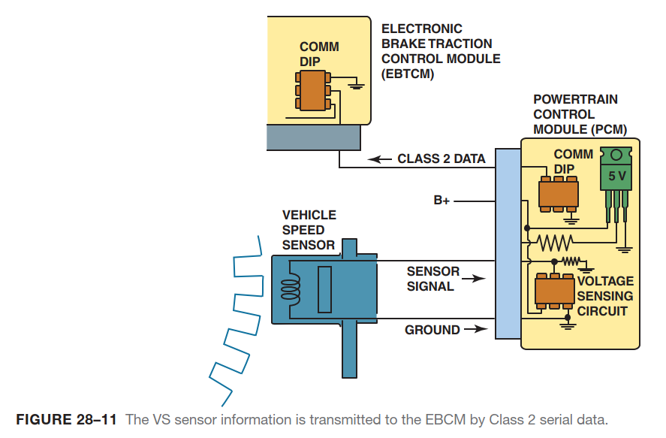
Electronic Suspension Controls And Sensors

Slide 14
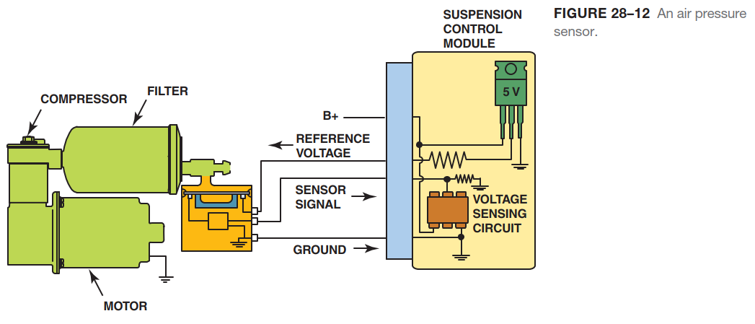
Electronic Suspension Controls And Sensors

Slide 15
Electronic Suspension Controls And Sensors
VEHICLE SPEED SENSOR- The vehicle speed (VS) sensor is used by the EBCM to help control the suspension system.
PRESSURE SENSOR- A pressure transducer (sensor) is typically mounted on the compressor assembly.
This sensor is typically found on systems such as air suspension, real-time damping, and road-sensing suspension that use a compressor assembly.
LATERAL ACCELEROMETER SENSOR- The function of the lateral accelerometer sensor is to provide the suspension control module with feedback regarding vehicle cornering forces.
This type of sensor is also called a G-sensor, with the letter “G” representing the force of gravity.

Slide 16
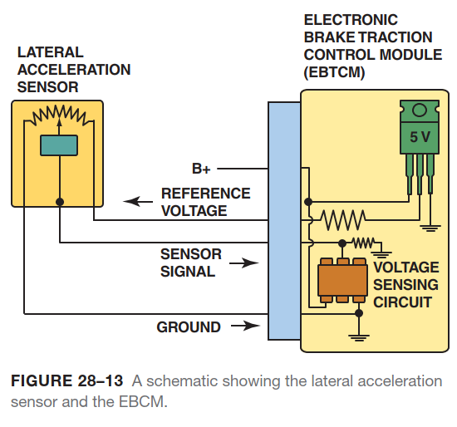
Electronic Suspension Controls And Sensors

Slide 17
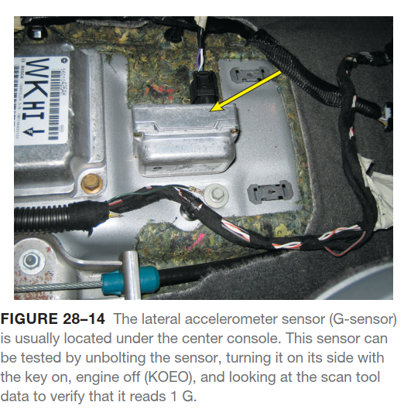
Electronic Suspension Controls And Sensors

Slide 18
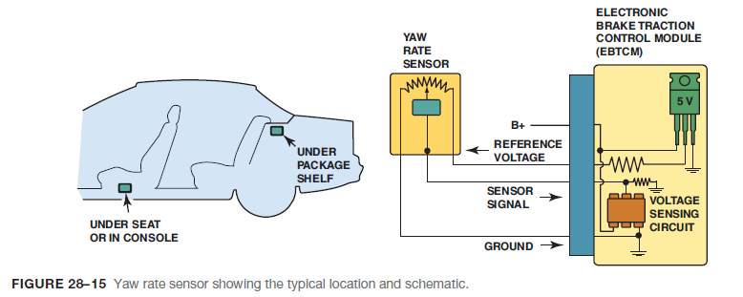
Electronic Suspension Controls And Sensors
YAW RATE SENSOR- The yaw rate sensor provides information to the suspension control module and the EBCM. This information is used to determine how far the vehicle has deviated from the driver’s intended direction.
DRIVER SELECTOR SWITCH- The driver selector switch is a two- or three-mode switch, usually located in the center console, and is an input to the suspension control module.

Slide 19
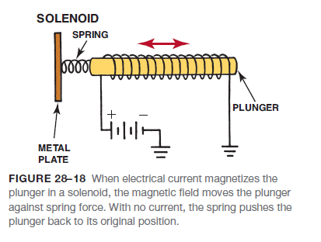
Electronic Suspension System Actuators
TERMINOLOGY- Each actuator in an electronically controlled suspension system receives output signals from the ECM and responds to these signals, or commands, by performing a mechanical action.
SOLENOIDS- In a solenoid, the core of the electromagnet also acts as a plunger to open and close a passage or to move a linkage.
Solenoids are cylindrically shaped with a metal plate at one end and open at the other end to allow the plunger to move in and out.
ACTUATOR MOTORS- If a current-carrying conductor is placed in a magnetic field, it tends to move from the stronger field area to the weaker field area.

Slide 20
Electronic Suspension System Actuators

Slide 21
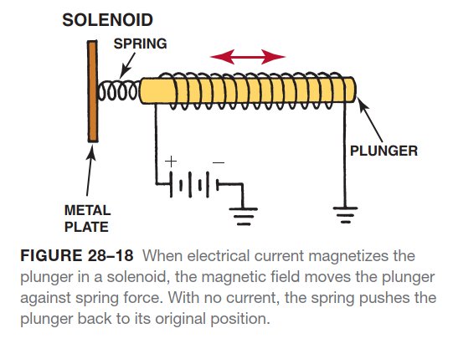
Electronic Suspension System Actuators

Slide 22
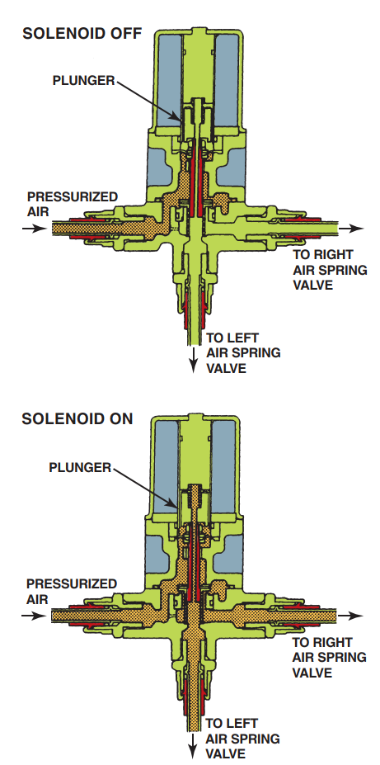
Electronic Suspension System Actuators
FIGURE 28-19 This air supply solenoid blocks pressurized air from the air spring valves when off. The plunger pulls upward to allow airflow to the air spring valves when the solenoid is energized.

Slide 23
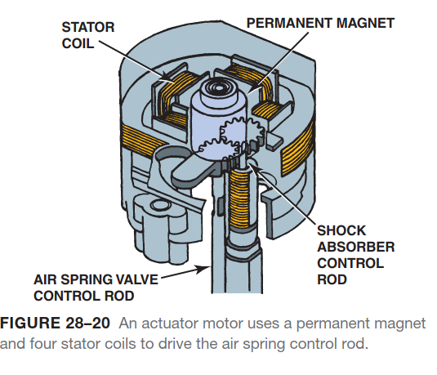
Electronic Suspension System Actuators

Slide 24
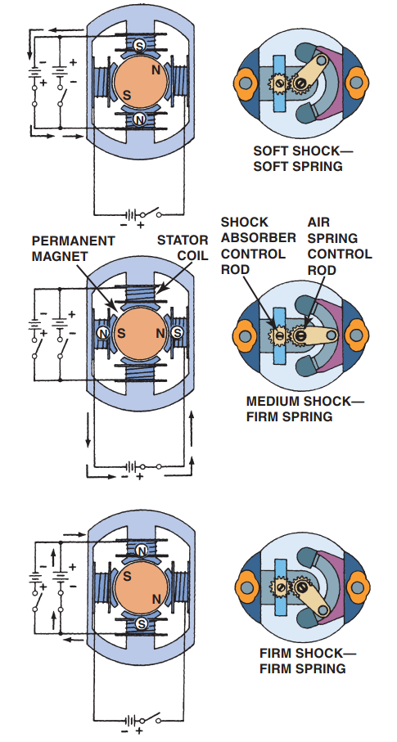
Electronic Suspension System Actuators
FIGURE 28–21 The stator coils of the actuator are energized
in three ways to provide soft, medium, or firm ride from the air
springs and shock absorbers.

Slide 25
Types Of Electronic Suspension
The types of electronic suspension systems used on General Motors vehicles, as examples, include:
Selectable Ride
Automatic Level Control
Air Suspension
Computer Command Ride
Real-Time Dampening/Road-Sensing Suspension
Vehicle Stability Enhancement System
Magneto-Rheological Suspension (F55)

Slide 26
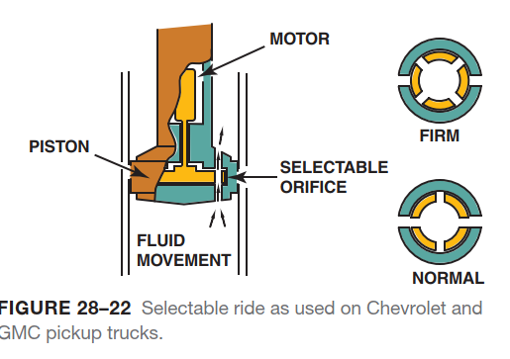
Types Of Electronic Suspension

Slide 27
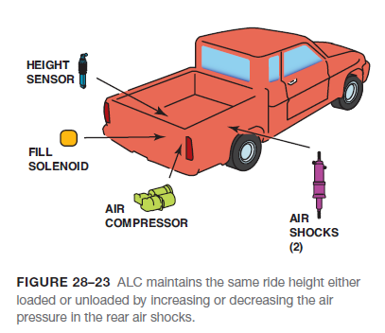
Types Of Electronic Suspension
SELECTABLE RIDE- The selectable ride (SR) system is the most basic of the electronic systems offered by General Motors.
Selectable ride allows the driver to choose between two distinct damping levels:
Firm
Normal
AUTOMATIC LEVEL CONTROL- The automatic level control (ALC) system automatically adjusts the rear height of the vehicle in response to changes in vehicle loading and unloading.
ALC is found on many General Motors vehicles.

Slide 28
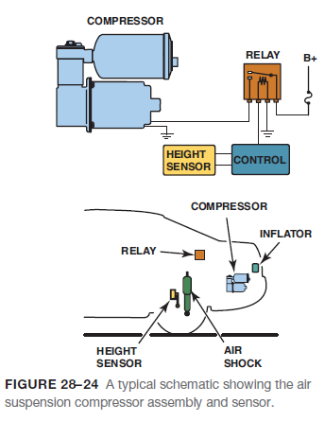
Types Of Electronic Suspension
AIR SUSPENSION- Air suspension (AS) is a system very similar to the ALC system.
The purpose of the AS system is to:
Keep the vehicle visually level.
Provide optimal headlight aiming.
Maintain optimal ride height.
The AS system includes the following components:
An air suspension compressor assembly
Rear air springs
Air suspension sensors

Slide 29
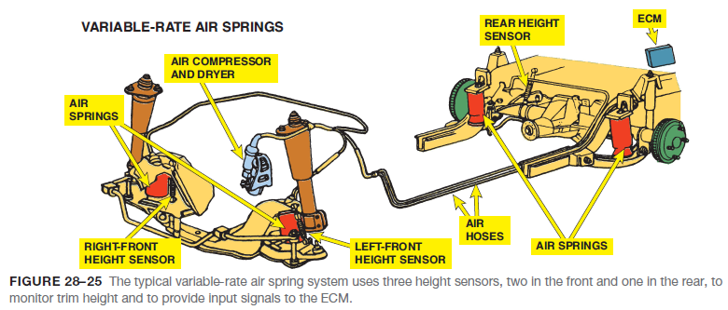
Types Of Electronic Suspension
VARIABLE-RATE AIR SPRINGS- In an air spring system with ordinary shock absorbers, the ECM uses the air springs to control trim height and is used on many Ford, Mercury, and Lincoln vehicles.

Slide 30
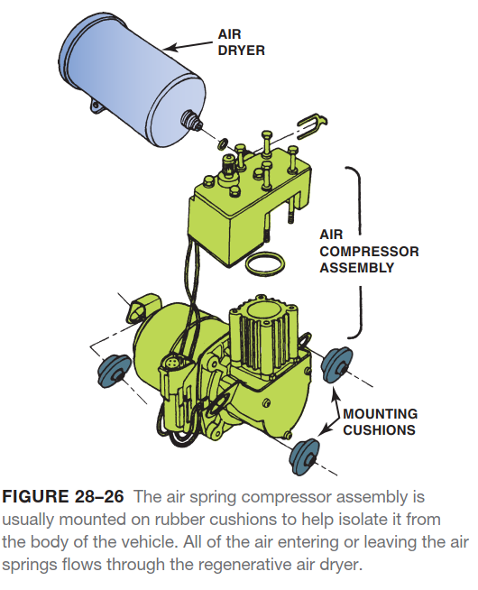
Types Of Electronic Suspension

Slide 31
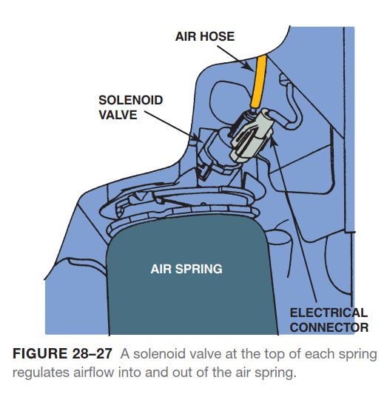
Types Of Electronic Suspension

Slide 32
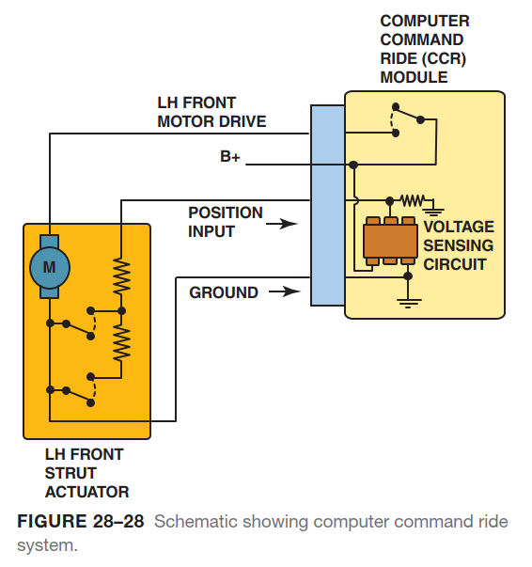
Types Of Electronic Suspension

Slide 33
Types Of Electronic Suspension
GENERAL MOTORS COMPUTER COMMAND RIDE- The General Motors computer command ride (CCR) system controls ride firmness by automatically controlling an actuator in each of the four struts to increase ride firmness as speed increases.
The three damping modes are:
Comfort
Normal
Sport
REAL-TIME DAMPENING AND ROAD-SENSING SUSPENSION- Real-time dampening (RTD) independently controls a solenoid in each of the four shock absorbers in order to control the vehicle ride characteristics and is capable of making changes within milliseconds (0.001 second).
BI-STATE AND TRI-STATE DAMPERS- The bi-state damper is also known as a solenoid controlled damper.
Bistate dampers are found on the RTD, RSS, and SR systems.

Slide 34
Types Of Electronic Suspension

Slide 35
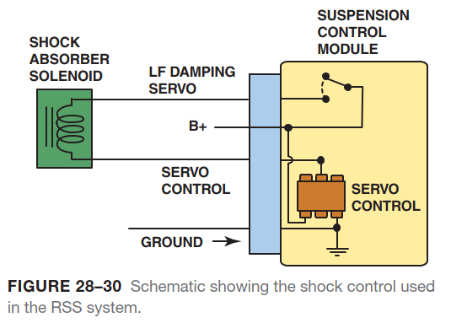
Types Of Electronic Suspension

Slide 36
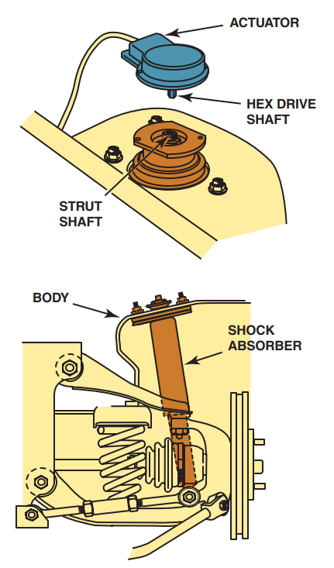
Types Of Electronic Suspension
FIGURE 28–31 Bi-state dampers (shocks) use a solenoid to control fluid flow in the unit to control compression and rebound actions.

Slide 37
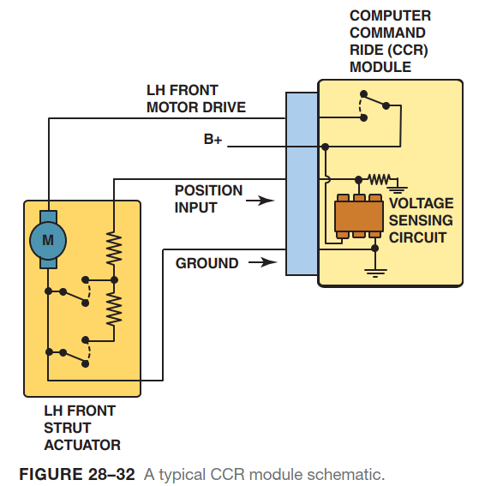
Types Of Electronic Suspension

Slide 38
Automatic Level Control (ALC)
PARTS AND OPERATION- Vehicles that have an air inflator system as part of the ALC system also have an air inflator switch.
INFLATOR OR COMPRESSOR RELAY- The suspension control module energizes the relay to activate the compressor motor.
COMPRESSOR- The compressor is a positive-displacement air pump and can generate up to 150 pounds of pressure per square inch (PSI).
AIR DRYER- Within the compressor is an air dryer. The air dryer is responsible for removing moisture from the compressor system.

Slide 39
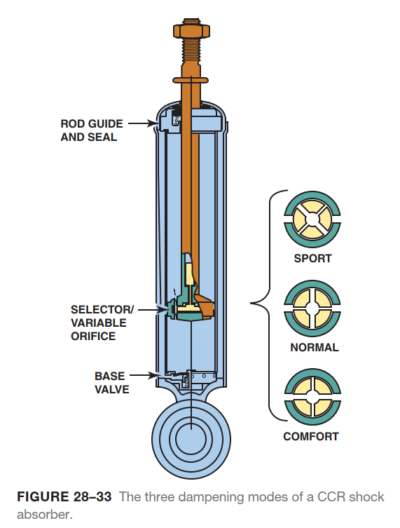
Automatic Level Control (ALC)

Slide 40
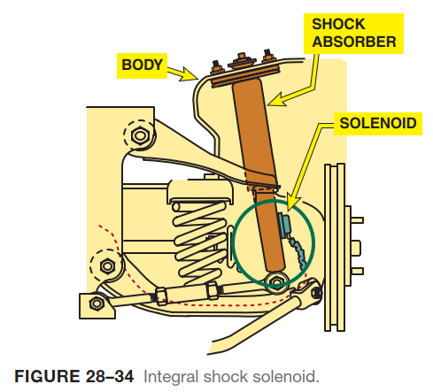
Automatic Level Control (ALC)

Slide 41
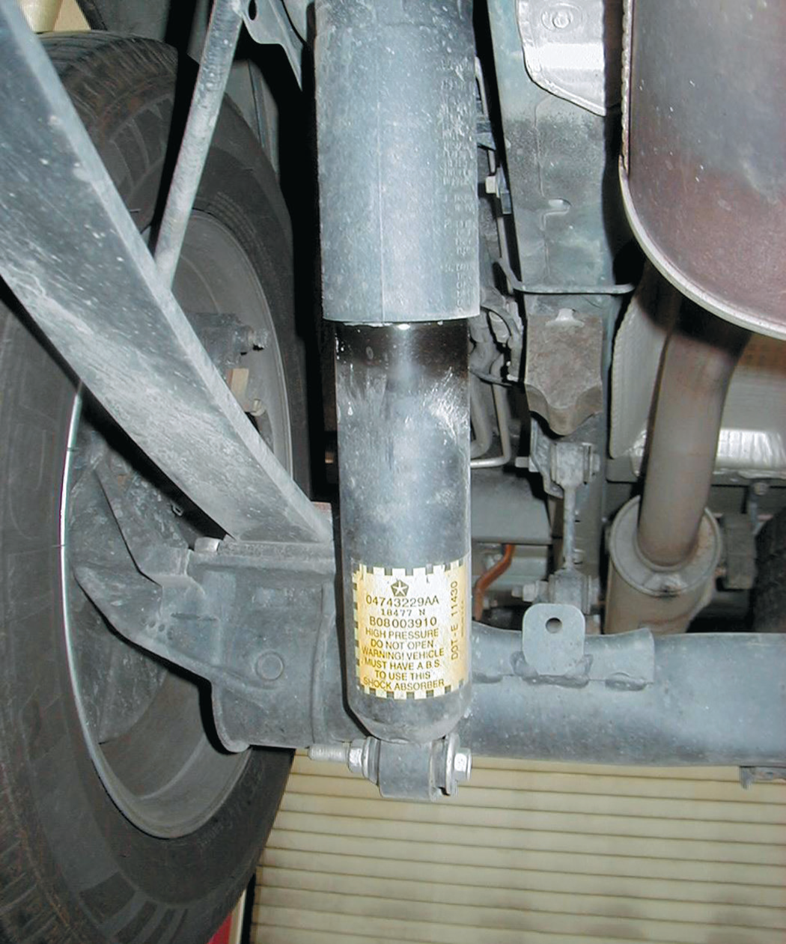
Automatic Level Control (ALC)
FIGURE 28–35 A typical ZF Sachs self-leveling shock, as
used on the rear of a Chrysler minivan.

Slide 42
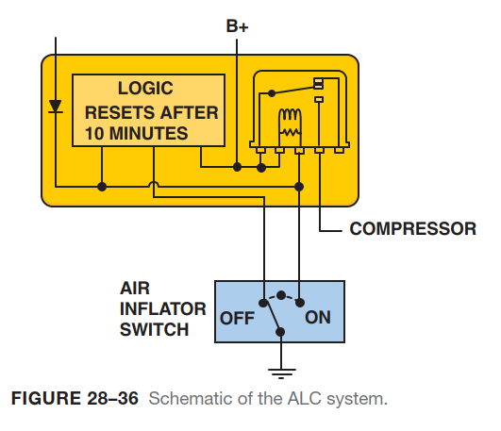
Automatic Level Control (ALC)

Slide 43
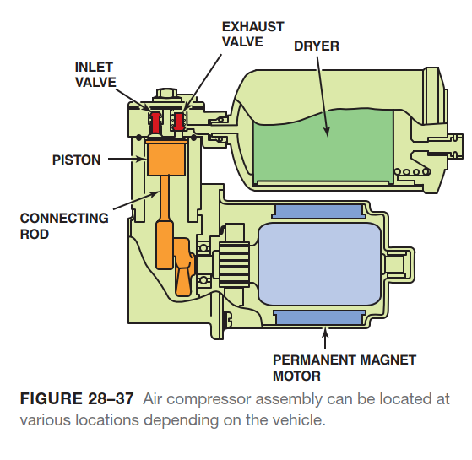
Automatic Level Control (ALC)

Slide 44
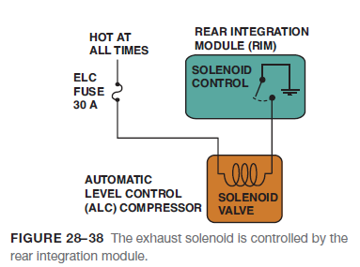
Automatic Level Control (ALC)
EXHAUST SOLENOID- The exhaust solenoid, which is located on the compressor, relieves pressure in the system.
The ground-side switched exhaust solenoid has three main functions:
It releases compressed air from the shock absorbers or air springs to lower the vehicle body.
It relieves compressor head pressure. By exhausting air, it protects compressor start-up from high head pressure, which can possibly cause fuse failure.
The solenoid acts as a pressure relief valve, which limits overall system pressure.

Slide 45
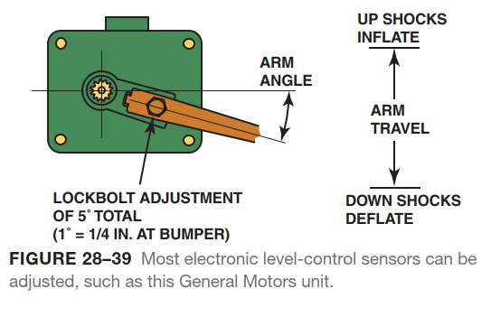
Automatic Level Control (ALC)

Slide 46
Troubleshooting Rear Electronic Leveling Systems
The first step with any troubleshooting procedure is to check for normal operation.
Some leveling systems require that the ignition key be on (run), while other systems operate all the time.
Begin troubleshooting by placing approximately 300 pounds (135 kg) on the rear of the vehicle.
If the compressor does not operate, check to see if the sensor is connected to a rear suspension member and that the electrical connections are not corroded.
Also check the condition of the compressor ground wire.

Slide 47
Magneto-Rheological (MR) Suspension
TERMINOLOGY- MR fluid shocks use a working fluid inside the shock that can change viscosity rapidly depending on electric current sent to an electromagnetic coil in each device.
The fluid is called magneto-rheological (MR) and is used in monotube-type shock absorbers.

Slide 48
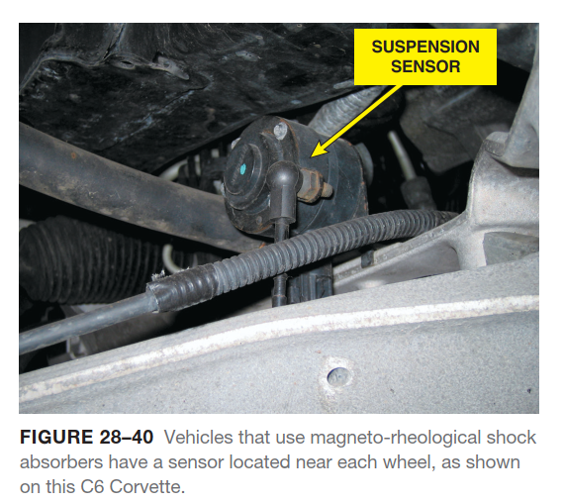
Magneto-Rheological (MR) Suspension

Slide 49
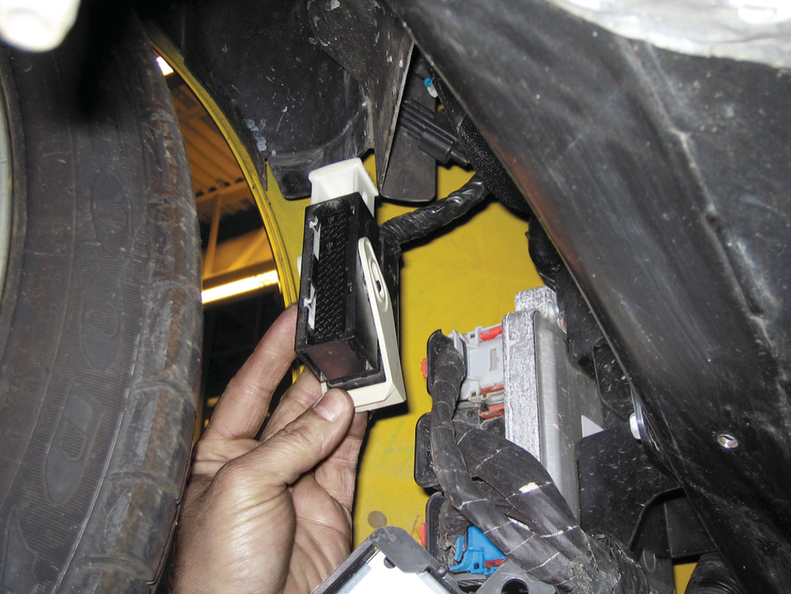
Magneto-Rheological (MR) Suspension
FIGURE 28–41 The controller for the magneto-rheological
suspension system on a C6 Corvette is located behind the
right front wheel.

Slide 50
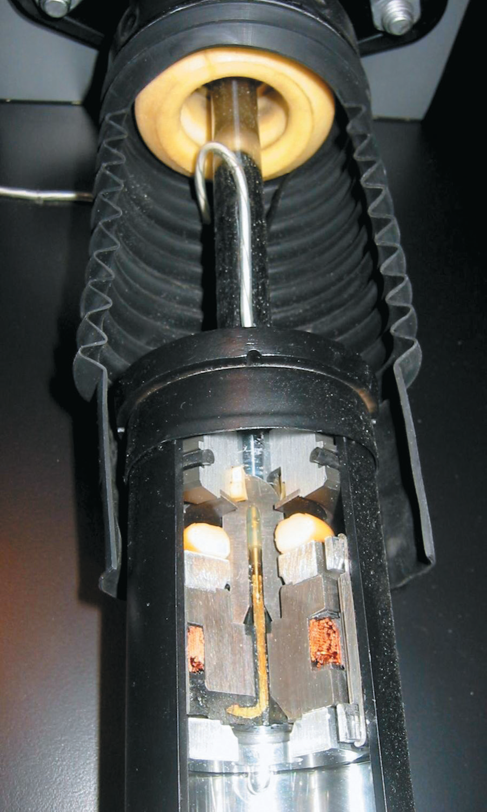
Magneto-Rheological (MR) Suspension
FIGURE 28–42 A cutaway of a magneto-rheological shock absorber as displayed at the Corvette Museum in Bowling
Green, Kentucky.

Slide 51
Summary
General Motors uses seven types of electronic suspension under many different names.
Suspension height sensors and steering wheel (handwheel) position sensors are used in many systems.
A vehicle speed sensor signal is used to control the suspension at various speeds.
Many electronic suspension systems use a lateral accelerometer sensor, which signals the suspension computer when the vehicle is rapidly accelerating, braking, or cornering.
Solenoids and motors are used to control the suspension movement by moving valves in the shock absorbers or air springs.
An air pump and air shocks are used to raise the rear of the vehicle to compensate for a heavy load.

Slide 52
Video Links (Internet Access Required)
Monroe CCES (time 6:47)
Bose Active Suspension (time 2:18)
Electronic Air Suspension System (time 1:41)

