Slide 1
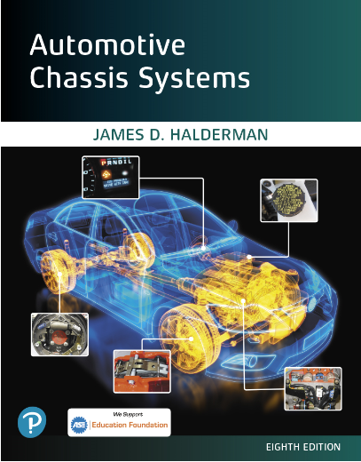
Automotive Chassis Systems Eighth Edition
Chapter 21
Regenerative Braking
Systems
Notes:
If this PowerPoint presentation contains mathematical equations, you may need to check that your computer has the following installed:
1) MathType Plugin
2) Math Player (free versions available)
3) NVDA Reader (free versions available)

Slide 2
Objectives
Explain the principles involved in regenerative braking.
State the types of regenerative braking systems.
Discuss the parts and components involved in regenerative braking.
Explain how the regeneration system works.
This chapter will help prepare for the Brakes (A5) ASE certification test content area “D” (Electronic Brake Control Systems: Antilock Brake System (ABS), Traction Control System (TCS), and Electronic Stability Control System (ESC) Diagnosis and Repair).

Slide 3
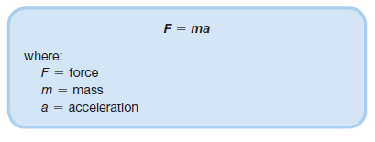
Introduction
Regenerative braking is the process of slowing the vehicle using the drive motor as a generator that is driven by the momentum of the vehicle.
PRINCIPLES OF REGENERATIVE BRAKING
INERTIA, FORCE, AND MASS- If a moving object has a mass, it has inertia.
Inertia is the resistance of an object to change its state of motion. In other words, an object in motion tends to stay in motion and an object at rest tends to stay at rest unless acted on by an outside force.
According to basic physics: A force applied to move an object results in the equation:

Slide 4
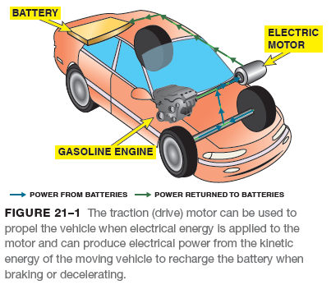
Principles of Regenerative Braking
RECLAIMING ENERGY IN A HYBRID- On a hybrid vehicle that has regenerative brakes, the kinetic energy of a moving vehicle can be reclaimed that would normally be lost due to braking.
Using the inertia of the vehicle is the key.
TRANSFERRING TORQUE BACK TO THE MOTOR- Inertia is the fundamental property of physics that is used to reclaim energy from the vehicle.
Instead of using 100% friction brakes (base brakes), the braking torque is transferred from the wheels back into the motor shaft.
PRINCIPLES INVOLVED- Brakes slow and stop a vehicle by converting kinetic energy, the energy of motion, into heat energy, which is then dissipated to the air.

Slide 5
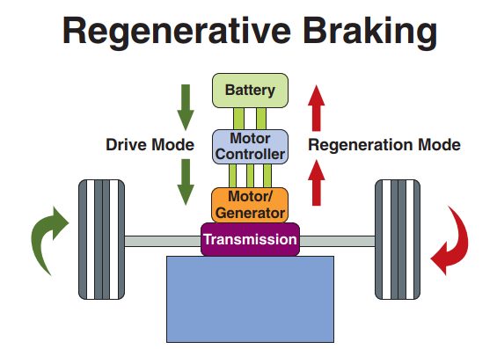
Principles of Regenerative Braking
FIGURE 21–2 The heavier the vehicle and faster it is traveling, the higher the kinetic energy that can be recovered by the regenerative braking system.

Slide 6
Animation: Regenerative Braking (The animation will automatically start in a few seconds)

Slide 7
Types of Regenerative Braking Systems
Two different regeneration designs include:
Series regeneration. In series regenerative braking systems, the amount of regeneration is proportional to the brake pedal position.
As the brake pedal is depressed further, the controller used to regulate the regenerative braking system computes the torque needed to slow the vehicle as would occur in normal braking.
Parallel regeneration. A parallel regenerative braking system is less complex because the base (friction) brakes are used along with energy recovery by the motors becoming generators.
The controller for the regenerative braking system determines the amount of regeneration that can be achieved based on the vehicle speed.

Slide 8
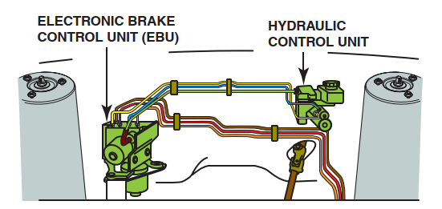
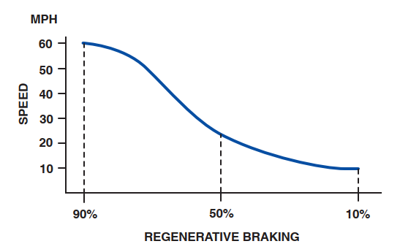
Types of Regenerative Braking Systems
FIGURE 21–3 The electronic brake control unit (EBU) is shown on the left (passenger side) and the brake hydraulic unit is shown on the right (driver’s side) on this Ford Escape system.
FIGURE 21–4 A typical brake curve showing the speed on the left and the percentage of regenerative braking along the bottom. notice that the base brakes are being used more when the vehicle speed is low.

Slide 9
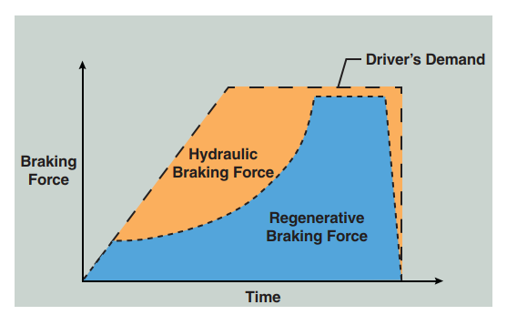
Types of Regenerative Braking Systems
FIGURE 21–5 The regenerative braking system works with the mechanical and hydraulic brake system to provide the necessary braking force to slow and stop the vehicle. Regenerative brakes seldom work at speeds below 10 mph (16 km/h).

Slide 10
Battery Charging During Regeneration
BACKGROUND- Kinetic energy can be converted into electrical energy with a generator, and it can be returned to the high-voltage batteries and stored for later use.
PARTS AND OPERATION- Motors work by activating electromagnets in just the right position and sequence.
LIMITATIONS OF REGENERATIVE BRAKES- There are some limitations that will always affect even the best regenerative braking systems including the following:
It only acts on the driven wheels.
The system has to be designed to allow for proper use of the antilock brake system.
The batteries are commanded to be kept at a maximum of about 60%, plus or minus 20%, which is best for long battery life and to allow for energy to be stored in the batteries during regenerative braking.

Slide 11
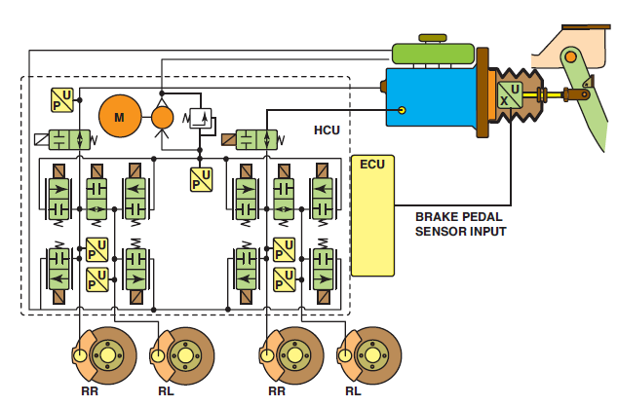
Regenerative Braking Systems
DASH DISPLAY- The Toyota Prius is equipped with a center dash LCD that shows how many watt-hours of regeneration have occurred every five minutes.
REGENERATIVE BRAKE COMPONENTS- It is the ABS ECU that handles regenerative braking, as well as ABS functions, sending a signal to the hybrid ECU how much regeneration to impose.
FIGURE 21–7 The Ford Escape regenerative braking system, showing all of the components. Notice the brake pedal position sensor is an input to the ECU, which controls both the brake and traction control systems.

Slide 12
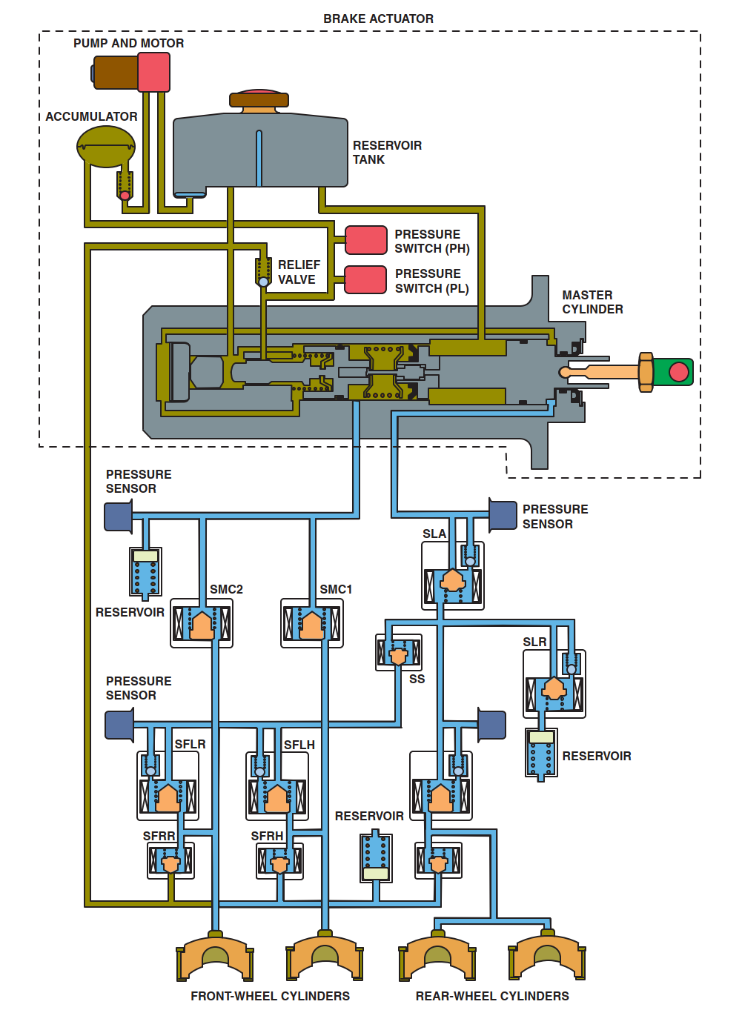
How The Regeneration System Works
FIGURE 21–6 The Toyota Prius regenerative braking system component showing the master cylinder and pressure switches.

Slide 13
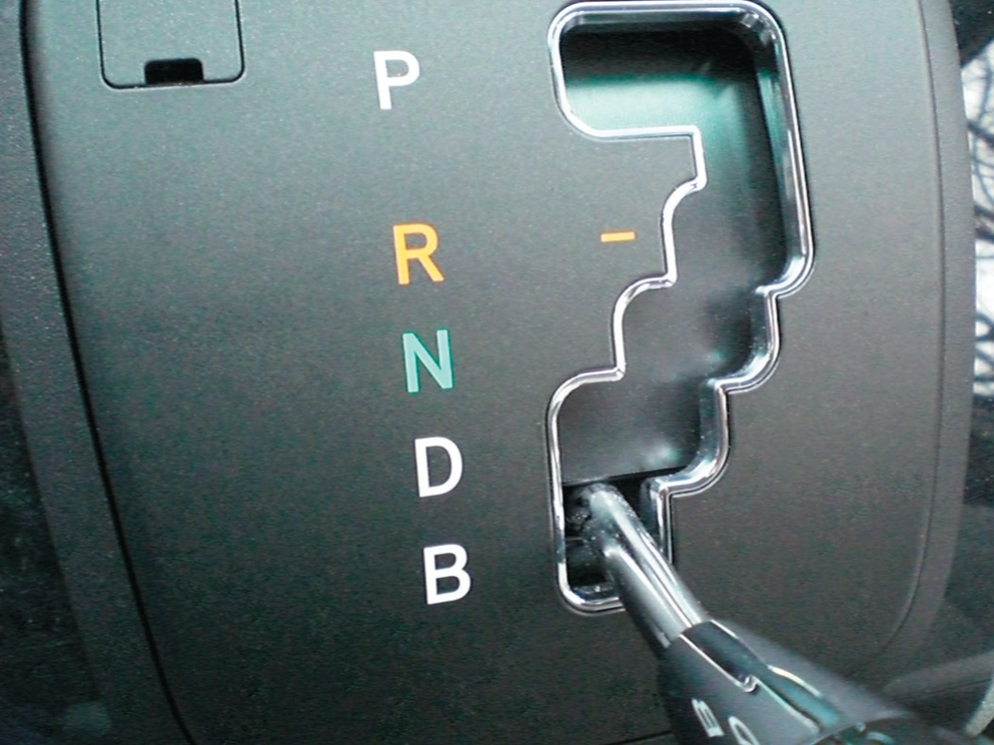
How The Regeneration System Works
FIGURE 21–8 The “B” position on the shift display on this Lexus RX 400h means braking. This shifter position can be selected when descending long hills or grades. The
regenerative braking system will be used to help keep the vehicle from increasing in speed down the hill without the use of the base brakes.

Slide 14
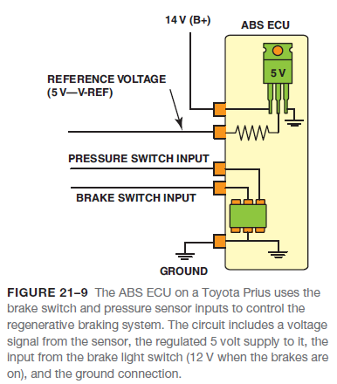
How The Regeneration System Works
To keep the hybrid electric vehicles feeling as much like other vehicles as possible, the hybrids from Toyota and Honda have both the regeneration and conventional brakes controlled by the one brake pedal.
ELECTRIC MOTOR BECOMES A GENERATOR- When a motor is used for regenerative braking, it acts as a generator and produces an alternating current (AC).
The AC current needs to be rectified (converted) to DC current to go into the batteries.

Slide 15
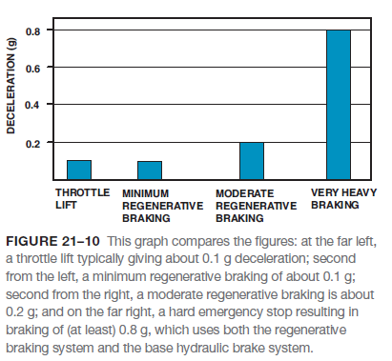
Deceleration Rates
Deceleration rates are measured in units of “feet per second per second.” What it means is that the vehicle will change in velocity during a certain time interval divided by the time interval. Deceleration is abbreviated “ft/sec2” (pronounced “feet per second, per second” or “feet per second squared”) or meters per sec2 (m/s2) in the metric system.
Typical deceleration rates include the following:
Comfortable deceleration is about 8.5 ft/sec2 (3 m/s2).
Loose items in the vehicle will “fly” above 11 ft/sec2 (3.5 m/s2).
Maximum deceleration rates for most vehicles and light trucks range from 16 to 32 ft/sec2 (5 to 10 m/s2).

Slide 16
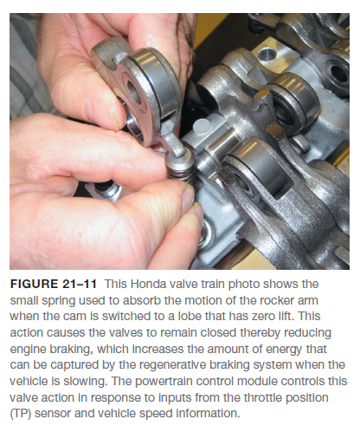
Engine Design Changes Related To Regenerative Braking
Some hybrid vehicles, such as the second-generation Honda Civic and Accord, use a variation of the VTEC valve actuation system to close all of the valves in three cylinders in both the V-6 and the inline four cylinder engines during deceleration.

Slide 17
Servicing Regenerative Braking Systems
UNIQUE MASTER CYLINDERS- Most hybrid electric vehicles use unique master cylinders that do look like conventional master cylinders.
Some use more than one brake fluid reservoir and others contain sensors and other components, which are often not serviced separately.
FORD ESCAPE PRECAUTIONS- On the Ford Escape hybrid system, the regenerative braking system checks the integrity of the brake system as a self-test.
After a certain amount of time, the brake controller will energize the hydraulic control unit and check that pressure can be developed in the system.

Slide 18
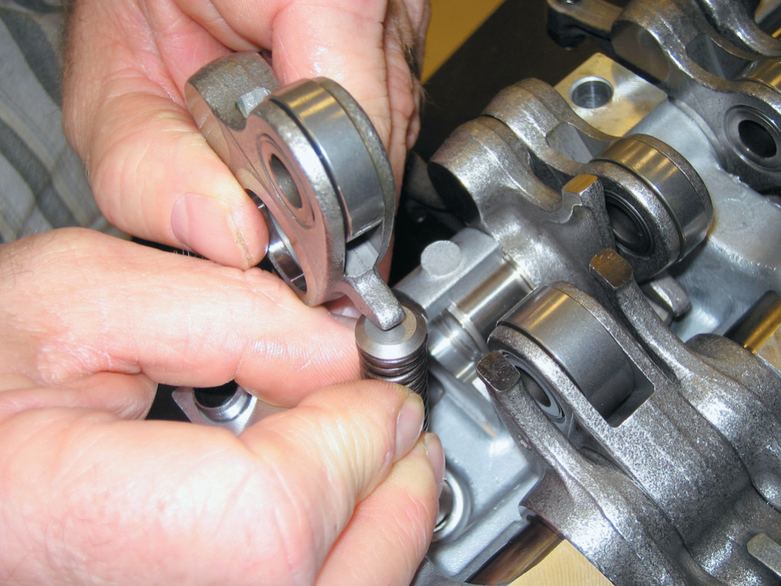
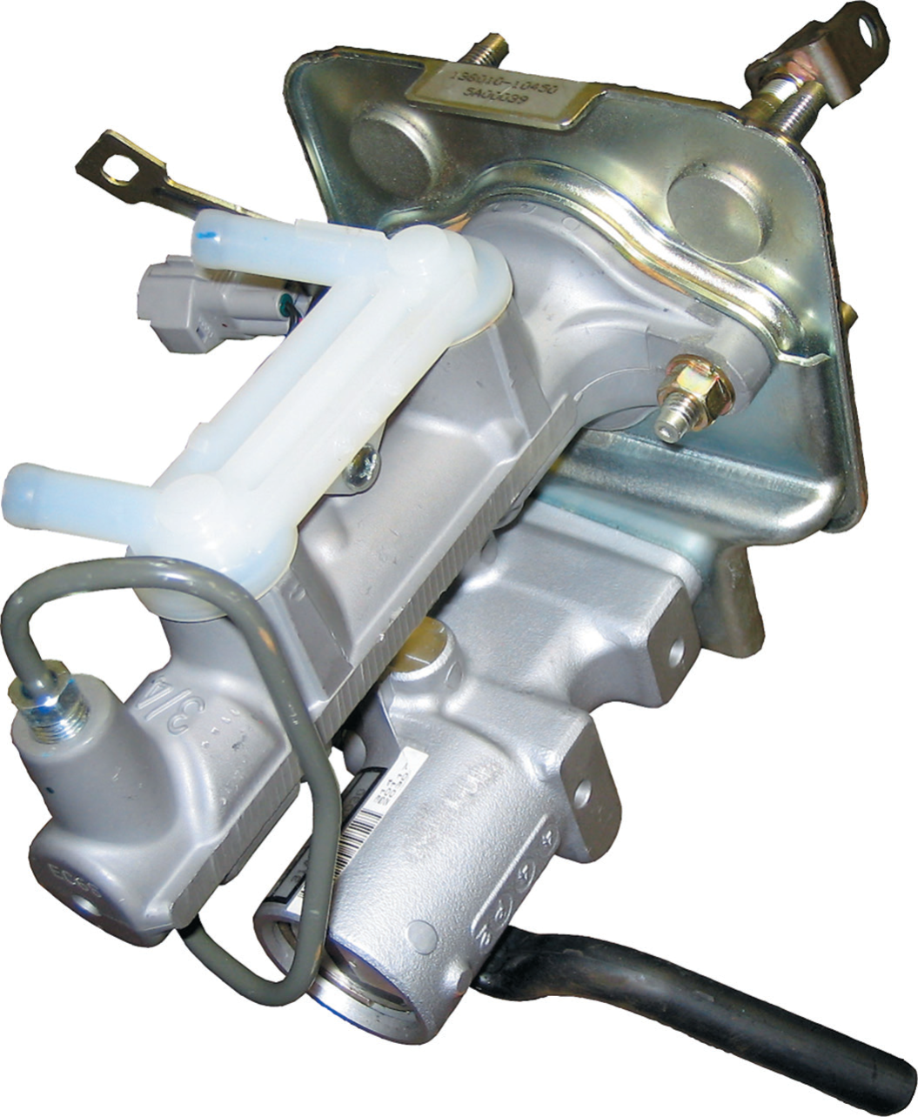
Servicing Regenerative Braking Systems
FIGURE 21–11 This Honda valve train photo shows the
small spring used to absorb the motion of the rocker arm
when the cam is switched to a lobe that has zero lift. This
action causes the valves to remain closed thereby reducing engine braking, which increases the amount of energy that can be captured by the regenerative braking system when the vehicle is slowing. The powertrain control module controls this valve action in response to inputs from the throttle position (TP) sensor and vehicle speed information.
FIGURE 21–12 A master cylinder from a Toyota Highlander hybrid electric vehicle.

Slide 19
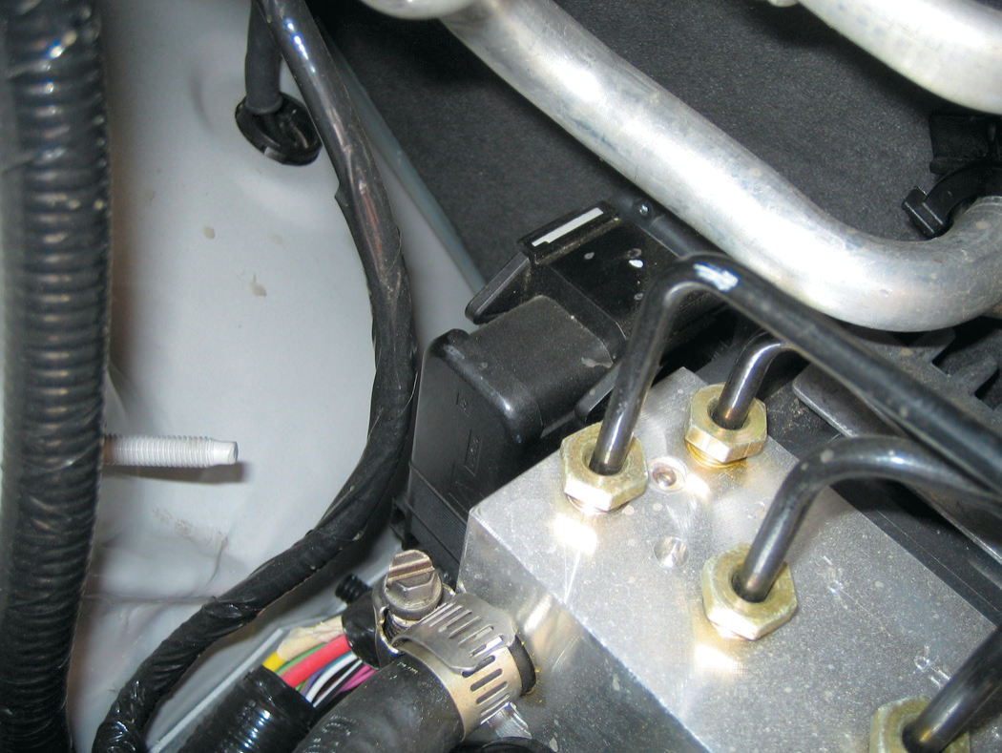
Servicing Regenerative Braking Systems
FIGURE 21–13 When working on the brakes on a Ford Escape or Mercury Mariner hybrid vehicle, disconnect the black electrical connector on the ABS hydraulic control unit located on the passenger side under the hood.

Slide 20
Summary
All moving objects that have mass (weight) have kinetic energy.
The regenerative braking system captures most of the kinetic energy from the moving vehicle and returns this energy to high-voltage batteries to be used later to help propel the vehicle.
The two types of regenerative braking include parallel and series.
Brushless DC and AC induction motors are used in hybrid electric vehicles to help propel the vehicle and to generate electrical energy back to the batteries during braking.
Most hybrid electric vehicles use an electrohydraulic braking system that includes pressure sensors to detect the pressures in the system.
The controller is used to control the motors and turn them into a generator as needed to provide regenerative braking.

Slide 21
Video Links (Internet Access Required)
Hybrid regeneration (time 3:12)
Regenerative Braking (time 3:17)
How regenerative braking works (time 4:10)

