Slide 1
Automotive Chassis Systems Eighth Edition
Chapter 01
Service Information, Work Orders, and Vehicle identification
Notes:
If this PowerPoint presentation contains mathematical equations, you may need to check that your computer has the following installed:
1) Math Type Plugin
2) Math Player (free versions available)
3) NVDA Reader (free versions available)

Slide 2
Objectives
Discuss the importance of vehicle owner’s manuals, service records, and service information.
Explain the different types of service information.
Describe vehicle recalls and campaigns.
Discuss the importance of the work order.
Explain why service records are important.
Discuss the parts of a vehicle, and differentiate between front-wheel drive and rear-wheel drive.
Explain vehicle identification, vehicle safety certification label, and the VECI label.
Discuss the different types of emission standards.
Explain calibration codes and casting numbers.

Slide 3
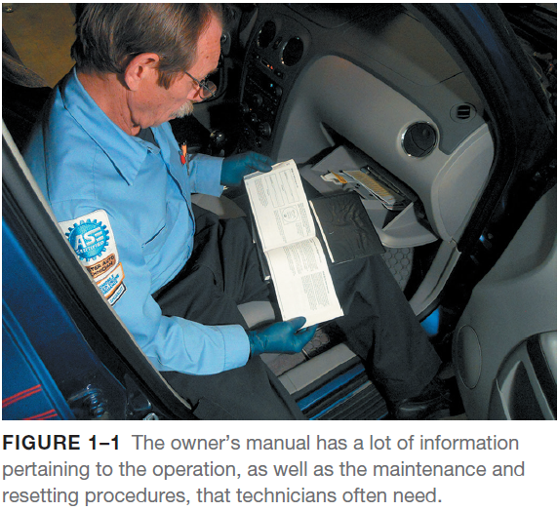
Owner’s Manuals
Content
The owner’s manual is the instructional booklet that comes with every new vehicle and includes important information.
Most owners’ manuals contain all or most of the following information.
Meaning of dash symbols
How to reset the maintenance reminder light
Specifications, including viscosity of oil needed and number of quarts (liters)
Tire pressures and standard, as well as optional, tire sizes
Maintenance schedule for all fluids, including coolant, brake fluid, automatic transmission fluid, and differential fluid
How to program the remote control, as well as the power windows and door locks
How to reset the tire pressure monitoring system (TPMS) after a tire rotation.

Slide 4
Service Information
Purpose of Service Information
Service information is needed to correctly service or repair vehicles because it contains all of the specifications, as well as the specified procedures to follow when servicing or repairing a vehicle.
Factory Service Information
Until the 1990s, most service information was found in paper manuals called service manuals or shop manuals.
More recently, the manufacturer provides this information in a digital format.
The most comprehensive and accurate service information is the service information from the vehicle manufacturer.

Slide 5
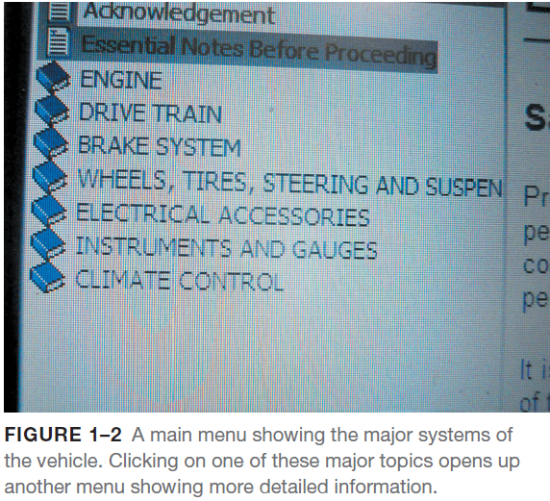
Service Information
Aftermarket Service Information
While factory service manuals cover just one year and one or more models of the same vehicle, most aftermarket service manuals cover multiple years and/or models in one manual.
Paper service manuals had the following disadvantages:
Required a lot of storage space
The pages would become dirty from handling
Difficult to use at the vehicle or to make copies from the thick manuals
Paper service manuals were replaced with electronic service information that came on CDs and then DVDs, before becoming available on the Internet.

Slide 6
Technical Service Bulletins
Technical Service Bulletins
A technical service bulletin (TSB) is issued by the vehicle manufacturer to notify service technicians of a potential problem or other critical information.
The TSB may include diagnostic procedures and the necessary corrective action.
TSBs are not an authorization for repair or a guarantee to correct a concern.
TSBs are designed for dealership technicians, but are republished by aftermarket companies and made available along with other service information to shops and vehicle repair facilities.
Recalls and Campaigns
A campaign is typically issued when a manufacturer wants to improve a product’s performance or increase the customer’s satisfaction.
If the campaign involves a safety or emissions concern, it is considered a recall.
A recall can occur when either the manufacturer or the National Highway Traffic Safety Administration (NHTSA) determines there is a concern.

Slide 7
Work Order
Service Advisor Documentation
The work order, also called a repair order (RO), is a legal document that is signed by the vehicle owner or his/her representative.
The service advisor or the person designated to complete the work order has to include the following information:
Make, model, and year and other identifying information, such as color and vehicle identification number (VIN)
Name and address of the owner with contact information, such as the cell phone number and email address
Date of service and the name of the person who wrote the service invoice
The miles shown on the odometer
Estimate amount and list of requested work
All professional service facilities and shops use a form that is designed for their purposes and include all of the required information, as specified by the local area and state.

Slide 8
Work Order
Service Technician Documentation
The role of the service technician is to not only perform the services and repairs as requested by the vehicle owner, but also to document the work order so that an accurate record of what was performed and the parts used on the work order.
The technician should document the work order by stating not only what was done, but what service tools were used such as:
Verified the customer concern of a rough running engine and the “check engine light” was on by visual inspection.
Looked for stored diagnostic trouble codes using a factory scan tool and noted that a P0300 (random misfire detected) was set.
Performed a visual inspection of the secondary ignition system components.
Found evidence of a coil boot that arced to the cylinder head on cylinders 2 and 3.

Slide 9
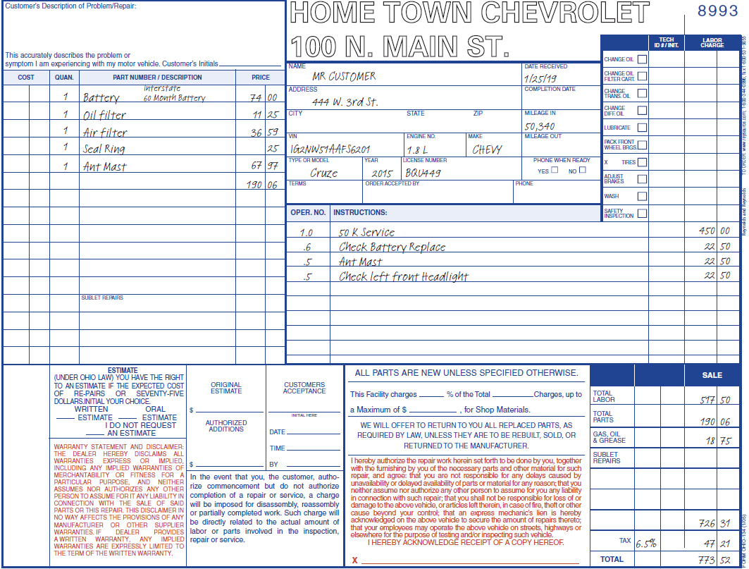
Work Order
FIGURE 1–3 A typical work order showing the customer concern and what was done to correct the issue. Electronic work orders include all of the same required information. This included a stored diagnostic trouble code and what was found to be wrong and what was done to complete the repair.

Slide 10
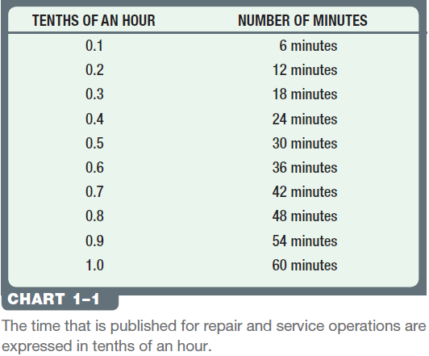
Work Order
Parts Documentation
Parts are those items used to repair a vehicle or to restore it to useful service.
The part number(s) and the costs are usually documented on the work order by the parts department personnel in larger shops, or the shop owner or service manager in smaller shops.
Labor Time Documentation
The labor time, called flat rate, is found in labor guides, and lists vehicle service procedures and the time it should take an average technician to complete the task.
This flat-rate time is the basis for estimates and the pay for the technicians.
Some TSBs include the time needed to accomplish the task.

Slide 11
TSBs
Figure 1-4 Some technical service bulletins also include the designated flat-rate time when specifying a repair procedure.

Slide 12
Animation: Complete Work Order, Estimate (The animation will automatically start in a few seconds)

Slide 13
Animation: Complete Work Order, Technician Copy (The animation will automatically start in a few seconds)

Slide 14
Animation: Complete Work Order, Total Costs (The animation will automatically start in a few seconds)

Slide 15
Animation: Complete Work Order, Customer Copy (The animation will automatically start in a few seconds)

Slide 16
Service Records
Purpose
The purpose of service records is to provide a history of the service work that has been performed on the vehicle in the past.
Often, a previous repair may indicate the reason for the current problem or it could be related to the same circuit or components.
Example #1—A collision could have caused hidden damage that can affect the operation of the vehicle.
Example #2—If the current issue is an error code for an engine misfire and the history of the service work on the vehicle does not show an oil change for several years, this might help the technician to find the root cause.

Slide 17
Additional Information
From the Customer
The service advisor or shop owner records the following information from the customer and about the vehicle:
Record the vehicle identification number (VIN) of the vehicle on the work order
Record the make, model, year, and mileage on the work order
Record what the customer’s complaint (concern) is so that the service technician can verify the complaint and make the proper repair
Review the customer’s vehicle history file and identify additional required service
Check the Vehicle Before Work is Started
As part of the work order writing process, the service advisor should look over the vehicle and make a written note of any vehicle damage that may already exist.

Slide 18
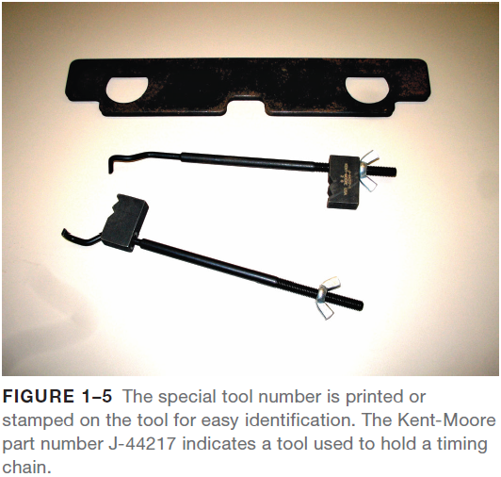
Additional Information
Special Service Tools (SSTs)
Automotive dealerships have tool rooms that are supposed to have all the SSTs that are recommended by the factory.
SSTs are made primarily by a small group of manufacturers.
They make the following SSTs:
Miller Special Tools (Chrysler)
Rotunda Tools (Ford, Mazda, Jaguar, Land Rover)
Kent-Moore Tools (Detroit Diesel, General Motors, Hyundai, Lexus, Mitsubishi, Nissan, Saab, Subaru, Volvo, Kia, Toyota, Isuzu).
Other Manufacturers of SSTs include:
Sir Tools
Assenmacher
Baum Tools

Slide 19
Parts of a Vehicle
The names of the parts of a vehicle are based on the location and purpose of the component.
Left Side of the Vehicle—Right Side of a Vehicle
Both of these terms refer to the left and right as if the driver is sitting behind the steering wheel.
Front and Rear
The proper term for the back portion of any vehicle is rear (e.g., left rear tire).
Front-Wheel Drive Versus Rear-Wheel Drive
Front-wheel drive (FWD) means that the front wheels are being driven by the engine, as well as turned by the steering wheel.
Rear-wheel drive (RWD) means that the rear wheels are driven by the engine.
If the engine is in the front, it can be either front- or rear-wheel drive. In many cases, a front engine vehicle can also drive all four wheels, called four wheel drive (4WD) or all-wheel drive (AWD).
If the engine is located at the rear of the vehicle, it can be rear-wheel drive or four-wheel drive.

Slide 20
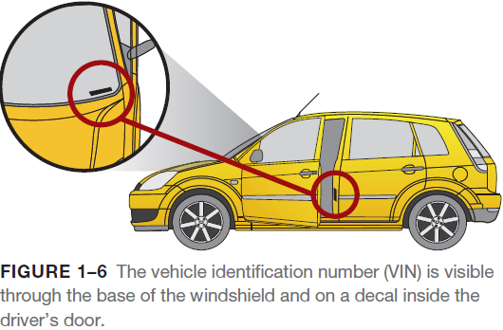
Vehicle Identification
All service work requires that the vehicle, including the engine and accessories, be properly identified.
The most common identification is the make, model, and year of the vehicle.
Make: e.g., Chevrolet
Model: e.g., Cruze
Year: e.g., 2014
The year of the vehicle is often difficult to determine exactly.
A model may be introduced as the next year’s model as soon as January of the previous year.
Typically, a new model year (abbreviated MY) starts in September or October of the year prior to the actual new year, but not always.
This is why the vehicle identification number, usually abbreviated VIN, is so important.

Slide 21
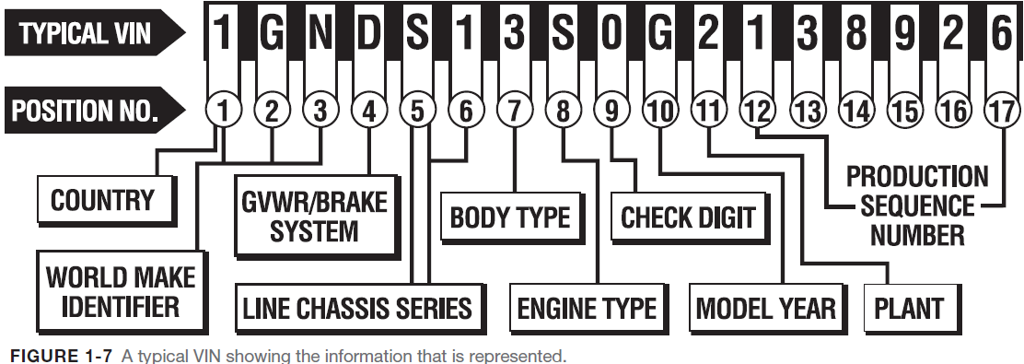
Vehicle Identification
Vehicle Identification
Since 1981, all vehicle manufacturers have used a VIN that is 17 characters long.
Although every vehicle manufacturer assigns various letters or numbers within these 17 characters, there are some constants, including:
The first number or letter designates the country of origin.

Slide 22
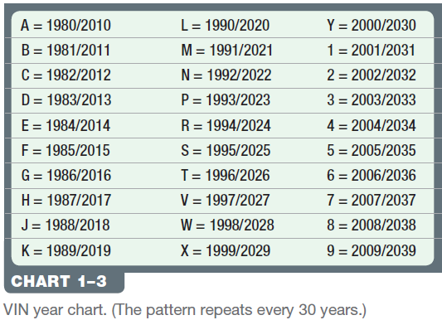
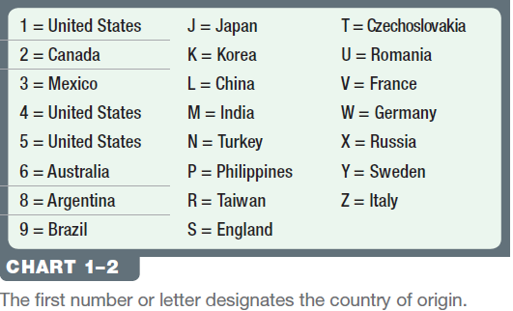
Vehicle Identification
Vehicle Identification
The model of the vehicle is commonly the fourth and/or fifth character.
The eighth character is often the engine code. (Some engines cannot be determined by the VIN.)
The tenth character represents the model year (MY) on all vehicles.

Slide 23
Animation: Vehicle Identification Number (The animation will automatically start in a few seconds)

Slide 24
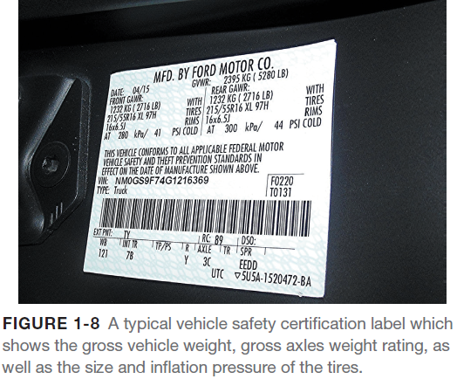
Vehicle Safety Certification Label
A vehicle safety certification label is attached to the left side pillar post on the rearward-facing section of the left front door.
This label indicates the month and year of manufacture, the (VIN), as well as the GVWR and GAWR.
Gross vehicle weight rating (GVWR)—The maximum (upper limit) weight of a vehicle as specified by the vehicle manufacturer.
This is important to know if hauling a heavy load, such as in a truck or SUV.
Gross axle weight rating (GAWR)—The maximum weight that an axle can support is usually followed by “FR” for front axle and “RR” for rear axle.

Slide 25
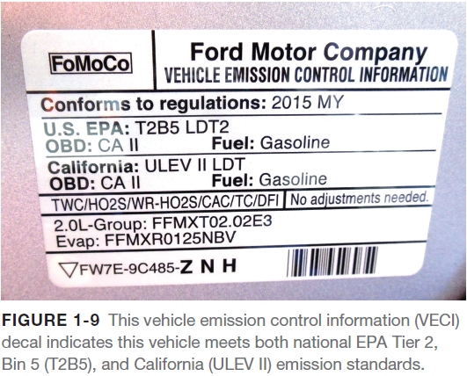
VECI Label
Vehicle Emissions Control Information
The vehicle emissions control information (VECI) label under the hood of the vehicle shows informative settings and emission hose routing information.
The VECI label (sticker) can be located on the bottom side of the hood, the radiator fan shroud, the radiator core support, or the strut towers.

Slide 26
Summary
Service information is needed to correctly service or repair vehicles because it contains all of the specifications, as well as the specified procedures to follow when servicing or repairing a vehicle.
A technical service bulletin (TSB) is issued by the vehicle manufacturer to notify service technicians of a potential problem or other critical information.
A campaign is typically issued when a manufacturer wants to improve a product’s performance or increase the customer’s satisfaction. If the campaign involves a safety or emissions concern, it is considered a recall. A recall can occur when either the manufacturer or the National Highway Safety Administration (NHTSA) determines there is a concern.
The work order, also called a repair order (RO), is a legal document that is signed by the vehicle owner or his/her representative.
The purpose of service records is to provide a history of the service work that has been performed on the vehicle in the past.
The new model year (MY) starts in September or October of the year prior to the actual new year, but not always. This is why the vehicle identification number (VIN) is so important.
The vehicle emissions control information (VECI) label under the hood of the vehicle shows informative settings and emission hose routing information

Slide 27
Video Links (Internet Access Required)
Online service manual (time 4:22)
Vehicle Service Information (time 4:22)

