Slide 1
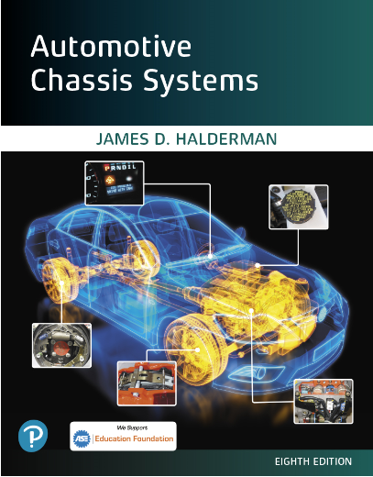
Automotive Chassis Systems Eighth Edition
Chapter 18
ABS Components
And Operation
Notes:
If this PowerPoint presentation contains mathematical equations, you may need to check that your computer has the following installed:
1) MathType Plugin
2) Math Player (free versions available)
3) NVDA Reader (free versions available)

Slide 2
Objectives
Explain the need for antilock brake system (ABS).
Describe the operation, components, and system configurations of ABS.
Explain the operation of passive and active wheel speed sensors.
This chapter will help prepare for the Brakes (A5) ASE certification test content area “D” (Electronic Brake Control Systems: Antilock Brake System (ABS), Traction Control System (TCS), and Electronic Stability Control System (ESC) Diagnosis and Repair).

Slide 3
Antilock Brake System
PURPOSE AND FUNCTION- Antilock brake systems (ABS) help prevent the wheels from locking during sudden braking, especially on slippery surfaces.
This helps the driver maintain control
Antilock brakes increase safety because they eliminate wheel/tire lockup and minimize the danger of skidding, allowing the vehicle to stop in a straight line.
ABS also allows the driver to maintain steering control during heavy braking so the vehicle can be steered to avoid an obstacle or another vehicle.
ABS can improve braking when road conditions are less than ideal, as when making a sudden panic stop or when braking on a wet or slick road. ABS does this by monitoring the relative speed of the wheels to one another. It uses this information to modulate brake pressure as needed to control slippage and maintain traction when the brakes are applied.

Slide 4
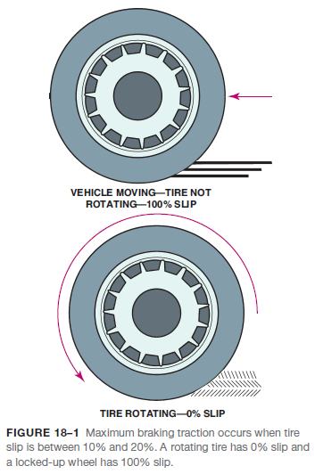
Antilock Brake System
ABS AND TIRE TRACTION- Preventing brake lockup is important because of the adverse effect a locked wheel has on tire traction.
Traction is defined in terms of tire slip, which is the difference between the actual speed and the rate at which the tire tread moves across the road.
A free-rolling wheel has nearly zero tire slip
A locked wheel has 100% tire slip

Slide 5
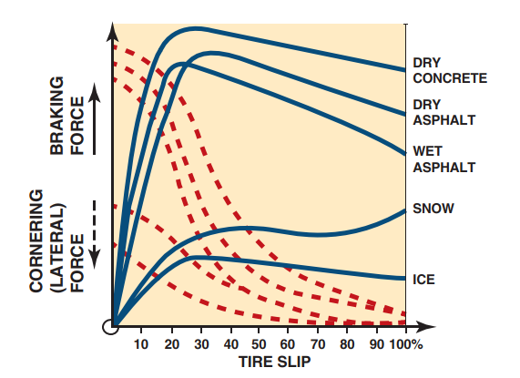
Antilock Brake System
FIGURE 18–2 traction is determined by pavement conditions and tire slip.

Slide 6
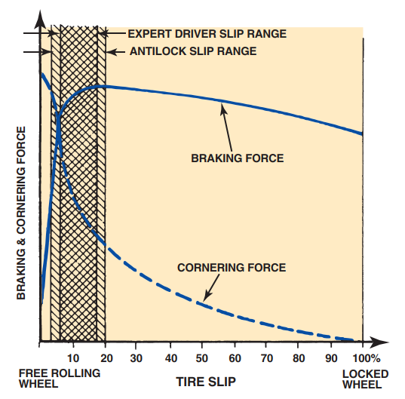
Antilock Brake System
FIGURE 18–3 A good driver can control tire slip more accurately than an Abs if the vehicle is traveling on a smooth, dry road surface.

Slide 7
Antilock Brake System
TIRE SLIP AND BRAKING DISTANCE- On dry or wet pavement, maximum braking traction occurs when tire slip is held between approximately 15% and 25%.
TIRE SLIP AND VEHICLE STABILITY- A tire’s contact patch with the road can provide only a certain amount of traction. When a vehicle is stopped in a straight line, nearly all of the available traction can be used to provide braking force.

Slide 8
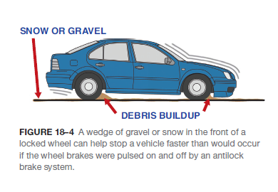
Antilock Brake System
ABS LIMITATIONS- There are two situations in which an antilock brake system will not provide the shortest stopping distances.
The first involves straight stops made on smooth, dry pavement by an expert driver. Under these conditions, a skilled driver can hold the tires consistently closer to the ideal slip rate than the ABS can.
The other situation in which antilock brakes will not provide the shortest stops is when braking on loose gravel or dirt, or in deep, fluffy snow. Under these conditions, a locked wheel will stop the vehicle faster because loose debris builds up and forms a wedge in front of the tire that helps stop the vehicle.

Slide 9
Antilock Brake System
ABS AND THE LAWS OF PHYSICS- No ABS can overcome the laws of physics.
The weight and speed of a moving vehicle give it a great deal of kinetic energy and only so much of that energy can be converted into braking or cornering force at any given time.

Slide 10
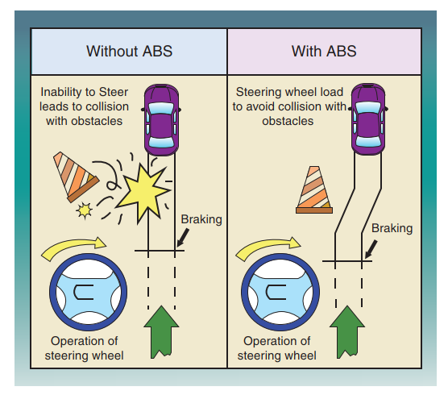
Antilock Brake System
FIGURE 18–5 being able to steer and control the vehicle during rapid braking is one major advantage of an antilock brake system.

Slide 11
ABS Parts Involved
WHEEL SPEED SENSOR INPUT- All ABS control tire slip by monitoring the relative deceleration rates of the wheels during braking.
Control Module- The control module receives wheel speed information from the wheel speed sensors (WSS) and then sends a voltage signal to the control solenoids which then controls brake fluid pressure at the wheel brakes.
The ABS controller may be referred to as:
Electronic brake control module (EBCM)
Electronic brake module (EBM)
Controller antilock brakes (CAB)

Slide 12
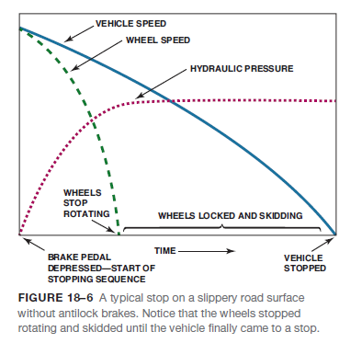
ABS Parts Involved
VALVES- Electrically operated solenoid valves are used to hold, release, and reapply hydraulic pressure to the brakes.
This produces a pulsating effect, which can be felt in the brake pedal during hard braking.
PUMP- A pump is used in most antilock systems to restore brake fluid pressure after the valves have released the pressure in an effort to control wheel slippage.

Slide 13
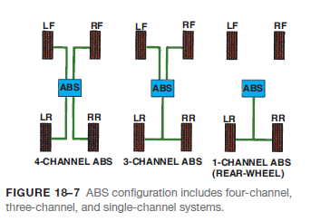
ABS Channels
All ABS keep track of wheel deceleration rates with wheel speed sensors.
The various ABS use a different number of sensors, depending on how the system is configured.
These include:
single-channel systems
three-channel systems
four-channel systems

Slide 14
Animation: Antilock Brake System, ABS (The animation will automatically start in a few seconds)

Slide 15
ABS Channels
SINGLE-CHANNEL SYSTEMS- Most of the early antilock brake systems were used to control the rear brakes only.
This type of system was called single-channel ABS .
THREE-CHANNEL ABS SYSTEMS- Some four-wheel ABS have a separate wheel speed sensor for each front wheel but use a common speed sensor for both rear wheels.
FOUR-CHANNEL ABS- On some applications, each wheel is equipped with its own speed sensor.
This type of arrangement is called a “four-wheel, four-channel” system since each wheel speed sensor provides input for a separate hydraulic control circuit or “channel.

Slide 16
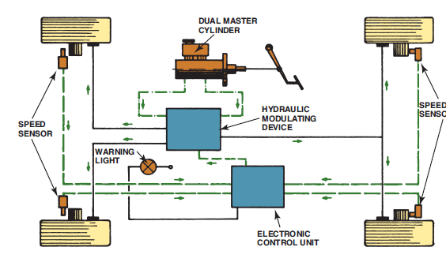
Nonintegral ABS
Nonintegral ABS have a conventional brake master cylinder and vacuum power booster with a separate hydraulic modulator unit.
FIGURE 18–9 A schematic drawing of a typical antilock
brake system.

Slide 17
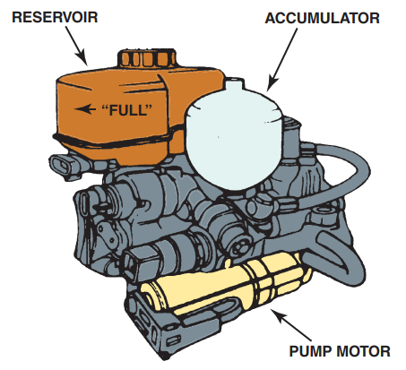
Nonintegral ABS
FIGURE 18–8 A typical integral Abs unit that combines the function of the master cylinder, brake booster, and antilock brake system in one assembly.

Slide 18
ABS Controller Inputs and Outputs
INPUTS- The key inputs for the ABS control module come from the wheel speed sensors and the brake pedal switch.
The brake switch allows the controller to react faster to an ABS event.
The signals being sent to the ABS controller (module) include the following:
Wheel speed—from wheel speed sensors
Brake on/off—from the brake pedal switch
Steering wheel position—used for electronic stability control
Yaw and accelerometer sensors—used for electronic stability control system.

Slide 19
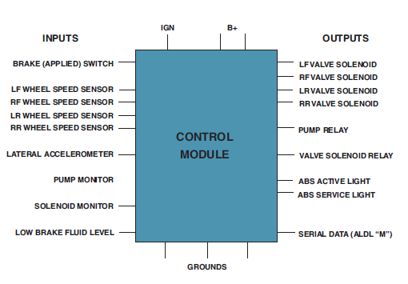
ABS Controller and Outputs
OUTPUTS- The ABS controller (module) controls the following components:
System relay
Inlet valves
Outlet valve
Pump motor
ABS warning lamp (amber ABS dash light)
FIGURE 18–10 Typical inputs and
outputs for brake control modules

Slide 20
ABS Controller Inputs and Outputs
MODULE OPERATION- If the control module detects a difference in the deceleration rate between one or more wheels when braking, or if the overall rate of deceleration is too fast and exceeds the limits programmed into the control module, it triggers the ABS control module to momentarily take over.
ABS WARNING LAMP- Every ABS has an amber indicator lamp on the instrument panel that warns the driver when a problem occurs within the ABS.

Slide 21
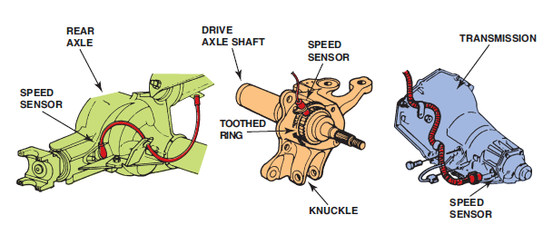
Wheel Speed Sensors
PURPOSE AND FUNCTION- The purpose and function of wheel speed sensors, abbreviated WSS, is to monitor the speed of the wheels.
WHEEL SPEED SENSOR LOCATIONS- The sensor itself may be mounted on or in:
steering knuckle
wheel hub
brake backing plate
transmission tail shaft housing
transfer case
differential housing
Integral part of the wheel bearing and hub assembly
FIGURE 18–11 Wheel speed sensors for the rear wheels may be located on the rear axle, on the transmission, or on the individual wheel knuckle.

Slide 22
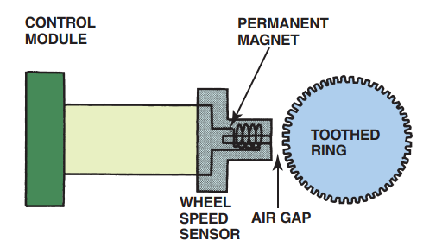
Wheel Speed Sensors
FIGURE 18–12 A schematic of a typical wheel speed sensor.

Slide 23
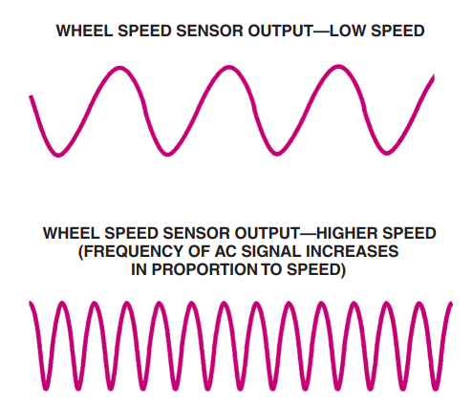
Wheel Speed Sensors
FIGURE 18–13 Wheel speed sensors produce an alternating current (AC) signal with a frequency that varies in proportion to wheel speed.

Slide 24
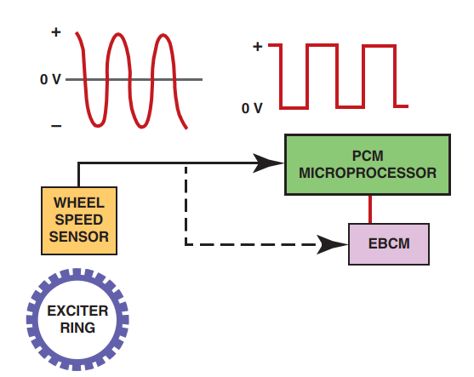
Wheel Speed Sensors
FIGURE 18–14 A typical passive variable-reluctance sensor produces a sine wave (continuously variable) output signal which is then converted to a square wave inside the PCM and/or the electronic brake control module (EBCM).

Slide 25
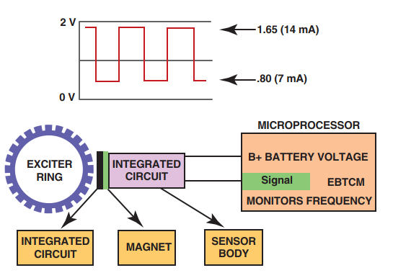
Wheel Speed Sensors
FIGURE 18–15 A digital wheel speed sensor produces a square wave output signal.

Slide 26
Wheel Speed Sensors
PASSIVE WHEEL SPEED SENSORS- A passive wheel speed sensor generates its own output signal and can operate without an outside voltage being applied.
Passive wheel speed sensors are often called variable reluctance (VR)-type sensor, which uses a magnetic core surrounded by coil windings.
ACTIVE WHEEL SPEED SENSORS- Active wheel speed sensors are called active because they require outside electrical power to operate.
There are two types of active wheel speed sensors:
Hall-effect—A Hall-effect sensor uses a permanent magnet behind an integrated circuit (IC) chip. The magnetic field penetrates the IC and the toothed wheel.
Magneto-resistive (MR)—The most common type of active sensor is the magneto-resistive type, which uses a magneto-resistive circuit to produce a square wave form where the frequency is proportional to the wheel speed.

Slide 27
Animation: Vehicle Speed Data (The animation will automatically start in a few seconds)

Slide 28
Animation: Hall-Effect Sensor (The animation will automatically start in a few seconds)

Slide 29
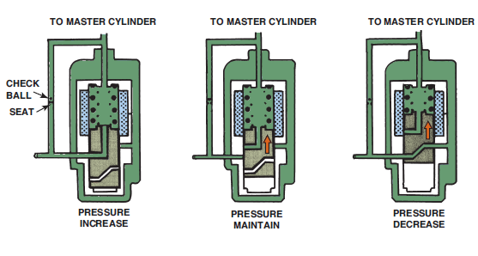
Hydraulic Modulator Assembly
PURPOSE AND FUNCTION- The modulator valve body is part of the master cylinder assembly in integral antilock systems but separate in nonintegral systems.
ABS SOLENOID- A solenoid consists of a wire coil with a movable core and a return spring. When current from the ABS control module energizes the coil, it pulls on the movable core.
FIGURE 18–16 An ABS three-way solenoid can increase,
maintain, or decrease brake pressure to a given brake circuit.

Slide 30
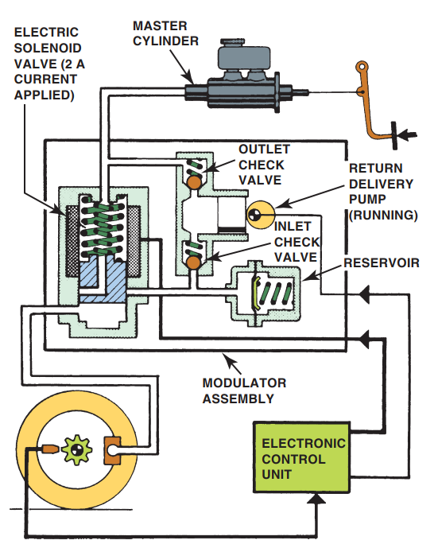
Hydraulic Modulator Assembly
FIGURE 18–17 The isolation or hold phase of an Abs on a Bosch 2 system.

Slide 31
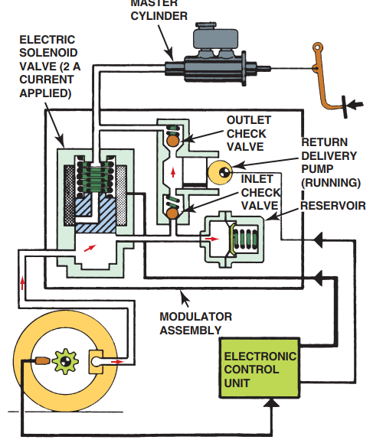
Hydraulic Modulator Assembly
FIGURE 18–18 During the pressure reduction stage, pressure is vented from the brake circuit so the tire can speed up and regain traction.

Slide 32
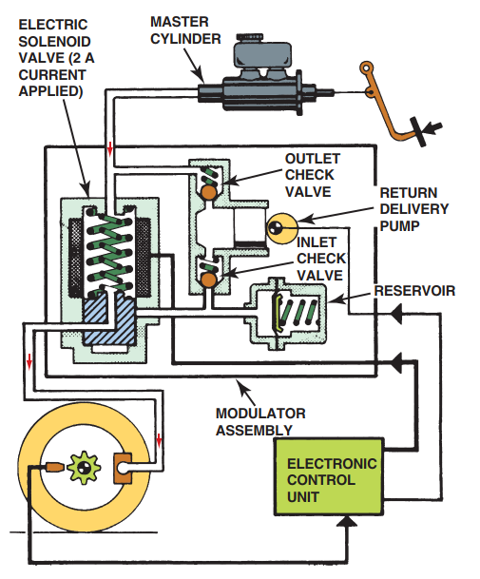
Hydraulic Modulator Assembly
FIGURE 18–19 The control module reapplies pressure to the affected brake circuit once the tire achieves traction so that normal braking can continue.

Slide 33
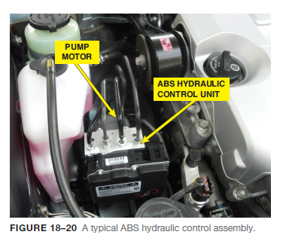
Hydraulic Modulator Assembly
PUMP MOTOR AND ACCUMULATOR- A high-pressure electric pump is used in some ABS to generate power assist for normal braking, as well as the reapplication of brake pressure during ABS braking.

Slide 34
Animation: Rotor ABS Modulator (The animation will automatically start in a few seconds)

Slide 35
Advanced ABS Functions
OVERVIEW- Much of the same equipment that allows an ABS system to control wheel lockup during braking can be adapted to control other vehicle dynamics.
TRACTION CONTROL- These systems may be called Traction Control (TC), Traction Control System (TCS), or Acceleration Slip Regulation (ASR).
STABILITY CONTROL- Some vehicles may be equipped with stability control systems (Stabilitrak®), also called Vehicle Stability Enhancement System (VSES), which is a software extension of the ABS control module that senses (using the WSS input) when a vehicle is braking in a turn.
ELECTRONIC PROPORTIONING- Electronic front-to rear proportioning control makes it possible to eliminate the mechanical proportioning valve on the vehicle.
HILL START ASSIST- The hill start assist feature allows the driver to launch his vehicle without a rollback while moving the foot from the brake pedal to the accelerator pedal.
TPMS- Tire-pressure monitoring systems (TPMS) are required on all new vehicles.

Slide 36
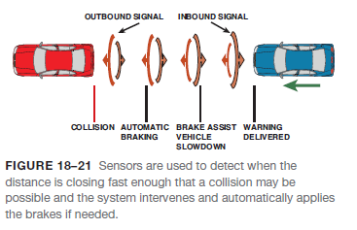
Automatic Emergency Braking
OPERATION- Automatic emergency braking (AEB) is often part of a safety package that includes radar cruise control and will apply the brakes in the event of a possible collision.
This warning can include one or more of the following:
A buzzer
A warning light flashing on the dash
A vibration of the driver’s seat
If the warnings are ignored, the automatic braking system will intervene and either provide brake assist or apply the brakes autonomously (by itself) to achieve maximum braking in an effort to avoid a collision.

Slide 37
Animation: Automatic Emergency Braking, AEB (The animation will automatically start in a few seconds)

Slide 38
Summary
Antilock brake systems (ABS) help prevent the wheels from locking during sudden braking, especially on slippery surfaces.
On dry or wet pavement, maximum braking traction occurs when tire slip is held between approximately 15% and 25%.
All ABS control tire slip by monitoring the relative deceleration rates of the wheels during braking. Wheel speed is monitored by wheel speed sensors.
Being able to steer and control the vehicle during rapid braking is one major advantage of an antilock brake system.
Nonintegral ABS have a conventional brake master cylinder and vacuum power booster with a separate hydraulic modulator unit.
The signals being sent to the ABS controller (module) include the following:
Wheel speed—from wheel speed sensors
Brake on/off—from the brake pedal switch
Steering wheel position—used for electronic stability control

Slide 39
Summary Cont…
Yaw and accelerometer sensors—used for electronic stability control
The ABS controller (module) controls the following components:
System relay
Inlet valves
Outlet valve
Pump motor
ABS warning lamp (amber ABS dash light)
The purpose and function of wheel speed sensors, abbreviated WSS, is to monitor the speed of the wheels.
The modulator valve body is part of the master cylinder assembly in integral antilock systems but separate in nonintegral systems.

Slide 40
Video Links (Internet Access Required)
Hall Effect WSS (time 2:17)
ABS and traction control (time 18:35)
ABS (time 4:47)
ABS brakes (time 3:10)
Hall effect WSS (time 2:17)

