Slide 1
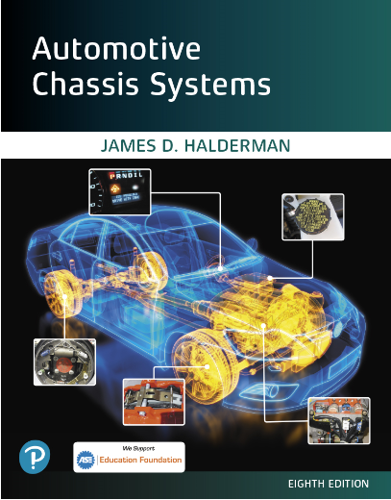
Automotive Chassis Systems Eighth Edition
Chapter 16
Machining Brake
Drums And Rotors
Notes:
If this PowerPoint presentation contains mathematical equations, you may need to check that your computer has the following installed:
1) MathType Plugin
2) Math Player (free versions available)
3) NVDA Reader (free versions available)

Slide 2
Objectives
Describe the types of brake drums.
Explain the factors that cause rotor damage.
Discuss brake drum distortion and removal.
Explain how to machine a brake drum and when a brake drum should be discarded.
Explain the procedure for machining disc brake rotor.
Discuss disc brake rotors and causes of rotor distortion.
Explain when to machine a disk brake rotor, and discuss rotor thickness and finish.
Explain the procedure for qualifying a brake lathe.
This chapter will help prepare for the Brakes (A5) ASE certification test content area “C” (Drum Brake Diagnosis and Repair) and “D” (Disc Brake Diagnosis and Repair).

Slide 3
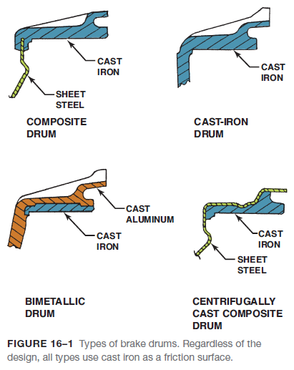
Brake Drums
CAST-IRON DRUMS- Brake drums are constructed of cast iron where the lining contacts the drum, with mild steel centers.
ALUMINUM DRUMS- Even aluminum brake drums use cast iron for the friction surface area.
Besides saving weight, aluminum brake drums transfer heat to the surrounding air faster than cast iron or steel.

Slide 4
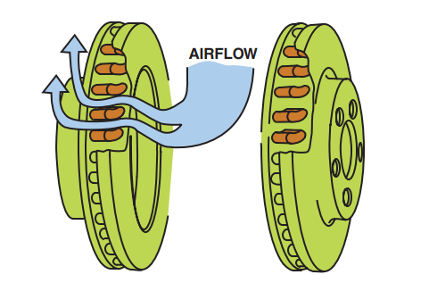
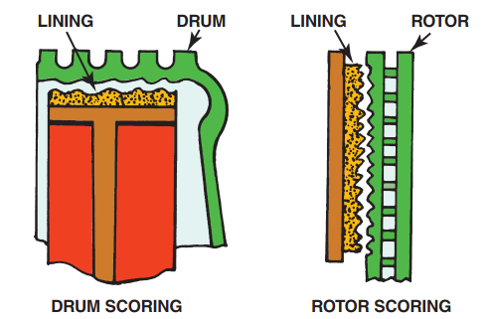
Brake Drums
FIGURE 16–2 The airflow through cooling vents helps brakes from overheating.
FIGURE 16–3 Scored drums and rotors often result in metal-to-metal contact.

Slide 5
Brake Drum And Rotor Damage
Besides wear, drums and rotors often experience damage to their friction surfaces.
SCORING- Scoring is an extreme form of drum and rotor wear consisting of scratches, deep grooves, and a generally rough finish on the friction surface.
There are a number of causes for scoring including the following:
1. The most common is brake linings that have worn to the point where a rivet, lining table, or pad backing plate contacts the drum or rotor.
2. Certain friction materials are more likely to score drums and rotors than others, and glazed linings that have hardened from exposure to extreme heat can also cause scoring.
3. Drum brakes are more likely to become scored than disc brakes because their closed construction holds dirt, sand, and abrasive dust inside the friction assembly. This allows the contaminants to be scrubbed repeatedly between the linings and drum.
4. Severe drum scoring often results when metal parts of the friction assembly fatigue, break loose, and are trapped between the linings and drum.

Slide 6
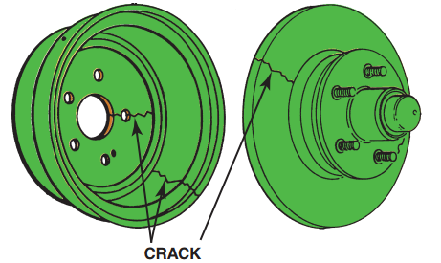
Brake Drum And Rotor Damage
FIGURE 16–4 Cracked drums or rotors must be replaced.

Slide 7
Brake Drum And Rotor Damage
CRACKING- Cracks in a brake drum or rotor are caused by the stress of severe braking or an impact during an accident.
HEAT CHECKING- A lesser form of drum and rotor cracking is called heat checking, which consists of many small, interlaced cracks on the friction surface.
HARD OR CHILL SPOTS- Earlier it was stated that cast-iron drums and rotors are durable because the friction, heat, and pressure of braking cause a tough “skin” to form on their friction surfaces.

Slide 8
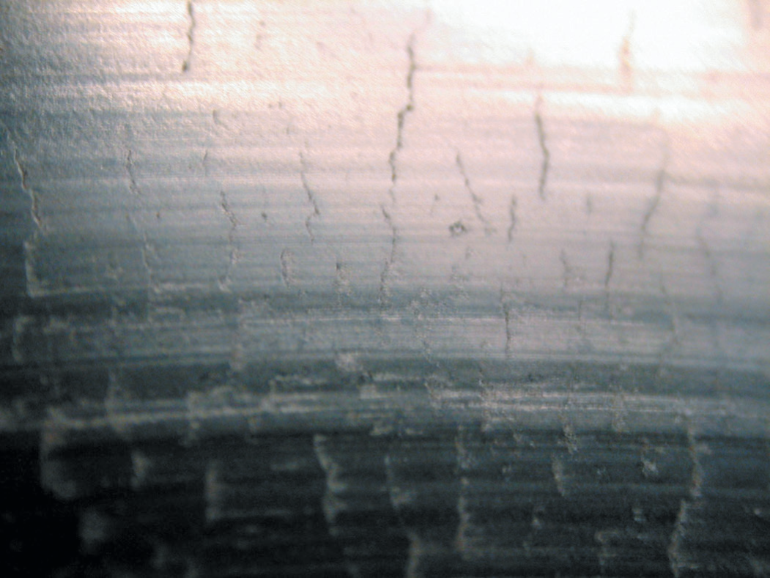
Brake Drum And Rotor Damage
FIGURE 16–5 A heat-checked surface of a disc brake rotor.

Slide 9
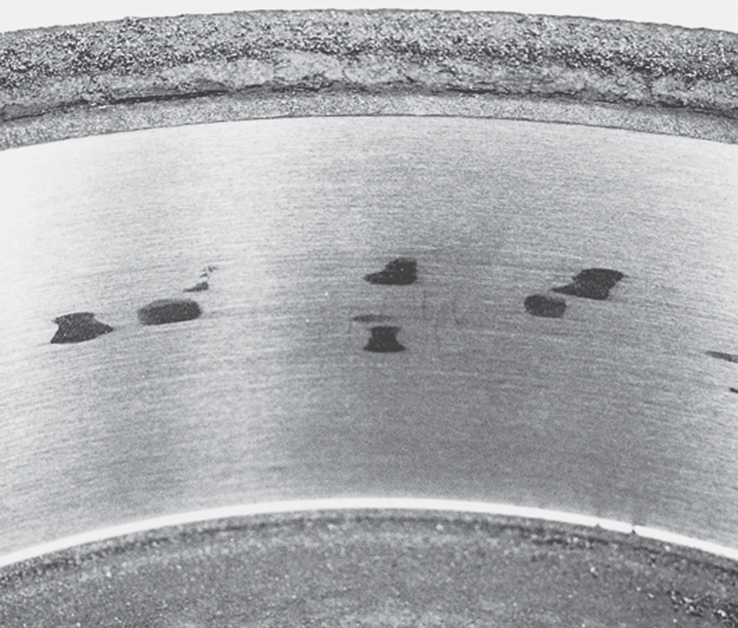
Brake Drum And Rotor Damage
FIGURE 16–6 These dark hard spots are created by heat that actually changes the metallurgy of the cast-iron drum. Most experts recommend replacement of any brake drum that has these hard spots.

Slide 10
Brake Drum Distortion
To ensure smooth brake application without pedal pulsation or other problems, brake drum friction surfaces must remain a fixed position in relation to the shoes.
DRUM DISTORTION- The friction surface of a brake drum in perfect condition is parallel to the axis of the axle and rotates in a precise circle centered on the axle or hub.
BELLMOUTH DRUMS- When an open edge of a brake drum friction surface has a larger diameter than the closed edge, the drum is suffering from bellmouth distortion.
OUT-OF-ROUND DRUMS- Uneven heat distribution can sometimes cause out-of-round distortion in which the drum radius varies when measured at different points around its circumference.
ECCENTRIC DRUMS- Eccentric distortion exists when the geometric center of the circle described by the brake drum friction surface is other than the center of the axle or the bolt circle of the drum web.

Slide 11
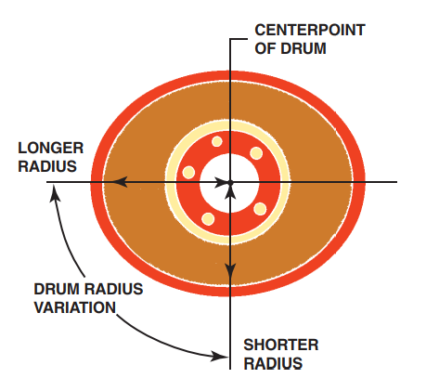
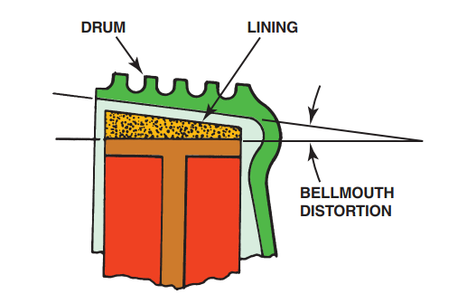
Brake Drum Distortion
FIGURE 16–7 Bellmouth brake drum distortion.
FIGURE 16–8 Out-of-round brake drum distortion.

Slide 12
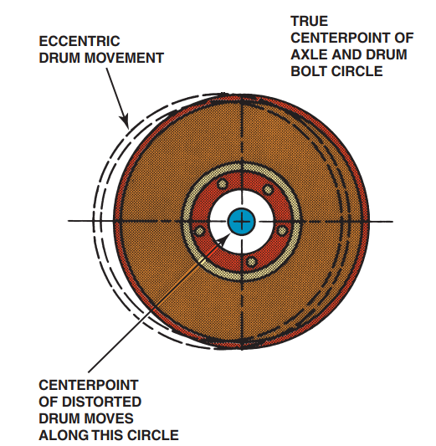
Brake Drum Distortion
FIGURE 16–9 Eccentric brake drum distortion.

Slide 13
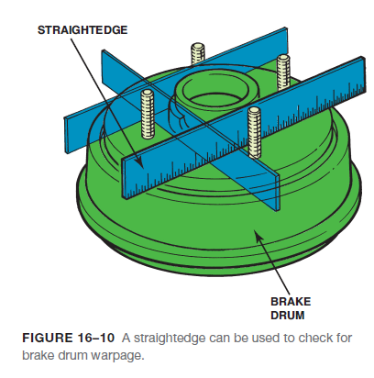
Brake Drum Distortion
Metal clips called tinnerman nuts are installed at the factory to keep the brake drums from falling off during vehicle assembly.
These clips can be removed and do not need to be reinstalled since the wheel lug nuts hold onto the brake drum.

Slide 14
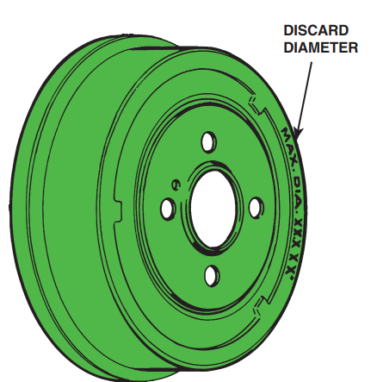
Brake Drum Distortion
FIGURE 16–11 Discard diameter and maximum diameter are brake drum machining and wear limits.

Slide 15
Animation: Brake Drum Micrometer (The animation will automatically start in a few seconds)

Slide 16
“Machine To” versus “Discard”
Brake drums can usually be machined a maximum of 0.060 inch (1.5 mm) oversize (e.g., a 9.500 in. drum could wear or be machined to a maximum inside diameter of 9.560 in.) unless otherwise stamped on the drum.
REASONS FOR EQUAL DRUM INSIDE DIAMETER- There are several reasons why the service technician should check and make sure that both brake drums on the same axle are close to the same inside diameter (ID).
Reason 1- Since heat is generated by braking, if there is less material (larger ID), the drum will tend to expand more rapidly than a drum with more material (smaller ID).
Reason 2- If one drum expands more than the drum on the other side of the vehicle, unequal braking forces result.
Reason 3- The drum that is larger in ID will expand away from the brake linings more than the other side.

Slide 17
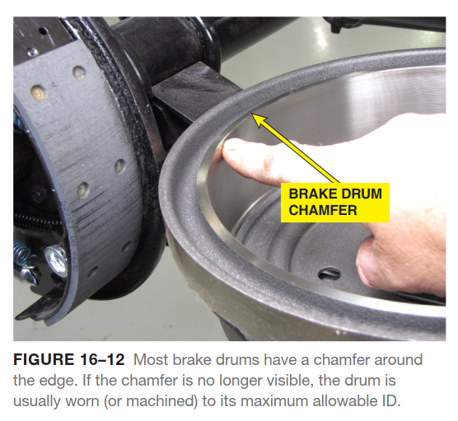
“Machine To” versus “Discard”

Slide 18
Machining Brake Drums
MEASURING A DRUM- Before measuring a brake drum, be sure it is not cracked by tapping it with a steel hammer. The brake drum should ring like a bell. If the brake drum makes a dull thud sound, discard the drum.
MACHINING A DRUM PROCEDURE- Always start any machining operation by making certain that the brake drum is clean and that excess grease is removed from the hub.
Typical drum brake machining steps include the following:
STEP 1- Mount the drum on the lathe and install the silencer band
STEP 2- Turn the drum by hand before turning on the lathe to be sure everything is clean. Advance the tool bit manually until it just contacts the drum. This is called scratch cut.
STEP 3- Stop the lathe and back off the tool bit. Loosen the arbor nut, rotate the drum one-half turn (180°) on the arbor, and retighten the arbor nut. Turn the lathe on and make a second scratch cut.
a. If the scratch cuts are side-by-side, the lathe is okay and machining can begin.
b. If the scratch cuts are opposite, remove the drum and check for nicks, burrs, or chips on the mounting surfaces.
STEP 4- Start the lathe and set the depth of the cut.

Slide 19
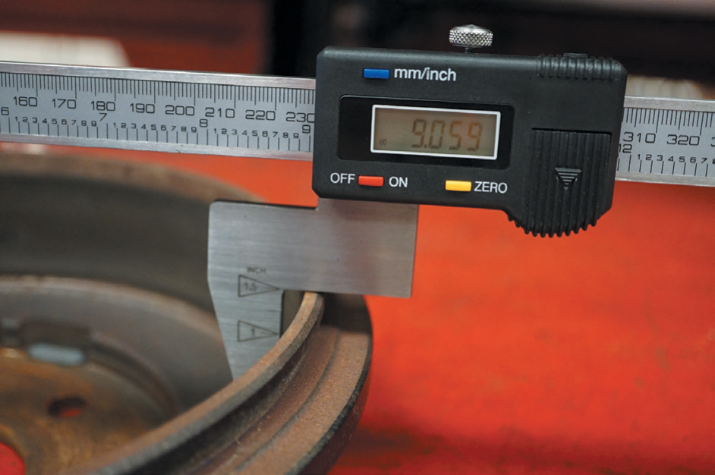
Machining Brake Drums
Figure 16-3 A digital drum micrometer makes measuring brake drums easy and accurate.

Slide 20
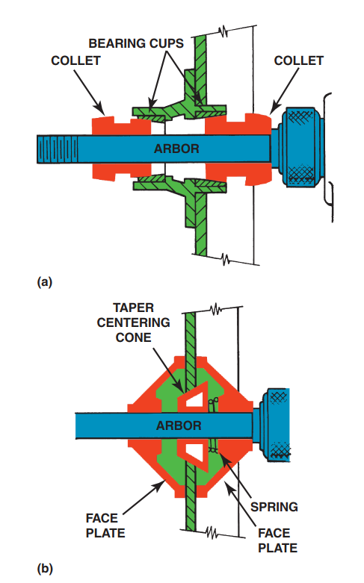
Machining Brake Drums
FIGURE 16–14 (a) A rotor or brake drum with a bearing hub should be installed on a brake lathe using the appropriate size collet that fits the bearing cups (races). (b) A hubless rotor or brake drum requires a spring and a tapered centering cone. A faceplate should be used on both sides of the rotor or drum to provide support.

Slide 21
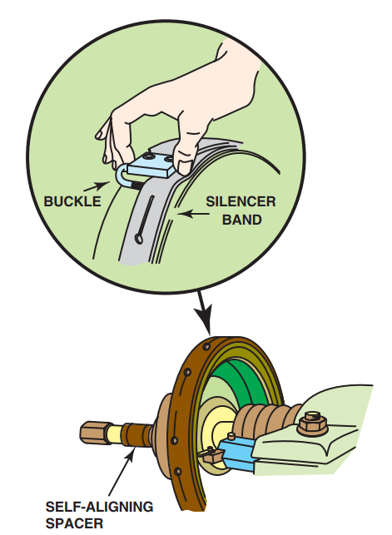
Machining Brake Drums
FIGURE 16–15 A self-aligning spacer (SAS) should always be used between the drum or rotor and the spindle retaining nut to help ensure an even clamping force and to prevent the adapters and cone from getting into a bind. A silence band should always be installed to prevent turning-tool chatter and to ensure a smooth surface finish.

Slide 22
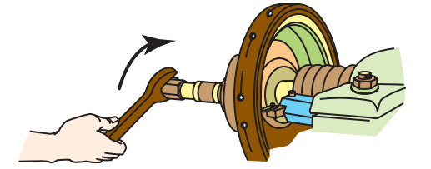
Machining Brake Drums
FIGURE 16–17 After making a scratch cut, loosen the retaining nut, rotate the drum on the lathe, and make another scratch cut. if both cuts are in the same location, the drum is installed correctly on the lathe and drum machining can begin.

Slide 23
Disk Brake Rotors
Disc brake rotors use cast gray iron at the area that contacts the friction pad. Rotors, also called discs or disks, have mass (weight) that absorbs heat.
STYLES OF ROTORS- Rotors are made in several styles, including the following:
1. Solid. These are used on the rear of many vehicles equipped with rear disc brakes and on the front of some small and midsize vehicles. Solid rotors are usually used on the rear where only 20% to 40% of the braking occurs. Solid rotors are much thinner than vented rotors.
2. Vented. These are used on the front of most vehicles. The internal vanes allow air to circulate between the two friction surfaces of the rotor.

Slide 24
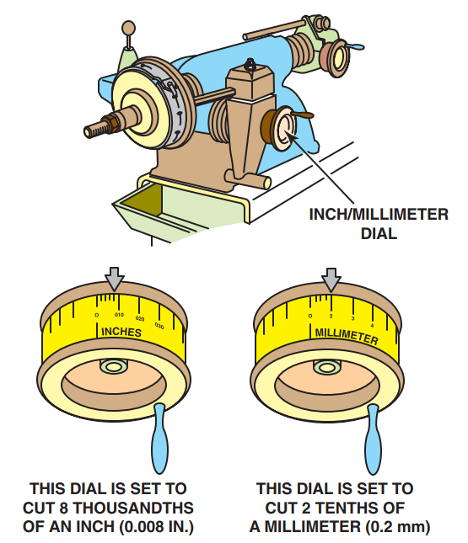
Disk Brake Rotors
FIGURE 16–18 Set the depth of the cut indicator to zero just as the turning tool touches the drum.

Slide 25
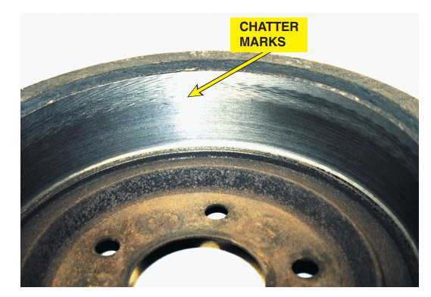
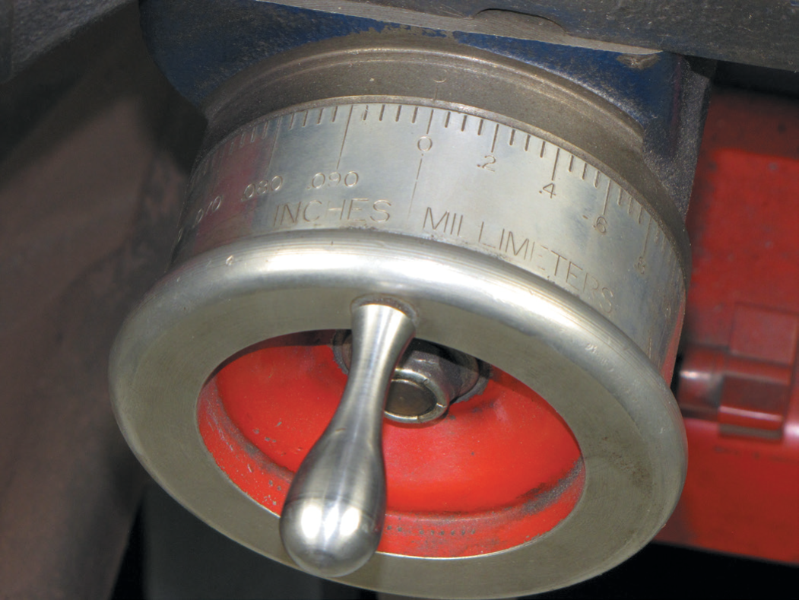
Disk Brake Rotors
FIGURE 16–19 This lathe has a dial that is “diameter graduated.” This means that a reading of 0.030 inch indicates a 0.015 inch cut that increases the inside diameter of the brake drum by 0.030 inch.
FIGURE 16–20 Notice the chatter marks at the edge of the
friction-area surface of the brake drum. These marks were
caused by vibration of the drum because the technician failed to wrap the dampening strap (silencer band) over the friction-surface portion of the brake drum.

Slide 26
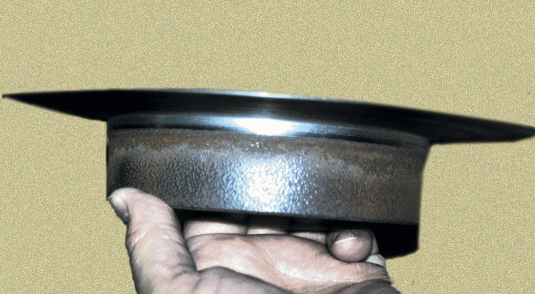
Disk Brake Rotors
FIGURE 16–21 This excessively worn (thin) rotor was removed from the vehicle in this condition. It is amazing that the vehicle was able to stop with such a thin rotor.

Slide 27
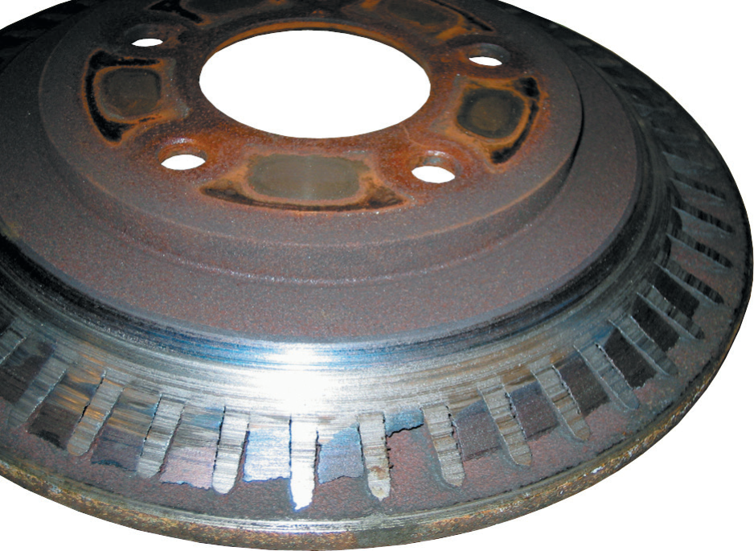
Disk Brake Rotors
FIGURE 16–22 Severely worn vented disc brake rotor. The braking surface has been entirely worn away exposing the cooling fins. The owner brought the vehicle to a repair shop because of a “little noise in the front.” notice the straight vane design.

Slide 28
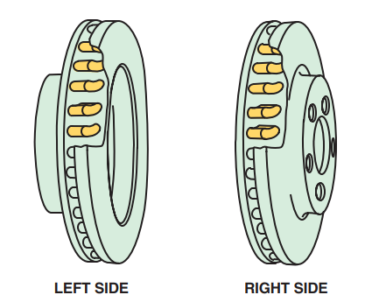
Disk Brake Rotors
FIGURE 16–23 Directional vane vented disc brake rotors. note that the fins angle toward the rear of the vehicle. It is
important that this type of rotor be reinstalled on the correct side of the vehicle.

Slide 29
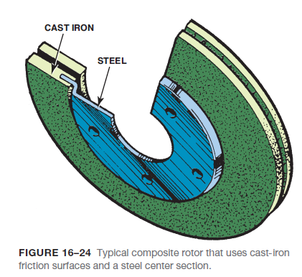
Disk Brake Rotors
COMPOSITE ROTORS- Composite rotors use a steel center section with a cast-iron wear surface. These composite rotors are lighter in weight than conventional cast-iron rotors.
ALUMINUM METAL MATRIX COMPOSITE ROTORS- Some disc brake rotors are manufactured from an aluminum metal matrix composite alloy reinforced with 20% silicon carbide particulate.

Slide 30
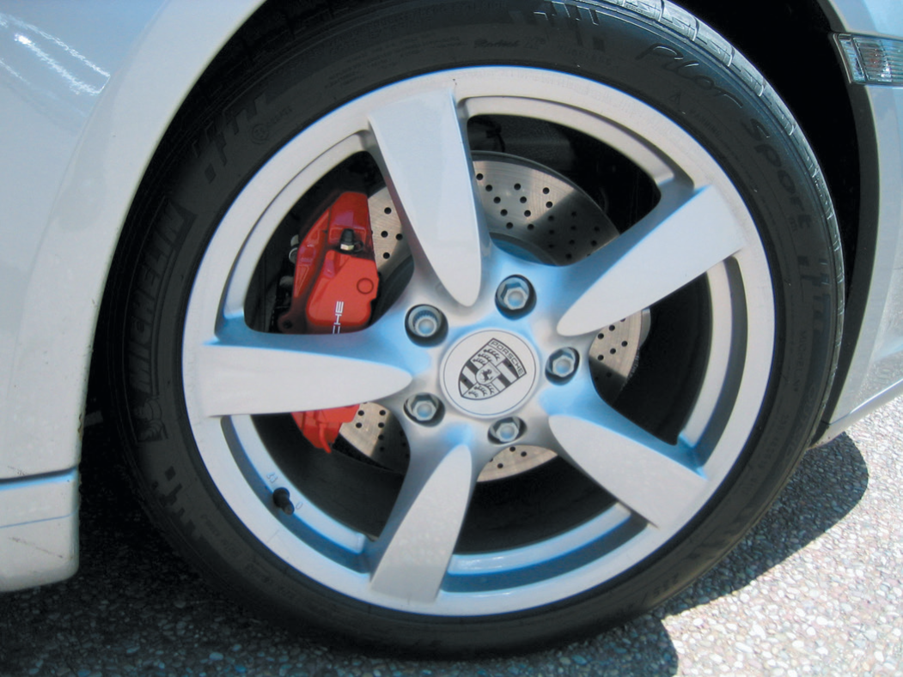
Disk Brake Rotor Distortion
FIGURE 16–25 This Porsche is equipped with high-performance brakes including cross-drilled brake rotors.

Slide 31
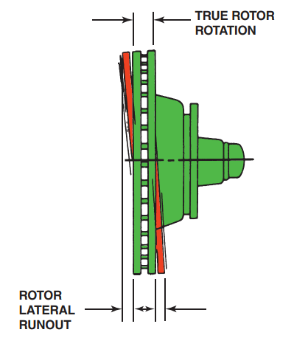
Disk Brake Rotor Distortion
FIGURE 16–26 Brake rotor lateral-runout distortion.

Slide 32
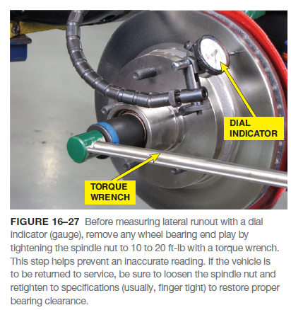
Disk Brake Rotor Distortion
CAUSES OF ROTOR DISTORTION- The friction surfaces of a rotor in perfect condition are perpendicular to the axle centerline and have no side-to-side movement.
ROTOR LATERAL RUNOUT- Lateral runout, often abbreviated LRO, is side-to-side wobble of the rotor as it rotates on the spindle.
ROTOR LACK OF PARALLELISM- Lack of parallelism, also called thickness variation (TV), is a variation in the thickness of the rotor when it is measured at several places around its circumference.

Slide 33
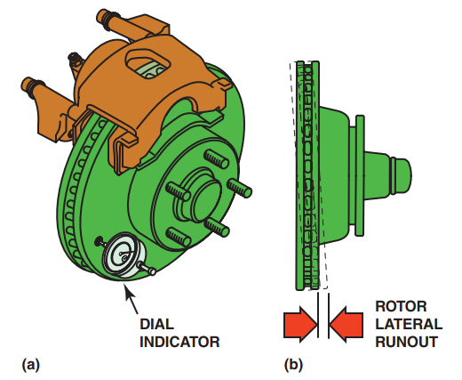
Disk Brake Rotor Distortion
FIGURE 16–28 (a) Rotate the disc brake rotor one complete
revolution while observing the dial indicator (gauge). (b) Most
vehicle manufacturers specify a maximum runout of about
0.003 inch (0.08 mm).

Slide 34
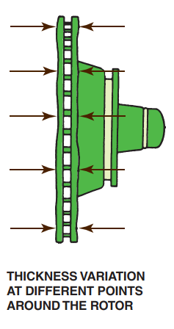
Disk Brake Rotor Distortion
FIGURE 16–29 Brake rotor
lack-of-parallelism distortion.
A variation in the thickness of
the rotor, commonly called disc
thickness variation (DTV) can
cause brake pedal pulsation
during braking.

Slide 35
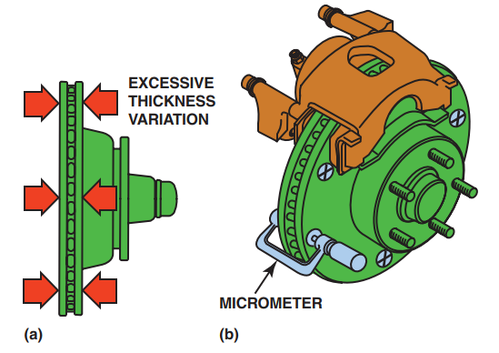
Disk Brake Rotor Distortion
FIGURE 16–30 (a) Disc brake rotor thickness variation
(parallelism). (b) The rotor should be measured with a micrometer at four or more equally spaced locations around the rotor.

Slide 36
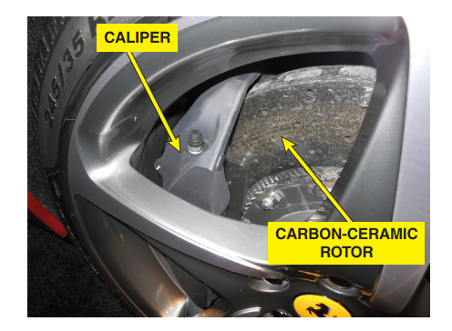
Disk Brake Rotor Distortion
FIGURE 16–31 A carbon-ceramic brake (CCB) rotor on a Ferrari.

Slide 37
Animation: Rotor Runout (The animation will automatically start in a few seconds)

Slide 38
Animation: Rotor Thickness Measurements (The animation will automatically start in a few seconds)

Slide 39
Animation: Rotor Parallelism Measurements (The animation will automatically start in a few seconds)

Slide 40
Animation: Micrometer, Metric (The animation will automatically start in a few seconds)

Slide 41
Carbon-Ceramic Rotors
DESCRIPTION- Carbon-ceramic brake (CCB) rotors are used on some high-performance vehicles and are very expensive.
CONSTRUCTION- Carbon-ceramic brake rotors are made of a carbon-fiber-reinforced ceramic silicon carbide material.
ADVANTAGES- The advantages of carbon-ceramic brake rotors include the following:
Low weight—This improves vehicle performance and handling.
Corrosion and wear resistant—This means that the rotors should not need to be replaced during the life of the vehicle.
SERVICE PROCEDURES- Carbon-ceramic brake rotors cannot be machined or serviced.

Slide 42
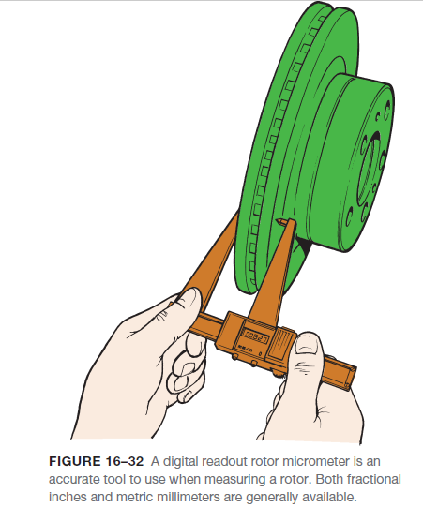
Disk Brake Rotor Thickness
Most rotors have a minimum thickness cast or stamped into the rotor. This thickness is minimum wear thickness.
At least 0.015 inch (0.4 mm) must remain after machining to allow for wear.

Slide 43
Animation: Brake Rotor Caliper Gauge (The animation will automatically start in a few seconds)

Slide 44
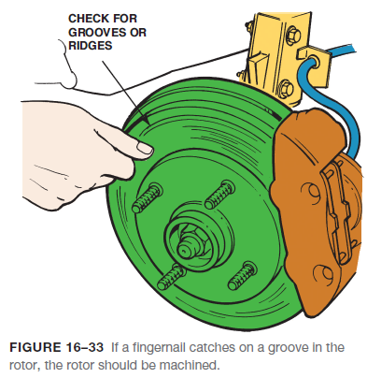
When The Rotors Should Be Machined
According to brake design engineers, a worn rotor has a very smooth friction surface that is ideal for replacement (new) disc brake pads.
Therefore, a rotor should be machined only if one of the following conditions exists:
1. Grooves deeper than 0.060 inch (1.5 mm). This is the approximate thickness of a nickel!
2. Thickness variation exceeding specifications and a brake pedal pulsation complaint.
3. Heavy rust that has corroded the friction surface of the rotor.

Slide 45
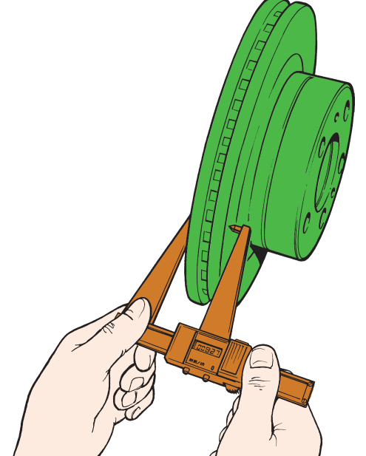
When The Rotors Should Be Machined
FIGURE 16–32 A digital readout rotor micrometer is an accurate tool to use when measuring a rotor. Both fractional inches and metric millimeters are generally available.

Slide 46
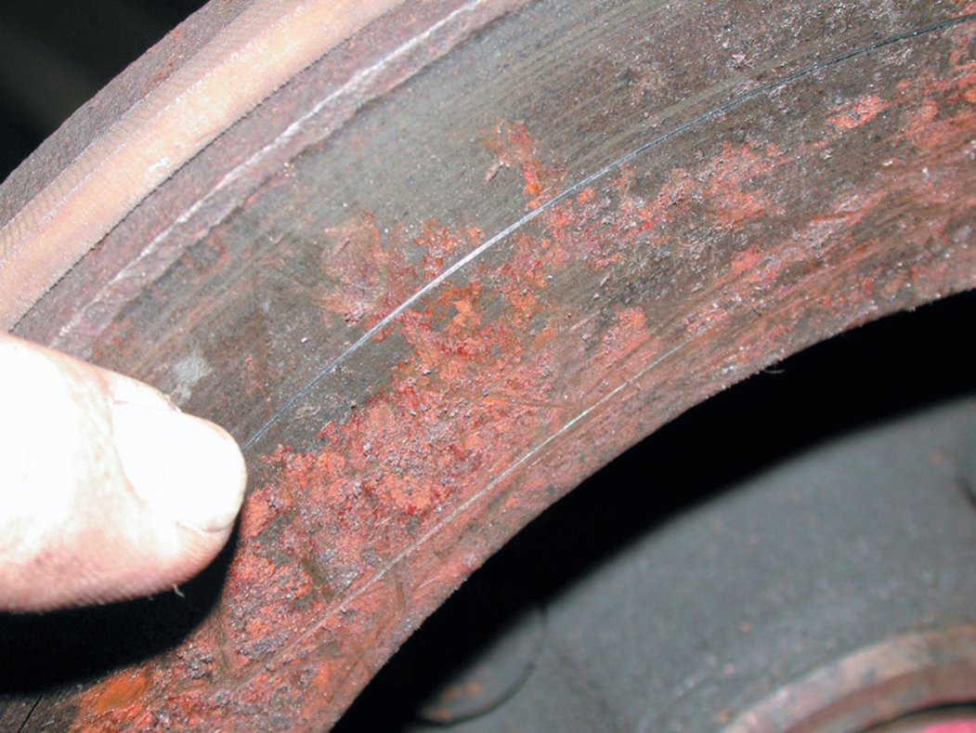
When The Rotors Should Be Machined
FIGURE 16–34 This rusted rotor should be machined.
FIGURE 16–35 Rotors that have deep rust pockets usually cannot be machined.

Slide 47
Rotor Finish
The smoothness of the rotor is called rotor finish or surface finish.
Surface finish is measured in units called microinches, abbreviated μin., where the symbol in front of “in.” is the Greek lowercase letter μ (mu).
Most new rotors have a surface finish of 45 to 60 μin. Ra.
The higher the Ra of a rotor, the rougher the surface finish.
The lower the Ra number, the smoother the surface finish.

Slide 48
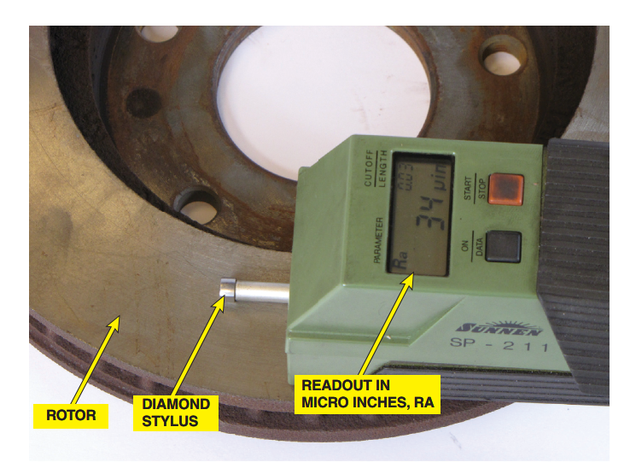
Rotor Finish
FIGURE 16–36 Electronic surface finish machine. The reading shows about 34 μin. This is a very smooth rotor and is suitable for use with any brake pad.

Slide 49
Qualifying A Brake Lathe
PURPOSE OF QUALIFYING A BRAKE LATHE- All brake lathes should be checked regularly to make sure that they are in good condition and are capable of machining brake drums and rotors accurately.
QUALIFYING PROCEDURE- To qualify a brake lathe, use the following generic checklist.
STEP 1- Check for proper operation and that all motors, switches, and feed controls that engage and disengage levers function properly.
STEP 2- Make sure radius cones, bell clamps, and taper cones are free of all nicks, burrs, rust, and foreign debris. To restore flatness, use an 80-grit silicon carbide hone and WD-40 lubricant. Apply light pressure using short figure eight movements to prevent rounding of the edges.
STEP 3- Check the tapered surfaces on the arbor and spindle to ensure these surfaces are totally free of any contamination. The arbor should not run out over two thousandths of an inch total indicator runout (TIR).
STEP 4- The shoulder of the arbor must also be free of nicks or debris. Spray the shoulder of the arbor with WD-40 and use the arbor shaft for a guide to hold the hone perpendicular to the shoulder. Turn the lathe on and hone the shoulder. Apply pressure on the hone with a finger on the arbor.

Slide 50
Qualifying A Brake Lathe
(Continued from previous slide)
STEP 5- Check fit of the rotor truer and the top of the dovetail way. A one thousandths feeler gauge should not be able to fit between the top dovetail surface and the bottom of the rotor. Remove the rotor truer and hone the top dovetail surface and the bottom of the rotor truer until the feeler gauge stock cannot be inserted.
STEP 6- The tool bit holder slots on the rotor truer should be clean. Make sure the bottom of the tool bit holder is also clean. The tool bit holder bottom can be cleaned by rubbing it on a hone or a single cut file. The carbide bit seat on the tool bit holder should be clean and flat. If the surface is not flat, replace the tool bit holder.
STEP 7- All end bell clamps can be remachined to reduce runout. Mount the bell clamp with the machined hub mating with the shoulder of the arbor. Use the two small radius adapters next on the arbor and space out to the threads with available radius adapters or one inch spacer.
Tighten the arbor nut. Put a reference mark on the bell clamp that lines up with the two marks on the spindle and arbor. Machine the face of the bell clamp with the rotor truer. True all four bell clamps.

Slide 51
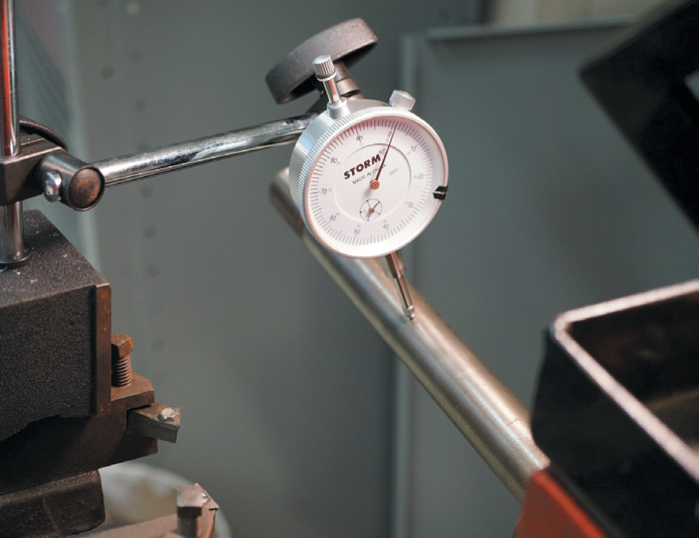
Qualifying A Brake Lathe
FIGURE 16–37 A dial indicator being used to check the arbor for total indicator runout (TIR) in a brake lathe.

Slide 52
Qualifying A Brake Lathe
(Continued from previous two slides)
STEP 8- Always align the inside bell clamp with the reference mark put on the hub after machining the bell clamp. Keep all mounting surfaces clean and occasionally check accuracy of setup by holding the inside bell clamp and rotating the rotor 180˚. Reclamp and check with the dial indicator. If runout is excessive, hone the adapter. If runout persists, remachine the adapter.
STEP 9- The inside of the hat section of the rotor must be cleaned of all rust, burrs, and any foreign matter. If any debris is present on this surface, the rotor will not reference properly while machining.
STEP 10- All surfaces of the lathe, arbor, and all of the adapter surfaces must be free of nicks, burrs, and foreign debris.

Slide 53
Machining A Disc Brake Rotor
Before machining a rotor, be sure that it can be machined by comparing the minimum thickness specification and the measured thickness of the rotor.
Following is an example of the steps necessary to machine a disc brake rotor.
Always follow the instructions for the equipment you are using.
1. Mount the disc brake rotor to the spindle of the lathe using the cones and adapters recommended.
2. Install a rotor damper and position the cutting tools close to the rotor surface
3. Make a scratch cut on the rotor face
4. To check that the rotor is mounted correctly, loosen the retaining nut, turn the rotor one-half turn (180°), and retighten the nut. Make another scratch cut.
a. The second scratch cut should be side-by-side with the first scratch cut if the rotor is properly installed,
b. If the second scratch cut is on the opposite side (180°) from the first scratch cut, the rotor may not be installed on the lathe correctly.

Slide 54
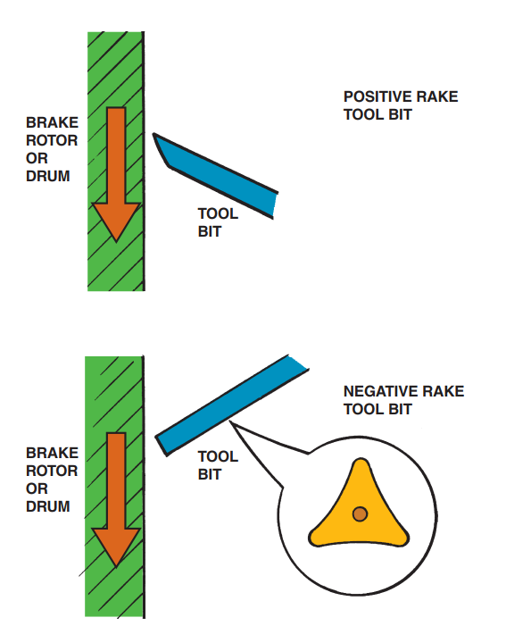
Machining A Disc Brake Rotor
FIGURE 16–38 Most positive rake brake lathes can cut any depth in one pass, thereby saving time. A typical negative rake lathe uses a three-sided turning tool that can be flipped over, thereby giving six cutting edges.

Slide 55
Machining A Disc Brake Rotor
ROUGH CUT- A rough cut on a lathe involves cutting 0.005 inch per side with a feed of 0.008 inch per revolution and 150 RPM spindle speed. This usually results in a very coarse surface finish of about 150 μin. Ra.
FINISH CUT- A finish cut means removing 0.002 inch per side with a feed of 0.002 inch per revolution and 150 RPM spindle speed.
NONDIRECTIONAL FINISH- Most vehicle and brake component manufacturers recommend a nondirectional finish to help prevent the grooves machined into the rotor from acting like record grooves that can force the pads to move outward while the rotor rotates.
SURFACE FINISHING THE ROTOR- The goal of any brake repair or service should be to restore the braking effectiveness to match new vehicle brakes.

Slide 56
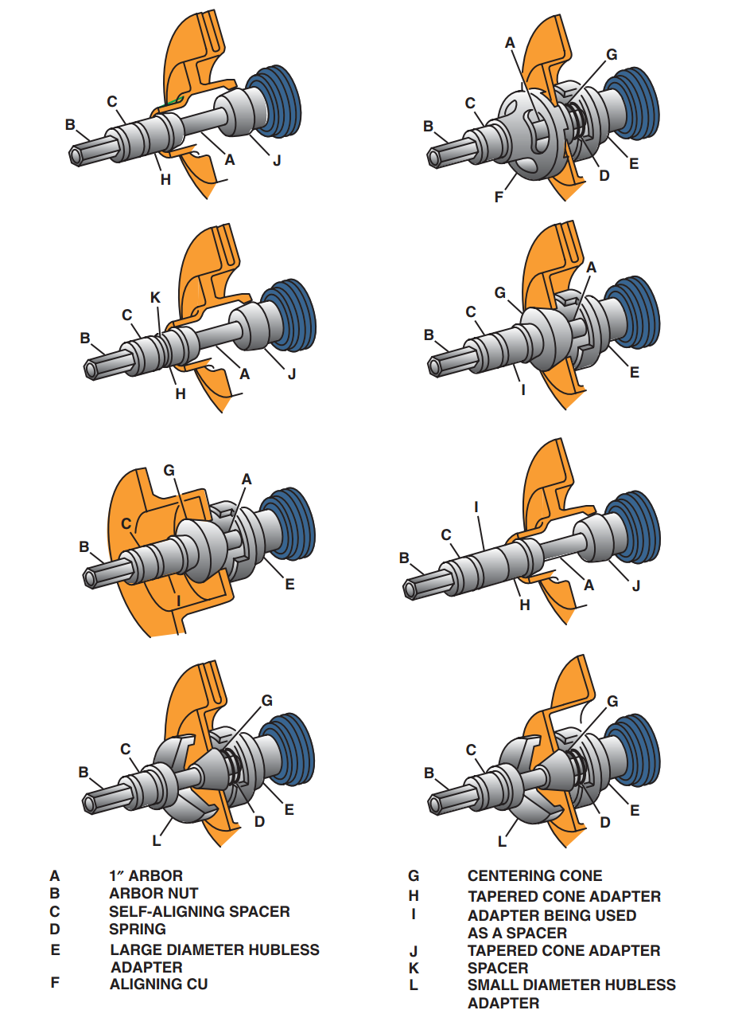
Machining A Disc Brake Rotor
FIGURE 16–39 Recommended adapters and location for machining hubbed and hubless rotors.

Slide 57
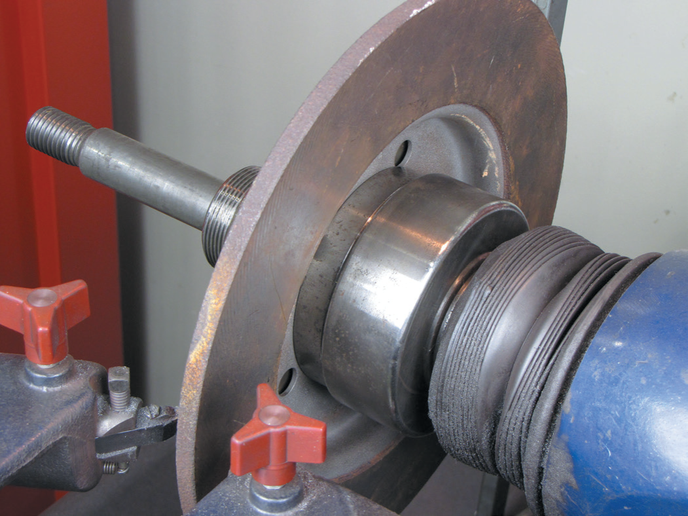
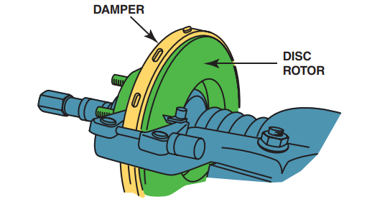
Machining A Disc Brake Rotor
FIGURE 16–41 A damper is necessary to reduce cutting-tool vibrations that can cause a rough surface finish.
FIGURE 16–40 A composite rotor properly mounted on a brake lathe.

Slide 58
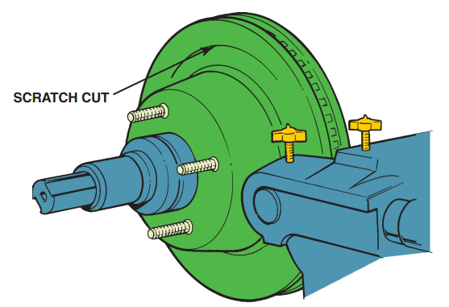
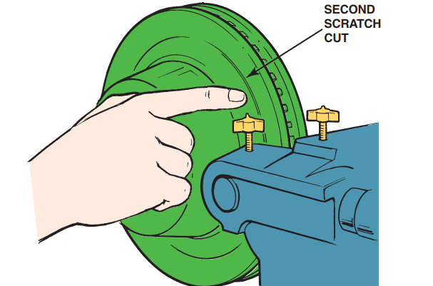
Machining A Disc Brake Rotor
FIGURE 16–42 After installing the rotor on the brake lathe, turn the cutting tool in just enough to make a scratch cut.
FIGURE 16–43 After making a scratch cut, loosen the retaining nut and rotate the rotor on the spindle of the lathe one-half turn. Tighten the nut and make a second scratch cut. The second scratch cut should be side-by-side with the first scratch if the rotor is installed correctly on the brake lathe.

Slide 59
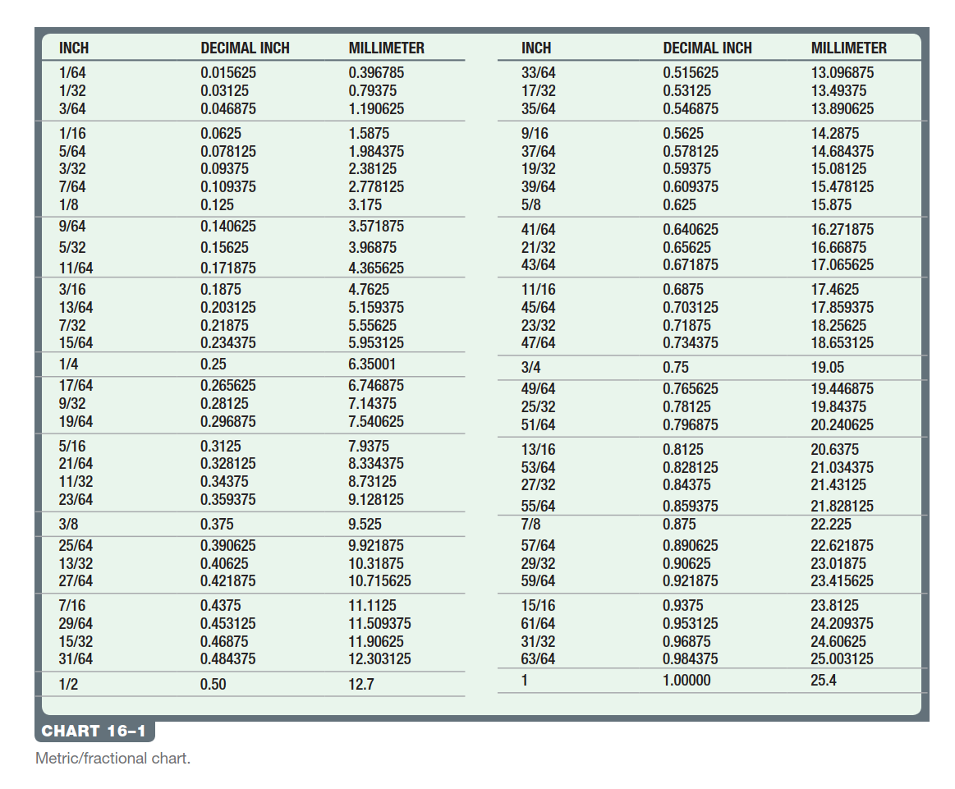
Machining A Disc Brake Rotor

Slide 60
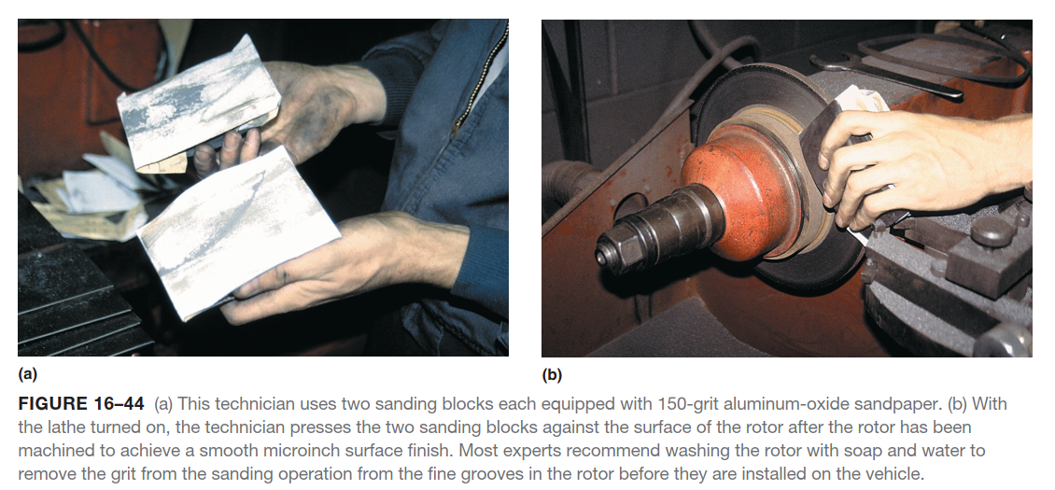
Machining A Disc Brake Rotor

Slide 61
Machining A Disc Brake Rotor

Slide 62
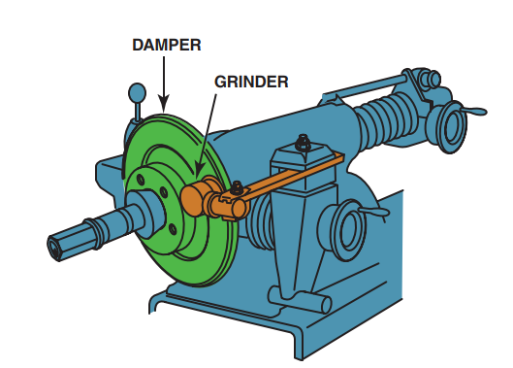
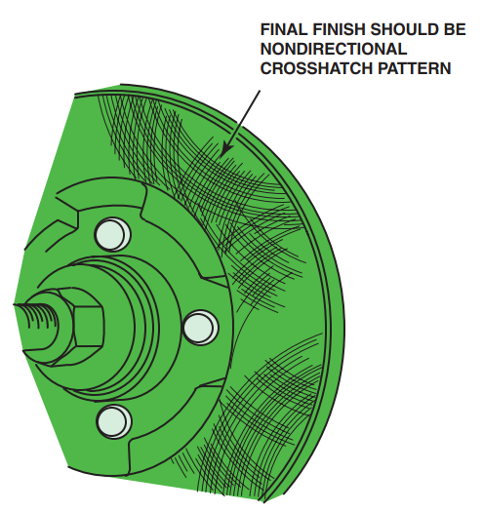
Machining A Disc Brake Rotor
FIGURE 16–46 A grinder with sandpaper can be used to give a smooth nondirectional surface finish to the disc brake rotor.
FIGURE 16–47 The correct final surface finish should be smooth and nondirectional.

Slide 63
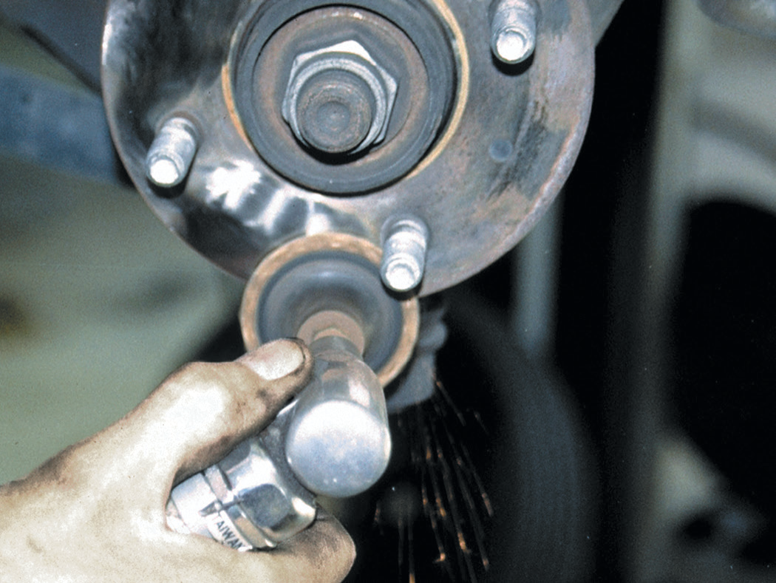
Machining A Disc Brake Rotor
FIGURE 16–48 Rust should always be cleaned from both the rotor and the hub whenever the rotors are machined or replaced. An air-powered die grinder with a sanding disc makes quick work of cleaning this hub.

Slide 64
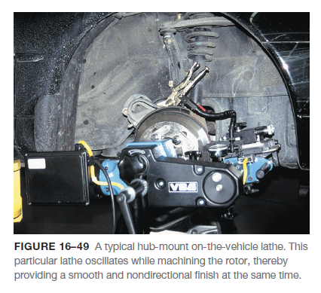
On-The-Vehicle Rotor Machining
Many vehicle manufacturers recommend on-the-vehicle machining for rotors if the disc brake rotor must be machined due to deep scoring or pulsating brake pedal complaint.

Slide 65
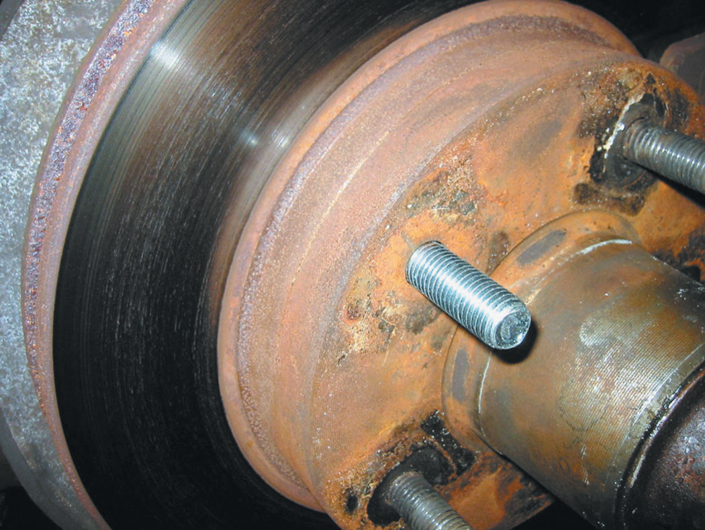
On-The-Vehicle Rotor Machining
FIGURE 16–50 A wheel stud was replaced on the rotor hub assembly when it was discovered to be stripped.

Slide 66
Summary
Brake drums are constructed of cast iron where the lining contacts the drum, with mild steel centers. The drum is drilled for the lug studs. Cast iron contains approximately 3% carbon, which makes the drum hard, yet brittle.
Brake drums are usually measured using a micrometer especially designed for brake drums.
Most brake experts recommend that both drums on the same axle be within 0.010 inch (0.25 mm) of each other. The maximum specified inside diameter (ID) means the maximum wear inside diameter.
Disc brake rotors use cast gray iron at the area that contacts the friction pad. Rotors, also called discs or disks, have mass (weight) that absorbs heat.
Most rotors have a minimum thickness cast or stamped into the rotor. This thickness is minimum wear thickness. At least 0.015 inch (0.4 mm) must remain after machining to allow for wear. Some vehicle manufacturers, such as General Motors, specify that 0.030 inch (0.8 mm) be left for wear.

Slide 67
Summary Cont….
Most new rotors have a surface finish of 45 to 60 μin. Ra.
The higher the Ra of a rotor, the rougher the surface finish.
The lower the Ra number, the smoother the surface finish.
All brake lathes should be checked regularly to make sure that they are in good condition and are capable of machining brake drums and rotors accurately.
After proper installation of the disc brake rotor on the brake lathe, proceed with machining the rotors. For best results, do not machine any more material from the rotor than is absolutely necessary. Always follow the recommendations and guidelines as specified by the vehicle manufacturer.
Many vehicle manufacturers recommend on-the-vehicle machining for rotors if the disc brake rotor must be machined due to deep scoring or pulsating brake pedal complaint.

Slide 68
Video Links (Internet Access Required)
On car brake machining (time 19:13)
Rotor machining (time 9:19)
Rotor machining (time 7:49)
On car brake lathe (time 15:18)
Turn a rotor (time 7:14)
Machine a brake rotor (time 4:52)
On car brake lathe (time 3:04)
Machining a brake drum (time 21:54)

