Slide 1
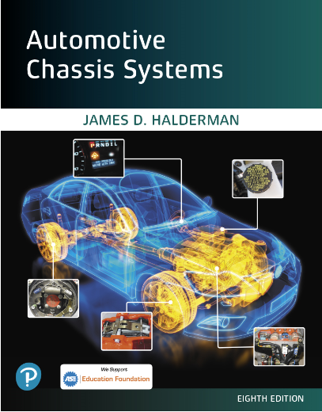
Automotive Chassis Systems Eighth Edition
Chapter 15
Parking Brake Operation,
Diagnosis, and Service
Notes:
If this PowerPoint presentation contains mathematical equations, you may need to check that your computer has the following installed:
1) MathType Plugin
2) Math Player (free versions available)
3) NVDA Reader (free versions available)

Slide 2
Objectives
Discuss parking brake standards, components, warning lamp, and automatic parking brake release.
Explain parking brake linkages.
Describe drum parking brakes.
Describe caliper-actuated disc parking brakes.
Explain how to adjust a parking brake properly.
Discuss electric parking brakes.
This chapter will help prepare for the Brakes (A5) ASE certification test content area "A" (Hydraulic, Power Assist, and Parking Brake Systems Diagnosis and Repair).

Slide 3
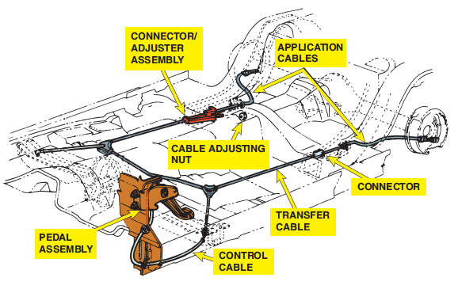
Parking Brake Standards
BACKGROUND- Before 1967, most vehicles had only a single master cylinder operating all four brakes.
If the fluid leaked at just one wheel, the operation of all brakes was lost.
FMVSS 135- According to Federal Motor Vehicle Safety-Standard (FMVSS) 135, the parking brake must hold a fully loaded (laden) vehicle stationary on a slope of 20% up or down grade.
FIGURE 15–1 Typical parking brake cable system showing the foot-operated parking brake lever and cable routing

Slide 4
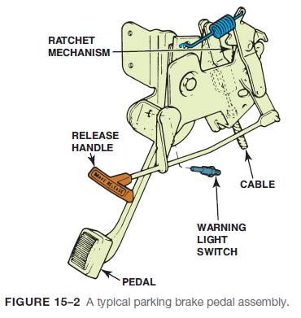
Pedals, Levers, and Handles
Parking brakes are applied by a pedal, a lever, or a handle from inside the vehicle.
Foot pedals and floor-mounted levers are the most common means of applying parking brakes.

Slide 5
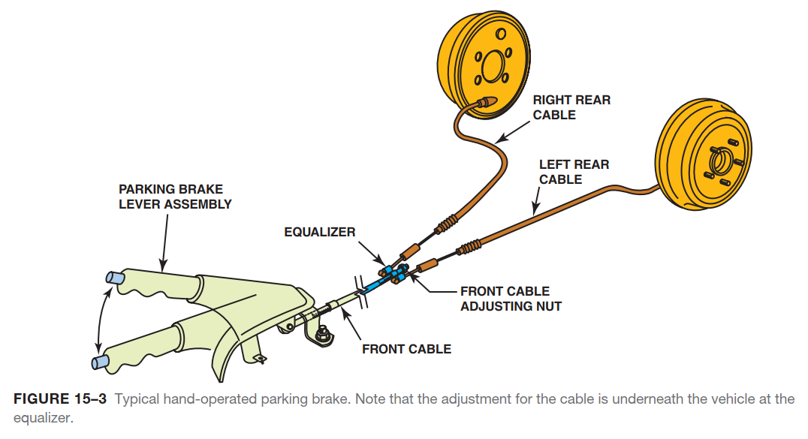
Pedals, Levers, and Handles

Slide 6
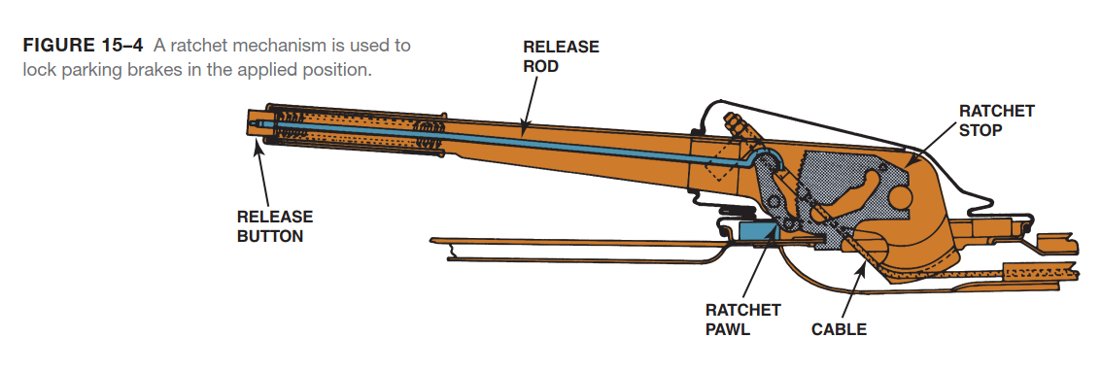
Pedals, Levers, and Handles

Slide 7
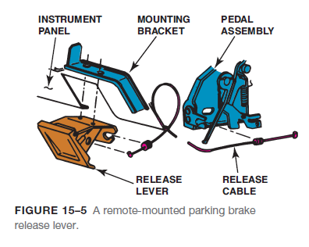
Pedals, Levers, and Handles
PARKING BRAKE PEDALS- A parking brake pedal is applied by depressing it with a foot.

Slide 8
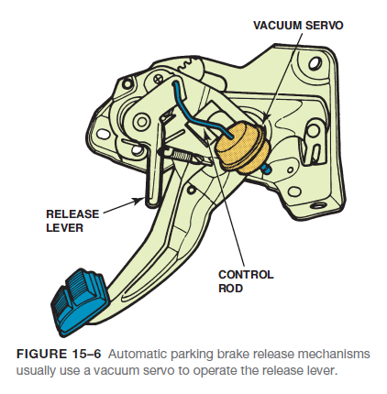
Pedals, Levers, and Handles
AUTOMATIC PARKING BRAKE RELEASE- Some vehicles with pedal-operated parking brakes have an automatic release mechanism that disengages the parking brake using a vacuum servo controlled by an electrical solenoid.

Slide 9
Parking Brake Warning Lamp
A red brake warning lamp lights on the dash if any of the following events occur:
On most vehicles, this is the same lamp that lights when there is a hydraulic or brake fluid level problem.
The warning lamp for the parking brake warns the driver that the parking brake is applied or partially applied. This warning helps prevent damage or overheating to the brake drums and linings that could occur if the vehicle was driven with the parking brake applied.

Slide 10
Animation: Parking Brake Warning Light (The animation will automatically start in a few seconds)

Slide 11
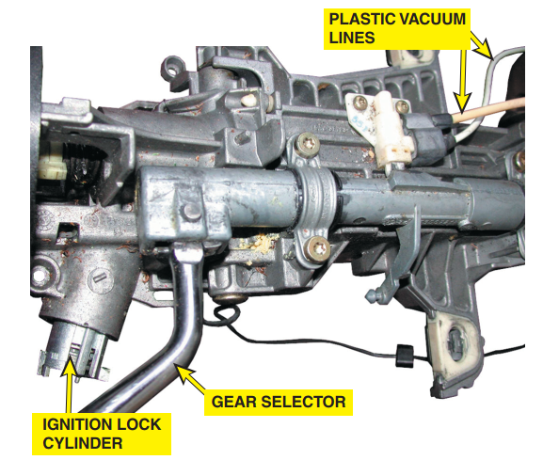
Parking Brake Warning Lamp
FIGURE 15–7 The two plastic vacuum tubes on the steering column are used to release the parking brake when the gear selector is moved from park into a drive gear.

Slide 12
Parking Brake Linkages
Parking brake linkages transmit force from the pedal, lever, or handle inside the vehicle to the brake friction assemblies.
LINKAGE RODS- Parking brake linkage rods made from solid steel are commonly used with floor-mounted actuating levers to span the short distance to an intermediate lever or an equalizer.

Slide 13
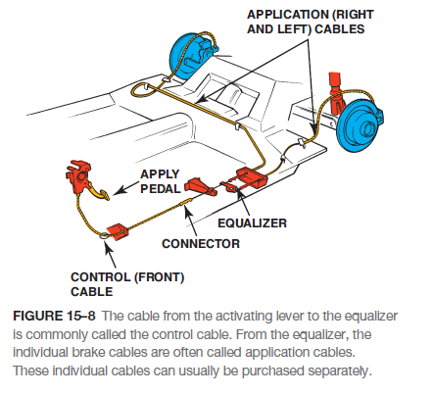
Parking Brake Linkages
LINKAGE CABLES- The typical parking brake cable is made of woven-steel wire encased in a reinforced rubber or plastic housing.
Parking brake linkages use control cables, transfer cables, and application cables.
Control cables attach to the parking brake pedal, lever, or handle inside the vehicle.
A transfer cable transmits force to an intermediate lever or equalizer to the application cables.
The application cables use the force passed through the linkage to apply the rear-wheel brake assembly.

Slide 14
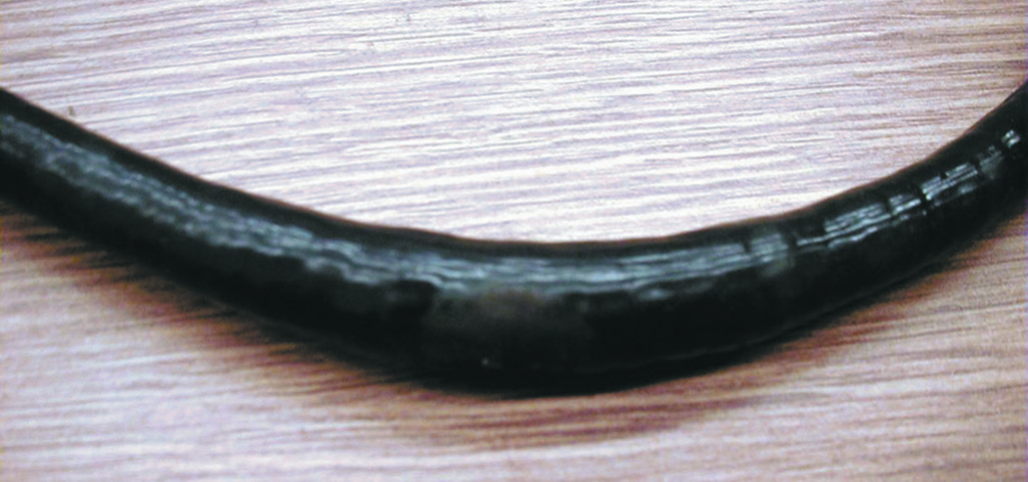
Parking Brake Linkages
FIGURE 15–9 Notice how rust inside the covering of this parking brake cable has caused the cable to swell.

Slide 15
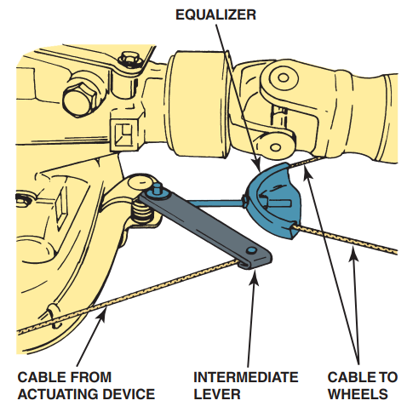
Parking Brake Linkages
FIGURE 15–10 Intermediate levers in the parking brake linkage increase the application force.

Slide 16
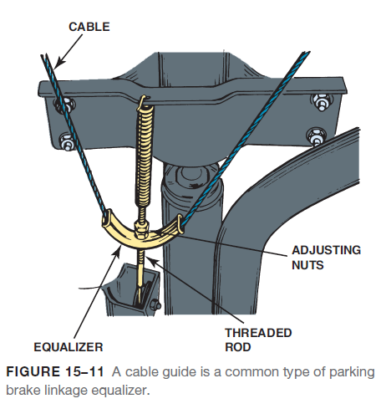
Parking Brake Linkages
LINKAGE LEVERS- Unfortunately, the amount of physical force a driver can apply to the parking brake control is often not enough to apply the parking brake.
LINKAGE EQUALIZERS- In some parking brake linkages, the rods or cables to the two friction assemblies are adjusted separately.
To prevent unequal application, most parking brake linkages use an equalizer to balance the force from the parking brake control and transmit an equal amount to each friction assembly.
LINKAGE DESIGN- The number of different parking brake linkage designs is almost as great as the number of vehicle models on the road.

Slide 17
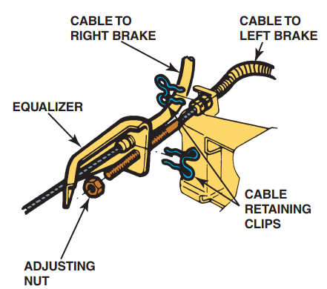
Parking Brake Linkages
FIGURE 15–12 Some parking brake equalizers are installed in the brake cable.

Slide 18
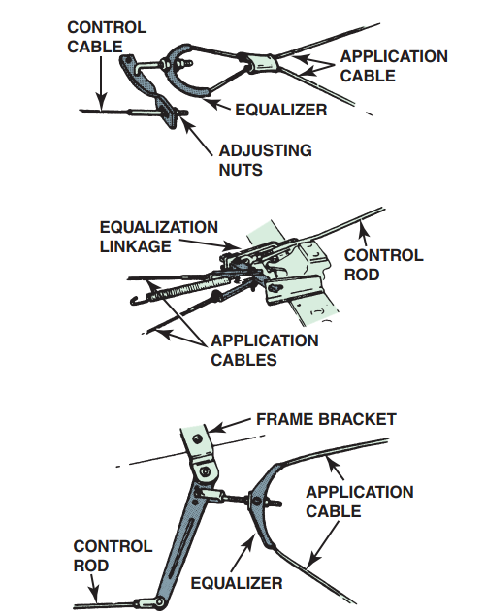
Parking Brake Linkages
FIGURE 15–13 Many parking brake linkages use both an intermediate lever and an equalizer.

Slide 19
Front and Rear Entry Parking Brake Cables
The parking brake standard requires that the vehicle be held stationary on a 20% grade facing either uphill or downhill.
Many drum parking brake systems attach the parking brake lever on the secondary (rearward) shoe and push the primary (forward facing) brake shoe against the drum.

Slide 20
Drum Parking Brakes
Drum parking brakes are the most common types on vehicles and light trucks.
Drum brakes make excellent parking brakes because they have a high static coefficient of friction combined with self-energizing action and, in the case of dual servo brakes, servo action that increases their application force.
INTEGRAL DRUM PARKING BRAKES- Integral drum parking brakes mechanically apply the rear drum service brakes to serve as the parking brakes.
REAR DISC AUXILIARY DRUM PARKING BRAKES- Rear disc service brakes with fixed calipers commonly have a parking brake drum formed into the hub of the brake rotor.

Slide 21
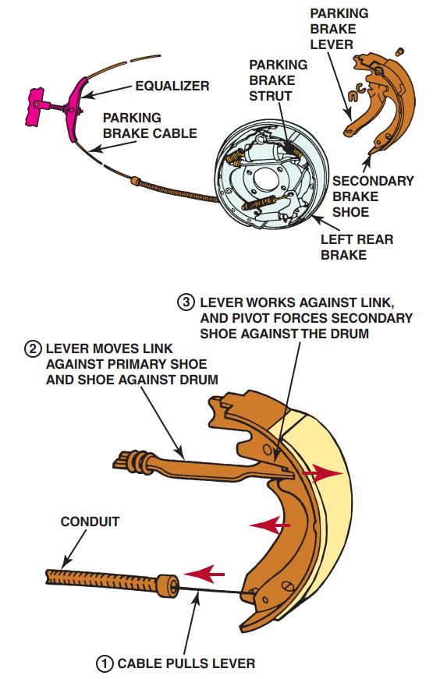
Drum Parking Brakes
FIGURE 15–14 Notice the spring at the end of the parking brake strut. This antirattle spring keeps tension on the strut. The parking brake lever is usually attached with a pin and
spring (wavy) washer and retained by a horseshoe clip.

Slide 22
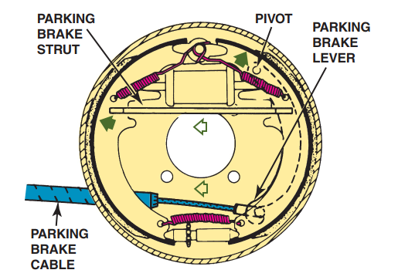
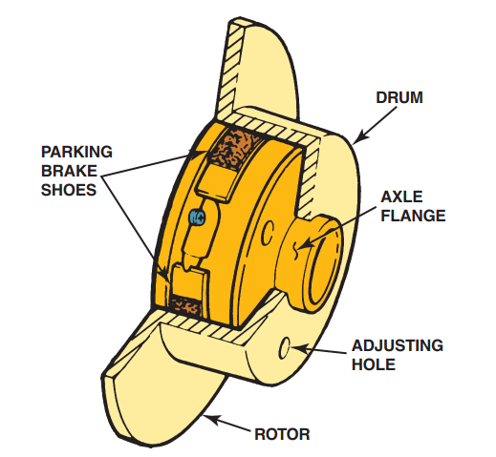
Drum Parking Brakes
FIGURE 15–15 The parking brake cable pulls on the parking brake lever, which in turn forces the brake shoe against the drum.
FIGURE 15–16 The inside “hat” of the disc brake rotor is the friction surface for the parking brake shoes.

Slide 23
Animation: Parking Brake Operation (The animation will automatically start in a few seconds)

Slide 24
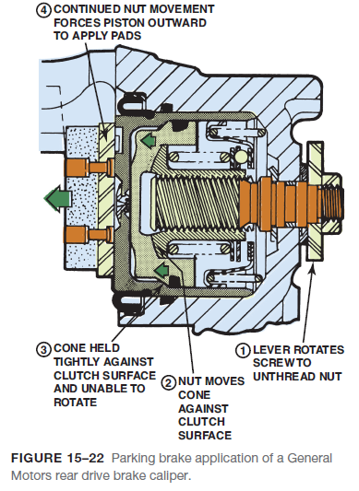
Caliper-Actuated Disk Parking Brakes
Caliper-actuated disc parking brakes are used on vehicles whose rear disc brakes are equipped with floating or sliding brake calipers.
BALL AND RAMP ACTUATION- The ball and ramp actuating system found in Ford rear brake calipers has three steel balls located in ramp-shaped detents between two plates.
SCREW, NUT, AND CONE ACTUATION- General Motors’ rear disc parking brake uses a screw, nut, and cone mechanism to apply the caliper piston.

Slide 25
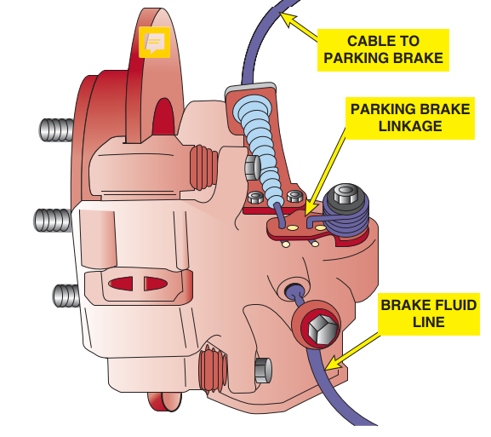
Caliper-Actuated Disk Parking Brakes
Figure 15-18 A typical rear disc brake showing the parking brake cable used to apply the caliper piston against the disc brake rotor.

Slide 26
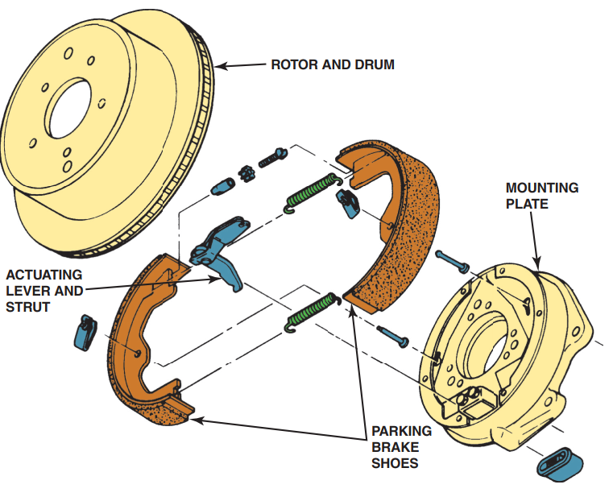
Caliper-Actuated Disk Parking Brakes
FIGURE 15–17 A typical rear
disc brake auxiliary drum brake
friction assembly.

Slide 27
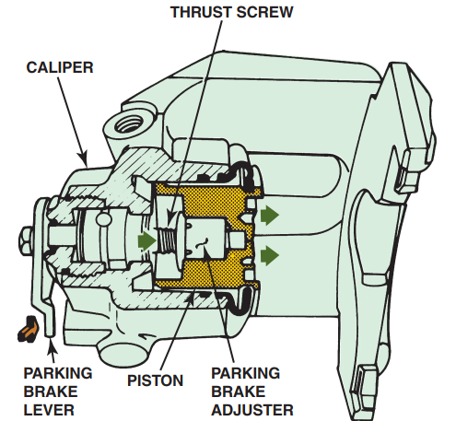
Caliper-Actuated Disk Parking Brakes
FIGURE 15–19 Operation of a ball and ramp-type rear disc brake caliper parking brake.

Slide 28
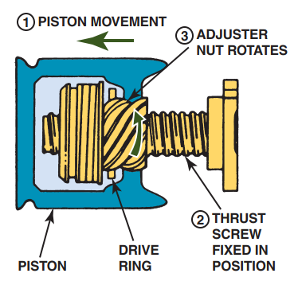
Caliper-Actuated Disk Parking Brakes
FIGURE 15–20 Automatic adjustment of a ball and
ramp-type rear disc brake parking brake occurs when
the service brakes are applied.

Slide 29
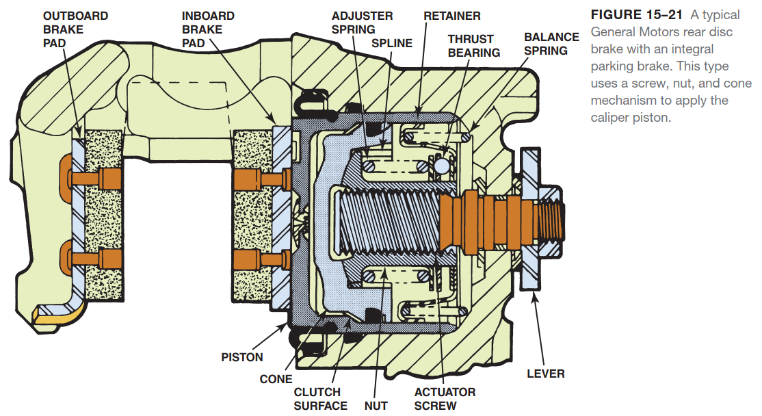
Caliper-Actuated Disk Parking Brakes

Slide 30
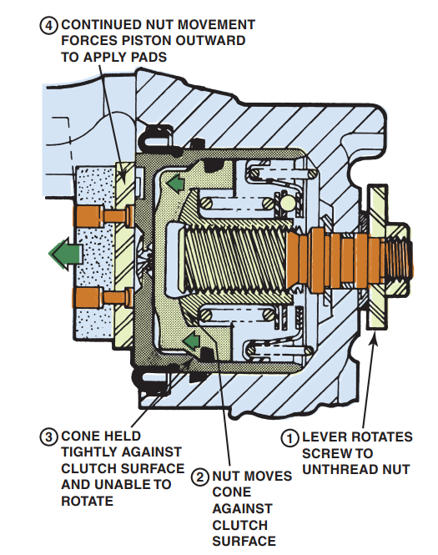
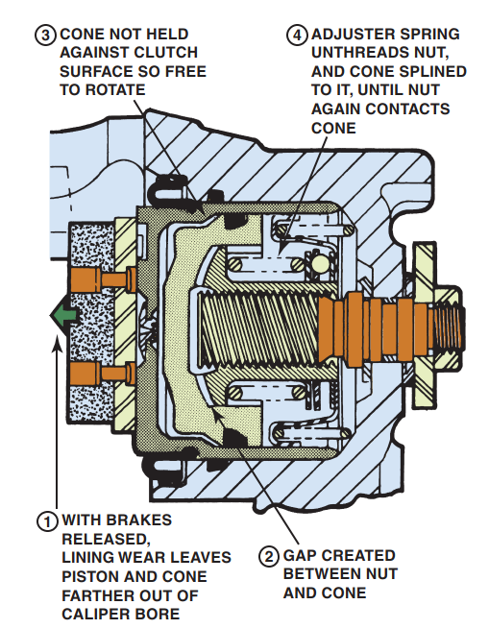
Caliper-Actuated Disk Parking Brakes
FIGURE 15–22 Parking brake application of a general Motors rear drive brake caliper.
FIGURE 15–23 Automatic adjustment of a general Motors rear disc brake caliper.

Slide 31
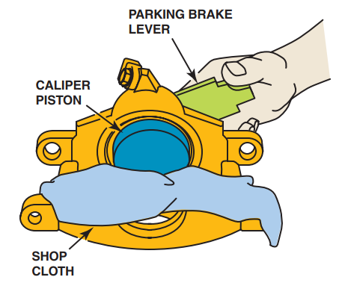
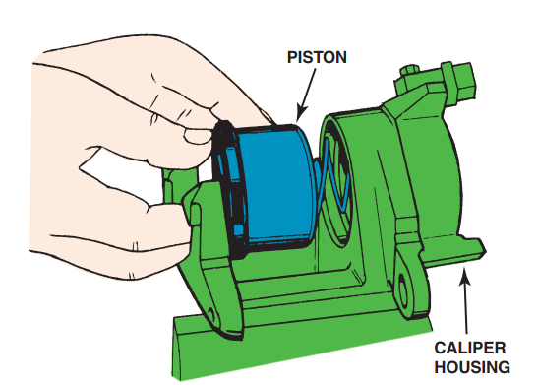
Caliper-Actuated Disk Parking Brakes
FIGURE 15–24 Removing the piston from a typical general Motors rear disc brake caliper.
FIGURE 15–25 Installing the piston into a general Motors rear disc brake caliper.

Slide 32
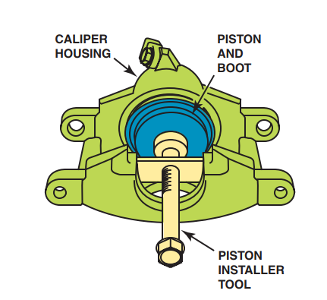
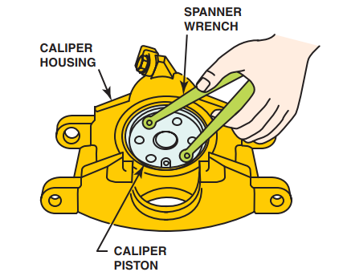
Caliper-Actuated Disk Parking Brakes
FIGURE 15–26 A piston installation tool is often needed to complete the installation of the piston in a general Motors rear disc brake.
FIGURE 15–27 A spanner wrench (or needle-nose pliers) can be used to rotate the caliper piston prior to installing the disc brake pads. A notch on the piston must line up with a tab on the back of the brake pad to keep the piston from rotating when the parking brake is applied.

Slide 33
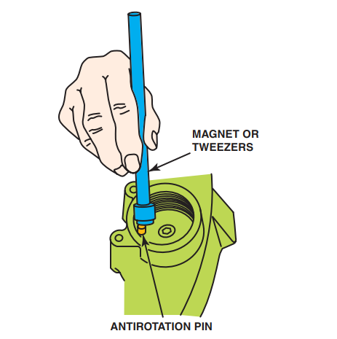
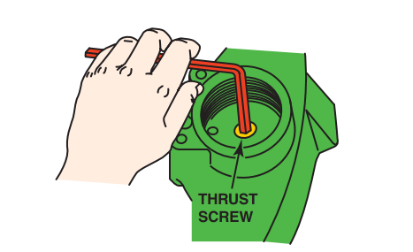
Caliper-Actuated Disk Parking Brakes
FIGURE 15–29 Unscrew the thrust screw from the piston with an Allen (hex) wrench. After removing the thrust screw, push the piston out of the caliper bore.
FIGURE 15–28 After removing the parking brake lever and thrust bearing, remove the antirotation pin.

Slide 34
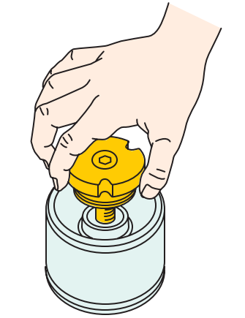
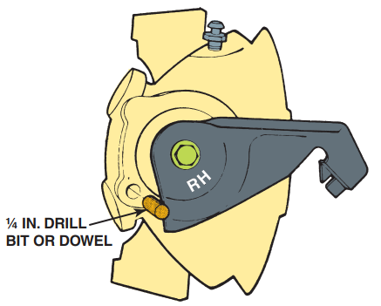
Caliper-Actuated Disk Parking Brakes
FIGURE 15–31 To adjust the parking brake cable on a Ford
vehicle equipped with rear disc brakes, start by loosening the
cable adjustment until the cables to the calipers are slack.
Tighten until the caliper lever moves. Position a 1/4 inch drill bit
or dowel into the caliper alignment hole. Adjustment is correct
if the parking brake lever does not hit the 1/4 inch dowel.
FIGURE 15–30 To test the piston adjuster, thread the thrust screw into the piston. Hold the piston and pull the thrust screw outward 1/4 inch (6 mm). The adjuster nut should not turn when the thrust screw retracts. Replace the piston assembly if not functioning correctly.

Slide 35
Parking Brake Cable Adjustment
Most manufacturers specify a minimum of three or four and a maximum of eight to ten clicks when applying the parking brake. Check service information for the vehicle being serviced for the exact specifications and adjustment procedures.
Below is a general procedure for parking brake adjustment:
1. Make certain that the rear service brakes are adjusted correctly and the lining is serviceable.
2. With the drums installed, apply the parking brake three or four clicks. There should be a slight drag on both rear wheels.
3. Adjust the cable at the equalizer (equalizes one cable’s force to both rear brakes) if necessary until there is a slight drag on both rear brakes. ●
4. Release the parking brake. Both rear brakes should be free and not dragging. Repair or replace rusted cables or read-just as necessary to ensure that the brakes are not dragging.

Slide 36
Parking Brake Cable Adjustment
To prevent possible parking brake cable adjustment problems when installing new rear brakes, always observe the following:
1. Both brake shoes should make contact with the anchor pin at the top. If not, check the parking brake cable for improper adjustment or improper installation of the brake shoes.
2. Feel the tension of the parking brake cable underneath the vehicle. It should be slightly loose (with the parking brake “off”).
3. Lubricate the parking brake cable to ensure that water or ice will not cause rust or freezing of the cable. This is necessary because even though the parking brake lever is released inside the vehicle, a stuck parking brake cable could cause the linings to remain out against the drums.
4. If the parking brake needs to be adjusted (will not hold on a hill or requires excessive lever movement), always check and adjust the rear brake adjustment before adjusting the parking brake cable.

Slide 37
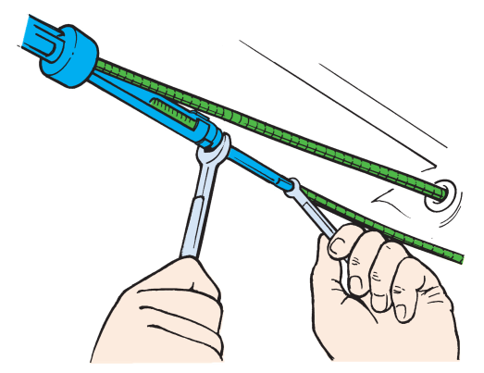
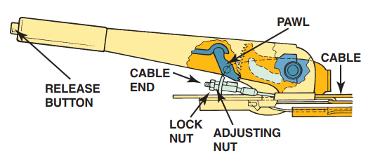
Parking Brake Cable Adjustment
FIGURE 15–33 Many hand-operated parking brakes are adjusted inside the vehicle.
FIGURE 15–32 After checking that the rear brakes are okay and properly adjusted, the parking brake cable can be adjusted. Always follow the manufacturer’s recommended procedure.

Slide 38
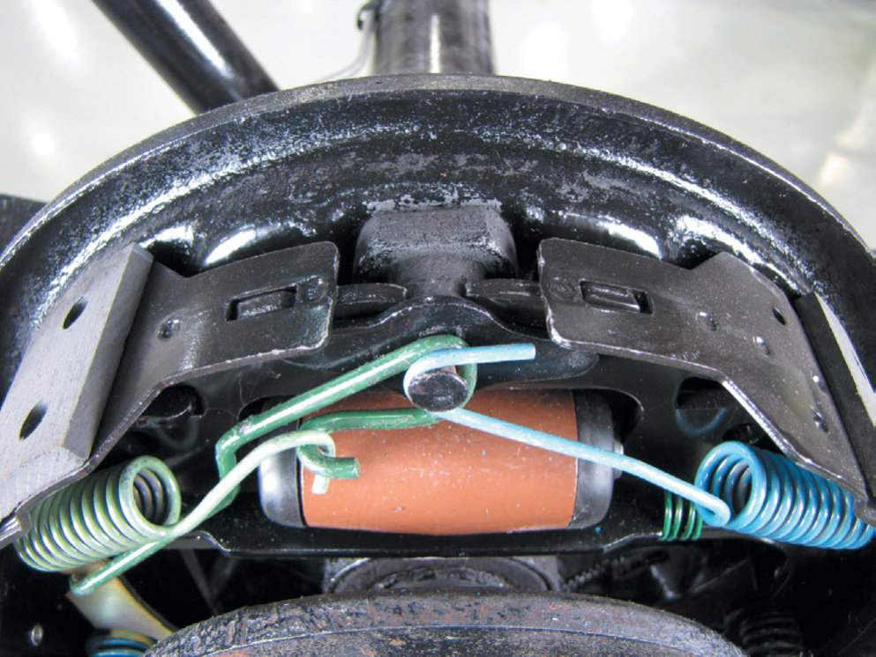
Parking Brake Cable Adjustment
FIGURE 15–34 Always check that the brake shoes contact the anchor pin.

Slide 39
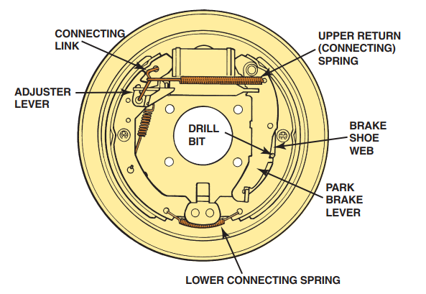
Parking Brake Cable Adjustment
FIGURE 15–35 A 1/8 inch (3 mm) drill bit is placed through an access hole in the backing plate to adjust this general Motors leading-trailing rear parking brake. Adjust the parking brake cable until the drill can just fit between the shoe web and the parking brake lever.

Slide 40
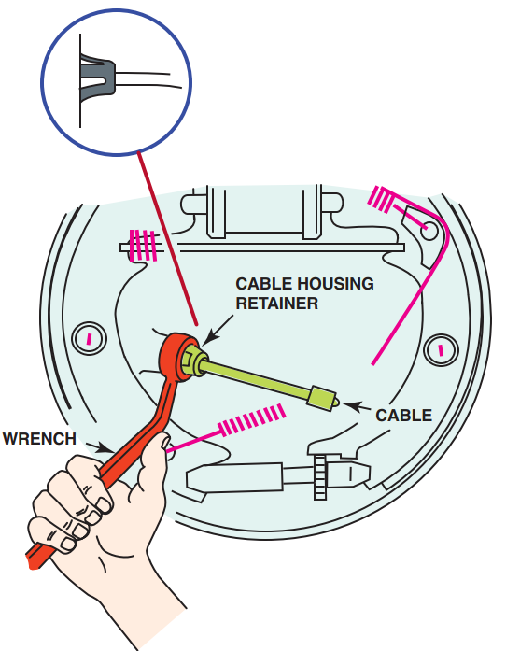
Parking Brake Cable Adjustment
FIGURE 15–36 Many parking brake cables can be removed easily from the backing plate using a 1/2 inch (13 mm) box-end wrench. The wrench fits over the retainer finger on the end of the parking brake cable.

Slide 41
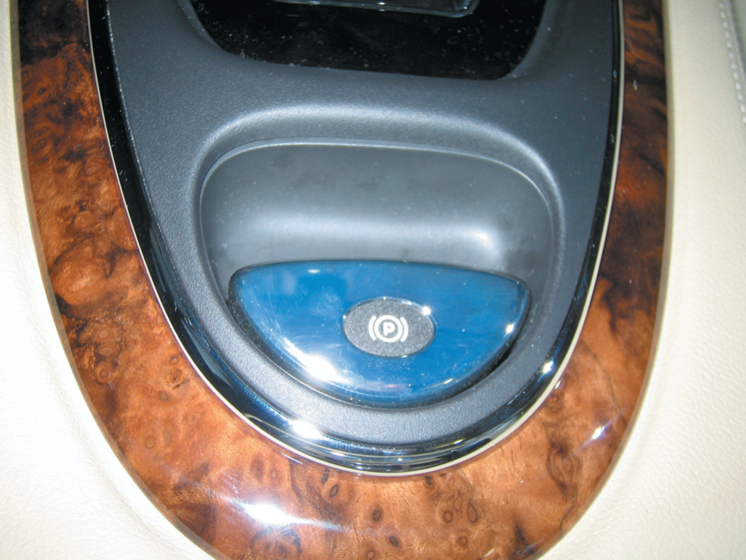
Parking Brake Cable Adjustment
FIGURE 15–37 An electric parking brake button on the center console of a Jaguar.

Slide 42
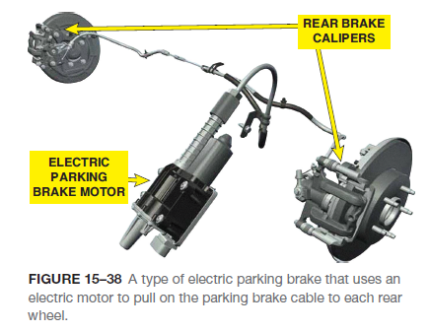
Electric Parking Brake
TYPES- Electric parking brake (EPB) systems are available using two different designs including the following:
1. A cable-pulling type that uses an electric motor to pull the parking brake cable rather than a mechanical handle or foot pedal.
2. A more advanced unit uses a computer-controlled motor attached to the brake caliper to activate it.

Slide 43
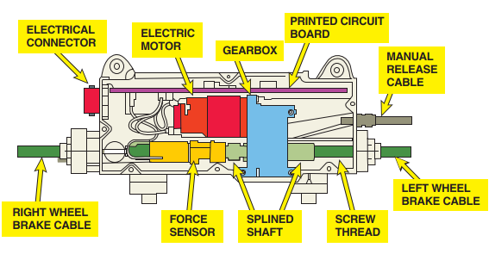
Electric Parking Brake
FIGURE 15–39 A DC electric motor is used to apply the cable running to the left and right parking brake.

Slide 44
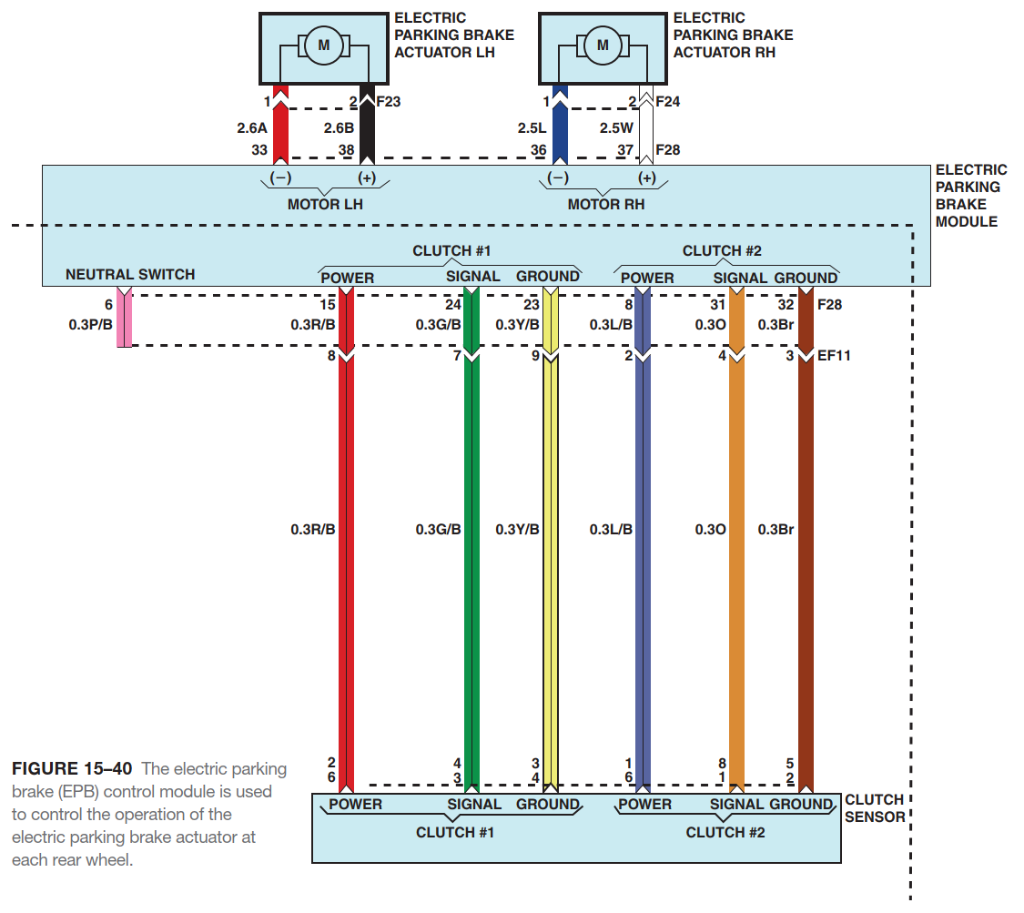
Electric Parking Brake

Slide 45
Electric Parking Brake
EPB SERVICE- If the vehicle being serviced is equipped with a cable-actuated system, then no special service procedures are needed when replacing rear brakes.
There are two ways that a technician can release the EPB including:
1. Manually follow a release procedure such as:
Place transmission in park (P) or neutral in a vehicle equipped with a manual transmission.
Press and hold the EPB switch for five seconds.
When the EPB warning light starts to flash, release the EPB switch to deactivate the parking brake.
2. Use a scan tool and follow the on-screen instructions to deactivate the electric parking brake.

Slide 46
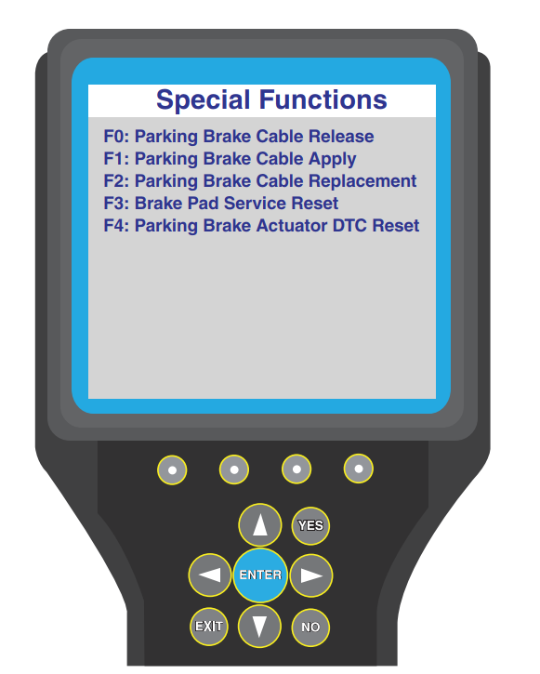
Electric Parking Brake
FIGURE 15–41 A scan tool can be used when servicing the rear brakes on a vehicle equipped with an electric parking brake.

Slide 47
Summary
According to Federal Motor Vehicle Safety Standard (FMVSS) 135, the parking brake must hold a fully loaded (laden) vehicle stationary on a slope of 20% up or down grade. The hand force required cannot exceed 80 pounds (18 N) or a foot force greater than 100 pounds (22 N).
Parking brakes are applied by a pedal, a lever, or a handle from inside the vehicle. Foot pedals and floor-mounted levers are the most common means of applying parking brakes.
Parking brake linkages transmit force from the pedal, lever, or handle inside the vehicle to the brake friction assemblies.
The parking brake cable pulls on the parking brake lever, which in turn forces the brake shoe against the drum.
Drum parking brakes are the most common types on vehicles and light trucks.

Slide 48
Summary Cont….
Caliper-actuated disc parking brakes are used on vehicles whose rear disc brakes are equipped with floating or sliding bra0ke calipers.
Most vehicle manufacturers specify that the rear brakes be inspected and adjusted correctly before attempting to adjust the parking brake cable.
Electric parking brake (EPB) systems are available using two different designs including the following:
A cable-pulling type that uses an electric motor to pull the parking brake cable rather than a mechanical handle or foot pedal.
A more advanced unit uses a computer-controlled motor attached to the brake caliper to activate it.

Slide 49
Video Links (Internet Access Required)
Park brake handle repair (time 1:47)
Park brake adjustment (time 2:33)
Park brake shoes (time 4:31)
Parking brake release cable (time 5:54)
Parking brake cable replace (time 2:21)
Emergency brake service (time 14:17)
Parking brake cable replace (time 9:58)
Parking brake cable replace (time 0:54)
Parking brake operation (time 1:00)
Parking brake failure (time 0:26)

Slide 50
Video Links (Internet Access Required)
Park brake failure (time 1:27)
Corvette parking brakes part 1 (time 2:20)
Corvette parking brakes part 2 (time 3:54)
Emergency brake inspection and repair (time 3:48)
Emergency brake adjust (time 4:53)
Rear caliper with parking brake (time 2:04)
Brake cable removal (time 2:36)
Install brake cable (time 1:41)
Brake cable removal (time 1:56)

