Slide 1
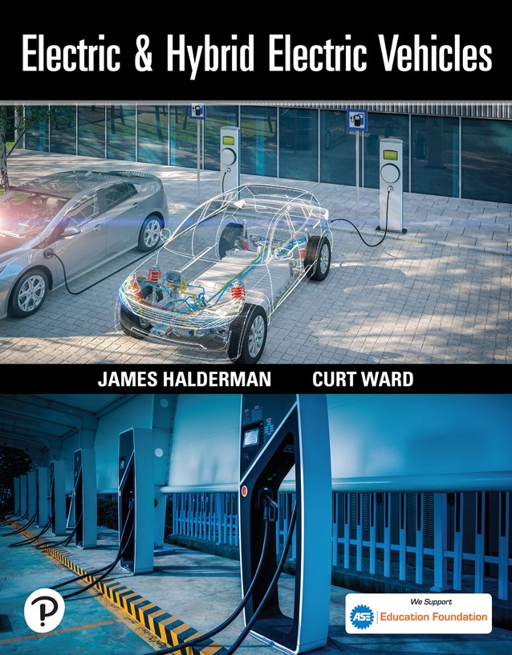

Electric and Hybrid Electric Vehicles
First Edition
Chapter 9
Low-Voltage Batteries and Stop-Start Micro Hybrids
Copyright © 2023 Pearson Education, Inc. All Rights Reserved
Notes:
If this PowerPoint presentation contains mathematical equations, you may need to check that your computer has the following installed:
1) Math Type Plugin
2) Math Player (free versions available)
3) NVDA Reader (free versions available)

Slide 2
Learning Objectives
9.1 Describe the purpose of the 12-volt battery.
9.2 Explain the 12-volt battery rating systems.
9.3 Describe the 12-volt battery test procedures.
9.4 Describe the function of the 36-48-volt battery.
9.5 Explain the 36-48-volt battery test procedure.
9.6 Describe the main advantages of a stop-start system.
9.7 Explain the difference between a micro and mild hybrid.
9.8 Explain how a disable condition prevents the operation of a stop-start system.

Slide 3
Introduction to the 12-Volt Battery (1 of 2)
Purpose and Function
  Every vehicle, hybrid or electric, has a 12-volt battery that is used to supply electrical current to the low-voltage components in the vehicle.
  The 12-volt auxiliary battery is used for the following purposes:
    Power all of the 12-volt accessories
    Power the electronic controller for the high-voltage system

Slide 4
Introduction to the 12-Volt Battery (2 of 2)
Why Batteries Are Important
  The battery acts as a stabilizer to the voltage for the entire electrical system.
  The battery must be in good (serviceable) condition to assure correct hybrid or electric vehicle operation.
The Hybrid or Electric Vehicle Will Not Start if the Auxiliary Battery Is Discharged
  If “nothing happens” when the vehicle is attempted to be started, always start the diagnosis with the state of charge and condition of the auxiliary 12-volt battery.

Slide 5
How a Battery Works (1 of 2)
Principles Involved
  When two dissimilar metals are placed in an acid, electrons flow between the metals if a circuit is connected between them.
  A fully charged lead-acid battery has a positive plate of lead dioxide (peroxide) and a negative plate of lead surrounded by a sulfuric acid solution (electrolyte).
  The difference in potential (voltage) between lead peroxide and lead in acid is approximately 2.1 volts.

Slide 6
How a Battery Works (2 of 2)
During Discharging
Fully Discharged State
During Charging

Slide 7
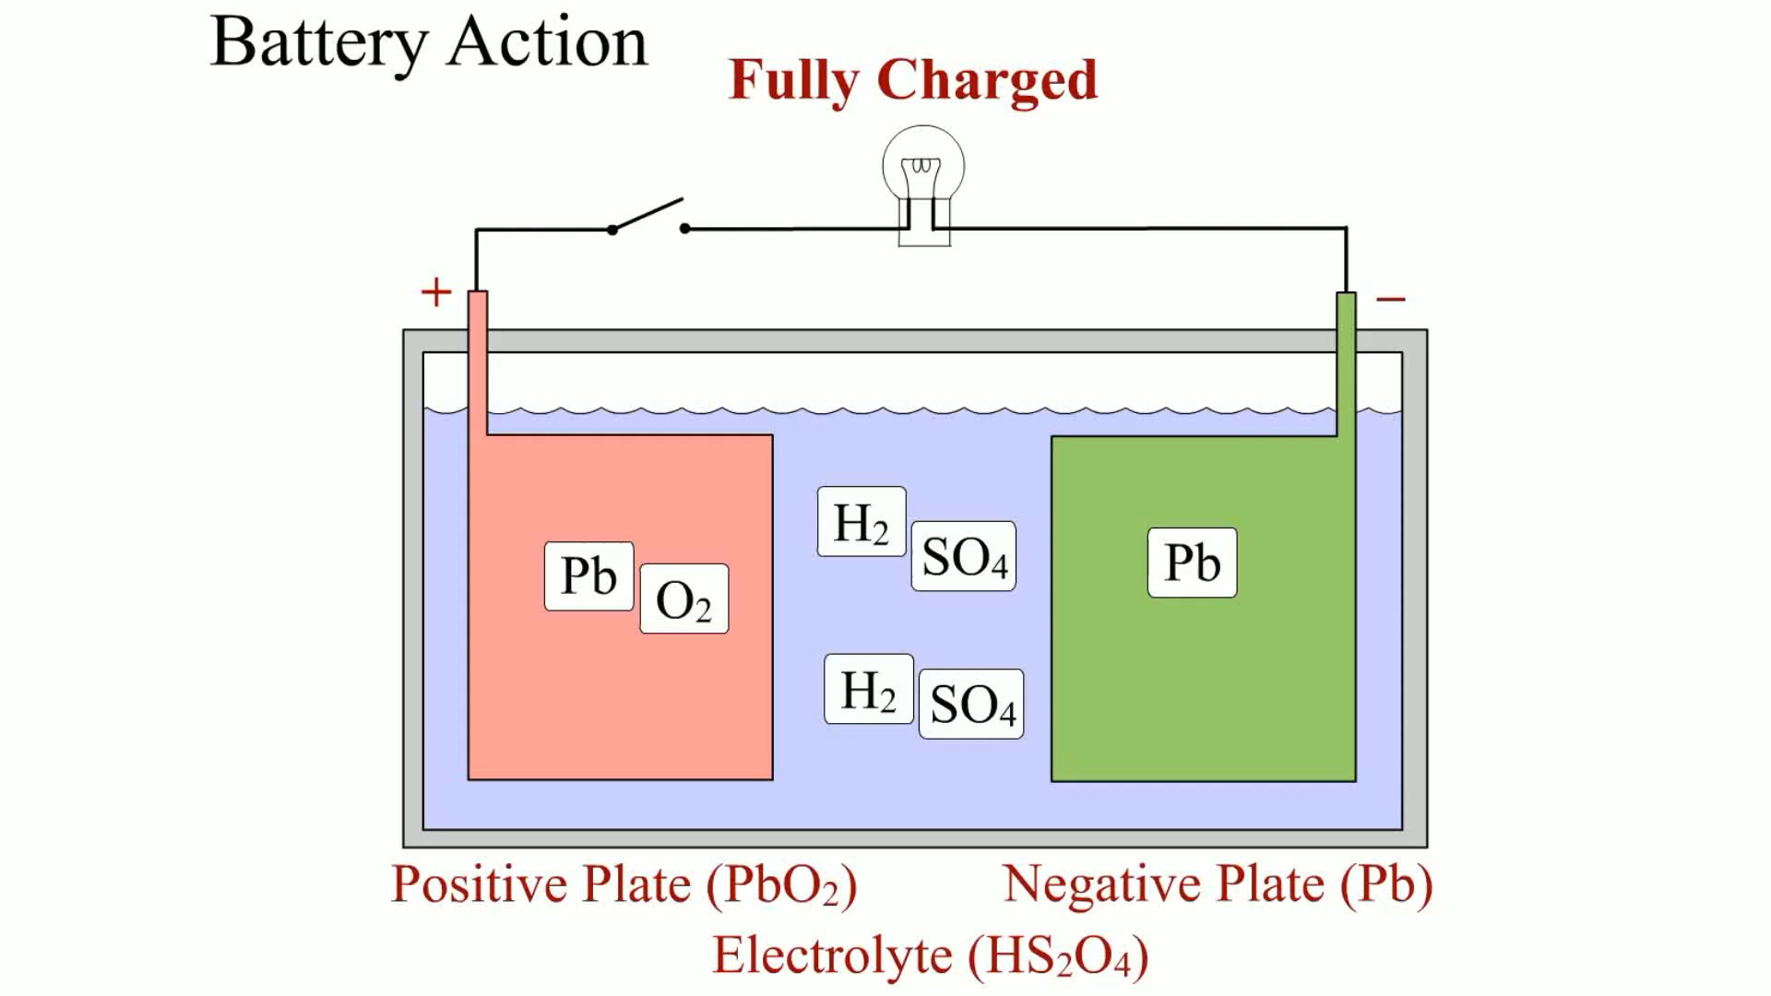
Animation:
Battery Action
(The animation will automatically start in a few seconds)

Slide 8
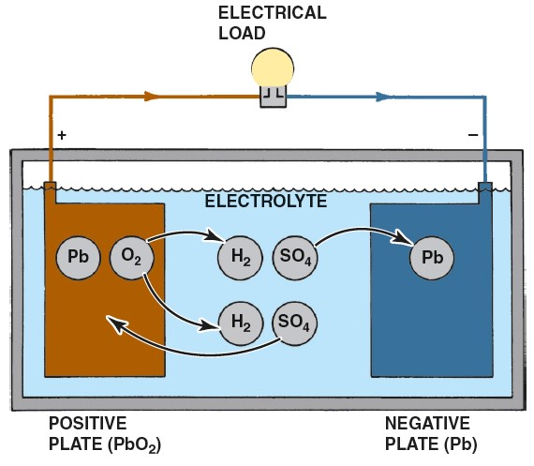
Figure 9.1
Chemical reaction for a lead-acid battery that is fully charged being discharged by the attached electrical load.
Notes:
Long Description:
A lead acid battery consists of positive and negative plates, separator, electrolyte, and hard plastic with a rubber case. The two plates are separated by insulating material. This total construction is kept in a hard plastic case with an electrolyte such as water and sulfuric acid. Due to the electron exchange across anode and cathode, electron balance across the plates is affected. The electrons then flow through the load and the battery gets discharged. During discharge, the diluted sulfuric acid gravity decreases.

Slide 9
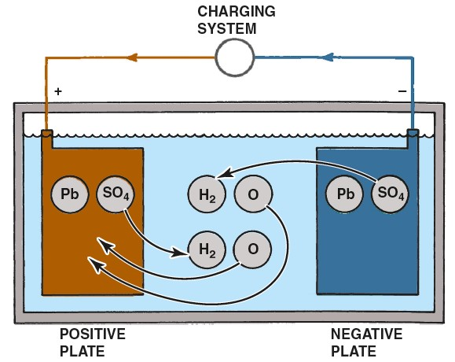
Figure 9.2
Chemical reaction for a lead-acid battery that is fully discharged being charged by the attached alternator.
Notes:
Long Description:
The lead acid battery uses lead as the anode and lead dioxide as the cathode, with an acid electrolyte. During the charging process, the reactions at each electrode are reversed; the anode becomes the cathode and the cathode becomes the anode. The positive plate becomes P b O sub 2, negative plate turns to P b, and the electrolyte turns to H sub 2 S O sub 4.

Slide 10
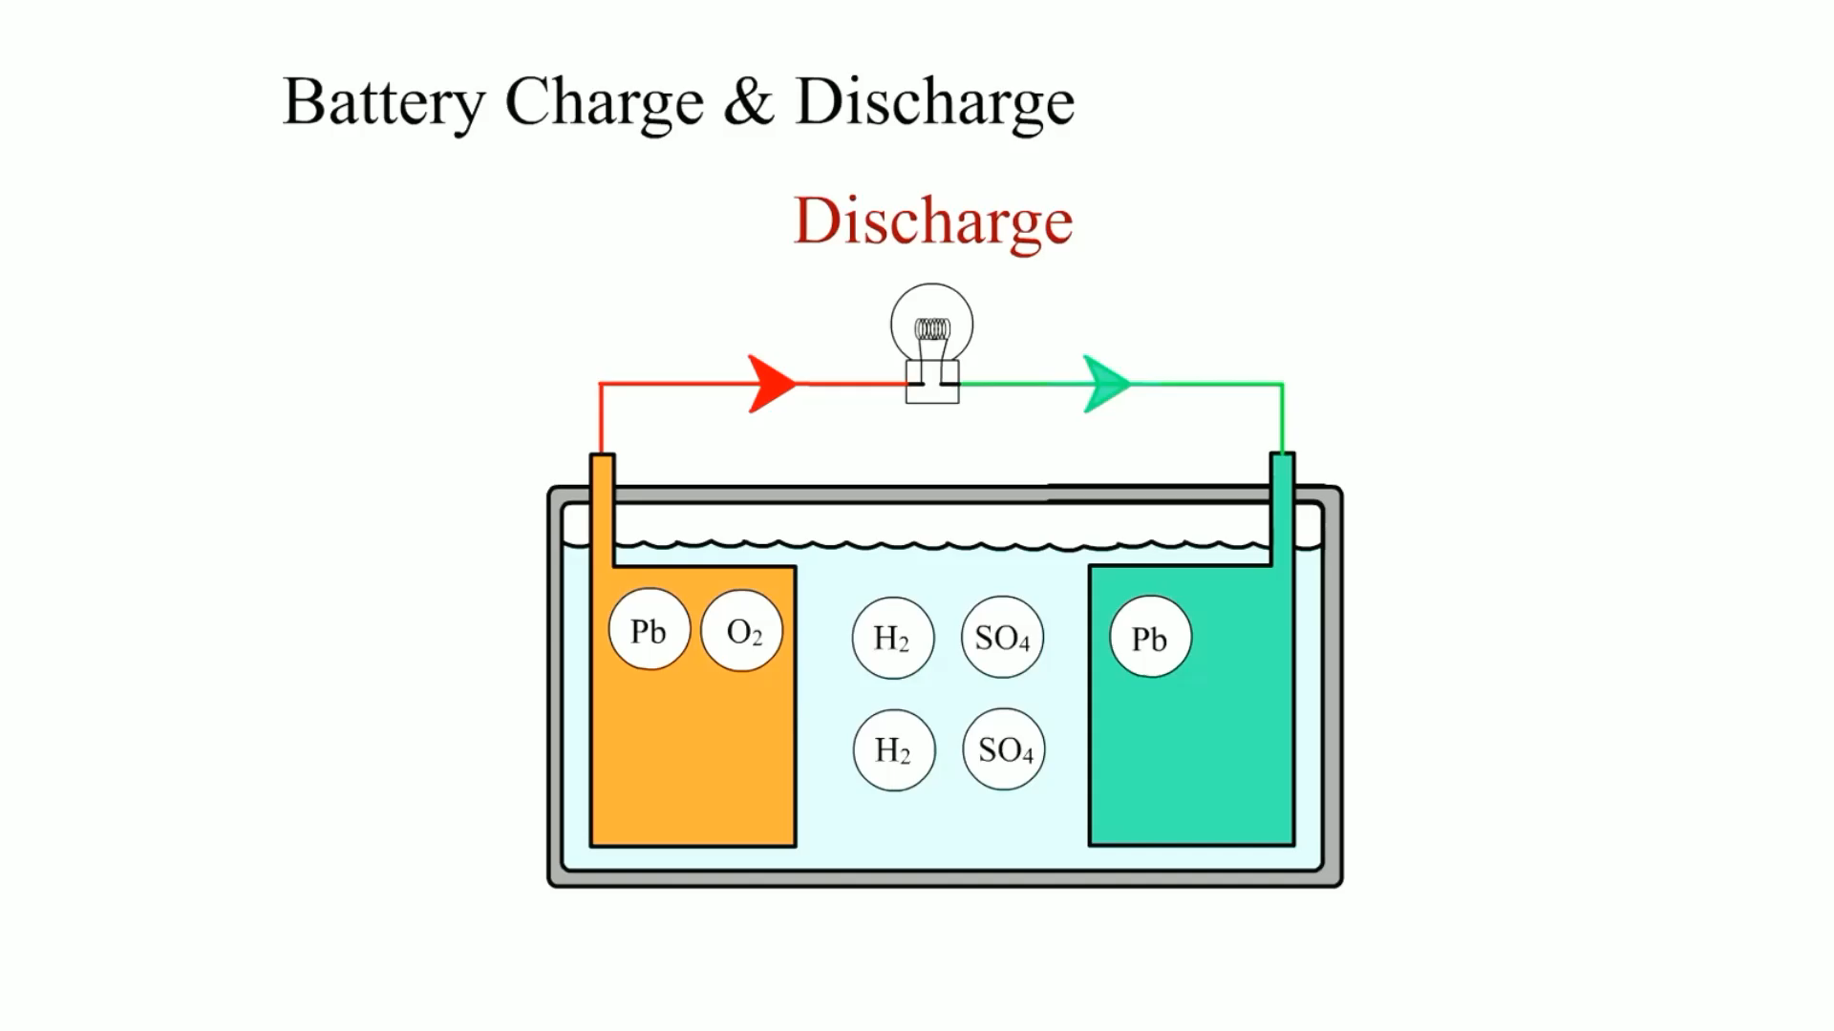
Animation:
Battery Charge & Discharge
(The animation will automatically start in a few seconds)

Slide 11
Valve-Regulated Lead-Acid Batteries
Terminology
  These batteries use a low-pressure venting system that releases excess gas and automatically reseals if a buildup of gas is created due to overcharging.
  Valve-regulated lead-acid (V R L A) batteries may also be called sealed valve-regulated (S V R) or sealed lead-acid (S L A), batteries.

Slide 12
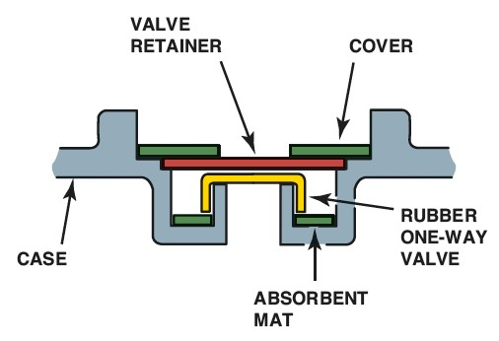
Figure 9.3
Pressure relief valve from a V R L A battery. This stays closed during normal operating conditions and prevents gases from entering or leaving the battery case.
Notes:
Long Description:
The battery consists of a strain relief value which gets activated when the battery initiates to build hydrogen gas pressure. The activation of this valve permits some of the gas quantity to escape so that the entire battery capacity will be lessened.

Slide 13
12-Volt Battery Ratings (1 of 2)
Cold-Cranking Amperes (C C A)
  The cold-cranking ampere rating of a battery is the number of amperes that can be supplied by a battery
  at 0°F
  for 30 seconds while the battery still
  maintains a voltage of 1.2 volts per cell or higher.
  This means that the battery voltage would be 7.2 volts for a 12-volt battery and 3.6 volts for a 6-volt battery.
Cranking Amperes (C A)
  The designation C A refers to the number of amperes that can be supplied by a battery at 32°F (0°C).

Slide 14
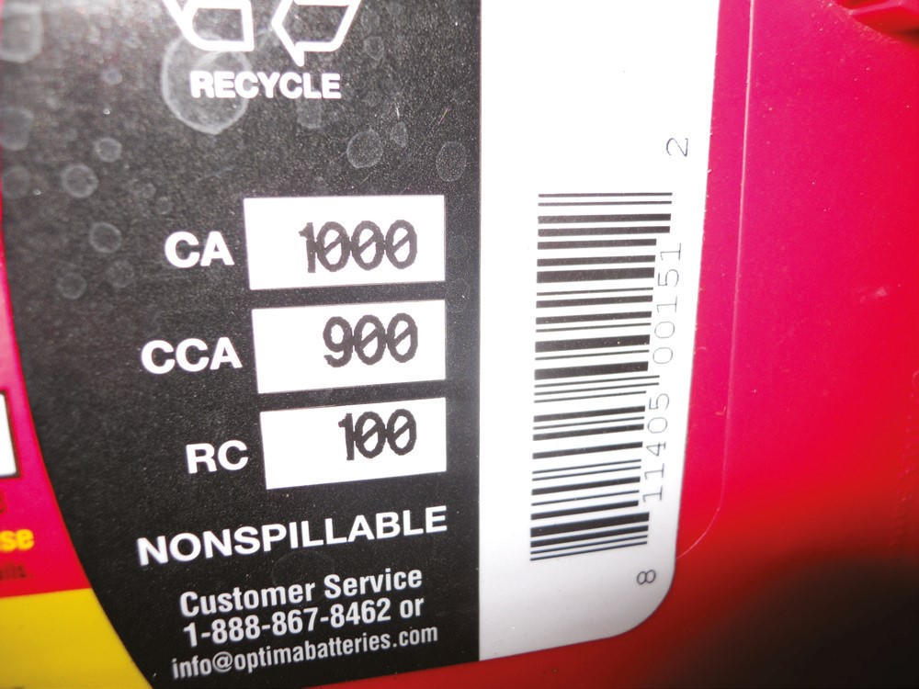
Figure 9.4
This battery has a rating of 1,000 cranking amperes (C A) and 900 amperes using the cold crank amperes (C C A) rating system.

Slide 15
12-Volt Battery Ratings (2 of 2)
Ampere Hour
  A measure of how many amperes of current the battery can produce over a period of time.
  For example, a battery that has a 50 amp-hour (A-H) rating can deliver 50 amperes for 1 hour or 1 ampere for 50 hours or any combination that equals 50 amp-hours.
J I S
  J I S stands for Japanese Industrial Standard. This rating standard can be found on A G M batteries found in Toyota and Nissan vehicles.

Slide 16
Battery Service Safety Precautions (1 of 2)
Hazards
  Batteries contain acid and release explosive gases (hydrogen and oxygen) during normal charging and discharging cycles.
Safety Procedures
  When working on any electrical component on a vehicle, disconnect the negative battery cable from the battery.
  Wear eye protection (goggles preferred) when working around any battery.

Slide 17
Battery Service Safety Precautions (2 of 2)
Safety Procedures (continued)
  Wear protective clothing to avoid skin contact with battery acid.
  Always adhere to all safety precautions as stated in the service procedures for the equipment used for battery service and testing.
  Never smoke or use an open flame around any battery.
  Never stand near a battery that is being jump started, especially in cold weather because the battery could explode.

Slide 18
12-Volt Battery Voltage Test
State of Charge
  Testing the battery voltage with a voltmeter is a simple method for determining the state of charge (S O C) of any battery.

Slide 19
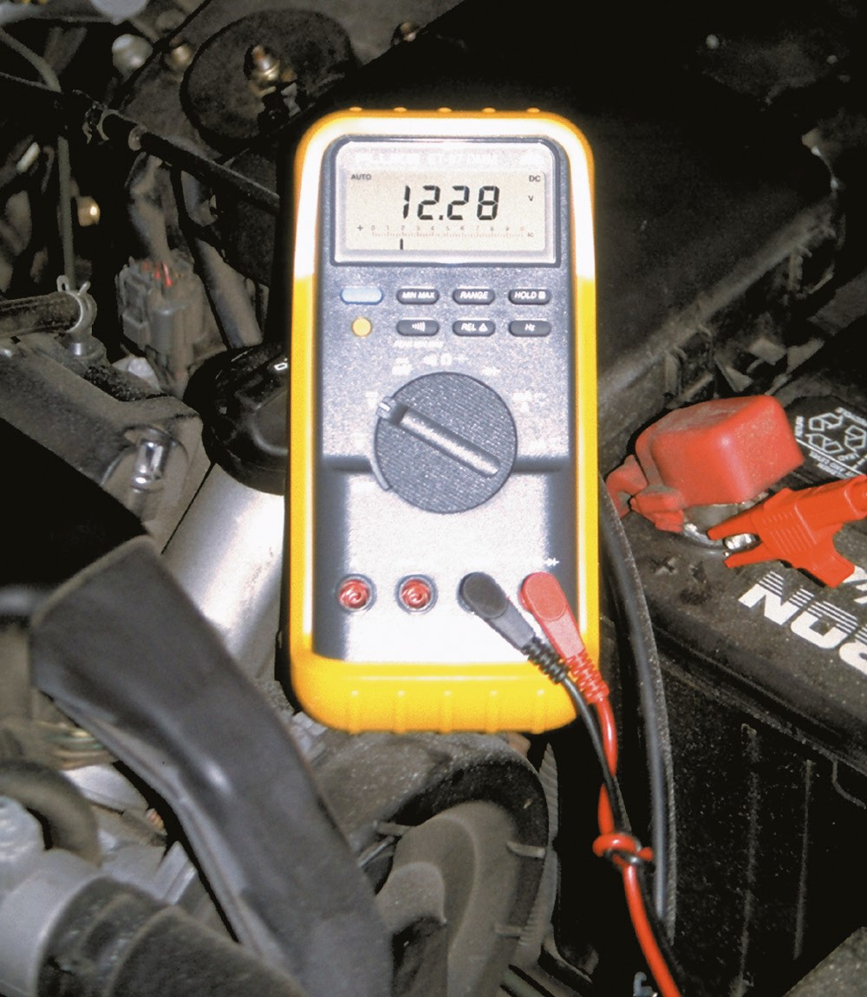
Figure 9.6 (a)
A voltage reading of 12.28 volts indicates that the battery is not fully charged and should be charged before testing.

Slide 20
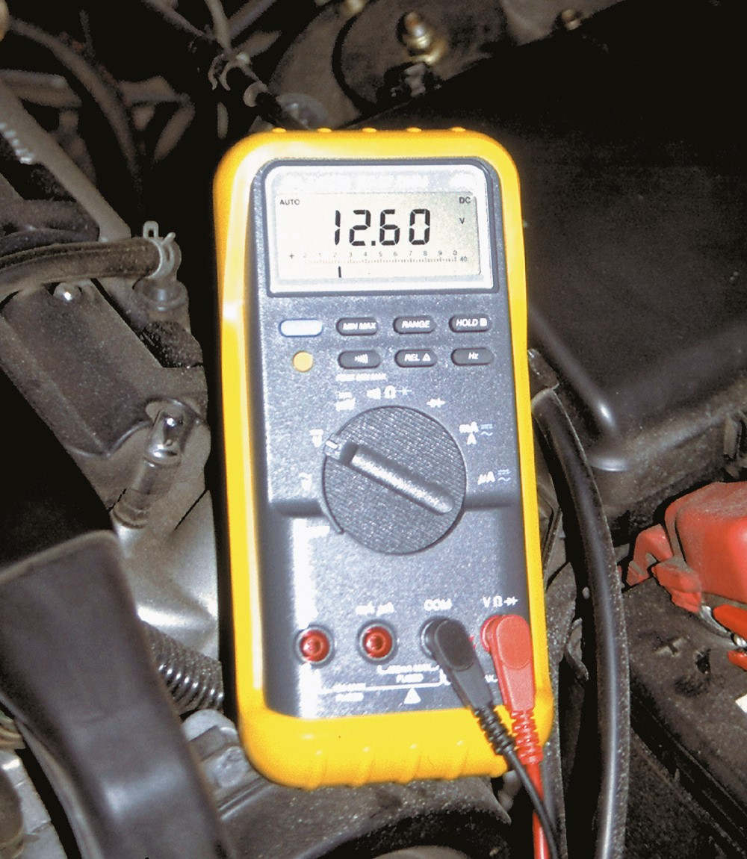
Figure 9.6 (b)
A battery that measures 12.6 volts or higher after the surface charge has been removed is 100% charged.

Slide 21
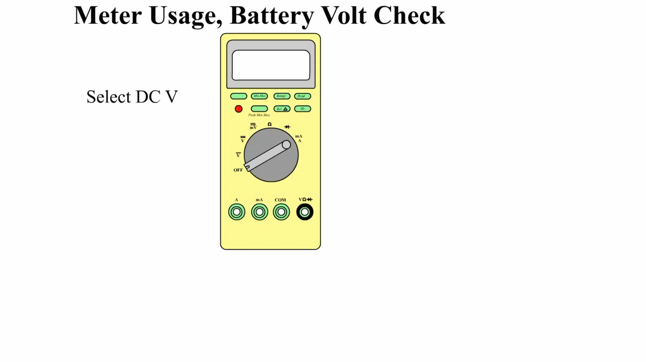
Animation:
Meter Usage, Battery Volt Check
(The animation will automatically start in a few seconds)

Slide 22
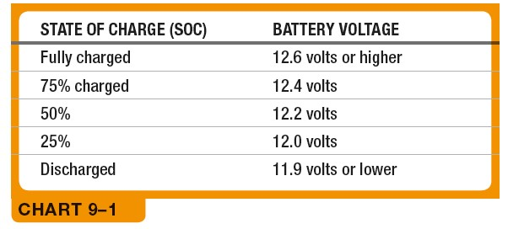
Chart 9.1
A comparison showing the relationship between battery voltage and S O C.
Notes:
Long Description:
When S O C is fully charged, the battery voltage (bv) is 12.6 volts or higher. If 75% charged, the bv is 12.4 volts. If 50%, 12.2. If 25%, 12.0. If discharged, 11.9 volts or lower.

Slide 23
12-Volt Battery Load Testing
Terminology
  One test to determine the condition of any 12-volt battery is the load test.
  Most automotive starting and charging testers use a carbon pile to create an electrical load on the battery.

Slide 24
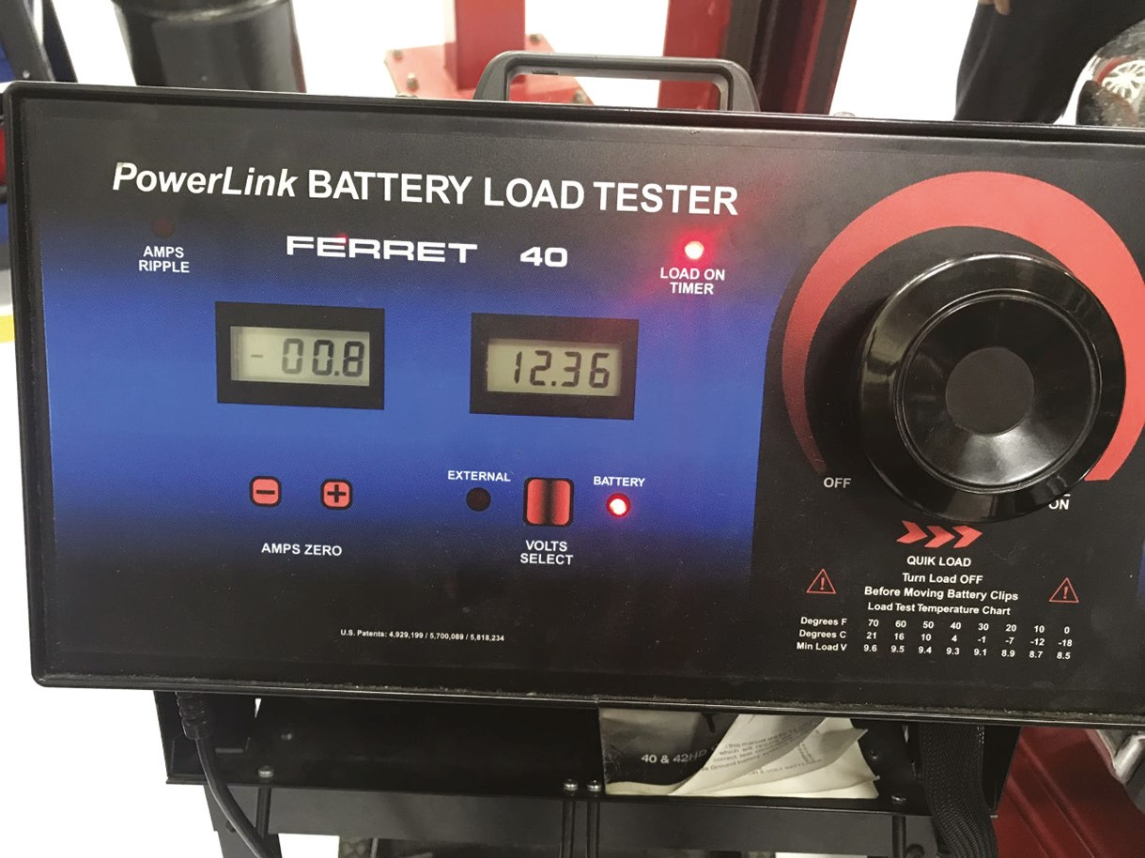
Figure 9.7
The carbon pile tester can be used to test a flooded battery.

Slide 25
12-Volt Battery Conductance Testing
Terminology
  General Motors, Chrysler, Honda, and Ford specify that an electronic conductance tester be used to test batteries in vehicles still under factory warranty.
  Conductance testers can be used to test flooded or A G M-type batteries.

Slide 26
12-Volt Battery Charging
Charging Procedure
  If the S O C of a battery is low, it must be recharged.
  It is best to slow charge any battery to prevent possible overheating damage to the battery.
Charging A G M Batteries
  Charging an A G M battery requires a different charger than is used to recharge a flooded-type battery.
  The charging voltage has to be kept at or below 14.4 volts to prevent damage.
Battery Charge Time

Slide 27
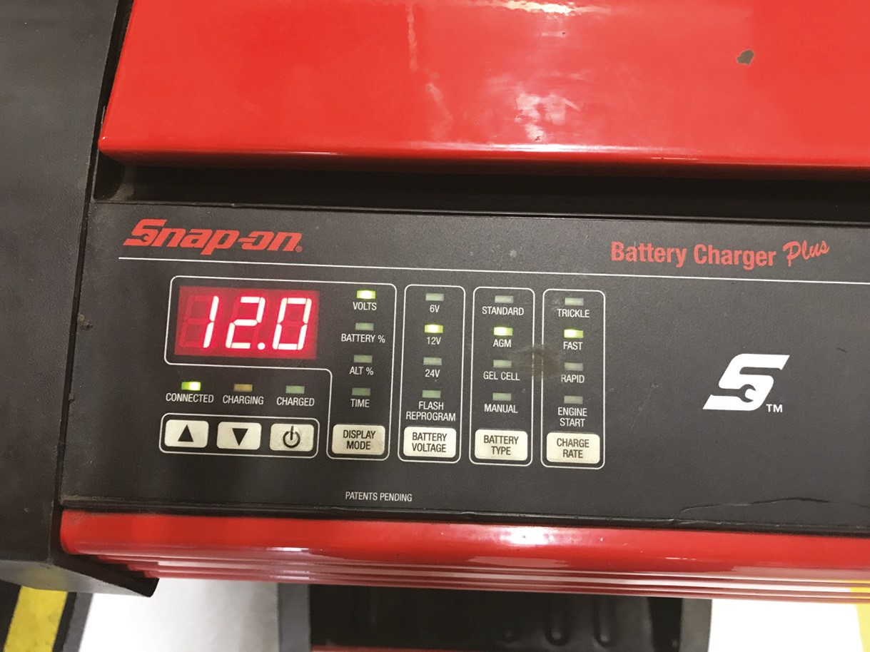
Figure 9.9
This battery charger has settings for both a flooded battery and an A G M battery.

Slide 28
The 36-48-Volt Battery (1 of 2)
Purpose and Function
  The 36-48-volt battery is used to drive the integrated starter generator (I S G) unit.
  The 36-48-volt battery system uses a D C-D C converter to charge the 12-volt battery.
Construction and Design
  Typically, 36-48-volt batteries are of lithium-ion design.
  These modules are generally located within the passenger compartment.

Slide 29
The 36-48-Volt Battery (2 of 2)
Diagnosis and Testing
  Early designs that use multiple 12-volt lead-acid batteries simply separate the batteries and test them individually.
  Vehicles that utilize 36-48-volt batteries that are lithium-ion rely on the hybrid or battery control module to continuously monitor the condition of the battery.
  A scan tool and the manufacturers diagnostic procedure is used to determine the correct course of repair.

Slide 30
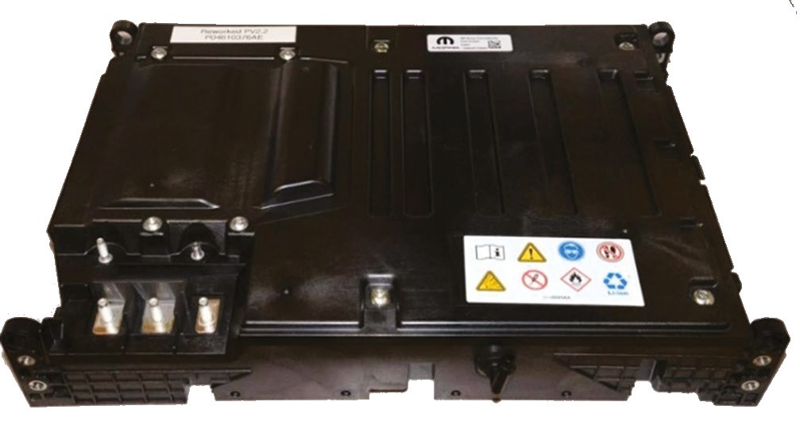
Figure 9.10
The 48-volt battery for the Ram eTorque system is incorporated into a power pack module that is located under the rear seat.

Slide 31
Stop-Start Defined
Purpose and Function
  The main feature is the idle-stop mode, in which the internal combustion engine (I C E) is stopped, rather than idling while stopped in traffic.
  The idle-stop mode improves the fuel economy slightly and reduces tailpipe emissions allowing manufacturers to meet emission standards.
Terms Used
  Depending on the manufacturer, the term stop-start and start-stop are used to describe the technologies.

Slide 32
Stop-Start Systems
B A S System
  The belt alternator starter (B A S) system was the most common early stop-start system.
  The B A S concept is to replace the belt-driven alternator with an electric motor that serves as a generator and a motor.
  A typical B A S system would achieve an 8% to 15% increase in fuel economy, mostly affecting the city mileage with little, if any, effect on the highway mileage.

Slide 33
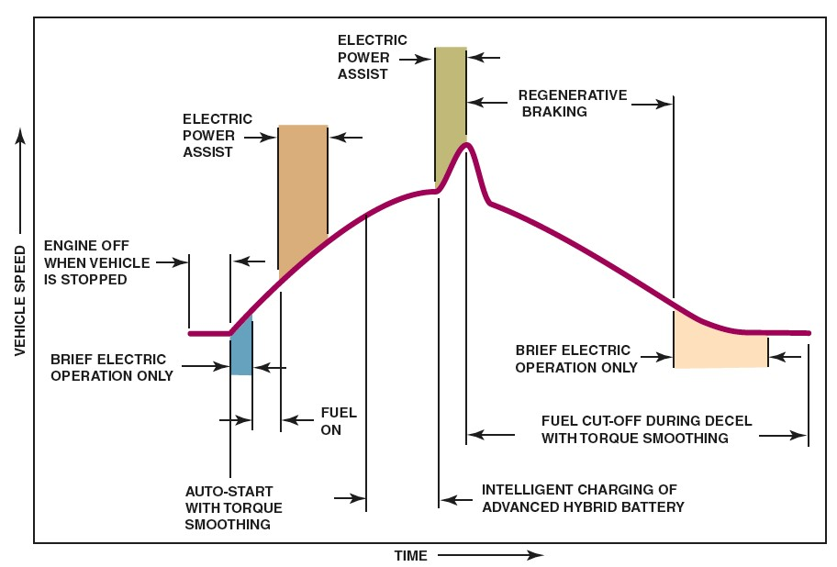
Figure 9.11
This figure shows what is occurring during various driving conditions in a B A S-type hybrid.
Notes:
Long Description:
A curve starts along the horizontal axis, remains constant for a certain time, and increases gradually, reaching a peak. It again decreases gradually, and remains constant along the horizontal axis. The driving conditions are compared one by one with the curve as follows: Engine off when vehicle is stopped, brief electrical operation only, auto-start with torque smoothing, fuel on, electric power assist, intelligent charging of advanced hybrid battery, electric power assist, regenerative breaking, brief electrical operation only, fuel cut-off during decel with torque smoothing.

Slide 34
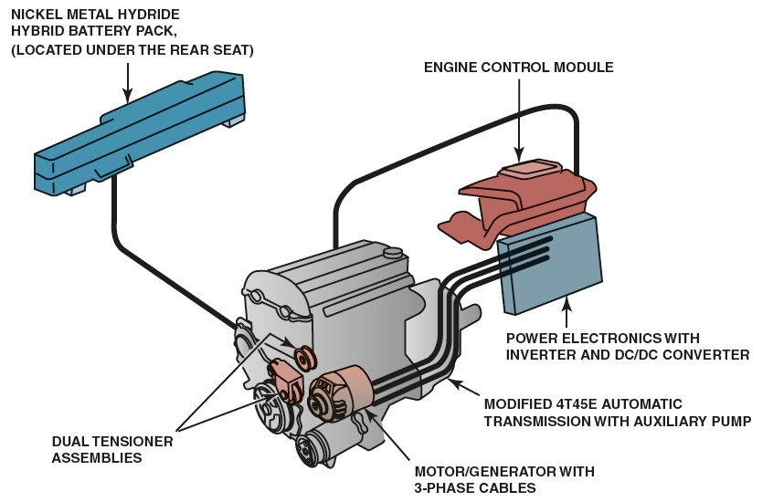
Figure 9.12
The components of a typical B A S system.
Notes:
Long Description:
The components of a BAS system have the following labels: Nickel Metal Hydride Hybrid Battery Pack (located under the rear seat), Engine Control Module, Power electronics with inverter and DC/DC converter, Modified 4T45E automatic transmission with auxiliary pump, Motor/Generator with 3-phase cables, and dual tensioner assemblies.

Slide 35
Micro Hybrids (1 of 3)
Parts Involved
  A micro hybrid utilizes a stop-start system that operates on a 12-volt system and does not contain any high-voltage components.
  When the enabling conditions are met at a stop, the engine will shut off.

Slide 36
Micro Hybrids (2 of 3)
Operation
  The heart of the system is an enhanced starter and heavy-duty flywheel as well as a second 12-volt battery.
  The micro-hybrid system also has a system disable button that allows the driver to turn off the feature.
Engine Control Module
Transmission Control Module
Intelligent Battery Sensor Module

Slide 37
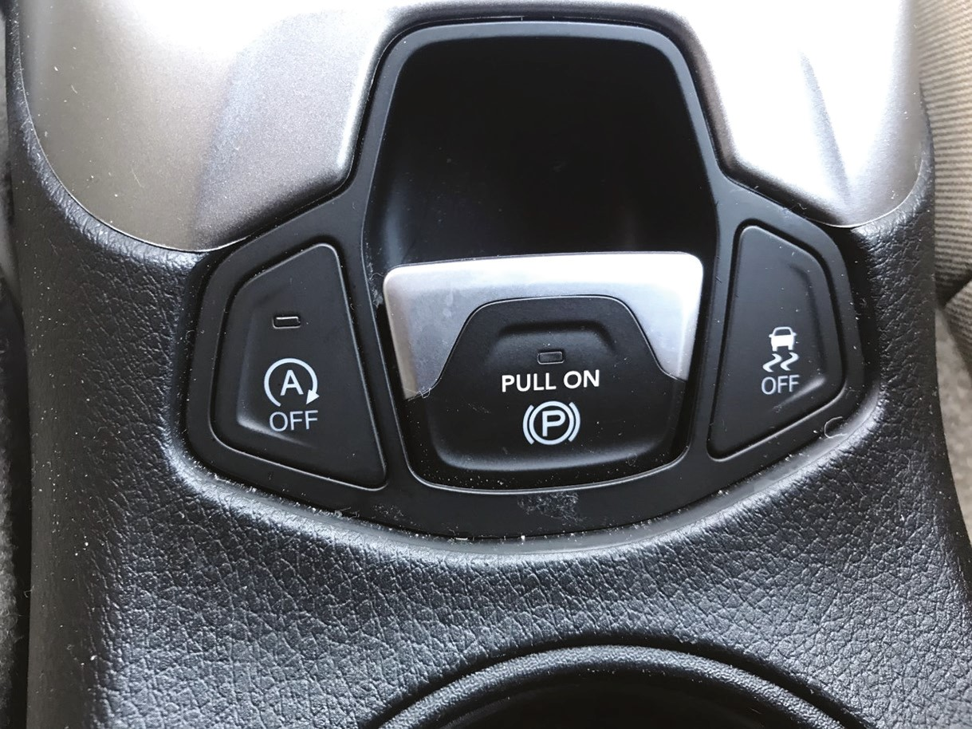
Figure 9.13
The button on the left allows the driver to disable the stop-start feature for the drive cycle.

Slide 38
Micro Hybrids (3 of 3)
Body Control Module
Manual Transmission Equipped Vehicles
Heavy-Duty Starter
Batteries
Ultracapacitor
Auxiliary Components

Slide 39
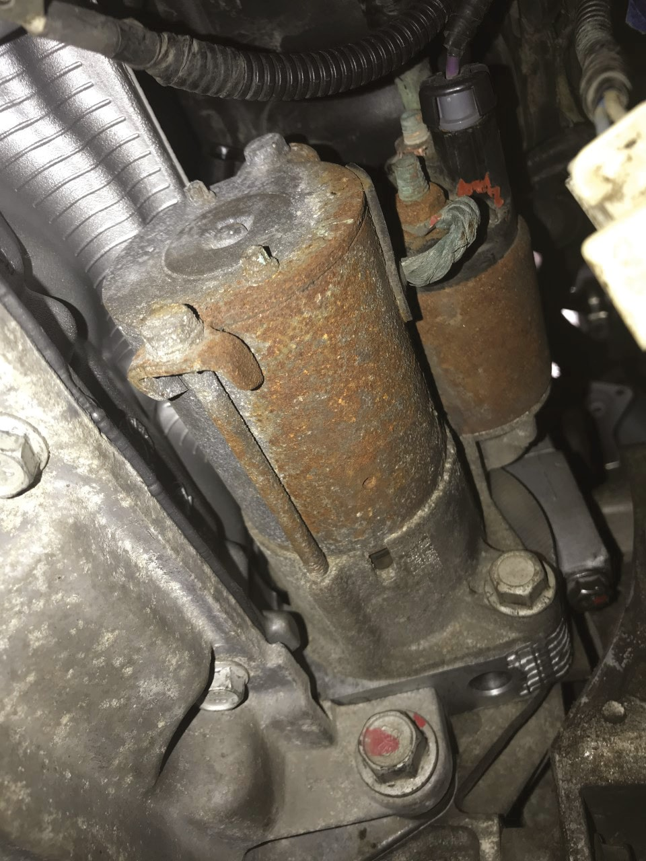
Figure 9.15
The starter on this Jeep Compass is designed to last longer than a standard starter motor.

Slide 40
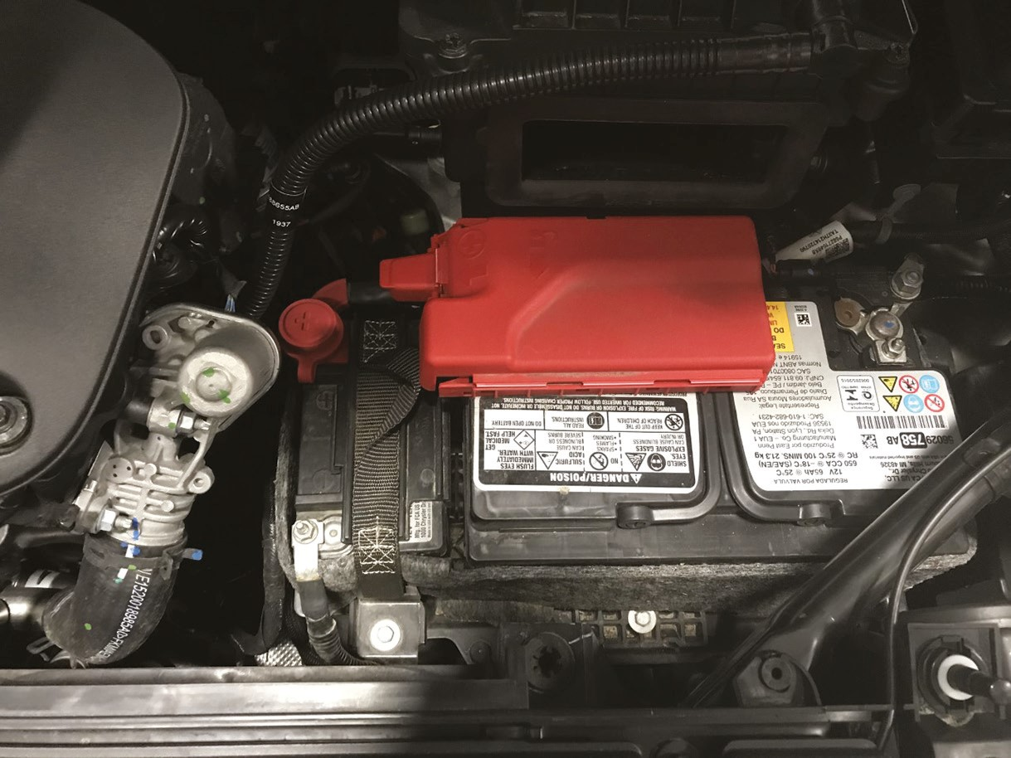
Figure 9.16
This Jeep Compass has two batteries under the hood. The smaller battery is used to maintain voltage during starting.

Slide 41
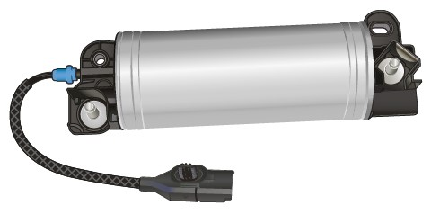
Figure 9.17
This ultracapacitor manufactured by Continental is an example of a system used in stop-start systems by General Motors.

Slide 42
Diagnosis
First Steps First
  There are many key safety conditions that will cause the stop-start system to become disabled.
  Before beginning diagnosis, ensure one or more of these conditions do not exist.
Diagnosis Procedure
  To begin stop-start system diagnosis, refer to the flowchart.
  The replacement of some parts will require a reset or relearn process before the system will operate normally.

Slide 43
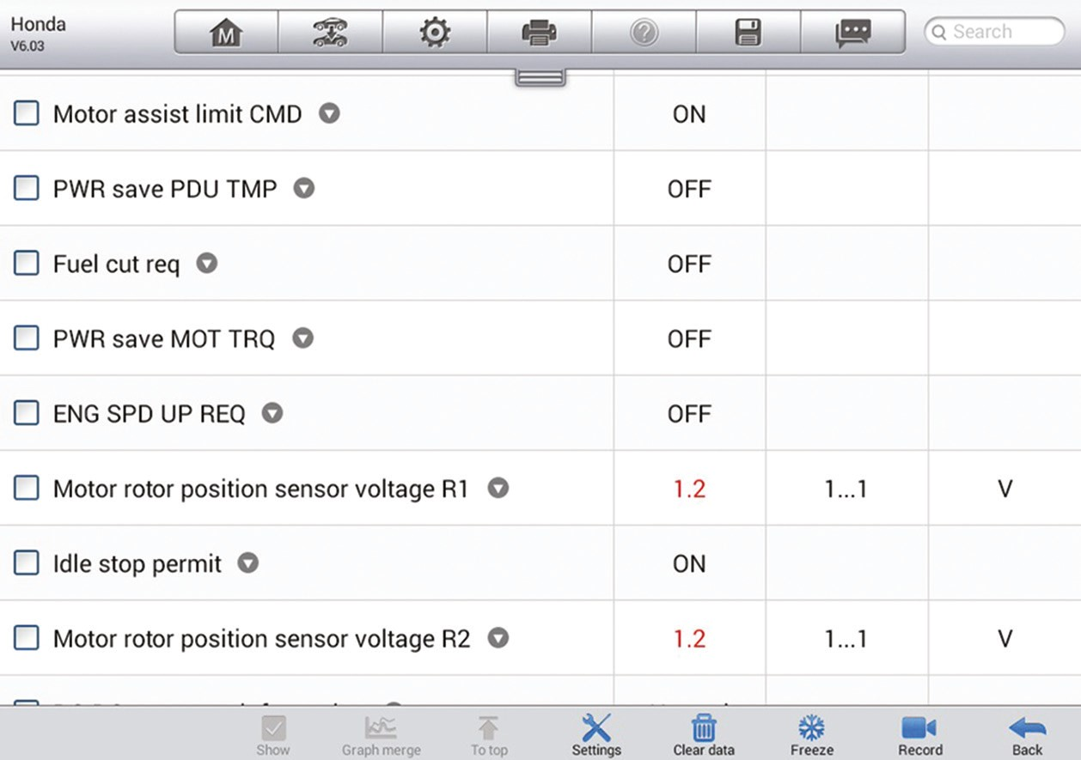
Figure 9.18
The P I D s displayed on the scan tool may indicate why the start-stop system is disabled.
Notes:
Long Description:
The screenshot shows the following readings: Motor Assist limit CMD, On. PWR save PDU TMP Off, Fuel cut req. Off, PWR save MOT TRQ Off, ENG SPD UP REQ Off, Motor rotor position sensor voltage R1: 1.2 (in red) 1…1, V. Idle stop permit ON. Motor rotor position sensor voltage R2: 1.2 (in red) 1...1, V.

Slide 44
Mild Hybrids (1 of 5)
Terminology
  A mild hybrid utilizes a stop-start system that operates on a voltage that is greater than normal system voltage.
  The voltage can vary from 36 to 144 volts, depending on the model.
  When the enabling conditions are met, the engine will shut off.
  On some models the electric motor can provide supplemental torque to the engine on acceleration to improve performance.

Slide 45
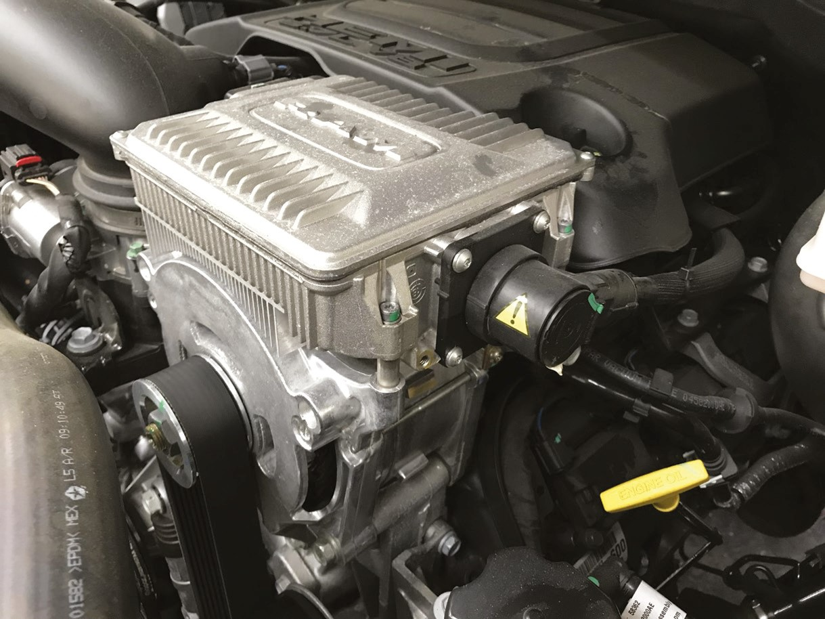
Figure 9.20
The eTorque system on the Ram truck is mounted on the engine.

Slide 46
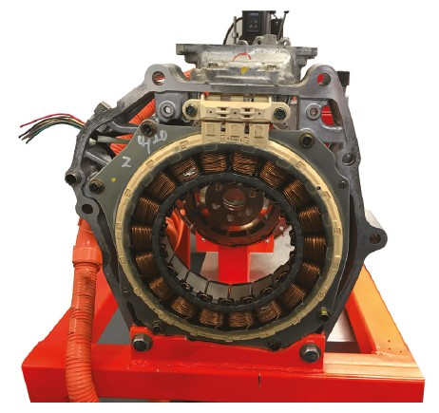
Figure 9.21
The electric motor on a Honda I M A system is mounted between the engine and transmission.

Slide 47
Mild Hybrids (2 of 5)
Parts and Operation
  Battery. The high-voltage battery will be either nickel metal hydride or lithium-ion construction.
  Electric motor. Typically, this is a permanent magnet motor.
  Inverter/converter. The inverter is used to convert A C voltage generated by the motor to D C voltage so that it can be stored in the high-voltage battery.

Slide 48
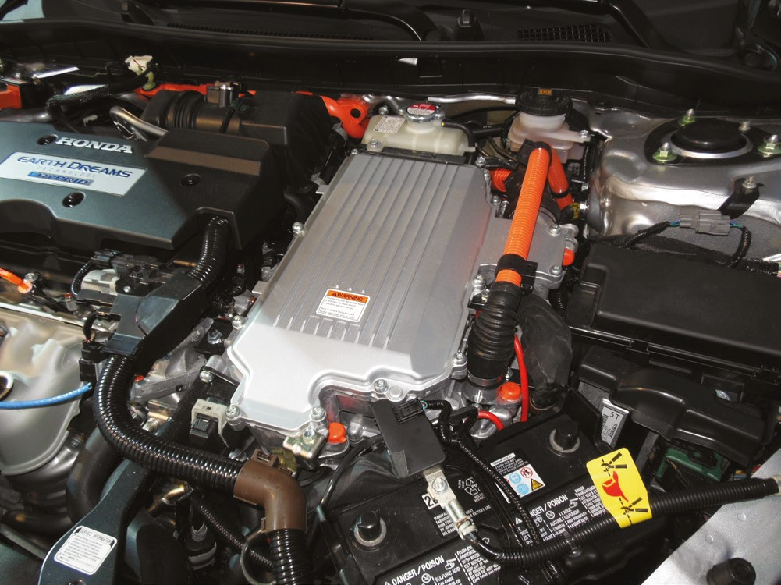
Figure 9.23
The inverter/converter assembly is located above the transmission with the orange cables connecting it to the transmission.

Slide 49
Mild Hybrids (3 of 5)
Parts and Operation (continued)
  High-voltage cables.
    Blue or yellow cables are used on vehicles when the system voltage is below 60 volts.
    Orange cables are used on vehicles where the system voltage is above 60 volts.
  Engine control module. The E C M is responsible for
  all engine control systems when the engine is running.

Slide 50
Mild Hybrids (4 of 5)
Parts and Operation (continued)
  Hybrid control module. The hybrid control module is responsible for controlling the electric portion of the powertrain.
  Transmission control module. The T C M monitors the range selector switch to determine what gear the driver has selected.

Slide 51
Mild Hybrids (5 of 5)
Diagnosis and Testing
  There are many key safety conditions that will cause the mild-hybrid stop-start system to become disabled.
  Begin diagnosis by checking the battery and charging system for proper operation.
  Complete a module scan and check for codes in any of the modules associated with the stop-start system.

Slide 52
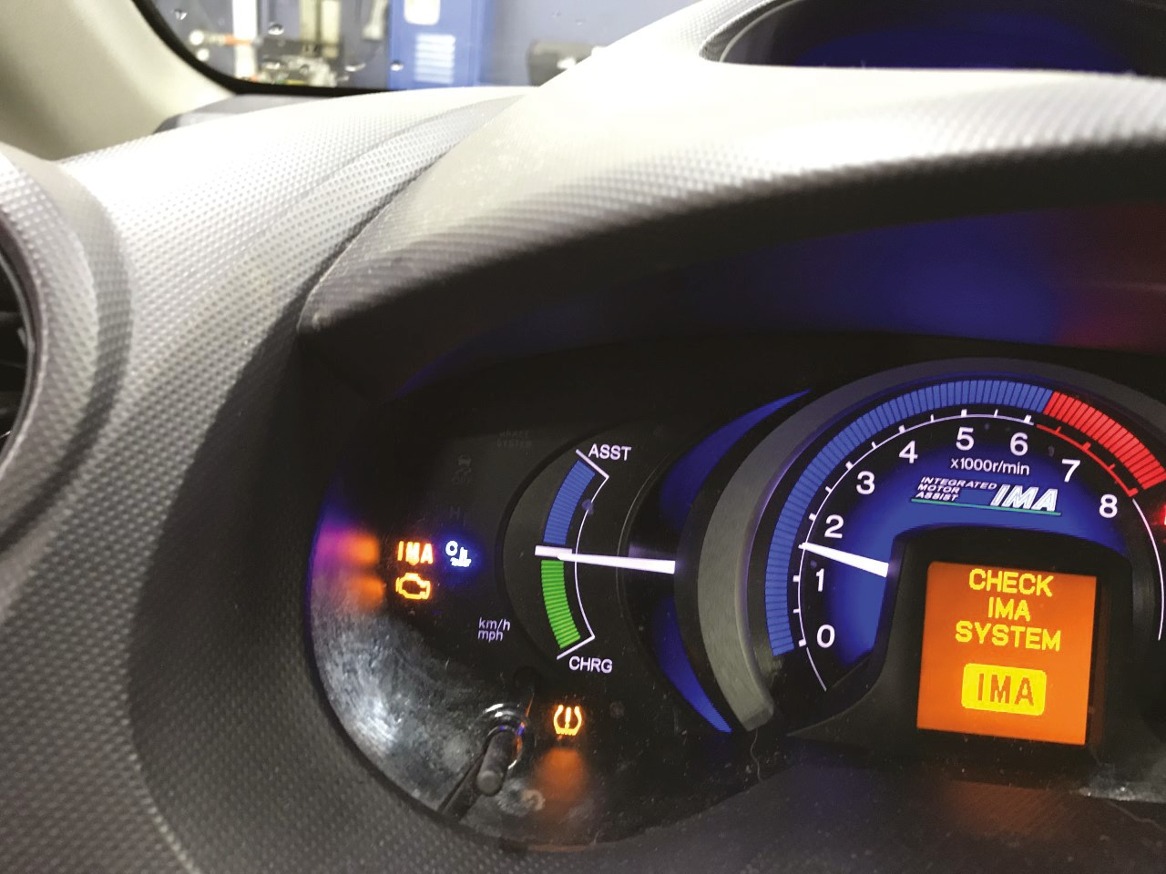
Figure 9.24
The Check I M A and Check Engine lights are both illuminated in the instrument cluster.

Slide 53
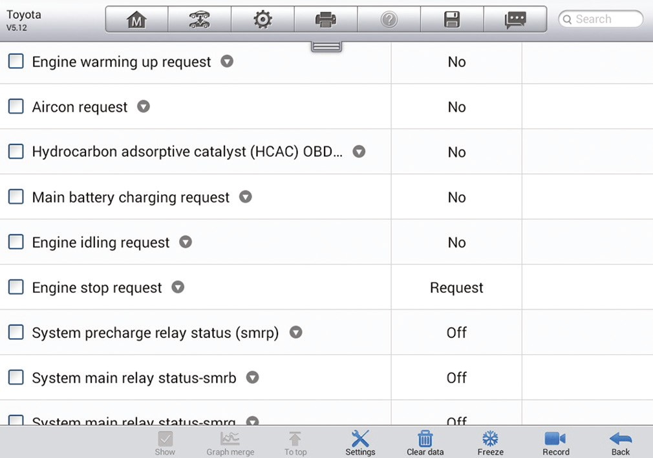
Figure 9.25
The P I D s displayed on the scan tool may help to identify the failed component or abnormal condition.
Notes:
Long Description:
The screenshot shows the following readings: Engine warming up request, No. Aircon request No, Hydrocarbon adsorptive catalyst (HCAC) OBD… No, Main battery charging request No, Engine idling request No, Engine stop request Request, System precharge relay status (smrp) Off, System main relay status-smrb Off...

Slide 54
Animation and Video Resources
The below listed resources are hyperlinked to the James Halderman website
(A6) Electrical/Electronic Systems Animations
(L3) Light Duty Hybrid Electric Animations
(A6) Electrical/Electronic Systems Videos
(L3) Light Duty Hybrid Electric Videos

Slide 55

Copyright
This work is protected by United States copyright laws and is provided solely for the use of instructors in teaching their courses and assessing student learning. Dissemination or sale of any part of this work (including on the World Wide Web) will destroy the integrity of the work and is not permitted. The work and materials from it should never be made available to students except by instructors using the accompanying text in their classes. All recipients of this work are expected to abide by these restrictions and to honor the intended pedagogical purposes and the needs of other instructors who rely on these materials.

