Slide 1
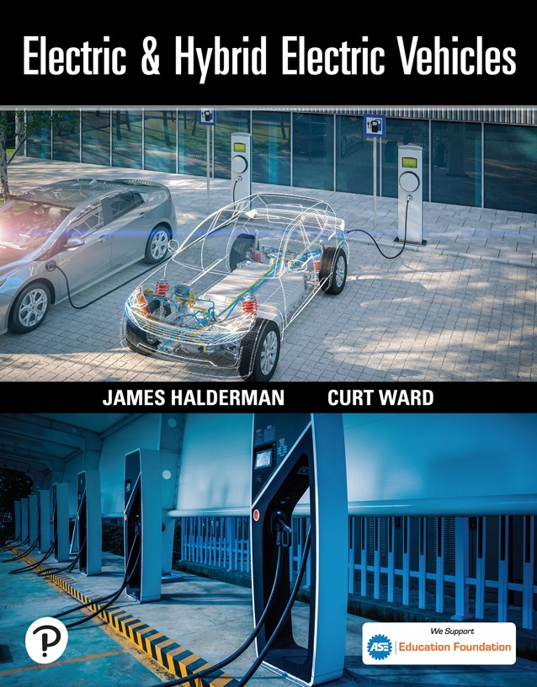

Electric and Hybrid Electric Vehicles
First Edition
Chapter 5
Hybrid and Electric Vehicle Preventative Maintenance
Copyright © 2023 Pearson Education, Inc. All Rights Reserved
Notes:
If this PowerPoint presentation contains mathematical equations, you may need to check that your computer has the following installed:
1) Math Type Plugin
2) Math Player (free versions available)
3) NVDA Reader (free versions available)

Slide 2
Learning Objectives
5.1 Describe routine service procedures for both hybrid and electric vehicles.
5.2 Explain how to place a hybrid vehicle in maintenance mode.
5.3 Describe the service cautions when changing the oil and filter on a hybrid vehicle.
5.4 Explain how to service the base brake system on a hybrid or electric vehicle.
5.5 List the different voltages at which hybrid and electric steering systems operate, and explain the safety precautions when performing service.
5.6 Explain the purpose of noise-reducing tires.

Slide 3
Routine Service Procedures
Customer Perception
  Over time, the customer begins to notice a decrease in the fuel economy.
  The perception is that the decrease is a result of a failing high-voltage battery.
  In many cases the decrease in fuel economy or performance is a result of a lack of routine maintenance.

Slide 4
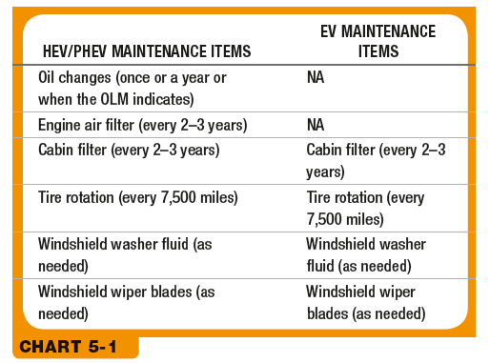
Chart 5.1
Routine maintenance service.
Notes:
Long Description:
The column headers are H E V/P H E V maintenance item and E V maintenance items. The row entries are as follows. Row 1. Oil changes (once or a year or when the O L M indicates). Not available. Row 2. Engine air filter (every 2 to 3 years). Not available. Row 3. Cabin filter (every 2 to 3 years). Cabin filter (every 2 to 3 years). Row 4. Tire rotation (every 7,500 miles). Tire rotation (every 7,500 miles). Row 5. Windshield washer fluid (as needed). Windshield washer fluid (as needed). Row 6. Windshield wiper blades (as needed). Windshield wiper blades (as needed).

Slide 5
Instrument Cluster Messages
Technician must understand what the indicators in the instrument cluster and message center mean.
Failure to understand these symbols may lead to unnecessary or incorrect initial diagnostic assumptions.

Slide 6
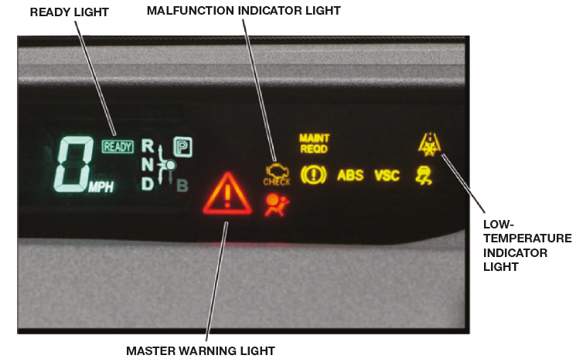
Figure 5.1
An example message screen from a Generation 2 Toyota Prius provides a wealth of information for the driver and the service technician.

Slide 7
Non-High Voltage Components That Impact Fuel Economy
The absence or change in any of the following components as it may affect the vehicles’ fuel economy:
  Low rolling resistance tires
  Low-mass wheels
  Spoilers
  Underbody trays
  Aerodynamic assist steps

Slide 8
Placing the Vehicle in Maintenance Mode
Required under conditions that can include the following:
  Checking air-conditioning pressures
  Bringing the engine to operating temperature
  Safety inspection of the exhaust system
The vehicle can be placed in this mode either with a scan tool or through a specific sequence of steps.

Slide 9
Lifting an Electric Vehicle
The high-voltage battery and its covers fill a large portion of the underside of the vehicle.
Some vehicles require special adapters for lifting.

Slide 10
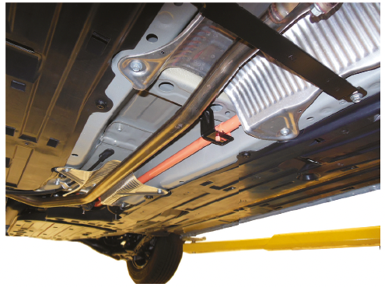
Figure 5.2
When positioning the lift, make sure the arms and contact points are clear of any high-voltage cables.

Slide 11
Oil and Filter Service
Most H E Vs require either S A E 0W-20, S A E 0W-16, or S A E 5W-20.
Be sure that the I C E is off and that the “READY” lamp is off.
Be sure that the key fob is at least 15 feet (5 meters) away from the vehicle.

Slide 12
Engine Maintenance
Hybrid vehicles may have specific engine maintenance requirements.
  Honda Insight requires the indexing of spark plugs.
  Some Honda engines require mechanical valve lash adjustments.
  Atkinson cycle engines may require more frequent throttle body service.

Slide 13
Cooling System Service
Service is similar to performing this service in any vehicle equipped with an I C E.
There are several items to know when servicing the cooling system on a hybrid and electric vehicle, including there may be two or three systems that require service.
  Use the specified coolant and replacement interval.
  Some hybrid vehicles use a different pressure cap on the engine as compared to the electronics cooling systems.

Slide 14
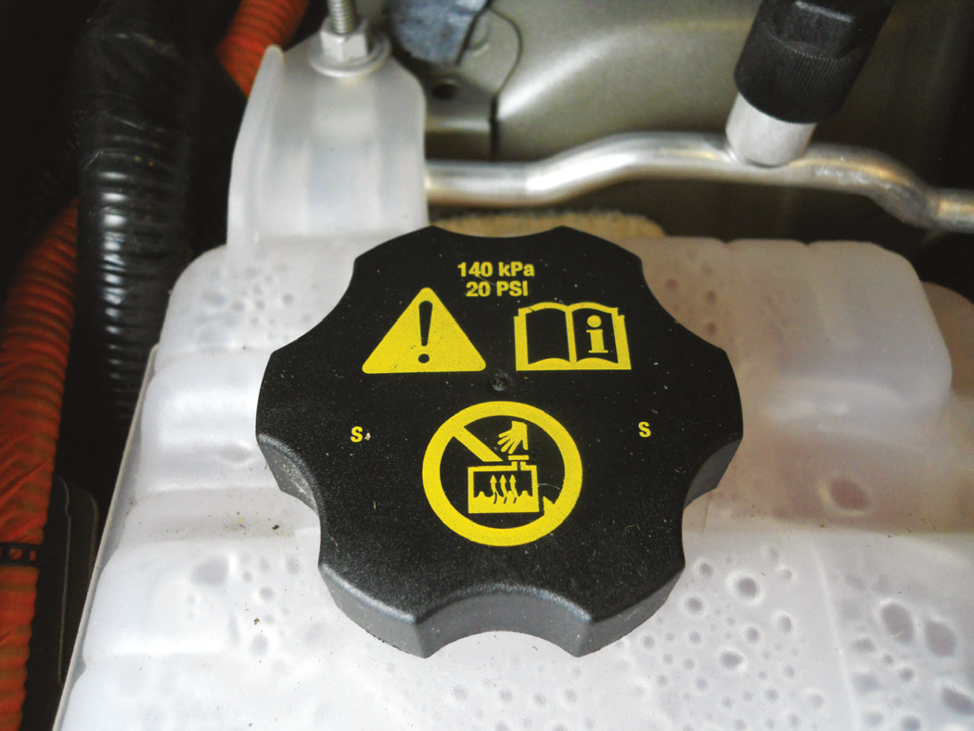
Figure 5.4
Chevrolet Volt engine cooling system with a 20 P S I rated reservoir cap.

Slide 15
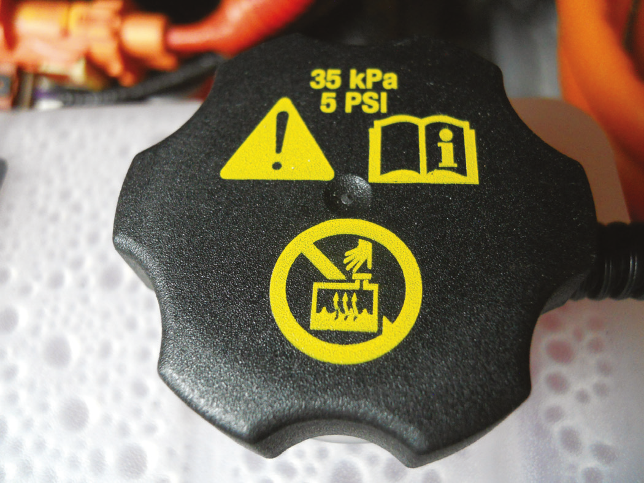
Figure 5.5
Chevrolet Volt electronics cooling system with a 5 P S I rated reservoir cap.

Slide 16
Braking System Service
Check service information for any precautions.
Make sure to have the needed scan tools, pressure bleeders, and other required tools.
The base brakes on many hybrid and electric vehicles are often found to be stuck or not functioning correctly because the brakes are not doing much work.

Slide 17
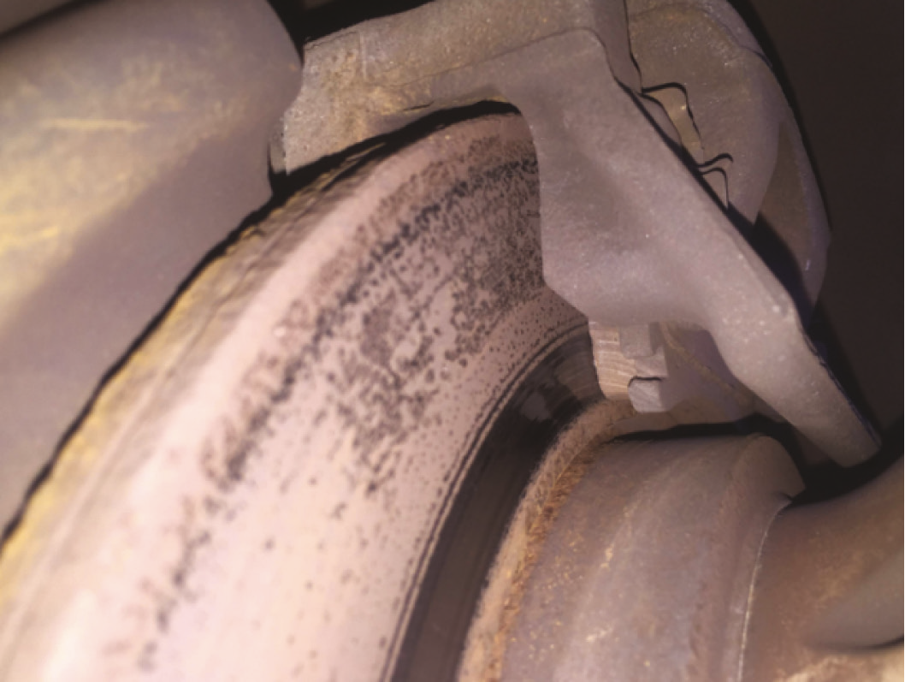
Figure 5.6
The brake rotor on this Audi Q5 hybrid is rusted and has very little pad contact due to a seized brake caliper pin.

Slide 18
Air-Conditioning Service
Many hybrid and electric vehicles use an air-conditioning compressor that uses high voltage from the high-voltage battery pack to operate the compressor.
  Make sure the high-voltage system has been properly depowered before removing the compressor for service.
  If the system is electrically driven, special refrigerant oil, P O E oil, is used.

Slide 19
Tire Service
Always inflate the tires to the pressure indicated on the door jamb sticker.
Follow normal tire inspections and tire rotation intervals as specified by the vehicle manufacturer.
Noise-reducing tires
  Noise reduction is accomplished by adding acoustical foam to the inside of a tire.
  The acoustical foam must be carefully cut from the area of the puncture and after the repair is complete it must be reattached.

Slide 20
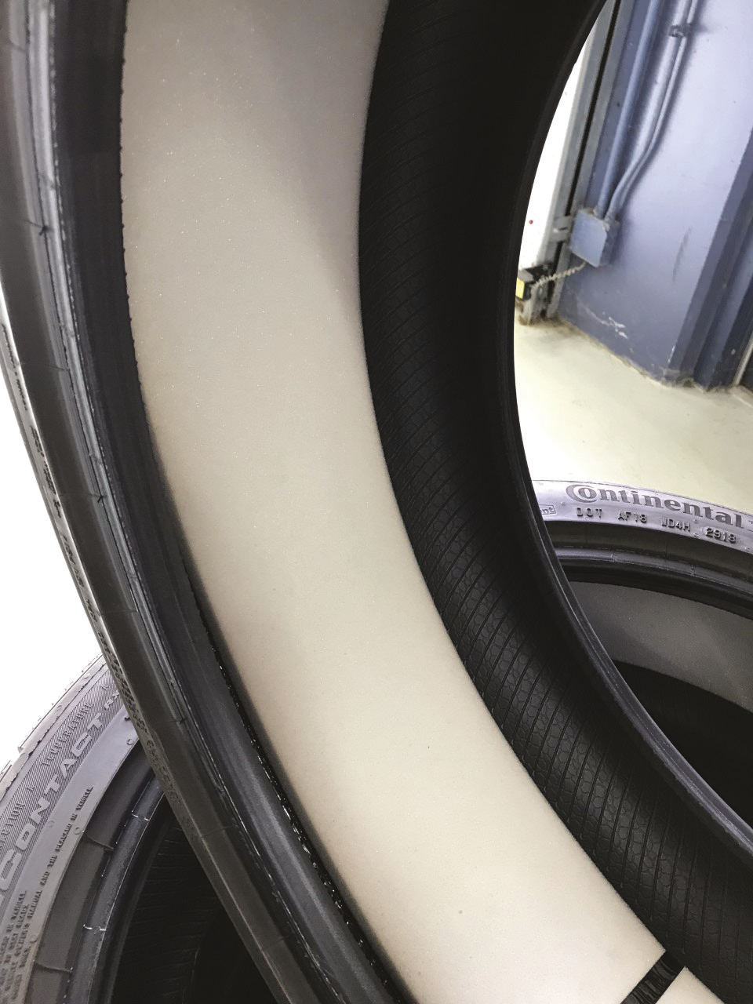
Figure 5.10
A tire off a Tesla Model 3 with acoustical foam.

Slide 21
Auxiliary Battery Service
Auxiliary 12-volt batteries used in hybrid or electric vehicles are located in one of two general locations
  Under the hood
  In the passenger or trunk compartment
Some micro hybrids with the stop-start feature will have two 12-volt batteries.

Slide 22
Steering System Service
Powered by one of two voltages:
  12 volts—These systems can be identified by red or black wiring conduit.
  42 volts—These systems use a yellow or blue plastic conduit.
  When depowering the power steering system to make repairs, it is important to follow the specific wait times to ensure the capacitors are completely discharged.

Slide 23
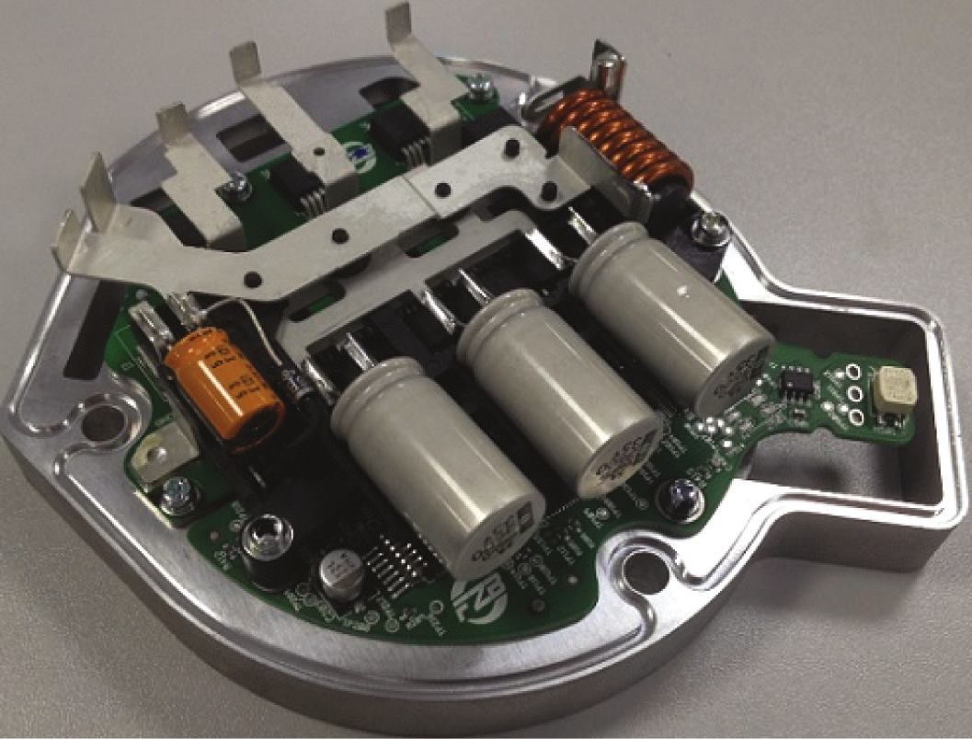
Figure 5.12
The capacitors in the power steering assist unit provide additional power when needed but must be allowed to discharge before service work begins.

Slide 24
Diagnosis Procedure
Hybrid and electric vehicles should be diagnosed the same as any other type of vehicle.
This means following a diagnostic routine as described in the text.

Slide 25
Animation and Video Resources
The below listed resources are hyperlinked to the James Halderman website
(A1) Engine Repair Animations
(L3) Light Duty Hybrid Electric Animations
(A1) Engine Repair Videos
(L3) Light Duty Hybrid Electric Videos

Slide 26

Copyright
This work is protected by United States copyright laws and is provided solely for the use of instructors in teaching their courses and assessing student learning. Dissemination or sale of any part of this work (including on the World Wide Web) will destroy the integrity of the work and is not permitted. The work and materials from it should never be made available to students except by instructors using the accompanying text in their classes. All recipients of this work are expected to abide by these restrictions and to honor the intended pedagogical purposes and the needs of other instructors who rely on these materials.

