Slide 1
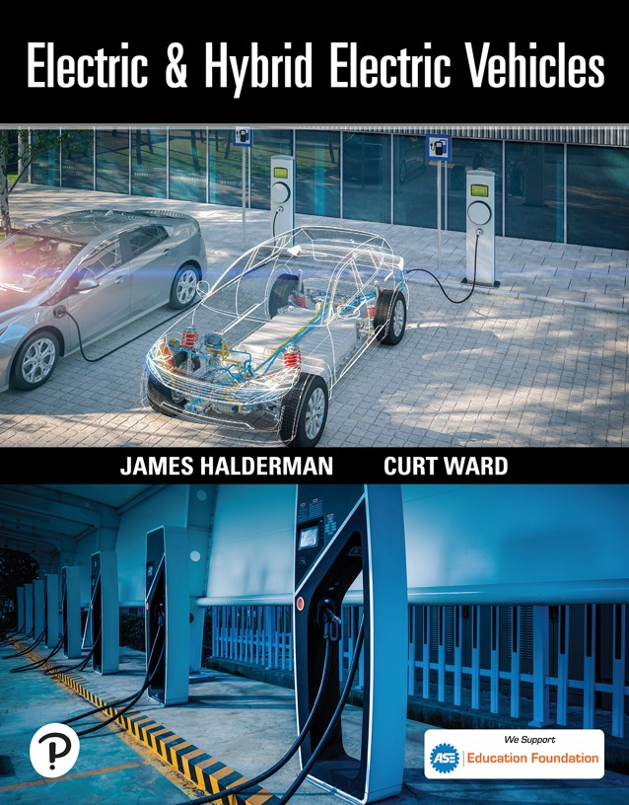

Electric and Hybrid Electric Vehicles
First Edition
Chapter 19
Fuel Cells and Advanced Technologies
Copyright © 2023 Pearson Education, Inc. All Rights Reserved
Notes:
If this PowerPoint presentation contains mathematical equations, you may need to check that your computer has the following installed:
1) Math Type Plugin
2) Math Player (free versions available)
3) NVDA Reader (free versions available)

Slide 2
Learning Objectives
19.1 Explain how a fuel cell generates electricity and list advantages and disadvantages of fuel cells.
19.2 List the types of fuel cells and vehicle systems that use them.
19.3 Explain how ultracapacitors and transaxle work in fuel cell hybrid vehicles.
19.4 Describe the H C C I combustion process.

Slide 3
Fuel Cell Technology (1 of 7)
Background
  A fuel cell is an electrochemical device in which the chemical energy of hydrogen and oxygen is converted into electrical energy.
  In the 1950s, national Aeronautics and Space Administration (N A S A) put this principle to work in building devices for powering space exploration vehicles.
  Fuel cells are being developed to power homes and vehicles while producing low or zero emissions.

Slide 4
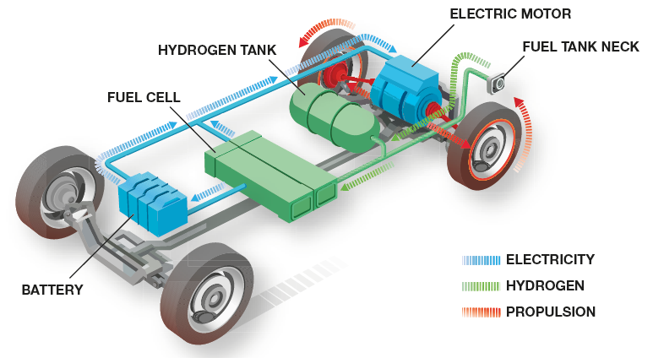
Figure 19.1
A fuel cell vehicle uses a fuel cell and a high-voltage battery to provide electrical power to the electric drive motor.

Slide 5
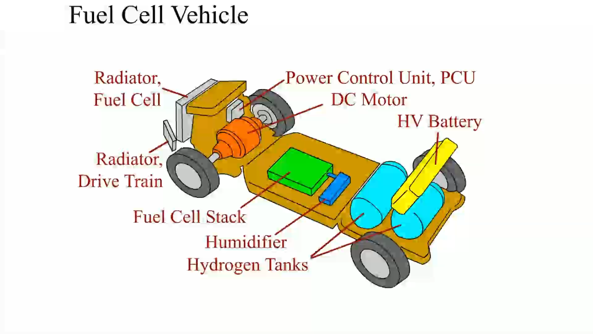
Animation:
Fuel Cell Vehicle
(The animation will automatically start in a few seconds)

Slide 6
Fuel Cell Technology (2 of 7)
Parts and Operation
  The chemical reaction in a fuel cell is the opposite of electrolysis.
  Energy is required to bring about electrolysis and this same energy can be retrieved by allowing hydrogen and oxygen to reunite in a fuel cell.

Slide 7
Fuel Cell Technology (3 of 7)
Hydrogen-Powered Battery
  A fuel cell is a hydrogen-powered battery.
  Hydrogen is an excellent fuel because it has a very high specific energy when compared to an equivalent amount of fossil fuel.
Hydrogen Sources
  Hydrogen is a low-carbon, non-toxic fuel that is domestically produced from local resources.
  Hydrogen is also found in many other compounds, such as natural gas or crude oil.

Slide 8
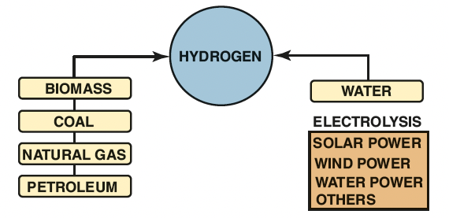
Figure 19.2
Hydrogen does not exist by itself in nature. Energy must be expended to separate it from other, more complex materials.

Slide 9
Fuel Cell Technology (4 of 7)
Advantages of a Fuel Cell
  Only emissions are water vapor and heat.
  More energy-efficient than a typical internal combustion engine (I C E).
  Very few moving parts and have the potential to be very reliable.

Slide 10
Fuel Cell Technology (5 of 7)
Disadvantages of Fuel Cells
  High cost
  Lack of refueling infrastructure
  Safety perception
  Insufficient vehicle range
  Lack of durability
  Cold weather starting problems
  Insufficient power density

Slide 11
Fuel Cell Technology (6 of 7)
Fuel Cell Types
  Differentiated by the type of electrolyte that is used in their design.
  The fuel cell design that is best suited for automotive applications is the Proton Exchange Membrane (P E M).
P E M Fuel Cell Operation
  A P E M fuel cell can start quickly and produce full power without an extensive warm-up period. The P E M is a design based on a membrane that is coated on both sides with a catalyst, such as platinum or palladium.

Slide 12
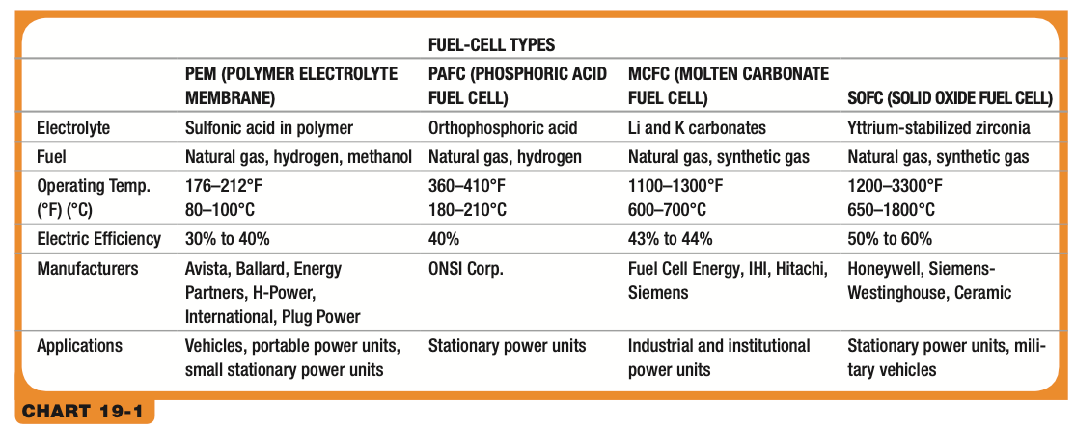
Chart 19.1
Types and details of fuel cells, including those most suitable to stationary power generation rather than for use in a vehicle.
Notes:
Long Description:
The column headers are PEM (Polymer electrolyte membrane), PAFC (Phosphoric acid fuel cell), MCFC (Molten carbonate fuel cell), and SOFC (Solid oxide fuel cell). The row entries are as follows. Row 1. Electrolyte: PEM: Sulfonic acid in polymer. PAFC: Orthophosphoric acid. MCFC: Li and K carbonates. SOFC: Yttrium-stabilized zirconia. Row 2. Fuel: PEM: Natural gas, hydrogen, methanol. PAFC: Natural gas, hydrogen. MCFC: Natural gas, synthetic gas. SOFC: Natural gas, synthetic gas. Row 3. Operating Temperature (°F) (°C): PEM: 176–212°F, 80–100°C. PAFC: 360–410°F, 180–210°C. MCFC: 1100–1300°F, 600–700°C. SOFC: 1200–3300°F, 650–1800°C. Row 4. Electric Efficiency: PEM: 30% to 40%. PAFC: 40%. MCFC: 43% to 44%. SOFC: 50% to 60%. Row 5. Manufacturers: PEM: Avista, Ballard, Energy Partners, H-Power,
International, Plug Power. PAFC: ONSI Corporation. MCFC: Fuel Cell Energy, IHI, Hitachi, Siemens. SOFC: Honeywell, Siemens-Westinghouse, Ceramic. Row 6. Applications: PEM: Vehicles, portable power units, small stationary power units. PAFC: Stationary power units. MCFC: Industrial and institutional power units. SOFC: Stationary power units, military vehicles.

Slide 13
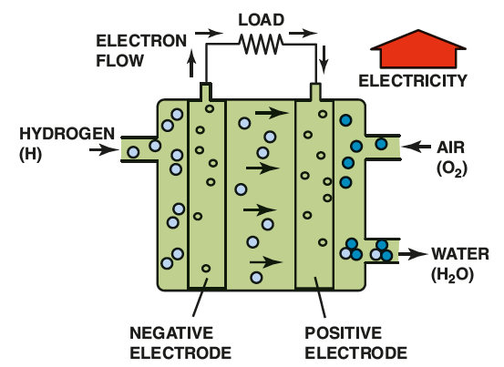
Figure 19.4
The polymer electrolyte membrane only allows H+ ions (protons) to pass through it. This means that electrons must follow the external circuit and pass through the load to perform work.
Notes:
Long Description:
Water acts at the anode to form oxygen and positively charged hydrogen ions (protons). The electrons flow through an external circuit and hydrogen ions selectively move across the PEM to the cathode.

Slide 14
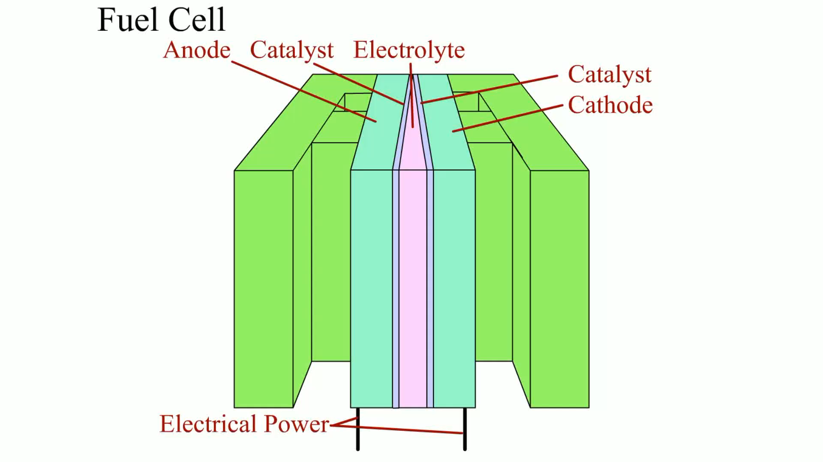
Animation:
Fuel Cell
(The animation will automatically start in a few seconds)

Slide 15
Fuel Cell Technology (7 of 7)
Fuel Cell Stacks
  A single fuel cell by itself is not particularly useful, as it generates less than 1 volt of electrical potential.
  It is more common for hundreds of fuel cells to be built together in a fuel cell stack.

Slide 16
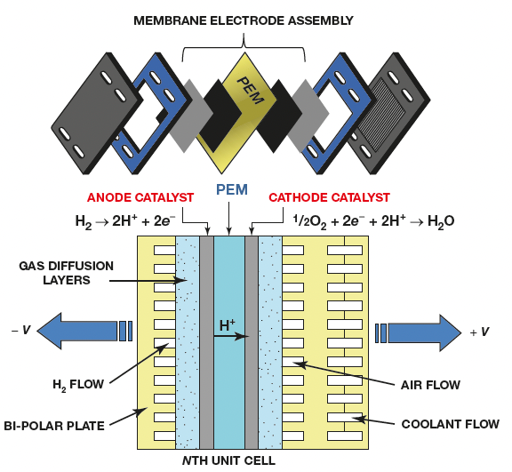
Figure 19.5
A fuel cell stack is made up of hundreds of individual cells connected in series.
Notes:
Long Description:
At the top, the electrodes assembly contains the stack of proton exchange membranes, catalyst and flat plate electrode, and elctrolyzers. At the bottom, the stack includes several plates, a fuel electrode, an oxygen electrode, and an electrolyte matrix. The bipolar plate connects the cells in a sequence and also supplies gas for the electrodes. The individual fuel cells are typically combined in a series into a fuel cell stack. Hydrogen rich fuel enters the fuel cell stack and produces electric current by an electrochemical reaction. Anode catalyst: H2 breakdown into H plus and 2 e minus. Cathode catalyst: 1/2 O 2, 2 e minus, and 2 H plus gives H 2 O.

Slide 17
Refueling with Hydrogen (1 of 2)
Fueling Procedure
  Hydrogen is a compressed gas that is stored aboveground at the station.
  Most hydrogen stations have fuel delivered by a tanker truck, although some stations make their fuel onsite.
  Filling up with hydrogen is very similar to putting propane in a barbeque tank.

Slide 18
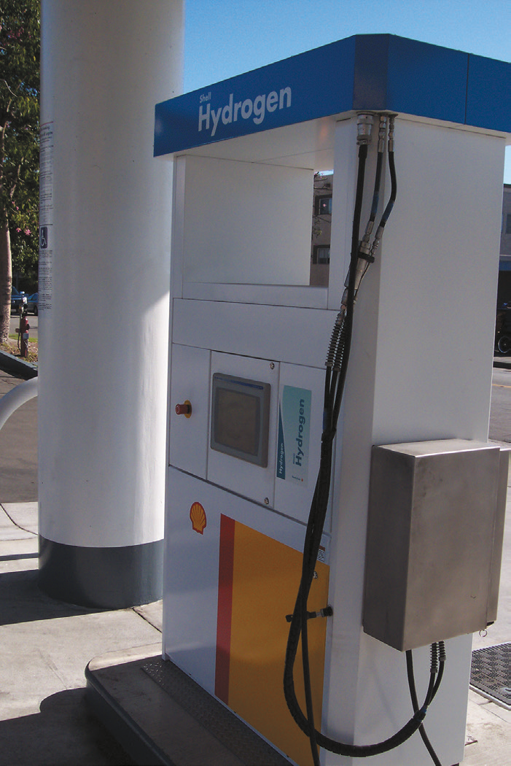
Figure 19.6 (a)
A hydrogen fueling station located at a Shell gasoline station in Los Angeles, C A.

Slide 19
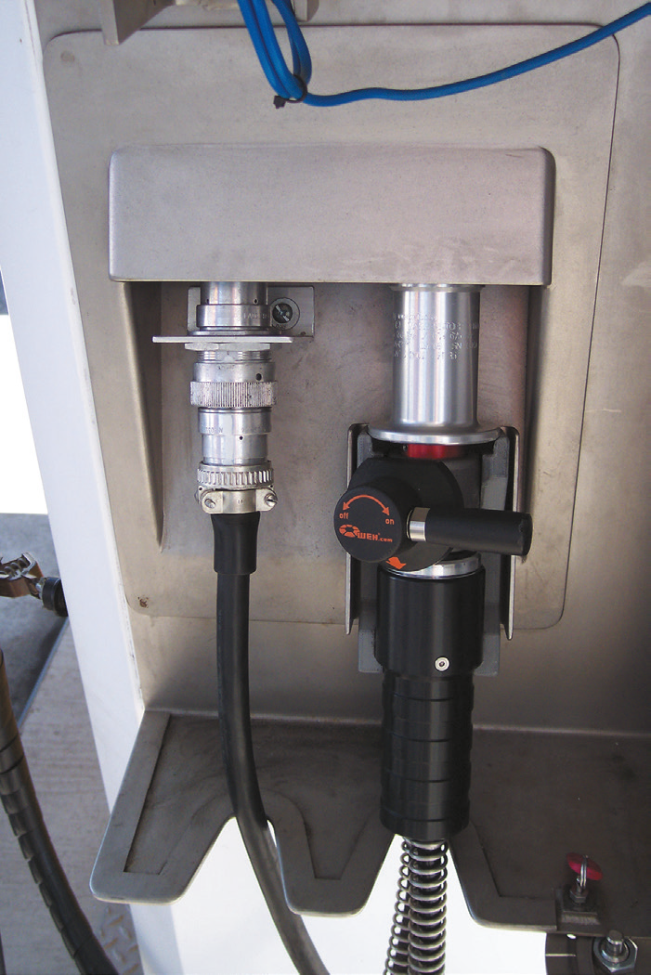
Figure 19.6 (b)
The door on the side is opened to show the fill nozzle with shut-off valve.

Slide 20
Refueling with Hydrogen (2 of 2)
Pressures Used
  The two most commonly used pressures at hydrogen filling stations include:
    H35 = 35 M P a (5,000 P S I)
    H70 = 70 M P a (10,000 P S I)
S A E J2601
  S A E International-created standard J2601 is the standard for hydrogen-fueling protocol of hydrogen fuel cell electric vehicles (F C E V s).
  A H70-T40 fueling dispenser enables fueling the fuel-cell vehicle in usually less than 3 minutes.

Slide 21
Direct Methanol Fuel Cells
Purpose and Function
  A modified P E M fuel cell can be fueled with liquid methanol instead of hydrogen gas.
Operation and Disadvantages
  No compressor or other high-pressure equipment is needed.
  Methanol cannot be stored in existing tanks.
  Direct methanol fuel cells require much greater amounts of catalyst in their construction, which leads to higher costs.

Slide 22
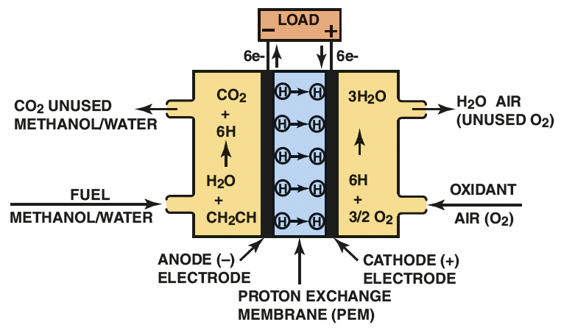
Figure 19.7
A direct methanol fuel cell uses a methanol/water solution for fuel instead of hydrogen gas.
Notes:
Long Description:
The direct methanol fuel cell has an anode and a cathode separated by a membrane. The cell relies upon the oxidation of methanol on a catalyst layer to form carbon dioxide. Water is consumed at the anode and produced at the cathode. Protons (H+) are transported across the proton exchange membrane (often made from Nafion) to the cathode where they react with oxygen to produce water.

Slide 23

Figure 19.8
A direct methanol fuel cell can be refueled similar to a gasoline-powered vehicle.

Slide 24
Fuel Cell Vehicle Systems (1 of 2)
Fuel Cell Humidifiers
  Water management inside a P E M fuel cell is critical.
  Too much water can prevent oxygen from making contact with the positive electrode; too little water can allow the electrolyte to dry out
Fuel Cell Cooling Systems
  Heat is generated by the fuel cell during normal operation.
  A liquid cooling system must be utilized to remove waste heat.

Slide 25
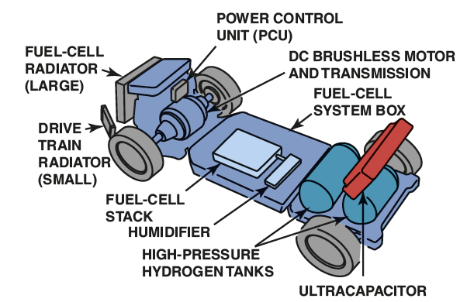
Figure 19.9
Powertrain layout in a Honda F C X fuel cell vehicle. note the use of a humidifier behind the fuel cell stack to maintain moisture levels in the membrane electrode assemblies.

Slide 26
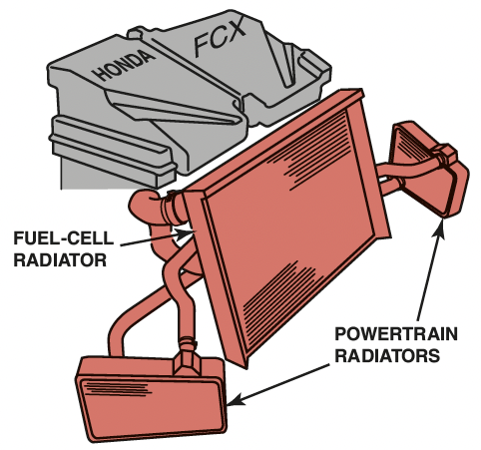
Figure 19.10
The Honda F C X uses one large radiator for cooling the fuel cell, and two smaller ones on either side for cooling drivetrain components.

Slide 27
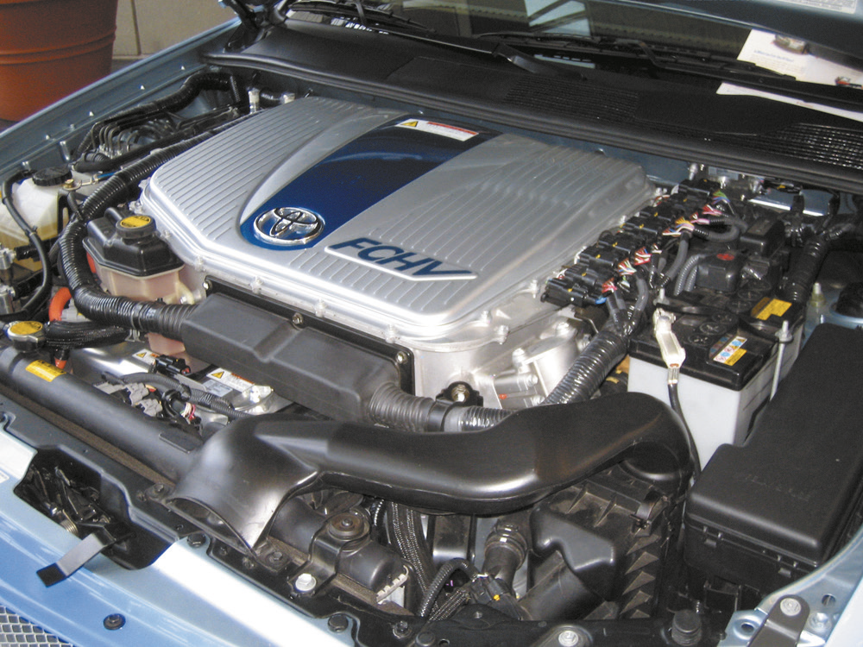
Figure 19.11
Space is limited at the front of the Toyota F C H V engine compartment, so an auxiliary heat exchanger is located under the vehicle to help cool the fuel cell stack.

Slide 28
Fuel Cell Vehicle Systems (2 of 2)
Air Supply Pumps
  Air must be supplied to the fuel cell stack at the proper pressure and flow rate to enable proper performance.
  This pump is often driven by a high-voltage electric drive motor.

Slide 29
Fuel Cell Hybrid Vehicles
Purpose and Function
  The fuel cell hybrid vehicle relies on both the fuel cell and an electrical storage device for motive power.
Secondary Batteries
  In most F C H V designs, a high-voltage nickel-metal hydride (N i M H) battery pack is used as a secondary battery.
  This is most often located near the back of the vehicle, either under or behind the rear passenger seat.

Slide 30
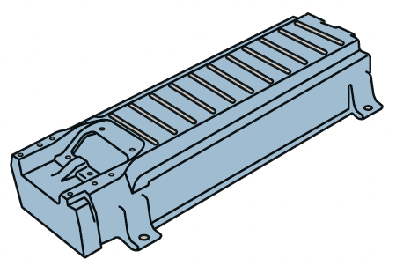
Figure 19.12
The secondary battery in a fuel cell hybrid vehicle is made up of many individual cells connected in series, much like a fuel cell stack.

Slide 31
Hydrogen Storage (1 of 3)
Purpose and Function
  One of the issues with fuel cell hybrid vehicles is how to store sufficient hydrogen onboard to allow for reasonable vehicle range.
  Hydrogen has very high energy content on a pound-for-pound basis, but its energy density is less than that of conventional liquid fuels.

Slide 32
Hydrogen Storage (2 of 3)
High-Pressure Compressed Gas
  Most current fuel cell hybrid vehicles use compressed hydrogen that is stored in tanks as a high-pressure gas.
  Multiple small storage tanks are often used rather than one large tank.
Liquid Hydrogen
  Hydrogen can be liquefied in an effort to increase its energy density, but this requires that it be stored in
  cryogenic tanks at

Slide 33
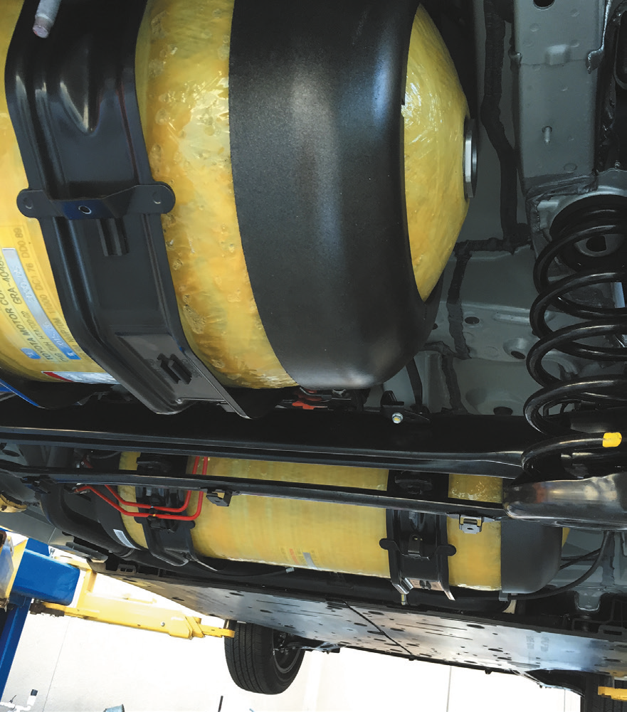
Figure 19.13
A photo showing the hydrogen storage tanks underneath a Toyota Mirai fuel cell vehicle. This vehicle uses two carbon-fiber-reinforced fuel tanks.

Slide 34
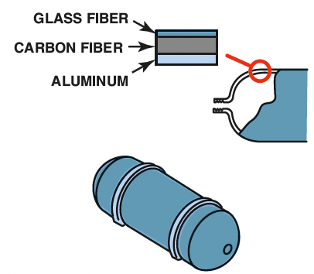
Figure 19.14
The Toyota F C H V uses high-pressure storage tanks that are rated at 350 bar. This is the equivalent of 5,000 pounds per square inch.

Slide 35
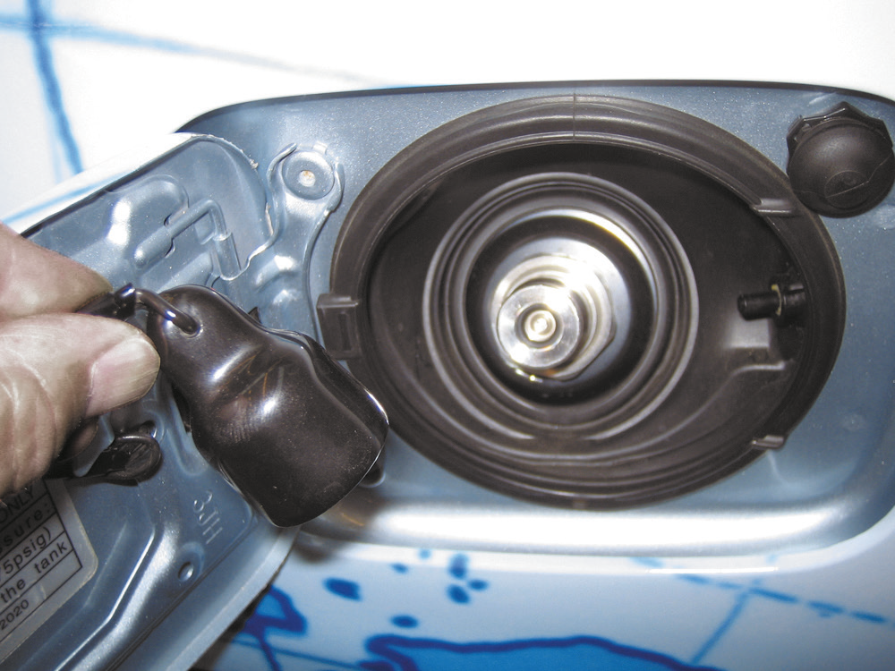
Figure 19.15
The high-pressure fitting used to refuel a fuel cell hybrid vehicle.

Slide 36
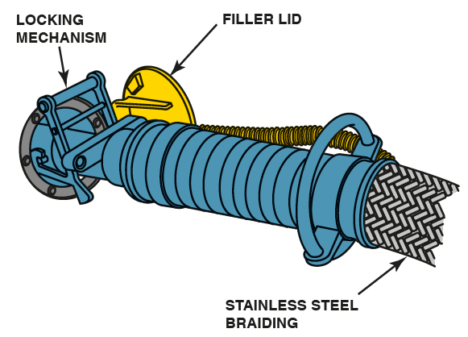
Figure 19.17
Refueling a vehicle with liquid hydrogen.

Slide 37
Hydrogen Storage (3 of 3)
Solid Storage of Hydrogen
  One method discovered to store hydrogen in solid form is as a metal hydride, similar to how a N i M H battery works.

Slide 38
Ultracapacitors
Purpose and Function
  An alternative to storing electrical energy in batteries is to use ultracapacitors.
Parts and Operation
  Ultracapacitor cells are based on double-layer technology, in which two activated carbon electrodes are immersed in an organic electrolyte.
Advantages
Disadvantages

Slide 39
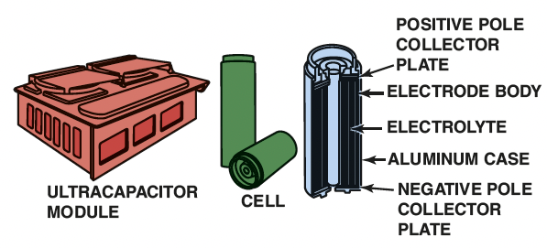
Figure 19.18
The Honda ultracapacitor module and construction of the individual cells.
Notes:
Long Description:
The double-side coated electrodes are made from graphite carbon in the form of activated conductive carbon, carbon nanotubes or carbon gels. A porous paper membrane called a separator keeps the electrodes apart, but allows positive ions to pass through while blocking larger electrons.

Slide 40
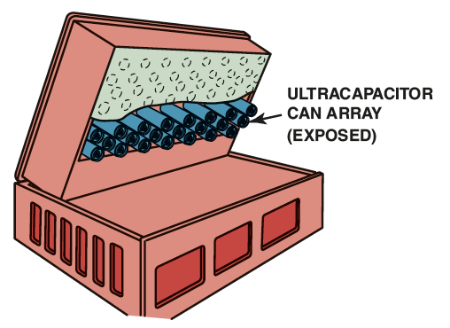
Figure 19.19
An ultracapacitor can be used in place of a high-voltage battery in a hybrid electric vehicle. This example is from the Honda F C X fuel cell hybrid vehicle.

Slide 41
Fuel Cell Transaxles (1 of 2)
Purpose and Function
  Some fuel cell hybrid vehicles use a single electric drive motor and a transaxle to direct power to the vehicle.
  It is also possible to use wheel motors to drive individual wheels.
Fuel Cell Traction Motors
  The electric traction motors used in fuel cell hybrid vehicles are very similar to those being used in current hybrid electric vehicles.

Slide 42
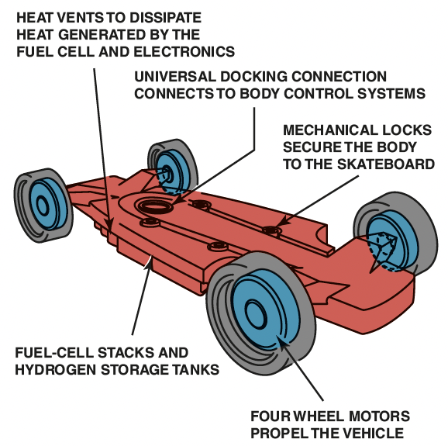
Figure 19.20
The general Motors “Skateboard” concept uses a fuel cell propulsion system with wheel motors at all four corners.

Slide 43

Figure 19.21
The electric drive motor and transaxle assembly from a Toyota F C H V. note the three orange cables, indicating that this motor is powered by high-voltage three-phase alternating current.

Slide 44
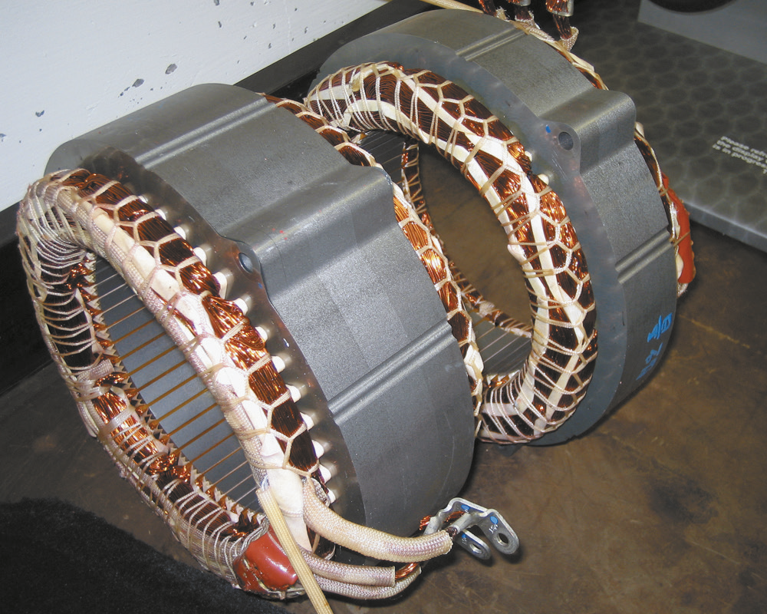
Figure 19.22
Drive motors in fuel cell hybrid vehicles often use stator assemblies similar to ones found in Toyota hybrid electric vehicles. The rotor turns inside the stator and has permanent magnets on its outer circumference.

Slide 45
Fuel Cell Transaxles (2 of 2)
Fuel Cell Power Units
  The drivetrain of a fuel cell hybrid vehicle is controlled by a power control unit (P C U), which controls fuel cell output and directs the flow of electricity between the various components.

Slide 46
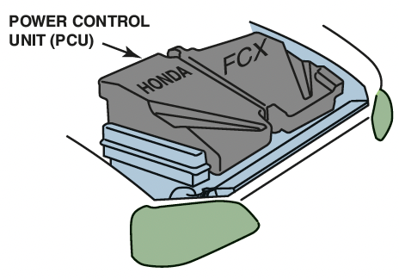
Figure 19.23
The power control unit (P C U) on a Honda F C X fuel cell hybrid vehicle is located under the hood.

Slide 47
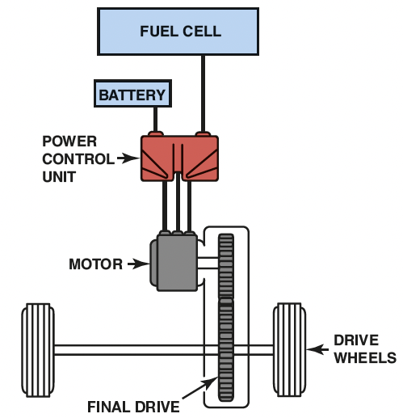
Figure 19.24
Toyota’s F C H V uses a power control unit that directs electrical energy flow between the fuel cell, battery, and drive motor.
Notes:
Long Description:
During acceleration, the PCU converts a battery's electric power from DC to AC, thus supplying power to the motor. During deceleration, it converts electric power from AC to DC to recover the regenerated electric power.

Slide 48
H C C I
Terminology
  Homogeneous Charge Compression Ignition (H C C I) is a combustion process.
  H C C I is the combustion of a very lean gasoline air–fuel mixture without the use of a spark ignition.
Future of H C C I
  Engineers need to improve the transition in and out of the H C C I mode.
  Work is also being done on piston and combustion chamber shape to reduce combustion noise.

Slide 49
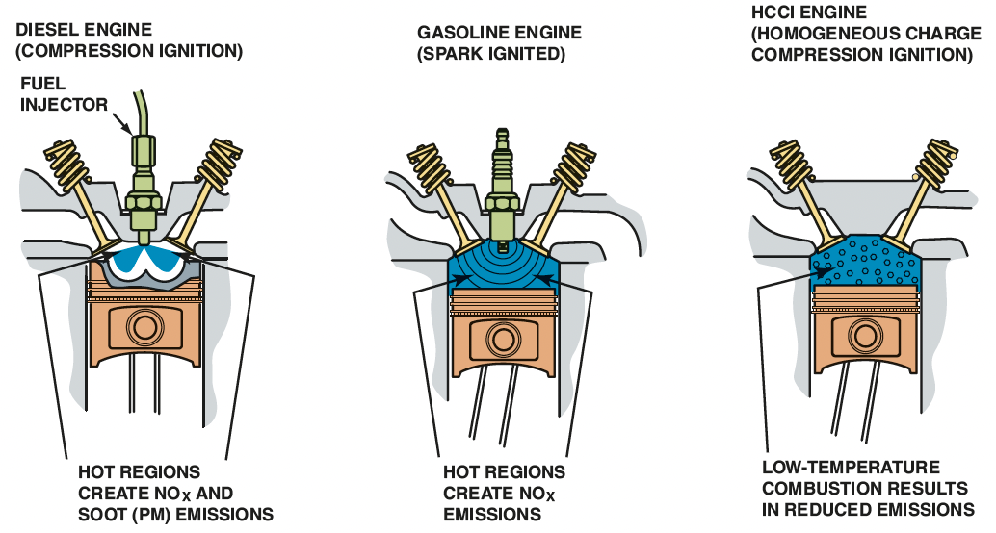
Figure 19.25
Both diesel and conventional gasoline engines create exhaust emissions due to high peak temperatures created in the combustion chamber. The lower combustion temperatures during H C C I operation result in high efficiency with reduced emissions.
Notes:
Long Description:
In a spark ignition engine, the fuel is mixed with air and then inducted into the cylinder during the intake process. After the piston compresses the fuel-air mixture, the spark ignites it, causing combustion. The expansion of the combustion gases pushes the piston during the power stroke.

Slide 50
Animation and Video Resources
The below listed resources are hyperlinked to the James Halderman website
Alternative Fuels Animations
(L3) Light Duty Hybrid Electric Animations
Alternative Fuels Videos
(L3) Light Duty Hybrid Electric Videos

Slide 51

Copyright
This work is protected by United States copyright laws and is provided solely for the use of instructors in teaching their courses and assessing student learning. Dissemination or sale of any part of this work (including on the World Wide Web) will destroy the integrity of the work and is not permitted. The work and materials from it should never be made available to students except by instructors using the accompanying text in their classes. All recipients of this work are expected to abide by these restrictions and to honor the intended pedagogical purposes and the needs of other instructors who rely on these materials.

