Slide 1
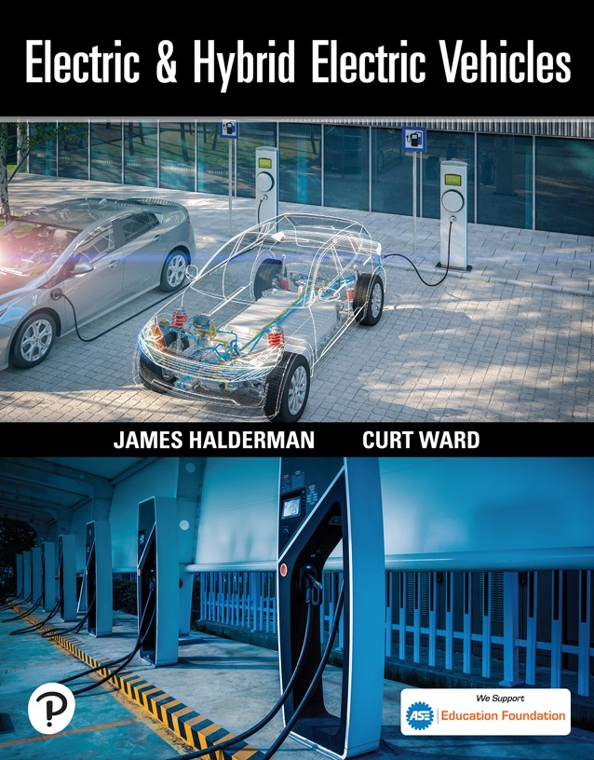

Electric and Hybrid Electric Vehicles
First Edition
Chapter 18
E V and H E V Driver Assist Systems
Copyright © 2023 Pearson Education, Inc. All Rights Reserved
Notes:
If this PowerPoint presentation contains mathematical equations, you may need to check that your computer has the following installed:
1) Math Type Plugin
2) Math Player (free versions available)
3) NVDA Reader (free versions available)

Slide 2
Learning Objectives
18.1 Describe the purpose and function of advanced driver assist systems.
18.2 Discuss blind spot monitors and parking assist, as well as self-parking systems.
18.3 Explain lane departure warning and lane keep assist systems.
18.4 Describe how adaptive cruise control systems work.
18.5 Discuss rear cross-traffic warning system operation.
18.6 Explain automatic emergency braking and pre- collision systems.
18.7 Describe the diagnostic and calibrations procedures for advanced driver assist systems.

Slide 3
Advanced Driver Assist Systems (1 of 2)
Foundation of Driver Assist
  Many of the existing systems on an electric or hybrid electric vehicle are also the foundation of driver assist systems including the following:
    Electronic power steering (E P S)
    Antilock brake system (A B S)
    Electronic throttle control (E T C)

Slide 4
Advanced Driver Assist Systems (2 of 2)
Purpose
  The purpose of advanced driver assist systems (A D A Ss) is to provide the driver with systems that help the driver by doing the following:
    Alert the driver of a potential issue.
    Help the driver maintain proper driving habits.
    Help the driver avoid a collision.
    Make the parking safer through parking assist systems.

Slide 5
Human–Machine Interface (H M I)
Definition
  The human–machine interface (H M I) was very basic in the past.
Methods of Communication
  Vehicles with advanced technology need to communicate to the driver or occupants using the following:
    Visual displays
    Sounds
    Tactile

Slide 6
Blind Spot Monitor (1 of 2)
Function and Terminology
  The blind spot monitor (B S M) is a vehicle-based sensor device that detects other vehicles located to the side and rear of the vehicle.
  Warnings can be any of the following:
    Visual—Usually a warning light in one or both of the out-side rearview mirrors.
    Audible—Usually a beep or buzzer sound.
    Vibrating (tactile)—A vibration is often created in the steering wheel or the driver’s seat called a haptic actuator.

Slide 7
Blind Spot Monitor (2 of 2)
Parts and Operation
  Most systems are designed to detect objects that are as small as a motorcycle with rider.
  The detection zone extends out from the sides and behind the vehicle about 10 feet (3 m).
  It is capable of detecting objects that are about 2 to 6 feet (0.6 to 1.8 m) tall (above the ground).

Slide 8
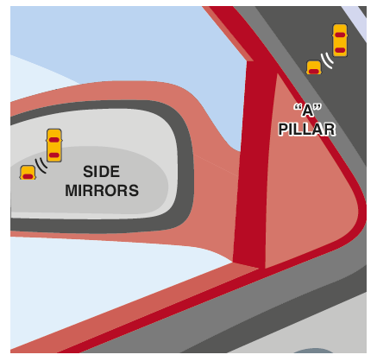
Figure 18.1
Blind spot monitoring systems usually use a warning system in the side-view mirror or in the “A” pillar near the side-view mirror to warn the driver that there is a vehicle in the potential blind spot.

Slide 9
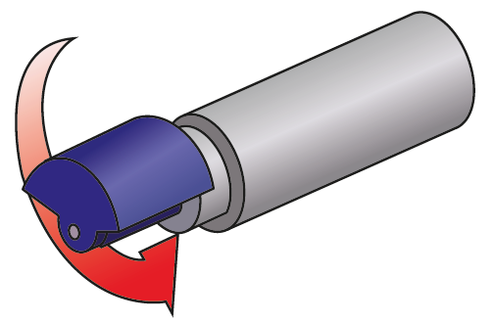
Figure 18.2
An actuator that causes the seat or the steering wheel to shake is a called a haptic actuator. The vibration is created by using a D C motor with a weight that is out of balance. When the motor rotates, a vibration is created.

Slide 10
Parking-Assist System (1 of 2)
Function, Components, and Operation
  The parking-assist system is used to help drivers avoid contact with another object while moving slowly.
  Ultrasonic object sensors are used to measure the distances to nearby objects and are built into the fender, and front and rear bumper assembly.
  Electromagnetic parking sensors (E P S) detect when a vehicle is moving slowly and toward an object.
  The system is activated automatically when the vehicle is started.

Slide 11
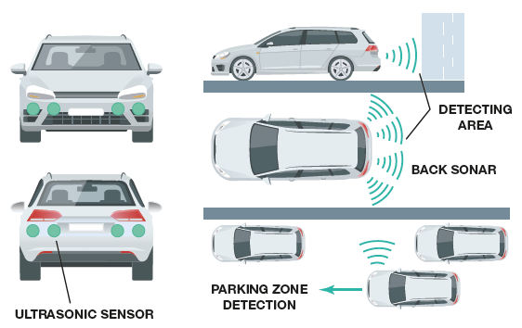
Figure 18.3
The small round buttons in the rear bumper are ultrasonic sensors used to sense distance to an object.
Notes:
Long Description:
Small button-like sensors are fixed on the front and rear bumper of the car. The sensors send out acoustic pulses when detecting an object (and its distance) at the back or front of the car. Similarly, It detects other parked vehicles in the parking zone.

Slide 12
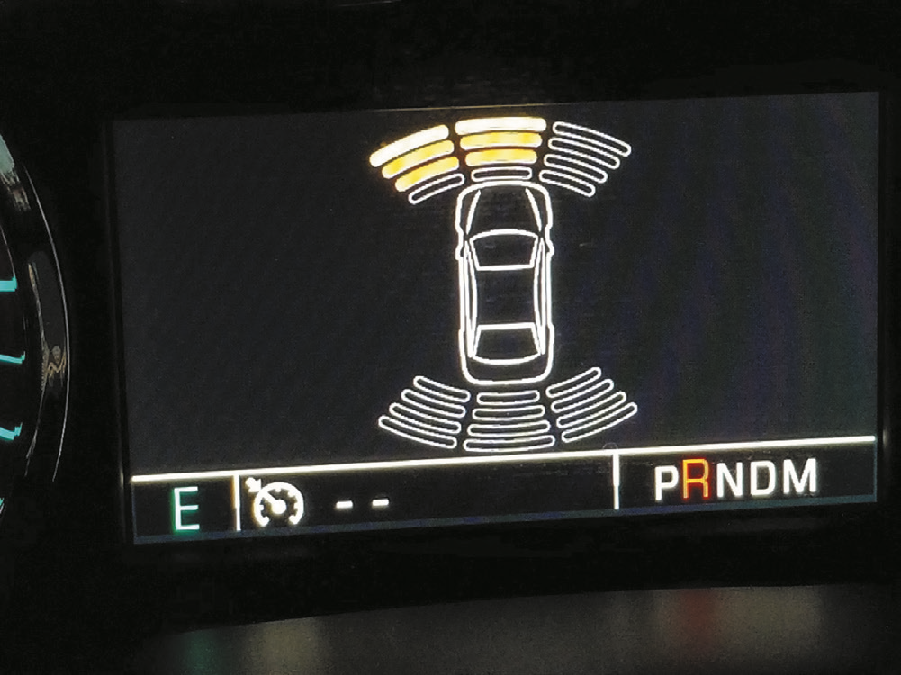
Figure 18.4
The dash display on a Chevrolet showing that an object is being detected at the front and left front of the vehicle.

Slide 13
Parking-Assist System (2 of 2)
Diagnosis
  The parking-assist control module can detect faults and store diagnostic trouble codes.
Self-Parking
  Self-parking vehicles, also called automatic parking vehicles, use the camera(s) and control the electric power steering to guide the vehicle into a parking space.

Slide 14
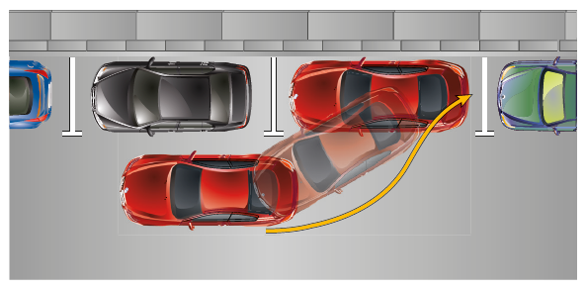
Figure 18.5
A self-parking-capable vehicle is able to parallel park or enter into a parking spot with little, or no input from the driver.

Slide 15
Lane Departure Warning
Parts and Operation
  The lane departure warning system (L D W S) uses cameras to detect if the vehicle is crossing over lane marking lines on the pavement.
  If the cameras detect that the vehicle is starting to cross over a lane dividing line, a warning chime sounds or a vibrating mechanism mounted in the driver’s seat cushion is triggered.
Diagnosis and Service
  Check service information for an explanation on how the system is supposed to work.

Slide 16
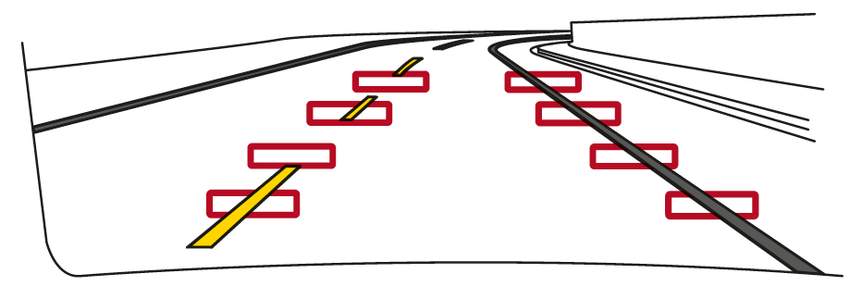
Figure 18.6
A lane departure warning system often uses cameras to sense the road lines and warns the driver if the vehicle is not staying within the lane, unless the turn signal is on.

Slide 17
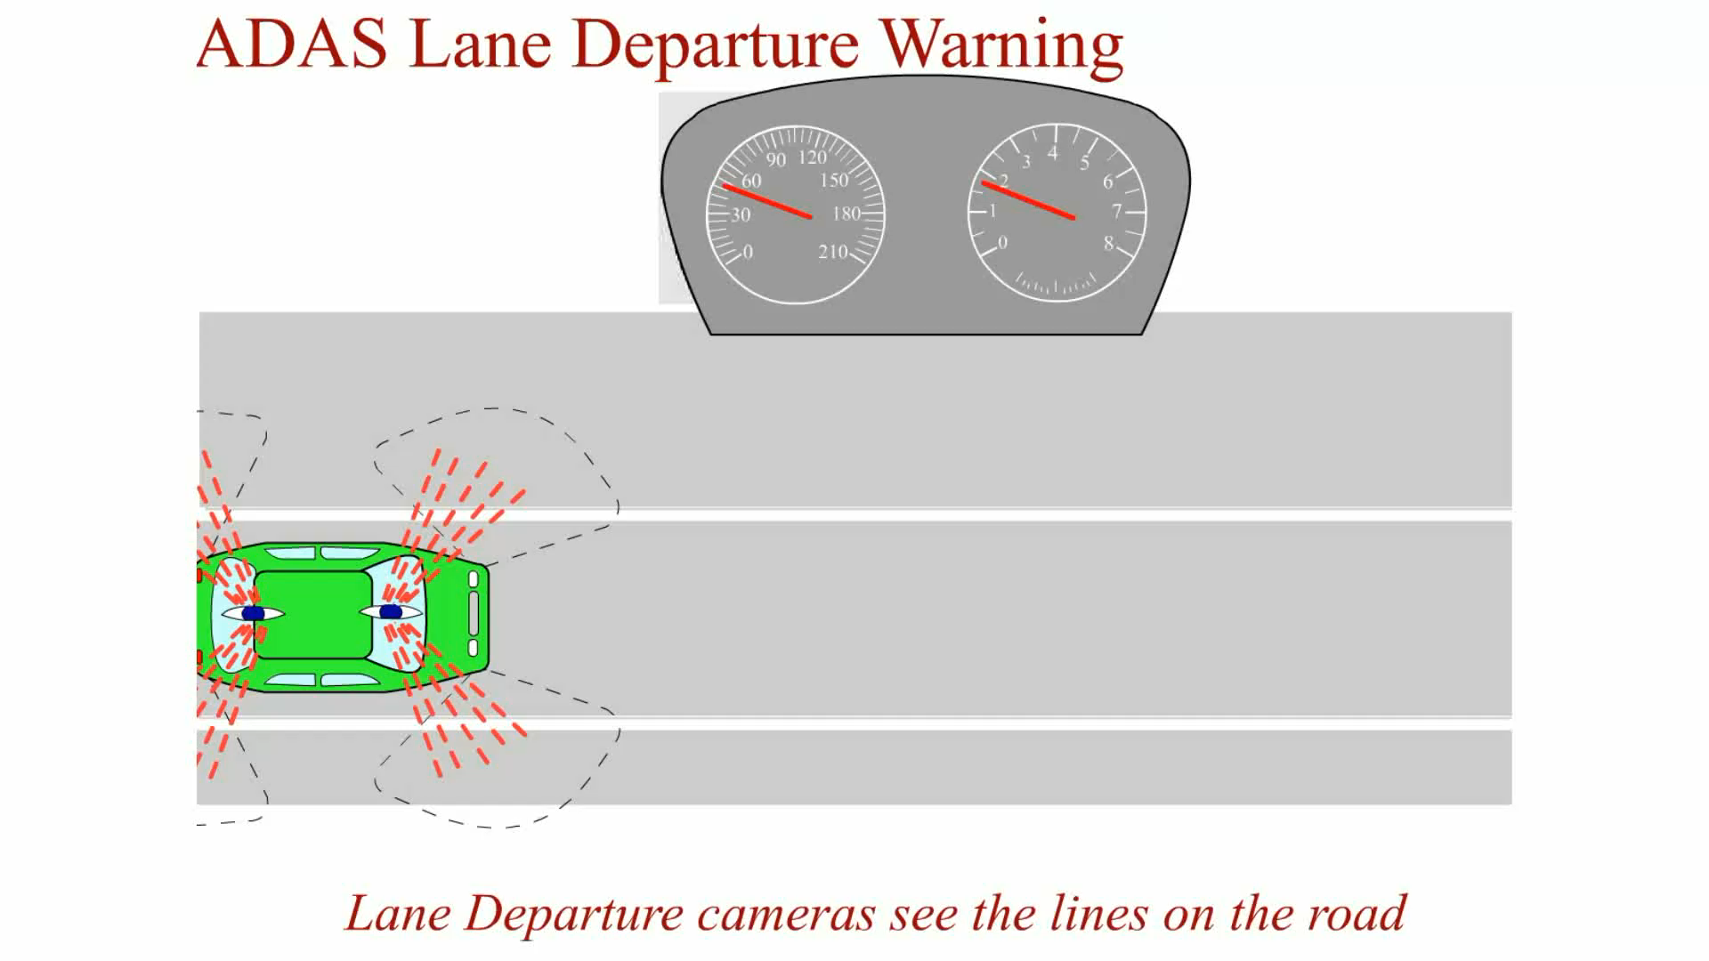
Animation:
ADAS Lane Departure Warning
(The animation will automatically start in a few seconds)

Slide 18
Lane Keep Assist
Purpose and Function
  The purpose of lane keep assist (L K A), also called lane keep assist system (L K A S), is not only to warn the driver if the vehicle is moving out of the lane of traffic, but when there is no response from the driver, to also automatically use the electric power steering system to steer the vehicle back into the lane.
Parts and Operation
  Most lane keep assist systems use a camera mounted in front of the inside rearview mirror with a clear view of the road ahead.

Slide 19
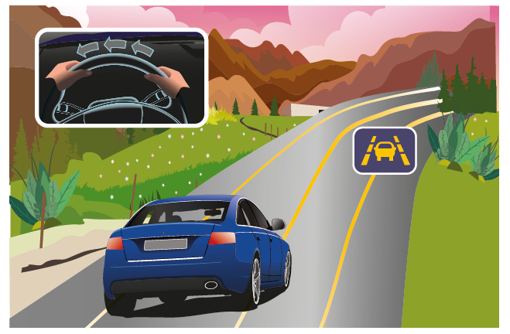
Figure 18.7
Lane keep assist systems not only warn the driver that the vehicle is not staying within the lane of traffic but will also use the electric power steering to actually move the steering wheel to bring the vehicle back into the lane.

Slide 20
Adaptive Cruise Control (1 of 2)
Purpose and Function
  Adaptive cruise control (A C C), also called radar cruise control, gives the driver more control over the vehicle by keeping an assured clear distance behind the vehicle in front.
Parts and Operation
  Radar cruise control systems use long-range radar (L R R) to detect faraway objects.
  Some systems use short-range radar (S R R) and/or infrared (I R) or optical cameras.

Slide 21
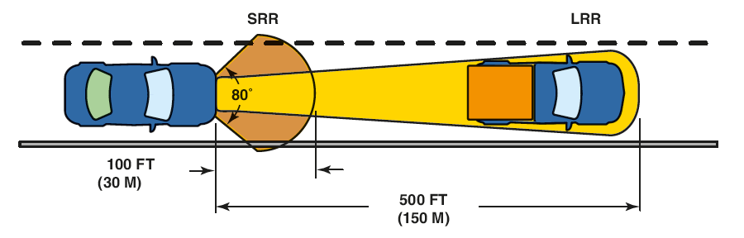
Figure 18.9
Most radar cruise control systems use radar, both long and short range. Some systems use optical or infrared cameras to detect objects.
Notes:
Long Description:
The short-range radar system operates around a car when in motion to detect possible impact with obstacles. The range of SRR is about 100 ft (30 m ). The long-range radar system measures the distance, speed of other vehicles, and detects objects within a wider field of view. The range of LRR is about 500 ft (150 m).

Slide 22
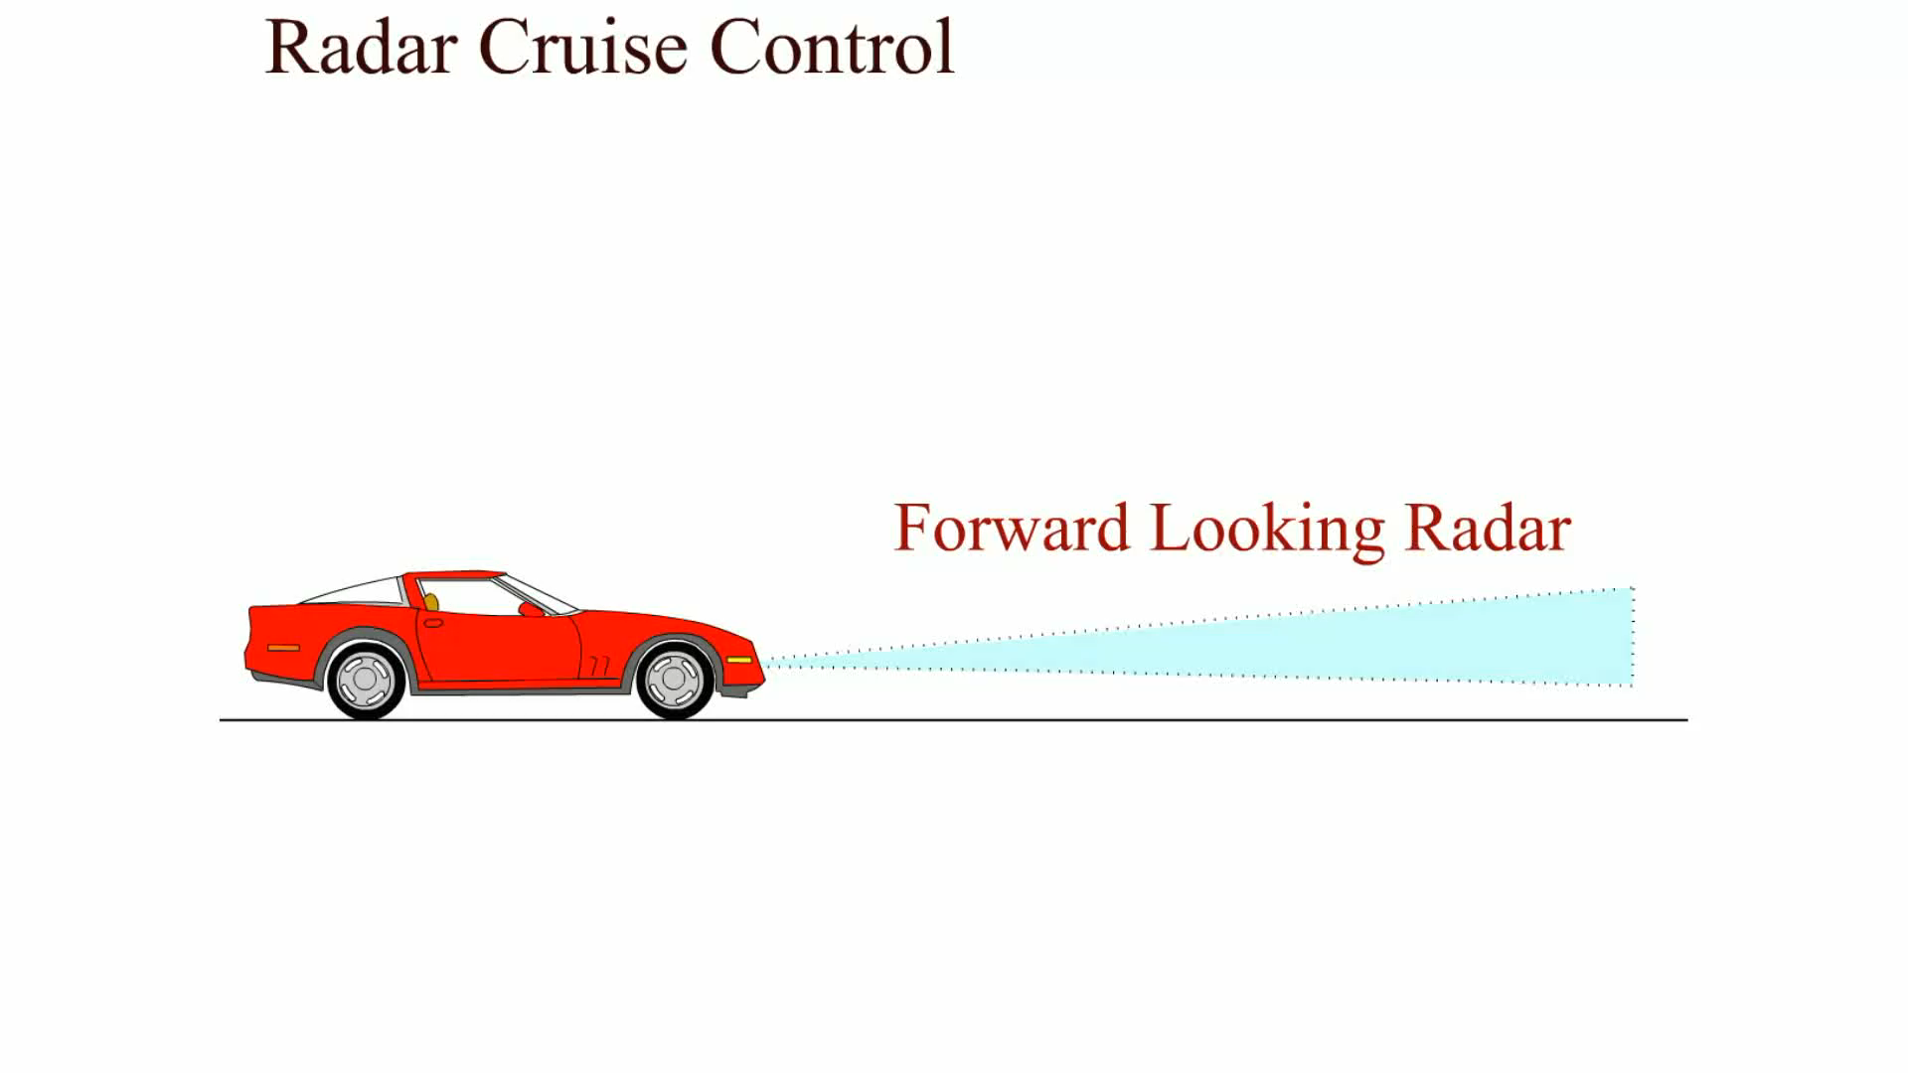
Animation:
Radar Cruise Control
(The animation will automatically start in a few seconds)

Slide 23
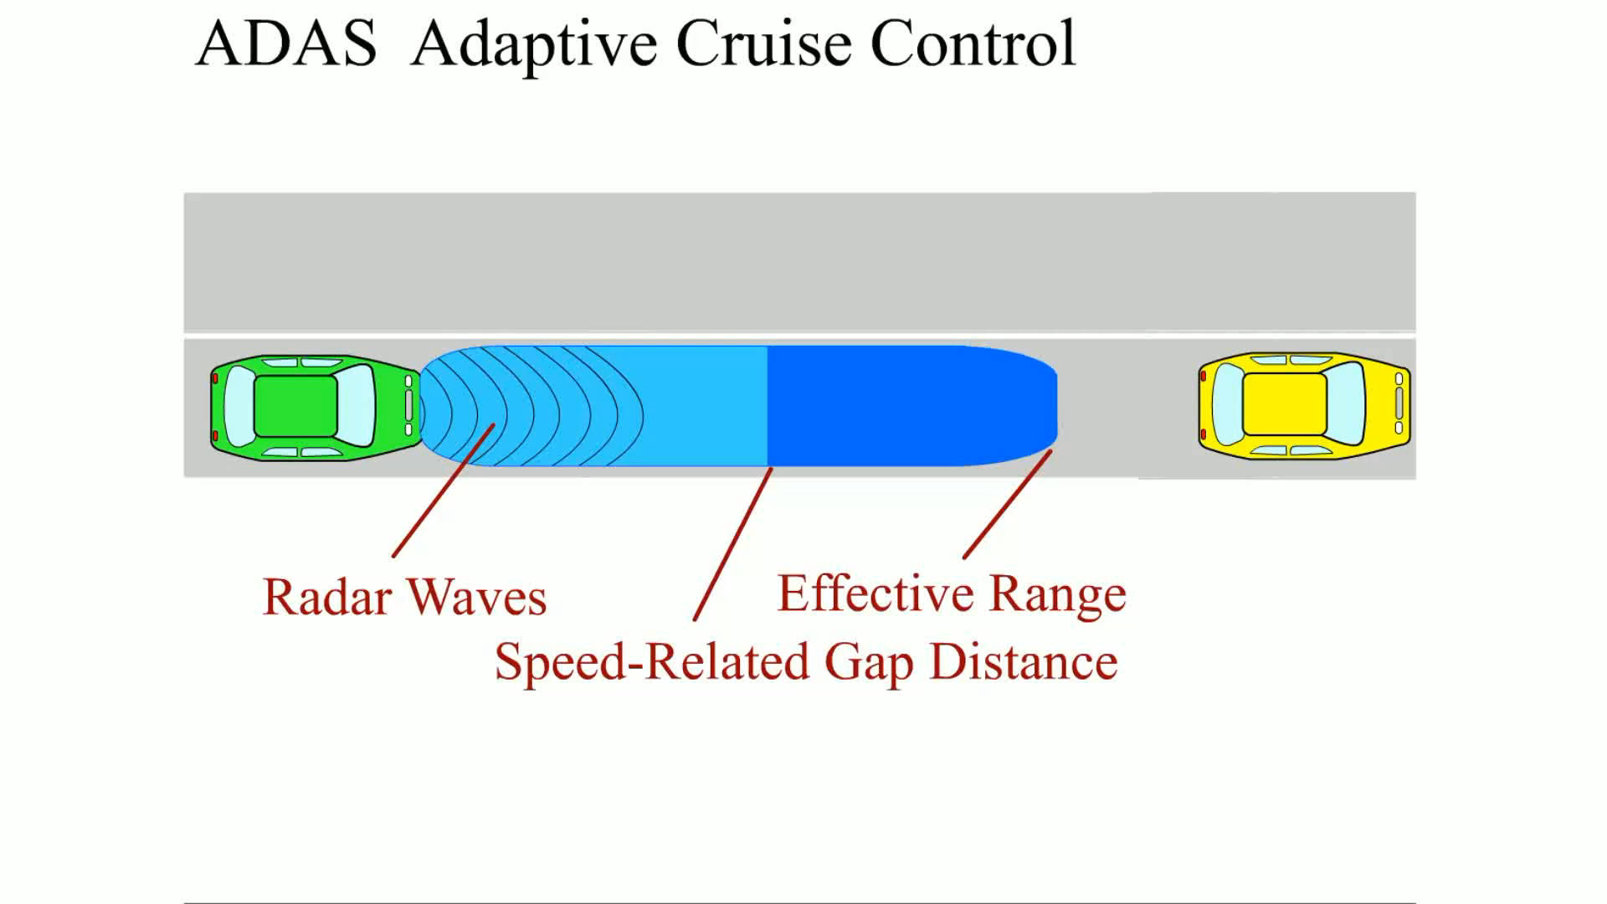
Animation:
ADAS Adaptive Cruise Control
(The animation will automatically start in a few seconds)

Slide 24
Adaptive Cruise Control (2 of 2)
Diagnosis and Service
  Make sure the sensor, which is usually behind the grille on most vehicles, is not covered.
  The system does not operate if the system is covered by heavy mud, ice, or snow.
  If the sensor is replaced, some systems require a realignment.

Slide 25
Rear Cross-Traffic Warning (R C T W)
Purpose
  A rear cross-traffic warning (R CT W) system sounds an audible warning when a vehicle is crossing at the rear while backing
Parts and Operation
  The system uses radar sensors that are installed on both sides of the vehicle near the rear bumper.
  These sensors are able to detect vehicles approaching from the left or right side of the vehicle.
  If a vehicle is detected, the system will sound a warning.

Slide 26
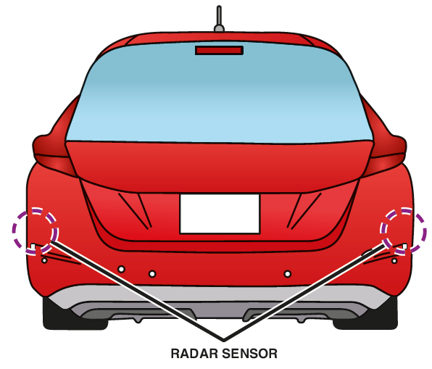
Figure 18.11
Rear cross-traffic warning systems use radar sensors at the rear corners of the vehicle, which are able to detect a moving vehicle approaching from the sides.

Slide 27
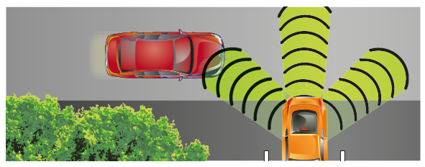
Figure 18.12
If a vehicle is approaching from the side when the gear selector is in reverse, a warning is sounded.

Slide 28
Automatic Emergency Braking
Purpose and Function
  An automatic emergency braking (A E B) system intervenes and automatically applies the brakes if needed.
  If the warnings are ignored, the automatic braking system will intervene and either provide brake assist or apply the brakes autonomously (by itself).

Slide 29
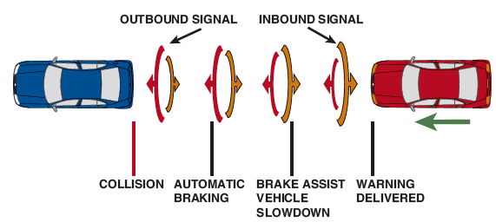
Figure 18.13
Sensors are used to detect when the distance is closing fast enough that a collision may be possible, and the system intervenes to automatically apply the brakes if needed.

Slide 30
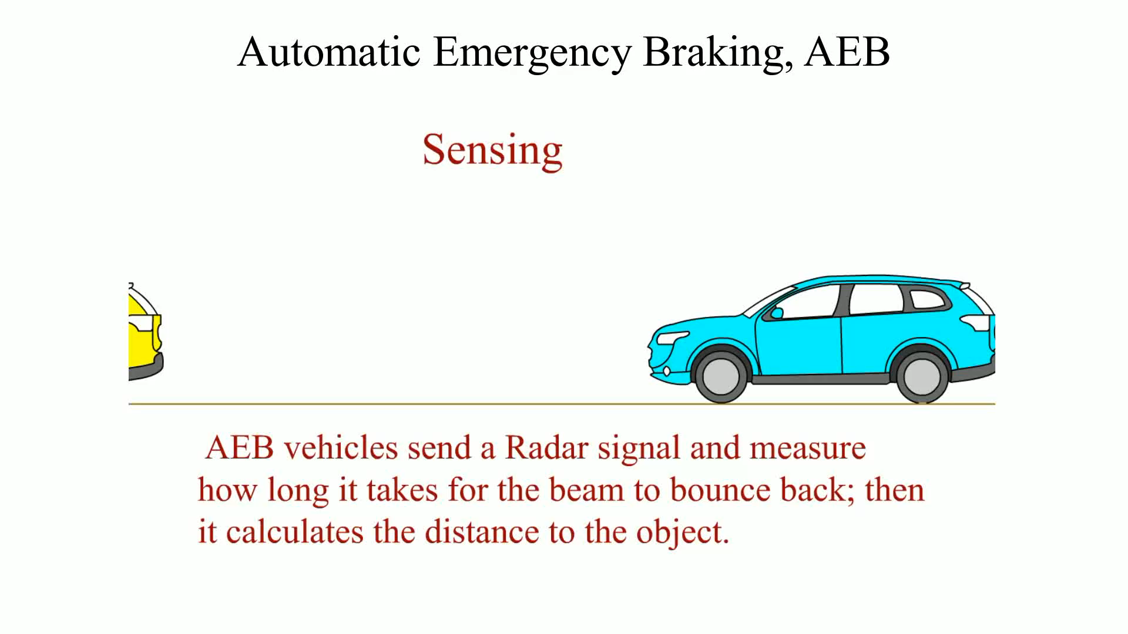
Animation:
Automatic Emergency Braking, AEB
(The animation will automatically start in a few seconds)

Slide 31
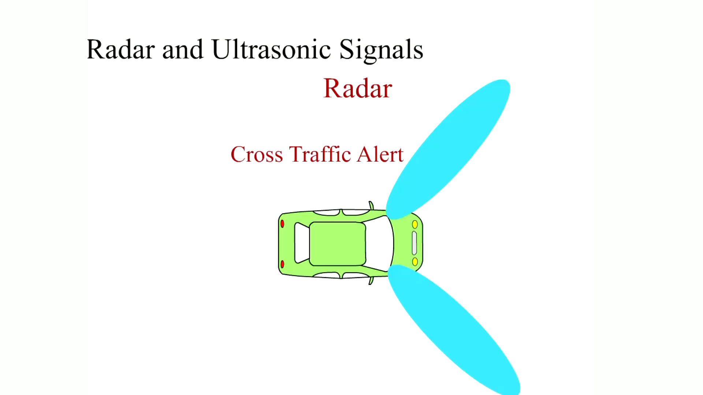
Animation:
Radar and Ultrasonic Signals
(The animation will automatically start in a few seconds)

Slide 32
Pre-Collision System
Purpose
  The purpose of a pre-collision system is to monitor the road ahead and prepare to avoid a collision, and to protect the driver and passengers.
  The system functions by monitoring objects in front of the vehicle and can act to avoid a collision by the following actions:
    Sounds an alarm
    Flashes a warning lamp
    Applies the brakes and brings the vehicle to a full stop (if needed)

Slide 33
Cameras
Purpose and Function
  While radar can detect objects, the camera is used to recognize objects.
Parts and Operation
  The light that reflects off an object in front of the lens passes through the lens and is collected at a focal point.
Diagnosis
  Begin by reading the D T Cs.

Slide 34
LiDAR Systems
Definition
  LiD A R means Light Detection and Ranging or Light Imaging, Detection, And Ranging.
  LiD A R systems are able to create 3-D images.
Parts and Operation
  LiD A R is usually seen on prototype autonomous vehicles that use a rotating object on the roof.
Diagnosis and Calibration
  LiD A R systems are capable of self-diagnosis.
  Calibration is performed using targets.

Slide 35
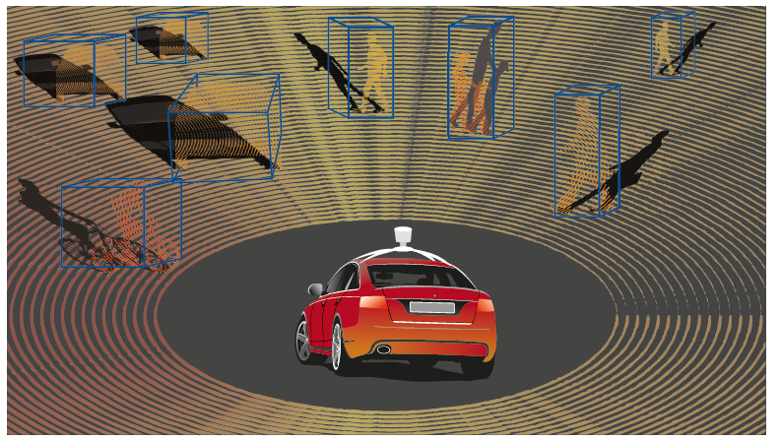
Figure 18.16
LiDAR is a detection system that uses light from a laser to create a picture of the surrounding area.

Slide 36
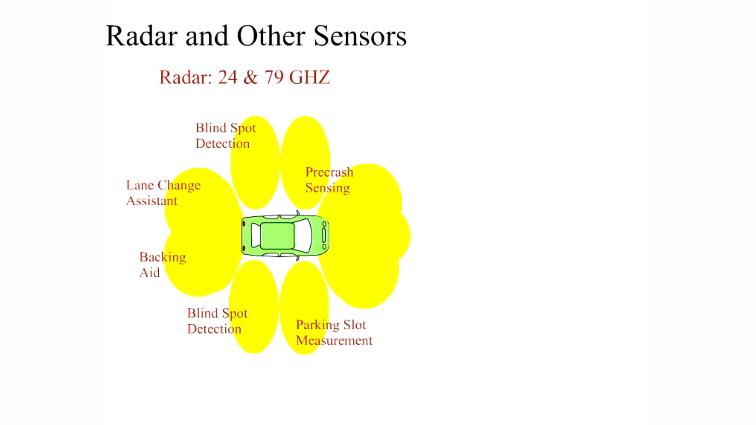
Animation:
Radar and Other Sensors
(The animation will automatically start in a few seconds)

Slide 37
Driver Assist Diagnosis
VIN Decoder
  To identify what A D A S a vehicle is equipped with, use the vehicle identification number (V I N), or the regular production order (R P O) code (G M vehicles).
Diagnostic Steps
  The steps are similar to troubleshooting any other system or fault.

Slide 38
Camera and Radar Sensor Calibration (1 of 3)
Camera Calibration
  Calibration of the camera is required when one or more cameras are replaced or a mounting component, such as a windshield, bumper cover, mirror, or door.
  The calibration is an in-shop, static process.

Slide 39
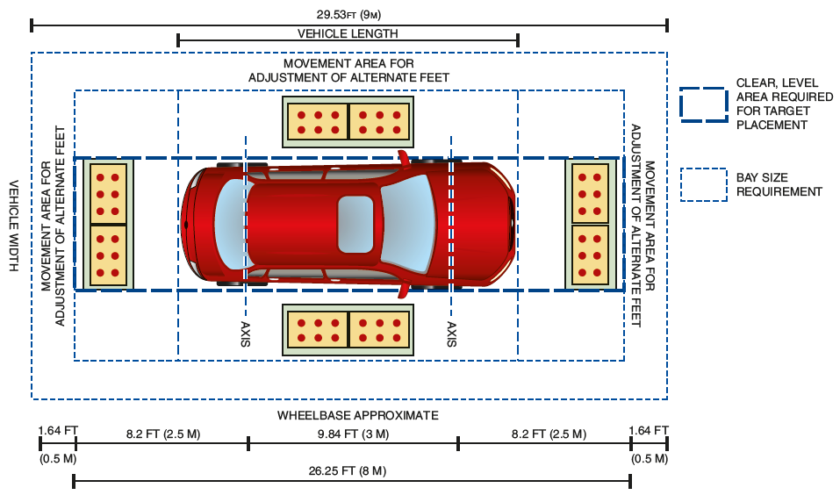
Figure 18.17
A typical camera calibration shop requirement to be used to calibrate the cameras on a vehicle equipped with advance driver assist systems. The area around the vehicle must be open and free from objects or windows that could affect the camera calibration.
Notes:
Long Description:
The total length of the area is 29.53 ft (9 m). The length of the back free space is 1.64 ft (0.5 m), and the length between this area and axis line is 8.2 ft (2.5 m). The length of two axis lines comes to 9.84 ft (3 m). The distance between the front axis line and front free space is 8.2 ft (2.5 m). The length of the movement area of alternate feet is 1.64 ft (0.5 m). The total length of area required for target placement is 26.25 ft (8 m). The bay size requirement is traced by dotted lines and the clear, level area required for target placement is traced by the dark dotted lines.

Slide 40
Camera and Radar Sensor Calibration (2 of 3)
Typical Procedure
  Some camera systems require a specific target so that the camera can be calibrated.
  Some vehicles that do not require a special target will often use lines that are taped to the floor around the vehicle to use as a target.
  Some systems also require that the vehicle be driven at slow speeds under specific operating conditions to complete the learning.

Slide 41
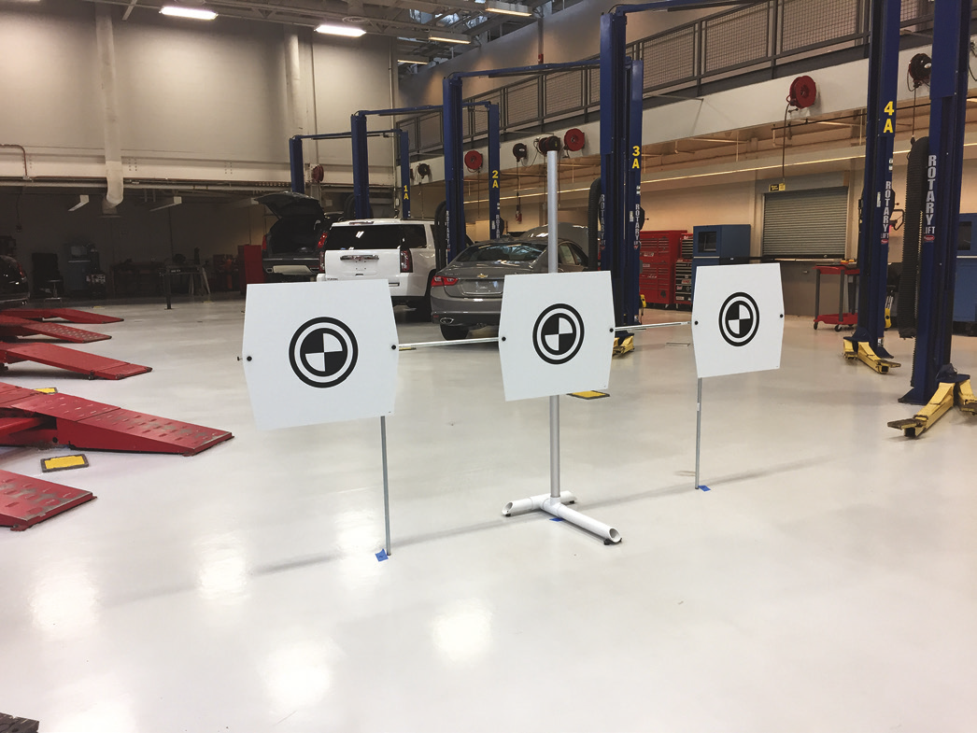
Figure 18.18
A typical target setup required to calibrate the camera on a vehicle equipped with an advanced driver assist system. Always follow the specified calibration procedure for the vehicle being serviced.

Slide 42
Camera and Radar Sensor Calibration (3 of 3)
Radar Calibration
  Calibration of the radar is required anytime the unit is replaced or reinstalled.
  In many cases, the calibration procedure must be performed anytime a grille or fascia is removed or replaced.
  The static process involves the use of a scan tool and an aiming procedure.

Slide 43
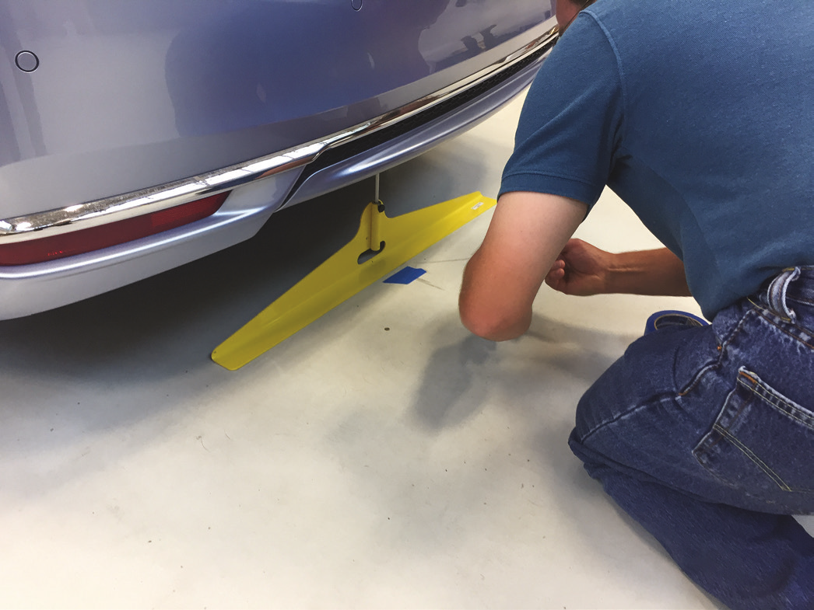
Figure 18.19
Before the radar sensor can be calibrated, the target must be installed at a very precise location at the front of the vehicle. The measurements involved include finding the exact center of the vehicle often using a special tool as shown.

Slide 44
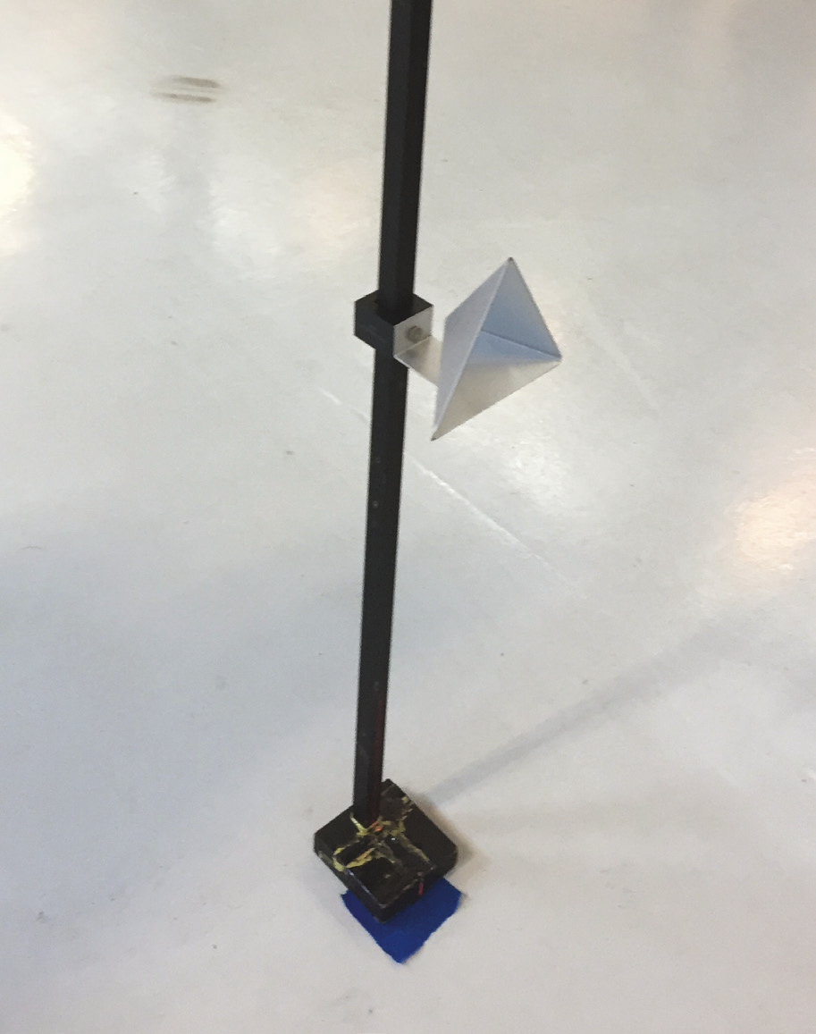
Figure 18.20
A typical radar target being placed in the specified position after careful measurements from the centerline of the vehicle and the exact distance from the front and at the specified height.

Slide 45
Autonomous Vehicle Operation
Definition
  Automotive Engineers (S A E) defines an autonomous vehicle (A V) as a vehicle that uses an automated driving system that monitors the driving environment and makes navigation decisions without driver input.
History
Benefits
Concerns

Slide 46
Levels of Automation
S A E Definitions
  S A E International, who establishes standards for the automotive industry, has created a standard (J3016) that classifies the vehicle capabilities into five levels.

Slide 47
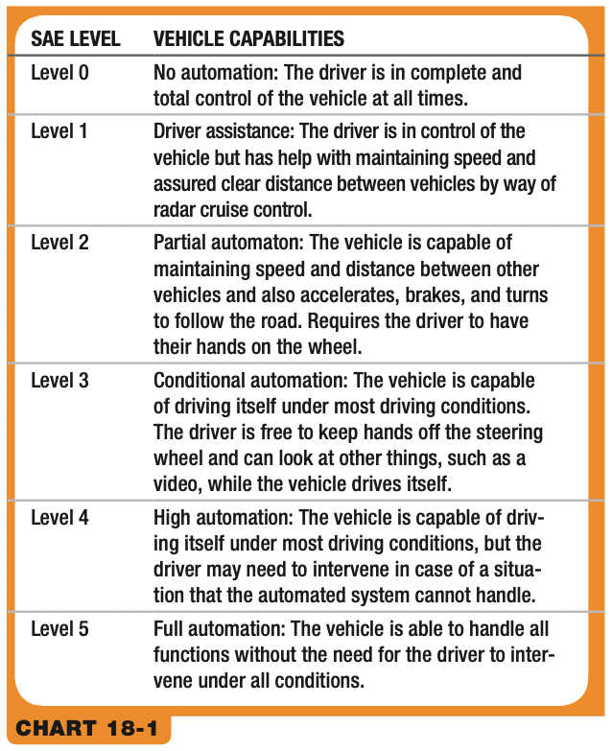
Chart 18.1
The S A E J3016 levels of automated vehicle capabilities.
Notes:
Long Description:
Level 0: No automation: The driver is in complete and
total control of the vehicle at all times.
Level 1: Driver assistance: The driver is in control of the
vehicle but has help with maintaining speed and
assured clear distance between vehicles by way of
radar cruise control.
Level 2: Partial automaton: The vehicle is capable of
maintaining speed and distance between other
vehicles and also accelerates, brakes, and turns
to follow the road. Requires the driver to have
their hands on the wheel.
Level 3: Conditional automation: The vehicle is capable
of driving itself under most driving conditions.
The driver is free to keep hands off the steering
wheel and can look at other things, such as a
video, while the vehicle drives itself.
Level 4: High automation: The vehicle is capable of driving
itself under most driving conditions, but the
driver may need to intervene in case of a situation
that the automated system cannot handle.
Level 5: Full automation: The vehicle is able to handle all
functions without the need for the driver to intervene
under all conditions.

Slide 48
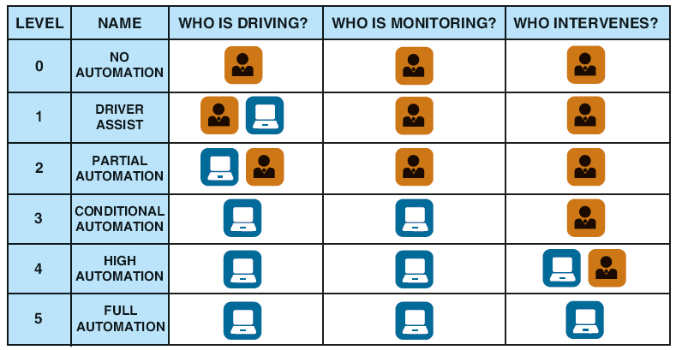
Figure 18.21
A graphic example of who is driving and monitoring the conditions, and who can intervene if a situation requires evasive action.
Notes:
Long Description:
The header columns are: Level, Name/Who is Driving?/Who is Monitoring?/Who Intervenes?
The entries are as follows.
Level 0: No Automation/Driver/Driver/Driver
Level 1: Driver Assist/Driver and System/Driver/Driver
Level 2: Partial Automation/System and Driver/Driver/Driver
Level 3: Conditional Automation/System/System/Driver
Level 4: High Automation/System/System/System and Driver
Level 5: Full Automation/System/System/System

Slide 49
Artificial Intelligence (A I)
The automotive industry is working to develop artificial intelligence (A I) systems for the transportation industry, including automated and autonomous driving systems.
It enables vehicles to understand their environment and to process sensor and camera data.

Slide 50
Dedicated Short-Range Communication (D S R C)
Purpose and Function
  Dedicated short-range communication (D S R C) is used for vehicle-to-vehicle communication, as well as the vehicle to the infrastructure.
Parts and Operation
  D S R C is supported by a network of roadside equipment and onboard equipment.
Diagnosis and Calibration
  Diagnosis of the D S R C systems involves testing hardware, as well as signal strength.

Slide 51
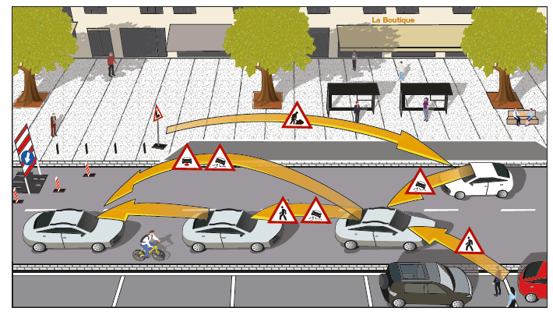
Figure 18.23
Dedicated short-range communication (D S R C) is used for vehicle-to-vehicle communication to help prevent accidents and makes it safer for everyone.

Slide 52
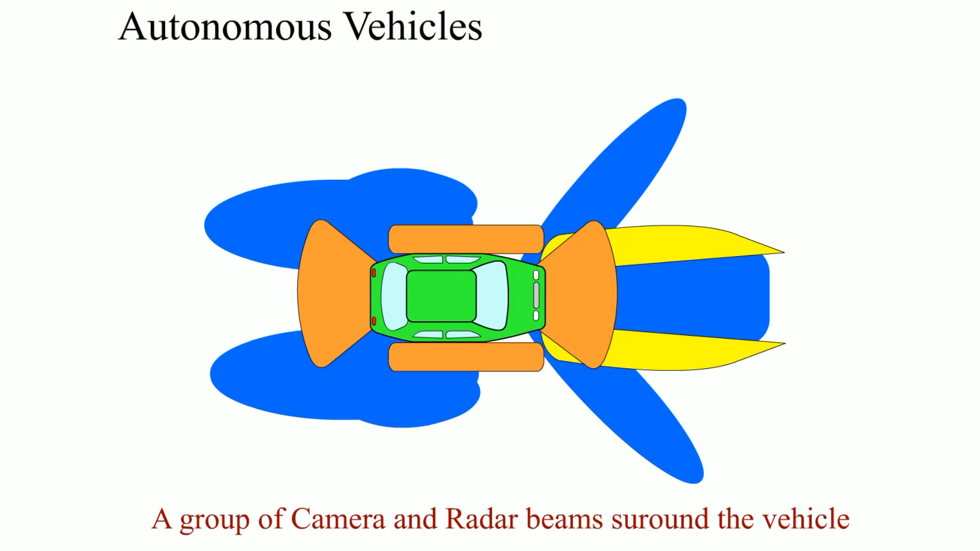
Animation:
Autonomous Vehicles
(The animation will automatically start in a few seconds)

Slide 53
Animation and Video Resources
The below listed resources are hyperlinked to the James Halderman website
(A6) Electrical/Electronic Systems Animations
(L3) Light Duty Hybrid Electric Animations
(A6) Electrical/Electronic Systems Videos
(L3) Light Duty Hybrid Electric Videos

Slide 54

Copyright
This work is protected by United States copyright laws and is provided solely for the use of instructors in teaching their courses and assessing student learning. Dissemination or sale of any part of this work (including on the World Wide Web) will destroy the integrity of the work and is not permitted. The work and materials from it should never be made available to students except by instructors using the accompanying text in their classes. All recipients of this work are expected to abide by these restrictions and to honor the intended pedagogical purposes and the needs of other instructors who rely on these materials.

