Slide 1


Automotive Engines Theory and Servicing
Tenth Edition
Chapter 35
Engine Installation and Break-In
Copyright © 2023 Pearson Education, Inc. All Rights Reserved
Notes:
If this PowerPoint presentation contains mathematical equations, you may need to check that your computer has the following installed:
1) MathType Plugin
2) Math Player (free versions available)
3) NVDA Reader (free versions available)

Slide 2
Learning Objectives
35.1 Discuss the preinstallation checklist.
35.2 Explain the procedure for transmission installation.
35.3 Explain the process of dressing the engine and engine installation.
35.4 Explain engine start and discuss the break-in precautions of an overhauled engine.

Slide 3
Preinstallation Checklist (1 of 4)
  Engine installation must be thoroughly checked to ensure that it is in proper condition to give the customer dependable operation for a long time.
  Using a checklist guarantees that all accessories are correctly reinstalled on the engine.

Slide 4
Preinstallation Checklist (2 of 4)
  Before installing or starting a new or rebuilt engine in a vehicle, be sure all of the following items have been checked.
  Be sure the battery is fully charged.
  Prelube the engine and check for proper oil pressure.
  Check that all electrical wiring connecters and harnesses are properly installed.
  Check that all of the vacuum lines are correctly installed and routed.

Slide 5
Preinstallation Checklist (3 of 4)
  Before installing or starting a new or rebuilt engine in a vehicle, be sure all of the following items have been checked.
  Check that all fuel lines are properly connected and free from leaks.
  Make sure all engine fluids are at the proper operating level such as coolant, engine oil, and power steering fluid.
  Know the ignition timing specification and procedure.

Slide 6
Preinstallation Checklist (4 of 4)
  Before installing or starting a new or rebuilt engine in a vehicle, be sure all of the following items have been checked.
  Check that fresh fuel is in the fuel tank.
  Be sure that the radiator has been tested, is free from leaks, and flows correctly.
  Check that all accessory drive belts are routed and tensioned correctly.

Slide 7
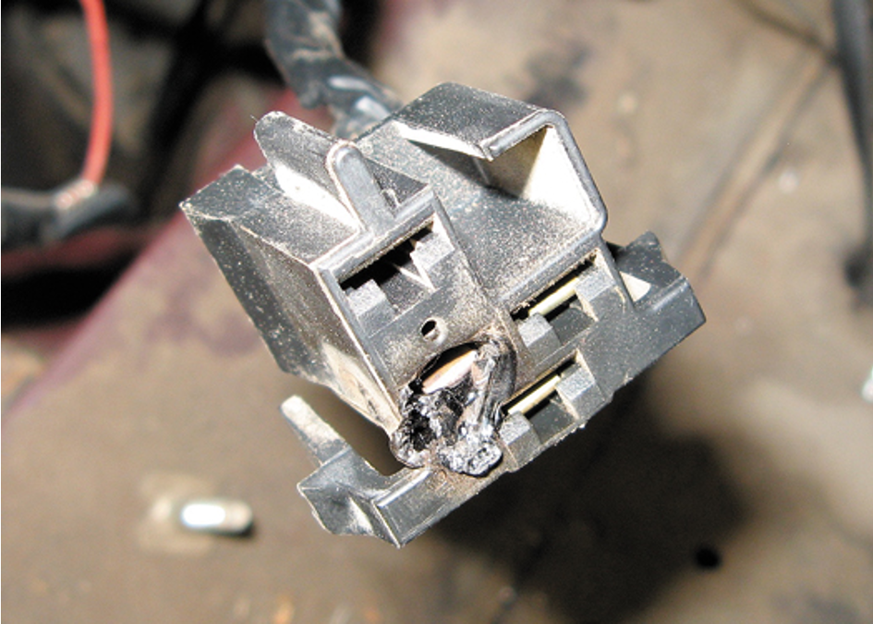
Figure 35.1
A partially melted electrical connector indicates that excessive current flow was present. The cause of the excessive current should be located and corrected before the engine is started.

Slide 8
Manual Transmission Installation
(1 of 2)
STEP 1 A new clutch assembly or, at the least, a new clutch friction disc should be installed.
STEP 2 The clutch friction disc must be held in position using an alignment tool that is secured in the pilot bearing.
STEP 3 The engine bell housing is put on the engine, if it was not installed before. The alignment of this type of bell housing is then checked.
STEP 4 The clutch release yoke should be checked for free movement.

Slide 9
Manual Transmission Installation
(2 of 2)
STEP 5 The transmission is installed by carefully guiding the transmission input (clutch) shaft straight into the clutch disc and pilot bearing.
  Rotate the transmission output shaft as needed to engage the splines of the clutch disc.

Slide 10
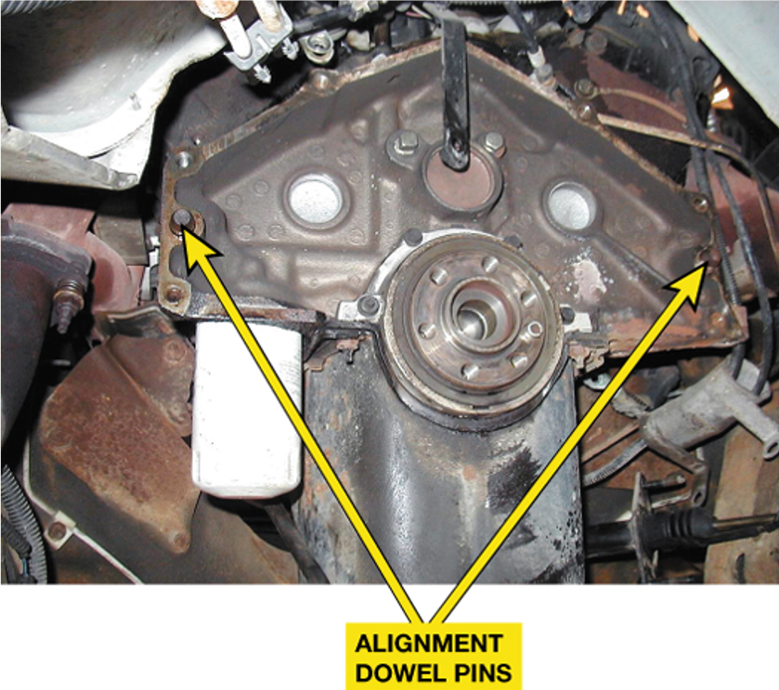
Figure 35.2
Bell housing alignment dowel pins are used to ensure proper alignment between the engine block and the transmission.

Slide 11
Automatic Transmission Installation (1 of 2)
STEP 1 The torque converter should be installed on the transmission before the transmission is put on the engine.
STEP 2 Rotate the torque converter while it is pushed onto the transmission shafts until the splines of all shafts are engaged in the torque converter.
STEP 3 The torque converter is held against the transmission as the transmission is fitted on the back of the engine. The transmission mounting bolts are attached finger tight.

Slide 12
Automatic Transmission Installation (2 of 2)
STEP 4 The torque converter should be rotated to make sure that there is no binding.
  The bell housing is secured to the block and then the torque converter is fastened to the drive plate.

Slide 13
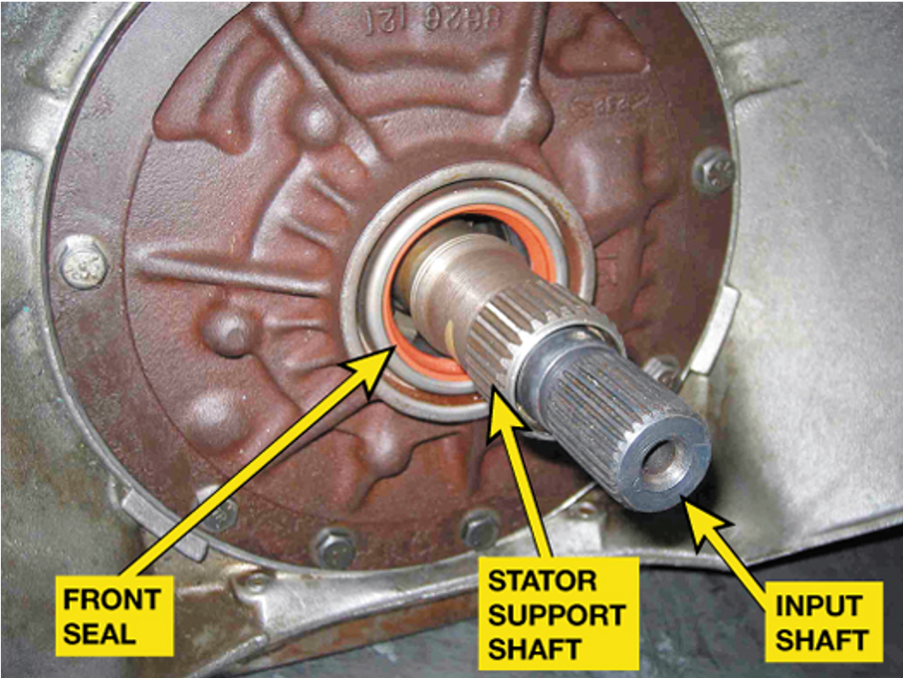
Figure 35.3
The internal splines inside the torque converter must be properly aligned with all of the splines of the automatic transmission.

Slide 14
Dressing the Engine (1 of 2)
  “Dressing the engine” is a term used to describe the process of attaching all of the auxiliary items to the engine. The items include:
  Starter motor
  Fuel rail and related fuel system components
  New oxygen sensor(s), to ensure that the engine will be operating at the correct air-fuel ratio

Slide 15
Dressing the Engine (2 of 2)
  Engine/transmission wiring harness
  Ignition components, such the ignition coil(s) and spark plug wires, if equipped
  All belt-driven engine accessories, mounted on the front of the engine
  Front accessories, such as the power steering pump, alternator, and air-conditioning compressor.

Slide 16
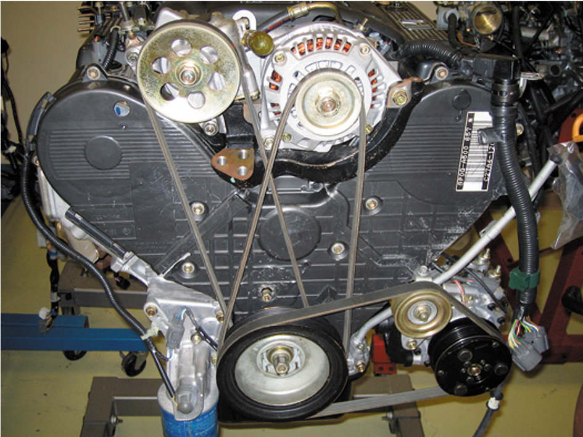
Figure 35.4
It is often easier to install all of the accessory drive belts before the engine is installed in the vehicle.

Slide 17
Engine Installation
  Securing the Engine
  Installing the Engine
  Rear-wheel Drive
  Front-wheel Drive
  Reconnecting Components and Connectors
  Cooling System
  Electrical System

Slide 18
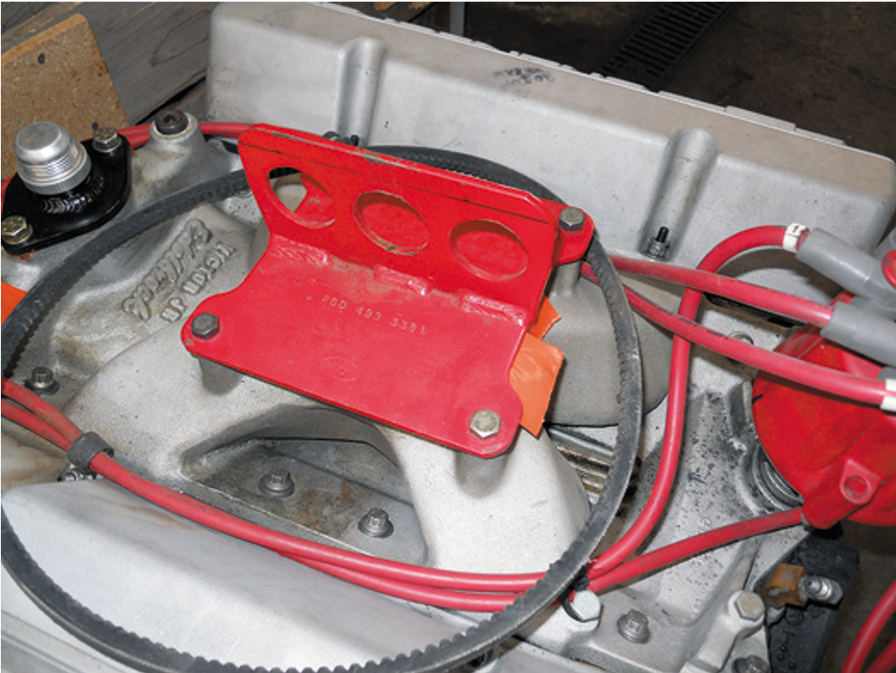
Figure 35.5
A fixture installed that is used as a place to attach the hosting chains.

Slide 19
Engine Start
  Precautions
  Normal Operating Temperature
  How to Warm Up a Cold Engine

Slide 20
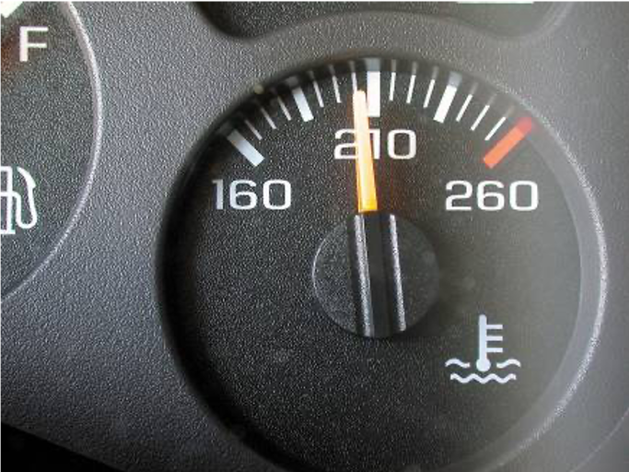
Figure 35.6
Even though the dash gauge may show normal operating temperature, a scan tool or an infrared pyrometer can also be used to verify proper coolant temperature.

Slide 21
Break-In Precautions (1 of 2)
  Any engine overhaul represents many hours of work and a large financial investment.
  Precautions should be taken to protect the investment, including the following:
  Never add cold water to the cooling system while the engine is running.
  Never lug any engine. Lugging means increasing the throttle opening without increasing engine speed.

Slide 22
Break-In Precautions (2 of 2)
  Applying loads to an engine for short periods of time creates higher piston ring pressure against the cylinder walls and assists the breaking-in process by helping to seat the rings.
  Change the oil and filter at 500 miles (800 km) or after 20 hours of operation.
  Check for leaks after the engine has gone through several warm-up and cooling down periods.

Slide 23
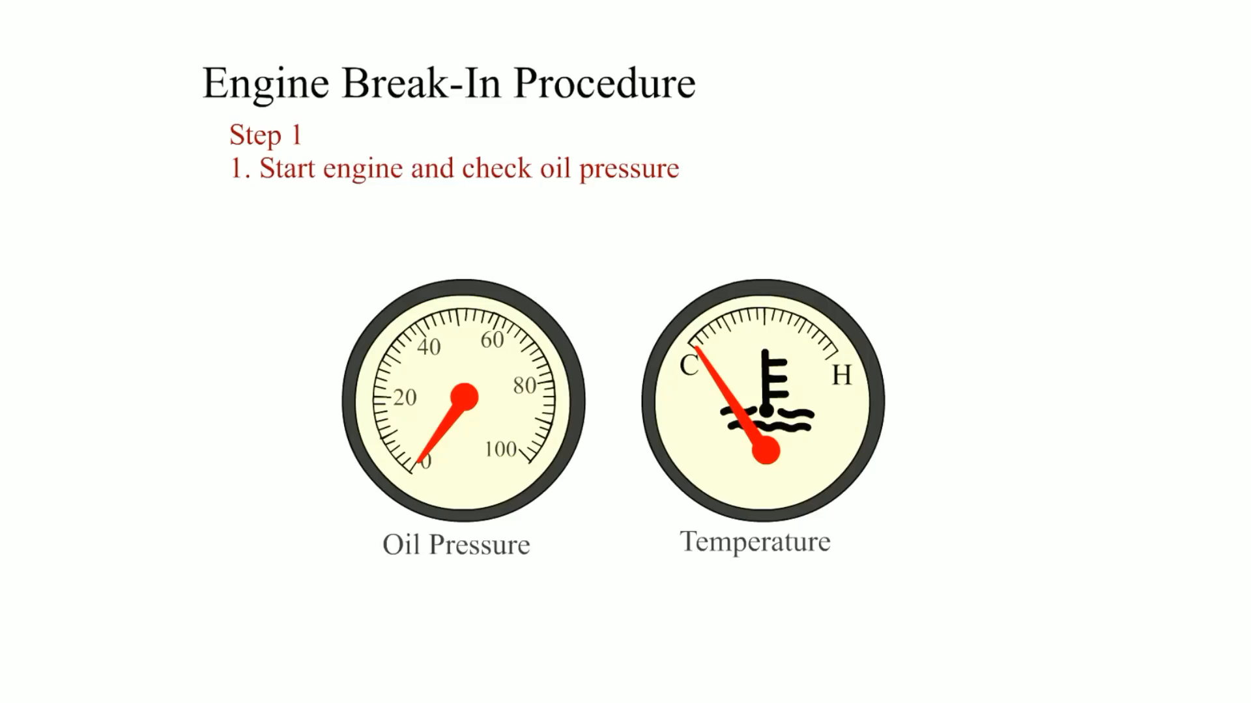
Animation:
Engine Break-In Procedure
(The animation will automatically start in a few seconds)

Slide 24
Summary
Carefully install all accessories.
When installing the transmission and other components on the engine block, be sure to use a torque wrench and tighten all fasteners to factory specifications.
Always adjust the clutch free play before starting the engine.
Change the engine oil after 500 miles (800 km) or sooner, and use the specified engine oil.

Slide 25
Animation and Video Resources
The below listed resources are hyperlinked to the James Halderman website
(A1) Engine Repair Animations
(A1) Engine Repair Videos
(A8) Engine Performance Animations
(A8) Engine Performance Videos

Slide 26

Copyright
This work is protected by United States copyright laws and is provided solely for the use of instructors in teaching their courses and assessing student learning. Dissemination or sale of any part of this work (including on the World Wide Web) will destroy the integrity of the work and is not permitted. The work and materials from it should never be made available to students except by instructors using the accompanying text in their classes. All recipients of this work are expected to abide by these restrictions and to honor the intended pedagogical purposes and the needs of other instructors who rely on these materials.

