Slide 1


Automotive Engines Theory and Servicing
Tenth Edition
Chapter 34
Engine Assembly and Testing
Copyright © 2023 Pearson Education, Inc. All Rights Reserved
Notes:
If this PowerPoint presentation contains mathematical equations, you may need to check that your computer has the following installed:
1) MathType Plugin
2) Math Player (free versions available)
3) NVDA Reader (free versions available)

Slide 2
Learning Objectives (1 of 2)
34.1 Explain short block preparation and cylinder head preparation.
34.2 Discuss trial assembly and final short block assembly.
34.3 Describe camshaft installation and piston/rod installation.

Slide 3
Learning Objectives (2 of 2)
34.4 Explain the cylinder head installation procedure.
34.5 Discuss torque-to-yield head bolts.
34.6 Explain valve train assembly and final assembly of an engine.
34.7 Explain dynamometer testing.

Slide 4
Details, Details, Details
  Read
  Read all instructions that are included with all new parts and gaskets.
  Understand
  Be sure to fully understand everything that is stated in the instructions.
  Follow
  Be sure to follow all of the instructions. Do not pick the easy procedures and skip others.

Slide 5
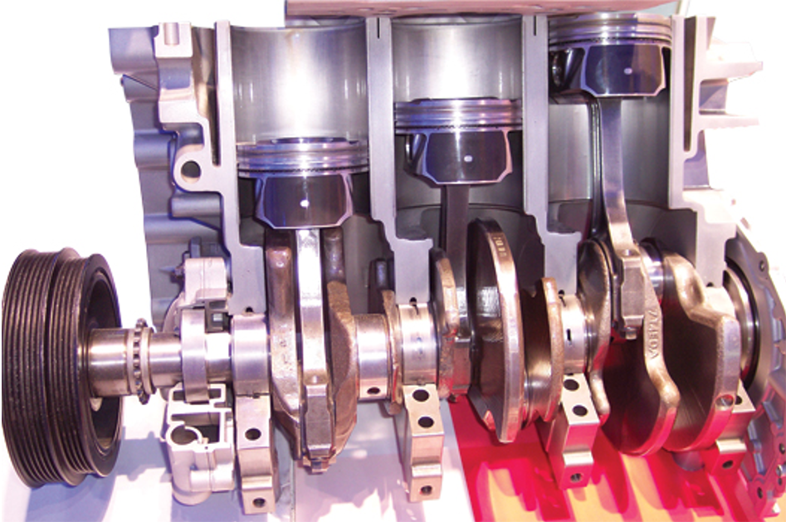
Figure 34.1
A Ford 1.0 liter 3-cylinder engine is different than many small engines and may require detailed service information to be sure that all of the steps are taken for proper assembly.

Slide 6
Short Block Preparation
  Items to Check
  Surface Finish
  Checking Surfaces Before Assembly
  Preparing the Block for Studs
  Preparing Threaded Holes

Slide 7
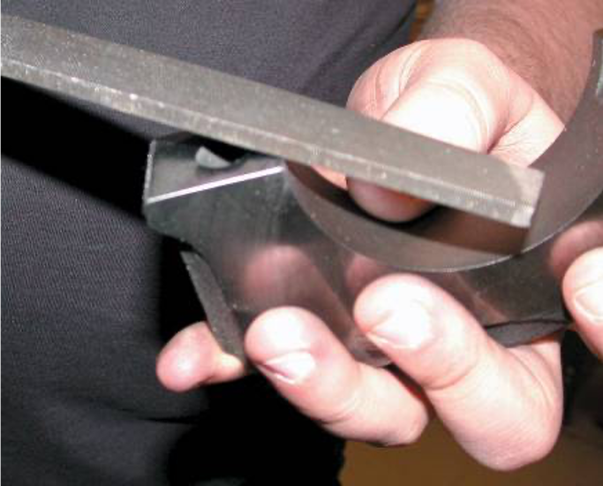
Figure 34.2
Deburring all sharp edges is an important step to achieve proper engine assembly.

Slide 8
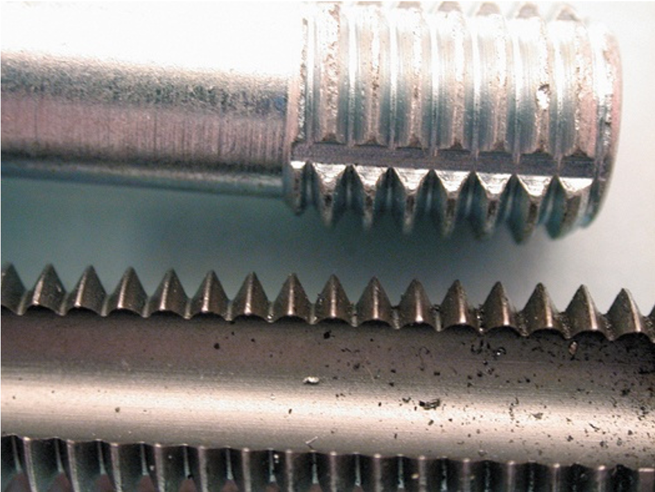
Figure 34.6
A thread chaser (top) is the preferred tool to clean threaded holes because it cleans without removing metal compared to a tap (bottom).

Slide 9
Cylinder Head Preparation
Check the following details on the cylinder head(s).
  The surface finish of the fire deck is as specified for the head gasket type to be used.
  All valves should be checked for leakage by pouring mineral spirits into the intake and exhaust parts and look for leakage past the valves.
  All valve springs should be checked for even spring pressure and installed height.
  Check for proper pushrod length.
  If replacement rocker arms are used, be sure that the geometry and total lift will be okay.

Slide 10
Trial Assembly
  Short Block
  Valve Train
  Check the Angle Between Heads

Slide 11
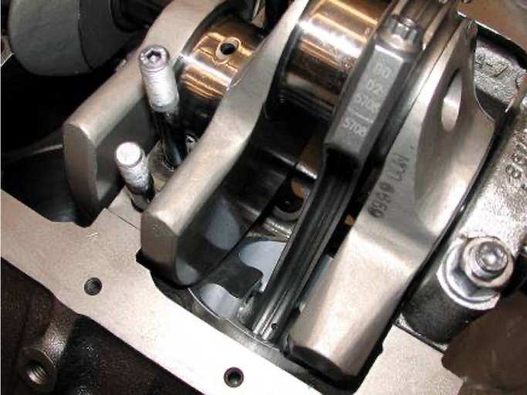
Figure 34.8
A trial assembly showed that some grinding of the block will be needed to provide clearance for the counterweight of the crankshaft. Also, notice that the engine has been equipped with studs for the four-bolt main bearing caps.

Slide 12
Final Short Block Assembly (1 of 2)
  Block Preparation
  Installing Cups and Plugs
  Cam Bearings
  Measuring Main Bearing Clearance
  Correcting Bearing Clearance
  Lip Seal Installation

Slide 13
Final Short Block Assembly (2 of 2)
  Rope Seal Installation
  Crankshaft Installation
  Thrust Bearing Clearance
  Main Bearing Tightening Procedure
  Crankshaft Rotating Torque

Slide 14
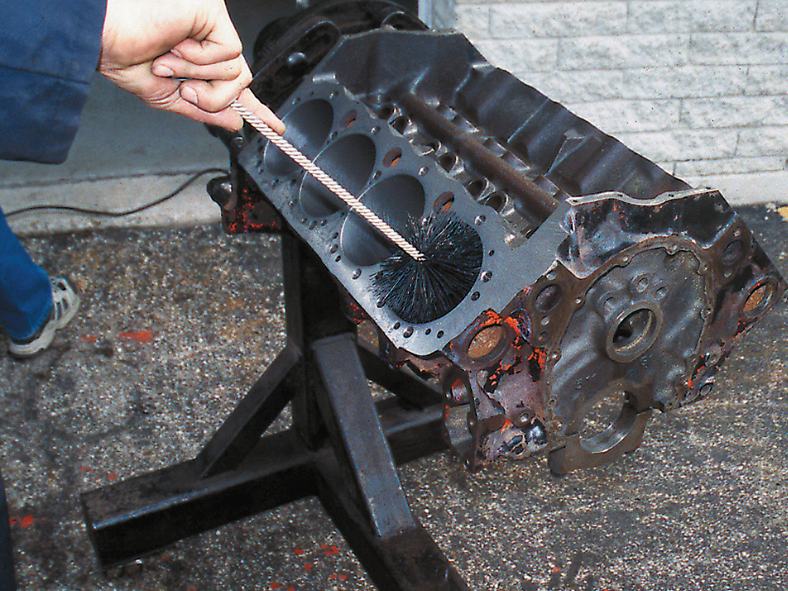
Figure 34.13
The best way to thoroughly clean cylinders is to use soap (detergent), water, and a large washing brush. This method floats the machining particles out of the block and washes them away.

Slide 15
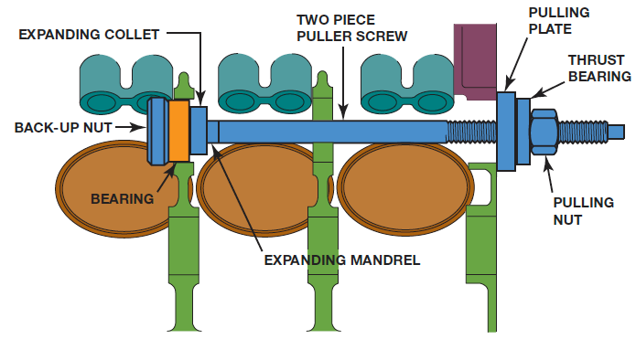
Figure 34.17
A screw-type puller being used to install a new cam bearing.

Slide 16
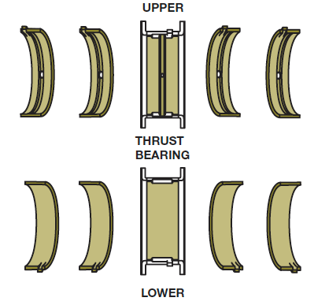
Figure 34.18
Typical main bearing set. Note that the upper halves are grooved for better oil flow and the lower halves are plain for better load support.

Slide 17
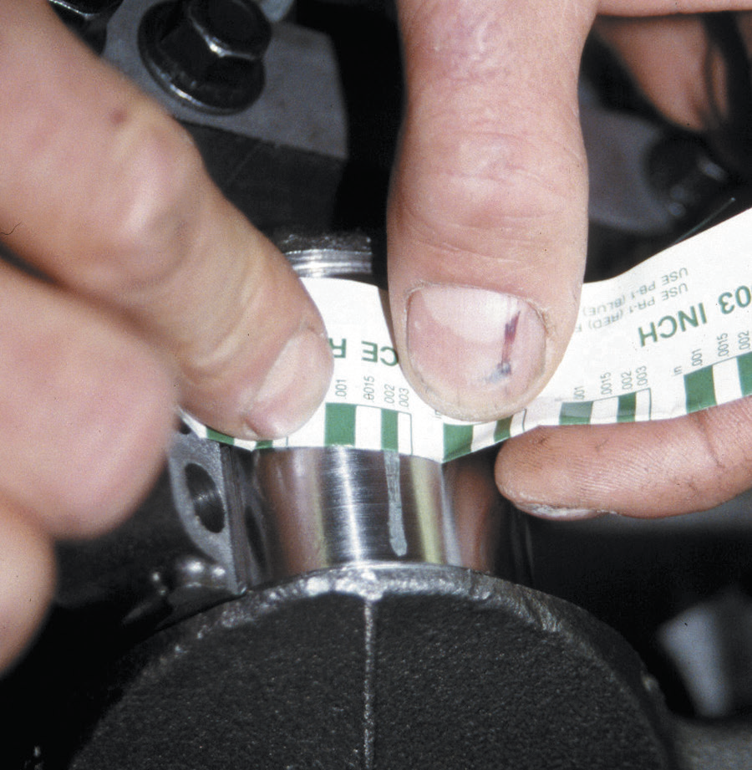
Figure 34.19
The width of the plastic gauging strip determines the oil clearance of the main bearing.

Slide 18
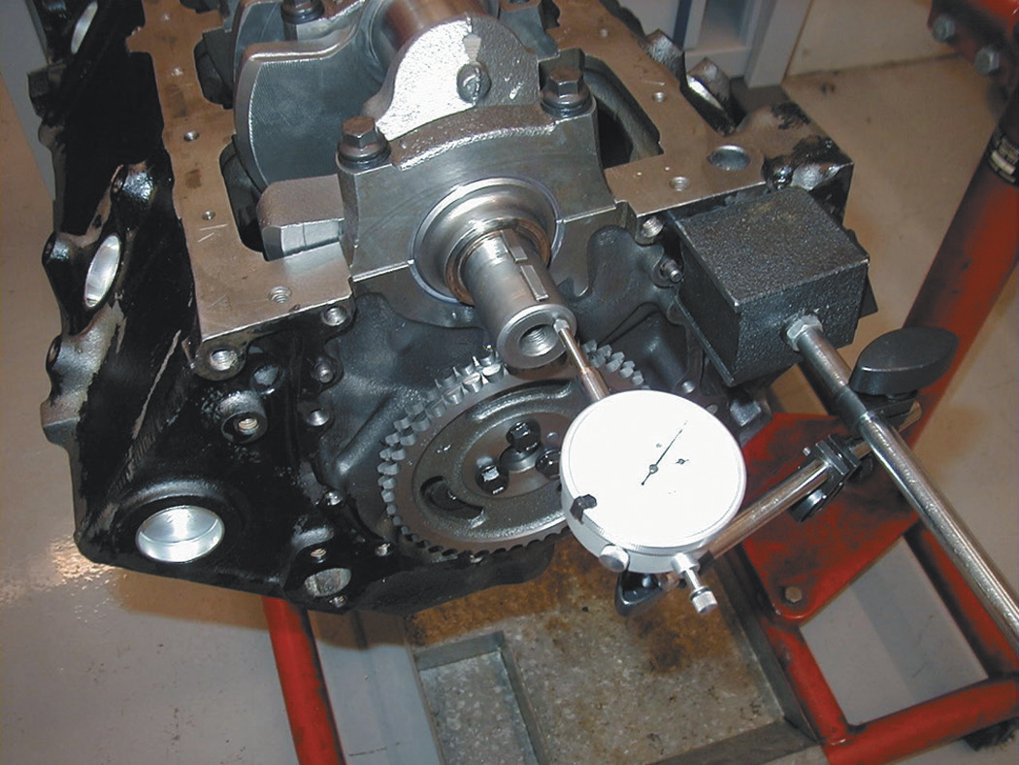
Figure 34.24
A dial indicator is being used to check the crankshaft end play, known as thrust bearing clearance. Always follow the manufacturer’s recommended testing procedures.

Slide 19
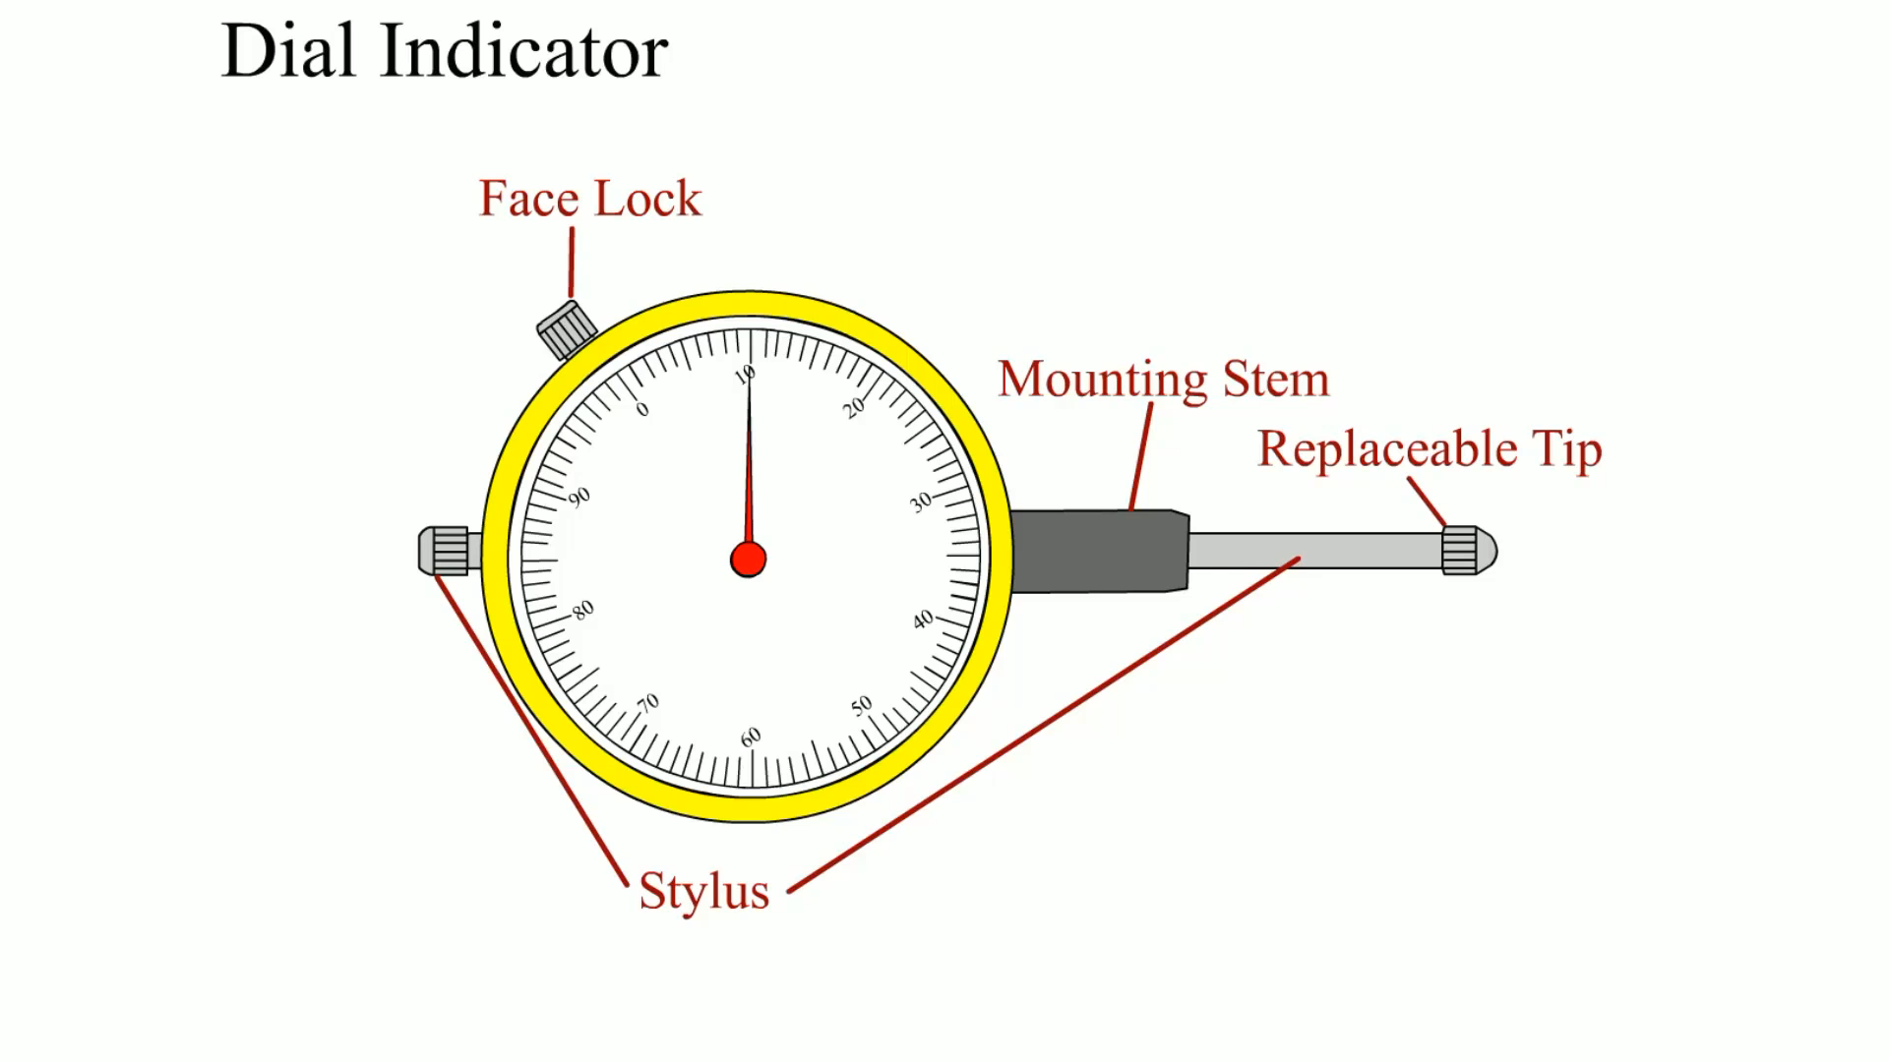
Animation:
Dial Indicator
(The animation will automatically start in a few seconds)

Slide 20
Installing the Camshaft
  Prelubrication
  Camshaft Precautions
  New valve lifters
  Reuse camshaft if possible
  Never use:
    A hydraulic lifter camshaft with solid lifters
    O R hydraulic lifters with a solid lifter camshaft.

Slide 21
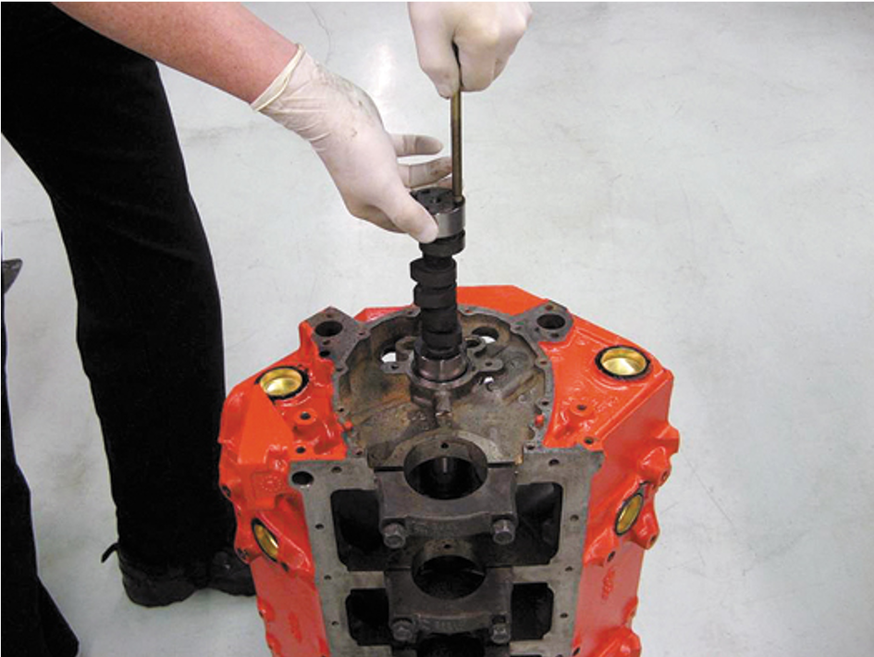
Figure 34.26
Installing a camshaft is easier if the engine is vertical so gravity can help, and this method reduces the possibility of damaging the cam bearings.

Slide 22
Piston/Rod Installation
  Checking Piston Rings
  Piston Markings
  Connecting Rod Bearing Clearance
  Piston Installation
  Connecting Rod Side Clearance

Slide 23
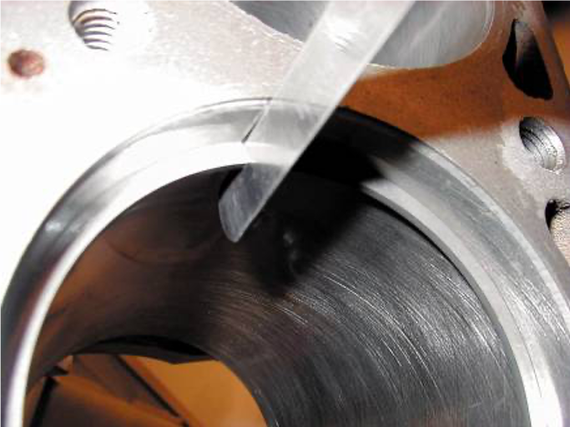
Figure 34.28
A feeler gauge is used to check piston ring gap.

Slide 24
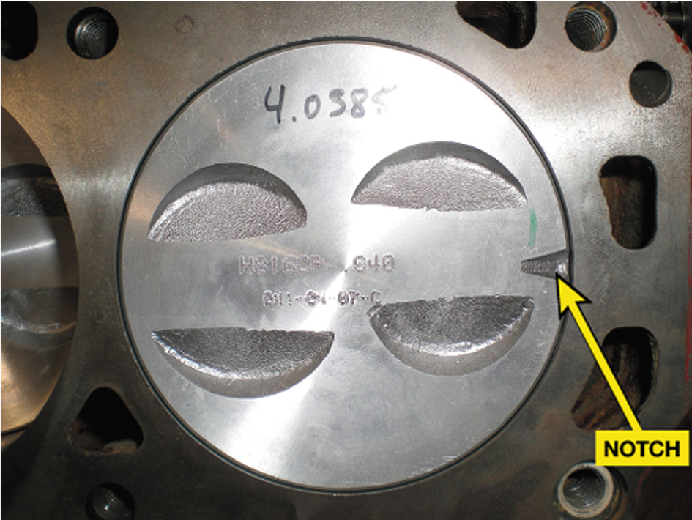
Figure 34.29
The notch on a piston should always face toward the front of the engine.

Slide 25
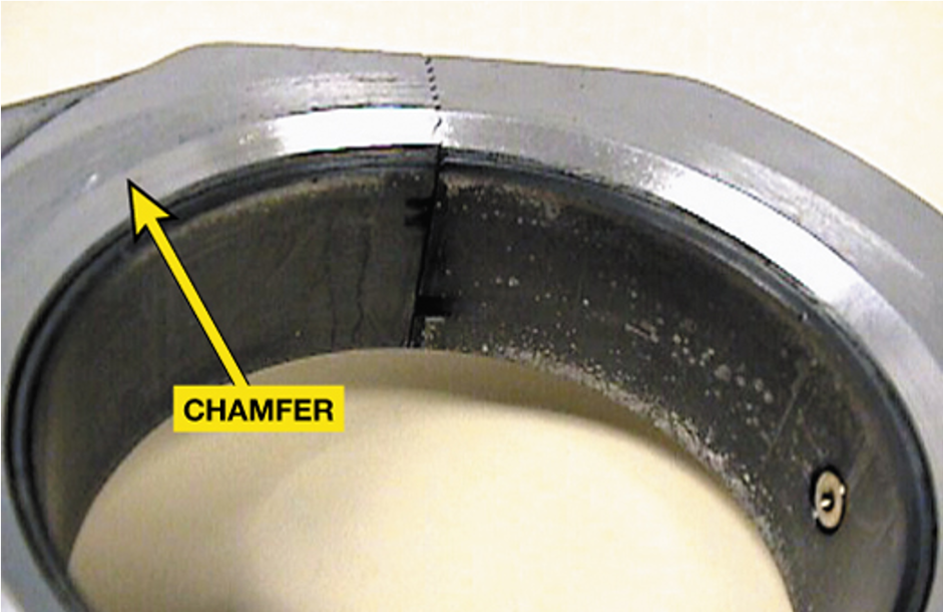
Figure 34.30
On V-type engines that use paired rod journals, the side of the rod with the large chamfer should face toward the crank throw (outward).

Slide 26
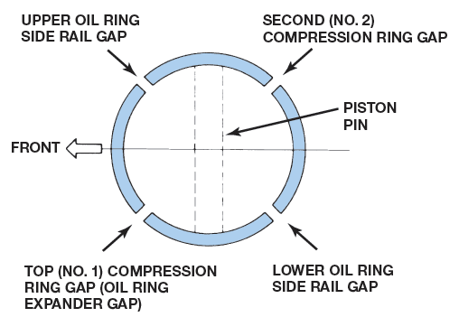
Figure 34.32
One method of piston ring installation showing the location of ring gaps. Always follow the manufacturer’s recommended method for the location of ring gaps and for ring gap spacing.
Notes:
Long Description:
The piston ring shows an upper oil ring side rail gap at the top left, a lower oil ring side rail gap at the bottom right, top (number 1) compression ring gap or oil ring expander gap at the bottom left, and second (number 2) compression ring gap at the top right.

Slide 27
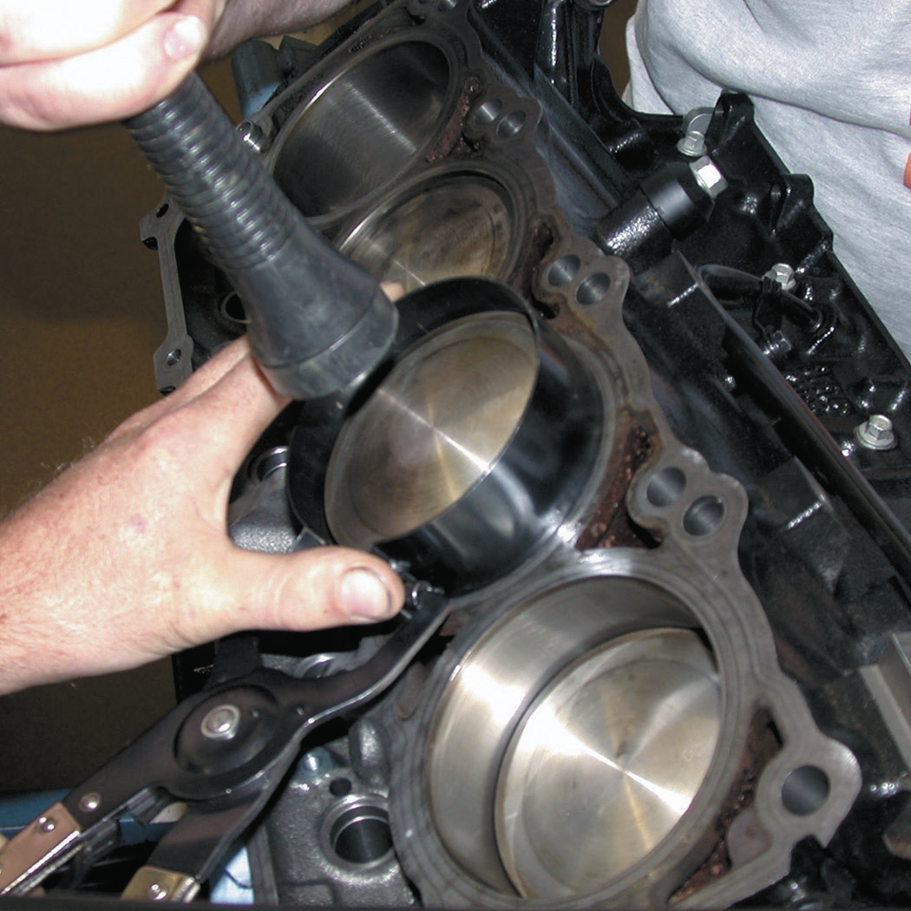
Figure 34.37
Installing a piston using a ring compressor to hold the rings into the ring grooves of the piston and then using a hammer handle to drive the piston into the bore.

Slide 28
Cylinder Head Installation
  Installing the Camshaft for O H C Engines
  Head Bolt Torque Sequence
  Clamping Force
  Fastener Consideration
  Thread Lubricant

Slide 29
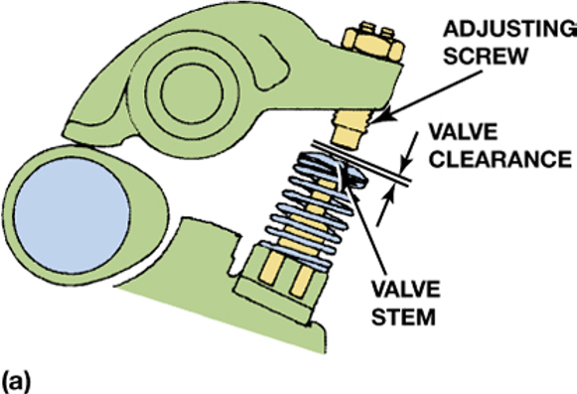
Figure 34.39a
Valve clearance allows the metal parts to expand and maintain proper operation, both when the engine is cold and at normal operating temperature. (a) Adjustment is achieved by turning the adjusting screw.

Slide 30
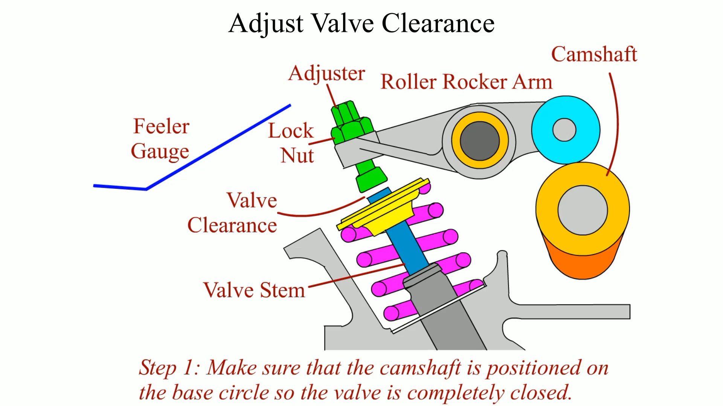
Animation:
Adjust Valve Clearance
(The animation will automatically start in a few seconds)

Slide 31
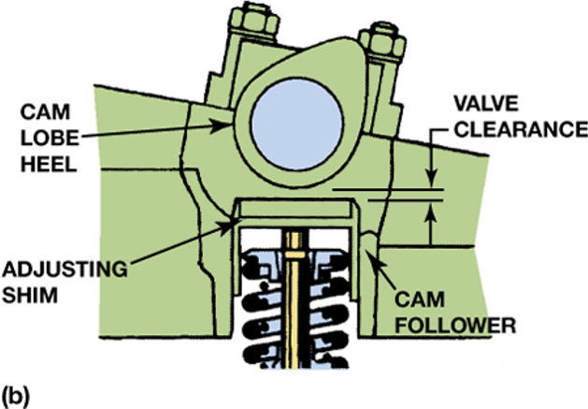
Figure 34.39b
(b) Adjustment is achieved by changing the thickness of the adjusting shim.

Slide 32
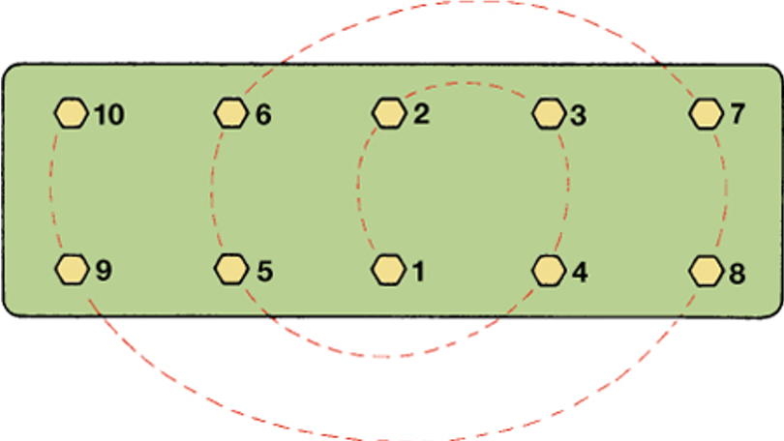
Figure 34.41
Typical cylinder head tightening sequence.
Notes:
Long Description:
The heads on the first row are labeled, "10, 6, 2, 3, and 7" from left to right. The heads on the second row are labeled, "9, 5, 1, 4, and 8" from left to right. The sequence of tightening is from 1 to 10, in increments of 1.

Slide 33
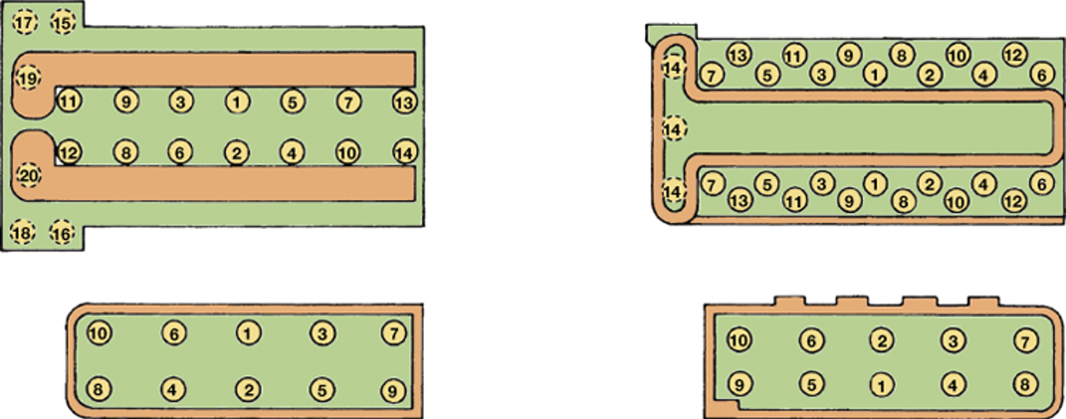
Figure 34.42
Examples of cylinder head bolt torque sequences.
Notes:
Long Description:
The first sequence shows six rows.
Row 1: 17 and 15.
Row 2: 19.
Row 3: Blank, 11, 9, 3, 1, 5, 7, and 13.
Row 4: Blank, 12, 8, 6, 2, 4, 10, and 14.
Row 5: 20.
Row 6: 18 and 16.
The second and fifth rows are shaded separately.
The second sequence has three rows, where the first and the third rows are in zigzag shape.
Row 1: 14, 7, 13, 6, 11, 3, 9, 1, 8, 2, 10, 4, 12, and 6.
Row 2: 14.
Row 3: 14, 7, 13, 5, 11, 3, 9, 1, 8, 2, 10, 4, 12, and 6.
The first heads of each row are grouped together.
The third sequence has two rows.
Row 1: 10, 6, 1, 3, and 7.
Row 2: 8, 4, 2, 5, and 9.
The fourth sequence has two rows.
Row 1: 10, 6, 2, 3, and 7.
Row 2: 9, 5, 1, 4, and 8.

Slide 34
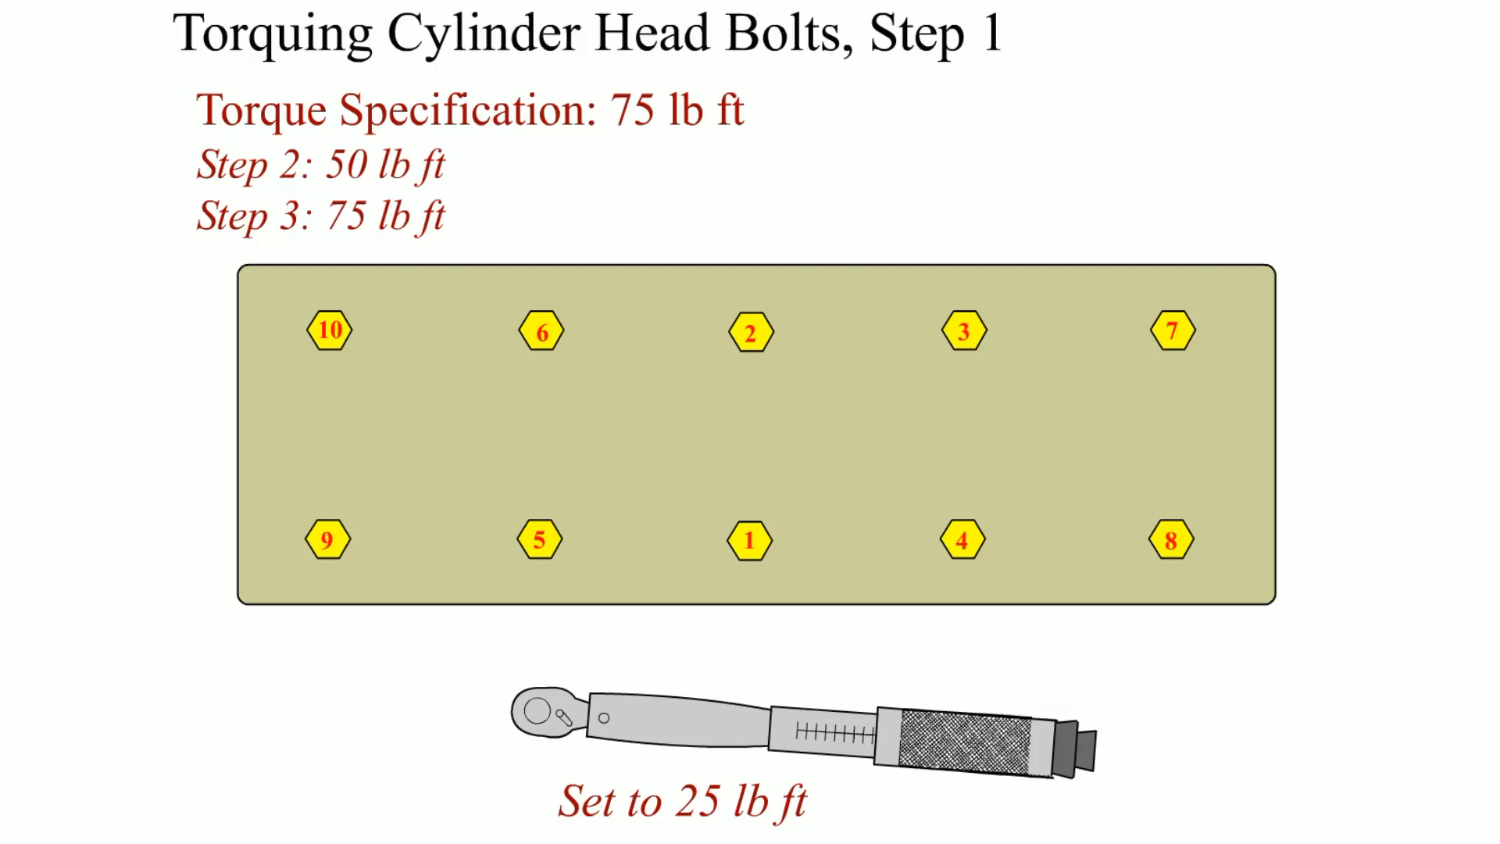
Animation:
Torquing Cylinder Head Bolts, Step 1
(The animation will automatically start in a few seconds)

Slide 35

Animation:
Torquing Cylinder Head Bolts, Step 2
(The animation will automatically start in a few seconds)

Slide 36

Animation:
Torquing Cylinder Head Bolts, Step 3
(The animation will automatically start in a few seconds)

Slide 37
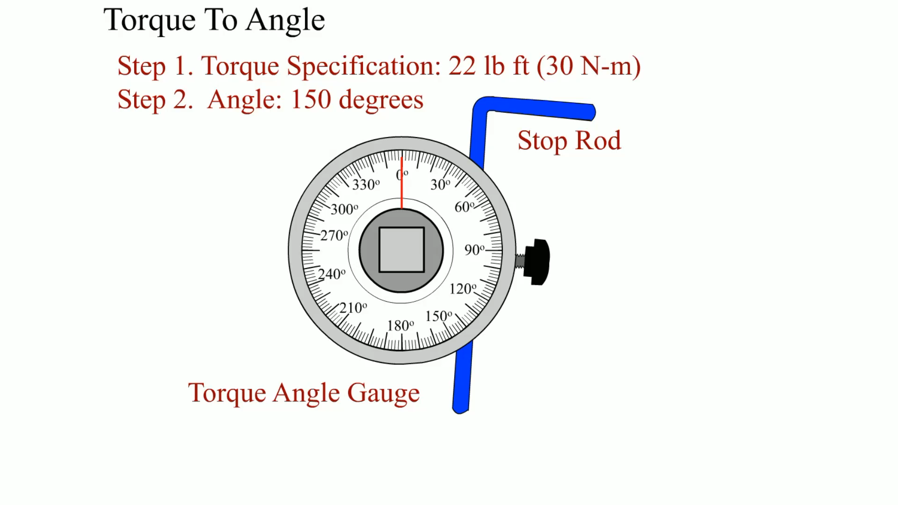
Animation:
Torque To Angle
(The animation will automatically start in a few seconds)

Slide 38
Torque-to-Yield Head Bolts
  Definition and Terminology
  Bolt Construction
  Torque-to-yield Procedure
  Torque Angle Method
  The first step is to torque the bolts by an even amount called the initial torque.
  Final clamping load is achieved by turning the bolt a specified number of degrees.
  Bolt stretch provides the proper clamping force.

Slide 39
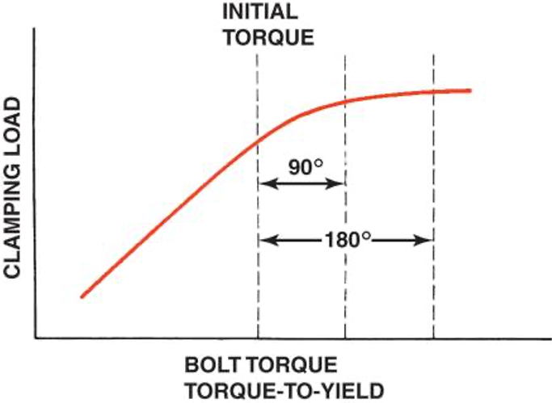
Figure 34.44
Due to variations in clamping force with turning force (torque) of head bolts, some engines are specifying the torque-to-yield procedure.
Notes:
Long Description:
The vertical axis is labeled "Bolt torque, torque to yield" and the vertical axis is labeled "Clamping load." Three vertical dashed lines are drawn intersecting the curve. The first line from the left is labeled initial torque and the horizontal distance with the second line is 90 degrees. The horizontal distance between the first and the third line is 180 degrees.

Slide 40
Valve Train Assembly
  Timing Drives for O H C Engines
  Hydraulic Valve Lifter Installation
  Bleeding Hydraulic Lifters
  Timing Chains and Gears Installation
  O H V Engine Lifter and Pushrod Installation
  Hydraulic Lifter Adjustment
  Solid Lifter Adjustment

Slide 41
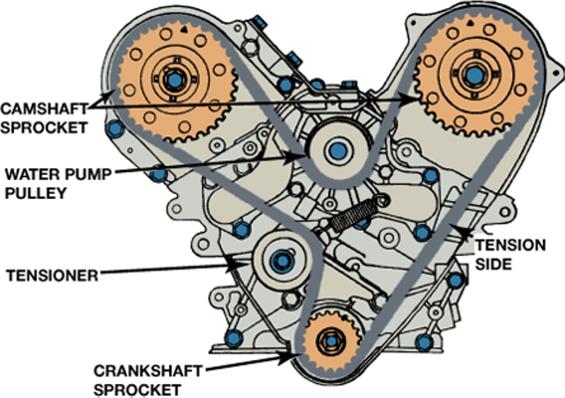
Figure 34.48
Both camshafts have to be timed on this engine and the timing belt also drives the water pump.

Slide 42
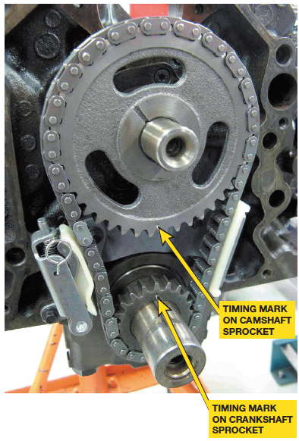
Figure 34.51
Timing chain and gears can be installed after the crankshaft and camshaft have been installed and the timing
marks are aligned with cylinder 1 at top dead center (T D C).

Slide 43
Final Assembly (1 of 2)
  Manifold Installation
  Timing Cover Installation
  Vibration Damper Installation
  Oil Pump Installation
  Oil Pan Installation

Slide 44
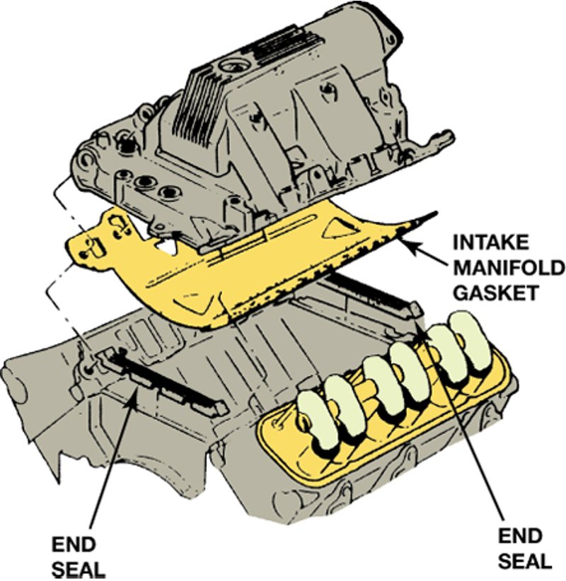
Figure 34.54
This intake manifold gasket includes end seals and a full shield cover for the valley to keep hot engine oil from heating the intake manifold.

Slide 45
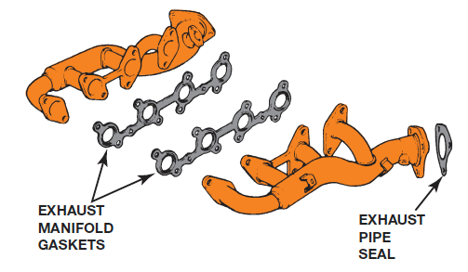
Figure 34.55
An exhaust manifold gasket is used on some engines. It seals the exhaust manifold to the cylinder head.

Slide 46
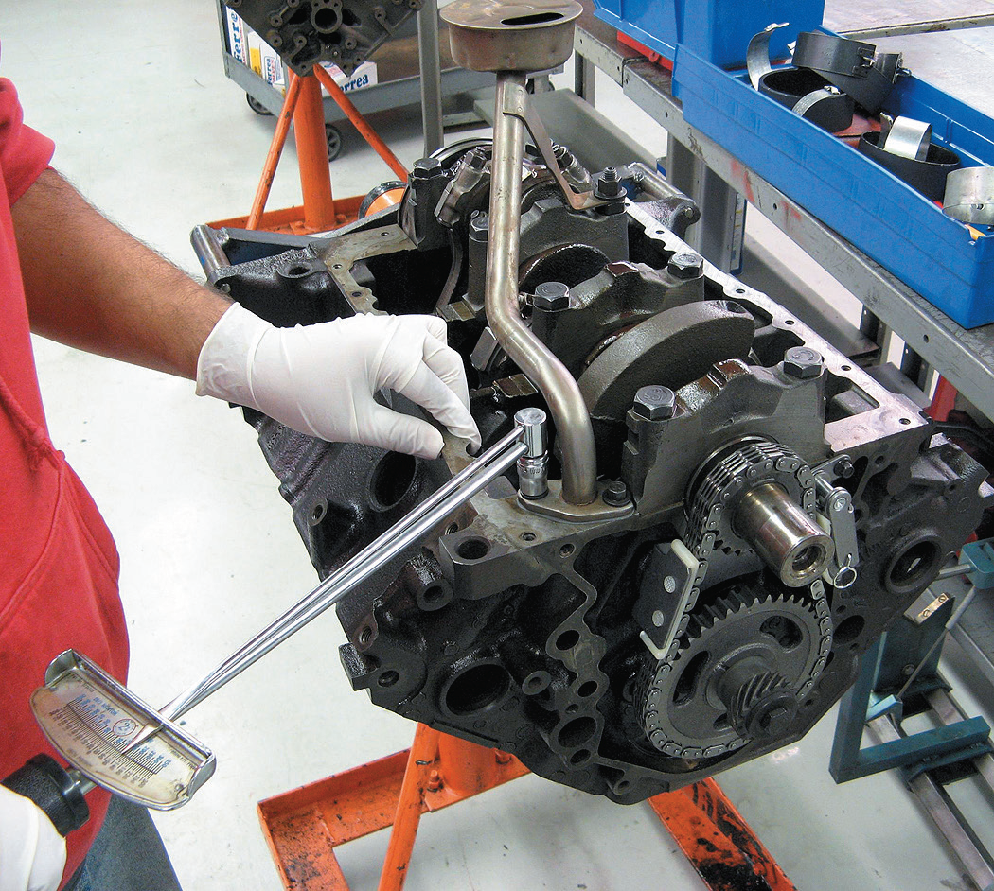
Figure 34.57
A beam-type torque wrench being used to tighten the oil pump pickup assembly to factory specification.

Slide 47
Final Assembly (2 of 2)
  Water Pump Installation
  Engine Painting
  Prelubricating the Engine
  Setting Ignition Timing

Slide 48
Dynamometer Testing
  Purposes
  Types of Dynamometers
  Terminology
  Measured Values
  Calculated Numbers
  Standards
  Final Notes

Slide 49
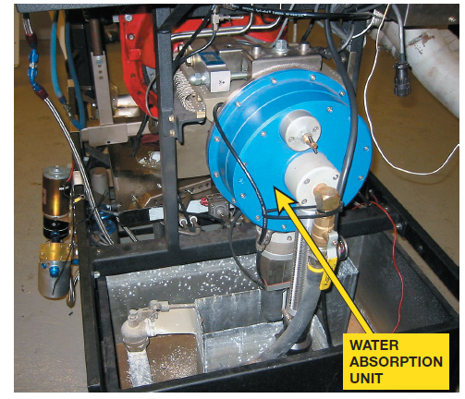
Figure 34.63
A dynamometer measures engine torque by applying a resistive force to the engine and measuring the force applied. Water is being used as the resistive load on this
dynamometer.

Slide 50
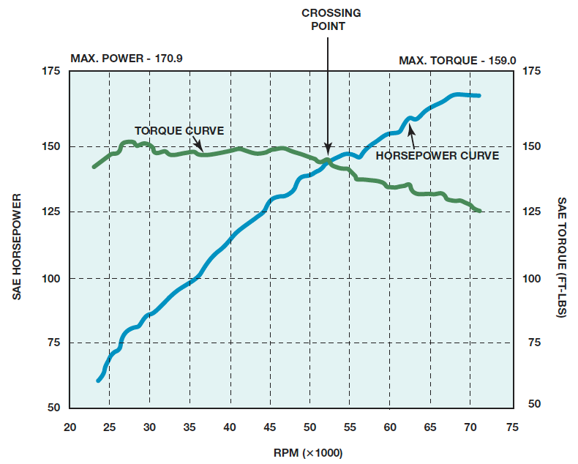
Figure 34.66
Because horsepower is calculated from measured torque, the horsepower and torque curves should always cross at exactly 5252 R P M.
Notes:
Long Description:
The horizontal axis is labeled R P M of 1000 times and it ranges from 20 to 75, in increments of 5. The left vertical axis is labeled S A E horsepower and the right vertical axis is labeled S A E torque in F T dash L B S. Both range from 50 to 175 in increments of 25. The first increasing curve with increasing and decreasing steepness is labeled "Horsepower curve" and it starts near the ordered pair 18 comma 60 and ends near the ordered pair 70 comma 170. The second decreasing curve with increasing and decreasing steepness is labeled "Torque curve" and it starts near the ordered pair 18 comma 140 and ends near the ordered pair 72 comma 125. Both the curves intersect near the ordered pair 52 comma 155. The maximum power is 170.9 and the maximum torque is 159.0. All data are approximate.

Slide 51

Animation:
Math Formula: Horsepower
(The animation will automatically start in a few seconds)

Slide 52
Summary (1 of 3)
Before assembling an engine, the technician should read, understand, and follow all instructions that came with the parts and gaskets to ensure proper assembly.
Assembling the short block includes preparing the block and installing the crankshaft and the piston/rod assemblies.
Cylinder head assembly includes checking valve spring tension as well as proper rocker arm and pushrod measurements.

Slide 53
Summary (2 of 3)
A trial assembly should be performed before the final assembly.
All bearing oil clearances should be checked using a micrometer and telescoping gauges or Plastigage.
Piston ring end gap should be checked before the pistons are installed.
Cylinder head bolts should be properly tightened and in the specified sequence.

Slide 54
Summary (3 of 3)
Timing chain or belt and all covers are installed using the specified gaskets or sealers.
Testing an engine on a dynamometer allows the engine to be tested before being installed in a vehicle.

Slide 55
Animation and Video Resources
The below listed resources are hyperlinked to the James Halderman website
(A1) Engine Repair Animations
(A1) Engine Repair Videos
(A8) Engine Performance Animations
(A8) Engine Performance Videos

Slide 56

Copyright
This work is protected by United States copyright laws and is provided solely for the use of instructors in teaching their courses and assessing student learning. Dissemination or sale of any part of this work (including on the World Wide Web) will destroy the integrity of the work and is not permitted. The work and materials from it should never be made available to students except by instructors using the accompanying text in their classes. All recipients of this work are expected to abide by these restrictions and to honor the intended pedagogical purposes and the needs of other instructors who rely on these materials.

