Slide 1
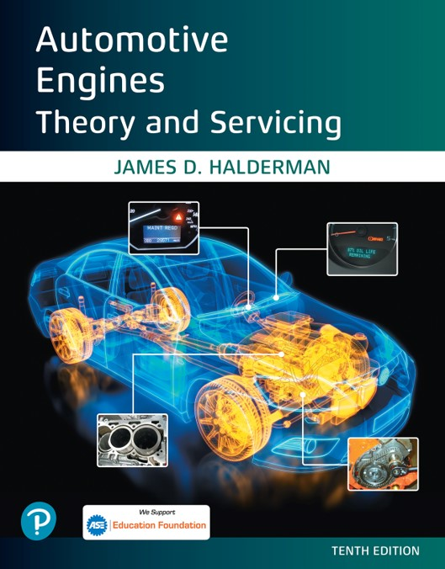

Automotive Engines Theory and Servicing
Tenth Edition
Chapter 31
Crankshafts, Balance Shafts, and Bearings
Copyright © 2023 Pearson Education, Inc. All Rights Reserved
Notes:
If this PowerPoint presentation contains mathematical equations, you may need to check that your computer has the following installed:
1) MathType Plugin
2) Math Player (free versions available)
3) NVDA Reader (free versions available)

Slide 2
Learning Objectives (1 of 2)
31.1 Explain the purpose of crankshaft, crankshaft construction, and crankshaft oiling holes.
31.2 Discuss the different engine crankshaft types.
31.3 Explain the purpose and function of counterweights.
31.4 Discuss engine balance, and explain externally and internally balanced engines.

Slide 3
Learning Objectives (2 of 2)
31.5 Explain the purpose of balance shafts.
31.6 Discuss crankshaft service.
31.7 Describe engine bearings and discuss the importance of bearing clearance.
31.8 Discuss camshaft bearings.

Slide 4
Crankshaft (1 of 2)
Purpose and Function
  Power from expanding gases in the combustion chamber is delivered to the crankshaft through the piston, piston pin, and connecting rod.
  The crank throw is offset from the crankshaft centerline.

Slide 5
Crankshaft (2 of 2)
The crankshaft includes the following parts:
  Main bearing journals
  Rod bearing journals
  Crankshaft throws
  Counterweights
  Front snout
  Flywheel flange
  Keyways
  Oil passages

Slide 6
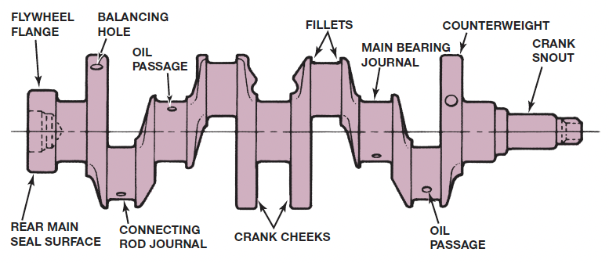
Figure 31.1
Typical crankshaft with main journals that are supported by main bearings in the block. Rod journals are offset from the crankshaft centerline.
Notes:
Long Description:
The crankshaft shows a flywheel flange, a rear main seal surface, a balancing hole, an oil passage, a connecting rod journal, two crank cheeks, two fillets, a main bearing journal, an oil passage, a counterweight, and a crank snot, from left to right, respectively.

Slide 7
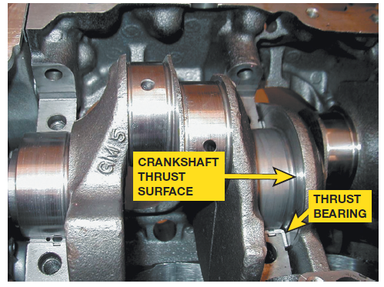
Figure 31.3
A ground surface on one of the crankshaft cheeks next to a main bearing supports thrust loads on the crank.

Slide 8
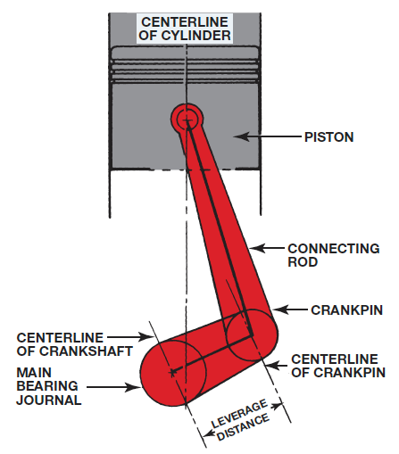
Figure 31.4
The distance from the crankpin centerline to the centerline of the crankshaft determines the stroke, which is the leverage available to turn the crankshaft.

Slide 9
Crankshaft Construction
Forged
Cast Crankshafts
Billet Crankshafts

Slide 10
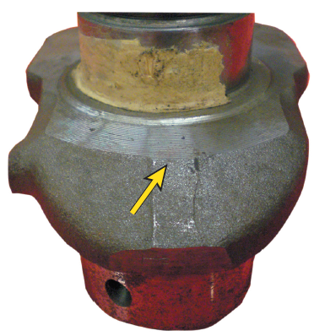
Figure 31.5
Wide separation lines of a forged crankshaft.

Slide 11
Crankshaft Oiling Holes
The crankshaft is drilled to allow oil from the main bearing oil groove to be directed to the connecting rod bearings.
Some of the oil may be sprayed out through a spit or bleed hole in the connecting rod.
Some of the oil that is thrown from the crankshaft bearings will land on the camshaft to lubricate the lobes.
A part of the throw off, oil splashes on the cylinder wall to lubricate the piston and rings.

Slide 12
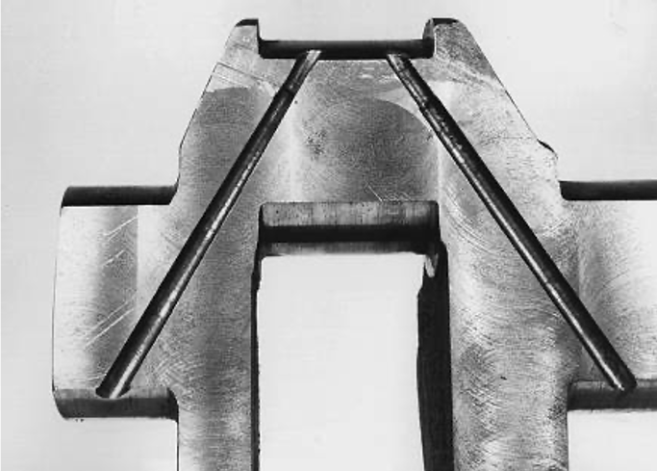
Figure 31.8
Crankshaft sawed in half, showing drilled oil passages between the main and rod bearing journals.

Slide 13
Engine Crankshaft Types
V-8 Engine Arrangement
Four-cylinder Engine Crankshafts
Five-cylinder Engine Crankshafts
Three-cylinder Engine Crankshafts
Inline Six-cylinder Engine Crankshaft
90-degree V-6 Engine Crankshafts
60-degree V-6 Engine Crankshafts

Slide 14
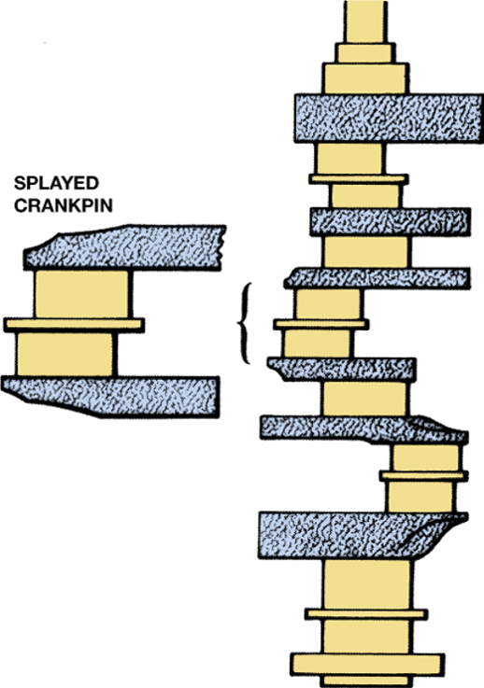
Figure 31.11
A splayed crankshaft design is used to create an even-firing 90 degree V-6.

Slide 15
Counterweights
Crankshafts are balanced by counterweights, which are cast, forged, or machined as part of the crankshaft.
A crankshaft that has counterweights on both sides of each connecting rod journal is called fully counterweighted.
Harmful crankshaft twisting vibrations are dampened with a torsional vibration damper.

Slide 16
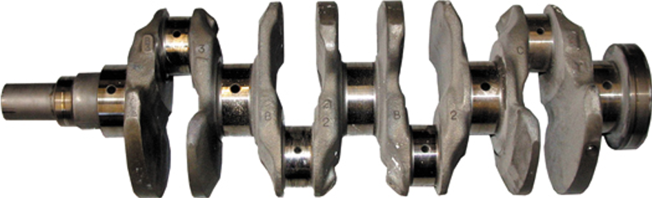
Figure 31.12
A fully counterweighted 4-cylinder crankshaft.

Slide 17
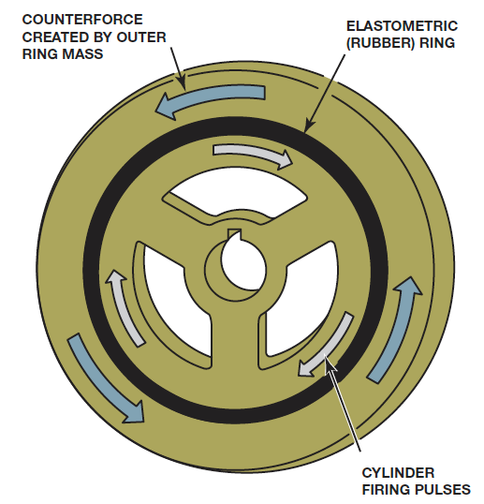
Figure 31.15
The hub of the harmonic balancer is attached to the front of the crankshaft. The elastomer (rubber) between the inertia ring and the center hub allows the absorption of crankshaft firing impulses.

Slide 18
Externally and Internally Balanced Engines
Most crankshaft balancing is done during manufacture.
Holes are drilled in the counterweight to lighten and improve balance.
Engine manufacturers balance an engine in one of two ways:
  Externally balanced. Weight is added to the harmonic balancer (vibration damper) and flywheel or the flexplate.
  Internally balanced. All rotating parts of the engine are individually balanced, including the harmonic balancer and flywheel (flexplate).

Slide 19
Flat-Plane v s. Cross-Plane Crankshafts (1 of 2)
The cross-plane crankshaft is used in most every production V8 sold in America today.
  A cross-plane crankshaft has four crank journals with two connecting rods per journal arranged at 90-degree intervals.
  Advantages: Smooth, vibration-free performance; distinctive American muscle car exhaust sound
  Disadvantages: Heavier and requires larger crankcase.

Slide 20
Flat-Plane v s. Cross-Plane Crankshafts (2 of 2)
The flat-plane crank is a type of crankshaft for use in internal combustion engines that have a 180-degree angle between crank throws.
  Advantages: Lighter, more compact, more responsive (high-revving), better exhaust scavenging.
  Disadvantages: Prone to vibration, lower torque levels.

Slide 21
Engine Balance
Primary balance. When pistons move up and down in the cylinders, they create a primary vibration, which is a strong low-frequency vibration.
Secondary balance. Four-cylinder engines, however, suffer from a vibration at twice engine speed. This is called a secondary vibration, which is a weak high-frequency vibration.

Slide 22
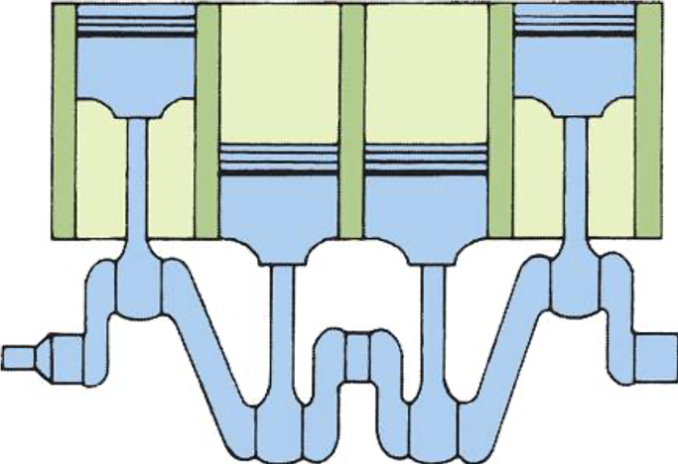
Figure 31.19
In a 4-cylinder engine, the two outside pistons move upward at the same time as the inner pistons move downward, which reduces primary unbalance.

Slide 23
Balance Shafts
Purpose and Function
  Some engines use balance shafts to dampen normal engine vibrations.
  On a four-stroke, 4-cylinder engine two shafts are used, and they turn at twice the engine speed.
Balance Shaft Applications
  Most 4-cylinder engines larger than 2.2 liters use balance shafts.
Both Ford and General Motors added a balance shaft to many of their V-6 engines.

Slide 24
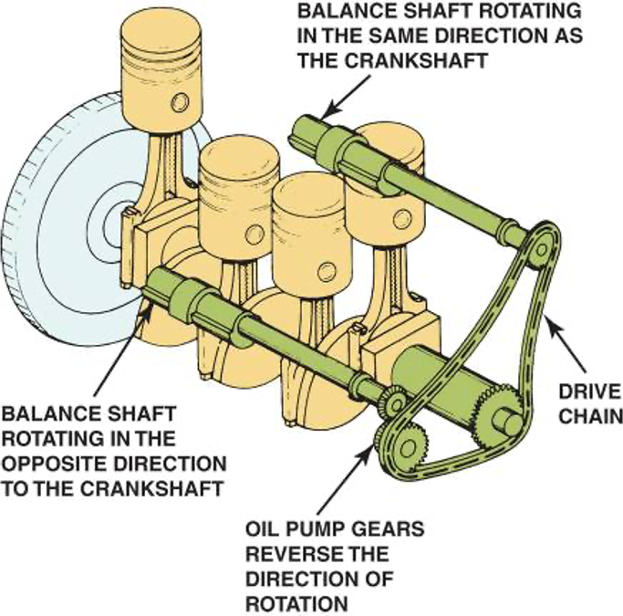
Figure 31.21
Two counter-rotating balance shafts used to counterbalance the vibrations of a 4-cylinder engine.

Slide 25
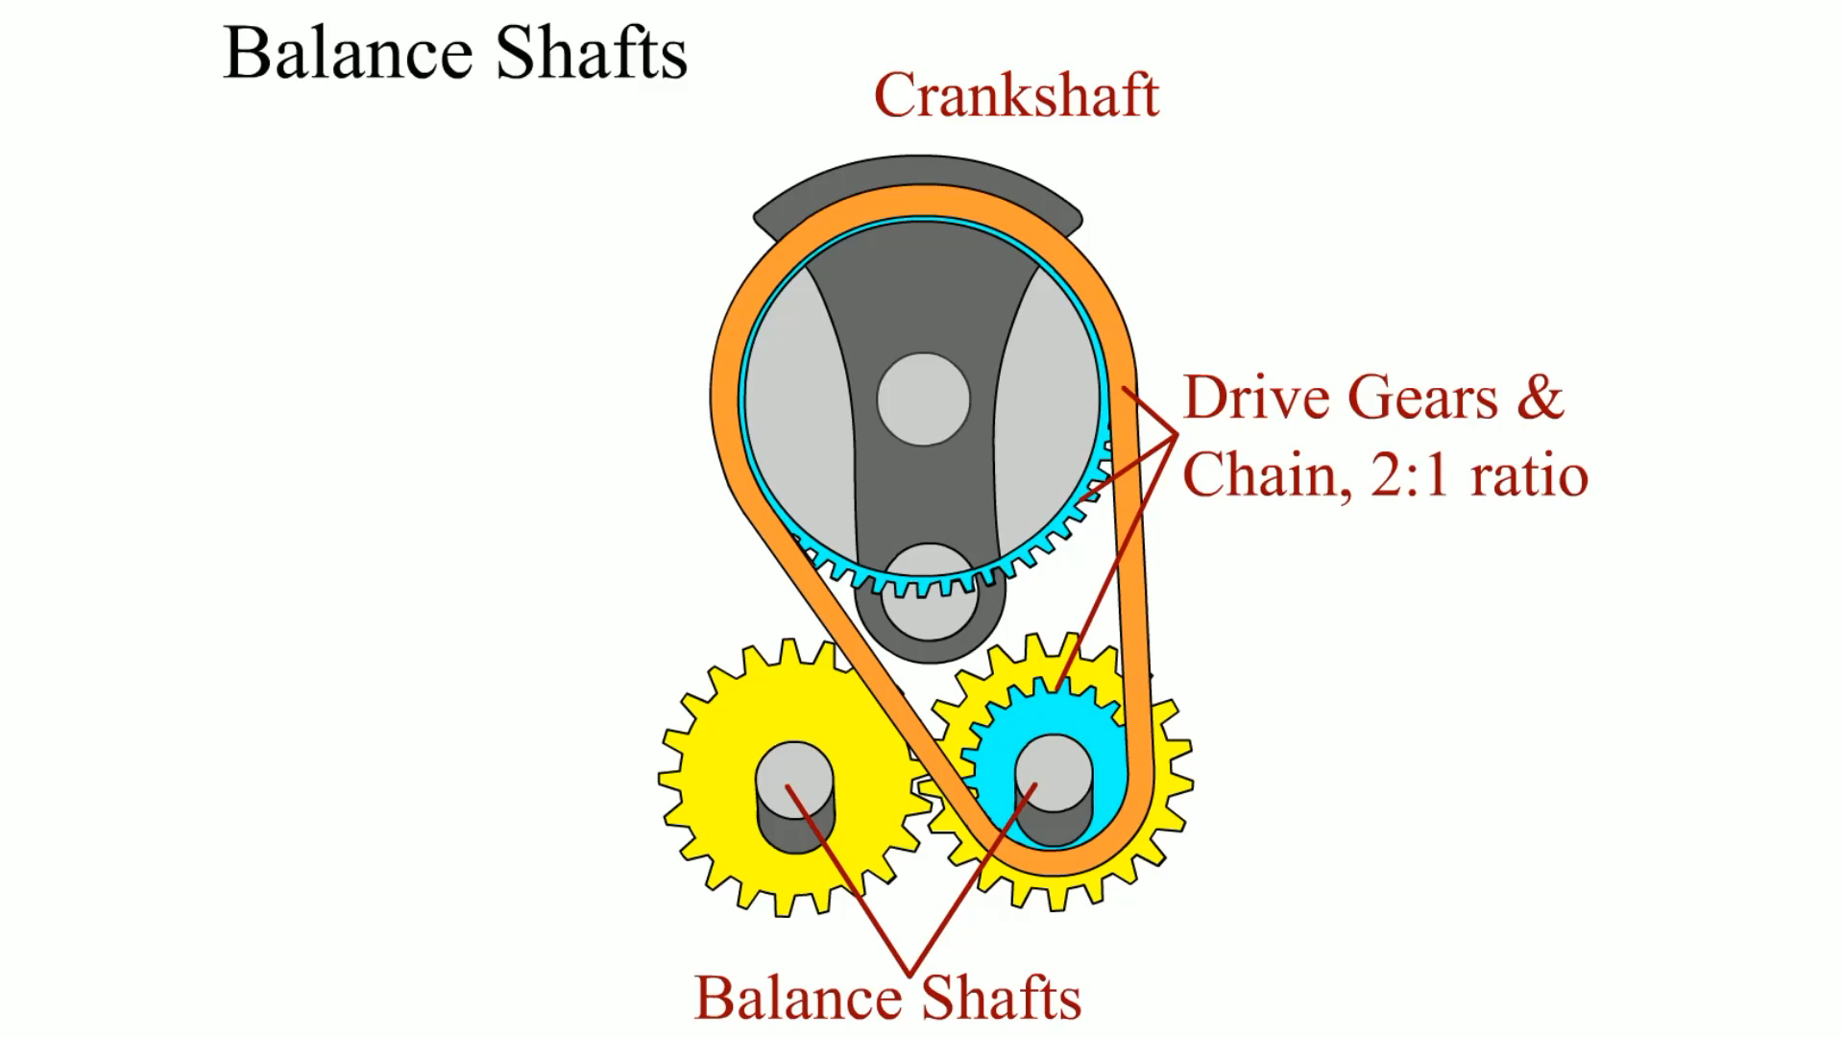
Animation:
Balance Shafts
(The animation will automatically start in a few seconds)

Slide 26
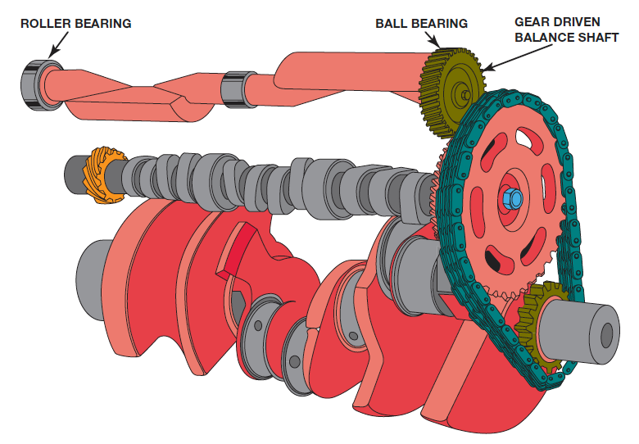
Figure 31.23
Many 90-degree V-6 engines use a balance shaft to reduce vibrations and effectively cancel a rocking motion
(rocking couple) that causes the engine to rock front to back.

Slide 27
Crankshaft Service (1 of 2)
Crankshaft damage includes:
  Worn journals
  Scored bearing journals
  Bends or warpage
  Cracks
  Thread damage (flywheel flange or front snout)
  Worn front or rear seal surfaces

Slide 28
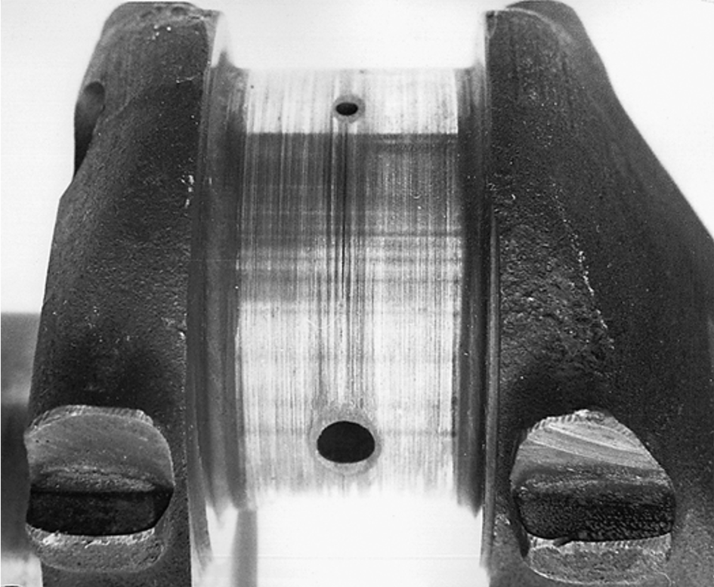
Figure 31.24
Scored connecting rod bearing journal.

Slide 29
Crankshaft Service (2 of 2)
Measuring the Crankshaft
Crankshaft Grinding
Crankshaft Polishing
Welding a Crankshaft
Stress Relieving the Crankshaft
Storing Crankshafts

Slide 30
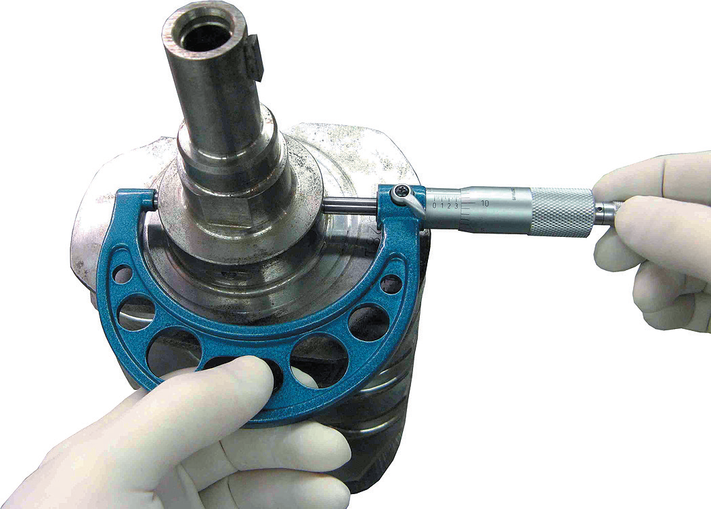
Figure 31.25
All crankshaft journals should be measured for diameter as well as taper and out-of-round.

Slide 31
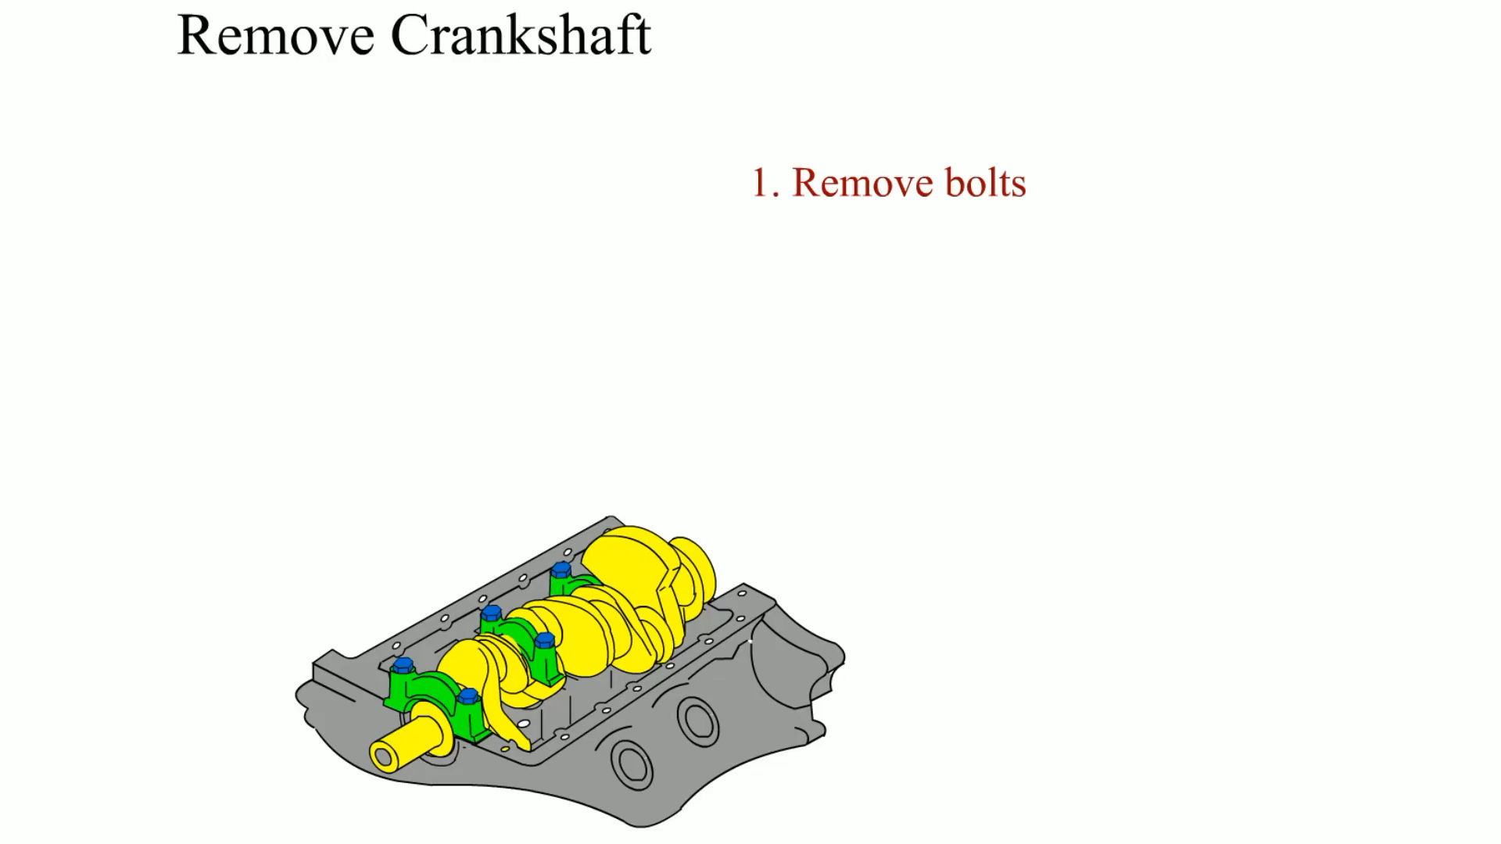
Animation:
Remove Crankshaft
(The animation will automatically start in a few seconds)

Slide 32
Engine Bearings (1 of 2)
Introduction
Types of Bearings
Bearing Materials
Bearing Manufacturing
Bearing Sizes
Bearing Loads

Slide 33
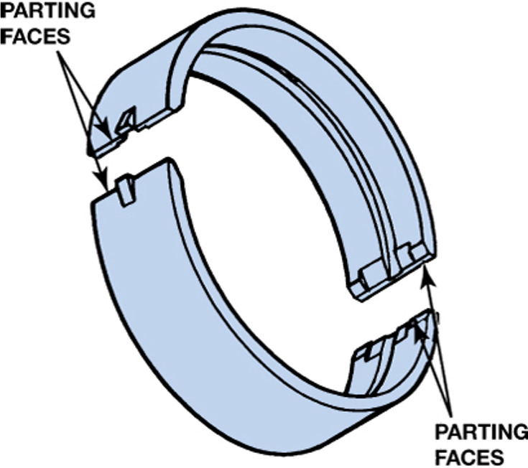
Figure 31.31
The two halves of a plain bearing meet at the parting faces.

Slide 34
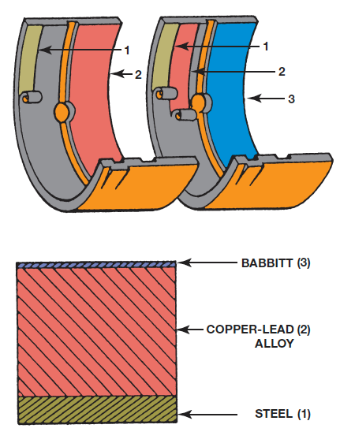
Figure 31.33
Typical two- and three-layer engine bearing inserts showing the relative thickness of the various materials.

Slide 35
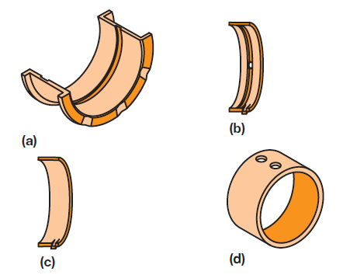
Figure 31.34
Typical bearing shell types found in modern engines: (a) half-shell thrust bearing, (b) upper main bearing insert, (c) lower main bearing insert, (d) full round-type camshaft bearing.

Slide 36
Engine Bearings (2 of 2)
Bearing Fatigue
Bearing Conformability
Bearing Embedability
Bearing Damage Resistance

Slide 37
Bearing Clearance
Importance of Proper Clearance
  The bearing-to-journal clearance may be from 0.0005 to 0.0025 inch (0.025 to 0.06 mm), depending on the engine.
Checking Bearing Clearance
  Using
  between the crankshaft journal
  and the bearing.
  Measuring the crankshaft journal diameter and the inside diameter of the bearing.
Bearing Spread and Crush

Slide 38
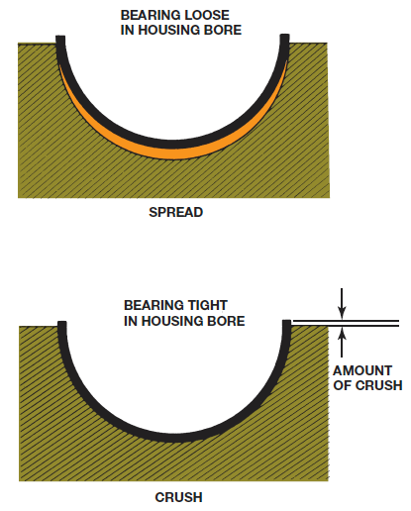
Figure 31.38
Bearing spread and crush.

Slide 39
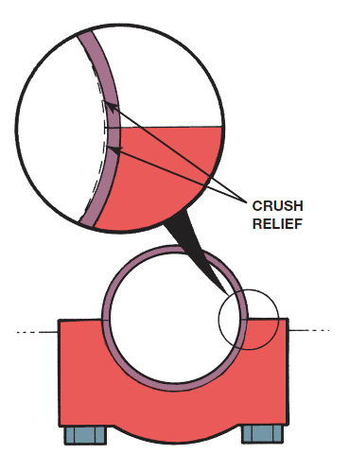
Figure 31.39
Bearings are thinner at the parting line faces to provide crush relief.

Slide 40
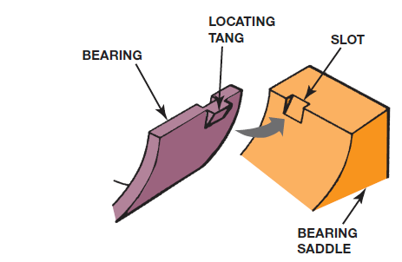
Figure 31.41
The tang (lug) and slot help index the bearing in the bore.

Slide 41
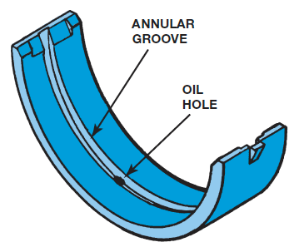
Figure 31.42
Many bearings are manufactured with a groove down the middle to improve the oil flow around the main journal.

Slide 42
Camshaft Bearings
Types of Camshaft Bearings
Camshaft Bearing Installation

Slide 43
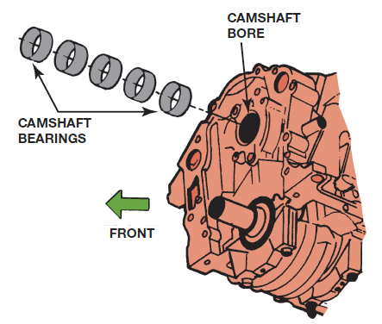
Figure 31.43
Cam-in-block engines support the camshaft with sleeve-type bearings.

Slide 44
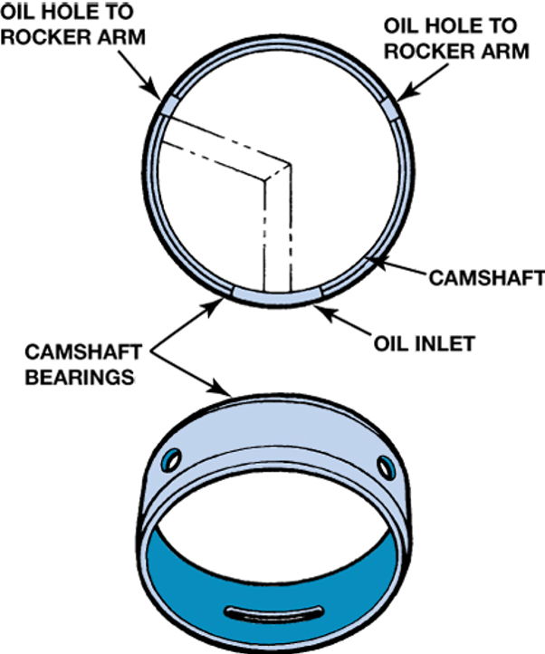
Figure 31.44
Camshaft bearings must be installed correctly so that oil passages are not blocked.

Slide 45
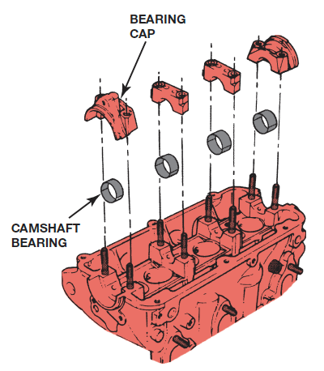
Figure 31.45
Some overhead camshaft engines use split bearing inserts.

Slide 46
Summary (1 of 2)
Cast crankshafts have a narrow mold parting line, and forged crankshafts have a wide parting line.
Even-fire 90-degree V-6 engines require that the crankshaft be splayed to allow for even firing.
Oil for the rod bearings comes from holes in the crankshaft drilled between the main journal and the rod journal.
A vibration damper, also known as a harmonic balancer, is used to dampen harmful twisting vibrations of the crankshaft.

Slide 47
Summary (2 of 2)
Most engines are internally balanced. This means that the crankshaft and vibration damper are both balanced. Other engines use an offset weight in the vibration damper to balance the crankshaft, called externally balanced engines.
Most crankshafts can be reground to be 0.01, 0.02, or 0.03 in. undersize.
Most engine bearings are constructed with a steel shell for strength and are covered with a copper-lead alloy.
Bearings should have spread and crush to keep them from spinning when the crankshaft rotates.

Slide 48
Animation and Video Resources
The below listed resources are hyperlinked to the James Halderman website
(A1) Engine Repair Animations
(A1) Engine Repair Videos
(A8) Engine Performance Animations
(A8) Engine Performance Videos

Slide 49

Copyright
This work is protected by United States copyright laws and is provided solely for the use of instructors in teaching their courses and assessing student learning. Dissemination or sale of any part of this work (including on the World Wide Web) will destroy the integrity of the work and is not permitted. The work and materials from it should never be made available to students except by instructors using the accompanying text in their classes. All recipients of this work are expected to abide by these restrictions and to honor the intended pedagogical purposes and the needs of other instructors who rely on these materials.

