Slide 1


Automotive Engines Theory and Servicing
Tenth Edition
Chapter 25
Cylinder Head and Valve Guide Service
Copyright © 2023 Pearson Education, Inc. All Rights Reserved

Slide 2
Learning Objectives
25.1 Explain the design and construction of cylinder heads.
25.2 Discuss intake and exhaust ports.
25.3 Discuss cylinder head passages and cylinder head servicing.
25.4 Explain cylinder head resurfacing, and intake manifold alignment.
25.5 Explain valve guides and the procedure for valve guide replacement.

Slide 3
Cylinder Heads (1 of 2)
Construction
Design Features
  Squish area
  Quench area
  Spark plug placement
  Surface-to-volume ratio
  Valve shrouding
  Crossflow valve placement

Slide 4
Cylinder Heads (2 of 2)
Combustion Chamber Designs
  Wedge
  Pentroof
  Hemi
Four-Valve Cylinder Heads

Slide 5
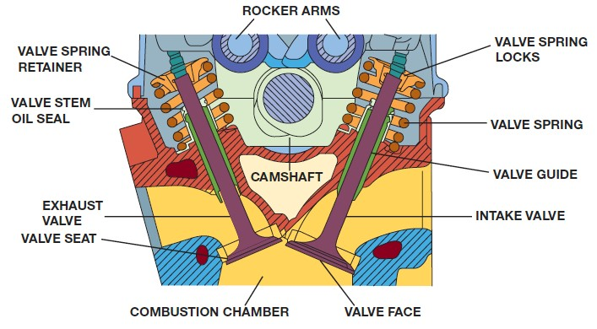
Figure 25.1
The seats and guides for the valves are in the cylinder head, as well as the camshaft and the entire valve train if it is an overhead camshaft design.
Notes:
Long Description:
The cylindrical head consists of an exhaust valve on the left and an intake valve on the right. The exhaust valve consists of a valve spring retainer and a valve stem oil seal. The intake valve consists of valve spring locks, a valve spring, and a valve guide. There is a camshaft in the middle of the two valves. There are two rocker arms at the top of the cylinder head and a combustion chamber at the bottom of the cylinder head. The bottom ends of the exhaust valve and intake valve are labeled valve seat and valve face, respectively.

Slide 6
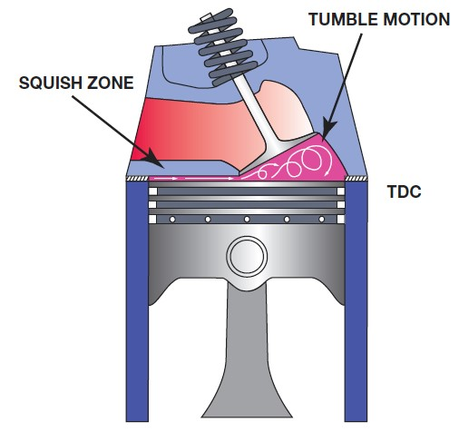
Figure 25.2
A wedge-shaped combustion chamber showing the squish area where the air-fuel mixture is squeezed, causing turbulence that pushes the mixture toward the spark plug.

Slide 7
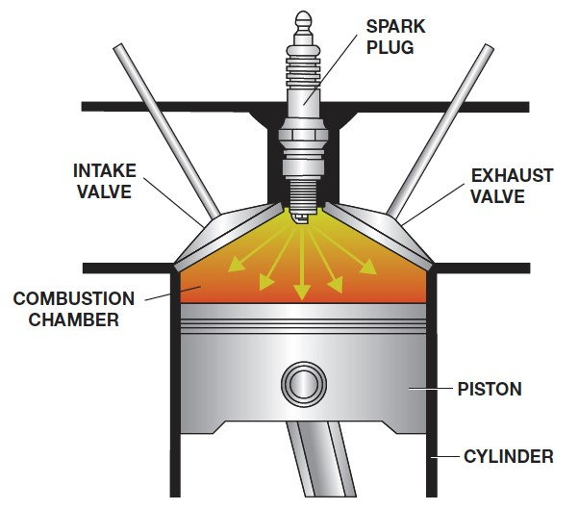
Figure 25.3
Locating the spark plug in the center of the combustion chamber reduces the distance the flame front must travel.
Notes:
Long Description:
There is an exhaust valve on the left and an intake valve on the right of the cylinder head, respectively. A spark plug is attached at the top center of a combustion chamber to reduce the distance that the flame front must travel. There is a piston below the combustion chamber attached with connecting rod.

Slide 8
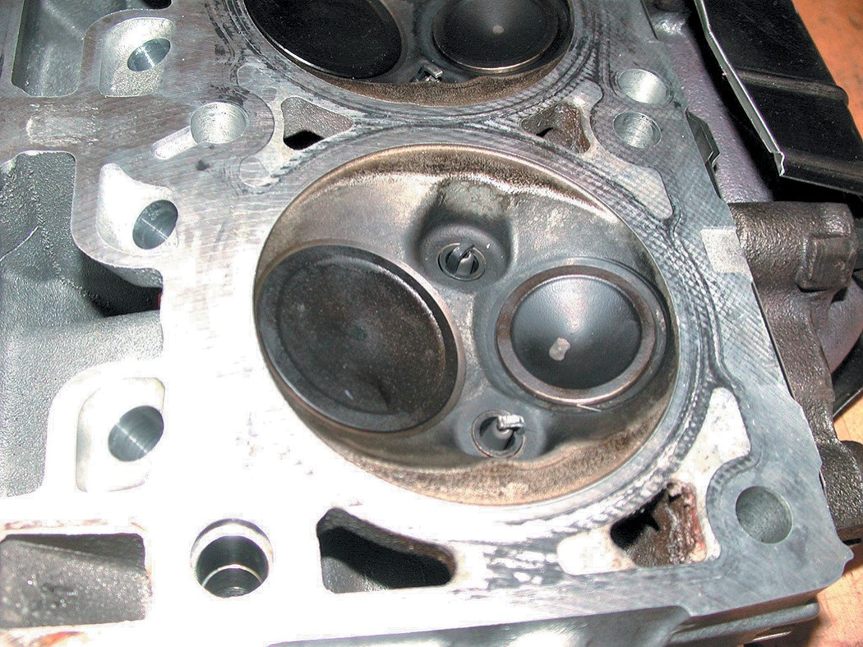
Figure 25.4
The combustion chamber of the 5.7 liter Chrysler Hemi cylinder head shows the two spark plugs used to ensure rapid burn for best power and economy with the lowest possible exhaust emissions.

Slide 9
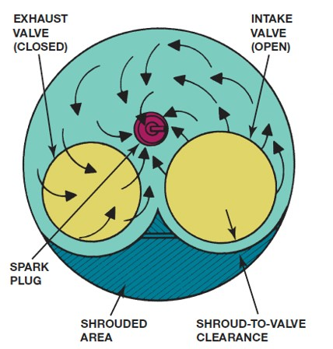
Figure 25.5
The shrouded area around the intake valve causes the intake mixture to swirl as it enters the combustion chamber.
Notes:
Long Description:
A combustion chamber with a closed exhaust valve on the left and an open intake valve on the right. There is a spark plug in between these two valves and a shrouded area at the bottom with a shroud to valve clearance area between the open intake valve and the shrouded area. This shrouded area causes the intake mixture to swirl as it enters the combustion chamber.

Slide 10
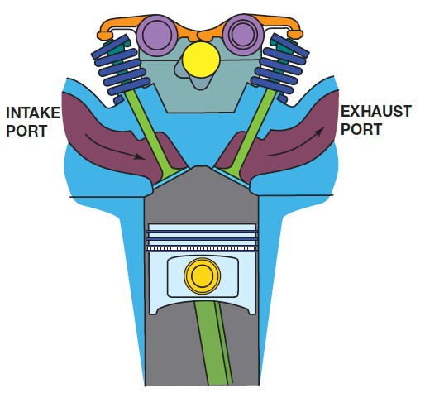
Figure 25.6
A typical crossflow cylinder head design, where the flow into and out of the combustion chamber is from opposite sides of the cylinder head.

Slide 11
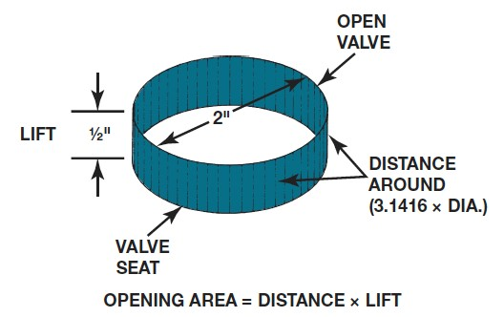
Figure 25.7
Method for measuring the valve opening space.
Notes:
Long Description:
The diameter of the ring is 2 inches, and the lift height is one half inches. The distance around the valve is 3 point 1416 times D I A. The bottom edge of the ring is labeled as a valve seat. The opening area equals distance times lift.

Slide 12
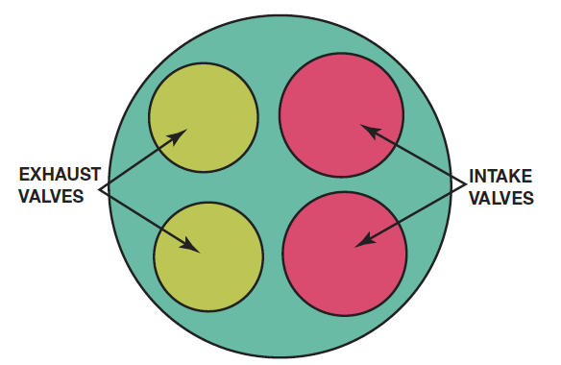
Figure 25.9
Typical four-valve head. The total area of opening of two small intake valves and two smaller exhaust valves is greater than the area of a two-valve head using much larger valves.
Notes:
Long Description:
The two valve heads on the left are labeled "exhaust valves" and the two right valves on the right are labeled "intake valves". The total area of the opening of two small intake valves and two smaller exhaust valves is greater than the area of a two-valve head using much larger valves. The smaller valves also permit the use of smaller intake runners for better low-speed engine response.

Slide 13
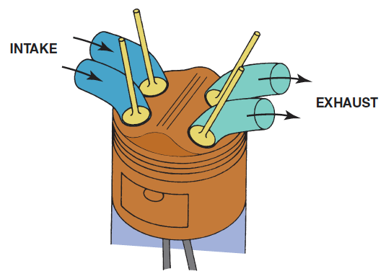
Figure 25.10
Four valves in a pentroof combustion chamber.

Slide 14
Intake and Exhaust Ports (1 of 2)
Purpose and Function
  Allow the free flow of exhaust gases from the engine.
Intake Ports
  The intake port in a cylinder head designed for use with a carburetor or throttle-body-type fuel injection is relatively long.
On engines that use port fuel injection, the cylinder head ports are designed to help promote swirl in the combustion chamber.

Slide 15
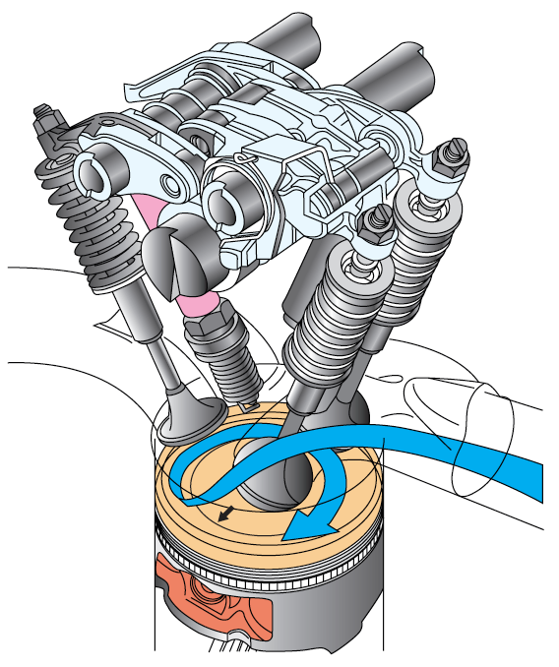
Figure 25.12
The intake manifold design and combustion chamber design both work together to cause the air-fuel mixture to swirl as it enters the combustion chamber.
Notes:
Long Description:
The intake manifold design and combustion chamber design both work together to cause the air-fuel mixture to swirl as it enters the combustion chamber.

Slide 16
Intake and Exhaust Ports (2 of 2)
Exhaust Ports
  The length of the exhaust ports is shorter than the intake ports to help reduce the amount of heat transferred to the coolant.

Slide 17
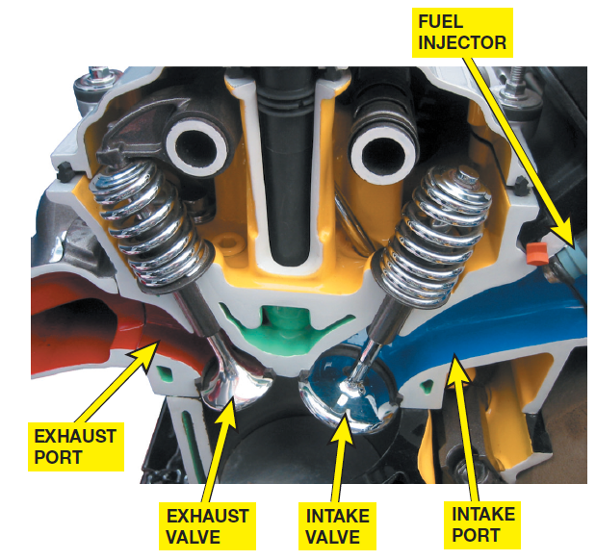
Figure 25.13
A port-injected engine showing the straight free-flowing intake and exhaust ports.

Slide 18
Cylinder Head Passages
Coolant Flow Passages
Head Gasket Holes
Lubricating Oil Passages

Slide 19
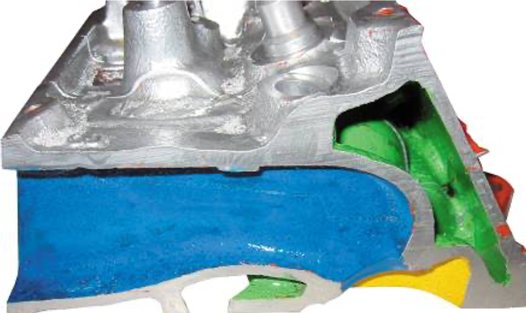
Figure 25.14
A cutaway head showing the coolant passages in green.

Slide 20
Cylinder Head Servicing
Cylinder Head Servicing Sequence
Disassembling Overhead Camshaft Head
Valve Train Disassembly
Cylinder Head Inspection

Slide 21
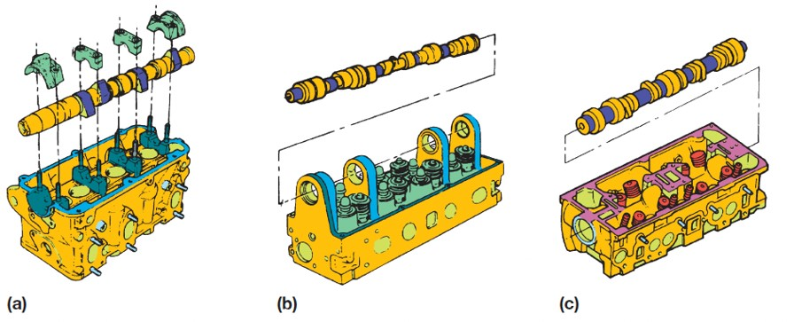
Figure 25.16
Overhead camshafts may be (a) held in place with bearing caps, (b) supported by towers, or (c) fitted into bearing bores machined directly into the head.
Notes:
Long Description:
In figure (a): a camshaft is held in place with four bearing caps. In figure (b): a camshaft is supported by some towers. In figure (c): a camshaft is fitted into bearing bores machined directly into the head of the cylinder.

Slide 22
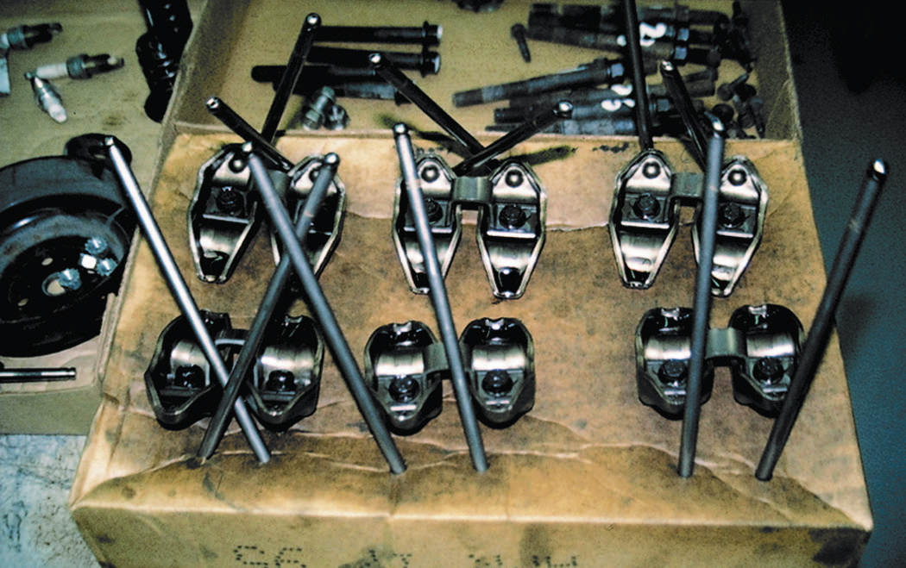
Figure 25.18
Pushrods can be kept labeled if stuck through a cardboard box. Individual parts become worn together. Using cardboard is a crude but effective material to keep all valve train parts together and labeled exactly as they came from the engine.

Slide 23
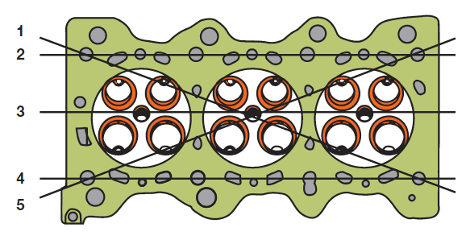
Figure 25.19
Cylinder heads should be checked in five planes for warpage, distortion, bend, and twist.
Notes:
Long Description:
Three horizontal lines labeled 2, 3, and 4 are drawn from top to bottom on the cylindrical head. Another two lines from top left to bottom right and from bottom left to the top right are drawn with the label 1 and 5, respectively. These cylinder heads are checked in five planes for warpage, distortion, bend, and twist.

Slide 24
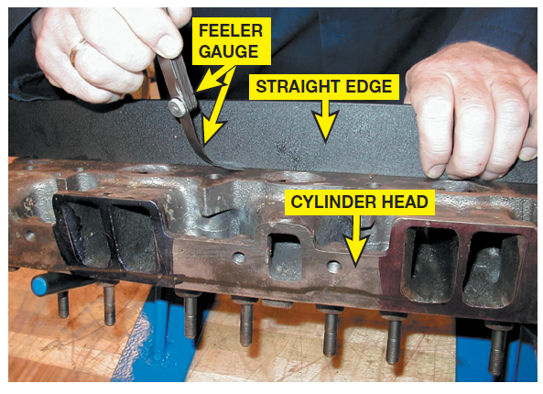
Figure 25.20
A precision ground straightedge and a feeler gauge are used to check the cylinder head for flatness.

Slide 25
Cylinder Head Resurfacing
Refinishing Methods
  Two common resurfacing methods are:
    Milling or broaching
    Grinding
Resurfacing the cylinder head changes the compression ratio of the engine by about 1/10 point per 0.01 inch of removed material.
Surface Finish

Slide 26
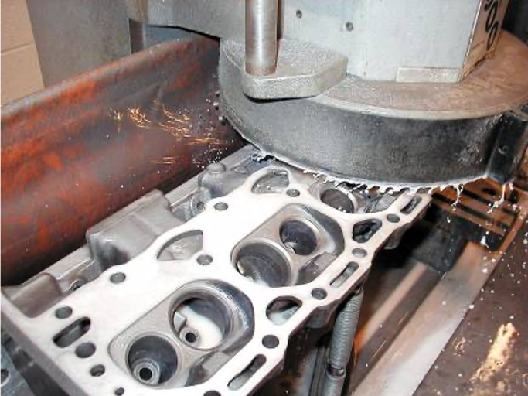
Figure 25.21
A cast-iron cylinder head being resurfaced using a surface grinder.

Slide 27
Intake Manifold Alignment
The intake manifold of a V-type engine may no longer fit correctly after the gasket surfaces of the heads are ground.
The intake manifold surface must be resurfaced to remove enough metal to rematch the ports and bolt holes.
Automotive machine shops that perform head resurfacing have tables that specify the exact amount of metal to be removed.

Slide 28
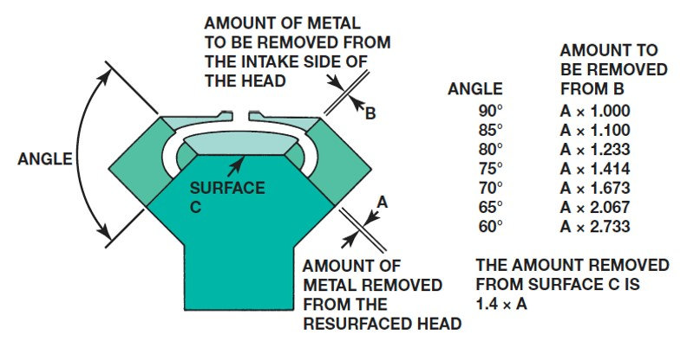
Figure 25.23
The material that must be removed for a good manifold fit.
Notes:
Long Description:
The intake manifold is divided into three parts, left, right, and the top with a C surface. The left part is labeled angle between two area separator lines. The upper area with B width of separation between the top and right parts is labeled "Amount of metal to be removed from the intake side of the head". The lower right area with A width of separation between the right parts is labeled "Amount of metal removed from the resurfaced head". A table with two columns and seven rows is shown on the right. From left to right the columns are labeled, "Angle, and Amount to be removed from B". The entries in the table are as follows:
Row 1: Angle: 90 degrees, Amount to be removed from B: A times 1.000.
Row 2: Angle: 85 degrees, Amount to be removed from B: A times 1.100.
Row 3: Angle: 80 degrees, Amount to be removed from B: A times 1.233.
Row 4: Angle: 75 degrees, Amount to be removed from B: A times 1.414.
Row 5: Angle: 70 degrees, Amount to be removed from B: A times 1.673.
Row 6: Angle: 65 degrees, Amount to be removed from B: A times 2.067.
Row 7: Angle: 60 degrees, Amount to be removed from B: A times 2.733.

Slide 29
Valve Guides
Types
Valve Stem-to-Guide Clearance
Measuring Valve Guides
Oversize Stem Valves

Slide 30
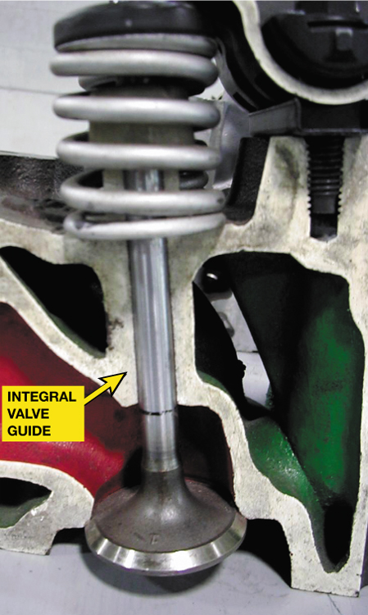
Figure 25.25
An integral valve guide is simply a guide that has been drilled into the cast-iron cylinder head.

Slide 31
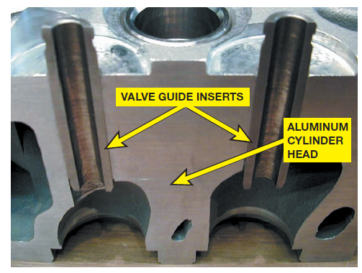
Figure 25.26
All aluminum cylinder heads use valve guide inserts.

Slide 32
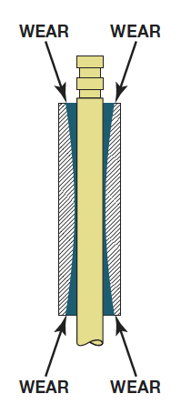
Figure 25.27
Valve guides often wear to a bell-mouth shape to both ends due to the forces exerted on the valve by the valve train components.

Slide 33
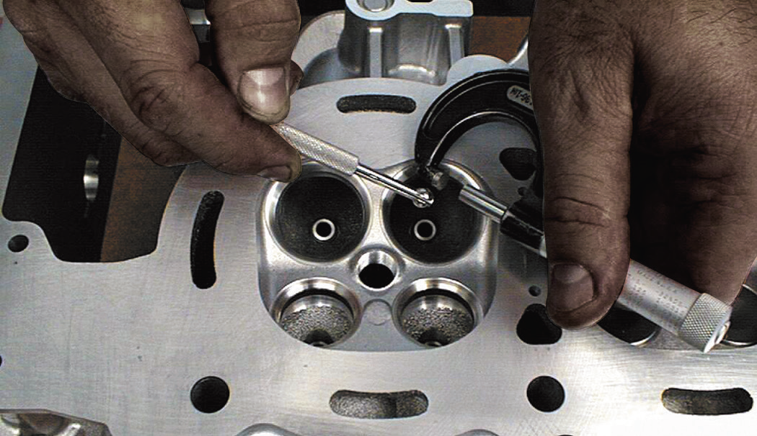
Figure 25.28
A small-hole gauge and a micrometer are being used to measure the valve guide. The guide should be measured in three places: at the top, middle, and bottom.

Slide 34
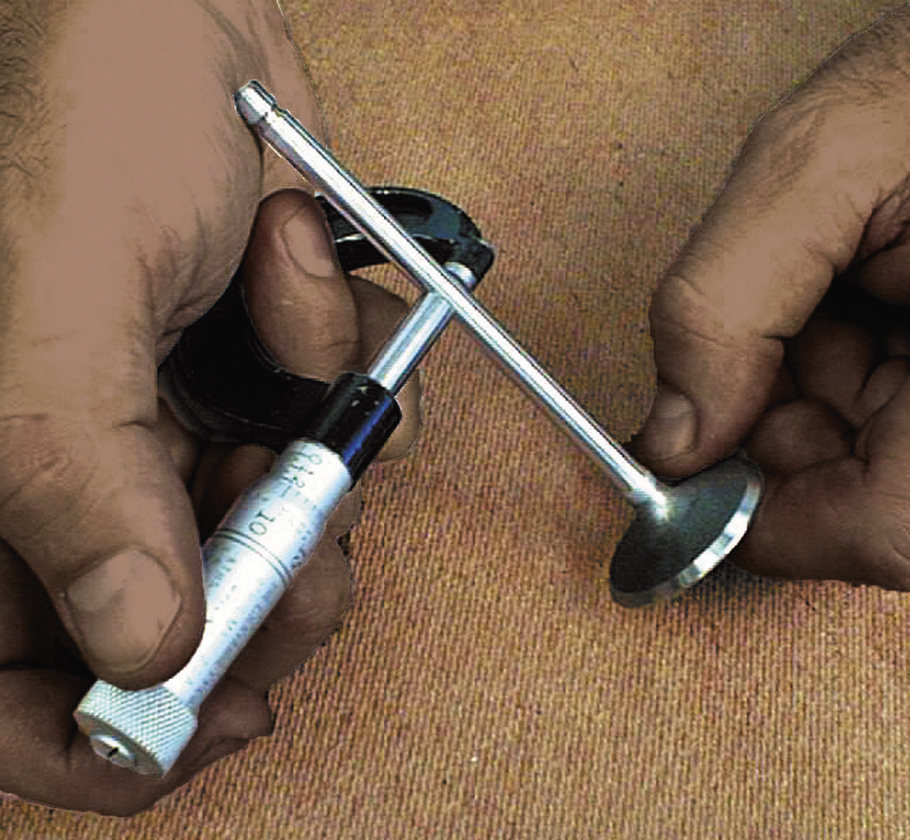
Figure 25.29
The diameter of the valve stem is being measured using a micrometer. The difference between the inside diameter of the valve guide and the diameter of the valve stem is the valve guide-to-stem clearance.

Slide 35
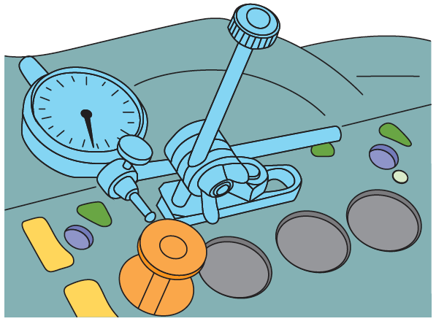
Figure 25.30
Measuring valve guide-to-stem clearance with a dial indicator while rocking the stem in the direction of normal thrust.
Notes:
Long Description:
The reading on the dial indicator should be compared to specifications because it does not give the guide to stem clearance directly. The valve is usually held open to its maximum operating lift.

Slide 36
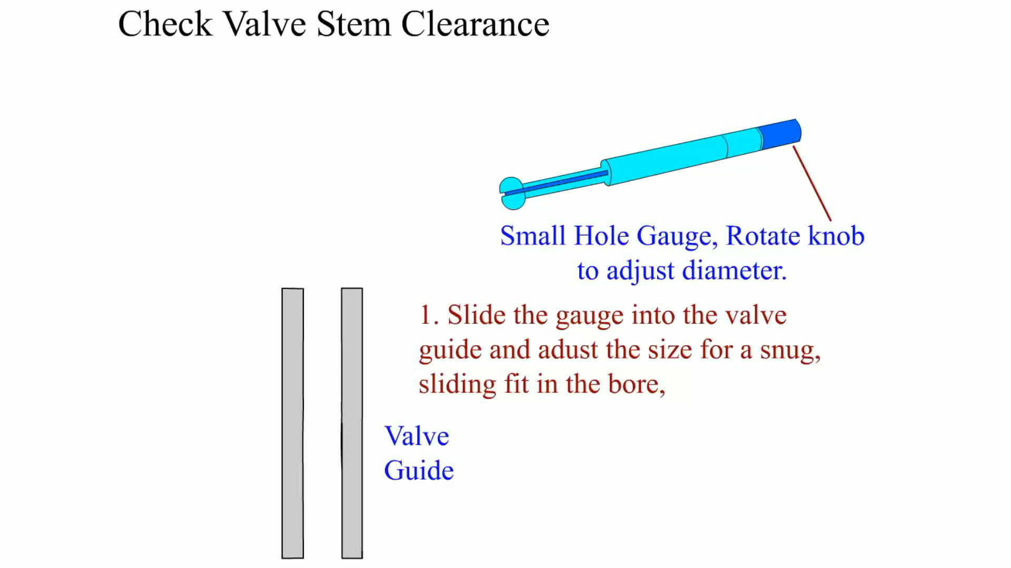
Animation:
Check Valve Stem Clearance
(The animation will automatically start in a few seconds)

Slide 37
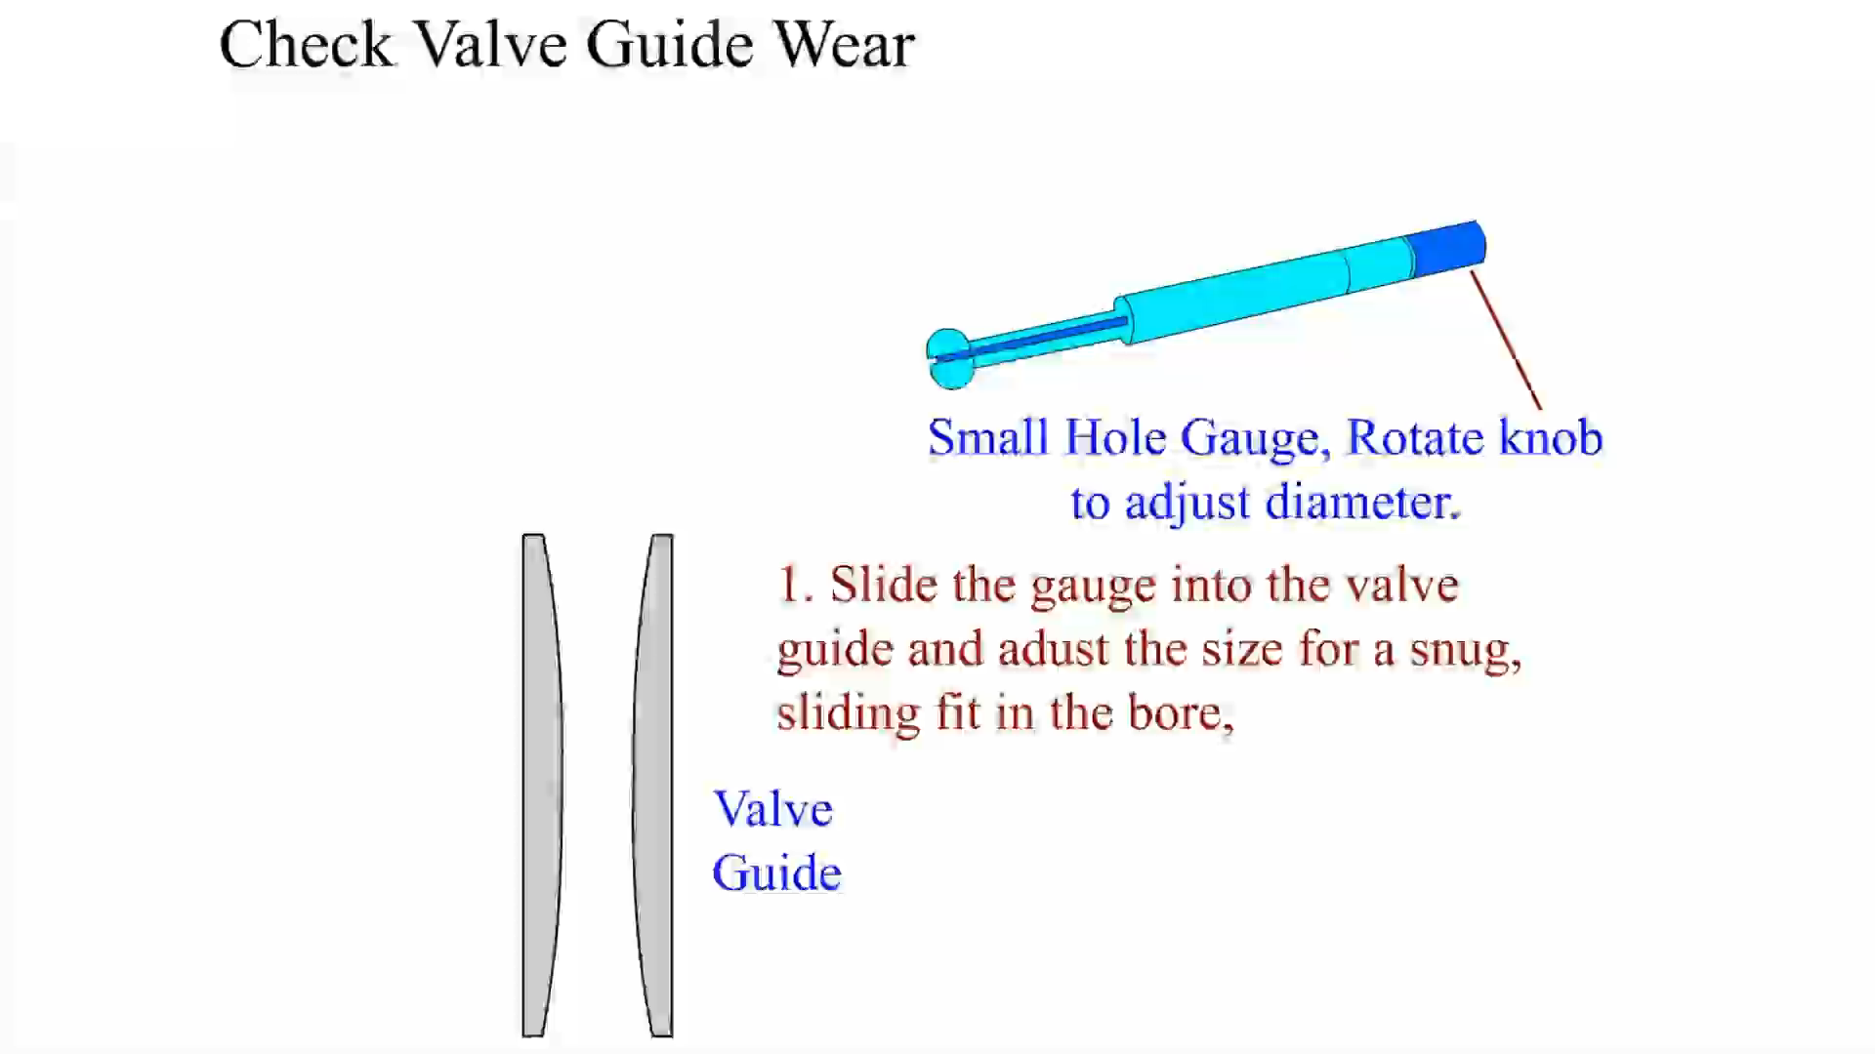
Animation:
Check Valve Guide Wear
(The animation will automatically start in a few seconds)

Slide 38
Valve Guide Replacement
Purpose
  After the valve guide height is measured, the worn guide is pressed from the head with a proper fitting driver.
  Replacement valve guides can also be installed to repair worn integral guides.
Valve Guide Sizes
Valve Guide Inserts
Spiral Bronze Insert Bushings

Slide 39
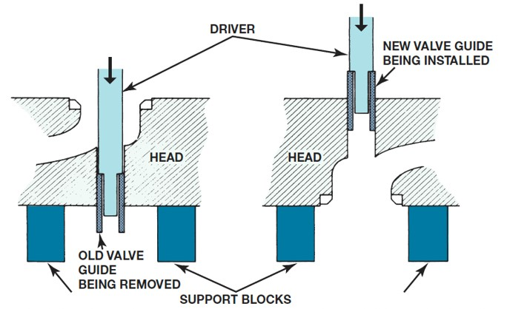
Figure 25.31
Valve guide replacement procedure.
Notes:
Long Description:
The first figure on the left has a cylinder head that is supported by two support blocks. A drive attached with an old valve guide is removed from the head. The second figure shows a driver with a new valve guide is installed on the cylindrical head.

Slide 40
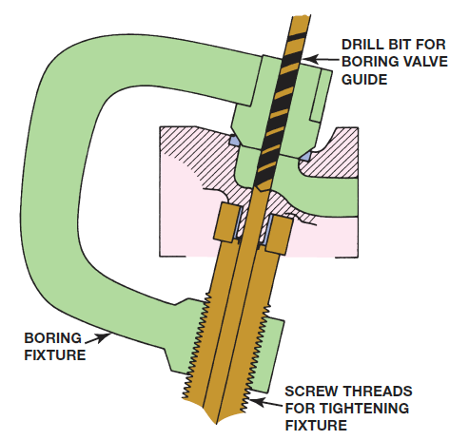
Figure 25.32
A type of fixture required to bore the valve guide to accept a thin-walled insert sleeve.

Slide 41
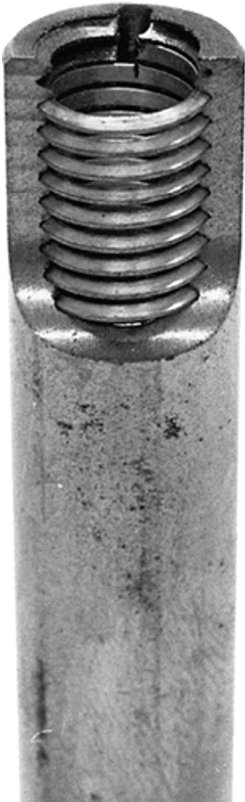
Figure 25.34
Installed spiral bronze insert bushing.

Slide 42
Summary (1 of 2)
The most commonly used combustion chamber types include hemispherical, wedge, and pentroof.
Coolant and lubricating openings and passages are located throughout most cylinder heads.
Cylinder head resurfacing machines include grinders and milling machines.

Slide 43
Summary (2 of 2)
Valve guides should be checked for wear using a ball gauge or a dial indicator.
Valve guide repair options include use of oversize stem valves, replacement valve guides, valve guide inserts, and knurling of the original valve guide.

Slide 44
Animation and Video Resources
The below listed resources are hyperlinked to the James Halderman website
(A1) Engine Repair Animations
(A1) Engine Repair Videos
(A8) Engine Performance Animations
(A8) Engine Performance Videos

Slide 45

Copyright
This work is protected by United States copyright laws and is provided solely for the use of instructors in teaching their courses and assessing student learning. Dissemination or sale of any part of this work (including on the World Wide Web) will destroy the integrity of the work and is not permitted. The work and materials from it should never be made available to students except by instructors using the accompanying text in their classes. All recipients of this work are expected to abide by these restrictions and to honor the intended pedagogical purposes and the needs of other instructors who rely on these materials.

