Slide 1
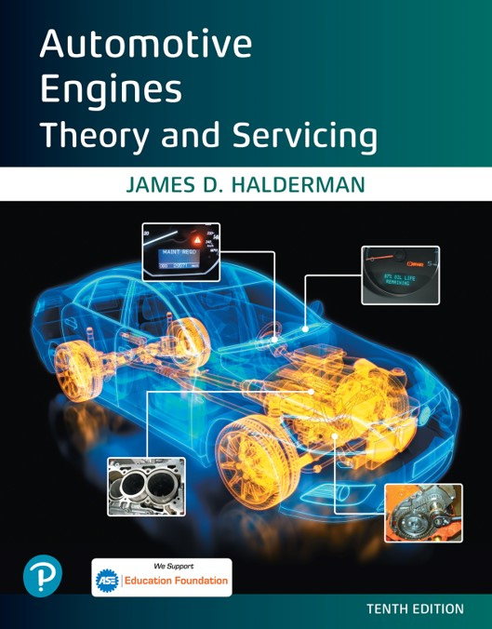

Automotive Engines Theory and Servicing
Tenth Edition
Chapter 21
Engine Condition Diagnosis
Copyright © 2023 Pearson Education, Inc. All Rights Reserved
Notes:
If this PowerPoint presentation contains mathematical equations, you may need to check that your computer has the following installed:
1) MathType Plugin
2) Math Player (free versions available)
3) NVDA Reader (free versions available)

Slide 2
Learning Objectives (1 of 2)
21.1 Discuss typical engine-related complaints and engine smoke diagnosis.
21.2 Discuss the importance of the driver’s description and visual checks.
21.3 Discuss engine noise diagnosis.
21.4 Explain oil pressure testing and the purpose of oil pressure warning lamps.
21.5 Explain compression testing and compare wet compression test and running compression test.

Slide 3
Learning Objectives (2 of 2)
21.6 Describe cylinder leakage test and cylinder power balance test.
21.7 Explain the vacuum test and exhaust restriction test.
21.8 Explain how to test back pressure with a vacuum gauge and a pressure gauge, and how to diagnose head gasket failure.
21.9 Discuss the operation of dash warning lights.

Slide 4
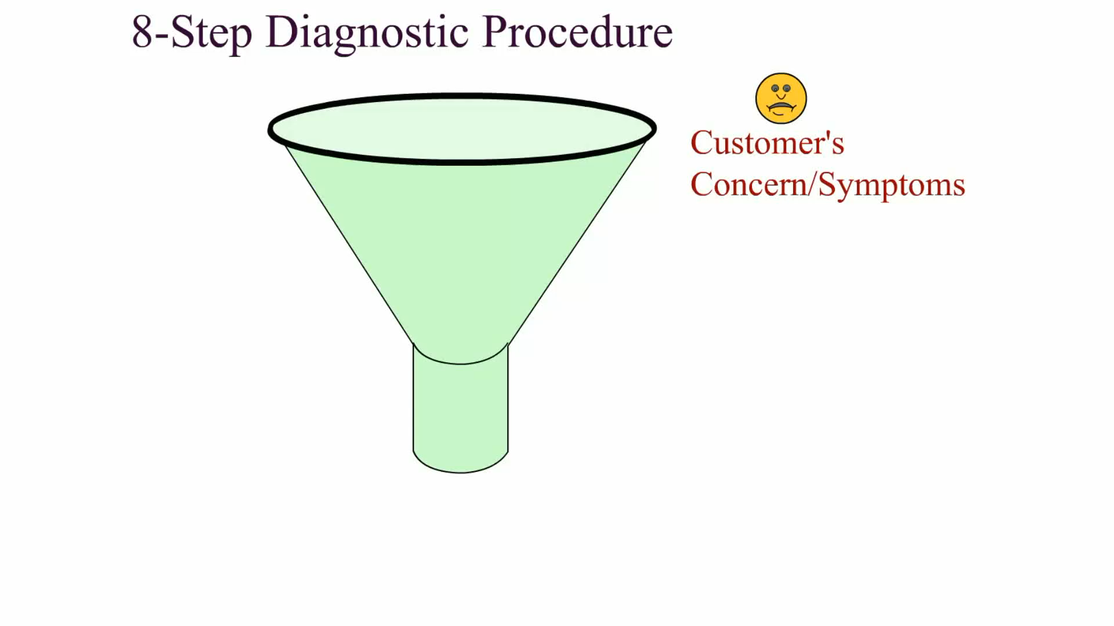
Animation:
8-Step Diagnostic Procedure
(The animation will automatically start in a few seconds)

Slide 5
Typical Engine-Related Complaints (1 of 2)
Many driveability problems are not caused by engine mechanical problems.
  A thorough inspection and testing of the ignition and fuel systems should be performed before testing for mechanical engine problems.

Slide 6
Typical Engine-Related Complaints (2 of 2)
Typical engine mechanical-related complaints include the following:
  Excessive oil consumption
  Engine misfiring
  Loss of power
  Smoke from the engine or exhaust
  Engine noise

Slide 7
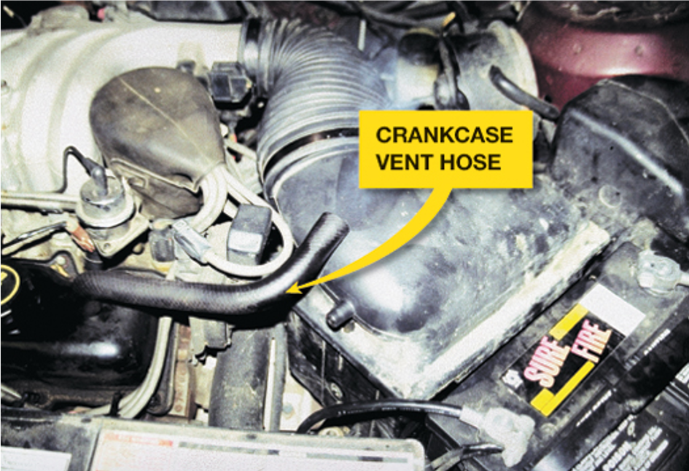
Figure 21.1
Blowby gases coming out of the crankcase vent hose. Excessive amounts of combustion gases flow past the piston rings and into the crankcase.

Slide 8
Engine Smoke Diagnosis
The color of engine exhaust smoke can indicate what engine problem might exist.
  Blue
  Black
  White (steam)

Slide 9
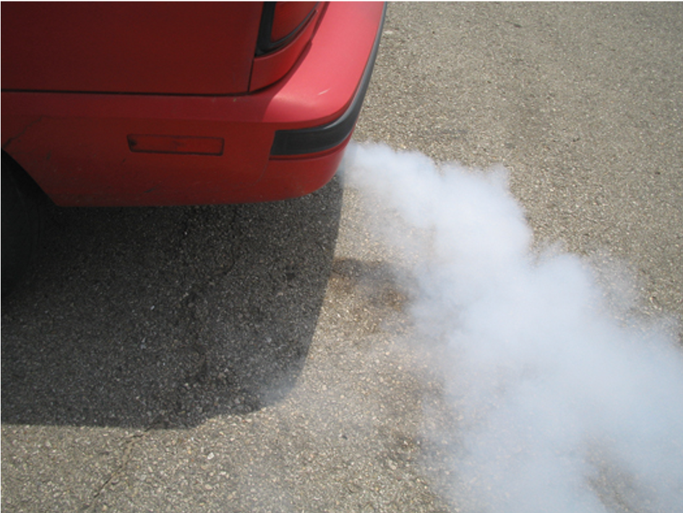
Figure 21.2
White steam is usually an indication of a blown (defective) cylinder head gasket that allows engine coolant to flow into the combustion chamber where it is turned to steam.

Slide 10
The Driver Is Your Best Resource
When did the problem first occur?
Under what conditions does it occur?
  Cold or hot?
  Acceleration, cruise, or deceleration?
  How far was it driven?
  What recent repairs have been performed?

Slide 11
Visual Checks
The first and most important “test” that can be performed is a careful visual inspection.
  Oil Level and Condition
  Coolant Level and Condition
  Oil Leaks

Slide 12
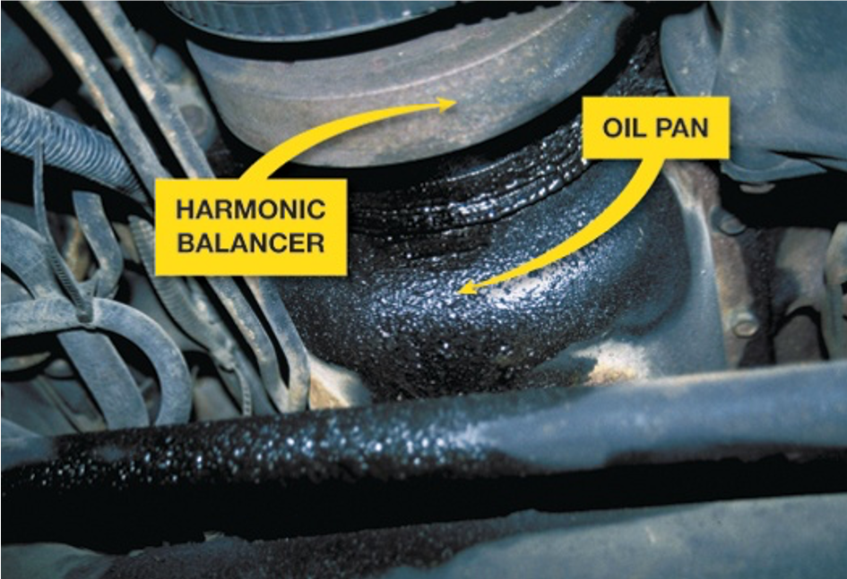
Figure 21.3
What looks like an oil pan gasket leak can be a rocker cover gasket leak. Always look for the highest place and most forward place you see oil leaking; that should be repaired first.

Slide 13
Engine Noise Diagnosis
An engine knocking noise is often difficult to diagnose. Several items that can cause it include:
  Valves clicking
  Torque converter
  Cracked flex plate
  Loose or defective drive belts or tensioners
  Piston pin knock
  Piston slap
  Timing chain noise
  Rod-bearing noise
  Main-bearing knock

Slide 14
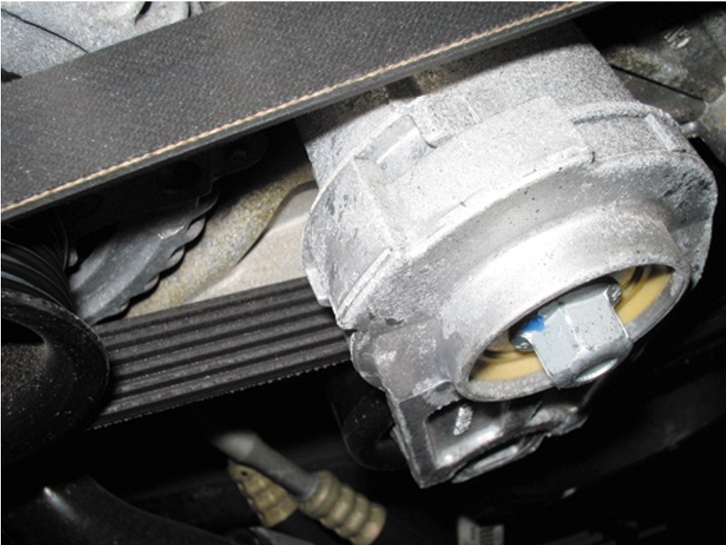
Figure 21.6
An accessory belt tensioner. Anything wrong with the belt or tensioner can cause noise.

Slide 15
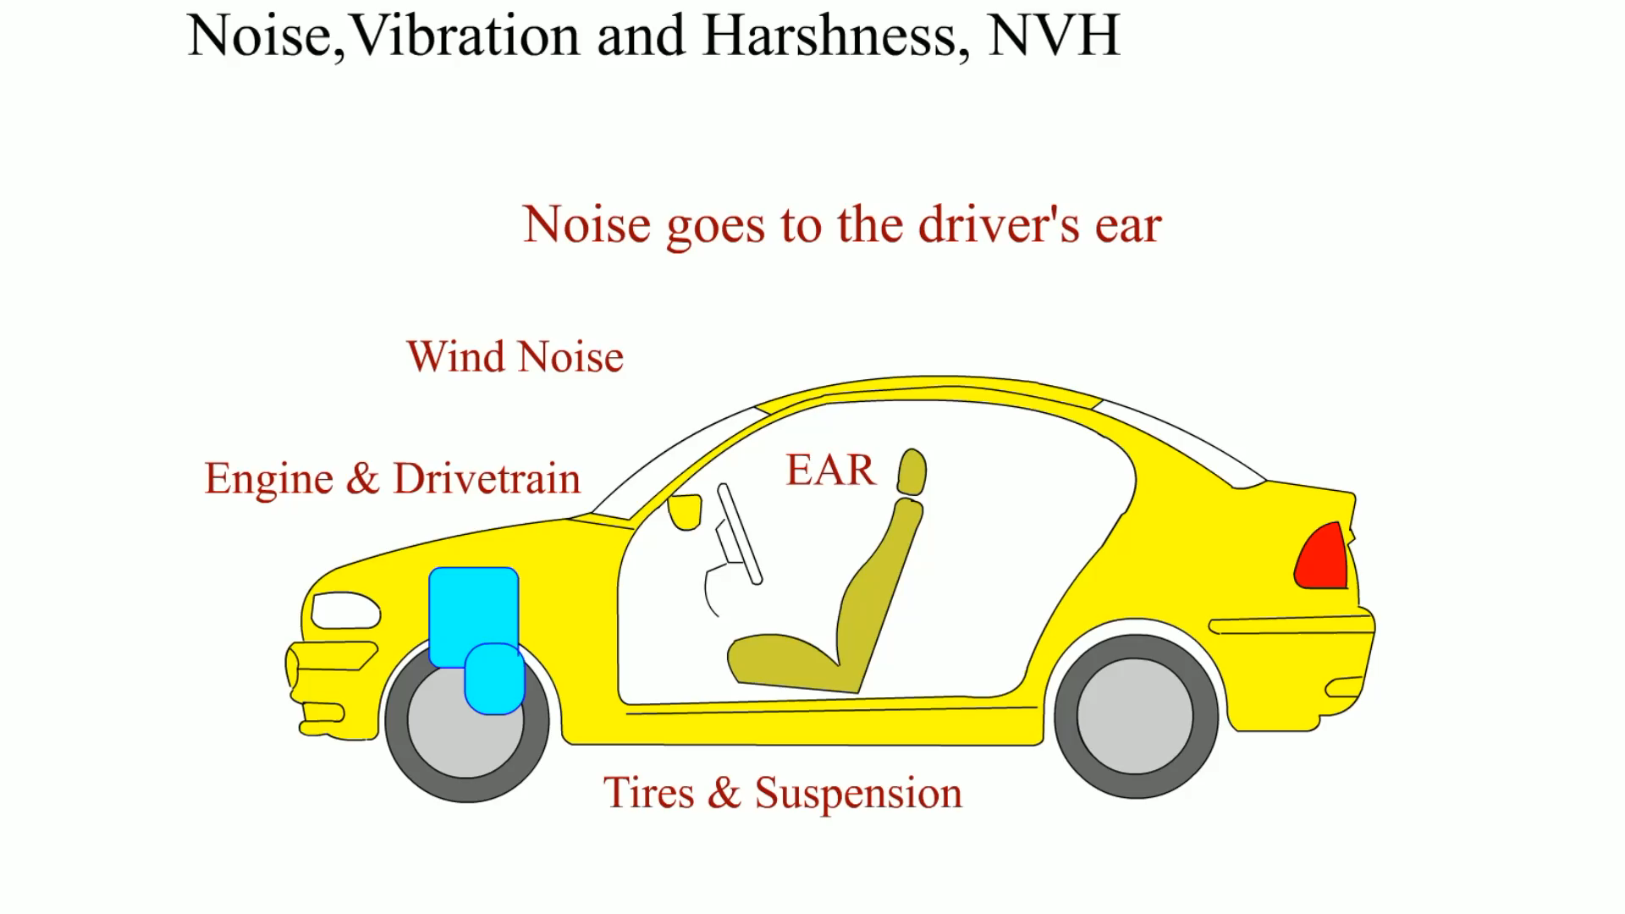
Animation:
Noise, Vibration and Harshness, NVH
(The animation will automatically start in a few seconds)

Slide 16
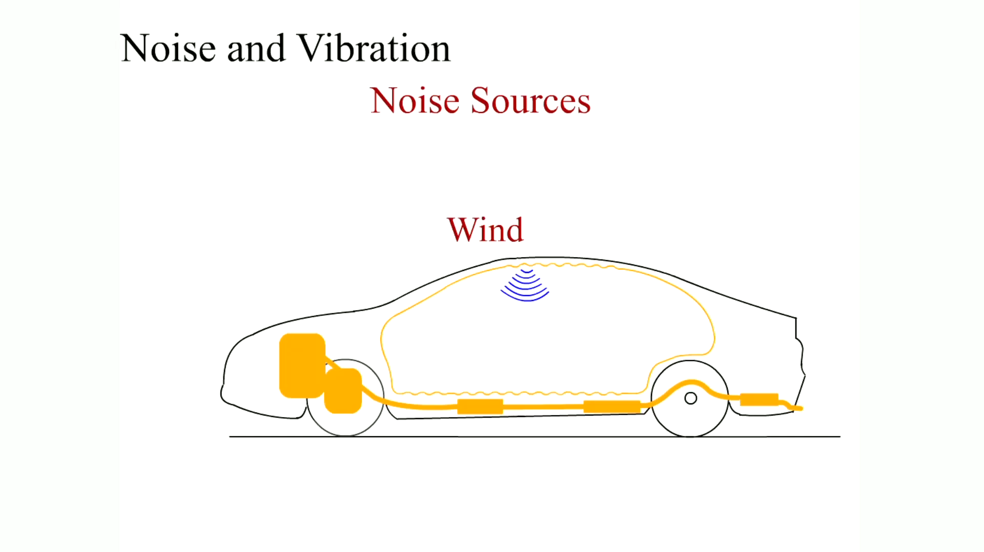
Animation:
Noise and Vibration
(The animation will automatically start in a few seconds)

Slide 17
Oil Pressure Testing
Proper oil pressure is very important for the operation of any engine.
  Low oil pressure can cause engine wear, and engine wear can cause low oil pressure.

Slide 18
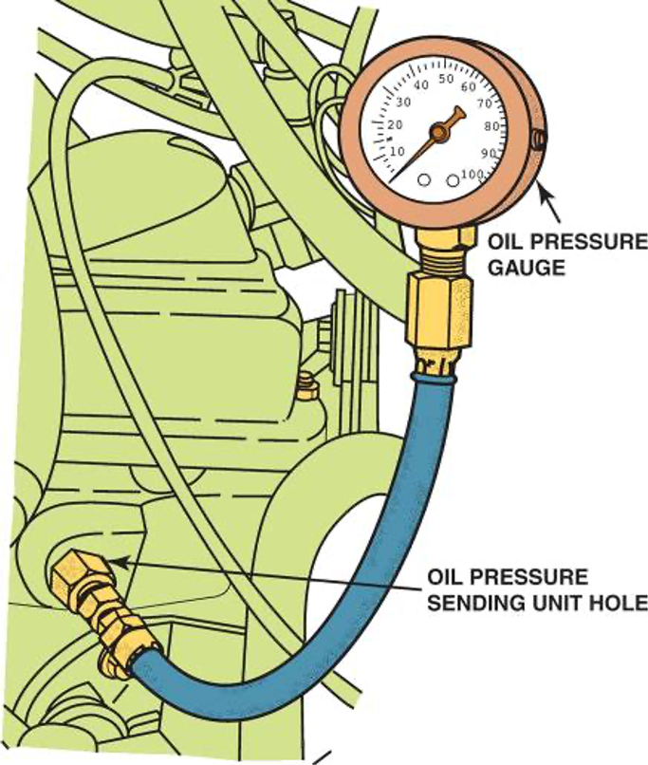
Figure 21.8
To measure engine oil pressure, remove the oil pressure sending (sender) unit usually located near the oil filter. Screw the pressure gauge into the oil pressure sending unit hole.

Slide 19
Oil Pressure Warning Lamp
The red oil pressure warning lamp in the dash usually lights when the oil pressure is less than 4 to 7 P S I, depending on vehicle and engine.
  The oil light should not be on during driving.
  If the oil warning lamp is on, stop the engine immediately.
Always confirm oil pressure with a reliable mechanical gauge before performing engine repairs.
  The sending unit or circuit may be defective.

Slide 20
Cylinder Contribution Test
A cylinder contribution test, also called a power balance test, is an automated test that a scan tool performs by turning a fuel injector off to one cylinder at the time and monitoring the drop, or increase in engine speed.

Slide 21
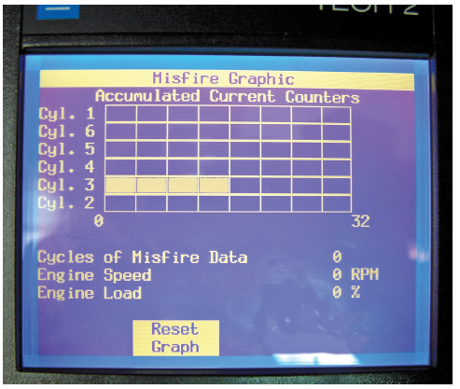
Figure 21.9
A Tech 2 scan tool display showing a fault with cylinder 3. Once the cylinder has been identified, then more detailed tests can be performed to determine the root cause, which could be an ignition, fuel or mechanical issue.
Notes:
The screen is titled, "Misfire Graphic." A 6 by 8 rectangular grid with the label "Accumulated Current Counters" is shown, whose rows are labeled, "Cylinder 1, Cylinder 6, Cylinder 5, Cylinder 4, Cylinder 3, and Cylinder 2" from top to bottom. The left and right sides of the columns are labeled 0 and 32, respectively. The first four entries of Cylinder 3 row are shaded. A note below reads,
Line 1: Cycles of Misfire Data: 0.
Line 2: engine Speed: 0 R P M.
Line 3: Engine Load: 0 percent. "Reset graph" is written at the bottom inside a rectangular section.

Slide 22
Relative Compression Test
The relative compression test uses the starter motor current to determine the compression values of all cylinders.
A digital storage oscilloscope (D S O) and a current clamp is used to measure the change in current that occurs when an engine is cranking.

Slide 23
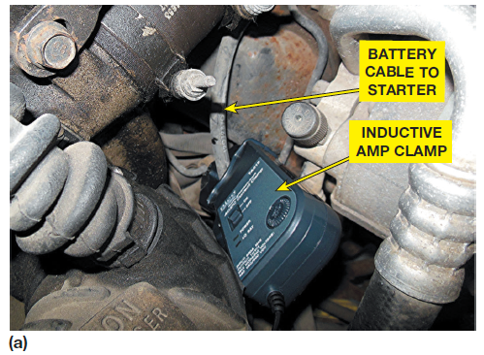
Figure 21.11a
A relative compression test using an amp clamp around the starter motor power cable and a Pico scope.

Slide 24
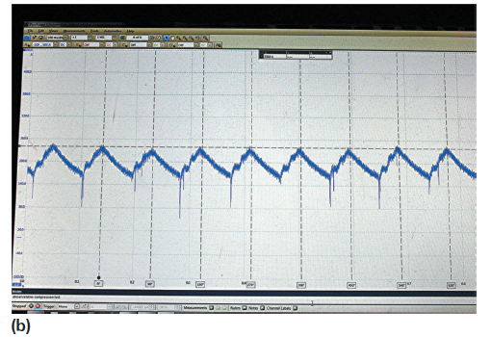
Figure 21.11b
The result is a waveform that displays the current (amps) needed for each cylinder under compression.

Slide 25
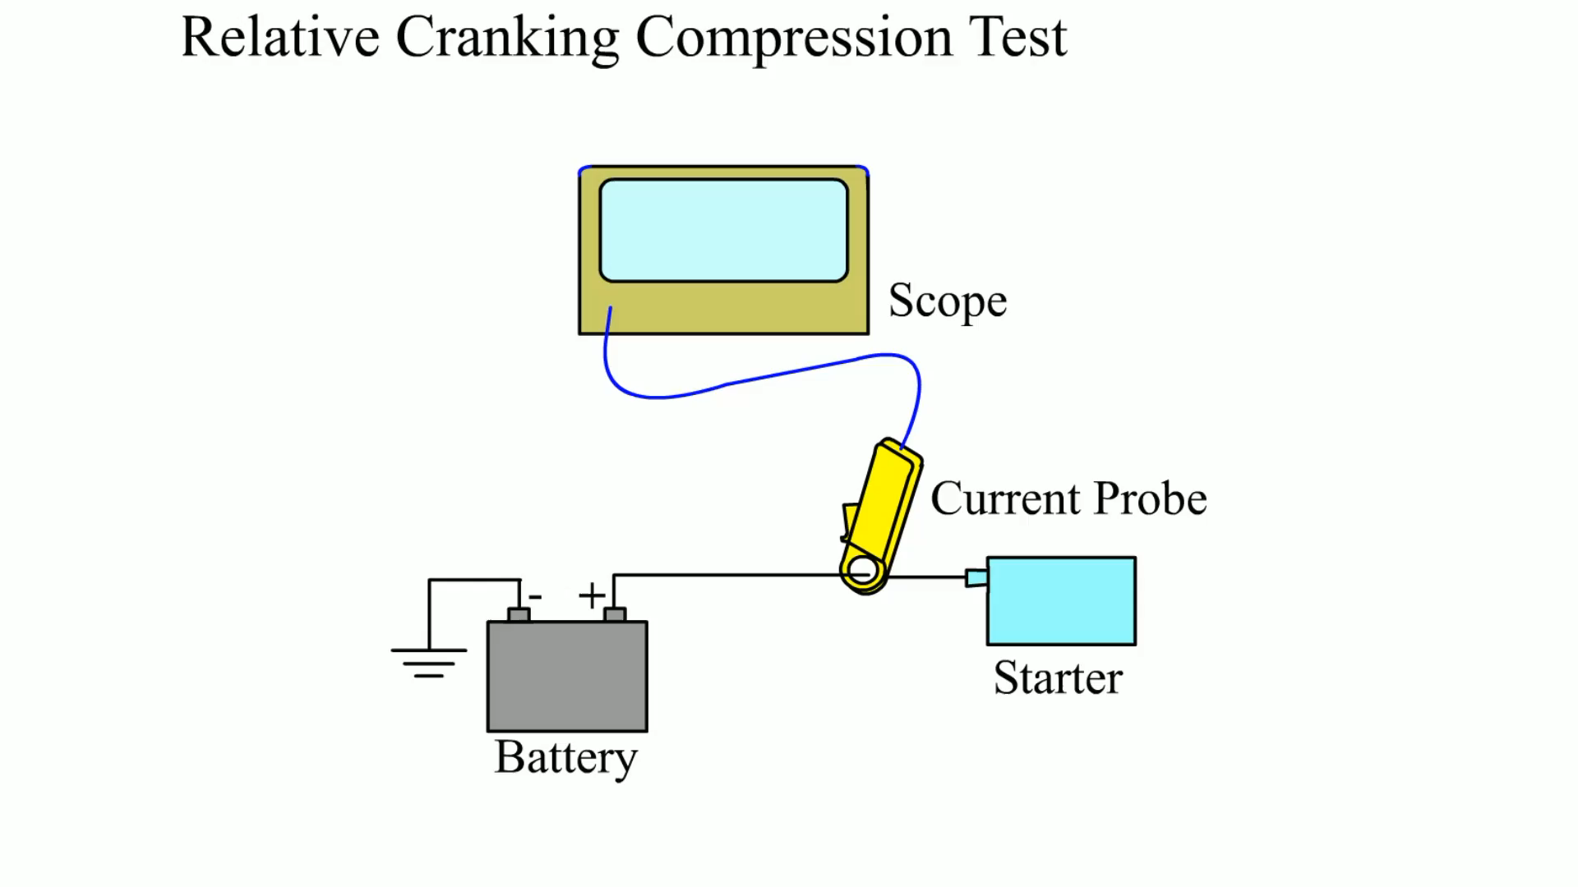
Animation:
Relative Cranking Compression Test
(The animation will automatically start in a few seconds)

Slide 26
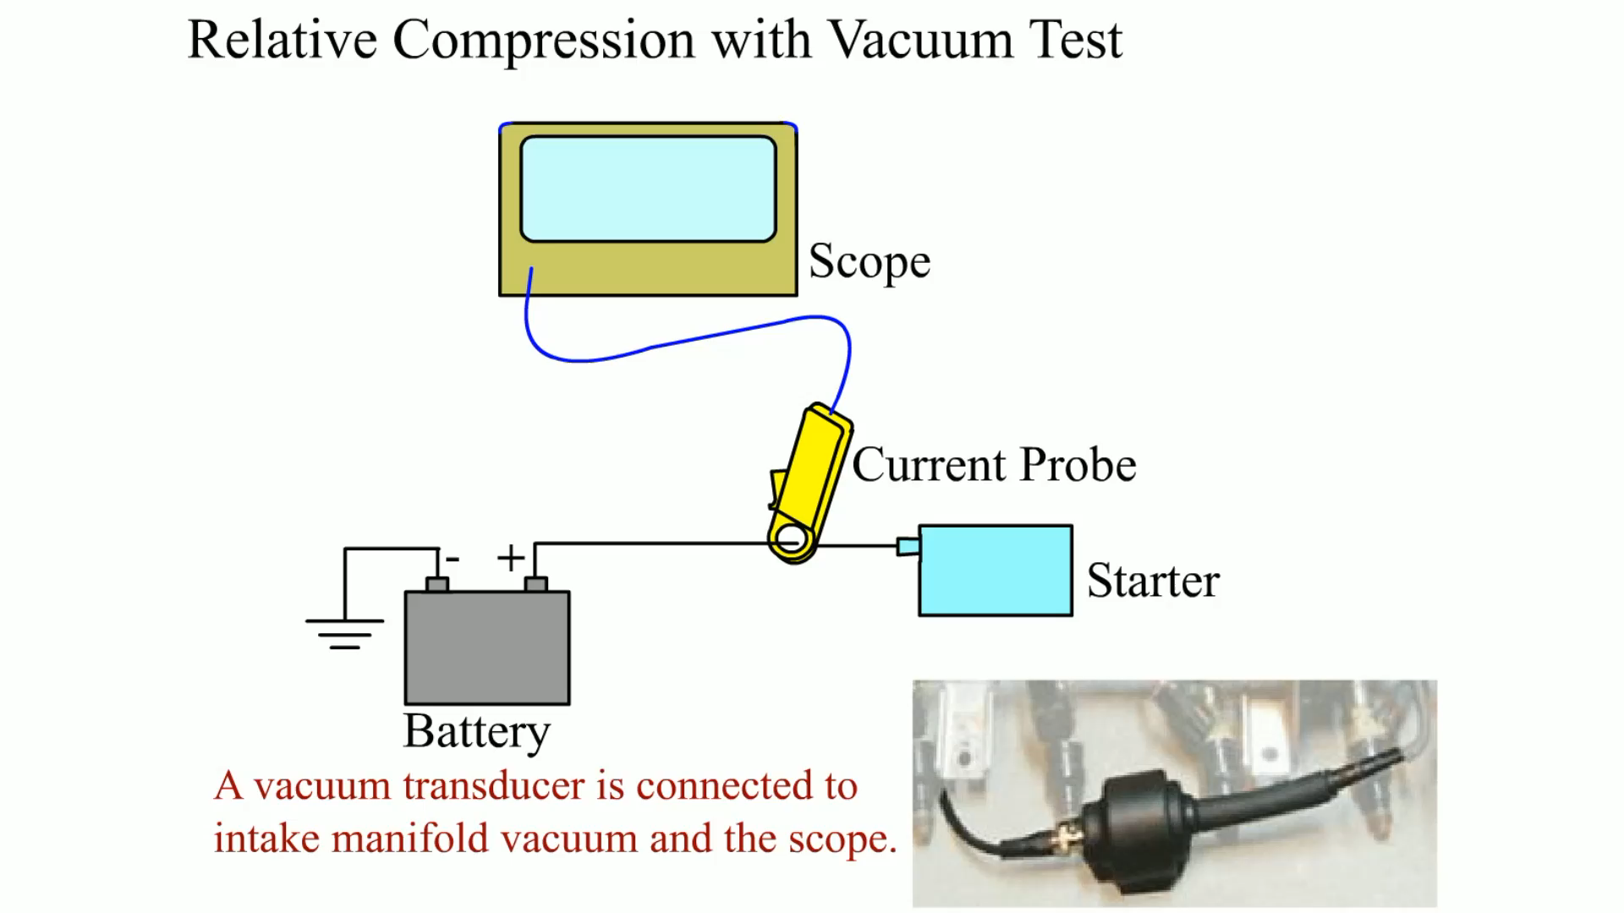
Animation:
Relative Compression with Vacuum Test
(The animation will automatically start in a few seconds)

Slide 27
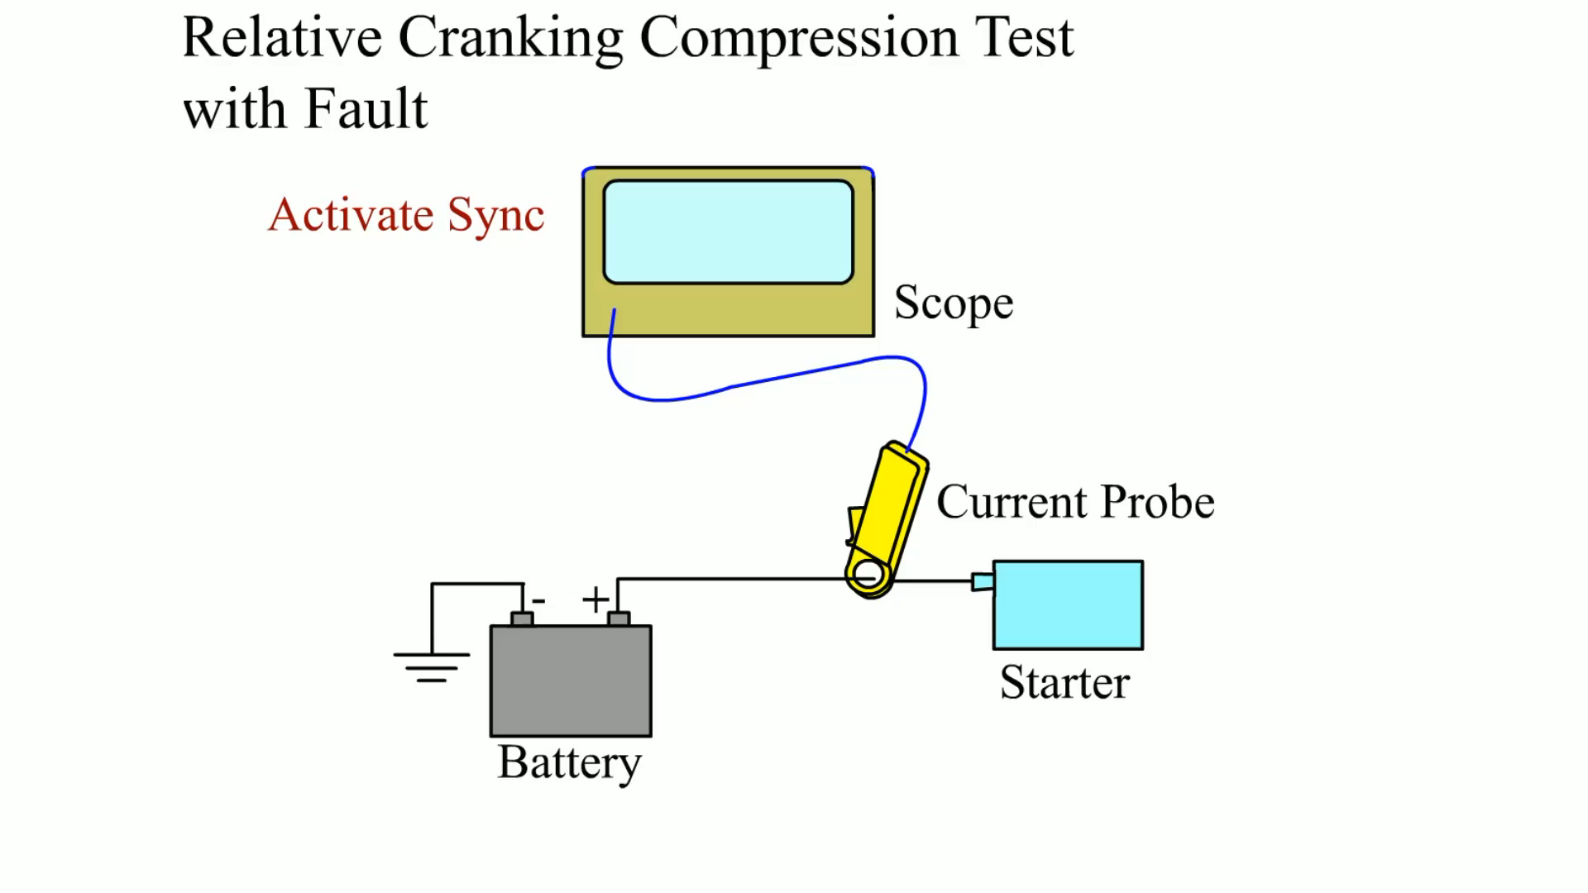
Animation:
Relative Cranking Compression Test with Fault
(The animation will automatically start in a few seconds)

Slide 28
Compression Test
An engine compression test is one of the fundamental engine diagnostic tests that can be performed.
For smooth engine operation, all cylinders must have equal compression.
An engine can lose compression by leakage of air through one or more of only three routes.
  Intake or exhaust valve
  Piston rings (or piston, if there is a hole)
  Cylinder head gasket

Slide 29
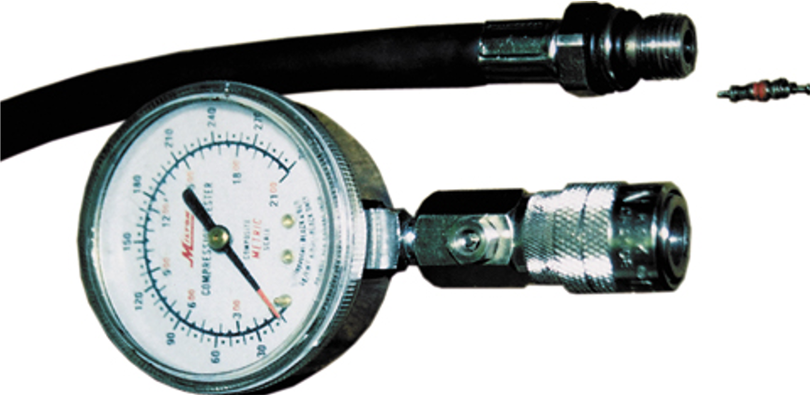
Figure 21.13
A two-piece compression gauge set. The threaded hose is screwed into the spark plug hole after removing the spark plug. The gauge part is then snapped onto the end of the hose.

Slide 30
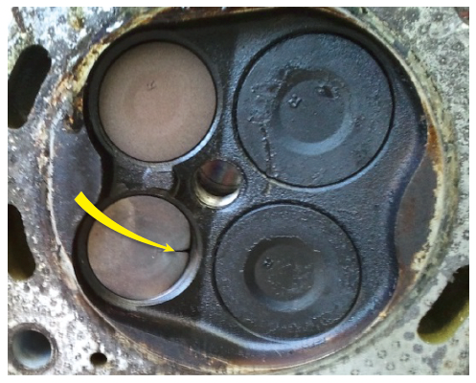
Figure 21.15
A badly burned exhaust valve. A compression test could have detected a problem, and a cylinder leakage test (leak-down test) could have been used to determine the exact problem.

Slide 31
Wet Compression Test
If the compression test reading indicates low compression on one or more cylinders, add three squirts of oil to the cylinder and retest.
This is called a wet compression test, when oil is used to help seal around the piston rings.

Slide 32
Running (Dynamic) Compression Test
A running compression test, also called a dynamic compression test, is done with the engine running rather than during engine cranking as is done in a regular compression test.
The compression pressure of a running engine is much lower than cranking compression pressure.
  Compression during cranking: 125 to 160 P S I
  Compression at idle: 60 to 90 P S I
  Compression at 2000 R P M: 30 to 60 P S I
Snap Test

Slide 33
Cylinder Leakage Test
One of the best tests that can be used to determine engine condition is the cylinder leakage test.
  This test involves injecting air under pressure into the cylinders one at a time.
  The amount and location of any escaping air helps the technician determine the condition of the engine.
  The air is injected into the cylinder through a cylinder leakage gauge into the spark plug hole.

Slide 34
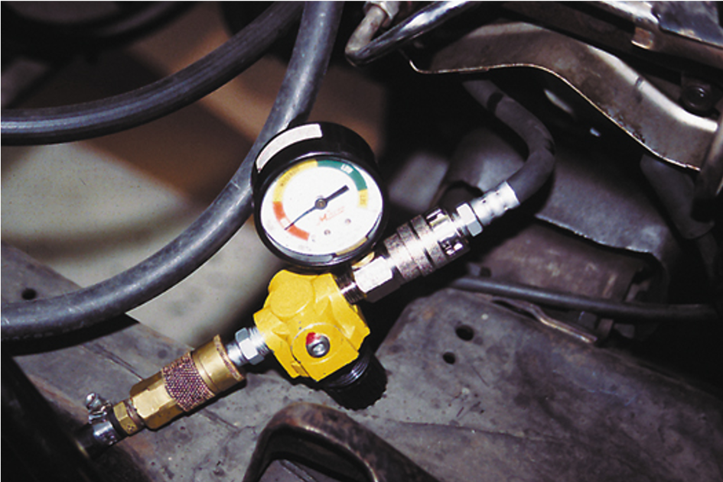
Figure 21.17
A typical handheld cylinder leakage tester.

Slide 35
Cylinder Power Balance Test
The purpose of a cylinder power balance test is to determine if all cylinders are contributing power equally.
The acceptable method of canceling cylinders is to ground the secondary current for each cylinder.
  The cylinder with the least R P M drop is the cylinder not producing its share of power.

Slide 36
Power Balance Test Procedure
Insert a short piece of vacuum hose between the coil terminal and the plug wire.
Use a standard light bulb-type test light to short out each cylinder.
To avoid possible damage to the catalytic converter, do not short out a cylinder for longer than five seconds.

Slide 37
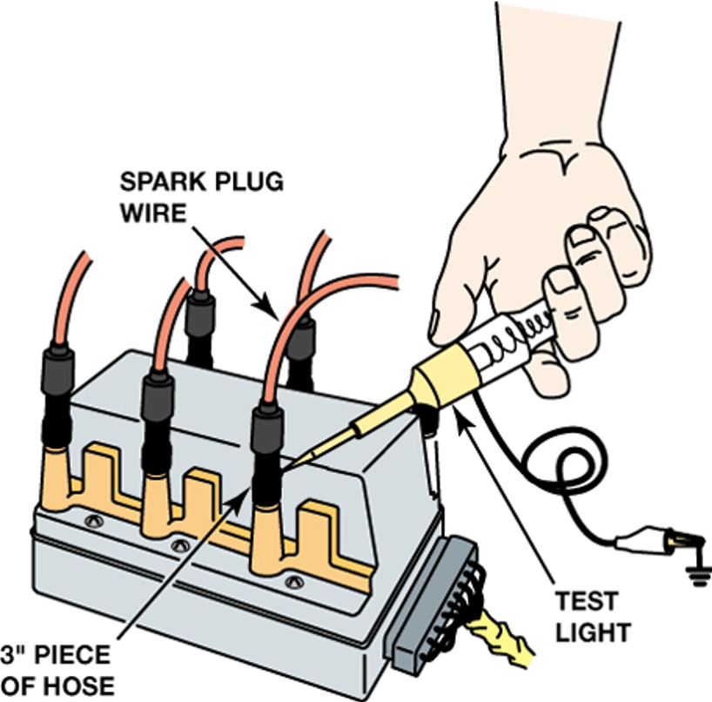
Figure 21.19
Using a vacuum hose and a test light to ground one cylinder at a time on a distributorless ignition system.

Slide 38
Vacuum Tests
Cranking Vacuum Test
Idle Vacuum Test
Low and Steady Vacuum
Fluctuating Vacuum

Slide 39
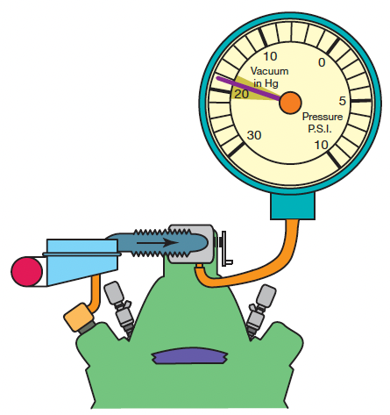
Figure 21.20
An engine in good mechanical condition should produce 17 to 21 inch Hg of vacuum at idle at sea level.

Slide 40
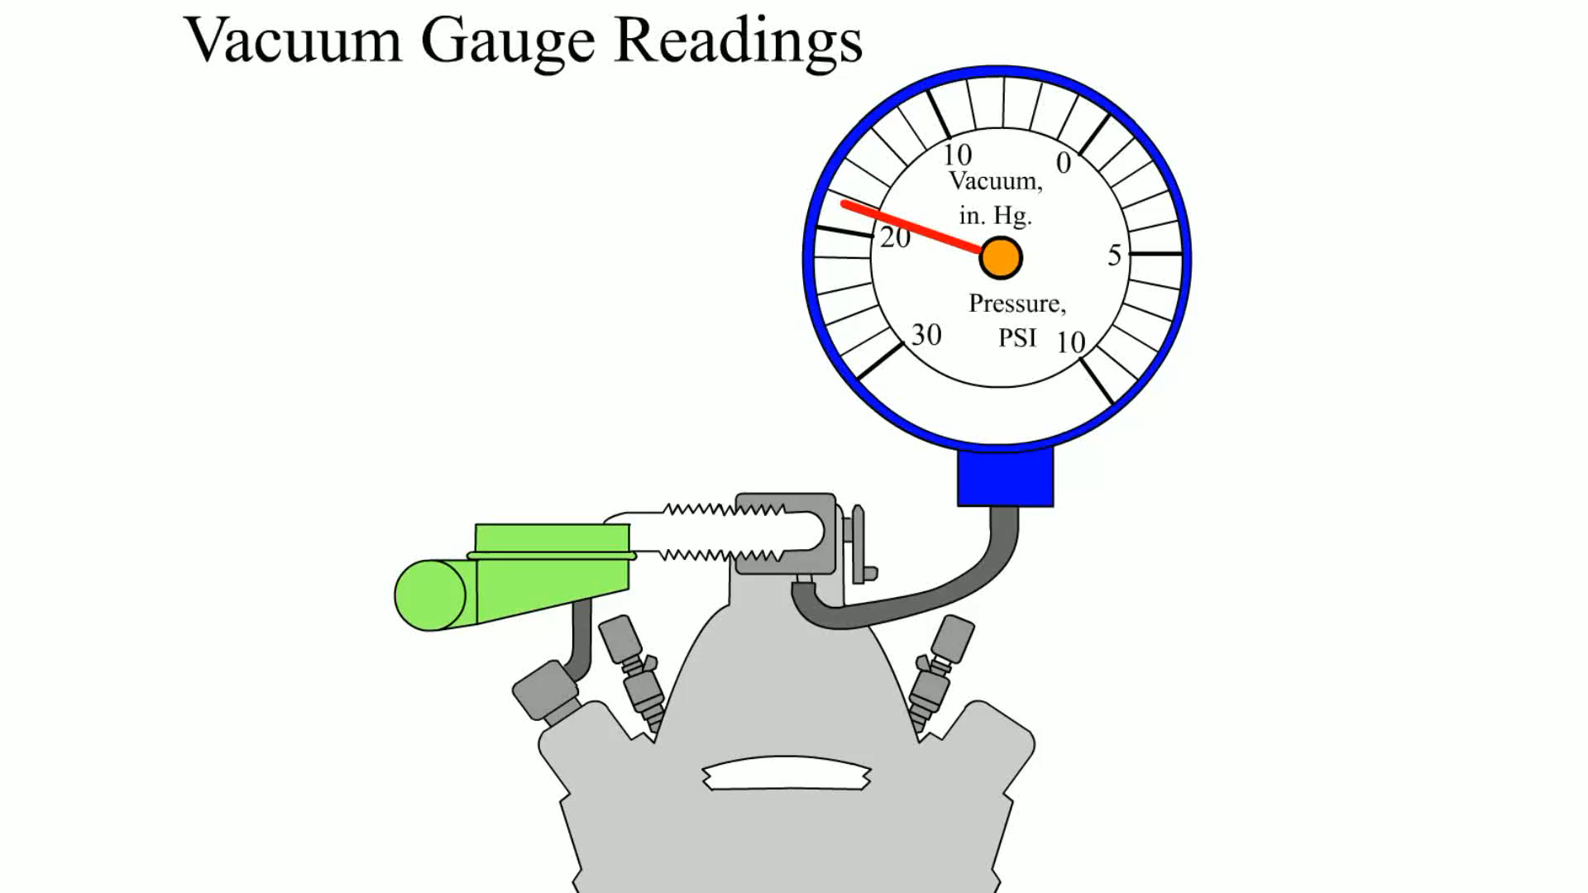
Animation:
Vacuum Gauge Readings
(The animation will automatically start in a few seconds)

Slide 41
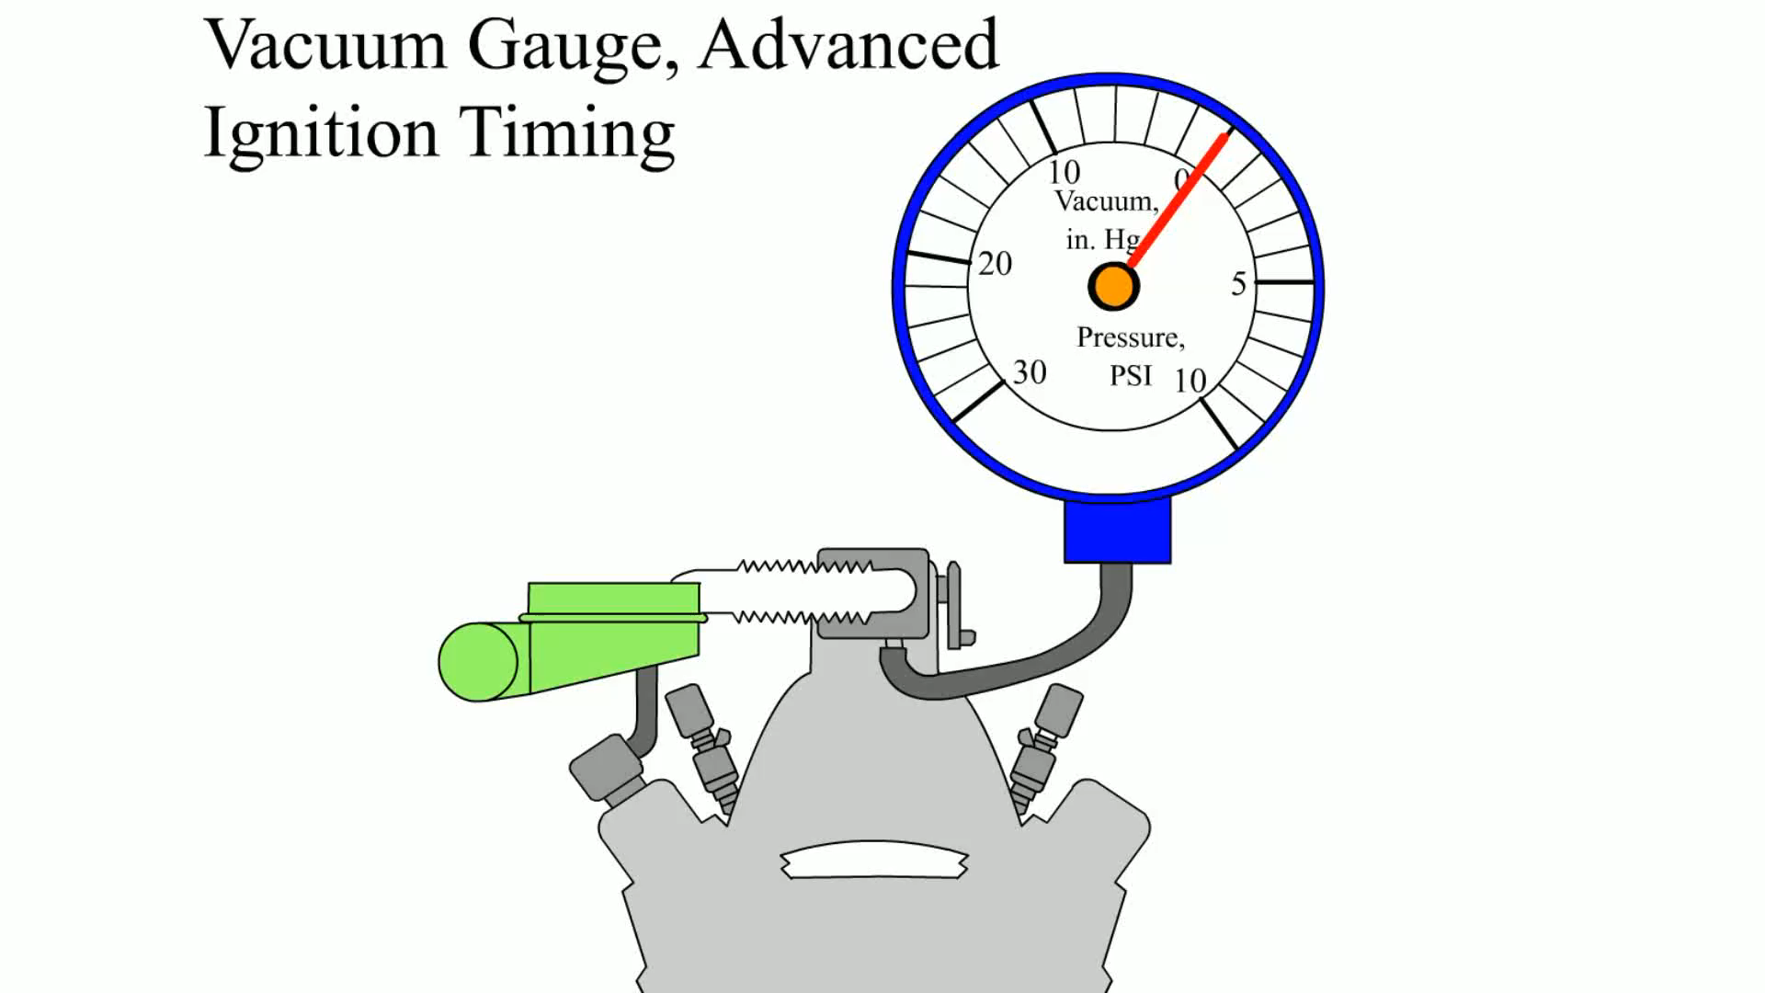
Animation:
Vacuum Gauge, Advanced Ignition Timing
(The animation will automatically start in a few seconds)

Slide 42

Animation:
Vacuum Gauge, Faulty Valve
(The animation will automatically start in a few seconds)

Slide 43
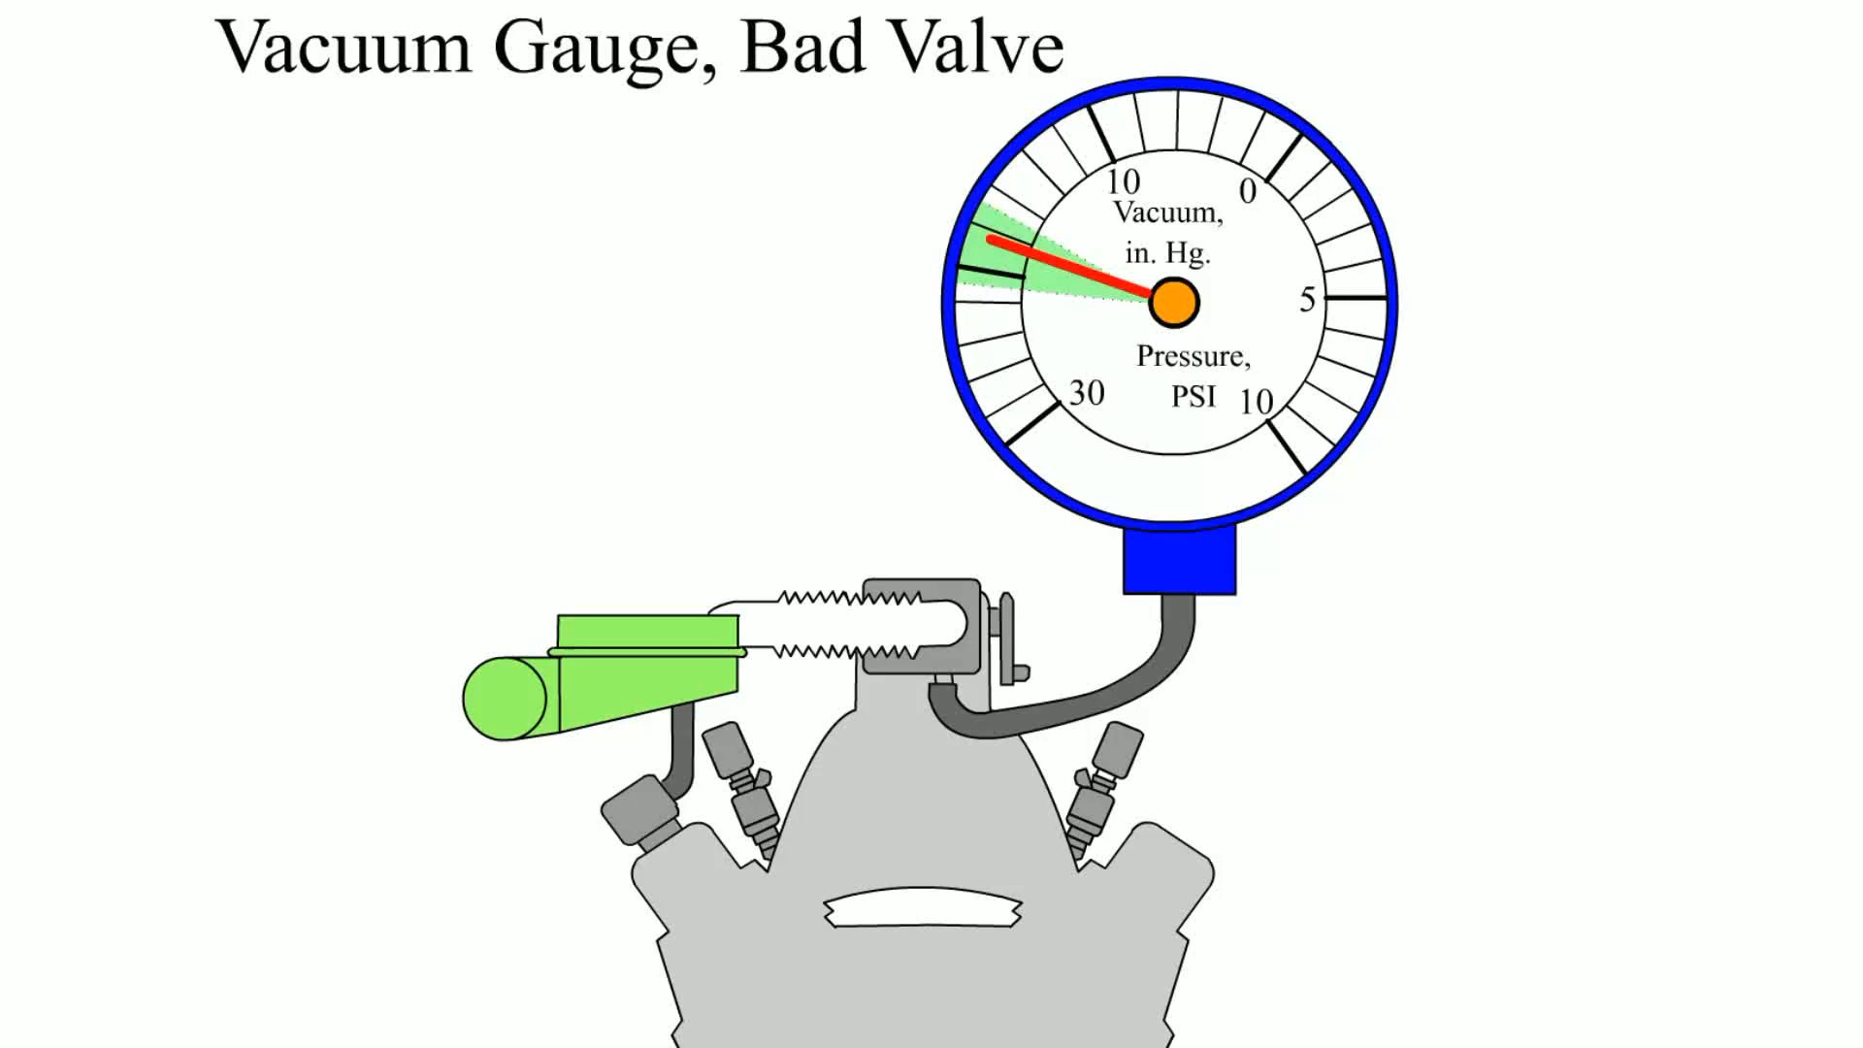
Animation:
Vacuum Gauge, Bad Valve
(The animation will automatically start in a few seconds)

Slide 44
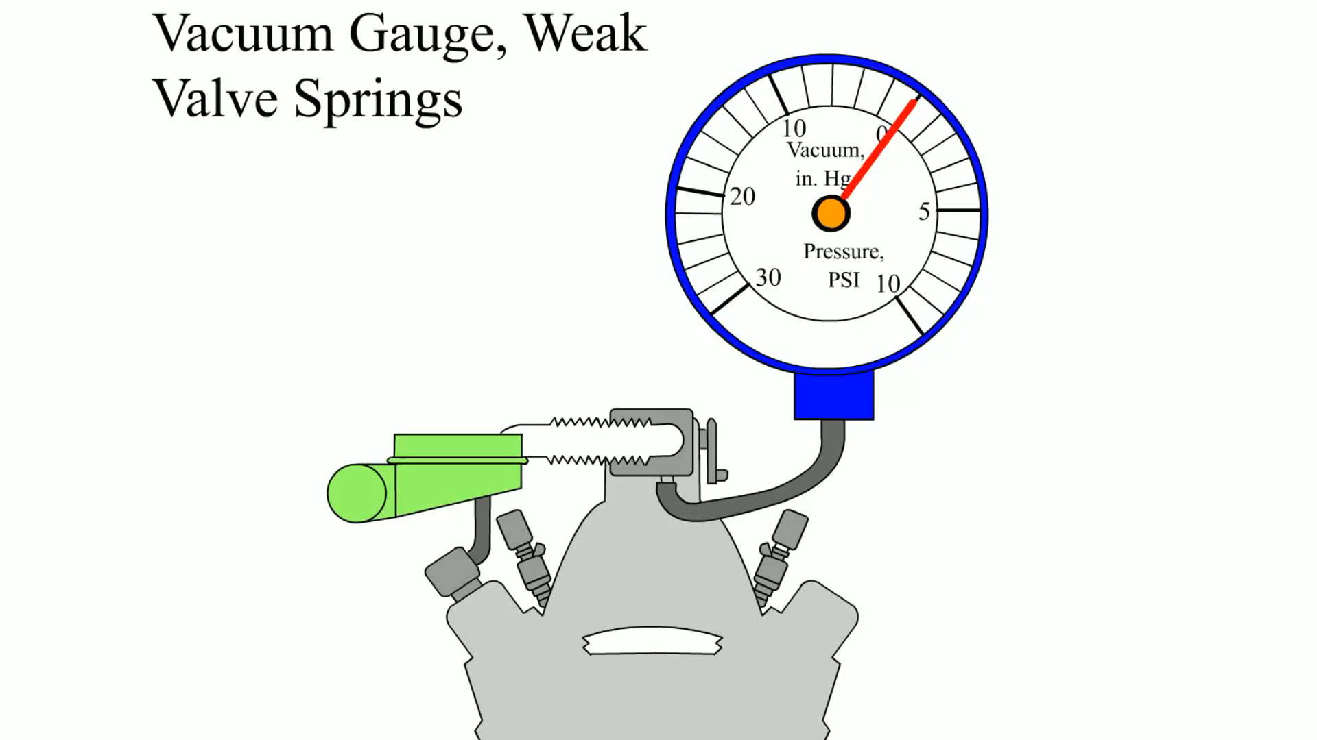
Animation:
Vacuum Gauge, Weak Valve Springs
(The animation will automatically start in a few seconds)

Slide 45
Animation:
Vacuum Gauge, Advanced Ignition Timing
(The animation will automatically start in a few seconds)

Slide 46
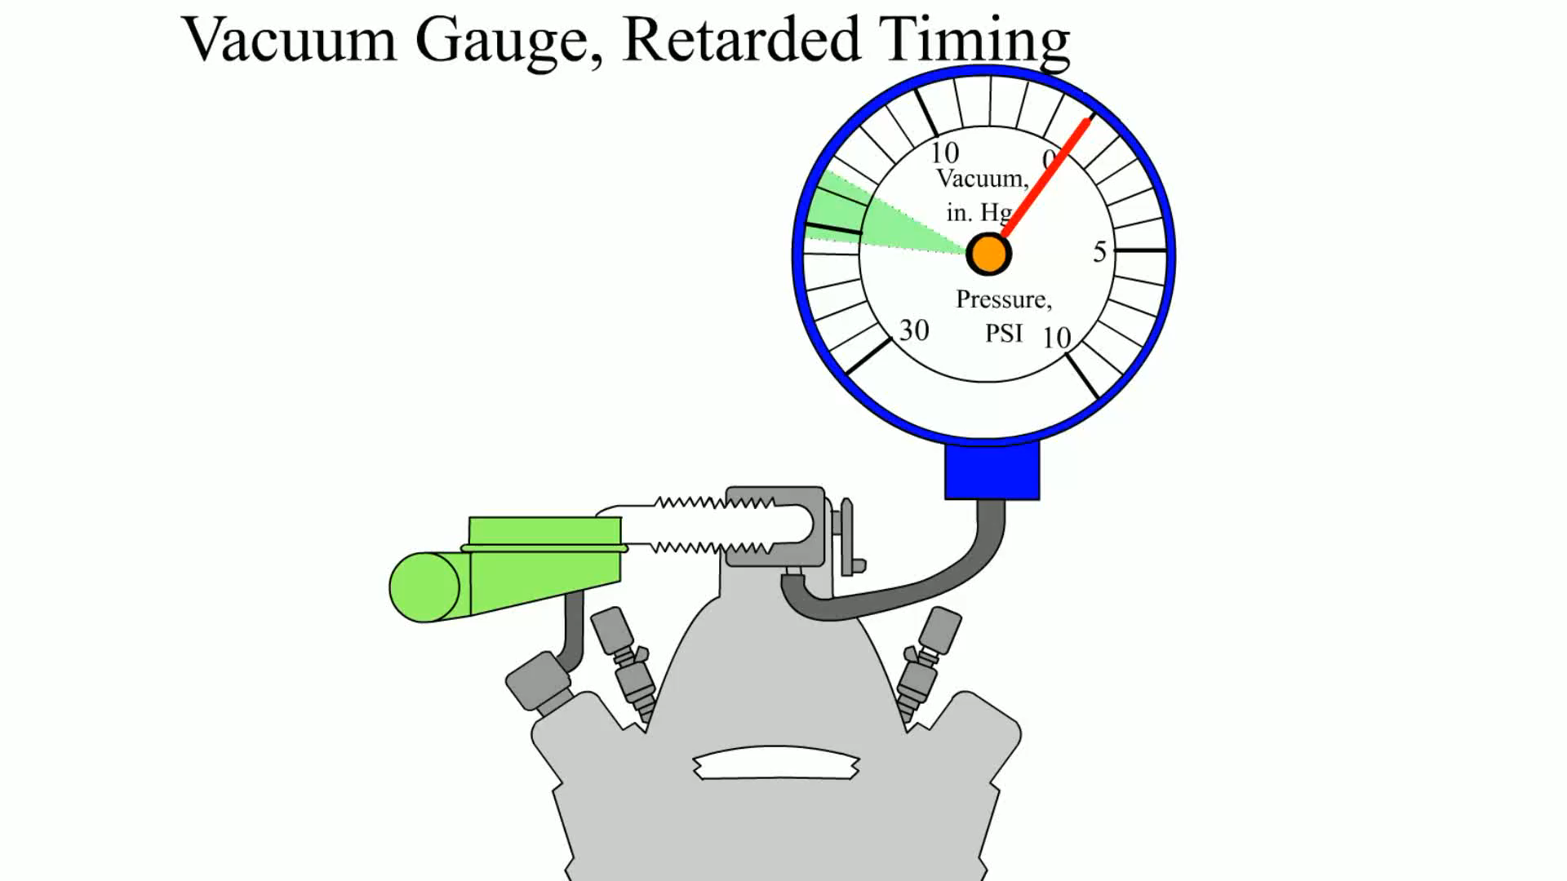
Animation:
Vacuum Gauge, Retarded Timing
(The animation will automatically start in a few seconds)

Slide 47
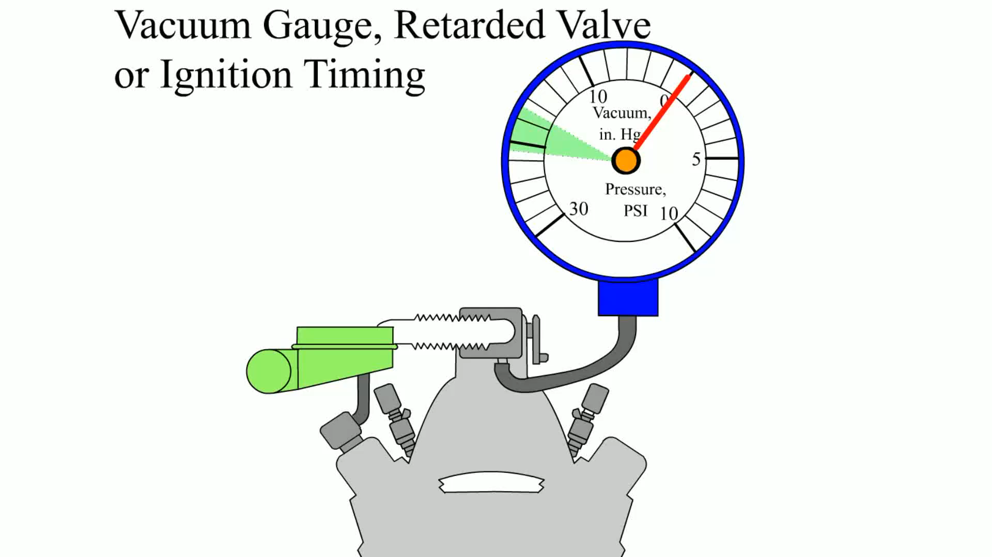
Animation:
Vacuum Gauge, Retarded Valve or Ignition Timing
(The animation will automatically start in a few seconds)

Slide 48
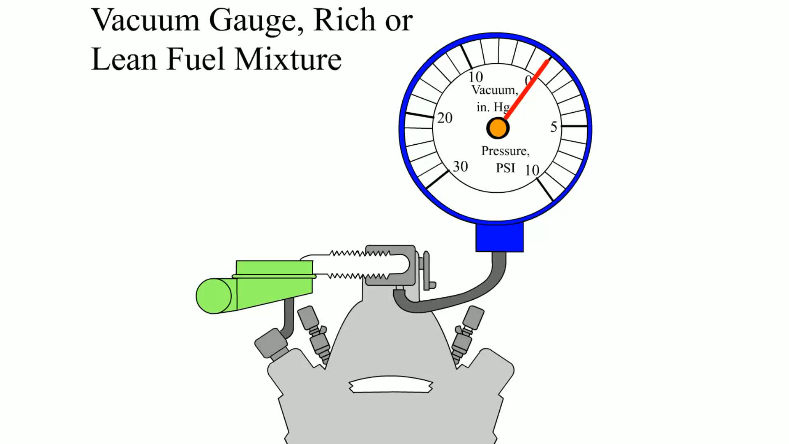
Animation:
Vacuum Gauge, Rich or Lean Fuel Mixture
(The animation will automatically start in a few seconds)

Slide 49
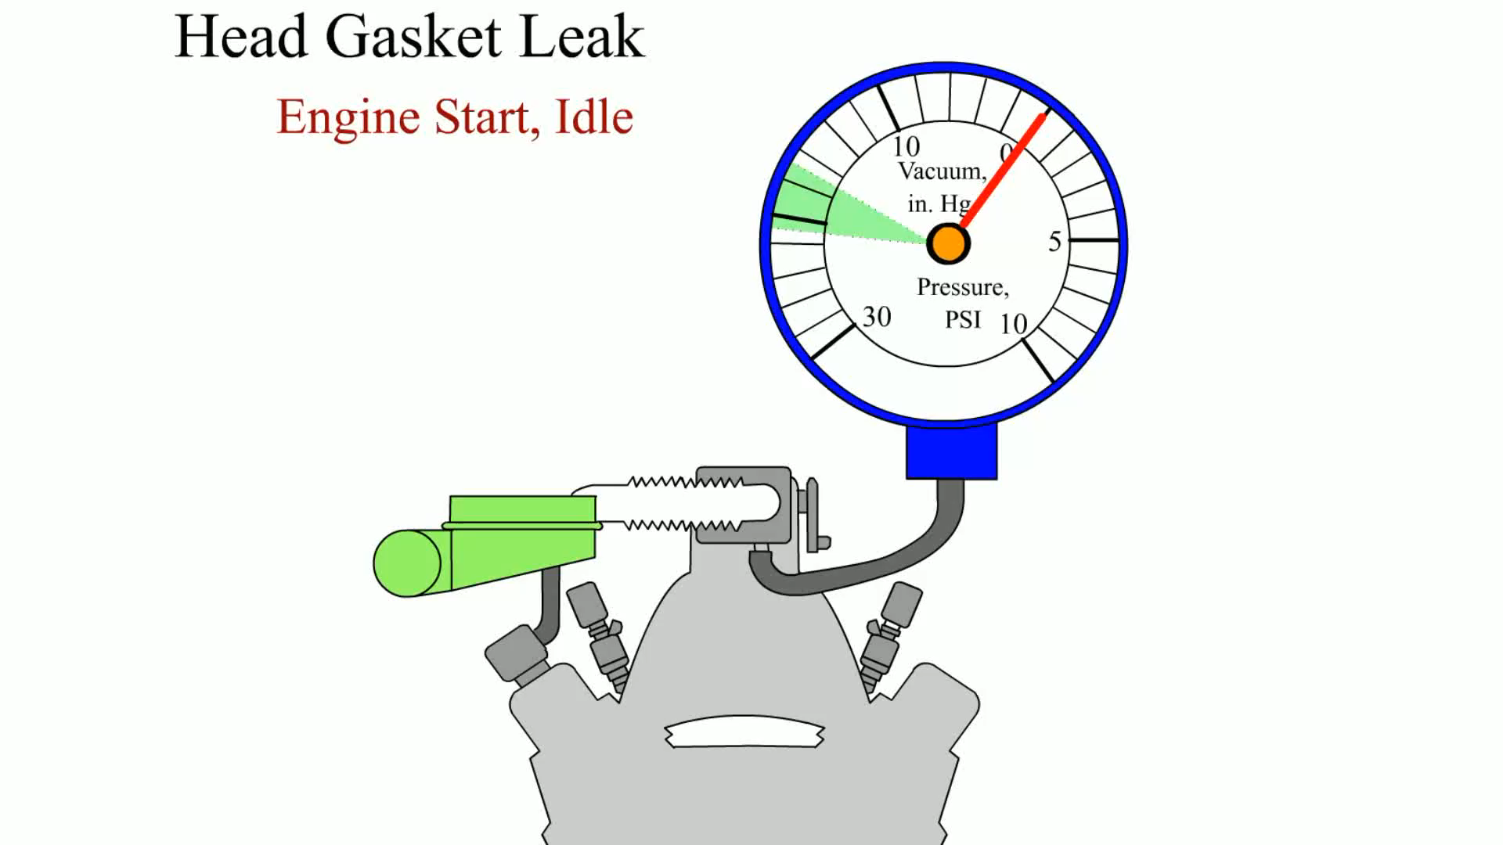
Animation:
Vacuum Gauge, Head Gasket Leak
(The animation will automatically start in a few seconds)

Slide 50
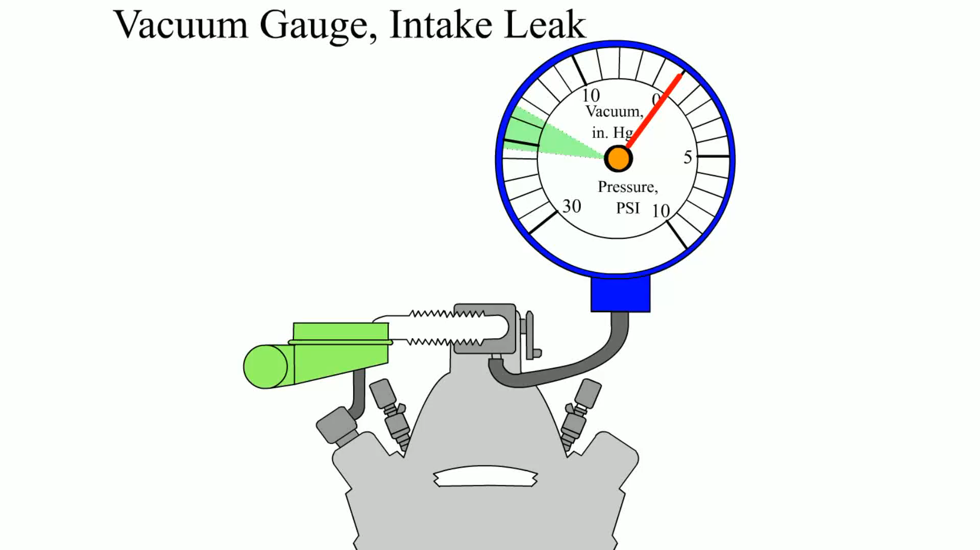
Animation:
Vacuum Gauge, Intake Leak
(The animation will automatically start in a few seconds)

Slide 51
Animation:
Vacuum Gauge, Rich or Lean Fuel Mixture
(The animation will automatically start in a few seconds)

Slide 52
Exhaust Restriction Test
If the exhaust system is restricted, the engine will be low on power, yet smooth.
Common causes of restricted exhaust include the following:
  Clogged catalytic converter
  Clogged or restricted muffler
  Damaged or defective piping

Slide 53
Testing Back Pressure With a Vacuum Gauge
A vacuum gauge can be used to measure manifold vacuum at a high idle (2000 to 2500 R P M).
  If the exhaust system is restricted, pressure increases in the exhaust system.
  This pressure is called back pressure.
  Manifold vacuum will drop gradually if the engine is kept at a constant speed if the exhaust is restricted.

Slide 54
Testing Back Pressure With a Pressure Gauge
Exhaust system back pressure can be measured directly by installing a pressure gauge into an exhaust opening.
This can be accomplished in one of the following ways.
  With an oxygen sensor
  With the exhaust gas recirculation (EG R) valve
At idle, the maximum back pressure should be less than 1.5 PSI (10 kPa), and it should be less than 2.5 P S I (15 kPa) at 2500 R P M.

Slide 55
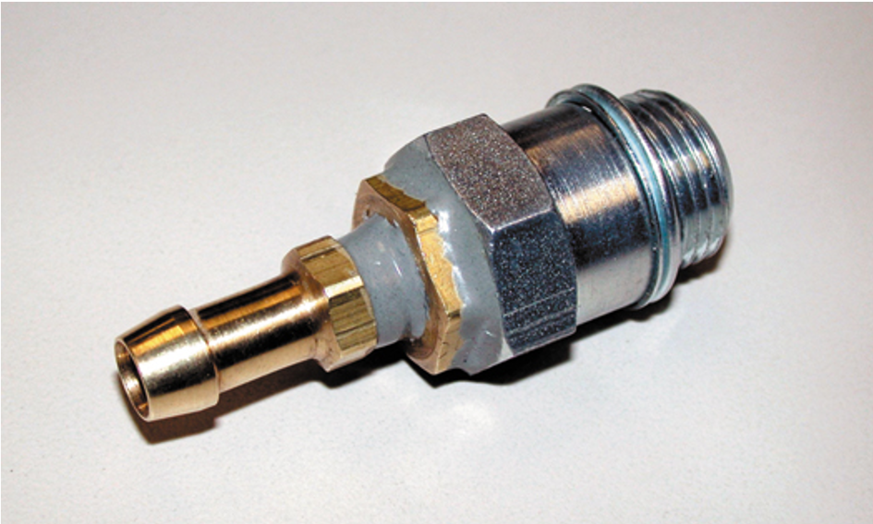
Figure 21.31
A technician-made adapter used to test exhaust system back pressure.

Slide 56
Diagnosing Head Gasket Failure
Several items can be used to help diagnose a head gasket failure.
  Exhaust gas analyzer
  Chemical test
  Bubbles in the coolant
  Excessive exhaust steam

Slide 57
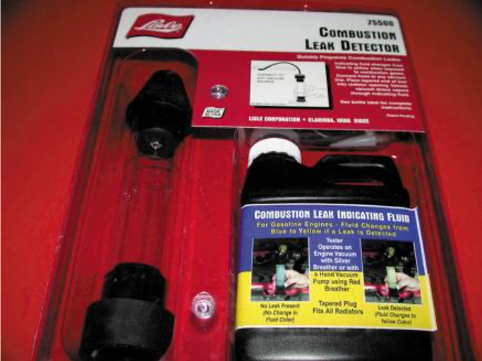
Figure 21.32
A tester that uses a blue liquid to check for exhaust gases in the coolant, which would indicate a head gasket leak problem.

Slide 58
Dash Warning Lights
Most vehicles are equipped with several dash warning lights often called “telltale” or “idiot” lights.
  These lights are often the only warning a driver receives that there may be engine problems.
  Oil (Engine) Light
  Coolant Temperature Light

Slide 59
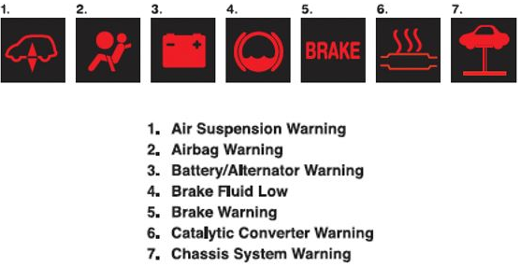
Dash Warning Light Symbols (1 of 5)
Notes:
Long Description:
The symbols are as follows:
1. Air Suspension Warning.
2. Airbag Warning.
3. Battery or Alternator Warning.
4. Brake Fluid Low.
5. Brake Warning.
6. Catalytic Converter Warning.
7. Chassis System Warning.
Above the texts, the corresponding symbols are shown.

Slide 60
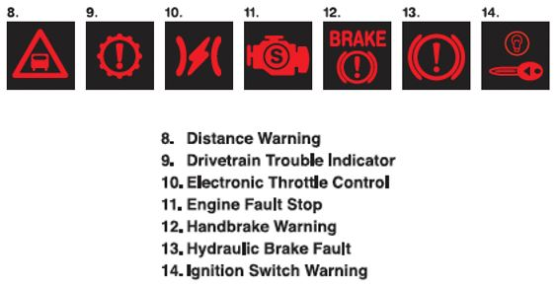
Dash Warning Light Symbols (2 of 5)
Notes:
Long Description:
The symbols are as follows:
8. Distance Warning.
9. Drivetrain Trouble Indicator.
10. Electronic Throttle Control.
11. Engine Fault Stop.
12. Handbrake Warning.
13. Hydraulic Brake Fault.
14. Ignition Switch Warning.
Above the texts, the corresponding symbols are shown.

Slide 61
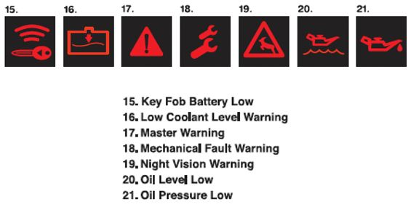
Dash Warning Light Symbols (3 of 5)
Notes:
Long Description:
The symbols are as follows:
15. Key Fob Battery Low.
16. Low Coolant Level Warning.
17. Master Warning.
18. Mechanical Fault Warning.
19. Night Vision Warning 20.
20. Oil Level Low.
21. Oil Pressure Low.
Above the texts, the corresponding symbols are shown.

Slide 62
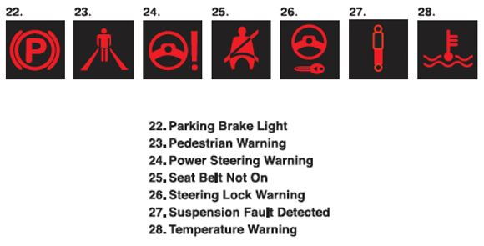
Dash Warning Light Symbols (4 of 5)
Notes:
Long Description:
The symbols are as follows:
22. Parking Brake Light.
23. Pedestrian Warning.
24. Power Steering Warning.
25. Seat Belt Not On.
26. Steering Lock Warning.
27. Suspension Fault Detected.
28. Temperature Warning.
Above the texts, the corresponding symbols are shown.

Slide 63
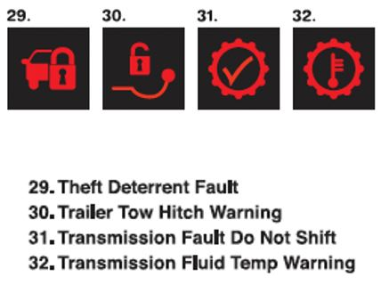
Dash Warning Light Symbols (5 of 5)
Notes:
Long Description:
The symbols are as follows:
29. Theft Deterrent Fault.
30. Trailer Tow Hitch Warning.
31. Transmission Fault Do Not Shift.
32. Transmission Fluid Temp Warning.
Above the texts, the corresponding symbols are shown.

Slide 64
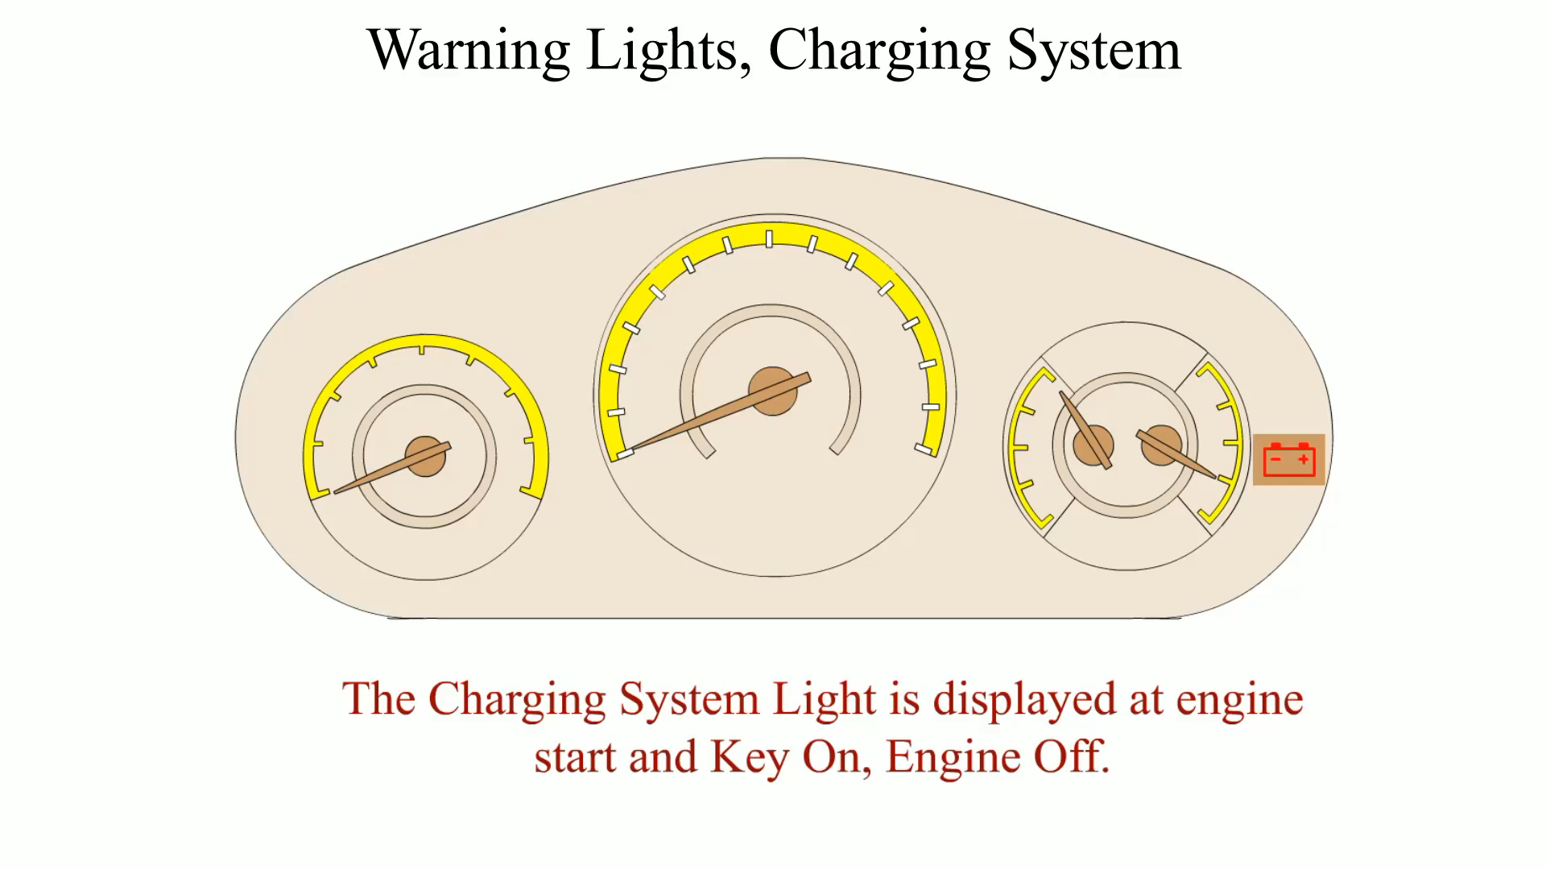
Animation:
Warning Lights, Charging System
(The animation will automatically start in a few seconds)

Slide 65
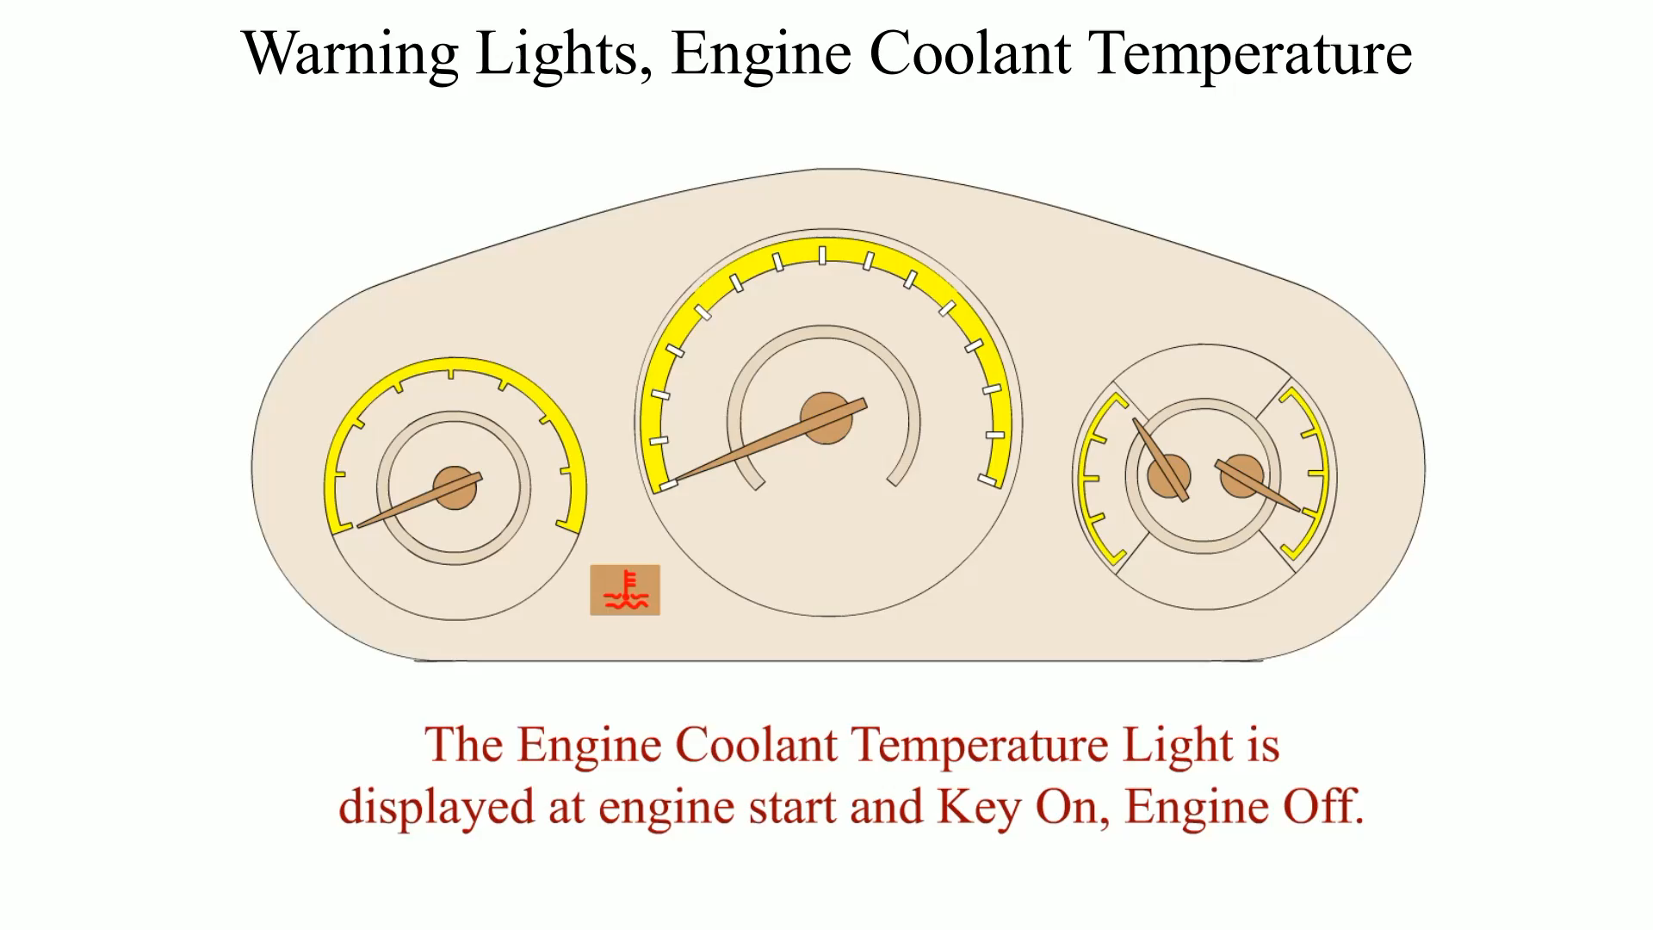
Animation:
Warning Lights, Engine Coolant Temperature
(The animation will automatically start in a few seconds)

Slide 66
Summary (1 of 2)
The first step in diagnosing engine condition is to perform a thorough visual inspection, including a check of oil and coolant levels and condition.
Oil leaks can be found by using a white powder or a fluorescent dye and a black light.
Many engine-related problems make a characteristic noise.

Slide 67
Summary (2 of 2)
A cylinder leakage test fills the cylinder with compressed air, and the gauge indicates the percentage of leakage.
A cylinder balance test indicates whether all cylinders are working okay.
Testing engine vacuum is another procedure that can help the service technician determine engine condition.

Slide 68
Animation and Video Resources
The below listed resources are hyperlinked to the James Halderman website
(A1) Engine Repair Animations
(A1) Engine Repair Videos
(A8) Engine Performance Animations
(A8) Engine Performance Videos

Slide 69

Copyright
This work is protected by United States copyright laws and is provided solely for the use of instructors in teaching their courses and assessing student learning. Dissemination or sale of any part of this work (including on the World Wide Web) will destroy the integrity of the work and is not permitted. The work and materials from it should never be made available to students except by instructors using the accompanying text in their classes. All recipients of this work are expected to abide by these restrictions and to honor the intended pedagogical purposes and the needs of other instructors who rely on these materials.

