Slide 1


Automotive Engines Theory and Servicing
Tenth Edition
Chapter 19
Intake and Exhaust Systems
Copyright © 2023 Pearson Education, Inc. All Rights Reserved
Notes:
If this PowerPoint presentation contains mathematical equations, you may need to check that your computer has the following installed:
1) MathType Plugin
2) Math Player (free versions available)
3) NVDA Reader (free versions available)
Slides in this presentation contain hyperlinks. JAWS users should be able to get a list of links by using INSERT+F7

Slide 2
Learning Objectives
19.1 Explain air intake filtration.
19.2 Discuss the throttle-body injection intake manifolds and port fuel-injection intake manifolds.
19.3 Describe the purpose and function of variable intake manifolds.
19.4 Discuss exhaust gas recirculation passages and exhaust manifolds.
19.5 Describe the purpose and function of exhaust system components.
19.6 Describe the purpose and function of mufflers.

Slide 3
Intake Air Filtration
Need For Air Filtering
Air Filter Elements
Filter Replacement
Remotely Mounted Air Filters And Ducts
Air Filter Restriction Indicator

Slide 4
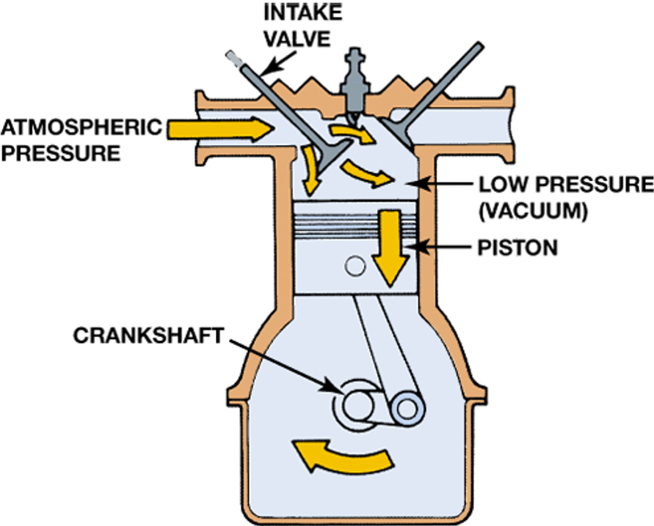
Figure 19.1
Downward movement of the piston lowers the air pressure inside the combustion chamber. The pressure differential between the atmosphere and the inside of the engine forces air into the engine.

Slide 5
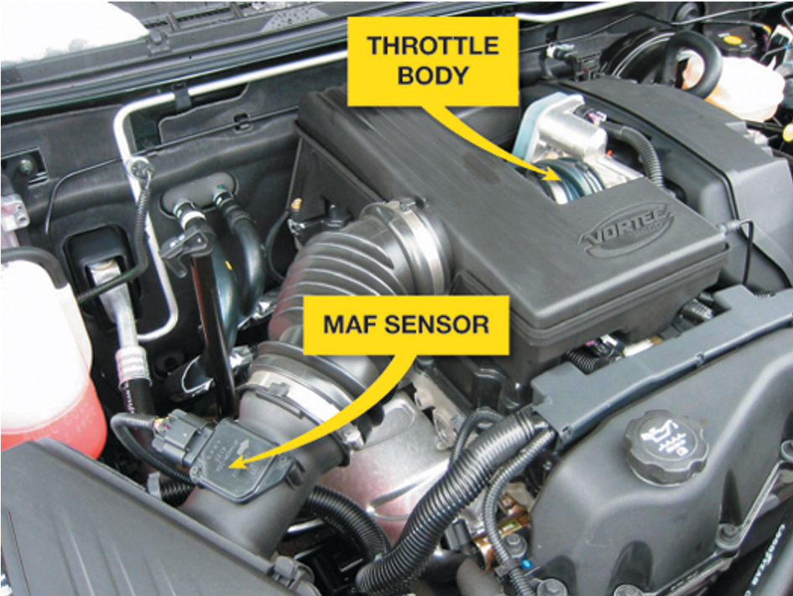
Figure 19.3
Most air filter housings are located on the side of the engine compartment and use flexible rubber hose to direct the airflow into the throttle body of the engine.

Slide 6
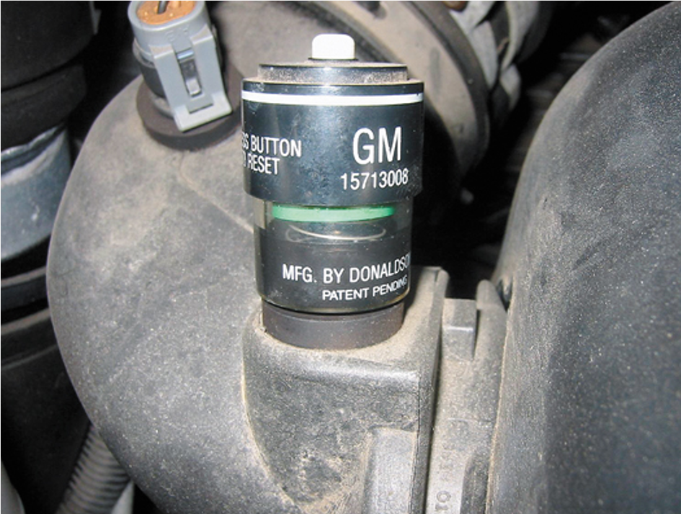
Figure 19.4
A typical air filter restriction indicator used on a General Motors truck engine. The indicator turns red when it detects enough restriction to require a filter replacement.

Slide 7
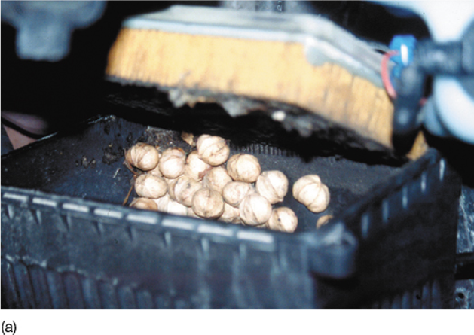
Figure 19.5a
Note the discovery as the air filter housing was opened during service on a Pontiac. The nuts were obviously deposited by squirrels (or some other animal).

Slide 8
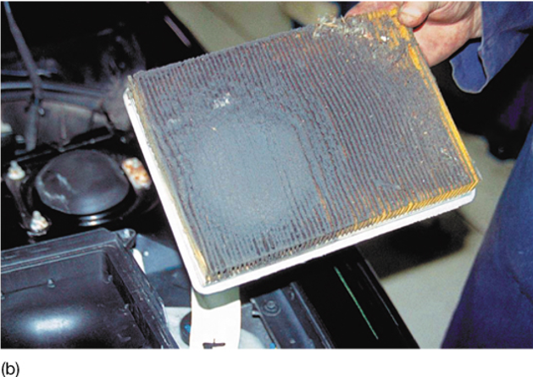
Figure 19.5b
Not only was the housing filled with nuts, but also this air filter was extremely dirty, indicating that this vehicle had not been serviced for a long time.

Slide 9
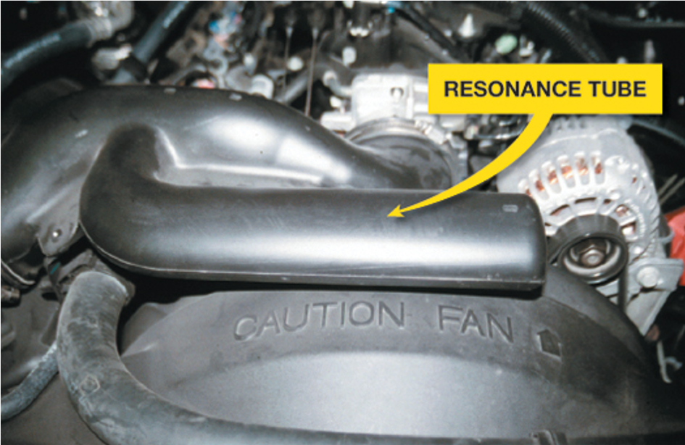
Figure 19.6
A resonance tube, called a Helmholtz resonator, is used on the intake duct between the air filter and the throttle body to reduce air intake noise during engine acceleration.

Slide 10
Intake Manifolds
The size and shape of port fuel-injected engine intake manifolds can be optimized because the only thing in the manifold is air.
Intake manifold runners are tuned to improve engine performance.
  Long runners build low-R P M torque.
  Shorter runners provide maximum high-R P M power.

Slide 11
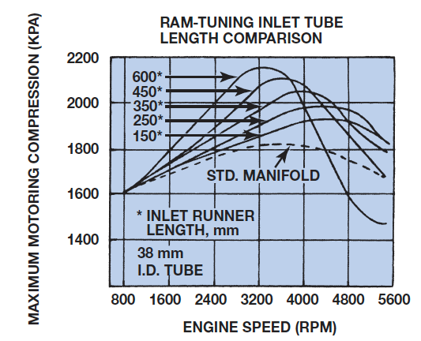
Figure 19.7
The graph shows the effect of sonic tuning of the intake manifold runners. The longer runners increase the torque peak and move it to a lower R P M.
Notes:
Long Description:
The graph is titled, "RAM tuning inlet tube length comparison." The horizontal axis is labeled "engine speed in R P M," ranging from 800 to 5600 in increments of 800, and the vertical axis is labeled "Maximum motoring comparison in K P A," ranging from 1400 to 2200 in increments of 200. The curves are labeled "150 star, 250 star, 350 star, 450 star, and 600 star" from bottom to top. All the curves start from the ordered pair 800 comma 1600, attain high points near ordered pair 4400 comma 1900, ordered pair 4400 comma 2000, ordered pair 4000 comma 2050, ordered pair 3600 comma 2100, and ordered pair 3200 comma 2100, respectively, then dip steeply and exit. Another dashed curve labeled standard manifold also starts from the same points, attains a maxima point near ordered pair 3600 comma 1800, dips steeply, and exits the right viewing window. The star indicates the inlet runner length in millimeters.

Slide 12
Intake Manifold Design
Most intake manifolds are made from thermoplastic molded from fiberglass-reinforced nylon by either casting or by injection molding.
Many intake manifolds are constructed in two parts.
  A lower section attaches to the cylinder heads and includes passages from the intake ports.
  An upper manifold, usually called the plenum, connects to the lower unit

Slide 13
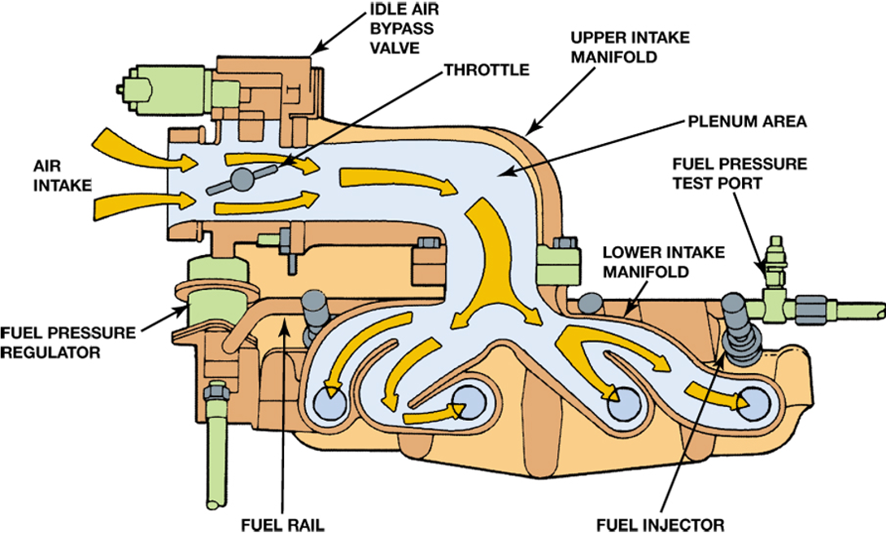
Figure 19.8
Airflow through the large diameter upper intake manifold is distributed to smaller diameter individual runners in the lower manifold in this two-piece manifold design.

Slide 14
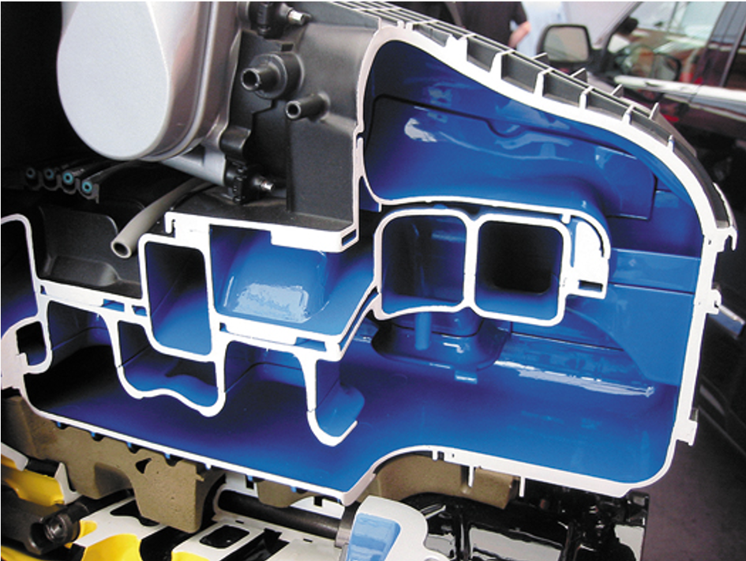
Figure 19.10
Many plastic intake manifolds are constructed using many parts glued together to form complex passages for airflow into the engine.

Slide 15
Variable Intake Manifolds
Variable intake manifolds allow the engine to produce a higher level of torque and horsepower over a wide range of engine speeds.
Vehicle manufacturers use different terms for their design of variable intake manifolds, such as variable intake system (V I S) or variable intake manifold (V I M).

Slide 16
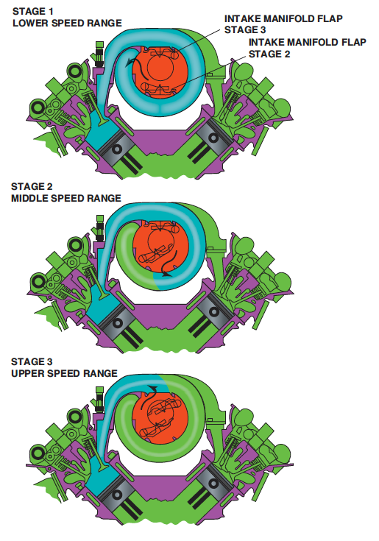
Figure 19.11
A typical variable intake manifold where the length of the intake passage is changed using a valve to change the direction of the airflow.
Notes:
Long Description:
Stage 1: Lower speed range: It shows that the length of the intake passage is full along with intake manifold flap stage 3 and intake manifold flap stage 2. Stage 2: Middle speed range: It shows that the length of the intake passage is half filled. Stage 3: Upper speed range: It shows that a small part of the length of the intake passage is filled.

Slide 17
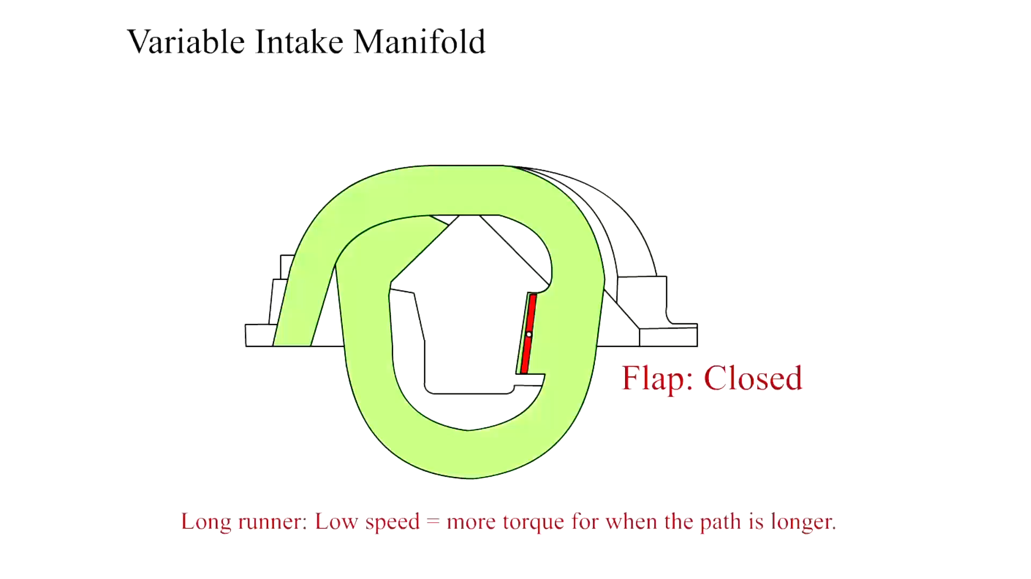
Animation:
Variable Intake Manifold
(The animation will automatically start in a few seconds)

Slide 18
Exhaust Gas Recirculation Passages
Most E G R valves are mounted on the intake manifold.
On V-type engines, the intake manifold crossover is used as a source of exhaust gas for the E G R system.
  A cast passage connects the exhaust crossover to the E G R valve.
On inline-type engines, an external tube is generally used to carry exhaust gas to the E G R valve.
Exhaust Gas Cooler

Slide 19
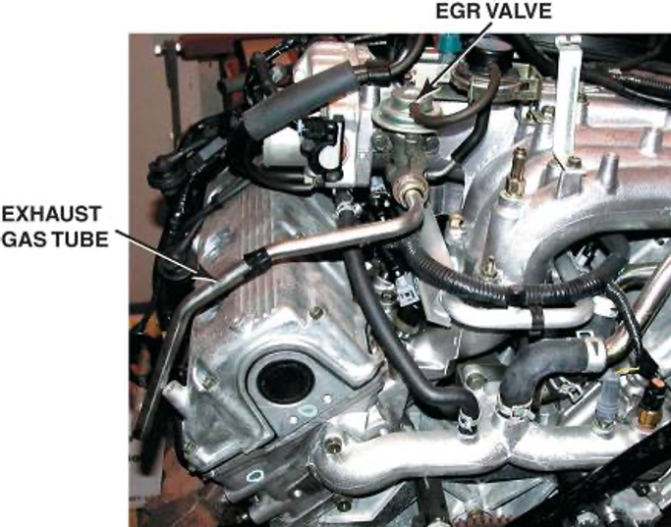
Figure 19.12
A typical long exhaust gas line used to cool the exhaust gases before being recirculated back into the intake manifold.

Slide 20
Exhaust Manifolds
Purpose and Function
Construction
Exhaust Manifold Gaskets

Slide 21
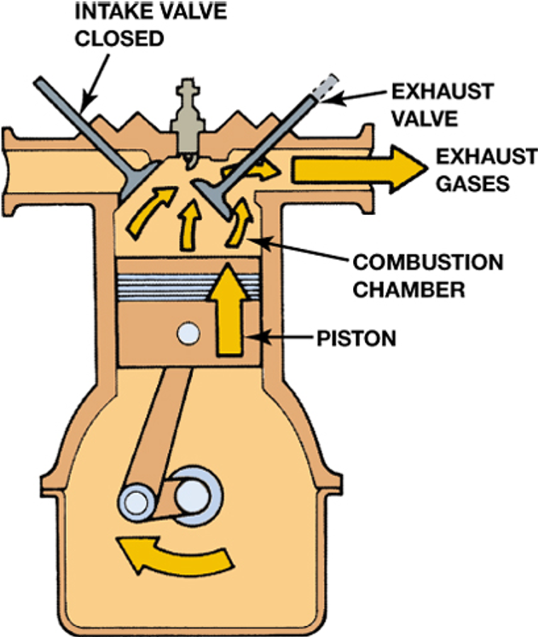
Figure 19.13
The exhaust gases are pushed out of the cylinder by the piston on the exhaust stroke.
Notes:
Long Description:
An air filter shows exhaust gases come out from the crankshaft through a piston, pass through the combustion chamber, and finally come out of the top right gap. A closed intake valve on the left and an exhaust valve on the top right are displayed.

Slide 22
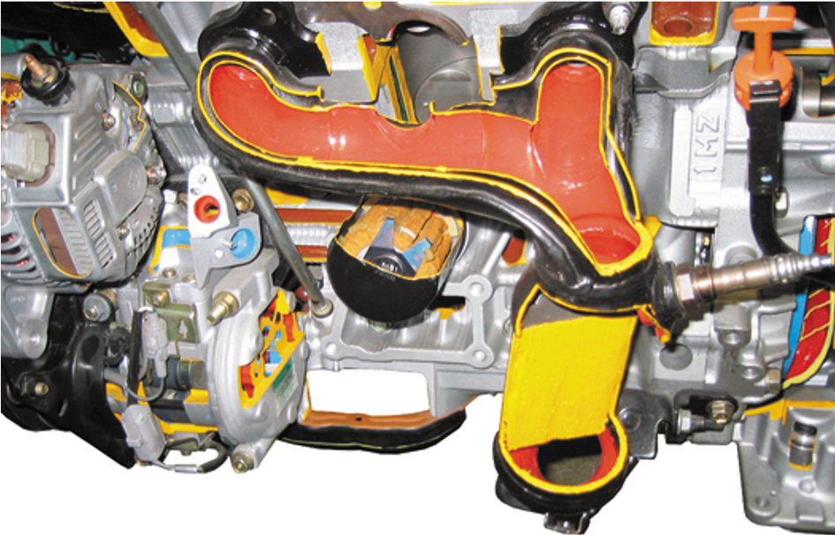
Figure 19.14
This exhaust manifold (red area) is equipped with a heat shield to help retain heat and reduce exhaust emissions.

Slide 23
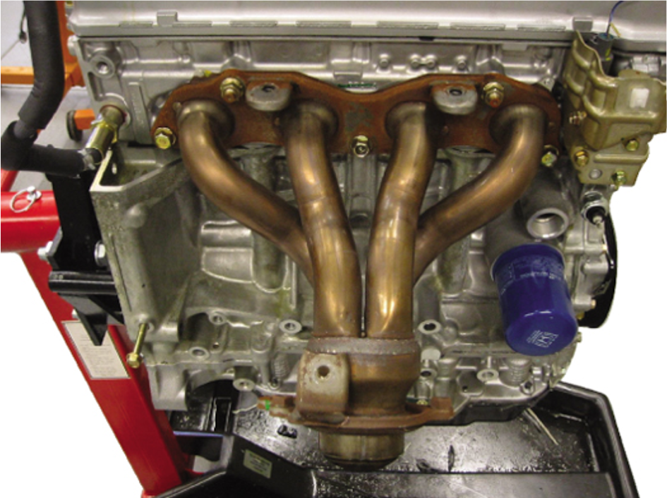
Figure 19.15
Many exhaust manifolds are constructed of steel tubing and are free flowing to improve engine performance.

Slide 24
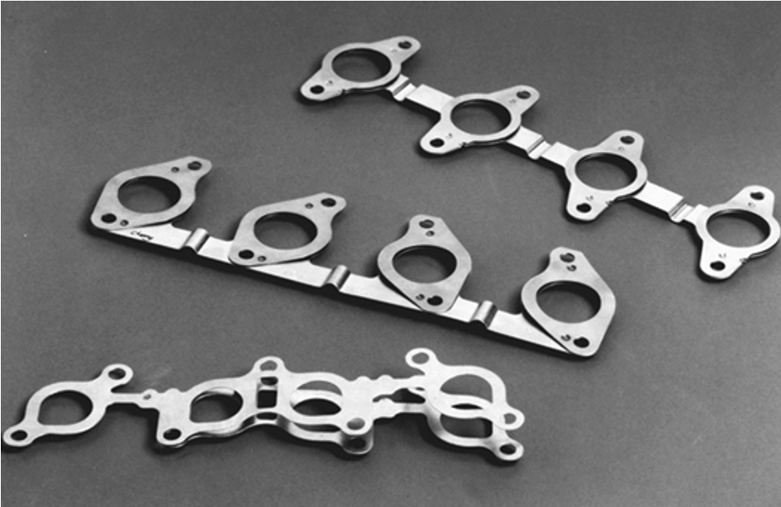
Figure 19.17
Typical exhaust manifold gaskets. Note how they are laminated to allow the exhaust manifold to expand and contract due to heating and cooling.

Slide 25
Exhaust System Components (1 of 2)
Catalytic Converter
  placed as close to the engine as possible so that the heat can help the converter work most efficiently.
  Some engines do not use a separate exhaust manifold and instead use a manifold that is cast as part of the cylinder head. In this situation, the catalytic converter is attached directly to the cylinder head.

Slide 26
Exhaust System Components (2 of 2)
Exhaust Pipes
  Conduct the hot exhaust gases to the rear of the vehicle.
Heat Shields and Hangers
  Prevent the heat from the exhaust system moving upward toward the floor of the vehicle.
  Hangers are used to isolate heat and vibrations in the exhaust system.

Slide 27
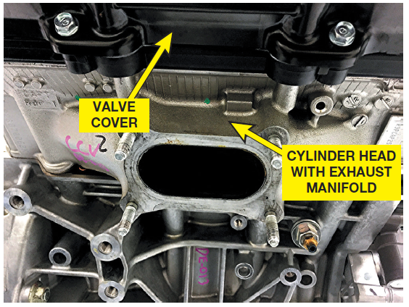
Figure 19.19
The “exhaust manifold” on this Honda is actually part of the cylinder head and not a separate part. The catalytic converter is attached directly to the cylinder head using four studs.

Slide 28
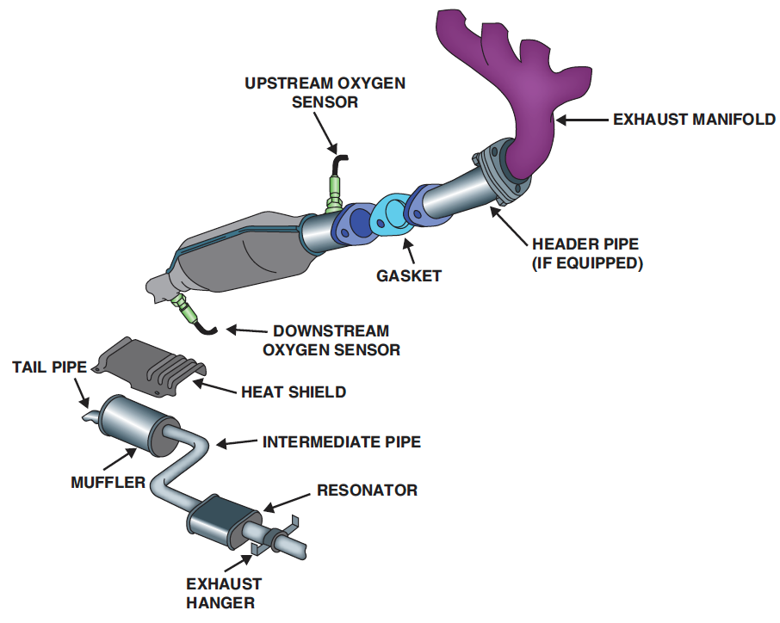
Figure 19.20
A typical exhaust system showing the heat shields and hangers used to isolate exhaust system vibrations from the vehicle body.
Notes:
Long Description:
A component of an engine contains the following parts: an exhaust manifold, a headed pipe if equipped, a gasket, an upstream oxygen sensor, and a downstream oxygen sensor, from top to bottom. A heat shield is displayed below. A hanger below shows a tail pipe linked with a muffler, an intermediate pipe, a resonator, and an exhaust hanger.

Slide 29
Mufflers
The muffler catches the large bursts of high-pressure exhaust gas from the cylinder
  Smoothing out the pressure pulses and allowing them to be released at an even and constant rate

Slide 30
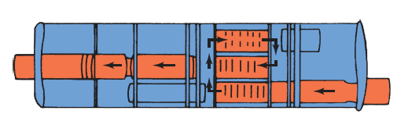
Figure 19.21
Exhaust gases expand and cool as they travel through passages in the muffler.

Slide 31
Summary (1 of 2)
All air entering an engine must be filtered.
The size and shape of port fuel-injected engine intake manifolds can be optimized because the only thing in the manifold is air.
Most intake manifolds have an E G R valve that regulates the amount of recirculated exhaust that enters the engine
to reduce
emissions.
Exhaust manifolds can be made from cast iron or steel tubing.

Slide 32
Summary (2 of 2)
The exhaust system also contains a catalytic converter, exhaust pipes, and muffler. The entire exhaust system is supported by rubber hangers that isolate the noise and vibration of the exhaust from the rest of the vehicle.

Slide 33
Animation and Video Resources
The below listed resources are hyperlinked to the James Halderman website
(A1) Engine Repair Animations
(A1) Engine Repair Videos
(A8) Engine Performance Animations
(A8) Engine Performance Videos

Slide 34

Copyright
This work is protected by United States copyright laws and is provided solely for the use of instructors in teaching their courses and assessing student learning. Dissemination or sale of any part of this work (including on the World Wide Web) will destroy the integrity of the work and is not permitted. The work and materials from it should never be made available to students except by instructors using the accompanying text in their classes. All recipients of this work are expected to abide by these restrictions and to honor the intended pedagogical purposes and the needs of other instructors who rely on these materials.

