Slide 1


Automotive Engines Theory and Servicing
Tenth Edition
Chapter 18
Emission Control Devices Operation and Diagnosis
Copyright © 2023 Pearson Education, Inc. All Rights Reserved
Notes:
If this PowerPoint presentation contains mathematical equations, you may need to check that your computer has the following installed:
1) MathType Plugin
2) Math Player (free versions available)
3) NVDA Reader (free versions available)
Slides in this presentation contain hyperlinks. JAWS users should be able to get a list of links by using INSERT+F7

Slide 2
Learning Objectives (1 of 2)
18.1 Explain exhaust gas recirculation systems.
18.2 Discuss OBD-
EGR monitoring strategies, diagnosing a
defective E G R system, and E G R trouble codes.
18.3 Discuss crankcase ventilation, P C V system diagnosis, and P C V-related trouble codes.
18.4 Explain the secondary air-injection system and its diagnosis.
18.5 Explain the purpose and function of catalytic converters, their diagnosis, and guidelines to replace them.

Slide 3
Learning Objectives (2 of 2)
18.6 Explain evaporative emission control systems, and compare enhanced evaporative control systems and nonenhanced evaporative control systems.
18.7 Discuss the leak detection pump system and onboard refueling vapor recovery.
18.8 Discuss the diagnosis of the E V A P system and state inspection E V A P tests.
18.9 Describe evaporative system monitors and typical E V A P monitors.

Slide 4
Smog
The common term used to describe air pollution is smog, a word that combines two words: smoke and fog.
Smog is formed in the atmosphere when sunlight combines with unburned fuel (hydrocarbon, or H C) and oxides of
nitrogen

Slide 5

Figure 18.1
Notice the red-brown haze which is often over many major cities. This haze is the result of oxides of nitrogen in the atmosphere.

Slide 6
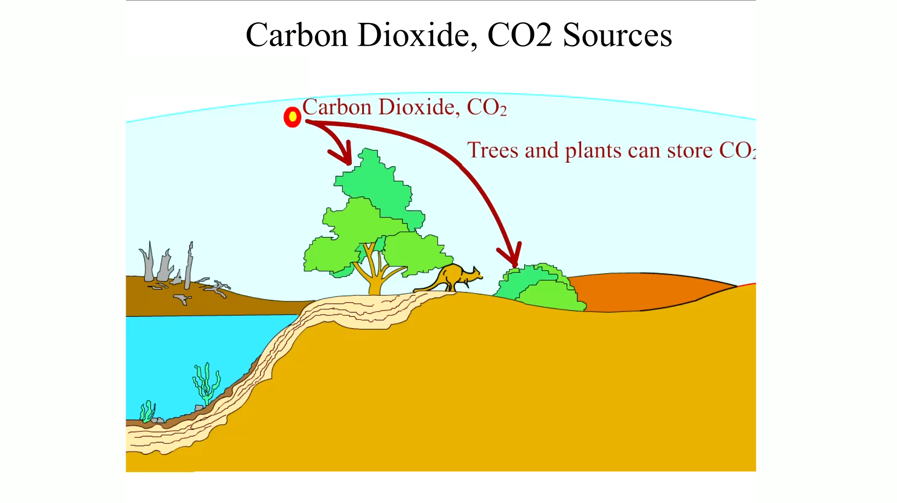
Animation:
Carbon Dioxide, CO2 Sources
(The animation will automatically start in a few seconds)

Slide 7
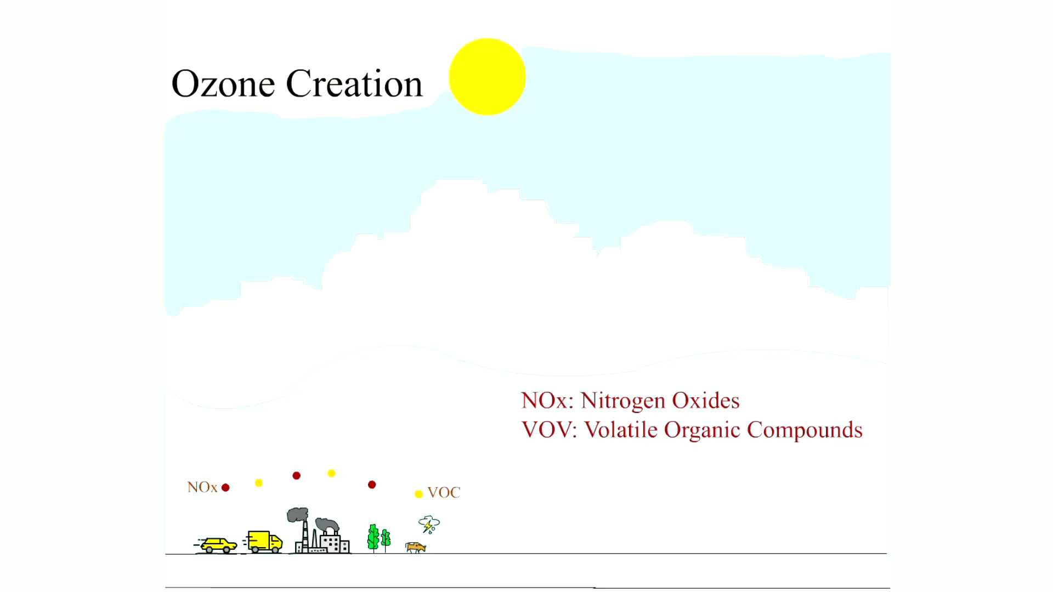
Animation:
Ozone Creation
(The animation will automatically start in a few seconds)

Slide 8
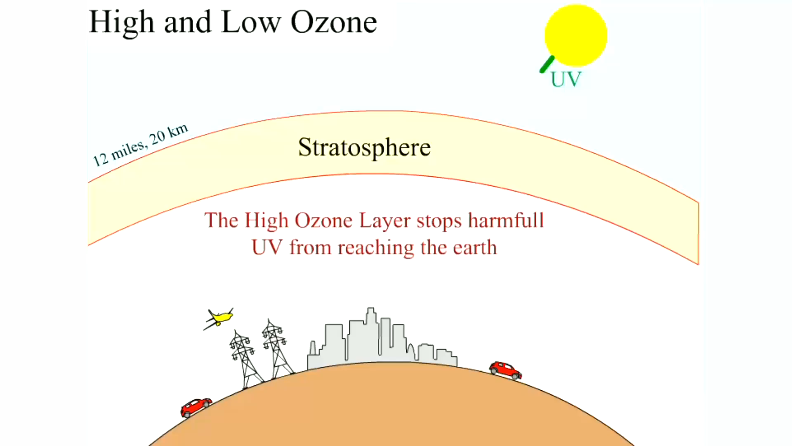
Animation:
High and Low Ozone
(The animation will automatically start in a few seconds)

Slide 9
Vehicle Emissions (1 of 2)
H C (unburned hydrocarbons). Excessive H C emissions (unburned fuel) are controlled by the evaporative system (charcoal canister), the positive crankcase ventilation (P C V) system, the secondary air-injection (S A I) system, and the catalytic converter.
C O (carbon monoxide). Excessive C O emissions are controlled by the positive crankcase ventilation (P C V) system, the secondary air-injection (S A I) system, and the catalytic converter.

Slide 10
Vehicle Emissions (2 of 2)
(oxides of nitrogen). Excessive
emissions are
controlled by the exhaust gas recirculation (E G R) system and the catalytic converter

Slide 11
Exhaust Gas Recirculation (E G R) Systems (1 of 2)
Exhaust gas recirculation (E G R) is an emission control system
that lowers the amount of nitrogen oxides
formed during
combustion.
  In the presence of sunlight,
  reacts with hydrocarbons
  in the atmosphere to form ozone (O 3) or photochemical smog, an air pollutant.
Formation
Controlling

Slide 12
Exhaust Gas Recirculation (E G R) Systems (2 of 2)
E G R System Operation
E G R Benefits
Digital E G R Valves
Linear E G R
Most newer vehicles that are equipped with variable valve timing (V V T) use the valve overlap to keep some exhaust gases in the combustion chamber. As a result, most newer engines do not use an E G R valve.

Slide 13
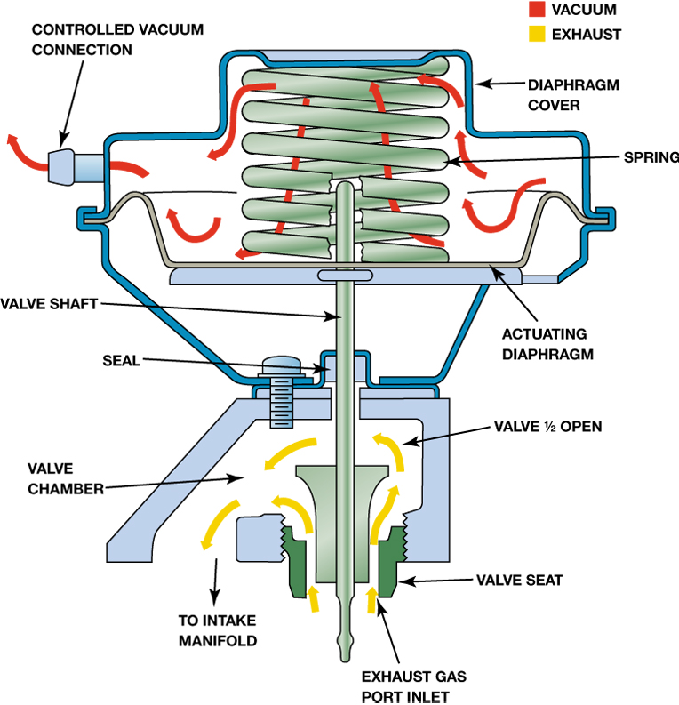
Figure 18.2
When the E G R valve opens, the exhaust gases flow through the valve and into passages in the intake manifold.
Notes:
Long Description:
The E G R valve shows a controlled vacuum connection, a diaphragm cover, a spring, a vertical valve shaft, actuating diaphragm, a seal, a valve chamber, a valve half open, a valve seat, and an exhaust gas port inlet through which gases flow to intake manifold.

Slide 14
O B D-I I E G R Monitoring Strategies
(1 of 2)
U. S. E P A began requiring O B D-
systems in all passenger
cars and most light-duty trucks.
  These systems include emissions system monitors that alert the driver and the technician if an emissions system is malfunctioning.
  The O B D-
system performs this test by opening and
closing the E G R valve.

Slide 15
O B D-I I E G R Monitoring Strategies
(2 of 2)
  The P C M monitors an E G R function sensor for a change in signal voltage.
  If the E G R system fails, a diagnostic trouble code (D T C) is set.
  If the system fails two consecutive times, the malfunction indicator light (M I L) is lit.

Slide 16
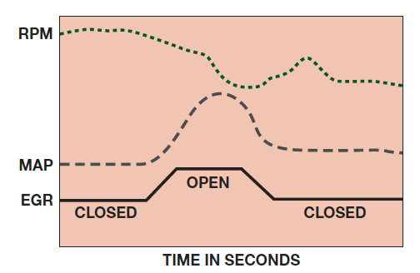
Figure 18.7
An O B D-
active test. The P C M opens the E G R valve
and then monitors the M A P sensor and/or engine speed (R P M) to verify that it meets acceptable values.
Notes:
Long Description:
The horizontal axis is labeled "Time in seconds." The first dashed curve R P M is a decreasing curve. The "M A P" dashed curve shows a steady state, a peak, and then almost back to the same steady state. The third horizontal curve "E G R" consists of line segments with a maxima point "Open." The left and right baselines of the open high point are labeled "Closed." The open is a higher pulse compared to the close signal.

Slide 17
Diagnosing a Defective E G R System
If the E G R valve is not opening or the flow of the exhaust gas is restricted, then the following symptoms are likely.
  Detonation (spark knock or ping) during acceleration or during cruise (steady-speed driving)
  Excessive oxides of nitrogen
exhaust emissions
If the E G R valve is stuck open or partially open, then the following symptoms are likely.
  Rough idle or frequent stalling
  Poor performance/low power, especially at low engine speed

Slide 18
E G R Testing
To check for proper operation of a vacuum-operated E G R valve, follow these steps.
  STEP 1 Check the vacuum diaphragm of the E G R valve to see if it can hold vacuum.
  STEP 2 Apply vacuum from a hand-operated vacuum pump and check for proper operation.
  STEP 3 Monitor engine vacuum drop.
Activate the E G R valve using a scan tool or vacuum pump, if vacuum controlled, and observe the vacuum gauge.

Slide 19
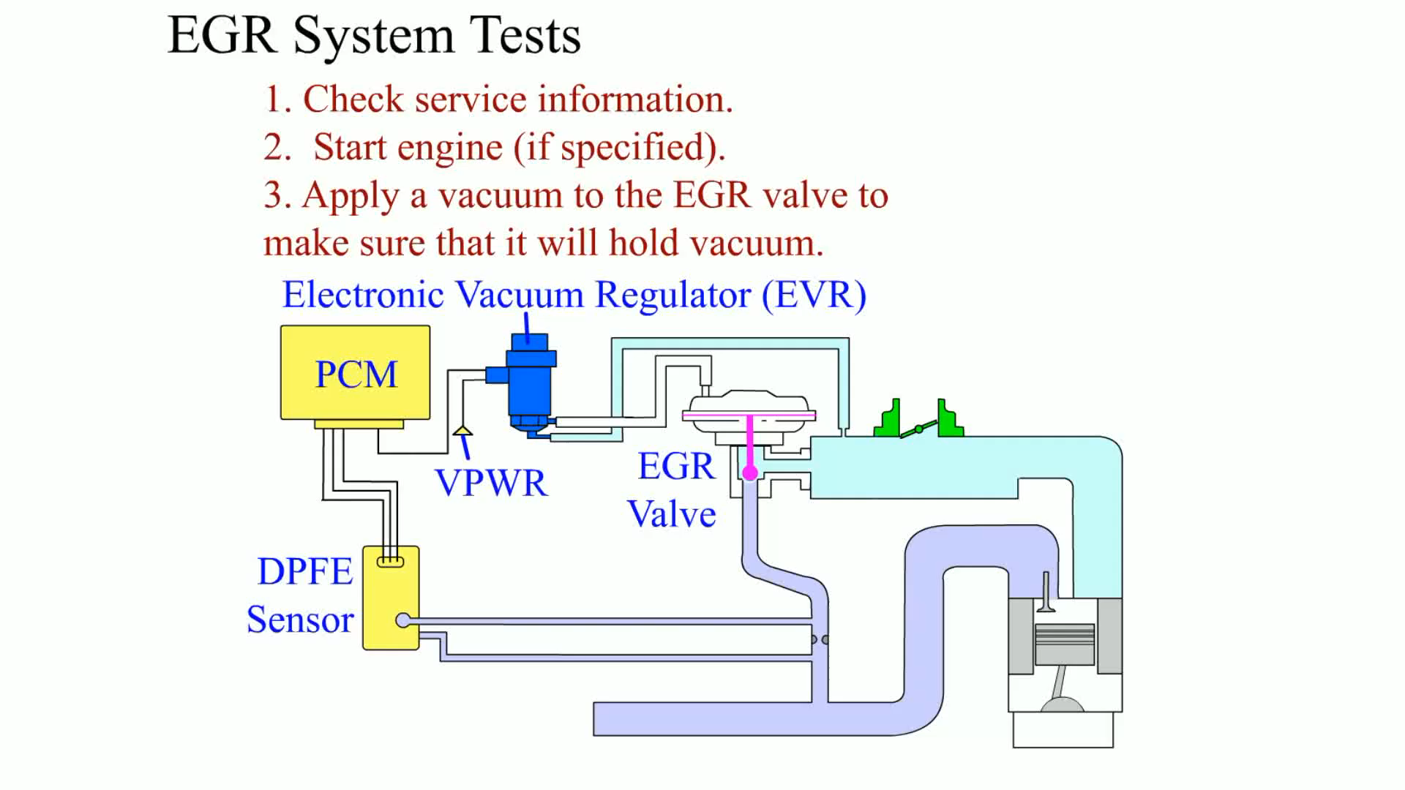
Animation:
EGR System Tests
(The animation will automatically start in a few seconds)

Slide 20
E G R-Related O B D-I I Diagnostic Trouble Codes
P0400
Exhaust gas recirculation flow problems
P0401
Exhaust gas recirculation flow insufficient
P0402
Exhaust gas recirculation flow excessive
What are the possible causes?

Slide 21
Crankcase Ventilation (1 of 2)
The problem of crankcase ventilation has existed since the beginning of the automobile, because no piston ring, new or old, can provide a perfect seal between the piston and the cylinder wall.
  When an engine is running, the pressure of combustion forces the piston downward.
  This same pressure also forces gases and unburned fuel from the combustion chamber, past the piston rings, and into the crankcase.
Blowby is the term used to describe when combustion gases are forced past the piston rings and into the crankcase.

Slide 22
Crankcase Ventilation (2 of 2)
Positive crankcase ventilation (P C V) systems were developed to ventilate the crankcase and recirculate the vapors to the engine’s induction system so they can be burned in the cylinders.
P C V systems help reduce H C and C O emissions.

Slide 23
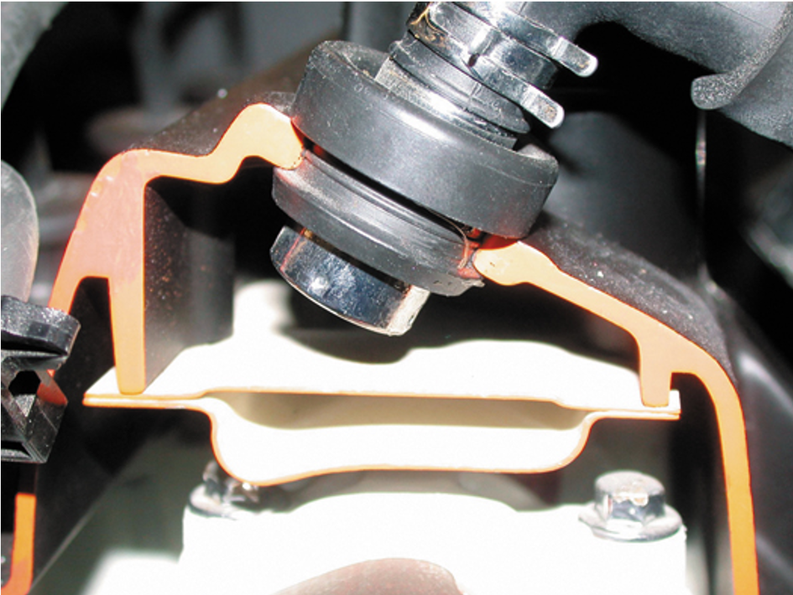
Figure 18.9
A P C V valve in a cutaway valve cover, showing the baffles that prevent liquid oil from being drawn into the intake manifold.

Slide 24
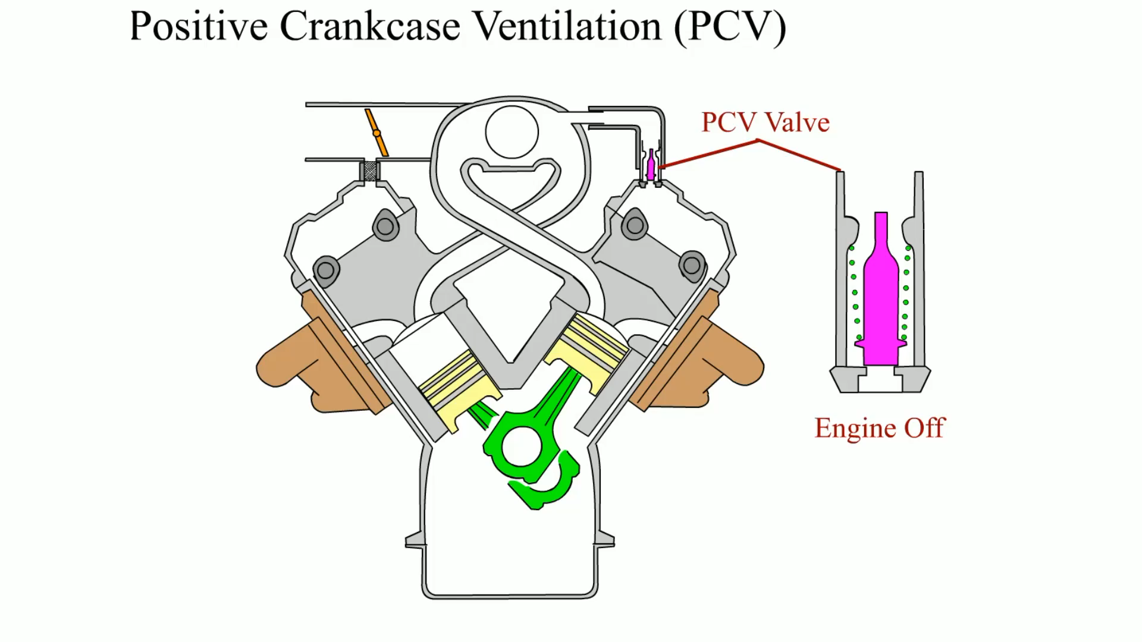
Animation:
Positive Crankcase Ventilation (PCV)
(The animation will automatically start in a few seconds)

Slide 25
P C V System Diagnosis
Symptoms
P C V System Performance Check
Rattle Test
The
Card Test
Snap-Back Test
Crankcase Vacuum Test
P C V Monitor

Slide 26
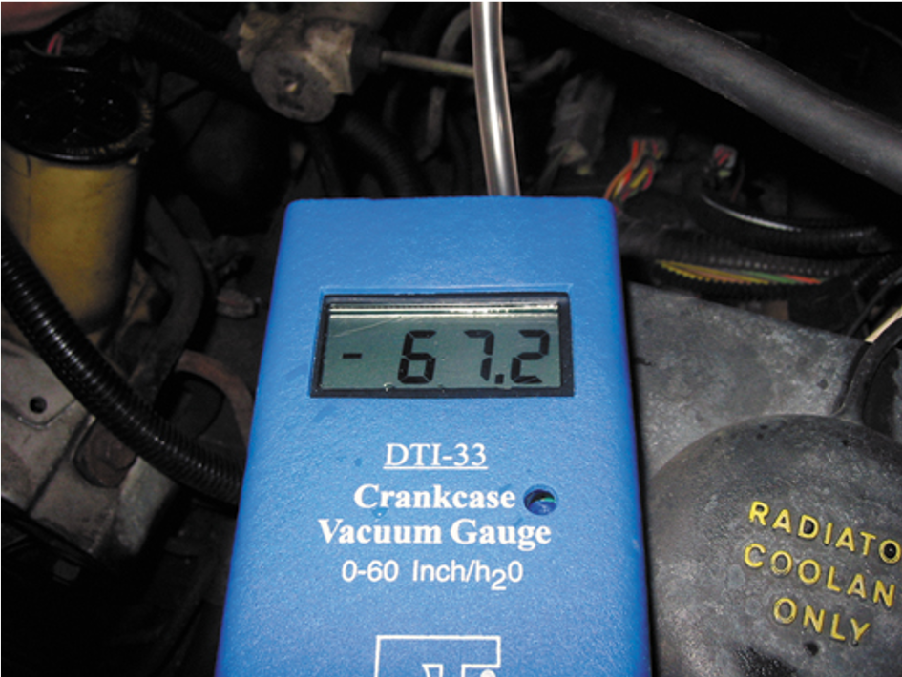
Figure 18.14
Using a gauge that measures vacuum in units of inches of water to test the vacuum at the dipstick tube.
Notes:
Long Description:
It is labeled as D T I 33, 0 to 60 inch per H subscript 2 O.

Slide 27
P C V-Related Diagnostic Trouble Codes
P0101
M A F or airflow circuit range problem
P0505
Idle control system problem
What are the possible causes?

Slide 28
Secondary Air-Injection System
The secondary air-injection (S A I) system provides the air necessary for the oxidizing process either at the exhaust manifold or inside the catalytic converter.
  Parts and Operation
  Air Distribution Manifolds and Nozzles
  Exhaust Check Valves
  Belt-Driven Air Pumps
  Electric Motor-Driven Air Pumps

Slide 29
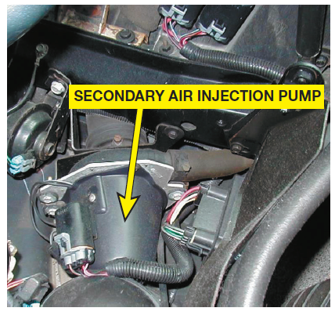
Figure 18.19
A typical electric motor-driven S A I pump. This unit is on a Chevrolet Corvette and only works when the engine is cold.

Slide 30
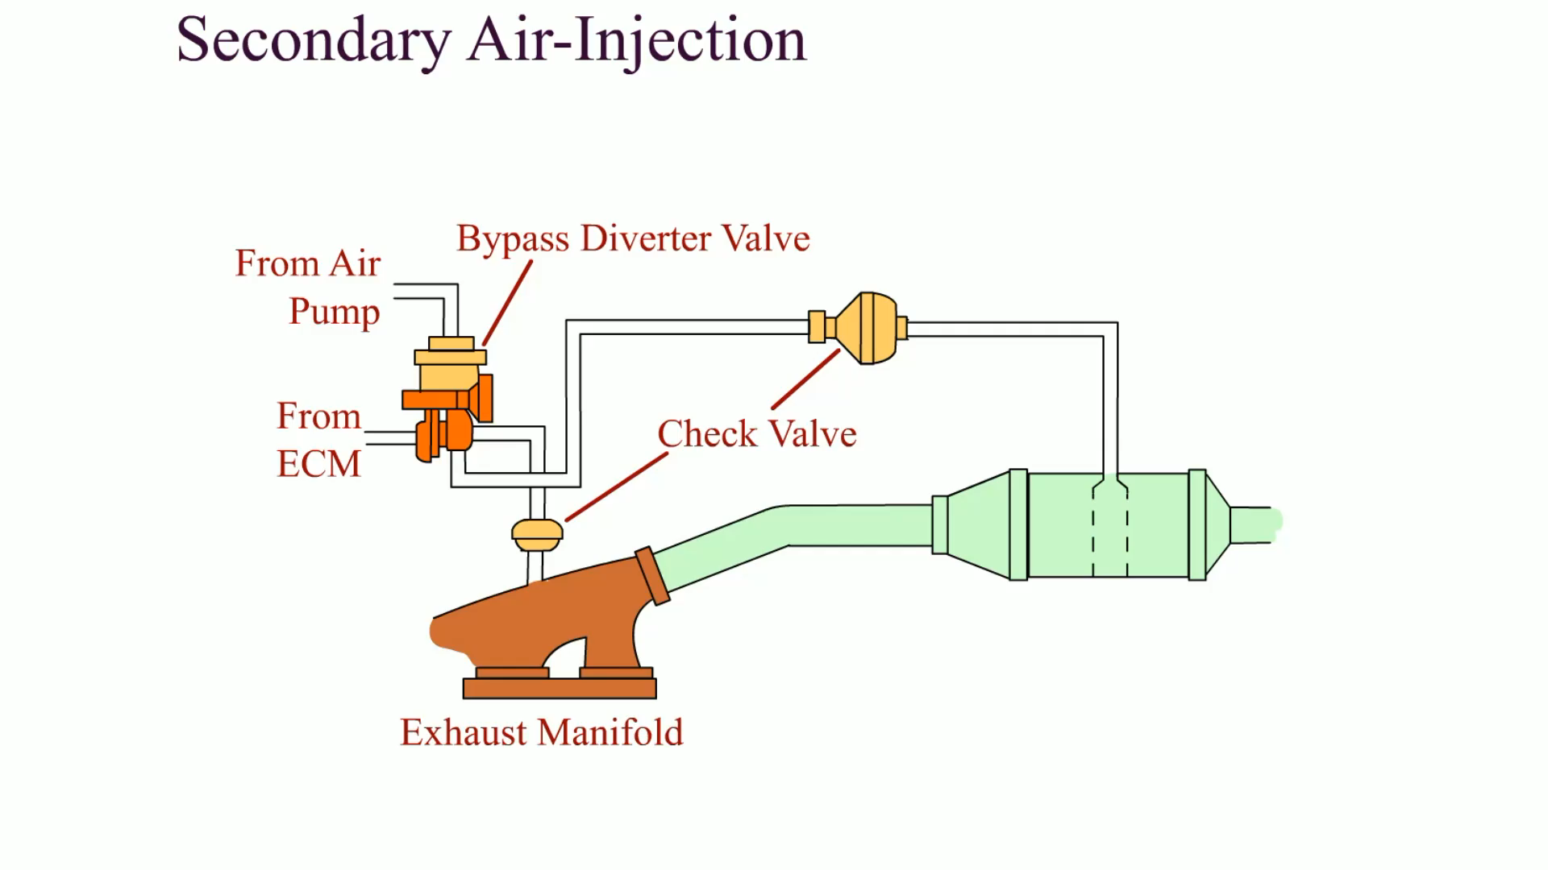
Animation:
Secondary Air-Injection
(The animation will automatically start in a few seconds)

Slide 31
Secondary Air-Injection System Diagnosis and D T C
The air pump system should be inspected if an exhaust emissions test failure occurs.
P0410
S A I solenoid circuit fault
What are the possible causes?

Slide 32
Catalytic Converters
A catalytic converter is an aftertreatment device used to reduce exhaust emissions outside of the engine.
The catalytic converter uses a catalyst, which is a chemical that helps start a chemical reaction but does not enter into the chemical reaction.
  The catalyst materials on the surface of the material inside the converter help create a chemical reaction.
  The chemical reaction changes harmful exhaust emissions into nonharmful exhaust emissions.

Slide 33
Catalytic Converter Construction
Catalytic converters are constructed of a ceramic material in a honeycomb shape with square openings for the exhaust gases.
The substrate is coated with a porous aluminum material called the washcoat, which makes the surface rough.
The catalytic materials are applied on top of the washcoat.
The substrate is contained within a round or oval shell made by welding together two stamped pieces of stainless steel.

Slide 34
Catalytic Converter Operation (1 of 3)
The converter substrate contains small amounts of rhodium, palladium, and platinum. These elements act as catalysts.
In a three-way catalytic converter (T W C), all three exhaust
emissions (
H C, and C O) are converted to carbon dioxide
and water
Oxides of nitrogen
are chemically reduced (i.e., nitrogen
and oxygen are separated) in the first section of the catalytic converter.

Slide 35
Catalytic Converter Operation (2 of 3)
In the second section of the catalytic converter, most of the hydrocarbons and carbon monoxide remaining in the exhaust
gas are oxidized to form harmless carbon dioxide
and water vapor

Slide 36
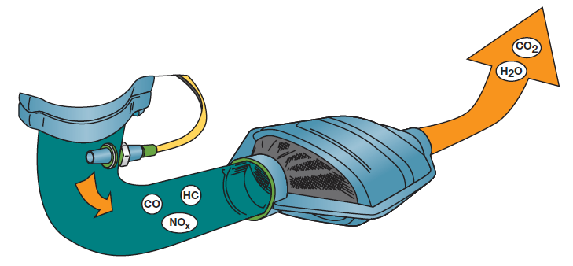
Figure 18.22
The three-way catalytic converter first separates the
into
nitrogen and oxygen and then converts the H C and C O into
harmless water
and carbon dioxide

Slide 37
Catalytic Converter Operation (3 of 3)
Converter Light-Off Temperature
Converter Usage
OBD-II Catalytic Converter Performance
Converter-Damaging Conditions
  Contamination
  Excessive temperatures
  Improper air-fuel mixtures

Slide 38
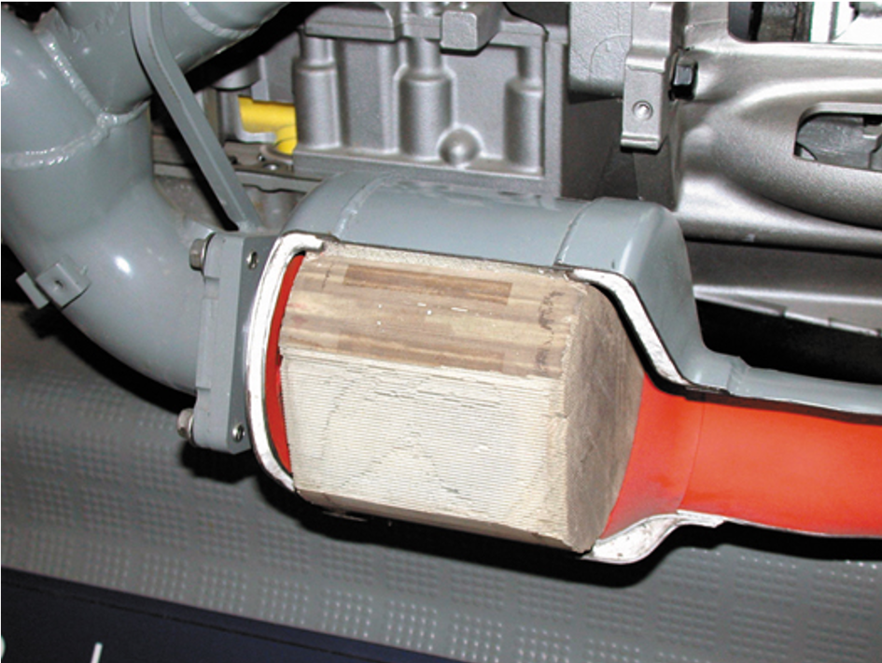
Figure 18.20
Most catalytic converters are located as close to the exhaust manifold as possible, as seen in this display of a Chevrolet Corvette.

Slide 39
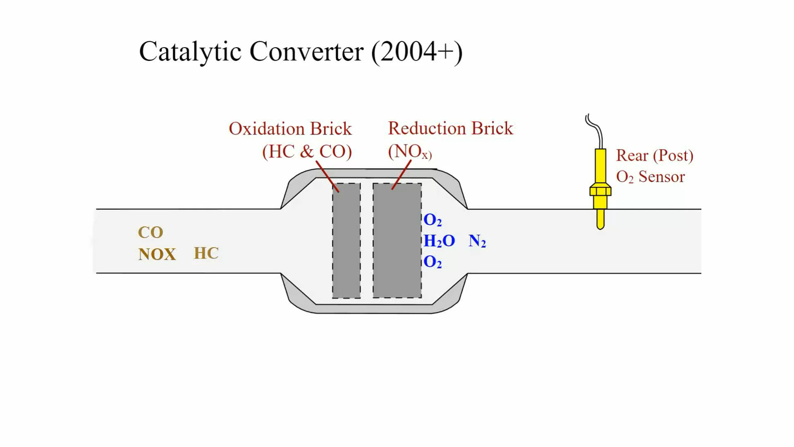
Animation:
Catalytic Converter (2004+)
(The animation will automatically start in a few seconds)

Slide 40
Diagnosing Catalytic Converters
The Tap Test
Testing Backpressure With a Pressure Gauge
Testing For Backpressure Using a Vacuum Gauge
Testing a Catalytic Converter For Temperature Rise
Catalytic Converter Efficiency Tests

Slide 41
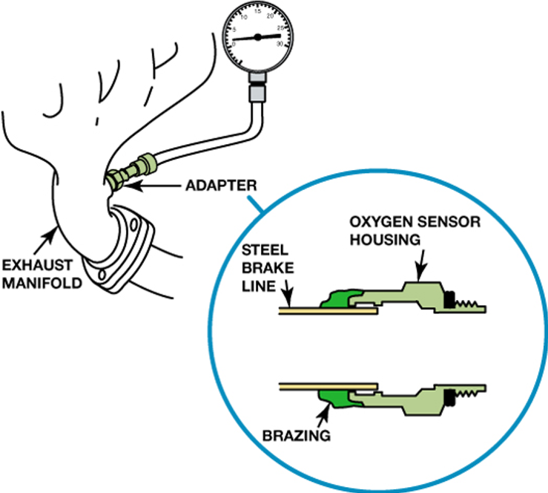
Figure 18.24
A back pressure tool can be made by using an oxygen sensor housing and epoxy or braze to hold the tube to the housing.

Slide 42
Catalytic Converter Replacement Guidelines (1 of 2)
Because a catalytic converter is a major exhaust gas emission control device, the Environmental Protection Agency (E P A) has strict guidelines for its replacement, including:
  If a converter is replaced on a vehicle with less than 80,000 miles or eight years, depending on the year of the vehicle, an original equipment catalytic converter must be used as a replacement.

Slide 43
Catalytic Converter Replacement Guidelines (2 of 2)
  The replacement converter must be of the same design as the original. If the original had an air pump fitting, so must the replacement.
  The old converter must be kept for possible inspection by the authorities for 60 days.
  A form must be completed and signed by both the vehicle owner and a representative from the service facility.

Slide 44
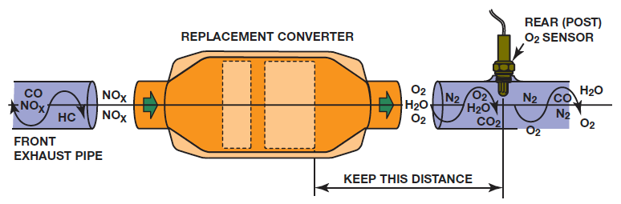
Figure 18.26
Whenever replacing a catalytic converter with a universal unit, first measure the distance between the rear brick and the center of the rear oxygen sensor. Be sure that the replacement unit is installed to the same dimension.
Notes:
Long Description:
Several gases C O, N O subscript x, and H C are converted to N O subscript x through a front exhaust pipe. They pass through a replacement converter with the new gases O subscript 2, water H subscript 2 O, and O subscript 2, then through a pipe having a rear or post O subscript 2 sensor at the top with gases N subscript 2 O subscript 2, H subscript 2 O, and C O, and finally give H subscript 2 O and O subscript 2. The rear O subscript 2 sensor maintains a distance from the replacement converter.

Slide 45
Catalytic Converter-Related DTC
P0420
Catalytic converter efficiency failure
What are the possible causes?

Slide 46
Evaporative Emission Control System (E V A P)
The purpose of the evaporative (E V A P) emission control system is to trap and hold gasoline vapors, also called volatile organic compounds, or V O Cs.
  The evaporative control system includes the charcoal canister, hoses, and valves.
  These vapors are routed into a charcoal canister, then into the intake airflow where they are burned in the engine instead of being released into the atmosphere.

Slide 47
Nonenhanced Evaporative Control System
Prior to 1996, evaporative systems were referred to as nonenhanced evaporative (E V A P) control systems
  Evaporative systems that had limited diagnostic capabilities
Background
Canister Vent Valve
Canister Purge Valve

Slide 48
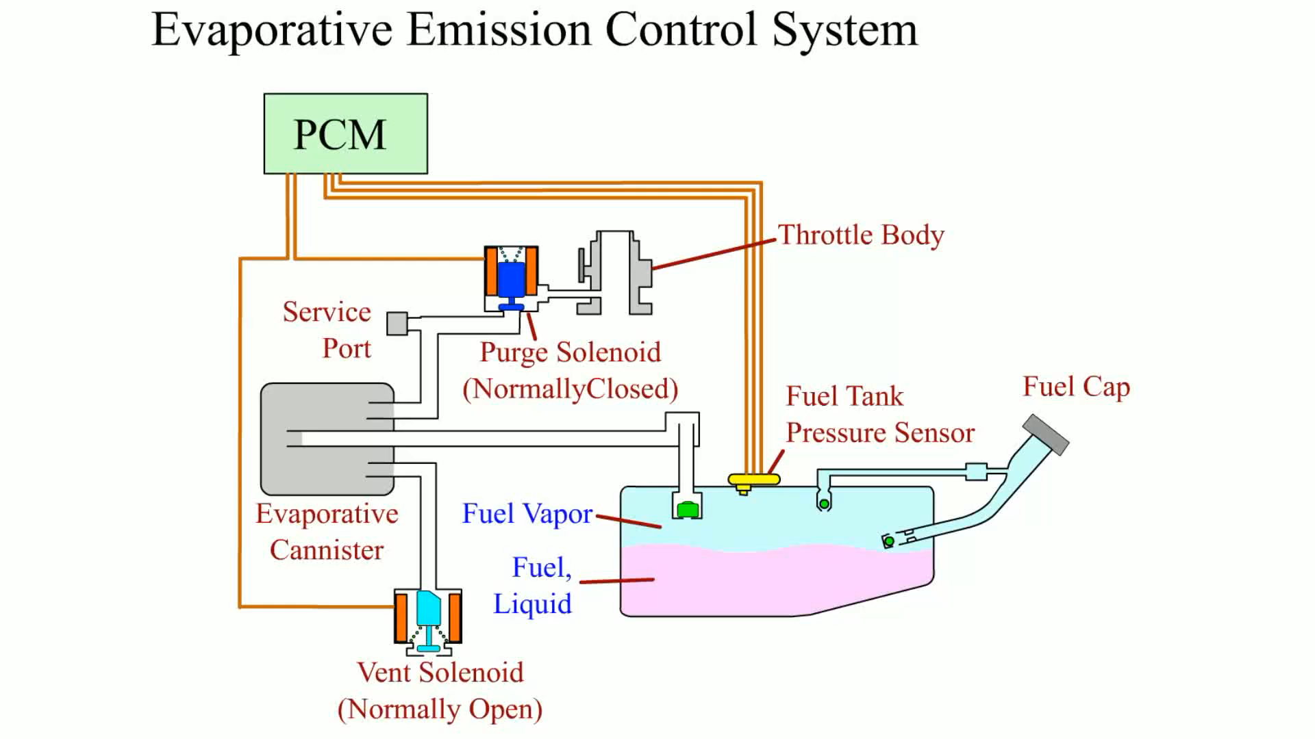
Animation:
Evaporative Emission Control System
(The animation will automatically start in a few seconds)

Slide 49
Enhanced Evaporative Control Systems
Beginning in 1996, with O B D-
vehicles, manufacturers were
required to install systems that are able to detect both purge flow and evaporative system leakage.
  The systems on models produced between 1996 and 2000 must be able to detect a leak as small as 0.04 inch diameter.
  Beginning in the model year 2000, the enhanced systems started a phase-in of 0.020 inch diameter leak detection.
  All vehicles built after 1995 have enhanced evaporative systems that have the ability to detect purge flow and system leakage.

Slide 50
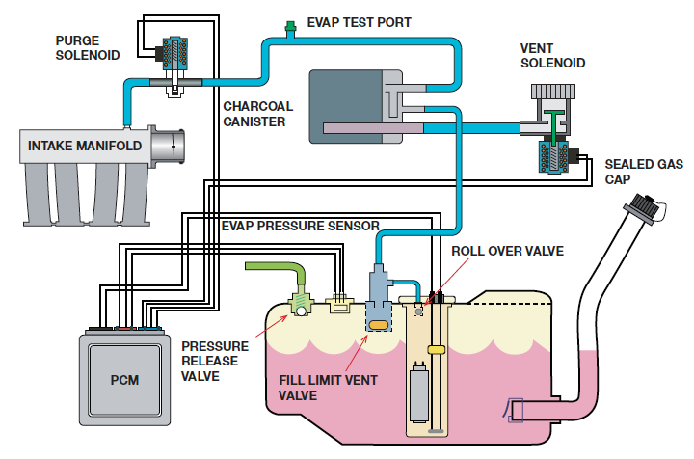
Figure 18.28
The components of a typical fuel system showing the vent solenoid and the purge solenoid.
Notes:
Long Description:
The P C M is connected to a container having a pressure release valve, an evap pressure sensor, and a roll-over valve. The container is sealed with a gas cap. P C M is also linked to a purge solenoid, which leads to an intake manifold, a charcoal canister, an evap test port, and a vent solenoid. The other parts labeled are fill limit vent valve, roll over valve, and sealed gas cap.

Slide 51
Leak Detection Pump
Many vehicles use a leak detection pump (L D P) as part of the evaporative control system diagnosis equipment.

Slide 52
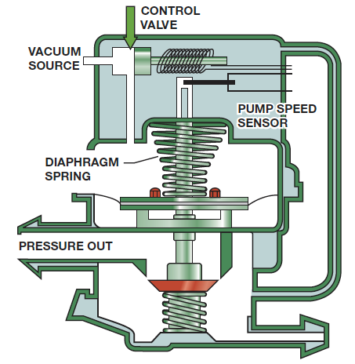
Figure 18.29
A leak detection pump (L D P) used on some Chrysler vehicles to pressurize (slightly) the fuel system to check for leaks.

Slide 53
Onboard Refueling Vapor Recovery
Purpose and Function
Operation
  The primary feature of most O R V R systems is the restricted tank filler tube, which is about 1 inch (25 m m) in diameter.
  During refueling, the fuel tank is vented to the charcoal canister, which captures the gas fumes.
  With air flowing into the filler tube, no vapors can escape to the atmosphere

Slide 54
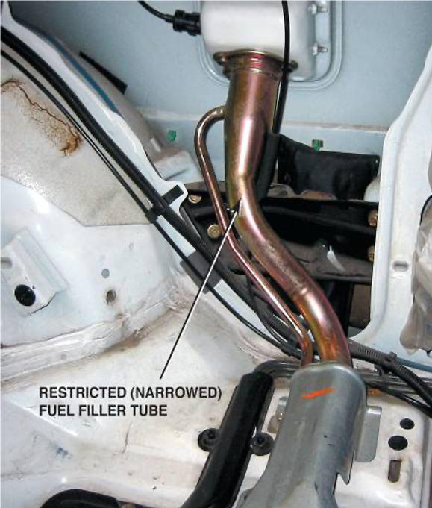
Figure 18.30
A restricted fuel fill pipe shown on a vehicle with the interior removed.

Slide 55
State Inspection E V A P Tests
In some states, a periodic inspection and test of the fuel system are mandated along with a dynamometer test.
How can the fuel tank, cap, fuel lines, canister, and other fuel system components be tested?

Slide 56
Diagnosing the EVAP System
Symptoms
  Poor fuel economy
  Poor performance
Locating leaks in the system
  Smoke machine testing
  Nitrogen gas pressurization

Slide 57
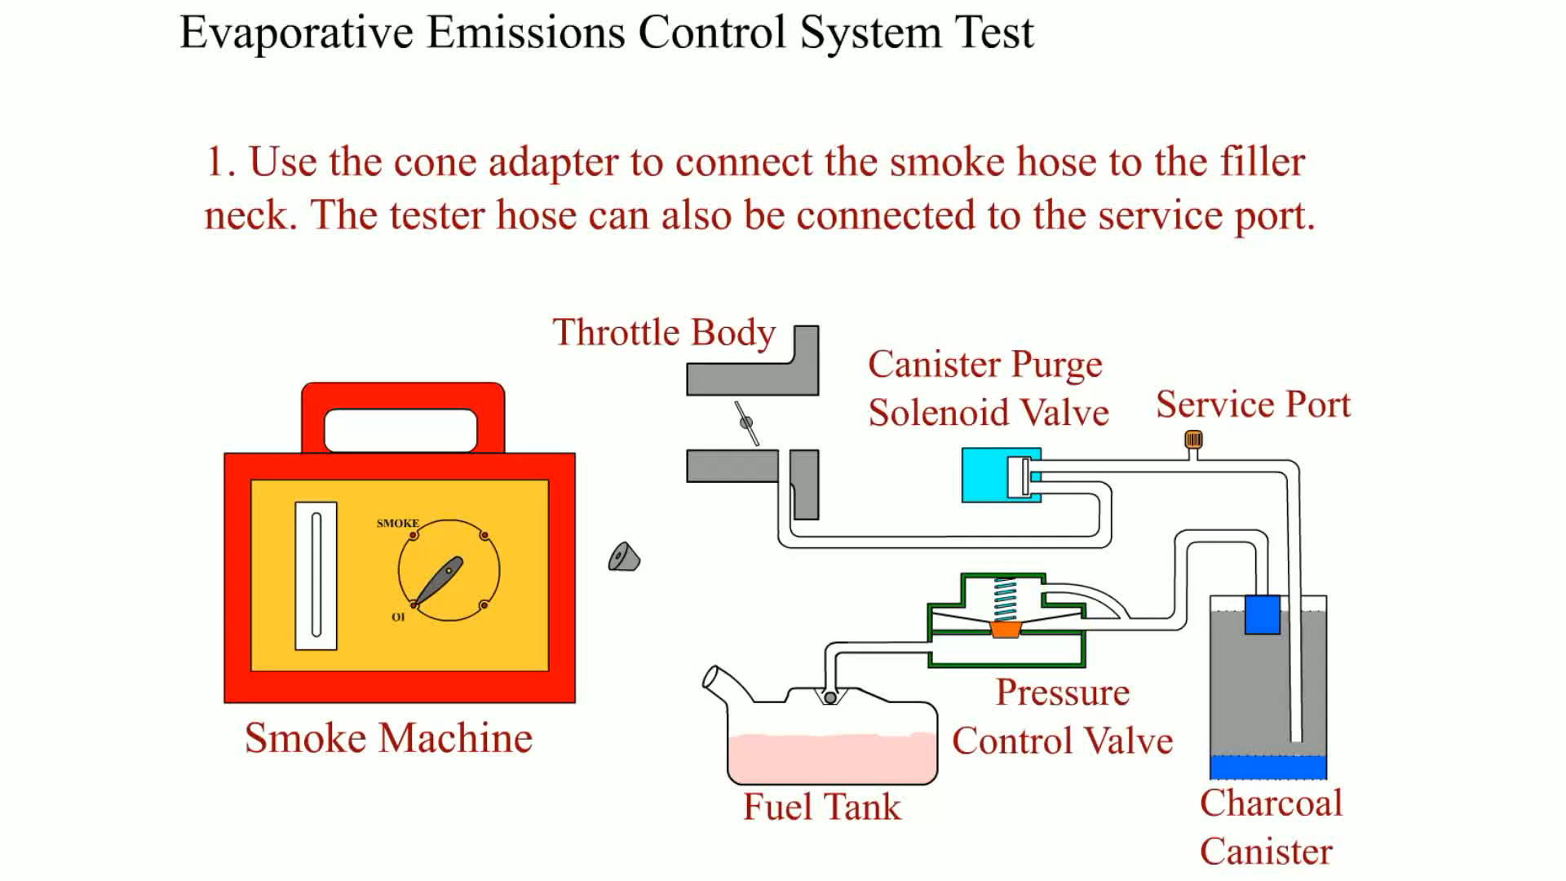
Animation:
Evaporative Emissions Control System Test
(The animation will automatically start in a few seconds)

Slide 58
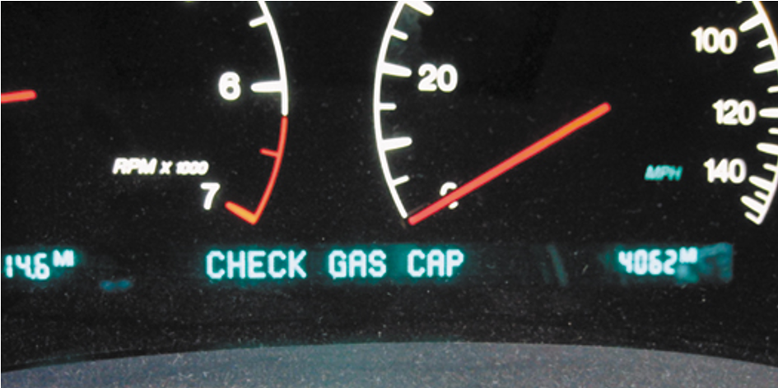
Figure 18.31
Some vehicles will display a message if an evaporative control system leak is detected that could be the result of a loose gas cap.

Slide 59
Evaporative System Monitor
O B D-II Requirements
  Serious faults cause a blinking malfunction indicator lamp (M I L) or even an engine shutdown.
  Less serious faults may simply store a code but not illuminate the M I L.
The O B D-II requirements state that vehicle fuel systems are to be routinely tested while underway by the P C M.
A fuel tank pressure (F T P) sensor monitors the rate with which vacuum increases in the system.
Engine-Off natural vacuum

Slide 60
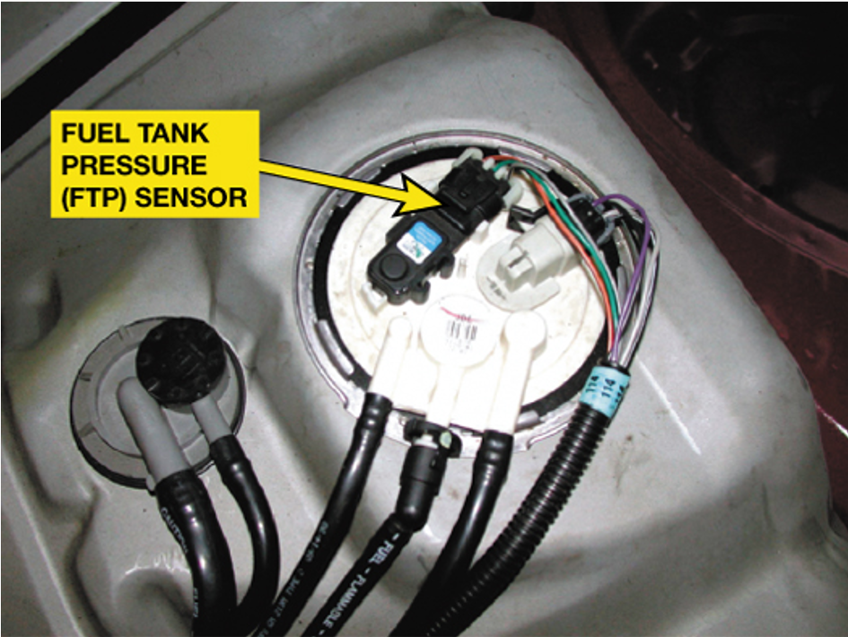
Figure 18.35
The fuel tank pressure sensor (black unit with three wires) looks like a M A P sensor and is usually located on top of the fuel pump module (white unit).

Slide 61
Typical EVAP Monitor (1 of 2)
The P C M will run the E V A P monitor when the following enable criteria are met.
  Cold start
  Barometric pressure (B A R O) greater than 70 k P a (20.7 in. H g or 10.2 P S I)
  Intake air temperature (I A T) between 39°F and 86°F at engine start-up

Slide 62
Typical EVAP Monitor (2 of 2)
  Engine coolant temperature (E C T) between 39°F and 86°F at engine start-up
  E C T and I A T within 39°F of each other at engine start-up
  Fuel level within 15% to 85%
  Throttle position (T P) sensor between 9% and 35%
Running the E V A P Monitor
  Weak vacuum test
  Small leak test
  Excess vacuum test

Slide 63
E V A P System-Related D T Cs
P0440
Evaporative system fault
P0442
Small leak detected
P0446
E V A P cannister vent blocked
What are the possible causes?

Slide 64
Summary (1 of 4)
Recirculating 6% to 10% inert exhaust gases back into the intake system by the E G R system reduces peak temperature
inside the combustion chamber and reduces
exhaust
emissions.
E G R is usually not needed at idle, at wide-open throttle, or when the engine is cold.
Many E G R systems use a feedback potentiometer to signal the P C M the position of the E G R valve pintle.
O B D-II requires that the flow rate be tested and then is achieved by opening the E G R valve and observing the reaction of the M A P sensor.

Slide 65
Summary (2 of 4)
Positive crankcase ventilation (P C V) systems use a valve or a fixed orifice to control and direct the fumes from the crankcase back into the intake system.
A P C V valve regulates the flow of fumes depending on engine vacuum and seals the crankcase vent in the event of a backfire.
As much as 30% of the air needed by the engine at idle speed flows through the P C V system.
The secondary air-injection (S A I) system forces air at low pressure into the exhaust to reduce C O and H C exhaust emissions.

Slide 66
Summary (3 of 4)
A catalytic converter is an aftertreatment device that reduces exhaust emissions outside of the engine. A catalyst is an element that starts a chemical reaction but is not consumed in the process.
The catalyst material used in a catalytic converter includes rhodium, palladium, and platinum.
The O B D-
system monitor compares the relative activity of
a rear oxygen sensor to the precatalytic oxygen sensor to determine catalytic converter efficiency.

Slide 67
Summary (4 of 4)
The purpose of the evaporative (E V A P ) emission control system is to reduce the release of volatile organic compounds (V O Cs) into the atmosphere.
A carbon (charcoal) canister is used to trap and hold gasoline vapors until they can be purged and run into the engine to be burned.
O B D-
regulation requires that the evaporative emission
control system be checked for leakage and proper purge flow rates.
External leaks can best be located by pressurizing the fuel system with low-pressure smoke.

Slide 68
Animation and Video Resources
The below listed resources are hyperlinked to the James Halderman website
(A8) Engine Performance Animations
(A8) Engine Performance Videos

Slide 69

Copyright
This work is protected by United States copyright laws and is provided solely for the use of instructors in teaching their courses and assessing student learning. Dissemination or sale of any part of this work (including on the World Wide Web) will destroy the integrity of the work and is not permitted. The work and materials from it should never be made available to students except by instructors using the accompanying text in their classes. All recipients of this work are expected to abide by these restrictions and to honor the intended pedagogical purposes and the needs of other instructors who rely on these materials.

