Slide 1
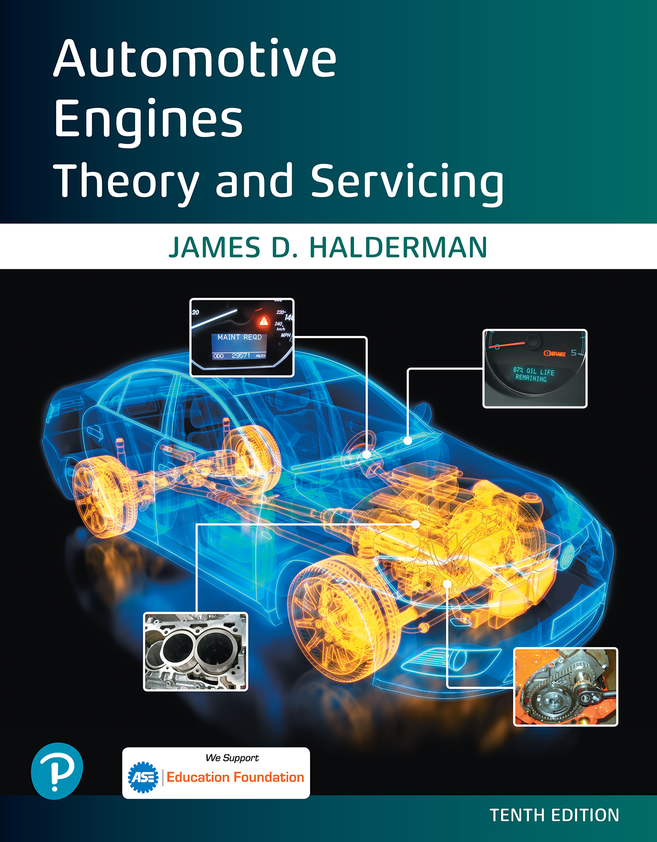

Automotive Engines Theory and Servicing
Tenth Edition
Chapter 17
Ignition System Operation and Diagnosis
Copyright © 2023 Pearson Education, Inc. All Rights Reserved

Slide 2
Learning Objectives (1 of 2)
17.1 Describe the purpose and function of the ignition system.
17.2 Discuss ignition switching and triggering.
17.3 Explain the purpose and function of distributor ignition systems.
17.4 Discuss waste-spark ignition systems and coil-on-plug ignition systems.

Slide 3
Learning Objectives (2 of 2)
17.5 Discuss the purpose and function of knock sensors.
17.6 Explain ignition system diagnosis.
17.7 Explain spark plug construction, service, and how to conduct a spark plug wire inspection.
17.8 Explain ignition timing and discuss the symptoms of a faulty ignition system.

Slide 4
Ignition System (1 of 2)
The ignition system includes components and wiring necessary to create and distribute a high voltage and sends it to the spark plug.
A high-voltage arc occurs across the gap of a spark plug inside the combustion chamber.
The spark raises the temperature of the air-fuel mixture and starts the combustion process inside the cylinder.

Slide 5
Ignition System (2 of 2)
Background
  Early ignition systems
    Contact points and condenser
    Distributor cap and rotor
  Electronic ignition
    D I systems use a distributor cap and rotor
    E I systems do not use a distributor
  Waste-spark system
  Coil-on-plug (C O P) system

Slide 6
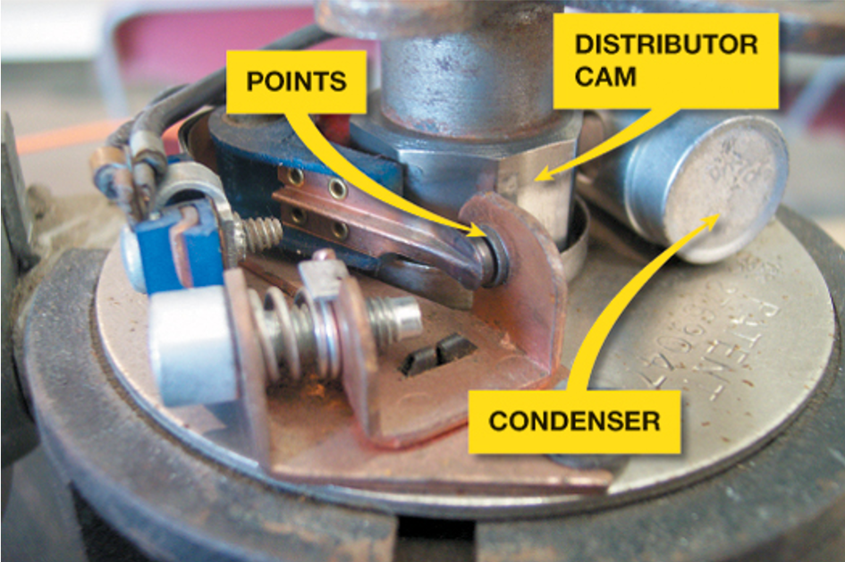
Figure 17.1
The points make and break electrical circuit of the coil primary winding in the ignition coil. The points are opened mechanically by the distributor cam.

Slide 7
Ignition Coil Construction (1 of 2)
Secondary coil winding. Surrounding the laminated core are approximately 20,000 turns of fine wire,
Primary coil winding. Surrounding the secondary windings are approximately 150 turns of heavy wire.
Many ignition coils contain two separate but electrically connected windings of copper wire.
Other coils are true transformers in which the primary and secondary windings are not electrically connected.

Slide 8
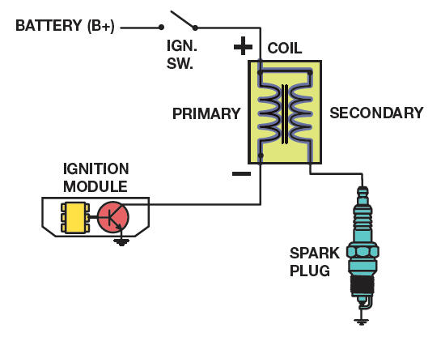
Figure 17.2a
Some ignition coils are electrically connected, called a “married” coil.
Notes:
Long Description:
The first coil shows a combination of primary and secondary coils with an inductance inside it. The left part of the coil is primary and the right part is secondary. The positive side of the primary coil is linked with an ignition coil and a battery B positive. The negative primary coil is linked with an ignition module and the negative secondary coil is connected to a spark plug. The second coil shows a combination of primary and secondary coils with an inductance inside it. The left part is primary and the right part is secondary. The positive side of the primary coil is linked with an open ignition coil and a battery B positive. The positive secondary coil is linked to an OR gate and a spark plug. The negative primary coil is linked with an ignition module and the negative secondary coil is connected to a spark plug.

Slide 9
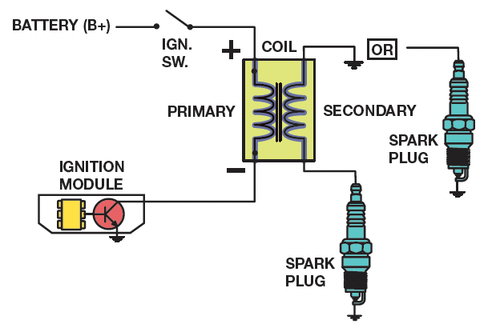
Figure 17.2b
Others use separate primary and secondary windings, called a “divorced” coil.
Notes:
Long Description:
The coil shows a combination of primary and secondary coils with an inductance inside it. The left part is primary and the right part is secondary. The positive side of the primary coil is linked with an open ignition coil and a battery B positive. The positive secondary coil is linked to an OR gate and a spark plug. The negative primary coil is linked with an ignition module and the negative secondary coil is connected to a spark plug.

Slide 10
Ignition Coil Construction (2 of 2)
Older coil windings are surrounded with a thin metal shield and insulating paper and placed into a metal container filled with transformer oil to help cool the coil windings.
Other coil designs use an air-cooled, epoxy-sealed E coil.

Slide 11
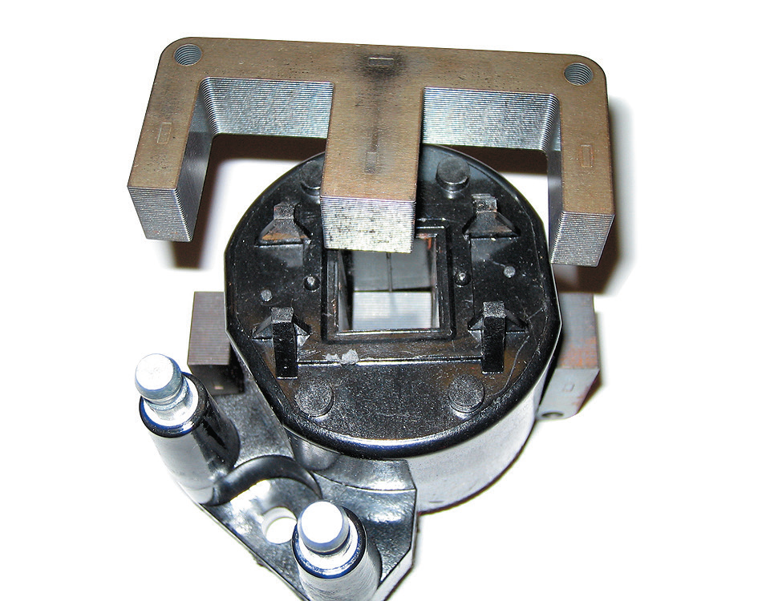
Figure 17.3
The steel lamination used in an E coil helps increase the magnetic field strength, which helps the coil produce higher energy output for a more complete combustion in the cylinders.

Slide 12
Ignition Coil Operation (1 of 2)
All ignition systems use electromagnetic induction to produce a high-voltage spark from the ignition coil.
Primary ignition circuit
  Battery
  Ignition switch
  Primary windings of coil
  Pickup coil (crankshaft position sensor)
  Ignition module (igniter)

Slide 13
Ignition Coil Operation (2 of 2)
Secondary ignition circuit
  Secondary windings of coil
  Distributor cap and rotor (if the vehicle is so equipped)
  Spark plug wires
  Spark plugs

Slide 14
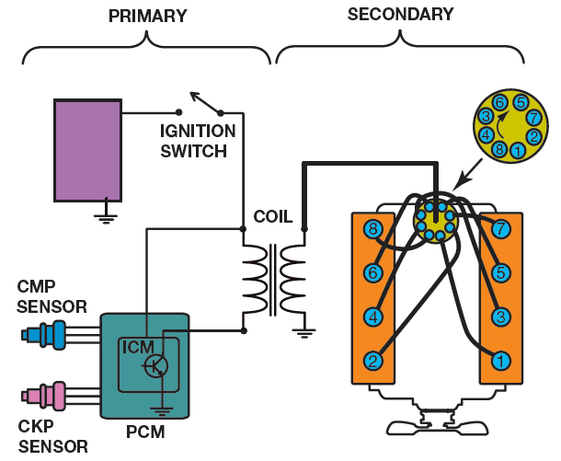
Figure 17.5
The primary ignition system is used to trigger the coil primary windings and therefore create the secondary (high-voltage) spark from the ignition coil.
Notes:
Long Description:
The system consists of a combination of a primary and a secondary coil. The primary coil is linked with an open switch, a battery connected to the ground, and I C M and P C M, linked with C M P and C K P sensors. The secondary coil consists of the secondary windings of the coil, distributor cap and rotor, spark plug wires, and spark plugs.

Slide 15
Ignition Switching and Triggering
Switching
  Ignition control module (I C M) or igniter
  Powertrain control module (P C M)
Triggering
  Magnetic sensor
  Hall-effect switch

Slide 16
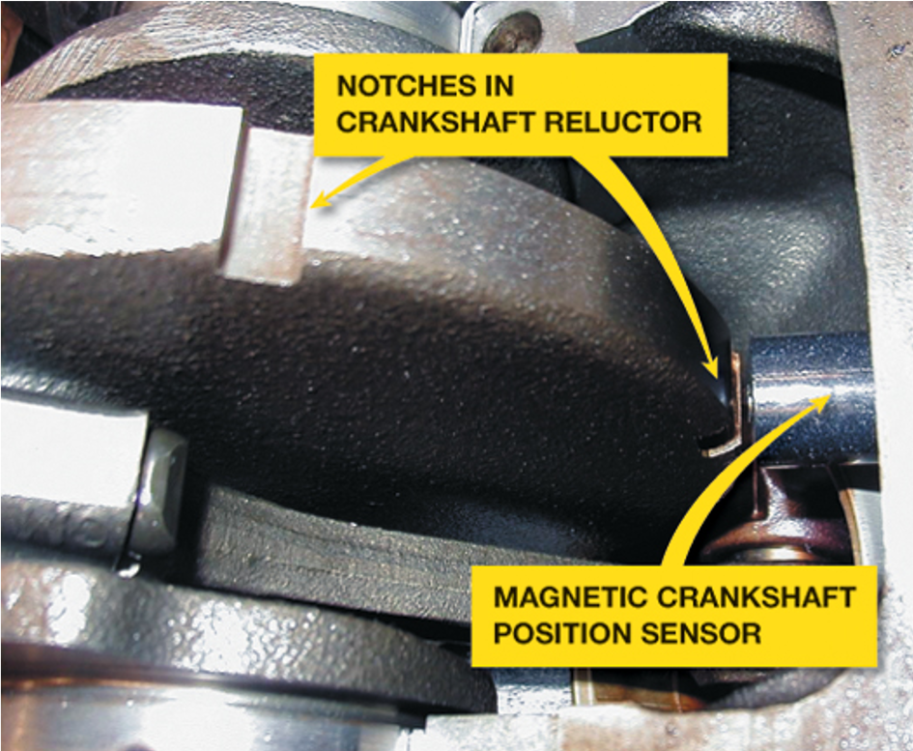
Figure 17.6
A typical magnetic crankshaft position sensor.

Slide 17
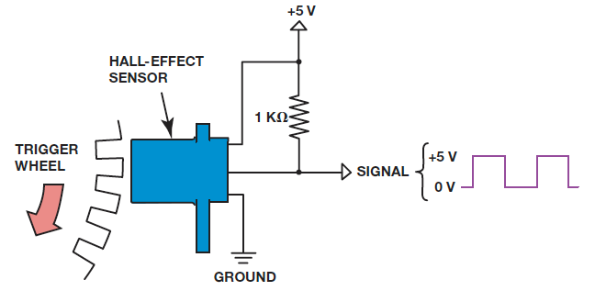
Figure 17.8
A Hall-effect sensor produces an on-off voltage signal whether it is used with a blade or a notched wheel.

Slide 18
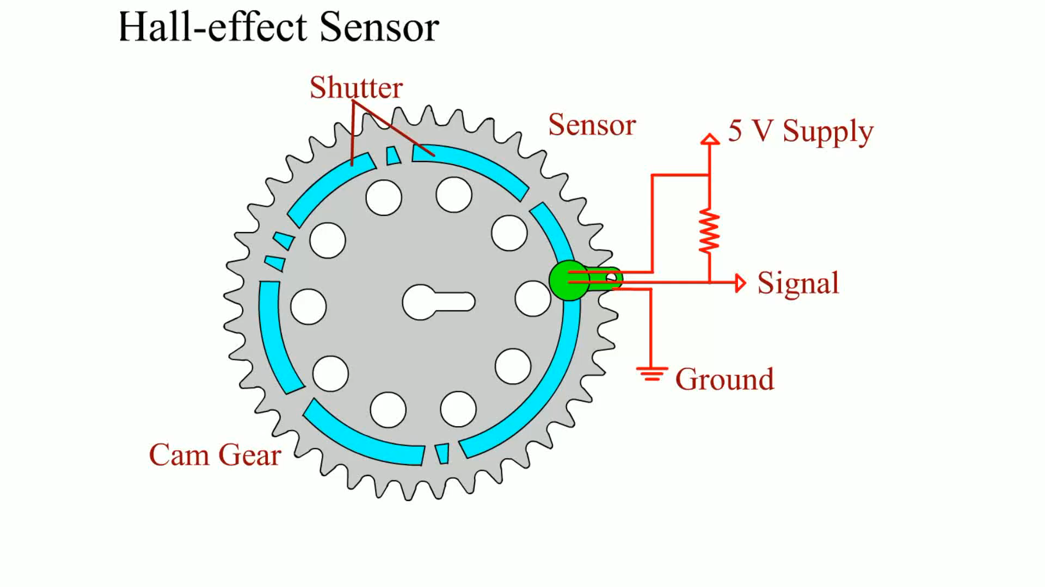
Animation:
Hall-Effect Sensor
(The animation will automatically start in a few seconds)

Slide 19
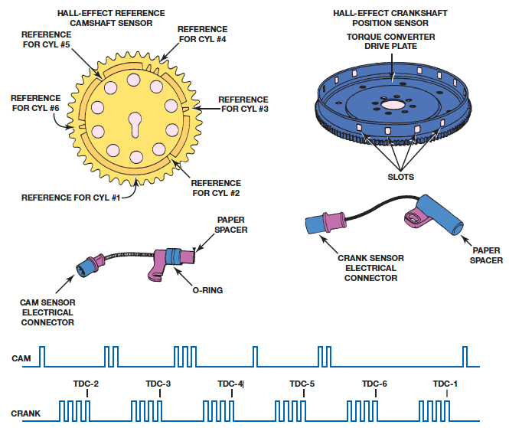
Figure 17.9
Some Hall-effect sensors look like magnetic sensors.
Notes:
Long Description:
Half effect reference camshaft sensor: This sensor consists of reference for C Y L hash 1, reference for C Y L hash 2, reference for C Y L hash 3, reference for C Y L hash 4, reference for C Y L hash 5, and reference for C Y L hash 6 from bottom to left in an anticlockwise direction on the circumference of the sensor. The sensor is connected to a circuit below, which consists of an O ring and a paper spacer at the right end. A rectangular waveform for the camshaft shows six groups of waves on a horizontal baseline. The groups have one, two, three, one, two, and one wave from left to right. Half effect crankshaft position sensor: The circular sensor consists of a torque converter drive plate and several slots. The sensor is connected to a circuit below, with a paper spacer at the right end. A rectangular waveform for the camshaft shows six groups of waves on a horizontal baseline. Each group has four waves. The groups are labeled "T D C 2," "T D C 3," "T D C4," "T D C 5," "T D C 6," and "T D C 1" from left to right.

Slide 20
Distributor Ignition (D I) (1 of 2)
The purpose of a distributor is to distribute the high-voltage spark from the output terminal of the ignition coil to the spark plugs for each cylinder.
A gear or shaft drives the distributor that is connected to the camshaft and is driven at camshaft speed.

Slide 21
Distributor Ignition (D I) (2 of 2)
Most distributor ignition systems also use a sensor to trigger the ignition control module.
  Magnetic pulse alternators, also called pickup coils
  Hall-effect sensors located in the distributor
  Optical sensors located in the distributor
Operation of Distributor Ignition
Firing Order

Slide 22
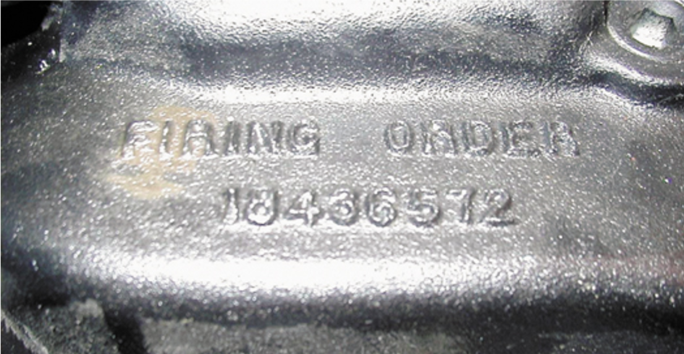
Figure 17.10
The firing order is cast or stamped on the intake manifold on most engines that have a distributor ignition.

Slide 23
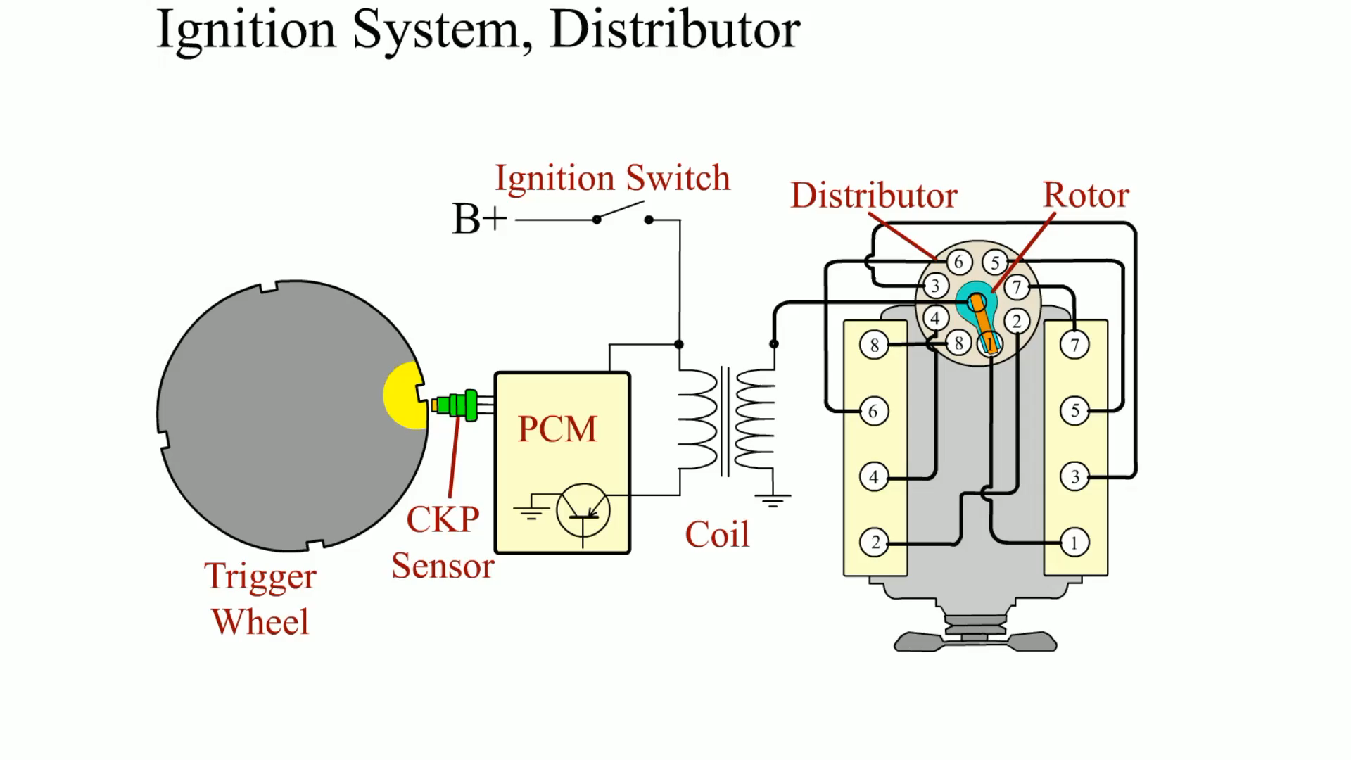
Animation:
Ignition System, Distributor
(The animation will automatically start in a few seconds)

Slide 24
Waste-Spark Ignition System
Parts Involved
  Uses the ignition control module (I C M) and/or the powertrain control module (P C M) to fire the ignition coils.
  A 4-cylinder engine uses two ignition coils, and a 6-cylinder engine uses three ignition coils.
  Each end of the secondary winding is connected to a cylinder exactly opposite the other in the firing order.
Waste-spark System Operation
  Both spark plugs fire at the same time (within nanoseconds of each other).

Slide 25
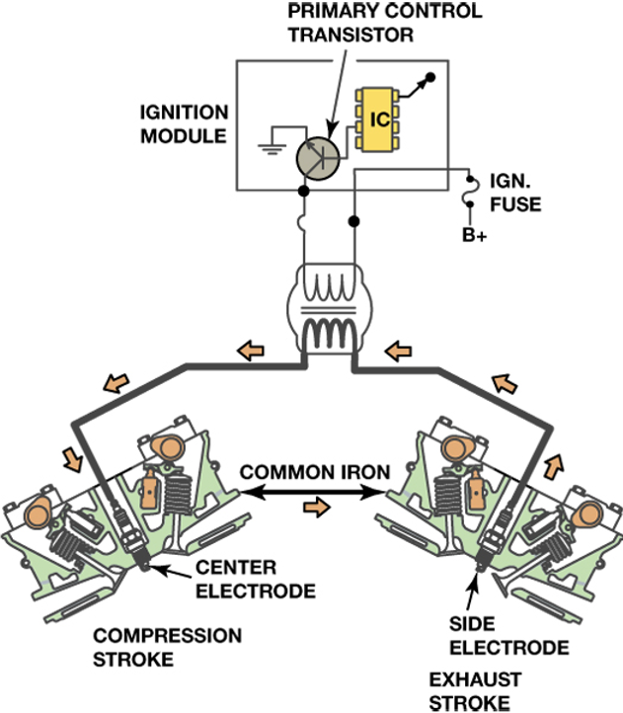
Figure 17.11
A waste-spark system fires one cylinder while its piston is on the compression stroke and into paired or companion cylinders while it is on the exhaust stroke.
Notes:
Long Description:
The system shows an ignition module consists of a primary control transistor, an I C, and an ignition fuse. It is linked with a compression stroke on the left and an exhaust stroke on the right. There is a common iron between them. The compression stroke consists of a center electrode and the exhaust electrode consists of a side electrode.

Slide 26
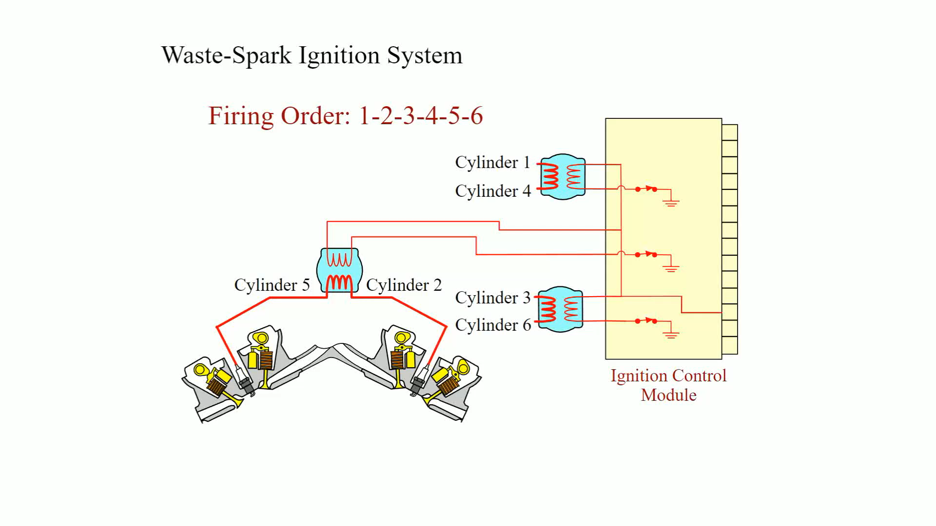
Animation:
Waste-Spark Ignition System
(The animation will automatically start in a few seconds)

Slide 27
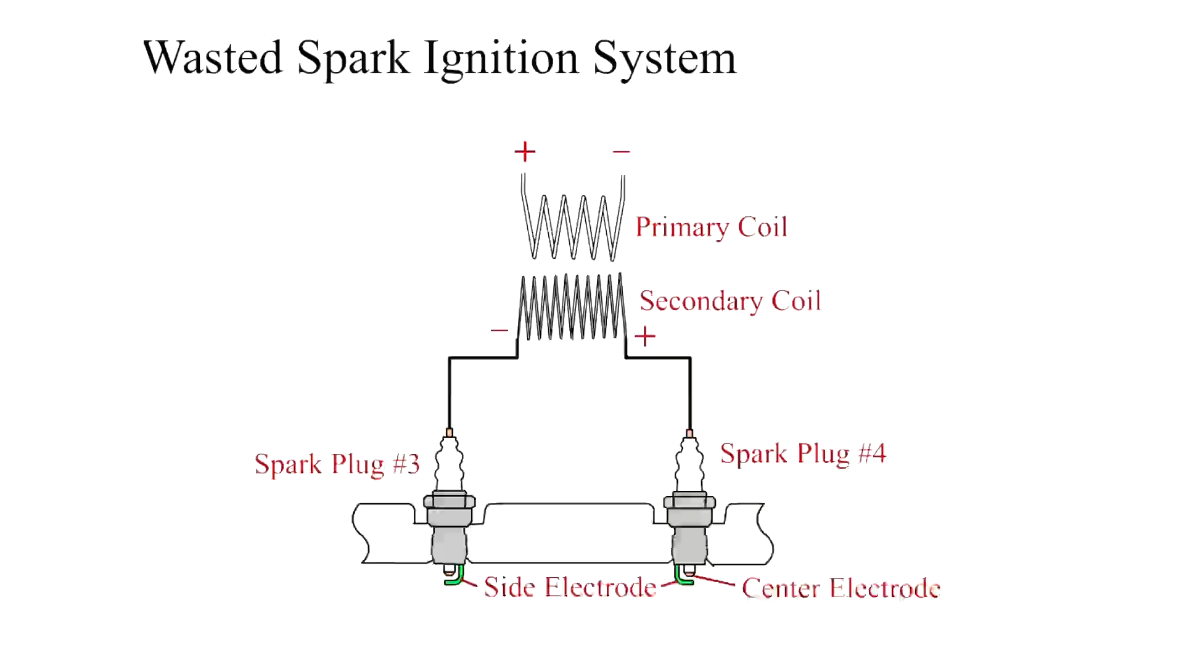
Animation:
Waste Spark Ignition System
(The animation will automatically start in a few seconds)
Waste Spark Ignition System

Slide 28
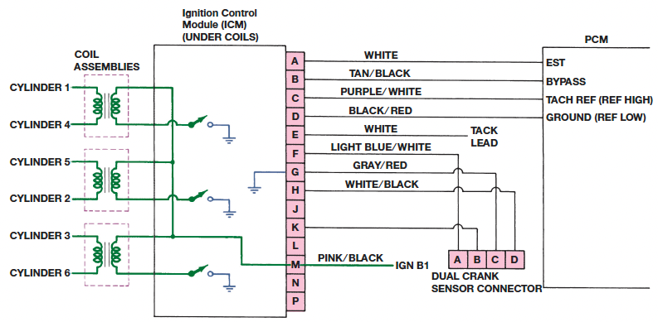
Figure 17.12
Typical wiring diagram of a V-6 waste-spark ignition system.
Notes:
Long Description:
The system consists of three coils assemble. The first coil is linked with cylinder 1 and cylinder 4. The second coil is linked with cylinder 5 and cylinder 2. The third coil is linked with cylinder 3 and cylinder 6. All the coils are then linked with an ignition control module or I C M under coils, which consists of fourteen rectangular vertical blocks labeled from A to P. P C M consisting of E S T, Bypass, tach ref (ref high), and ground (ref low) is shown on the right and a dual crank sensor connector consisting of four horizontal blocks A, B, C, and D is shown at the bottom. A from I C M links with a wire labeled "white" to E S T. B through the wire labeled "Tan or black" is connected to Bypass. C through the wire labeled "purple or white" is connected to tach ref. D through the wire "black or red" is connected to the ground. E through the wire white is connected to a tack lead. F through the wire light blue or white is connected to the A of the dual crank sensor connector. G through the wire gray or red is connected to the C of the dual crank sensor connector. H through the wire white or black is connected to the D of the sensor connector. K is connected to the C of the sensor connector. M through the wire pink or black is connected to I G N B 1.

Slide 29
Coil-on-Plug Ignition
Coil-on-plug (C O P) ignition uses one ignition coil for each spark plug.
This system is also called coil-by-plug, coil-near-plug, or coil-over-plug ignition.
Advantages
Types of C O P Systems
  Two primary wires
  Three primary wires

Slide 30
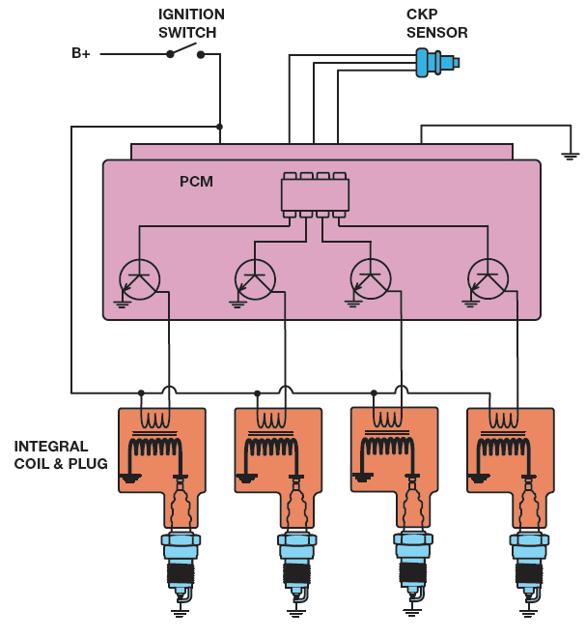
Figure 17.13
A typical coil-on-plug ignition system showing the triggering and the switching being performed by the P C M from input from the crankshaft position sensor.
Notes:
Long Description:
The system shows a B positive battery linked with an open ignition switch that is connected to a P C M consisting of four transistors. All four transistors are connected to an integral coil and a plug, in turn. The P C M at the top is connected to a C K P sensor with three wires. The system is also connected to the ground.

Slide 31
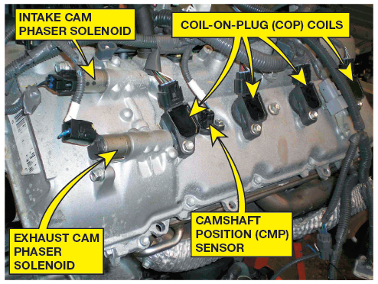
Figure 17.14
An overhead camshaft engine equipped with variable valve timing on both the intake and exhaust camshafts and coil-on-plug ignition.

Slide 32
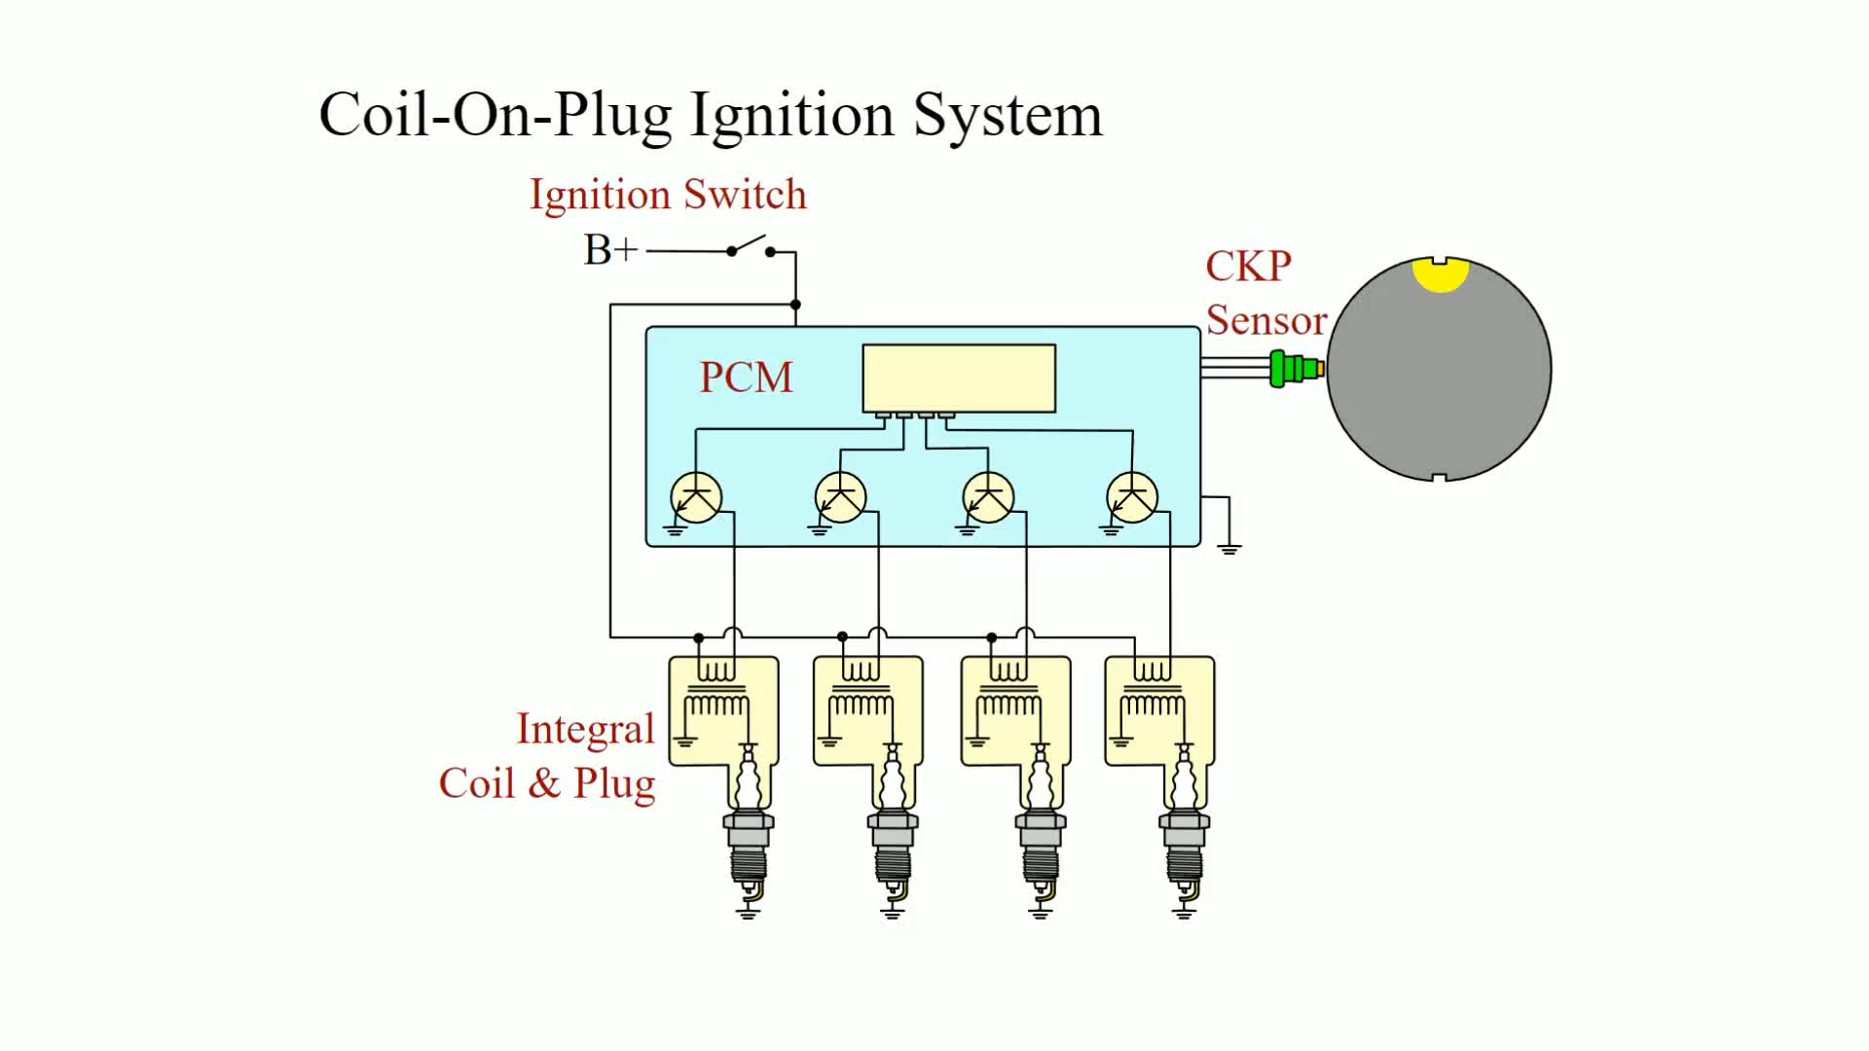
Animation:
Coil-On-Plug Ignition System
(The animation will automatically start in a few seconds)

Slide 33
Knock Sensors
Knock sensors are used to detect abnormal combustion, often called ping, spark knock, or detonation.
Diagnosing the Knock Sensor
Replacing a Knock Sensor

Slide 34
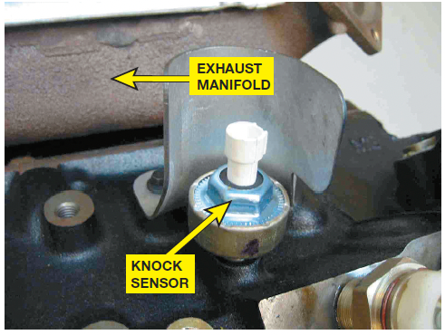
Figure 17.17
A typical knock sensor on the side of the block. Some are located in the “V” of a V-type engine and are not noticeable until the intake manifold has been removed.

Slide 35
Ignition System Diagnosis
Checking For Spark
Ignition Coil Testing Using An Ohmmeter
Magnetic Sensor Testing
Testing Hall-Effect Sensors
Testing Optical Sensors

Slide 36
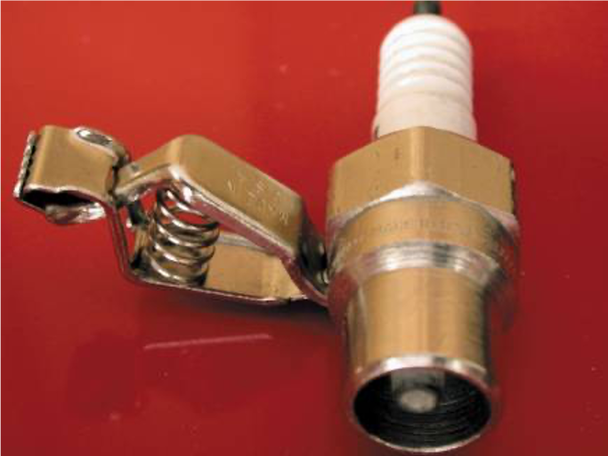
Figure 17.19
A spark tester looks like a regular spark plug with an alligator clip attached to the shell. This tester has a specified gap that requires at least 25,000 volts (25 kV) to fire.

Slide 37
Spark Plug Wire Inspection
Spark plug wires should be visually inspected for cuts or defective insulation.
  Faulty spark plug wire insulation can cause hard starting or no starting in rainy or damp weather conditions.
  When removing a spark plug wire, be sure to rotate the boot of the wire at the plug before pulling it off the spark plug.
    This will help prevent damaging the wire as many wires are stuck to the spark plug and are often difficult to remove.

Slide 38
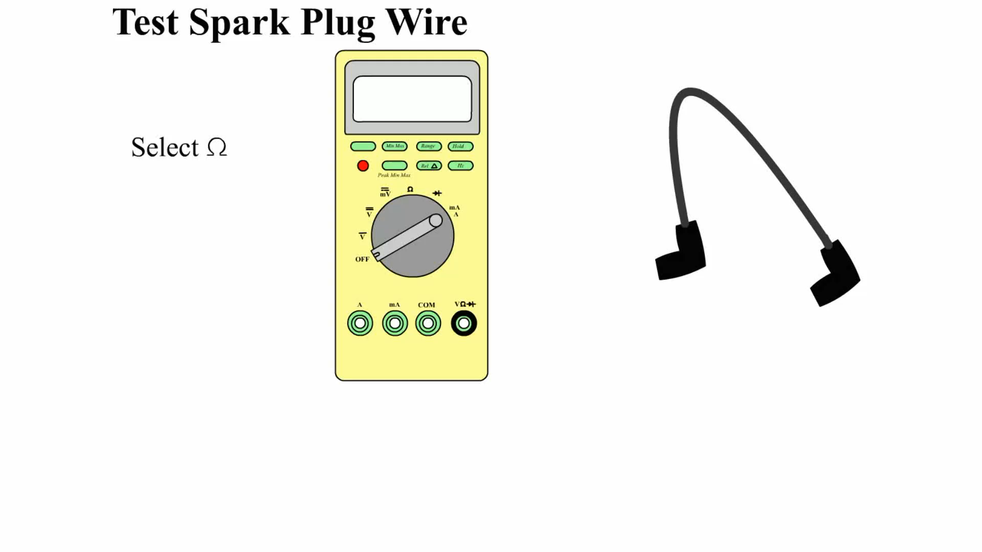
Animation:
Test Spark Plug Wire
(The animation will automatically start in a few seconds)

Slide 39
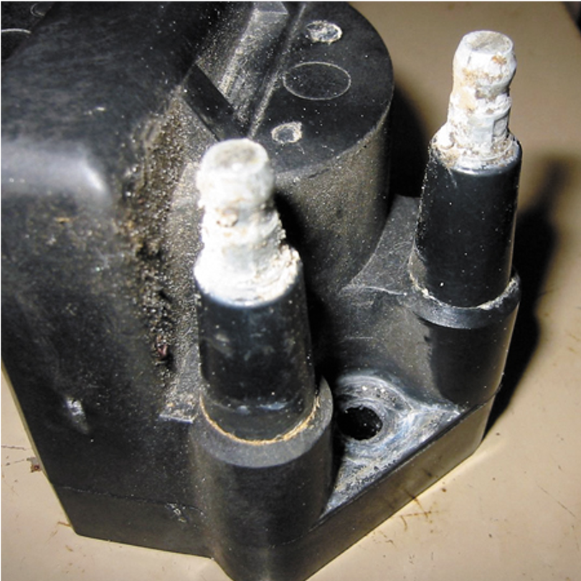
Figure 17.26
Corroded terminals on a waste-spark coil can cause misfire diagnostic trouble codes to be set.

Slide 40
Spark Plugs
Spark plugs are manufactured from ceramic insulators inside a steel shell.
The threads of the shell are rolled, and a seat is formed to create a gas-tight seal with the cylinder head.
Spark Plug Service
The physical differences in spark plugs include:
  Reach.
  Heat range.
  Type of seat.

Slide 41
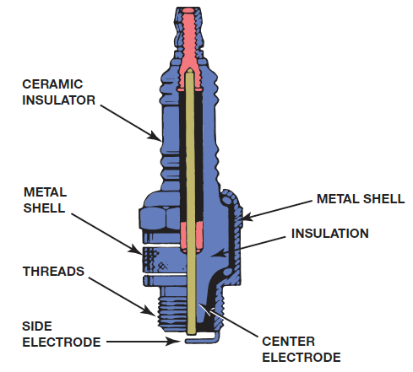
Figure 17.31
Parts of a spark plug.

Slide 42
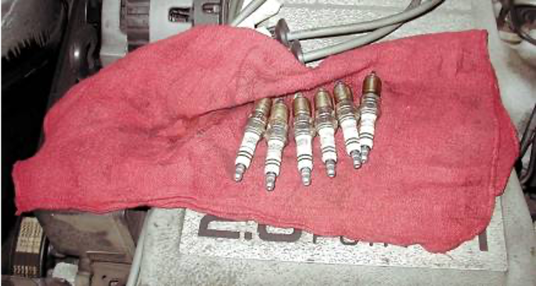
Figure 17.33
When removing spark plugs, it is wise to arrange them so that they can be compared and any problem can be identified with a particular cylinder.

Slide 43
Ignition Timing
Ignition timing is when the spark plug fires in relation to piston position.
  The time when the spark occurs depends on engine speed and, therefore, must be advanced as the engine rotates faster.
Follow exactly the timing procedure indicated on the underhood vehicle emission control information (V E C I) decal.

Slide 44
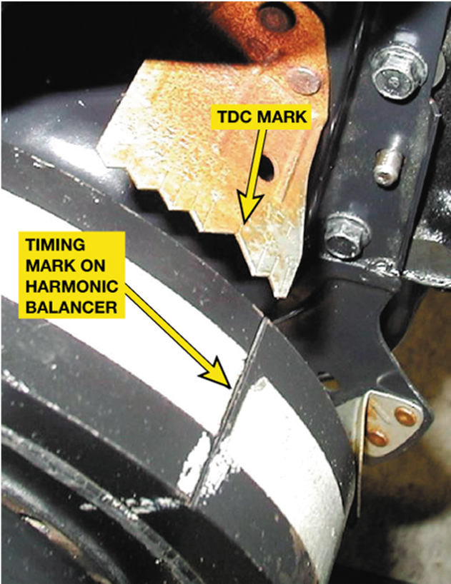
Figure 17.40
Ignition timing marks are found on the harmonic balancers on engines equipped with distributors that can be adjusted for timing.

Slide 45
Summary (1 of 2)
All inductive ignition systems supply battery voltage to the positive side of the ignition coil and pulse the negative side of the coil on and off to ground to create a high-voltage spark.
If an ignition system uses a distributor, it is a distributor ignition (D I) system.
If an ignition system does not use a distributor, it is an electronic ignition (E I) system.

Slide 46
Summary (2 of 2)
A waste-spark ignition system fires two spark plugs at the same time.
A coil-on-plug ignition system uses an ignition coil for each spark plug.
A thorough visual inspection should be performed on all ignition components when diagnosing an engine performance problem.
Platinum spark plugs should not be regapped after use in an engine.

Slide 47
Animation and Video Resources
The below listed resources are hyperlinked to the James Halderman website
(A6) Electrical/Electronic Systems Animations
(A6) Electrical/Electronic Systems Videos

Slide 48

Copyright
This work is protected by United States copyright laws and is provided solely for the use of instructors in teaching their courses and assessing student learning. Dissemination or sale of any part of this work (including on the World Wide Web) will destroy the integrity of the work and is not permitted. The work and materials from it should never be made available to students except by instructors using the accompanying text in their classes. All recipients of this work are expected to abide by these restrictions and to honor the intended pedagogical purposes and the needs of other instructors who rely on these materials.

