Slide 1


Automotive Engines Theory and Servicing
Tenth Edition
Chapter 16
Engine Starting and Charging Systems
Copyright © 2023 Pearson Education, Inc. All Rights Reserved
Notes:
If this PowerPoint presentation contains mathematical equations, you may need to check that your computer has the following installed:
1) MathType Plugin
2) Math Player (free versions available)
3) NVDA Reader (free versions available)

Slide 2
Learning Objectives (1 of 3)
16.1 Explain the purpose and function of a battery, and discuss battery ratings.
16.2 Discuss battery service and battery service safety considerations.
16.3 Discuss battery voltage test, battery load testing, and conductance testing.
16.4 Explain how to safely jump start a battery, and discuss battery charging and charging circuit.

Slide 3
Learning Objectives (2 of 3)
16.5 Explain the battery electrical drain test.
16.6 Describe the cranking circuit, and discuss how to diagnose starter problems using visual inspection.
16.7 Explain starter testing on a vehicle and how to test a starter using a scan tool.
16.8 Discuss voltage drop testing and how to check starting system voltage.

Slide 4
Learning Objectives (3 of 3)
16.9 Discuss how to test an alternator using a scan tool and using a scope.
16.10 Discuss A C ripple voltage check and A C current check.
16.11 Explain charging system voltage drop testing and alternator output test.

Slide 5
Purpose and Function of a Battery
An automotive battery provides a source of electrical power for starting and for electrical demands that exceed alternator output.
  The battery also acts as a voltage stabilizer for the entire electrical system.
  It is important to test the vehicle battery before further testing of the cranking or charging system.

Slide 6
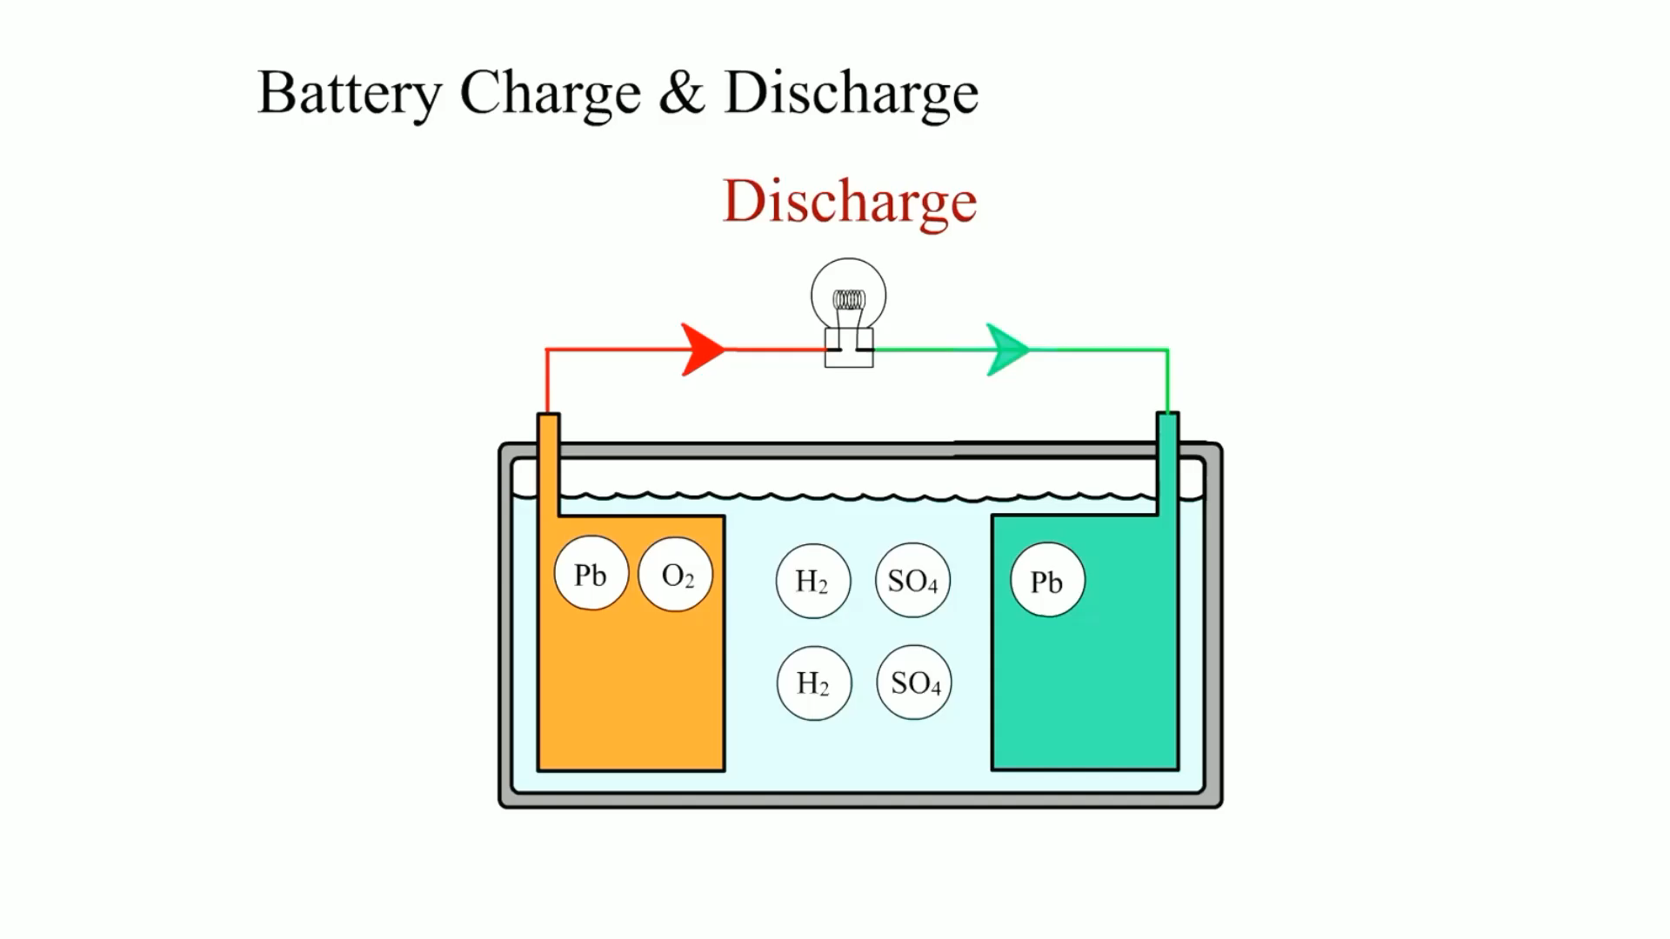
Animation:
Battery Charge & Discharge
(The animation will automatically start in a few seconds)

Slide 7
Battery Ratings
Batteries are rated according to the amount of current they can produce under specific conditions.
  Cold-Cranking Amperes
  Cranking Amperes
  Marine Cranking Amperes
  Ampere-Hour Rating
  Reserve Capacity

Slide 8
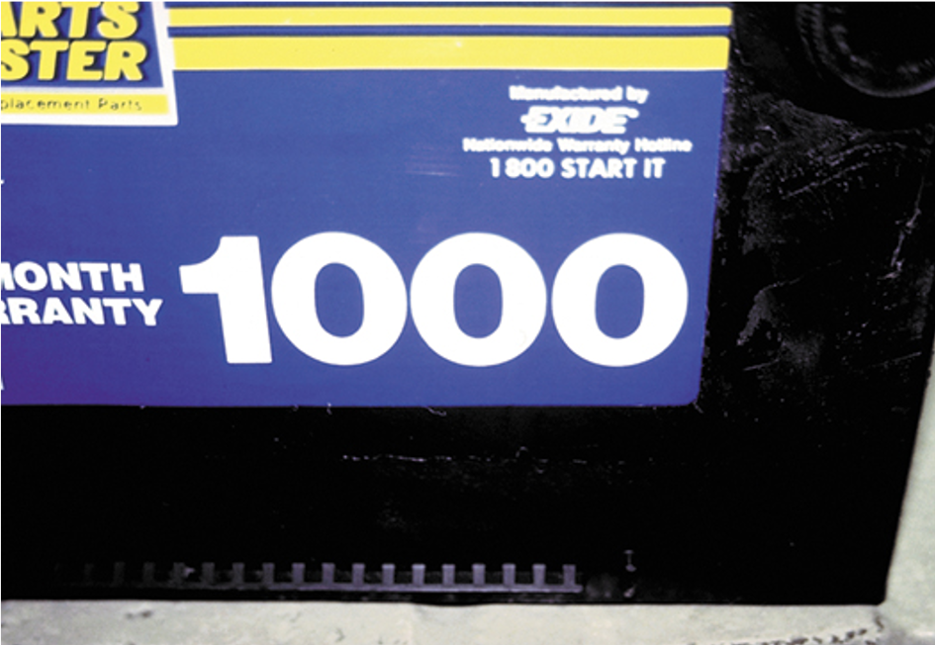
Figure 16.1
This battery shows a large “1000” on the front panel but this is the C A rating and not the more important C C A rating. Always compare batteries with the same rating.

Slide 9
Battery Service Safety Considerations (1 of 2)
Batteries contain acid and release explosive gases (hydrogen and oxygen) during normal charging and discharging cycles.
To help prevent physical injury or damage to the vehicle, always adhere to the following safety procedures.
  Whenever working on any electrical component on a vehicle, disconnect the negative battery cable from the battery.

Slide 10
Battery Service Safety Considerations (2 of 2)
  Wear eye protection whenever working around any battery.
  Wear protective clothing to avoid skin contact with battery acid.
  Always adhere to all safety precautions as stated in the service procedures for the equipment used for battery service and testing.
  Never smoke or use an open flame around any battery.

Slide 11
Battery Visual Inspection and Voltage Test
The battery and battery cables should be included in the list of items checked during a thorough visual inspection.
Check the battery cables for corrosion and tightness
Testing the battery voltage with a voltmeter is a simple method for determining the state of charge of any battery.

Slide 12
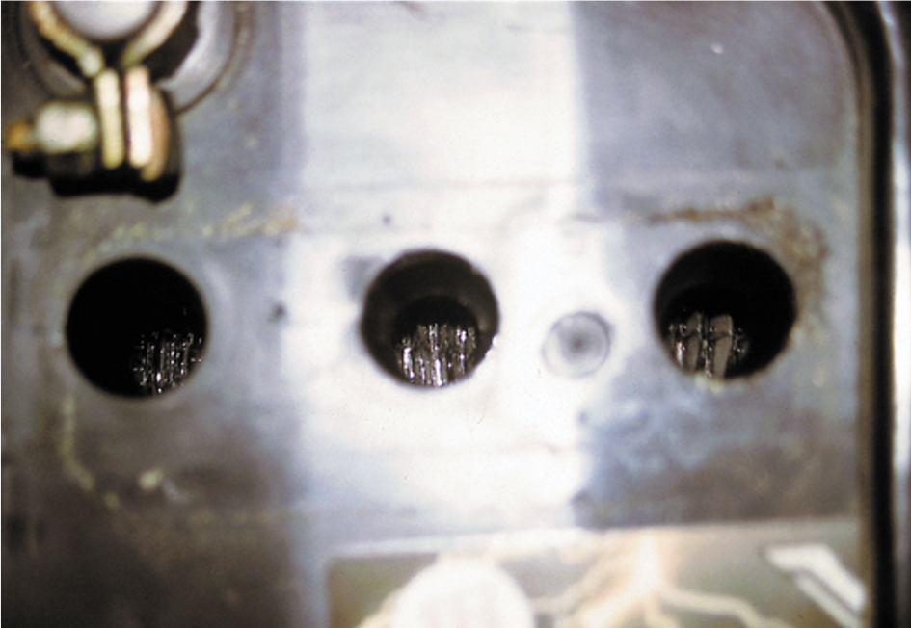
Figure 16.3
A visual inspection on this battery showed that the electrolyte level was below the plates in all cells.

Slide 13
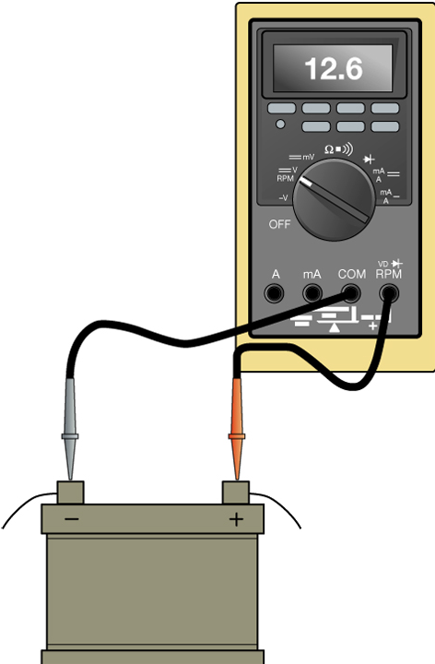
Figure 16.4
Using a D M M to measure the open-circuit voltage of a battery.

Slide 14
Battery Load Testing
What is a battery load test?
If the battery fails the load test, recharge the battery and retest.
If the battery fails the load test again, replace the battery.

Slide 15
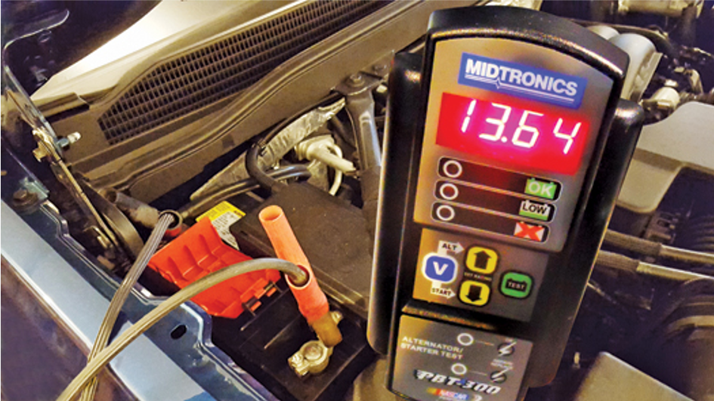
Figure 16.7
A Midtronics tester that can not only test the battery but can also detect faults with the starter and alternator.

Slide 16
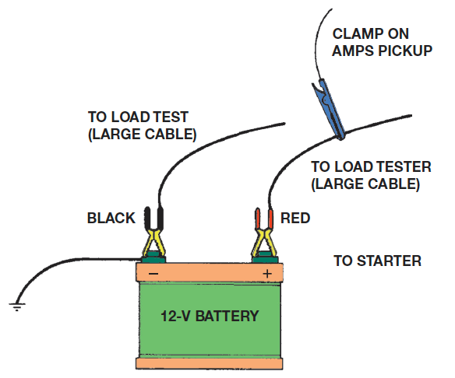
Figure 16.8
This shows a typical battery load tester hookup.
Notes:
Long Description:
The battery has black and red terminals. The black terminal is connected to a large cable or load test and the red terminal is connected to a load tester or a large cable having a clamp on A M P S pickup. The black terminal is also connected to the ground.

Slide 17
Conductance Testing
General Motors Corporation, Chrysler Corporation, Ford, and other vehicle manufacturers specify that a conductance tester be used to test batteries in vehicles still under factory warranty.
  It uses its internal electronic circuitry to determine the state of charge and capacity of the battery by measuring the voltage and conductance of the plates.

Slide 18
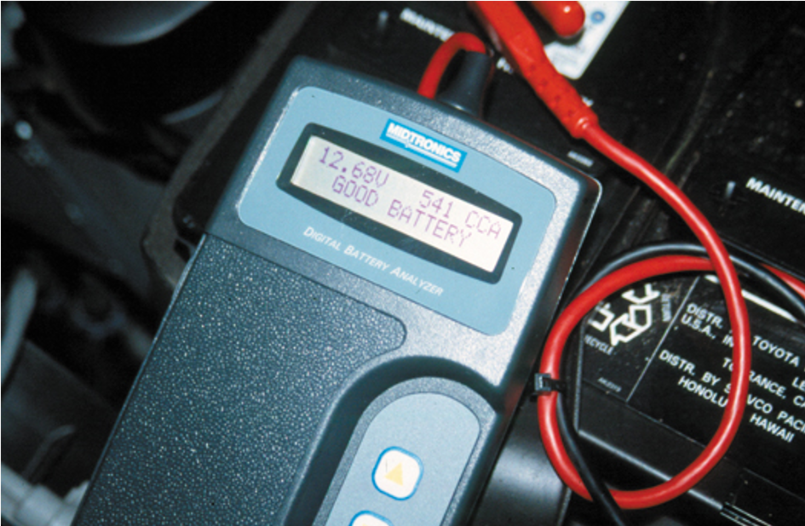
Figure 16.9
An electronic battery tester.

Slide 19
Jump Starting
To safely jump start a vehicle without doing any harm, use the following procedure.
  Be certain the ignition switch is off on both vehicles.
  Connect good-quality copper jumper cables.
  Start the vehicle with the good battery and allow it to run for 5 to 10 minutes. This allows the alternator of the good vehicle to charge the battery on the disabled vehicle.
  Start the disabled vehicle and, after the engine is operating smoothly, disconnect the jumper cables in the reverse order of step 2.

Slide 20
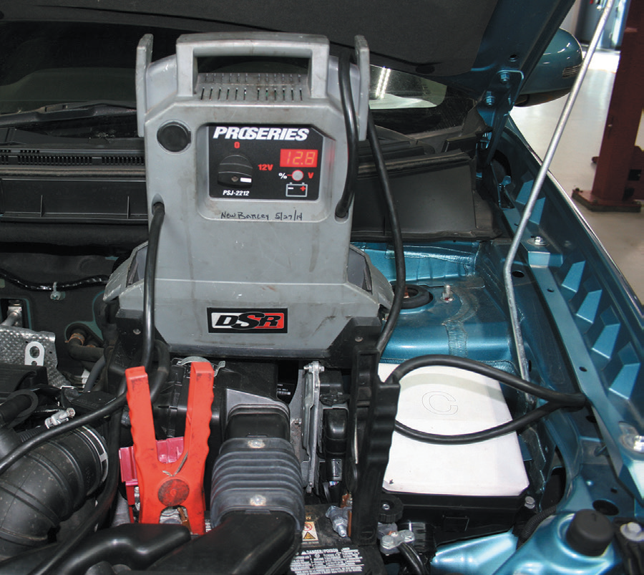
Figure 16.10
A battery jump box used to jump start vehicles. These hand-portable units have made jumper cables obsolete.

Slide 21
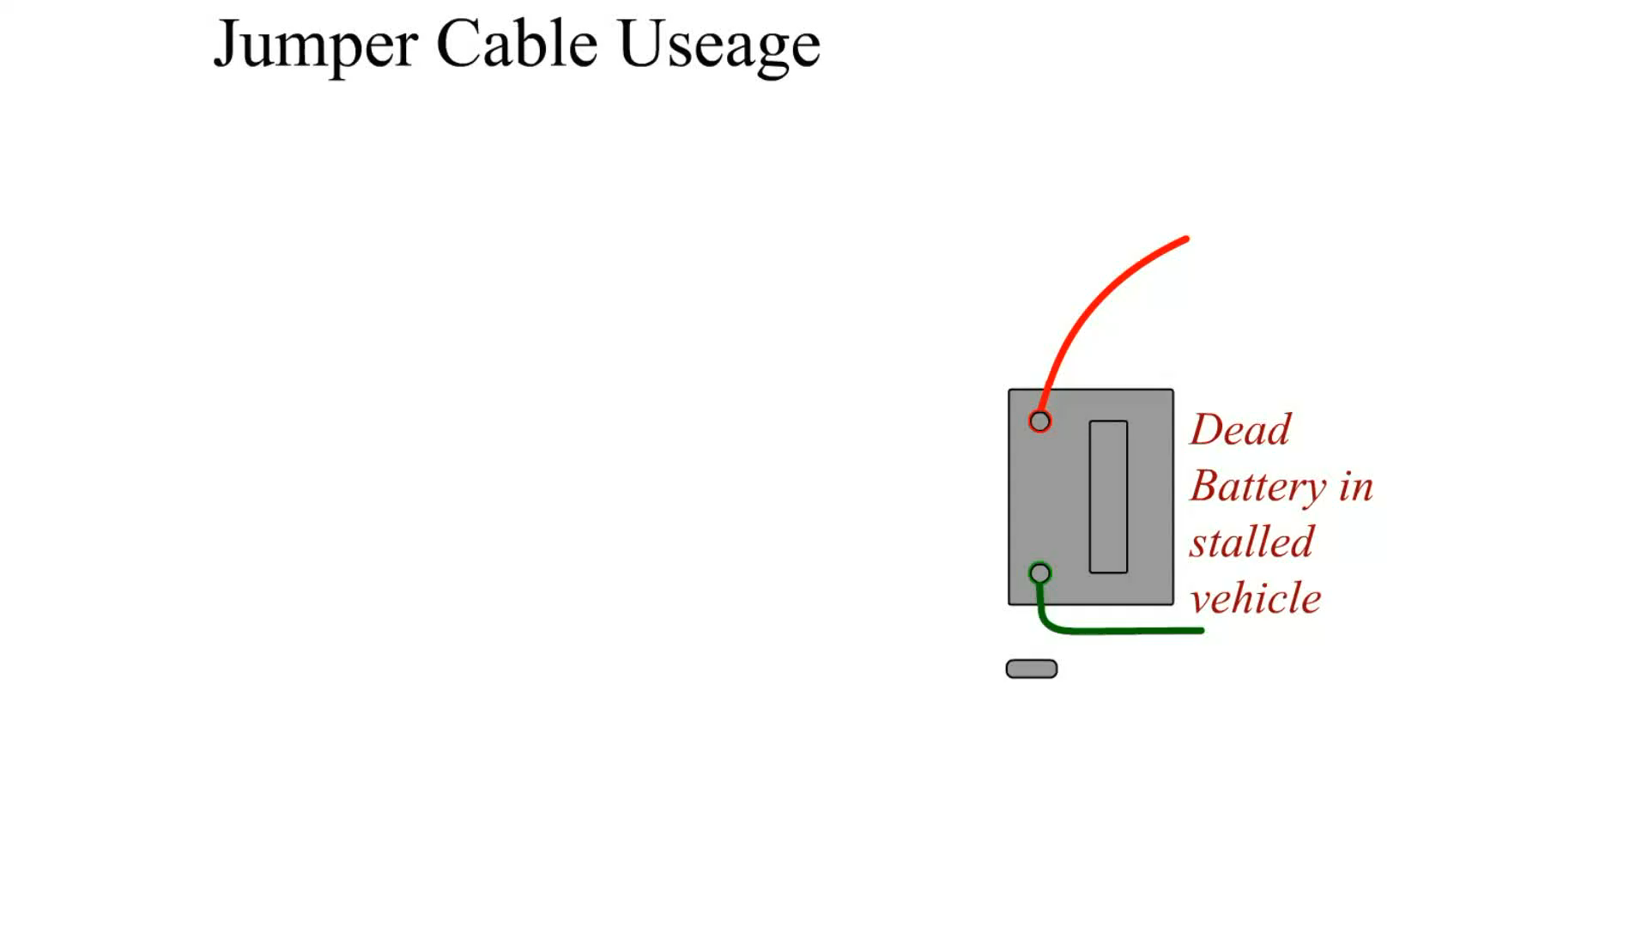
Animation:
Jumper Cable Usage
(The animation will automatically start in a few seconds)

Slide 22

Animation:
Jumper Box Usage
(The animation will automatically start in a few seconds)

Slide 23
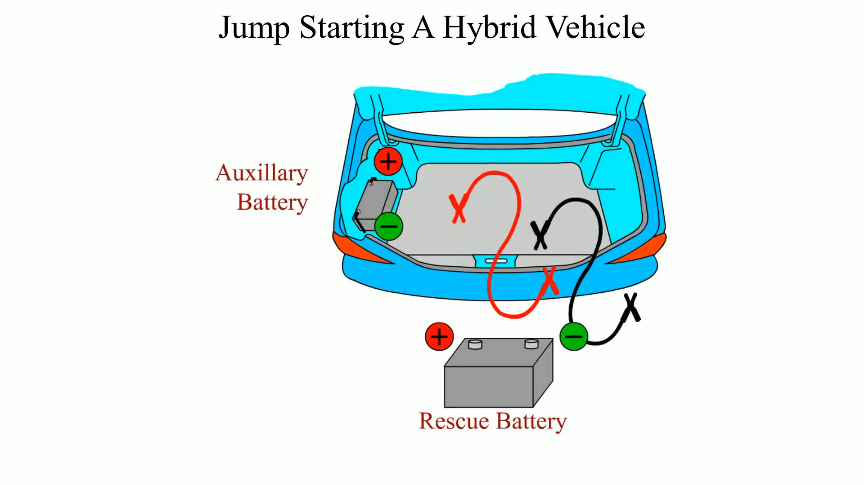
Animation:
Jump Starting A Hybrid Vehicle
(The animation will automatically start in a few seconds)

Slide 24
Battery Charging and Service
It is best to slow-charge any battery to prevent possible overheating damage to the battery.
Remember, it may take eight hours or more to charge a fully discharged battery.
Check and service the following items if needed.
  Neutralize and clean any corrosion from the battery terminals with a solution of baking soda and water.
  Carefully inspect the battery cables by visual inspection.
  Check the tightness and cleanliness of all ground connections.

Slide 25
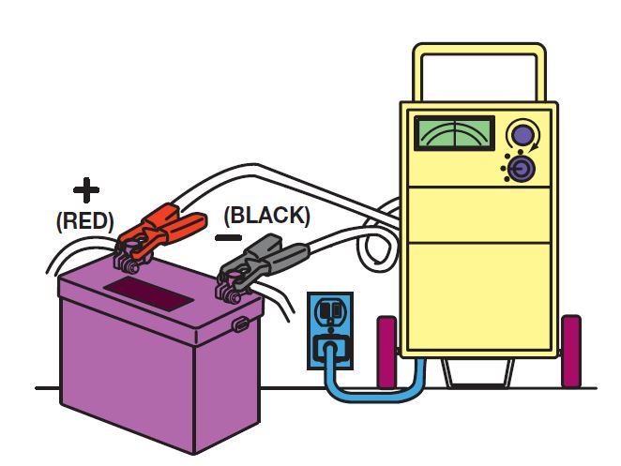
Figure 16.11
To use a battery charger, make sure the charger is connected to the battery before plugging in the charger.

Slide 26
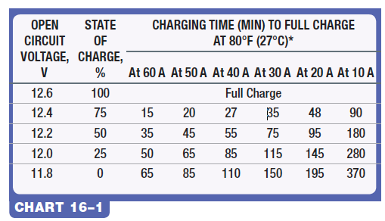
Chart 16.1
A chart that can be used to estimate the charging time based on battery voltage and charging rate.
*If colder, allow additional time.
Notes:
Long Description:
The chart has eight columns and five rows. From left to right, the columns are labeled "Open circuit voltage in volts, State of charge in percent, Charging time in minutes to full charge at 80 degrees Fahrenheit or 27 degrees Celsius: At 60 amperes, At 50 amperes, At 40 amperes, At 30 amperes, At 20 amperes, and At 10 amperes." The entries in the chart are as follows:
Row 1: Open circuit voltage in volts: 12.6, State of charge in percent: 100, At 60 amperes: Full charge, At 50 amperes: Full charge, At 40 amperes: Full charge, At 30 amperes: Full charge, At 20 ampere: Full charge, At 10 amperes: Full charge.
Row 2: Open circuit voltage in volts: 12.4, State of charge in percent: 75, At 60 amperes: 15, At 50 amperes: 20, At 40 amperes: 27, At 30 amperes: 35, At 20 ampere: 48, At 10 amperes: 90.
Row 3: Open circuit voltage in volts: 12.2, State of charge in percent: 50, At 60 amperes: 35, At 50 amperes: 45, At 40 amperes: 55, At 30 amperes: 75, At 20 ampere: 95, At 10 amperes: 180.
Row 4: Open circuit voltage in volts: 12.0, State of charge in percent: 25, At 60 amperes: 50, At 50 amperes: 65, At 40 amperes: 85, At 30 amperes: 115, At 20 ampere: 145, At 10 amperes: 280.
Row 5: Open circuit voltage in volts: 11.8, State of charge in percent: 0, At 60 amperes: 65, At 50 amperes: 85, At 40 amperes: 110, At 30 amperes: 150, At 20 ampere: 195, At 10 amperes: 370.

Slide 27
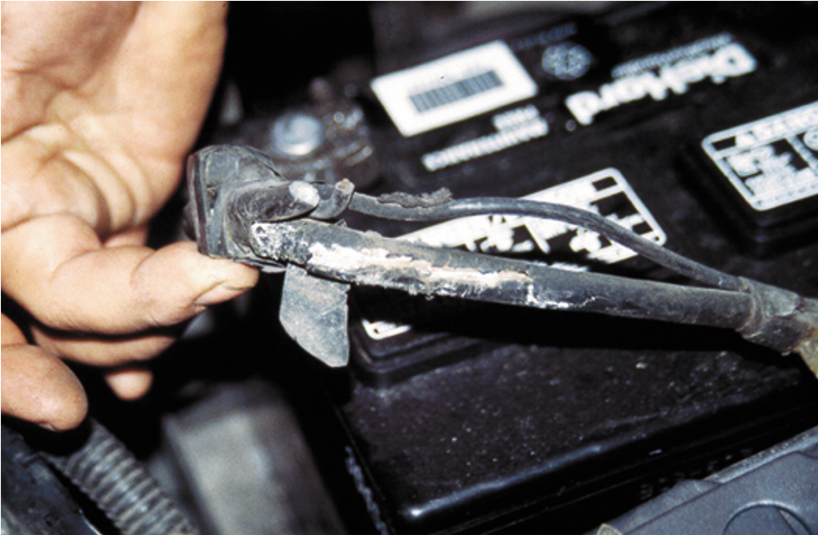
Figure 16.12
This battery cable was found corroded underneath. The corrosion had eaten through the insulation yet was not noticeable without careful inspection. This cable should be replaced.

Slide 28
Battery Electrical Drain Test
The battery electrical drain test determines if some component or circuit in a vehicle or truck is causing a drain on the battery when everything is off.
  This test is also called the ignition off-draw (I O D) or parasitic load test.
This test should be performed whenever one of the following conditions exists.
  Whenever a battery is being charged or replaced
  Whenever the battery is suspected of being drained

Slide 29
Battery Electrical Drain Test Using an Ammeter
The ammeter method is the most accurate way to test for a possible battery drain.
Connect an ammeter in series between the battery terminal (post) and the disconnected cable.
  Normal battery drain is 0.020 to 0.030 A and any drain greater than 0.050 A should be found and corrected.
Many digital multimeters have an ammeter scale that can be used to safely and accurately test for an abnormal parasitic drain.

Slide 30
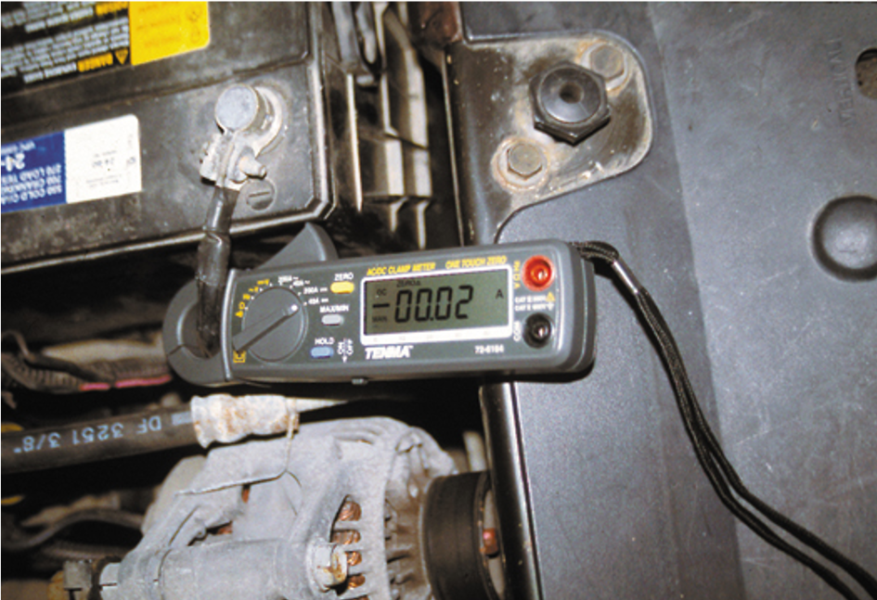
Figure 16.14
This mini clamp-on D M M is being used to measure the amount of battery electrical drain that is present. In this case, a reading of 20 m A (displayed on the meter as 00.02 A) is within the normal range of 20 to 30 m A.

Slide 31
Procedure for Battery Electrical Drain Test
What conditions should exist in order to perform this test?
Normal battery drain on a vehicle equipped with electronic radio, climate control, and computerized fuel injection, is usually about 20 to 30 mA (0.02 to 0.03 A).

Slide 32
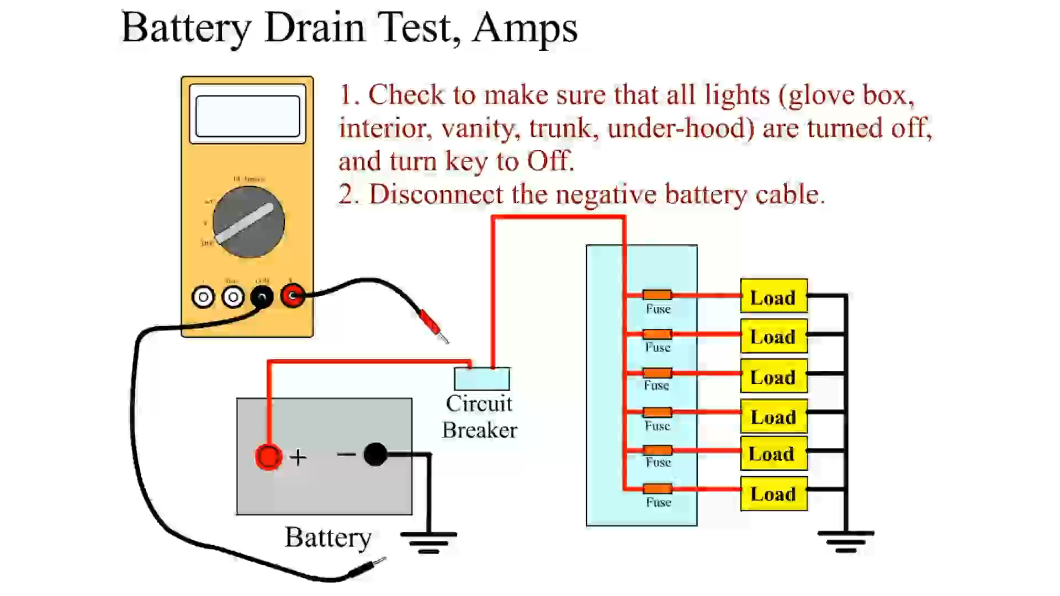
Animation:
Battery Drain Test, Amps
(The animation will automatically start in a few seconds)

Slide 33
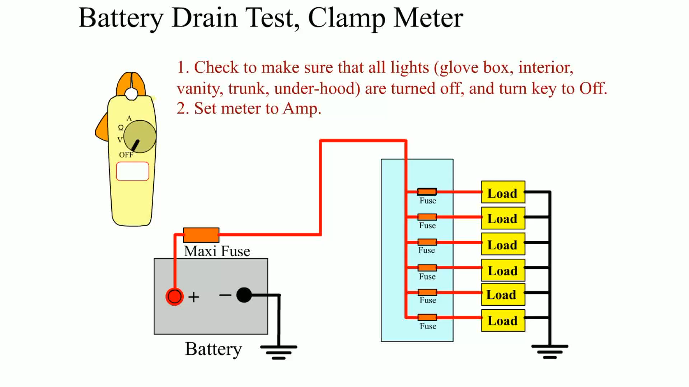
Animation:
Battery Drain Test, Clamp Meter
(The animation will automatically start in a few seconds)

Slide 34
Finding the Source of the Drain
If there is a drain, check and temporarily disconnect the following components.
  Cell phone or M P3 player still connected to the vehicle
  Glove compartment light
  Trunk light

Slide 35
When a Battery Drain Exists After Fuses Are Disconnected
The most common sources of drain under the hood include:
  The alternator. Disconnect the alternator wires and retest.
  The starter solenoid (relay) or wiring near its components. These are also a common source of battery drain, due to high current flows and heat, which can damage the wire or insulation.

Slide 36
Cranking Circuit
The cranking circuit includes those mechanical and electrical components required to crank the engine for starting.
Modern cranking circuits include the following:
  Starter motor
  Battery
  Starter solenoid or relay
  Starter drive
  Ignition switch

Slide 37
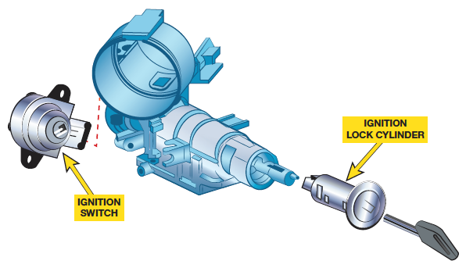
Figure 16.18
The lock cylinder is often a separate part from the electrical ignition switch and operates it directly or uses a link between two components.

Slide 38
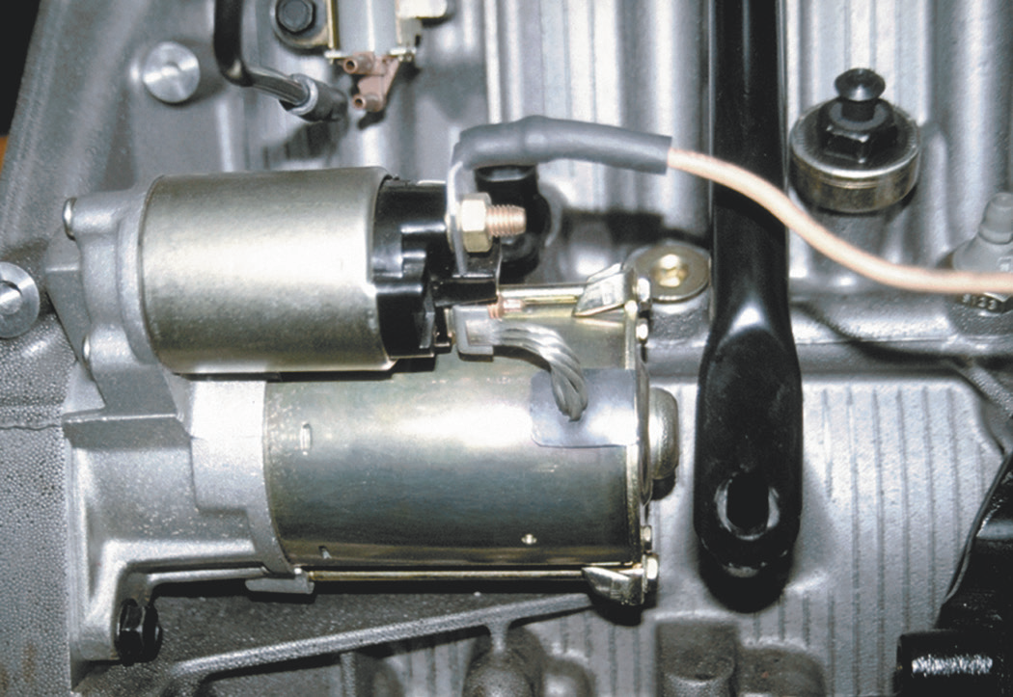
Figure 16.19
A typical solenoid-operated starter.

Slide 39
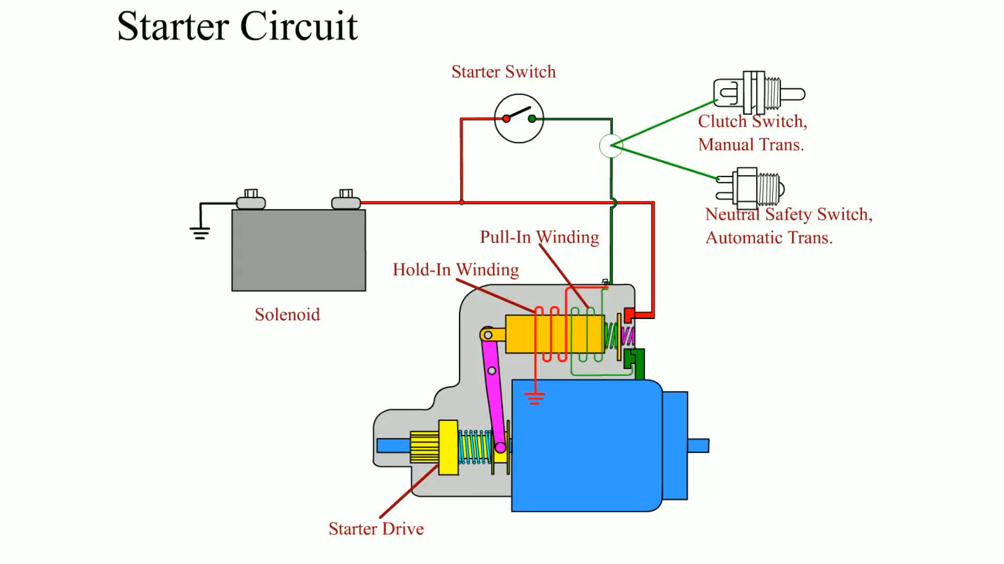
Animation:
Starter Circuit
(The animation will automatically start in a few seconds)

Slide 40
Starter Visual Inspection
Carefully check the battery cables for tightness both at the battery and at the starter, and block connections.
Check to see if the heat shield (if equipped) is in place.
Check for any nonstock add-on accessories or equipment that may drain the battery such as a sound system or extra lighting.
Crank the engine. Feel the battery cables and connections. If any cables or connections are hot to the touch, then an excessive voltage drop is present or the starter is drawing too much current.

Slide 41
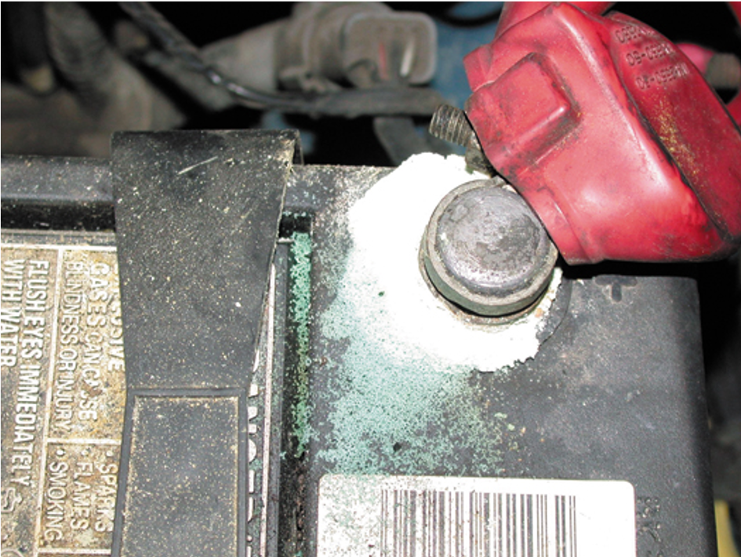
Figure 16.20
Carefully inspect all battery terminals for corrosion.

Slide 42
Starter Testing On the Vehicle (1 of 2)
Check Battery
Starter Amperage Test
  Excessive current draw may indicate one or more of the following:
    Low battery voltage (discharged or defective battery)
    Binding of starter armature as a result of worn bushings

Slide 43
Starter Testing On the Vehicle (2 of 2)
    Oil too thick (viscosity too high) for weather conditions
    Shorted or grounded starter windings or cables
    Tight or seized engine

Slide 44
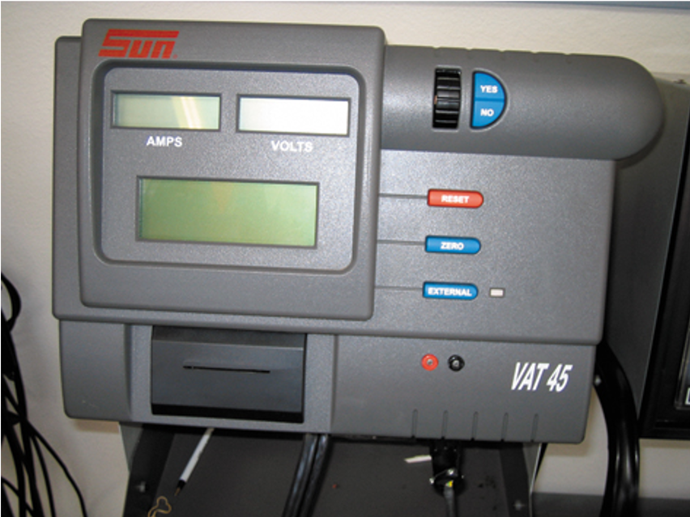
Figure 16.21
When connecting a starter tester such as a Sun V A T 45 to the vehicle, make certain that the inductive probe is placed over all of the cables or wires from the battery.

Slide 45
Testing a Starter Using a Scan Tool
Connect the scan tool according to the manufacturer's instructions.
Select battery voltage and engine R P M on the scan tool.
Select "snapshot" and start recording or graphing if the scan tool is capable.
Crank the engine. Stop the scan tool recording.
Retrieve the scan data and record cranking R P M and battery voltage during cranking.

Slide 46
Voltage Drop Testing
Purpose of Voltage Drop Testing
Results of Excessive Voltage Drop
Performing A Voltage Drop Test

Slide 47
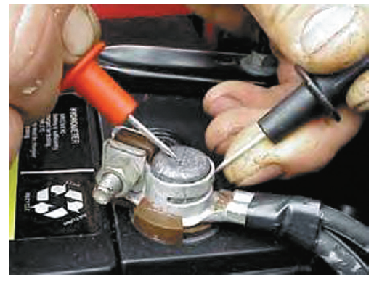
Figure 16.25
Using the voltmeter leads from a starting and charging test unit to measure the voltage drop between the battery
terminal (red lead) and the cable end (black lead).

Slide 48
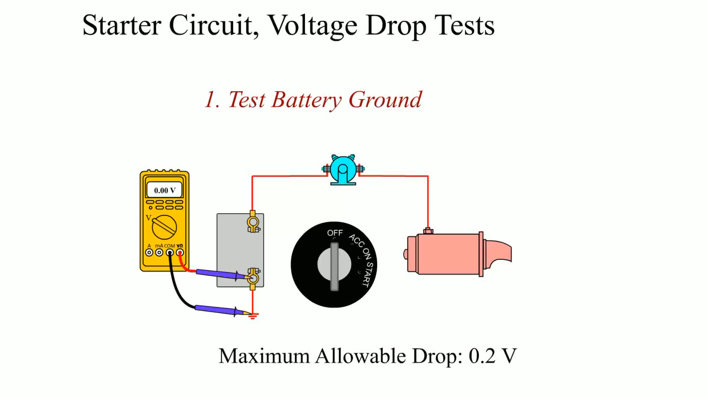
Animation:
Starter Circuit, Voltage Drop Tests
(The animation will automatically start in a few seconds)

Slide 49
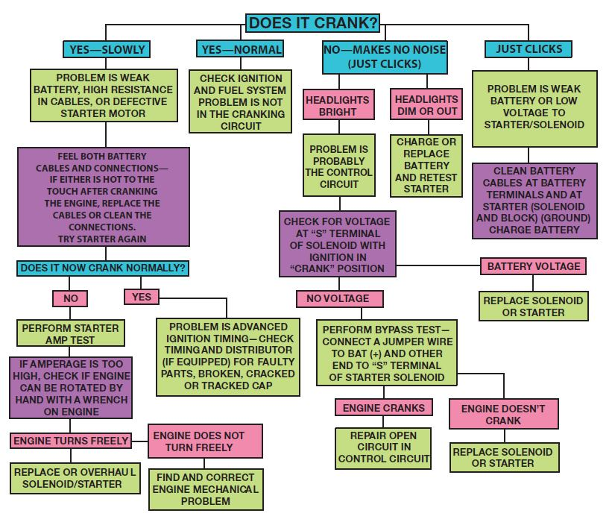
Figure 16.26
Starter diagnosis chart.
Notes:
Long Description:
A question, "Does it crank?" is divided into four parts namely, "Yes slowly, Yes normal, No makes no noise (just clicks), and Just clicks." The first section yes slowly leads to "Problem is weak battery, high resistance is cables, or defective starter motor," then to "Feel both battery cables and connections if either is hot to the touch after cranking the engine, replace the cables or clean the connections. Try starter again." It leads to "Does it now crank normally?" which is divided into two sections, "No and Yes." No leads to "Perform starter A M P test," which leads to "If amperage is too high, check if engine can be rotated by hand with a wrench on engine." It leads to "Engine turns freely" that in turn leads to "Replace or overhaul solenoid or starter. "Engine turns freely" also leads to "Engine does not turn freely," which leads to "Find and correct engine mechanical problem." The second section "Yes normal" leads to "Check ignition and fuel system problem is not in the cranking circuit." The third section "No makes no noise (just clicks)" leads to two sections, "Headlights bright" and "Headlights dim or out." "Headlights bright" leads to "Problem is probably the control circuit," which in turn leads to "Check for voltage at "S" terminal of solenoid with ignition in "crank" position." It flows to "No voltage," goes to "Perform bypass test: connect A jumper wire to bat positive and other end to S terminal of starter solenoid," and leads to "engine cranks" and "Engine does not crank." "Engine cranks" leads to "Repair open circuit in control circuit" and "Engine does not crank" leads to "Replace solenoid or starter." The fourth section "Just clicks" leads to "Problem is weak battery or low voltage to starter pr solenoid," which flows to "Clean battery cables at battery terminals and at starter (solenoid and block) (ground) charge battery), flows to "Battery voltage," and finally leads to "replace solenoid or starter." "Check for voltage at 'S' terminal of solenoid with ignition in "crank" position" flows to "No voltage" from the third section that is linked to "Battery voltage" from the fourth section.

Slide 50
Charging Circuit
An alternator is constructed of a two-piece cast-aluminum housing.
  Aluminum is used because of its lightweight, nonmagnetic properties and heat transfer properties
  A front ball bearing is pressed into the front housing to provide the support and friction reduction necessary for the belt-driven rotor assembly.
  The rear housing usually contains a roller-bearing support for the rotor and mounting for the brushes, diodes, and internal voltage regulator

Slide 51
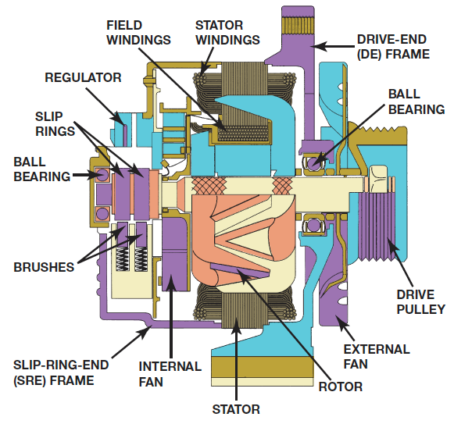
Figure 16.27
Cutaway view of a typical A C alternator.
Notes:
Long Description:
The system shows stator windings, field windings, a regulator, slip rings, a ball bearing, brushes, a slip ring end frame, an internal fan, a stator, a rotor, an external fan, a drive pulley, a ball bearing, and a drive end frame, from top to the top right in an anticlockwise direction.

Slide 52
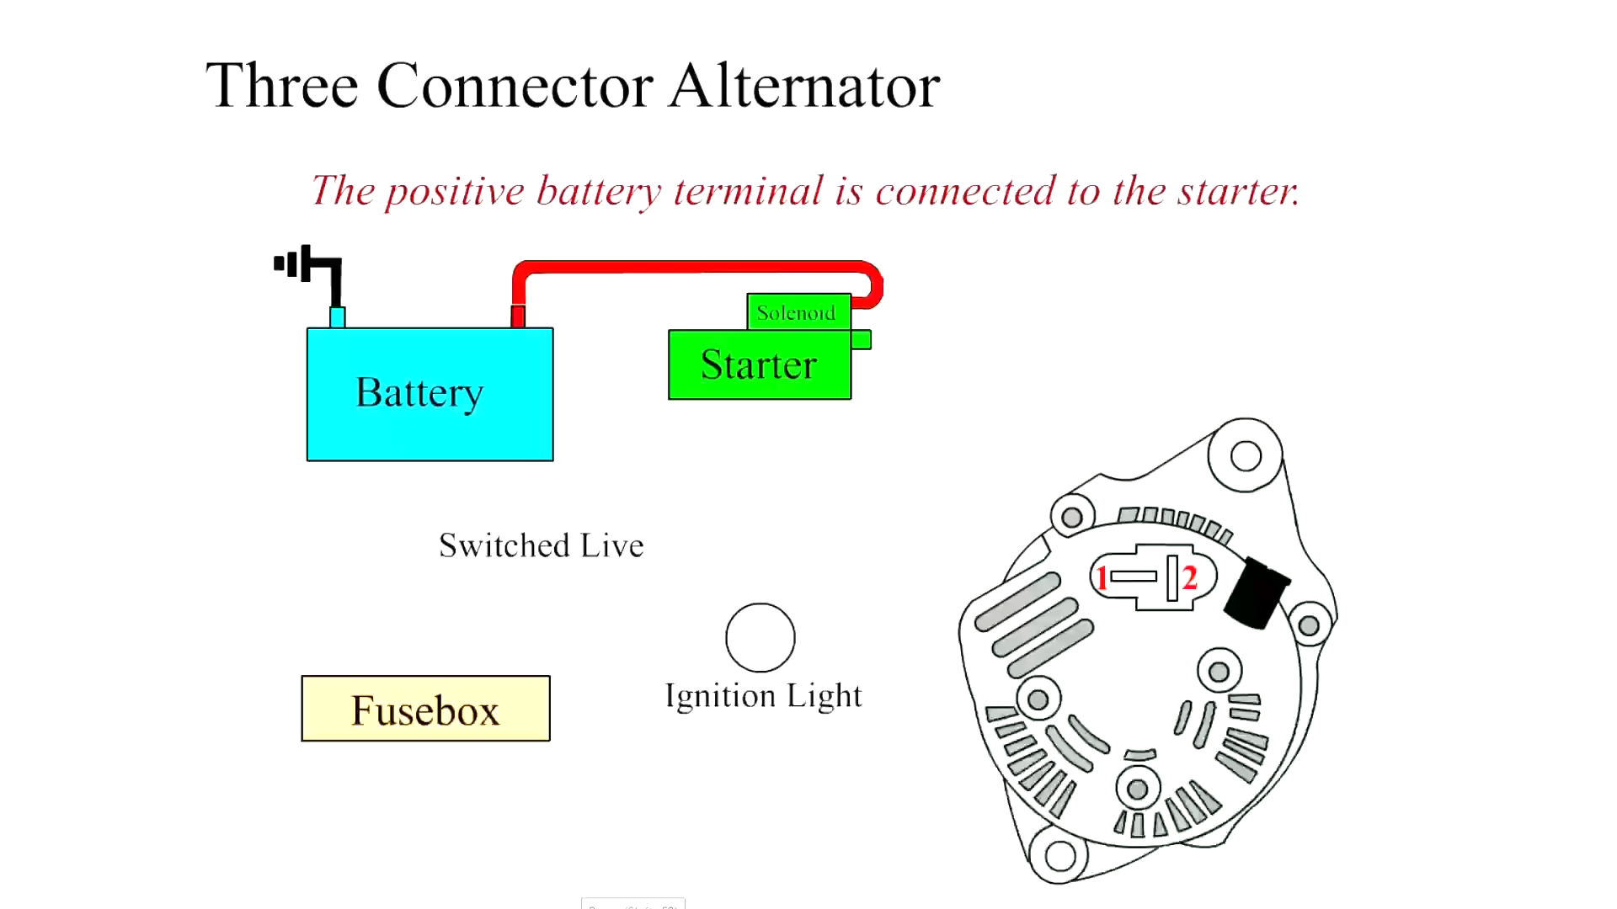
Animation:
Three Connector Alternator
(The animation will automatically start in a few seconds)

Slide 53
Checking Charging System Voltage
Digital Multimeter Connections
Charging System Voltage Specifications
Charging System Voltage Test Procedure

Slide 54
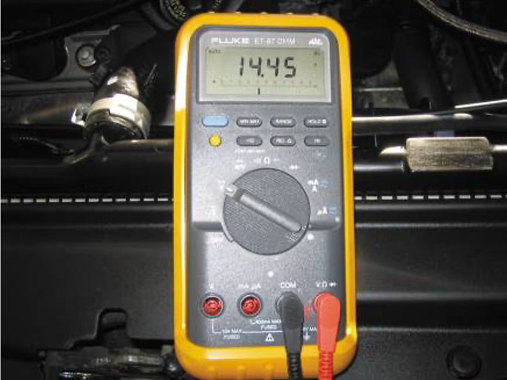
Figure 16.28
The digital multimeter should be set to read D C volts and the red lead connected to the battery positive (+) terminal and the black meter lead connected to the negative (-) battery terminal.

Slide 55
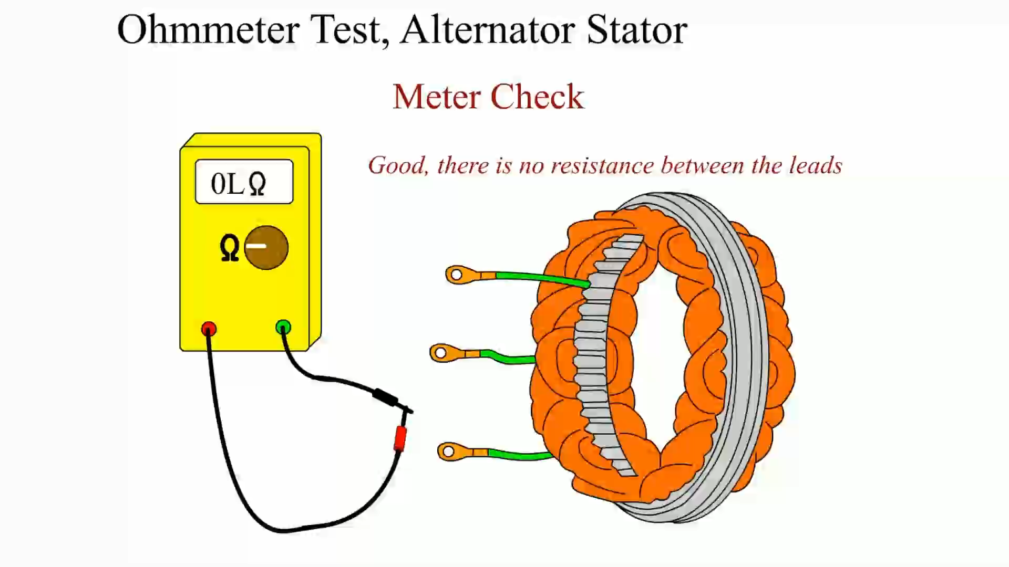
Animation:
Ohmmeter Test, Alternator Stator
(The animation will automatically start in a few seconds)

Slide 56
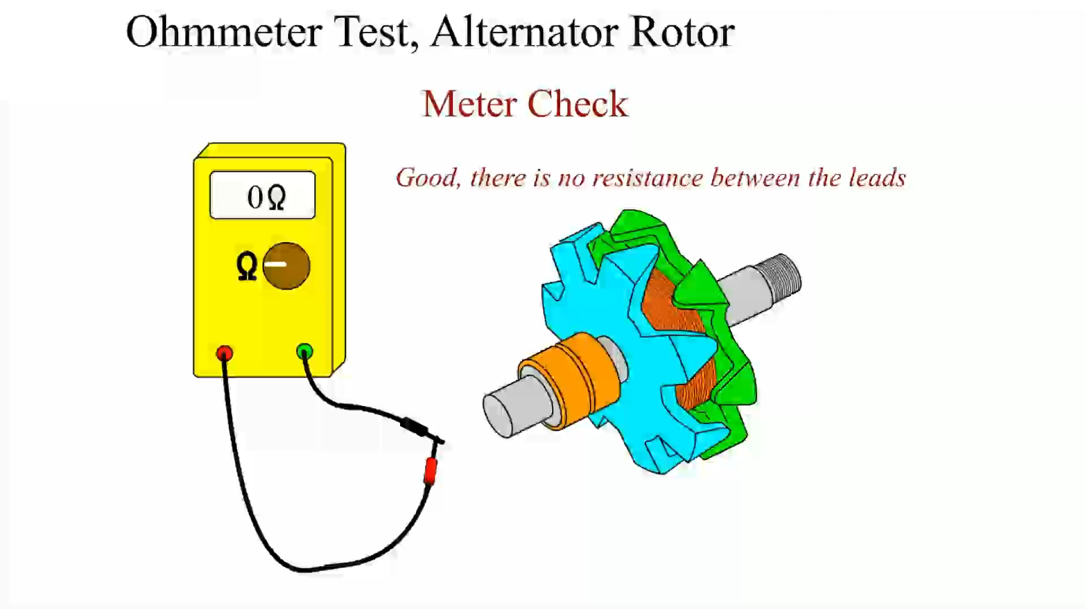
Animation:
Ohmmeter Test, Alternator
(The animation will automatically start in a few seconds)

Slide 57
Testing an Alternator Using a Scan Tool
A scan tool can be used on most vehicles that have data stream information.
Follow these steps:
  Connect the scan tool according to the manufacturer's instructions.
  Select battery voltage and engine R P M on the scan tool.
  Start the engine and operate at 2,000 R P M.
  Observe the battery voltage. This voltage should be between 13.5 and 15 volts (or within the manufacturer's specifications).

Slide 58
AC Ripple Voltage Check
Set the digital meter to read A C volts.
Start the engine and operate it at 2,000 R P M (fast idle).
Connect the voltmeter leads to the positive and negative battery terminals.
Turn on the headlights to provide an electrical load on the alternator.

Slide 59
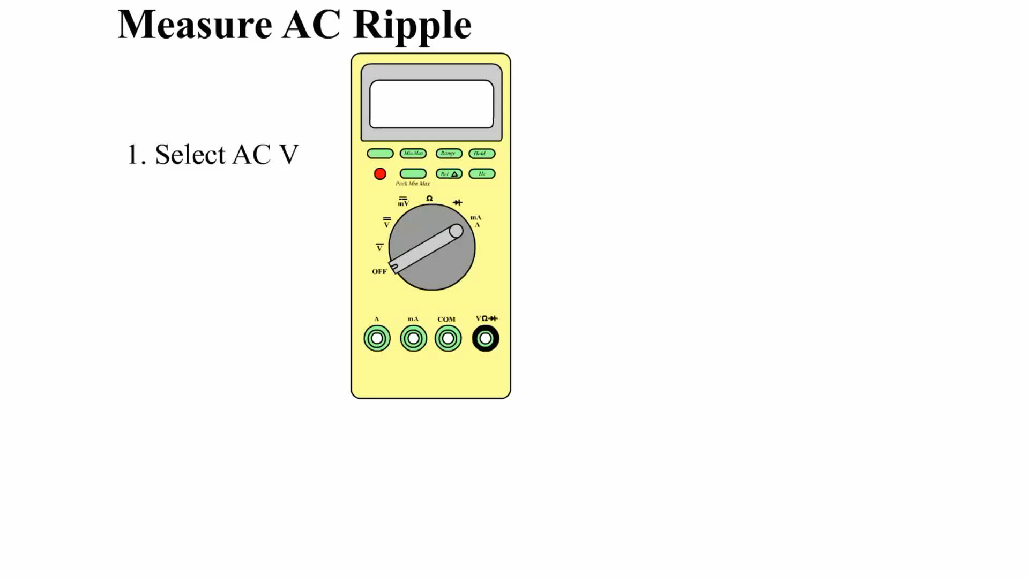
Animation:
Measure AC Ripple
(The animation will automatically start in a few seconds)

Slide 60
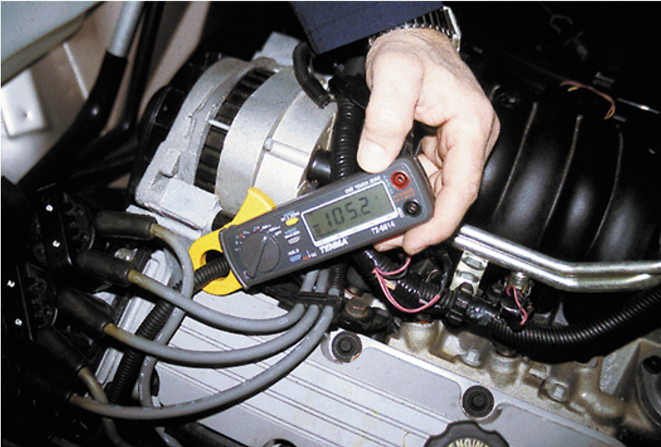
Figure 16.31
A mini clamp-on digital multimeter can be used to measure alternator output and unwanted A C current by switching the meter to read D C amperes.

Slide 61
Charging System Voltage Drop Test
Purpose of Charging System Voltage Drop Testing
Charging System Voltage Drop Testing Procedure

Slide 62
Alternator Output Test
Connect the starting and charging test leads according to the manufacturer’s instructions.
Turn the ignition on and observe the ammeter. It should be about 2 to 8 amperes.
Start the engine and operate it at 2,000 R P M. Turn the load increase control slowly to obtain the highest reading on the ammeter scale while maintaining a battery voltage of at least 13 volts.
Total the amperes from steps 2 and 3. Results should be within 10% (or 15 amperes) of the rated output.

Slide 63
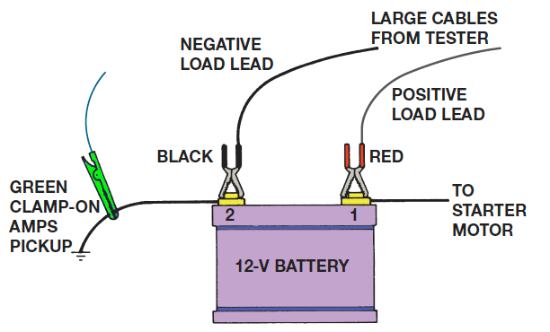
Figure 16.33
Typical hookup of a starting and charging tester.
Notes:
Long Description:
The battery has black and red terminals. The black terminal is connected to a negative load lead and the red terminal is connected to a positive load lead. Both leads are connected to the large cables from the tester. The red terminal also leads to a starter motor through a wire, and the black terminal through another wire that has a green clamp on A M P s pickup. A note below reads, "Test lead connections for testing the starting system, charging system, voltage regulator, and diode stator."

Slide 64
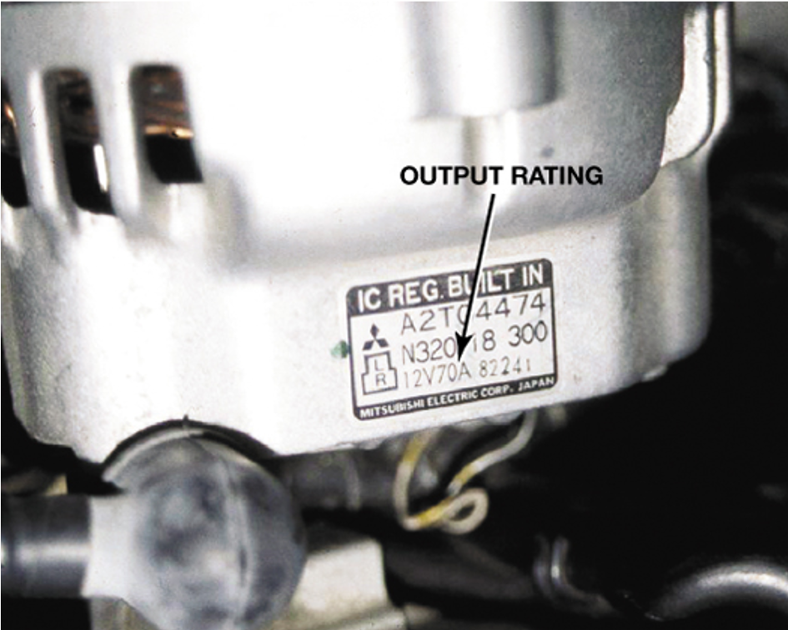
Figure 16.34
The output on this alternator is printed on a label.

Slide 65
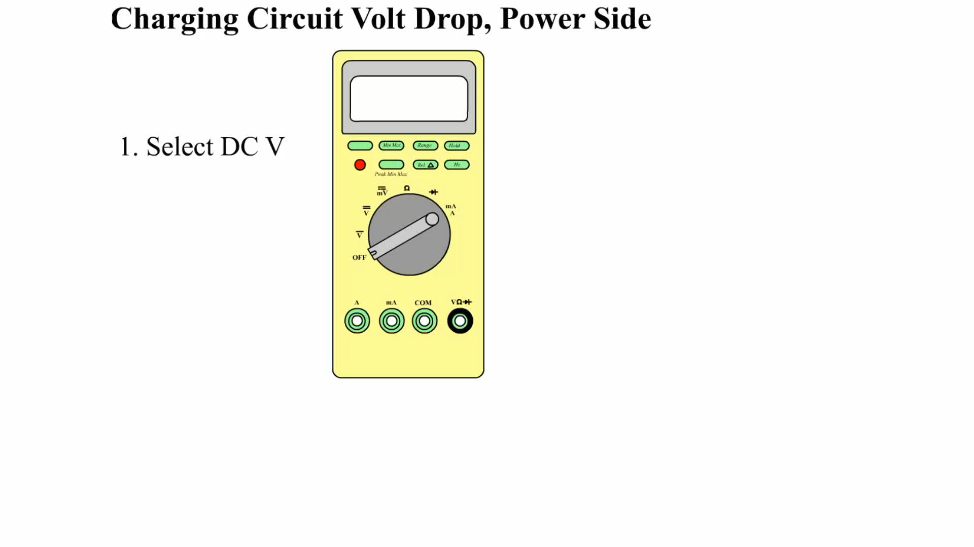
Animation:
Charging Circuit Volt Drop, Power Side
(The animation will automatically start in a few seconds)

Slide 66
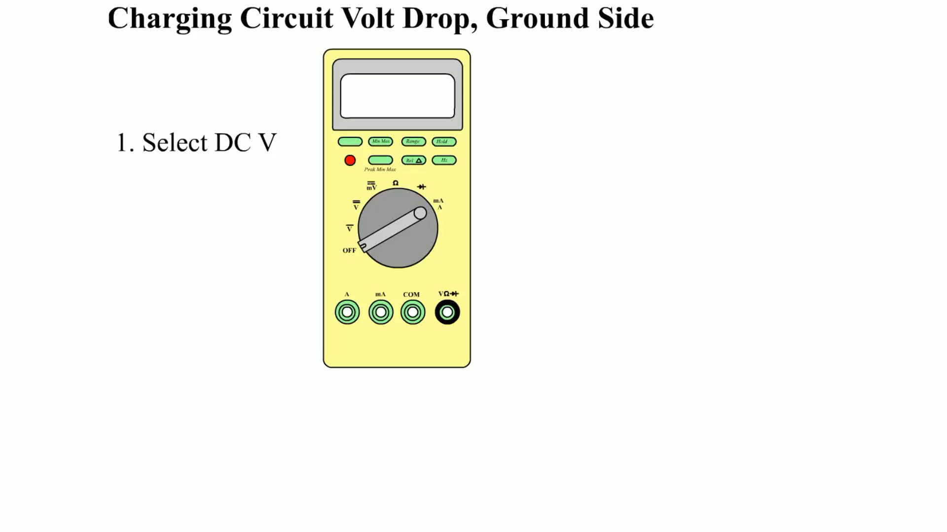
Animation:
Charging Circuit Volt Drop, Ground Side
(The animation will automatically start in a few seconds)

Slide 67
Summary (1 of 3)
Batteries can be tested with a voltmeter to determine the state of charge.
A battery drain test should be performed if the battery runs down.
Proper operation of the starter motor depends on the battery being at least 75% charged and the battery cables being of the correct size (gauge) and having no more than a 0.2-volt drop.

Slide 68
Summary (2 of 3)
Charging system testing requires that the battery be at least 75% charged to be assured of accurate test results.
Cranking system voltage drop testing includes cranking the engine, measuring the drop in voltage from the battery to the starter, and measuring the drop in voltage from the negative terminal of the battery to the engine block.

Slide 69
Summary (3 of 3)
The cranking circuit should be tested for proper amperage draw.
An open in the control circuit can prevent starter motor operation.
To check for excessive resistance in the wiring between the alternator and the battery, perform a voltage drop test.

Slide 70
Animation and Video Resources
The below listed resources are hyperlinked to the James Halderman website
(A6) Electrical/Electronic Systems Animations
(A6) Electrical/Electronic Systems Videos

Slide 71

Copyright
This work is protected by United States copyright laws and is provided solely for the use of instructors in teaching their courses and assessing student learning. Dissemination or sale of any part of this work (including on the World Wide Web) will destroy the integrity of the work and is not permitted. The work and materials from it should never be made available to students except by instructors using the accompanying text in their classes. All recipients of this work are expected to abide by these restrictions and to honor the intended pedagogical purposes and the needs of other instructors who rely on these materials.

