Slide 1
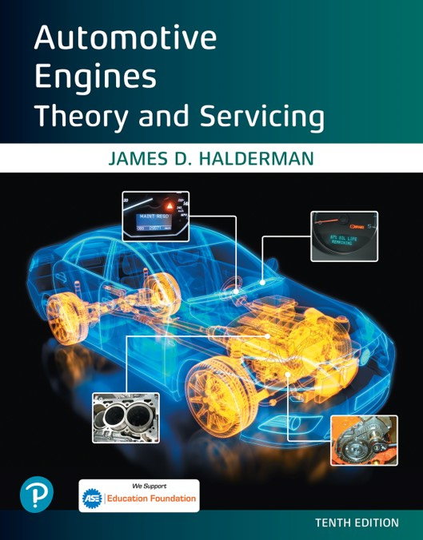

Automotive Engines Theory and Servicing
Tenth Edition
Chapter 6
Power Tools and Shop Equipment
Copyright © 2023 Pearson Education, Inc. All Rights Reserved
Notes:
If this PowerPoint presentation contains mathematical equations, you may need to check that your computer has the following installed:
1) MathType Plugin
2) Math Player (free versions available)
3) NVDA Reader (free versions available)

Slide 2
Learning Objectives
6.1 Describe the purpose of the air compressor, and other air and electrically operated tools.
6.2 Compare the different types of trouble lights.
6.3 Describe the purpose of the bench/pedestal grinder and the bench vise.
6.4 Discuss the purpose of hydraulic presses, portable crane and chain hoist, and engine stands.

Slide 3
Air Compressor
A shop air compressor is usually located in a separate room or an area away from the customer area of a shop.
An air compressor is powered by a 220 volt A C electric motor. It includes
  A storage tank and the compressor itself
  Pressure switches, which are used to maintain a certain minimum level of air pressure in the system

Slide 4
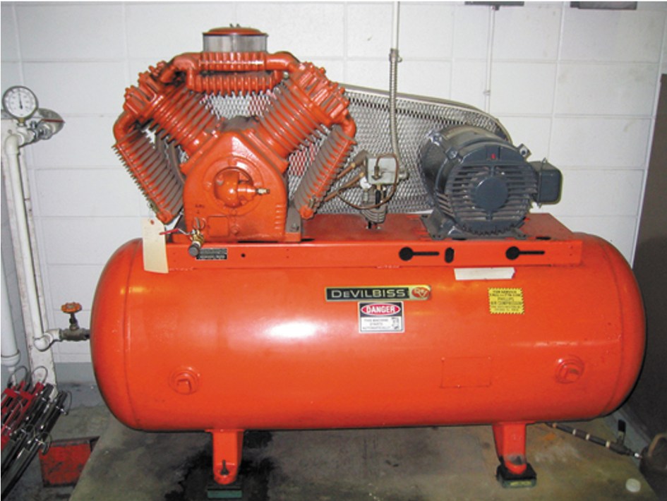
Figure 6.1
A typical shop compressor. It is usually placed out of the way, yet accessible to provide for maintenance to the unit.

Slide 5
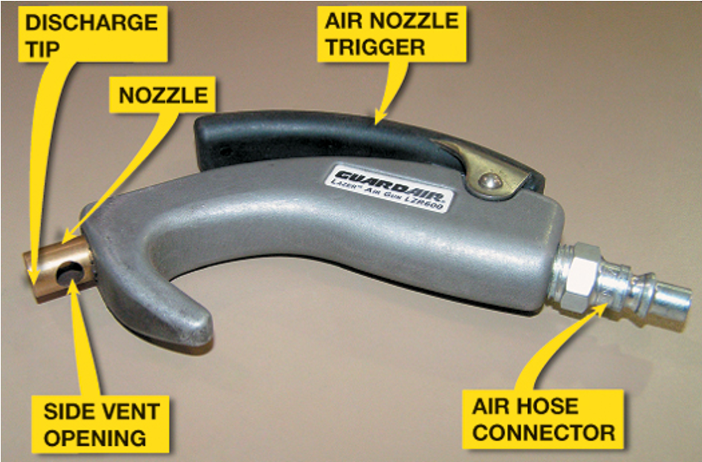
Figure 6.2
Always use an air nozzle that is O S H A approved. The openings in the side are used to allow air to escape if the nozzle tip were to become clogged.
Notes:
Long Description:
This is a handheld device with an air nozzle trigger at the top of the handle. An air hose connector is at the back. The nozzle is at the front with the discharge tip. Below the nozzle is a side vent opening.

Slide 6
Air and Electrically Operated Tools
Impact Wrench
Air Ratchet
Die Grinder
Air Drill
Air-blow Gun
Air-operated Grease Gun
Battery-powered Grease Gun

Slide 7
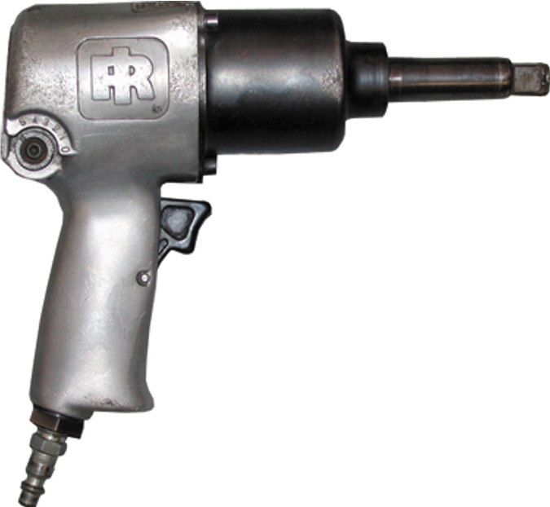
Figure 6.3
A typical 1/2 inch drive impact wrench.

Slide 8
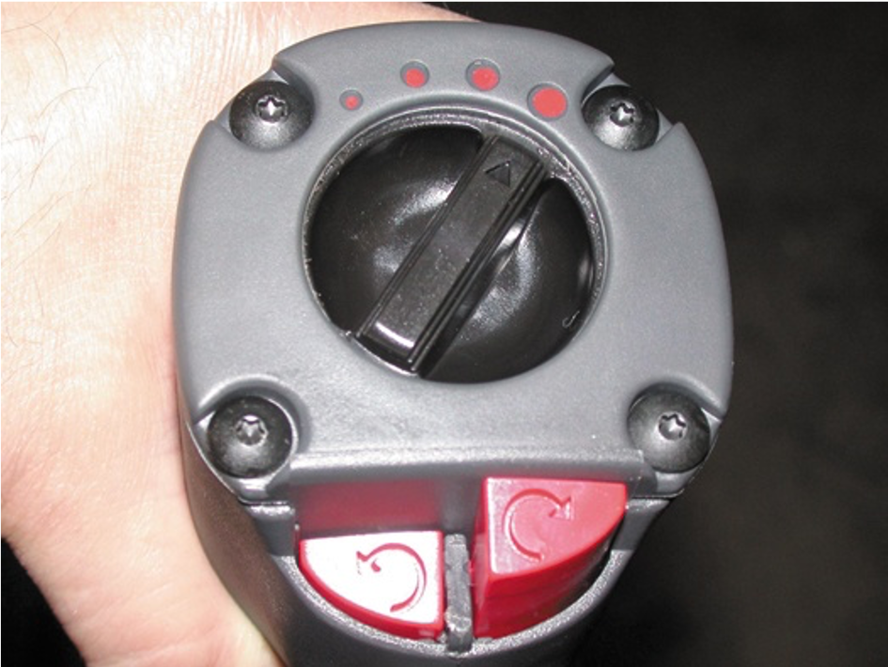
Figure 6.4
This impact wrench features a variable torque setting using a rotary knob. The direction of rotation can be changed by pressing the button at the bottom.

Slide 9
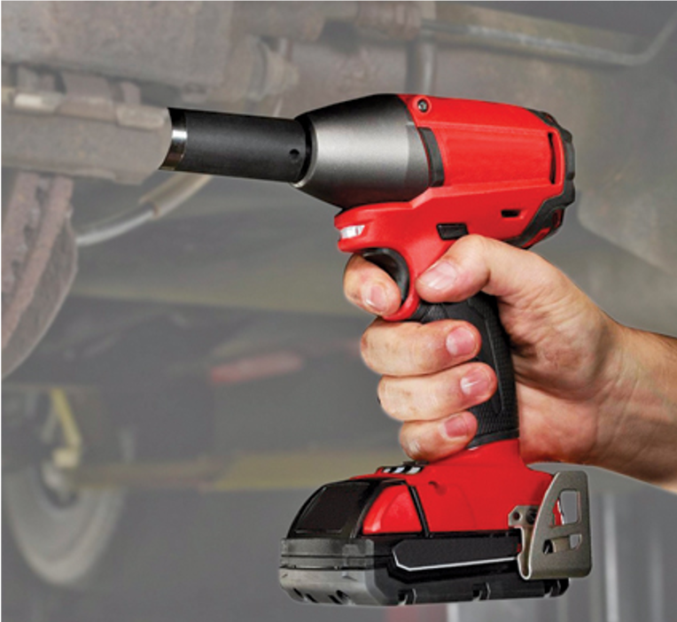
Figure 6.5
A typical battery-powered 1/2-inch drive impact wrench.

Slide 10
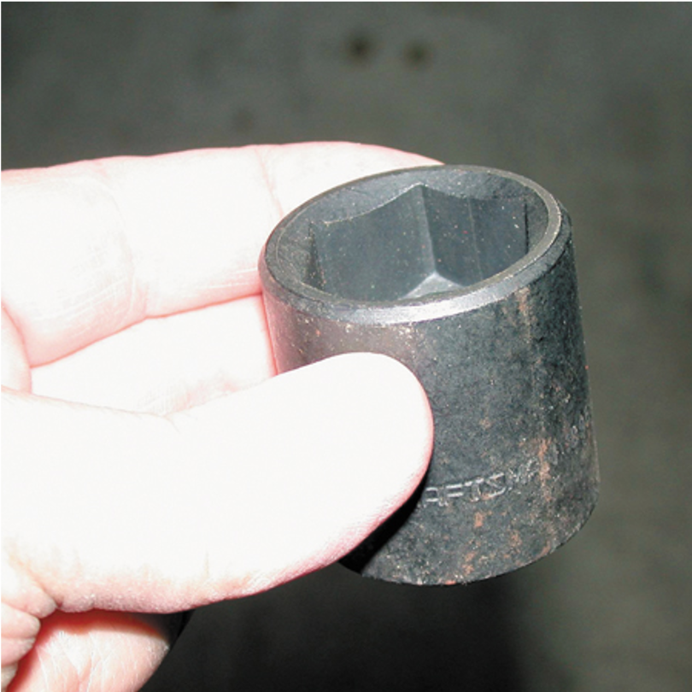
Figure 6.6
A black impact socket. Always use impact-type sockets whenever using an impact wrench to avoid the possibility of shattering the socket, which can cause personal injury.

Slide 11
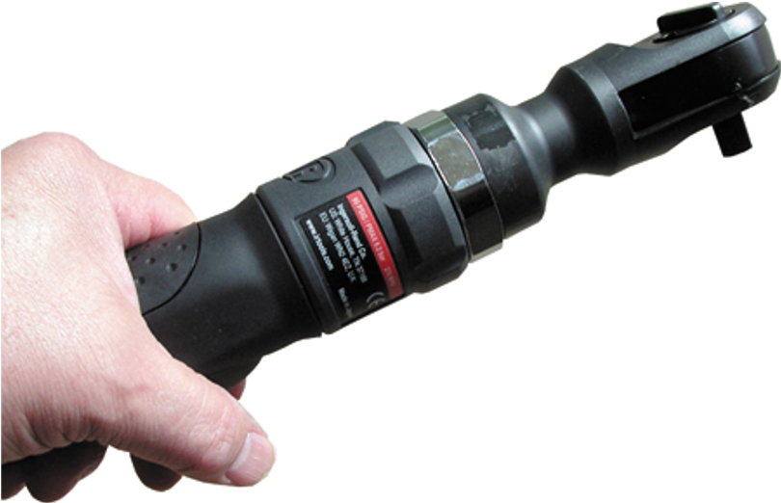
Figure 6.7
An air ratchet is a very useful tool that allows fast removal and installation of fasteners, especially in areas that are difficult to reach or do not have room enough to move a hand ratchet wrench.

Slide 12
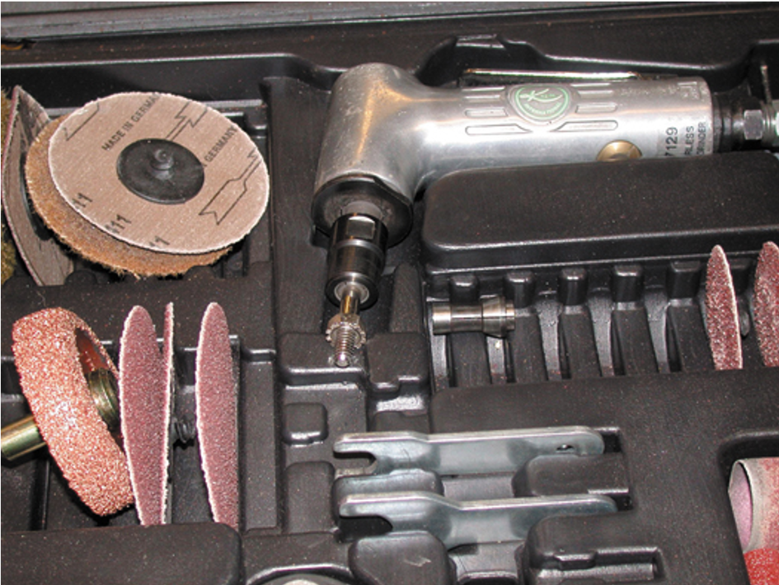
Figure 6.8
This typical die grinder surface preparation kit includes the air-operated die grinder, as well as a variety of sanding discs for smoothing surfaces or removing rust.

Slide 13
Trouble Lights
Incandescent: standard trouble light (work light)
Fluorescent: essential light for shop safety
L E D Trouble Light: excellent because they are shock resistant, long lasting, and do not pose a fire hazard

Slide 14
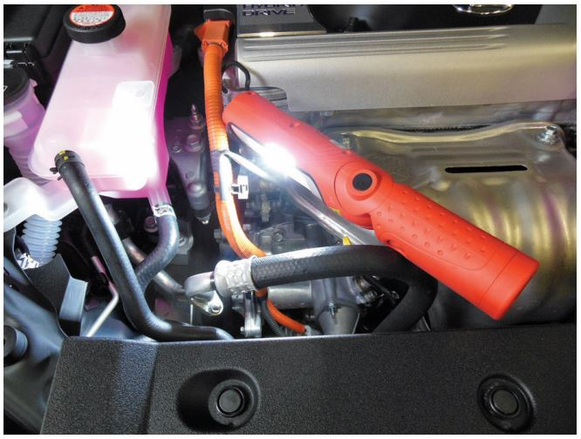
Figure 6.9
A battery-powered LED trouble light.

Slide 15
Bench/Pedestal Grinder
Bench- or Pedestal-mounted Grinder
  These high-powered grinders can be equipped with a wire brush wheel and/or a stone wheel.
    A wire brush wheel is used to clean steel or sheet metal parts.
    A stone wheel is used to grind metal or to remove the mushroom from the top of punches or chisels.

Slide 16
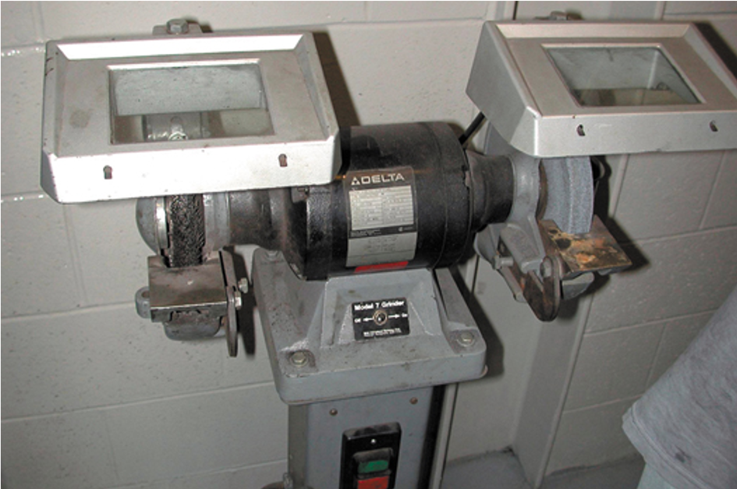
Figure 6.10
A typical pedestal grinder with a wire wheel on the left side and a stone wheel on the right side. Even though this machine is equipped with guards, safety glasses or a face shield should always be worn when using a grinder or wire wheel.

Slide 17
Bench Vise
A bench vise is used to hold components so that work can be performed on the unit.
The size of a vise is determined by the width of the jaws.
Two common sizes of vises are 4 inch and 6 inch models.

Slide 18
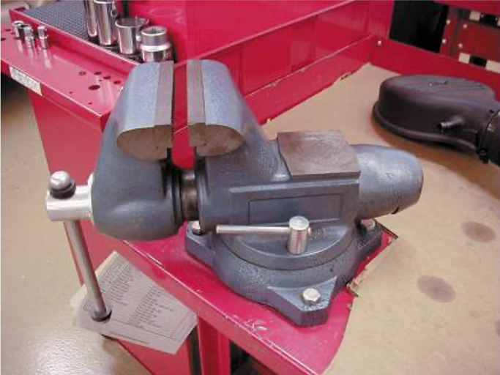
Figure 6.11
A typical vise mounted to a workbench.

Slide 19
Hydraulic Presses
Hydraulic presses are hand-operated hydraulic cylinders mounted to a stand and designed to press bearings on or off of shafts and other components.
  A bearing splitter is often required to apply force to the inner race of a bearing.

Slide 20
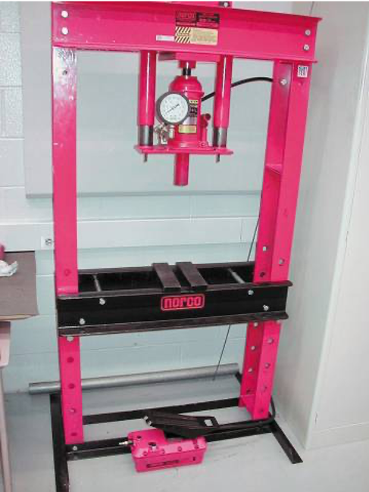
Figure 6.12
A hydraulic press is usually used to press bearings on and off of rear axles and transmissions.

Slide 21
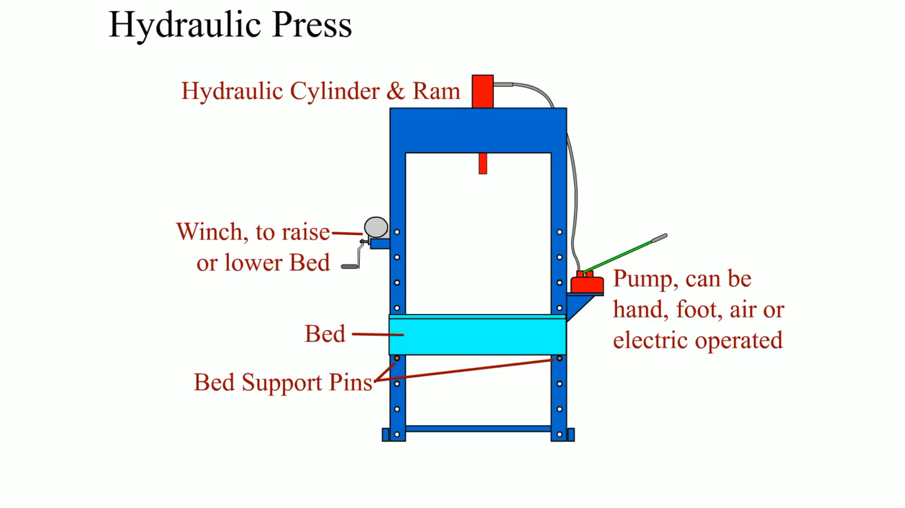
Animation:
Hydraulic Press
(The animation will automatically start in a few seconds)

Slide 22
Portable Crane and Chain Hoist
A portable crane is used to remove and install engines and other heavy vehicle components.

Slide 23
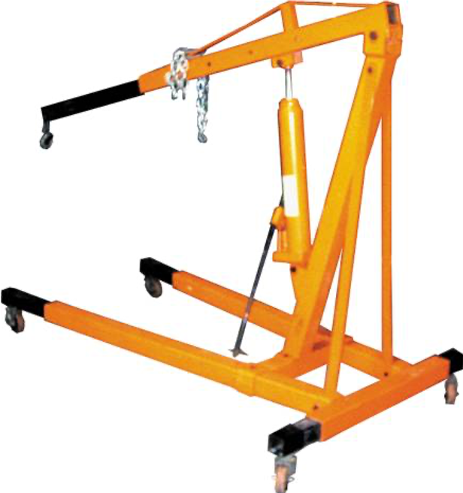
Figure 6.13
A typical portable crane used to lift and move heavy assemblies, such as engines and transmissions.

Slide 24
Engine Stands
An engine stand is designed to safely hold an engine and to allow it to be rotated.
  This allows the technician to easily remove, install, and perform service work to the engine.

Slide 25
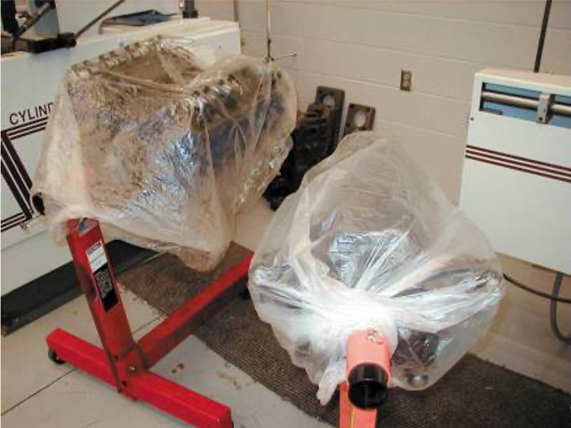
Figure 6.14
Two engines on engine stands. The plastic bags over the engines help keep dirt from getting onto these engines and engine parts.

Slide 26
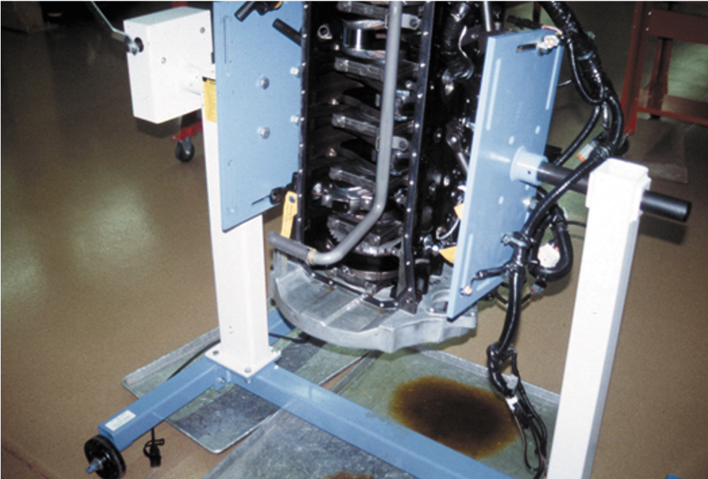
Figure 6.15
An engine stand that grasps the engine from the sides rather than the end.

Slide 27
Summary (1 of 3)
Most shops are equipped with a large air compressor that supplies pressurized air to all stalls for use by the technician.
An air impact wrench is the most commonly used power tool in the shop. It is used mostly to remove fasteners. Caution should be exercised not to overtighten a fastener, using an air impact wrench.
Other air-operated tools include an air ratchet and a die grinder.

Slide 28
Summary (2 of 3)
A bench or pedestal grinder usually has both a grinding stone and a wire brush wheel.
Trouble lights should be fluorescent or L E D for maximum safety in the shop.
A hydraulic press is used to remove bearings from shafts and other similar operations.

Slide 29
Summary (3 of 3)
A portable crane is used to remove and install engines or engine/transmission assemblies from vehicles.
Engine stands are designed to allow the technician to rotate the engine to get access to the various parts and components.

Slide 30
Animation and Video Resources
The below listed resources are hyperlinked to the James Halderman website
(A0) Automotive Fundamentals Animations
(A0) Automotive Fundamentals Videos

Slide 31

Copyright
This work is protected by United States copyright laws and is provided solely for the use of instructors in teaching their courses and assessing student learning. Dissemination or sale of any part of this work (including on the World Wide Web) will destroy the integrity of the work and is not permitted. The work and materials from it should never be made available to students except by instructors using the accompanying text in their classes. All recipients of this work are expected to abide by these restrictions and to honor the intended pedagogical purposes and the needs of other instructors who rely on these materials.

