Slide 1


Automotive Engines Theory and Servicing
Tenth Edition
Chapter 4
Fasteners and Thread Repair
Copyright © 2023 Pearson Education, Inc. All Rights Reserved
Notes:
If this PowerPoint presentation contains mathematical equations, you may need to check that your computer has the following installed:
1) MathType Plugin
2) Math Player (free versions available)
3) NVDA Reader (free versions available)

Slide 2
Learning Objectives
4.1 Identify bolts and explain the strength ratings of threaded fasteners.
4.2 Discuss the purpose of nuts, taps, dies, and washers.
4.3 Discuss how snap rings and clips are used.
4.4 Explain how to avoid broken fasteners.
4.5 Compare the different types of thread repair inserts.

Slide 3
Threaded Fasteners
The fastener threads must match the threads in the casting or nut.
The threads may be measured either in fractions of an inch or in metric units.
The size is measured across the outside of the threads.

Slide 4
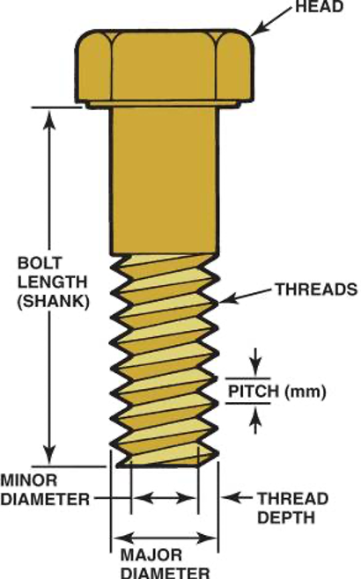
Figure 4.1
The dimensions of a typical bolt showing where sizes are measured. The major diameter is called the crest.
Notes:
Long Description:
The bolt has a circular head at the top. The distance between bolt head and bottom of bolt is labeled bolt length or shank. The spiral length of the bolt is labeled threads. The distance between every two threads is labeled pitch in millimeters. The diameter of the bolt including the horizontally extended sharp edges of the threads is labeled major diameter and excluding the sharp edges is labeled minor diameter. The difference on one end between the major radius and the minor radius is labeled thread depth.

Slide 5
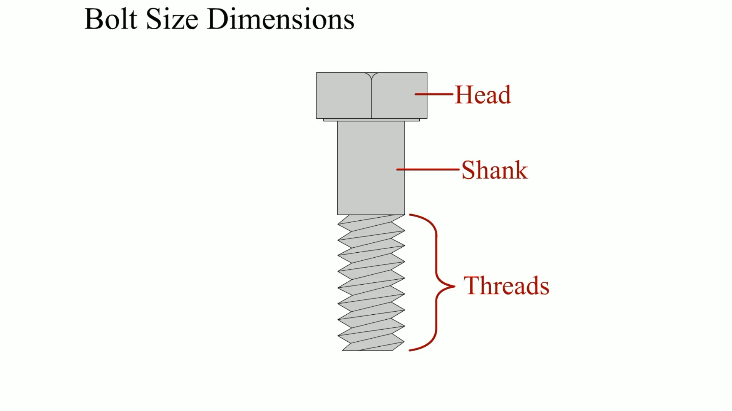
Animation:
Bolt Size Dimensions
(The animation will automatically start in a few seconds)

Slide 6
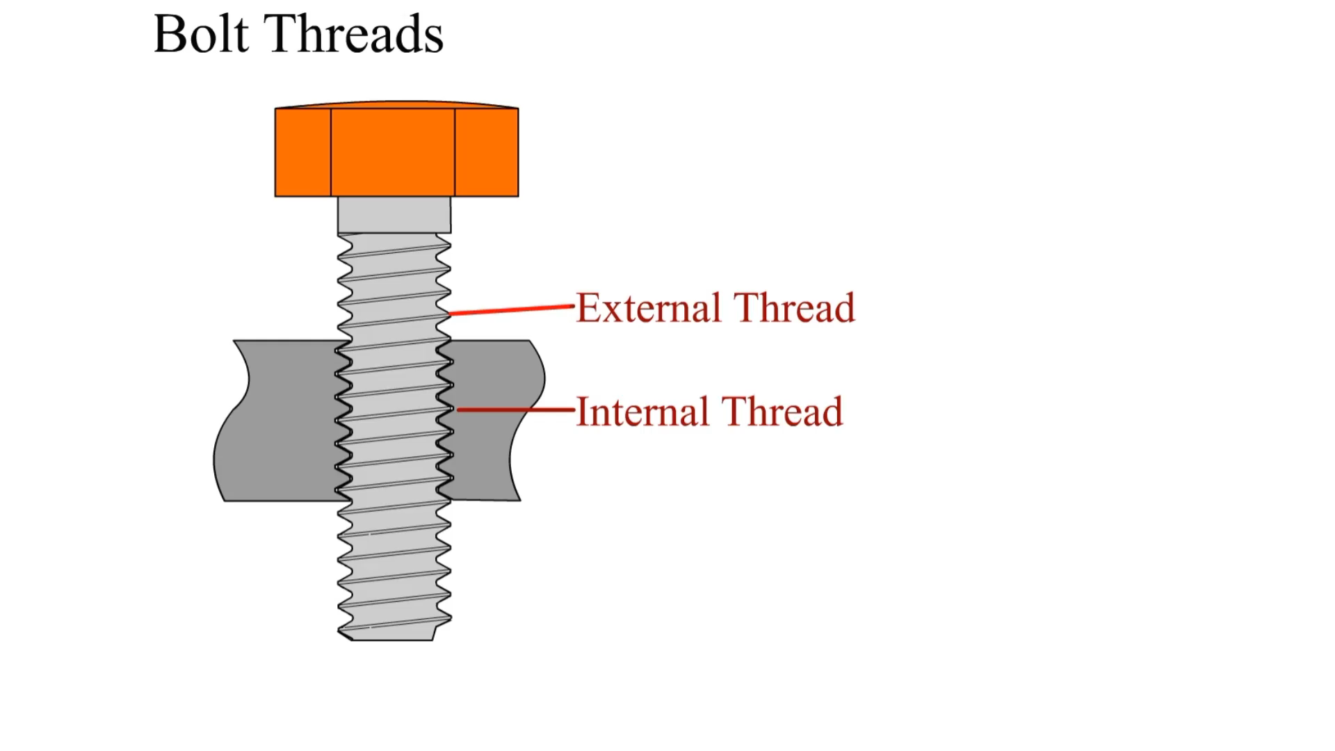
Animation:
Bolt Threads
(The animation will automatically start in a few seconds)

Slide 7
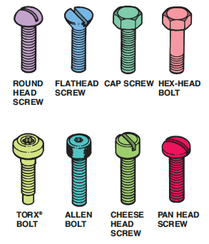
Figure 4.3
Bolts and screws have many different heads which determine what tool must be used.

Slide 8
Metric Bolts
The size of a metric bolt is specified by the letter M followed by the diameter in millimeters (m m) across the outside (crest) of the threads.
Typical metric sizes would be M8 and M12.
Fine metric threads are specified by the thread diameter followed by X and the distance between the threads measured in millimeters (M8 X 1.5).

Slide 9
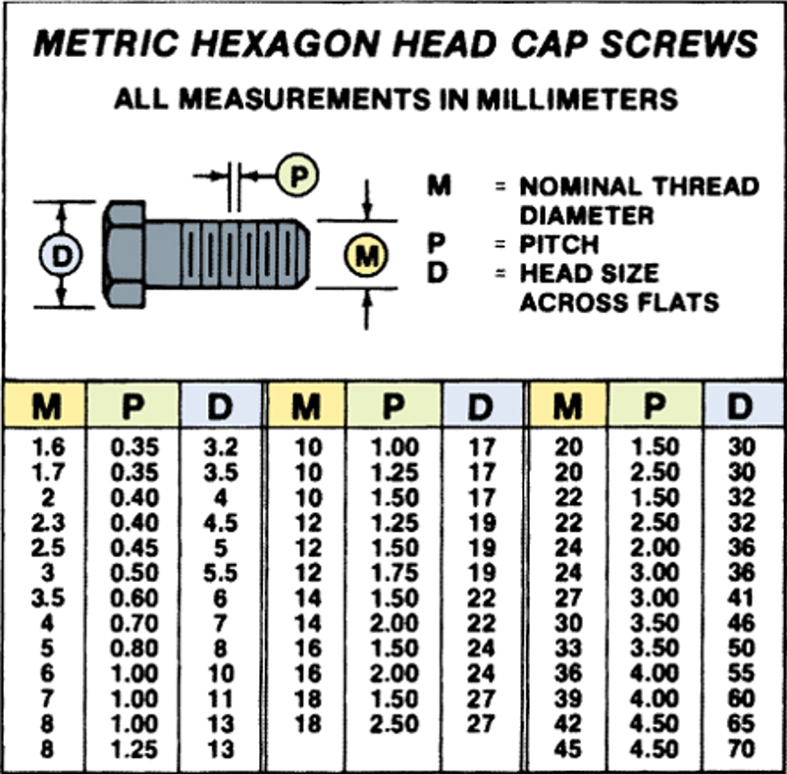
Figure 4.4
The metric system specifies fasteners by diameter, length, and pitch.
Notes:
Long Description:
The figure shows a horizontally placed bolt with nominal thread diameter M, pitch P, and head size across flats D. The table is titled, "Metric hexagon head cap screws, all measurements in millimeters." The table has three sections with three columns and 13 rows in the first and third sections, and 12 rows in the second section. From left to right, the columns are labeled, "M, P, and D." The entries in the table are as follows:
Section 1:
Row 1: M: 1.6, P: 0.35, D: 3.2.
Row 2: M: 1.7, P: 0.35, D: 3.5.
Row 3: M: 2, P: 0.40, D: 4.
Row 4: M: 2.3, P: 0.40, D: 4.5.
Row 5: M: 2.5, P: 0.45, D: 5.
Row 6: M: 3, P: 0.50, D: 5.5.
Row 7: M: 3.5, P: 0.60, D: 6.
Row 8: M: 4, P: 0.70, D: 7.
Row 9: M: 5, P: 0.80, D: 8.
Row 10: M: 6, P: 1.00, D: 10.
Row 11: M: 7, P: 1.00, D: 11.
Row 12: M: 8, P: 1.00, D: 13.
Row 13: M: 8, P: 1.25, D: 13.
Section 2:
Row 1: M: 10, P: 1.00, D: 17.
Row 2: M: 10, P: 1.25, D: 17.
Row 3: M: 10, P: 1.50, D: 17.
Row 4: M: 12, P: 1.25, D: 19.
Row 5: M: 12, P: 1.50, D: 19.
Row 6: M: 12, P: 1.75, D: 19.
Row 7: M: 14, P: 1.50, D: 22.
Row 8: M: 14, P: 2.00, D: 22.
Row 9: M: 16, P: 1.50, D: 24.
Row 10: M: 16, P: 2.00, D: 24.
Row 11: M: 18, P: 1.50, D: 27.
Row 12: M: 18, P: 2.50, D: 27.
Section 3:
Row 1: M: 20, P: 1.50, D: 30.
Row 2: M: 20, P: 2.50, D: 30.
Row 3: M: 22, P: 1.50, D: 32.
Row 4: M: 22, P: 2.50, D: 32.
Row 5: M: 24, P: 2.00, D: 36.
Row 6: M: 24, P: 3.00, D: 36.
Row 7: M: 27, P: 3.00, D: 41.
Row 8: M: 30, P: 3.50, D: 46.
Row 9: M: 33, P: 3.50, D: 50.
Row 10: M: 36, P: 4.00, D: 55.
Row 11: M: 39, P: 4.00, D: 60.
Row 12: M: 42, P: 4.50, D: 65.
Row 13: M: 45, P: 4.50, D: 70.

Slide 10
Grades of Bolts
Bolts are made from many different types of steel, and for this reason some are stronger than others.
The strength or classification of a bolt is called the grade.
The bolt heads are marked to indicate their grade strength.
Graded bolts are commonly used in the suspension parts of the vehicle but can be used almost anywhere in the vehicle.

Slide 11
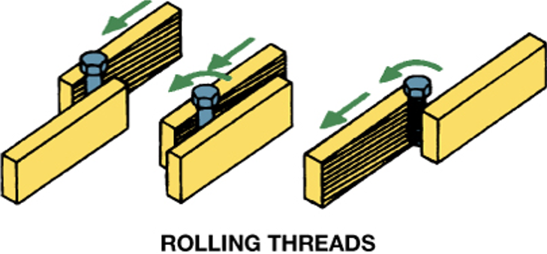
Figure 4.5
Stronger threads are created by cold-rolling a heat-treated bolt blank instead of cutting the threads using a die.

Slide 12
Tensile Strength
What is tensile strength?
Metric bolt tensile strength property class is shown on the head of the bolt as a number, such as 4.6, 8.8, 9.8, and 10.9
  The higher the number, the stronger the bolt.

Slide 13
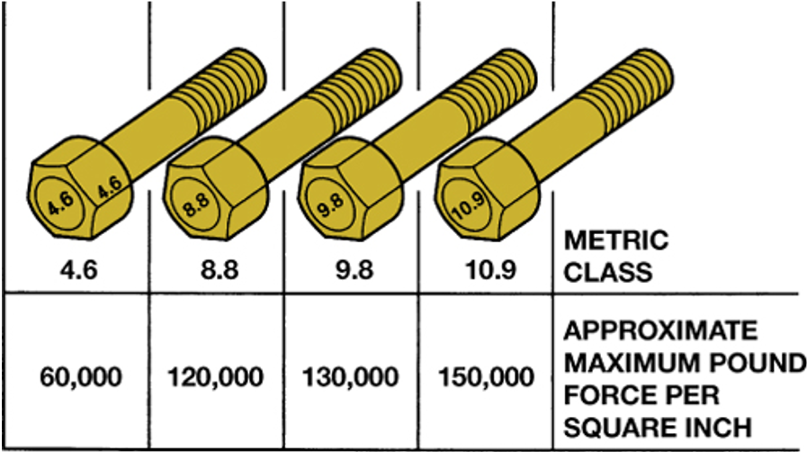
Figure 4.6
Metric bolt (cap screw) grade markings and approximate tensile strength.
Notes:
Long Description:
The table has four columns and two rows. From top to bottom, the rows are labeled: "Metric class, and Approximate maximum pound force per square inch." The column-wise entries in the table are as follows:
Column 1: Metric class: 4.6, Approximate maximum pound force per square inch: 60,000.
Column 2: Metric class: 8.8, Approximate maximum pound force per square inch: 120,000.
Column 3: Metric class: 9.8, Approximate maximum pound force per square inch: 130,000.
Column 1: Metric class: 10.9, Approximate maximum pound force per square inch: 150,000.
Each section of the metric class contains its respective bolt.

Slide 14
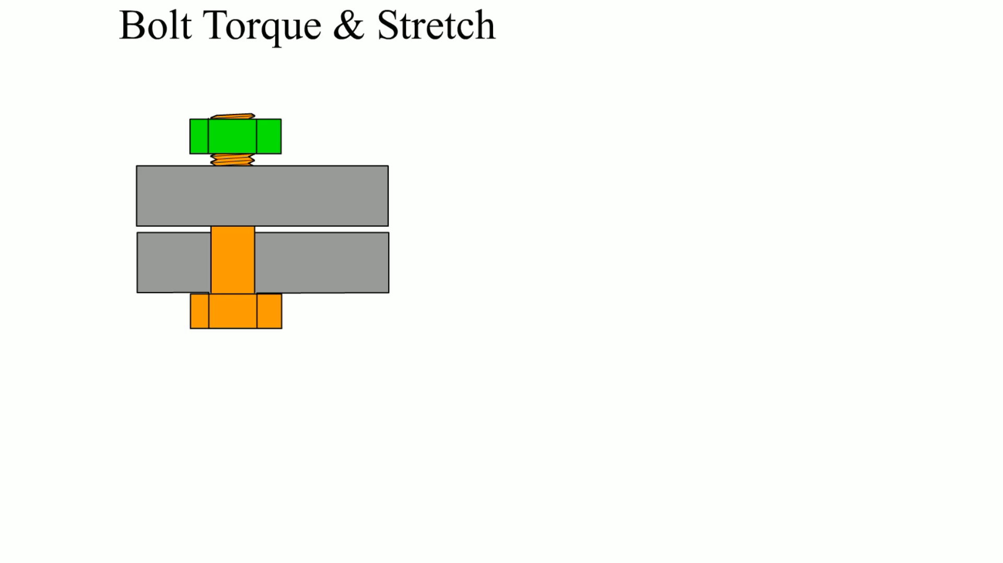
Animation:
Bolt Torque & Stretch
(The animation will automatically start in a few seconds)

Slide 15
Nuts
Most nuts used on cap screws have the same hex size as the cap screw head.
Metric nuts are often marked with dimples to show their strength.
  More dimples indicate stronger nuts.
Some nuts and cap screws use interference fit threads to keep them from accidentally loosening.
Nuts can also be kept from loosening with a nylon washer fastened in the nut or with a nylon patch or strip on the threads.

Slide 16
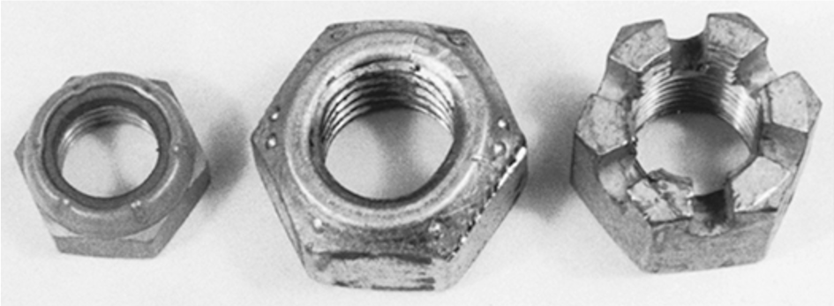
Figure 4.7
Types of lock nuts. On the left, a nylon ring; in the center, a distorted shape; and on the right, a castle for use with a cotter key.
Notes:
Long Description:
The inside of the nuts is threaded and there is a rim along the hexagonal exterior.

Slide 17
Taps and Dies (1 of 2)
Taps and dies are used to cut threads.
  Taps are used to cut threads in holes drilled to an exact size depending on the size of the tap.
  A die is used to cut threads on round rods or studs.
Most taps and dies come as a complete set for the most commonly used fractional and metric threads.
  Taps
    Taper tap
    Bottoming tap

Slide 18
Taps and Dies (2 of 2)
  Dies
Proper Use of Taps and Dies
  Tap Usage
  Die Usage

Slide 19
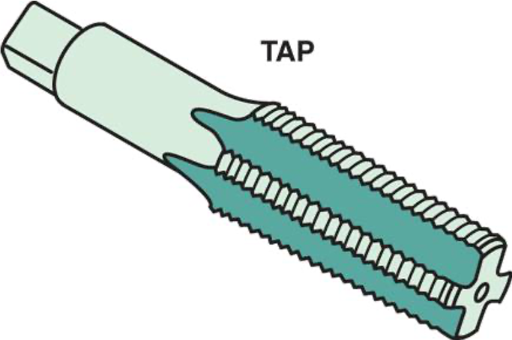
Figure 4.8
A typical bottoming tap used to create threads in holes that are not open, but stop in a casting, such as an engine block.
Notes:
Long Description:
The head is cubical and the body is smooth at the start and then gets threaded. The thread is grooved vertically in between.

Slide 20
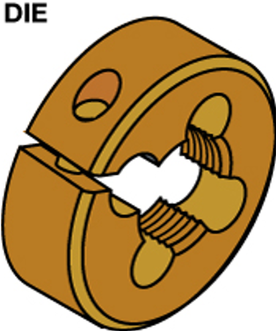
Figure 4.10
A die is used to cut threads on a metal rod.

Slide 21
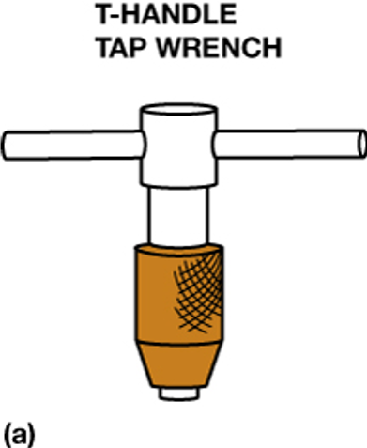
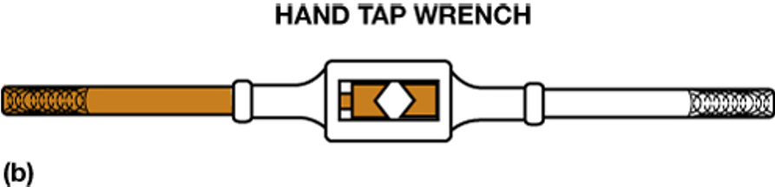
Figure 4.11
(a) A T-handle is used to hold and rotate small taps. (b) A tap wrench is used to hold and drive larger taps.
Notes:
Long Description a:
The vertical portion of the wrench shows an additional covering around.
Long Description b:
The middle is rectangular with handle on both sides.

Slide 22
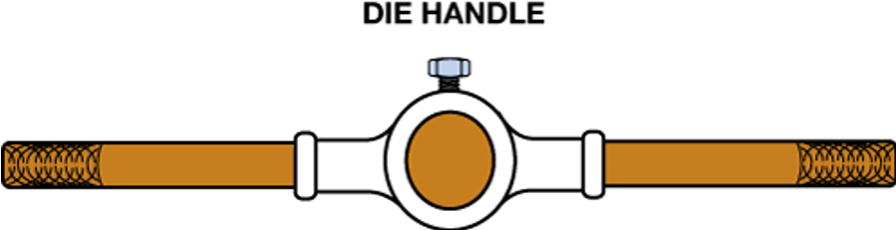
Figure 4.12
A die handle used to rotate a die while cutting threads on a metal rod.

Slide 23
Thread Pitch Gauge
What is a thread pitch gauge?
How does a technician determine the thread pitch size of a fastener?

Slide 24
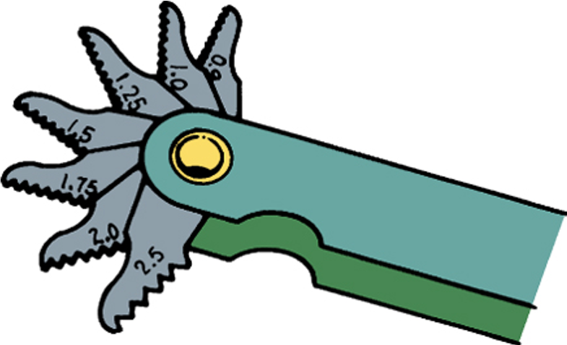
Figure 4.13
A typical metric thread pitch gauge.

Slide 25
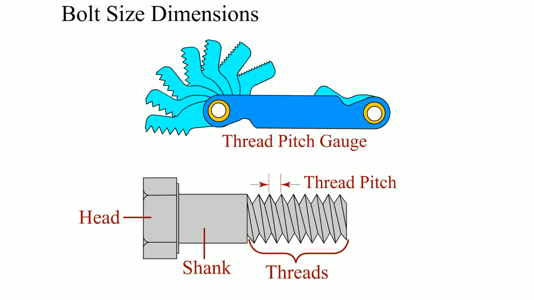
Animation:
Bolt Size and Dimenesions
(The animation will automatically start in a few seconds)

Slide 26
Sheet Metal Screws
What are sheet metal screws?
How can you reinstall self-tapping screws?

Slide 27
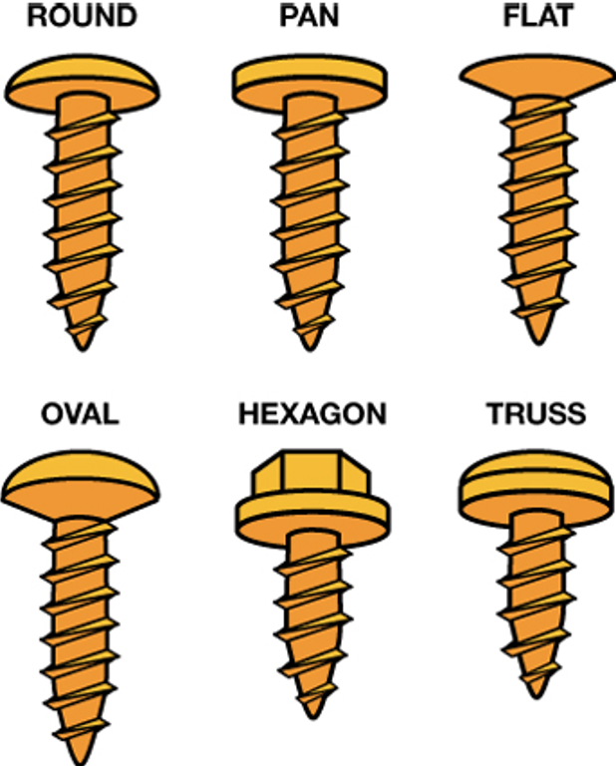
Figure 4.15
Sheet metal screws come with many head types.

Slide 28
Snap Rings and Clips
Snap Rings
  Constructed of spring steel
  Used to attach parts without a threaded fastener
Door Panel Clips
Pins
Rivets
Locking Nuts

Slide 29
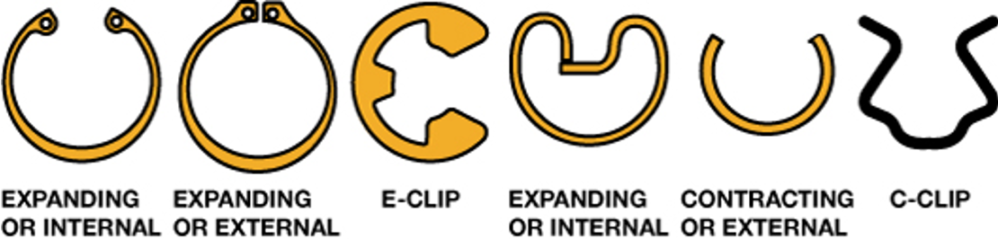
Figure 4.17
Some different types of snap rings. An internal snap ring fits inside of a housing or bore, into a groove. An external snap ring fits into a groove on the outside of a shaft or axle. An E-clip fits into a groove in the outside of a shaft. A C-clip shown is used to retain a window regulator handle on its shaft.

Slide 30
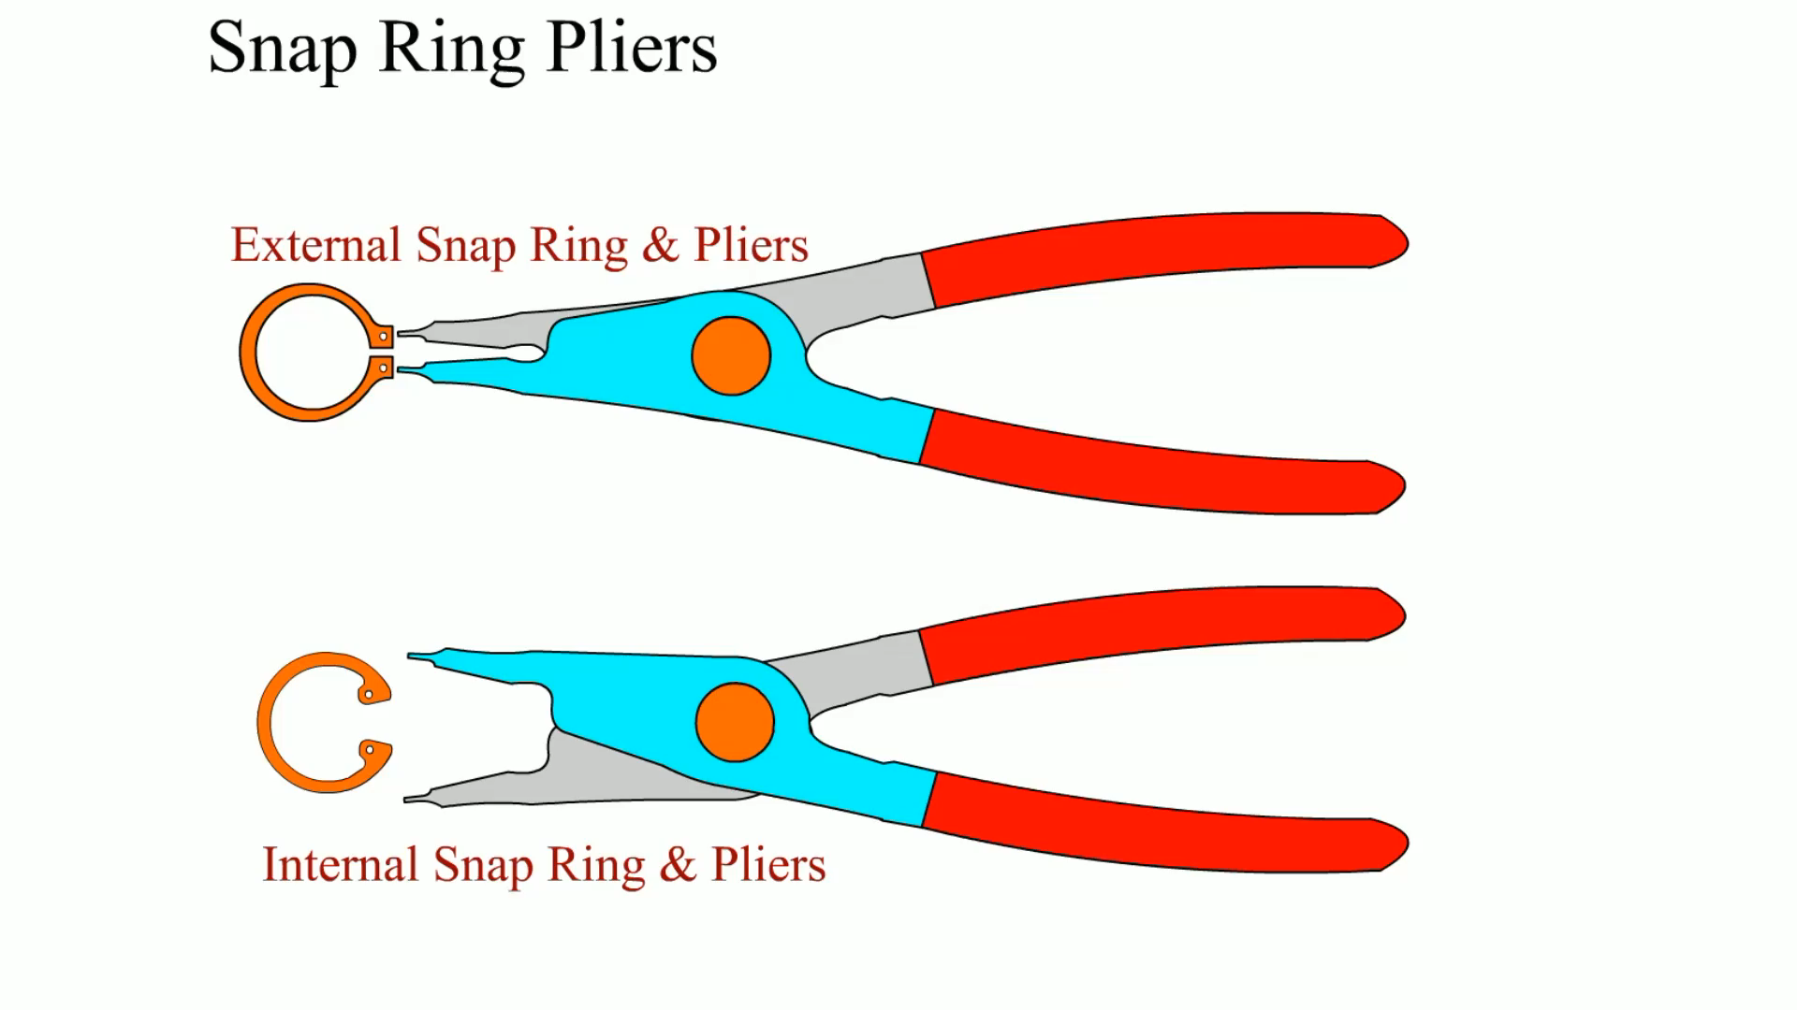
Animation:
Snap Ring Pliers
(The animation will automatically start in a few seconds)

Slide 31
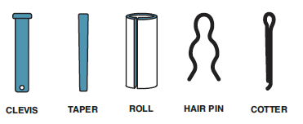
Figure 4.20
Pins come in various types.

Slide 32
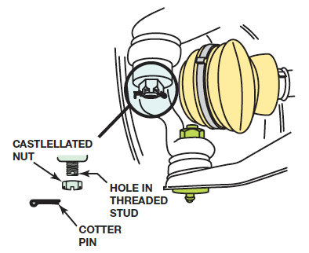
Figure 4.23
A castellated nut is locked in place with a cotter pin.

Slide 33
Broken Fastener Removal
Try not to break, strip, or round off fasteners
Don't force fasteners loose
  Left-handed threads
  Penetrating oil
  Proper tightening

Slide 34
Thread Repair Inserts
Thread repair inserts are used to replace the original threaded hole when it has become damaged beyond use.
The original threaded hole is enlarged and tapped for threads and a threaded insert is installed to restore the threads to the original size.
  Helical Inserts
  Threaded Inserts
  Self-tapping Inserts
  Solid-bushing Inserts
  Key-locking Inserts

Slide 35
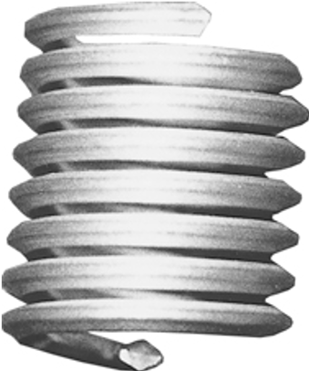
Figure 4.24
Helical inserts look like small, coiled springs. The outside is a thread to hold the coil in the hole, and the inside is threaded to fit the desired fastener.

Slide 36
Summary (1 of 2)
The most common type of fastener is a threaded one often referred to as a bolt. A nut or threaded hole is used at the end of a bolt to fasten two parts together.
The size of threaded fasteners includes the diameter, length, and pitch of the threads, as well as the shape of the head of the bolt.
Metric bolts are labeled with an “M,” and the diameter across the threads is in millimeters followed by the distance between the threads measured in millimeters, such as M8 3 1.5.

Slide 37
Summary (2 of 2)
Graded bolts are hardened and are capable of providing more holding force than nongraded bolts.
Many nuts are capable of remaining attached to the bolt regardless of vibration. These types of nuts are often called prevailing torque nuts.
Other commonly used fasteners in the automotive service industry include sheet metal screws, snap rings and clips, door panel clips, cotter pins, and rivets.
Threads can be repaired using a Heli-Coil® or threaded insert.

Slide 38
Animation and Video Resources
The below listed resources are hyperlinked to the James Halderman website
(A0) Automotive Fundamentals Animations
(A0) Automotive Fundamentals Videos

Slide 39

Copyright
This work is protected by United States copyright laws and is provided solely for the use of instructors in teaching their courses and assessing student learning. Dissemination or sale of any part of this work (including on the World Wide Web) will destroy the integrity of the work and is not permitted. The work and materials from it should never be made available to students except by instructors using the accompanying text in their classes. All recipients of this work are expected to abide by these restrictions and to honor the intended pedagogical purposes and the needs of other instructors who rely on these materials.

