Slide 1


Automotive Engines Theory and Servicing
Tenth Edition
Chapter 2
Service Information, Work Orders, and Vehicle information
Copyright © 2023 Pearson Education, Inc. All Rights Reserved
Notes:
If this PowerPoint presentation contains mathematical equations, you may need to check that your computer has the following installed:
1) MathType Plugin
2) Math Player (free versions available)
3) NVDA Reader (free versions available)

Slide 2
Learning Objectives (1 of 2)
2.1 Discuss the importance of vehicle owner’s manuals, service records, and service information.
2.2 Explain the different types of service information.
2.3 Describe vehicle recalls and campaigns.
2.4 Discuss the importance of the work order.
2.5 Explain why service records are important.
2.6 Discuss the parts of a vehicle and differentiate between front-wheel drive and rear-wheel drive.

Slide 3
Learning Objectives (2 of 2)
2.7 Explain vehicle identification, vehicle safety certification label, and the V E C I label.

Slide 4
Owner’s Manuals (1 of 2)
The owner’s manual is the instructional booklet that comes with every new vehicle and includes important information.
Most owners’ manuals contain all or most of the following information.
Meaning of dash symbols
How to reset the maintenance reminder light
Specifications, including viscosity of oil needed and number of quarts (liters)

Slide 5
Owner’s Manuals (2 of 2)
Tire pressures and standard, as well as optional, tire sizes
Maintenance schedule for all fluids, including coolant, brake fluid, automatic transmission fluid, and differential fluid
How to program the remote control, as well as the power windows and door locks
How to reset the tire pressure monitoring system (T P M S) after a tire rotation.

Slide 6
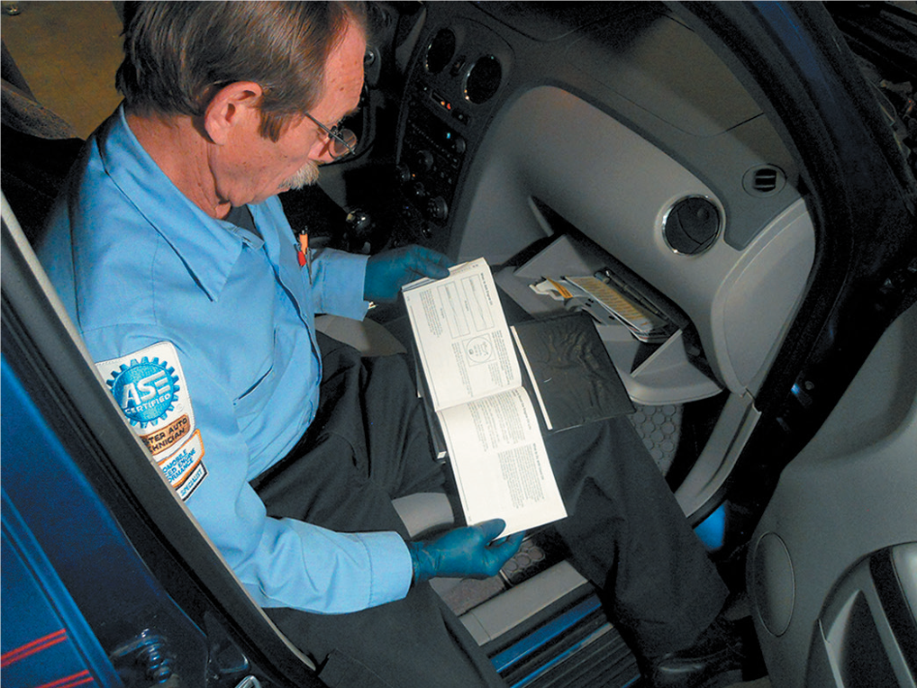
Figure 2.1
The owner’s manual has a lot of information pertaining to the operation, as well as the maintenance and resetting procedures, that technicians often need.

Slide 7
Service Information
Service information is needed to correctly service or repair vehicles because it contains all of the specifications, as well as the specified procedures to follow when servicing or repairing a vehicle
Factory service information
  The most comprehensive and accurate service information is the service information from the vehicle manufacturer.
Aftermarket service information
  Most aftermarket service manuals cover multiple years and/or models in one manual.

Slide 8
Technical Service Bulletins
A technical service bulletin (T S B) is issued by the vehicle manufacturer to notify service technicians of a potential problem or other critical information.
The T S B may include diagnostic procedures and the necessary corrective action.

Slide 9
Recalls and Campaigns
A campaign is typically issued when a manufacturer wants to improve a product’s performance or increase the customer’s satisfaction.
A recall can occur when either the manufacturer or the National Highway Traffic Safety Administration (N H T S A) determines there is a concern.
A recall or campaign is issued by a vehicle manufacturer and a notice is sent to all owners of record.

Slide 10
Work Order (1 of 2)
The work order, also called a repair order (R O), is a legal document that is signed by the vehicle owner or his/her representative.
All work performed on the vehicle should be clearly stated, including any measured values along with the specified values from service information.

Slide 11
Work Order (2 of 2)
The work order has to include the following information:
  Make, model, and year and other identifying information, such as color and vehicle identification number (V I N)
  Name and address of the owner with contact information, such as the cell phone number and email address
  Date of service and the name of the person who wrote the service invoice
  The miles shown on the odometer
  Estimate amount and list of requested work

Slide 12
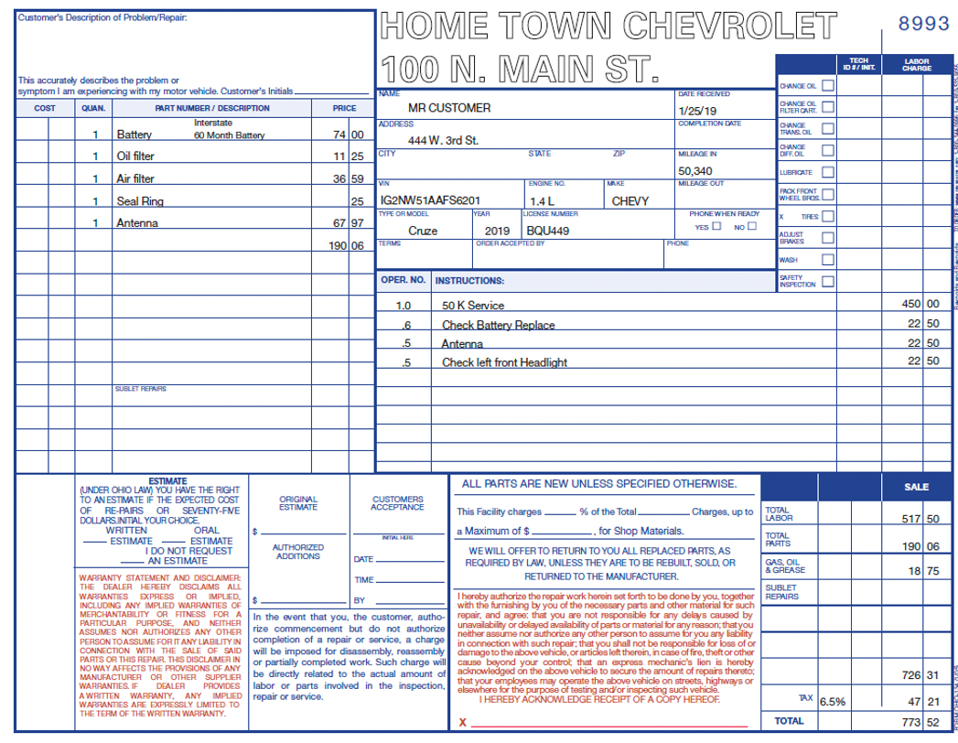
Figure 2.3
A typical work order showing the customer concern and what was done to correct the issue. Electronic work orders include all of the same required information.

Slide 13
Work Order Documentation (1 of 2)
Service technician documentation
  The technician should document the work order by stating not only what was done, but what service tools were used.
Parts documentation
  The part number(s) and the costs are usually documented on the work order by the parts department personnel.

Slide 14
Work Order Documentation (2 of 2)
Labor time documentation
  The labor time, called flat rate, is found in labor guides and lists vehicle service procedures and the time it should take an average technician to complete the task.
  All times are expressed in tenths of an hour.

Slide 15
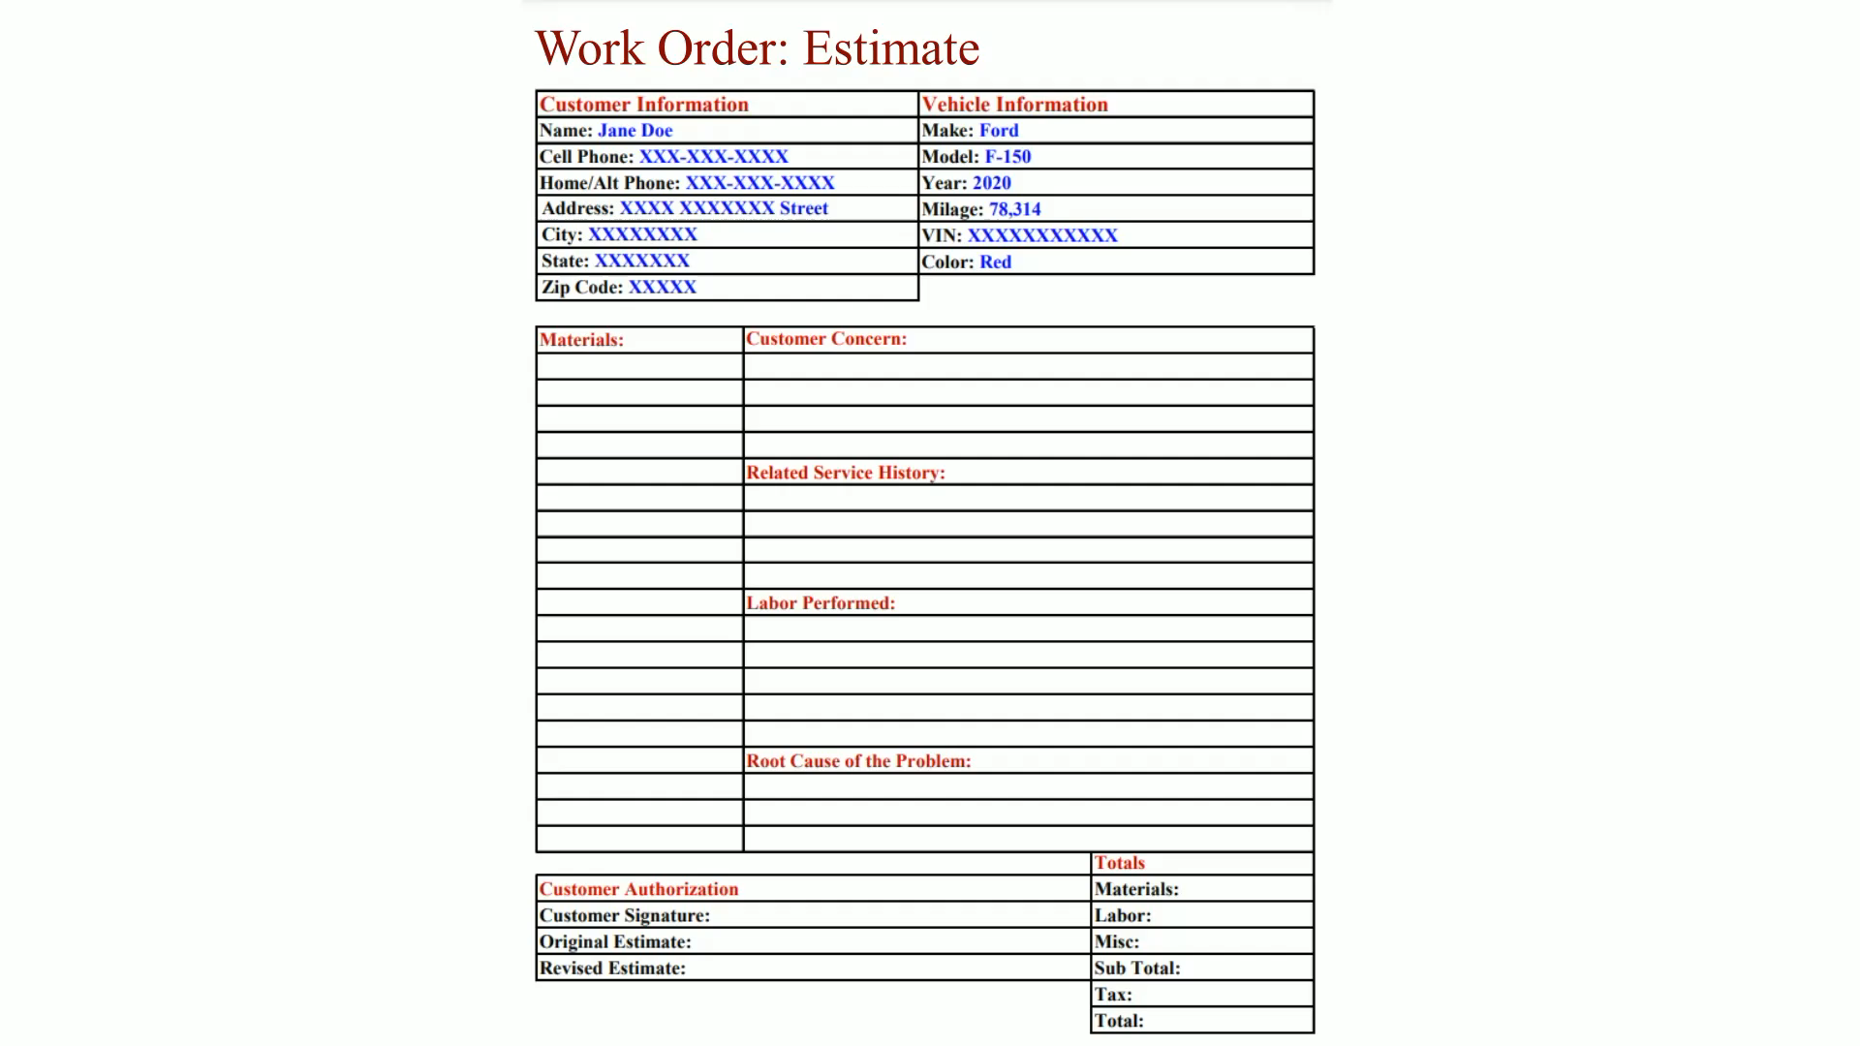
Animation:
Work Order: Estimate
(The animation will automatically start in a few seconds)

Slide 16
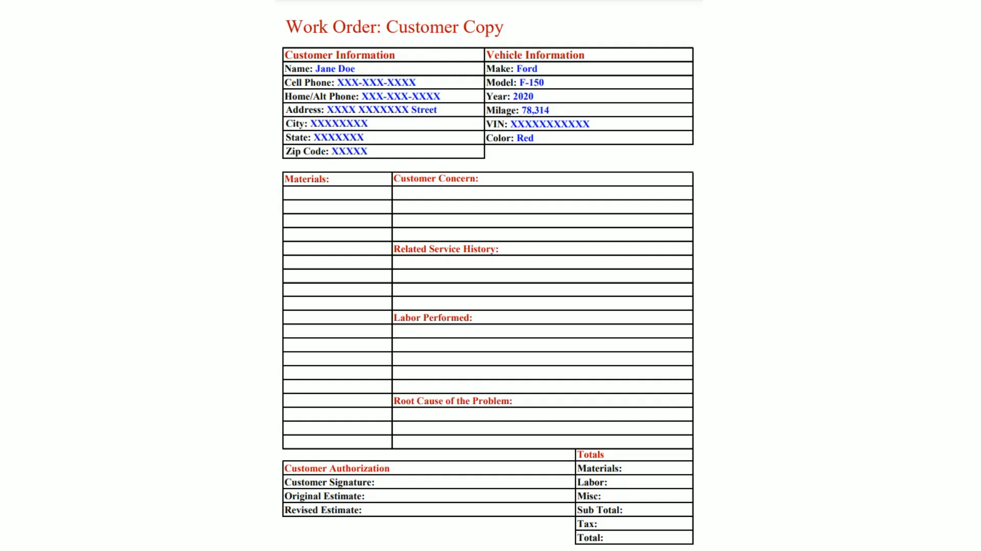
Animation:
Work Order: Customer Copy
(The animation will automatically start in a few seconds)

Slide 17
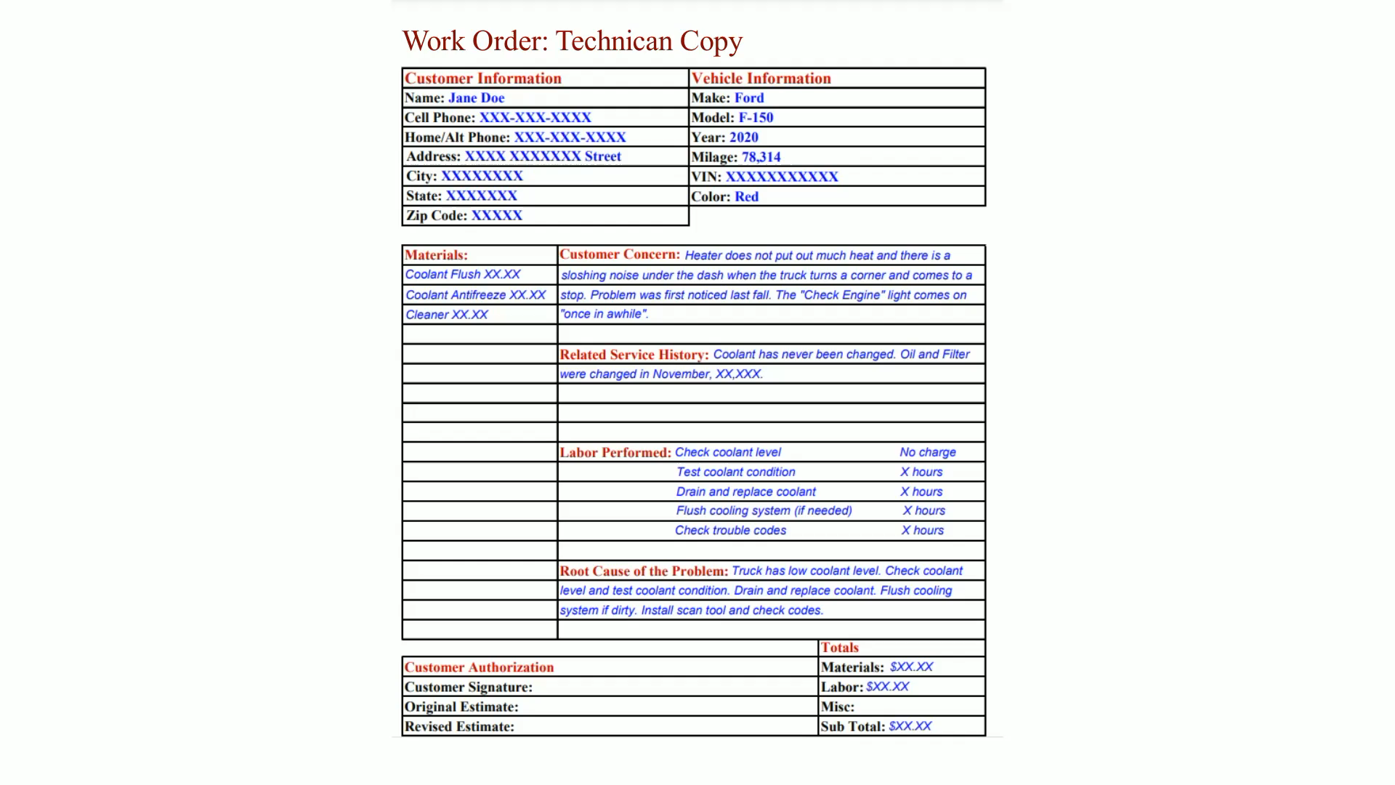
Animation:
Work Order: Technician Copy
(The animation will automatically start in a few seconds)

Slide 18
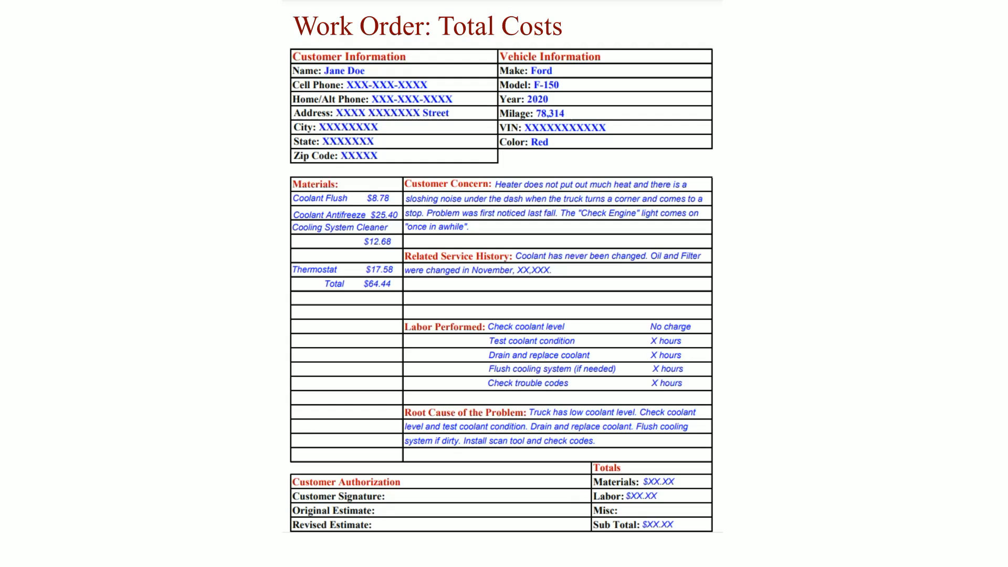
Animation:
Work Order: Total Costs
(The animation will automatically start in a few seconds)

Slide 19
Chart 2.1
Tenths of an hour | Number of minutes
0.1 | 6 minutes
0.2 | 12 minutes
0.3 | 18 minutes
0.4 | 24 minutes
0.5 | 30 minutes
0.6 | 36 minutes
0.7 | 42 minutes
0.8 | 48 minutes
0.9 | 54 minutes
1.0 | 60 minutes
The time that is published for repair and service operations are expressed in tenths of an hour.

Slide 20
Service Records
Provides a history of the service work that has been performed on the vehicle in the past.
A record of what was done is usually kept on file or stored electronically on a network or online server
A previous repair may indicate the reason for the current problem, or it could be related to the same circuit or components.

Slide 21
Additional Information
Check the vehicle before work is started
  The service advisor should look over the vehicle and make a written note of any vehicle damage that may already exist.
Special service tools (S S T s)
Automotive dealerships have tool rooms that have all the S S T s that are recommended by the factory.
  These tool rooms are for the use of the dealership technicians so that they have access to the tools needed to work on the vehicle being serviced.

Slide 22
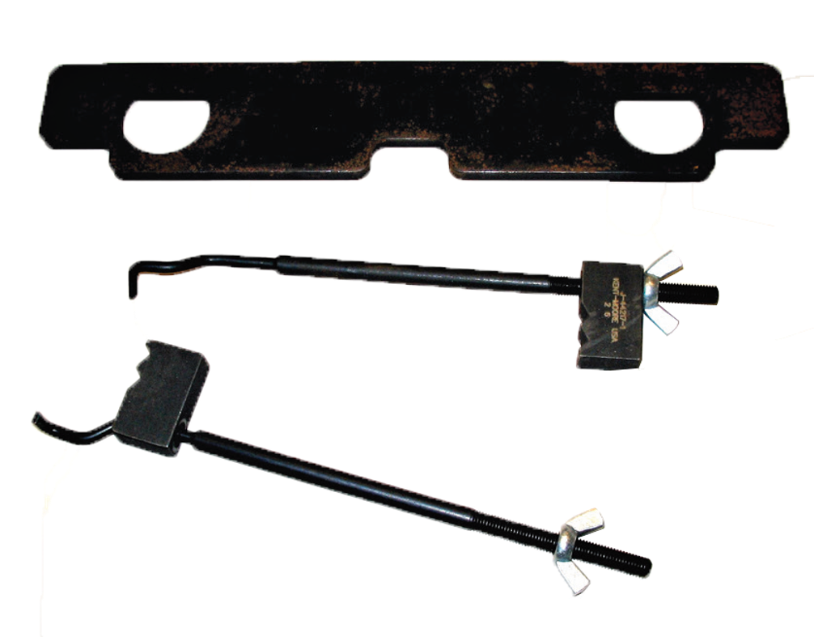
Figure 2.5
The special tool number is printed or stamped on the tool for easy identification. The Kent-Moore part number
J-44217 indicates a tool used to hold a timing chain.

Slide 23
Parts of a Vehicle
Left side of the vehicle—right side of the vehicle
  Both of these terms refer to the left and right as if the driver is sitting behind the steering wheel.
Front and rear
  The proper term for the back portion of any vehicle is rear (e.g., left rear tire).

Slide 24
Front-Wheel Drive/Rear-Wheel Drive/All-Wheel Drive
Front-wheel drive (F W D) means that the front wheels are being driven by the engine, as well as turned by the steering wheel.
Rear-wheel drive (R W D) means that the rear wheels are driven by the engine.
A front engine vehicle can also drive all four wheels, called four-wheel drive (4 W D) or all-wheel drive (A W D).

Slide 25
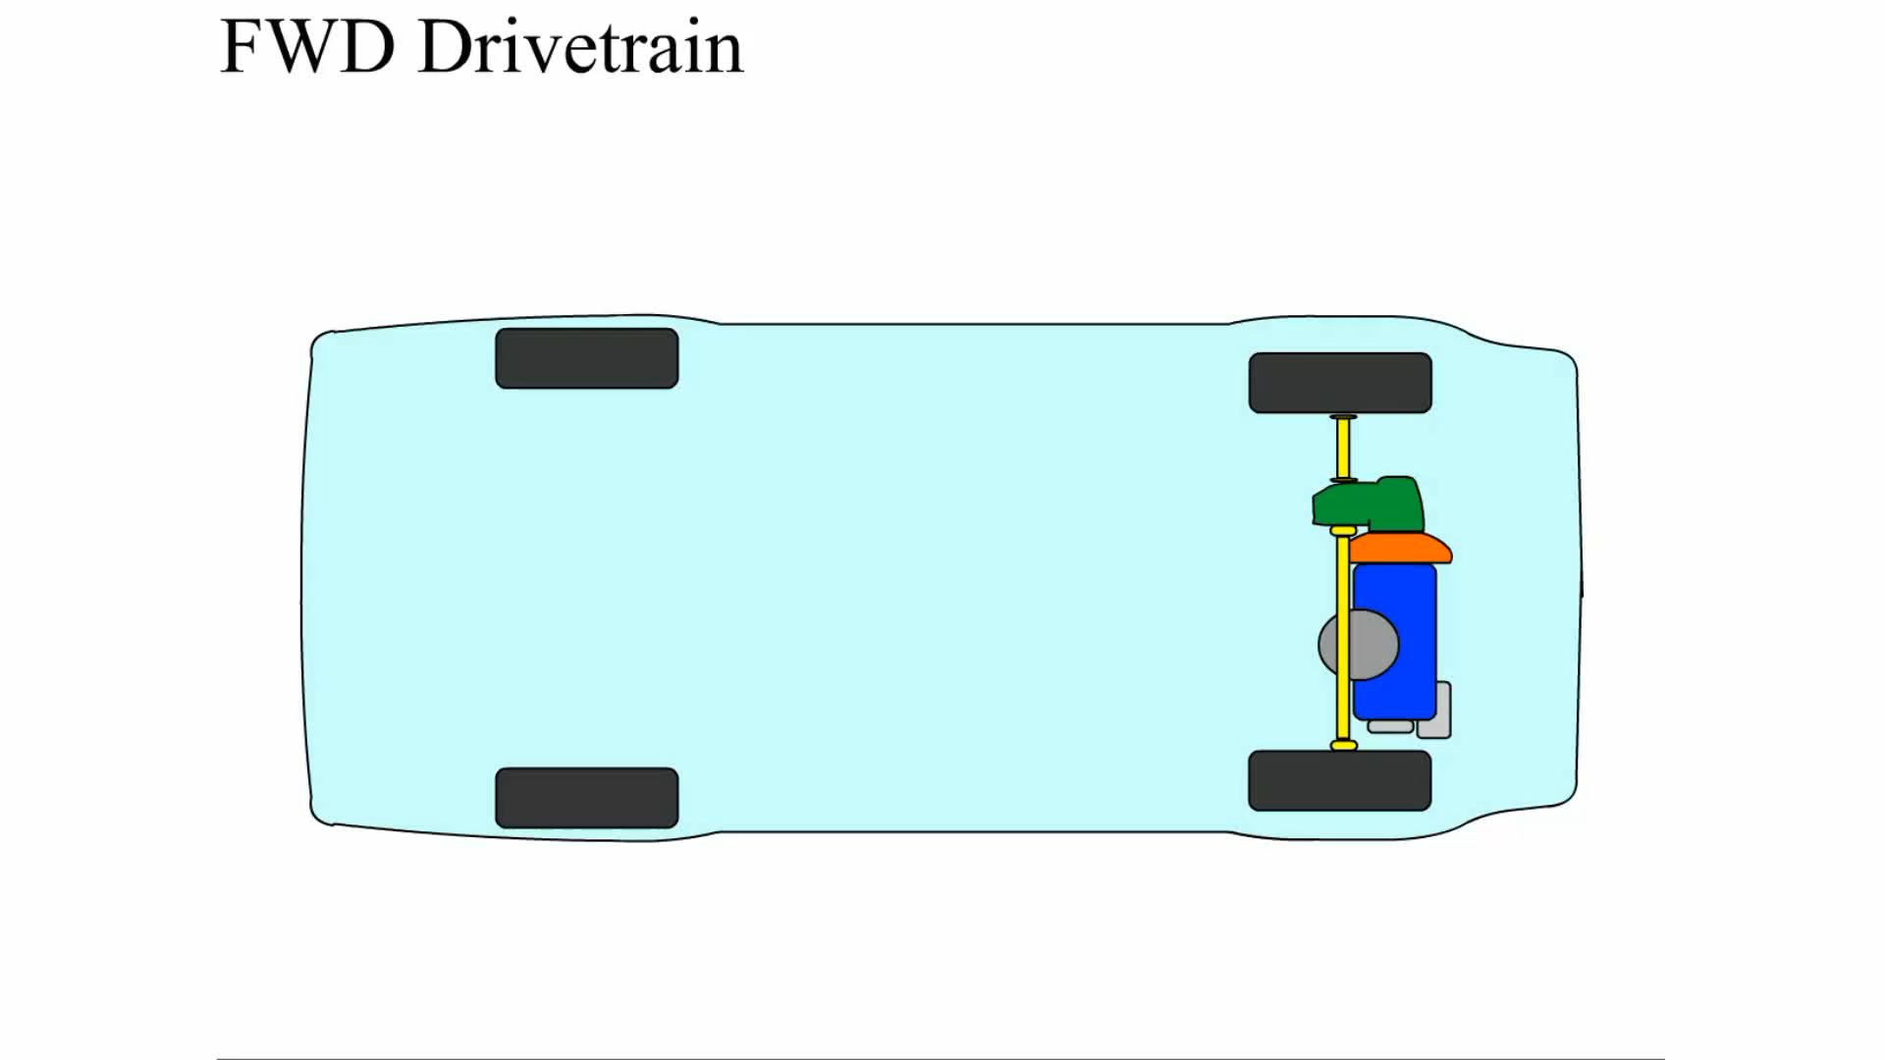
Animation:
FWD Drivetrain
(The animation will automatically start in a few seconds)

Slide 26
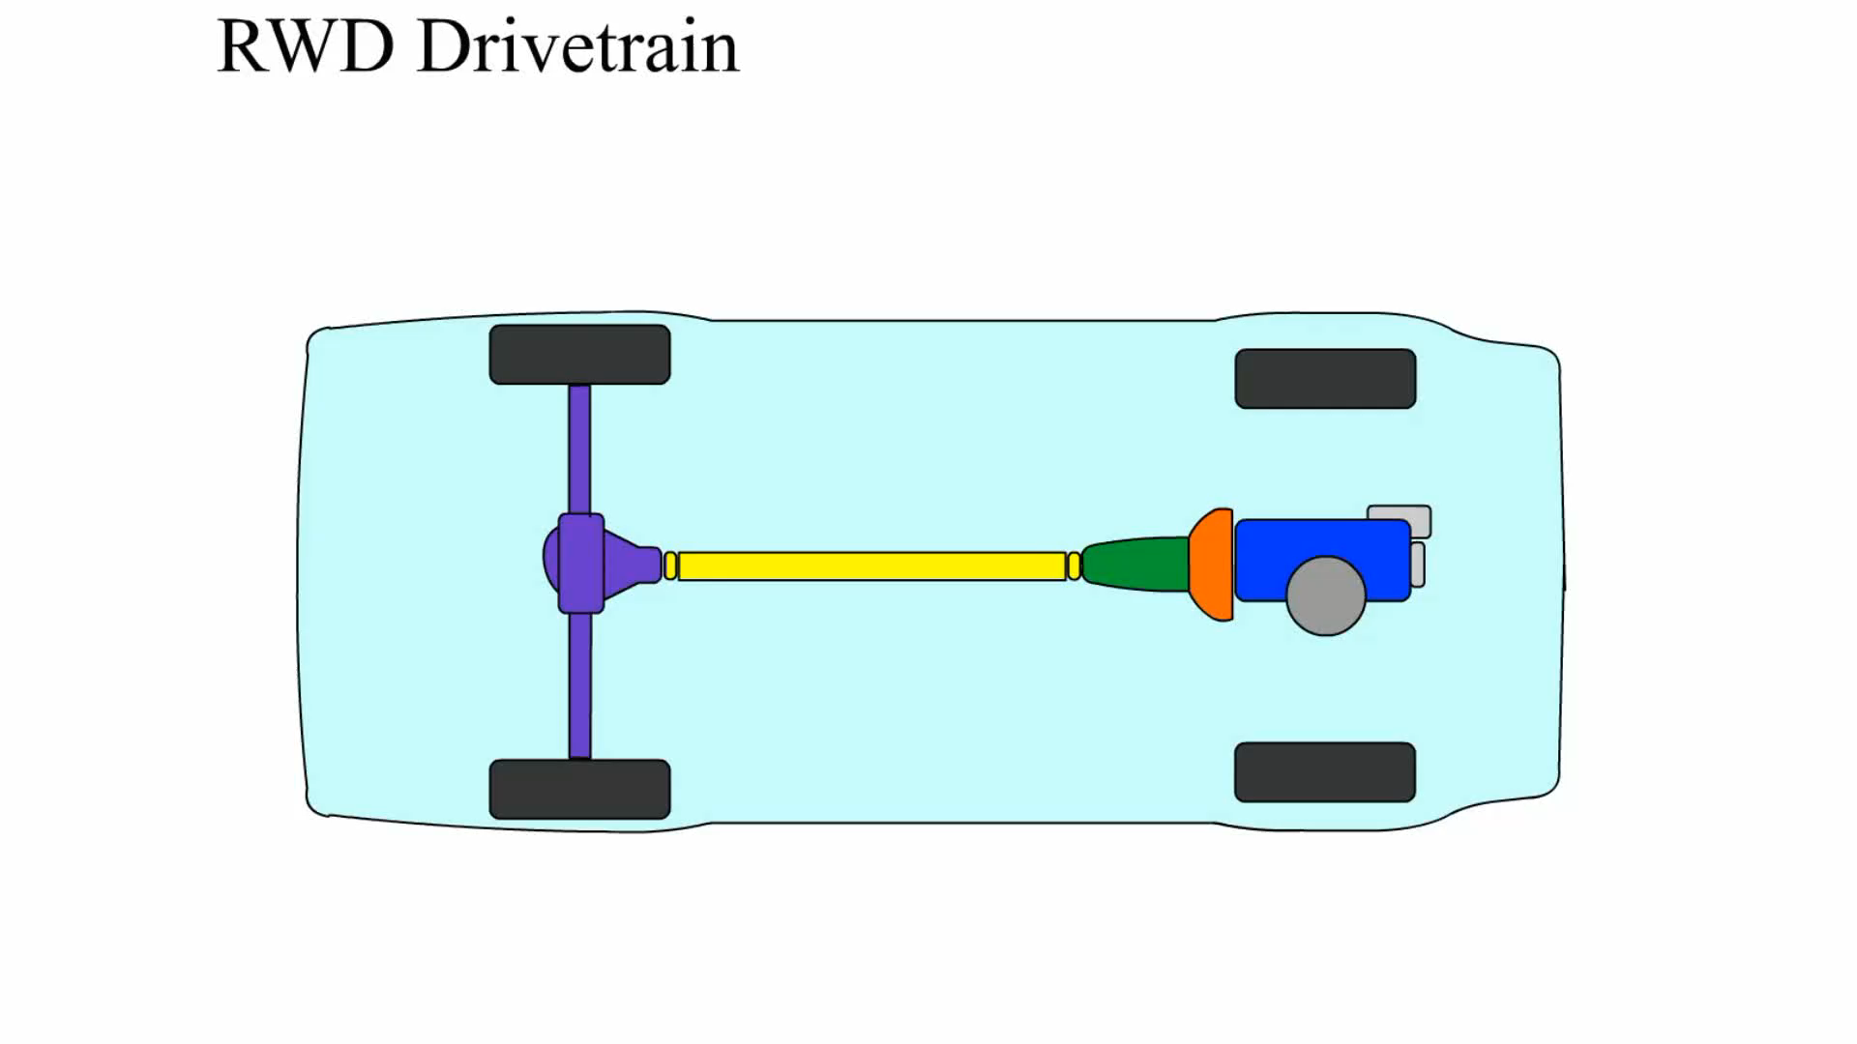
Animation:
RWD Drivetrain
(The animation will automatically start in a few seconds)

Slide 27
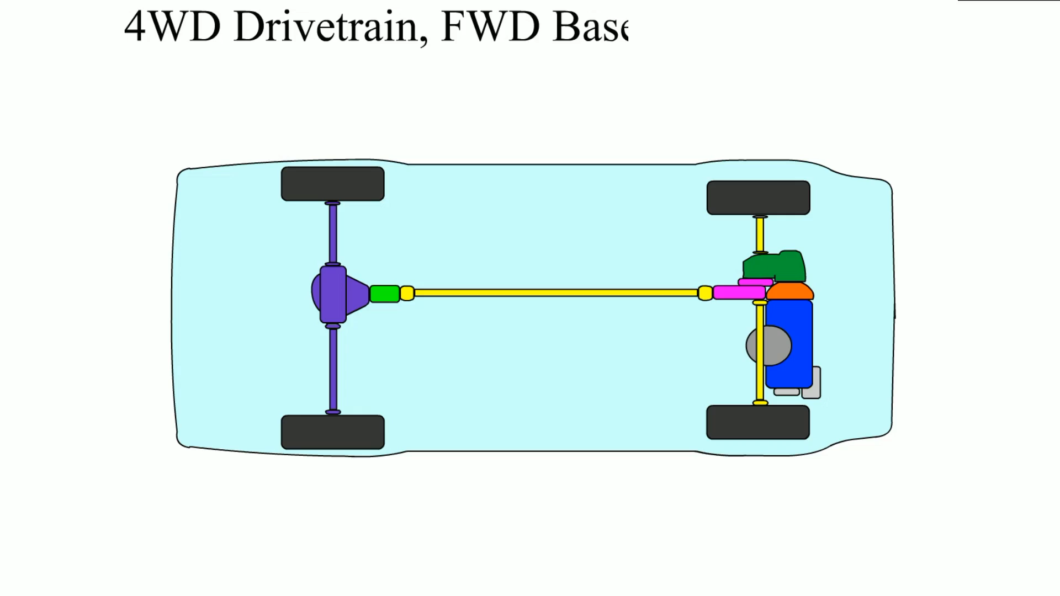
Animation:
4WD Drivetrain, FWD Based
(The animation will automatically start in a few seconds)
FWD Based

Slide 28
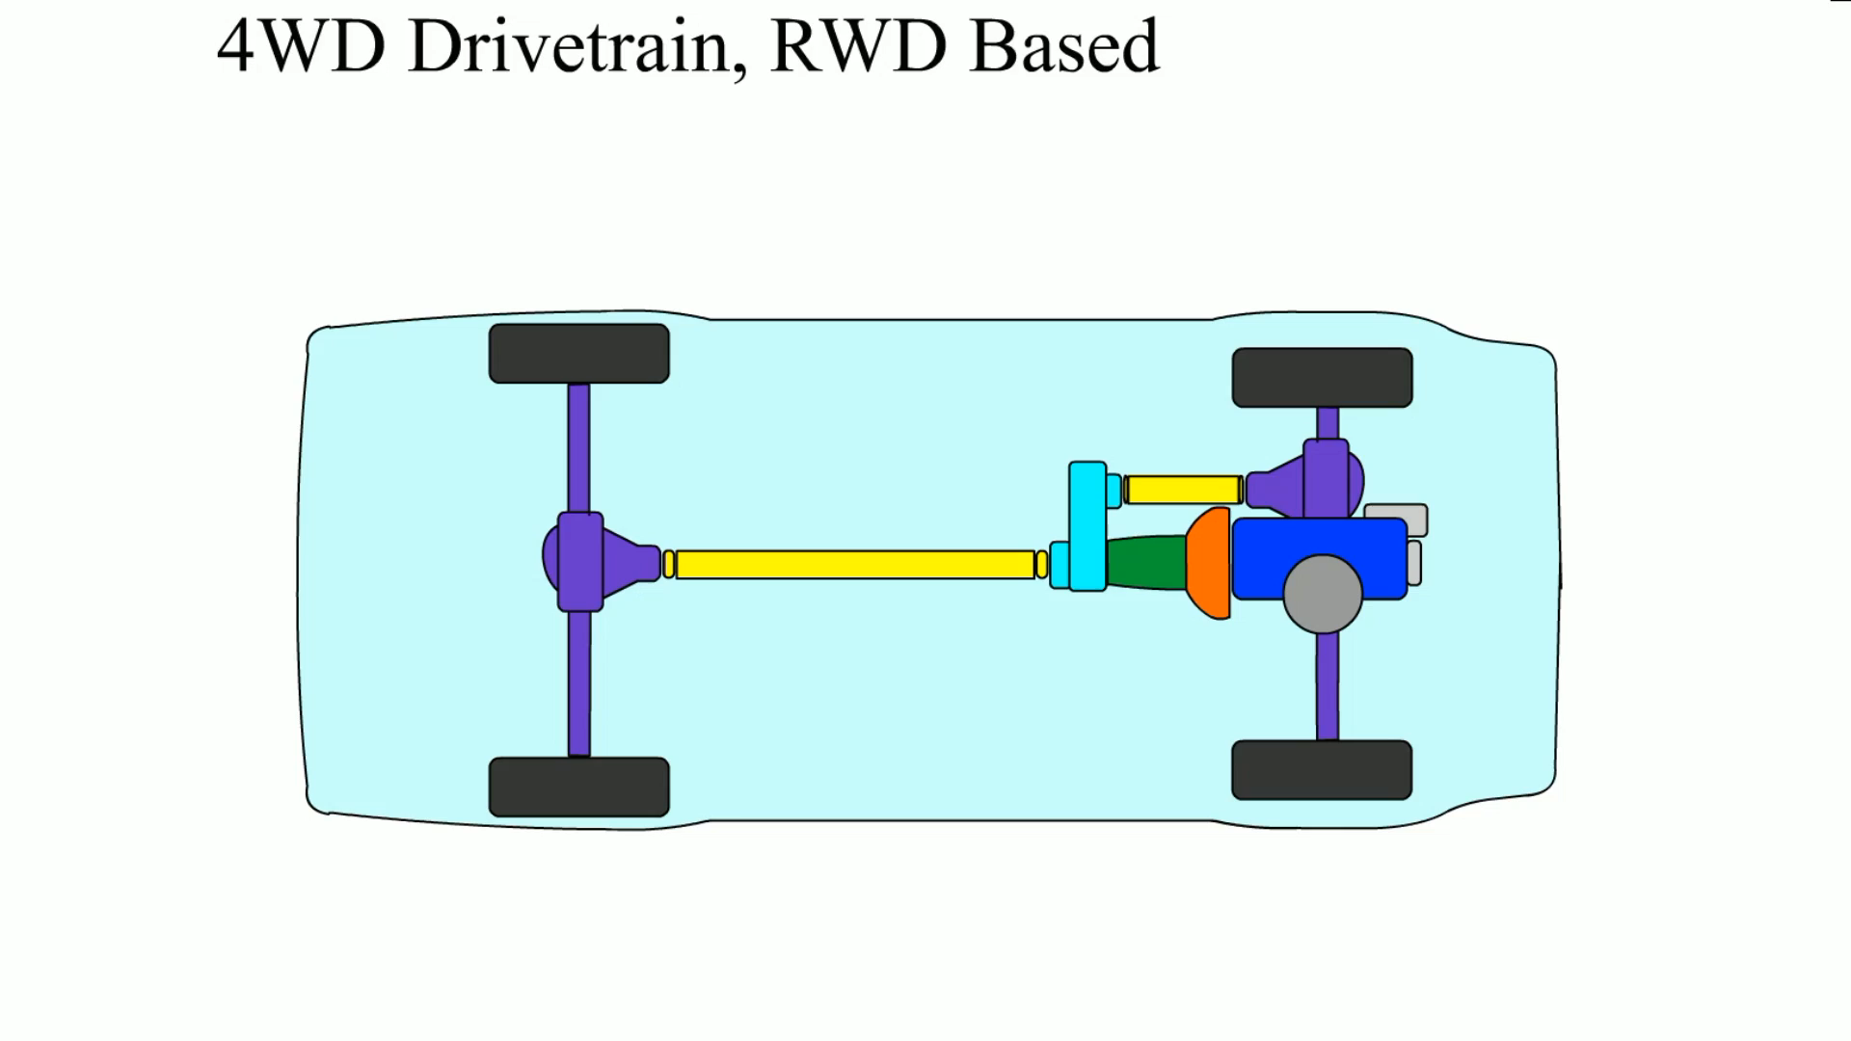
Animation:
4WD Drivetrain, RWD Based
(The animation will automatically start in a few seconds)

Slide 29
Vehicle Identification
The most common identification is the make, model, and year of the vehicle.
  Make: e.g., Chevrolet
  Model: e.g., Traverse
  Year: e.g., 2018

Slide 30
Vehicle Identification Number (V I N) (1 of 2)
Since 1981, all vehicle manufacturers have used a V I N that is 17 characters long.
Vehicle manufacturer assigns various letters or numbers within these 17 characters

Slide 31
Vehicle Identification Number (V I N) (2 of 2)
Some characters are common from one manufacturer to another
  The first number or letter designates the country of origin.
  The model of the vehicle is commonly the fourth and/or fifth character.
  The eighth character is often the engine code.
  The tenth character represents the model year (M Y) on all vehicles.

Slide 32
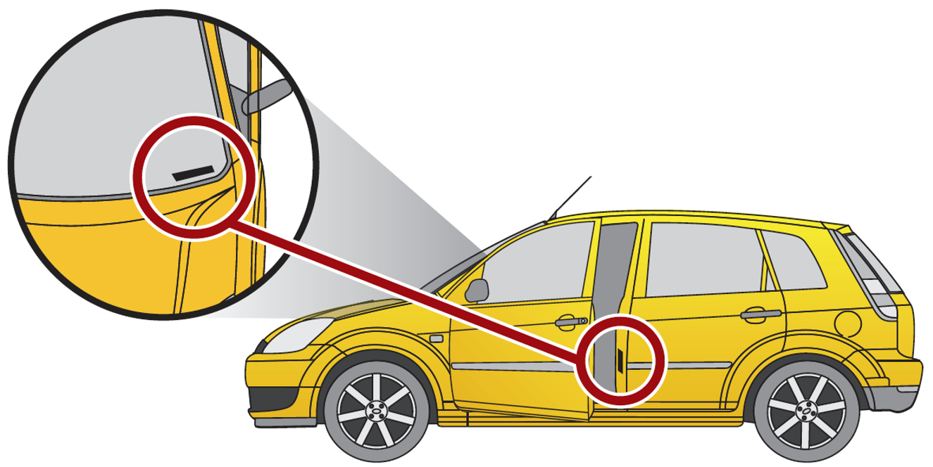
Figure 2.6
The vehicle identification number (V I N) is visible through the base of the windshield and on a decal inside the driver’s door.

Slide 33
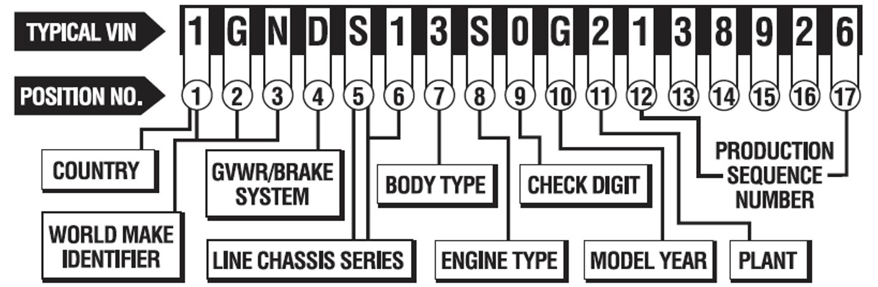
Figure 2.7
A typical V I N showing the information that is represented.
Notes:
Long Description:
The V I N is 1 G N D S 1 3 S 0 G 2 1 3 8 9 2 6. From left to right, 17 positions of the V I N are shown below it as 1 to 17 in increments of 1. The first position represents the "Country." The first three positions together represent "World make identifier." The fourth position represents "G V W R or Brake system." The fifth and sixth positions represent the "Line chassis series." The seventh, eighth, ninth, tenth, and eleventh positions represent "Body type, Engine type, Check digit, Model Year, and Plant," respectively. The digits from the twelfth to the seventeenth positions represent "Production sequence number."

Slide 34
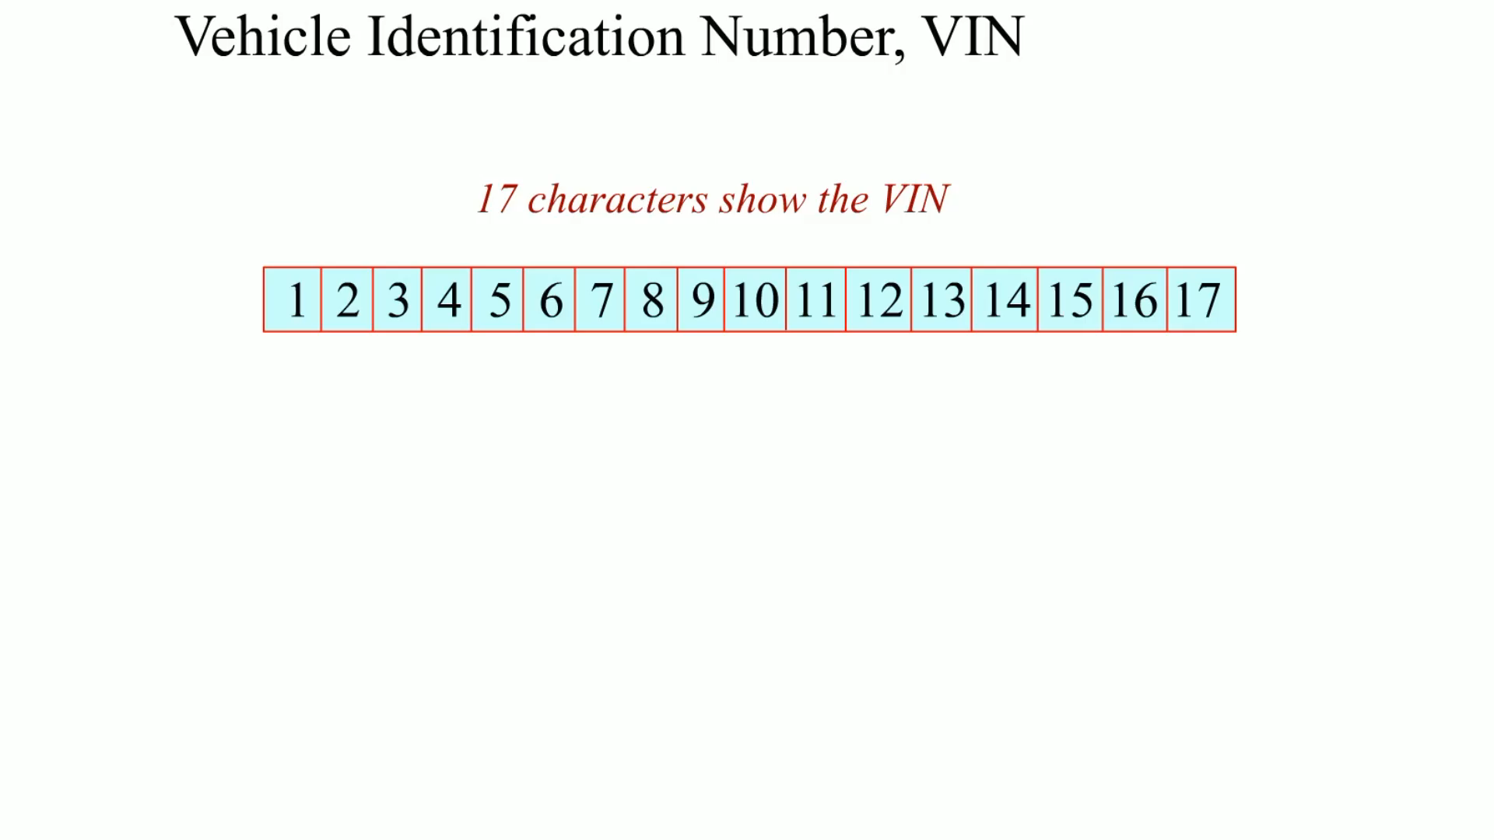
Animation:
Vehicle Identification Number, VIN
(The animation will automatically start in a few seconds)

Slide 35
Vehicle Safety Certification Label
A vehicle safety certification label is attached to the left side pillar post or the rearward-facing section of the left front door.
This label indicates the month and year of manufacture, the V I N, as well as the G V W R and G A W R.
  Gross vehicle weight rating (G V W R)—The maximum (upper limit) weight of a vehicle as specified by the vehicle manufacturer.
  Gross axle weight rating (G A W R)—The maximum weight that an axle can support is usually followed by “F R” for front axle and “R R” for rear axle.

Slide 36
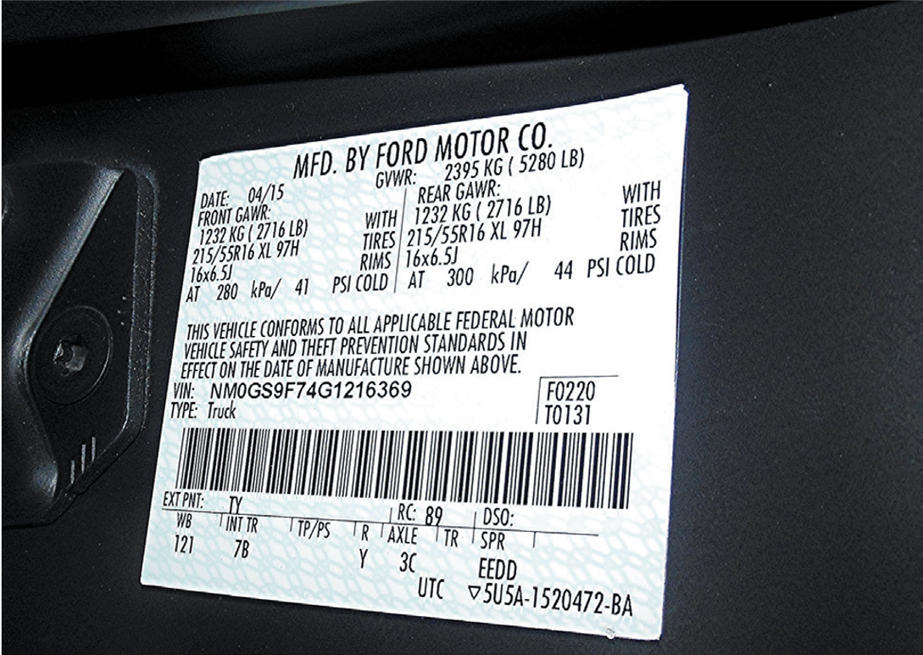
Figure 2.8
A typical vehicle safety certification label which shows the gross vehicle weight, gross axles weight rating, as well as the size and inflation pressure of the tires.
Notes:
Long Description:
It displays a Q R code along with the gross vehicle weight, gross axles weight rating, and the size and inflation pressure of the tires. It shows the pressure reading for rear G A W R as 300 kilo Pascal or 300 P S I cold and for front G A W R as 280 kilo Pascal or 41 P S I cold.

Slide 37
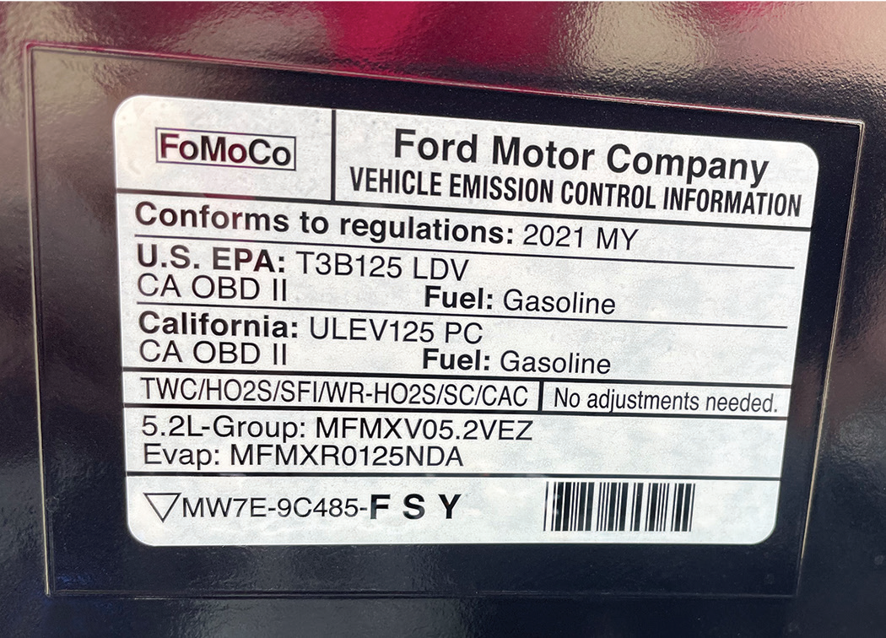
Figure 2.9
This vehicle emission control information (V E C I) decal indicates this vehicle meets both national E P A Tier3 Bin 125 (T3B125) and California U L E V 125 P C (passenger car) standard.
Notes:
Long Description:
It indicates that the vehicle meets both national E P A Tier 3, Bin 125 light duty vehicle (T 3 B 1 2 5 L D V) and California U L E V 1 2 5 P C, and the passenger car emission standards. The text on it reads, "Conforms to regulation: 2021 M Y, Fuel: Gasoline." At the bottom a code reads, "M W 7 E- 9 C 485- F S Y against a Q R code."

Slide 38
Summary (1 of 3)
Service information is needed to correctly service or repair vehicles because it contains all of the specifications, as well as the specified procedures to follow when servicing or repairing a vehicle.
A technical service bulletin (T S B) is issued by the vehicle manufacturer to notify service technicians of a potential problem or other critical information.

Slide 39
Summary (2 of 3)
A campaign is typically issued when a manufacturer wants to improve a product’s performance or increase the customer’s satisfaction. If the campaign involves a safety or emissions concern, it is considered a recall. A recall can occur when either the manufacturer or the National Highway Safety Administration (N H T S A) determines there is a concern.
The work order, also called a repair order (R O), is a legal document that is signed by the vehicle owner or his/her representative.

Slide 40
Summary (3 of 3)
The purpose of service records is to provide a history of the service work that has been performed on the vehicle in the past.
The new model year (M Y) starts in September or October of the year prior to the actual new year, but not always. This is why the vehicle identification number (V I N) is so important.
The vehicle emissions control information (V E C I) label under the hood of the vehicle shows informative settings and emission hose routing information.

Slide 41
Animation and Video Resources
The below listed resources are hyperlinked to the James Halderman website
(A0) Automotive Fundamentals Animations
(A3) Manual Drive Train Axles Animations
(A0) Automotive Fundamentals Videos
(A3) Manual Drive Train Axles Videos

Slide 42

Copyright
This work is protected by United States copyright laws and is provided solely for the use of instructors in teaching their courses and assessing student learning. Dissemination or sale of any part of this work (including on the World Wide Web) will destroy the integrity of the work and is not permitted. The work and materials from it should never be made available to students except by instructors using the accompanying text in their classes. All recipients of this work are expected to abide by these restrictions and to honor the intended pedagogical purposes and the needs of other instructors who rely on these materials.

