Slide 1


Automotive Engines Theory and Servicing
Tenth Edition
Chapter 1
Shop Safety
Copyright © 2023 Pearson Education, Inc. All Rights Reserved
Notes:
If this PowerPoint presentation contains mathematical equations, you may need to check that your computer has the following installed:
1) MathType Plugin
2) Math Player (free versions available)
3) NVDA Reader (free versions available)

Slide 2
Learning Objectives
1.1 Describe the personal protective equipment used by technicians.
1.2 Explain the safety tips for technicians and the cleaning methods and processes used in vehicle service.
1.3 Discuss shop safety procedures.
1.4 Describe the purpose of fire extinguishers, fire blankets, and first aid and eye washing stations.

Slide 3
Personal Protective Equipment
Safe work habits can reduce accidents and injuries, ease the workload, and keep employees pain free.
  Safety Glasses
  Steel-toed Shoes
  Gloves
    Latex surgical gloves; vinyl gloves; polyurethane gloves; nitrile gloves; mechanic's gloves
  Bump Cap
  Hands, jewelry, and clothing

Slide 4
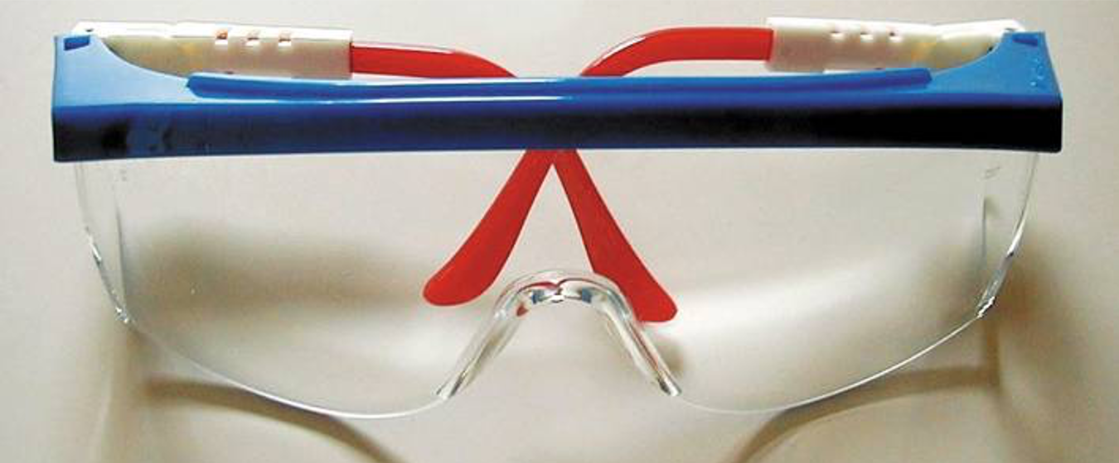
Figure 1.1
Safety glasses should be worn at all times when working on or around any vehicle or servicing any component.

Slide 5
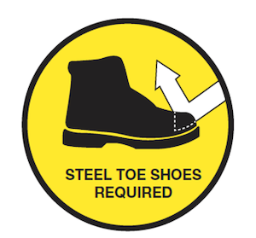
Figure 1.2
Steel-toed shoes are a worthwhile investment to help prevent foot injury due to falling objects.

Slide 6
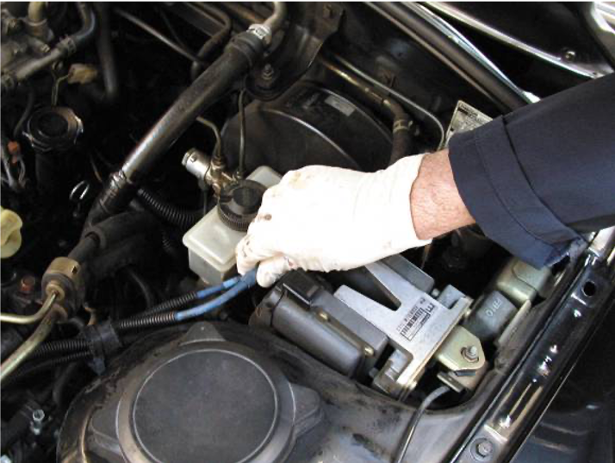
Figure 1.3
Protective gloves such as these vinyl gloves are available in several sizes. Select the size that allows the gloves to fit snugly.

Slide 7
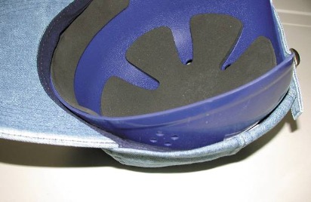
Figure 1.4
One version of a bump cap is this padded plastic insert that is worn inside a regular cloth cap.

Slide 8
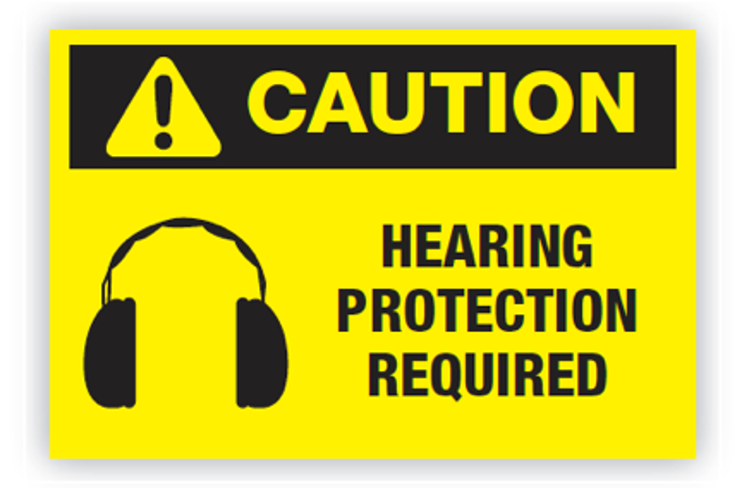
Figure 1.5
Hearing protection is recommended for use if the noise level exceeds 90 dB, which is often the case in a noisy automotive shop if air tools or grinders are being used.

Slide 9
Safety Tips for Technicians (1 of 2)
When lifting any object, get a secure grip with solid footing.
  Keep the load close to your body to minimize the strain. Lift with your legs and arms, not your back.
Do not twist your body when carrying a load. Instead, pivot your feet to help prevent strain on the spine.
Ask for help when moving or lifting heavy objects.
Push a heavy object rather than pull it.

Slide 10
Safety Tips for Technicians (2 of 2)
Always connect an exhaust hose to the tailpipe of any running vehicle to help prevent the buildup of carbon monoxide inside a closed garage space.
When standing, keep objects, parts, and tools with which you are working between chest height and waist height.
  If seated, work at tasks that are at elbow height.
Ask for help when pushing or vehicle or use a motorized pusher.

Slide 11
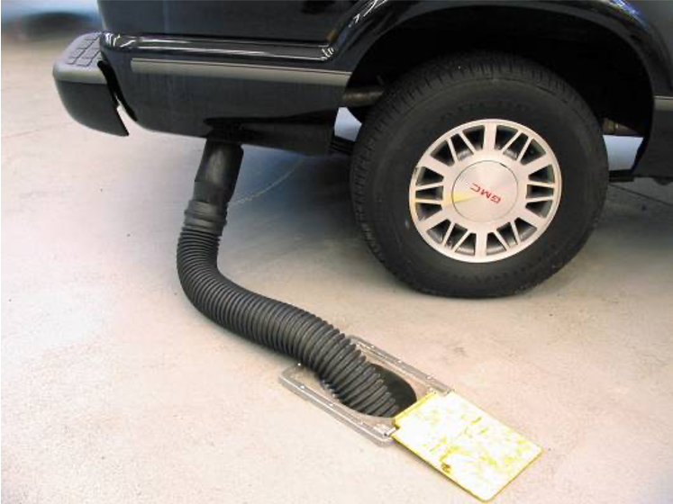
Figure 1.6
Always connect an exhaust hose to the tailpipe of the engine of a vehicle to be run inside a building.

Slide 12
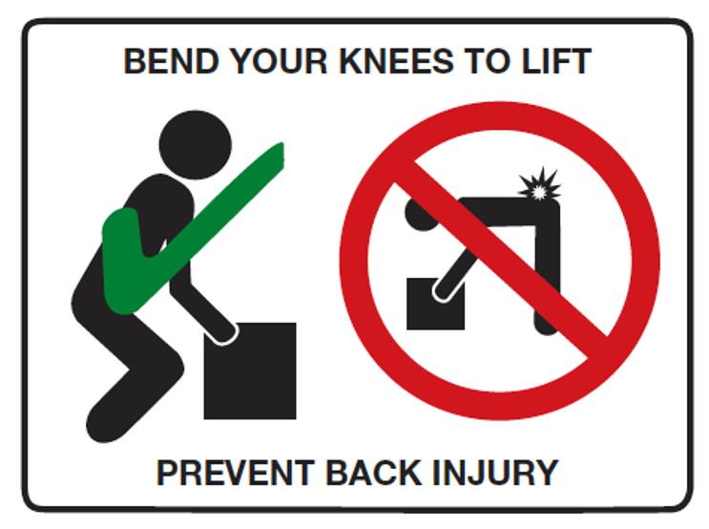
Figure 1.7
When lifting heavy objects, lift using your legs instead of your back to help avoid strain and injury.
Notes:
Long Description:
The correct way shows a person lifting an object with their legs by bending the hips and knees to squat down to the load and straightening the legs to lift. Incorrect way shows a person bending completely with the back to lift an object. A text in the signboard reads: “Bend your knees to lift”, "Prevent back injury."

Slide 13
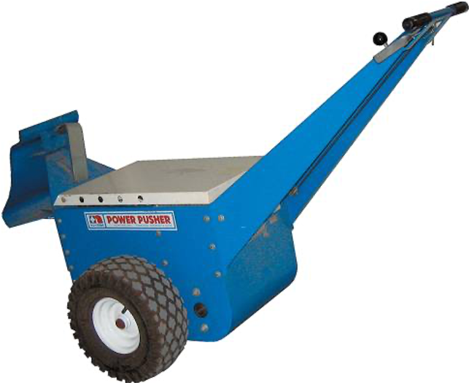
Figure 1.8
An electric pusher used to push vehicles into or around the shop.

Slide 14
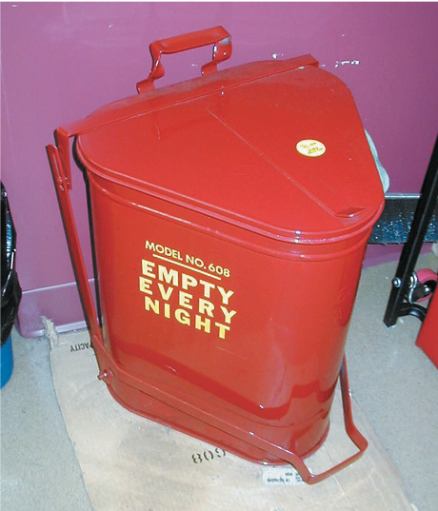
Figure 1.9
All oily shop cloths should be stored in a metal container equipped with a lid to help prevent spontaneous
combustion.

Slide 15
Cleaning Methods and Processes
There are four basic types of cleaning methods and processes used in vehicle service.
  Power Washing
  Chemical/Microbe Cleaning
  Abrasive Cleaning
  Thermal Ovens

Slide 16
Electrical Cord Safety
Use correctly grounded three-prong sockets and extension cords to operate power tools.
  Some tools use only two-prong plugs.
  Make sure these are double insulated and repair or replace any electrical cords that are cut or damaged to prevent the possibility of an electrical shock.
When not in use, keep electrical cords off the floor to prevent tripping over them.
Tape the cords down if they are placed in high foot traffic areas.

Slide 17
Jump Starting and Battery Safety
To jump-start another vehicle with a dead battery, connect good-quality copper jumper cables or use a jump box.
The last connection made should always be on the engine block or an engine bracket as far from the battery as possible.

Slide 18
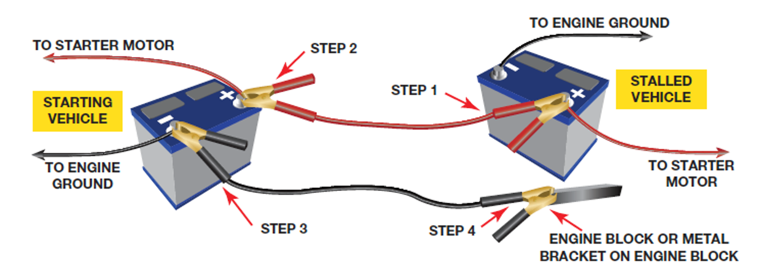
Figure 1.10
Jumper cable usage guide. Follow the same connections if using a portable jump box.
Notes:
Long Description:
The left battery is labeled "Starting vehicle" and the right battery is labeled "Stalled vehicle." The steps are as follows:
Step 1: Attach the red clip of jumper cable to the positive terminal of the stalled vehicle’s battery.
Step 2: Attach the red clip of jumper cable to the positive terminal of the starting vehicle’s battery.
Step 3: Attach the black clip of jumper cable to the negative terminal of the starting vehicle’s battery.
Step 4: Attach the black clip of jumper cable to engine block or metal bracket on engine block of the stalled vehicle.
The wires from positive terminals of both batteries lead to the starter motor and from negative terminal of the starting vehicle to the engine ground.

Slide 19
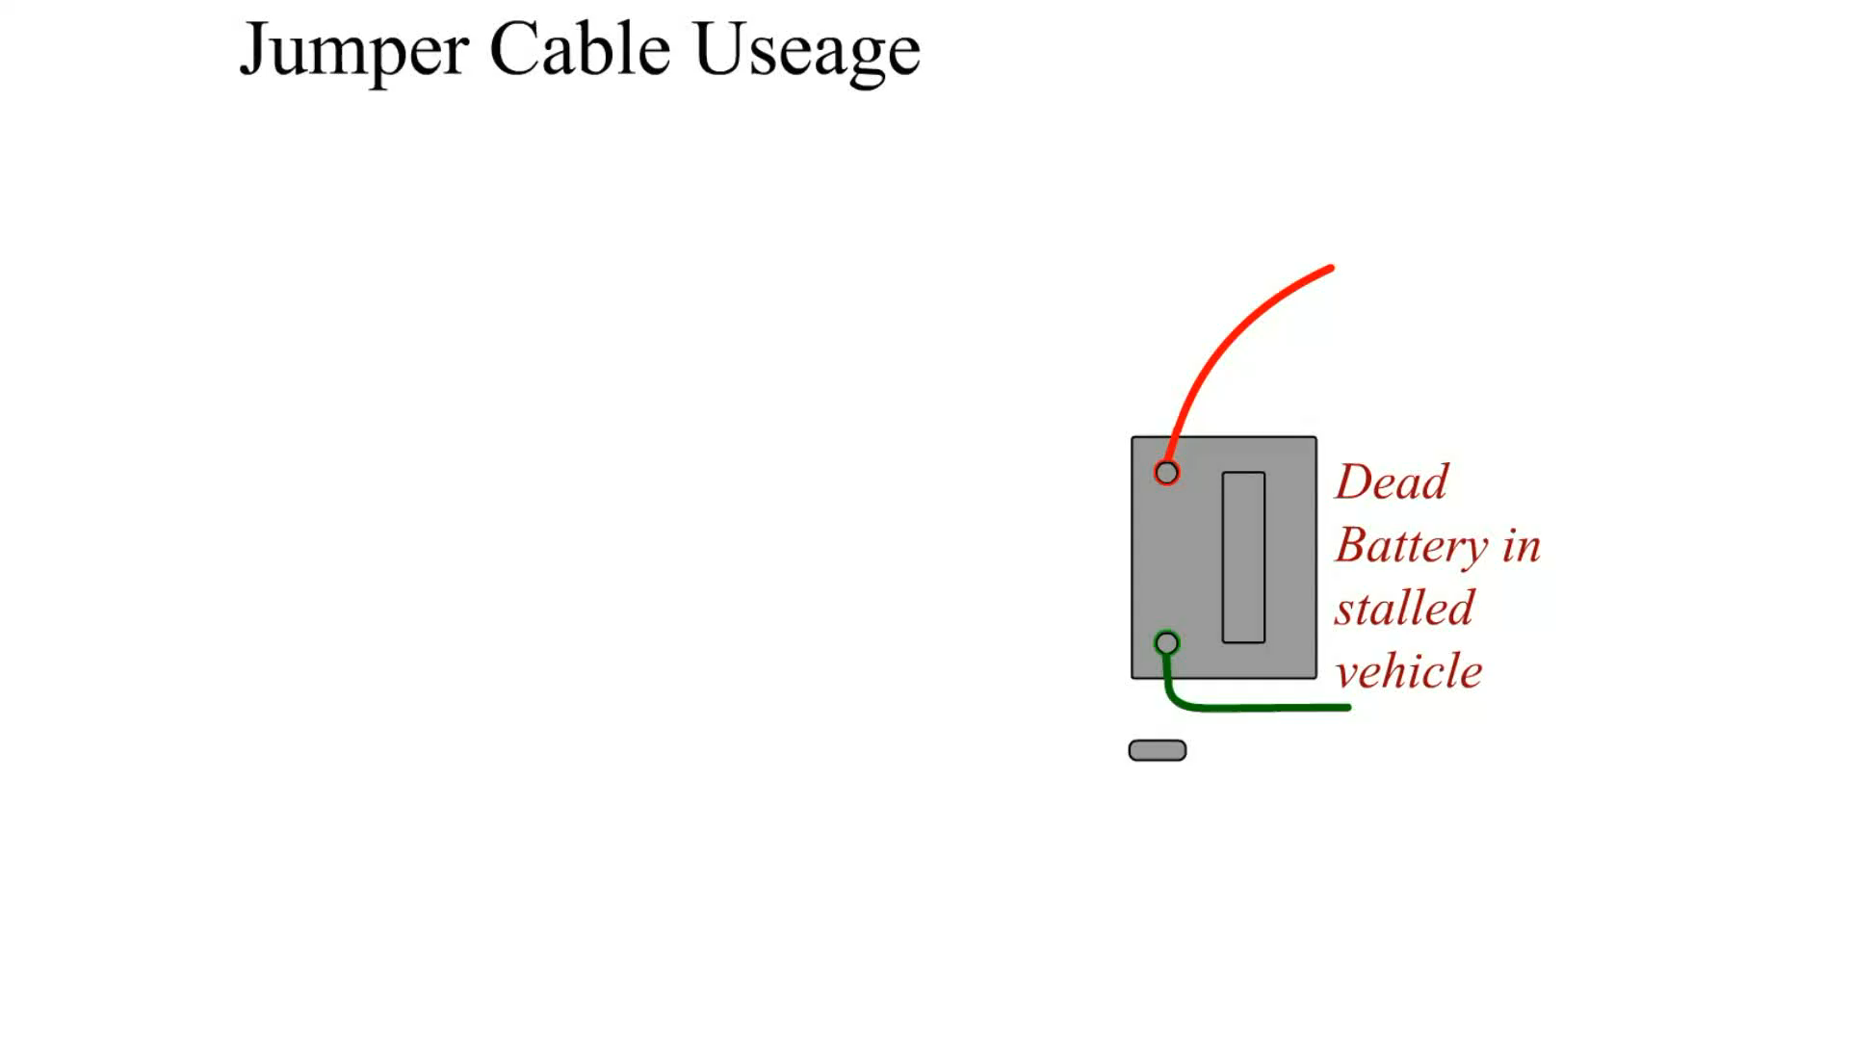
Animation:
Work Order Customer Copy
(The animation will automatically start in a few seconds)

Slide 20

Animation:
Jumper Box Usage
(The animation will automatically start in a few seconds)

Slide 21
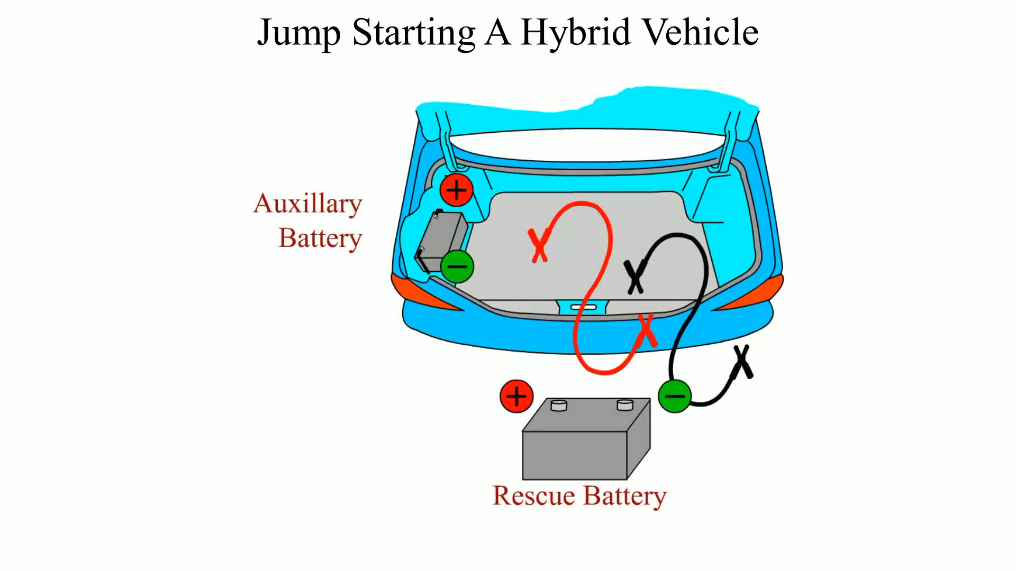
Animation:
Jump Starting A Hybrid Vehicle
(The animation will automatically start in a few seconds)

Slide 22
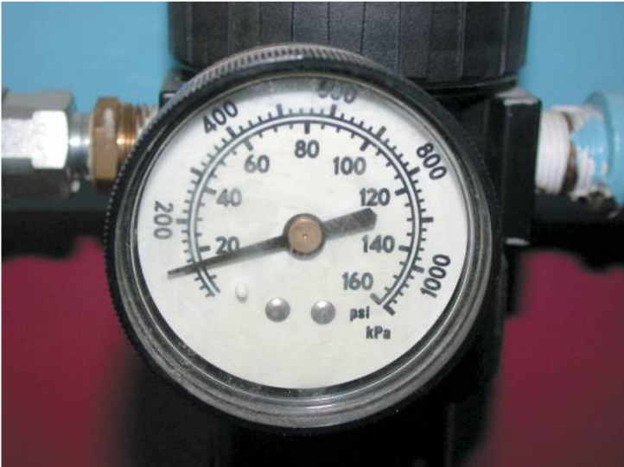
Figure 1.11
The air pressure going to the nozzle should be reduced to 30 P S I or less.

Slide 23
Fire Extinguishers (1 of 2)
There are four classes of fire extinguishers.
  Class A is designed for use on general combustibles, such as cloth, paper, and wood.
  Class B is designed for use on flammable liquids and greases, including gasoline, oil, thinners, and solvents.
  Class C is used only on electrical fires.
  Class D is effective only on combustible metals such as powdered aluminum, sodium, or magnesium.
The class rating is clearly marked on the side of every fire extinguisher.

Slide 24
Fire Extinguishers (2 of 2)
Many extinguishers are good for multiple types of fires.
Remember the word "P A S S."
  P Pull the safety pin.
  A Aim the nozzle of the extinguisher at the base of the fire.
  S Squeeze the lever to actuate the extinguisher.
  S Sweep the nozzle from side to side.

Slide 25
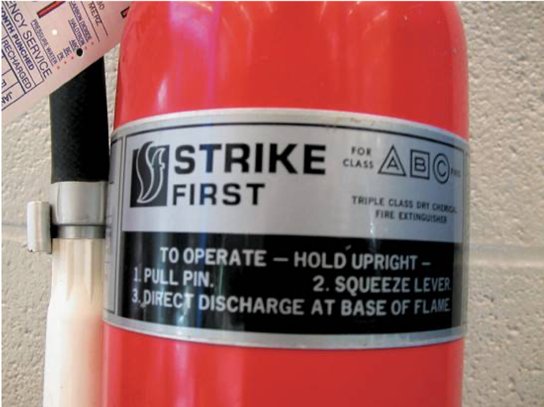
Figure 1.12
A typical fire extinguisher designed to be used on type class A, B, or C fires.

Slide 26
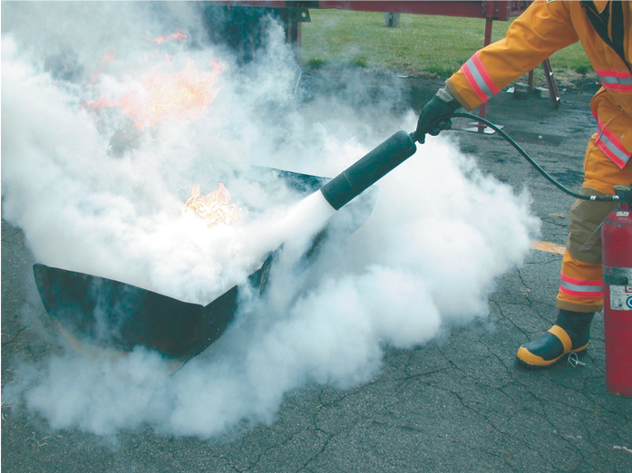
Figure 1.13
A
fire extinguisher being used on a fire set in an open
steel drum during a demonstration at a fire department
training center.

Slide 27
Fire Blanket
Fire blankets are required to be available in the shop areas.
If a person is on fire, a fire blanket should be removed from its storage bag and thrown over and around the victim to smother the fire.

Slide 28
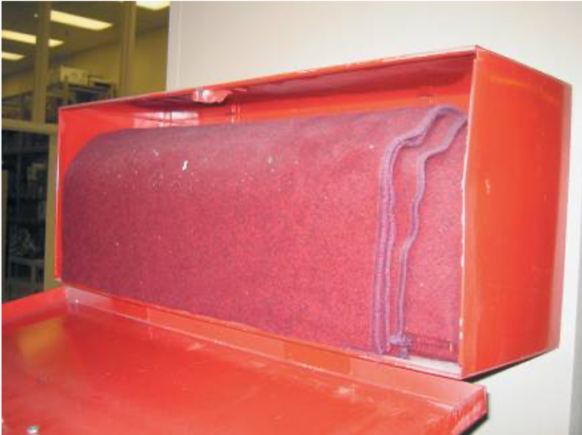
Figure 1.14
A treated wool blanket is kept in this easy-to-open wall-mounted holder and should be placed in a centralized location in the shop.

Slide 29
First Aid and Eye Wash Stations
All shop areas must be equipped with a first aid kit and an eye wash station centrally located and kept stocked with emergency supplies.
  First Aid Kit
  Eye Wash Station

Slide 30
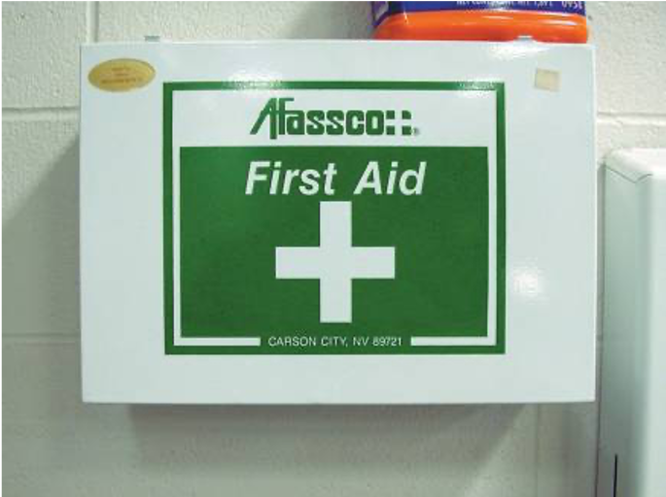
Figure 1.15
A first aid box should be centrally located in the shop and kept stocked with the recommended supplies.

Slide 31
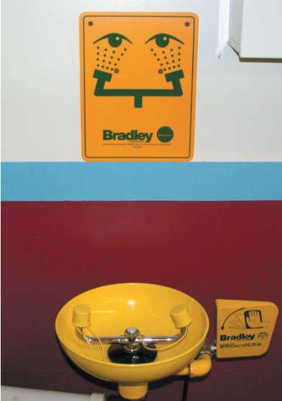
Figure 1.16
A typical eye wash station. Often a thorough flushing of the eyes with water is the best treatment in the event of eye contamination.

Slide 32
Evacuation Routes
Evacuation routes are commonly posted throughout the building
Aisles leading to the emergency exits must be marked with yellow paint or tape

Slide 33
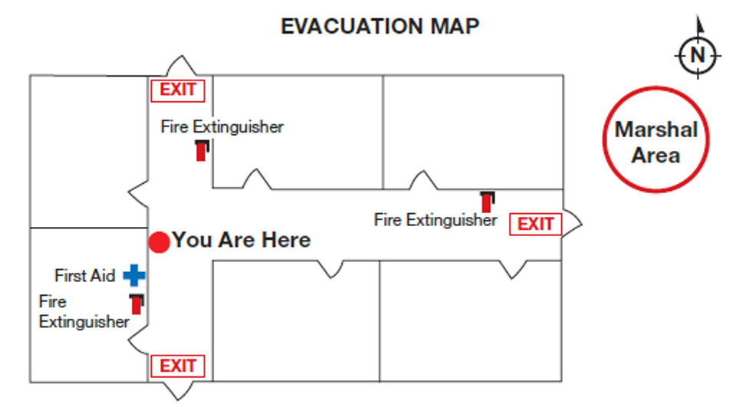
Figure 1.17
The evacuation routes from where you are in the building is shown on maps that are attached to the walls in schools and commercial buildings.

Slide 34
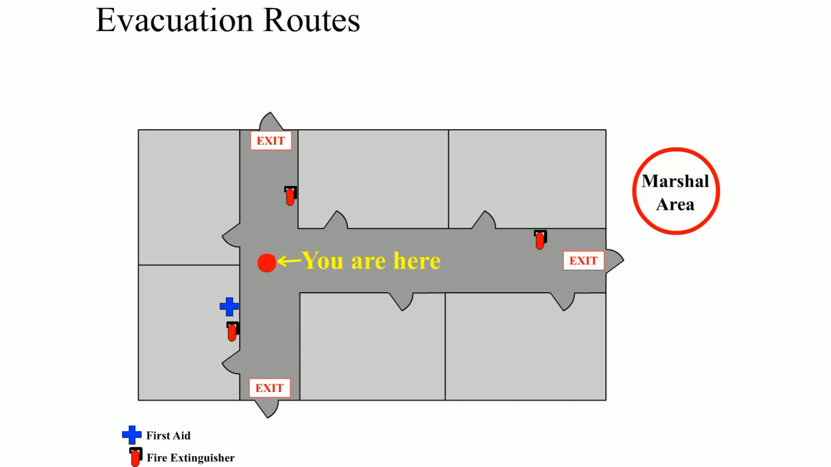
Animation:
Evacuation Routes
(The animation will automatically start in a few seconds)

Slide 35
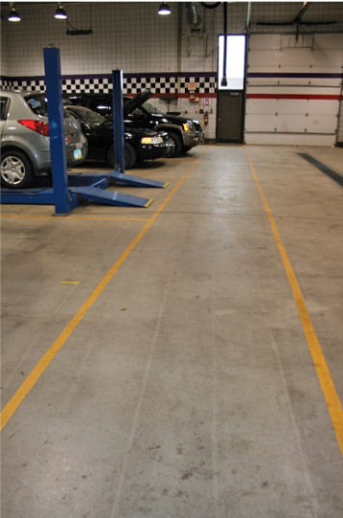
Figure 1.18
A properly marked aisle using yellow paint stripes leading to an exit.

Slide 36
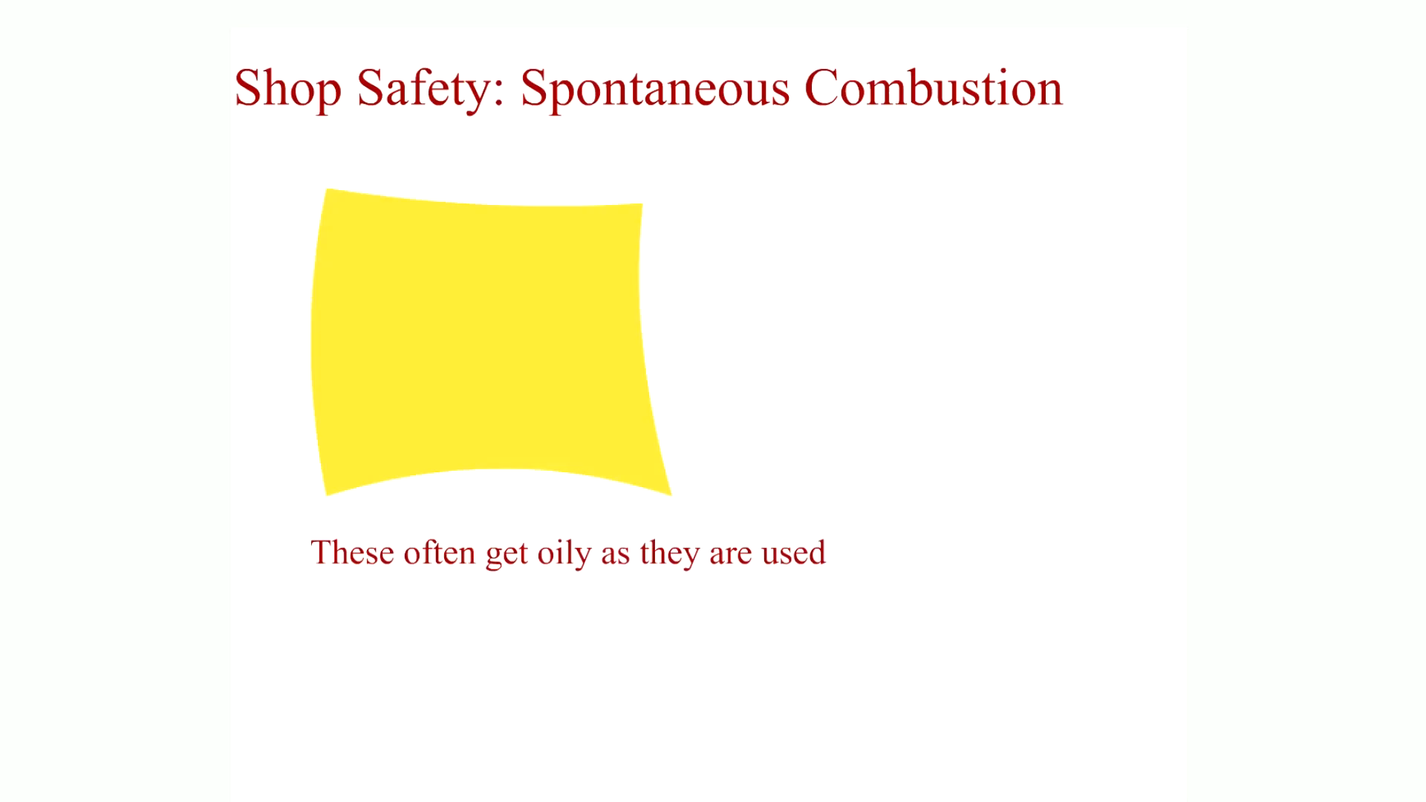
Animation:
Shop Safety: Spontaneous Combustion
(The animation will automatically start in a few seconds)

Slide 37
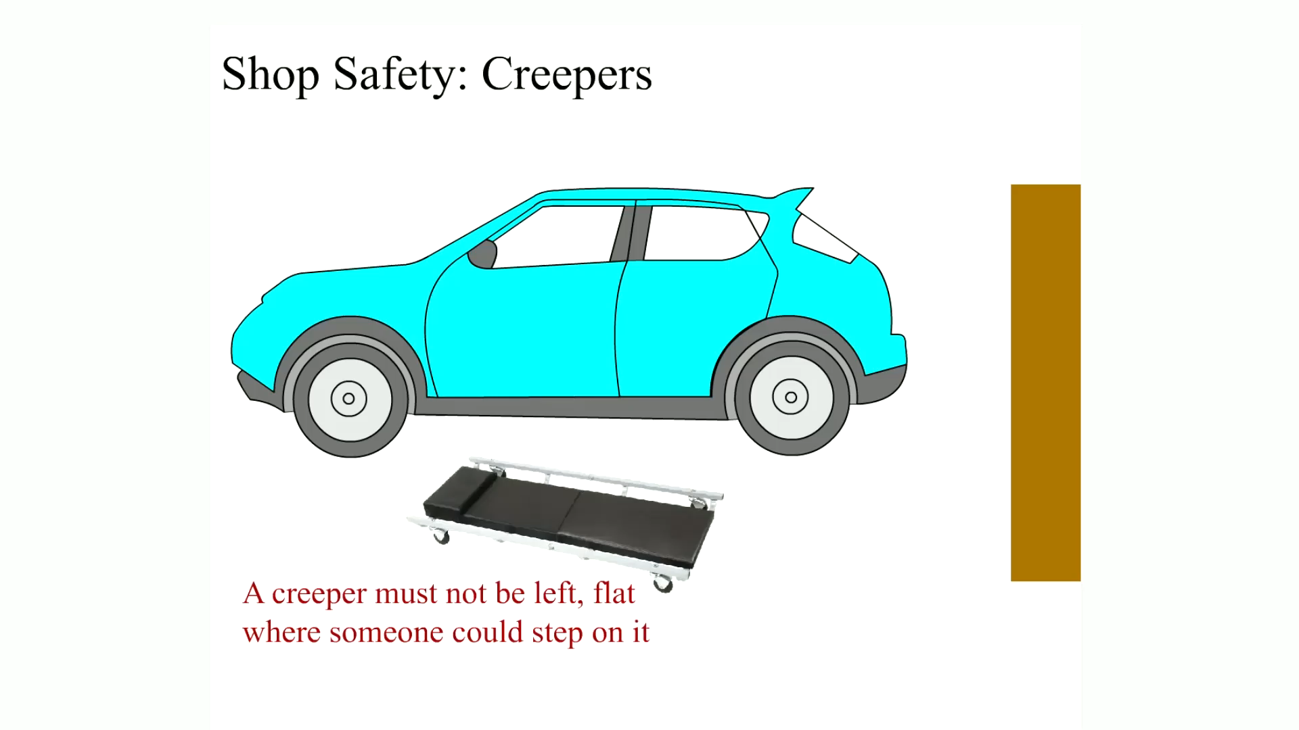
Animation:
Shop Safety: Creepers
(The animation will automatically start in a few seconds)

Slide 38
Summary
All service technicians should wear safety glasses that meet standard A N S I Z87.1.
Ear protection should be worn anytime the noise level is at 90 decibels (d B) or higher.
Safety should be exercised when working with electrical cords or when jump-starting another vehicle.
If a fire extinguisher is needed, remember P A S S: Pull the safety pin, aim the nozzle, squeeze the lever, and sweep the nozzle from side-to-side.

Slide 39
Animation and Video Resources
The below listed resources are hyperlinked to the James Halderman website
(A0) Automotive Fundamentals Animations
(A0) Automotive Fundamentals Videos

Slide 40

Copyright
This work is protected by United States copyright laws and is provided solely for the use of instructors in teaching their courses and assessing student learning. Dissemination or sale of any part of this work (including on the World Wide Web) will destroy the integrity of the work and is not permitted. The work and materials from it should never be made available to students except by instructors using the accompanying text in their classes. All recipients of this work are expected to abide by these restrictions and to honor the intended pedagogical purposes and the needs of other instructors who rely on these materials.

