Slide 1
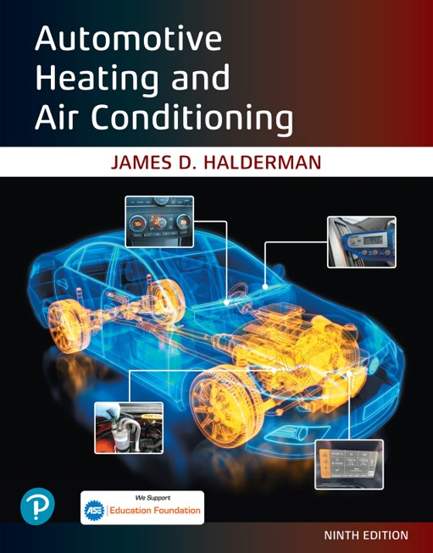
Automotive Heating and Air Conditioning
Ninth Edition
Chapter 4
Air-Conditioning Compressors and Service
Copyright © 2021, 2018, 2015 Pearson Education, Inc. All Rights Reserved
Notes:
If this PowerPoint presentation contains mathematical equations, you may need to check that your computer has the following installed:
1) Math Type Plugin
2) Math Player (free versions available)
3) NVDA Reader (free versions available)

Slide 2
Learning Objectives
4.1 Prepare for A S E Heating and Air Conditioning (A7) certification test content area “B” (Refrigeration System Component Diagnosis and Repair).
4.2 State the different types of A/C compressors.
4.3 Discuss the parts and operation of compressor clutches.
4.4 Discuss compressor valves and switches.
4.5 Explain A/C compressor diagnosis and service.

Slide 3
Types of A/C Compressors (1 of 2)
Piston compressors
  Most older automotive compressors used a crankshaft, similar to a small gasoline engine, and a reciprocating-piston type. Newer piston compressors use a swash or wobble plate.
Vane compressors
  Vane compressors have vanes that contact the rotor housing at each end, and they slide to make a seal at each end as the rotor turns.

Slide 4
Types of A/C Compressors (2 of 2)
Scroll compressors
  Scroll compressors require rather complex machining to achieve constant sealing between the fixed and movable scrolls.

Slide 5
Piston Compressors
What does a piston compressor do?
Radial-type piston compressors
Coaxial swash-plate compressors
Coaxial wobble-plate compressors
Variable displacement wobble-plate compressors

Slide 6
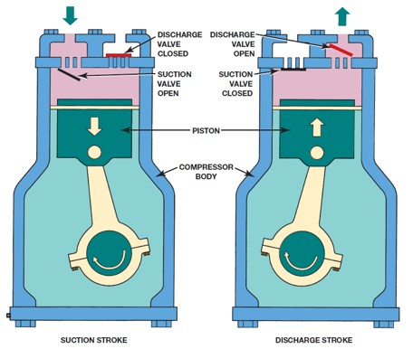
Figure 4.1
In a piston compressor, when moving downward, the piston creates a drop in pressure inside the cylinder. Refrigerant then flows into the cylinder. When the piston moves upward on discharge stroke, the pressure forces the refrigerant out the discharge valve.
Notes:
Long Description:
Both the strokes have the following parts from top to bottom: "Discharge valve, suction valve, piston, and compressor body." The discharge valve is closed in the suction stroke, while it is open in the discharge stroke. The suction valve is open in the suction stroke, while it is closed in discharge stroke.

Slide 7
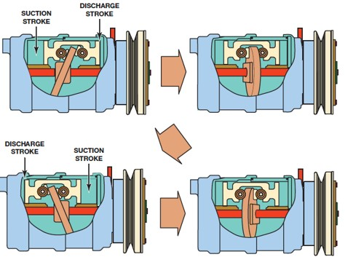
Figure 4.3
One of the double pistons of a swash-plate compressor as it move through a pumping cycle.
Notes:
Long Description:
The compressor has two parts, a suction stroke and a discharge stroke. The piston is at the bottom dead center, and the suction stroke is at the top with more available area. The discharge stroke at the bottom has less available area. It leads to the second figure where the piston is at the center. In the third figure, the discharge stroke is at the top with less available area and the suction stroke is at the bottom with more available area. It finally leads to the fourth figure where the piston is again at the center.

Slide 8
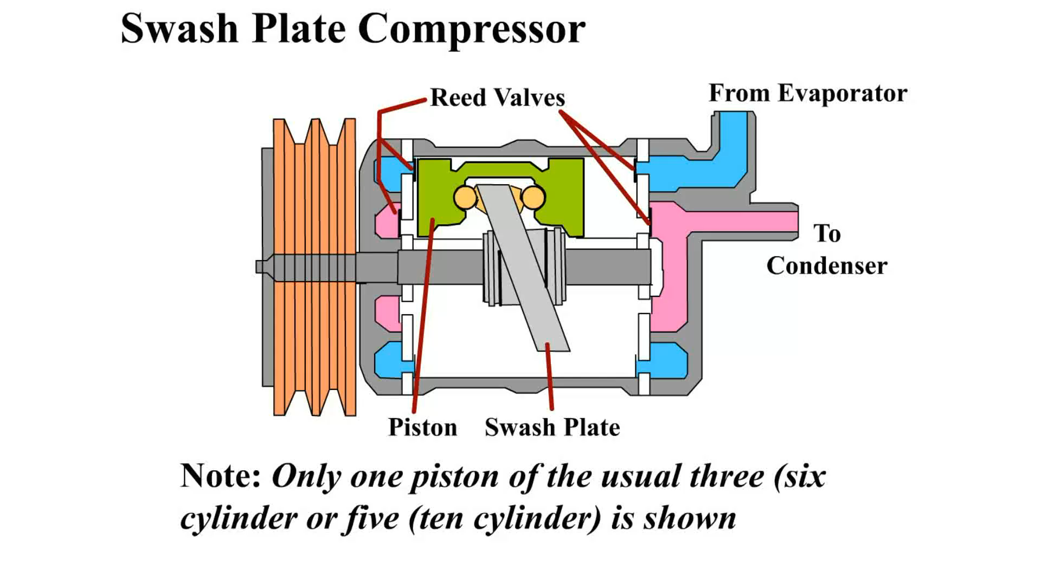
Animation:
Swash Plate Compressor
(The animation will automatically start in a few seconds)

Slide 9
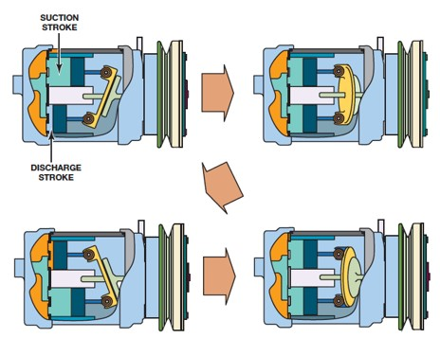
Figure 4.4
Two of the pistons of a wobble-plate compressor as they move through a pumping cycle.

Slide 10
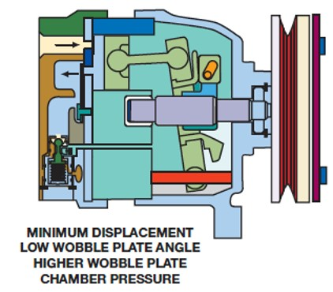
Figure 4.5
A variable displacement compressor can change the angle of the wobble plate and piston stroke.
Notes:
Long Description:
The figure reads, "Minimum displacement low wobble plate angle higher wobble plate chamber pressure."

Slide 11
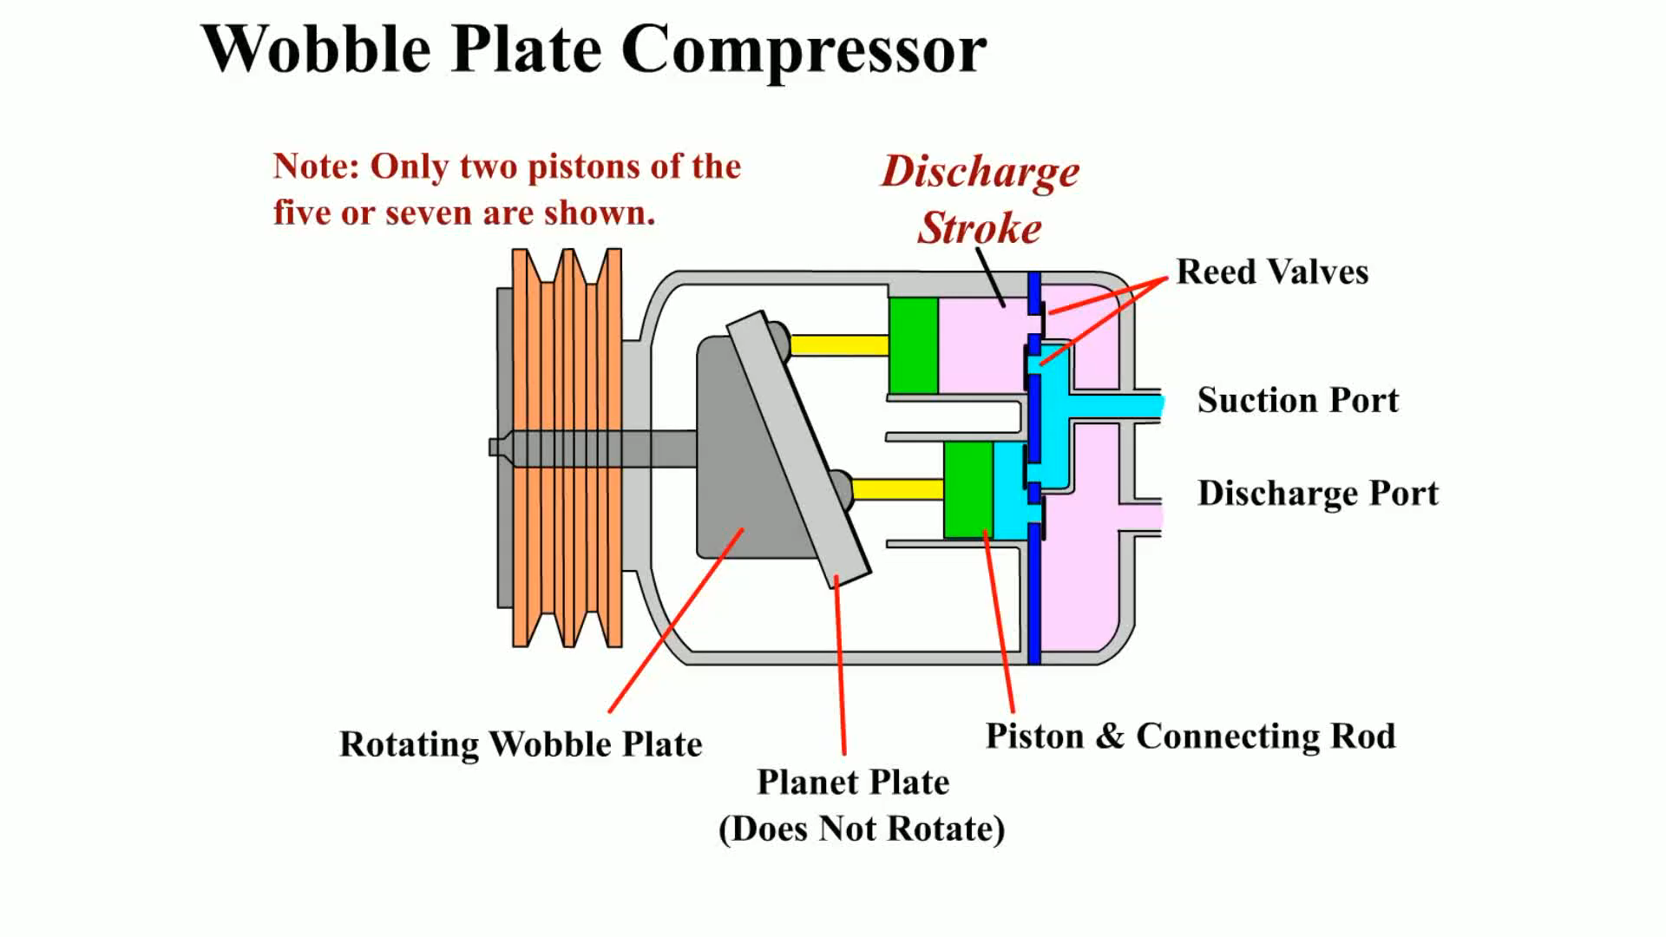
Animation:
Wobble Plate Compressor
(The animation will automatically start in a few seconds)

Slide 12
Vane Compressors
The vanes of these compressors are mounted in a rotor that runs inside a round, eccentric, or a somewhat elliptical, chamber.
The vanes slide in and out of the rotor as their outer end follows the shape of the chamber.

Slide 13
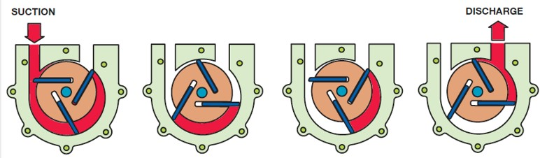
Figure 4.7
As the rotor turns in a counterclockwise direction, the vanes move in and out to follow the contour of the housing.
This action forms chambers that get larger at the suction ports and smaller at the discharge ports.
Notes:
Long Description:
The substance passes through the three vanes where the suction and discharge are controlled by the position of the vanes.

Slide 14
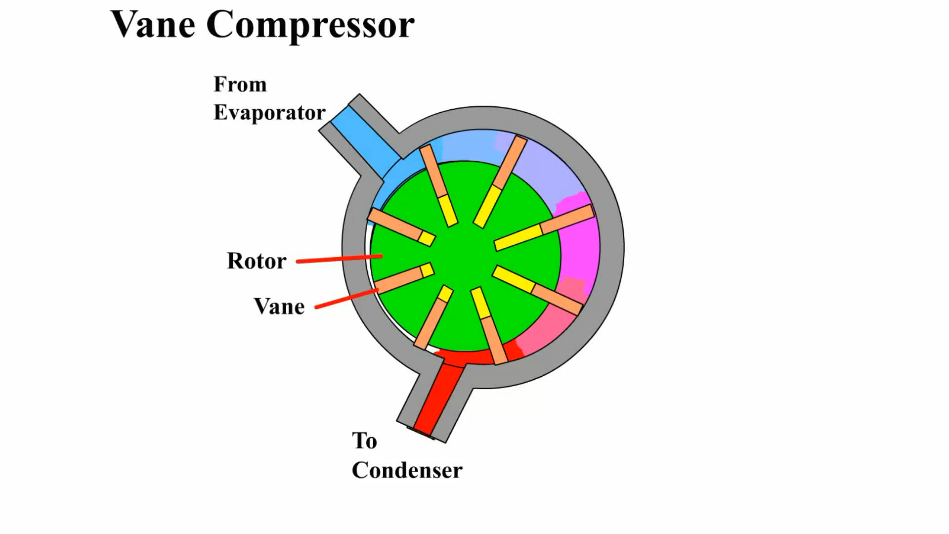
Animation:
Vane Compressor
(The animation will automatically start in a few seconds)

Slide 15
Scroll Compressors
Scroll compressors use two major components:
  Fixed scroll—The fixed scroll is attached to the compressor housing.
  Movable scroll—The movable scroll is mounted over an eccentric bushing and counterweight on the crankshaft.
Advantages
Disadvantages

Slide 16
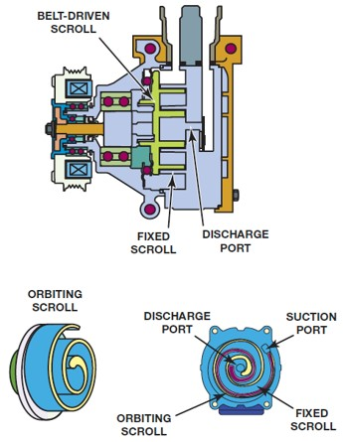
Figure 4.8
As the orbital scroll moves, it forms pumping chambers/gas pockets that start at the suction port and forces the refrigerant to the discharge port at the center.
Notes:
Long Description:
The first unit has the following parts: belt-driven scroll, fixed scroll, and discharge port. The second figure shows an orbiting scroll of spiral shape. The third scroll compressor shows the following parts: "Discharge port, orbiting scroll, fixed scroll, and suction port."

Slide 17
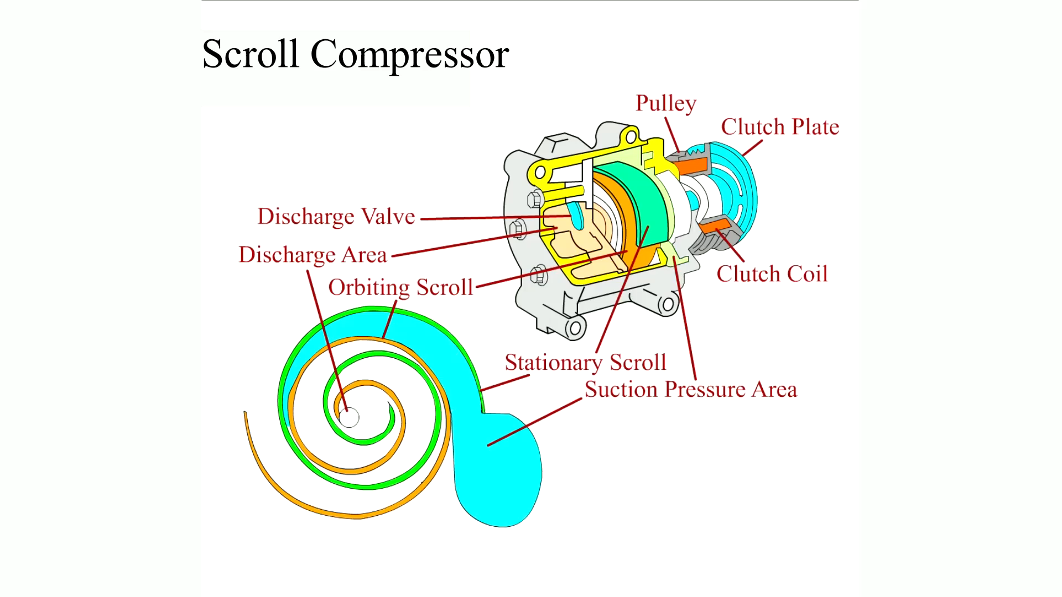
Animation:
Scroll Compressor
(The animation will automatically start in a few seconds)

Slide 18
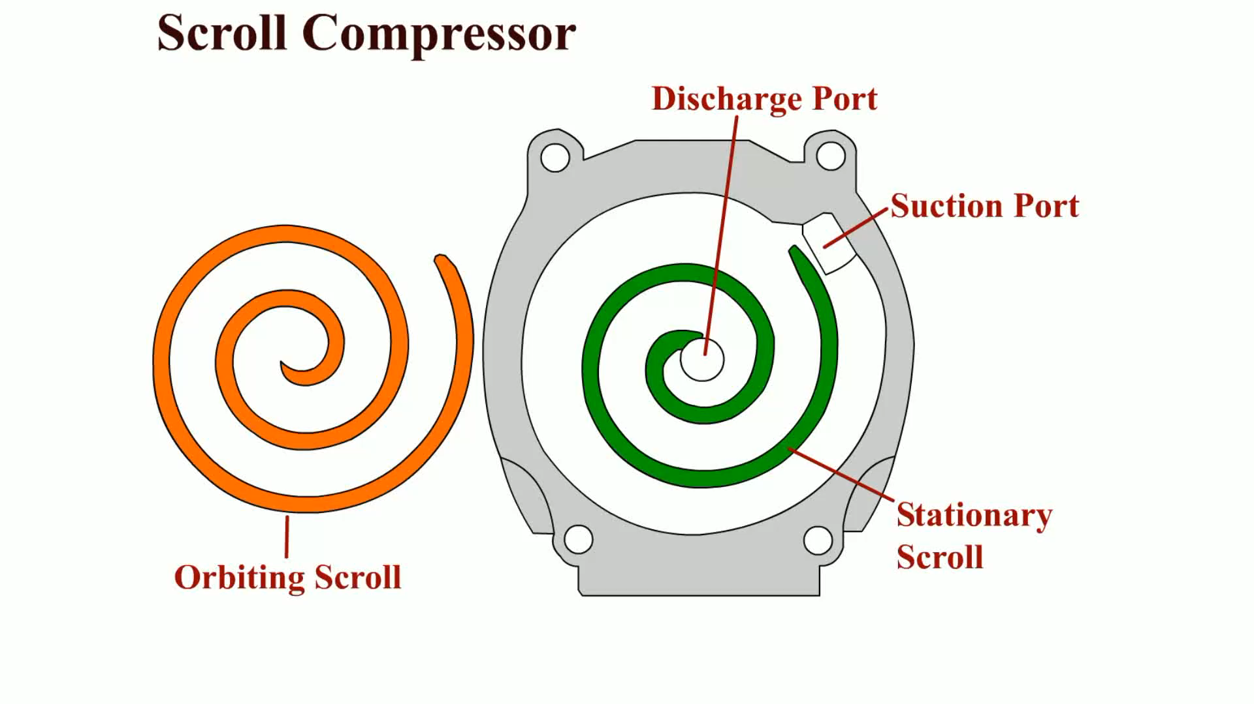
Animation:
Scroll Compressor
(The animation will automatically start in a few seconds)

Slide 19
Compressor Clutches
The clutch uses a coil of wire where a magnetic field is generated when electrical current flows through it.
The magnetic field pulls the drive plate against the rotating pulley to drive the compressor.
The clutch coil and pulley are both mounted on an extension from the front of the compressor housing.
  The pulley may also be called a rotor.
The drive plate is attached to the compressor shaft.
  The drive plate is also called a clutch hub or armature.

Slide 20
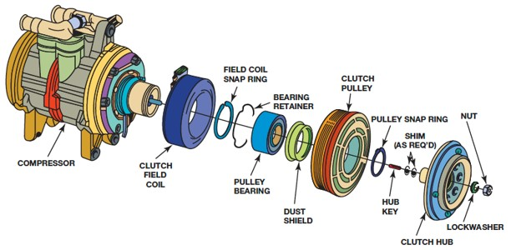
Figure 4.9
The electromagnetic clutch assembly includes the clutch field coil; the clutch pulley; the pulley bearing; and the clutch hub. Shims adjust the air gap between the clutch hub and the clutch pulley.
Notes:
Long Description:
The assembly has the following parts from left to right: "Compressor, clutch field coil, field coil snap ring, bearing retainer, pulley bearing, dust shield, clutch pulley, pulley snap ring, hub key, shim, clutch hub, lockwasher, and nut."

Slide 21
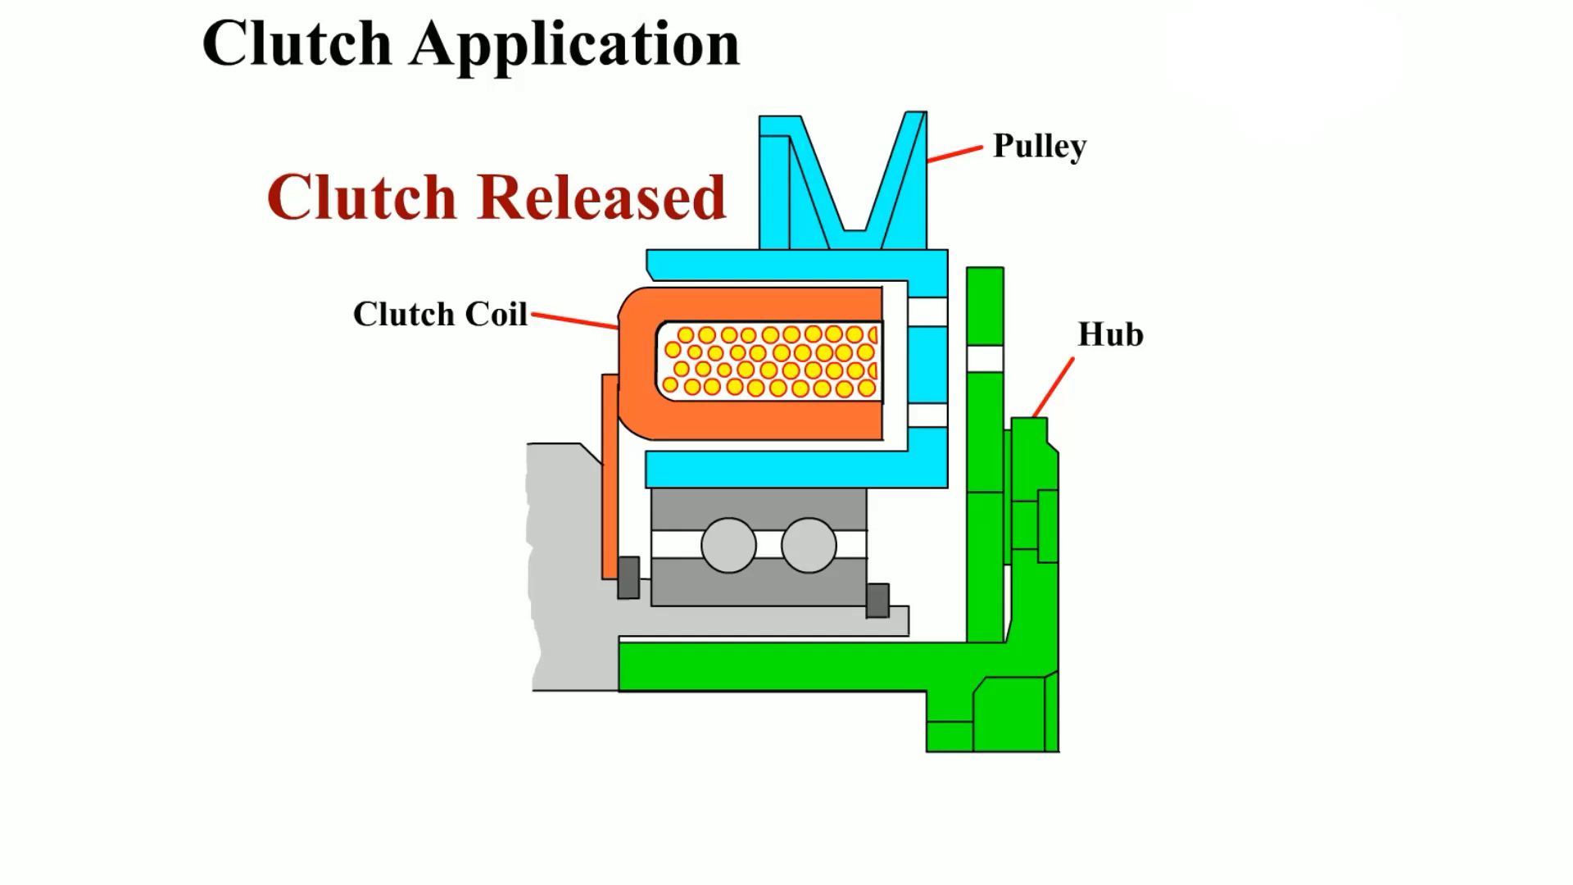
Animation:
Compressor Clutch Application
(The animation will automatically start in a few seconds)

Slide 22
Damper Drives
Many recent vehicles use a clutchless damper drive, electronic-controlled, variable displacement compressor.
The pulley always drives the compressor through a rubber portion that dampens rotating engine pulsations.
One variable displacement compressor that uses a damper drive is electronically controlled to go to minimum displacement of 2% output when A/C is not used.

Slide 23
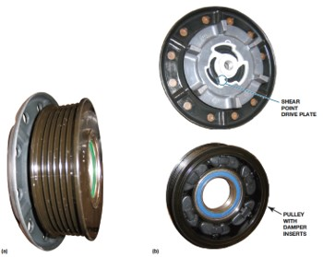
Figure 4.11
(a) This damper drive is a one-piece pulley and hub. (b) Torque is transferred from the pulley through the rubber damper inserts (bottom), and the drive plate uses torque-limiting fingers that will shear if the compressor should seize (top).

Slide 24
Compressor Lubrication
Refrigerant oil serves several purposes, including the following:
  Lubricates the moving parts of the compressor to reduce friction and prevents wear.
  Helps seal the compressor shaft seal, the insides of the hoses, and various connections between the parts to reduce refrigerant leakage.
  Lubricates the T X V and coats the metal parts inside the system to reduce corrosion.

Slide 25
Filters and Mufflers
Inline filters are available from aftermarket sources for installation in the liquid line between the condenser and the O T or T X V.
Mufflers are installed in the discharge or suction line of some systems.
  These mufflers are usually a simple baffled cylinder and are used to dampen the pumping noise of the compressor.

Slide 26
Compressor Valves and Switches (1 of 3)
Control switches can be located anywhere in the system, including at the following positions:
  Compressor discharge
  Compressor suction cavities
  Receiver–drier
  Accumulator

Slide 27
Compressor Valves and Switches (2 of 3)
Excessive high-side pressure can produce compressor damage and a potential safety hazard if the system should rupture.
Many compressors contain one or more of the following:
  A low-pressure switch
  A high-pressure switch
  A low- and/or high-pressure sensor

Slide 28
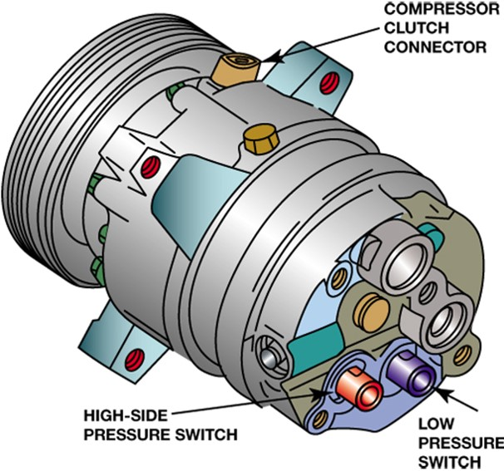
Figure 4.16
Check service information for the exact purpose and function of each of the switches located on the compressor.

Slide 29
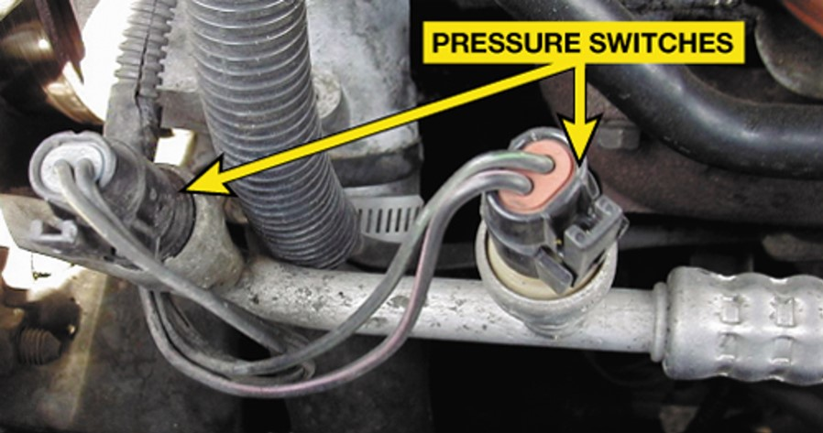
Figure 4.17
Typical air-conditioning pressure switches. Check service information to determine the purpose and function of each switch for the vehicle being inspected.

Slide 30
Compressor Valves and Switches (3 of 3)
Some vehicles use an A/C compressor speed (R P M) sensor so the E C M will know if the compressor is running, and by comparing the compressor and engine speed signals, the E C M can determine if the compressor clutch is slipping excessively.
  This system is often called a belt lock or belt protection system.

Slide 31
A/C Compressor Diagnosis (1 of 2)
A faulty compressor or compressor clutch is indicated if the following conditions are observed:
  The high- and low-side pressures are too close, within 50 PSI (345 k P a).
  It cannot produce a high-side pressure of 350 P S I (2,400 k P a) or greater. This test usually requires disconnecting the fan(s) or blocking condenser airflow.
  There is visible damage to the compressor, clutch, or pulley.

Slide 32
A/C Compressor Diagnosis (2 of 2)
A faulty compressor or compressor clutch is indicated if the following conditions are observed:
  The compressor shaft rotates freely with no resistance.
  Shaft rotation is rough or harsh.
  There is free play when shaft rotation is reversed.
  The clutch has too much or too little air gap.
  The clutch does not apply or release.
  The pulley rotation is rough or with too much free play.

Slide 33
Drive Belt Service
Engine drive belts should be checked periodically for damage and proper tension.
If a belt shows excessive wear, severe glazing, rubber breakdown, or frayed cords, it should be replaced.
Belt slippage is caused by either a worn tensioner or worn belt.
Stretch belt.

Slide 34
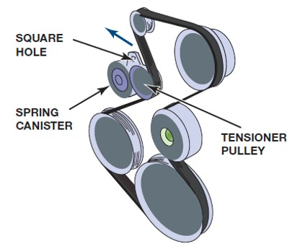
Figure 4.25
Moving the automatic tensioner outward allows the serpentine belt to be removed from the pulleys.

Slide 35
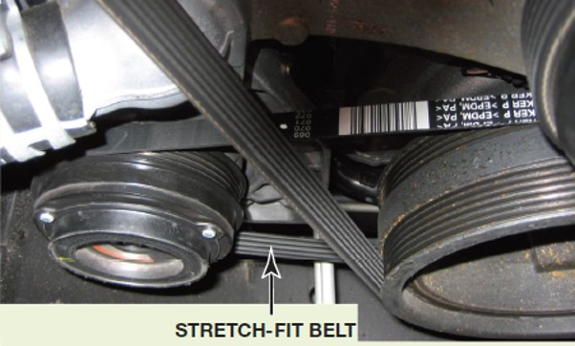
Figure 4.26
A stretch-fit belt is identified by the lack of an idler or method of adjusting belt tension.

Slide 36
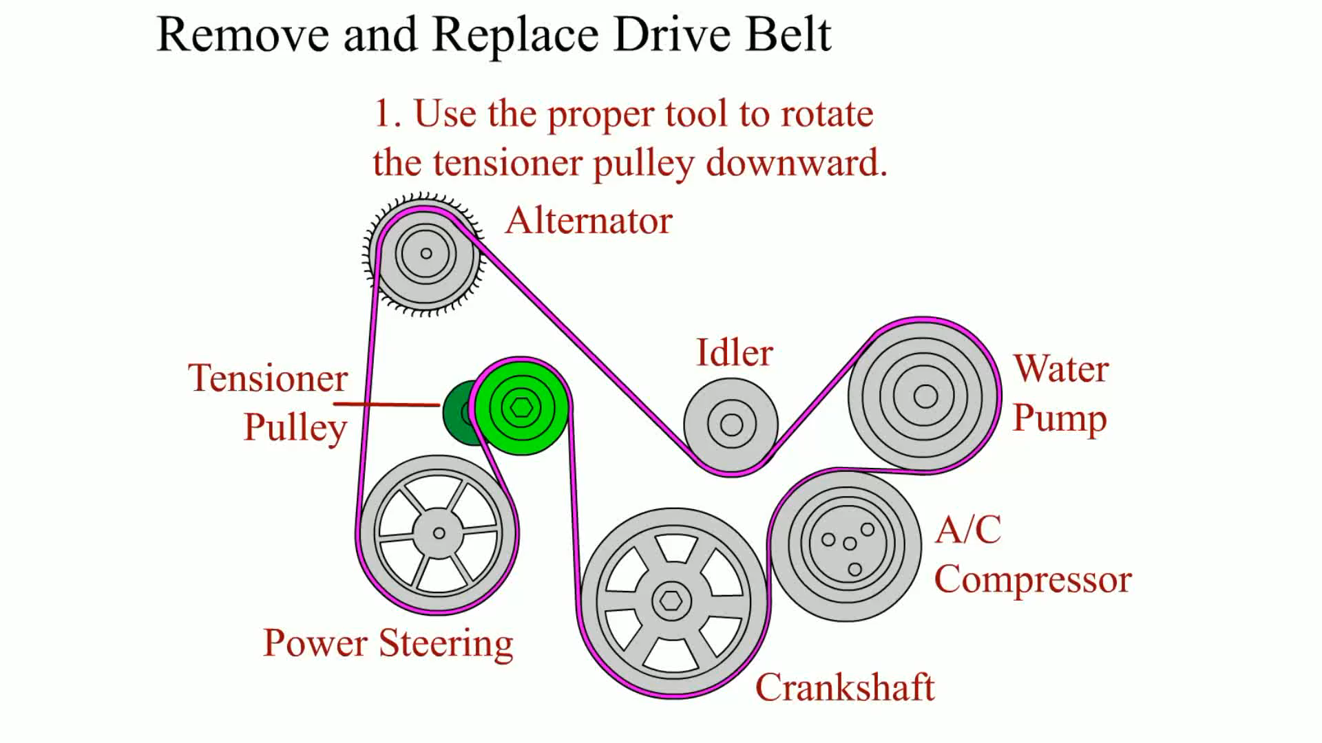
Animation:
Remove and Replace Drive Belt
(The animation will automatically start in a few seconds)

Slide 37
Replacement Compressors
Replacement compressors are available as new or rebuilt units, and proper identification is made from the vehicle make, model, and engine size.
Having the proper amount of oil in the system during compressor replacement is an important factor.
  Compressors are equipped with shipping oil that is not intended for long-term lubrication.
  Most manufacturers recommend draining all the oil from the old compressor and measuring the amount drained.

Slide 38
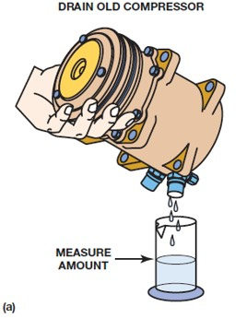
Figure 4.30a
The oil should be drained from the old compressor; rotate the compressor shaft and the compressor to help the draining.

Slide 39
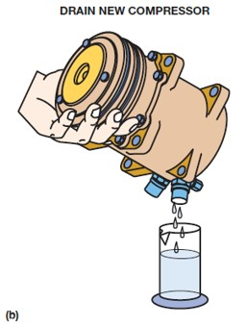
Figure 4.30b
Drain the oil from the new compressor.

Slide 40
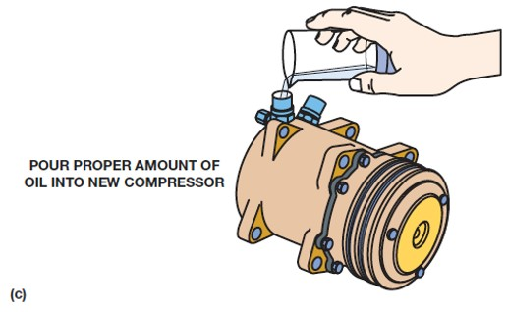
Figure 4.30c
Pour the same amount of oil drained from the old compressor or the amount specified by the compressor manufacturer of the proper oil into the new compressor.

Slide 41
Summary
Various compressor types and models are used with vehicle A/C systems.
Compressor models can use a variety of clutch and pulley designs.
Some variable displacement compressors use a damper pulley in place of a clutch.
Compressors are lubricated by oil that is circulated by the refrigerant.

Slide 42
Animation and Video Resources
The below listed resources are hyperlinked to the James Halderman website
(A7) Heating & Air Conditioning Animations
(A7) Heating & Air Conditioning Videos

Slide 43

Copyright
This work is protected by United States copyright laws and is provided solely for the use of instructors in teaching their courses and assessing student learning. Dissemination or sale of any part of this work (including on the World Wide Web) will destroy the integrity of the work and is not permitted. The work and materials from it should never be made available to students except by instructors using the accompanying text in their classes. All recipients of this work are expected to abide by these restrictions and to honor the intended pedagogical purposes and the needs of other instructors who rely on these materials.

