Slide 1
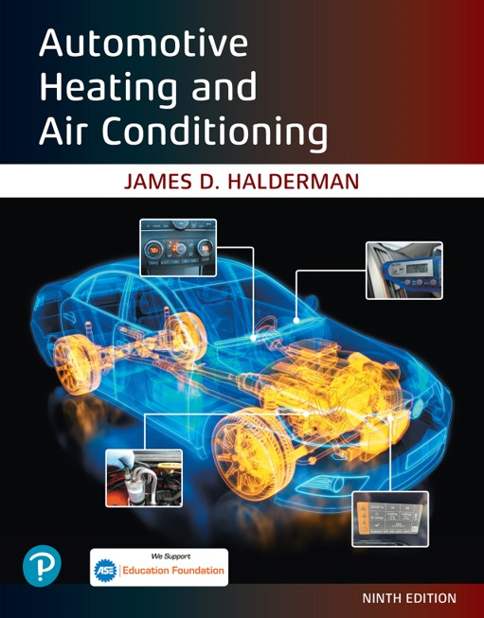
Automotive Heating and Air Conditioning
Ninth Edition
Chapter 3
The Refrigeration Cycle
Copyright © 2021, 2018, 2015 Pearson Education, Inc. All Rights Reserved
Notes:
If this PowerPoint presentation contains mathematical equations, you may need to check that your computer has the following installed:
1) Math Type Plugin
2) Math Player (free versions available)
3) NVDA Reader (free versions available)

Slide 2
Learning Objectives (1 of 2)
3.1 Prepare for the A S E Heating and Air Conditioning (A7) certification test content area “A” (A/C System Service, Diagnosis and Repair).
3.2 Define the terms superheat and sub cooling.
3.3 Discuss pressure-temperature relationship.
3.4 Explain heating and cooling load.
3.5 Explain flooded versus starved evaporator.
3.6 Describe saturated liquid/vapor.

Slide 3
Learning Objectives (2 of 2)
3.7 Explain how the A/C system works.
3.8 Identify the low and high side of an A/C system.
3.9 Explain the purpose and function of evaporators in an A/C system.
3.10 Explain the purpose and function of thermal expansion valves and orifice tube systems.
3.11 Explain the purpose and function of condensers.

Slide 4
The Refrigeration Cycle
Heat travels from a higher temperature (higher energy level) to a lower temperature (lower energy level).
The flow of a refrigerant through the system is called the refrigeration cycle and is used to cool the interior of the vehicle.
The heating system transfers heat from the engine’s cooling system to the passenger compartment.

Slide 5
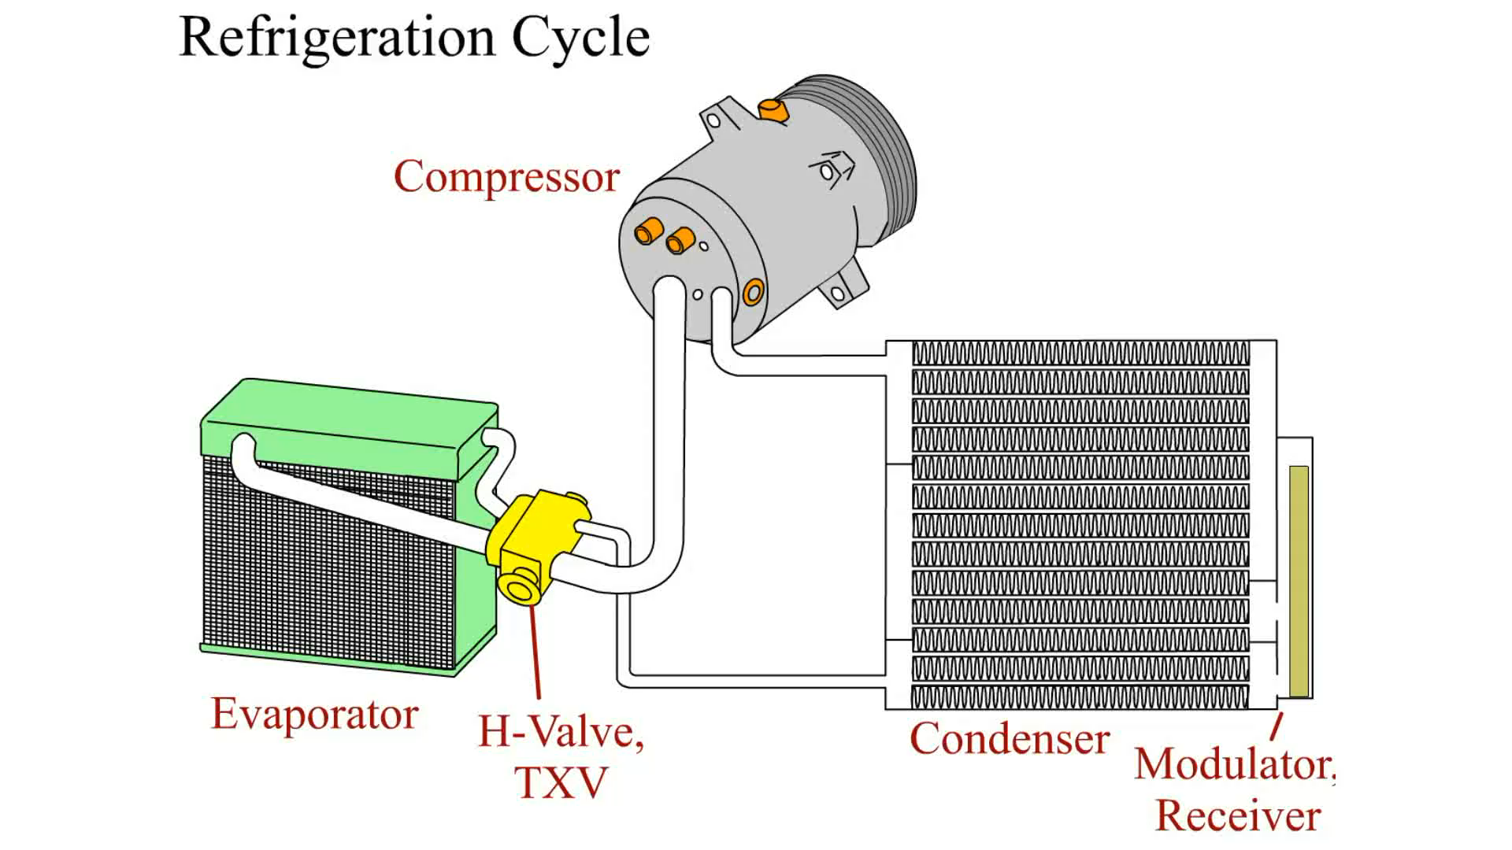
Animation:
Refrigeration Cycle
(The animation will automatically start in a few seconds)

Slide 6
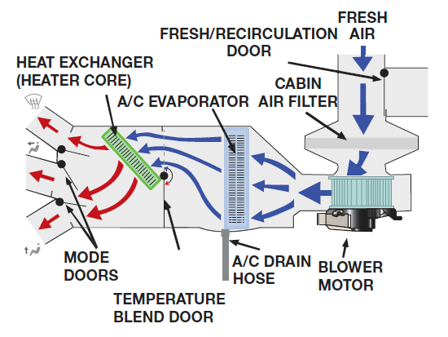
Figure 3.1
Air is circulated through the A/C and heating system and the vehicle to either add or remove heat.
Notes:
Long Description:
Fresh air enters through a fresh or recirculation door, moves to the cabin air filter, and then to a blower motor. It further leads to the A C drain hose through an A C evaporation, passes through a temperature blend door to a heat exchanger or heater core, and finally comes out through three mode doors.

Slide 7
How the A/C System Works (1 of 6)
High-pressure liquid refrigerant flows through an expansion device, which controls the amount of refrigerant that is allowed to pass through.
When the high-pressure liquid passes through the expansion device, the pressure drops. This causes the liquid refrigerant to evaporate in a small radiator-type unit called the evaporator.
  When the refrigerant evaporates, it absorbs heat when changing from a liquid to a gas. As the heat is absorbed by the refrigerant, the evaporator becomes cold.

Slide 8
How the A/C System Works (2 of 6)
The refrigerant flows into the engine-driven compressor
  The compressor compresses the low-pressure refrigerant gas into a high-temperature, high-pressure gas and forces it through the system.
This high-pressure gas flows into the condenser located in front of the cooling system radiator.

Slide 9
How the A/C System Works (3 of 6)
The high-pressure liquid then flows to the expansion device, which controls the amount of refrigerant that is allowed to pass through and meters the flow into the evaporator.
  When the high pressure of the liquid passes through the expansion device, the pressure drops and causes the refrigerant to vaporize, starting the cycle all over again.

Slide 10
How the A/C System Works (4 of 6)
Air is blown through the evaporator by the blower motor. The air is cooled as heat is removed from the air and transferred to the refrigerant in the evaporator, then directed inside the passenger compartment through vents.

Slide 11
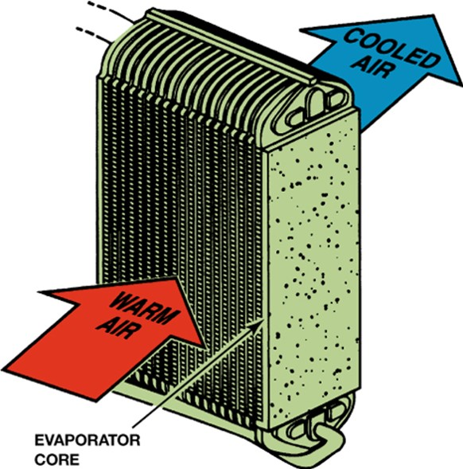
Figure 3.2
The evaporator removes heat from the air that enters a vehicle by transferring it to the vaporizing refrigerant.

Slide 12
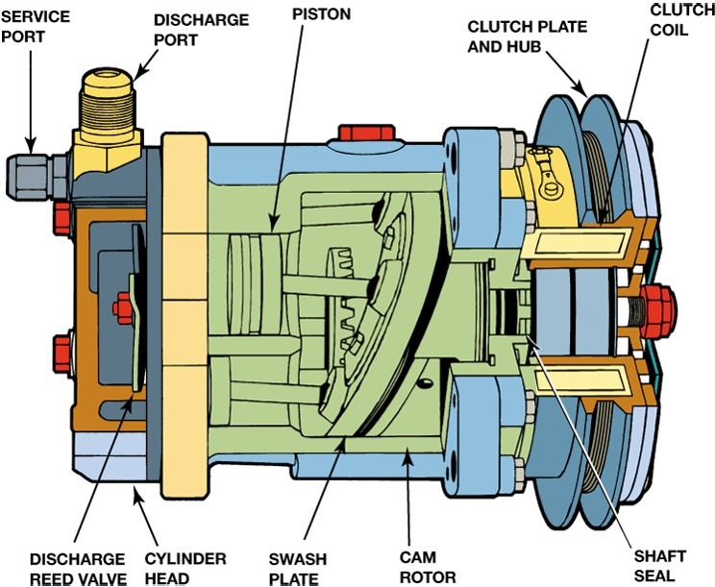
Figure 3.3
The compressor provides the mechanical force needed to pressurize the refrigerant.
Notes:
Long Description:
The parts of the compressor from top right to bottom right are as follows: "Wobble plate, Connecting rod, Piston, Suction or Discharge connections, Low pressure vapor, Charge ports, Intake or discharge valves, Cylinder head, High pressure vapor, Cam rotor, and Clutch assembly" in an anticlockwise direction.

Slide 13
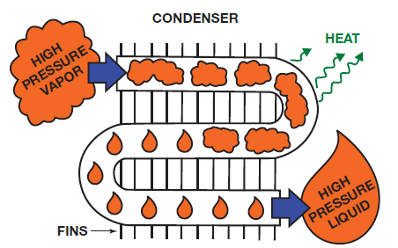
Figure 3.4
The condenser changes the refrigerant vapor into a liquid by transferring heat from the refrigerant to the air stream that flows between the condenser fins.

Slide 14
How the A/C System Works (5 of 6)
Low side—it has low pressure and temperature.
  The low side begins at the expansion device and ends at the compressor. The refrigerant boils or evaporates in the low side.
High side—it has higher pressures and temperatures.
  The high side begins at the compressor and ends at the expansion device. The refrigerant condenses in the high side. The high side line is often called the liquid line.

Slide 15
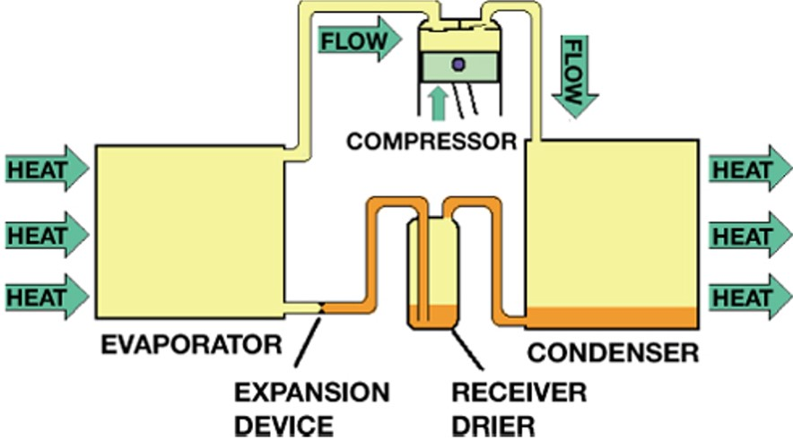
Figure 3.5
Refrigerant changes state to a vapor as it absorbs heat in the low side and into a liquid as it loses heat in the high side.
Notes:
Long Description:
An evaporator absorbs the heat from outside and it flows from the evaporator to a compressor and then to a condenser. The condenser releases the heat outside and leads the condensate to a receiver drier. The drier is connected to an expansion device, which finally leads to the evaporator.

Slide 16
How the A/C System Works (6 of 6)
In an operating system, the low and high sides can be identified by
  Pressure
  Sight
  Temperature
  Tubing size

Slide 17
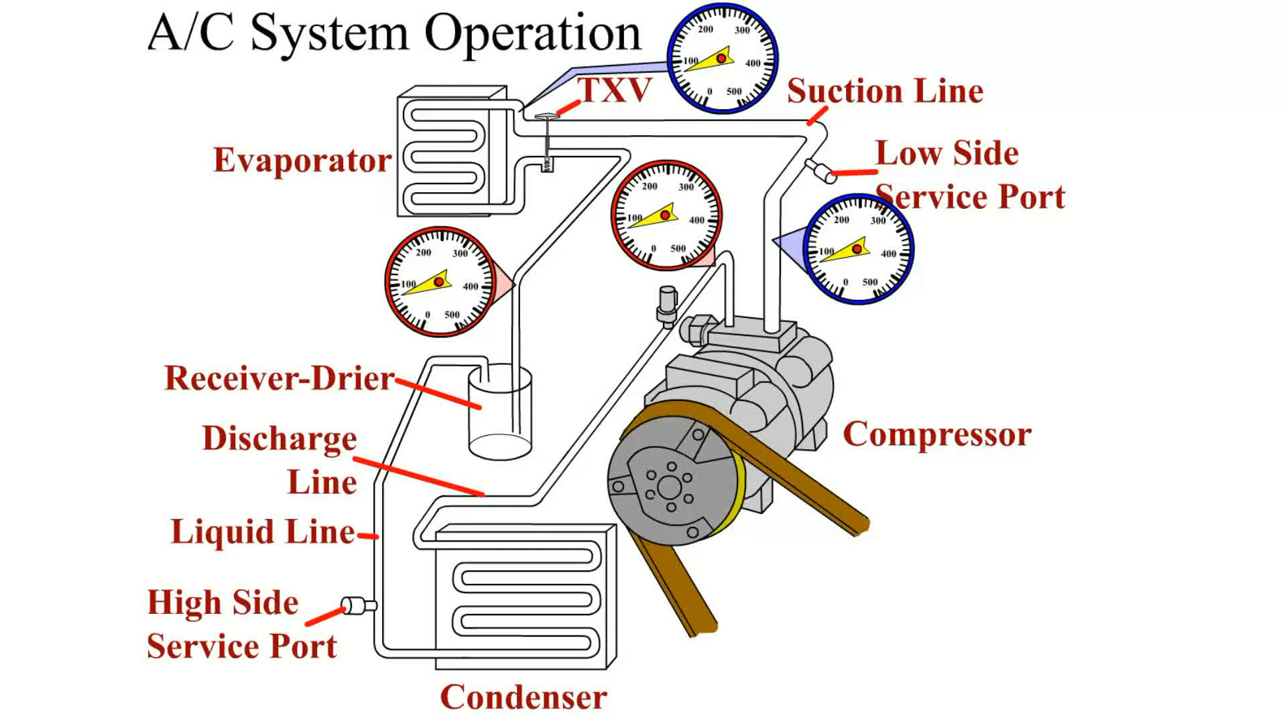
Animation:
A/C System Operation
(The animation will automatically start in a few seconds)

Slide 18
Orifice Tube Systems
An orifice tube is a restriction in the liquid line that forces the refrigerant to expand as it passes through the small opening (orifice).
When the refrigerant expands, the temperature of the refrigerant drops and starts to evaporate in the evaporator.

Slide 19
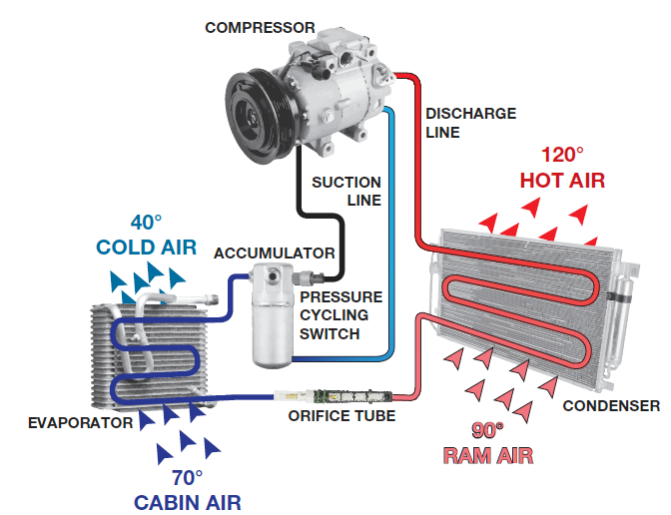
Figure 3.6
Orifice tube systems in this figure use a pressure switch located at the accumulator to control the compressor clutch.
Notes:
Long Description:
The office tube connects a condenser with an evaporator to obtain cold air of 40 degrees from 70 degrees cabin air through the evaporator. The condenser transfers 90 degrees R A M air into 120 degrees hot air. The condenser is linked to a compressor through a discharge line. It leads to an accumulator through a suction line and a pressure cycling switch. The accumulator is then linked with the evaporator.

Slide 20
Thermal Expansion Valve
A thermal expansion valve (T X V) is a variable valve that changes the size of the valve opening in response to the cooling load of the evaporator.
A T X V is controlled by evaporator temperature and pressure so that it opens to flow as much refrigerant as possible when a lot of cooling is needed and all of the refrigerant must boil in the evaporator.

Slide 21
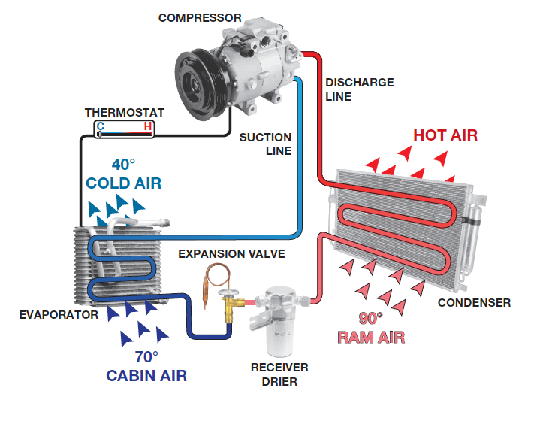
Figure 3.7
A thermal expansion valve (TXV) system uses a receiver–drier and the compressor clutch on this older system uses thermostat located at the evaporator to control compressor operation.
Notes:
Long Description:
The receiver drier connects a condenser with an evaporator through an expansion valve between drier and evaporator to obtain cold air of 40 degrees from 70 degrees cabin air through the evaporator. The condenser transfers 90 degrees R A M air into hot air. The condenser is linked with a compressor through a discharge line. It leads to the evaporator by a suction line. The compressor is also linked to the evaporator with a thermostat, parallelly. The hot and cold points are labeled on the thermostat.

Slide 22
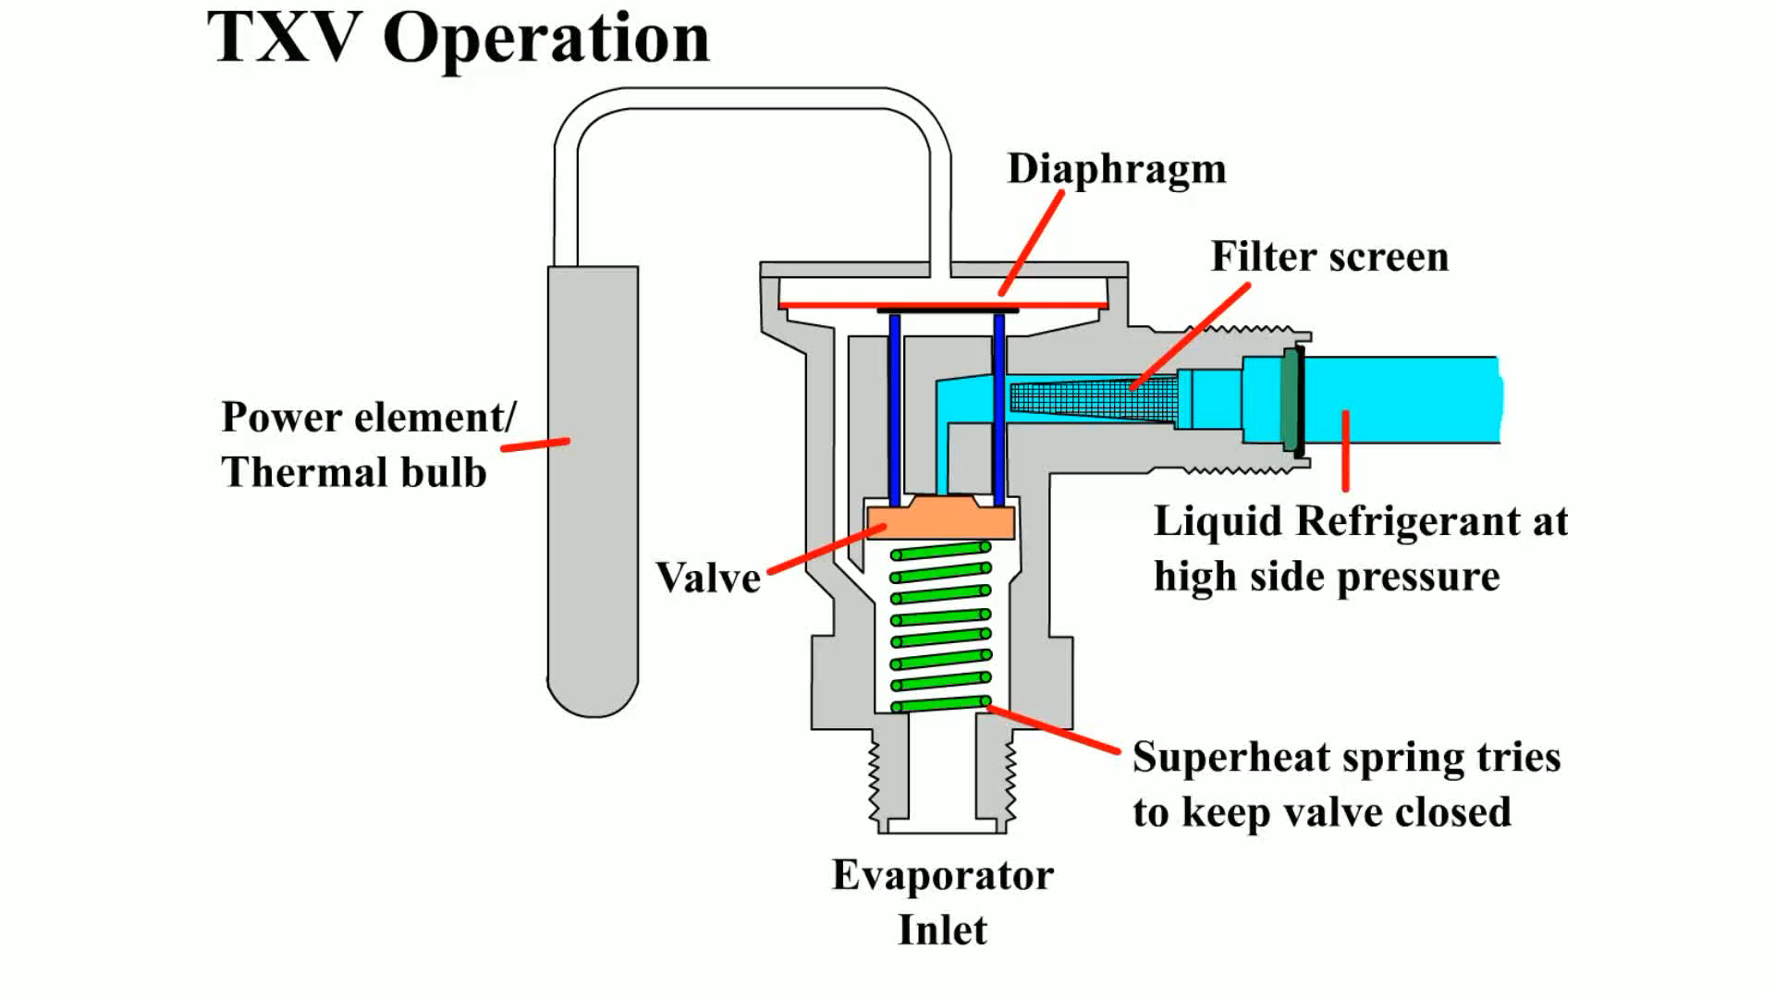
Animation:
TXV Operation
(The animation will automatically start in a few seconds)

Slide 23
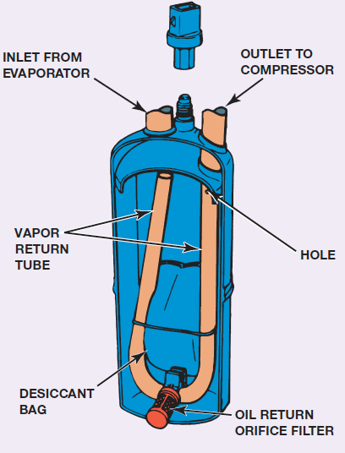
Figure 3.8
Expansion-valve systems store excess refrigerant in a receiver–drier, which is located in the high-side liquid section of the system.
Notes:
Long Description:
At the top, two valves are labeled "Inlet from evaporator and outlet to compressor." A U-shaped tube running all over from the valves is labeled "Vapor return tube." At the top-right end of the tube, "hole" is labeled. A bag inside, near the bottom end of the tube, is labeled "Desiccant bag." At the bottom, a filter is labeled "Oil return orifice filter."

Slide 24
Evaporators
The evaporator is the heat exchanger and absorbs heat from the passenger compartment.
Like most heat exchangers, a well-designed evaporator has a large amount of surface area in contact with the refrigerant and the air from the passenger compartment.
The cold temperature in the evaporator is produced by boiling the refrigerant.
Abnormal temperatures and pressures indicate that something is wrong, such as the evaporator might have too much or too little refrigerant.
  Starved evaporator; flooded evaporator

Slide 25
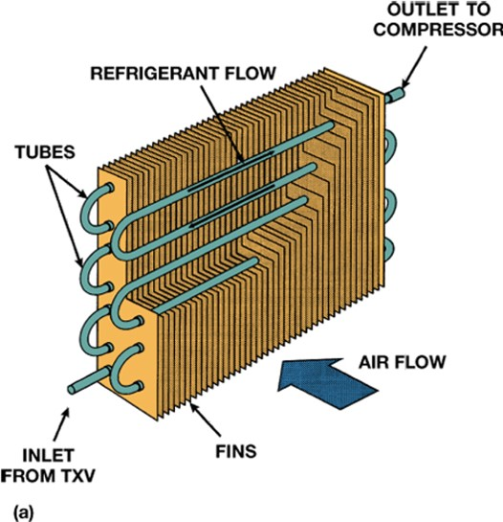
Figure 3.10a
A tube-and-fin evaporator.
Notes:
Long Description:
The system shows an evaporator is linked to a compressor and a clutch through the suction line. The compressor is linked to a condenser through the discharge line. The condensate from the condenser passes through the receiver drier connected to the condenser. The receiver drier is further connected to T X V valve and it finally leads to the evaporator. A dashed line links T X V to the compressor and clutch. The heat and refrigerant flow above T X V, near the condenser, is labeled "high flow," and below T X V, near the evaporator, is labeled "low side."

Slide 26
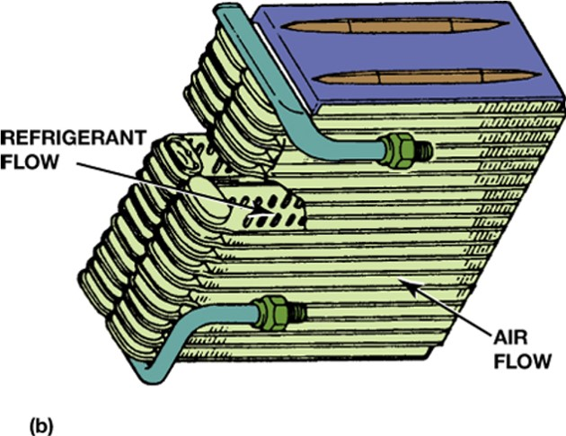
Figure 3.10b
A plate evaporator. Each type has a large contact area for heat to leave the air and enter the refrigerant.
Notes:
Long Description:
The system shows an evaporator is linked to an accumulator through the suction line. The suction line further connects the accumulator to a compressor and a clutch. The compressor is linked to the condenser through the discharge line. The condensate from the condenser passes through the office tube, and the office tube finally leads to the evaporator. A dashed line links the office tube to the compressor and clutch. The heat and refrigerant flow above the office tube, near the condenser, is labeled "high flow," and below the office tube, near the evaporator, is labeled "low side."

Slide 27
Condensers
The condenser, like the evaporator, is a heat exchanger. Low-pressure refrigerant vapor is compressed by the compressor into a high-temperature, high-pressure vapor.
  This vapor then passes into the condenser where air passing over the condenser cools the refrigerant and causes it to condense into a high-temperature liquid.

Slide 28
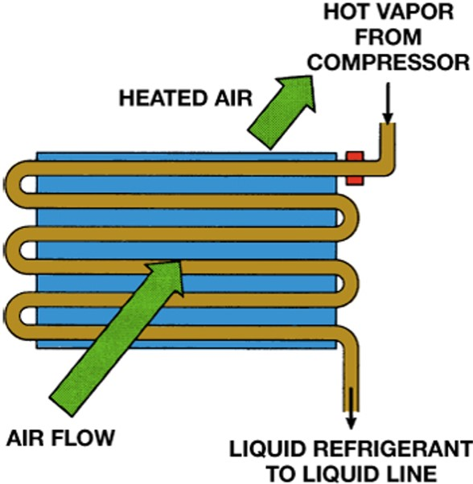
Figure 3.13
A condenser is a heat exchanger that transfers heat from the refrigerant to the air flowing through it.

Slide 29
Refrigerant Charge Level
While operating, the following occurs:
  The evaporator contains a refrigerant mist in the first two-thirds to three-fourths of its volume, with vapor in the remaining portion.
  The condenser contains a condensing vapor in the upper portion, with liquid in the bottom passages.
  The line connecting the condenser to the expansion device is filled with liquid.
  The accumulator is about half full of liquid so that liquid refrigerant does not enter the compressor.

Slide 30
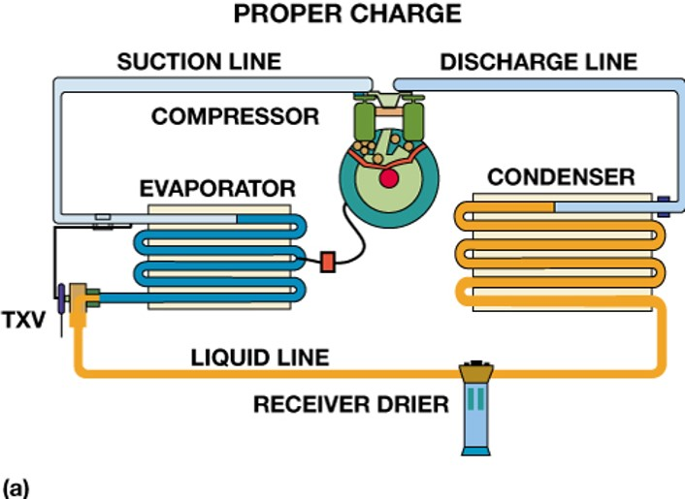
Figure 3.15a
A properly charged system has the condenser filled with condensing vapor and some liquid, a liquid line filled with liquid, a receiver–drier about half full of liquid, and an evaporator with vaporizing liquid.
Notes:
Long Description:
The system consists of an evaporator and a condenser linked to a receiver drier through a liquid line. This liquid line further connects the receiver drier to the T X V, which is further attached to the evaporator. The evaporator is linked to the compressor through the suction line, and the compressor is linked to the condenser through the discharge line. The condenser is filled with condensing vapor and some liquid, and the liquid line is filled with liquid.

Slide 31
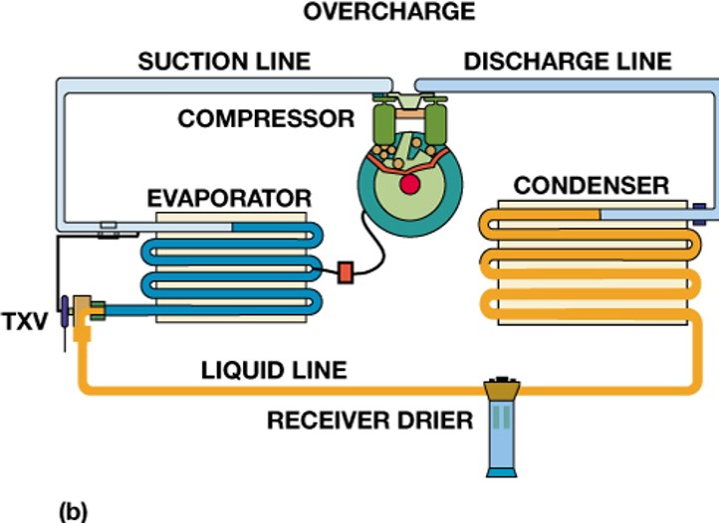
Figure 3.15b
An overcharge with too much liquid causes liquid to partially fill the condenser.
Notes:
Long Description:
The system consists of an evaporator and a condenser linked to a receiver drier through a liquid line. This liquid line further connects the receiver drier to the T X V, which is further attached to the evaporator. The evaporator is linked to the compressor through the suction line. The compressor is linked to the condenser through the discharge line. The condenser is partially filled with the liquid.

Slide 32
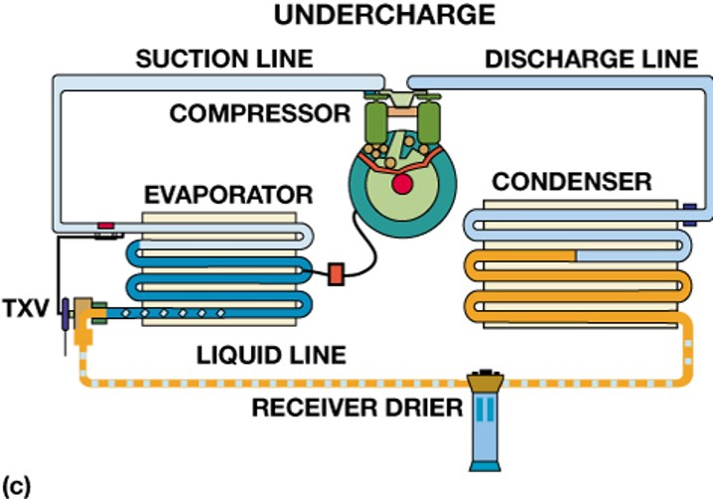
Figure 3.15c
An undercharge has vapor in the liquid line and a starved evaporator.
Notes:
Long Description:
The system consists of an evaporator and a condenser linked to a receiver drier through a liquid line. This liquid line further connects the receiver drier to the T X V, which is further attached to the evaporator. The evaporator is linked to the compressor through the suction line. The compressor is linked to the condenser through the discharge line. There is some vapor in the liquid line.

Slide 33
Animation:
Refrigeration Cycle
(The animation will automatically start in a few seconds)

Slide 34
Evaporator Icing Controls
What is the purpose and function?
What is “superheat”?
Thermistor
Pressure switches

Slide 35
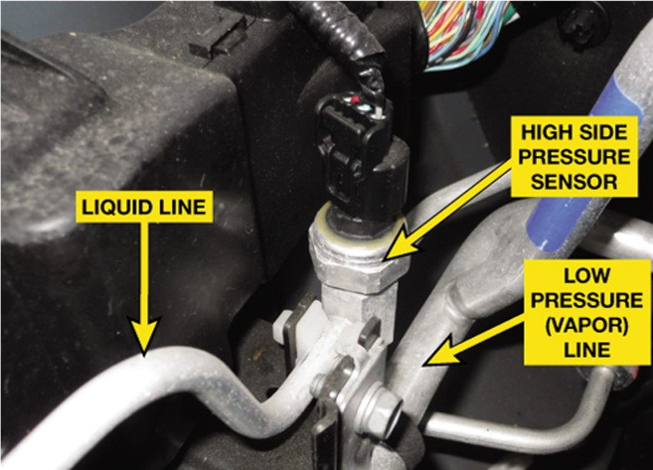
Figure 3.17
A typical three-wire pressure sensor used on the high side (vapor) line. The three wires are the voltage supply (usually 5 volts), ground, and signal wire.

Slide 36
Summary (1 of 2)
Automotive A/C systems operate on the principle of moving heat from inside to outside of the vehicle.
All automotive air-conditioning systems are closed and sealed. A refrigerant is circulated through the system by a compressor that is usually powered by the engine through an accessory drive belt.
The liquid refrigerant evaporates in a small radiator-type unit called the evaporator.
After the refrigerant has evaporated into a low-pressure gas in the evaporator, the refrigerant flows into the engine-driven compressor.

Slide 37
Summary (2 of 2)
From the compressor, high-pressure gas flows into the condenser located in front of the cooling system radiator.
The high-pressure gas condenses into a high-pressure, high-temperature liquid in the condenser.
Automotive A/C systems are either orifice tube (O T) systems or thermal expansion valve (T X V) systems.
A receiver–drier is used with a T X V system and is located in the high pressure (liquid) side of the system.
An accumulator is used in orifice tube system and is located in the low side of the system between the evaporator and the compressor.

Slide 38
Animation and Video Resources
The below listed resources are hyperlinked to the James Halderman website
(A7) Heating & Air Conditioning Animations
(A7) Heating & Air Conditioning Videos

Slide 39

Copyright
This work is protected by United States copyright laws and is provided solely for the use of instructors in teaching their courses and assessing student learning. Dissemination or sale of any part of this work (including on the World Wide Web) will destroy the integrity of the work and is not permitted. The work and materials from it should never be made available to students except by instructors using the accompanying text in their classes. All recipients of this work are expected to abide by these restrictions and to honor the intended pedagogical purposes and the needs of other instructors who rely on these materials.

