Slide 1
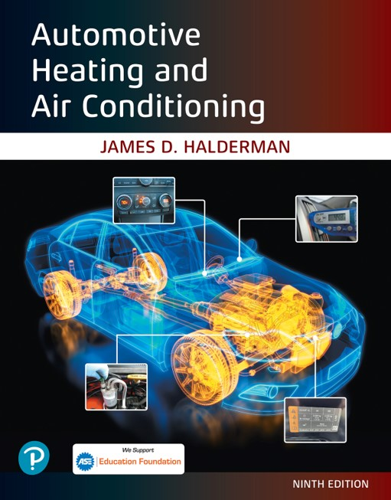
Automotive Heating and Air Conditioning
Ninth Edition
Chapter 17
E P A Section 609 Certification
Copyright © 2021, 2018, 2015 Pearson Education, Inc. All Rights Reserved
Notes:
If this PowerPoint presentation contains mathematical equations, you may need to check that your computer has the following installed:
1) Math Type Plugin
2) Math Player (free versions available)
3) NVDA Reader (free versions available)

Slide 2
Learning Objectives (1 of 2)
17.1 Service mobile air-conditioning systems.
17.2 Explain service procedures for mobile air-conditioning systems.
17.3 Perform refrigerant recovery and recycling procedures.
17.4 Practice best service practices for mobile A/C systems.
17.5 Practice avoiding refrigerant contamination.

Slide 3
Learning Objectives (2 of 2)
17.6 Identify tanks, labels, and fittings.
17.7 Identify R-1234yf.
17.8 Perform leak detection.
17.9 Use recovery, recycling, and recharging equipment.
17.10 Perform refrigerant recycling and service procedures for mobile air-conditioning technicians.

Slide 4
609 Certification Test
Any person who repairs or services a motor vehicle air-conditioning (M V A C) system for consideration (payment or bartering) must be properly trained and certified under Section 609 of the Clean Air Act by an E P A-approved program.
E P A-approved technician training and certification (T T&C) programs provide education.
Technicians must be trained by an E P A-approved program and pass a test demonstrating their knowledge.

Slide 5
609 Training Requirement
A Section 609 training program is designed with the goal of covering all the essentials involved with mobile air-conditioning repair.
These essentials include refrigerant recovery, and recycling, as well as charging equipment.
The procedures involved with the Section 609 regulatory requirements are also covered.
Study materials are issued, and at-home study is recommended before taking the exam.

Slide 6
Section 609 Certification Exam (1 of 2)
An open book test is given, a score of 84% or higher is required.
If a closed book test is given, a passing score of 72% or higher is required.

Slide 7
Section 609 Certification Exam (2 of 2)
Passing this exam will provide auto technicians with the following privileges.
The right to provide automotive service to A/C systems on motor vehicles.
The ability to buy smaller-sized containers of regulated refrigerants.
Technicians will be able to provide repair or service to C F C-12, H F C-134a, R-744 (C O 2), H F C-152a, or R-1234y f.

Slide 8
Certification Exam Topics (1 of 2)
Refrigerants and the Environment—R-12, ozone depletion and global warming, environmental impact of M V A C refrigerants.
E P A Regulations—Section 609, approved equipment, certification, recordkeeping, Section 608 overlap, venting of refrigerants.
Alternative Refrigerants—S N A P overview, retrofitting, refrigerant fittings, flammable refrigerants, next generation systems.

Slide 9
Certification Exam Topics (2 of 2)
Refrigerant Management—Recovery/recycling/recharge (R R R) equipment, service hoses, R-1234y f and R-744 systems, refrigerant identification, leaks and leak detection.

Slide 10
Section 609 Service Practices (1 of 3)
Those who become certified will be expected to uphold the following service practices:
Fixing leaks as opposed to just topping off the unit with more refrigerant. Adding the right amount of refrigerant and being aware that too much could damage the system.
No mixing of refrigerants because a specific type is used in A/C units and it is not interchangeable with other refrigerant types.

Slide 11
Section 609 Service Practices (2 of 3)
Technicians should be aware of the packaging of refrigerant in order to prevent contamination.
Safety equipment should always be utilized, and the work area should always be adequately ventilated.
Refrigerant Tanks
Identify Refrigerants
Vehicle Label
Fittings

Slide 12
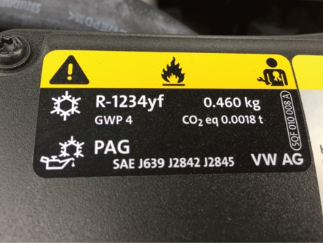
Figure 17.1
The underhood decal indicates what refrigerant is used and the amount used to fill the system.

Slide 13
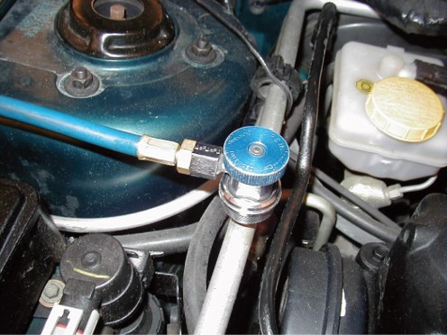
Figure 17.2a
The low-side connection.

Slide 14
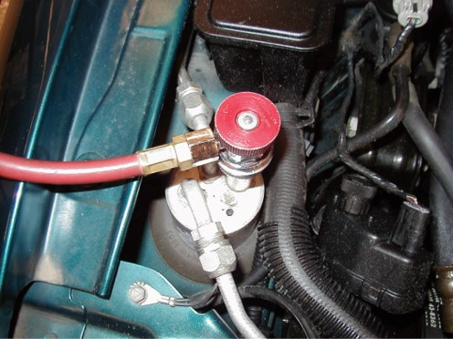
Figure 17.2b
The high-side connection.

Slide 15
Section 609 Service Practices (3 of 3)
Refrigerant Recovery
Engine pre-heat procedure
Recovery procedure
A/C System Evacuation
Leaks Must Be Repaired
Leak Check Procedure Using an RRR Machine
Check Oil Removed
Safety Precautions

Slide 16
Charging (1 of 2)
Proper charge needed
Undercharge causes poor cooling, poor lubricant circulation, and compressor overheating.
Overcharge causes high operating pressures and temperatures, poor performance, possible component damage, and system shutdown.
Leak detection
S A E J2791 detectors have the capability of identifying leakage rates as low as 0.15 ounces per year
Using dye to detect leaks

Slide 17
Charging (2 of 2)
Recordkeeping
An automotive service business that provides M V A C service must keep detailed records, including the exact facilities where recovered refrigerant is sent.
R R R Machine Maintenance
Disposal of Refrigerants

Slide 18
Benefits of a Section 609 Certification
Adds value to an auto technician’s skillset.
Auto repair shops are required to show valid proof of auto technicians who hold a Section 609 certification.
Some auto repair shops even make it mandatory for their auto technicians to be Section 609 certified.
Another benefit is the safety factor.
Any mishandling of refrigerant could prove to be a tremendous health hazard.

Slide 19
Sample Questions (1 of 4)
Which of these is the color code for R-134a disposable refrigerant cylinders?
a. Brown
b. Grey
c. Light blue
d. White

Slide 20
Sample Questions (2 of 4)
According to the Clean Air Act, all records related to M V A C (mobile vehicle air-conditioning) system servicing must be retained for________.
a. 1 year
b. 2 years
c. 3 years
d. 4 years

Slide 21
Sample Questions (3 of 4)
Which refrigerant is rated as mildly flammable and can ignite under certain circumstances?
a. R-134a
b. R-1234y f
c. R-12
d. R-152a

Slide 22
Sample Questions (4 of 4)
R-12 production ended in the United States in what year?
a. 1992
b. 2000
c. 1990
d. 1995

Slide 23
Summary (1 of 3)
Any person who repairs or services a motor vehicle air-conditioning (M V A C) system for consideration (payment or bartering) must be properly trained and certified under Section 609 of the Clean Air Act by an E P A approved program.
A Section 609 training program is designed with the goal of covering all the essentials involved with M V A C repair. These essentials include M V A C refrigerant recovery, and recycling, as well as charging equipment.
Study materials are issued, and at-home study is recommended before taking the exam.

Slide 24
Summary (2 of 3)
This exam is usually an open book test and generally a passing score of 84% is required.
Tools and equipment used by auto technicians have passed standards set by Intertek E X I T and Underwriters Laboratory (U L).
The law requires that the service fittings (ports) on the vehicle and connectors be unique for each refrigerant used.

Slide 25
Summary (3 of 3)
Improved S A E J2791 detectors have the capability of identifying leakage rates as low as 0.15 ounces per year at a distance of 3/8 inch.
A Section 609 Certification adds value to an auto technician’s skillset.

Slide 26
Animation and Video Resources The below listed resources are hyperlinked to the James Halderman website
(A7) Heating & Air Conditioning Animations
(A7) Heating & Air Conditioning Videos

Slide 27
Copyright
This work is protected by United States copyright laws and is provided solely for the use of instructors in teaching their courses and assessing student learning. Dissemination or sale of any part of this work (including on the World Wide Web) will destroy the integrity of the work and is not permitted. The work and materials from it should never be made available to students except by instructors using the accompanying text in their classes. All recipients of this work are expected to abide by these restrictions and to honor the intended pedagogical purposes and the needs of other instructors who rely on these materials.

