Slide 1
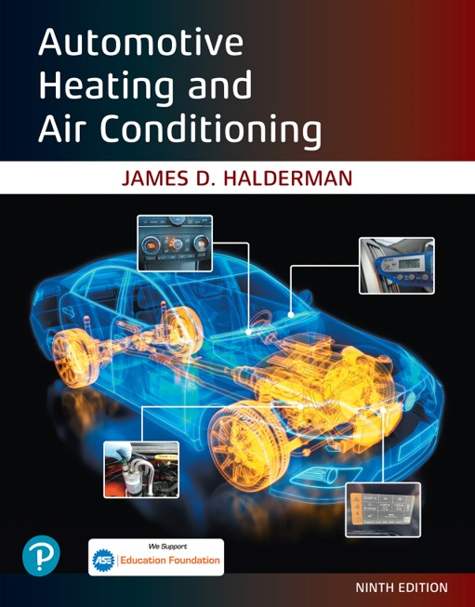
Automotive Heating and Air Conditioning
Ninth Edition
Chapter 12
Automatic Temperature Control Systems
Copyright © 2021, 2018, 2015 Pearson Education, Inc. All Rights Reserved
Notes:
If this PowerPoint presentation contains mathematical equations, you may need to check that your computer has the following installed:
1) Math Type Plugin
2) Math Player (free versions available)
3) NVDA Reader (free versions available)

Slide 2
Learning Objectives (1 of 2)
12.1 Discuss the purpose and function of automatic temperature control (A T C) systems.
12.2 Discuss the sensors used in A T C systems.
12.3 State the need for airflow control.
12.4 Discuss the purpose of automatic H V A C controls.

Slide 3
Learning Objectives (2 of 2)
12.5 Discuss how to diagnose the electrical A T C system faults.
12.6 Explain the automatic climatic control diagnostic procedure.
12.7 Explain the types of actuators in A T C systems.

Slide 4
Automatic Temperature Control Systems (1 of 2)
The purpose and function of the H V A C system is to provide comfortable temperature and humidity levels inside the passenger compartment.
Proper temperature control to enhance passenger comfort during heating should maintain air temperature at the foot level about 7°F to 14°F (4°C to 8°C) above the temperature around the upper body.

Slide 5
Automatic Temperature Control Systems (2 of 2)
Operation
  With an automatic temperature control system (A T C), the driver can turn the automatic controls on or off and select the desired temperature.
  The A T C will adjust the following parameters:
    Blower speed
    Temperature door
    Air inlet door
    Mode door to achieve the proper temperature.
    Control the air-conditioning compressor operation.

Slide 6
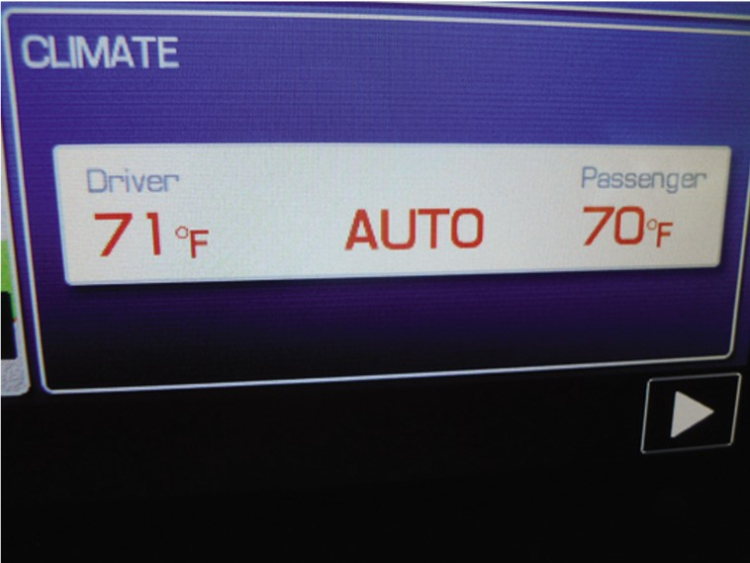
Figure 12.1
The automatic climatic control display is part of the navigation screen on this vehicle.

Slide 7
Sensors (1 of 4)
The outside air temperature (O A T) sensor, also called the ambient temperature sensor, measures outside air temperature and is often mounted at the radiator shroud or in the area behind the front grill.
The in-vehicle temperature sensor is often mounted behind the instrument panel, and a set of holes or a small grill allows air to pass by it.
The discharge air temperature (D A T) sensor is used to measure the temperature of the air leaving the dash vents.

Slide 8
Sensors (2 of 4)
The evaporator temperature (E V T) sensor is used to measure the temperature of the air leaving the evaporator.
The sun load sensor (also called a solar sensor) is normally mounted on top of the instrument panel and is used to measure radiant heat load that might cause an increase of the in-vehicle temperature.
Infrared (I R) sensors are mounted in the control head or overhead in the headliner.

Slide 9
Sensors (3 of 4)
The air-conditioning (A/C) compressor speed sensor, also called a lock or belt lock sensor, is used so the E C M will know if the compressor is running, and by comparing the compressor and engine speed signals, the E C M can determine if the compressor clutch or drive belt is slipping excessively.
The engine coolant temperature (E C T) sensor is a thermistor and measures the temperature of the engine coolant and is usually located near the engine thermostat.

Slide 10
Sensors (4 of 4)
A pressure transducer can be used in the low- and/or high-pressure refrigerant line.
  Allows the E C M to monitor pressure
Some systems use an air quality sensor, which detects
hydrocarbons (H C) or ozone
A few vehicles use a relative humidity (R H) sensor to determine the level of in-vehicle humidity.
A few vehicles that are equipped with a global positioning system (G P S) for navigation will have a sun position strategy that tracks the angle of the sunlight entering the vehicle.

Slide 11
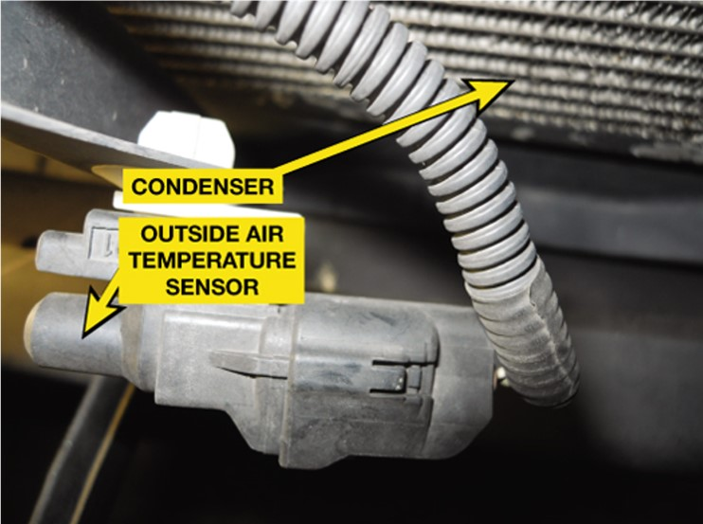
Figure 12.2
The outside air temperature sensor is mounted on the radiator core support in front of the A/C condenser on this vehicle.

Slide 12
Airflow Control
Air flows into the housing (case) that contains the evaporator and heater core from two possible inlets.
  Outside air, often called fresh air
  Inside air, usually called recirculation (recirc)

Slide 13
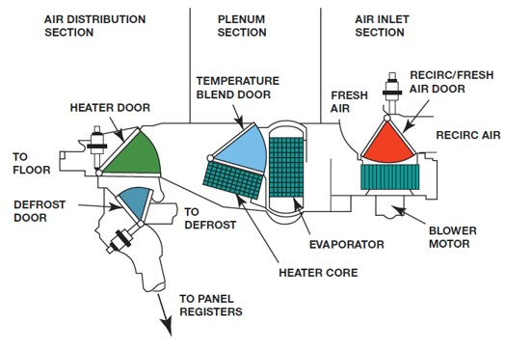
Figure 12.8
The three major portions of the A/C and heat system are air inlet, plenum, and air distribution. The shaded portions show the paths of the four control doors.
Notes:
Long Description:
The major portions are Air distribution section, Plenum section, and Air inlet section. The air distribution section consists of a heater door, and four tubes to the floor, door, defrost, and panel registers, respectively. The heater door and defrost doors have a triangular cross-section. The plenum section consists of a temperature blend door, evaporator, and heater core. The evaporator has a rectangular cross-section. The temperature blend door appears like a triangular prism. The air inlet section consists of a recirc or fresh air door, and a blower motor. The recirc door also has a triangular cross-section, and fresh air enters to the recirc door from the heater door via the temperature blend door.

Slide 14
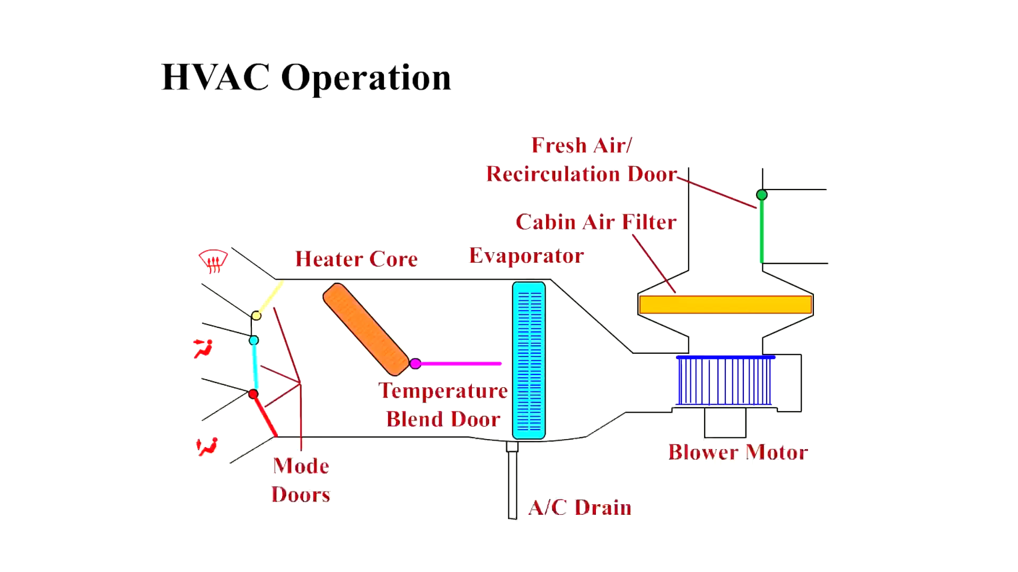
Animation:
HVAC Operation
(The animation will automatically start in a few seconds)

Slide 15
Actuators
Dual-Position Actuator
  A dual-position actuator is able to move either open or closed.
Three-Position Actuator
  A three-position actuator is able to provide three air door positions.
Variable-Position Actuator
  A variable-position actuator is capable of positioning a valve in any position.

Slide 16
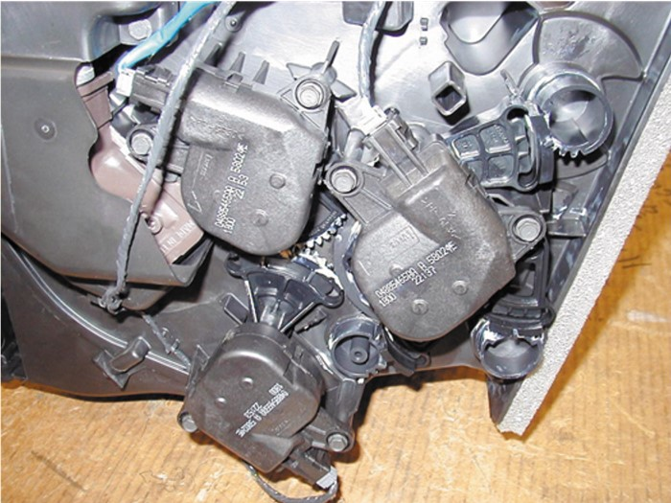
Figure 12.9
Three electric actuators can be easily seen on this demonstration unit. However, accessing these actuators in a vehicle can be difficult.

Slide 17
Automatic H V A C Controls
The control head provides the switches and levers needed to control the different aspects of the heating and A/C system, which include
  H V A C system on and off
  A/C on/off
  outside or recirculated air
  A/C, defrost, or heating mode
  temperature desired
  blower speed

Slide 18
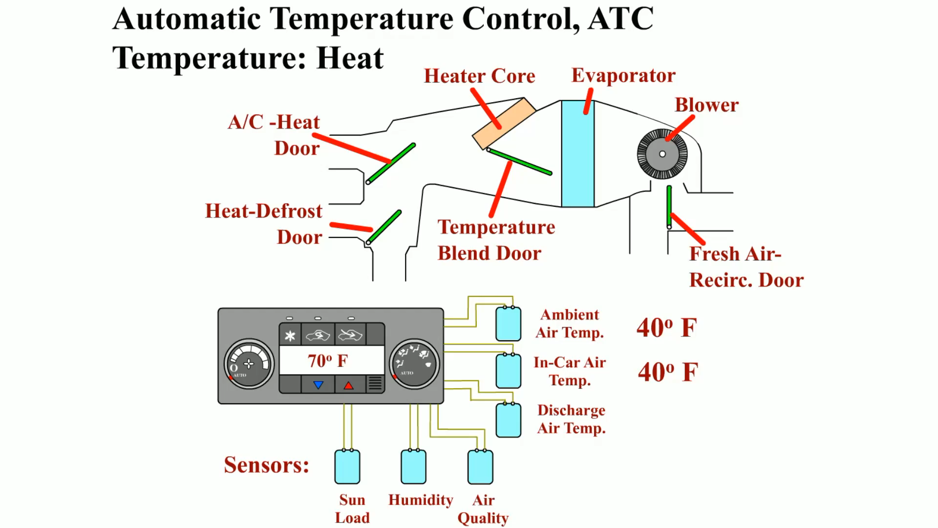
Animation:
Automatic Temperature Control, ATC Heat
(The animation will automatically start in a few seconds)

Slide 19
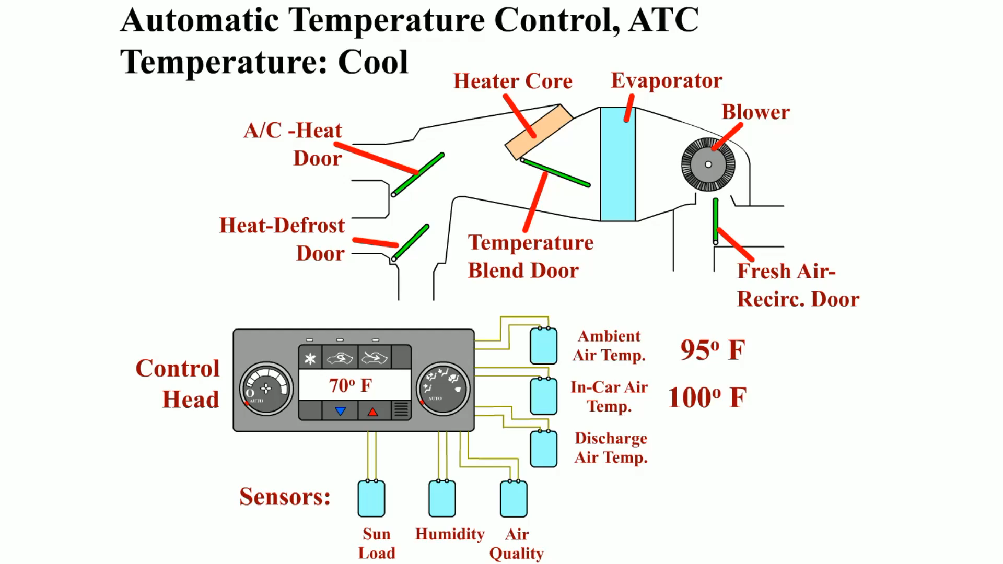
Animation:
Automatic Temperature Control, ATC Cool
(The animation will automatically start in a few seconds)

Slide 20
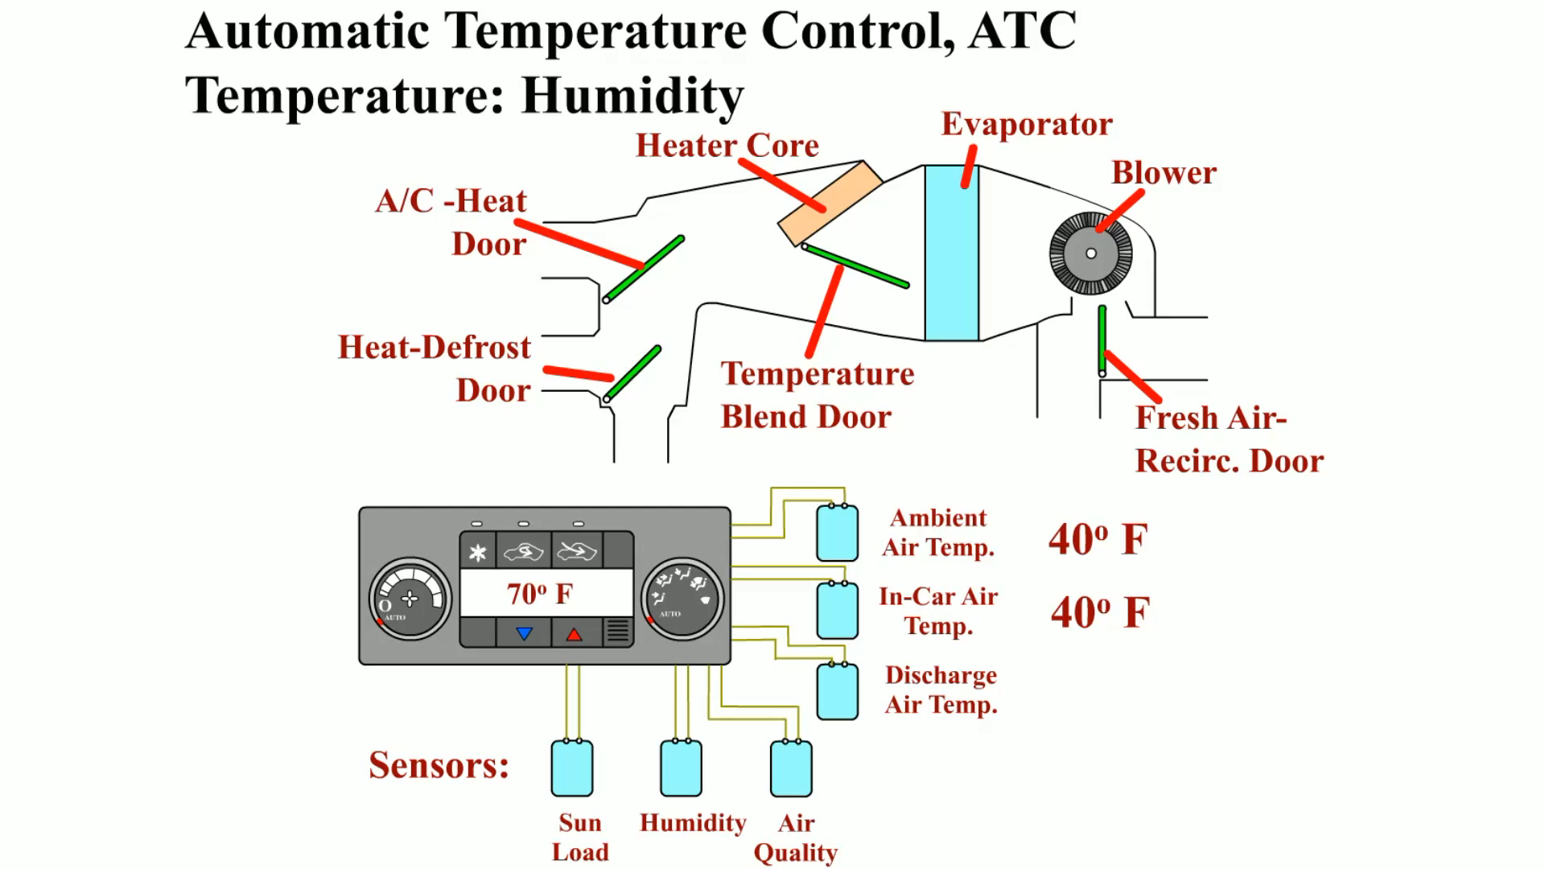
Animation:
Automatic Temperature Control, ATC Humidity
(The animation will automatically start in a few seconds)

Slide 21
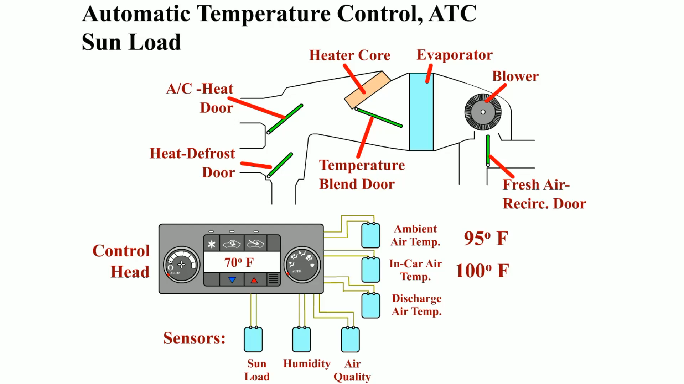
Animation:
Automatic Temperature Control, ATC Sun Load
(The animation will automatically start in a few seconds)

Slide 22
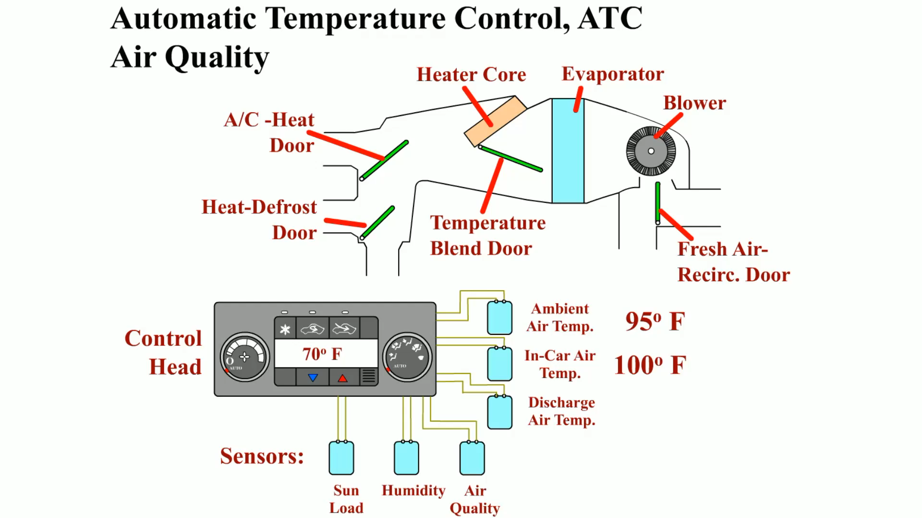
Animation:
Automatic Temperature Control, ATC Air Quality
(The animation will automatically start in a few seconds)

Slide 23
Control Module
The control module used for automatic climatic control systems can be referred by various terms.
  E C M (electronic control module)
  B C M (body control module)
  H V A C control module (often is built into the smart control head)
  H V A C controller or programmer
The control modules are programmed to open or close circuits to the actuators based on the values of the various sensors.

Slide 24
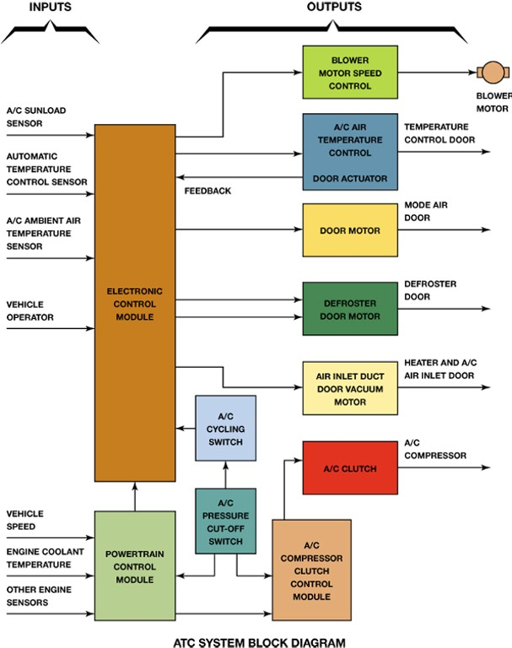
Figure 12.13
A block diagram showing the inputs to the electronic control assembly and the outputs; note that some of the outputs have feedback to the E C M.
Notes:
Long Description:
The inputs are the electronic control module and powertrain control module. The electronic control module consists of an A C sunload sensor, automatic temperature control sensor, A C ambient air temperature sensor, and vehicle operator. The powertrain control module consists of vehicle speed, engine coolant temperature, and other engine sensors. The output has the following parts: blower motor speed control with a blower motor, A C air temperature control and door actuator with a temperature control door, a door motor with a mode air door, a defroster door motor, an air inlet duct door vacuum motor with a heater and A C air inlet door, A C clutch with an A C compressor, and an A C compressor clutch control module. The A C compressor clutch control module, and powertrain control module are linked to an A C pressure cut off switch, which leads to an A C cycling switch and then to the electronic control module.

Slide 25
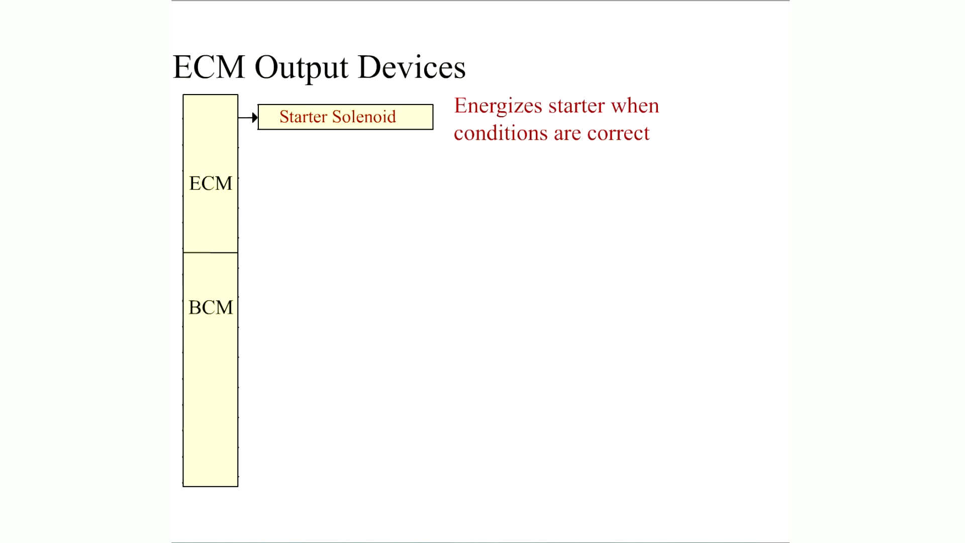
Animation:
ECM Output Devices
(The animation will automatically start in a few seconds)

Slide 26
Air Filtration
What is the purpose and function of air filtration?
Types of Cabin Filters
  Particle filters
  Adsorption filters

Slide 27
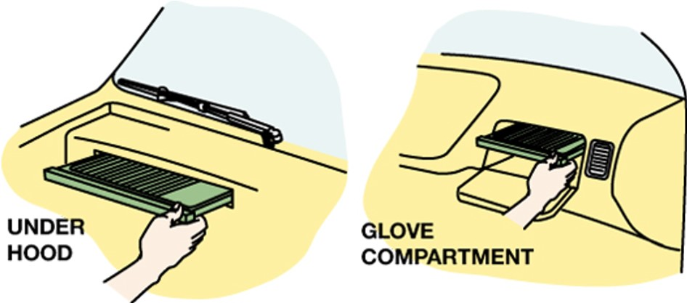
Figure 12.14
A cabin filter can be accessed either through the glove compartment or under the hood on most vehicles.

Slide 28
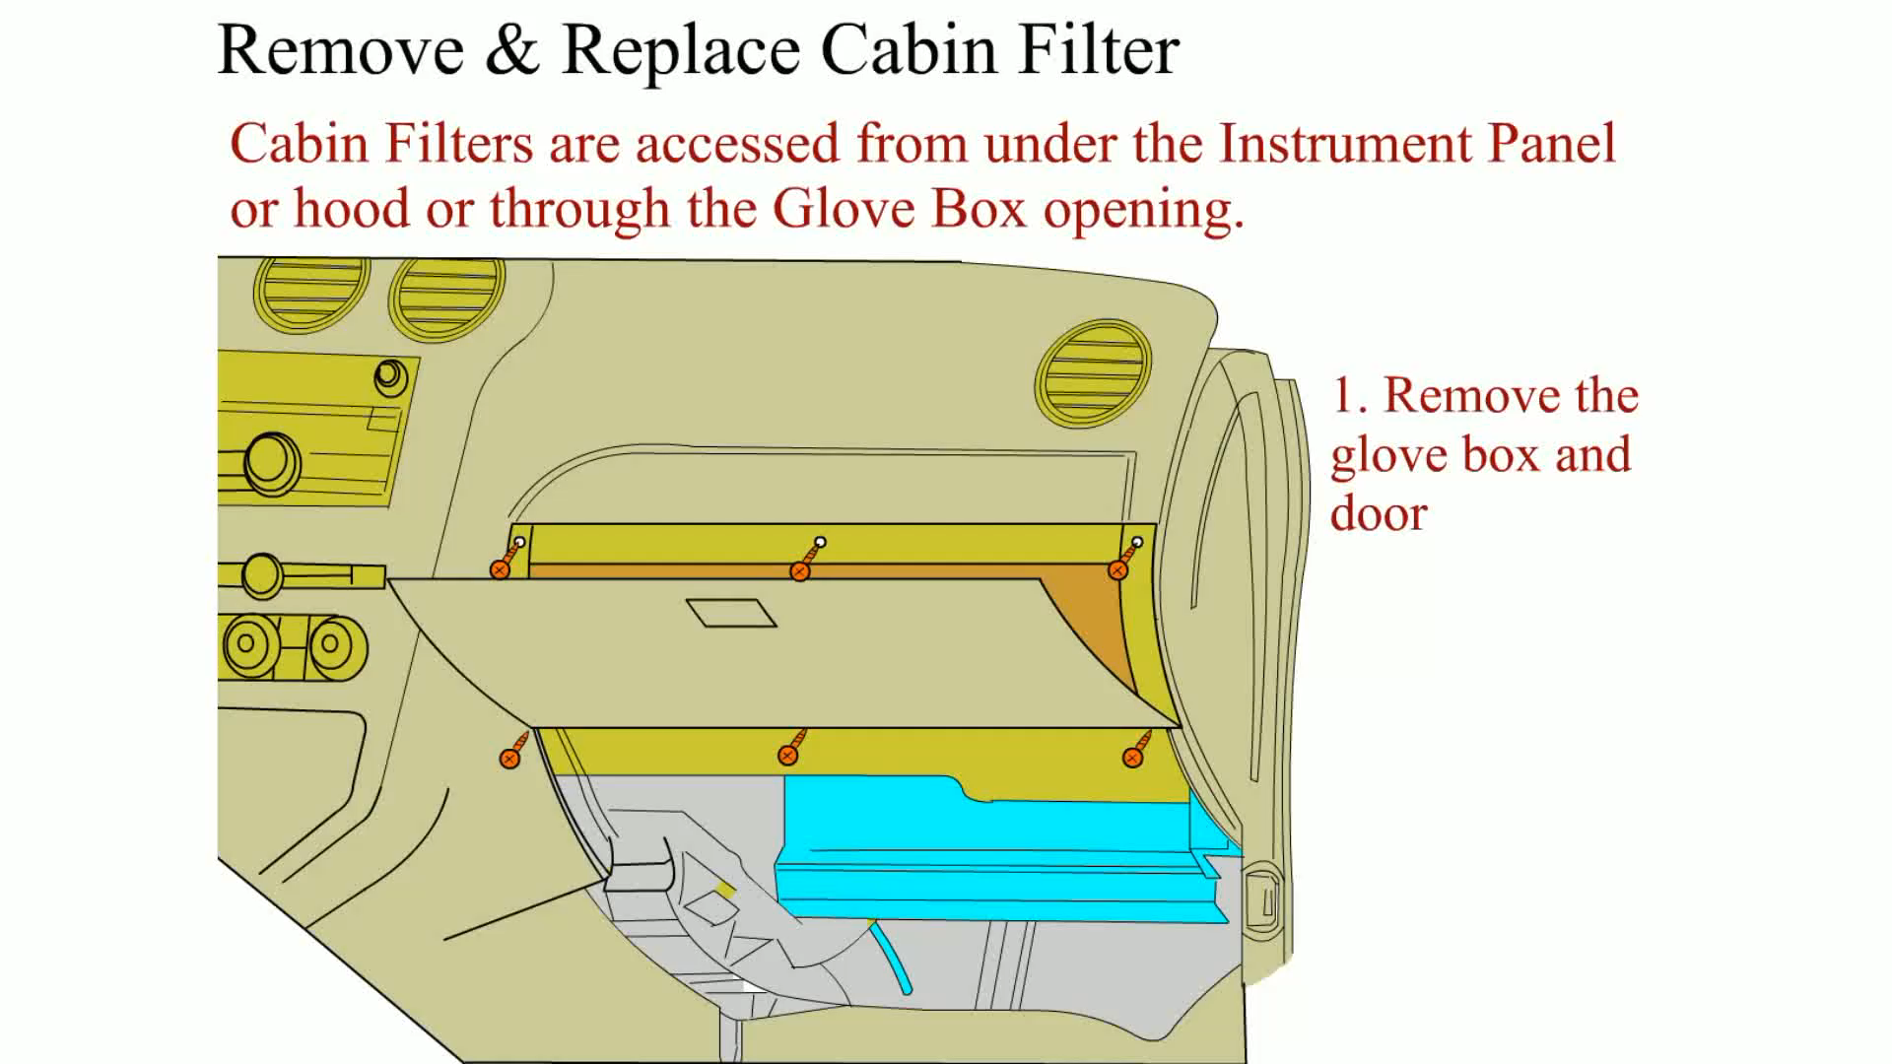
Animation:
Remove and Replace Cabin Filter
(The animation will automatically start in a few seconds)

Slide 29
Automatic Climatic Control Diagnosis (1 of 2)
STEP 1 Verify the customer concern.
STEP 2 Perform a thorough visual inspection of the heating and cooling system for any obvious faults.
STEP 3 Use a factory scan tool or a factory-level aftermarket scan tool and check for diagnostic trouble codes (D T C s).

Slide 30
Automatic Climatic Control Diagnosis (2 of 2)
STEP 4 If there are stored diagnostic trouble codes, follow service information instructions for diagnosing the system.
STEP 5 If there are no stored diagnostic trouble codes, check scan tool data for possible fault areas in the system.

Slide 31
Scan Tool Bidirectional Control (1 of 2)
Scan tools are the most important tool for any diagnostic work on all vehicles.
  Factory scan tools
  Aftermarket scan tools

Slide 32
Scan Tool Bidirectional Control (2 of 2)
A T C components that may be able to be controlled or checked using a scan tool include:
  Blower speed control (faster and slower to check operation)
  Command the position of airflow doors to check for proper operation and to check for proper airflow from the vents and ducts
  Values of all sensors
  Pressures of the refrigerant in the high and low sides of the systems

Slide 33
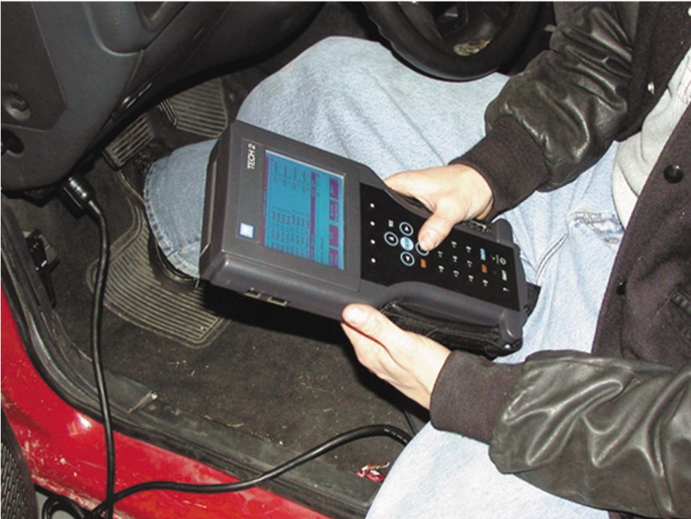
Figure 12.15
A T E C H 2 scan tool is the factory scan tool used on General Motors vehicles.

Slide 34
Summary (1 of 3)
Automatic temperature control (A T C) systems use sensors to detect the conditions both inside and outside the vehicle.
The sensors used include the following:
  Sun load sensor
  Evaporator temperature sensor
  Ambient air temperature (outside air temperature) sensor
  In-vehicle temperature sensor
  Infrared sensors
  Engine coolant temperature (E C T) sensor

Slide 35
Summary (2 of 3)
Pressure transducers detect the pressures in the refrigerant system.
Some systems use a compressor speed sensor to detect if the drive belt or compressor clutch is slipping.
The heater core is placed downstream from the evaporator in the airflow so that air can be routed either through or around it and one or two doors are used to control this airflow. This door is called the temperature-blend door.

Slide 36
Summary (3 of 3)
In many vehicles, the H V A C system is capable of supplying discharge air of more than one temperature to different areas in the vehicle. This type of system is usually referred to as a Dual-Zone Climate Control System.
The diagnostic steps include
  Verify the customer concern
  Perform a thorough vial inspection
  Retrieve diagnostic trouble codes (D T C s)
  Check the data as displayed on a scan tool to determine what sensors or actuators are at fault.

Slide 37
Animation and Video Resources
The below listed resources are hyperlinked to the James Halderman website
(A7) Heating & Air Conditioning Animations
(A7) Heating & Air Conditioning Videos

Slide 38

Copyright
This work is protected by United States copyright laws and is provided solely for the use of instructors in teaching their courses and assessing student learning. Dissemination or sale of any part of this work (including on the World Wide Web) will destroy the integrity of the work and is not permitted. The work and materials from it should never be made available to students except by instructors using the accompanying text in their classes. All recipients of this work are expected to abide by these restrictions and to honor the intended pedagogical purposes and the needs of other instructors who rely on these materials.

