Slide 1
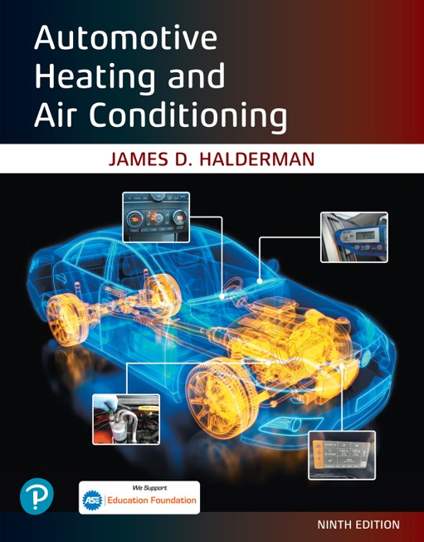
Automotive Heating and Air Conditioning
Ninth Edition
Chapter 11
H V A C Electricity and Electronics
Copyright © 2021, 2018, 2015 Pearson Education, Inc. All Rights Reserved
Notes:
If this PowerPoint presentation contains mathematical equations, you may need to check that your computer has the following installed:
1) Math Type Plugin
2) Math Player (free versions available)
3) NVDA Reader (free versions available)

Slide 2
Learning Objectives (1 of 2)
11.1 Prepare for the Heating and Air Conditioning (A7) A S E certification test content area “D” (Operating Systems and Related Controls Diagnosis and Repair).
11.2 Explain the characteristics of electricity.
11.3 Differentiate between conductors, insulators, and semiconductors.
11.4 Explain the units of electrical measurement.
11.5 List the parts of a complete circuit.

Slide 3
Learning Objectives (2 of 2)
11.6 Discuss the types of electrical circuit faults.
11.7 Explain how to detect and measure electrical voltage, current, and resistance using digital meters.
11.8 Discuss wire repair.
11.9 Discuss the purpose of terminals, connectors, relays, and switches.
11.10 Discuss networks and network classifications.

Slide 4
Introduction
Electricity may be difficult for some people to learn for the following reasons:
  It cannot be seen.
  Only the results of electricity can be seen.
  It has to be detected and measured.

Slide 5
Electricity (1 of 3)
Electricity is the movement of electrons from one atom to another.
The dense center of each atom is called the nucleus. The nucleus contains the following sub-atomic particles:
  Protons, which have a positive charge
  Neutrons, which are electrically neutral (have no charge)
Electrons, which have a negative charge, orbit the nucleus.
Magnets and Electrical Charge

Slide 6
Electricity (2 of 3)
Electron Orbits
  Electrons orbit around the nucleus in rings and the outermost ring is called the “valence ring.”
  Whether a material is a conductor or an insulator strictly depends on how many electrons are in the outer ring.
Conductors
  Conductors are materials with fewer than four electrons in their atom’s outer orbit.

Slide 7
Electricity (3 of 3)
Insulators
  Insulators are materials with more than four electrons in their atom’s outer orbit.
Semiconductors
  Materials with exactly four electrons in their outer orbit are called semiconductors.

Slide 8
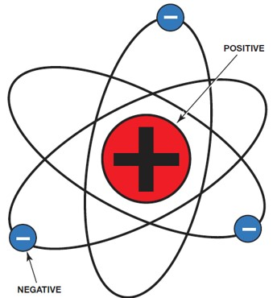
Figure 11.2
The nucleus of an atom has a positive (+) charge, and the surrounding electrons have a negative (−) charge

Slide 9
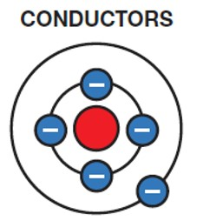
Figure 11.5
A conductor is any element that has one to three electrons in its outer orbit.

Slide 10
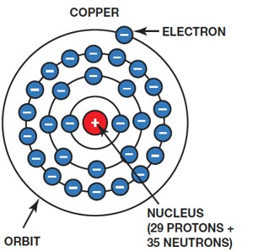
Figure 11.6
Copper is an excellent conductor of electricity because it has just one electron in its outer orbit, making it easy to be knocked out of its orbit and flow to other nearby atoms.

Slide 11
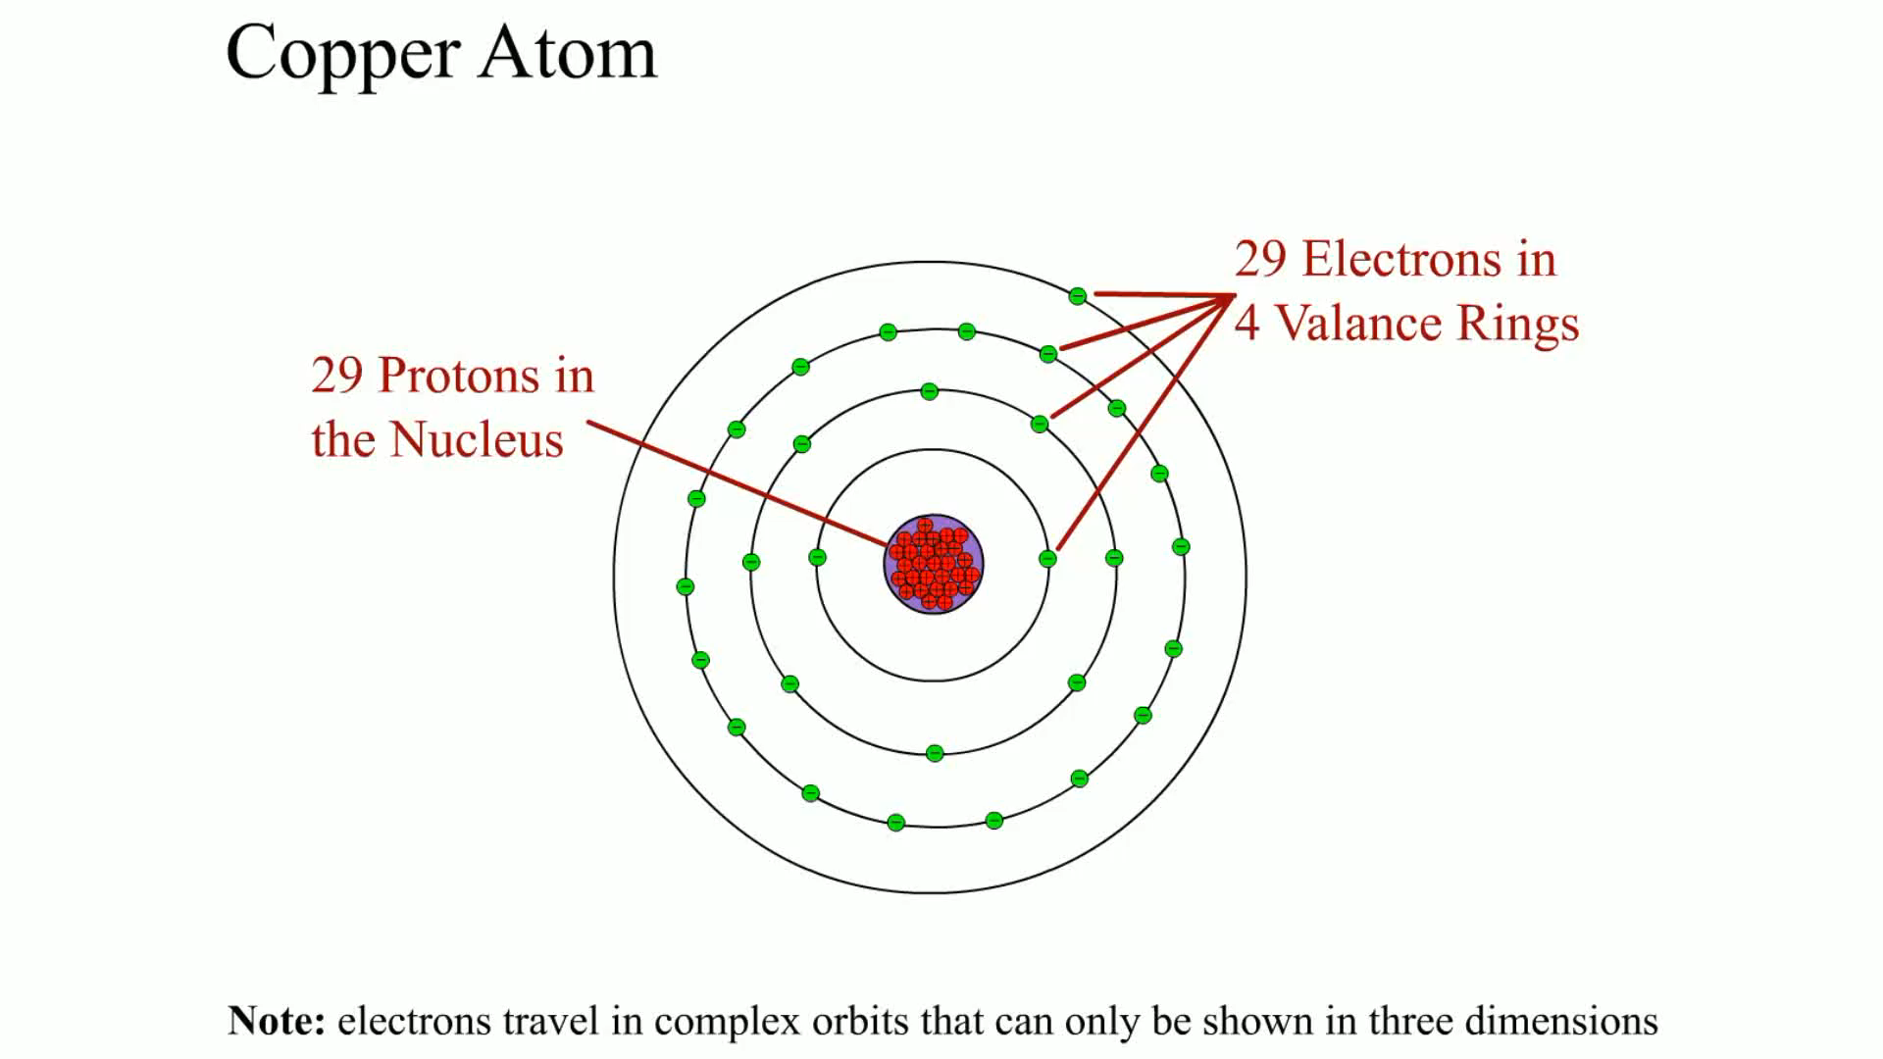
Animation:
Copper Atom
(The animation will automatically start in a few seconds)

Slide 12
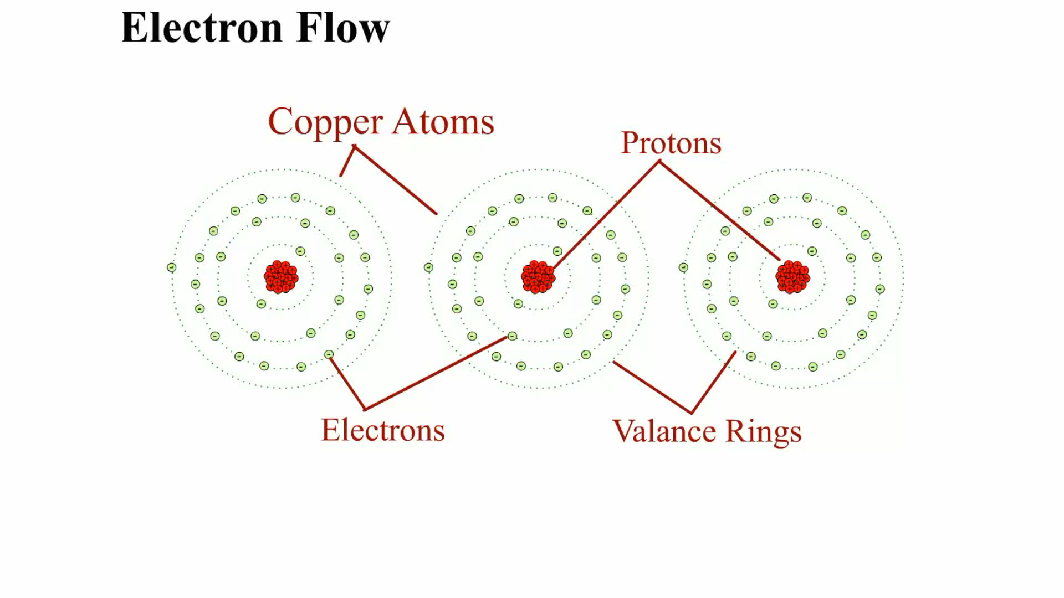
Animation:
Electron Flow
(The animation will automatically start in a few seconds)

Slide 13
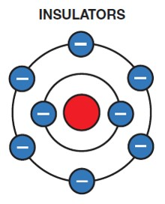
Figure 11.7
Insulators are elements with five to eight electrons in the outer orbit.

Slide 14
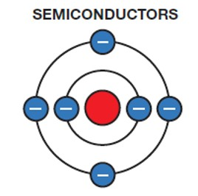
Figure 11.8
Semiconductor elements contain exactly four electrons in the outer orbit.

Slide 15
How Electrons Move Through a Conductor
Conventional Theory Vs. Electron Theory
  It was once thought that electricity had only one charge and moved from positive to negative. This theory of the flow of electricity through a conductor is called the conventional theory of current flow.
  The discovery of the electron and its negative charge led to the electron theory, which states that there is electron flow from negative to positive.
  Most automotive applications use the conventional theory.

Slide 16
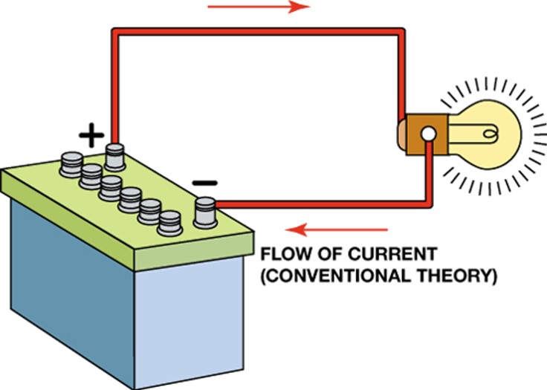
Figure 11.10
Conventional theory states that current flows through a circuit from positive (+) to negative (−).

Slide 17
Units of Electricity (1 of 2)
The three fundamentals of electricity-related units are the ampere, volt, and ohm.
The ampere is the measure of the amount of current flow.
  “A” and “amps” are acceptable abbreviations for amperes.
  The capital letter “I,” for intensity, is used in mathematical calculations to represent amperes.

Slide 18
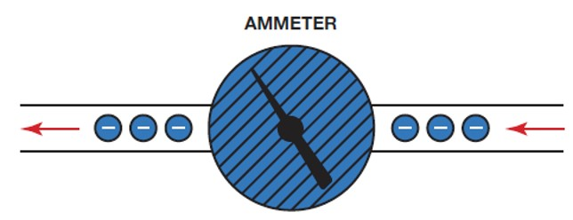
Figure 11.12
An ammeter is installed in the path of the electrons similar to a water meter used to measure the flow of water in gallons per minute. The ammeter displays current flow in amperes.

Slide 19
Units of Electricity (2 of 2)
Voltage is the unit of electrical pressure.
  Voltage is also called electrical potential.
  “V” is the generally accepted abbreviation for volts.
  The symbol used in calculations is “E,” for electromotive force.
The ohm is the unit of electrical resistance.
  The symbol for ohms is “Ω” (Greek capital letter omega), the last letter of the Greek alphabet.
  The symbol used in calculations is “R,” for resistance.

Slide 20
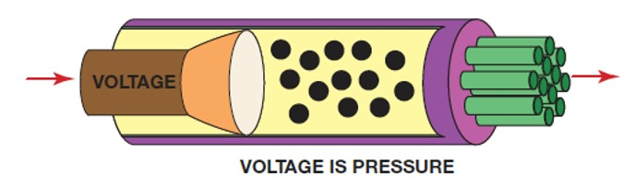
Figure 11.13
Voltage is the electrical pressure that causes the electrons to flow through a conductor.

Slide 21
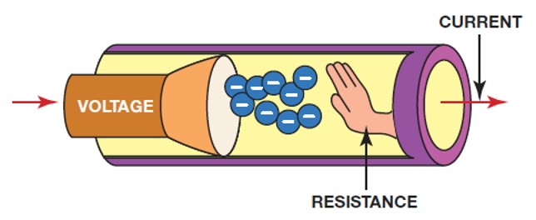
Figure 11.15
Resistance to the flow of electrons through a conductor is measured in ohms.

Slide 22
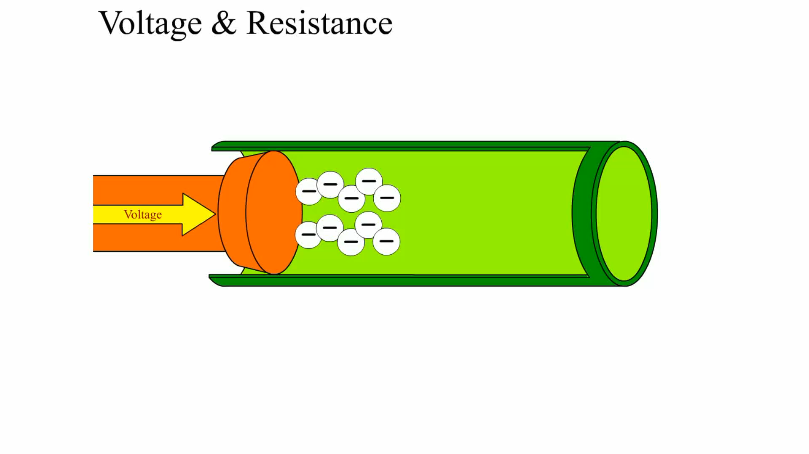
Animation:
Voltage & Resistance
(The animation will automatically start in a few seconds)

Slide 23
Electrical Circuits
For any electrical circuit to work at all, it must be continuous from the battery (power), through all the wires and components, and back to the battery (ground).
A circuit that is continuous throughout is said to have continuity.
All complete electrical circuits have
  A power source, a circuit protection device, a power-side wire or path, an electrical load, a ground return path, and a switch or a control device.

Slide 24
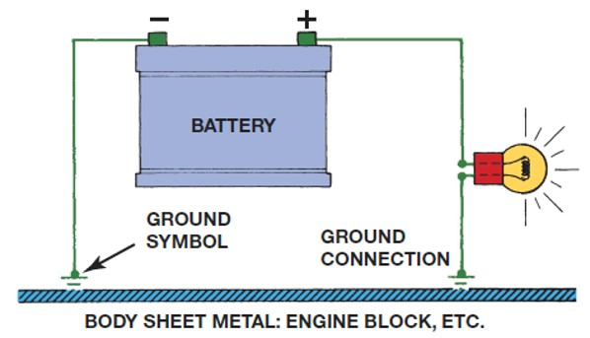
Figure 11.16
The return path back to the battery can be any electrical conductor, such as a copper wire or the metal frame or body of the vehicle.

Slide 25
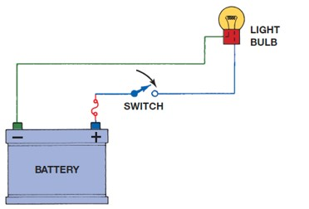
Figure 11.17
An electrical switch opens the circuit and no current flows. The switch could also be on the return (ground) path wire.

Slide 26
Electrical Schematics (1 of 2)
All circuit schematics or diagrams include
  Power-side wiring of the circuit
  All splices
  Connectors
  Wire size
  Wire color
  Trace color (if any)
  Circuit number
  Electrical components

Slide 27
Electrical Schematics (2 of 2)
  Ground return paths
  Fuses and switches
Circuit Information
Wire Size
Open Circuits
Short-to-Voltage
Short-to-Ground
High Resistance

Slide 28
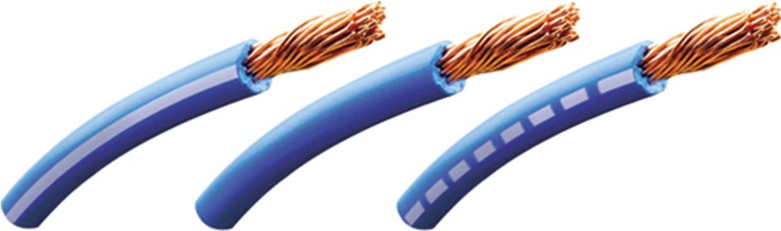
Figure 11.18
The center wire is a solid color wire, meaning that the wire has no other identifying tracer or stripe color. The two end wires could be labeled “B L U/W H T,” indicating a blue wire with a white tracer or stripe.

Slide 29
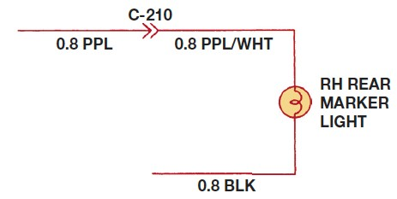
Figure 11.19
Typical section of a wiring diagram. Notice that the wire color changes at connection C210. The “0.8” represents the metric wire size in square millimeters.

Slide 30
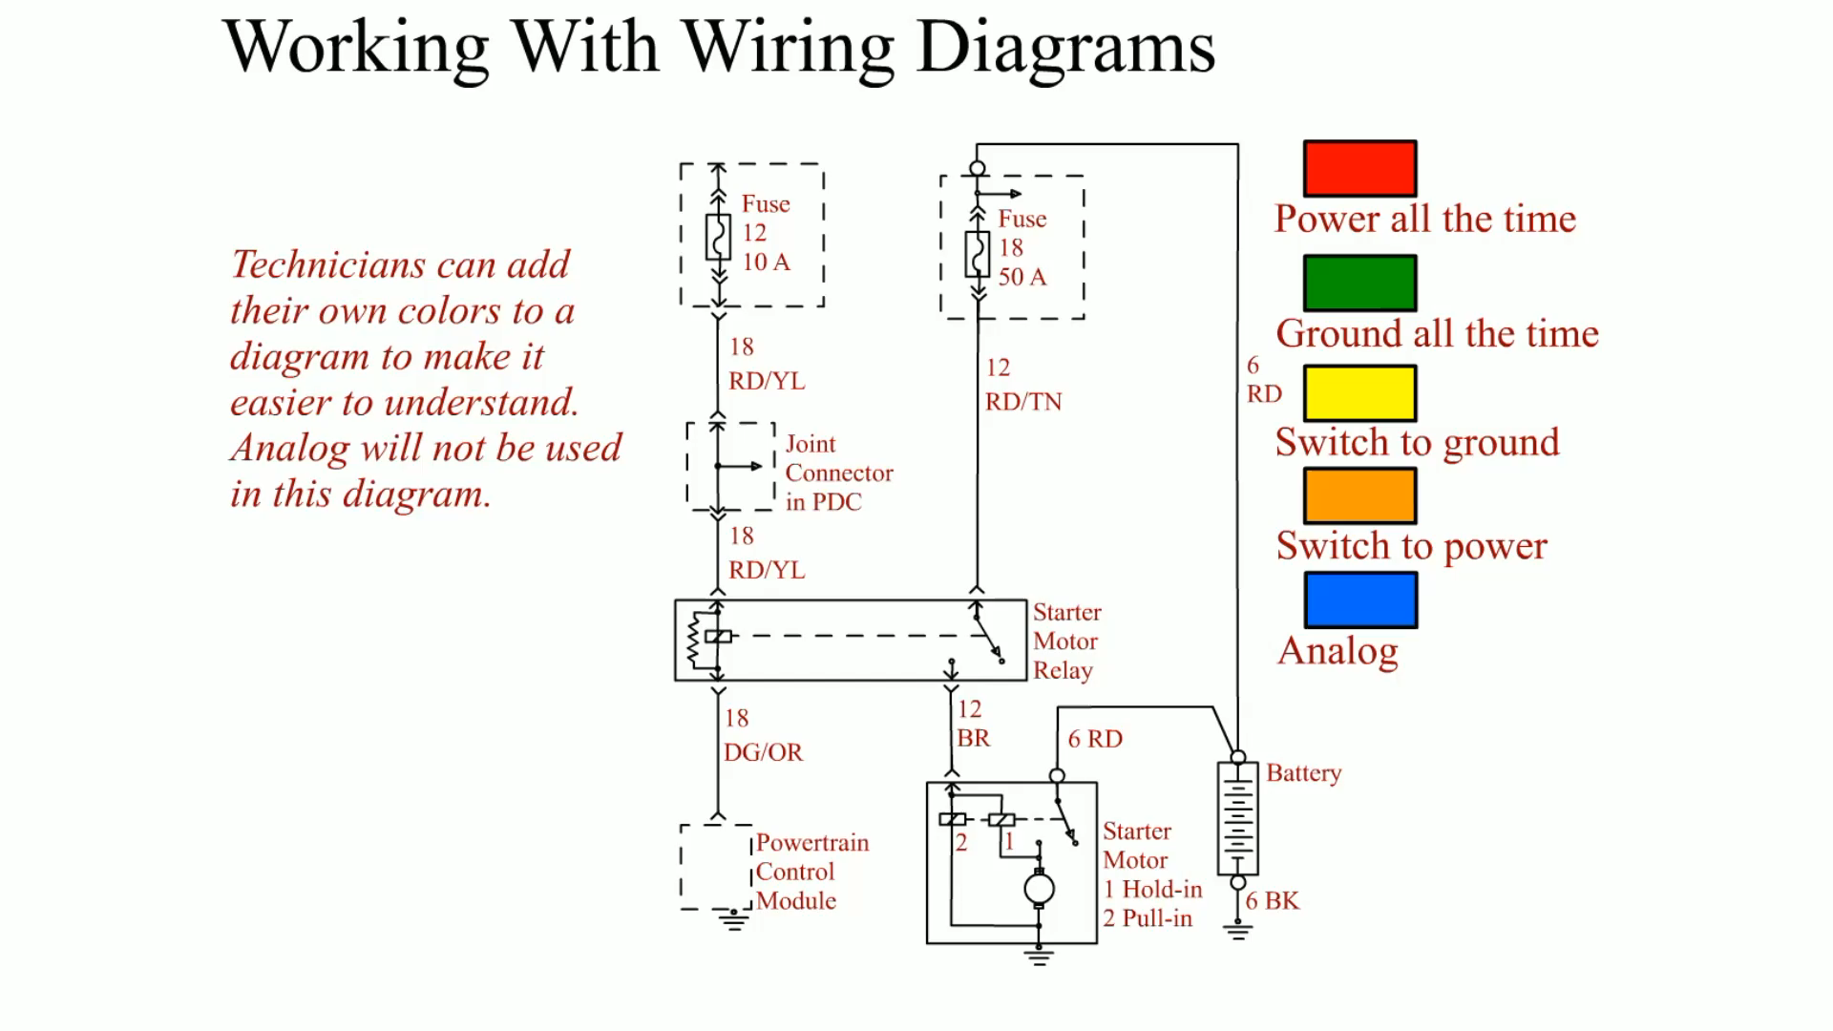
Animation:
Working With Wiring Diagrams
(The animation will automatically start in a few seconds)

Slide 31
Types of Circuit Faults (1 of 2)
An open circuit is any circuit that is not complete, or that lacks continuity, such as a broken wire.
A short-to-voltage occurs when the power side of one circuit is electrically connected to the power side of another circuit.

Slide 32
Types of Circuit Faults (2 of 2)
A short-to-ground is a type of short circuit that occurs when the current bypasses part of the normal circuit and flows directly to ground.
High resistance is resistance higher than normal circuit resistance.

Slide 33
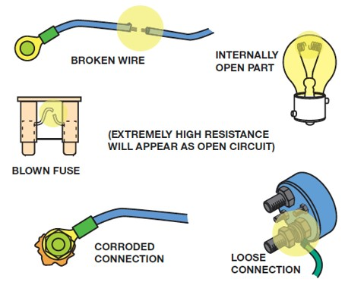
Figure 11.21
Examples of common causes of open circuits. Some of these causes are often difficult to find.

Slide 34
Fused Jumper Wire
Purpose and Function
  Fuse
  Alligator clip ends
  Good-quality insulated wire

Slide 35
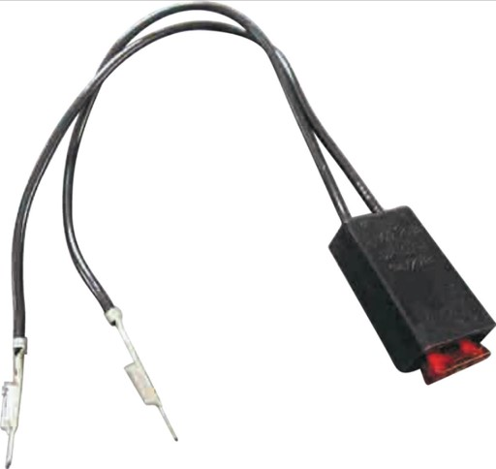
Figure 11.25
A technician-made fused jumper lead, which is equipped with a red 10-ampere fuse. This fused jumper wire uses terminals for testing circuits at a connector instead of alligator clips.

Slide 36
Test Light
Non-Powered Test Light
Use of a 12-Volt Test Light
  Electrical power
  Grounds

Slide 37
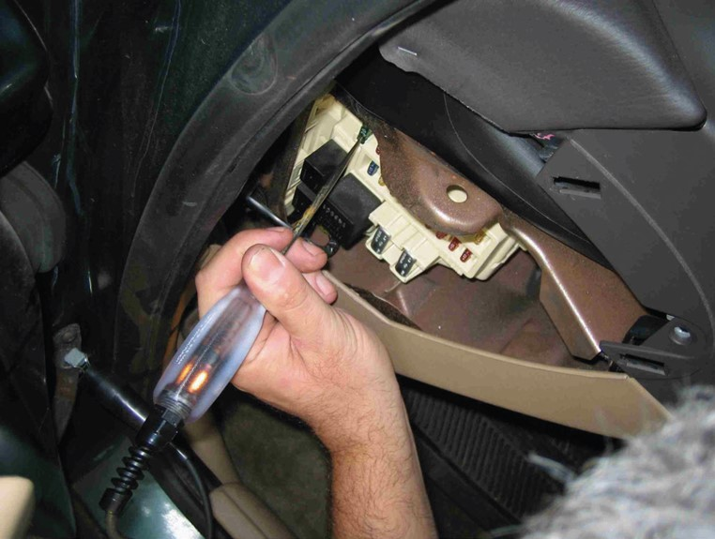
Figure 11.26
Testing a fuse with a test light. If the fuse is good, the test light should light on both sides (power side and load side) of the fuse.

Slide 38
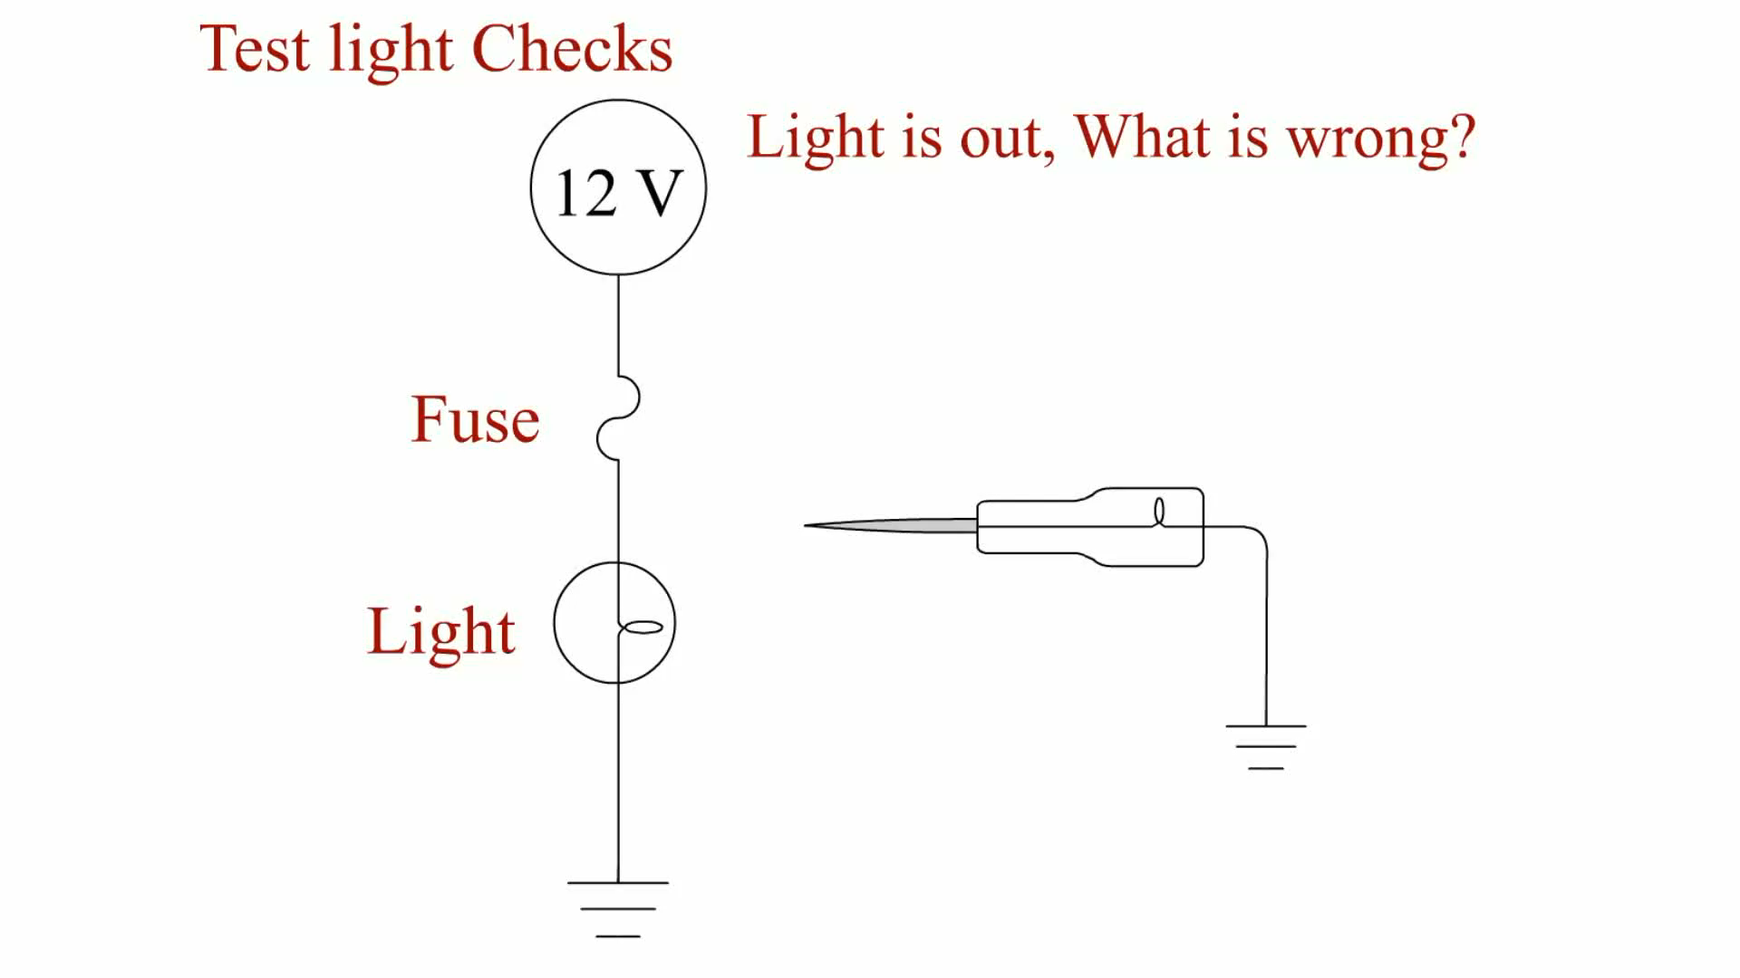
Animation:
Test Light Checks
(The animation will automatically start in a few seconds)

Slide 39
Digital Meters
A voltmeter measures the pressure or potential of electricity in units of volts.
An ohmmeter measures the resistance in ohms of a component or circuit section when no current is flowing through the circuit.
An ammeter measures the flow of current through a complete circuit in units of amperes or milliamperes.

Slide 40
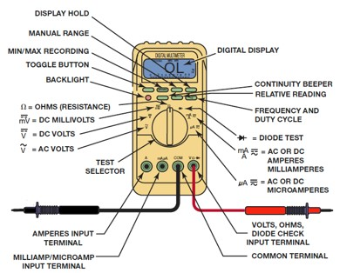
Figure 11.28
Typical digital multimeter.
Notes:
Long Description:
The device consists of display hold, manual range, minimum or maximum recording, toggle button, backlight, resistance, D C millivolts, D C volts, A C volts, test selector, amperes input terminal, milliamp or microamp input terminal, digital display, continuity beeper, relative reading, frequency and duty cycle, diode test, A C or D C amperes milliamperes, A C or D C microamperes, volts ohms diode check input terminal, and a common terminal.

Slide 41
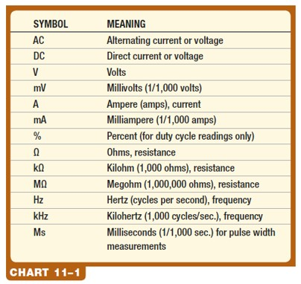
Chart 11.1
Common symbols and abbreviations used on digital meters.
Notes:
Long Description:
The table has two columns and 13 rows. From left to right, the columns are labeled "Symbol, and Meaning." The entries in the table are as follows:
1. Symbol: A C, Meaning: Alternating current or voltage.
2. Symbol: D C, Meaning: Direct current or voltage.
3. Symbol: V, Meaning: Volts.
4. Symbol: m V, Meaning: Millivolts or 1 over 1,000 volts.
5. Symbol: A, Meaning: Ampere or amps, current.
6. Symbol: m A, Meaning: Milliampere or 1 over 1,000 amps.
7. Symbol: Percent, Meaning: Percent for duty cycle readings only.
8. Symbol: Ohms, Meaning: Ohms, resistance.
9. Symbol: k Ohms, Meaning: Kiloohm or 1,000 Ohms, resistance.
10. Symbol: M Ohms, Meaning: Megaohm or 1,000,000 ohms, resistance.
11. Symbol: Hz, Meaning: Hertz or cycles per second, frequency.
12. Symbol: k Hz, Meaning: Kilohertz or 1,000 cycles per second, frequency.
13. Symbol: M s, Meaning: Milliseconds or 1 over 1,000 seconds, for pulse width measurements.

Slide 42
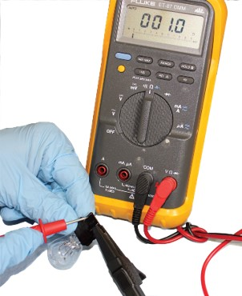
Figure 11.31
Using a digital multimeter set to read ohms (Ω) to test this light bulb. The meter reads the resistance of the filament.

Slide 43
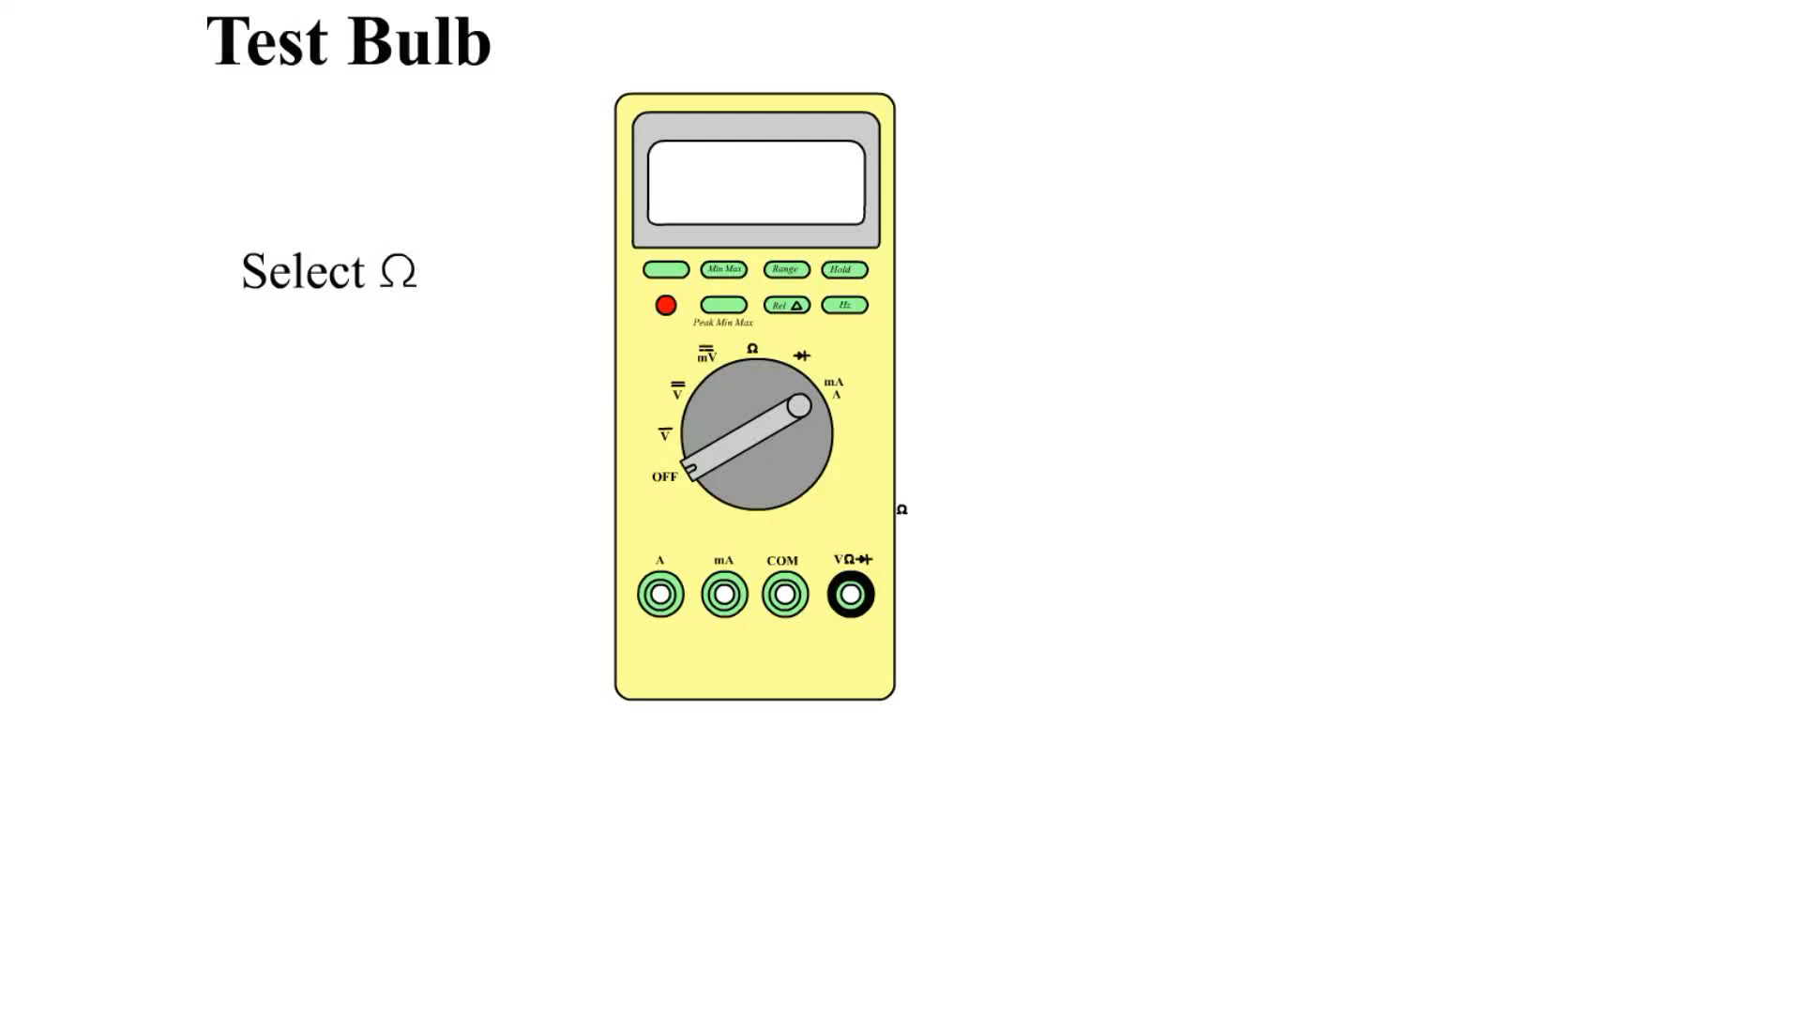
Animation:
Test Bulb
(The animation will automatically start in a few seconds)

Slide 44
Inductive Ammeters
Able to read much higher amperages than 10 amperes.
The ammeter uses the strength of the magnetic field to measure the electrical current.
An A C/D C clamp-on digital multimeter is a useful meter for automotive diagnostic work.

Slide 45
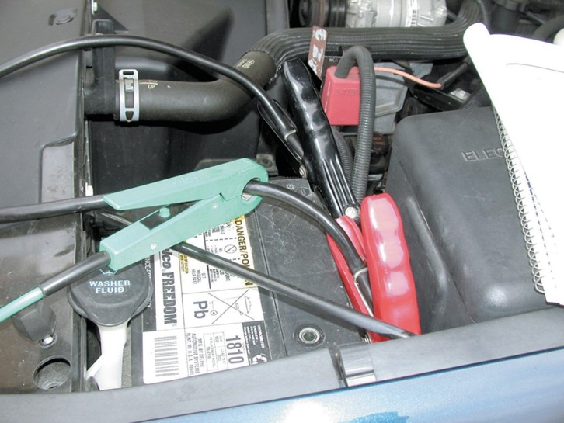
Figure 11.35
An inductive ammeter clamp is used with all starting and charging testers to measure the current flow through the battery cables.

Slide 46
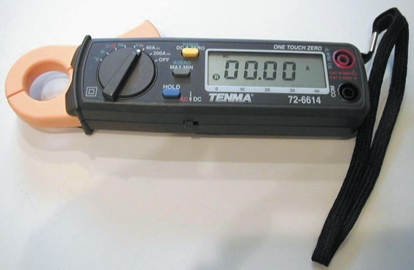
Figure 11.36
A typical mini clamp-on-type digital multimeter.

Slide 47
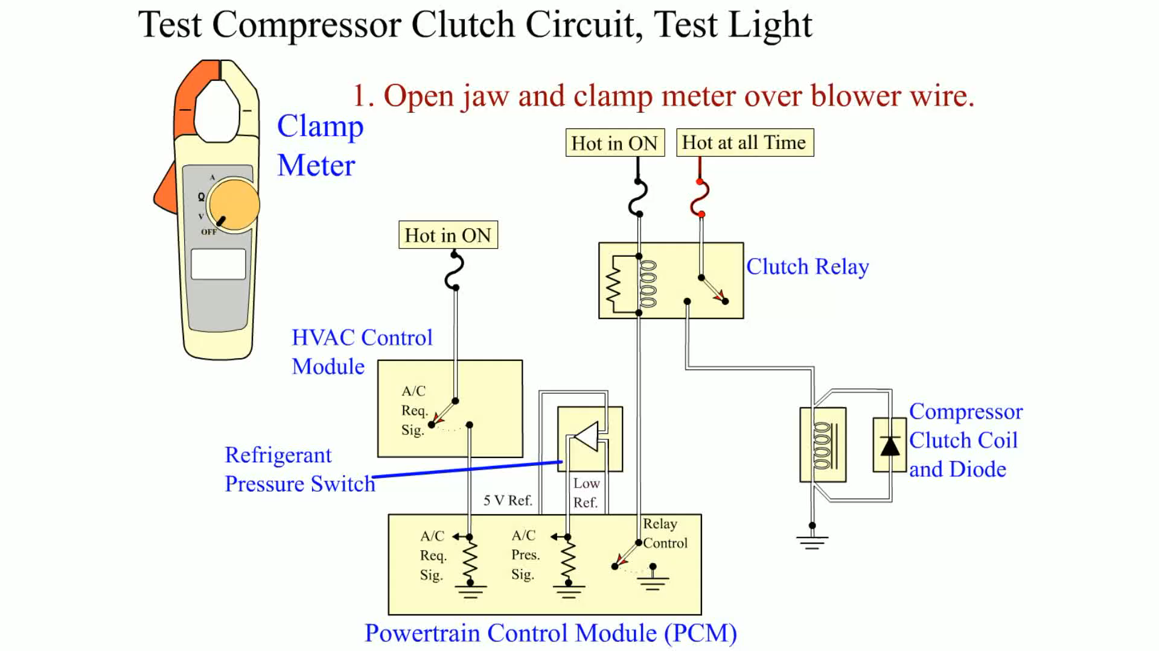
Animation:
Test Compressor Clutch Circuit, Clamp Meter
(The animation will automatically start in a few seconds)
Clamp Meter

Slide 48
Terminals and Connectors
A terminal is the metal end of a wire, whereas a connector is the plastic housing for the terminal.
Servicing Terminals

Slide 49
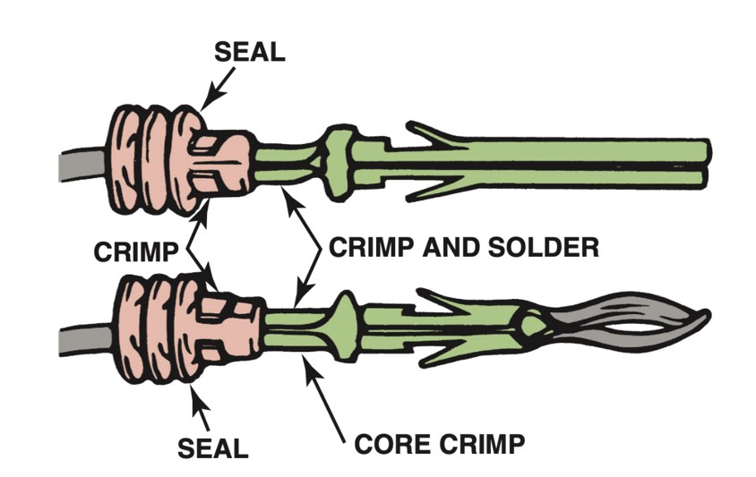
Figure 11.37
Some terminals have seals attached to help seal the electrical connections.

Slide 50
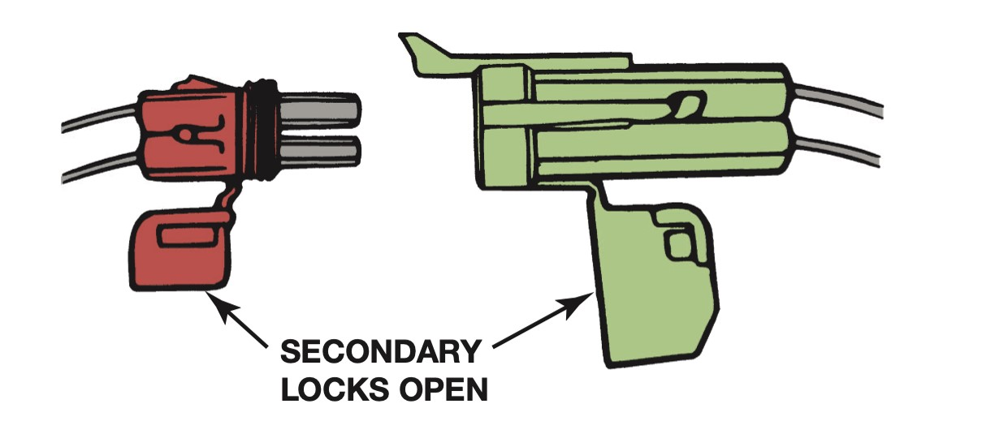
Figure 11.39
The secondary locks help retain the terminals in the connector.

Slide 51
Wire Repair (1 of 2)
Many manufacturers recommend that all wiring repairs be soldered.
  Solder is an alloy of tin and lead used to make a good electrical contact between two wires or connections in an electrical circuit.
Terminals can be crimped to create a good electrical connection if the proper type of crimping tool is used.

Slide 52
Wire Repair (2 of 2)
Heat shrink tubing is usually made from polyvinyl chloride (P V C) or polyolefin and shrinks to about half of its original diameter when heated; this is usually called a 2:1 shrink ratio.
  Heat shrink by itself does not provide protection against corrosion.
Several vehicle manufacturers recommend the use of crimp-and-seal connectors as the method for wire repair.

Slide 53
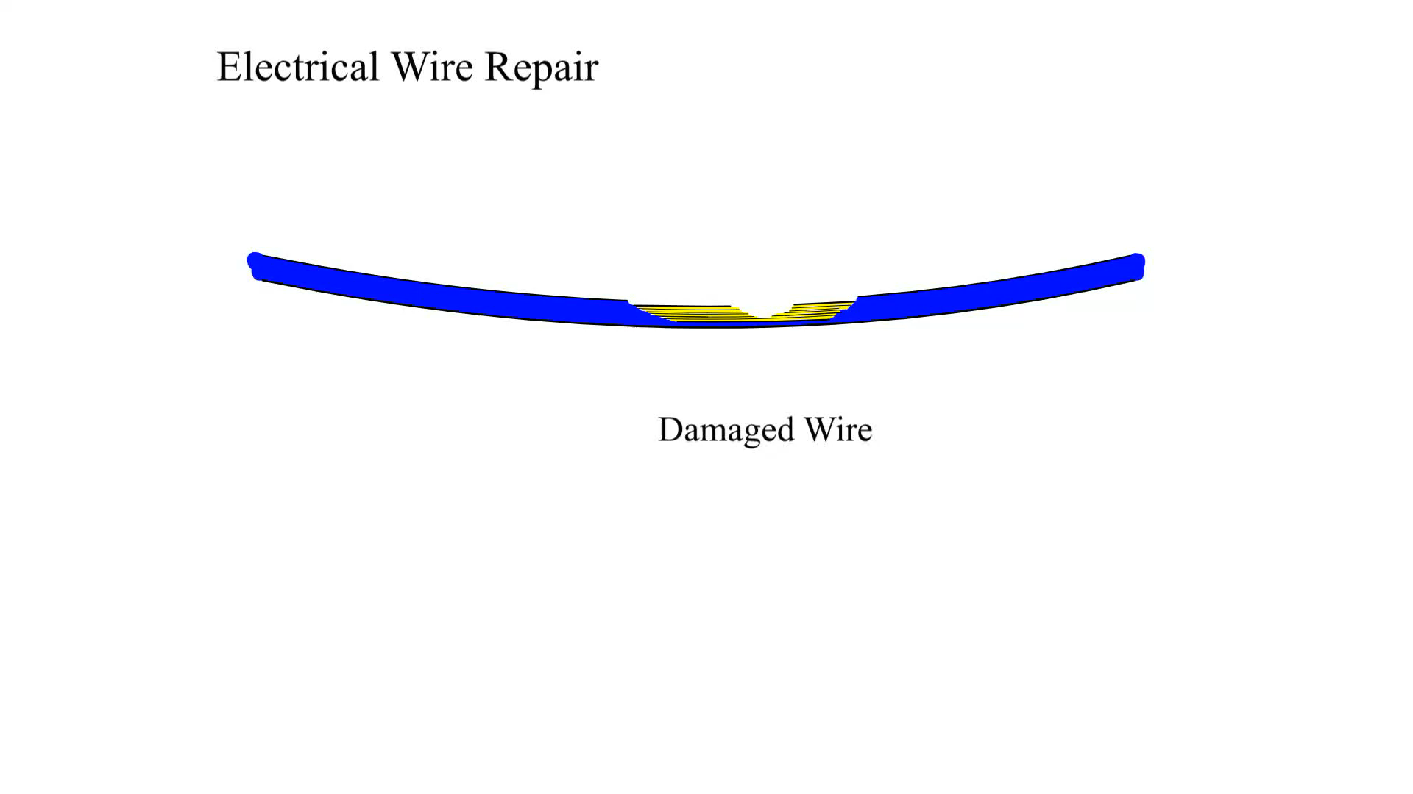
Animation:
Electrical Wire Repair
(The animation will automatically start in a few seconds)

Slide 54
Relays
A relay is a magnetic switch that uses a movable armature to control a high-amperage circuit by using a low-amperage electrical switch.
Terminal Identification
  Coil
  Other terminals used to control the load current

Slide 55
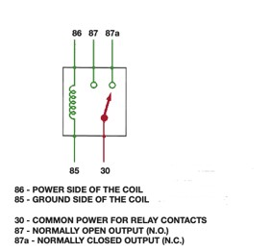
Figure 11.47
A relay uses a movable arm to complete a circuit whenever there is a power at terminal 86 and a ground at terminal 85. The movable arm then closes the contacts (#30 to #87).
Notes:
Long Description:
The circuit consists of five terminals 85, 86, 87, 87 a, and 30 with an inductance between 85 and 86. The power side of the coil is 86, 85 is the ground side of the coil, 30 is the common power for relay contacts, 87 is the normally open output, and 87 a is the normally closed output.

Slide 56
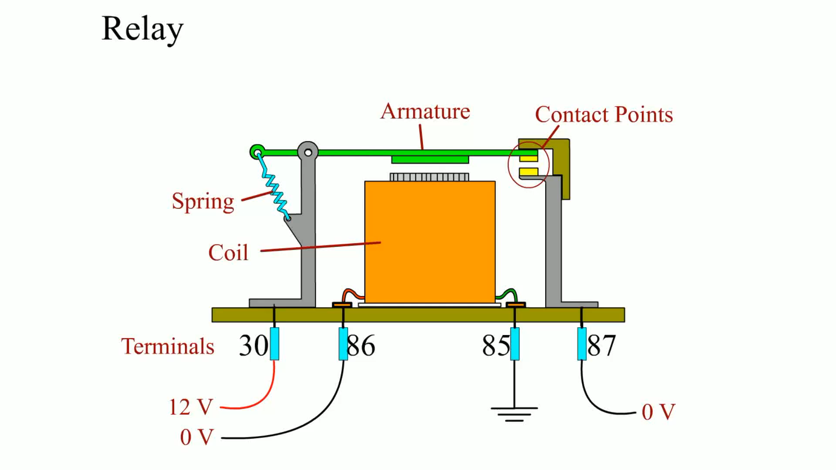
Animation:
Relay
(The animation will automatically start in a few seconds)

Slide 57
Networks
Modules communicate with each other over data lines or hard wiring.
  The use of a network for module communications reduces the number of wires and connections needed.
Types of Communication
  Differential
  Parallel
  Serial data
  Multiplexing

Slide 58
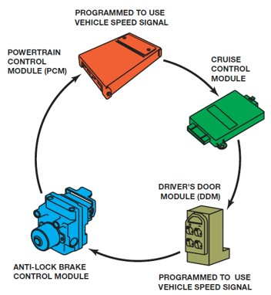
Figure 11.53
A network allows all modules to communicate with other modules.
Notes:
Long Description:
The cyclic diagram shows a cruise control module, a driver's door module, antilock brake control module, and a powertrain control module are connected one after another in a clockwise direction. A note below the driver's door module reads, "Programmed to use vehicle speed signal." Another note for the powertrain control module reads, "Programmed to use vehicle speed signal."

Slide 59
Network Classifications
The S A E communication classifications for vehicle communications system.
  Class A
  Class B
  Class C

Slide 60
Controller Area Network
Robert Bosch Corporation developed the C A N protocol, which was called C A N 1.2, in 1993.
The C A N protocol was approved by the Environmental Protection Agency (E P A) for 2003 and newer vehicle diagnostics, and a legal requirement for all vehicles by 2008.
The C A N diagnostic systems use pins 6 and 14 in the standard 16 pin O B D-II (J-1962) connector.

Slide 61
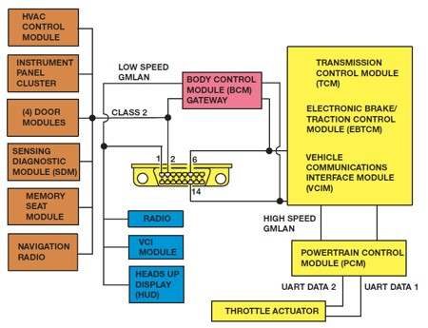
Figure 11.55
A schematic of a Chevrolet Equinox shows that the vehicle uses a G M L A N B U S (D L C pins 6 and 14), plus a Class 2 (pin 2).
Notes:
Long Description:
The system shows an H V A C control module, instrument panel cluster, door modules, sensing diagnostic module, memory seat module, and a navigation radio are connected to low speed G M L A N, class 2, radio, V C I module, and heads up display. It then leads to a body control module gateway and finally passes to a transmission control module, electronic brake or traction control module, vehicle communications interface module, powertrain control module, and a throttle actuator.

Slide 62
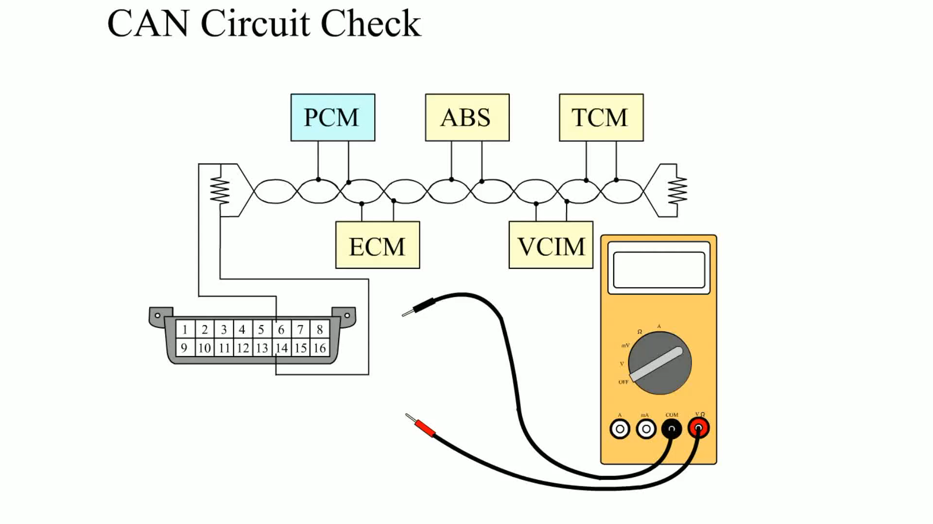
Animation:
CAN Circuit Check
(The animation will automatically start in a few seconds)

Slide 63
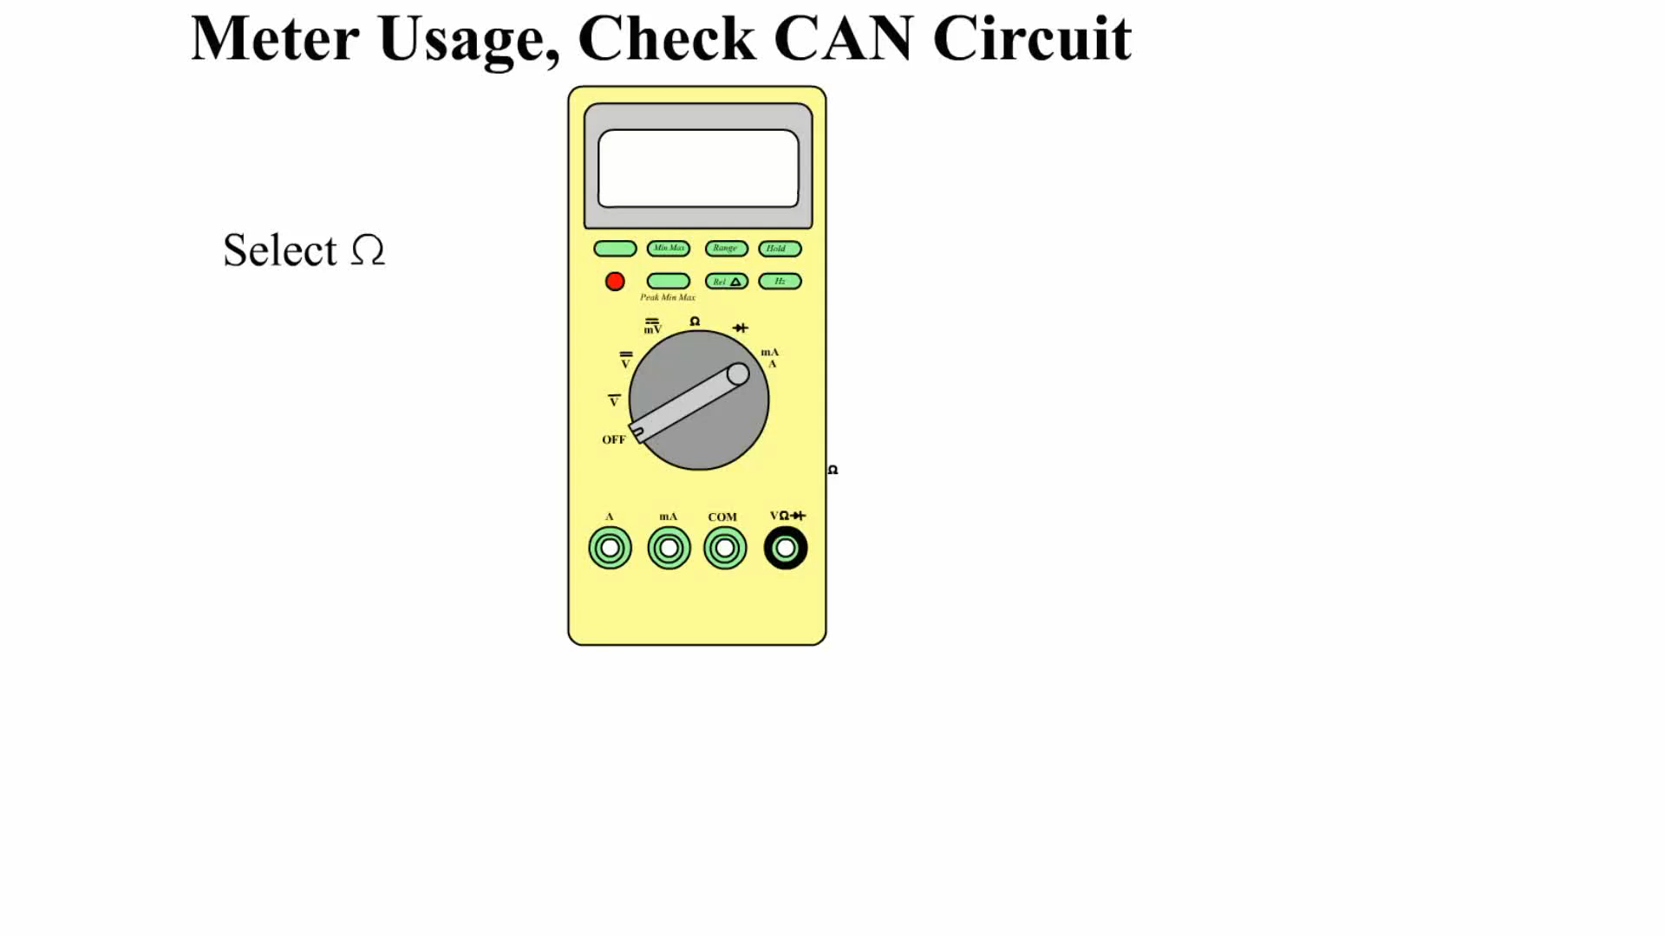
Animation:
Meter Usage, Check CAN Circuit
(The animation will automatically start in a few seconds)

Slide 64
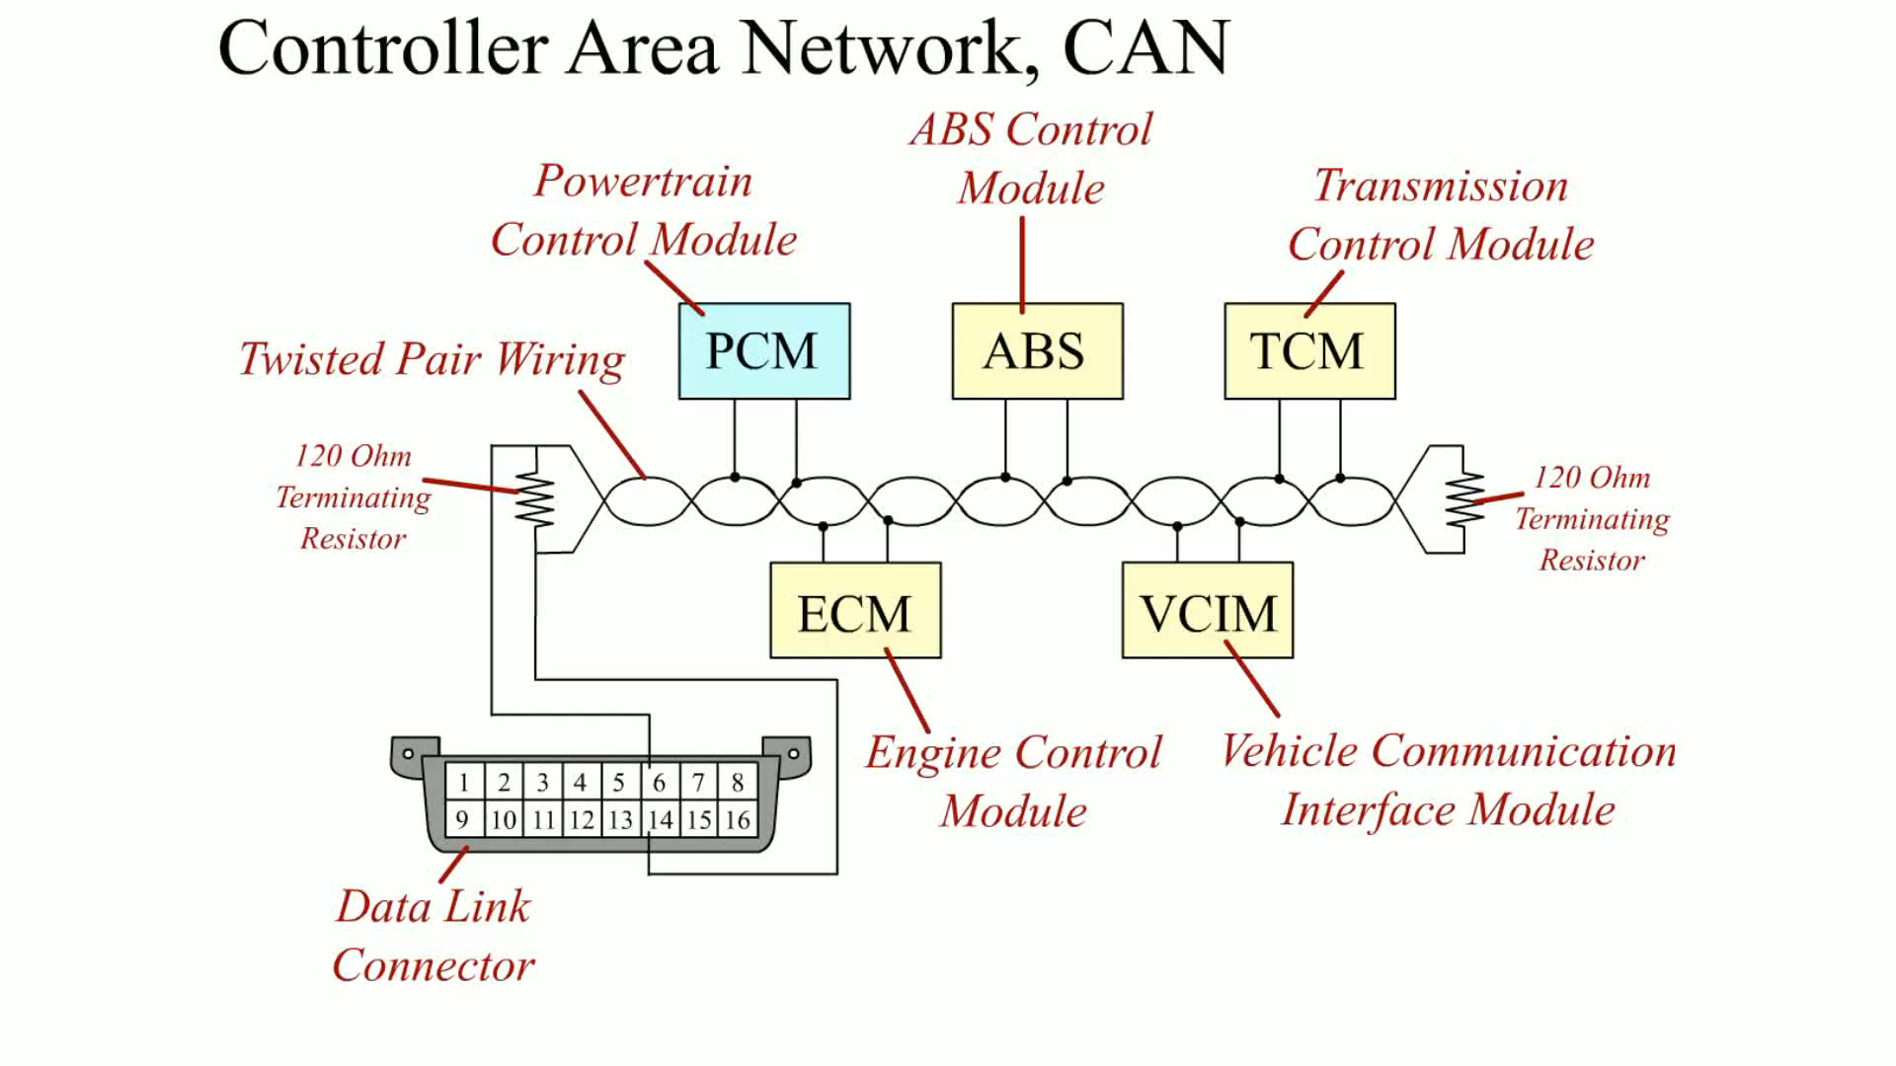
Animation:
Controller Area Network, CAN
(The animation will automatically start in a few seconds)

Slide 65
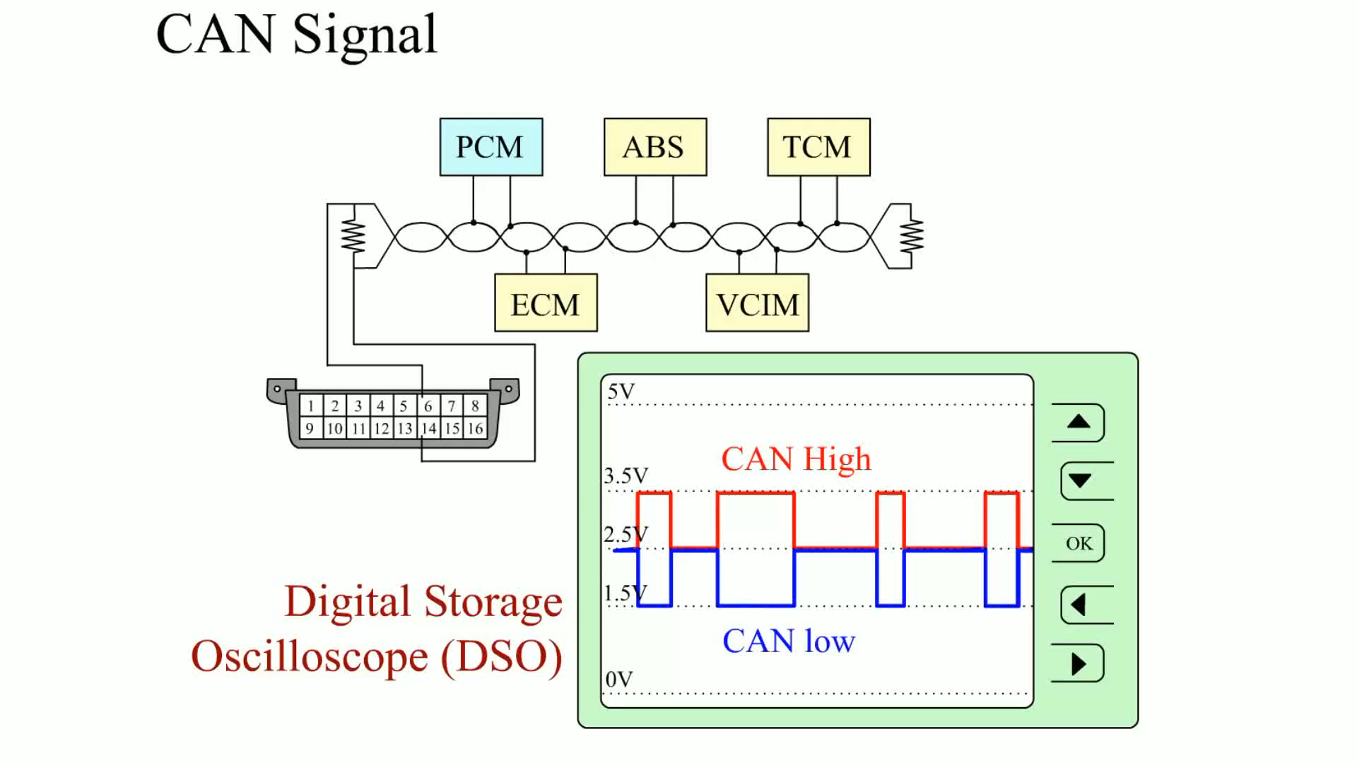
Animation:
CAN Signal
(The animation will automatically start in a few seconds)

Slide 66
Summary (1 of 5)
Electricity is the movement of electrons from one atom to another.
In order for current to flow in a circuit or wire, there must be an excess of electrons at one end and a deficiency of electrons at the other end.
Automotive electricity uses the conventional theory that electricity flows from positive to negative.
The ampere is the measure of the amount of current flow.
Voltage is the unit of electrical pressure.

Slide 67
Summary (2 of 5)
The ohm is the unit of electrical resistance.
All complete electrical circuits have a power source, a circuit protection device, a power-side wire or path, an electrical load, a ground return path, and a switch or a control device.
A short-to-voltage involves a copper-to-copper connection and usually affects more than one circuit.
A short-to-ground usually involves a power path conductor coming in contact with a return (ground) path conductor and usually causes the fuse to blow.

Slide 68
Summary (3 of 5)
An open is a break in the circuit resulting in absolutely no current flow through the circuit.
Circuit testers include test lights and fused jumper leads.
Digital multimeter (D M M) and digital volt-ohm-meter (D V O M) are terms commonly used for electronic test meters.
Ammeters measure current and must be connected in series in the circuit.
Voltmeters measure voltage and are connected in parallel.

Slide 69
Summary (4 of 5)
Ohmmeters measure resistance of a component and must be connected in parallel with the circuit or component disconnected from power.
A terminal is the metal end of a wire, whereas a connector is the plastic housing for the terminal.
All wire repair should use either soldering or a crimp-and-seal connector.
All switches and relays on a schematic are shown in their normal position either normally closed (N.C.) or normally open (N.O.).

Slide 70
Summary (5 of 5)
A typical relay uses a small current through a coil (terminals 85 and 86) to operate the higher current part (terminals 30 and 87).
The use of a network for module communications reduces the number of wires and connections needed.
The SAE communication classifications for vehicle communications systems include Class A (low speed), Class B (medium speed), and Class C (high speed).

Slide 71
Animation and Video Resources
The below listed resources are hyperlinked to the James Halderman website
(A6) Electrical/Electronic Systems Animations
(A7) Heating & Air Conditioning Animations
(A6) Electrical/Electronic Systems Videos
(A7) Heating & Air Conditioning Videos

Slide 72
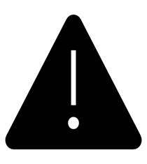
Copyright
This work is protected by United States copyright laws and is provided solely for the use of instructors in teaching their courses and assessing student learning. Dissemination or sale of any part of this work (including on the World Wide Web) will destroy the integrity of the work and is not permitted. The work and materials from it should never be made available to students except by instructors using the accompanying text in their classes. All recipients of this work are expected to abide by these restrictions and to honor the intended pedagogical purposes and the needs of other instructors who rely on these materials.

