Slide 1
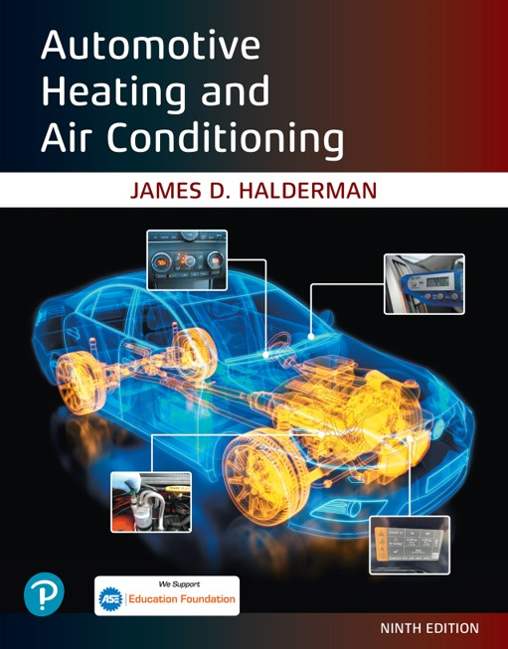
Automotive Heating and Air Conditioning
Ninth Edition
Chapter 10
Heating System Operation and Diagnosis
Copyright © 2021, 2018, 2015 Pearson Education, Inc. All Rights Reserved
Notes:
If this PowerPoint presentation contains mathematical equations, you may need to check that your computer has the following installed:
1) Math Type Plugin
2) Math Player (free versions available)
3) NVDA Reader (free versions available)

Slide 2
Learning Objectives
10.1 Prepare for the A S E Heating and Air Conditioning (A7) certification test content area “C” (Heating and Engine Cooling Systems Diagnosis and Repair).
10.2 Discuss the operation of heating systems.
10.3 Discuss the diagnosis of heating systems.
10.4 Explain the operation of electrically heated seats.
10.5 Explain the operation of heated and cooled seats.
10.6 Explain the operation of heated steering wheel.

Slide 3
Heating Systems
The inlet hose to the heater core connects to an outlet fitting near the engine thermostat or an area of the engine with the hottest coolant.
The outlet hose from the heater core is connected near the inlet of the water pump, which is the area with the lowest coolant pressure.
When the engine runs, coolant flows through the engine’s water jackets, past the thermostat, and through the heater core.
The heated coolant warms the heater core and the air passing through it.

Slide 4
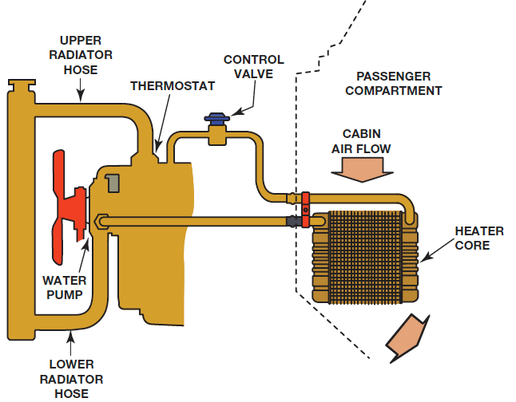
Figure 10.1
The main parts of a vehicle’s heating system are the heater core, blower, heater hoses, and, in some cases, a heater control valve.

Slide 5
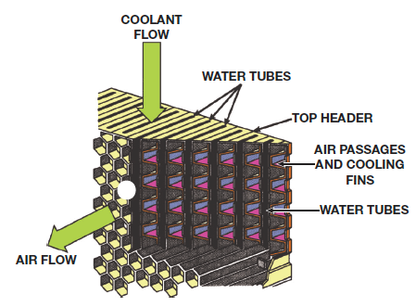
Figure 10.3
Heat is transferred from the hot coolant flowing through the water tubes to warm the air flowing through the fins of the core.

Slide 6
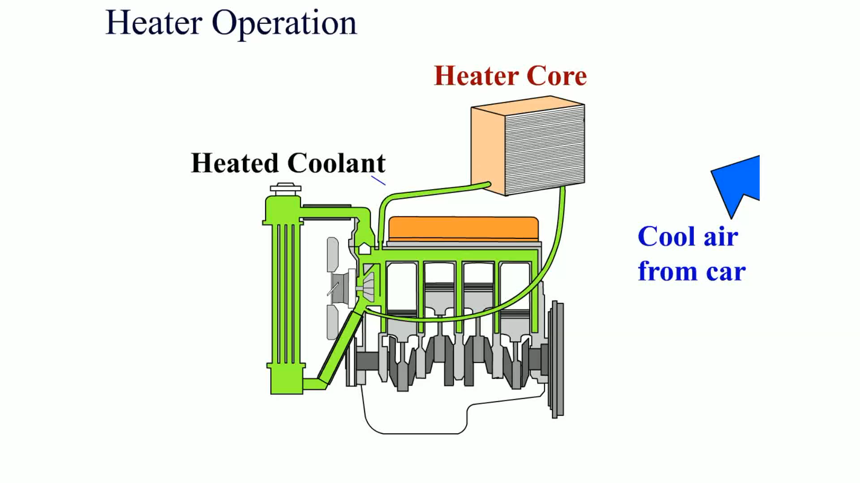
Animation:
Heater Operation
(The animation will automatically start in a few seconds)

Slide 7
Dual Heating Systems
Larger vehicles with rear A/C systems include a heater in the rear unit.
  These rear units include a heater core and temperature-blend door.
  Heater hoses include a tee fitting in each hose so that the heated coolant can flow through either or both heater cores.

Slide 8
Heater Diagnosis (1 of 3)
Visual Inspection
  Coolant level and condition
  Water pump drive belt condition and proper tension
    Belt tension gauge
    Marks on the tensioner
    Torque wrench reading
    Deflection

Slide 9
Heater Diagnosis (2 of 3)
To check a radiator or condenser for possible clogged or restricted areas
  Check the temperature of the heater hoses
  Check for proper airflow across the heater core
  Pressure test the cooling system

Slide 10
Heater Diagnosis (3 of 3)
Scan Tool Diagnosis
  Use a scan tool and check for any stored or pending diagnostic trouble codes, especially those that pertain to the H V A C controls.
  Check that the coolant temperature as measured by the engine coolant temperature (E C T) sensor is correct, usually 180°F to 200°F (82°C to 93°C). Check service information for the specified coolant temperature for the vehicle being checked.
  Perform a bidirectional control of the blend door and blower motor speed, if possible, to confirm that these are operating correctly.

Slide 11
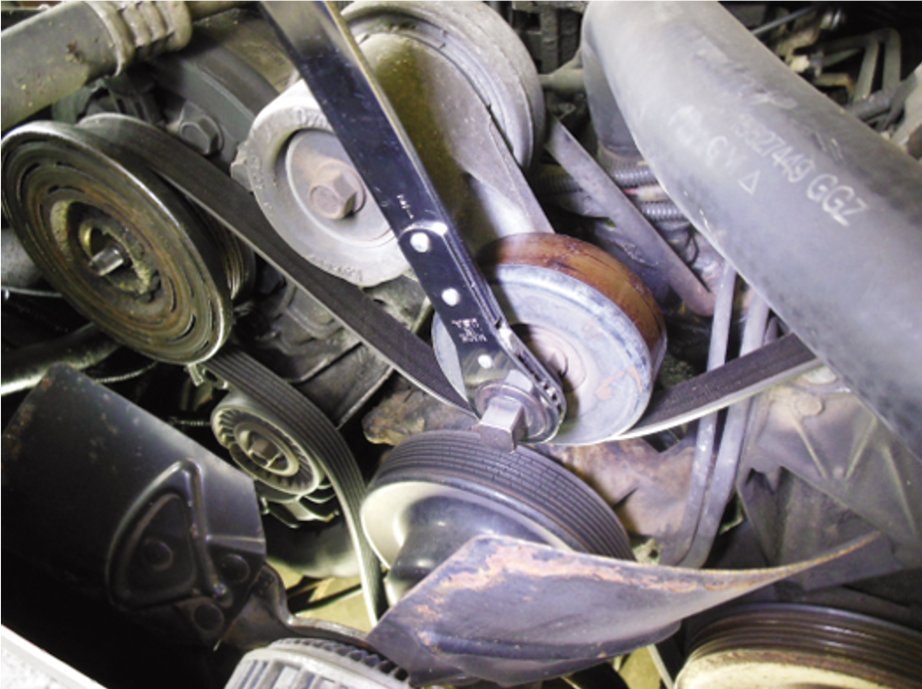
Figure 10.4
A special wrench being used to remove the tension from the accessory drive belt so that it can be removed.

Slide 12
Electrically Heated Seats (1 of 2)
Heated seats use electric heating elements in the seat bottom, as well as in the seat back in many vehicles.
The heating element is designed to warm the seat and/or back of the seat to about 100°F (37°C) or close to normal body temperature (98.6°F).
A temperature sensor in the seat cushion is used to regulate the temperature.
The sensor is a variable resistor that changes with temperature and is used as an input signal to a heated seat control module.

Slide 13
Electrically Heated Seats (2 of 2)
The heated seat module uses the seat temperature input, as well as the input from the high–low (or variable) temperature control, to turn the current on or off to the heating element in the seat.
Some vehicles are equipped with heated seats in both the rear and the front.

Slide 14
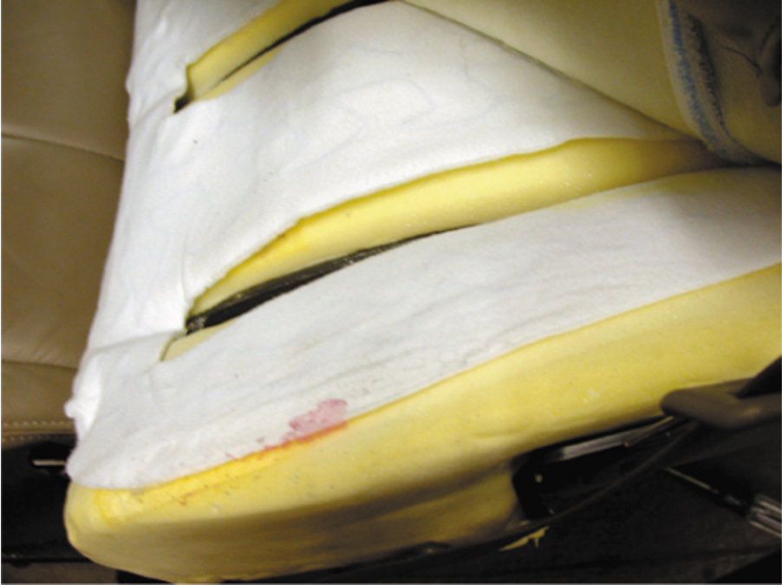
Figure 10.6
The heating element of a heated seat is a replaceable part, but service requires that the upholstery be removed.

Slide 15
Heated and Cooled Seats (1 of 2)
Most electrically heated and cooled seats use a thermoelectric device (T E D) located under the seat cushion and seat back.
The thermoelectric device uses the Peltier effect.
Most vehicles equipped with heated and cooled seats use two modules per seat.

Slide 16
Heated and Cooled Seats (2 of 2)
Each thermoelectric device has a temperature sensor, called a thermistor.
The control module uses sensors to determine the temperature of the fins in the thermoelectric device so that the controller can maintain the set temperature.

Slide 17
Heated Steering Wheel
A signal is sent to the control module and electrical current flows through the heating element in the rim of the steering wheel.
The system remains on until the ignition switch is turned off or the driver turns off the control switch.
The temperature of the steering wheel is usually calibrated to stay at about 90°F (32°C), and it requires three to four minutes to reach that temperature depending on the outside temperature.

Slide 18
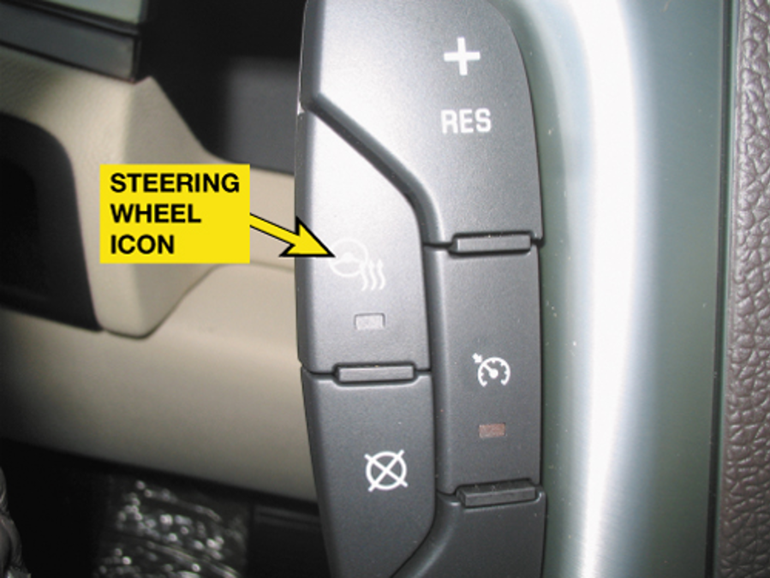
Figure 10.8
The heated steering wheel is controlled by a switch on the steering wheel in this vehicle.

Slide 19
Summary (1 of 2)
Hot coolant from the engine cooling system provides the heat for heater output.
The heater core resembles a small radiator, and it is connected to the engine by a pair of hoses.
Some vehicles use a coolant flow valve to control heater output temperature.

Slide 20
Animation and Video Resources
The below listed resources are hyperlinked to the James Halderman website
(A7) Heating & Air Conditioning Animations
(A7) Heating & Air Conditioning Videos

Slide 21
Summary (2 of 2)
Heated seats can use either a resistance-type heater located under the seat covering or a thermoelectric (T E) device.
Heater diagnosis includes verifying the problem, visual inspections, and scan tool usage.

Slide 22

Copyright
This work is protected by United States copyright laws and is provided solely for the use of instructors in teaching their courses and assessing student learning. Dissemination or sale of any part of this work (including on the World Wide Web) will destroy the integrity of the work and is not permitted. The work and materials from it should never be made available to students except by instructors using the accompanying text in their classes. All recipients of this work are expected to abide by these restrictions and to honor the intended pedagogical purposes and the needs of other instructors who rely on these materials.

