Slide 1

By Jim Halderman

Slide 2
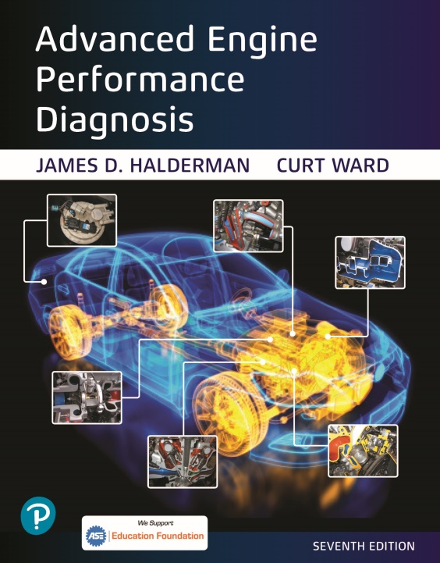




Introduction
Jim Halderman
Former flat-rate technician
Author and former automotive instructor
jim@jameshalderman.com

Slide 3



Download this presentation
www.JamesHalderman.com

Slide 4
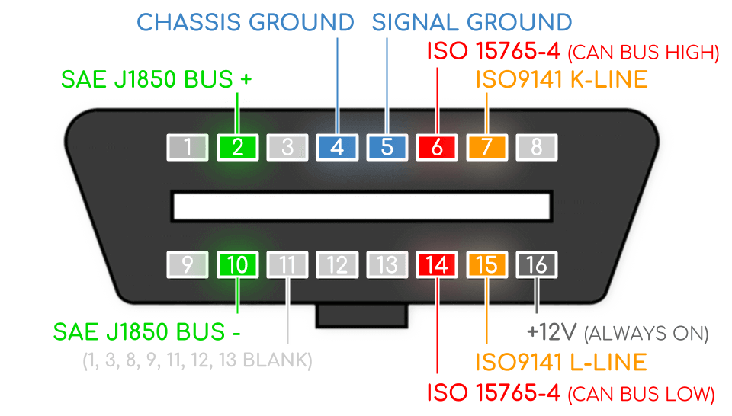
Topics to be Discussed
Diagnosis of the battery, starting and charging systems from the driver's seat.
Using an OBD II breakout box (BOB).
How to check DTCs, monitor status and scan tool data all from the driver’s seat.
Test drive.

Slide 5
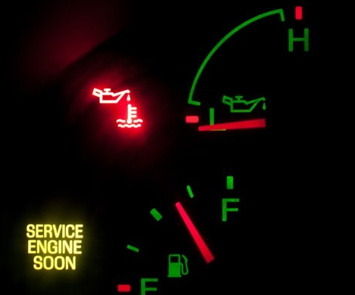
Today All or Mostly Electrical
What do you think could be checked from the driver's seat?
Oil level?
Battery voltage?
Starter/ alternator issues?
Air conditioning condition?
Diagnosis?

Slide 6
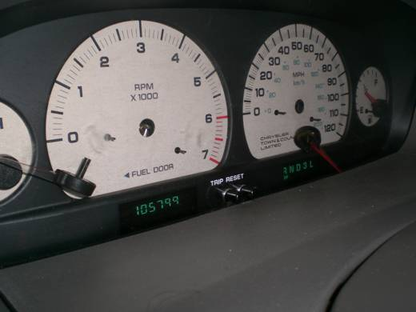
Verify Customer Concern
Customer stated that he had to pound on dash to get the car to start.
Yep. the customer pounded on the dash,
So hard that the needles fell off.

Slide 7
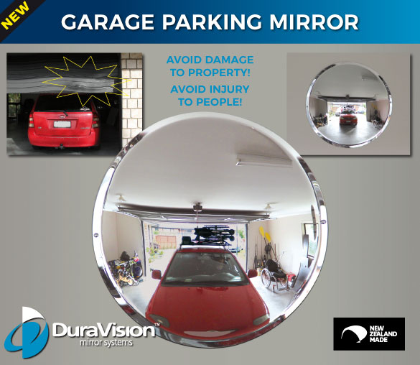
Visual Inspection
Check the following:
Lights, turn signal, and horn
Windshield wipers and washers
All accessories
Use mirrors in the shop to see the lights

Slide 8
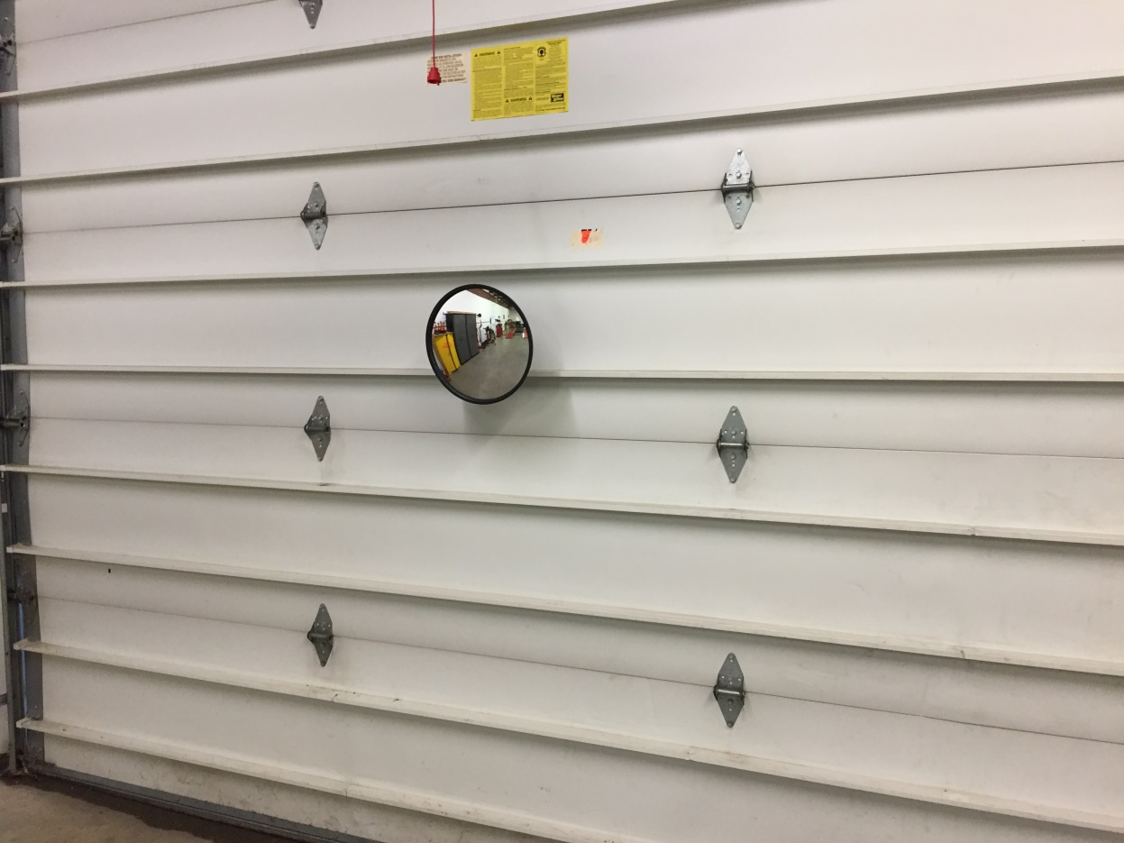
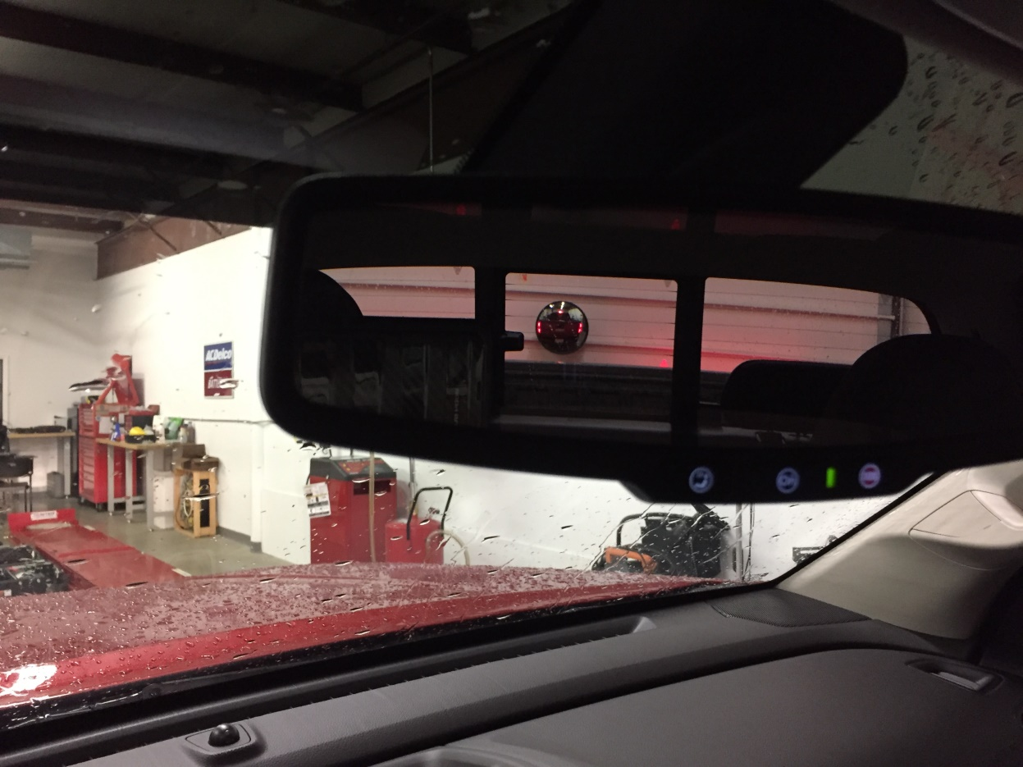
My Shop Mirror

Slide 9

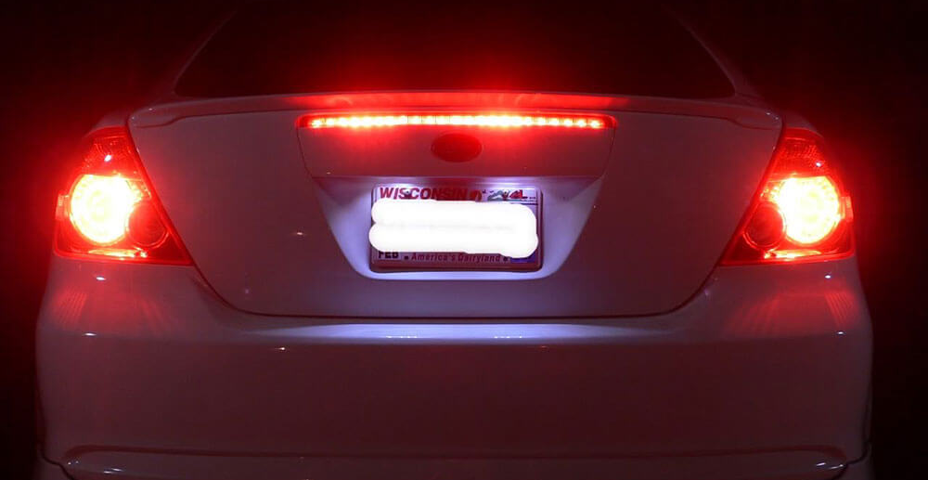
TECH TIP
If the cruise control is inoperative,
Could be due to inoperative brake lights or CHMSL.
Check them by looking through the rearview mirror, using the mirrors in the shop.

Slide 10
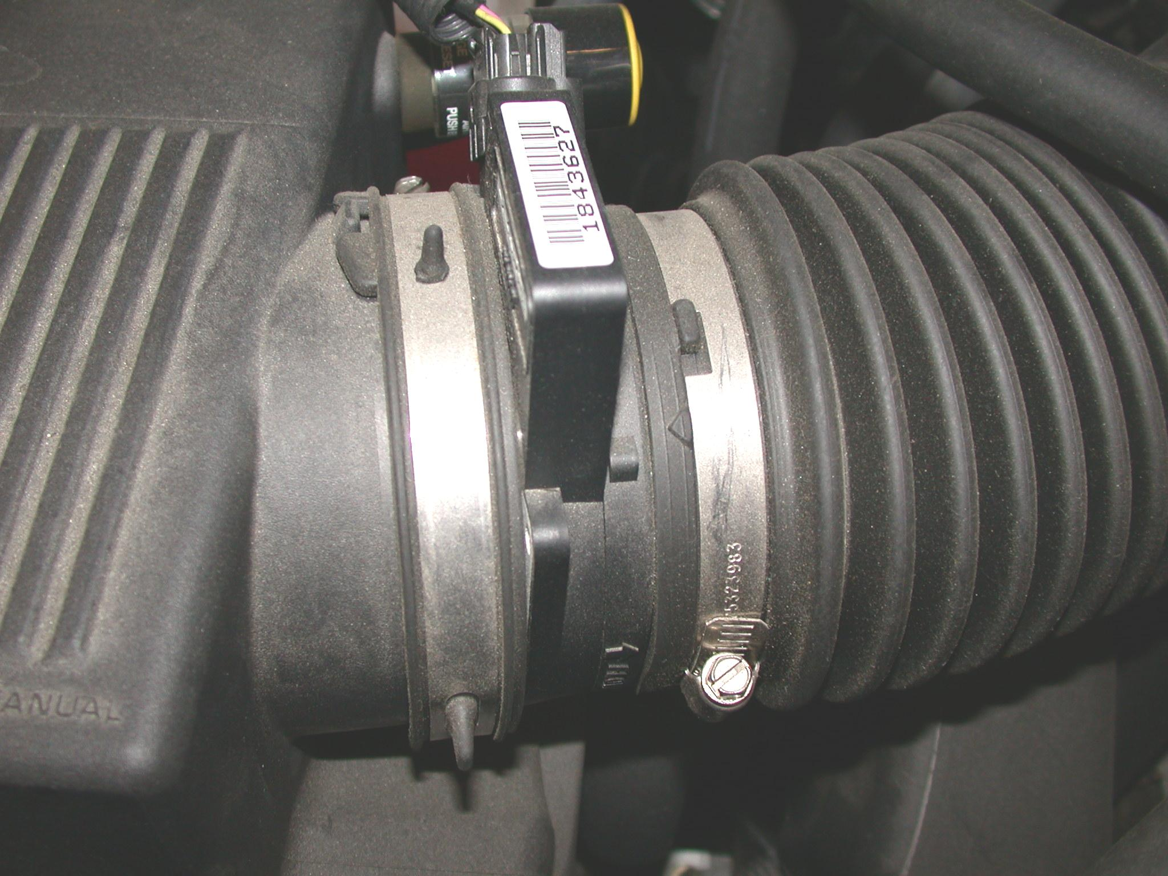
Visual Inspection
According to General Motors, 20% of faults are found using visual inspection
Ask students to perform a visual inspection.
Typical bugs: Remove the dipstick; Turn MAF backwartds

Slide 11
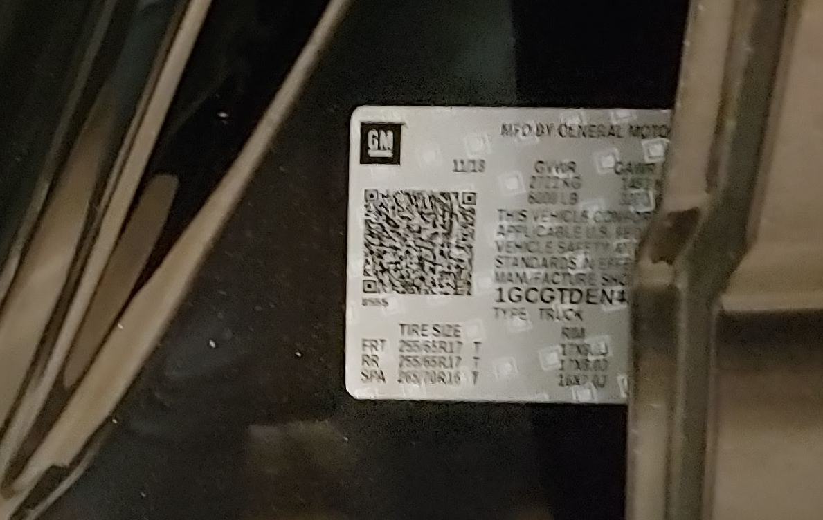
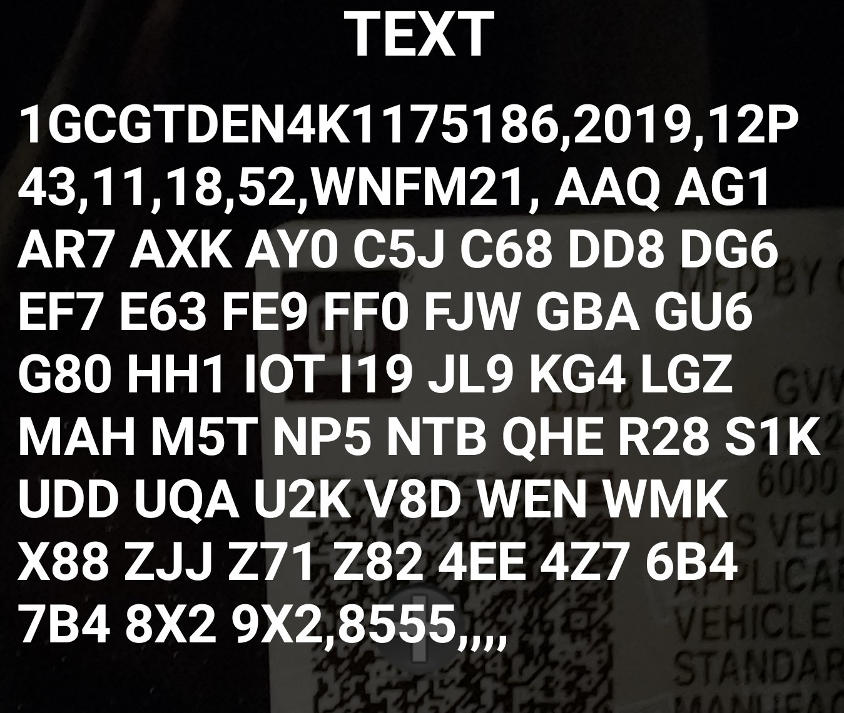
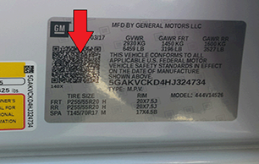
Service Information – GM RPO Codes
2018+ GM use a QR code on the “B” pillar.
When using a QR reader on a smartphone or scan tool camera, shows the VIN and the “Regular Production Option” (RPO) codes. (2016-2017 VIN only)
Needed for the right parts and diagnosis.

Slide 12
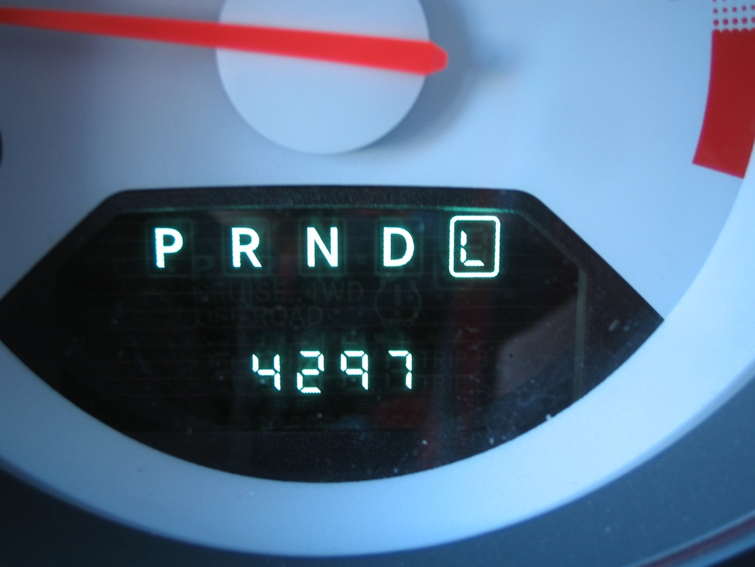
Where to Start?
Check everything that does and does not work, including:
Test the brake pedal feel.
Check for proper engagement into drive and reverse.
If the vehicle moves forward and back, but does not shift, it is usually the valve body.
If the vehicle does not move, usually the unit needs to be removed.

Slide 13
Any Dash Warning Lights On?

Slide 14
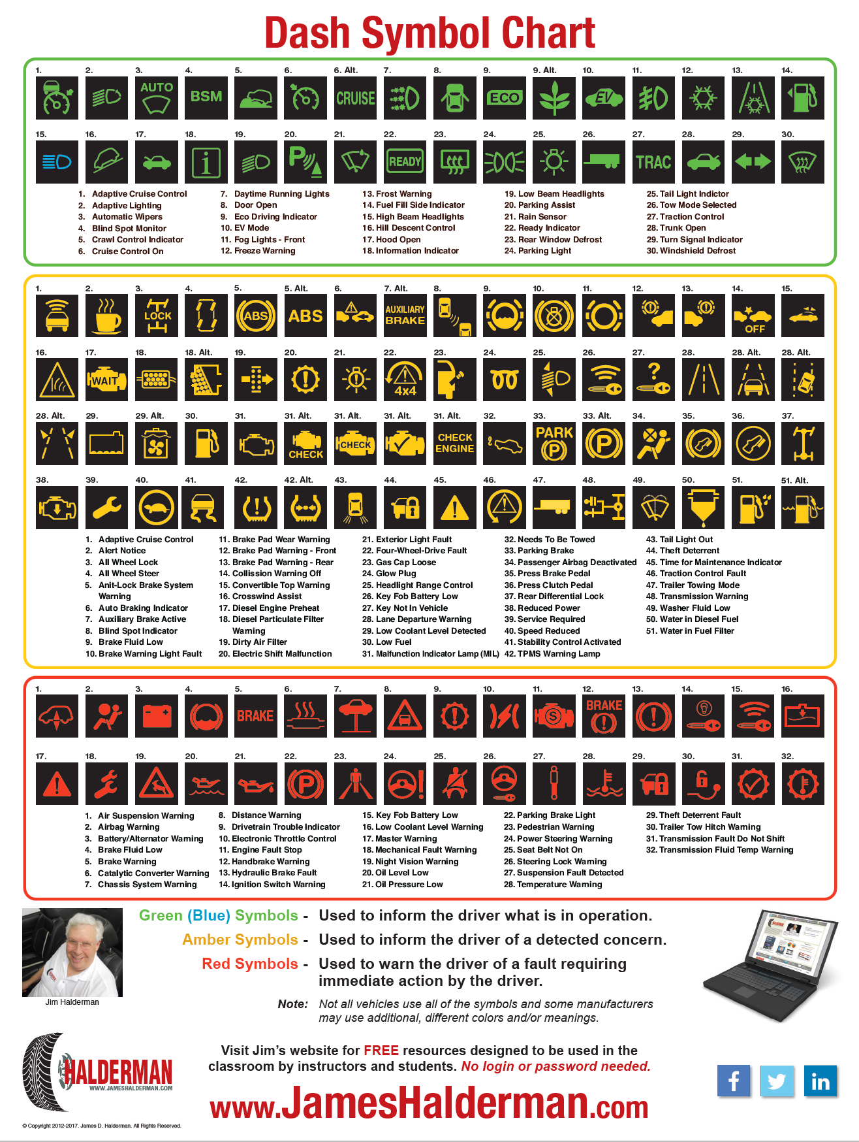

Dash Symbol Chart
www.JamesHalderman.com
Green = Information
Amber = Caution
Red = Warning

Slide 15
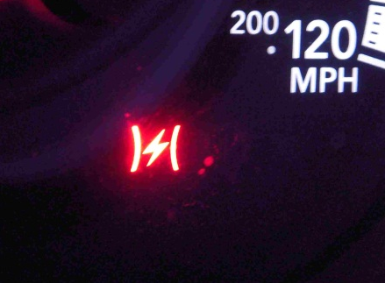
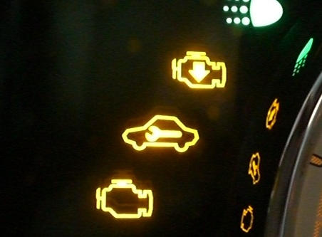
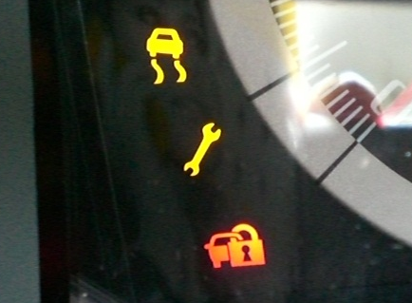
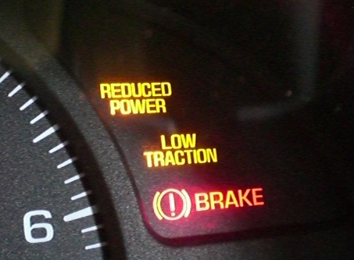
Dash Warning Lights Mean?
(Electronic Throttle control fault detected)

Slide 16

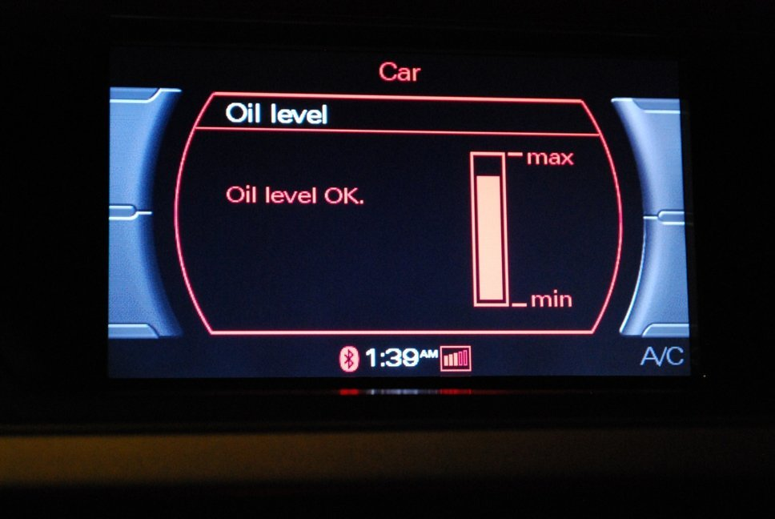
Checking Oil Level
Old school
Under the hood
New school
From the driver’s seat

Slide 17

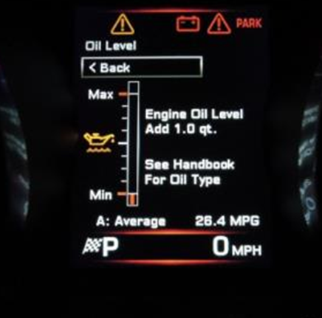
Ultrasonic Oil Level Sensor
Since 2010, Jaguar uses an ultrasonic oil level sensor.
It uses sound waves that bounce off the oil surface and then displays the oil level.
Scroll through trip settings, using the trip button on the end of the turn signal stalk.

Slide 18
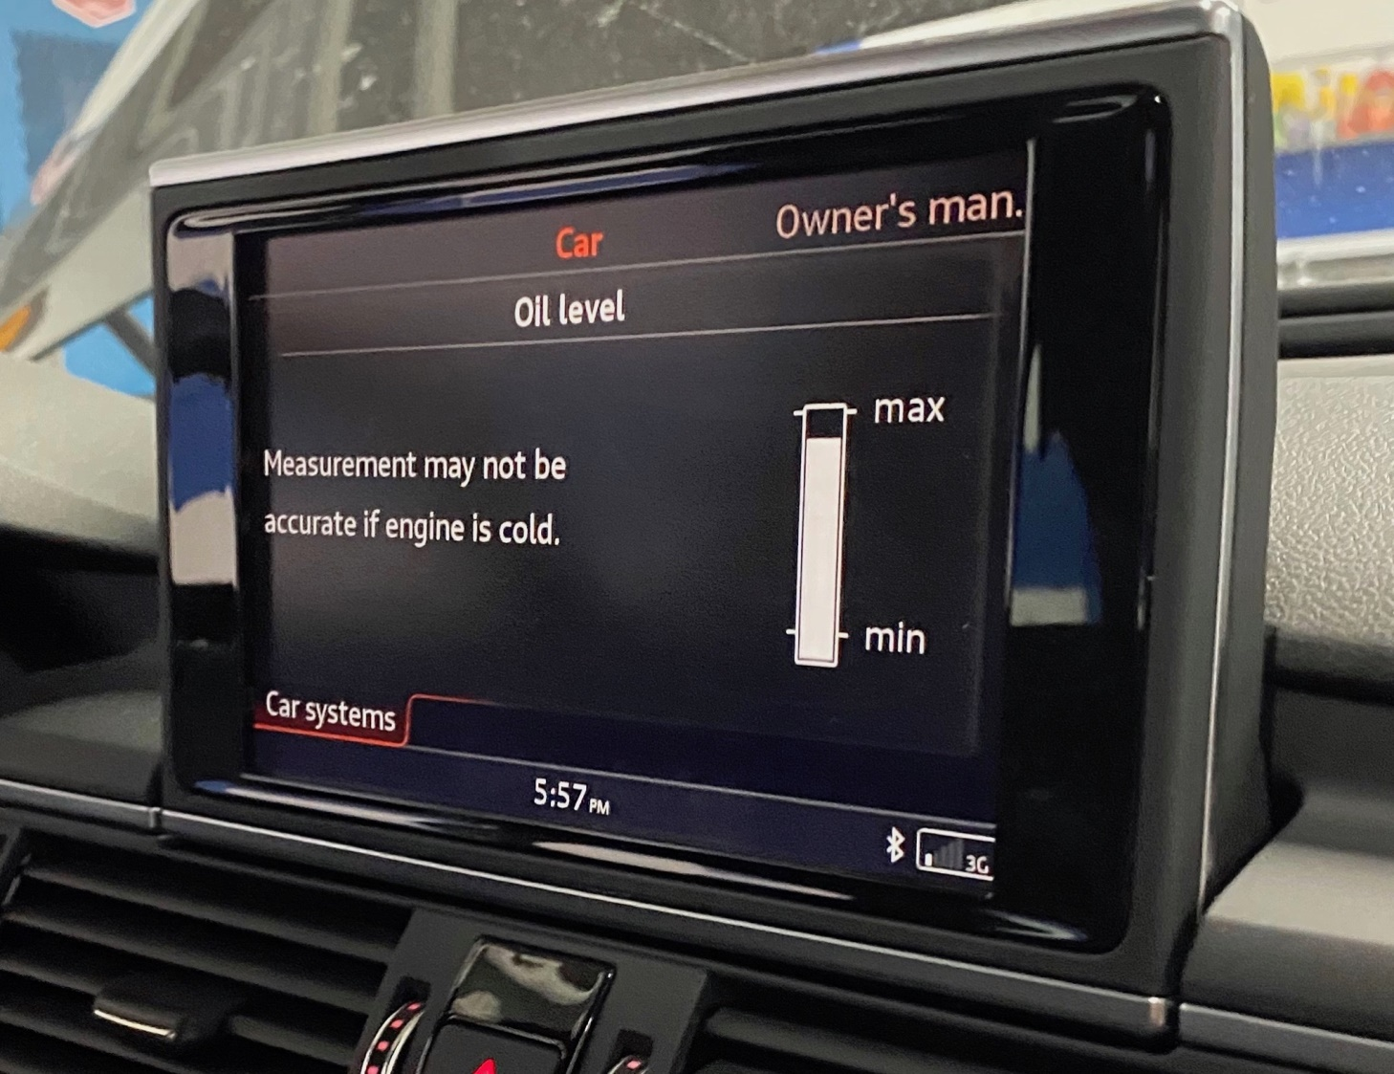
Oil Level Dash Displays
Oil level displayed on the dash is mostly on European vehicles at this this time, including:
Jaguar
BMW
Mercedes
Audi (Audi A8 shown)

Slide 19
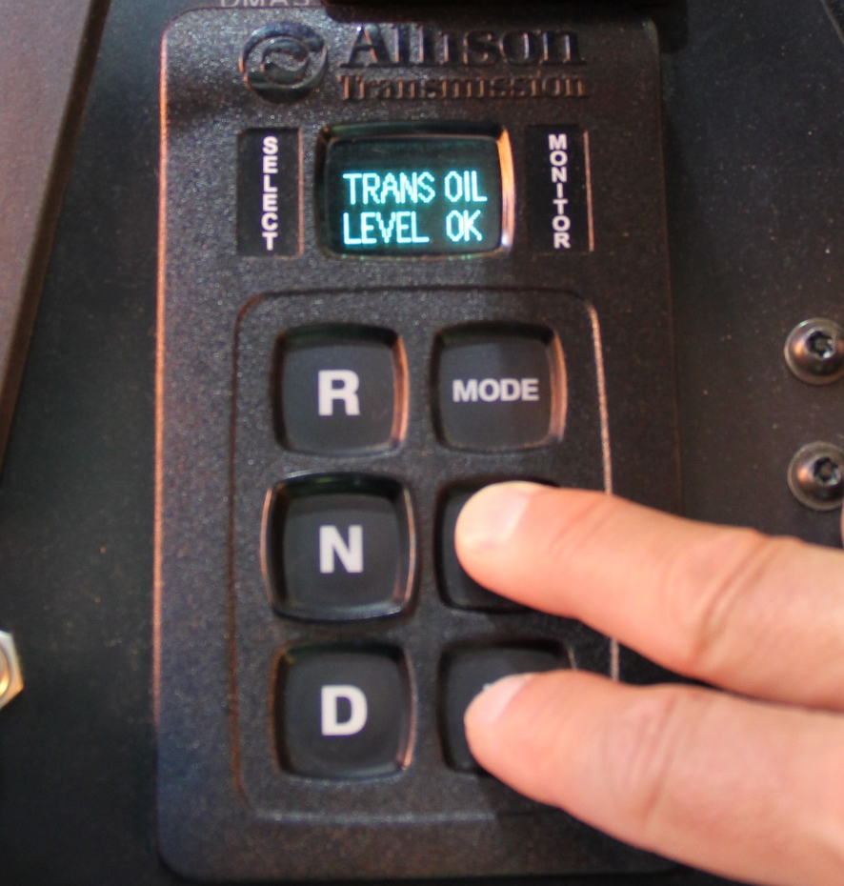
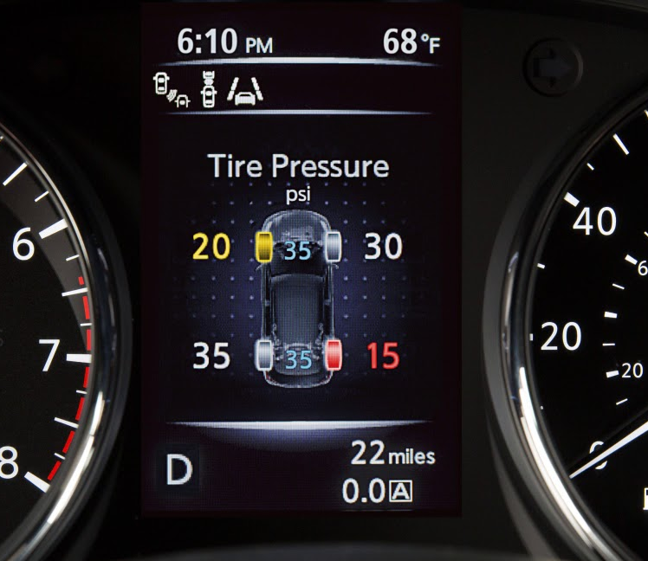
What else can be measured from the driver’s seat?
ATF? - Some vehicles
Tire Pressure? - Most vehicles

Slide 20
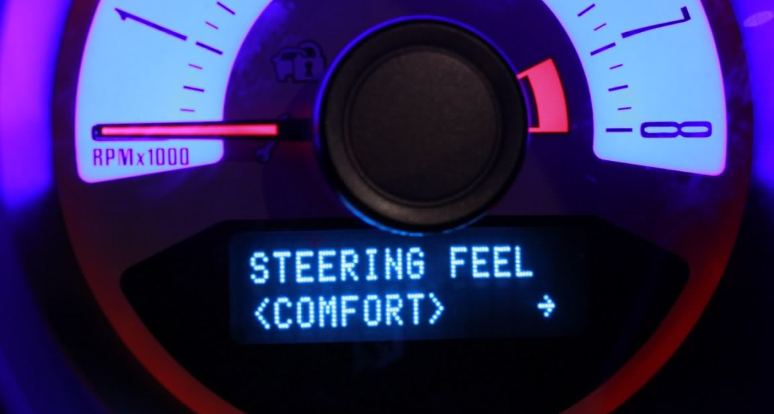
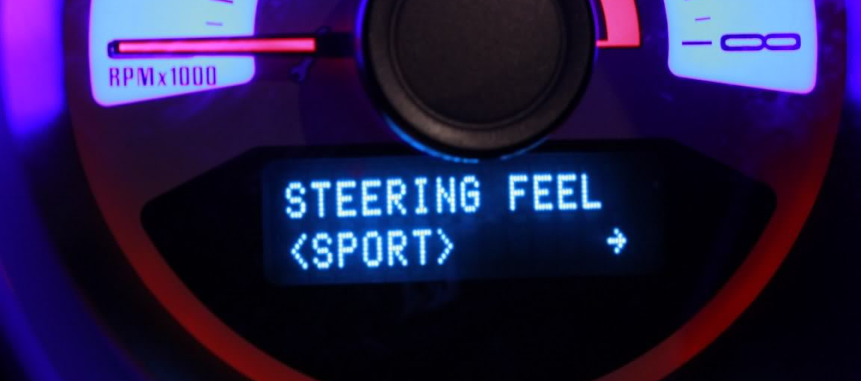
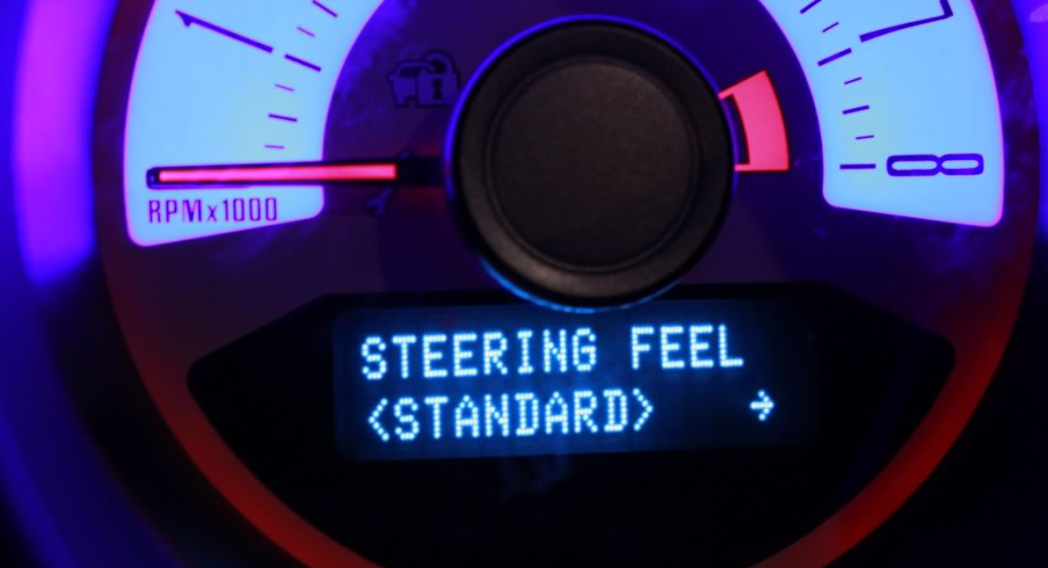
Ford Mustang Variable Effort Steering
Changeable from the driver’s seat

Slide 21
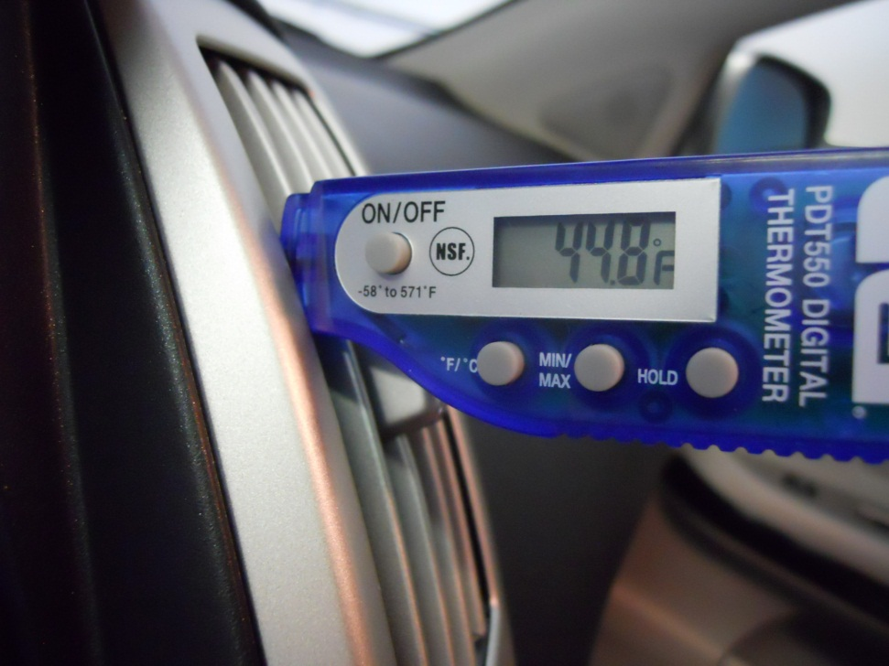
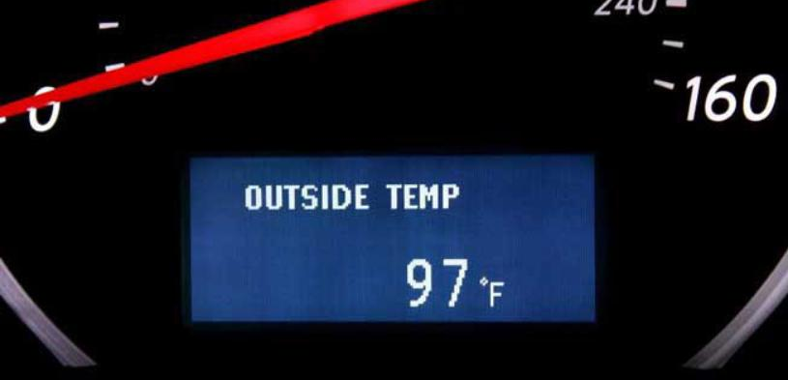
A/C Diagnosis from the Driver’s Seat
Is the air conditioning working as designed?
Measure vent temperature and look at outside temperature.

Slide 22
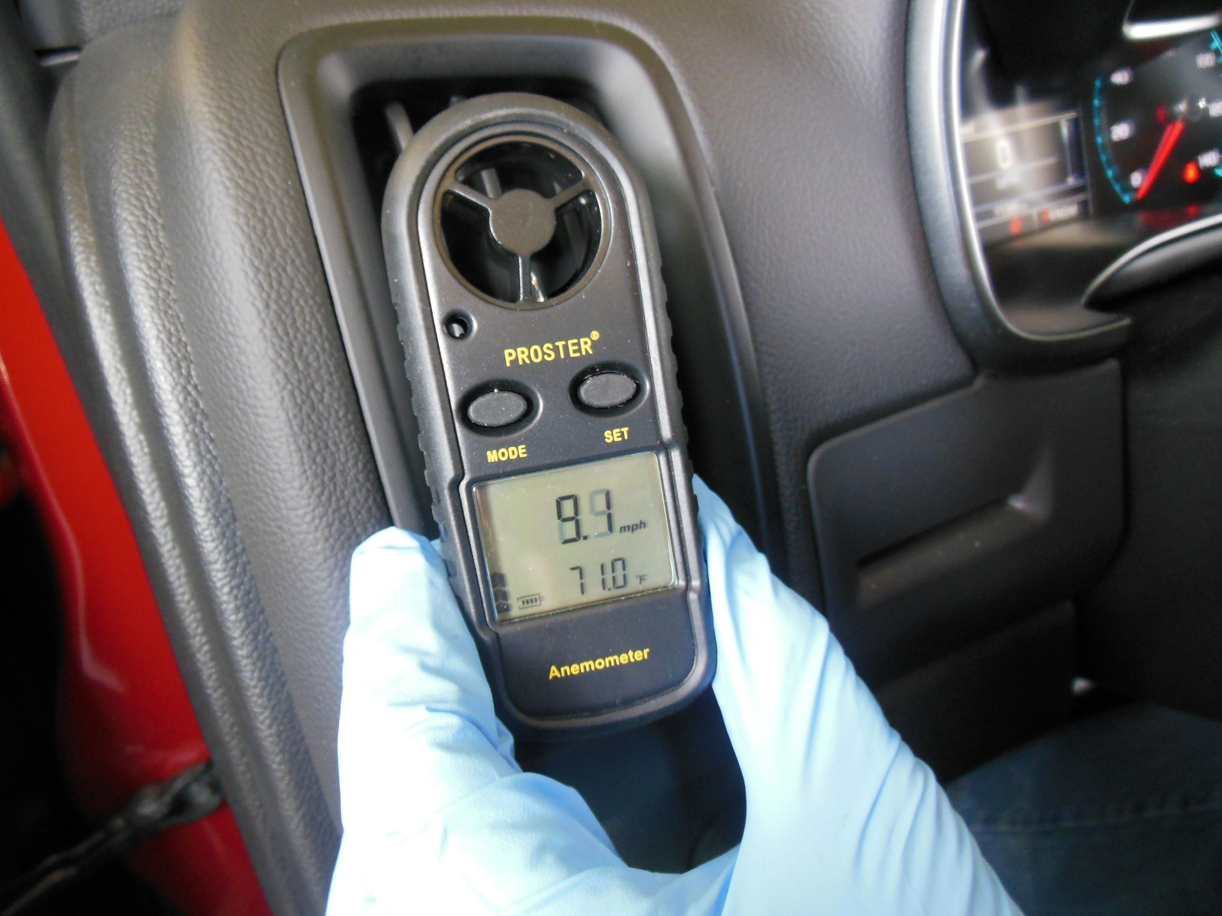
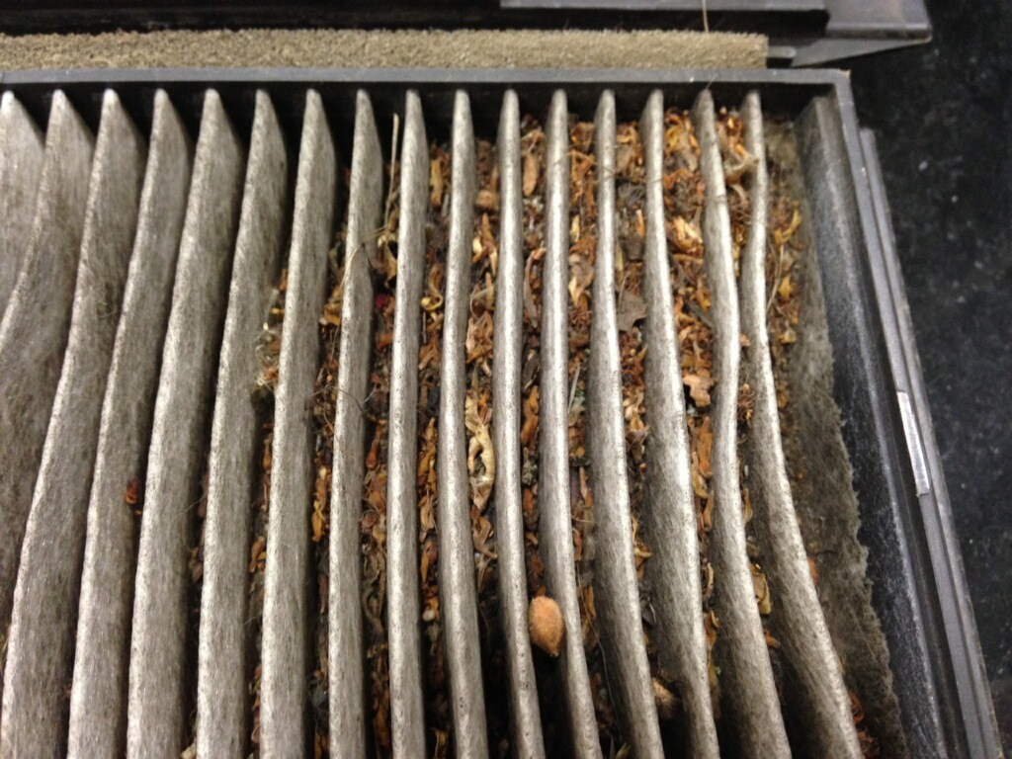
Airflow Check

Slide 23

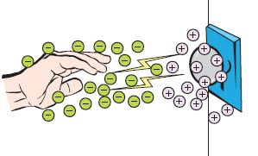
Case Study
Complaint - There is an “electrical short” because the driver gets shocked when touching the door handle when leaving the car.
Cause - Driver’s movement on the upholstery caused a static charge buildup.
Correction - Used static guard spray on the seats.

Slide 24
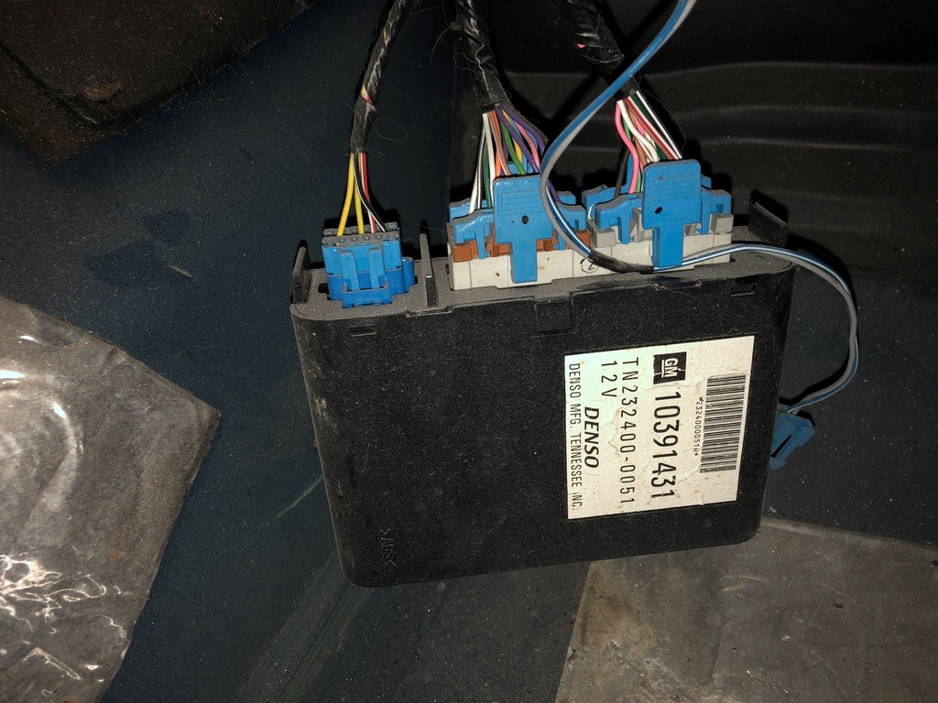
Case Study
Buick LaCrosse 3.8 L
Complaint - Customer states that the battery goes dead overnight.
Customer says that a “humming” sound is heard from under the dash.

Slide 25
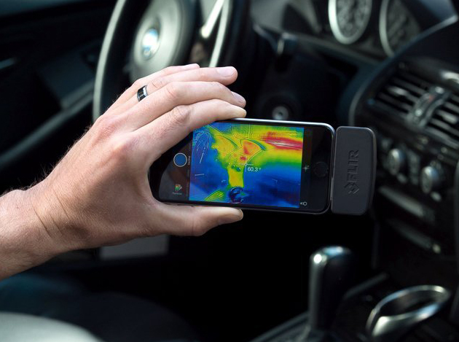
Case Study - Solution
Used a thermal image camera (FLIR) to locate which module was powered up all the time.
The HVAC module was not shutting down.
It was controlled by the BCM.
Replaced BCM and programmed the unit.

Slide 26
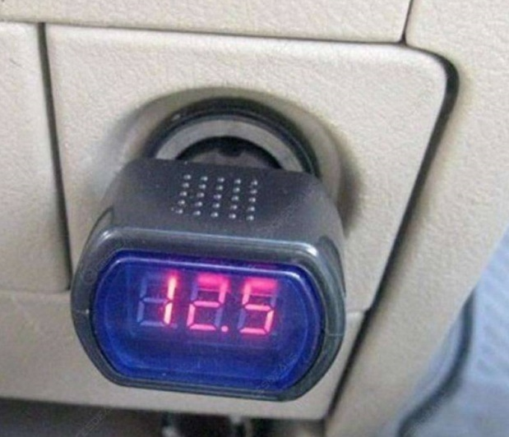
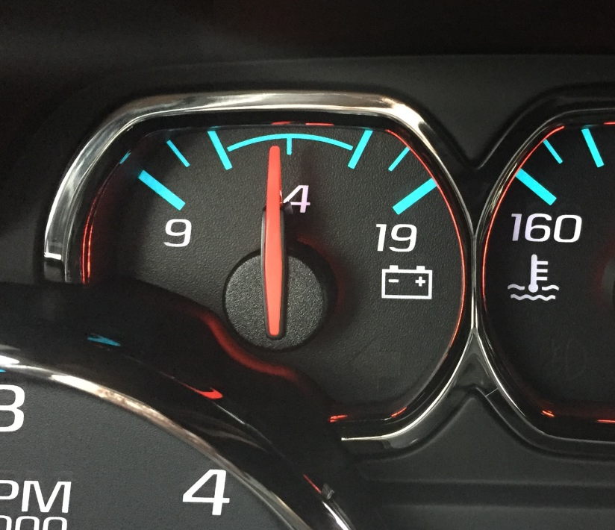
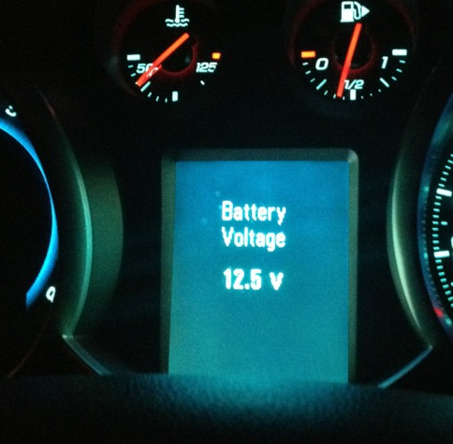
Voltage Display

Slide 27
Electrical Measurements from the Driver’s Seat
DC voltage (cranking and charging voltage)
AC voltage (AC ripple voltage)
Used to determine the condition of the following:
  Battery SOC
  Starter
  Alternator

Slide 28
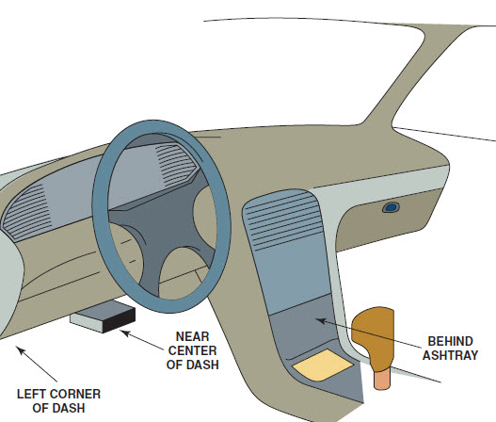
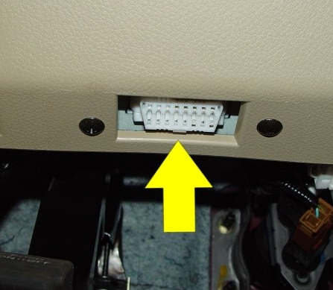
Where is the DLC?

Slide 29
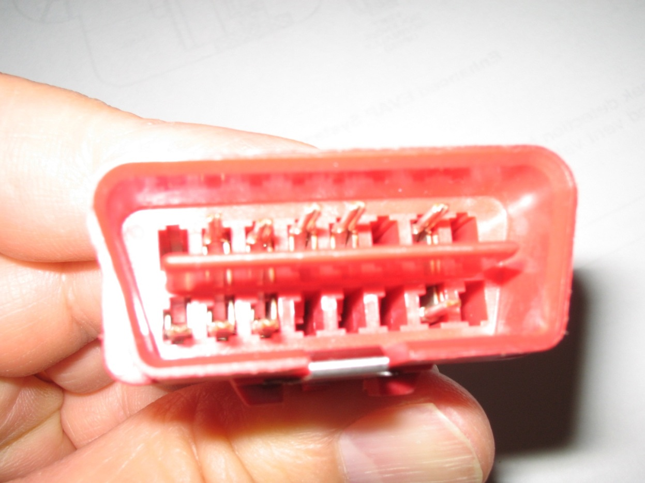
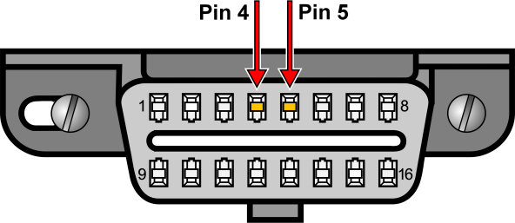
OBD II Connector
OBD II Plug - Pins #4 and #5 are longer.
Why?

Slide 30

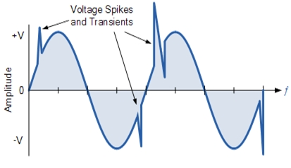
OBD II Connector
Because the ground touches first when making the connection.
Helps prevent voltage spikes.

Slide 31
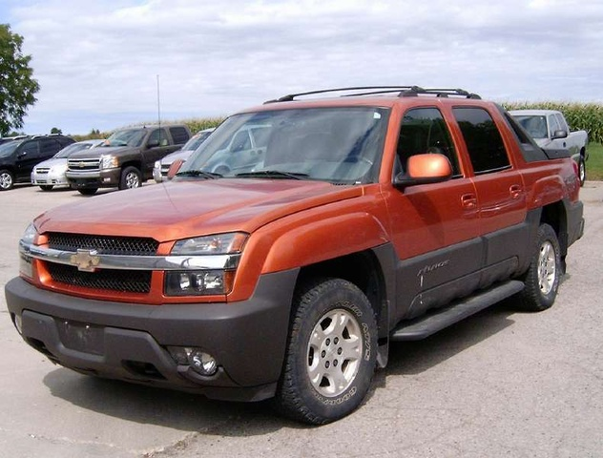
Case Study
Compliant - On a Chevrolet Avalanche, the scan tool would not power up.
Cause - No 12 volts at pin #16 of the DLC. Found a blown fuse for the lighter (power socket).
(Customer remembered hearing a “pop” when he plugged in a device to the power outlet.)
Correction - Replaced the that fuse feeds pin #16 of the DLC.

Slide 32
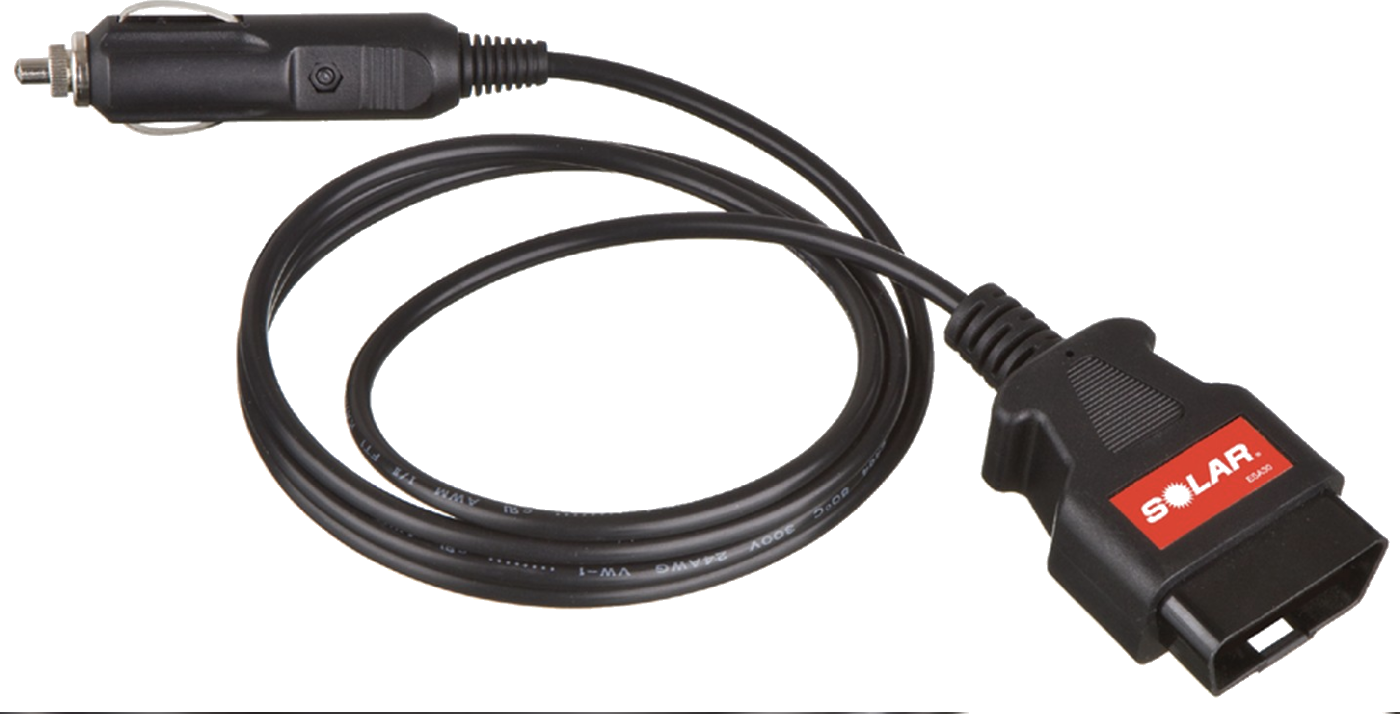
OBD II DLC Memory Saver
Use OBD II male connector…Pin #4 (-) and #16 (+) go to power plug and to a jump box.

Slide 33
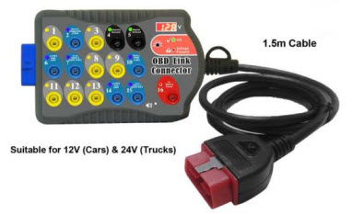
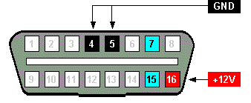
Checking Voltage at the DLC
Use a break-out box (BOB) and a DMM.
Connect the Meter to the Terminals 4 and 16 of the DLC

Slide 34
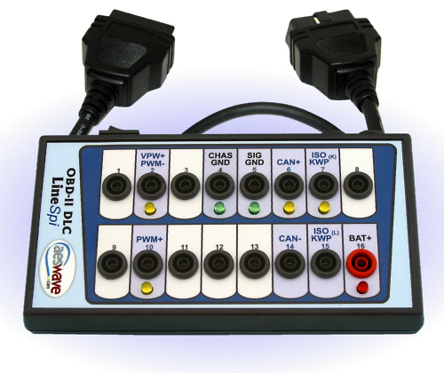
LEDs on the OBD II BOB
Pin 16: Red LED lights up when there is power.
Pins 4 and 5: Green LED's on each pin light up when ground is good.
Pins 2, 6, 7, 10: Yellow LED's on each pin light up to identify vehicle data OBD-II protocol and activity.

Slide 35
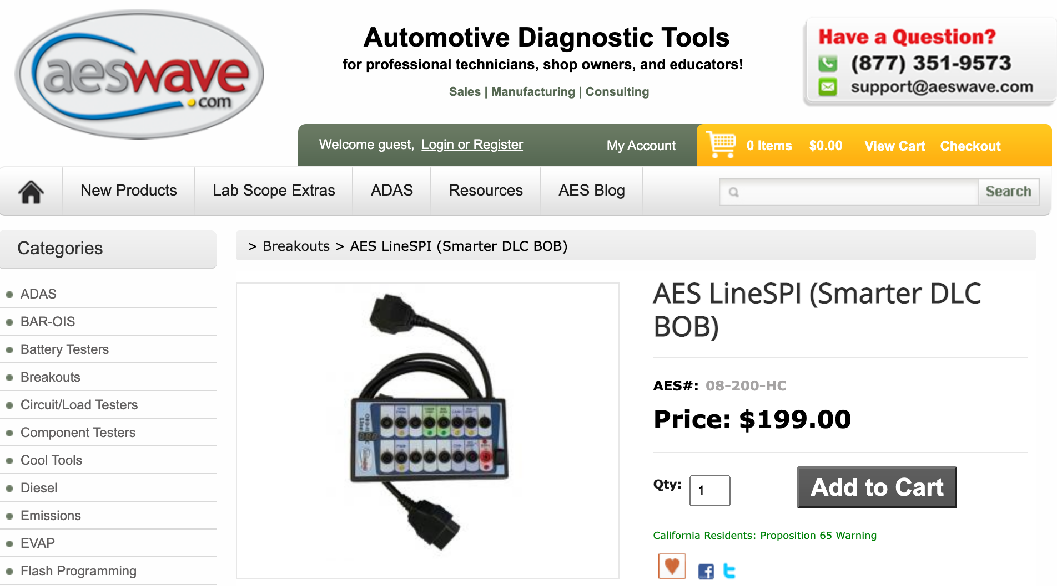
Where to Purchase a Break-Out Box (BOB)

Slide 36
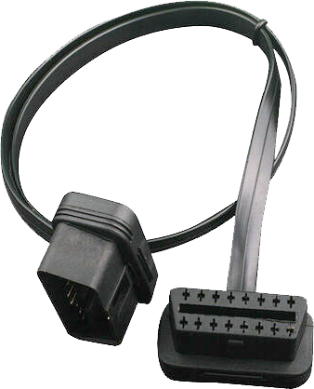
Tech Tip
Add a breakout box or a DLC extension harness to every vehicle.
Protects the DLC from damage from students trying to plug in a scan tool.
A breakout box makes it easy to check for voltages without doing any harm to the vehicle.

Slide 37
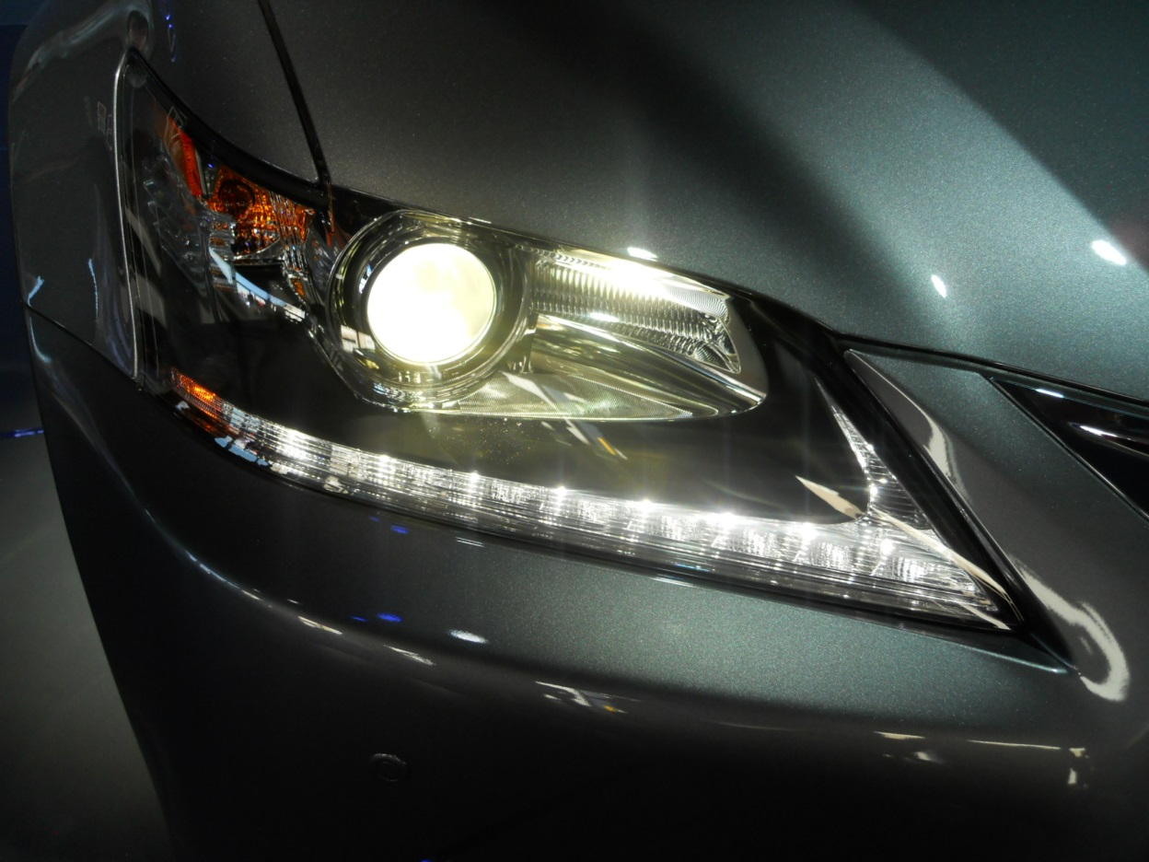
Battery Voltage
Battery Testing-
Connect and watch the voltmeter and turn on high beam headlights.
Watch voltage drop.
After it stabilizes, turn off the lights.
Watch how fast the voltage increases.
The final voltage is the SOC.

Slide 38
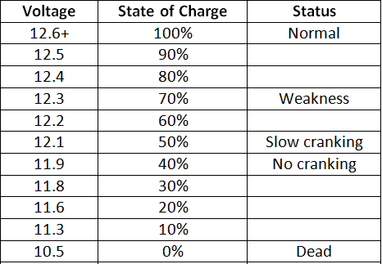

Battery Condition Test
Battery voltage should be 12.6 V or higher.

Slide 39

Cranking System Voltage
Cranking voltage -
Crank the engine.
Observe the battery voltage.
It should be above 9.6 Volts during cranking.

Slide 40

Case Study
Complaint – Chevy Equinox infotainment system rebooting on occasion when starting the engine.
Cause – Voltage briefly dropping too low while cranking.
Captured by Fluke 87 using the peak min/max feature (250 µSec capture rate).
Correction – Replacing the battery corrected the problem.

Slide 41


Charging System Voltage
Charging Voltage -
Start the engine and observe the voltmeter.
It should be 13.5-15.0 Volts.

Slide 42

Case Study
Complaint - Ford F-150 speedometer needle went up and down with engine speed, rather than vehicle speed.
Cause - Excessive AC Ripple voltage (over 1 volt AC) at the battery.
Correction - Replacing the alternator restored the proper operation of the speedometer.

Slide 43
Case Study
Complaint - The owner of a Chevrolet Silverado (6.6L diesel V8) stated that the battery warning light would come on when accelerating hard. Retrieved a C0800 DTC (system voltage is greater than 16 volts).
Cause - The charging voltage was measured at 17.7 volts.
Correction - The alternator was replaced, the DTC was cleared, and the vehicle returned to the customer.

Slide 44


Ripple Voltage Testing
AC Ripple Voltage –
Start the engine.
Turn on the headlights to provide an electrical load.
Switch the meter to read AC volts.
Meter should read less than 0.5 Volt.

Slide 45


Relative Power Balance Test
Connect scope leads to terminals #4 and #16 at the DLC.
Hold the accelerator pedal to the floor to enter “clear flood” mode.
Crank the engine and observe the waveform.

Slide 46


Anything already plugged into the DLC?

Slide 47


Insurance Telematics
Because the device is plugged into the DLC, it has power (#16) and ground (#4) at all times.
Can cause some driveability issues and false DTCs.
Can result in no savings. (Driving late at night because of a flight from the west coast, for example.)

Slide 48


Diagnosis Telematics
The PCM, of course, monitors all functions.
Can transmit “state of health” messages to the vehicle manufacturer (i.e. On Star).

Slide 49


Smart Phone Interface – Chevrolet Volt

Slide 50


OBD DLC Wiring

Slide 51

CAN Terminating Resistors

Slide 52


Terminating Resistance Testing
(Two 120 ohm in parallel – 60 Ohms)

Slide 53


Stop-Start Systems

Slide 54

Check Engine Light On?
This means that a DTC has been stored.
Check for stored DTCs.
Then check TSBs.
Follow service information.

Slide 55


Diagnosing OBD II DTCs
Check DTCs

Slide 56
Case Study
Cadillac CTS
Complaint: Check engine light on and stumble on acceleration at times.
Cause: Code P0101 Check PIDs with an Autolink scanner. (Mass air flow sensor out of range.)
Correction - Replaced MAF.

Slide 57

Scan Tool
Before starting the engine, connect the scan tool.
Four types of scan tools:
Code readers
OBD II global (generic)
Factory scan tool
Enhanced aftermarket scan tool.

Slide 58








Code Readers
(Usually cost less than $100)

Slide 59

Smart Phone Scan Tool
Uses a smart phone Bluetooth adapter (usually less than $20).
Purchase a phone app (about $5.00).
IOS: OBD Car Doctor, E OBD2
Android: OBD Car Doctor, Torque, EOBD2, Dash Command
Third-party apps may need to pay to get full function.

Slide 60



OBD II Global (Generic) Scan Tools

Slide 61



Enhanced Aftermarket Scan Tools

Slide 62



Factory Scan Tools

Slide 63

2016+ Hyundai Genesis
Some scan tool technology is built into the vehicle.
Cars like the Hyundai Genesis include a “System Check” visual that pops up in the center of the gauge cluster at start-up.

Slide 64


Scan Tool Data (PIDs)
(Perform all Module Scan)

Slide 65


Cylinder Contribution Test
Cylinder Contribution Test
Such as provided by the Ford IDS scan tool.

Slide 66


P0300 Random Misfire DTC
P0300 etc.
Use the scan tool to do the hard work from the driver’s seat.
Look at the misfire data.

Slide 67


Misfire Data
Some scan tools can show misfire data or use Mode $06.

Slide 68

Global OBD II Modes
Mode $01 — Request live data
Mode $02—Request freeze frame information
Mode $03 – Request Stored Trouble Codes
Mode $04—Clear/reset emissions-related diagnostic information
Mode $05—Request oxygen sensor test results
Mode $06—Request on-board monitoring test results for specific monitored systems
Mode $07 — Request emission-related diagnostic trouble codes detected during current or last completed driving cycle
Mode $08—Request control of on-board system, test or component
Mode $09—Request vehicle information
Mode $0A (10)—Request emissions-related diagnostic trouble codes with permanent status after a clear/reset emission-related diagnostic information service.

Slide 69

Mode $06
Global OBD II was designed for engineers to check the operation of non-continuously monitored systems.
It was not intended to be used by service technicians.
Mode $06 is used by service technicians to monitor the PCM test results of various systems.
Mode $06 is used to maintain all noncontinuous monitors and pending DTCs.

Slide 70


Check Monitor Status

Slide 71

Case Study
(1997 Chevy Truck 350 V8)
Rough Idle
Surge
No Codes
What data PID indicates the problem?

Slide 72
Case Study
(1997 Chevy Truck 350 V8)
Rough Idle
Surge
No Codes
What data PID indicates the problem?

Slide 73


Camshaft Wear
Causing the CMP Retard (-6 degrees)

Slide 74

Bi-Directional Control
A factory or an enhanced aftermarket scan tool allows the technician to:
Turn on individual lights
Operate individual power windows and other accessories that are connected to the BUS system.

Slide 75

High Authority Inputs
The engine RPM signal comes from the CPK sensor.
As the number goes up, the engine is going faster.
This is usually the most important input.

Slide 76

Look Carefully at All PIDs

Slide 77


ECT = IAT
On a cold engine -
Key on/Engine off (KOEO) and look at the values for ECT (engine coolant temperature) and IAT (intake air temperature).
Basically, the same sensor and the two temperatures should agree.

Slide 78

ECT = IAT (continued)
The ECT sensor has a higher authority than the IAT and is therefore more likely to be the cause of a starting or cold running problem.
The ECT is the only sensor used by the PCM when the ignition key is first turned from on to start.

Slide 79

MAP = BARO
A MAP sensor is a high-authority sensor, especially on speed density-controlled engines.
The MAP reading at KOEO should be atmospheric pressure (about 29.50 in. Hg.), depending on altitude and weather conditions.
An easier value to remember is that it should be about 4.6- 4.8 volts.

Slide 80


MAP vs. Vacuum
The MAP sensor is basically a vacuum gauge connected to the intake manifold.
Can be used to monitor basic engine health such as:
Retarded cam timing (low steady vacuum)
Restricted exhaust (vacuum drops at higher engine speeds)

Slide 81

Long Term/Short Term Fuel Trim
Long-term fuel trim (LTFT) can add or subtract more fuel than STFT.
LTFT is slower than STFT.
The purpose of LTFT is to keep STFT within plus or minus 10%.

Slide 82

LTFT and STFT Diagnosis
I suggest that you ignore STFT.
STFT is what is happening this instant.
LTFT gives a history of the exhaust mixture and is more helpful when it comes to a diagnosis.
Add the two together to get the total amount of added or subtracted fuel.
LTFT = +8%, STFT = -3%, total = +5%.

Slide 83

+LTFT Too High
Look for a vacuum leak.
Look for a cracked exhaust manifold.

Slide 84

Fuel Trim Example
LTFT = +12%
STFT = +2%
How is the
engine running
now?

Slide 85

Fuel Trim Example
Answer:
  The engine is operating normally now because the PCM has compensated for a slightly lean air-fuel mixture by increasing the injector pulse-width.
  Look for a vacuum leak or low fuel pressure.

Slide 86

Test Drive the Vehicle

Slide 87

Volumetric Efficiency
Volumetric efficiency (VE) is the percentage of air entering the engine compared to the theoretical airflow.
Typical normally aspirated engines will test having a VE of 75% to 90%.
Older two-valve cylinder head engines will test lower than newer engines equipped with four valves per cylinder.
Percentages above 100% are possible on supercharged or turbocharged engines.

Slide 88

Must Maintain at least 850mV

Slide 89

Power Test Drive
Accelerate -
If O₂ goes low, the fuel system is lean.
Check for MAF reporting error, clogged fuel filter, or weak fuel pump.
If O₂ goes high, something is restricted. Check intake and exhaust.

Slide 90


Test Drive - continued
O₂ High -
BARO PID stays steady. Exhaust system is restricted.
O₂ High -
BARO PID ratchets down. Intake is restricted.

Slide 91

Module Programming
An everyday repair.
Most replacement modules require programming.
Current hardware and subscription access is a must.
Advantages to both generic and manufacturer specific J2534 pass through devices.

Slide 92
Summary Chart
Item | Yes | No | Maybe
Warning lights | X
A/C Vent temperature | X
Tire pressure | X (most vehicles)
Steering wheel effort | X (some vehicles)
Battery testing | X
Oil level |  |  | X
Starter Amp testing |  | X
Starting/charging testing | X (several tests)
DLC protocol activity | X
CAN Resistance | X
Head and brake lights | X
Scan tool data | X
Diagnose restricted intake | X
Diagnose restricted exhaust | X

Slide 93

Cars in the Future?

Slide 94


Summary
There are many systems that can be checked and diagnosed from the driver’s seat.
Think easy.
Think flat-rate.
Think fast diagnosis.
Get to the root cause quickly.
Fix the car right the first time.
Customer satisfaction

Slide 95


Website

Slide 96



Textbooks

Slide 97
Contact Information
Jim Halderman
Jim@JamesHalderman.com

