Slide 1
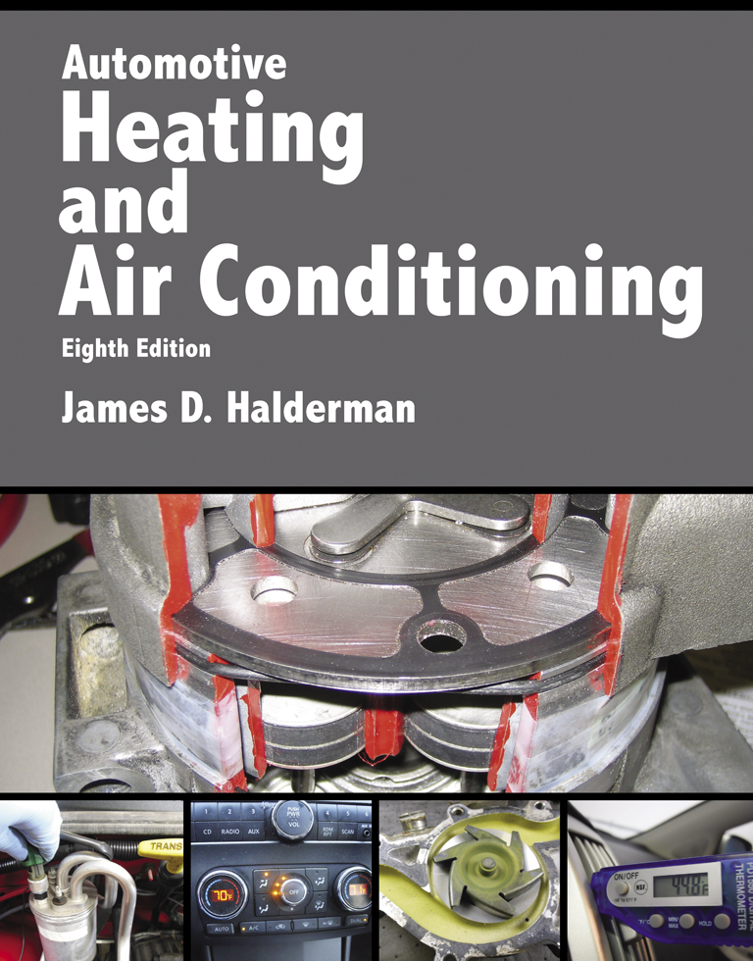
Automotive Heating And Air Conditioning
Eighth Edition
Chapter 9
Heating System Operation and Diagnosis

Slide 2
Learning Objectives (1 of 2)
9.1 Prepare for the ASE Heating and Air Conditioning (A7) certification test content area “C” (Heating and Engine Cooling Systems Diagnosis and Repair).
9.2 Discuss the operation of heating systems.
9.3 Discuss the diagnosis of heating systems.

Slide 3
Learning Objectives (2 of 2)
9.4 Explain the operation of electrically heated seats.
9.5 Explain the operation of heated and cooled seats.
9.6 Explain the operation of heated steering wheel.

Slide 4
Heating Systems (1 of 2)
The inlet hose to the heater core connects to an outlet fitting near the engine thermostat, or an area of the engine with the hottest coolant.
The outlet hose from the heater core is connected near the inlet of the water pump, which is the area with the lowest coolant pressure.

Slide 5
Heating Systems (2 of 2)
When the engine runs, coolant flows through the engine’s water jackets, past the thermostat, and through the heater core.
The heated coolant warms the heater core and the air passing through it.

Slide 6
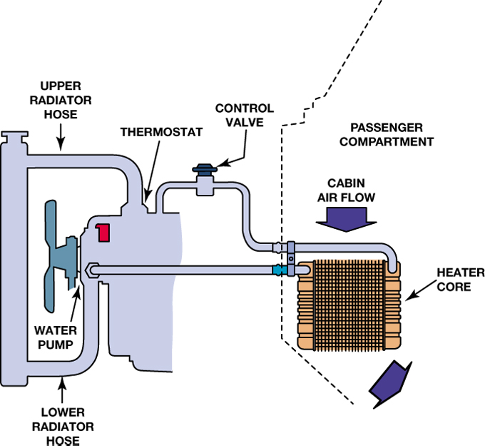
FIGURE 9–1 The main parts of a vehicle’s heating system are the heater core, blower, heater hoses, and, in some cases, a heater control valve.

Slide 7
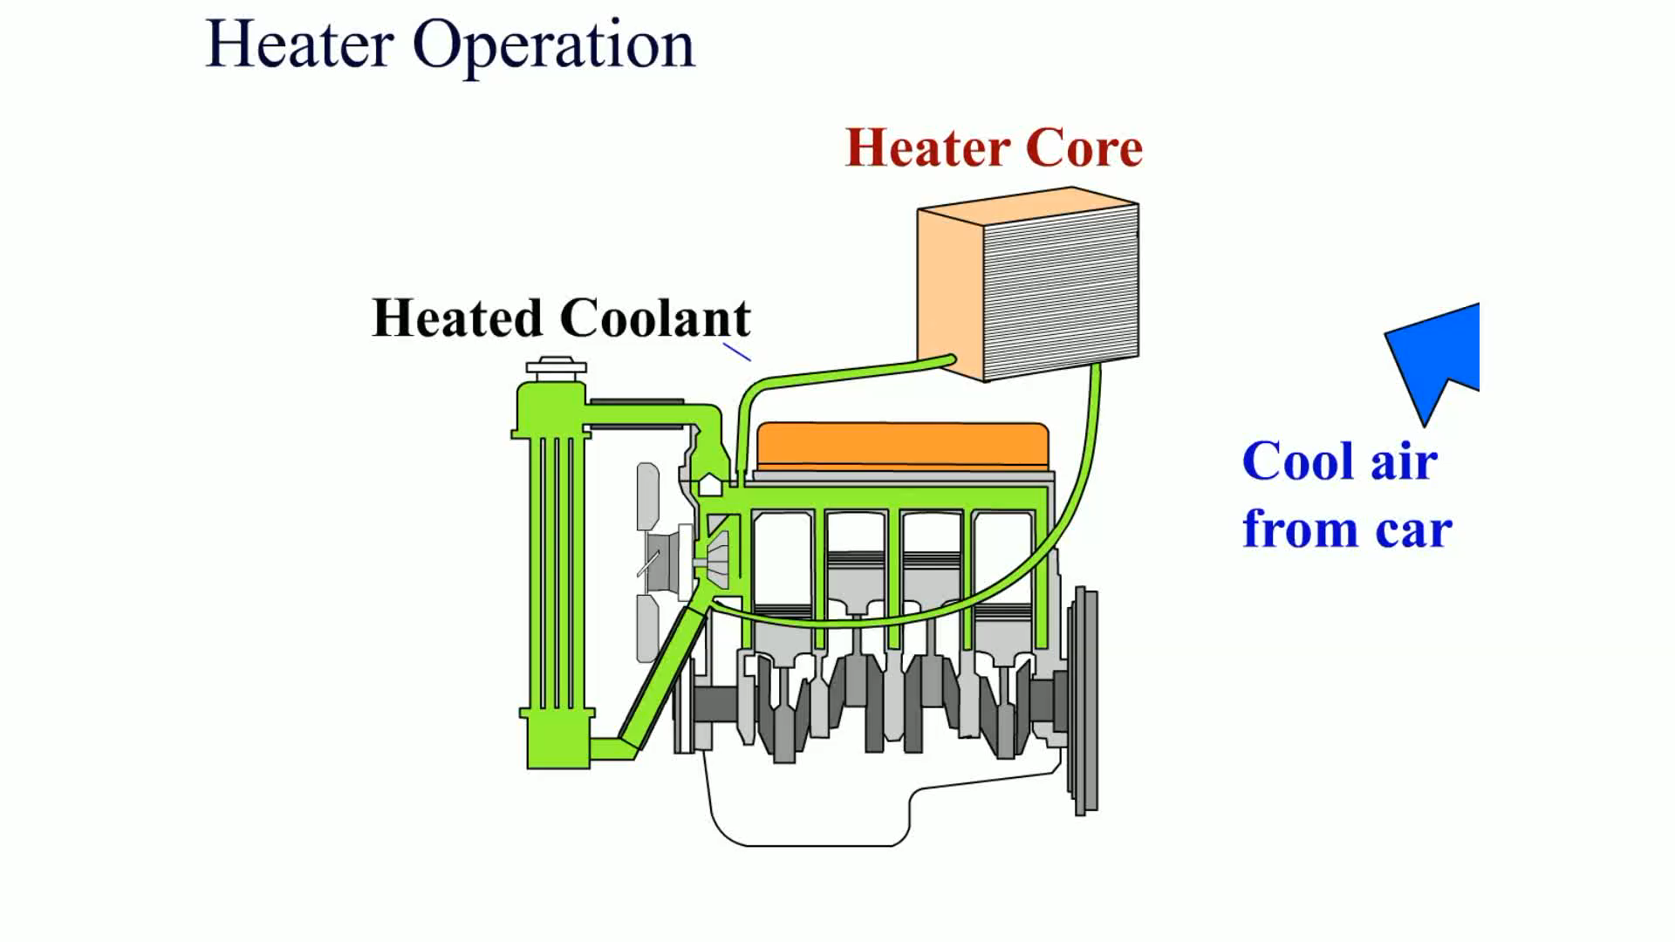
Animation: Heater Operation
(The animation will automatically start in a few seconds)

Slide 8
Dual Heating Systems
Larger vehicles with rear A/C systems include a heater in the rear unit.
  These rear units include a heater core and temperature-blend door.
  Heater hoses

Slide 9
Heater Diagnosis (1 of 5)
Visual Inspection
  Coolant level and condition
  Water pump drive belt condition and proper tension
    Belt tension gauge
    Marks on the tensioner
    Torque wrench reading
    Deflection

Slide 10
Heater Diagnosis (2 of 5)
To check a radiator or condenser for possible clogged or restricted areas
  Check the temperature of the heater hoses
  Check for proper airflow across the heater core
  Pressure test the cooling system

Slide 11
Heater Diagnosis (3 of 5)
Scan Tool Diagnosis
  Use a scan tool and check for any stored or pending diagnostic trouble codes, especially those that pertain to the HVAC controls.

Slide 12
Heater Diagnosis (4 of 5)
Scan Tool Diagnosis
  Check that the coolant temperature as measured by the engine coolant temperature (ECT) sensor is correct, usually 180°F to 200°F (82°C to 93°C). Check service information for the specified coolant temperature for the vehicle being checked.

Slide 13
Heater Diagnosis (5 of 5)
Scan Tool Diagnosis
  Perform a bidirectional control of the blend door and blower motor speed, if possible, to confirm that these are operating correctly.

Slide 14
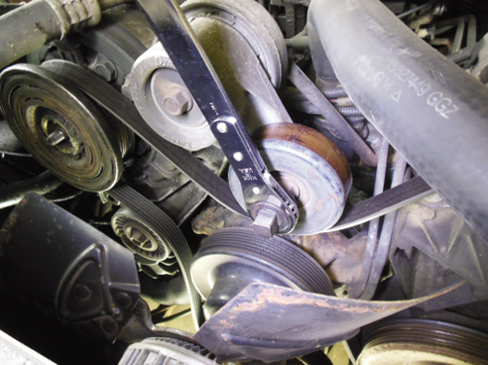
FIGURE 9–4 A special wrench being used to remove the tension from the accessory drive belt so it can be removed.

Slide 15
Electrically Heated Seats (1 of 3)
Heated seats use electric heating elements in the seat bottom, as well as in the seat back in many vehicles.
The heating element is designed to warm the seat and/or back of the seat to about 100°F (37°C) or close to normal body temperature (98.6°F).

Slide 16
Electrically Heated Seats (2 of 3)
A temperature sensor in the seat cushion is used to regulate the temperature.
The sensor is a variable resistor that changes with temperature and is used as an input signal to a heated seat control module.

Slide 17
Electrically Heated Seats (3 of 3)
The heated seat module uses the seat temperature input, as well as the input from the high–low (or variable) temperature control, to turn the current on or off to the heating element in the seat.
Some vehicles are equipped with heated seats in both the rear and the front.

Slide 18
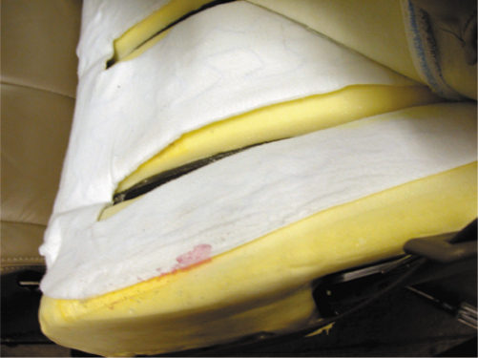
FIGURE 9–6 The heating element of a heated seat is a replaceable part, but service requires that the upholstery be removed. The yellow part is the seat foam material and the entire white cover is the replaceable heating element. This is then covered by the seat material.

Slide 19
Heated and Cooled Seats (1 of 2)
Most electrically heated and cooled seats use a thermoelectric device (TED) located under the seat cushion and seat back.
The thermoelectric device uses the Peltier effect.
Most vehicles equipped with heated and cooled seats use two modules per seat.

Slide 20
Heated and Cooled Seats (2 of 2)
Each thermoelectric device has a temperature sensor, called a thermistor.
The control module uses sensors to determine the temperature of the fins in the thermoelectric device so the controller can maintain the set temperature.

Slide 21
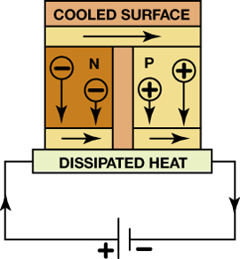
FIGURE 9–7 A Peltier effect device is capable of heating or cooling, depending on the polarity of the applied current.

Slide 22
Heated Steering Wheel (1 of 2)
A signal is sent to the control module and electrical current flows through the heating element in the rim of the steering wheel.
The system remains on until the ignition switch is turned off or the driver turns off the control switch.

Slide 23
Heated Steering Wheel (2 of 2)
The temperature of the steering wheel is usually calibrated to stay at about 90°F (32°C), and it requires three to four minutes to reach that temperature depending on the outside temperature.

Slide 24
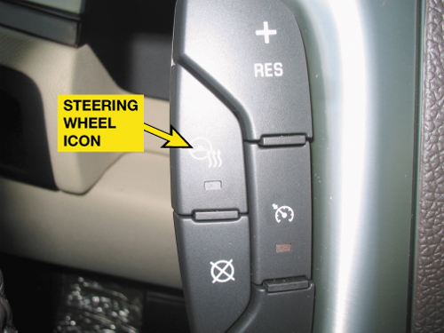
FIGURE 9–8 The heated steering wheel is controlled by a switch on the steering wheel in this vehicle.

Slide 25
Summary
The heater core resembles a small radiator, and it is connected to the engine by a pair of hoses.
Heated seats can use either a resistance type heater located under the seat covering or a thermoelectric (TE) device.
Heater diagnosis includes verifying the problem, visual inspections and scan tool usage.

Slide 26
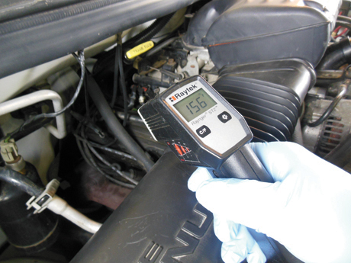
1 The diagnosis of a lack of heat from the heater started by checking the temperature of the heater hoses. The return hose was colder than the inlet hose.

Slide 27
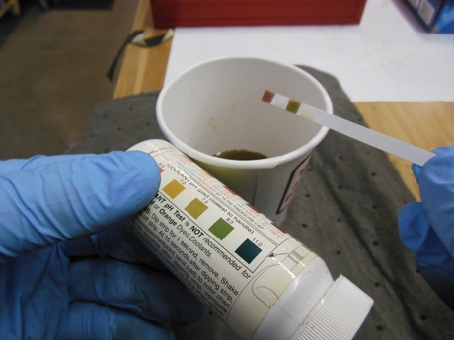
2 A test strip was used to check the coolant pH and freezing point. The coolant did not look fresh, but the test strip results were normal.

Slide 28
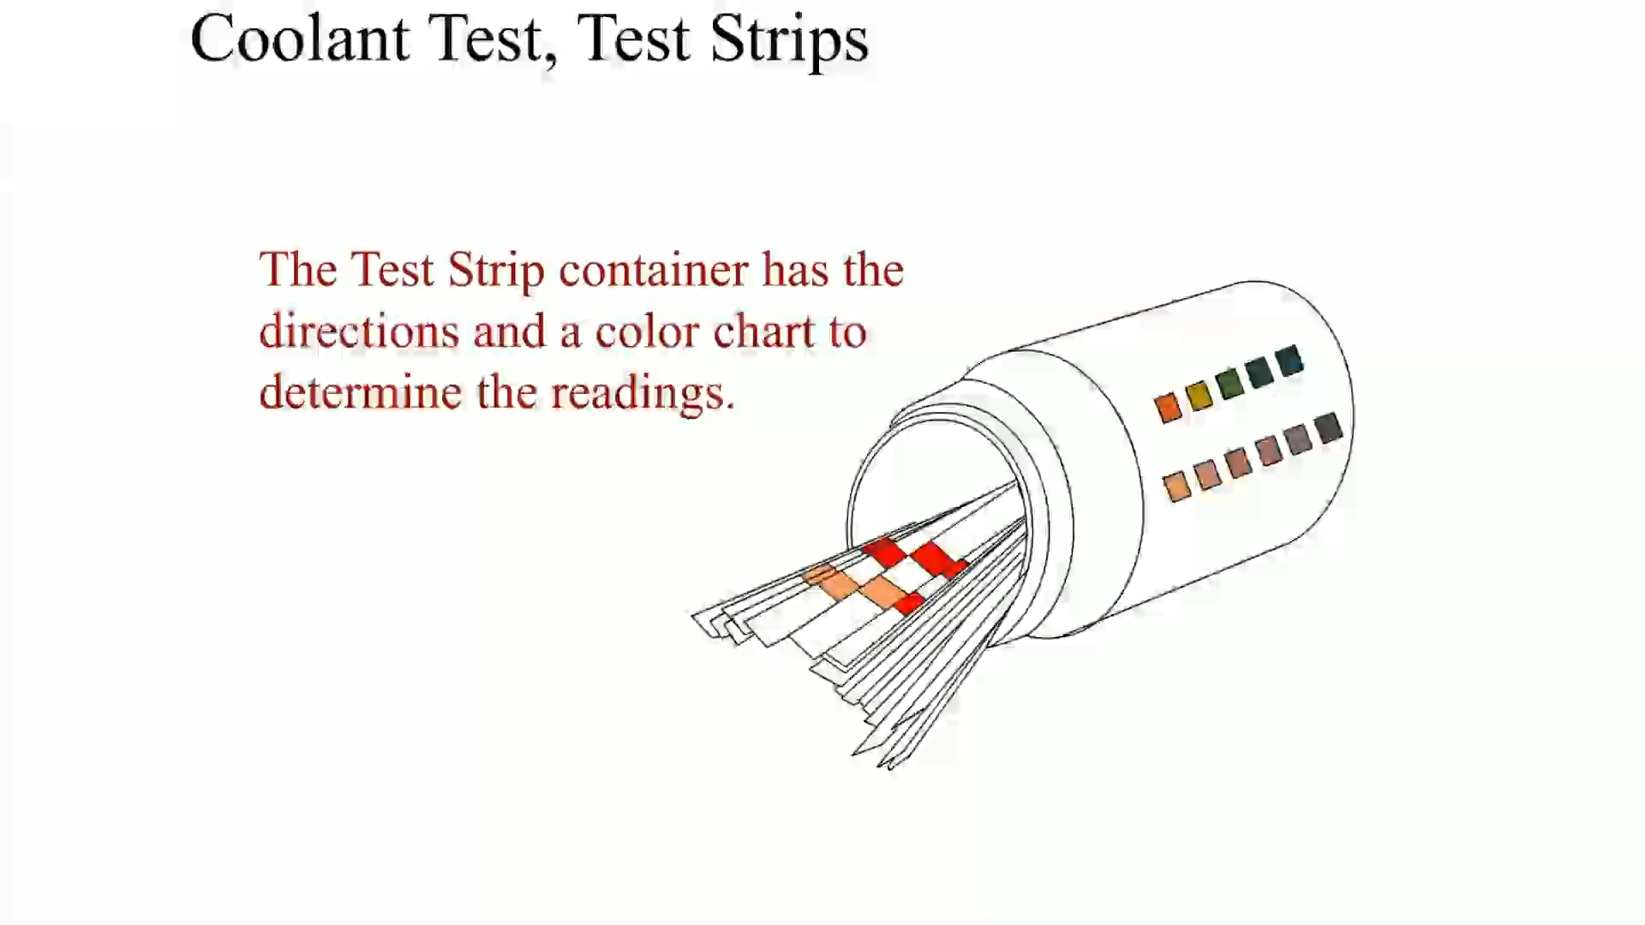
Animation: Coolant Test, Test Strips
(The animation will automatically start in a few seconds)

Slide 29
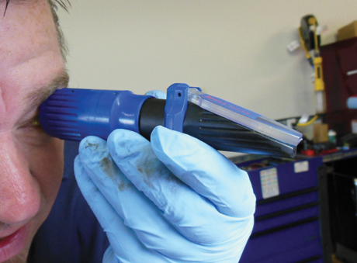
3 The refractometer test confirmed that the freezing protection was –32°F (–36°C).

Slide 30
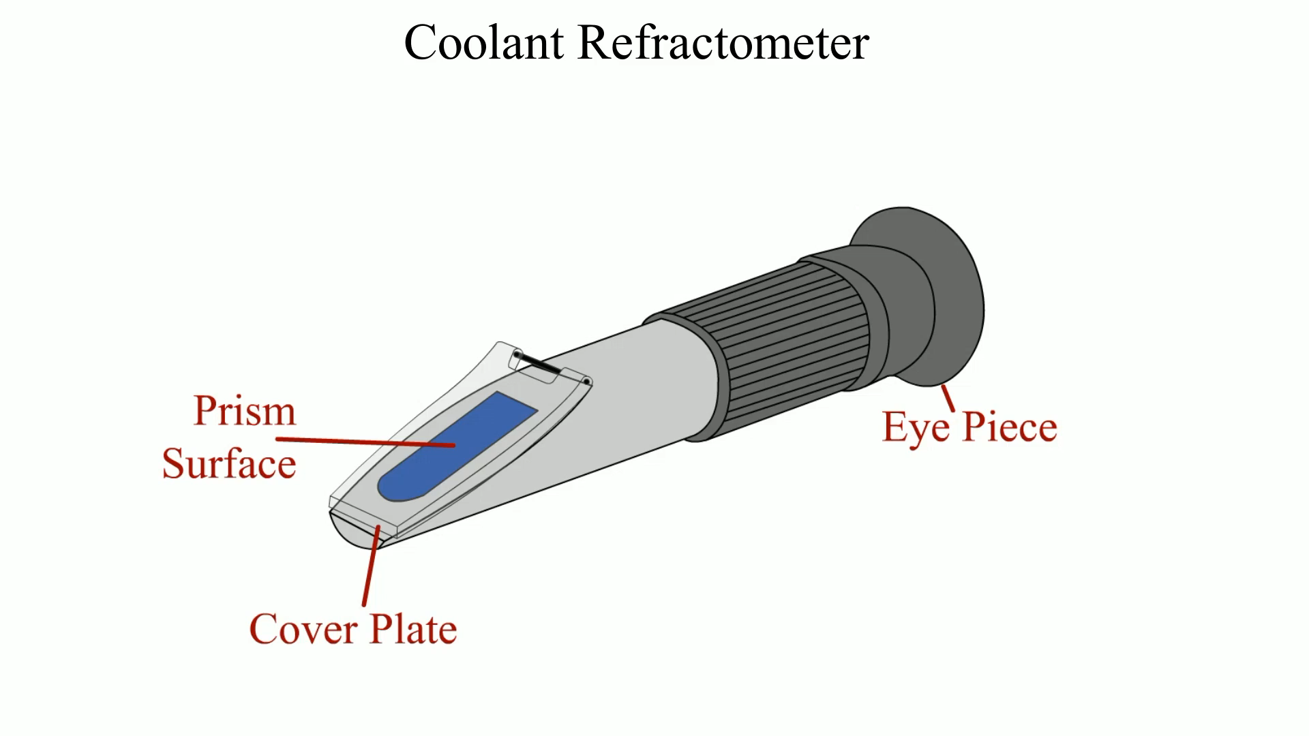
Animation: Coolant Refractometer
(The animation will automatically start in a few seconds)

Slide 31
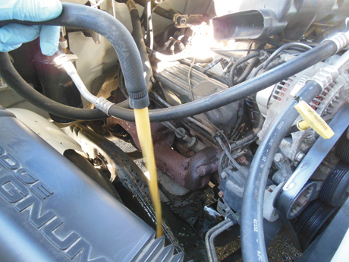
4 The heater core was flushed and the coolant flow through the hoses seemed to be normal.

Slide 32
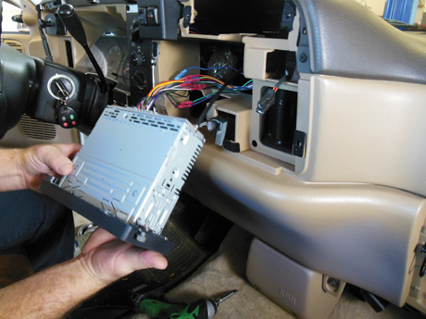
5 The heater core had to be removed and this required that the dash assembly be removed. Starting to remove the dash components to get access to the heater core.

Slide 33
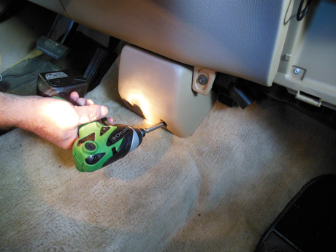
6 The fasteners used to retain the dash to the bulkhead being removed.

Slide 34
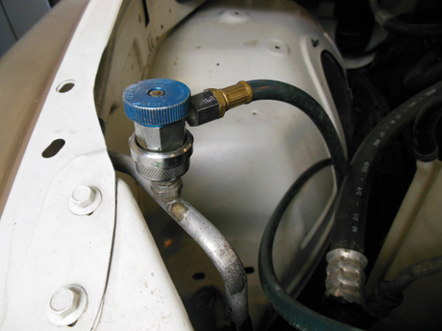
7 The A/C system was evacuated because it was necessary to remove HVAC module which contained the evaporator.

Slide 35
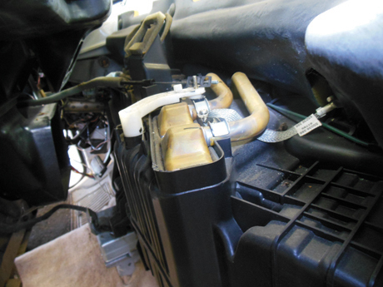
8 The dash was pulled back and the heater core became visible.

Slide 36
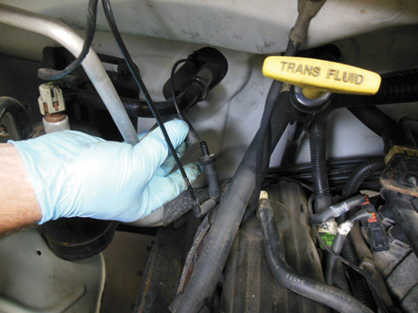
9 The vacuum connection for the HVAC vacuum actuators was disconnected from under the hood.

Slide 37
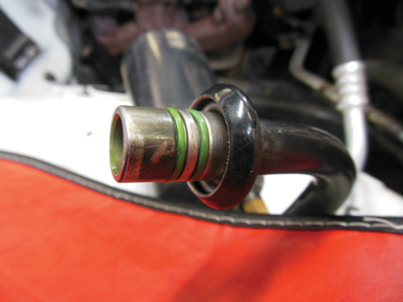
10 The AC hose connections to the evaporator were removed.

Slide 38
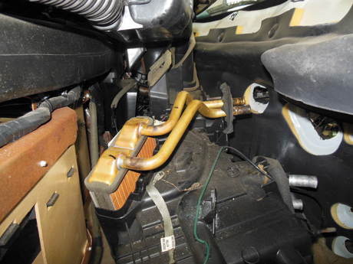
11 The heater core being removed from inside the vehicle.

Slide 39
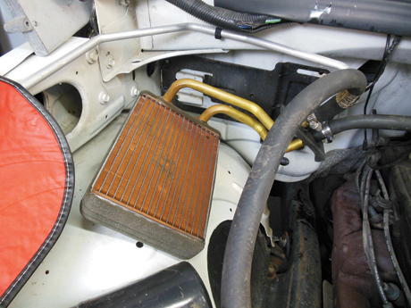
12 The heater core was removed from the inside of the vehicle and connected to the heater hoses and then the engine was started. The heater core felt hot across the entire surface.

Slide 40
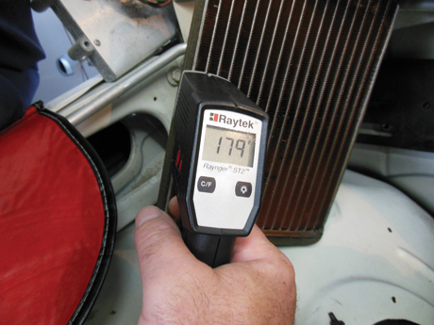
13 However, when an infrared temperature gun was used, the temperature measured about 20 degrees different depending on where it was measured.

Slide 41
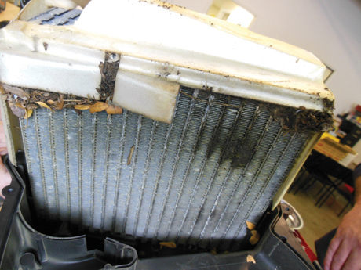
14 The evaporator had signs that it was leaking as indicted by the oil seen on the surface. It was replaced at the same time as the heater core.

Slide 42
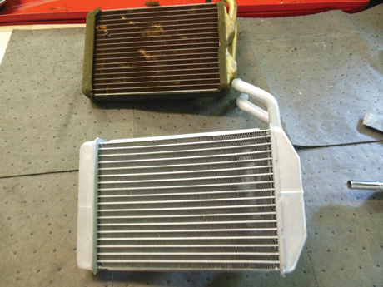
15 The replacement heater core was made of aluminum instead of brass like the original but it fit correctly.

Slide 43
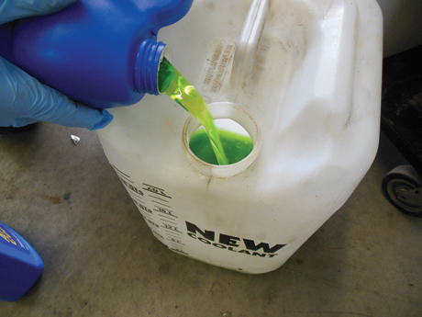
16 Fresh coolant was added to a coolant exchange machine. Conventional green (IAT) coolant was used because it had been converted to this coolant during a previous service.

Slide 44
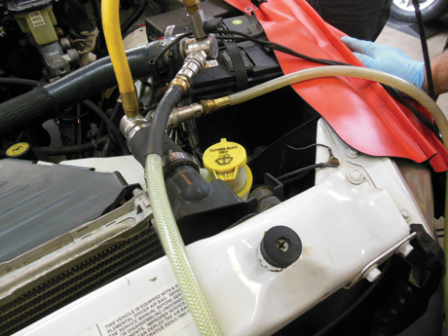
17 The coolant was replaced using the exchange machine, which also purged any air from the system. The heater worked great and was very hot and the vehicle owner was pleased.

Slide 45
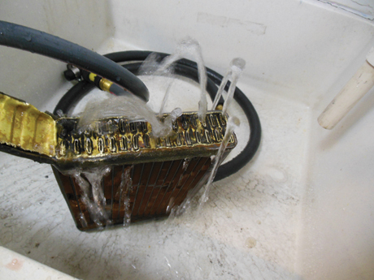
18 The end cap was removed from the old heater core and connected to a water hose. Only about half of the tubes were flowing water indicating that this heater core did require replacement.

Slide 46
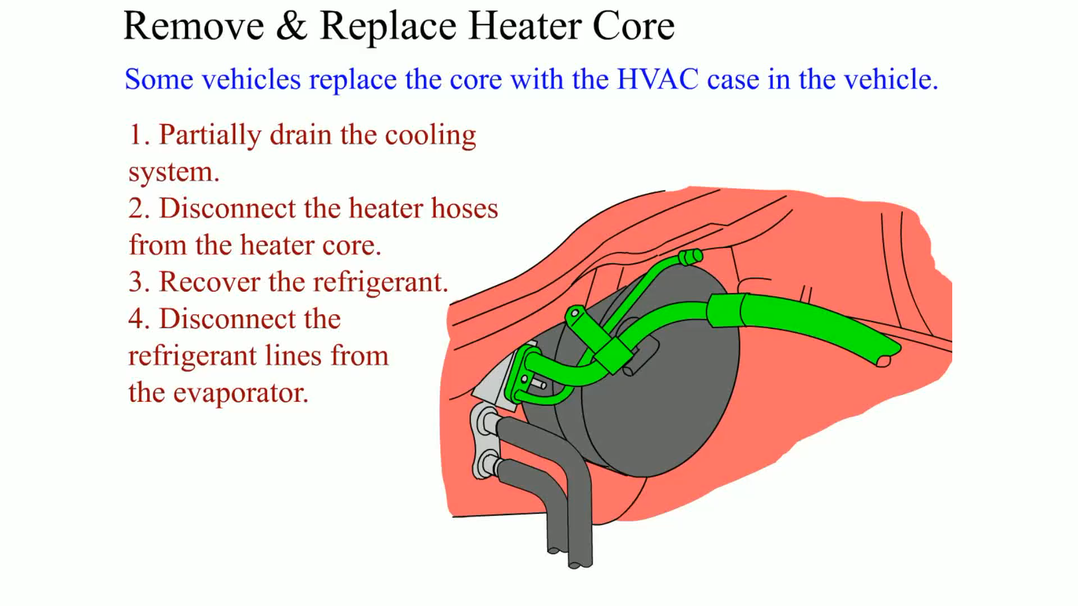
Animation: Remove & Replace Heater Core
(The animation will automatically start in a few seconds)

Slide 47
Video Links (Internet Access Required)
Low pressure switch (time 2:50)
Clutch circuit (time 2:23)
A/C switches (time 19:55)
Checking heater controls (time 3:14)
Heater controls (time 1:31)
Broken heater control valve (time 1:44)
A/C fan control (time 2:50)
ATC (time 31:12)
Buick ATC (time 20:43)
ATC part 2 (time 2:33)

Slide 48
Video Links (Internet Access Required)
EATC self test (time 3:51)
Blower motor speed control (time 8:49)
Blower resistor (time 7:58)
Blower motor amperage test (time 7:16)
Blower resistor (time 7:49)
Blower motor replacement (time 7:15)
Blower motor replacement (time 6:59)
Blower motor (time 4:01)

