Slide 1
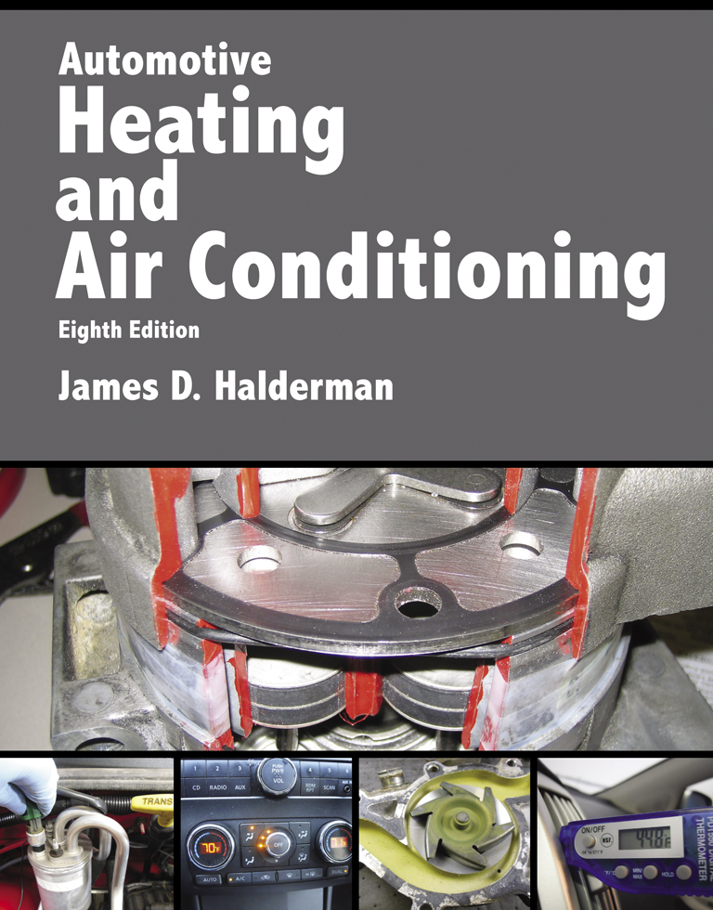
Automotive Heating And Air Conditioning
Eighth Edition
Chapter 6
Air Management System

Slide 2
Learning Objectives (1 of 2)
6.1 Prepare for the ASE Heating and Air Conditioning (A7) certification test content area “B” (Refrigeration System Component Diagnosis and Repair).
6.2 Discuss the different components of an air management system.

Slide 3
Learning Objectives (2 of 2)
6.3 Explain airflow control and air temperature control in an A/C system.
6.4 Discuss plenum and control doors.
6.5 Explain nonelectrical and electronic HVAC controls.

Slide 4
Introduction (1 of 2)
Outside air
Inside air
Air inlet
Temperature-blend door
Mode door

Slide 5
Introduction (2 of 2)
Heat
Air conditioning
Ventilation
Defogging or defrosting the inside of the windshield
HVAC control head

Slide 6
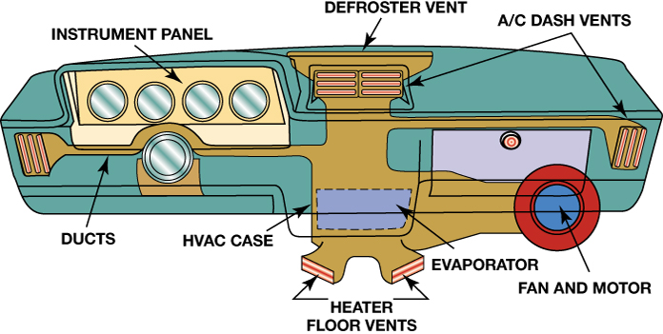
FIGURE 6–1 The HVAC airflow is directed toward the windshield, dash or floor vents, or combinations depending on the system settings.

Slide 7
Airflow Control
A multispeed blower is used to force air through the ductwork when the vehicle is moving at low speeds or to increase the airflow at any speed
Most systems use a flap door that swings about 45° to 90°

Slide 8
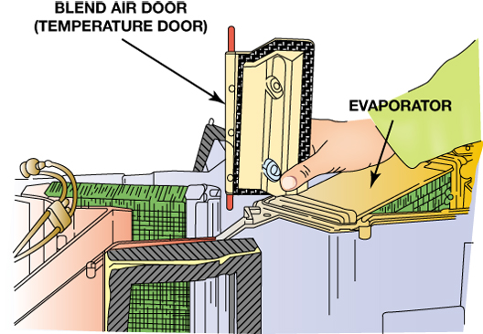
FIGURE 6–6 Many air control doors swing on their upper and lower pivots, in red.

Slide 9
Air Temperature Control
Most HVAC systems are considered reheat systems in that the incoming air is chilled as it passes through the evaporator.
There is an increasing trend to use an electronically controlled variable displacement compressor with an air temperature sensor after the evaporator.

Slide 10
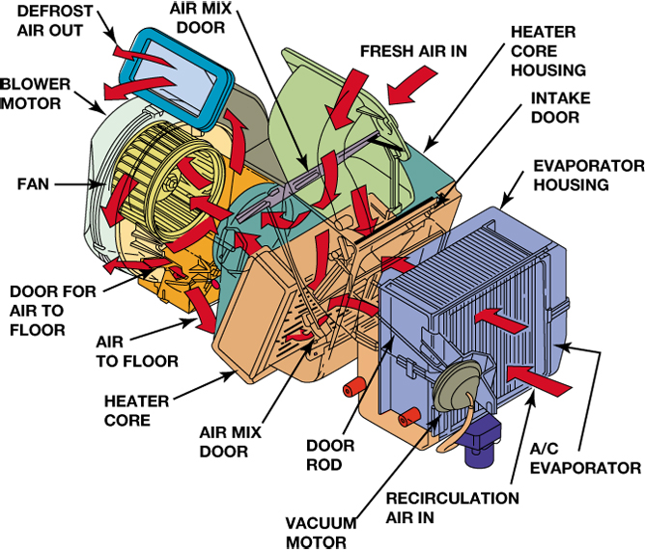
FIGURE 6–8 The blower motor forces air to flow through the A/C evaporator to remove moisture from the air before it is sent through the heater core where the air is heated before being directed to the defrost and floor vents.

Slide 11
Air Filtration
HVAC air filter
Interior ventilation filter
Micron filter
Particulate filter
Pollen filter

Slide 12
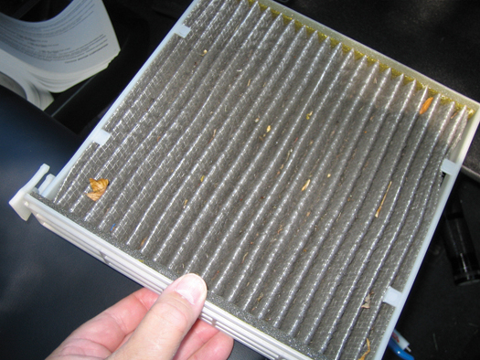
FIGURE 6–9 A cabin filter being removed from behind the glove compartment. The dark color is part of the filter and is activated charcoal used to help remove odors.

Slide 13
Cases and Ducts
Plenum
  Connected to the air inlets and outlets using formed plastic. These parts are required to contain and direct airflow, reduce noise, keep outside water and debris from entering, and isolate engine fumes and noises

Slide 14
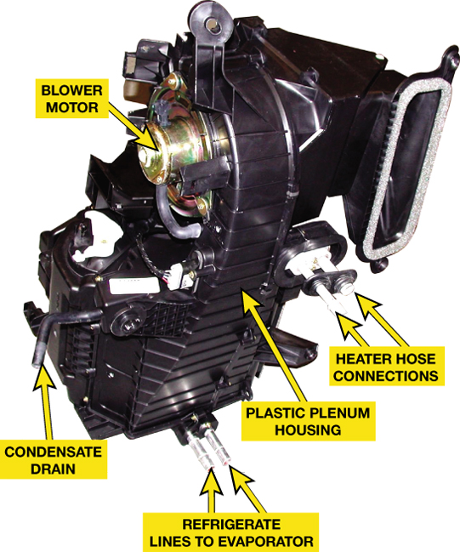
FIGURE 6–10 A typical HVAC housing that often has to be removed from the vehicle as an assembly to get access to the heater core and evaporator.

Slide 15
Plenum and Control Doors (1 of 6)
Ducts
  Air can enter the duct system from either the plenum chamber in front of the vehicle’s windshield (outside air) or from the recirc (short for recirculation) or return register (inside air).
Air doors
  This door is normally positioned so it allows airflow from one source while it shuts off the other

Slide 16
Plenum and Control Doors (2 of 6)
The air inlet control door is also called
  Fresh air door
  Recirculation door
  Outside air door

Slide 17
Plenum and Control Doors (3 of 6)
Temperature-Blend Door is also called
  Air-mix door
  Temperature door
  Blend door
  Diverter door
  Bypass door

Slide 18
Plenum and Control Doors (4 of 6)
Air from the plenum can flow into one or two of three outlet paths:
  The A/C registers (vents) in the face of the instrument panel
  The defroster registers at the base of the windshield
  The heater outlets at the floor under the instrument panel.

Slide 19
Plenum and Control Doors (5 of 6)
Mode doors are also called function, floor-defrost, and panel-defrost doors.
Mode/function control sets the doors as follows:
  A/C: in-dash registers with outside air inlet
  Max A/C: in-dash registers with recirculation
  Heat: floor level with outside air inlet

Slide 20
Plenum and Control Doors (6 of 6)
Mode/function control sets the doors as follows:
  Max Heat: floor level with recirculation
  Bi-level: both in-dash and floor discharge
  Defrost: windshield registers

Slide 21
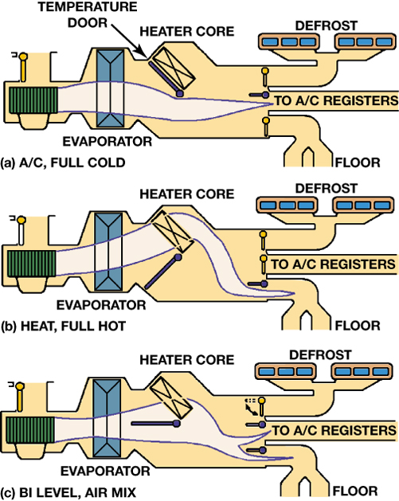
FIGURE 6–12 (a) The temperature and mode doors swing to direct all of the cool air past the heater core, (b) through the core to become hot, (c) or to blend hot and cool air.

Slide 22
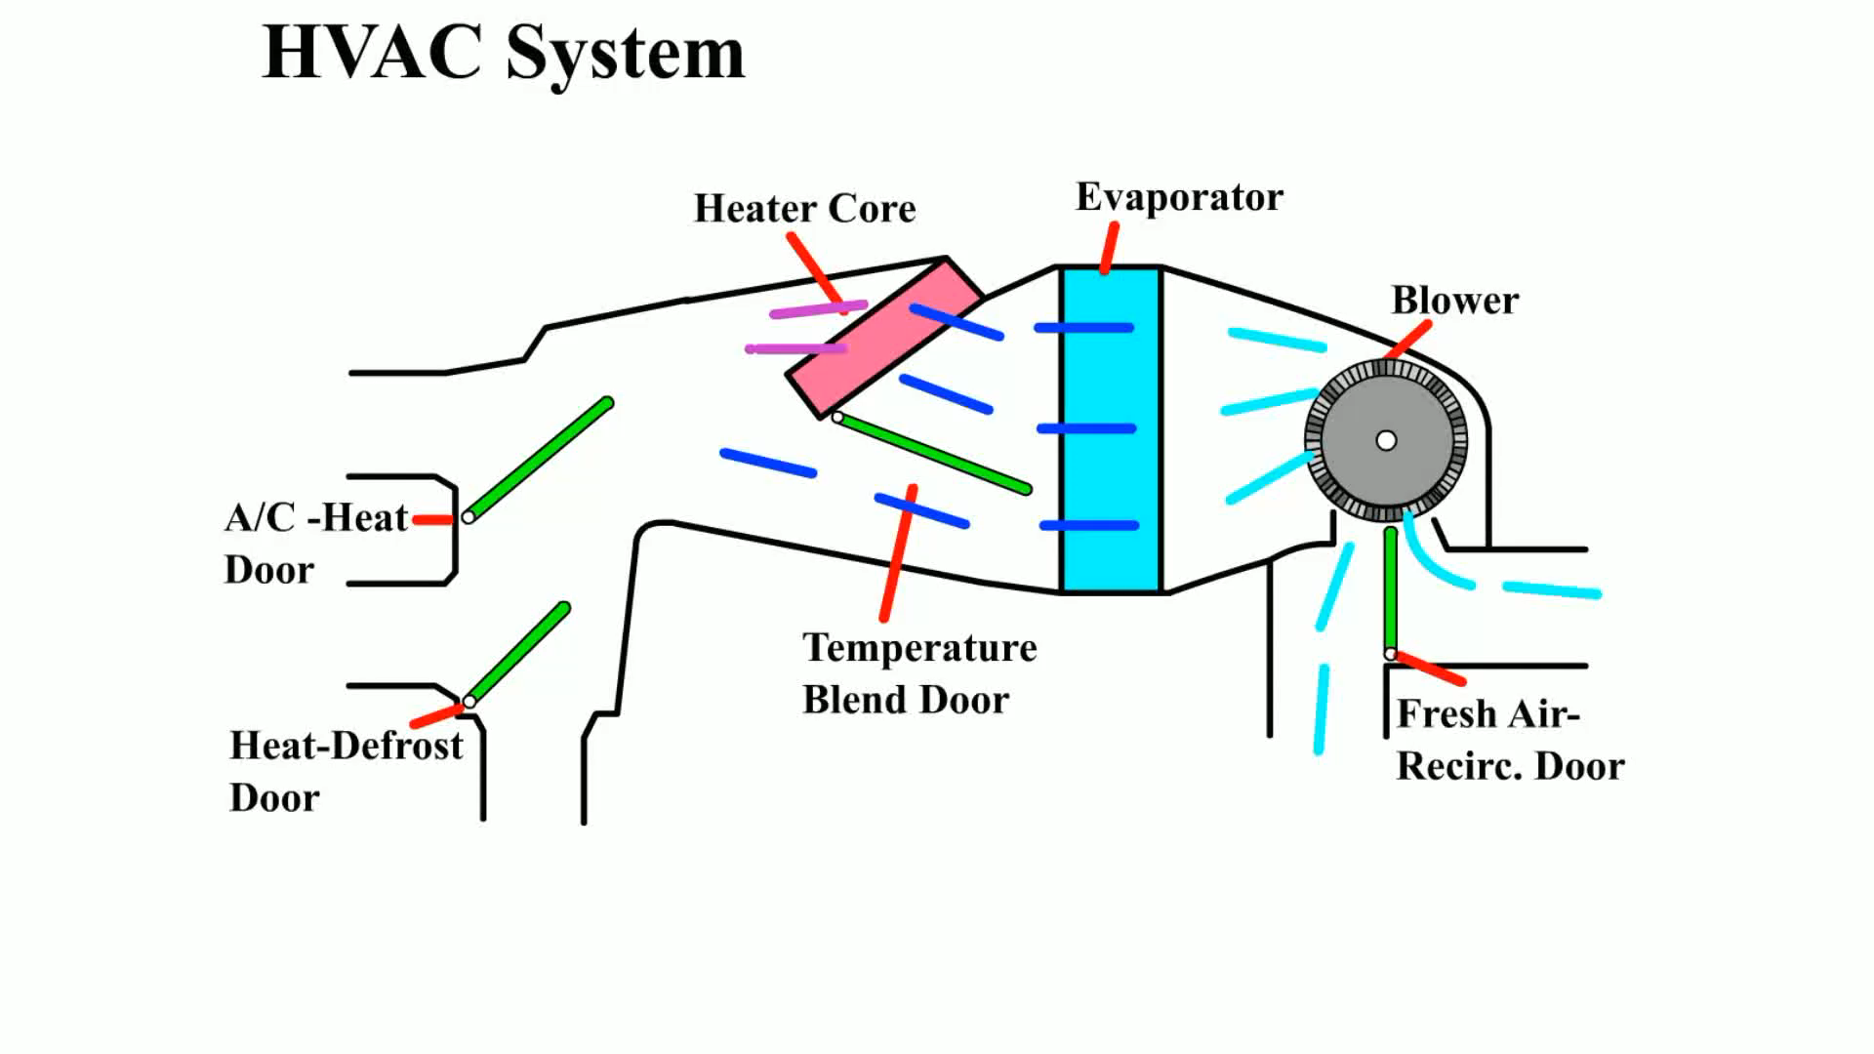
Animation: HVAC System
(The animation will automatically start in a few seconds)

Slide 23
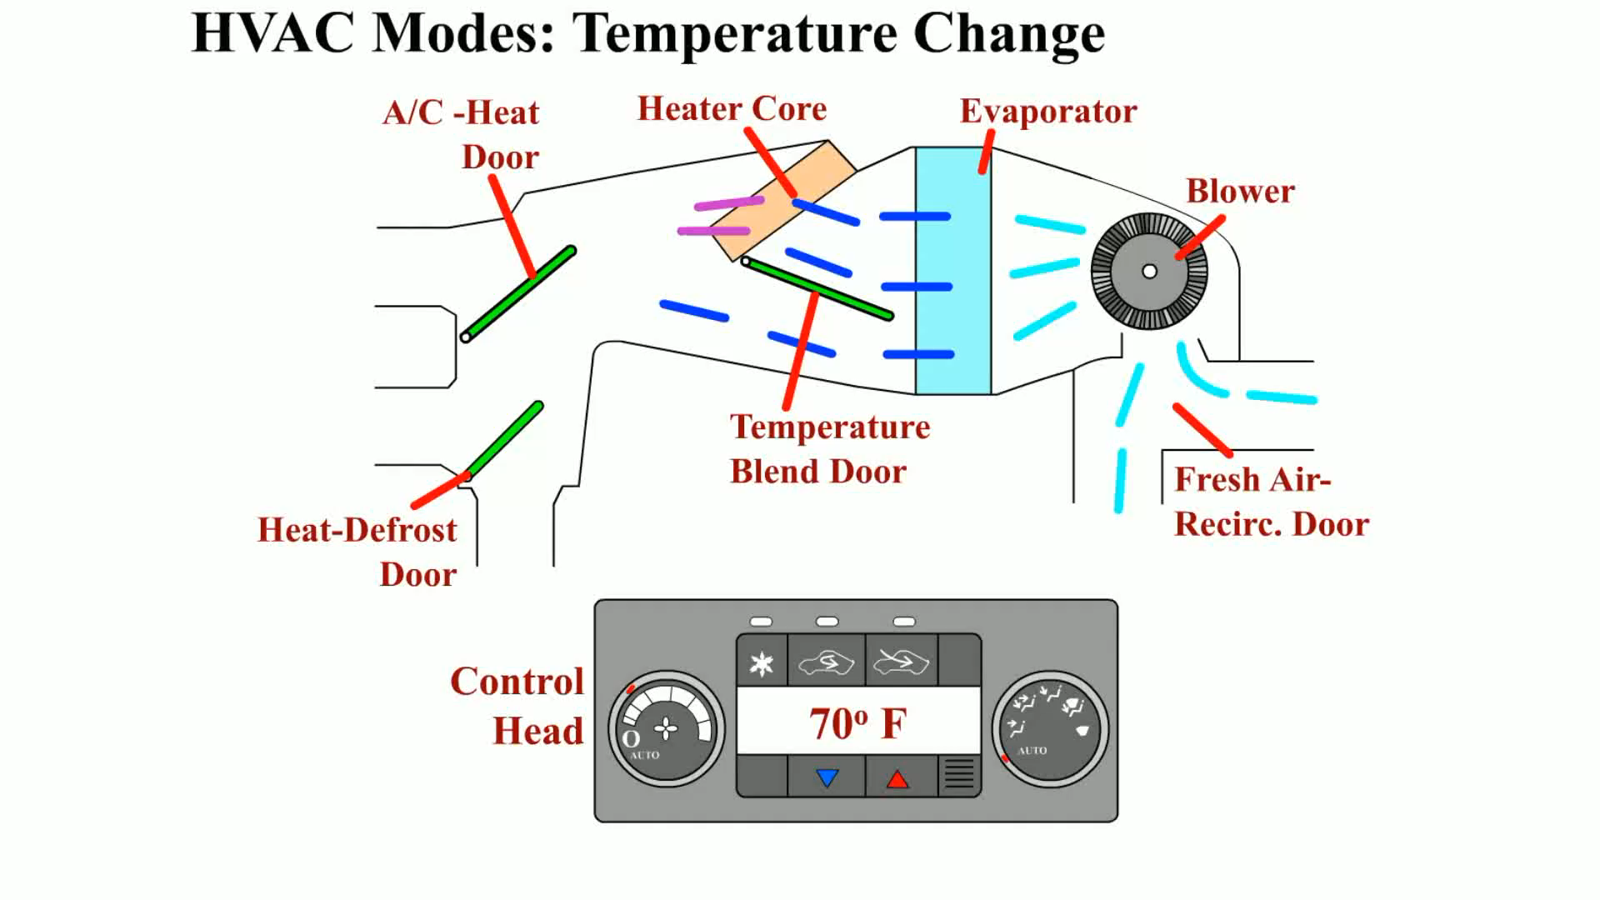
Animation: HVAC Modes: Temperature Change
(The animation will automatically start in a few seconds)

Slide 24
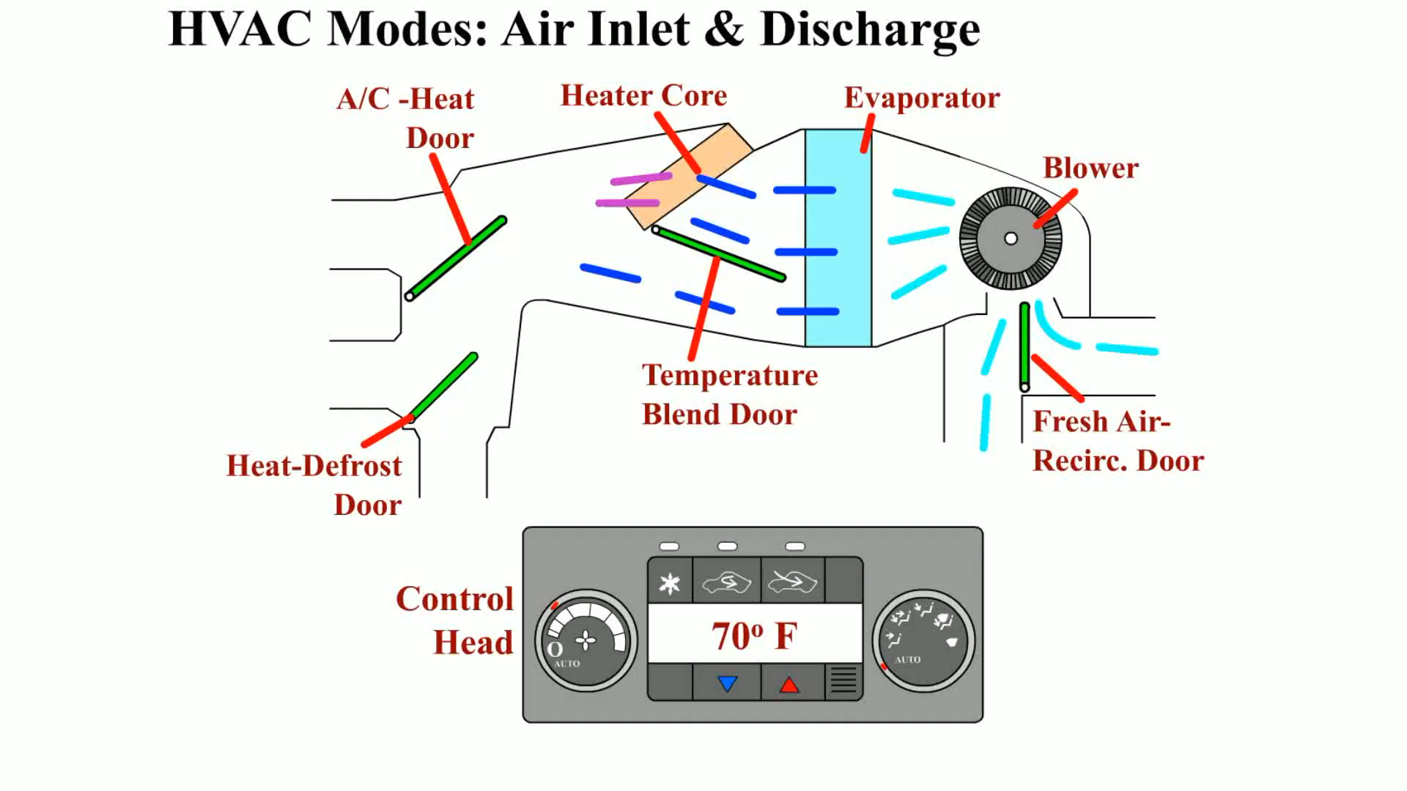
Animation: HVAC Modes Air Inlet & Discharge
(The animation will automatically start in a few seconds)

Slide 25
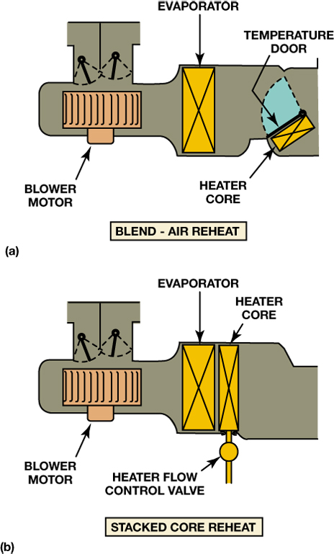
FIGURE 6–13 (a) In a blend-air system, all of the air is cooled. Then some of it is reheated and blended with the cool air to get the right temperature. (b) In a reheat system, all of the air is cooled and then reheated to the correct temperature.

Slide 26
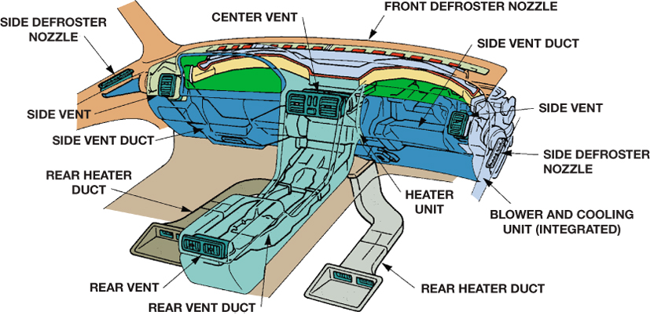
FIGURE 6–14 Ducts are placed in the center console or on the floor under the front seats to provide heated and cooled air to the rear seat passengers.

Slide 27
Nonelectrical and Electronic HVAC Controls (1 of 6)
Nonelectrical HVAC Controls
  Cable-Operated Systems
    Mechanical systems are the least expensive
    Tended to bind and could require a good deal of effort to operate
  Vacuum-Operated Systems
    Many vehicles use vacuum actuators, sometimes called vacuum motors, to operate the air inlet and mode doors

Slide 28
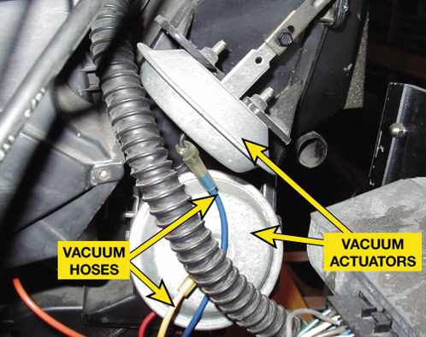
FIGURE 6–16 Many older vehicles used vacuum actuators to move the HVAC doors. When vacuum actuators operate, they alter the air–fuel mixture in the engine. Because vacuum controls affect engine operation and therefore emissions, recent vehicles use electric control systems.

Slide 29
Nonelectrical and Electronic HVAC Controls (2 of 6)
Electronic HVAC Controls
  Most recent vehicles use electrical function switches at the HVAC control head.
  These switches operate a group of solenoid valves that control the vacuum flow to the vacuum motors or use an electric actuator (motor) to operate the air distribution and temperature-blend doors

Slide 30
Nonelectrical and Electronic HVAC Controls (3 of 6)
Electronic HVAC Controls
  A typical two-wire actuator rotates when electric impulses are sent to the brushes by the HVAC control head
  A typical three-wire actuator uses a power, ground, and an input signal wire from the HVAC control module

Slide 31
Nonelectrical and Electronic HVAC Controls (4 of 6)
Electronic HVAC Controls
  A five-wire actuator uses two wires to power the motor (power and ground) and three wires for a potentiometer that is used to signal the HVAC control module of the motor’s location

Slide 32
Nonelectrical and Electronic HVAC Controls (5 of 6)
Electronic HVAC Controls
  Actuator Calibration Procedures
    STEP 1 Clear all diagnostic trouble codes (DTCs)
    STEP 2 Turn the ignition switch to the off position
    STEP 3 Install the replacement actuator and reconnect all mechanical and electrical connections

Slide 33
Nonelectrical and Electronic HVAC Controls (6 of 6)
Electronic HVAC Controls
  Actuator Calibration Procedures
    STEP 4 Start the engine and select motor recalibration program on the scan tool under the functions menu
    STEP 5 Verify that no diagnostic trouble codes have been set.

Slide 34
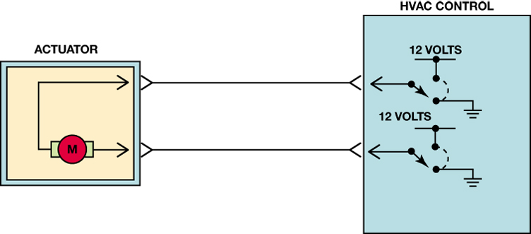
FIGURE 6–18 A two-wire HVAC electronic actuator where the direction of rotation is controlled by the HVAC control head or module, which changes the direction of rotation by changing the polarity of the power and ground connection at the motor.

Slide 35
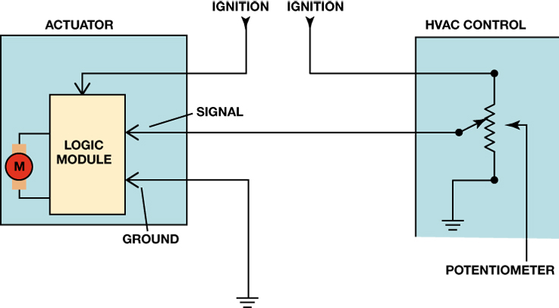
FIGURE 6–19 Three-wire actuators include a logic chip inside the motor assembly. The HVAC control module then sends a 0 volt to 5 volt signal to the motor assembly to control the direction of rotation.

Slide 36
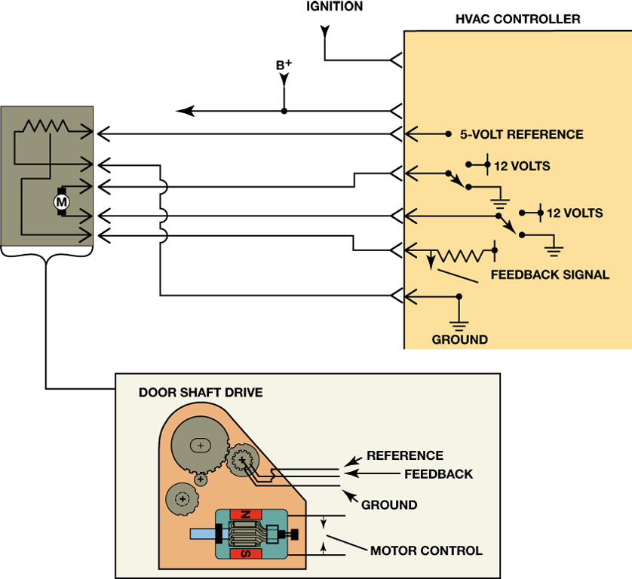
FIGURE 6–20 A typical five-wire HVAC actuator showing the two wires used to power the motor and the three wires used for the motor position potentiometer.

Slide 37
Blower Motor Control
Blower speed control in many of these systems is through a multiposition electrical switch and a group of resistors or electronic controls.

Slide 38
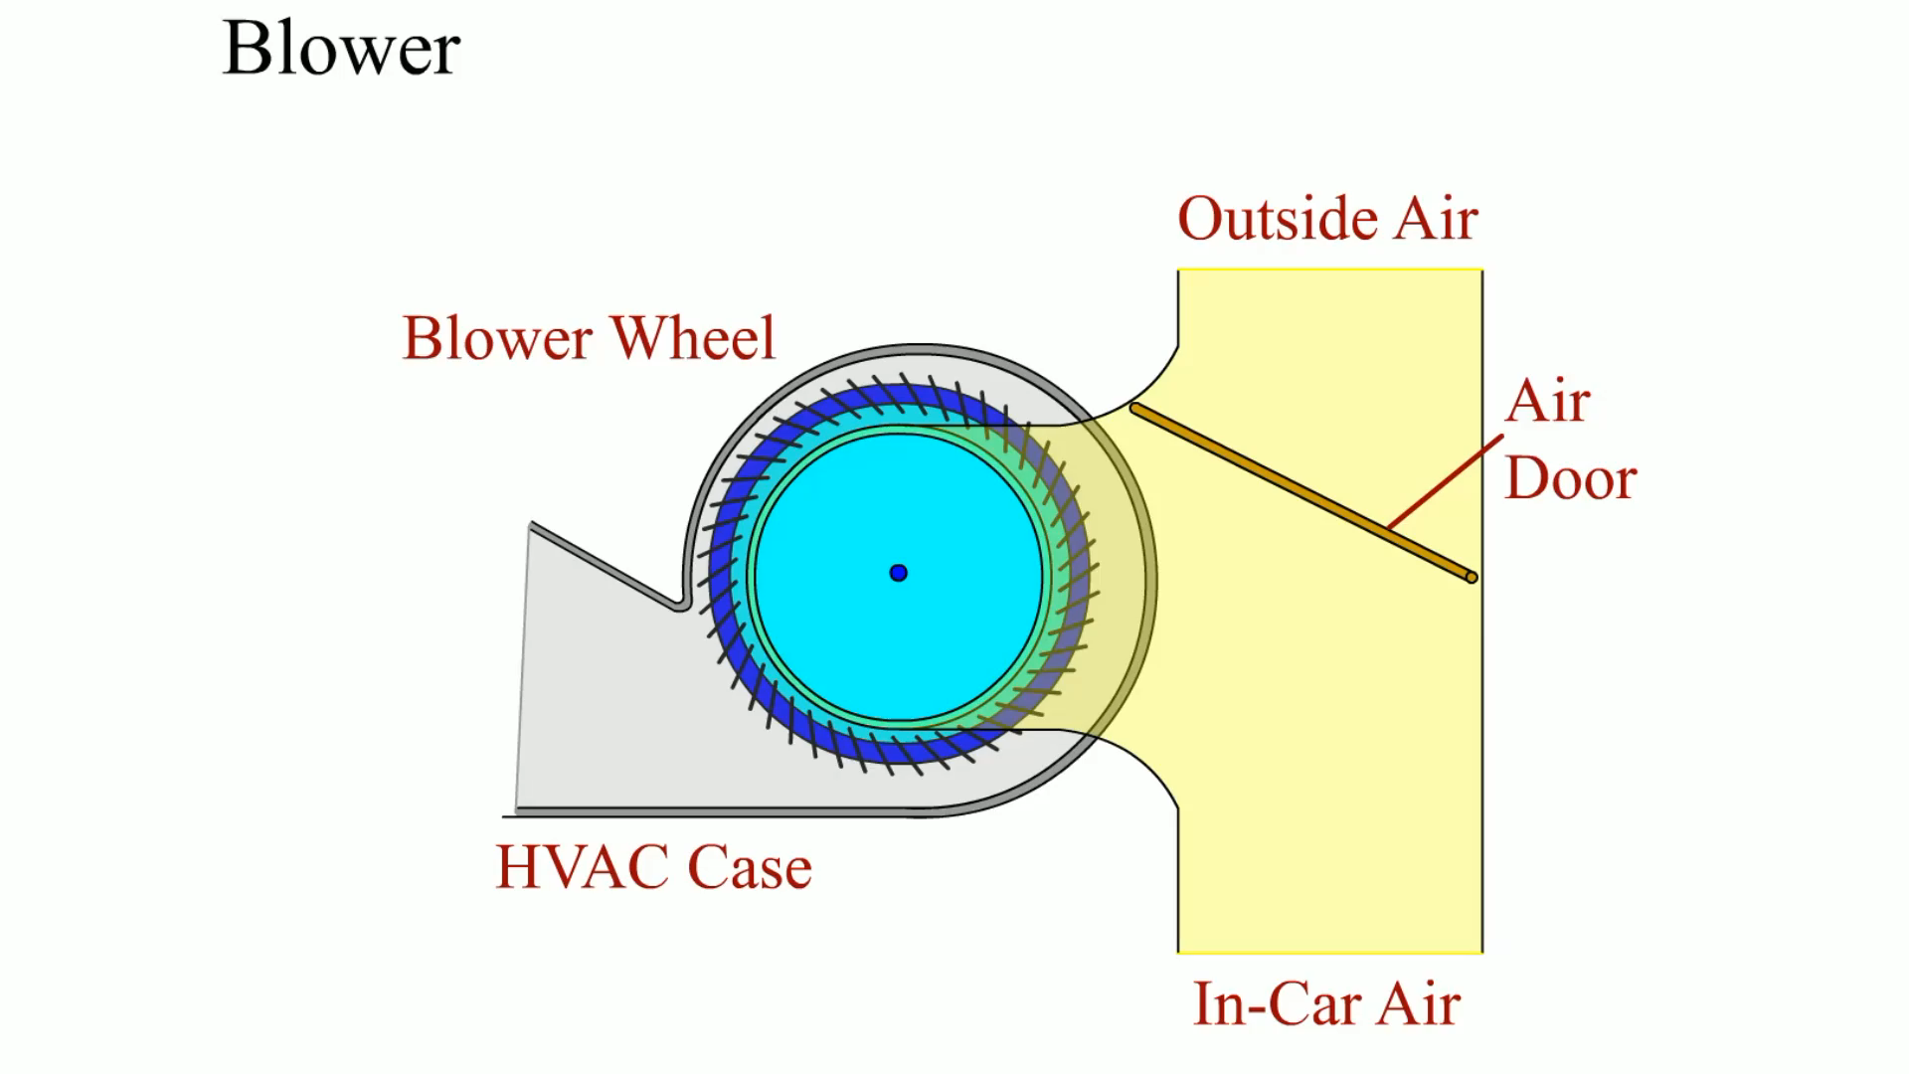
Animation: Blower
(The animation will automatically start in a few seconds)

Slide 39
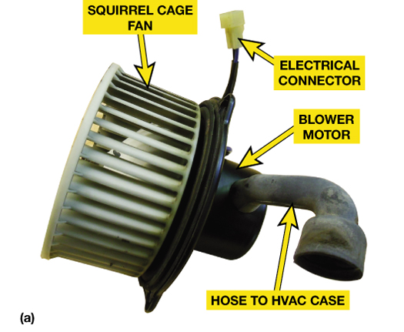
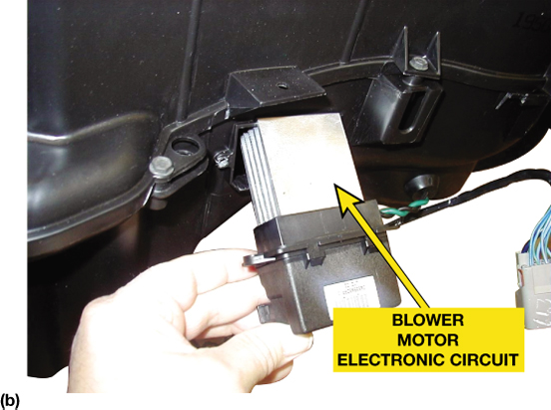
FIGURE 6–21 (a) A typical blower motor assembly with a squirrel-cage fan attached. The hose to the HVAC case is used to bring clean cabin air, instead of dirty outside air, to cool the motor. (b) Blower motor speed is controlled through an electronic circuit (shown) or through a resistor pack.

Slide 40
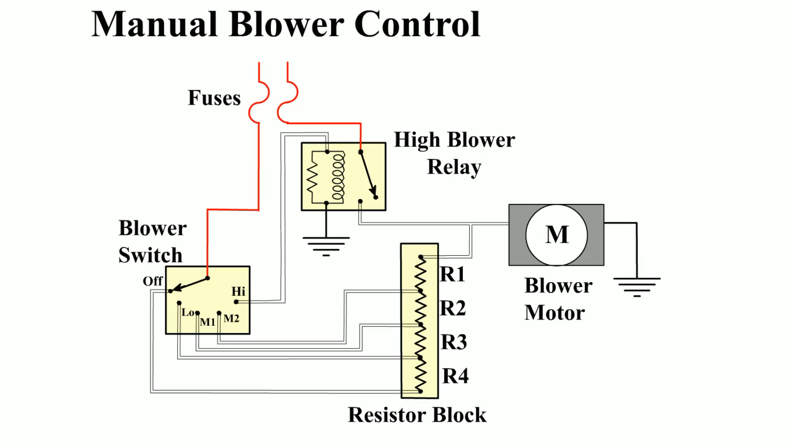
Animation: Manual Blower Control
(The animation will automatically start in a few seconds)

Slide 41
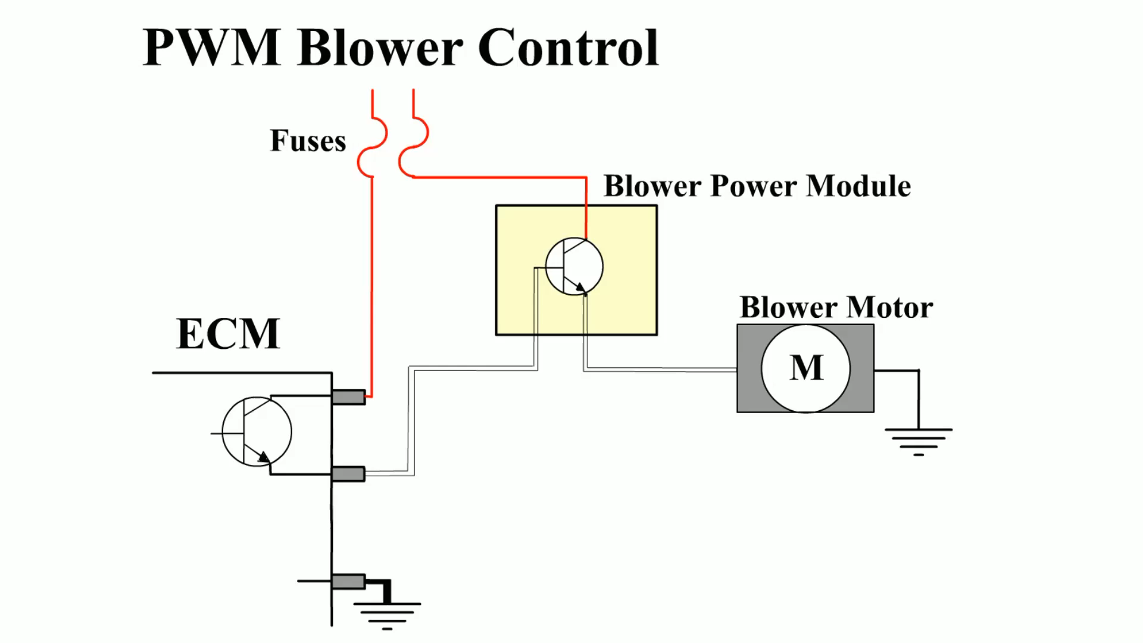
Animation: PWM Blower Control
(The animation will automatically start in a few seconds)

Slide 42
Summary
Air flows into the case that contains the evaporator and heater core
The HVAC case contains a blower, A/C evaporator, the heater core, and doors to control the air temperature and flow.
Most HVAC systems include a filter to remove particles and odors from the air.

Slide 43
Video Links (Internet Access Required)
HVAC Controls Basics (time 7:55)
HVAC Systems, Power & Control (time 37:01)
HVAC Blower Motor & Circuit (time 3:27)
How a cabin air filter works (time 2:07)
How automotive HVAC systems work (time 1:38)

