Slide 1
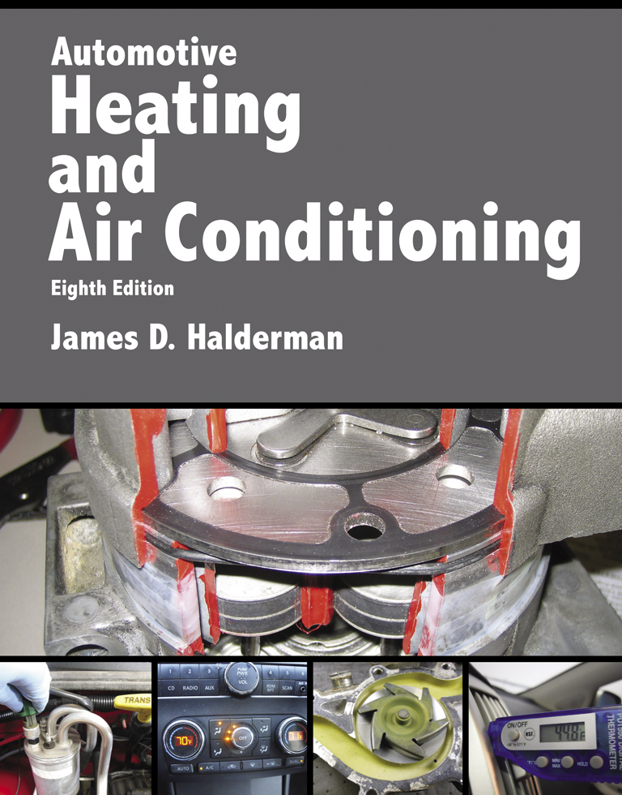
Automotive Heating And Air Conditioning
Eighth Edition
Chapter 5
A/C System Components, Operation, and Service

Slide 2
Learning Objectives (1 of 3)
5.1 Prepare for the ASE Heating and Air Conditioning (A7) certification test content area “B” (Refrigeration Component Diagnosis and Repair).
5.2 Discuss the purpose and function of compressors and condensers.
5.3 Describe the operation of thermal expansion valves.

Slide 3
Learning Objectives (2 of 3)
5.4 Explain the construction and operation of orifice tubes.
5.5 Explain the purpose and function of evaporators and accumulators.
5.6 Discuss the use of lines and hoses in refrigeration.

Slide 4
Learning Objectives (3 of 3)
5.7 Describe electrical switches and evaporator temperature controls used in A/C systems.
5.8 Explain component replacement procedures.

Slide 5
Background
What is the background of early air conditioning?

Slide 6
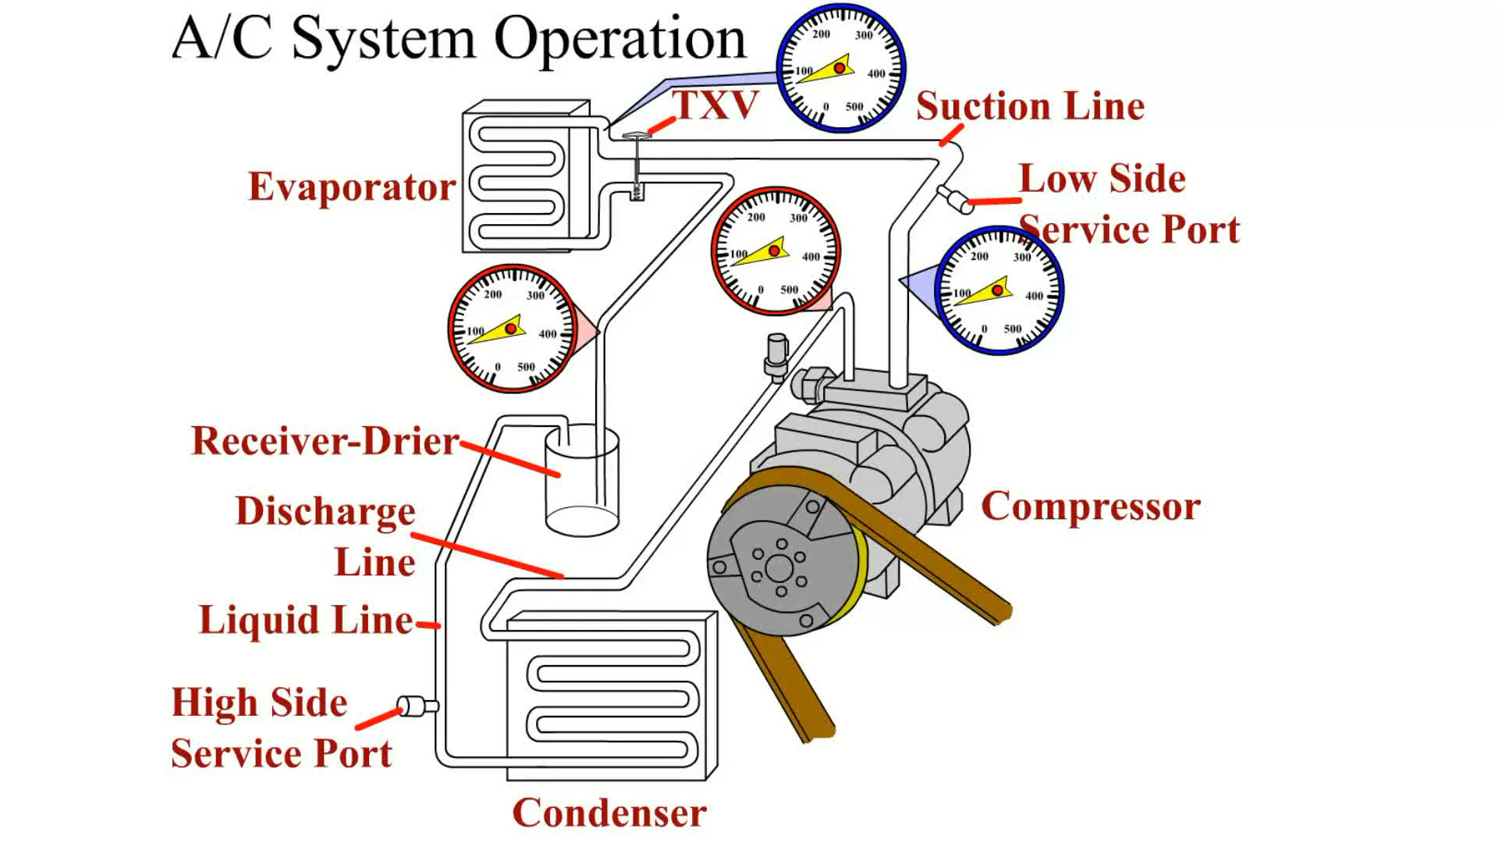
Animation: A/C System Operation
(The animation will automatically start in a few seconds)

Slide 7
Compressors and Condensers
The compressor is the pump in the system that circulates the refrigerant.
The condenser is a heat exchanger that is used to get rid of the heat removed from the passenger compartment.

Slide 8
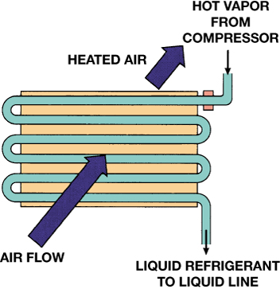
FIGURE 5–1 A condenser is a heat exchanger that transfers heat from the refrigerant to the air flowing through it.

Slide 9
Thermal Expansion Valves (1 of 2)
In most TXV systems, the evaporator outlet is connected to the compressor inlet by the suction line with an internal diameter (ID) of about 5/8 inch or 3/4 inch.
The outlet from the high-pressure side to the low-pressure side is a variable-diameter hole.

Slide 10
Thermal Expansion Valves (2 of 2)
The expansion valve uses the pintle valve to control how rapidly refrigerant enters the evaporator.
The expansion valve controls the refrigerant flow in response to the temperature of the evaporator outlet.

Slide 11
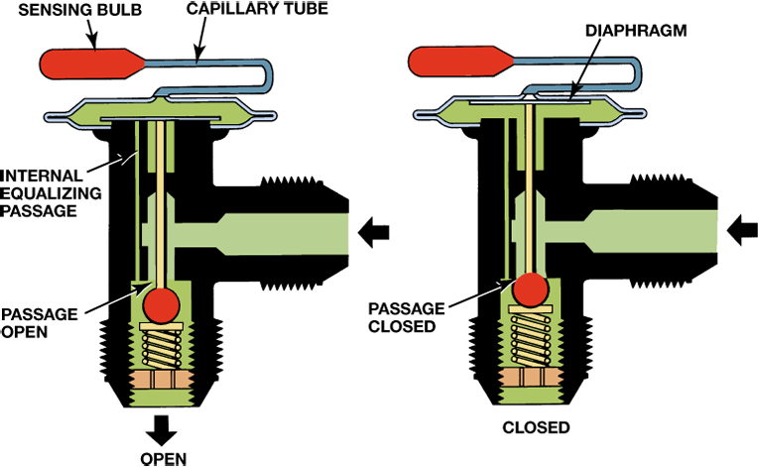
FIGURE 5–9 Pressure from the capillary tube pushes on the spring-loaded diaphragm to open the expansion valve. As the pressure in the capillary tube contracts, the reduced pressure on the diaphragm allows the valve to close.

Slide 12
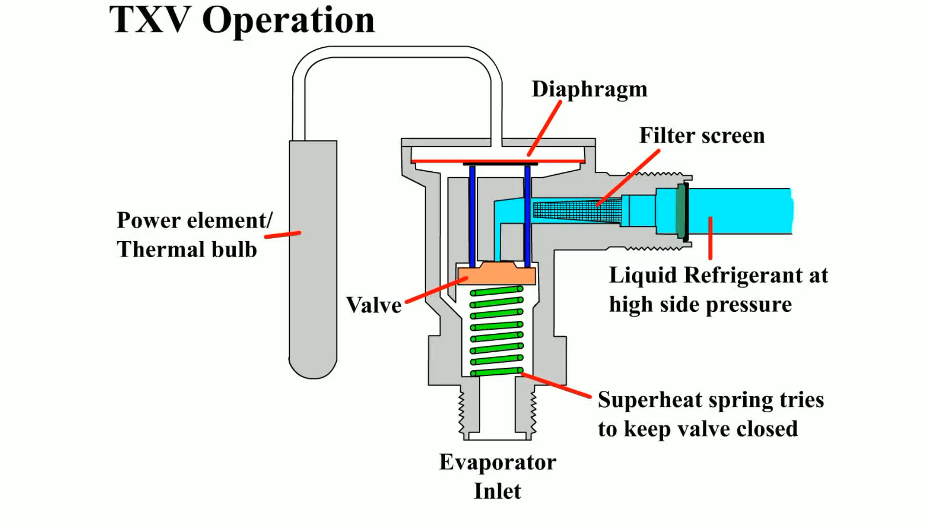
Animation: TXV Operation
(The animation will automatically start in a few seconds)

Slide 13
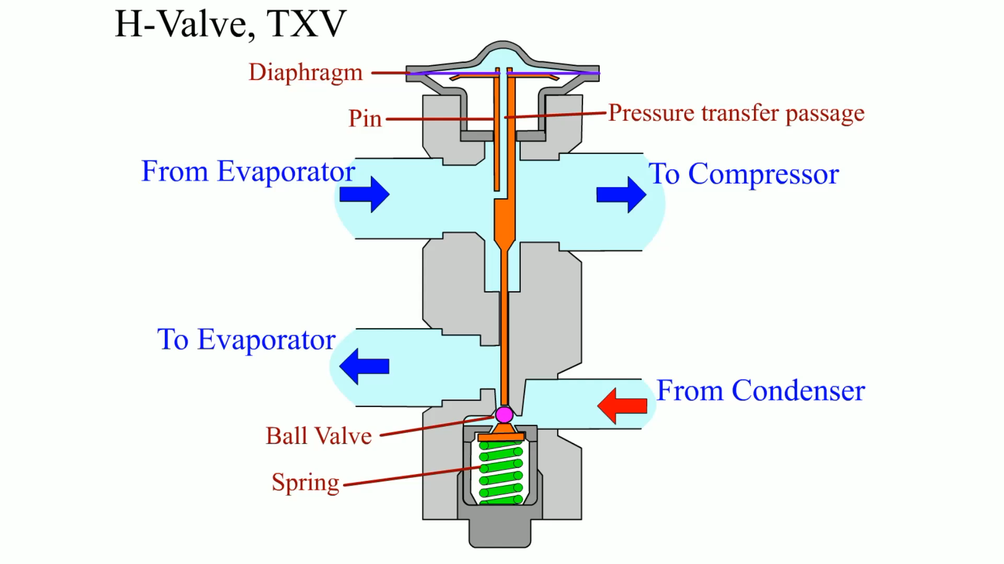
Animation: H-Valve, TXV
(The animation will automatically start in a few seconds)

Slide 14
Orifice Tube Systems
Some orifice tubes use a filter made up of many small plastic beads in place of the screen.
The orifice tube floods the evaporator during light cooling loads, so a low-side accumulator is always used with an orifice.

Slide 15
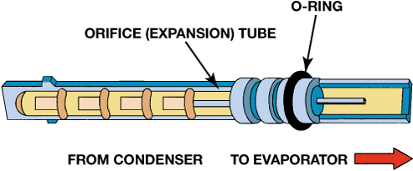
FIGURE 5–13 A typical orifice tube. The refrigerant flow is from the left toward the right.

Slide 16
Evaporators
The purpose and function of the evaporator is to remove heat from the air being forced through it to cool the inside of the vehicle.

Slide 17
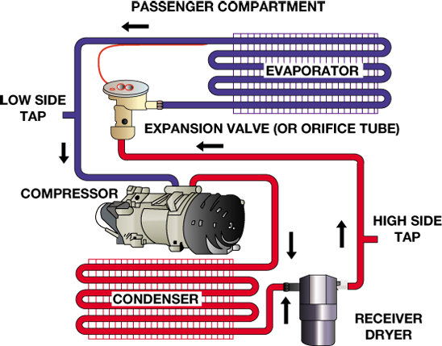
FIGURE 5–17 The evaporator is part of the low pressure side of the refrigeration cycle and is used to transfer the heat from inside the vehicle to the refrigerant flowing through the internal tubes.

Slide 18
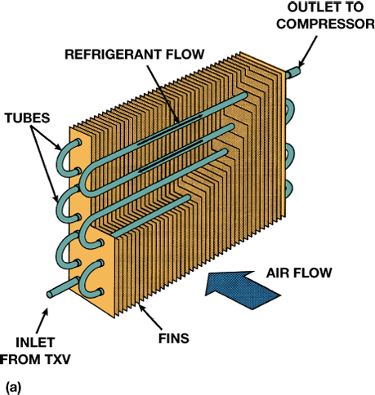
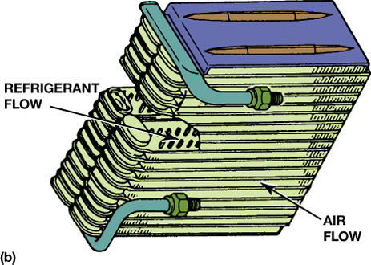
FIGURE 5–18 (a) An older design tube-and-fin evaporator. (b) A plate evaporator. Each type has a large contact area for heat to leave the air and enter the refrigerant.

Slide 19
Receiver-Driers and Accumulators
The purpose of refrigerant storage is to compensate for volume changes due to temperature change or refrigerant loss.
  Desiccant is needed to remove moisture or water, which can cause rusting or corrosion.

Slide 20
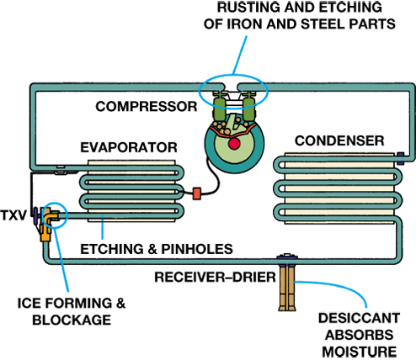
FIGURE 5–20 Water in an A/C system can combine with the refrigerant to form acid. These acids can etch and dissolve components, causing rusting of metal parts, and ice blockage at the expansion device.

Slide 21
Lines and Hoses
The various system components must be interconnected so that refrigerant can circulate through the system.
The components are connected using hoses and tubing (also called pipes).

Slide 22
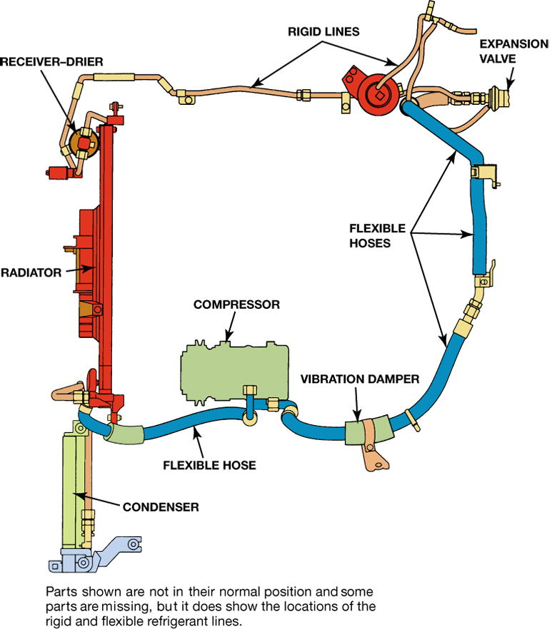
FIGURE 5–24 Rigid lines and flexible hoses are used throughout the air-conditioning system. The line to and from the compressor must be flexible because it is attached to the engine, which moves on its mounts during normal vehicle operation.

Slide 23
Electrical Switches and Evaporator Temperature Controls (1 of 9)
Control switches can be located anywhere in the system, such as at the:
  compressor discharge
  suction cavities
  receiver–drier
  accumulator

Slide 24
Electrical Switches and Evaporator Temperature Controls (2 of 9)
A sensor is usually an input to an electronic control module (ECM) or body control module (BCM).
Any one A/C system will have some but not all of these, depending on the type of system and manufacturer:
  A/C clutch relay
  Ambient sensor or switch

Slide 25
Electrical Switches and Evaporator Temperature Controls (3 of 9)
Any one A/C system will have some but not all of these, depending on the type of system and manufacturer:
  Compressor high-pressure sensor or switch
  Compressor low-pressure sensor or switch
  Compressor RPM sensor

Slide 26
Electrical Switches and Evaporator Temperature Controls (4 of 9)
Any one A/C system will have some but not all of these, depending on the type of system and manufacturer:
  Compressor superheat sensor or switch
  Compressor high-temperature switch
  Power Steering Compressor cutoff switch
  Engine coolant temperature (ECT)
  Evaporator pressure sensor

Slide 27
Electrical Switches and Evaporator Temperature Controls (5 of 9)
Any one A/C system will have some but not all of these, depending on the type of system and manufacturer:
  Evaporator temperature sensor
  High-pressure cutout switch
  High-temperature cutoff sensor or switch

Slide 28
Electrical Switches and Evaporator Temperature Controls (6 of 9)
Any one A/C system will have some but not all of these, depending on the type of system and manufacturer:
  Low-pressure cutout sensor or switch
  Master switch
  Pressure cycling switch
  Thermostatic cycling switch
  Trinary pressure switch

Slide 29
Electrical Switches and Evaporator Temperature Controls (7 of 9)
Any one A/C system will have some but not all of these, depending on the type of system and manufacturer:
  Blower relay
  Clutch cutoff relay
  Condenser fan relay
  Radiator fan relay

Slide 30
Electrical Switches and Evaporator Temperature Controls (8 of 9)
Evaporator temperature in a cycling clutch system is sometimes controlled by either a thermostatic (thermal) switch or pressure switch.

Slide 31
Electrical Switches and Evaporator Temperature Controls (9 of 9)
A thermistor is commonly used to sense temperatures.
A transducer senses pressure and changes a variable pressure signal into a variable electrical signal.

Slide 32
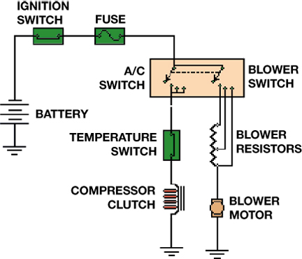
FIGURE 5–32 Many early A/C systems used a simple electrical circuit.

Slide 33
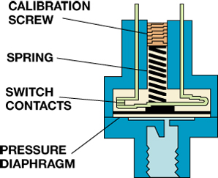
FIGURE 5–33 A pressure switch is either on or off. The contacts are closed by gas pressure on the diaphragm; they are opened by the spring.

Slide 34
Rear A/C Systems
Parts and Operation
  Some larger vehicles (vans and small buses) have dual heat and A/C assemblies, with the rear unit mounted in a rear side panel or in the roof
  Tee fittings are placed in the liquid and suction lines so that refrigerant can flow through both units, with the flow through the rear unit dependent on the cooling load

Slide 35
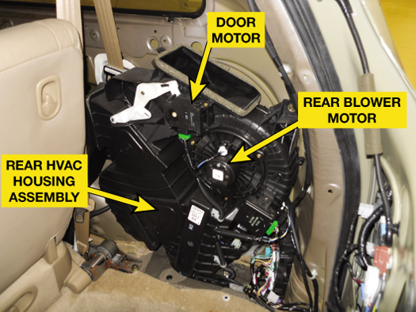
FIGURE 5–35 The rear HVAC module assembly used on a Honda Odyssey minivan.

Slide 36
Component Replacement Procedures (1 of 3)
If the fitting is tight and still leaks, it must be taken apart and inspected for damage and a new O-ring must be installed.
A faulty hose or metal line is often repaired by replacing it with a new or repaired line.

Slide 37
Component Replacement Procedures (2 of 3)
Inside-out failure is caused by acids inside of the system, and the accumulator or receiver–drier must be replaced and the refrigerant recycled to remove these acids.

Slide 38
Component Replacement Procedures (3 of 3)
Special puller that attaches to the orifice tube or needle-nose pliers is normally used to remove it.
When replacing a TXV (other than a H-block-type TXV), the thermal bulb must be securely attached to the evaporator outlet tube.
  This area must be clean to ensure good heat transfer.

Slide 39
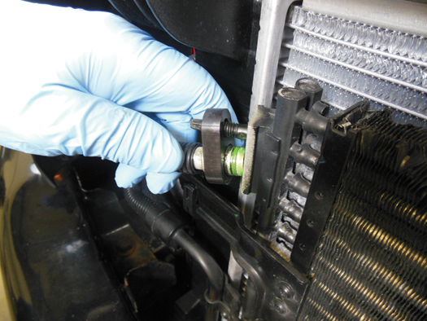
FIGURE 5–36 The line to the condenser from the compressor includes a flange mount with an O-ring. This line is being replaced with a new original equipment line as a result of an accident, which caused the line to be kinked.

Slide 40
Summary
Orifice tubes divide the high side from the low side and are used with accumulators located in the low side.
Various line fitting types are used to connect the components.
Various switches, sensors, and controls are used to control compressor, blower, and fan operation.

Slide 41
Video Links (Internet Access Required)
Compressor installation (time 8:08)
Compressor operation (time 0:52)
Compressor installation (time 0:57)
Compressor removal (time 0:55)
Compressor clutch replacement (time 5:17)
Compressor reseal (time 16:20)
Pulley bearing replacement (time 4:33)
A/C compressor (time 3:26)

