Slide 1
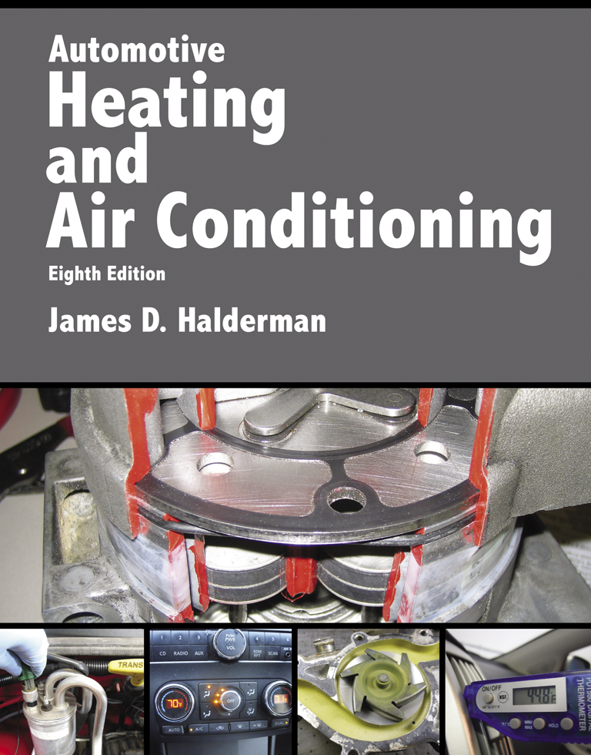
Automotive Heating And Air Conditioning
Eighth Edition
Chapter 4
Refrigerants and Refrigerant Oils

Slide 2
Learning Objectives (1 of 2)
4.1 Prepare for the ASE Heating and Air Conditioning (A7) certification test content area “B” (Refrigeration System Component Diagnosis and Repair).
4.2 Discuss the depletion of the ozone layer and the resulting issues of global warming.
4.3 Explain the impact of legislative laws on automotive A/C systems.

Slide 3
Learning Objectives (2 of 2)
4.4 Discuss identifying refrigerants and proper storage container.
4.5 State the changes considered for future refrigerants.
4.6 Explain refrigerant safety precautions.
4.7 Discuss the different types and viscosities of refrigerant oils.

Slide 4
Refrigerants and Environmental Issues (1 of 2)
A chlorine atom from a chlorinated fluorocarbon (CFC) such as R-12 can travel into the stratosphere if it escapes or is released.
  Under the effects of ice clouds and sunlight, it can combine with one of the oxygen atoms of an ozone molecule to form chlorine monoxide and an ordinary oxygen molecule, O2.
  This destroys that ozone molecule.

Slide 5
Refrigerants and Environmental Issues (2 of 2)
The chlorine can then break away and attack other ozone molecules.
It is believed that 1 chlorine atom can destroy 10,000 to 100,000 ozone molecules.
Global warming traps heat at the Earth’s surface and lower atmosphere, and it is increasing the temperature of our living area.

Slide 6
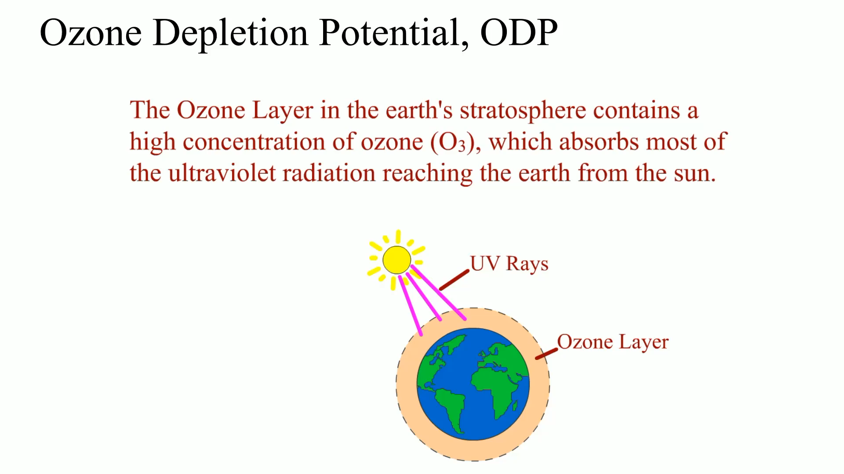
Animation: Ozone Depletion Potential, ODP
(The animation will automatically start in a few seconds)

Slide 7
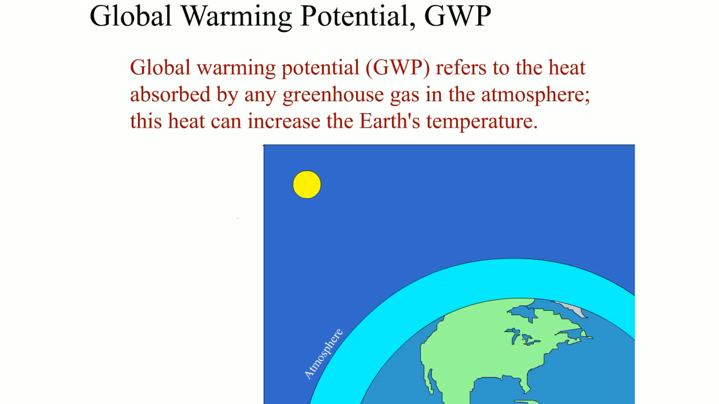
Animation: Global Warming Potential, GWP
(The animation will automatically start in a few seconds)

Slide 8
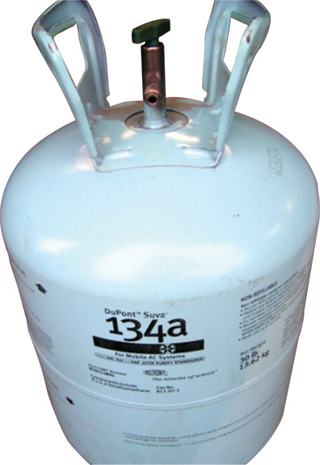
FIGURE 4–1 Large 30 pound containers of R-134a are light blue for easy identification.

Slide 9
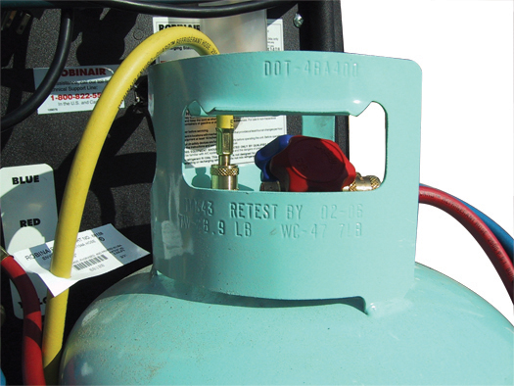
FIGURE 4–2 The stamped text at the top of this container reads “DOT-4BA400.”

Slide 10
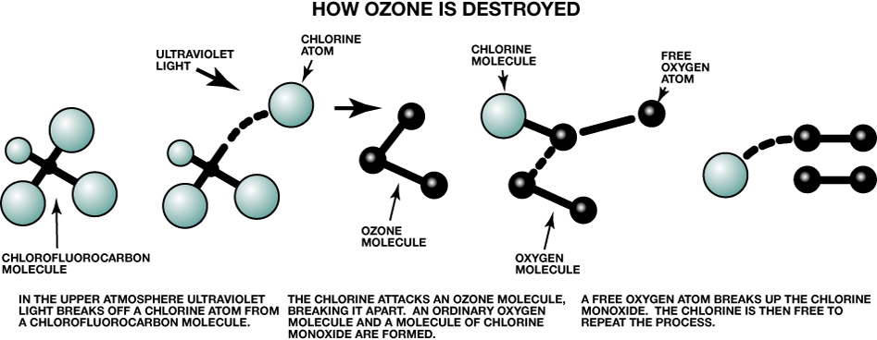
FIGURE 4–4 Chlorofluorocarbon molecules break apart in the atmosphere.

Slide 11
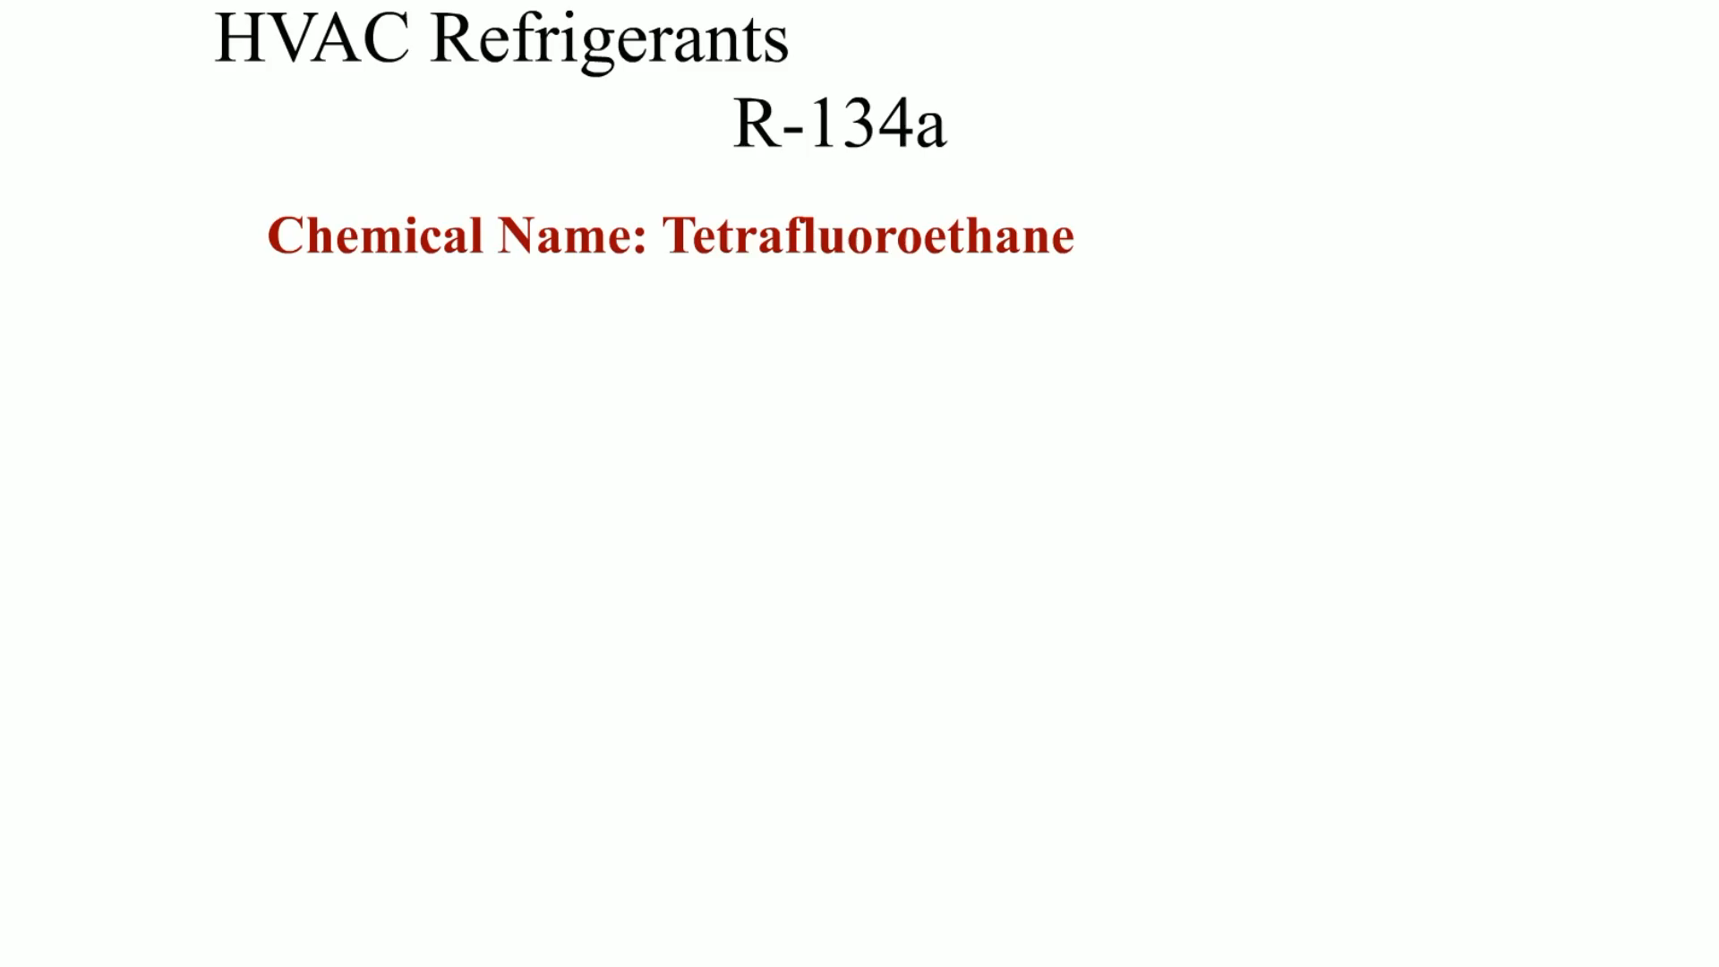
Animation: HVAC Refrigerants R-134a
(The animation will automatically start in a few seconds)

Slide 12
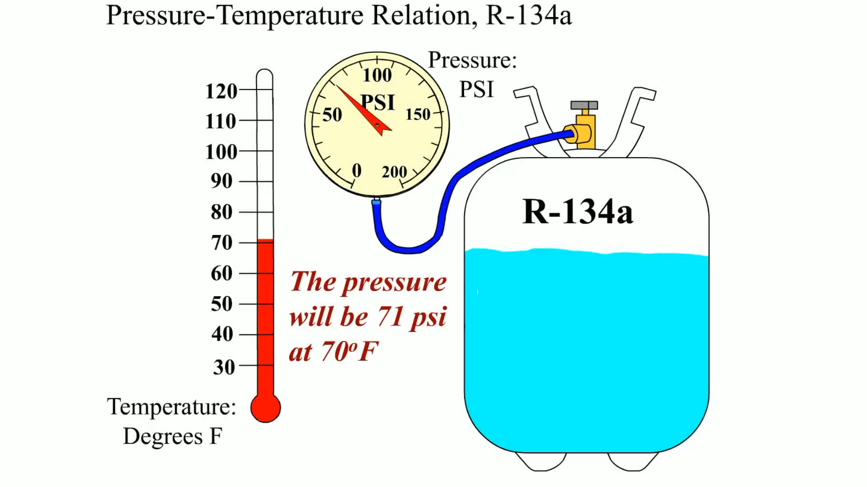
Animation: Pressure-Temperature Relation, 134a
(The animation will automatically start in a few seconds)

Slide 13
Legislation (1 of 3)
Clean Air Act
  Limit the production of ozone-depleting chemicals.
  R-12 production in the United States ceased at the end of 1995.

Slide 14
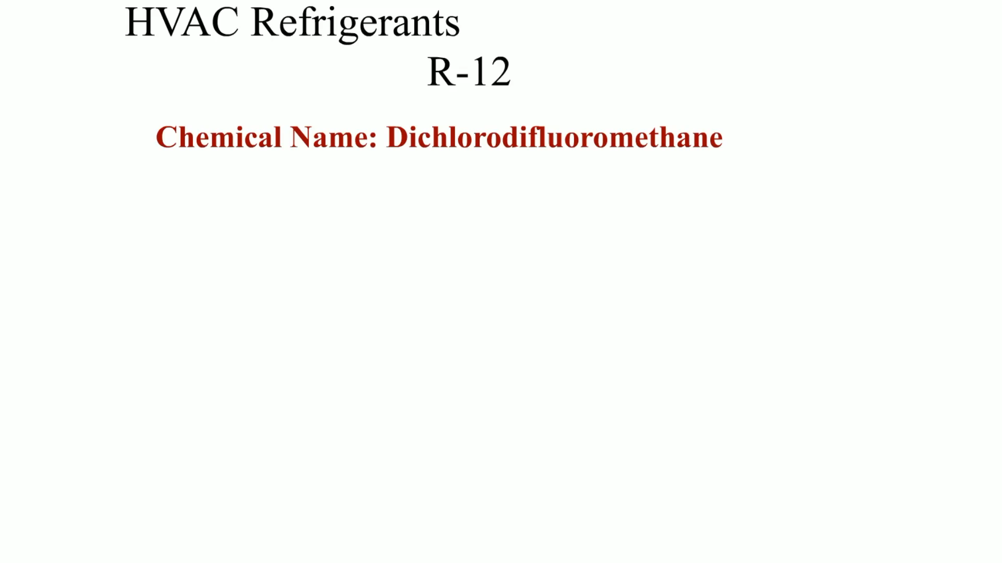
Animation: HVAC Refrigerants R-12
(The animation will automatically start in a few seconds)

Slide 15
Legislation (2 of 3)
Section 609
  A portion of the Clean Air Act that places certain requirements on the mobile vehicle air conditioning (MVAC) service field.
  Manufacture of HCFC-22 was stopped in 2010 in the United States and other developed countries.

Slide 16
Legislation (3 of 3)
Kyoto Protocol
  Total Environmental Warming Impact (TEWI) index was developed, which rates the impact of various refrigerants along with the energy required to perform the cooling operation.

Slide 17
HFO-1234yf
What is HFO-1234yf?
Ozone depletion and Global Warming potential
Mandated
Flammability
R-1234yf concerns

Slide 18
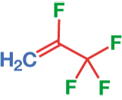
FIGURE 4–6 The chemical symbol for HFO-1234yf.

Slide 19
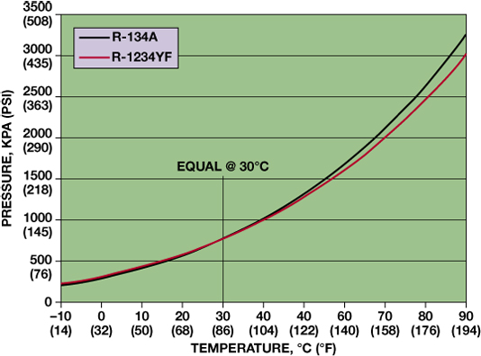
FIGURE 4–8 R-134a and R-1234yf have similar operating pressures.

Slide 20
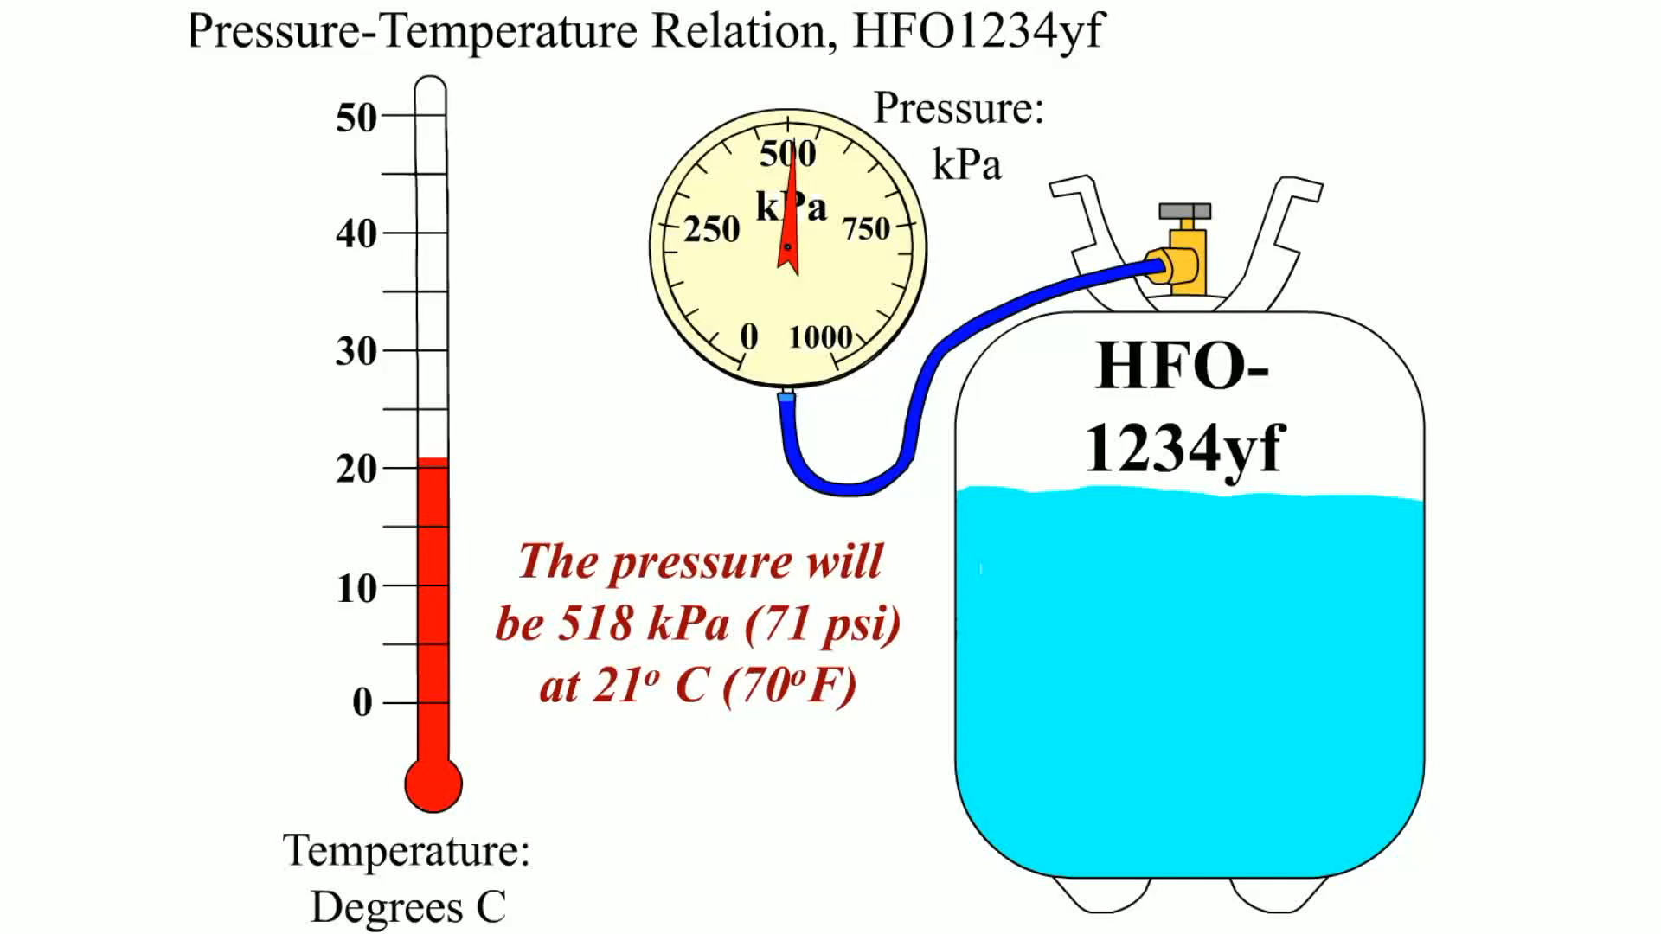
Animation: Pressure-Temperature Relation, HFO1234yf
(The animation will automatically start in a few seconds)

Slide 21
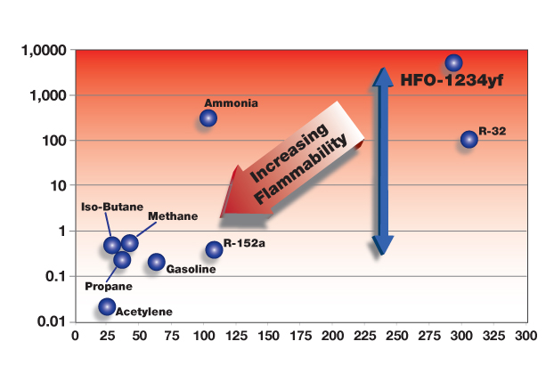
FIGURE 4–9 R-1234yf is just mildly flammable as shown at the top right of the chart.

Slide 22
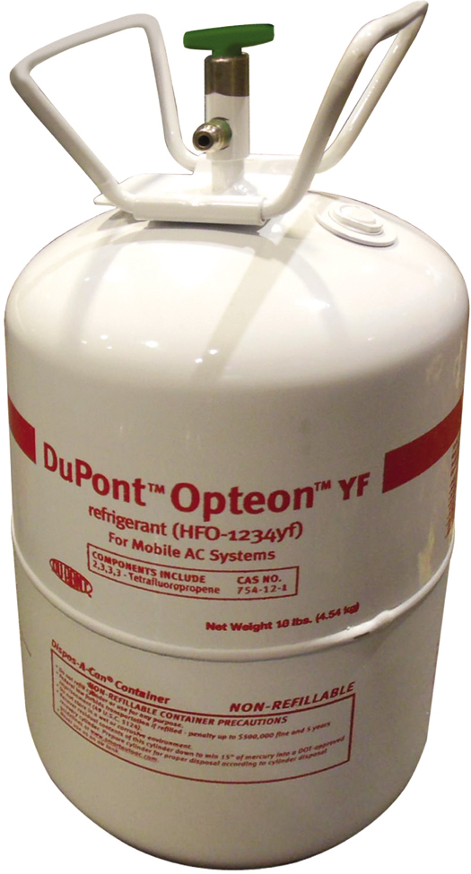
FIGURE 4–7 Due to the cost of R-1234yf, most shops will purchase 10 or 20 pound containers compared to the normal 30 pound container that most shops purchased for R-134a.

Slide 23
Carbon Dioxide as a Refrigerant
What is Carbon Dioxide?
CO₂ as a refrigerant

Slide 24
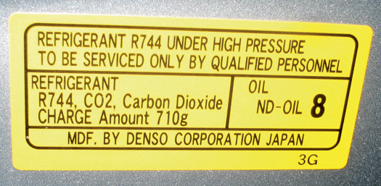
FIGURE 4–10 The label on a Toyota Fuel Cell Hybrid Vehicle (FCHV) showing that CO₂ (R744) is being used as the refrigerant.

Slide 25
Alternative Refrigerants
What is the SNAP program?
Counterfeit and bootleg refrigerants

Slide 26
Secondary Loop Systems
Systems that use potentially hazardous refrigerants will probably use a secondary loop.
  A heat exchanger will provide a very cold fluid to connect with a liquid-to-air heat exchanger that will replace the evaporator.

Slide 27
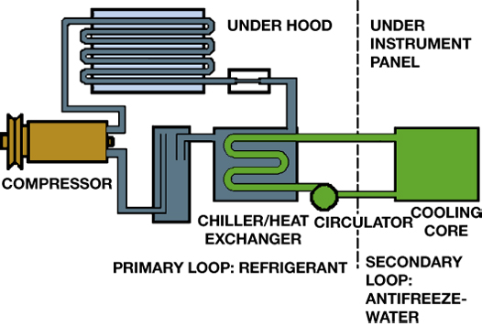
FIGURE 4–11 A secondary loop A/C system keeps the potentially dangerous or flammable refrigerant out of the passenger compartment by using a chiller/heat exchanger to cool an antifreeze and water mixture. This fluid then transfers heat from the cooling core in the air distribution section to the chiller.

Slide 28
Refrigerant Safety Precautions (1 of 3)
Wear safety goggles or a clear face shield and protective clothing (gloves) when working with refrigerants.
Always be in a well-ventilated shop area when working with refrigerants and avoid small, enclosed areas.

Slide 29
Refrigerant Safety Precautions (2 of 3)
If liquid refrigerant is splashed onto the skin or into the eyes of a human or animal, it immediately boils and absorbs heat from the body part it is in direct contact with.
If a CFC such as R-12 or R-22 comes into contact with a flame or heated metal, a poisonous gas similar to phosgene is formed.

Slide 30
Refrigerant Safety Precautions (3 of 3)
Several flammable refrigerants have been marketed, and even though they have been banned and are illegal, they still show up.
When refrigerant containers are filled, room is left for expansion and the container is marked with its critical temperature, the maximum that it should be subjected to.

Slide 31
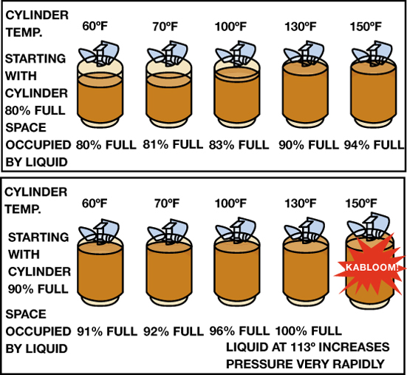
FIGURE 4–12 When recovering refrigerant, the container should be filled to a maximum of about 80%.

Slide 32
Refrigerant Oils (1 of 2)
Refrigerants are commonly available in several sizes of containers including:
  Small cans of 12 oz. to 14 oz. (400 g)
  Larger drums or canisters of 15 lb. or 30 lb. (6.8 kg or 13.6 kg)
Refrigerant containers are color coded:
  R-12 containers are white; R-22 containers are green; R-134a containers are light blue

Slide 33
Refrigerant Oils (2 of 2)
Types of Refrigerant Oils
  Mineral oil
  PAG (polyalkylene glycol)
  POE (polyol ester)
Refrigerant oils are commonly available in several viscosities, including:
  46; 100; 150

Slide 34
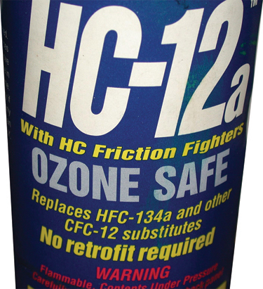
FIGURE 4–13 A container of refrigerant, which is a replacement for R-12 or R-134a and contains R-134a but also butane, a flammable gas.

Slide 35
Summary (1 of 2)
Refrigerants escaping into the atmosphere can have detrimental effects on the ozone layer and also increase climate change and global warming.
The Clean Air Act places requirements for technicians to follow when servicing mobile A/C systems.

Slide 36
Summary (2 of 2)
Safety precautions should be followed when handling refrigerants.
Refrigerant oils are available in different viscosities and the specified oil must be used when servicing an air-conditioning system.

Slide 37
Video Links (Internet Access Required)
Refrigerant operation (time 2:53)

