Slide 1
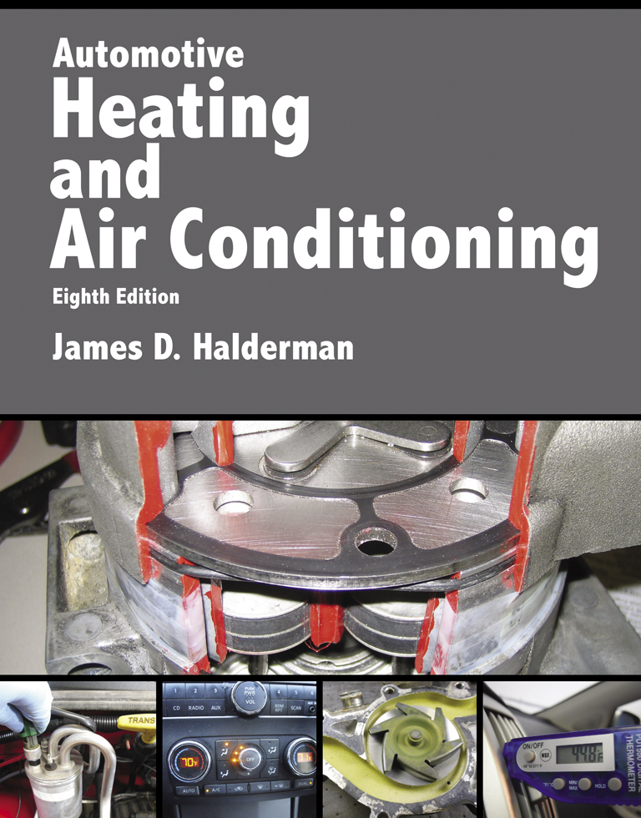
Automotive Heating And Air Conditioning
Eighth Edition
Chapter 3
Air-Conditioning Compressors and Service

Slide 2
Learning Objectives (1 of 2)
3.1 Prepare for ASE Heating and Air Conditioning (A7) certification test content area “B” (Refrigeration System Component Diagnosis and Repair).
3.2 State the different types of A/C compressors.

Slide 3
Learning Objectives (2 of 2)
3.3 Discuss the parts and operation of compressor clutches.
3.4 Discuss compressor valves and switches.
3.5 Explain A/C compressor diagnosis and service.

Slide 4
Compressors (1 of 2)
Piston compressors
  Most older automotive compressors used a crankshaft, similar to a small gasoline engine, and a reciprocating-piston type. Newer piston compressors use a swash or wobble plate.

Slide 5
Compressors (2 of 2)
Vane compressors
  Vane compressor has vanes that contact the rotor housing at each end, and they slide to make a seal at each end as the rotor turns.
Scroll compressors
  Scroll compressors require rather complex machining to achieve constant sealing between the fixed and movable scrolls.

Slide 6
Piston Compressors
What does a piston compressor do?
Radial-type piston compressors
Coaxial swash-plate compressors
Coaxial wobble-plate compressors
Variable displacement wobble-plate compressors

Slide 7
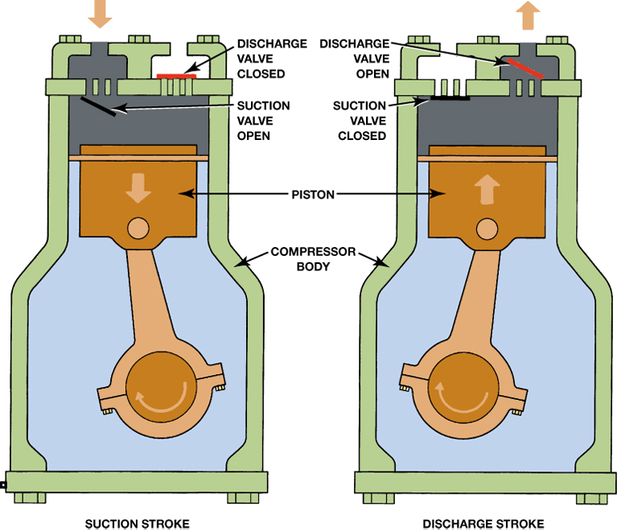
FIGURE 3–1 In a piston compressor, when moving downward, the piston creates a drop in pressure inside the cylinder. The resulting difference in pressure allows the suction valve to open. Refrigerant then flows into the cylinder. When the piston moves upward on discharge stroke, the pressure closes the intake valve and forces the refrigerant out the discharge valve.

Slide 8
Vane Compressors
What is the construction of vane compressors?
What is the operation of vane compressors?

Slide 9
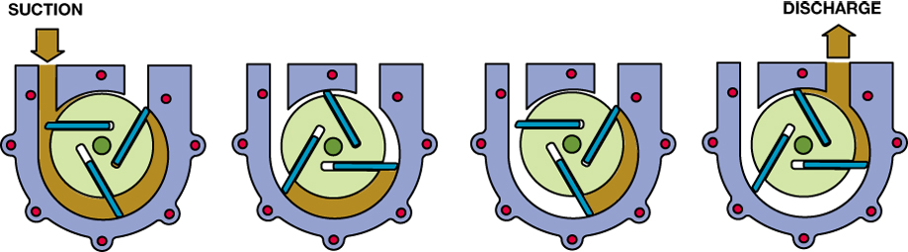
FIGURE 3–7 As the rotor turns in a counterclockwise direction, the vanes move in and out to follow the contour of the housing. This action forms chambers that get larger at the suction ports and smaller at the discharge ports. Evaporator pressure fills the chambers as they get larger, and the reducing size forces the refrigerant into the high side.

Slide 10
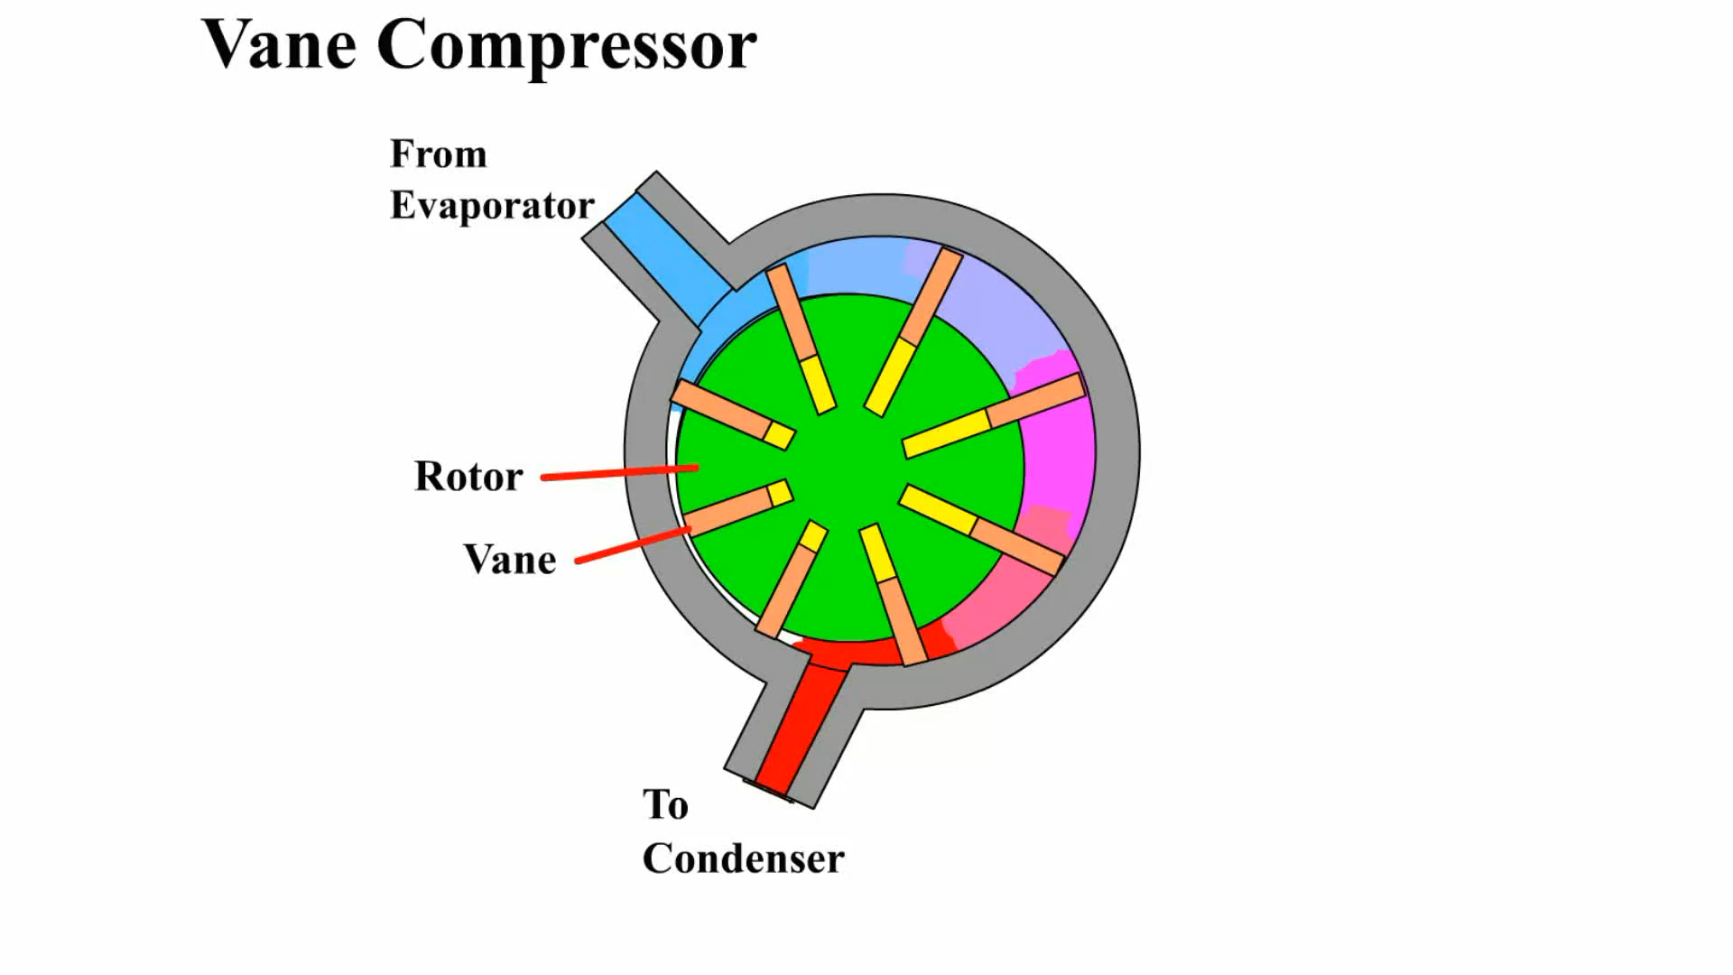
Animation: Vane Compressor
(The animation will automatically start in a few seconds)

Slide 11
Scroll Compressors
Scroll compressors use two major components
  What are they?
Operation
Advantages
Disadvantages

Slide 12
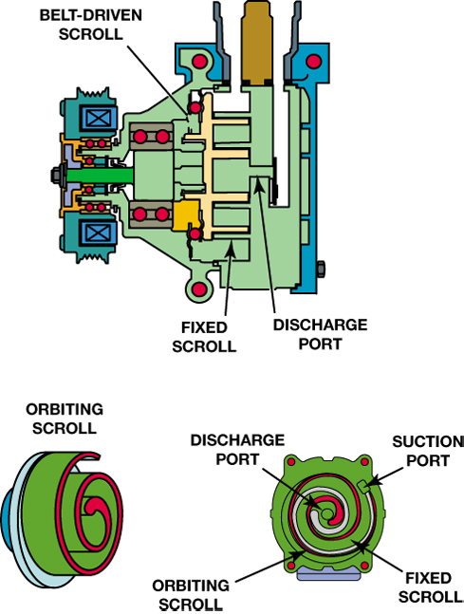
FIGURE 3–8 As the orbital scroll moves, it forms pumping chambers/gas pockets that start at the suction port and forces the refrigerant to the discharge port at the center.

Slide 13
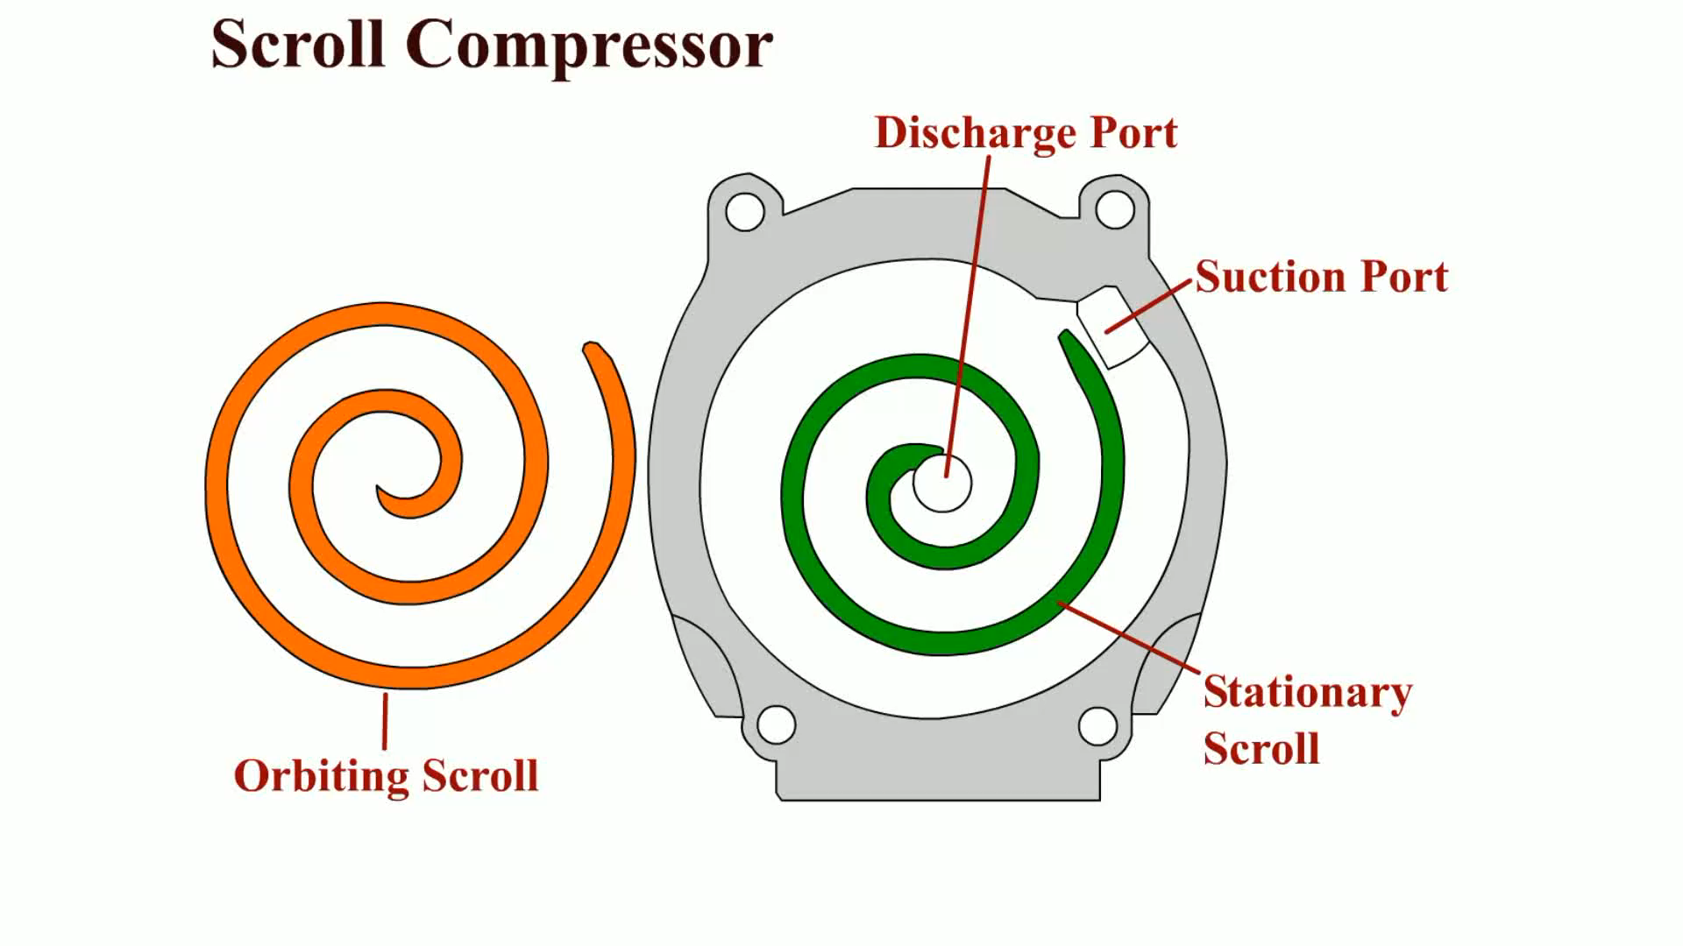
Animation: Scroll Compressor
(The animation will automatically start in a few seconds)

Slide 14
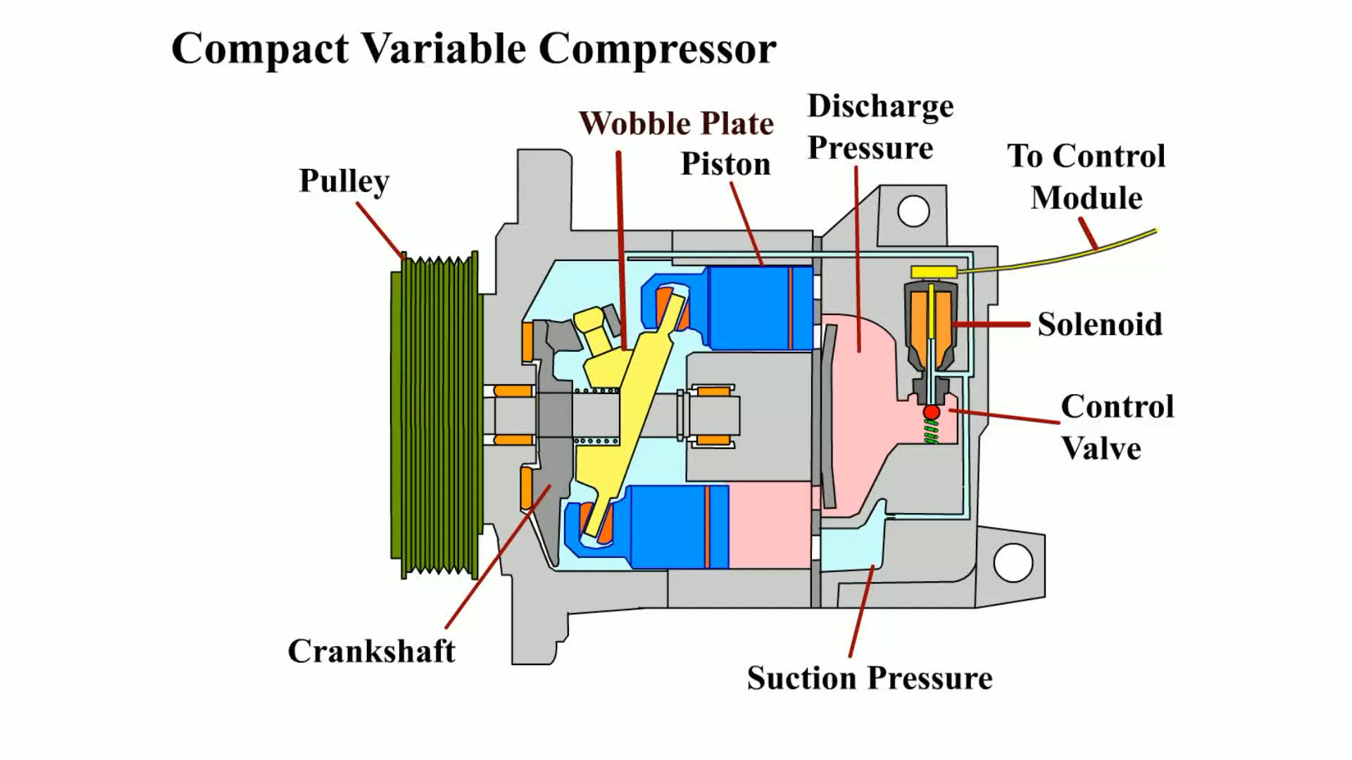
Animation: Compact Variable Compressor
(The animation will automatically start in a few seconds)

Slide 15
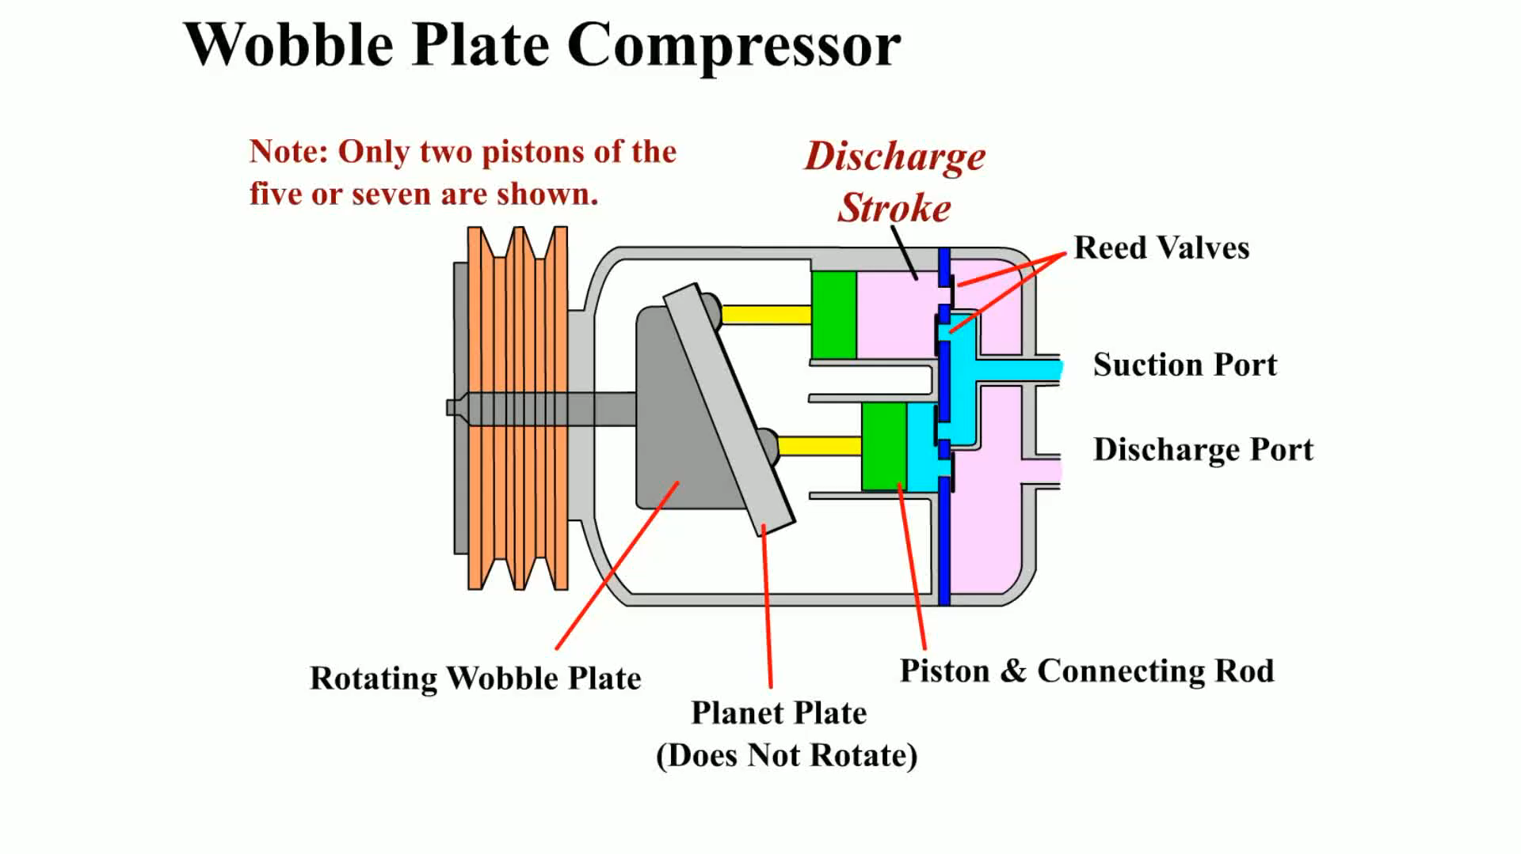
Animation: Wobble Plate Compressor
(The animation will automatically start in a few seconds)

Slide 16
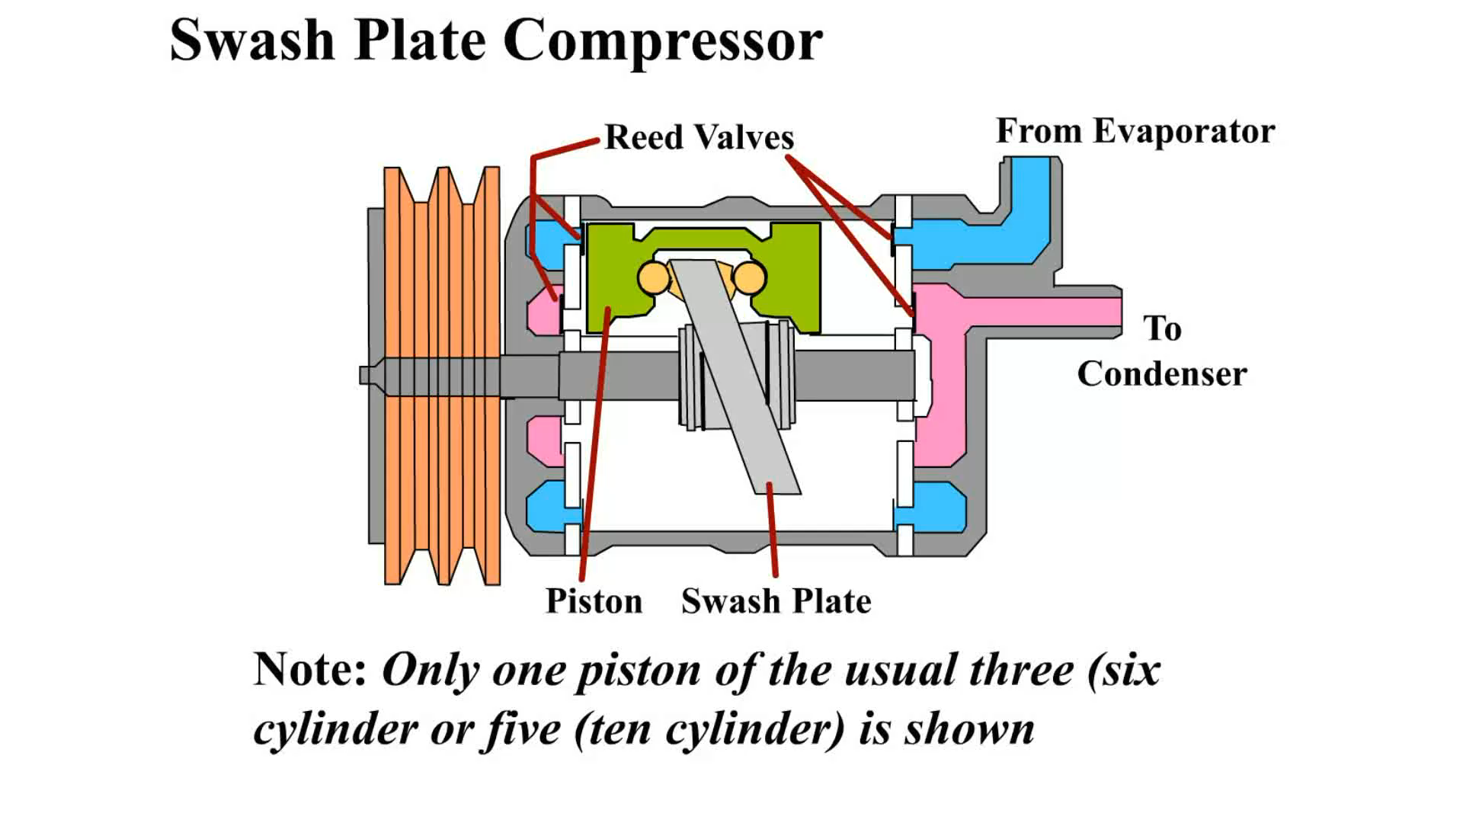
Animation: Swash Plate Compressor
(The animation will automatically start in a few seconds)

Slide 17
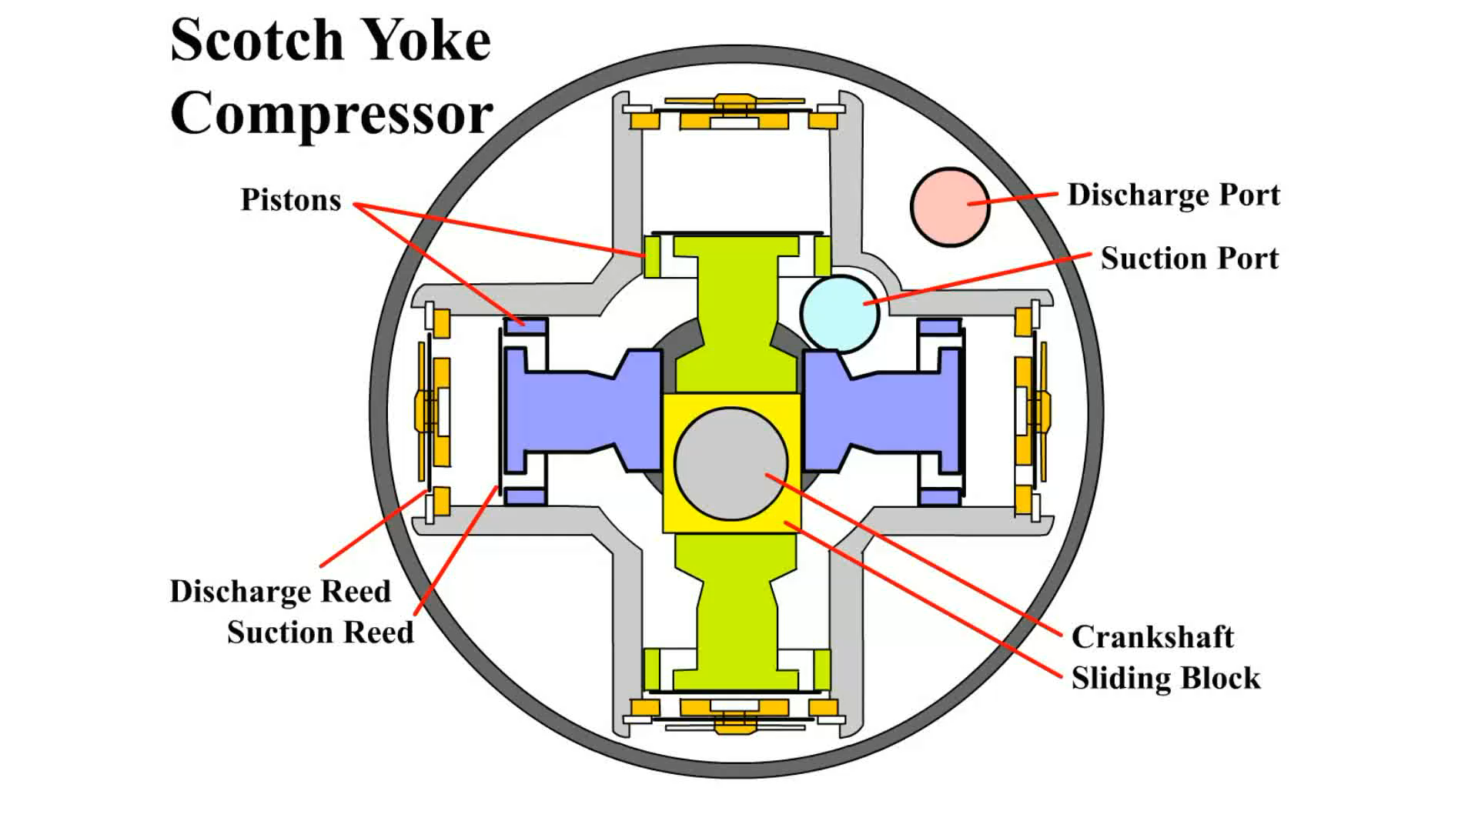
Animation: Scotch Yoke Compressor
(The animation will automatically start in a few seconds)

Slide 18
Compressor Clutches
Magnetic clutches include:
  The clutch coil and pulley are both mounted on an extension from the front of the compressor housing
  The drive plate, also called an a clutch pulley, and the pulley, also called a rotor

Slide 19
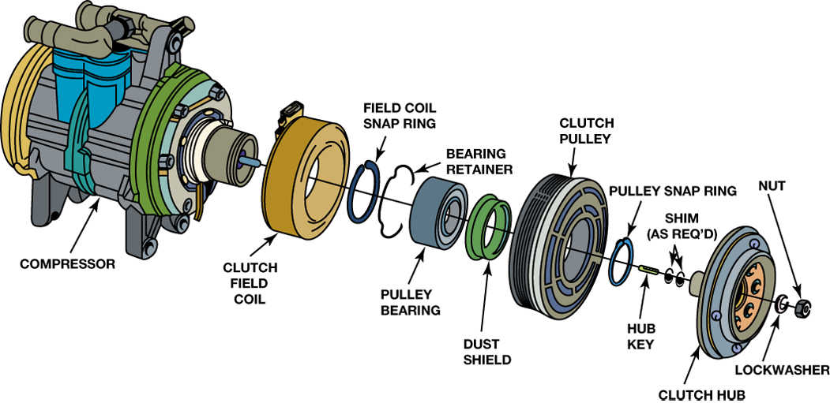
FIGURE 3–9 The electromagnetic clutch assembly includes the clutch field coil, where the magnetic field is created; the clutch pulley, which rides on the pulley bearing; and the clutch hub, which is attached to the input shaft of the compressor. The small shims are added or deleted as needed to adjust the air gap between the clutch hub and the clutch pulley.

Slide 20
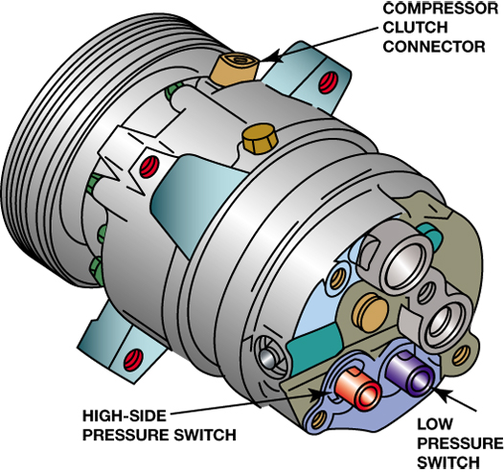
FIGURE 3–16 Check service information for the exact purpose and function of each of the switches located on the compressor because they can vary according to make, model, and year of manufacture of vehicle and can also vary as to what compressor is used.

Slide 21
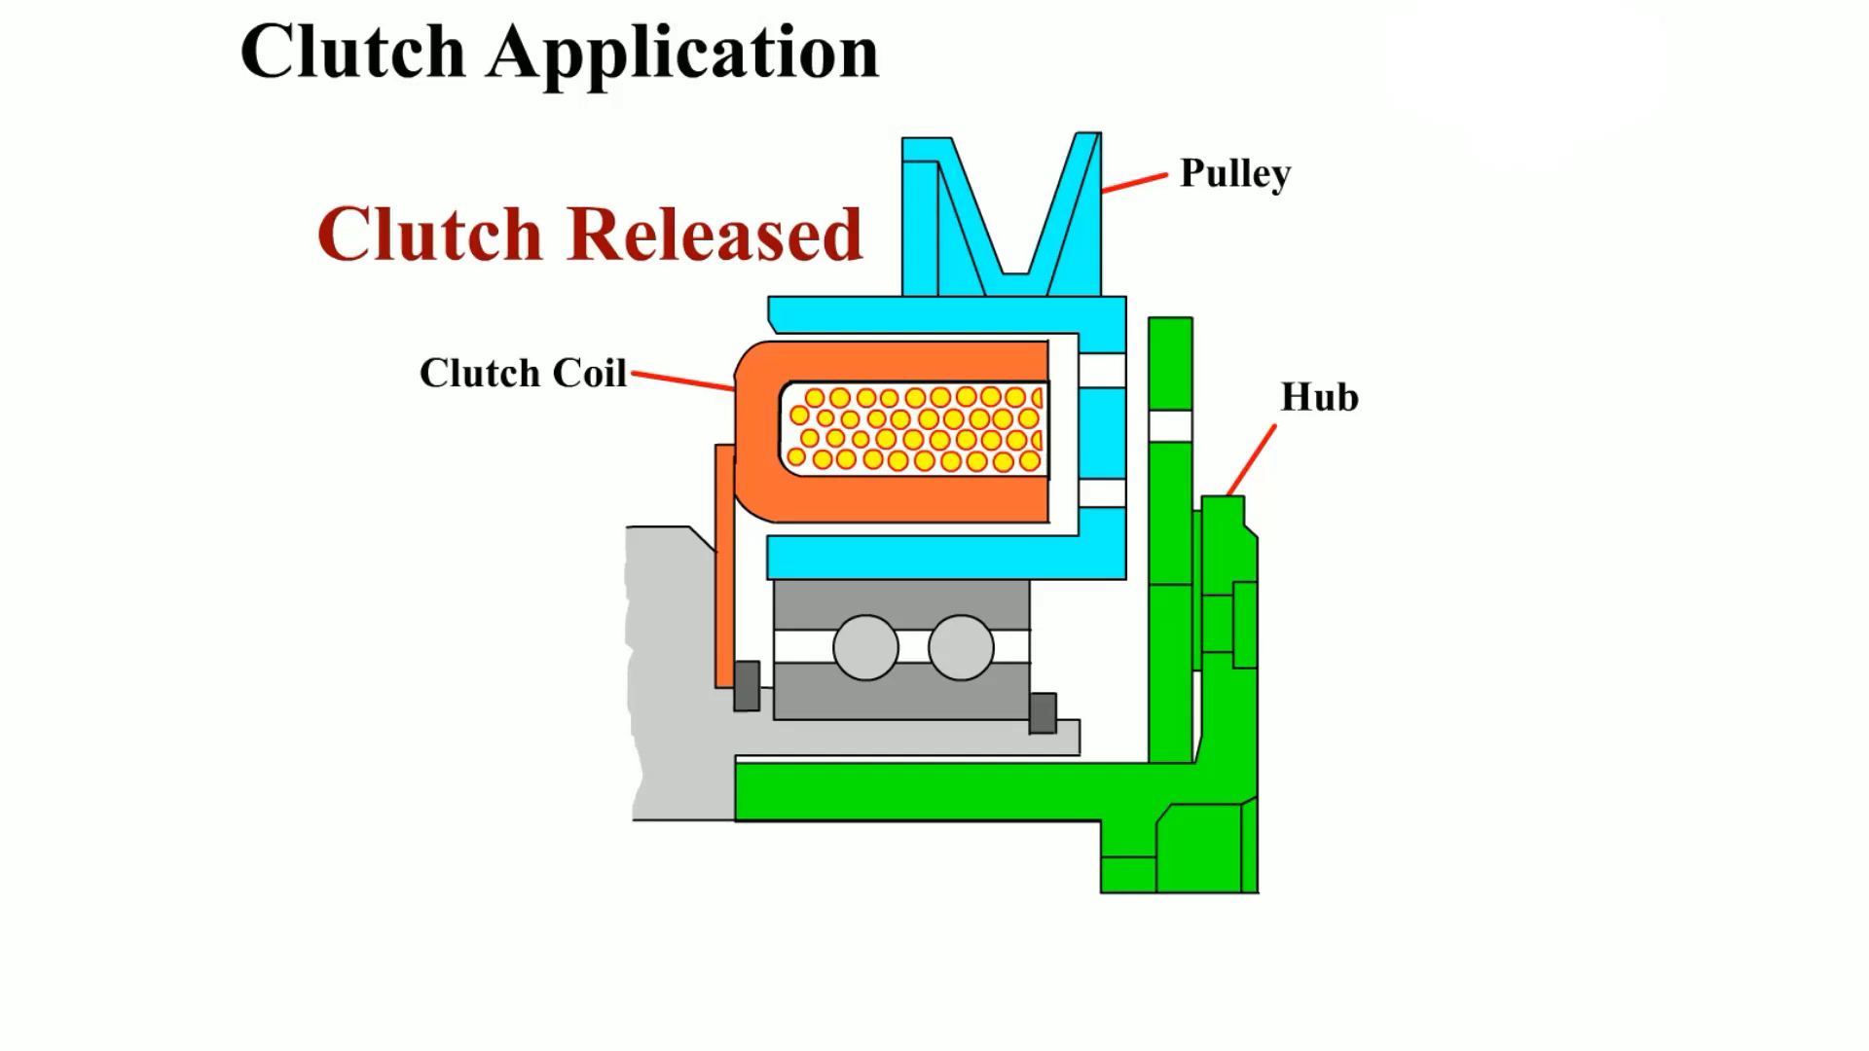
Animation: Clutch Application
(The animation will automatically start in a few seconds)

Slide 22
Compressor Valves and Switches (1 of 3)
Control switches can be located anywhere in the system, including at the following positions:
  Compressor discharge
  Compressor suction cavities
  Receiver–drier
  Accumulator

Slide 23
Compressor Valves and Switches (2 of 3)
Excessive high-side pressure can produce compressor damage and a potential safety hazard if the system should rupture.
Many compressors contain one or more of the following:
  A low-pressure switch
  A high-pressure switch
  A low- and/or high-pressure sensor

Slide 24
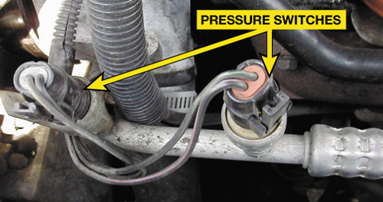
FIGURE 3–17 Typical air-conditioning pressure switches. Check service information to determine the purpose and function of each switch for the vehicle being inspected.

Slide 25
Compressor Valves and Switches (3 of 3)
Some vehicles use an A/C compressor speed (RPM) sensor so the ECM will know if the compressor is running, and by comparing the compressor and engine speed signals, the ECM can determine if the compressor clutch is slipping excessively.
  This system is often called a belt lock or belt protection system.

Slide 26
A/C Compressor Diagnosis and Service (1 of 8)
A faulty compressor or compressor clutch is indicated if the following conditions are observed:
  The high- and low-side pressures are too close, within 50 PSI (345 kPa).
  It cannot produce a high-side pressure of 350 PSI (2,400 kPa) or greater. This test usually requires disconnecting the fan(s) or blocking condenser airflow.

Slide 27
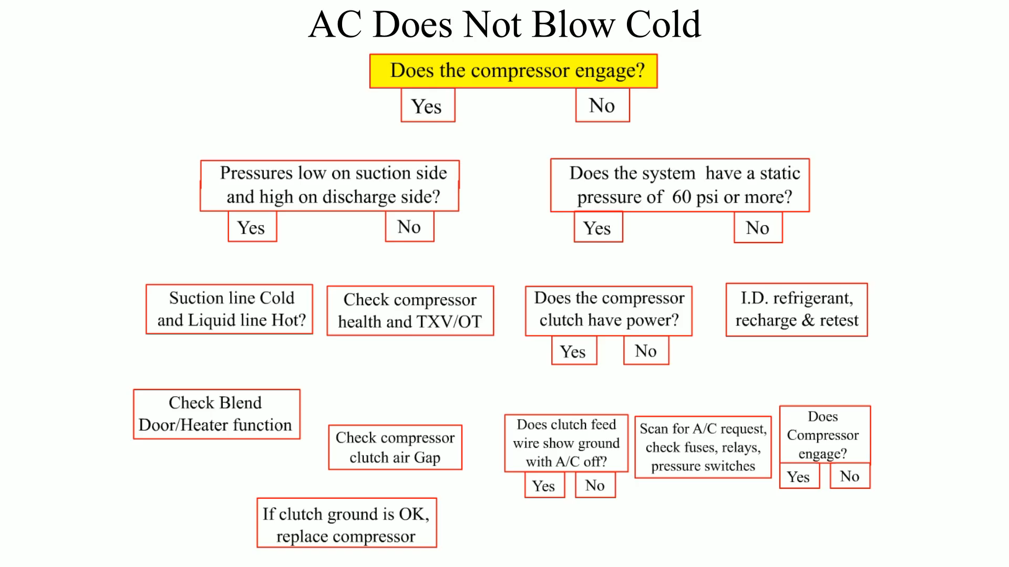
Animation: AC Does Not Blow Cold
(The animation will automatically start in a few seconds)

Slide 28
A/C Compressor Diagnosis and Service (2 of 8)
A faulty compressor or compressor clutch is indicated if the following conditions are observed:
  There is visible damage to the compressor, clutch, or pulley.
  The compressor shaft rotates freely with no resistance.

Slide 29
A/C Compressor Diagnosis and Service (3 of 8)
A faulty compressor or compressor clutch is indicated if the following conditions are observed:
  Shaft rotation is rough or harsh.
  There is free play when shaft rotation is reversed.
  The clutch has too much or too little air gap.

Slide 30
A/C Compressor Diagnosis and Service (4 of 8)
A faulty compressor or compressor clutch is indicated if the following conditions are observed:
  The clutch does not apply or release.
  The pulley rotation is rough or with too much free play.

Slide 31
A/C Compressor Diagnosis and Service (5 of 8)
To remove a clutch assembly:
  STEP 1 Remove the locknut or bolt from the compressor shaft. A clutch hub wrench is often required to keep the hub from turning. Some compressors do not use a locknut.

Slide 32
A/C Compressor Diagnosis and Service (6 of 8)
To remove a clutch assembly:
  STEP 2 Use the correct tool to pull the hub from the compressor shaft.
  STEP 3 A special puller is required on most compressors but the rotor pulley can be slid off some compressors, such as the Nippondenso compressors.

Slide 33
A/C Compressor Diagnosis and Service (7 of 8)
Every compressor has a seal that keeps refrigerant from escaping through the opening where the pulley driveshaft enters.

Slide 34
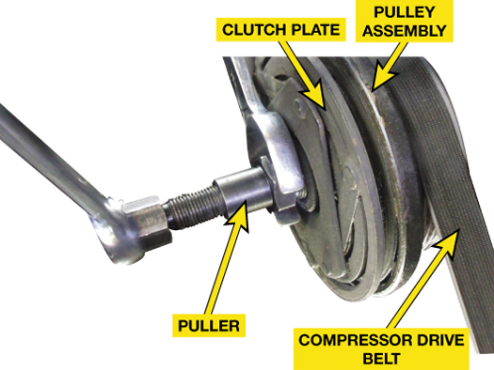
FIGURE 3–18 After removing the retaining nut from the A/C compressor shaft, a special puller is used to remove the compressor clutch plate (hub).

Slide 35
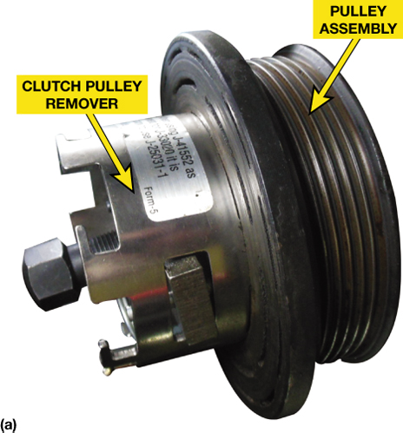
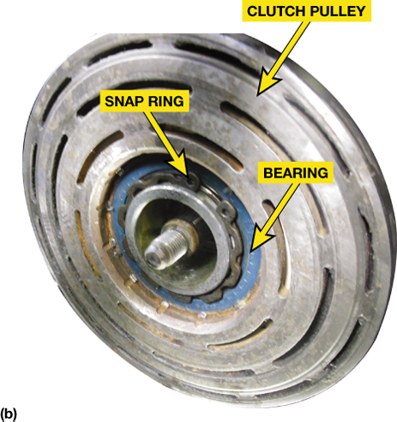
FIGURE 3–19 (a) The pulley assembly is removed using a special puller on this Dodge truck. (b) The pulley assembly includes the bearing which may or may not be a replaceable part, depending on the compressor.

Slide 36
A/C Compressor Diagnosis and Service (8 of 8)
Engine drive belts should be checked periodically for damage and proper tension.
The tensioner is designed to keep the belt tight enough so it does not slip but not so tight that the belt or bearings in the driven components will fail early.

Slide 37
Replacement Compressors
Identify the unit
Oil charge

Slide 38
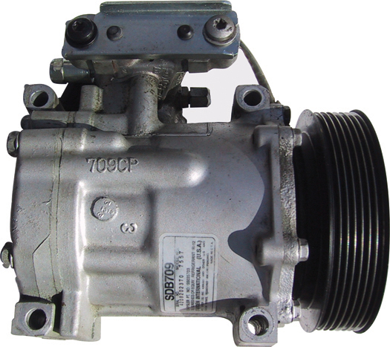
FIGURE 3–29 The decal on this compressor identifies the type (SDB709) and the serial number. Note also that it uses a seven-groove, multi-V clutch, four mounting bolts, and vertical-pad service ports at the side.

Slide 39
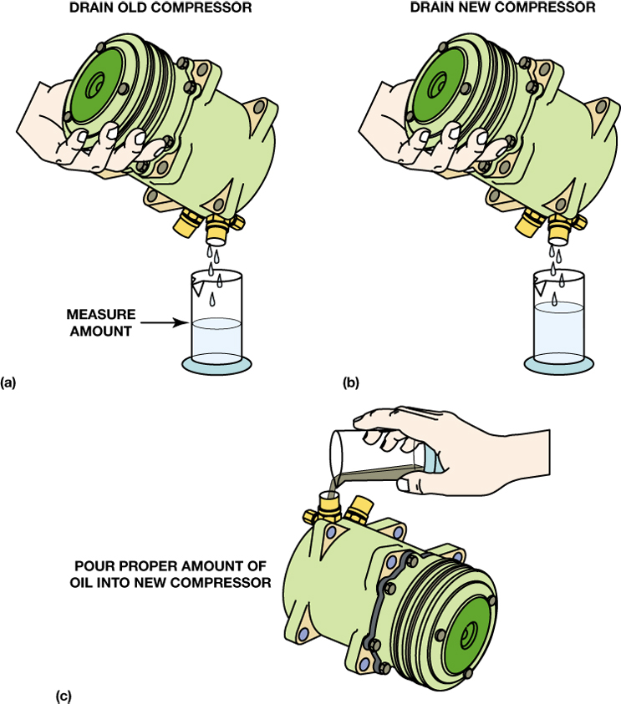
FIGURE 3–30 (a) The oil should be drained from the old compressor (top left); rotate the compressor shaft and the compressor to help the draining. (b) Drain the oil from the new compressor (top right). (c) Pour the same amount of oil drained from the old compressor or the amount specified by the compressor manufacturer of the proper oil into the new compressor (lower).

Slide 40
Summary
Various compressor types and models are used with vehicle A/C systems.
Compressor models can use a variety of clutch and pulley designs.
Some variable displacement compressors use a damper pulley in place of a clutch.
Compressors are lubricated by oil that is circulated by the refrigerant.

Slide 41
Video Links (Internet Access Required)
Auto air conditioning systems at a glance (time 3:53)
AC System Basics (time 6:11)

