Slide 1
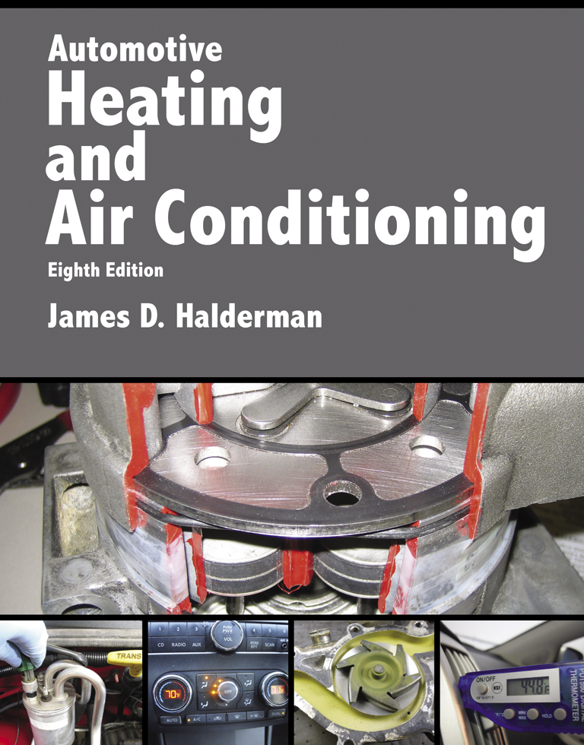
Automotive Heating And Air Conditioning
Eighth Edition
Chapter 2
The Refrigeration Cycle

Slide 2
Learning Objectives (1 of 2)
2.1 Prepare for the ASE Heating and Air Conditioning (A7) certification test content area “A” (A/C System Service, Diagnosis and Repair).
2.2 Explain how the A/C system works.
2.3 Identify the low and high side of an A/C system.

Slide 3
Learning Objectives (2 of 2)
2.4 Explain the purpose and function of evaporators in an A/C system.
2.5 Explain the purpose and function of thermal expansion valves and orifice tube systems.
2.6 Explain the purpose and function of condensers.

Slide 4
Basic Principles (1 of 9)
High-pressure liquid refrigerant flows through an expansion device, which controls the amount of refrigerant that is allowed to pass through.

Slide 5
Basic Principles (2 of 9)
When the high-pressure liquid passes through the expansion device, the pressure drops. This causes the liquid refrigerant to evaporate in a small radiator-type unit called the evaporator.
  When the refrigerant evaporates, it absorbs heat when changing from a liquid to a gas. As the heat is absorbed by the refrigerant, the evaporator becomes cold.

Slide 6
Basic Principles (3 of 9)
The refrigerant flows into the engine-driven compressor
  The compressor compresses the low-pressure refrigerant gas into a high-temperature, high-pressure gas and forces it through the system.

Slide 7
Basic Principles (4 of 9)
This high-pressure gas flows into the condenser located in front of the cooling system radiator.

Slide 8
Basic Principles (5 of 9)
The high-pressure liquid then flows to the expansion device, which controls the amount of refrigerant that is allowed to pass through and meters the flow into the evaporator.
  When the high pressure of the liquid passes through the expansion device, the pressure drops and causes the refrigerant to vaporize, starting the cycle all over again.

Slide 9
Basic Principles (6 of 9)
Air is blown through the evaporator by the blower motor. The air is cooled as heat is removed from the air and transferred to the refrigerant in the evaporator, then directed inside the passenger compartment through vents.

Slide 10
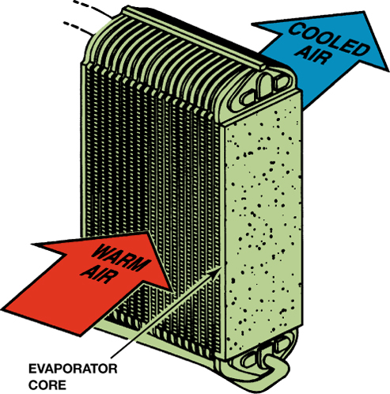
FIGURE 2–2 The evaporator removes heat from the air that enters a vehicle by transferring it to the vaporizing refrigerant.

Slide 11
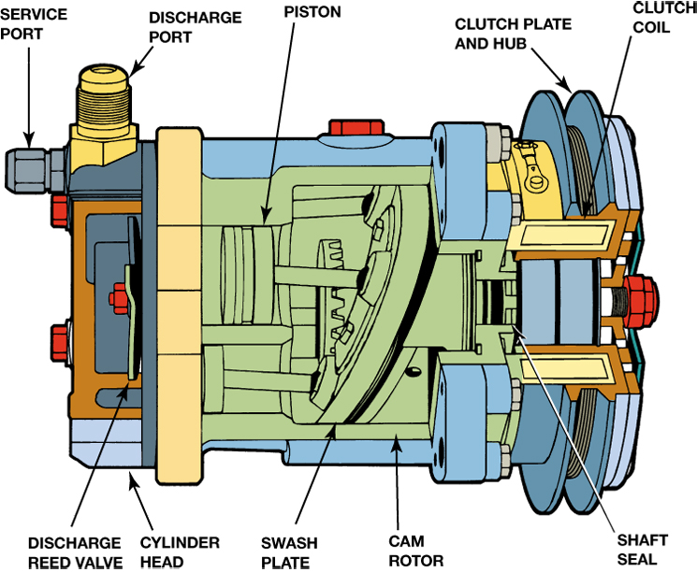
FIGURE 2–3 The compressor provides the mechanical force needed to pressurize the refrigerant.

Slide 12
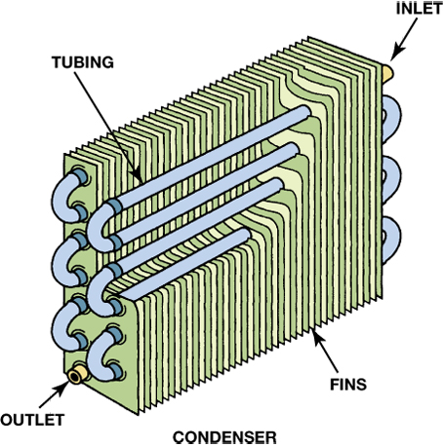
FIGURE 2–4 The condenser changes the refrigerant vapor into a liquid by transferring heat from the refrigerant to the air stream that flows between the condenser fins.

Slide 13
Basic Principles (7 of 9)
Low side—it has low pressure and temperature.
  The low side begins at the expansion device and ends at the compressor. The refrigerant boils or evaporates in the low side.

Slide 14
Basic Principles (8 of 9)
High side—it has higher pressures and temperatures.
  The high side begins at the compressor and ends at the expansion device. The refrigerant condenses in the high side. The high side line is often called the liquid line.

Slide 15
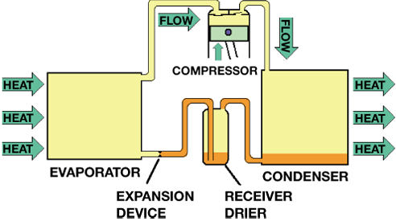
FIGURE 2–5 Refrigerant changes state to a vapor as it absorbs heat in the low side and into a liquid as it loses heat in the high side.

Slide 16
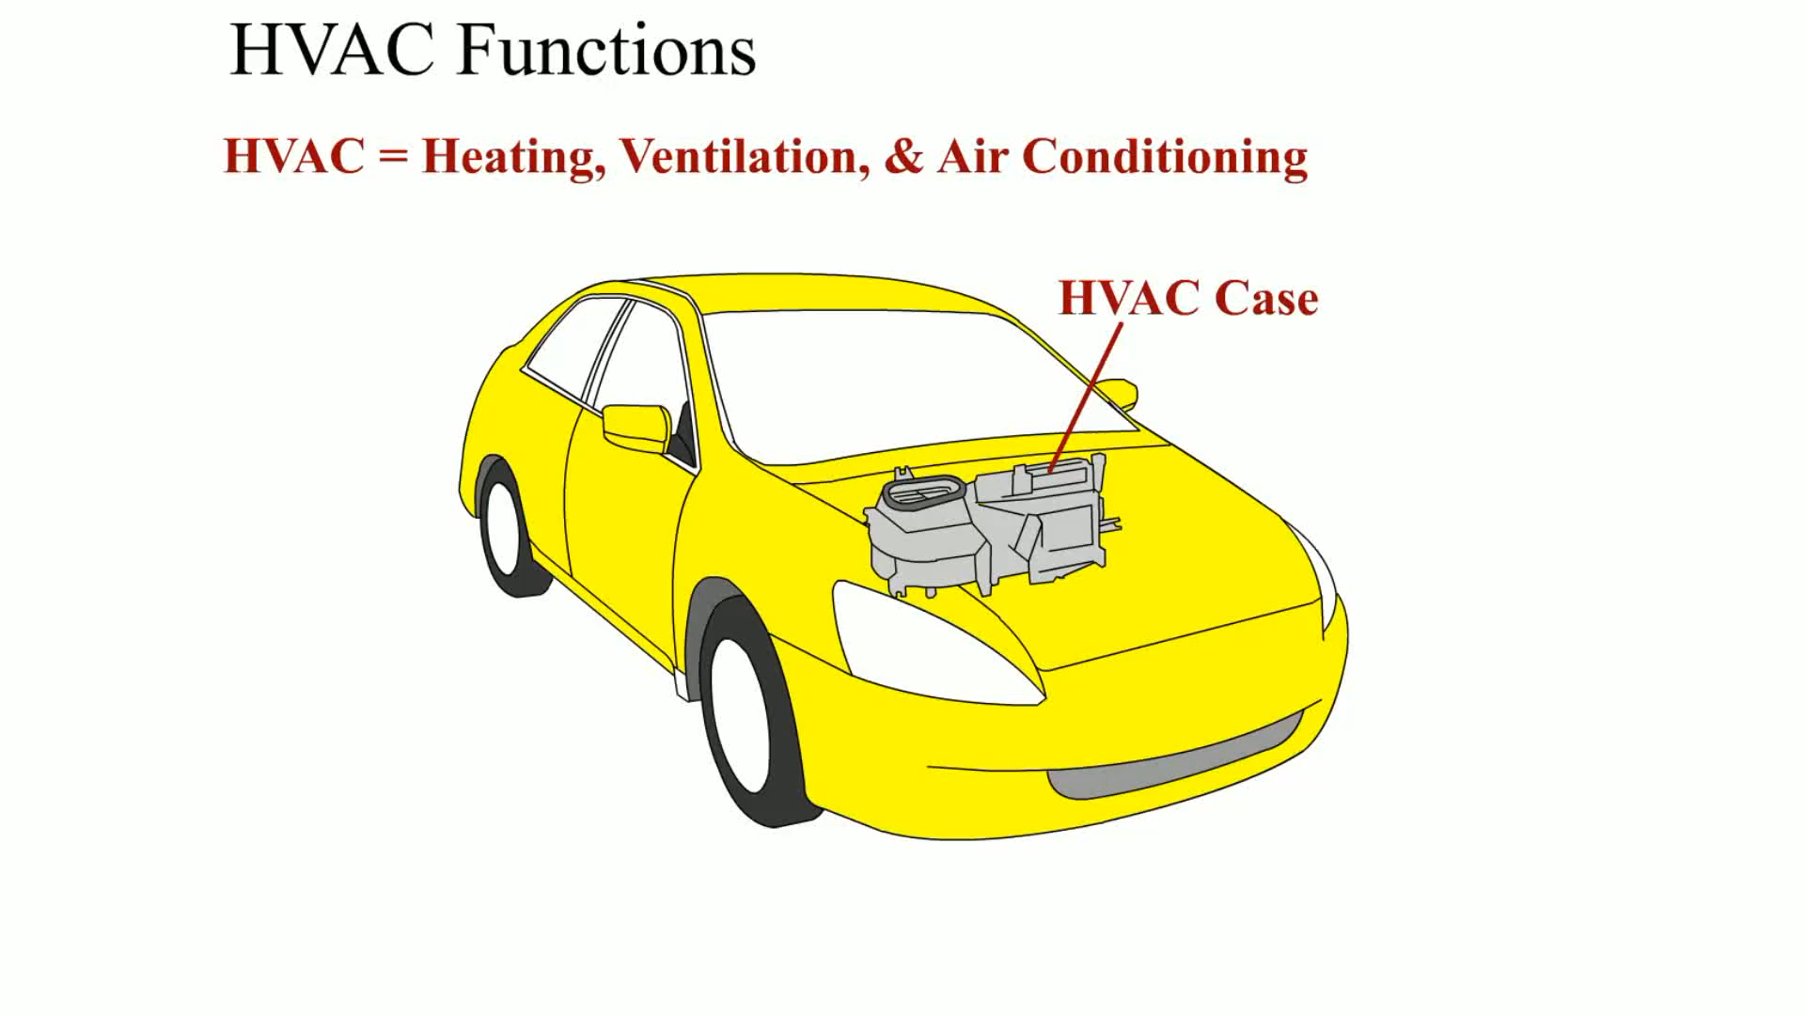
Animation: HVAC Functions
(The animation will automatically start in a few seconds)

Slide 17
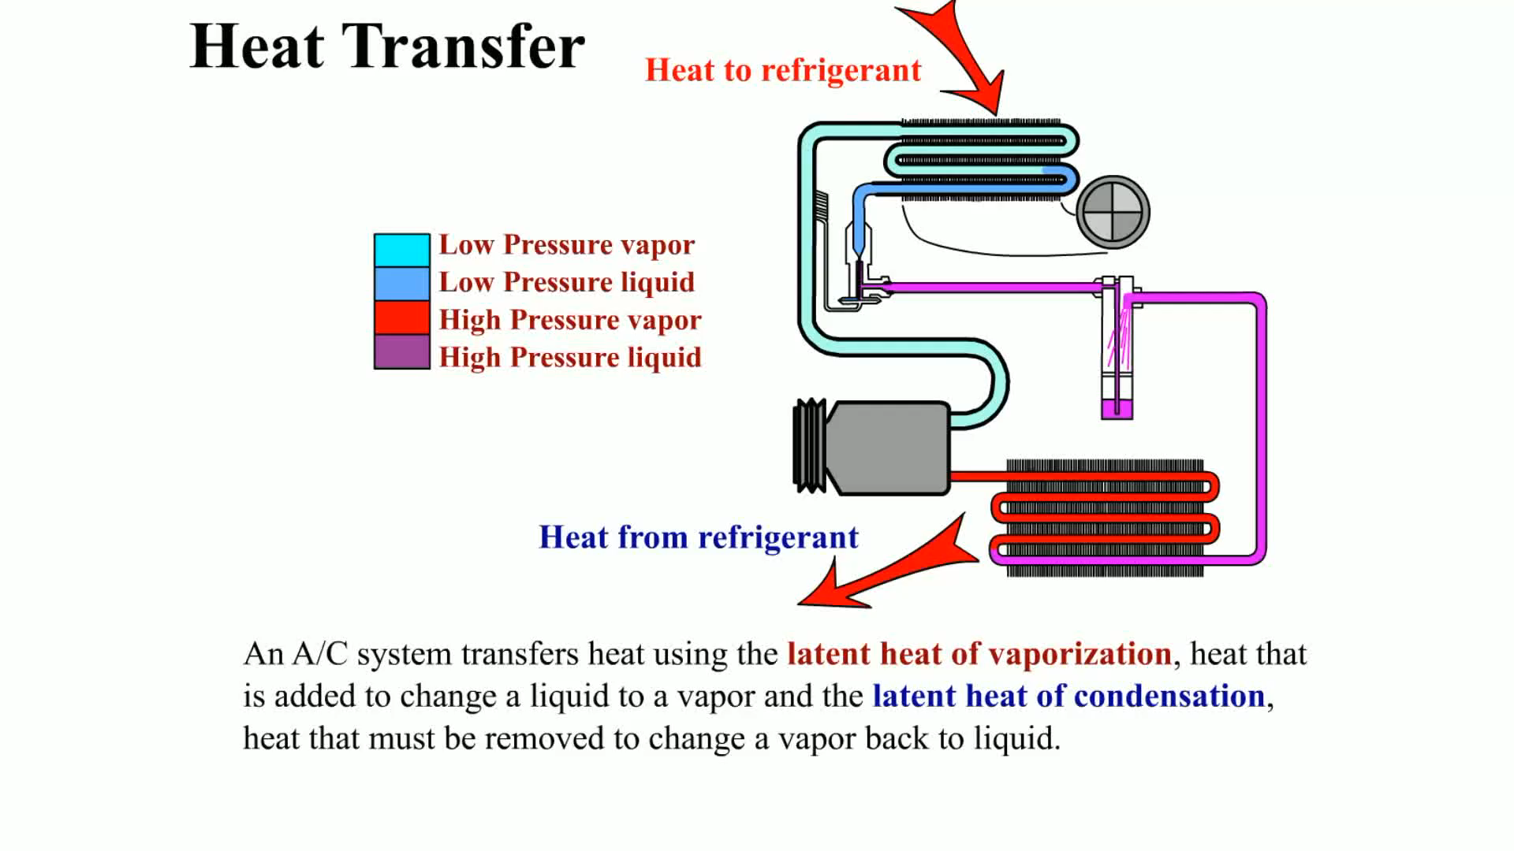
Animation: Heat Transfer
(The animation will automatically start in a few seconds)

Slide 18
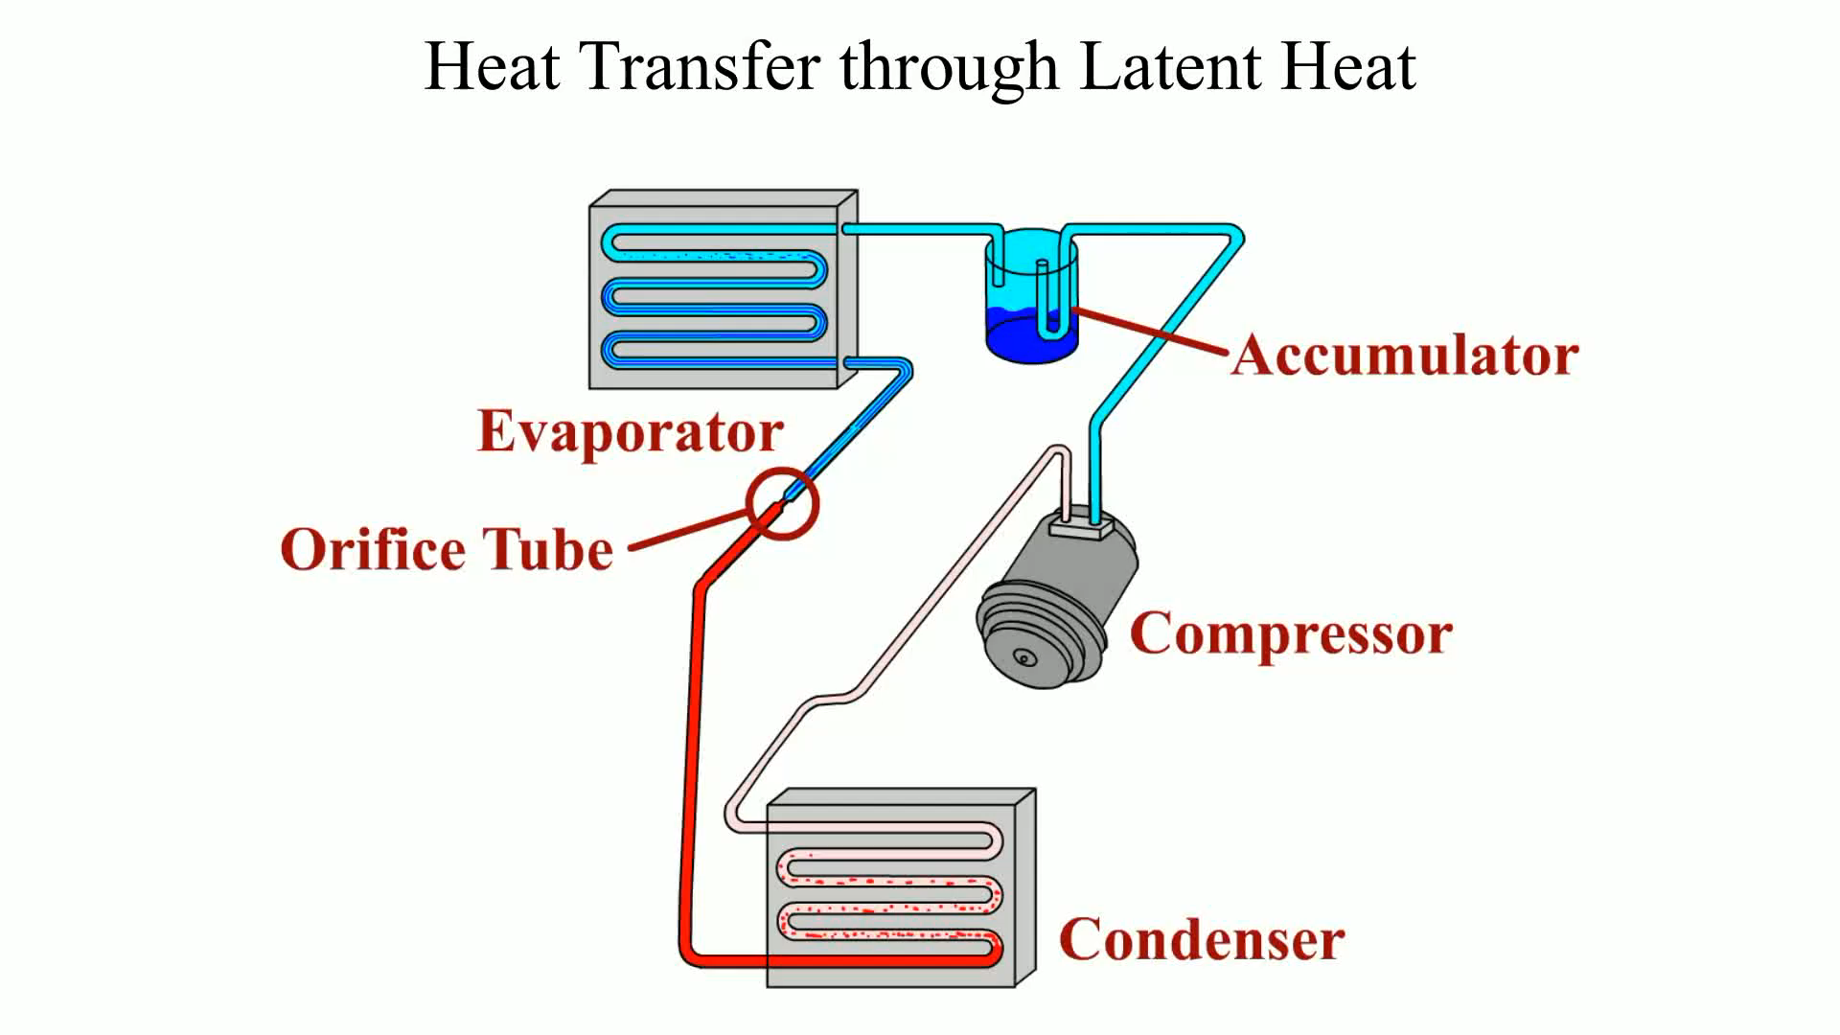
Animation: Heat Transfer through Latent Heat
(The animation will automatically start in a few seconds)

Slide 19
Basic Principles (9 of 9)
In an operating system, the low and high sides can be identified by:
  Pressure
  Sight
  Temperature
  Tubing size

Slide 20
Evaporators (1 of 2)
The evaporator is the heat exchanger and absorbs heat from the passenger compartment.
Like most heat exchangers, a well-designed evaporator has a large amount of surface area in contact with the refrigerant and the air from the passenger compartment.

Slide 21
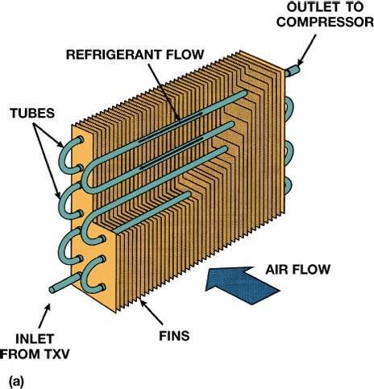
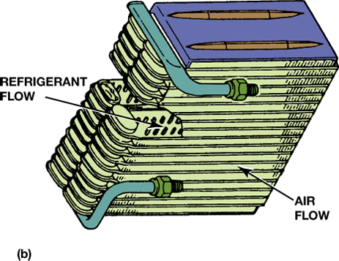
FIGURE 2–8 (a) A tube-and-fin and (b) a plate evaporator. Each type has a large contact area for heat to leave the air and enter the refrigerant.

Slide 22
Evaporators (2 of 2)
The cold temperature in the evaporator is produced by boiling the refrigerant.
Abnormal temperatures and pressures indicate that something is wrong, such as the evaporator might have too much or too little refrigerant.
  Starved evaporator; flooded evaporator

Slide 23
Thermal Expansion Valves (1 of 2)
A thermal expansion valve (TXV) is a variable valve that changes the size of the valve opening in response to the cooling load of the evaporator.

Slide 24
Thermal Expansion Valves (2 of 2)
A TXV is controlled by evaporator temperature and pressure so that it opens to flow as much refrigerant as possible when a lot of cooling is needed and all of the refrigerant must boil in the evaporator.

Slide 25
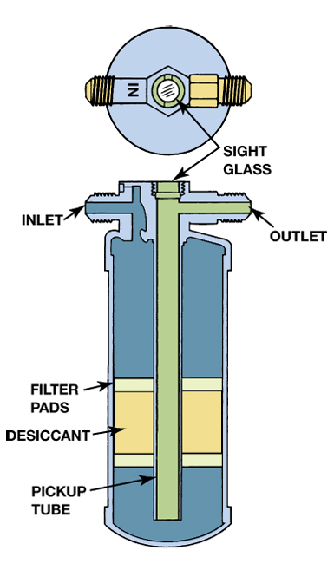
FIGURE 2–11 Expansion-valve systems store excess refrigerant in a receiver–drier, which is located in the high-side liquid section of the system.

Slide 26
Orifice Tube Systems
An orifice tube is a restriction in the liquid line that forces the refrigerant to expand as it passes through the small opening (orifice).
When the refrigerant expands, the temperature of the refrigerant drops and starts to evaporate in the evaporator.

Slide 27
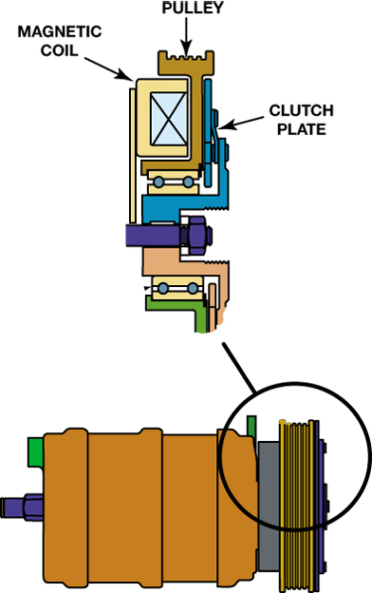
FIGURE 2–12 The compressor clutch allows the compressor to cycle off and on to control evaporator temperature and to shut the system off.

Slide 28
Condensers
The condenser, like the evaporator, is a heat exchanger. Low-pressure refrigerant vapor is compressed by the compressor into a high-temperature, high-pressure vapor.
  This vapor then passes into the condenser where air passing over the condenser cools the refrigerant and causes it to condense into a high-temperature liquid.

Slide 29
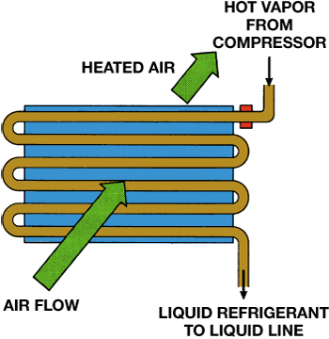
FIGURE 2–14 A condenser is a heat exchanger that transfers heat from the refrigerant to the air flowing through it.

Slide 30
Refrigerant Charge Level
While operating, the following occurs:
  The evaporator contains a refrigerant mist in the first two-thirds to three-fourths of its volume, with vapor in the remaining portion.
  The condenser contains a condensing vapor in the upper portion, with liquid in the bottom passages.
  The line connecting the condenser to the expansion device is filled with liquid.
  The accumulator is about half full of liquid so that liquid refrigerant does not enter the compressor.

Slide 31
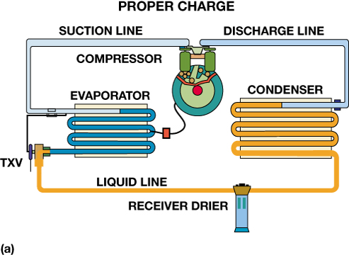
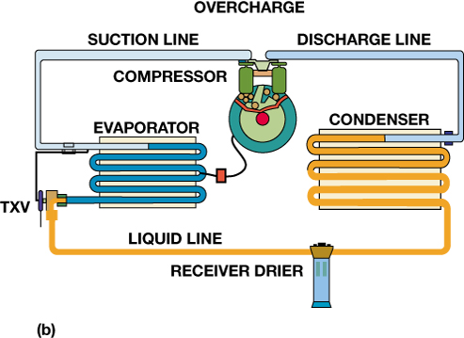
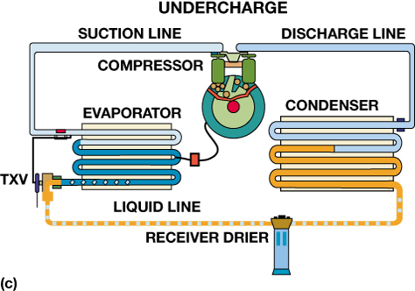
FIGURE 2–15 (a) A properly charged system has the condenser filled with condensing vapor and some liquid, a liquid line filled with liquid, a receiver–drier about half full of liquid, and an evaporator with vaporizing liquid. (b) An overcharge with too much liquid causes liquid to partially fill the condenser. (c) An undercharge has vapor in the liquid line and a starved evaporator.

Slide 32
Evaporator Icing Controls
What is the purpose and function?
What is “Superheat”?
Thermistor
Pressure Switches

Slide 33
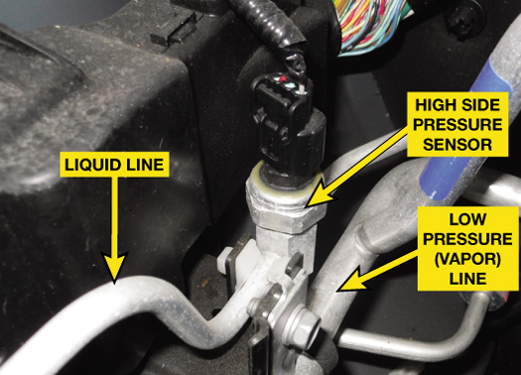
FIGURE 2–17 A typical three-wire pressure sensor used on the high side (vapor) line. The three wires are the voltage supply (usually 5 volts), ground, and signal wire.

Slide 34
Summary (1 of 4)
Automotive A/C systems operate on the principle of moving heat from inside to outside of the vehicle.
All automotive air-conditioning systems are closed and sealed. A refrigerant is circulated through the system by a compressor that is usually powered by the engine through an accessory drive belt.

Slide 35
Summary (2 of 4)
The liquid refrigerant evaporates in a small radiator-type unit called the evaporator.
After the refrigerant has evaporated into a low-pressure gas in the evaporator, the refrigerant flows into the engine-driven compressor.

Slide 36
Summary (3 of 4)
From the compressor, high-pressure gas flows into the condenser located in front of the cooling system radiator.
Automotive A/C systems are either orifice tube (OT) systems or thermal expansion valve (TXV) systems.
A receiver–drier is used with a TXV system and is located in the high pressure (liquid) side of the system.

Slide 37
Summary (4 of 4)
An accumulator is used in orifice tube system and is located in the low side of the system between the evaporator and the compressor.

Slide 38
Video Links (Internet Access Required)
Hazardous waste and waste manifests (time 2:58)
Fluid disposal (time 15:37)

