Slide 1
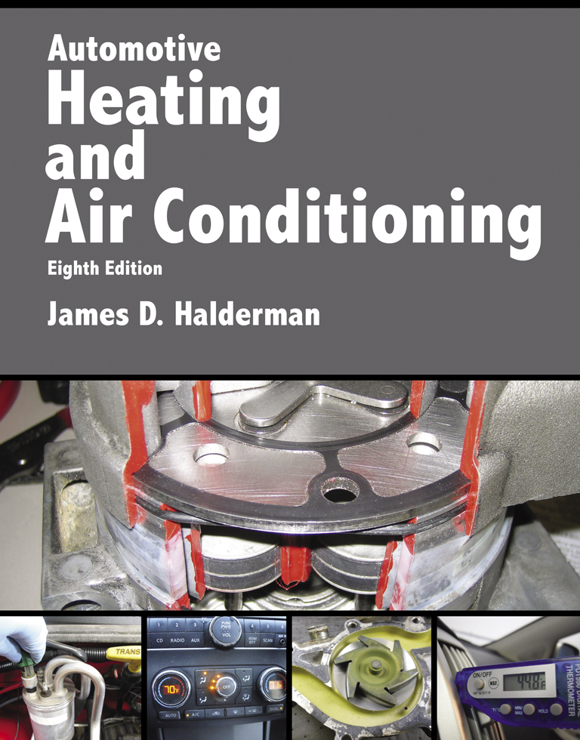
Automotive Heating And Air Conditioning
Eighth Edition
Chapter 15
A/C System Diagnosis and Repair

Slide 2
Learning Objectives (1 of 2)
15.1 Prepare for the ASE Heating and Air Conditioning (A7) certification test content area “A” (A/C System Service, Diagnosis, and Repair).
15.2 Describe the eight-step diagnostic procedure for an A/C system.

Slide 3
Learning Objectives (2 of 2)
15.3 Explain how to perform a visual inspection of an A/C system.
15.4 Discuss how to perform an A/C performance test.
15.5 Describe how to determine the root cause of the problem in an A/C system.

Slide 4
The Diagnostic Procedure (1 of 2)
STEP 1 Verify the Customer Complaint (concern).
STEP 2 Perform a Thorough Visual Inspection.
STEP 3 Check for Diagnostic Trouble Codes (DTCs).
STEP 4 Check for Related Technical Service Bulletins (TSBs).

Slide 5
The Diagnostic Procedure (2 of 2)
STEP 5 Perform an A/C Performance Test.
STEP 6 Determine the Root Cause.
STEP 7 Repair the System.
STEP 8 Verify the Repair.

Slide 6
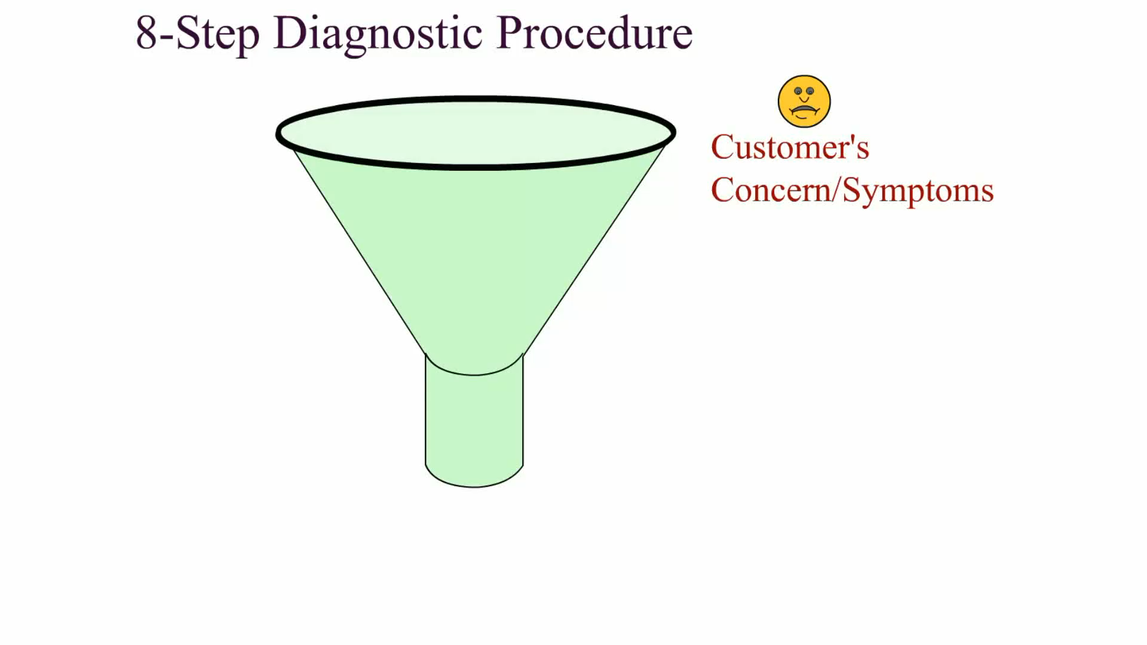
Animation: 8-Step Diagnostic Procedure (The animation will automatically start in a few seconds)

Slide 7
Step 1 Verify the Customer Concern
Understand the exact fault
Higher than normal outside air (ambient) temperature
High humidity level
A new vehicle that is larger or has more glass area than the customer’s previous vehicle
A new vehicle that is black or dark in color compared with their previous vehicle that was a lighter color such as white or silver. A light-colored vehicle reflects light and the heat from the sun instead of being absorbed as with a dark-colored vehicle.

Slide 8
Step 2 Visual Inspections (1 of 6)
A visual inspection of the underhood items includes the following:
Check the condition of the A/C compressor drive belt.
Check the tension of the A/C compressor drive belt and the automatic tensioner.
Inspect the refrigerant hoses and lines for signs of oily residue and damage.

Slide 9
Step 2 Visual Inspections (2 of 6)
While checking the hoses and lines, determine if the system uses a thermal expansion valve system (TXV) or an orifice tube (OT) system and if a variable displacement compressor is used.
Check that the compressor mounting bolts are tight.
Check to make sure that the air gap of the A/C compressor clutch is correct.

Slide 10
Step 2 Visual Inspections (3 of 6)
Check the electrical wires to the clutch, blower motor, and any A/C switches for good, tight connections, and possible damage.
SEE FIGURE 15–1.
Check the condition of any vacuum hoses between the intake manifold and bulkhead, if equipped.

Slide 11
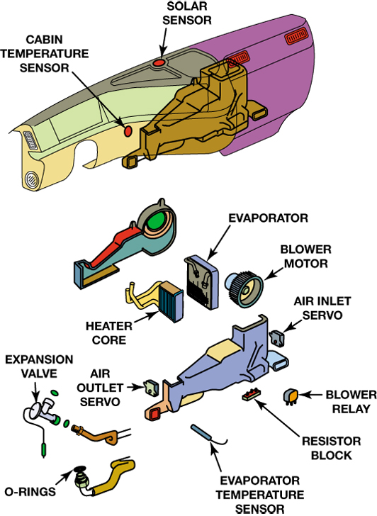
FIGURE 15–1 A visual inspection checks all of the visible, underhood components for possible wear or damage. The underdash components are checked for noise and proper airflow.

Slide 12
Step 2 Visual Inspections (4 of 6)
Check the faces of the condenser and radiator core for restriction to airflow caused by debris and clean as needed.
With the engine off, the in-vehicle checks include:
Operate the blower switch through its various speeds while listening to the fan and motor for unusual noises.

Slide 13
Step 2 Visual Inspections (5 of 6)
Move the temperature lever of mechanically operated doors to both ends of its travel. It should move smoothly and stop before making contact at the ends.
With the engine running, the underhood checks include:
Make sure the compressor clutch is engaged and the compressor is running. Listen for any signs of improper compressor operation.

Slide 14
Step 2 Visual Inspections (6 of 6)
Turn off the A/C clutch to make sure it releases smoothly. With the clutch released, listen for proper clutch bearing operation.
Feel the temperature of the A/C lines and hoses.
Feel the temperature of the heater hoses.
Check the engine cooling fan operation (if running). The fan should be turning smoothly, with good airflow.
Check the evaporator drain.

Slide 15
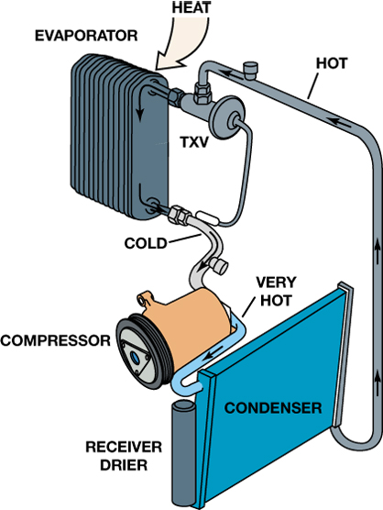
FIGURE 15–2 When a system is operating properly, the suction line to the compressor should be cool, and the discharge line should be hot to very hot. The liquid lines should also be hot.

Slide 16
Step 3 Check Diagnostic Trouble Codes (1 of 2)
Most HVAC-related trouble codes will be “B”, “C” or “U” codes
There are some that are Powertrain-related P-codes including:
P0645 A/C Clutch Relay Control Circuit
P0646 A/C Clutch Relay Control Circuit Low
P0647 A/C Clutch Relay Control Circuit High

Slide 17
Step 3 Check Diagnostic Trouble Codes (2 of 2)
P0691 Fan 1 Control Circuit Low
P0692 Fan 1 Control Circuit High
P0693 Fan 2 Control Circuit Low
P0694 Fan 2 Control Circuit High

Slide 18
Step 4 Check for Technical Service Bulletins
Technical service bulletins (TSBs) are issued by vehicle and aftermarket manufacturers to inform technicians of a situation or technical problem and give the corrective steps and a list of parts needed to solve the problem.
Any diagnostic trouble codes should be retrieved before looking at the technical service bulletins because many bulletins include what DTCs may or may not be present.

Slide 19
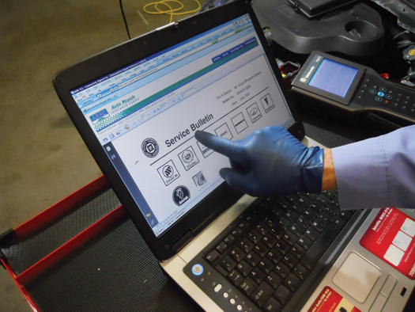
FIGURE 15–5 After checking for stored diagnostic trouble codes (DTCs), the wise technician checks service information for any technical service bulletins that may relate to the vehicle being serviced.

Slide 20
Step 5 Perform A/C Performance Test (1 of 3)
STEP 1 Install pressure gauges to the service ports.
STEP 2 Start the engine, set the parking brake, and raise the idle to 2000 RPM.
STEP 3 Measure ambient temperature 3 inches (80 mm) in front of the condenser and measure the humidity.

Slide 21
Step 5 Perform A/C Performance Test (2 of 3)
STEP 4 Place a thermometer in the air conditioner center vent.
STEP 5 Set the air conditioner for maximum cooling.
STEP 6 Open the doors and set the blower speed to high, which applies the maximum load on the system.

Slide 22
Step 5 Perform A/C Performance Test (3 of 3)
STEP 7 Allow the system to operate for another five minutes before recording the gauge readings.

Slide 23
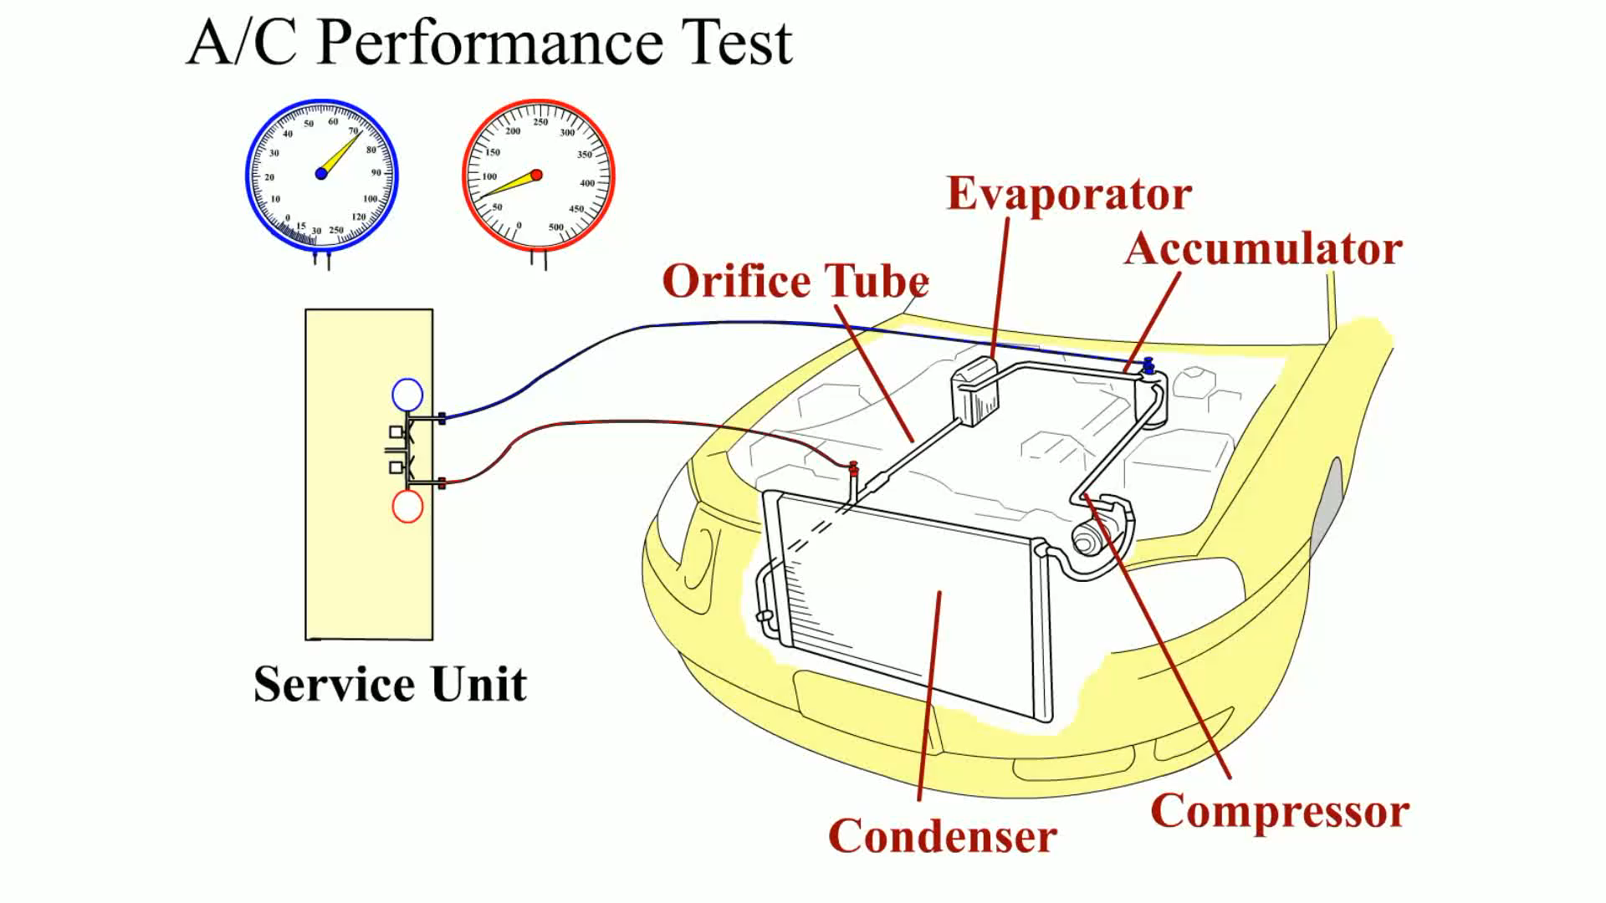
Animation: A/C Performance Test (The animation will automatically start in a few seconds)

Slide 24
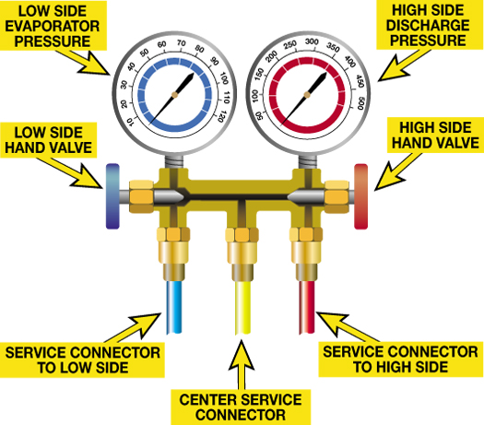
FIGURE 15–6 The center, yellow hose is used to connect the air conditioning system to a vacuum pump or refrigerant cans. When the hose is not being used, it should be attached to the blanks fitting to seal the system.

Slide 25
Step 6 Determine the Root Cause (1 of 4)
Temperature and pressure are directly related in A/C systems.
High-side pressure
Low-side pressure

Slide 26
Step 6 Determine the Root Cause (2 of 4)
Test for heat transfer at the evaporator and the condenser.
Temperature change across the evaporator
Temperature change across the condenser

Slide 27
Step 6 Determine the Root Cause (3 of 4)
If the A/C system is low on a charge of refrigerant, the sources of the leak should be found and corrected
Electronic leak detector
Dye in the refrigerant

Slide 28
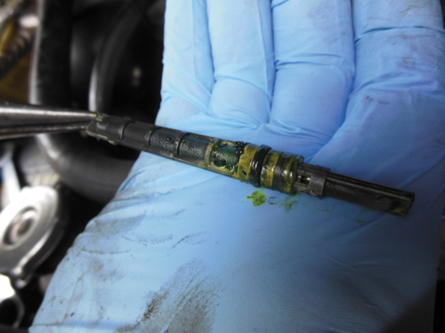
FIGURE 15–12 A partially restricted orifice tube should be replaced if discovered during service.

Slide 29
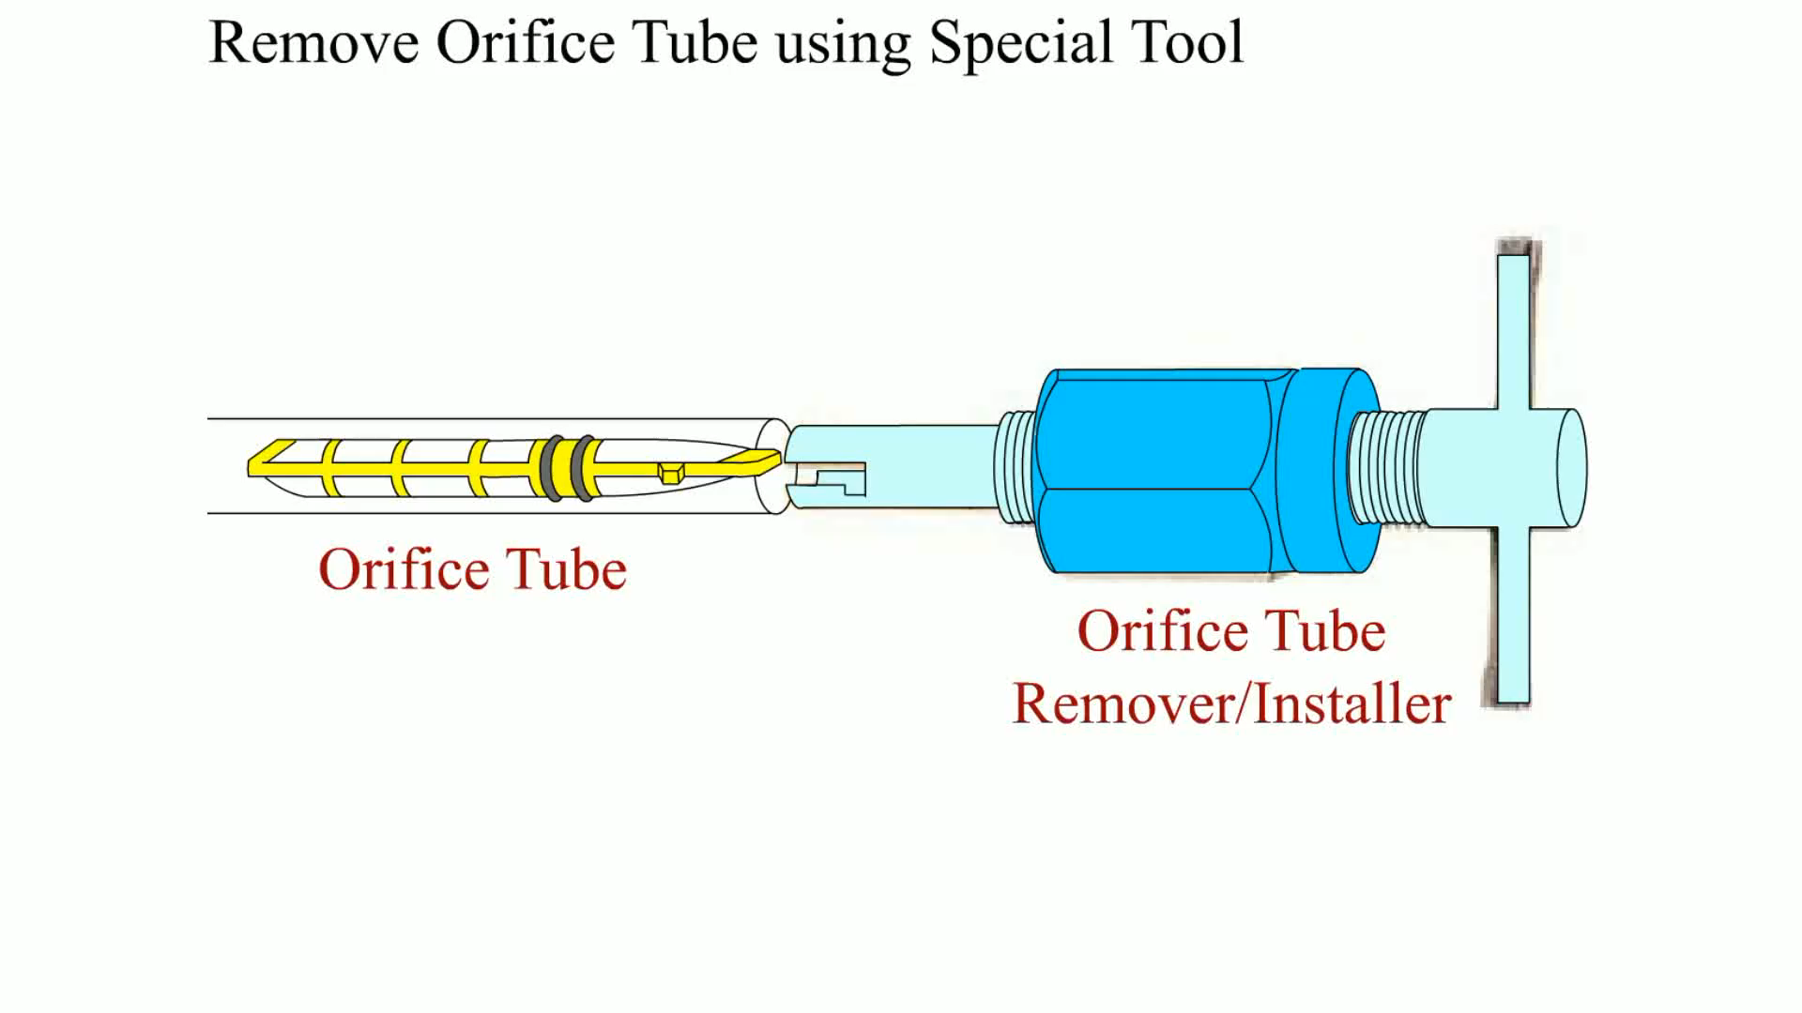
Animation: Remove Orifice Tube using Special Tool (The animation will automatically start in a few seconds)

Slide 30
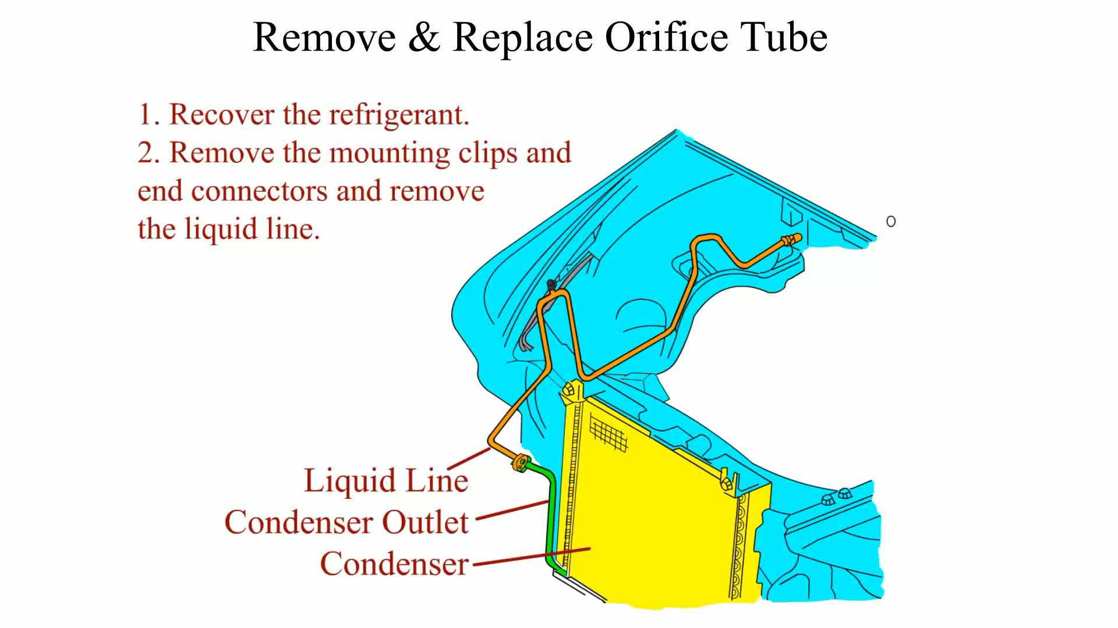
Animation: Remove & Replace Orifice Tube (The animation will automatically start in a few seconds)

Slide 31
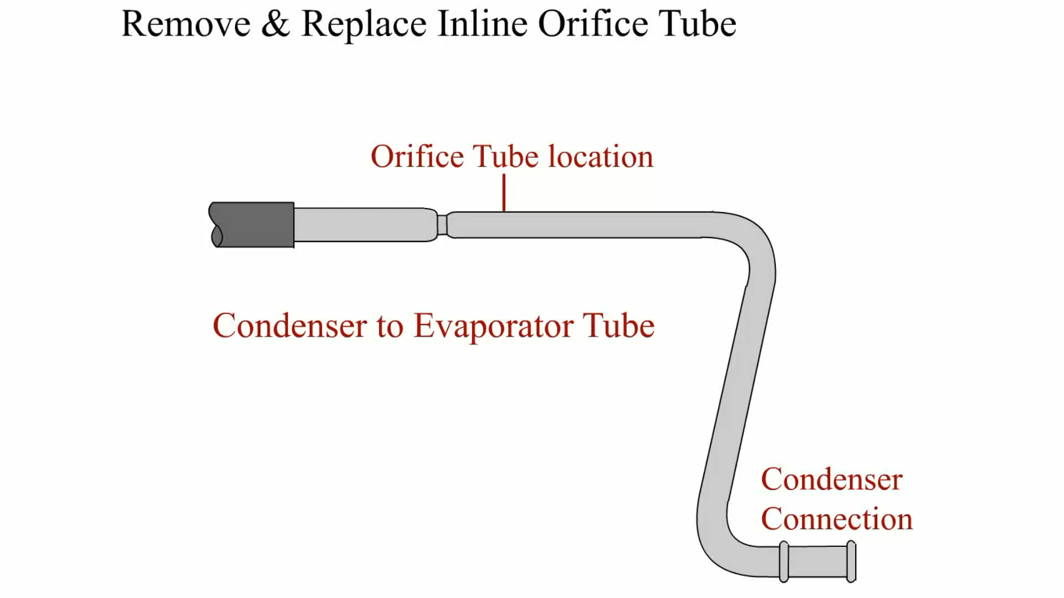
Animation: Remove & Replace Inline Orifice Tube (The animation will automatically start in a few seconds)

Slide 32
Step 6 Determine the Root Cause (4 of 4)
Addressing System Odors
“Dirty socks/gym locker” odor, which has an organic cause
“Refrigerator, cement, or dusty room” odor, which is caused by chemicals

Slide 33
Step 7 Repair the System
What is the purpose of any repair?
Many repairs require the proper identification, recovery, evacuation, and charging of the refrigerant.
After the repairs, the system should function and operate as designed and the repair should be performed according to established industry and vehicle manufacturer’s recommendations.

Slide 34
Step 8 Verify the Repair
Operate the system
After the repairs or service procedures have been performed, verify that the system is working as designed.

Slide 35
Summary (1 of 3)
When diagnosing a heating and air-conditioning system problem, most vehicle manufacturers recommend that the following steps be performed.
STEP 1 Verify the customer complaint (concern).
STEP 2 Perform a Thorough Visual Inspection.

Slide 36
Summary (2 of 3)
STEP 3 Check for Diagnostic Trouble Codes (DTCs).
STEP 4 Check for Related Technical Service Bulletins (TSBs).
STEP 5 Perform an A/C Performance Test.
STEP 6 Determine the Root Cause.
STEP 7 Repair the System.
STEP 8 Verify the Repair.

Slide 37
Summary (3 of 3)
Sometimes the A/C system is functioning normally for the conditions which could include any of the following:
Higher than normal outside air (ambient) temperature
High humidity level

Slide 38
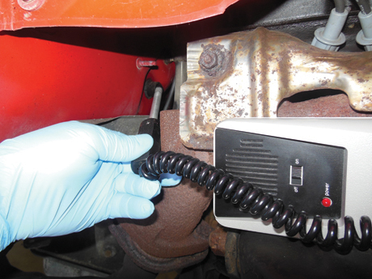
1 The lack of cooling was diagnosed using a leak detector which showed the evaporator was leaking when tested at the condensate drain.

Slide 39
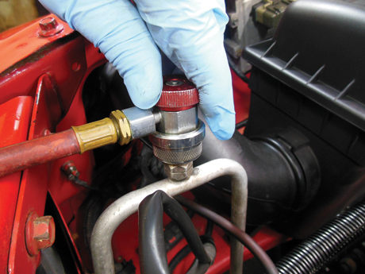
2 The recovery process was started by connecting an RRR machine to the high-side fitting.

Slide 40
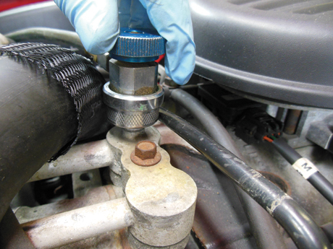
3 The low-side fitting was connected and the recovery was begun.

Slide 41
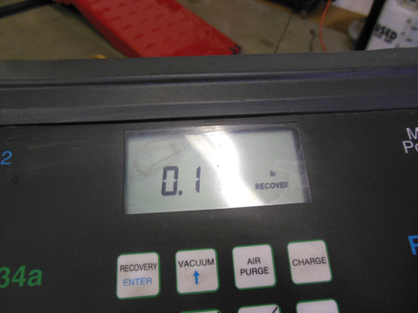
4 Very little refrigerant was left in the system (0.1 pound) but it was recovered.

Slide 42
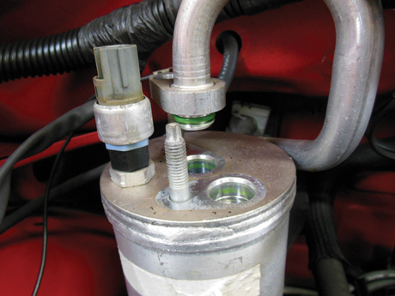
5 The lines to the accumulator were removed.

Slide 43
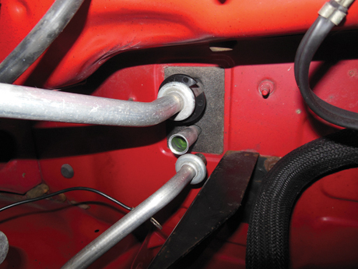
6 The lines to the evaporator were disconnected using a quick connect tool to release the fitting.

Slide 44
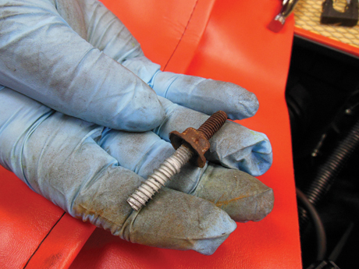
7 The retaining nuts were removed that held the HVAC case to the bulkhead from under the hood. In one case, the entire stud came out instead of just the nut.

Slide 45
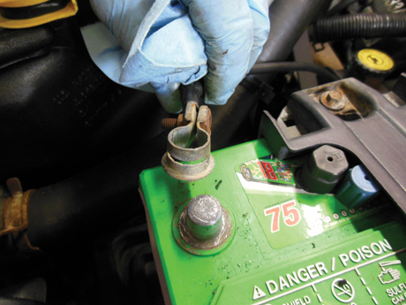
8 Before going into the passenger compartment, the negative battery cable was disconnected from the battery.

Slide 46
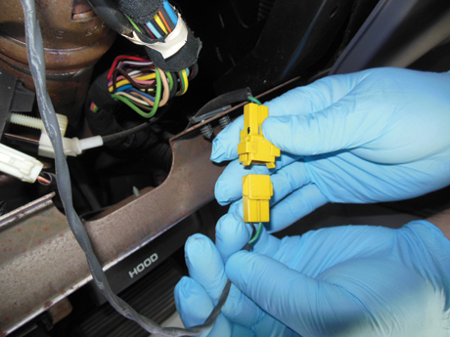
9 The dash assembly is being removed and this process includes disconnecting the airbag wiring connectors.

Slide 47
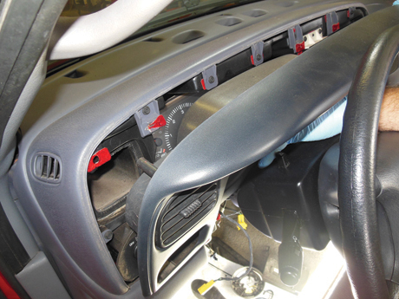
10 The driver/passenger side of the dash is removed to gain access to the additional fasteners.

Slide 48
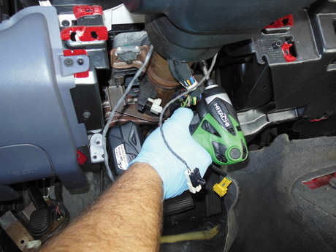
11 The two retaining fasteners that hold the steering column to the dash are removed and the steering column lowered into the seat, which is protected using a fender cover.

Slide 49
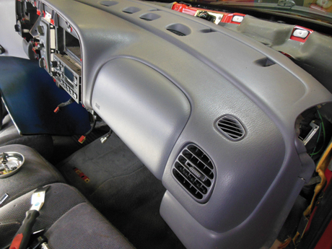
12 The entire dash assembly is being gently removed.

Slide 50
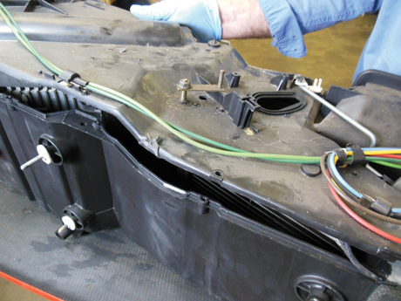
13 The HVAC case is being disassembled after being removed from the vehicle.

Slide 51
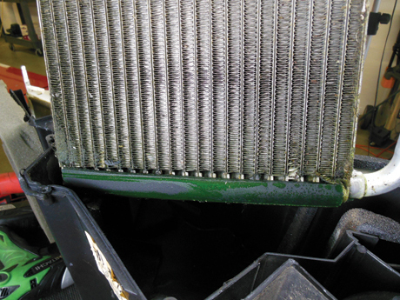
14 The evaporator is removed and it shows signs of leaking. The root cause of the lack of cooling has been found.

Slide 52
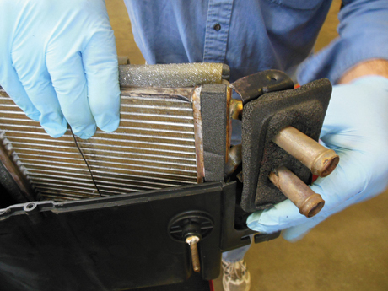
15 The heater core was also removed and replaced at the same time as insurance against possible future leaks from this unit.

Slide 53
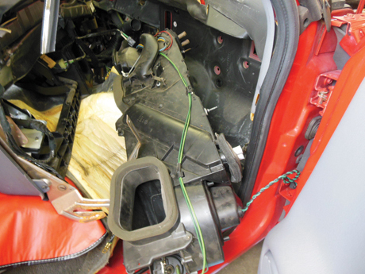
16 The reassembled HVAC case is now being installed back into the vehicle.

Slide 54
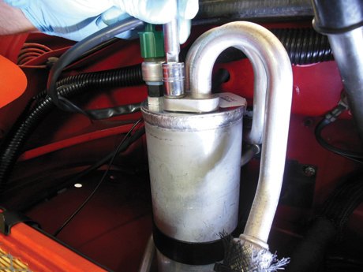
17 A new accumulator is installed.

Slide 55
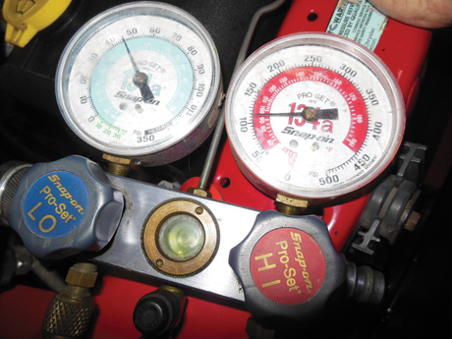
18 The system was evacuated and charged to the specified amount and the pressure gauge and temperature reading indicated that the system was restored to like-new performance.

Slide 56
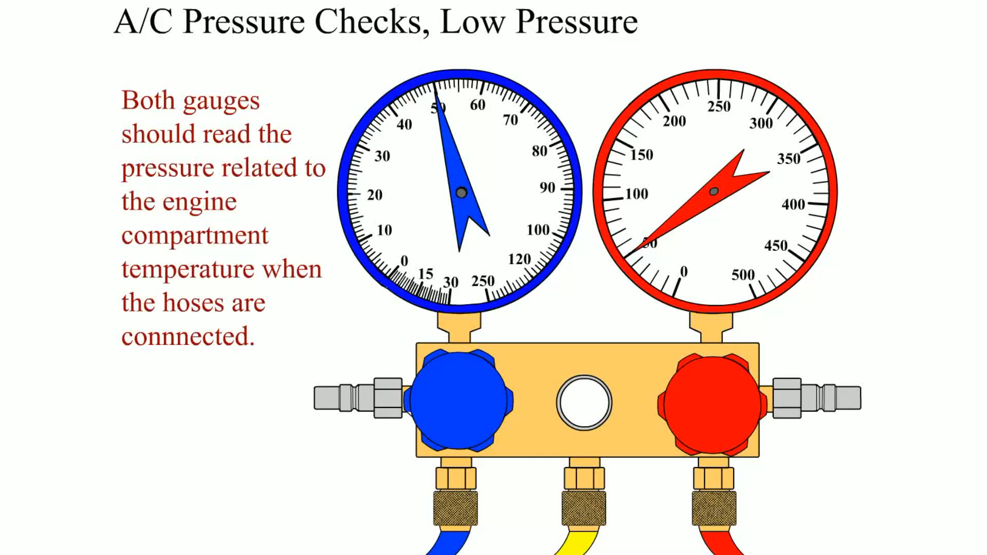
Animation: A/C Pressure, Low Pressure (The animation will automatically start in a few seconds)

Slide 57
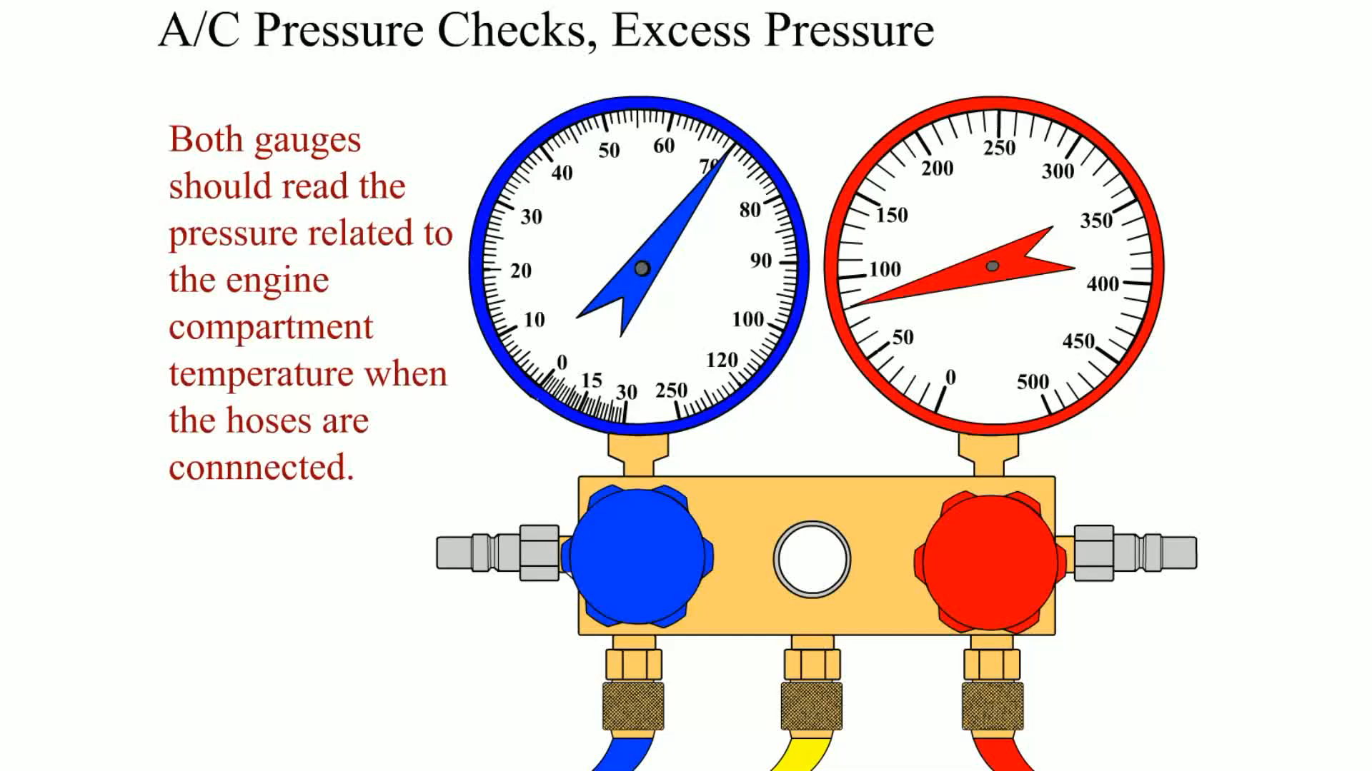
Animation: A/C Pressure Checks, Excess Pressure (The animation will automatically start in a few seconds)

Slide 58
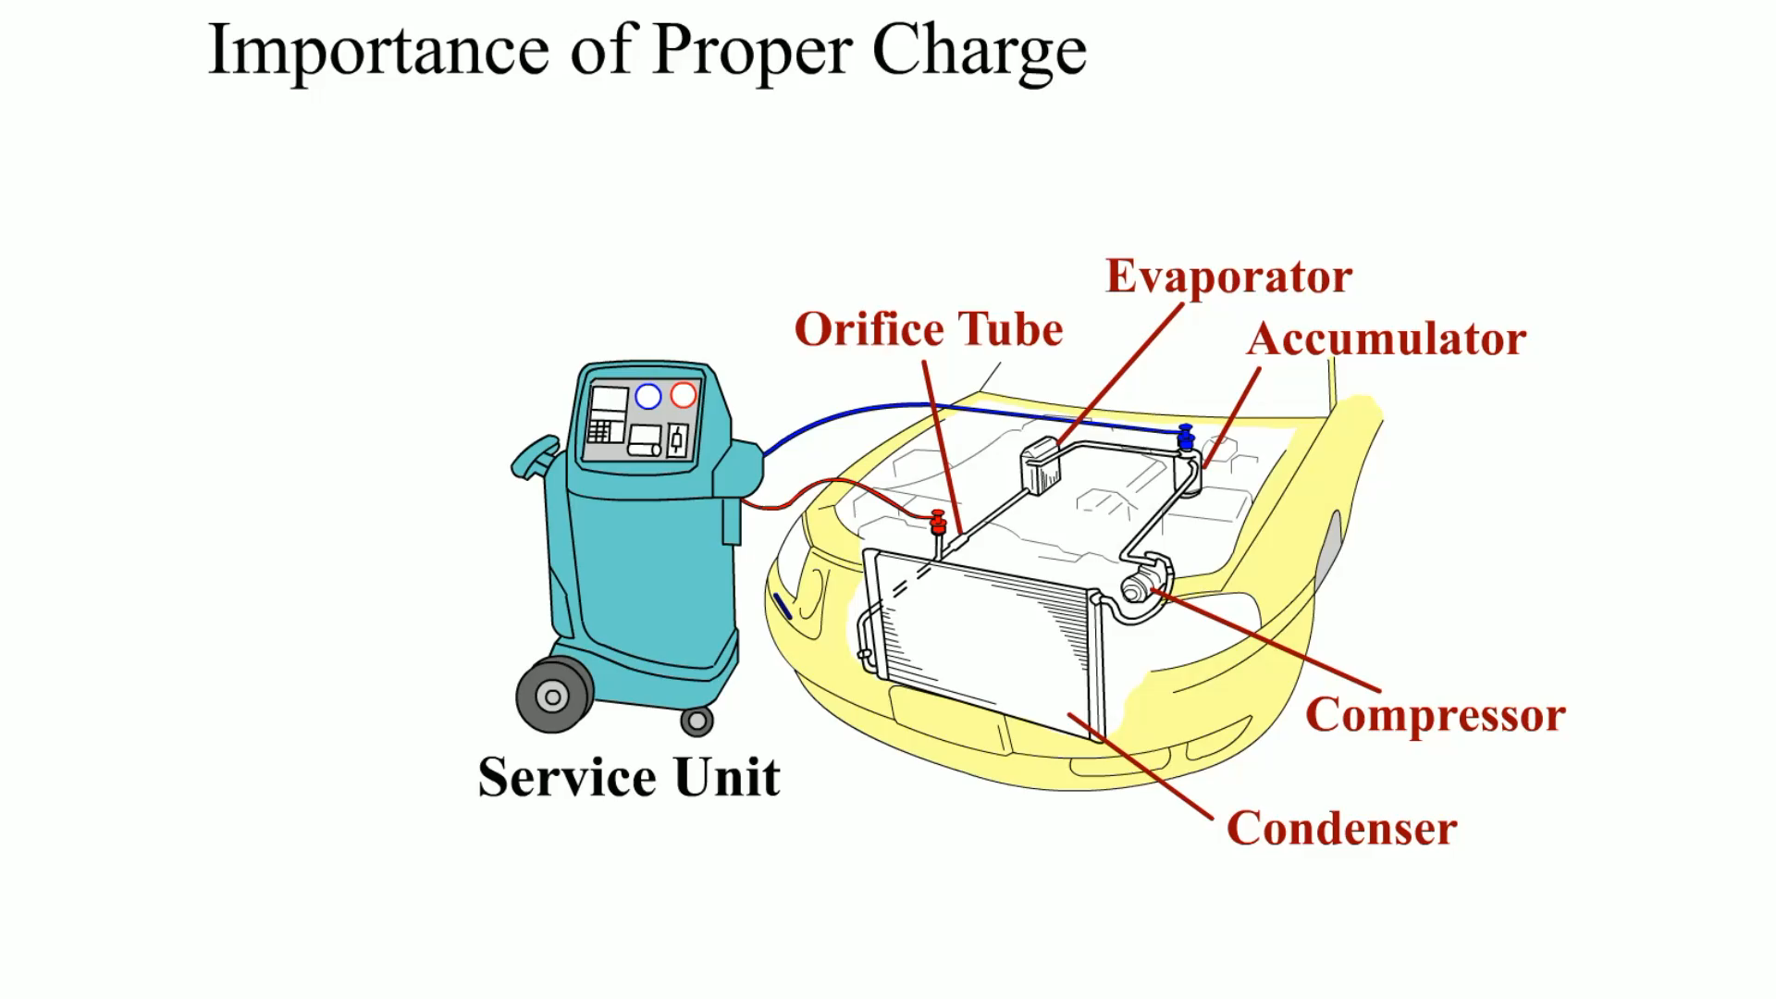
Animation: Importance of Proper Charge (The animation will automatically start in a few seconds)

Slide 59
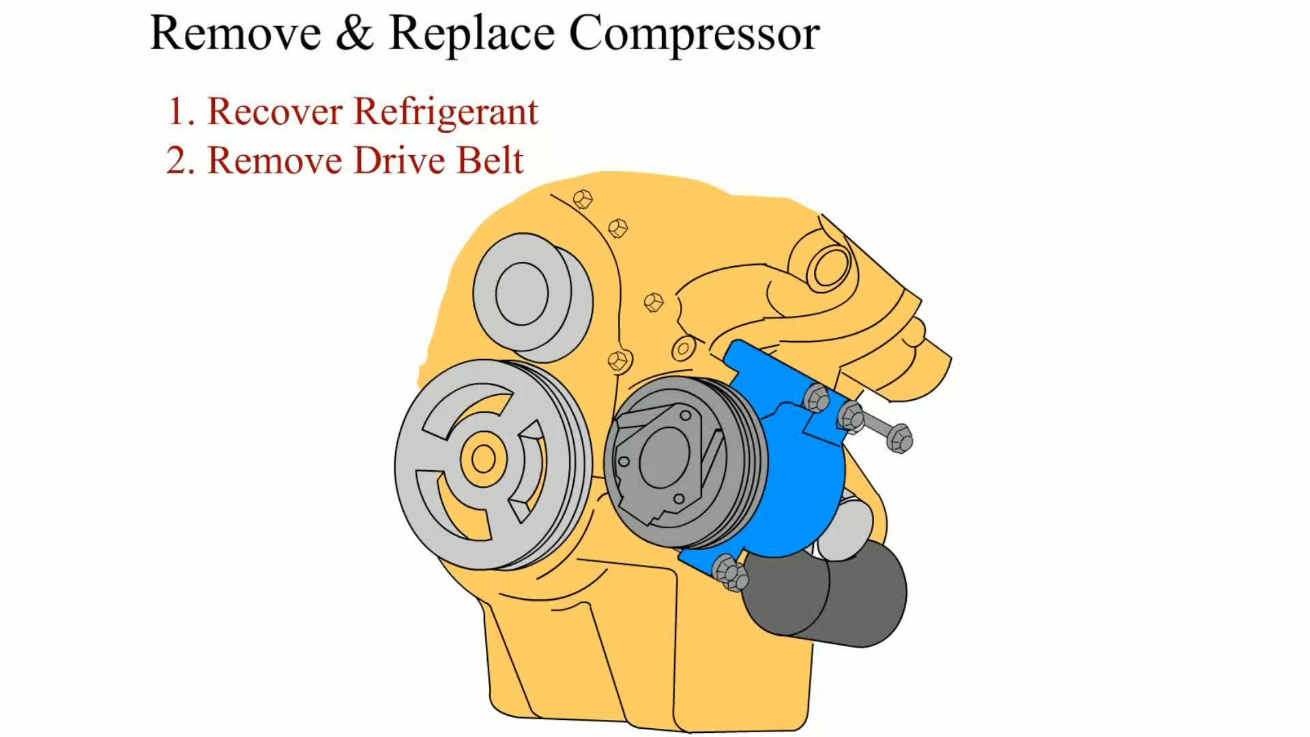
Animation: Remove & Replace Compressor (The animation will automatically start in a few seconds)

Slide 60
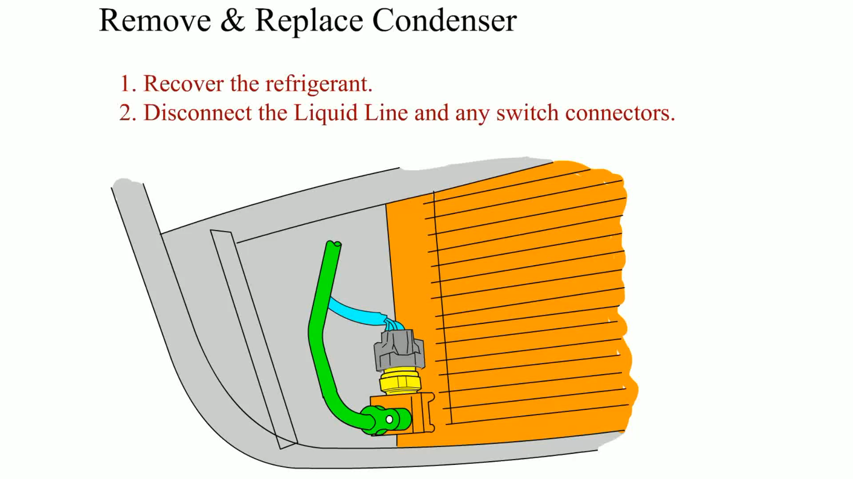
Animation: Remove & Replace Condenser (The animation will automatically start in a few seconds)

Slide 61
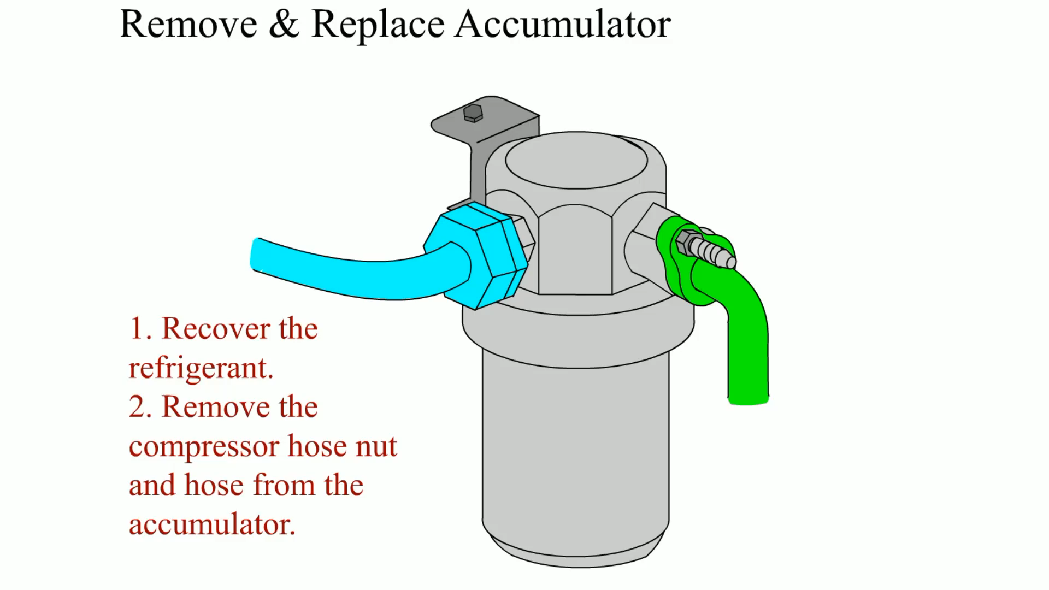
Animation: Remove & Replace Accumulator (The animation will automatically start in a few seconds)

Slide 62
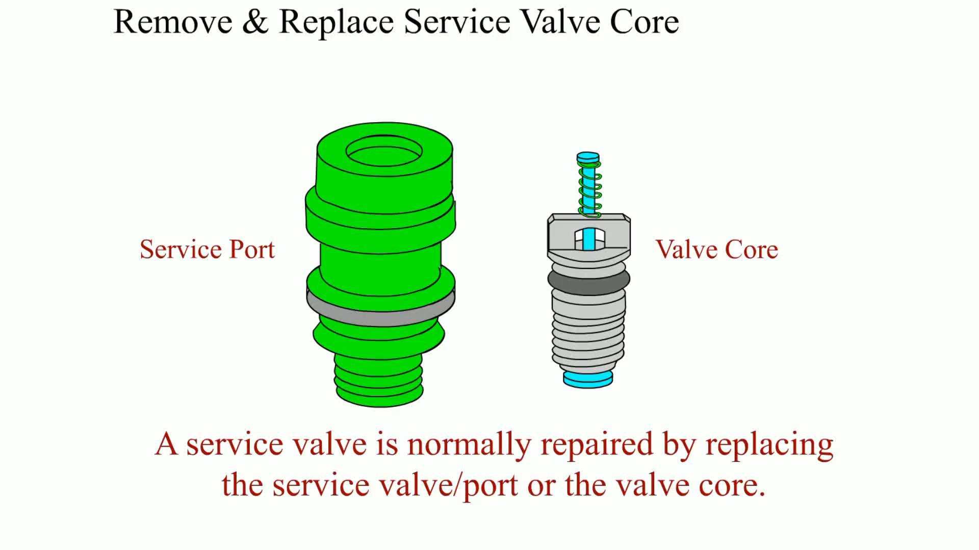
Animation: Remove & Replace Service Valve Core (The animation will automatically start in a few seconds)

Slide 63
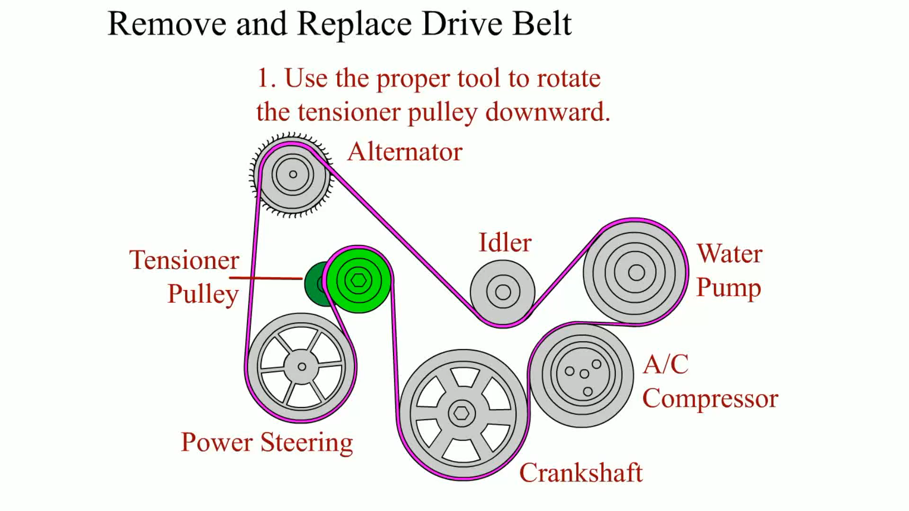
Animation: Remove and Replace Drive Belt (The animation will automatically start in a few seconds)

Slide 64
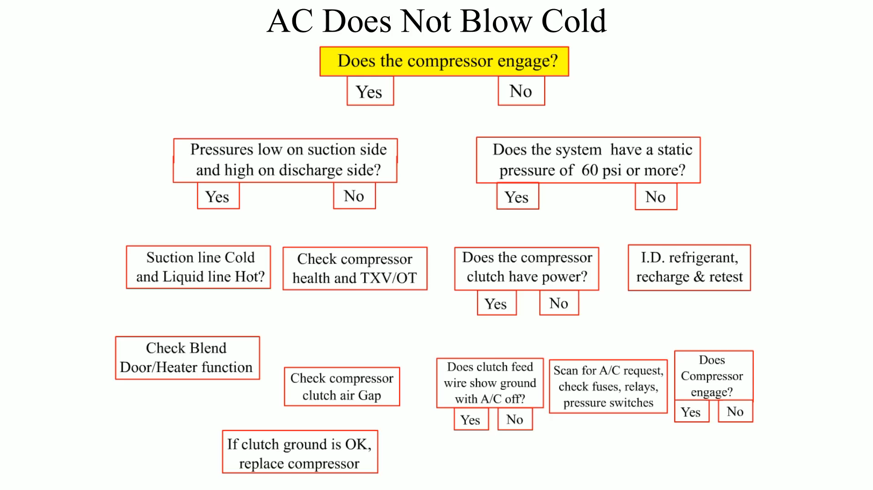
Animation: AC Does Not Blow Cold (The animation will automatically start in a few seconds)

Slide 65
Video Links (Internet Access Required)
Low pressure sensor testing (time 2:50)
High pressure sensor testing (time 2:32)
A/C diagnosis (time 9:16)
Leak detection (time 2:48)
Leak detection (time 1:01)
Pressure testing (time 5:25)
A/C troubleshooting part 1 (time 9:11)
A/C troubleshooting part 2 (time 6:59)
A/C diagnosis (time 10:31)
A/C leak detection (time 2:16)

Slide 66
Video Links (Internet Access Required)
A/C temperature testing (time 6:30)
HVAC scan tool data (time 1:08)

