Slide 1
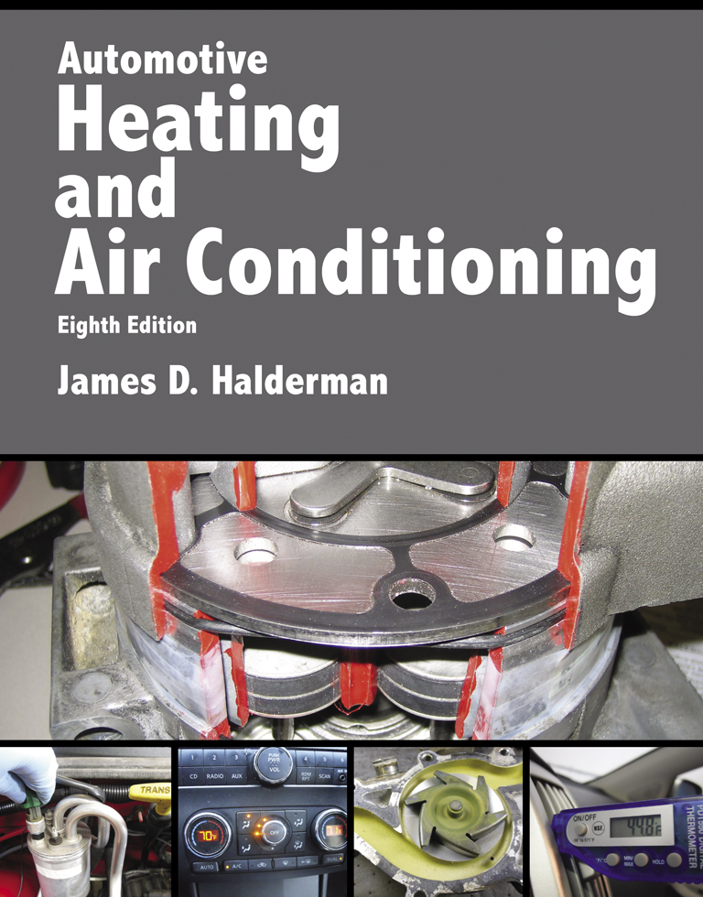
Automotive Heating And Air Conditioning
Eighth Edition
Chapter 13
Heating and
Air-Conditioning System Inspection

Slide 2
Learning Objectives
13.1 Describe how to verify AC compressor clutch operation.
13.2 Discuss normal AC discharge outlet temperatures.
13.3 Discuss how to verify proper heating and cooling airflow to the inside of the vehicle.
13.4 Explain how to inspect the AC condenser.
13.5 Discuss AC odors and how to eliminate them.

Slide 3
AC System Working As Designed (1 of 2)
Verify
AC Compressor Operation
Compressor Drive Belt
  Belt tension gauge
  Marks on a tensioner
  Torque wrench reading
  Deflection

Slide 4
AC System Working As Designed (2 of 2)
AC Temperature Readings
  Steps 1-2
  If the temperature is 35°F to 45°F (2°C to 7°C)…
  If the temperature is over 45°F (7°C)…

Slide 5
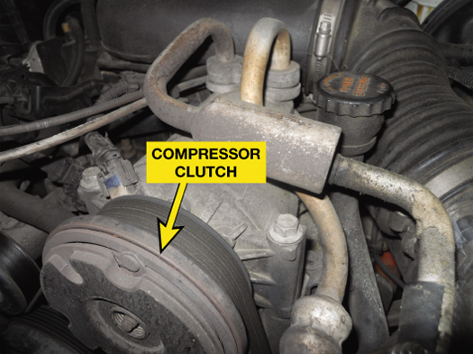
FIGURE 13–1 The compressor is working if the center of the compressor clutch is rotating with the engine running.

Slide 6
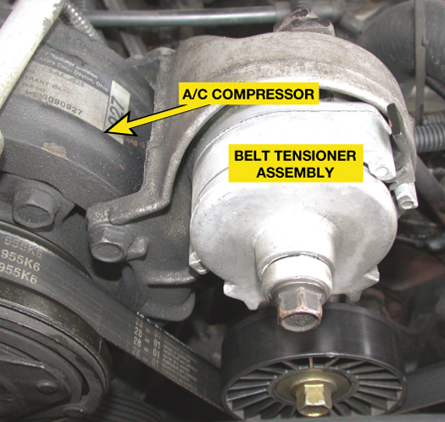
FIGURE 13–2 The AC compressor drive belt tensioner is used to keep a constant and even tension on the drive belt so it can properly transfer engine torque to the AC compressor.

Slide 7
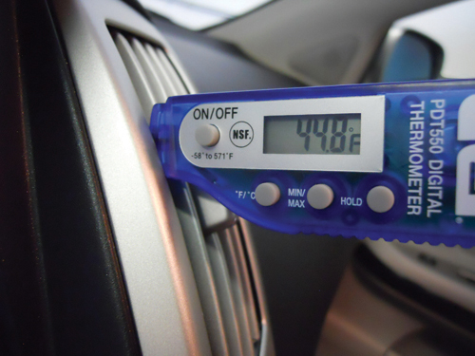
FIGURE 13–3 An air-conditioning thermometer being used to check the discharge temperature at the center vents.

Slide 8
HVAC System Inspection (1 of 2)
Visual Inspection
Cab in Filter
AC and Heater Duct Inspection
  Steps 1-4
Heater Hose Inspection
Condenser Inspection

Slide 9
HVAC System Inspection (2 of 2)
AC Leak Detection
  Visual inspection
  Electronic leak detector
  Dye in the refrigerant
  Soap solution

Slide 10
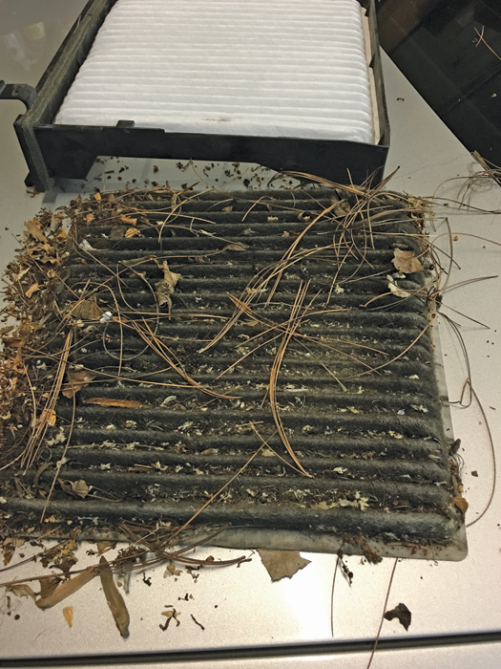
FIGURE 13–4 A dirty cabin filter removed from a Subaru that driver complained of poor cooling from the air conditioning system.

Slide 11
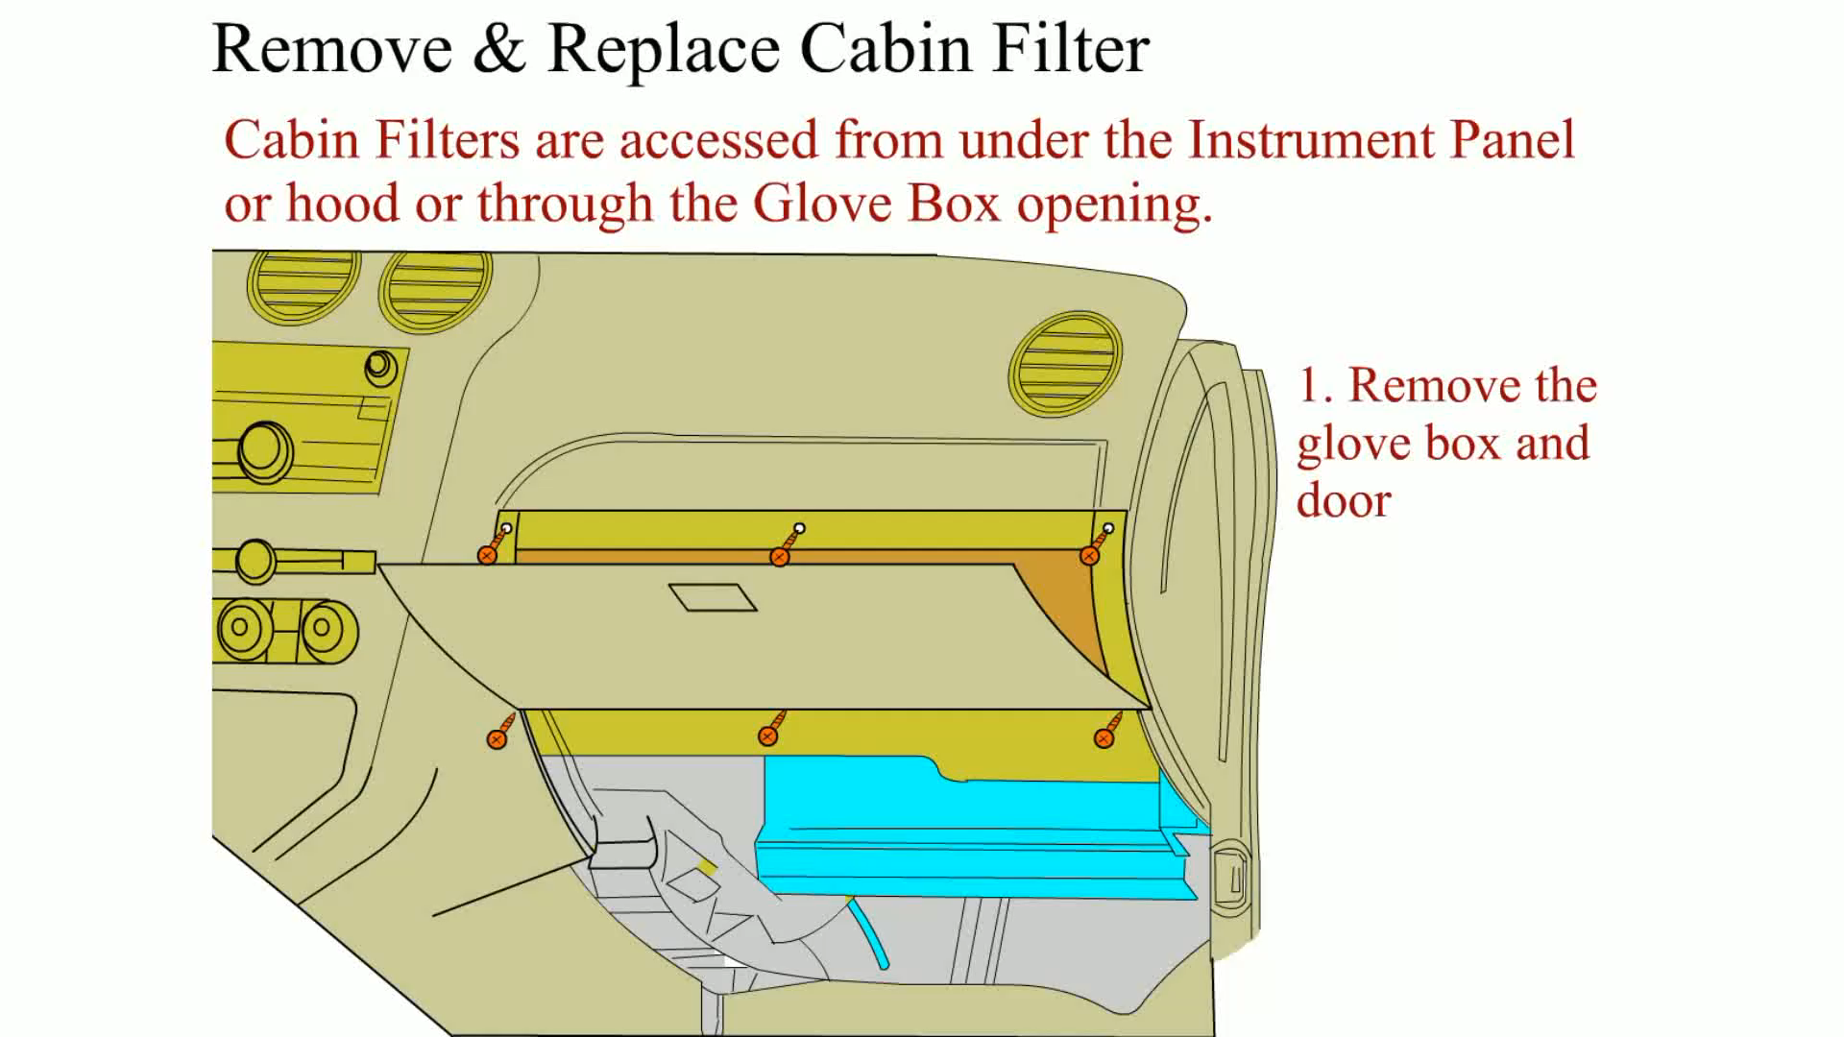
Animation: Remove & Replace Cabin Filter
(The animation will automatically start in a few seconds)

Slide 12
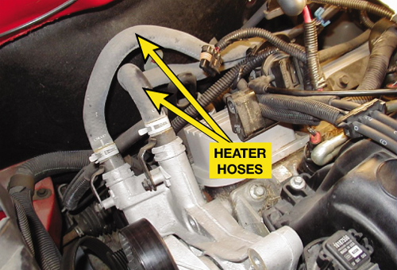
FIGURE 13–5 Heater hoses are the smaller coolant hoses that run from and back to the engine.

Slide 13
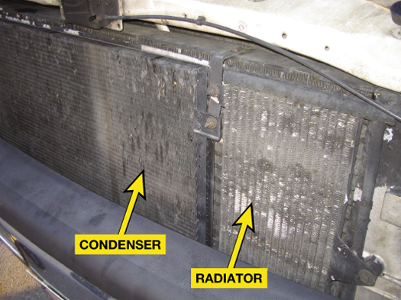
FIGURE 13–6 The air-conditioning condenser is located in front of the radiator and is therefore more likely to be become partially restricted due to road debris and dirt.

Slide 14
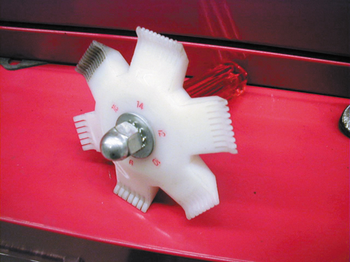
FIGURE 13–7 A fin comb is used to straighten the fins on the condenser to help increase airflow and heat transfer.

Slide 15
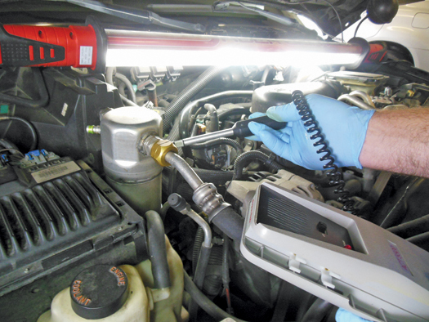
FIGURE 13–8 A typical electronic leak detector being used to locate a possible leak in a system.

Slide 16
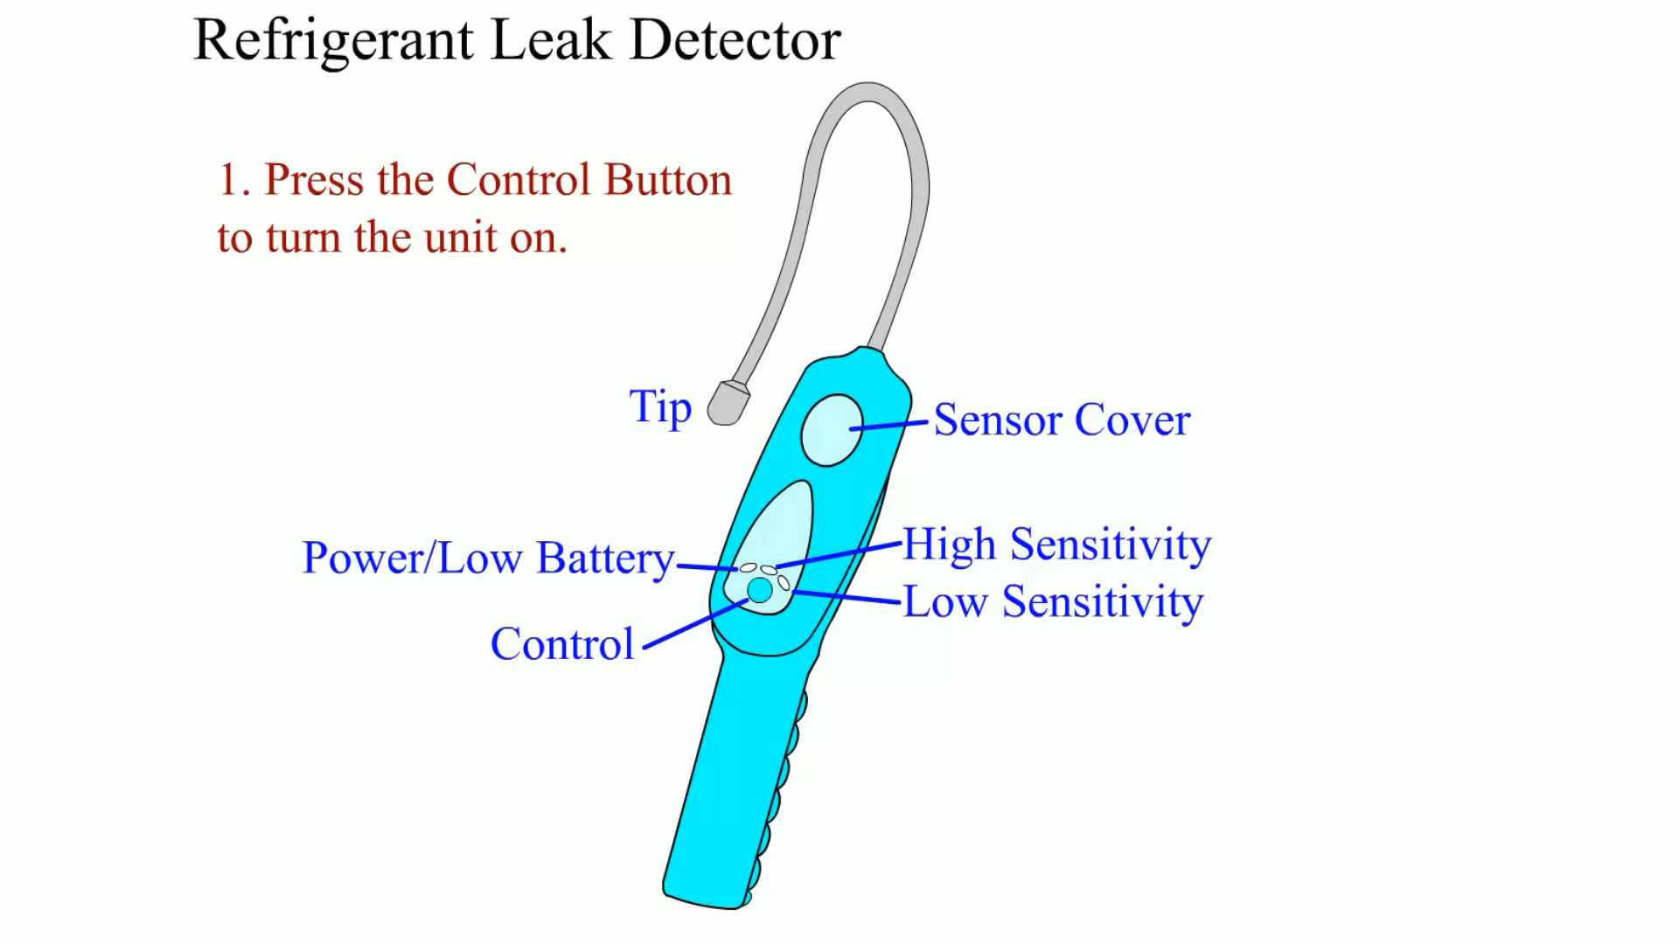
Animation: Refrigerant Leak Detector
(The animation will automatically start in a few seconds)

Slide 17
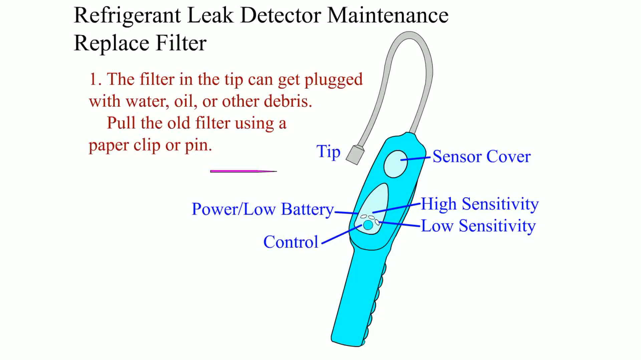
Animation: Refrigerant Leak Detector Maintenance Replace Filter
(The animation will automatically start in a few seconds)

Slide 18
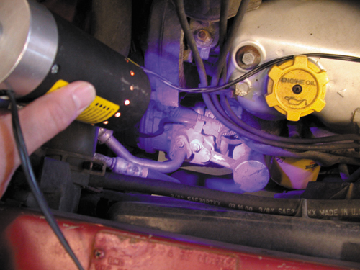
FIGURE 13–9 A black light being used to look for refrigerant leakage after a fluorescent dye was installed in the system.

Slide 19
Summary (1 of 2)
The heating and air-conditioning system should be checked to see if it functioning as designed.
Belt tension in factory specifications
When checking for proper air-conditioning operation, the discharge vent temperature should be 35°F to 45°F (2°C to 7°C).

Slide 20
Summary (2 of 2)
Cabin filters should be checked regularly and replaced as per vehicle manufacturers recommended intervals.
Poor air-conditioning performance (lack of cooling) can be caused by a partially clogged condenser.
Several different methods of leak detection are available.

Slide 21
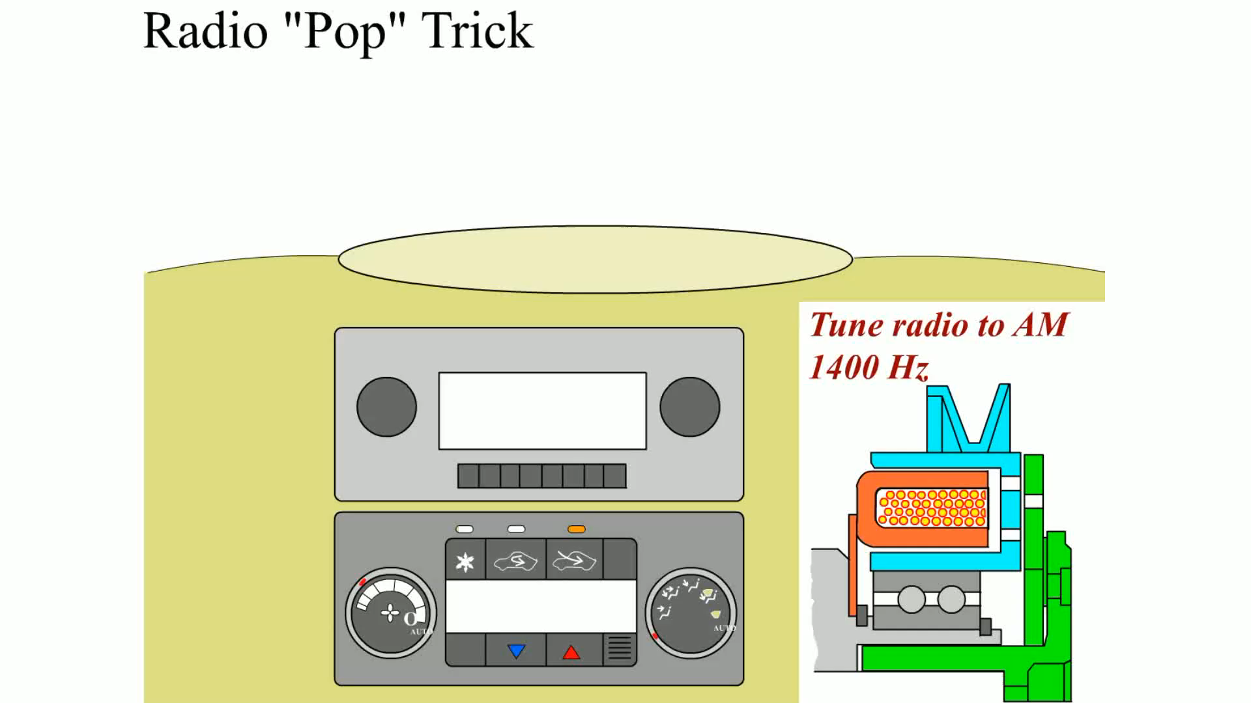
Animation: Radio “Pop” Trick
(The animation will automatically start in a few seconds)

Slide 22
Video Links (Internet Access Required)
Hybrid A/C system (time 2:24)

