Slide 1
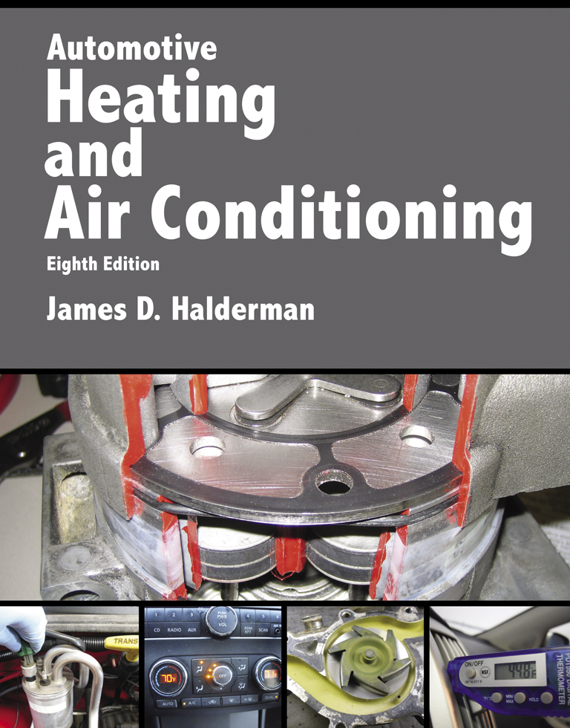
Automotive Heating And Air Conditioning
Eighth Edition
Chapter 12
Hybrid and Electric Vehicle HVAC Systems

Slide 2
Learning Objectives (1 of 2)
12.1 Prepare for the ASE Heating and Air Conditioning (A7) certification test content area “A” (A/C System Service, Diagnosis and Repair).
12.2 Explain the basic operation of the air-conditioning system used in hybrid electric vehicles.
12.3 Discuss the types of compressors used in a hybrid electric vehicle.

Slide 3
Learning Objectives (2 of 2)
12.4 Explain the components and modes of operation of a coolant heat storage system.
12.5 Describe the parts and operation of cabin heating systems.
12.6 Explain the effect of heat on the electrical/ electronic systems of a hybrid electric vehicle.

Slide 4
Hybrid Vehicle Air-Conditioning Systems (1 of 3)
The fundamental purpose of any air-conditioning system is to absorb heat in one location and then dissipate (move) that heat to another location.
Control of the air-conditioning system is the operation of the compressor, as well as the airflow across the evaporator and condenser.

Slide 5
Hybrid Vehicle Air-Conditioning Systems (2 of 3)
Belt-driven by the internal combustion engine (ICE) accessory drive.
Dual compressor where a large section of it is driven by the internal combustion engine and another smaller section driven by a high-voltage electric motor to provide cooling during idle/stop (start/stop) operation.

Slide 6
Hybrid Vehicle Air-Conditioning Systems (3 of 3)
Electric-motor powered compressor used in all electric vehicles and many hybrid electric vehicles.

Slide 7
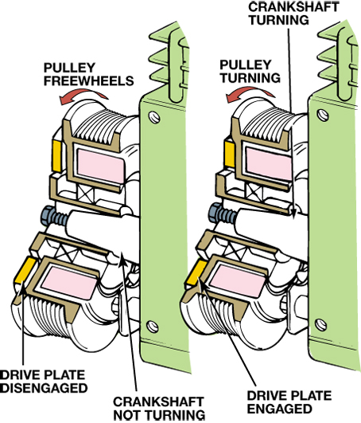
FIGURE 12–1 The A/C compressor clutch allows the compressor to engage and disengage as necessary while the ICE continues to run.

Slide 8
Hybrid Electric Vehicle Compressors
What is the difference between the following compressors?
Conventional compressors
Dual compressors
Electric compressors
Refrigerant oil

Slide 9
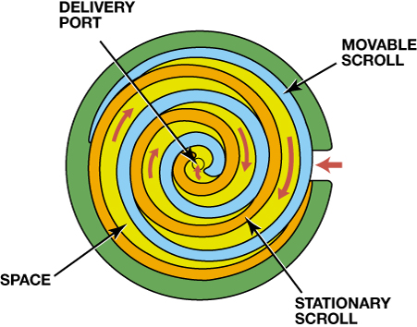
FIGURE 12–4 Basic components of a scroll compressor. Note the “pockets” of refrigerant that occupy the spaces labeled with red arrows.

Slide 10
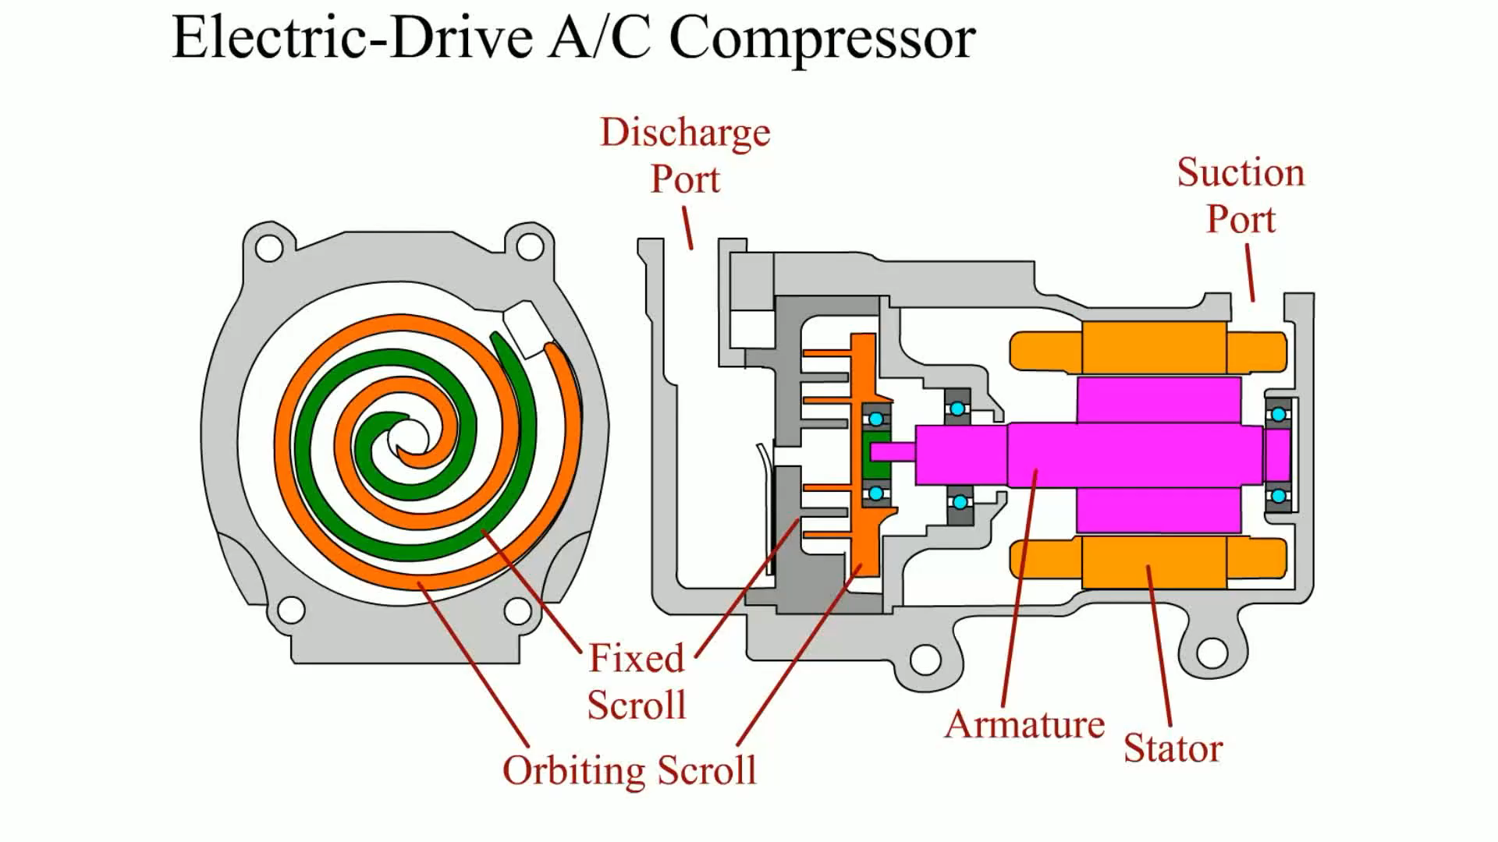
Animation: Electric-Drive A/C Compressor (The animation will automatically start in a few seconds)

Slide 11
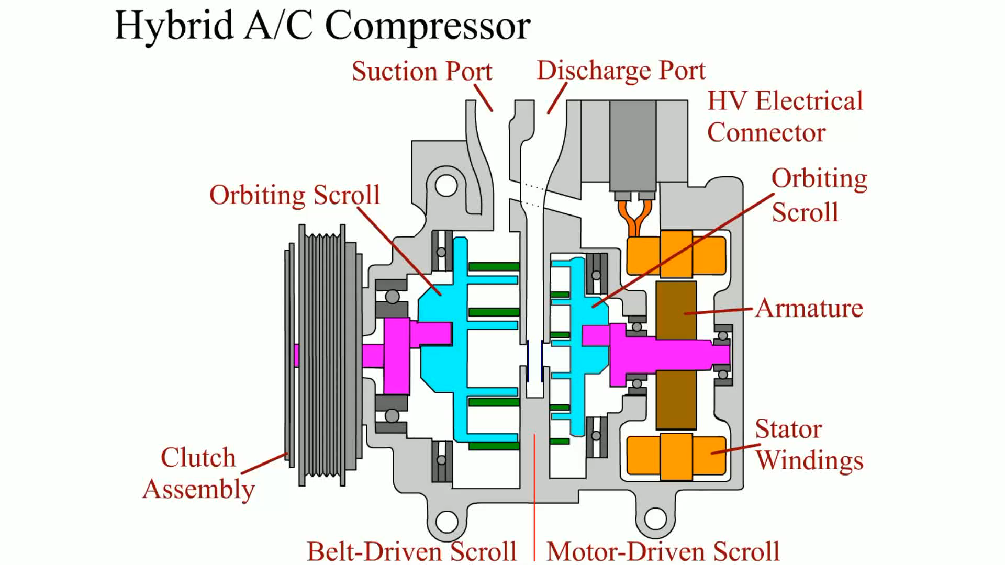
Animation: Hybrid A/C Compressor (The animation will automatically start in a few seconds)

Slide 12
Coolant Heat Storage System (1 of 3)
The coolant heat storage tank
The tank is built with an inner and outer casing, and a vacuum is formed between them.
There is a standpipe that extends inside of the inner casing, so coolant must rise in order to exit the tank through the standpipe.

Slide 13
Coolant Heat Storage System (2 of 3)
Water valve
Used to direct the coolant flow between the coolant storage tank, the ICE, and the vehicle’s heater core.
The water valve is controlled by the ECM and consists of an electric motor, drive gears, a rotary valve, and a valve position sensor.

Slide 14
Coolant Heat Storage System (3 of 3)
The storage tank pump is used to move coolant through the heat storage tank at times when the ICE is shut off.

Slide 15
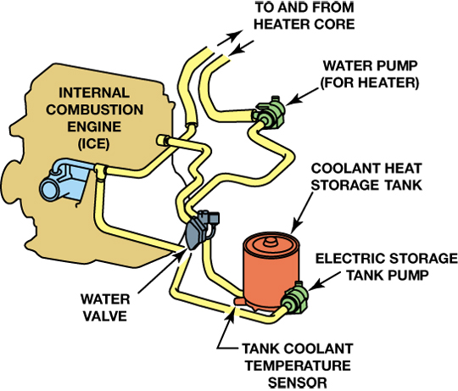
FIGURE 12–9 Toyota’s coolant heat storage system. Note that the electric storage tank pump is located behind the coolant storage tank.

Slide 16
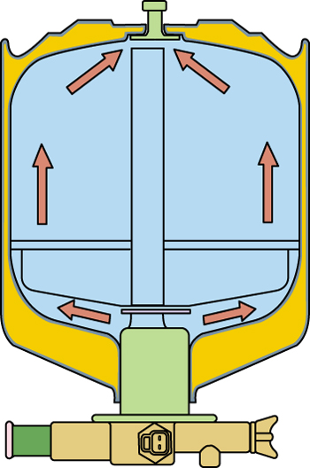
FIGURE 12–10 A vacuum exists between the inner and outer casing of the coolant heat storage tank. The outlet temperature sensor and the drain plug are located in the manifold at the bottom of the tank.

Slide 17
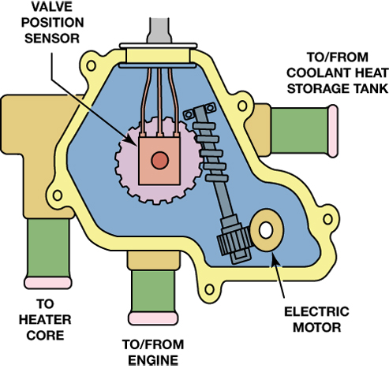
FIGURE 12–11 The valve position sensor in the water valve provides feedback to the ECM concerning the position of the water valve.

Slide 18
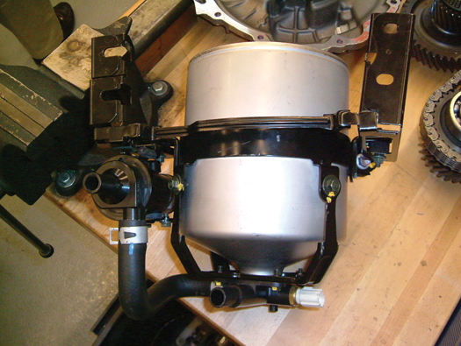
FIGURE 12–12 The storage tank and pump assembly as removed from underneath the vehicle. This pump is energized when coolant must be moved through the tank but the ICE is shut off.

Slide 19
Cabin Heating Systems (1 of 2)
The heater core is located in the passenger compartment, inside the plenum chamber (air distribution box) for the vehicle’s heater and air-conditioning components.

Slide 20
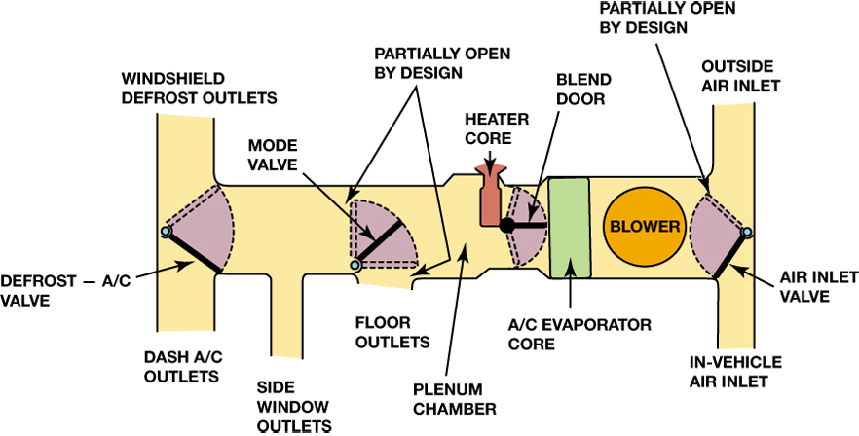
FIGURE 12–17 The heater core is located in the plenum chamber. Air temperature in this system is controlled by the position of the air mix valve (blend door).

Slide 21
Cabin Heating Systems (2 of 2)
Air entering the plenum chamber must first pass through the A/C evaporator core, and then is directed either through or around the heater core by the blend door (air mix valve).
The air is blended with any air that has bypassed it and then is sent to its destination through a series of mode doors.

Slide 22
HEV Electric Motor and Control System Cooling
All hybrid electric vehicles have cooling systems for their motors and motor controls, and some utilize air cooling to remove excess heat from these components.
Many hybrid electric vehicles use a liquid cooling system for their motors and motor controls.

Slide 23
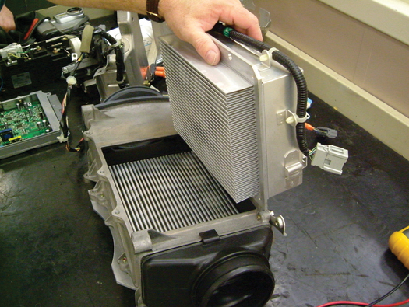
FIGURE 12–21 The motor and HV battery electronics on Honda hybrid vehicles are air cooled. Note the cooling fins for the modules.

Slide 24
Service Procedures (1 of 2)
If recovering the refrigerant, use a hybrid-specific refrigerant recovery, recycling, and recharge (RRR) machine.
If removing a compressor that is powered by high voltage and has orange cables running to it, disable the HV system by removing the high-voltage disconnect (service) plug before work is begun.

Slide 25
Service Procedures (2 of 2)
Always follow the vehicle specific service procedures.
Read, understand, and follow all safety notices and precautions.

Slide 26
Summary (1 of 2)
The purpose of the ICE cooling system is to bring the ICE up to optimum temperature as quickly as possible and to maintain that temperature under all operating conditions.
The coolant heat storage system is used to limit vehicle emissions during cold starts.

Slide 27
Summary (2 of 2)
Some HEVs use A/C compressors with electric drive or a combination belt-electric drive mechanism.
Most hybrid electric vehicle manufacturers specify that the same coolant used in the vehicle’s ICE (engine) be used for cooling the motors and electronics.

Slide 28
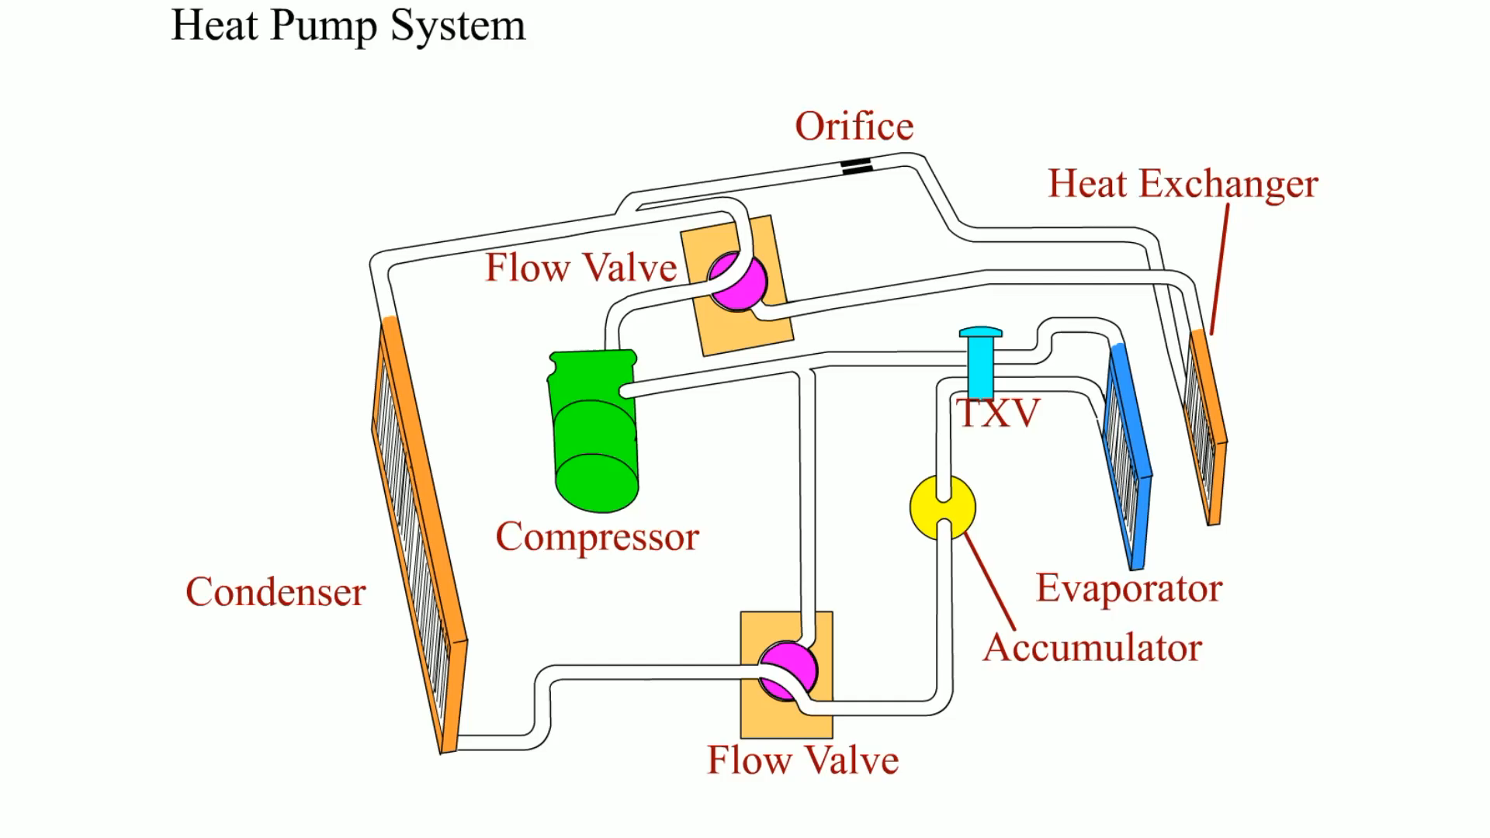
Animation: Heat Pump System (The animation will automatically start in a few seconds)

Slide 29
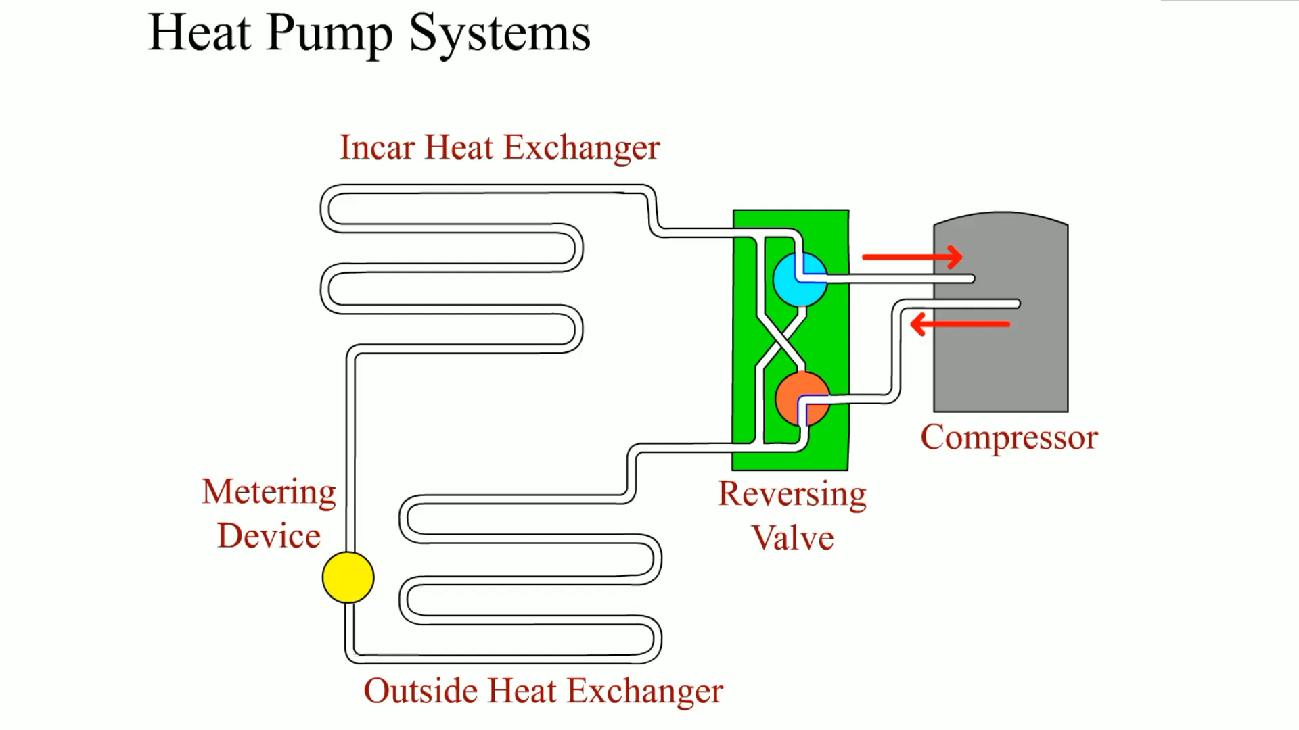
Animation: Heat Pump Systems (The animation will automatically start in a few seconds)

Slide 30
Video Links (Internet Access Required)
Audi A8 automatic climate control (time 5:02)
Hybrid and EV Cooling Systems (time 36:43)

