Slide 1

Automotive Heating And Air Conditioning
Eighth Edition
Chapter 11
Automatic Temperature Control Systems

Slide 2
Learning Objectives (1 of 2)
11.1 Discuss the purpose and function of automatic temperature control (ATC) systems.
11.2 Discuss the sensors used in ATC systems.
11.3 State the need for airflow control.
11.4 Discuss the purpose of automatic HVAC controls.

Slide 3
Learning Objectives (2 of 2)
11.5 Discuss how to diagnose the electrical ATC system faults.
11.6 Explain the automatic climatic control diagnostic procedure.
11.7 Explain the types of actuators in ATC systems.

Slide 4
Automatic Temperature Control Systems (1 of 2)
The purpose and function of the HVAC system is to provide comfortable temperature and humidity levels inside the passenger compartment.

Slide 5
Automatic Temperature Control Systems (2 of 2)
Proper temperature control to enhance passenger comfort during heating should maintain air temperature at the foot level about 7°F to 14°F (4°C to 8°C) above the temperature around the upper body.

Slide 6
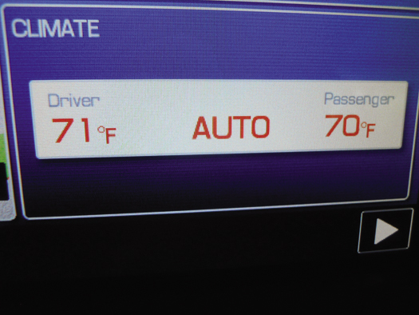
FIGURE 11–1 The automatic climatic control display is part of the navigation screen on this vehicle.

Slide 7
Sensors (1 of 6)
The outside air temperature (OAT) sensor, also called the ambient temperature sensor, measures outside air temperature and is often mounted at the radiator shroud or in the area behind the front grill.
The in-vehicle temperature sensor is often mounted behind the instrument panel, and a set of holes or a small grill allows air to pass by it.

Slide 8
Sensors (2 of 6)
The discharge air temperature (DAT) sensor is used to measure the temperature of the air leaving the dash vents.
The evaporator temperature (EVT) sensor is used to measure the temperature of the air leaving the evaporator.

Slide 9
Sensors (3 of 6)
The sun load sensor (also called a solar sensor) is normally mounted on top of the instrument panel and is used to measure radiant heat load that might cause an increase of the in-vehicle temperature.
Infrared (IR) sensors are mounted in the control head or overhead in the headliner.

Slide 10
Sensors (4 of 6)
The air-conditioning (A/C) compressor speed sensor, also called a lock or belt lock sensor, is used so the ECM will know if the compressor is running, and by comparing the compressor and engine speed signals, the ECM can determine if the compressor clutch or drive belt is slipping excessively.

Slide 11
Sensors (5 of 6)
The engine coolant temperature (ECT) sensor is a thermistor and measures the temperature of the engine coolant and is usually located near the engine thermostat.
A pressure transducer can be used in the low- and/or high-pressure refrigerant line.
  Allows the ECM to monitor pressure

Slide 12
Sensors (6 of 6)
Some systems use an air quality sensor, which detects hydrocarbons (HC) or ozone (O3).
A few vehicles use a relative humidity (RH) sensor to determine the level of in-vehicle humidity.
A few vehicles that are equipped with a global positioning system (GPS) for navigation will have a sun position strategy that tracks the angle of the sunlight entering the vehicle.

Slide 13
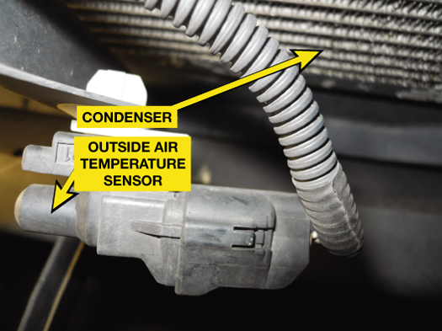
FIGURE 11–2 The outside air temperature sensor is mounted on the radiator core support in front of the A/C condenser on this vehicle.

Slide 14
Airflow Control
Air flows into the housing (case) that contains the evaporator and heater core from two possible inlets.
  Outside air, often called fresh air
  Inside air, usually called recirculation (recirc)

Slide 15
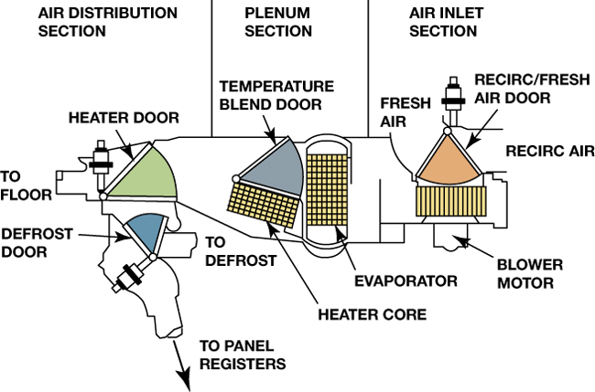
FIGURE 11–8 The three major portions of the A/C and heat system are air inlet, plenum, and air distribution. The shaded portions show the paths of the four control doors.

Slide 16
Actuators
Dual-Position Actuator
  A dual-position actuator is able to move either open or closed.
A three-position actuator is able to provide three air door positions.
A variable-position actuator is capable of positioning a valve in any position.

Slide 17
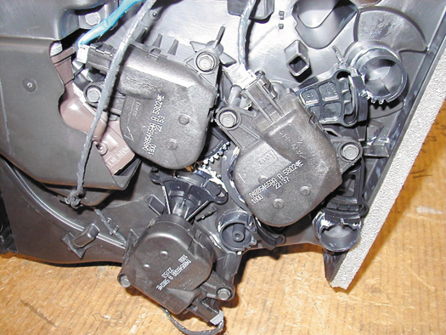
FIGURE 11–9 Three electric actuators can be easily seen on this demonstration unit. However, accessing these actuators in a vehicle can be difficult.

Slide 18
Automatic HVAC Controls
The control head provides the switches and levers needed to control the different aspects of the heating and A/C system, which include:
  HVAC system on and off; A/C on/off; Outside or recirculated air; A/C, defrost, or heating mode; Temperature desired; Blower speed

Slide 19
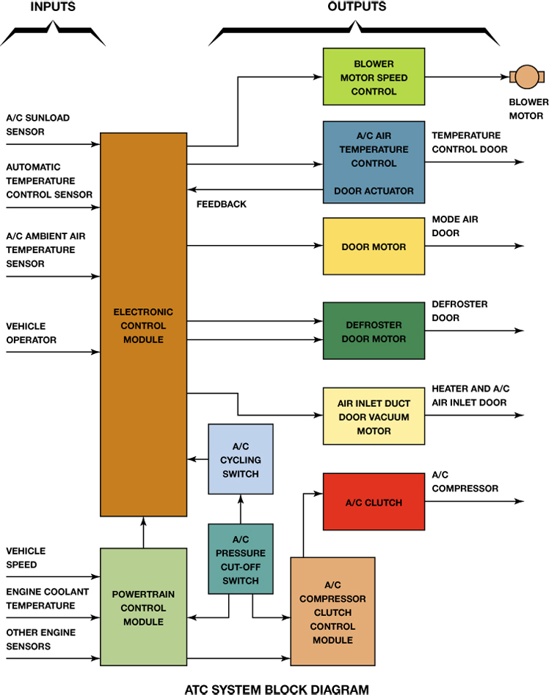
FIGURE 11–13 A block diagram showing the inputs to the electronic control assembly and the outputs; note that some of the outputs have feedback to the ECM.

Slide 20
Air Filtration
What is the purpose and function of air filtration?
Types of Cabin Filters
  Particle filters
  Adsorption filters

Slide 21
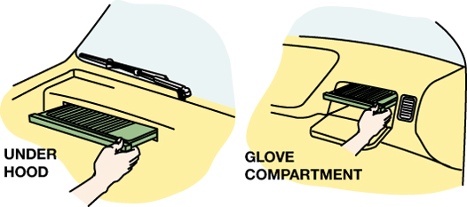
FIGURE 11–14 A cabin filter can be accessed either through the glove compartment or under the hood on most vehicles.

Slide 22
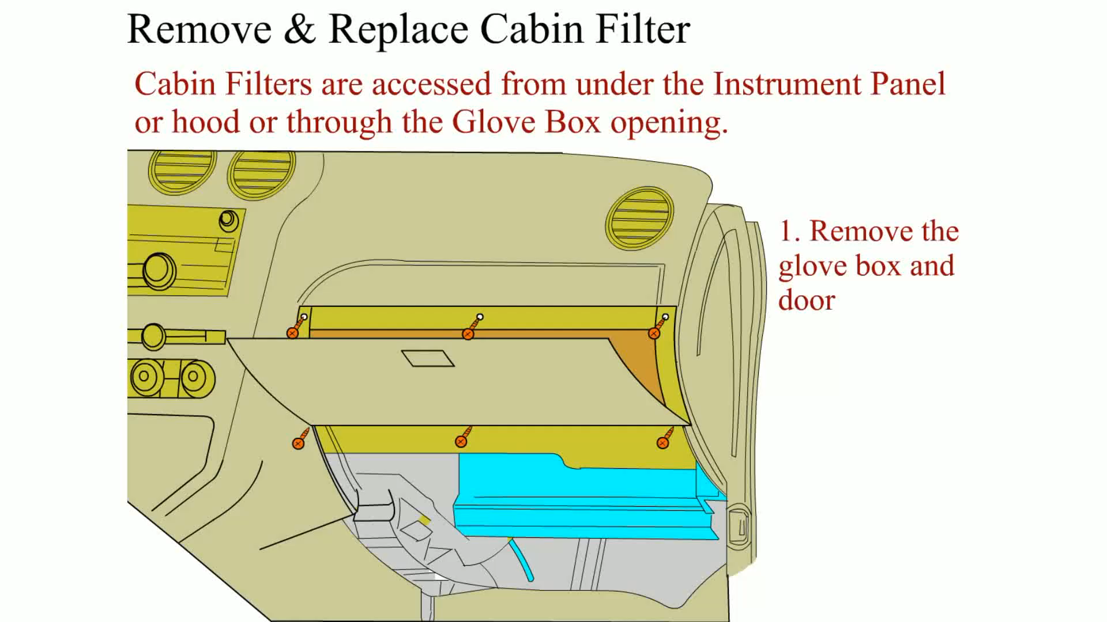
Animation: Remove & Replace Cabin Filter
(The animation will automatically start in a few seconds)

Slide 23
Automatic Climatic Control Diagnosis (1 of 3)
Scan tools are the most important tool for any diagnostic work on all vehicles.
  Factory scan tools
  Aftermarket scan tools

Slide 24
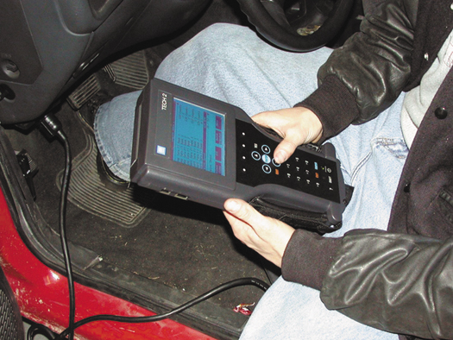
FIGURE 11–15 A TECH 2 scan tool is the factory scan tool used on General Motors vehicles.

Slide 25
Automatic Climatic Control Diagnosis (2 of 3)
STEP 1 Verify the customer concern.
STEP 2 Perform a thorough visual inspection of the heating and cooling system for any obvious faults.
STEP 3 Use a factory scan tool or a factory level aftermarket scan tool and check for diagnostic trouble codes (DTCs).

Slide 26
Automatic Climatic Control Diagnosis (3 of 3)
STEP 4 If there are stored diagnostic trouble codes, follow service information instructions for diagnosing the system.
STEP 5 If there are no stored diagnostic trouble codes, check scan tool data for possible fault areas in the system.

Slide 27
Summary (1 of 5)
Automatic temperature control (ATC) systems use sensors to detect the conditions both inside and outside the vehicle.
The sensors used include the following:
  Sun load sensor
  Evaporator temperature sensor
  Ambient air temperature (outside air temperature) sensor

Slide 28
Summary (2 of 5)
  In-vehicle temperature sensor
  Infrared Sensors
  Engine coolant temperature (ECT) sensor
Some systems use a compressor speed sensor to detect if the drive belt or compressor clutch is slipping.

Slide 29
Summary (3 of 5)
The heater core is placed downstream from the evaporator in the airflow so that air can be routed either through or around it and one or two doors are used to control this airflow.
  This door is called the temperature-blend door.

Slide 30
Summary (4 of 5)
In many vehicles, the HVAC system is capable of supplying discharge air of more than one temperature to different areas in the vehicle.
  This type of system is usually referred to as a Dual-Zone Climate Control System.

Slide 31
Summary (5 of 5)
The diagnostic steps include:
  Verify the customer concern
  Perform a thorough vial inspection
  Retrieve diagnostic trouble codes (DTCs)
  Check the data as displayed on a scan tool to determine what sensors or actuators are at fault.

Slide 32
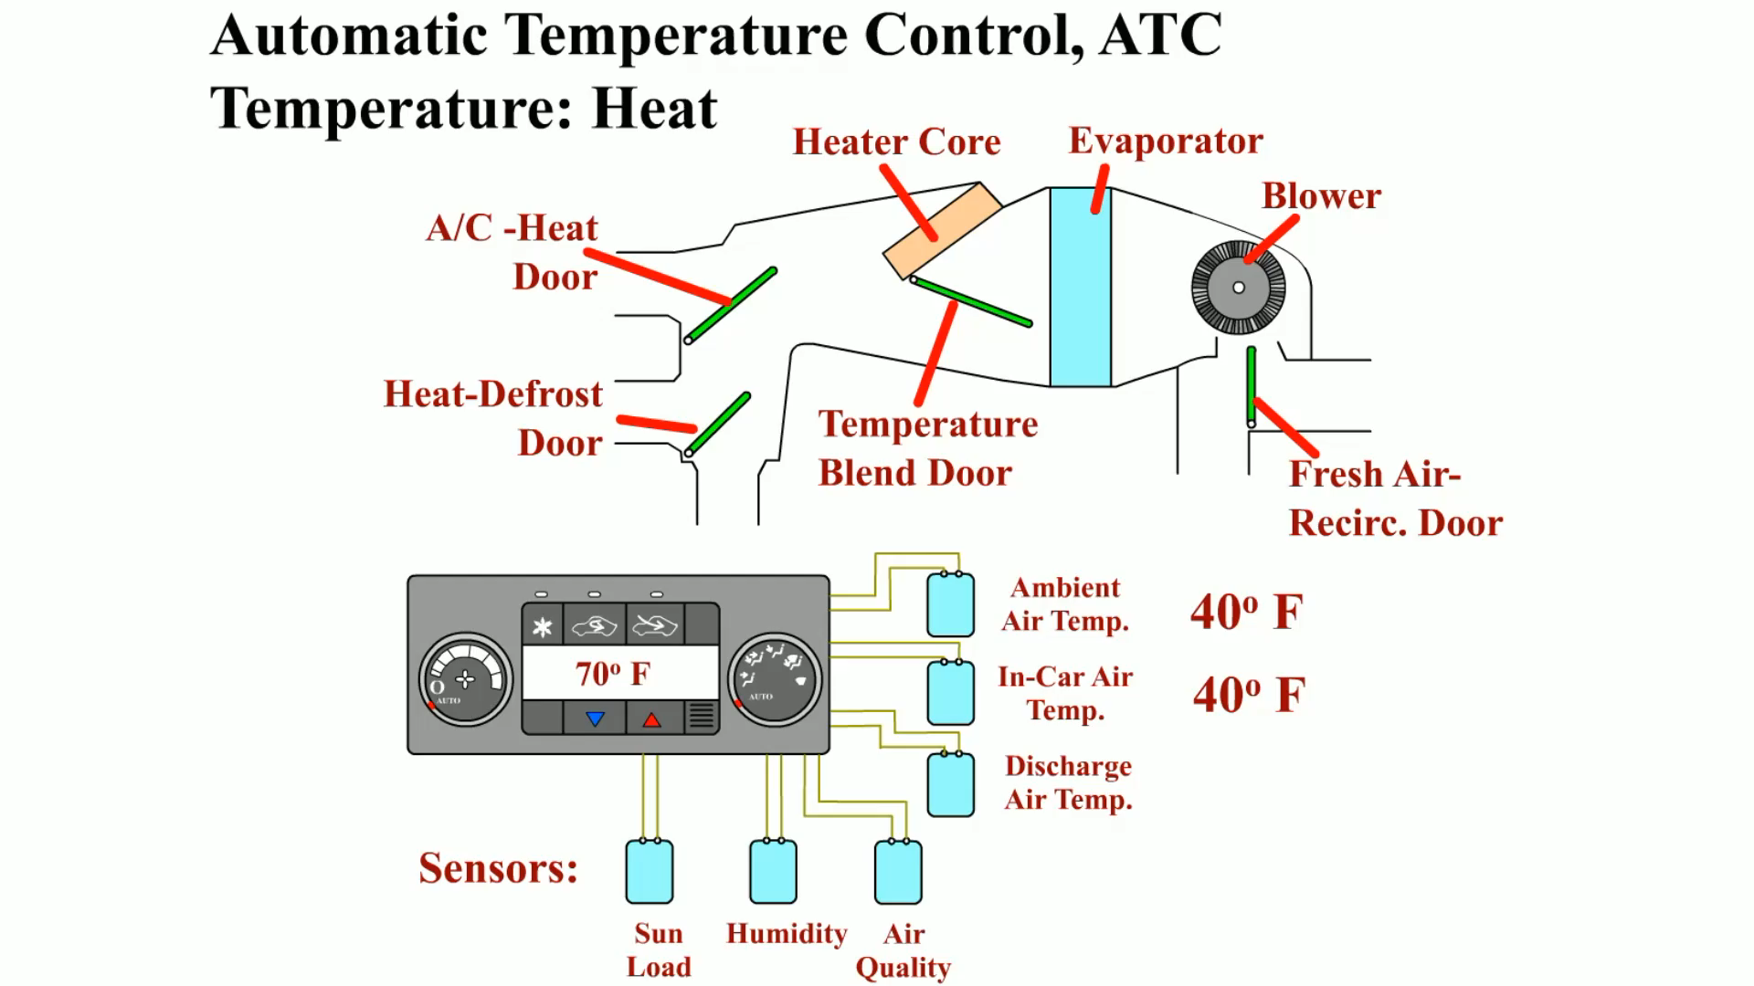
Animation: ATC Temperature: Heat
(The animation will automatically start in a few seconds)

Slide 33
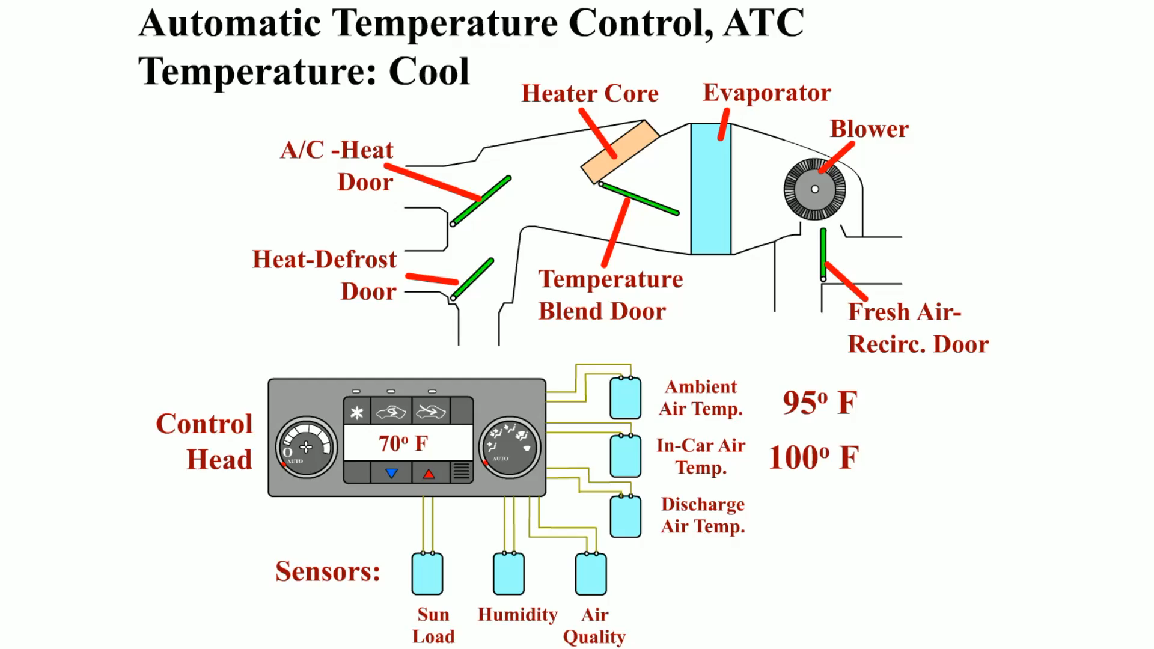
Animation: ATC Temperature: Cool
(The animation will automatically start in a few seconds)

Slide 34
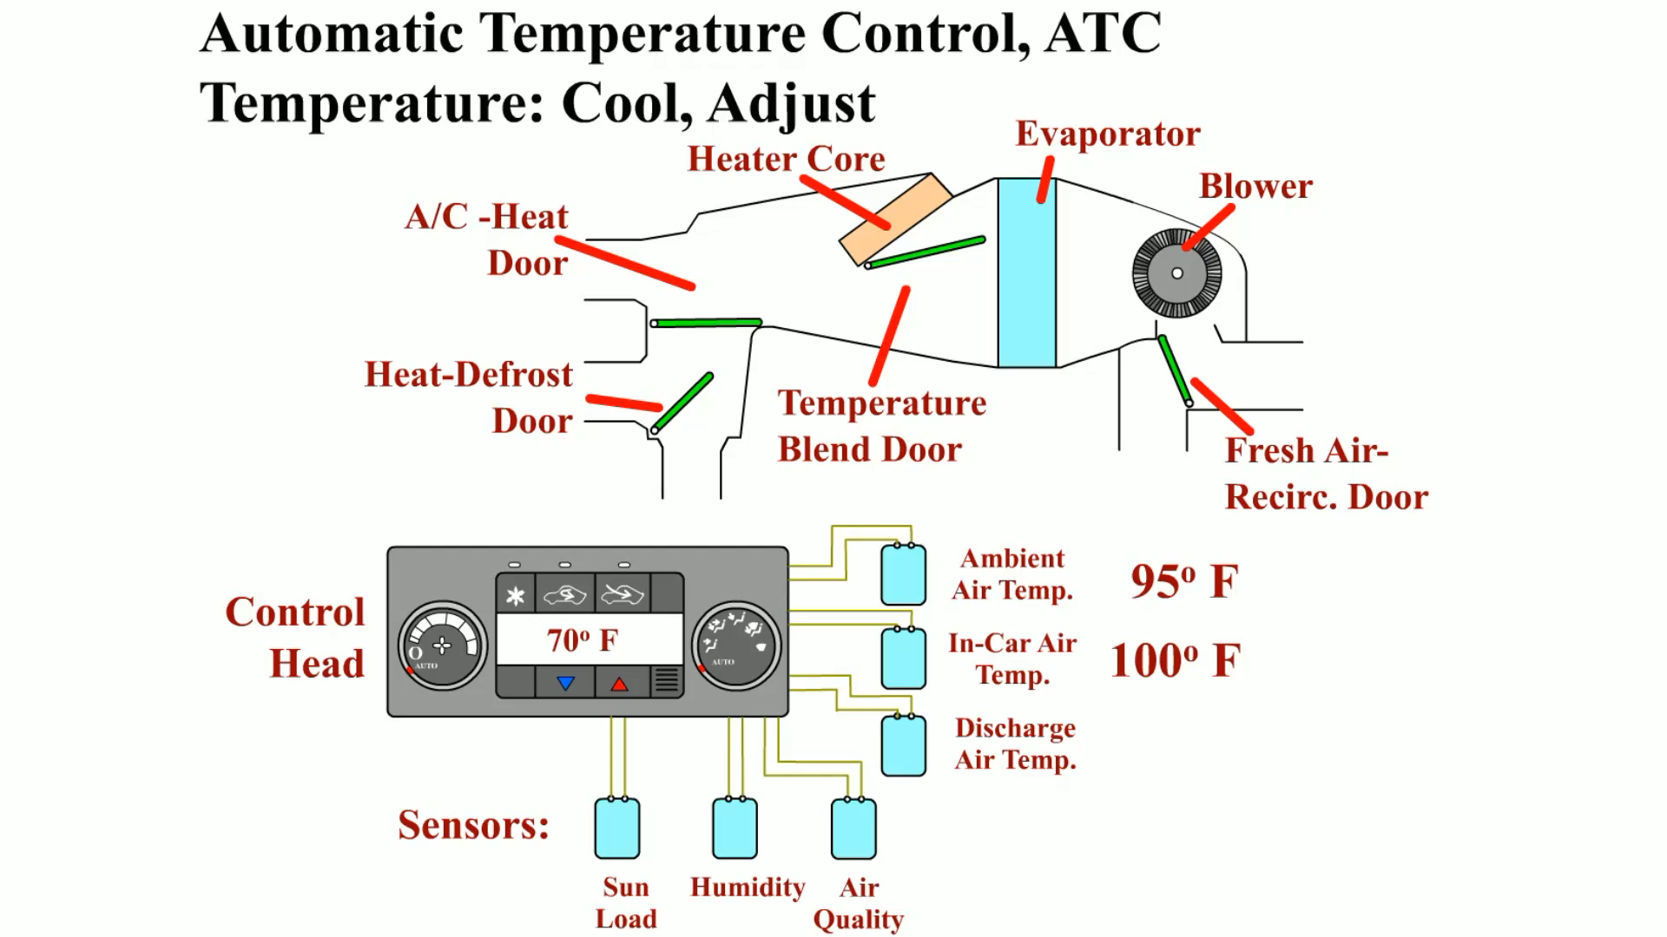
Animation: ATC Temperature: Cool Adjust
(The animation will automatically start in a few seconds)

Slide 35
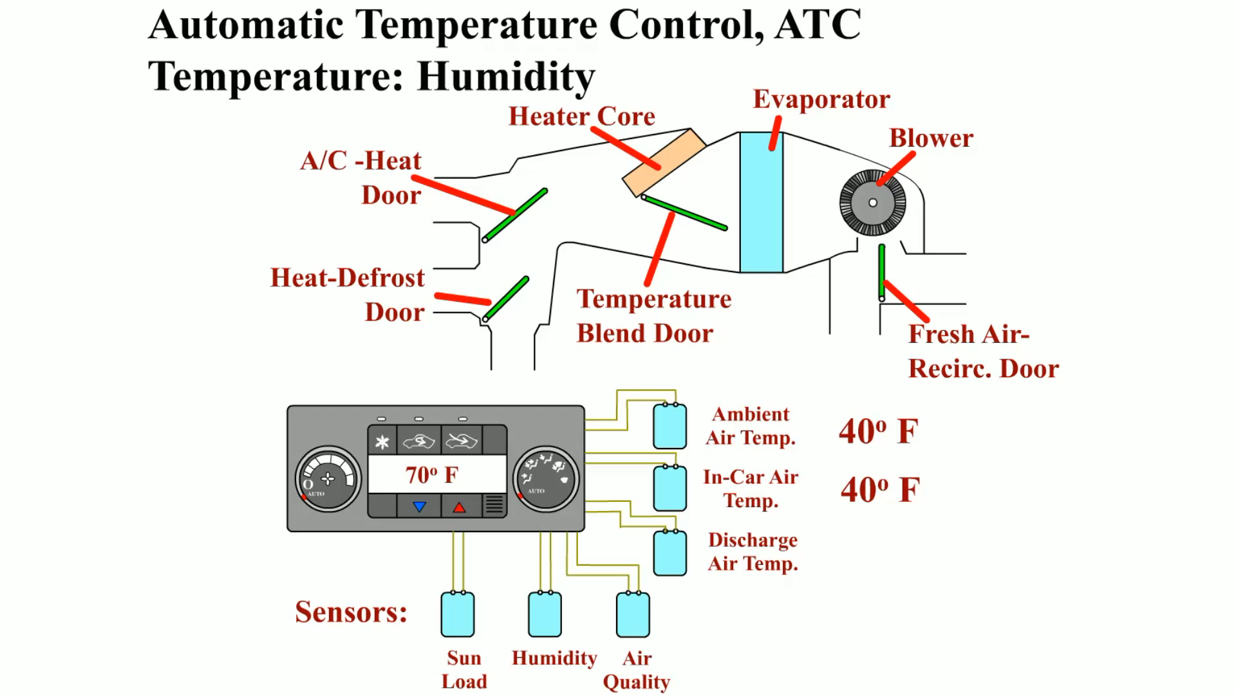
Animation: ATC Temperature: Humidity
(The animation will automatically start in a few seconds)

Slide 36
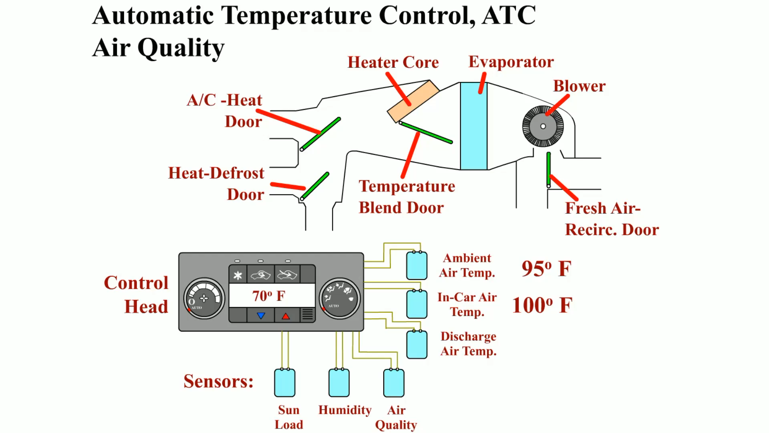
Animation: ATC Air Quality
(The animation will automatically start in a few seconds)

Slide 37
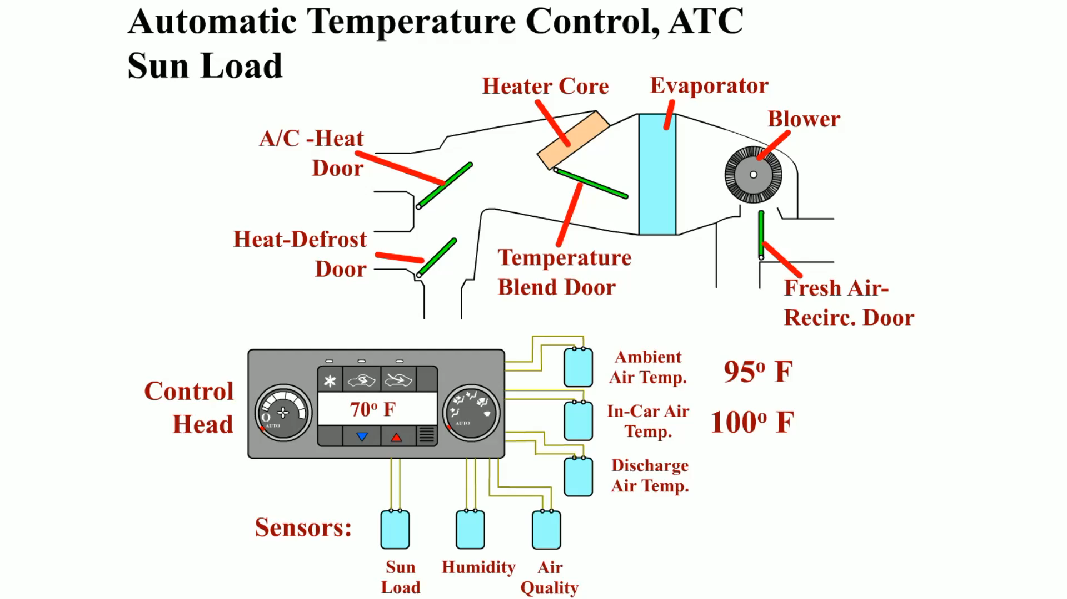
Animation: ATC Sun Load
(The animation will automatically start in a few seconds)

Slide 38
Video Links (Internet Access Required)
No heat (time 4:52)

